Slide 1
An update on advanced plasma accelerator activities in China
Wei Lu
Tsinghua University/BAQIS
Sep. 23, 2022

Slide 2
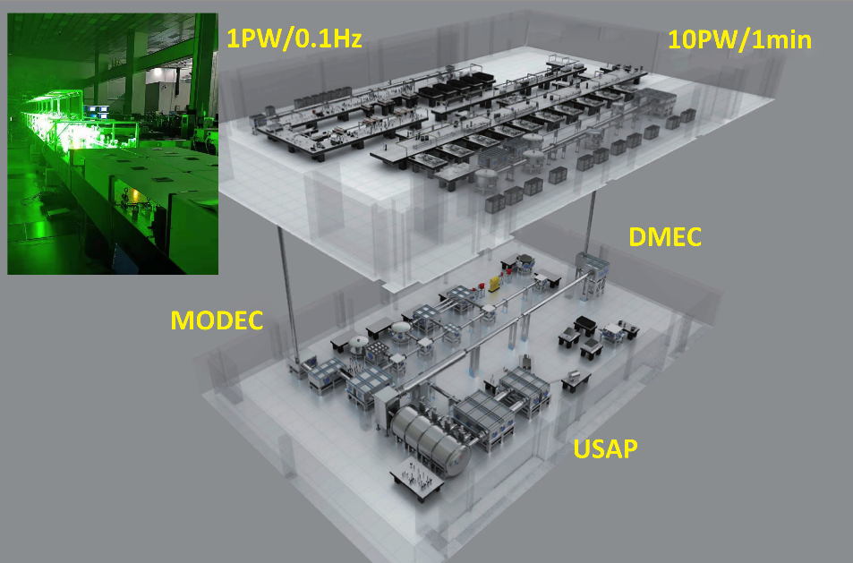
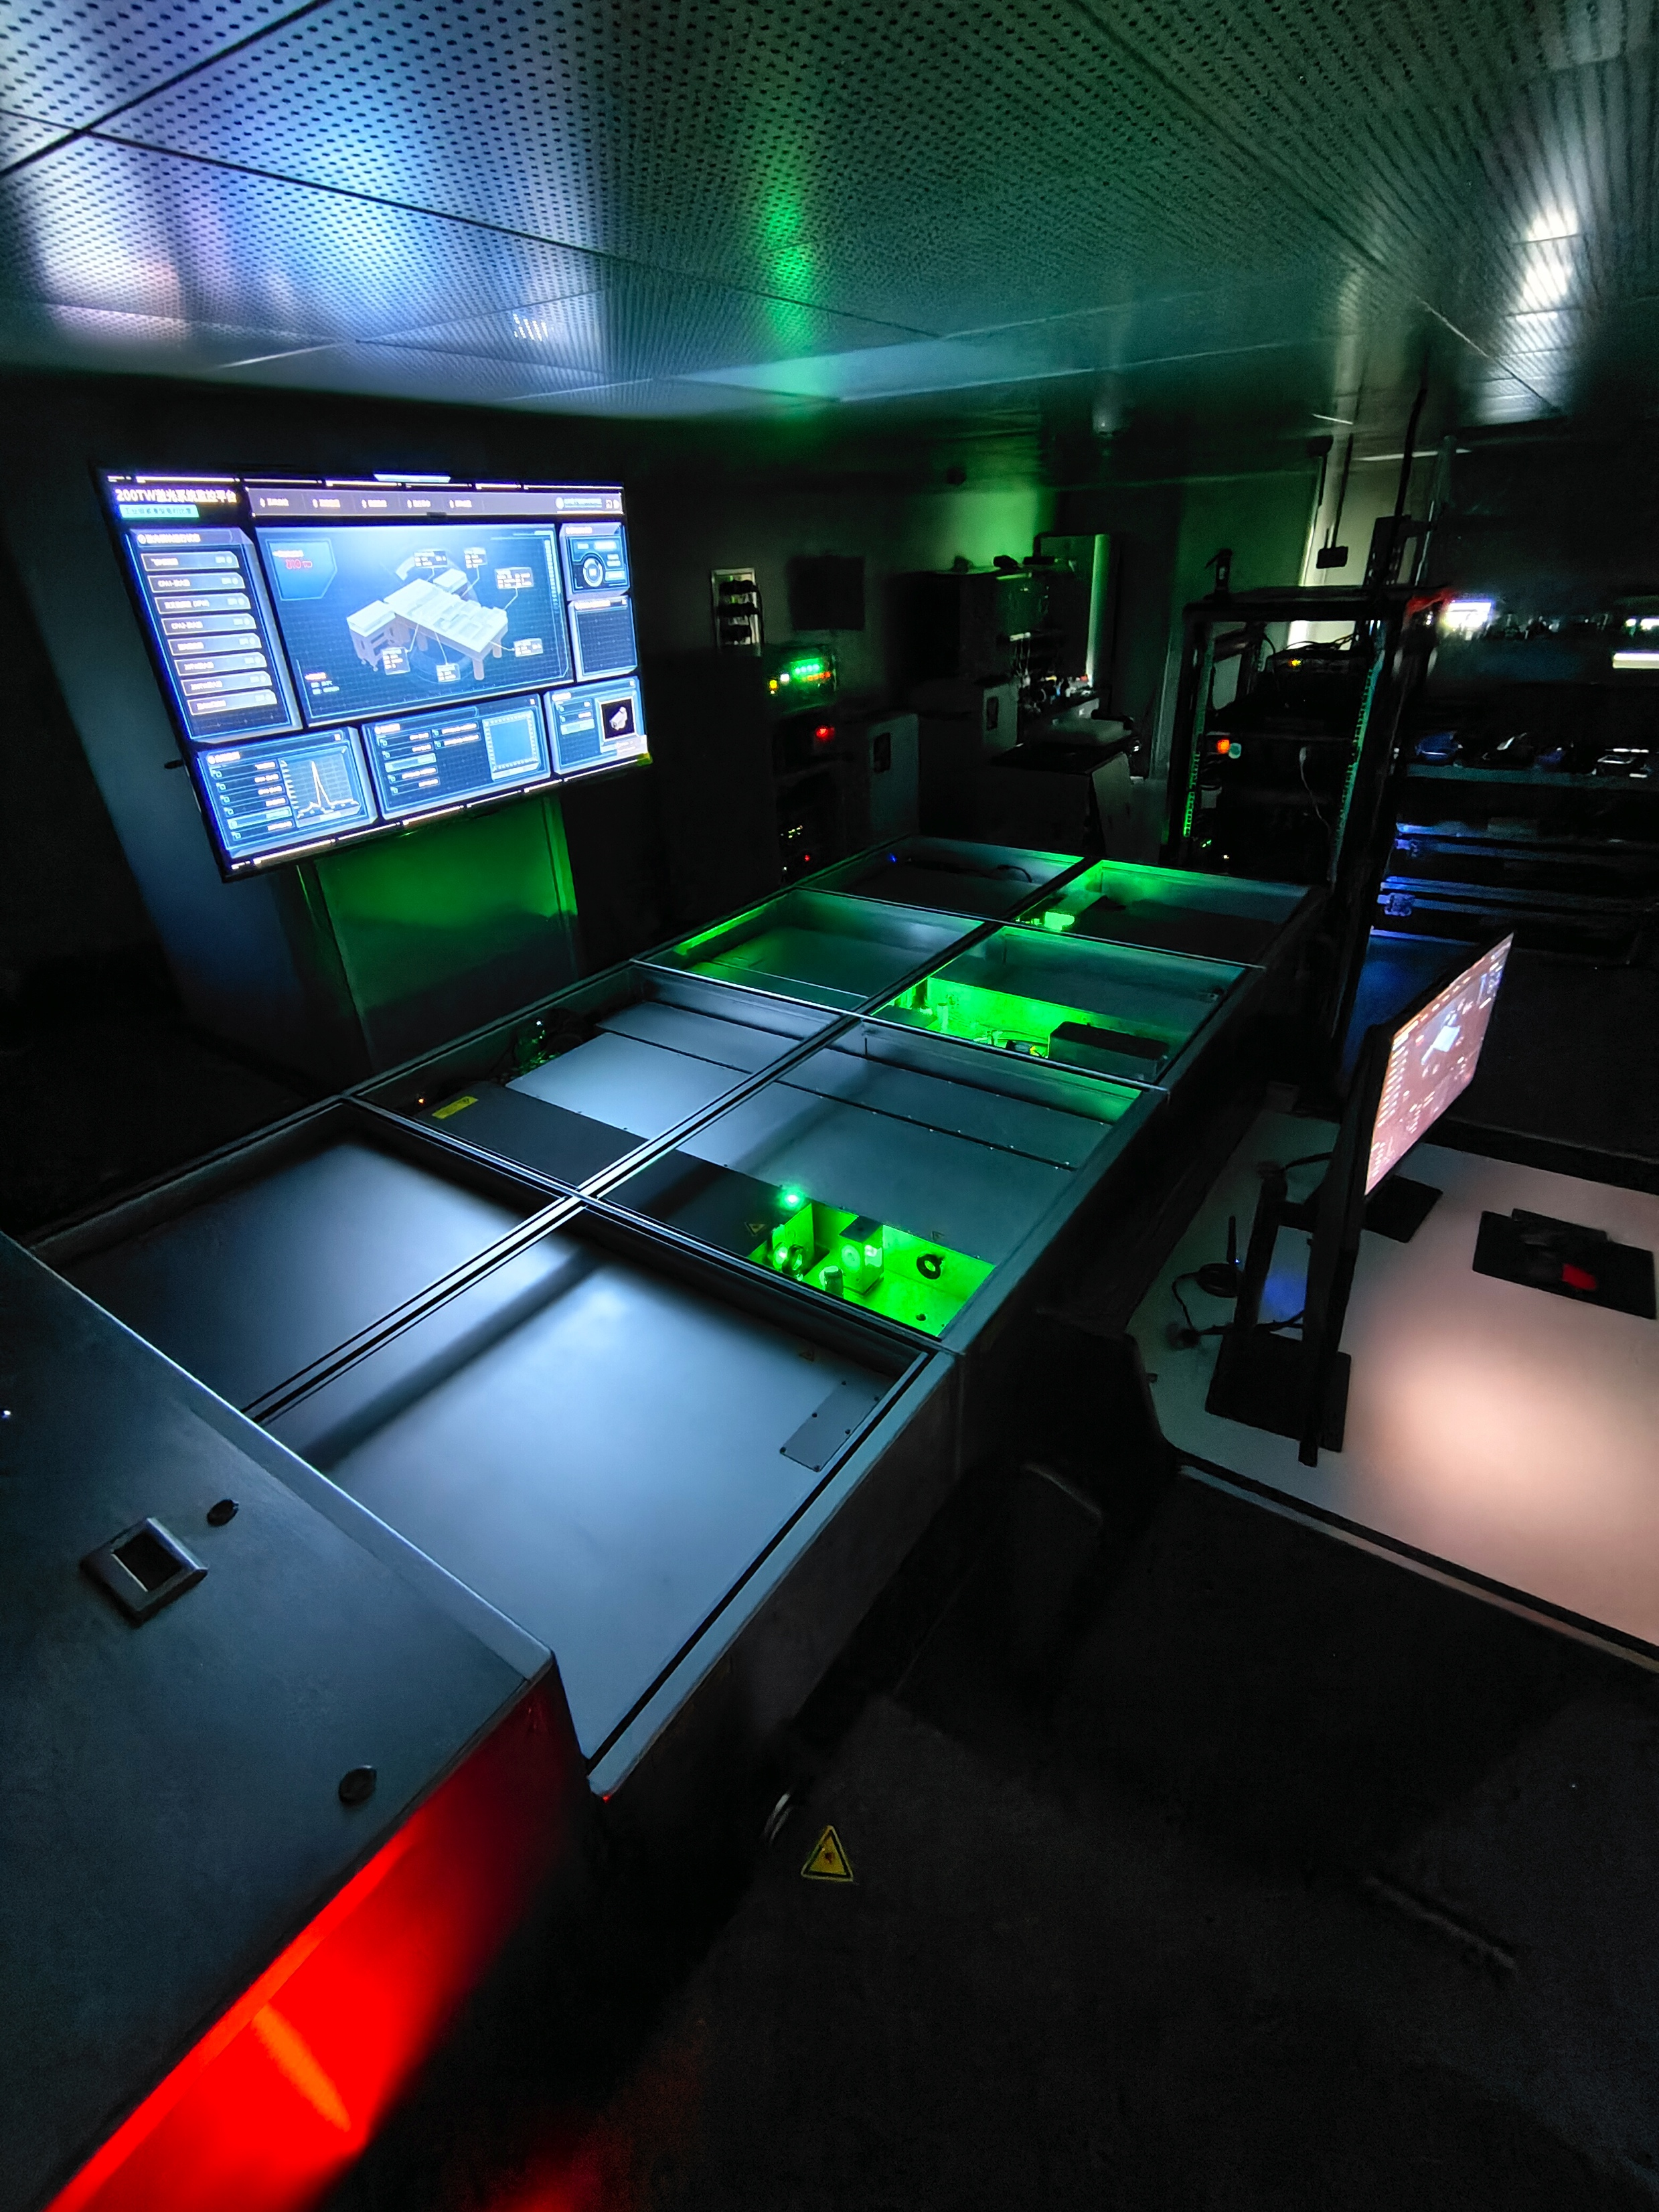
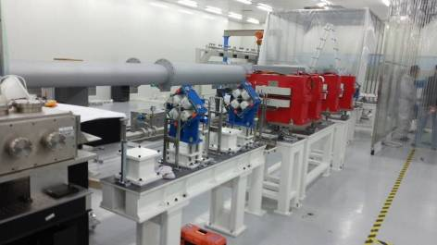
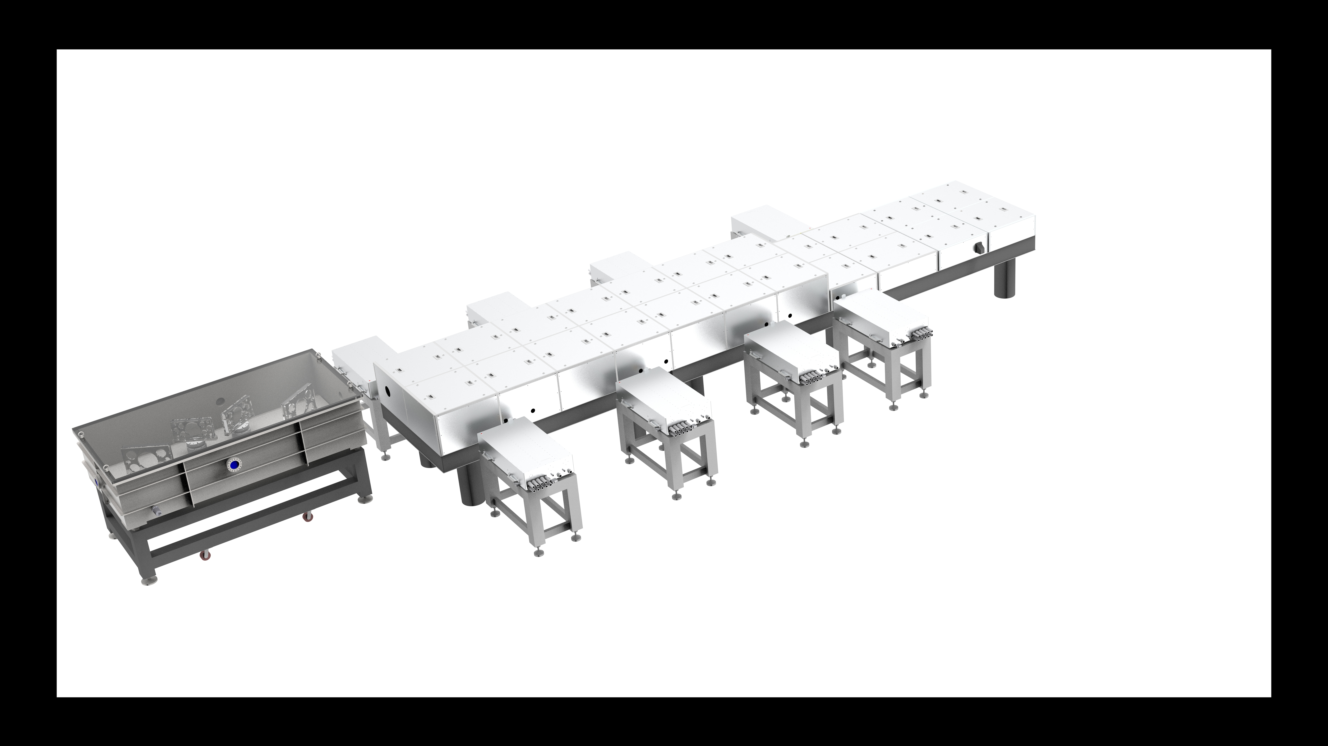
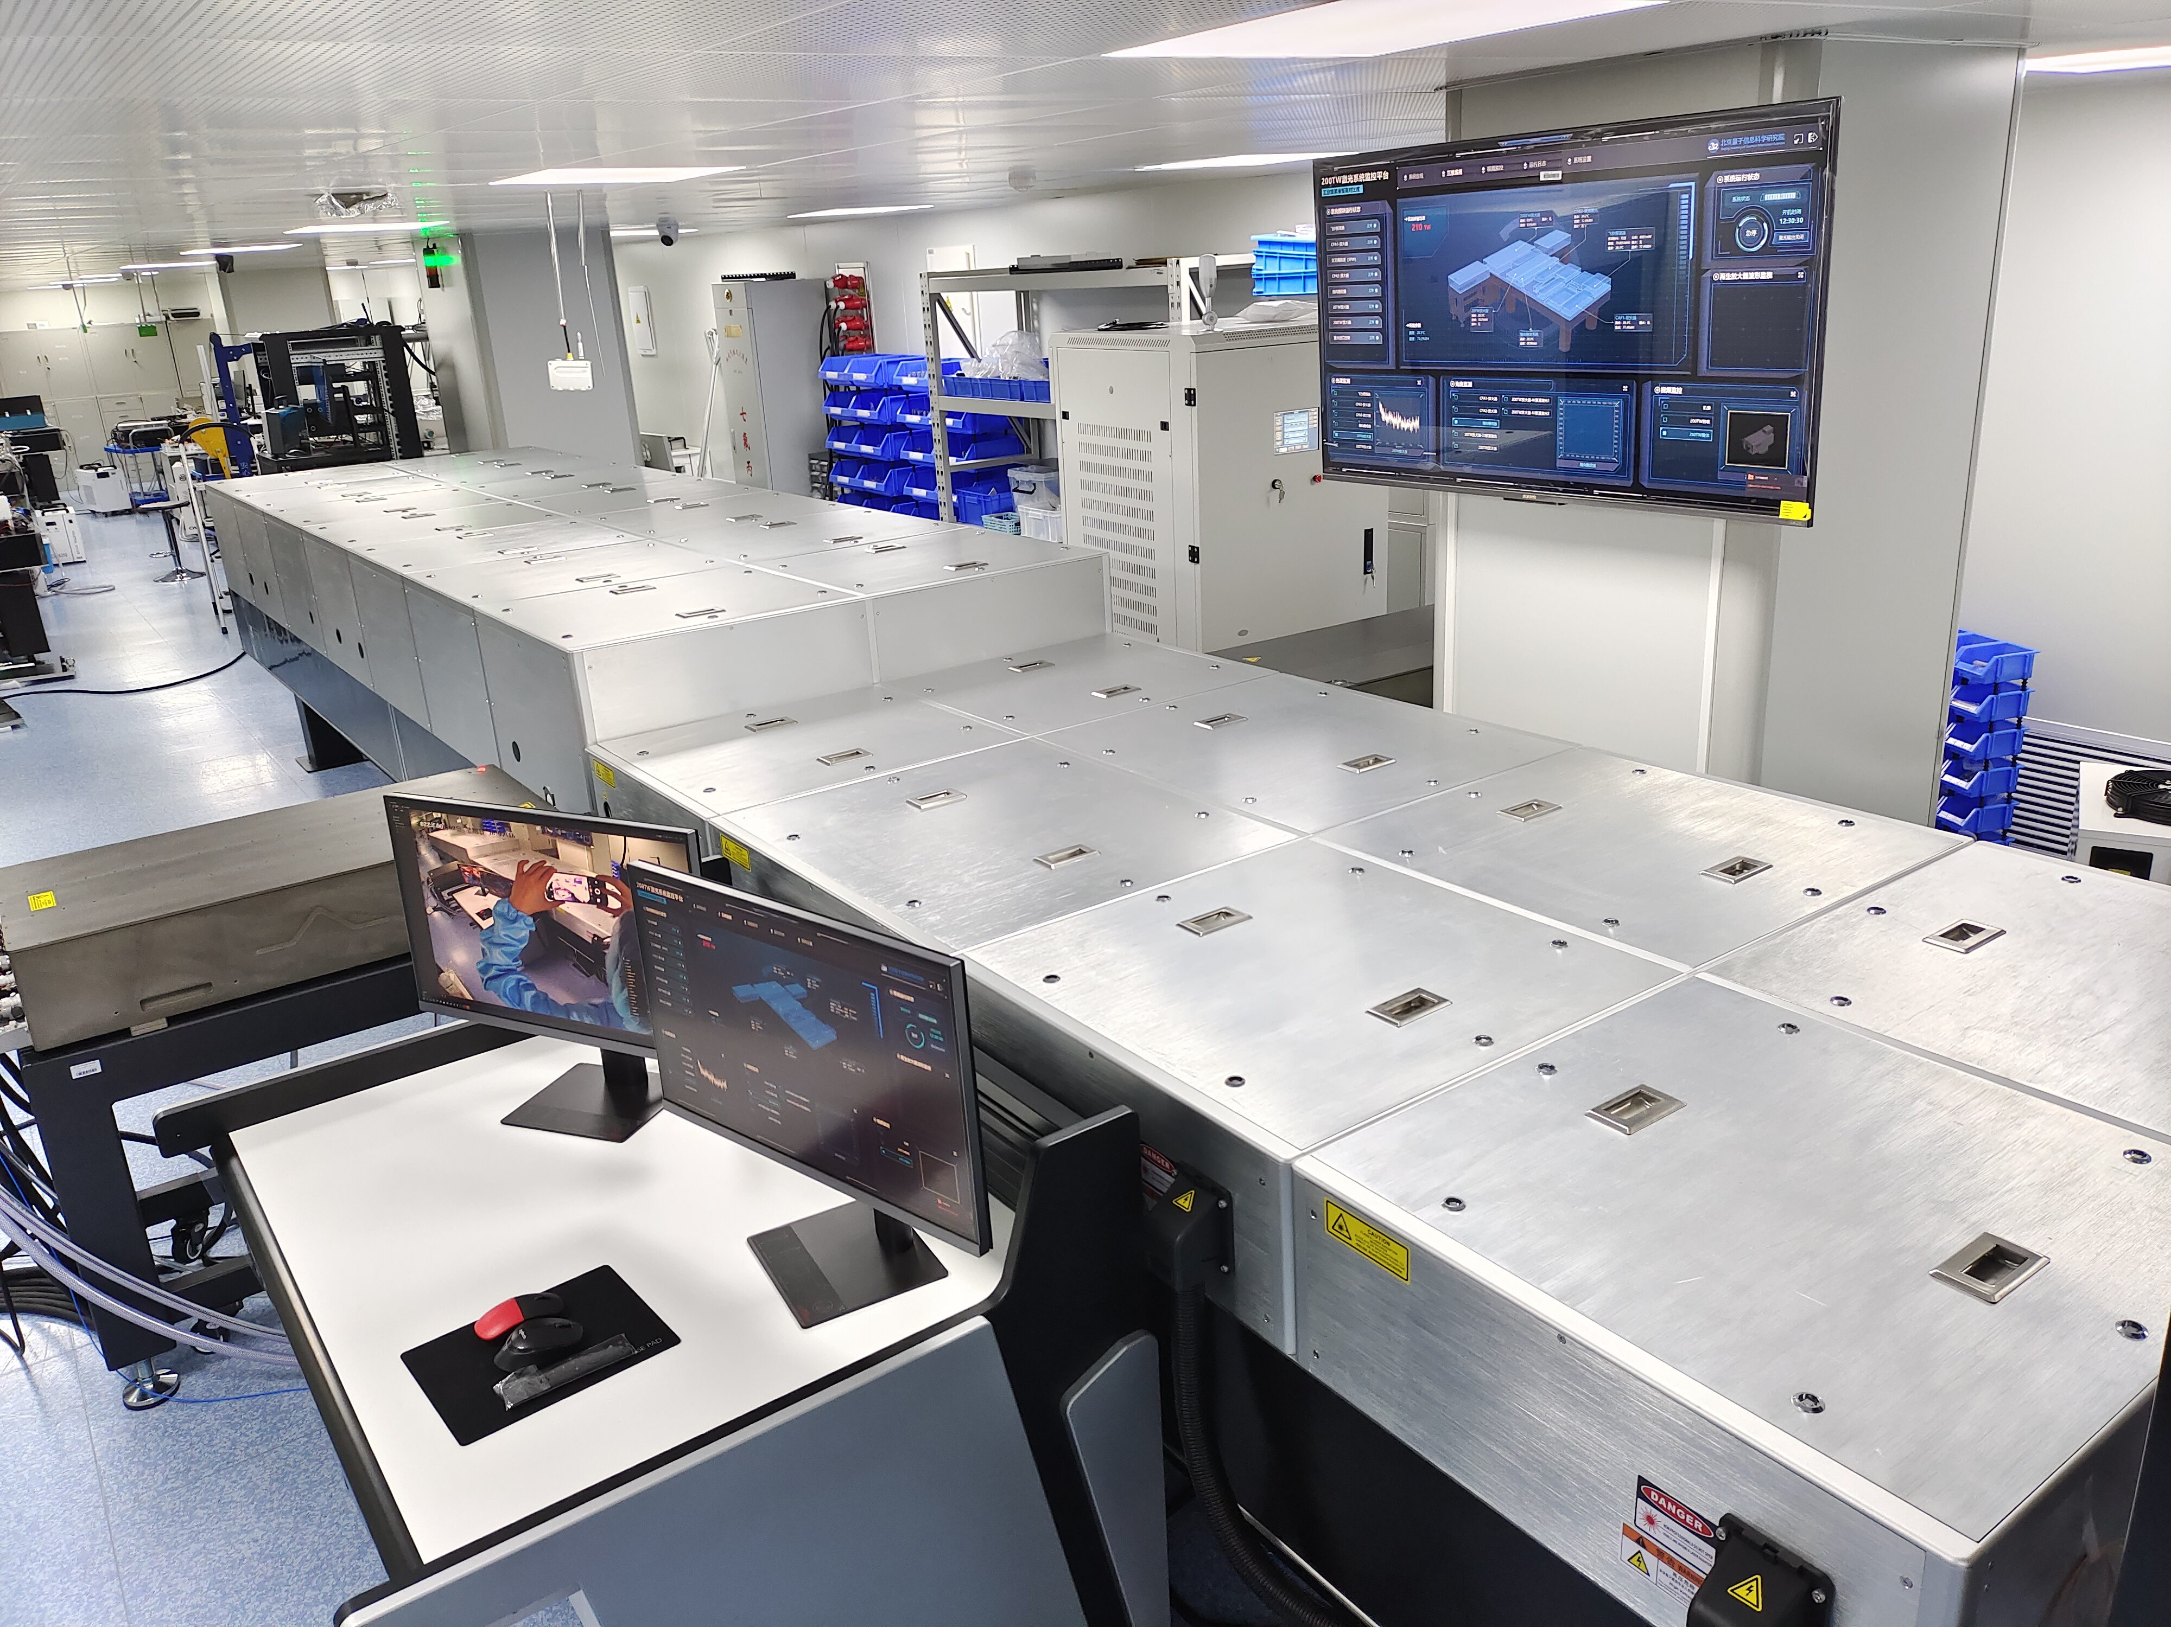
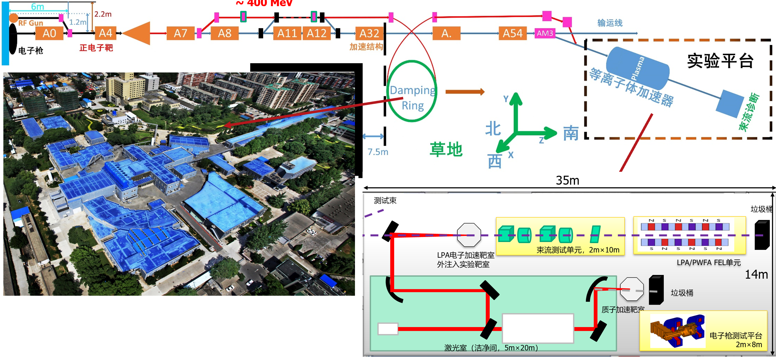
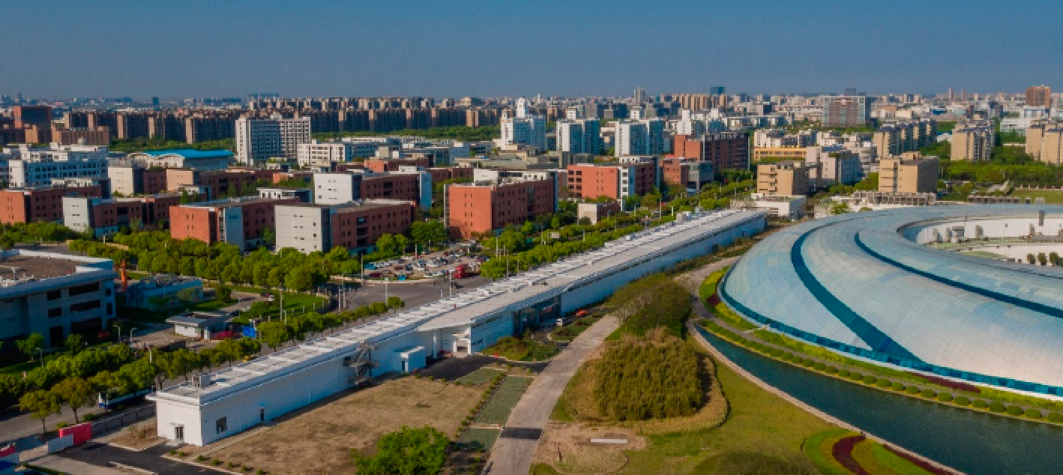
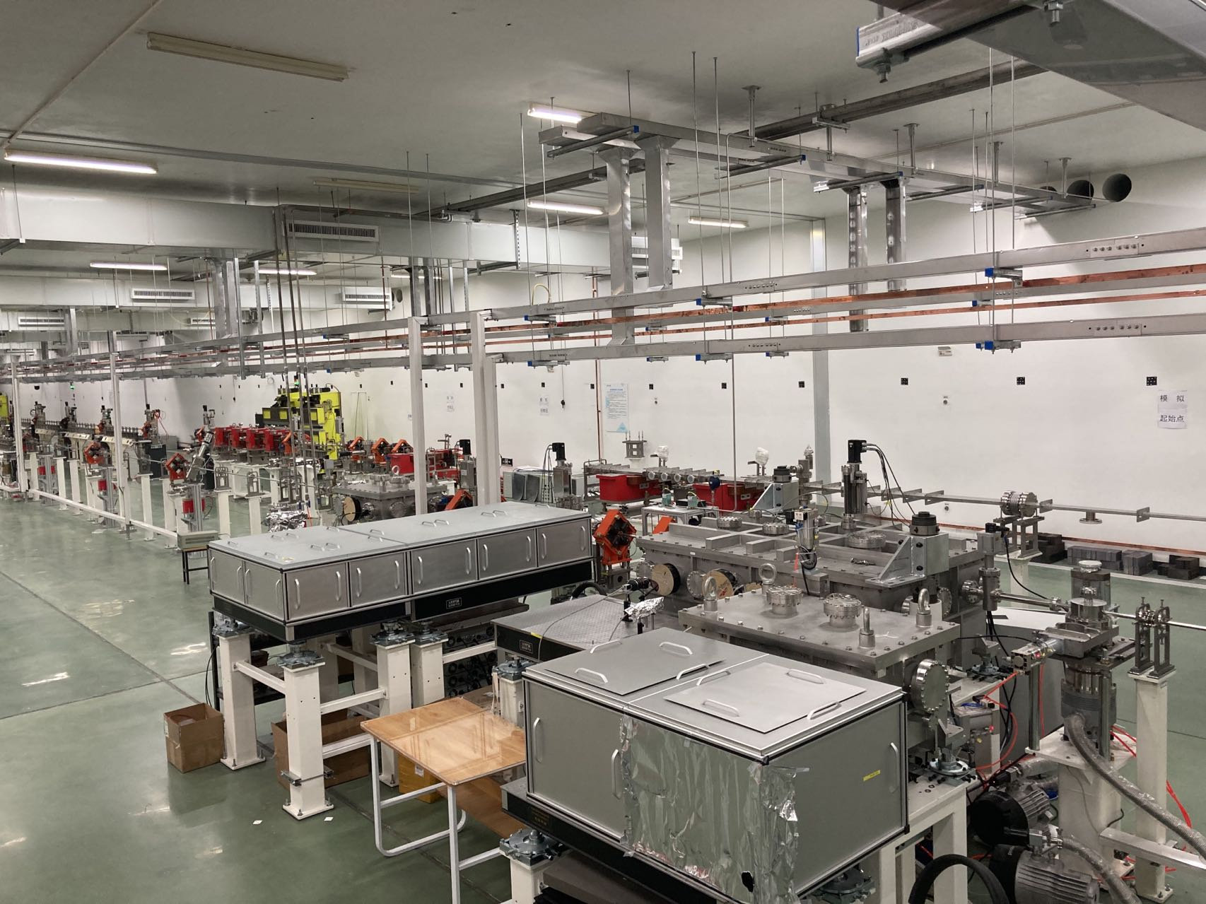
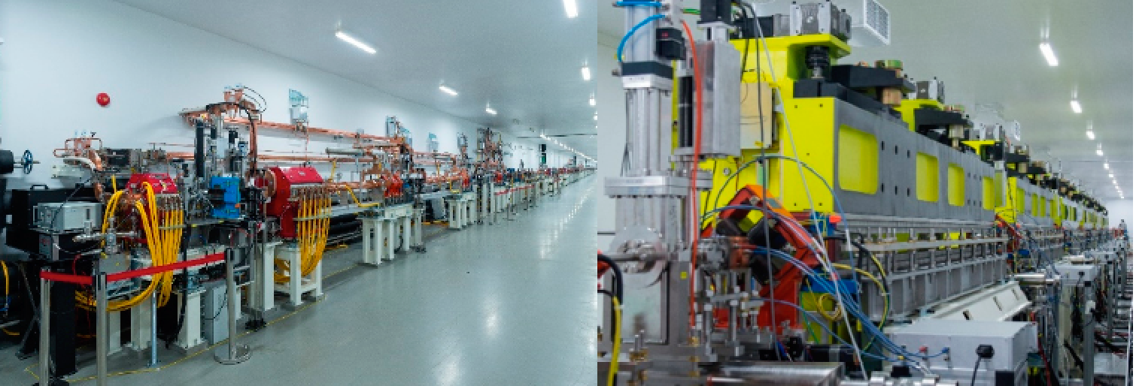
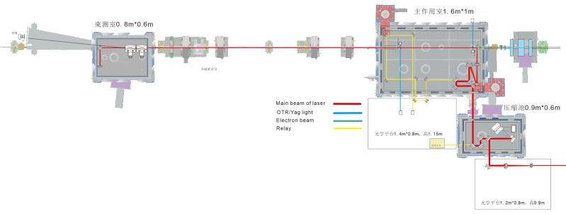
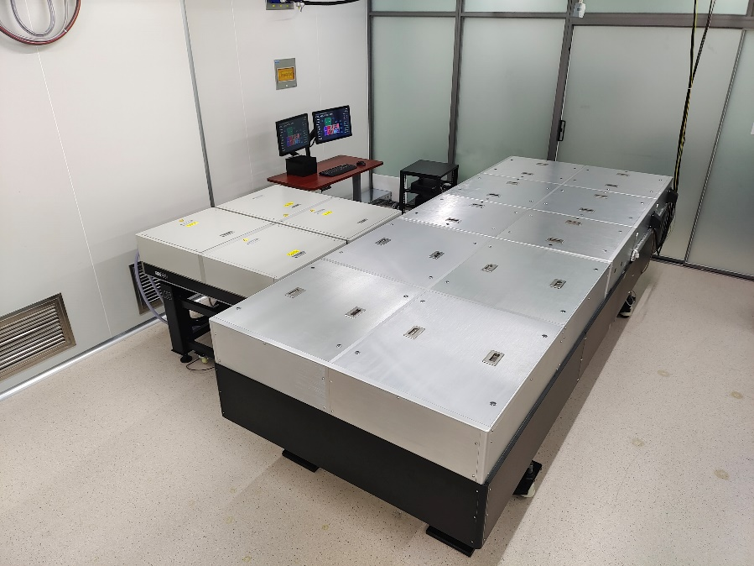
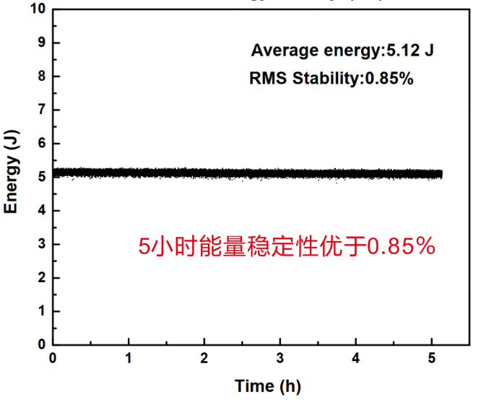
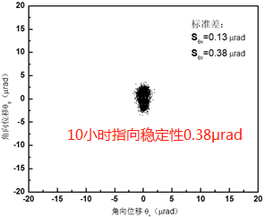
Outline
Major Laser Facilities: 6 PW+ systems in 1-3years
Institute | Peak Power | rep rate | main research | timeline
SIOM | 10PW | 1shot/min | extreme light physics | laser ready
LFRC | 5PW | 1shot/hour | extreme light physics | laser ready
IOP | 1PW | 1shot/min | X ray source (Betatron) | in 1 year
BAQIS+THU | 1PW | 1Hz | Electron accelerator | in 2 years
PKU | 2PW | 1Hz | Ion accelerator | in 2 years
SJTU | 2.5PW | 1shot/min | Lab Astronomy | in 3 years
BAQIS compact PW
Two major initiatives on PWFA
Institute | Facility | Energy | Research | timeline
IHEP | BEPC | 2.5GeV | e-/e+ for collider | in 5 years
SARI | SXFEL | 1.5GeV | e- for FEL | ready
Laser development towards applications:
BAQIS + Qi-NLS + THU
7+ years effort on compact industry level TW-PW lasers
Lasers with much reduced size, enhanced long term performance
Table top ultrafast synchrotron light sources demonstrated
(with very compact 20-40TW systems)
200TW compact system

Slide 3
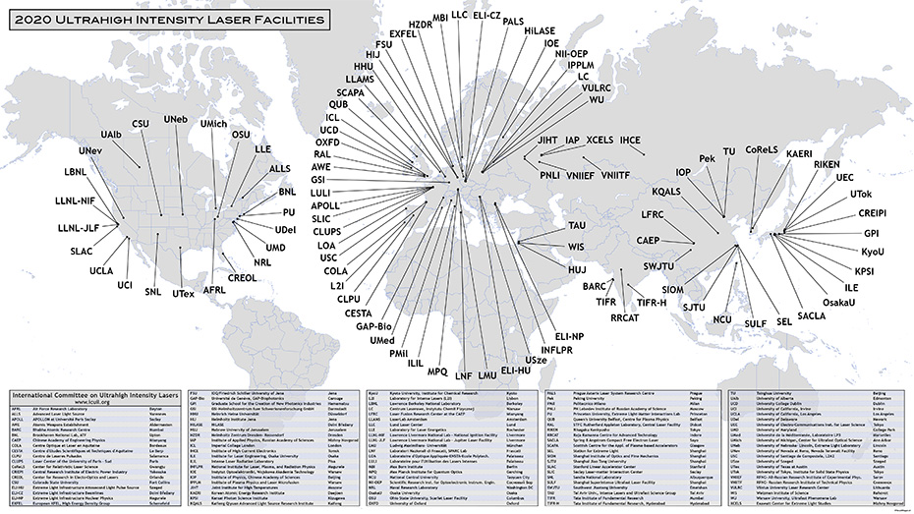

Slide 4
Major laser facilities involved in plasma acceleration in China
Institute | Peak Power | rep rate | main research | timeline
SIOM | 10PW | 1shot/min | extreme light physics | laser ready
LFRC | 5PW | 1shot/hour | extreme light physics | laser ready
IOP | 1PW | 1shot/min | X ray source (Betatron) | in 1 year
BAQIS+THU | 1PW | 1Hz | Electron accelerator | in 2 years
PKU | 2PW | 1Hz | Ion accelerator | in 2 years
SJTU | 2.5PW | 1shot/min | Lab Astronomy | in 3 years

Slide 5
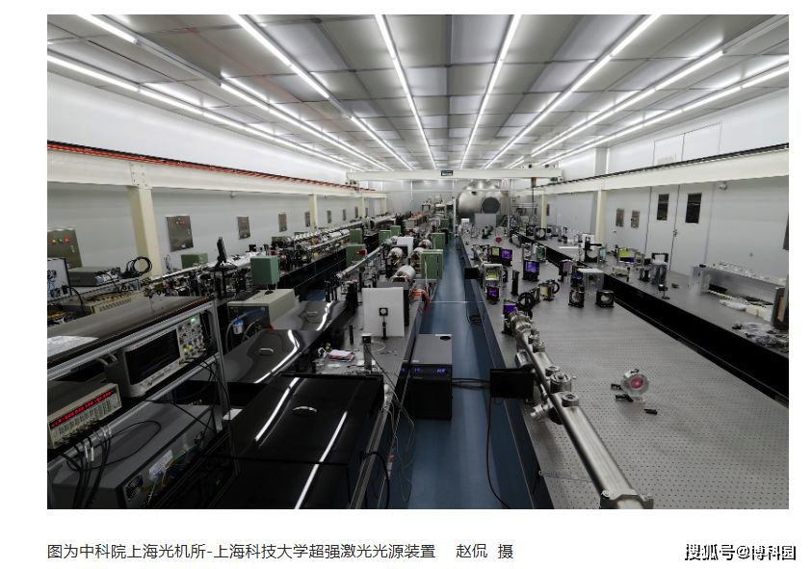
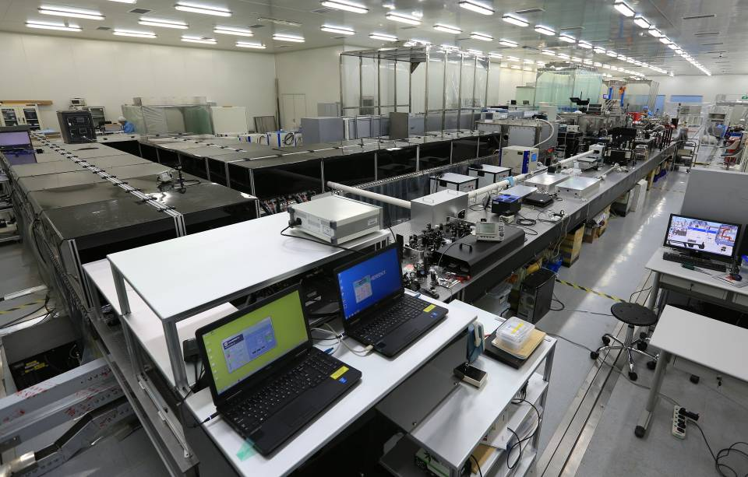
SULF at SIOM

Slide 6
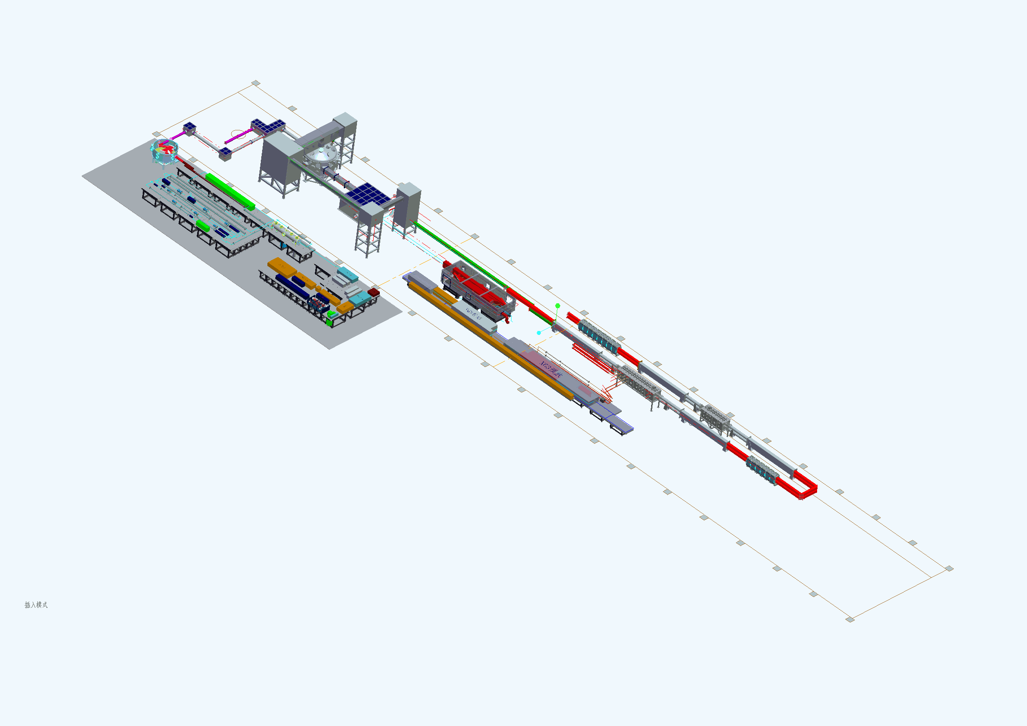
LFRC Xingguang III OPCPA 5PW (ns/ps/fs)
ps compressor
Main amplifier
Target chamber
主放
Femtosecond laser (500TW)
Front-end of ps lase
Pre-amplifier

Slide 7
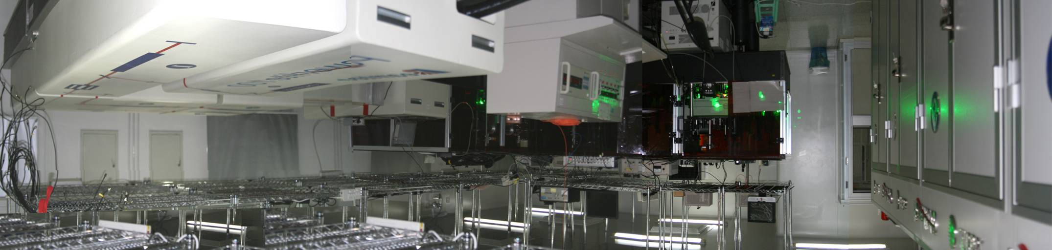
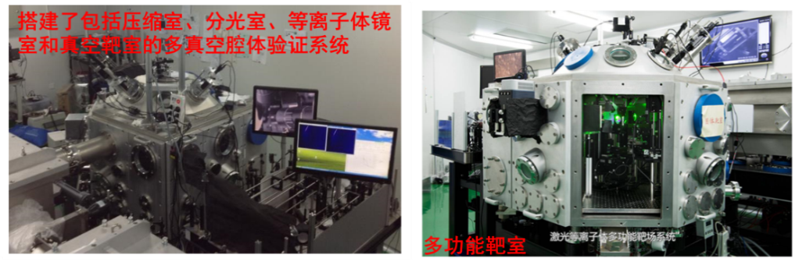
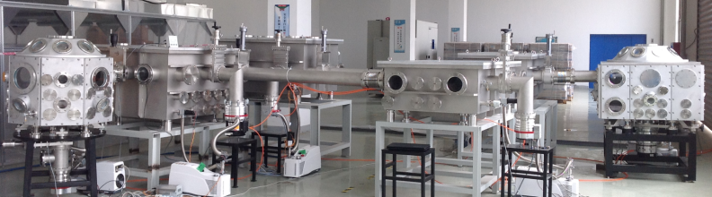
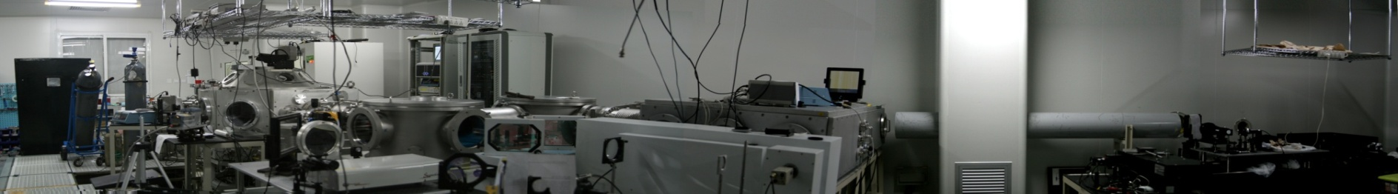
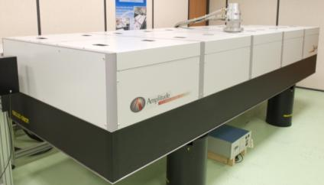
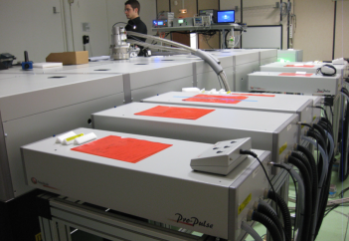
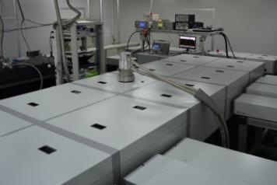
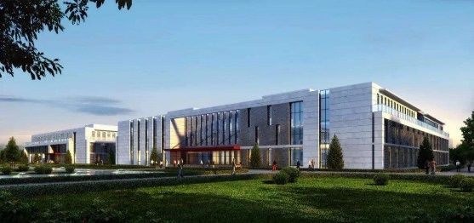
SJTU and IOP
20TW/200TW/2.5PW/1PW

Slide 8
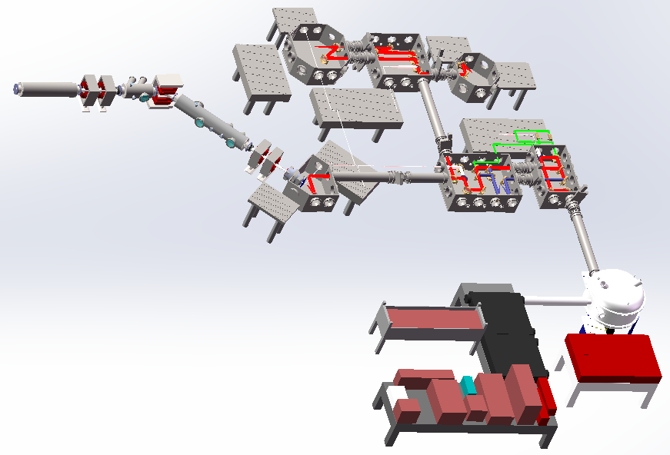
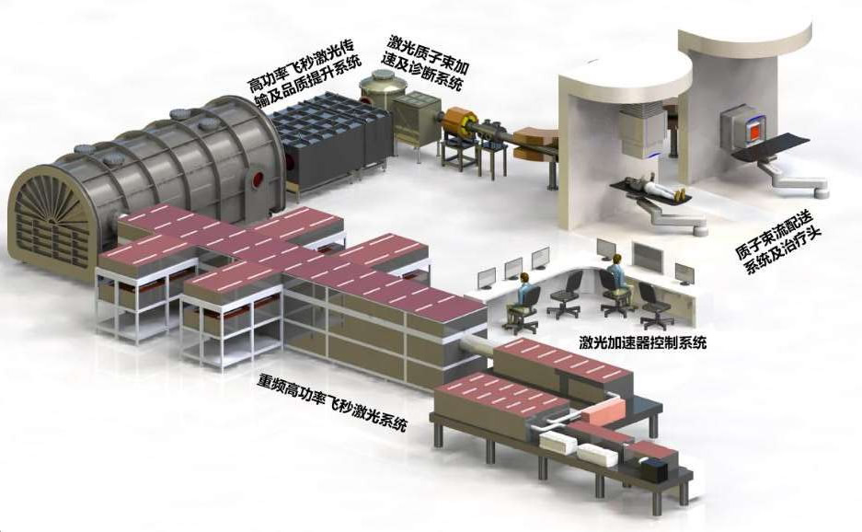
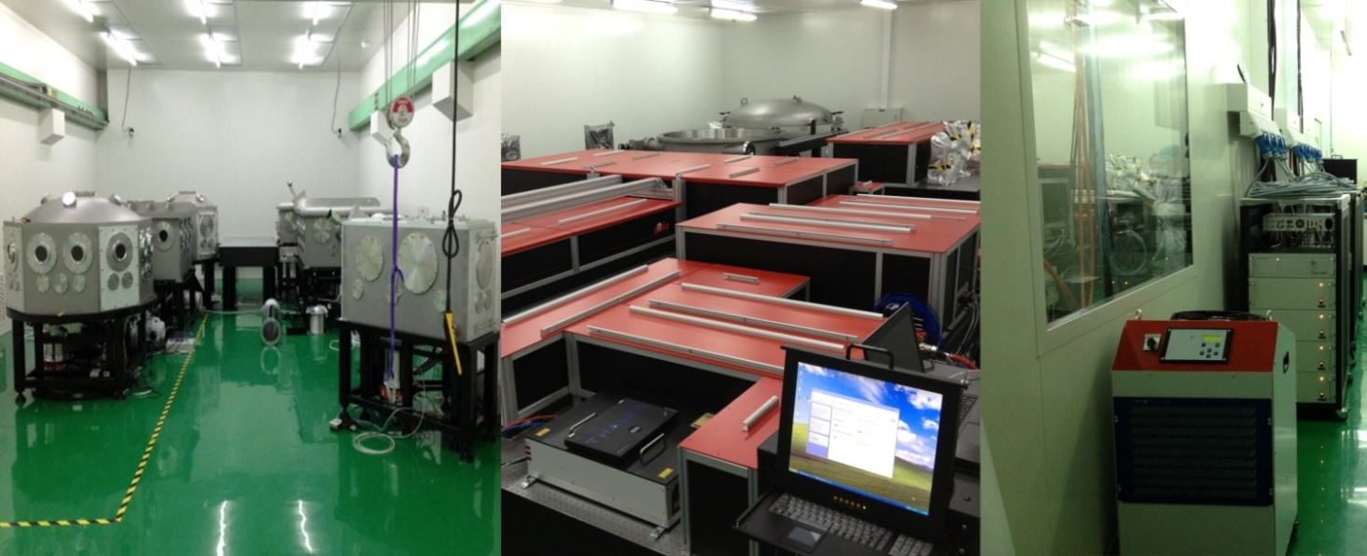
CLAPA at PKU (laser ion source)
Gas-target Chamber
Cluster-target Chamber
200TW 5Hz
2PW 1Hz
Proton Beam Line
Laser

Slide 9
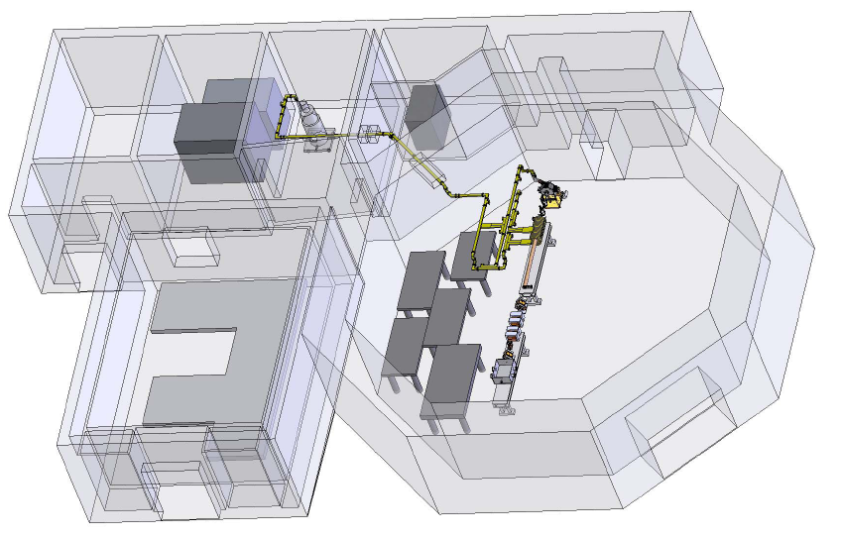
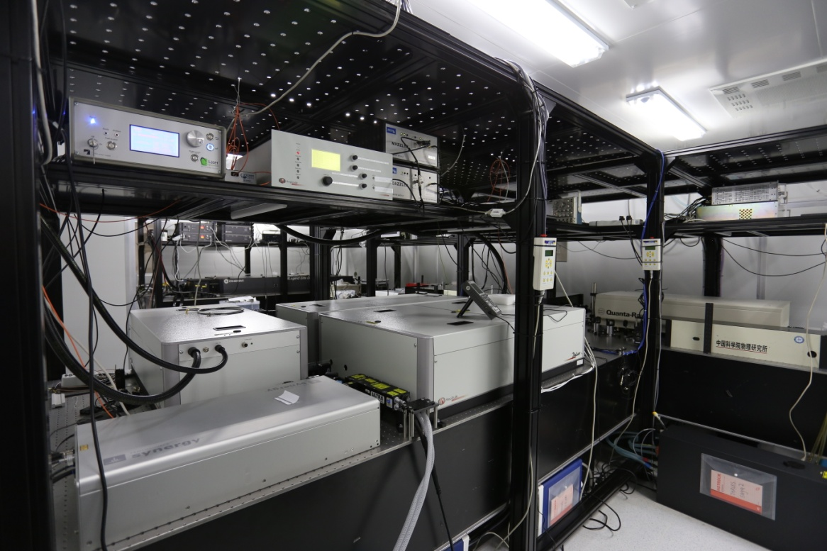
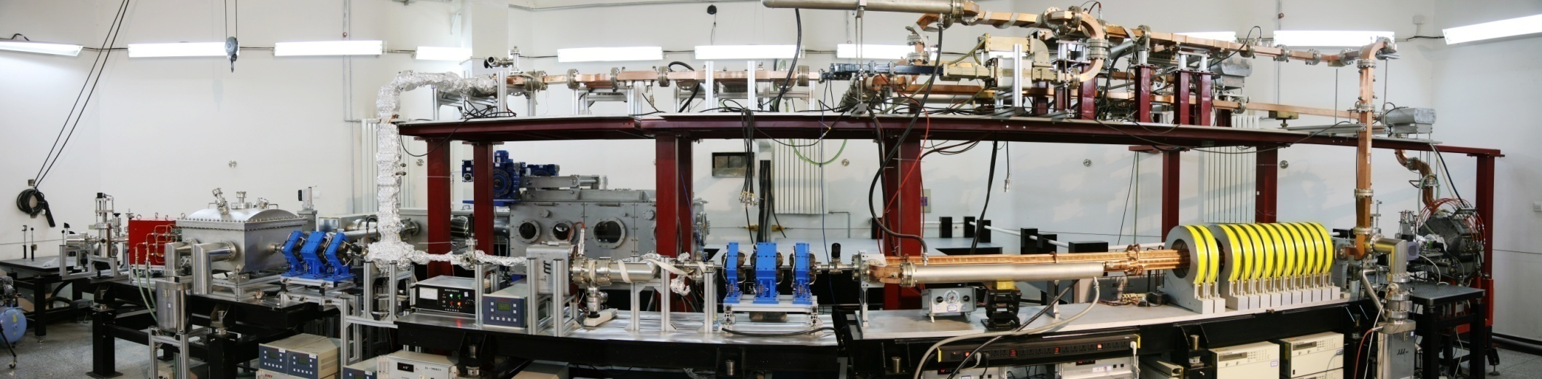
THU/BAQIS/Qi-NLS
40TW Laser ＋45MeV Linac
45MeV LINAC
25fs 40TW Laser System
Sub 50fs high current (>5kA) electron beam obtained through hybrid compression

Slide 10
BAQIS Compact 1PW 1Hz

Slide 11
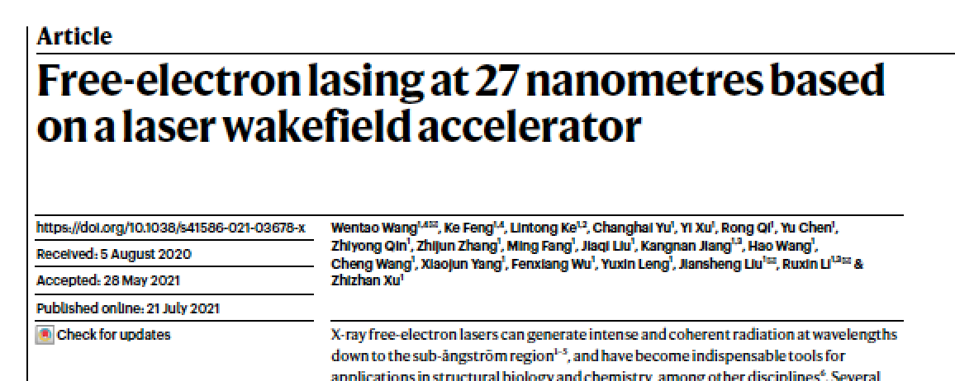
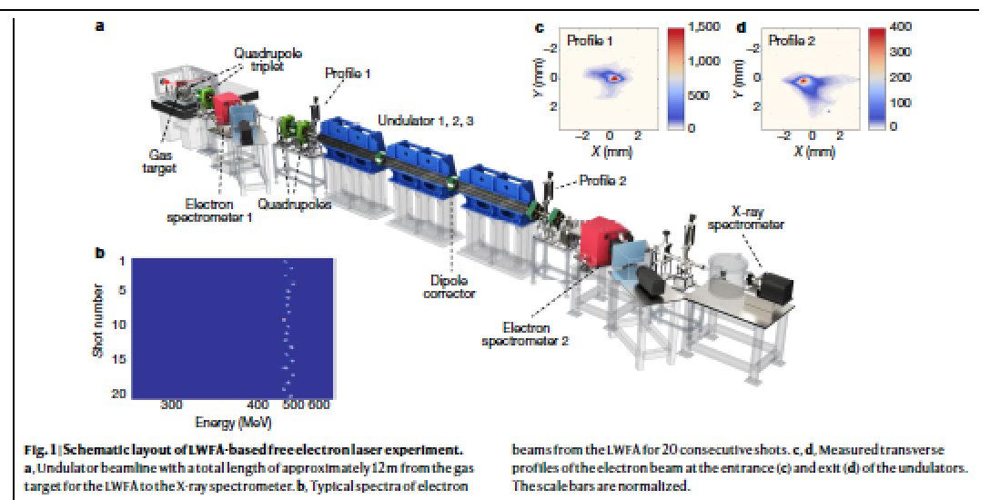
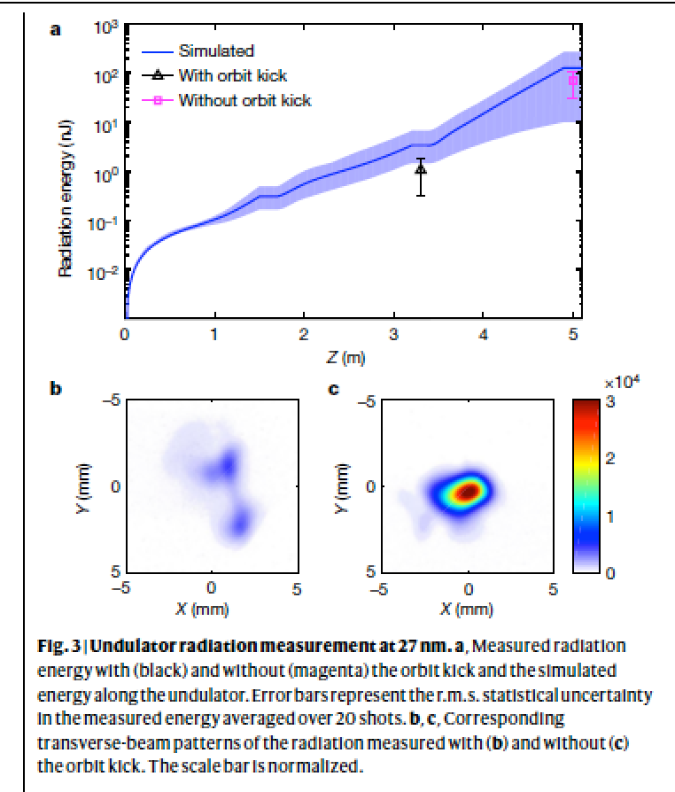

Slide 12
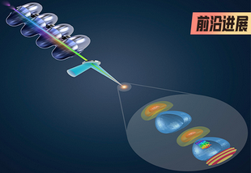
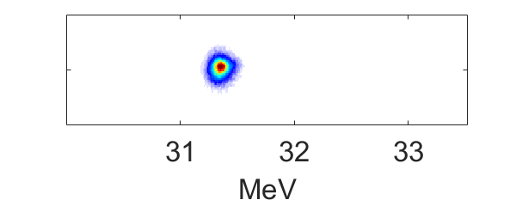
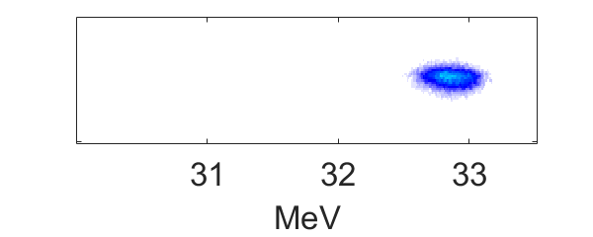
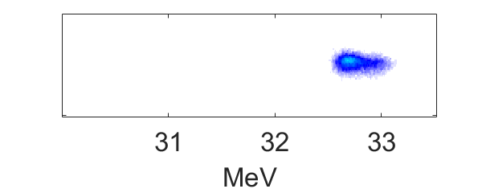
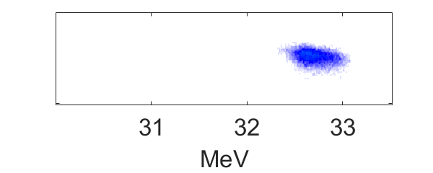
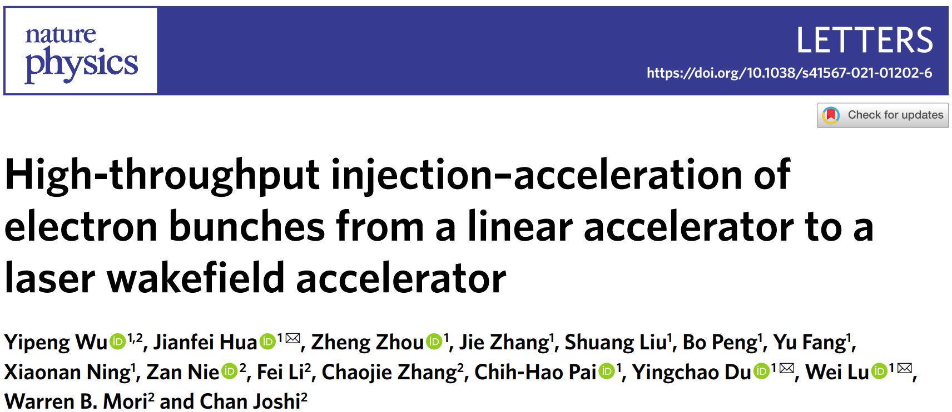
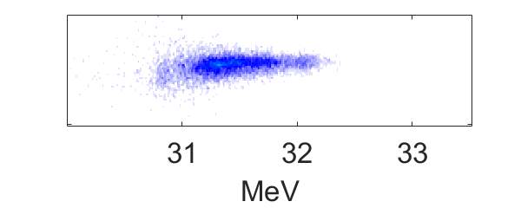
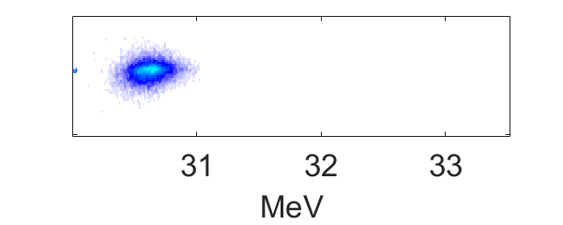
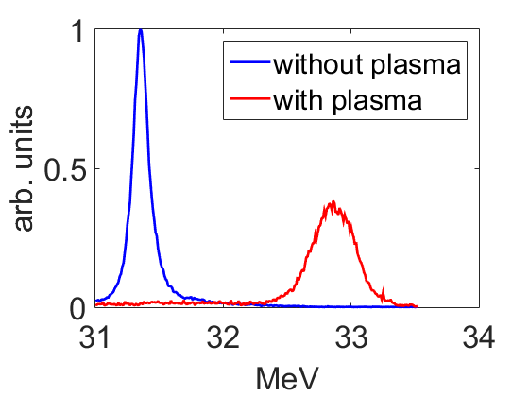
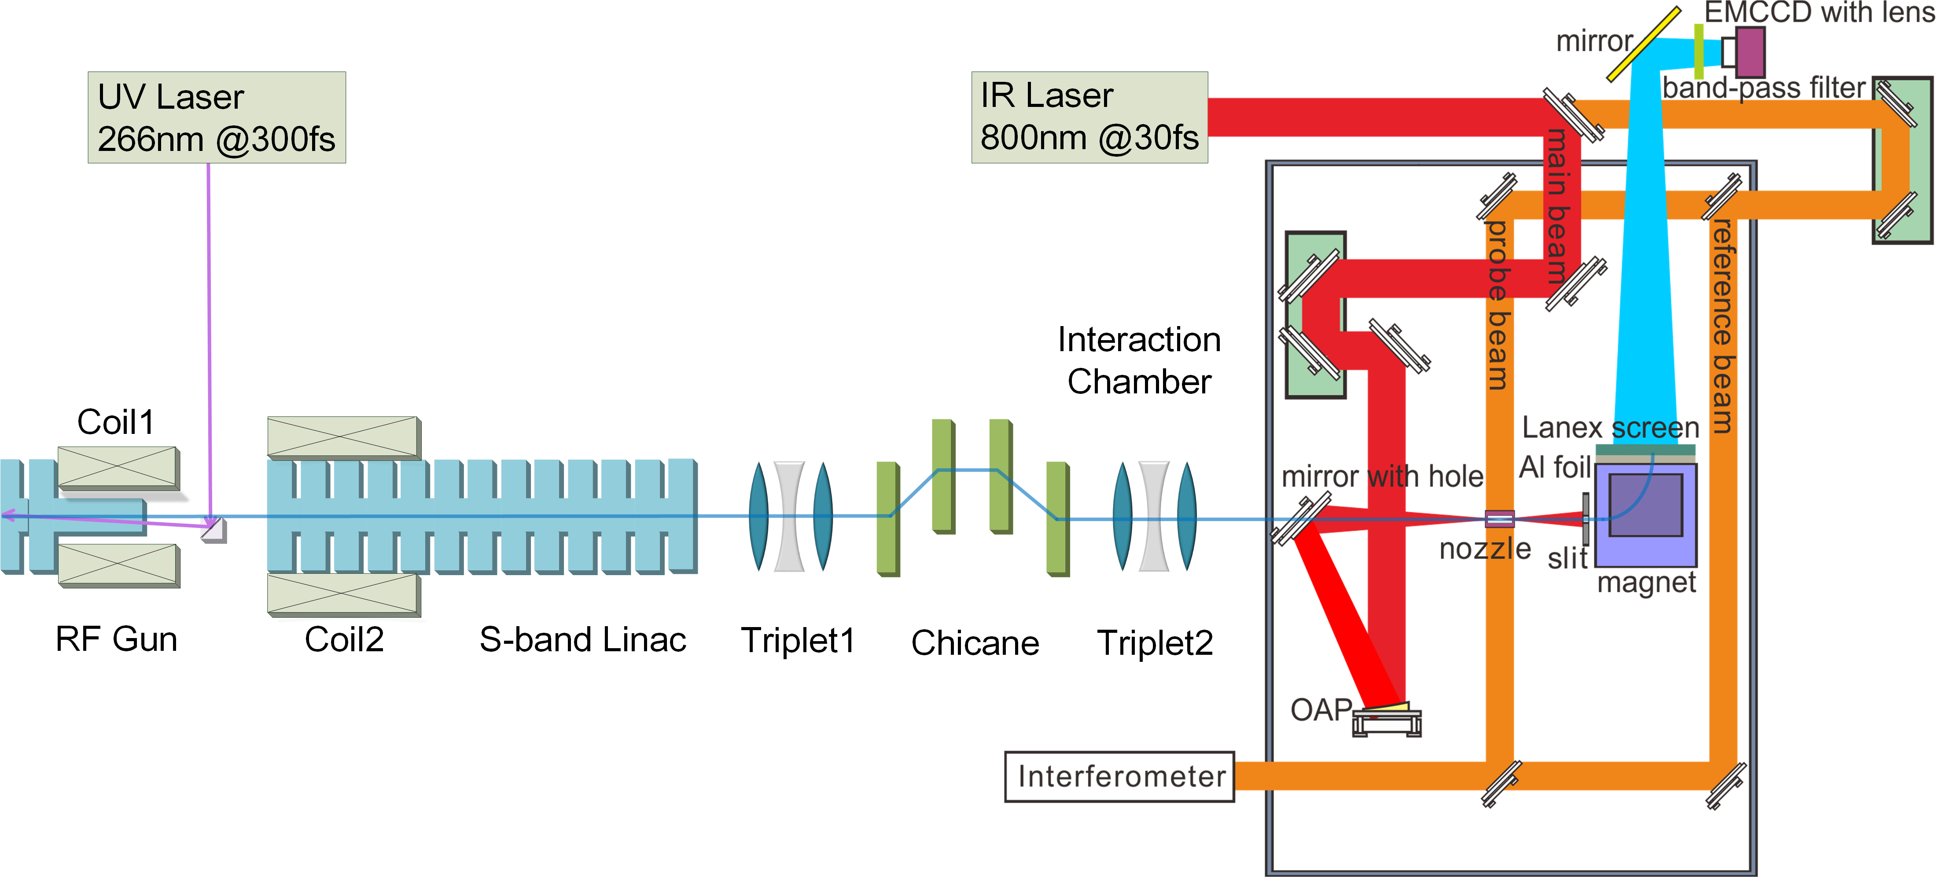

Slide 13
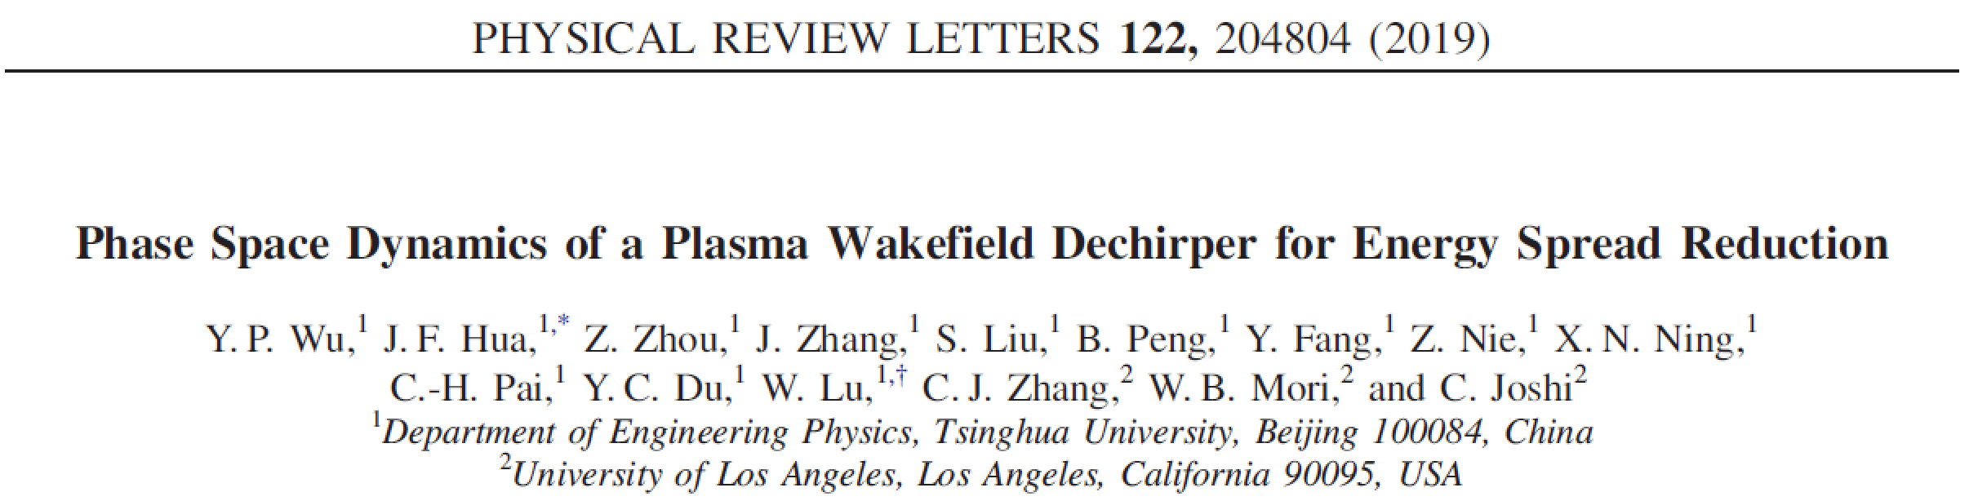
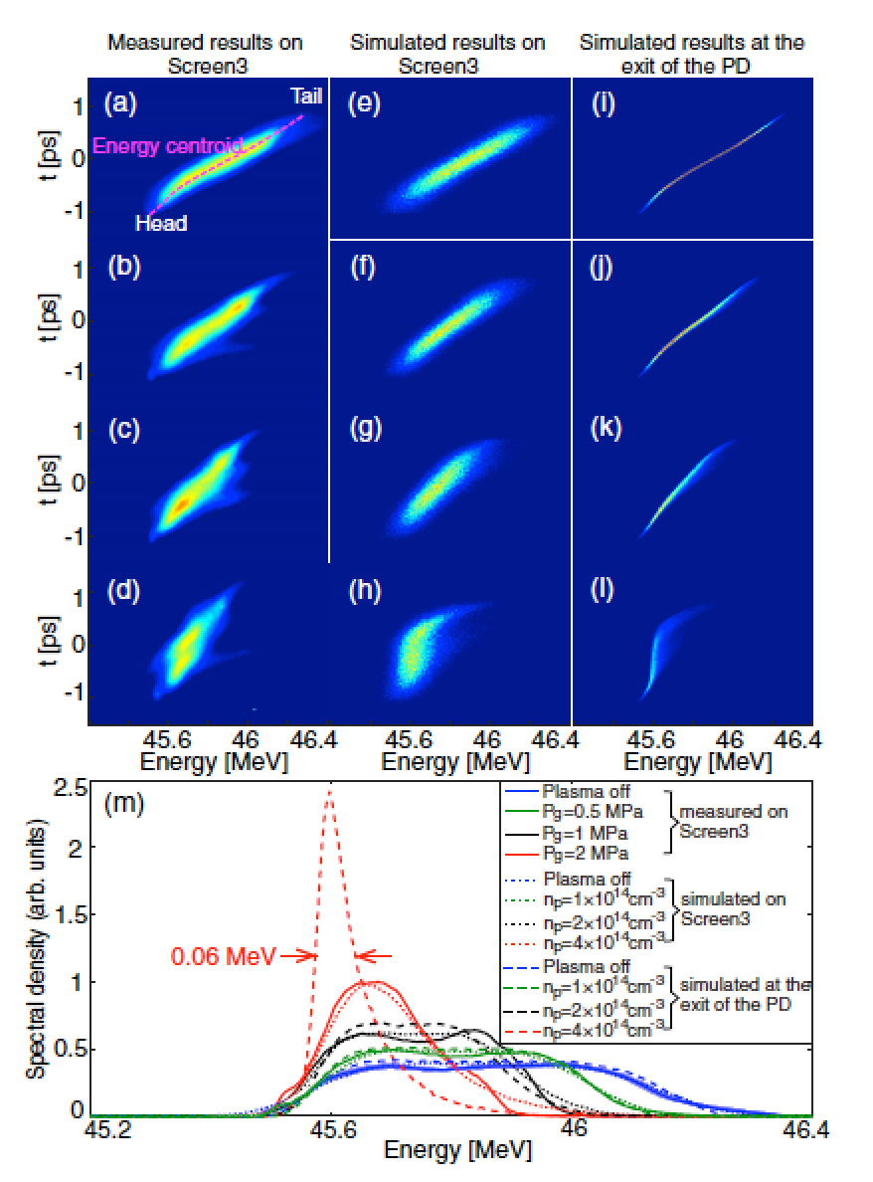
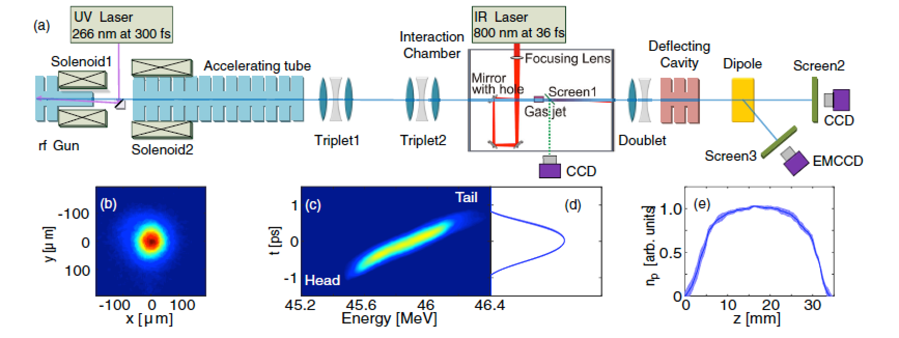

Slide 14
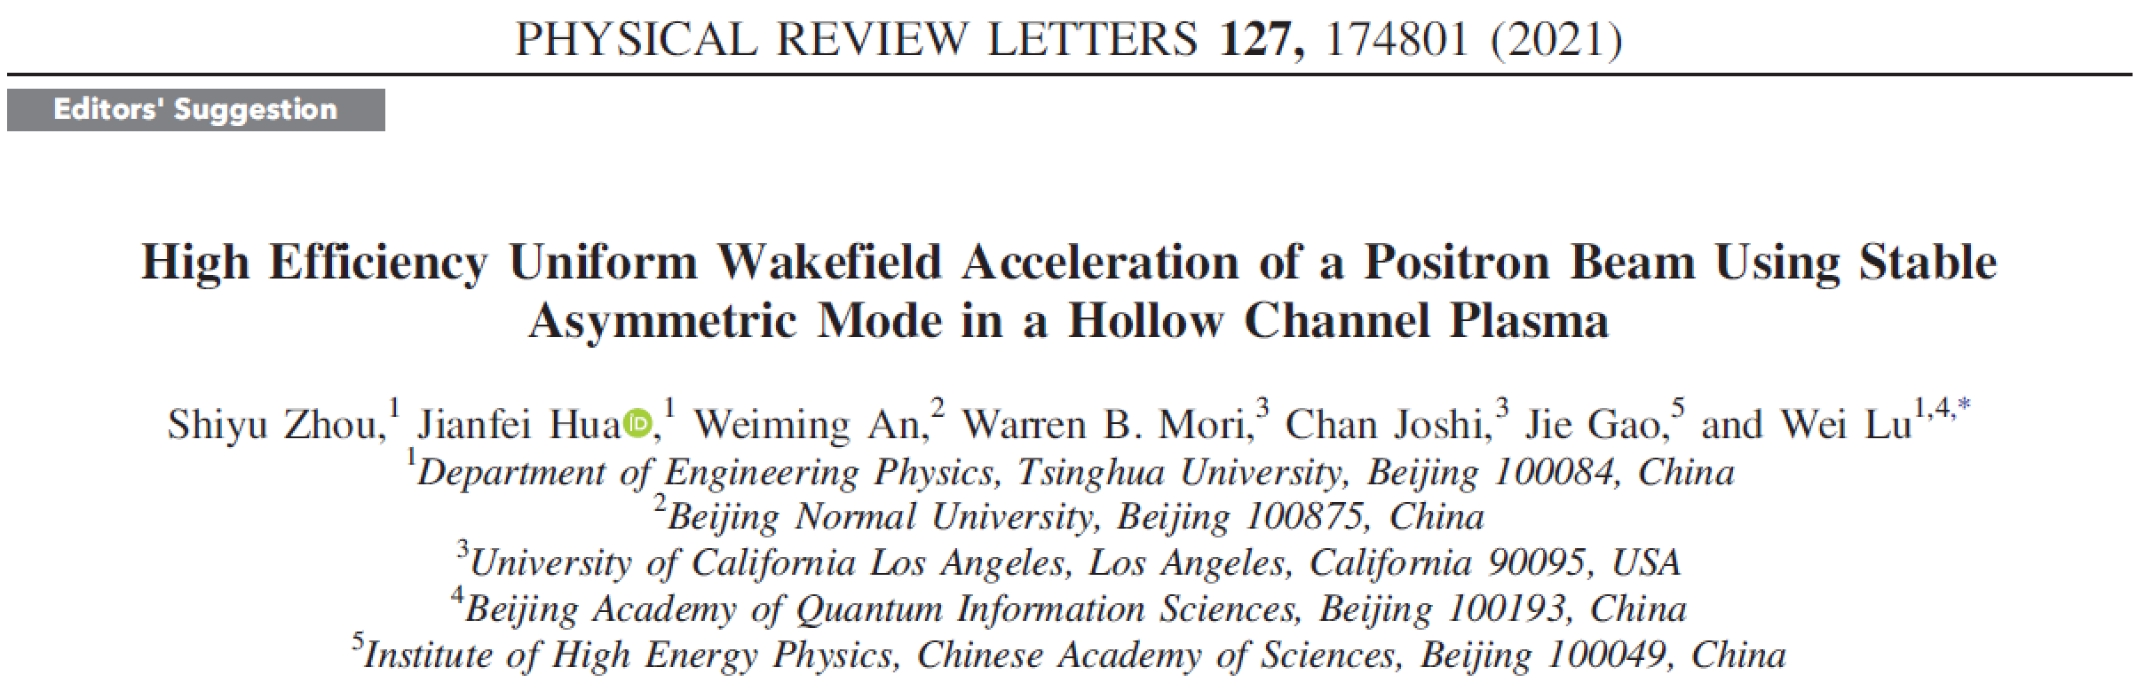
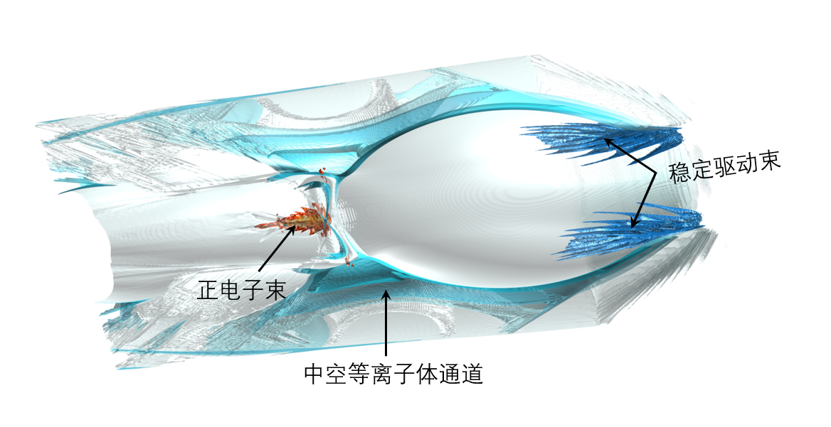
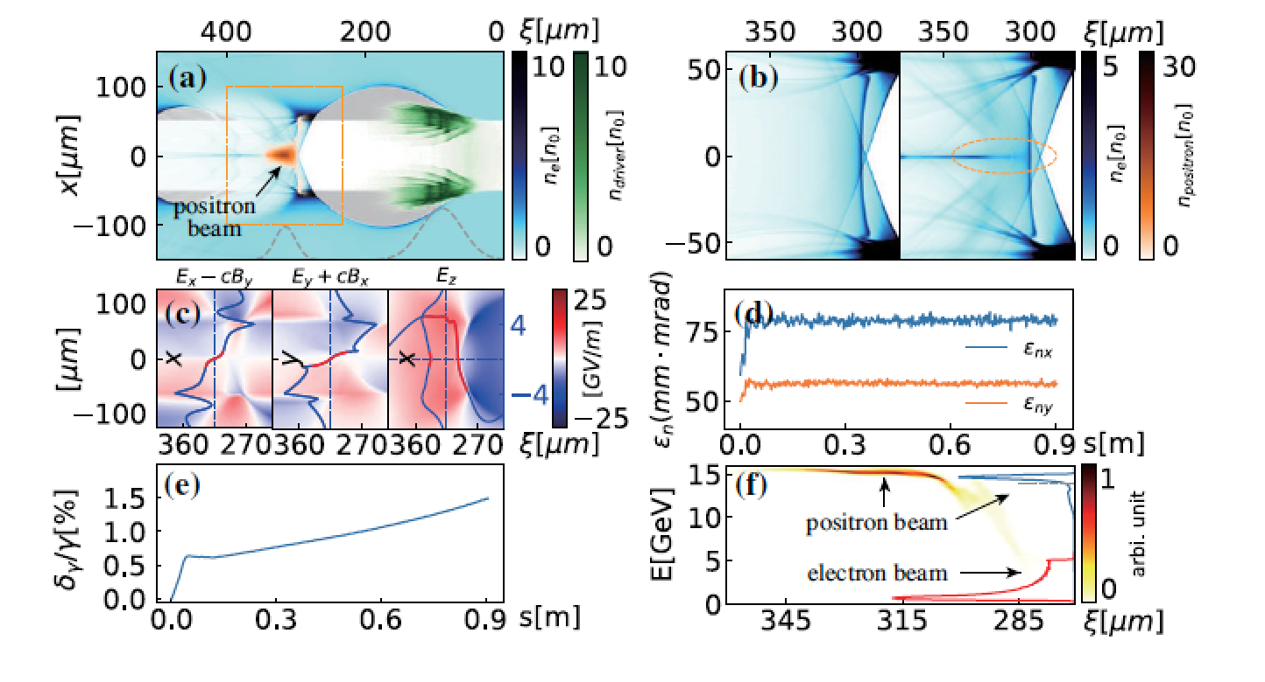

Slide 15
PWFA platform at SXFEL in Shanghai
S. Huang et al., IPAC proceeding 2017

Slide 16



PWFA platform at SXFEL in Shanghai

Slide 17

CEPC plan in China
Plasma Injector？
CDR (Acc.) International Review @ 2018.6.28-6.30 & Final Released @ 2018.9.2

Slide 18


CEPC Plasma Injector V.3

Slide 19
A planed PWFA test facility at BEPC of IHEP

Slide 20




A joint effort on compact robust lasers
BAQIS
北京量子信息科学研究院
启源研究院

Slide 21




Compact robust industry level intense laser development
A laser built by the user, and for the user!
20TW
1.3米
1.5米

Slide 22



40TW compact laser
1.5米
1.5米
8 hours 0.7%（rms）

Slide 23



200TW compact laser
σ_{θx}= 0.13μrad
σ_{θy}= 0.38μrad
10hours pointing0.38μrad（rms）
3米
1.5米

Slide 24
Stability for varied temperature
长期能量稳定性（±0.5℃）
长期能量稳定性（±1.5℃）
8 h 0.76%（rms）
14h 0.91%（rms）

Slide 25



Compact high energy pump 16J
16J泵源激光器
激光波长 | 532nm
重频 | 1~5Hz
光斑调制度 | <1.3 PTA
能量稳定度rms | <0.4% @ 24hrs
尺寸 | 1200*530*300mm
0.3米
1.2米
0.53米
24小时能量稳定度0.34%（rms）

Slide 26

Table top ultrafast synchrotron source

Slide 27


A movable system in a container

Slide 28

Stable high charge beams

Slide 29

10Hz stable electron beam (100shots)

Slide 30

10 hours stable electron beam

Slide 31

A Laser Plasma Accelerator Application Facility

Slide 32


Slide 33
Thank you!

