Slide 1
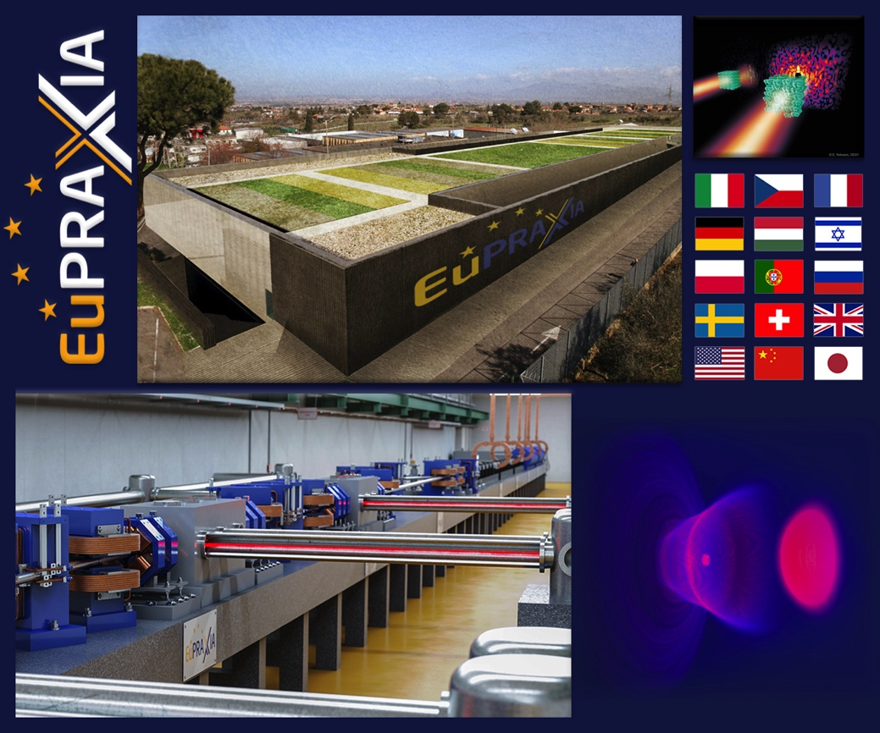
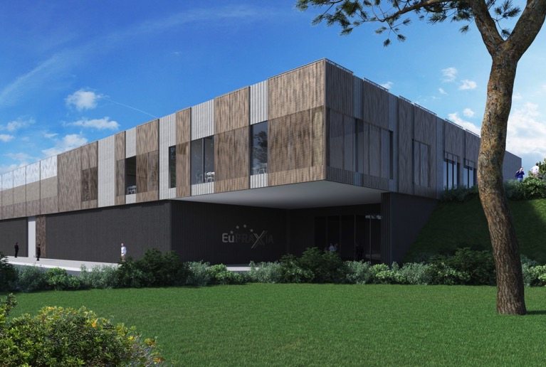

EuPRAXIA
Ralph W. Aßmann, Coordinator
(INFN and DESY)
EuroNNAc Special Topics Workshop, Elba, Italy
21 September 2022
Notes:
Ralph

Slide 2
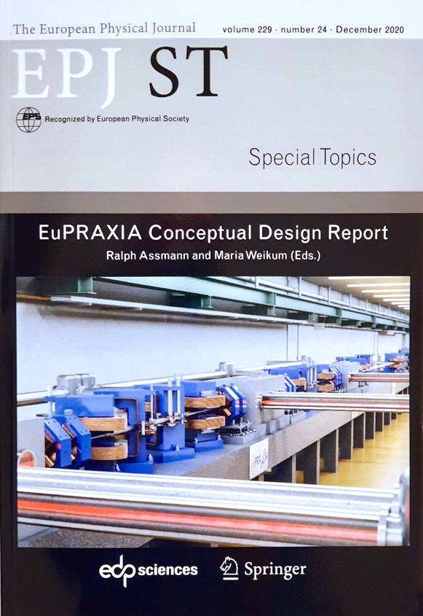
The EuPRAXIA Project
http://www.eupraxia-project.eu/
First ever design of a plasma accelerator facility.
Conceptual Design Report for a distributed research infrastructure funded by EU Horizon2020 program. Completed by 16+25 institutes.
Challenges addressed by EuPRAXIA since 2015:
  Can plasma accelerators produce usable electron beams?
  For what can we use those beams while we increase the beam energy towards HEP and collider usages?
Next phase consortium: > 50 institutes
Preparatory Phase project: 1 Nov 2022 – 31 Oct 2026
Start of 1st operation: 2028
600+ page CDR, 240 scientists contributed

Slide 3

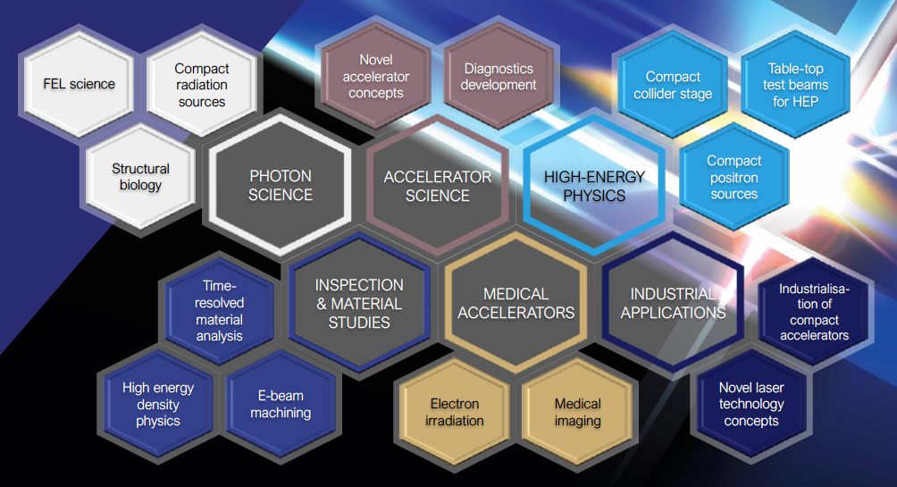

European Plasma Research Accelerator with eXcellence In Applications
Versatile – Designed for Users in Multiple Science Fields
Delivers 10-100 Hz ultra-short pulses
Electrons
(0.1-5 GeV, 30 pC)
Positrons
(0.5-10 MeV, 10⁶)
Positrons (GeV source)
Lasers
(100 J, 50 fs, 10-100 Hz)
Betatron X rays
(1-110 keV, 10¹⁰)
FEL light
(0.2-36 nm, 10⁹-10¹³)
Topics of research: proteins, viruses, bacteria, cells, metals, semiconductors, superconductors, magnetic materials, organic molecules
This project has received funding from the European Union’s Horizon 2020 research and innovation programme under grant agreement No 653782.

Slide 4

Human-made Sources of Light
Visible
light
fire (400,000 bc), oil lamp (10,000 bc), gas lamp (500 bc), candle (500 bc)
1 μm 100 nm 10 nm 1 nm 100 pm 10 pm 1 pm 100 fm 10 fm

Slide 5
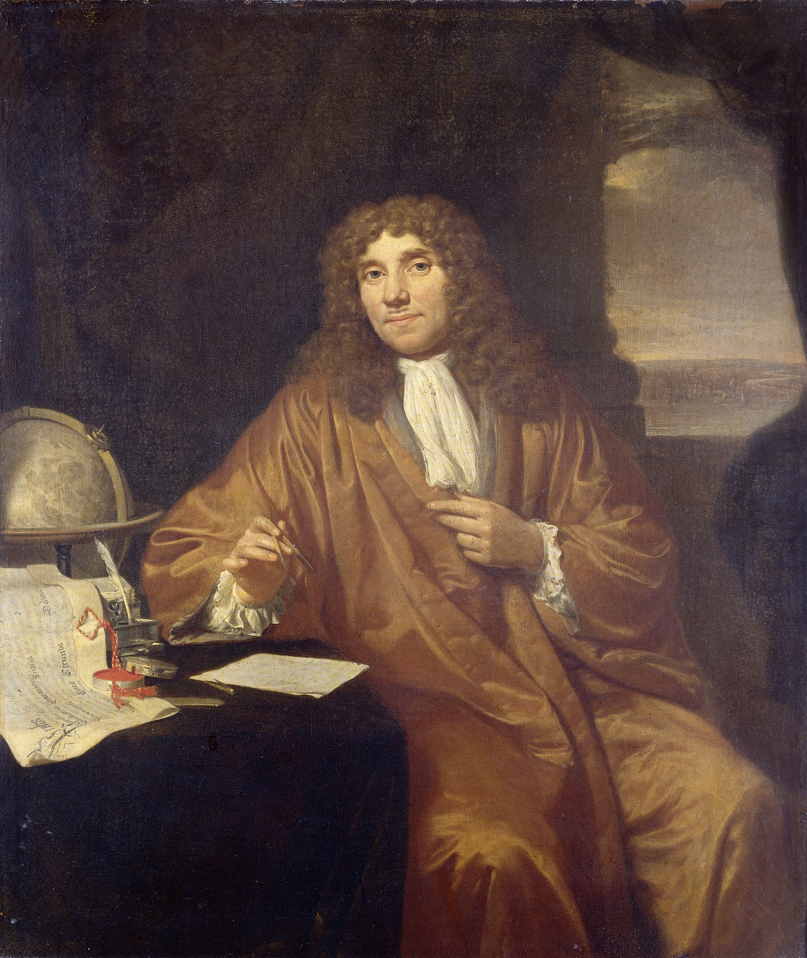
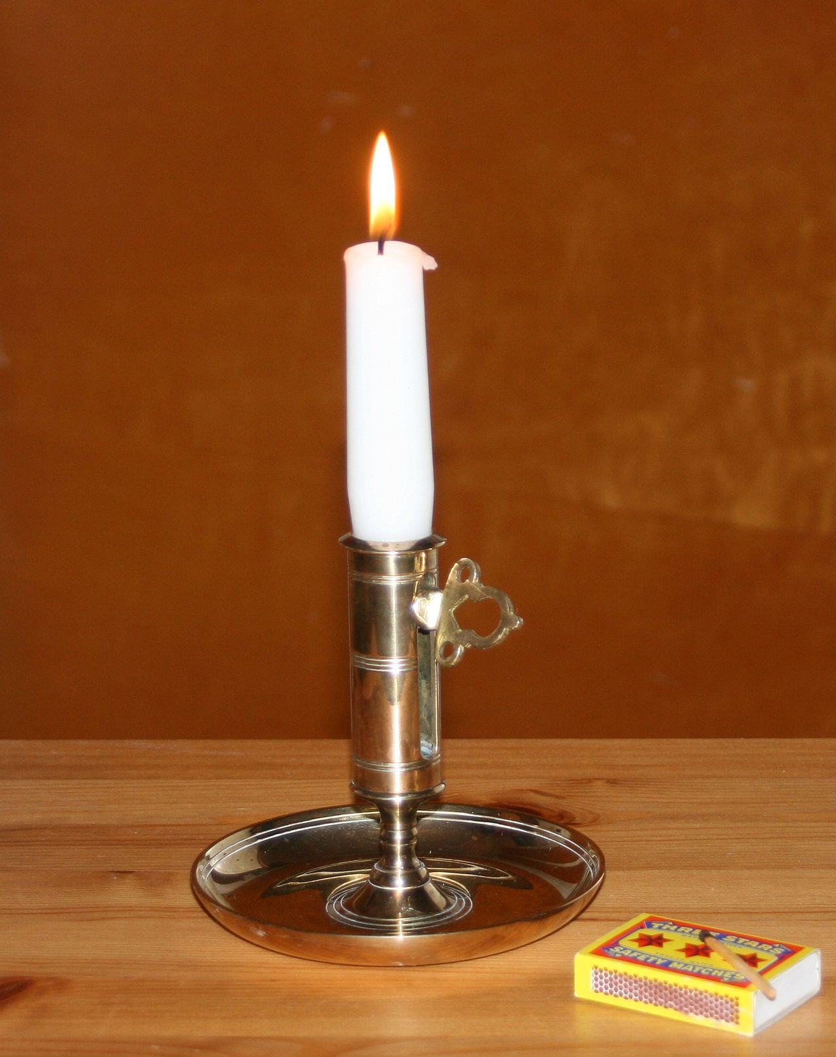
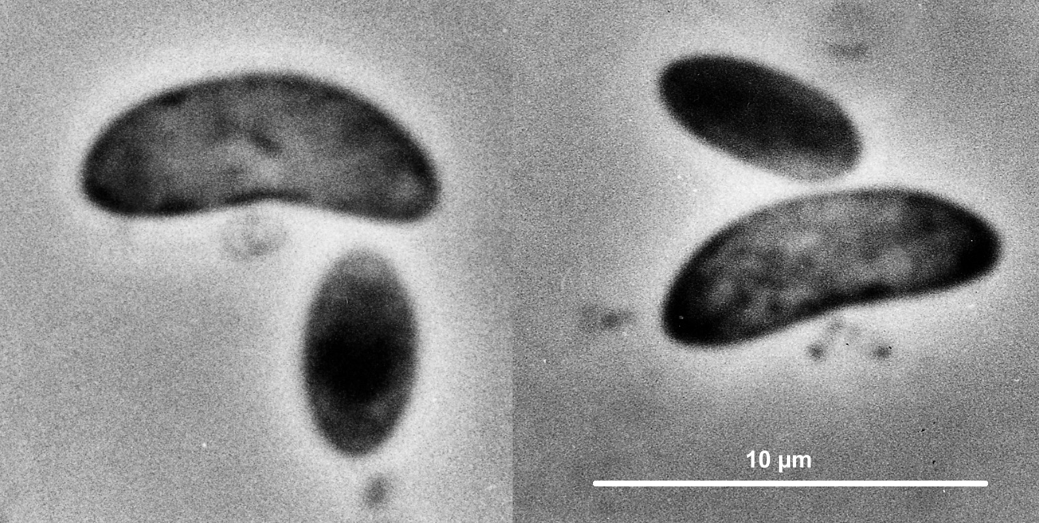
Human-made Sources of Light
Visible
light
fire (400,000 bc), oil lamp (10,000 bc), gas lamp (500 bc), candle (500 bc)
Anthonie van Leeuwenhoek (1632-1723)
Candle light plus improved microscope → Leeuwenhoek discovered the bacteria (large Selenomonads from the human mouth) in 1683
1 μm 100 nm 10 nm 1 nm 100 pm 10 pm 1 pm 100 fm 10 fm

Slide 6
Human-made Sources of Light
Visible
light
fire (400,000 bc), oil lamp (10,000 bc), gas lamp (500 bc), candle (500 bc), electric light (1805)
Ultraviolet light
Soft X Rays
Hard X Rays
Gamma Rays
1 μm 100 nm 10 nm 1 nm 100 pm 10 pm 1 pm 100 fm 10 fm

Slide 7
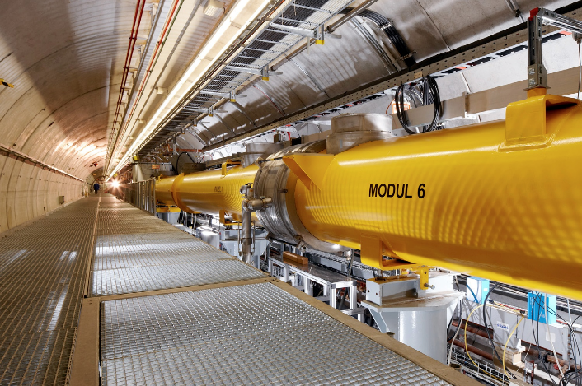
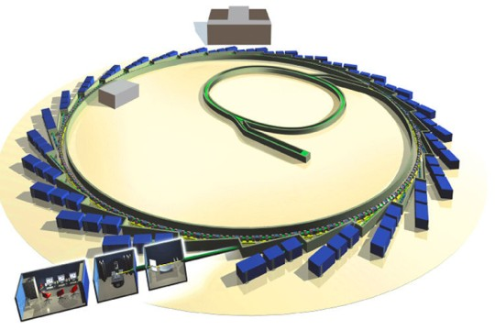

Human-made Sources of Light
Visible
light
New capabilities with light sources based on circular (1970) and linear (2005) particle accelerators
X rays with extremely high brilliance and time resolution capabilities
Ultraviolet light
Soft X Rays
Hard X Rays
Gamma Rays
1 μm 100 nm 10 nm 1 nm 100 pm 10 pm 1 pm 100 fm 10 fm

Slide 8
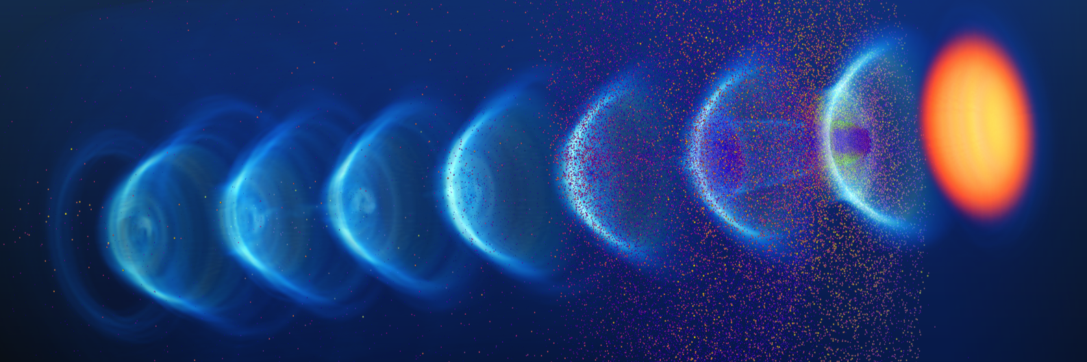

Human-made Sources of Light
Visible
light
New capabilities with light sources based on circular (1970) and linear (2005) particle accelerators
X rays with extremely high brilliance and time resolution capabilities
Ultraviolet light
Soft X Rays
Compact plasma-based source (2030)
Hard X Rays
Gamma Rays
1 μm 100 nm 10 nm 1 nm 100 pm 10 pm 1 pm 100 fm 10 fm

Slide 9
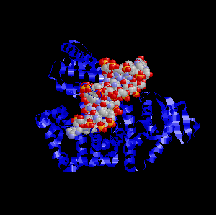
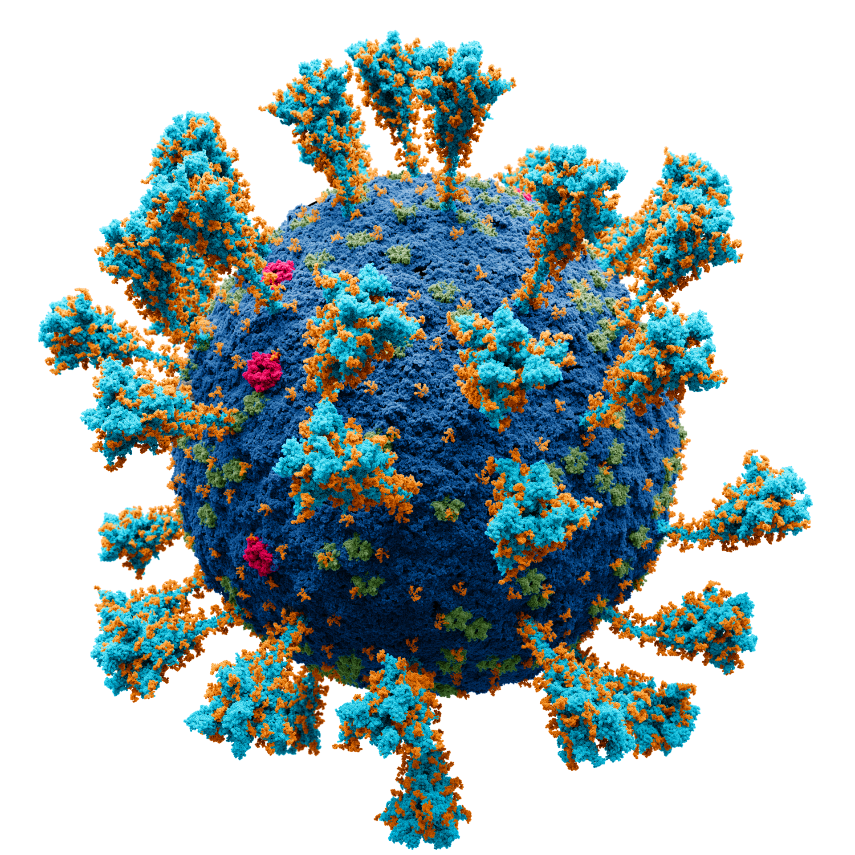
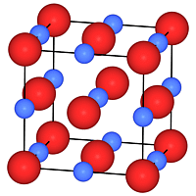
Why Additional Compact Light Sources? at the moment less powerful than the big machines
Visible
light
Practically unlimited number of study objects with potentially high impact on our lives:
About 320,000 unknown viruses that infect mammals
There may be a million bacterial species in 30 grams of rich soil in Norway
Need for access and screening time – work for students at many universities
Ultraviolet light
Soft X Rays
Hard X Rays
Gamma Rays
1 μm 100 nm 10 nm 1 nm 100 pm 10 pm 1 pm 100 fm 10 fm

Slide 10
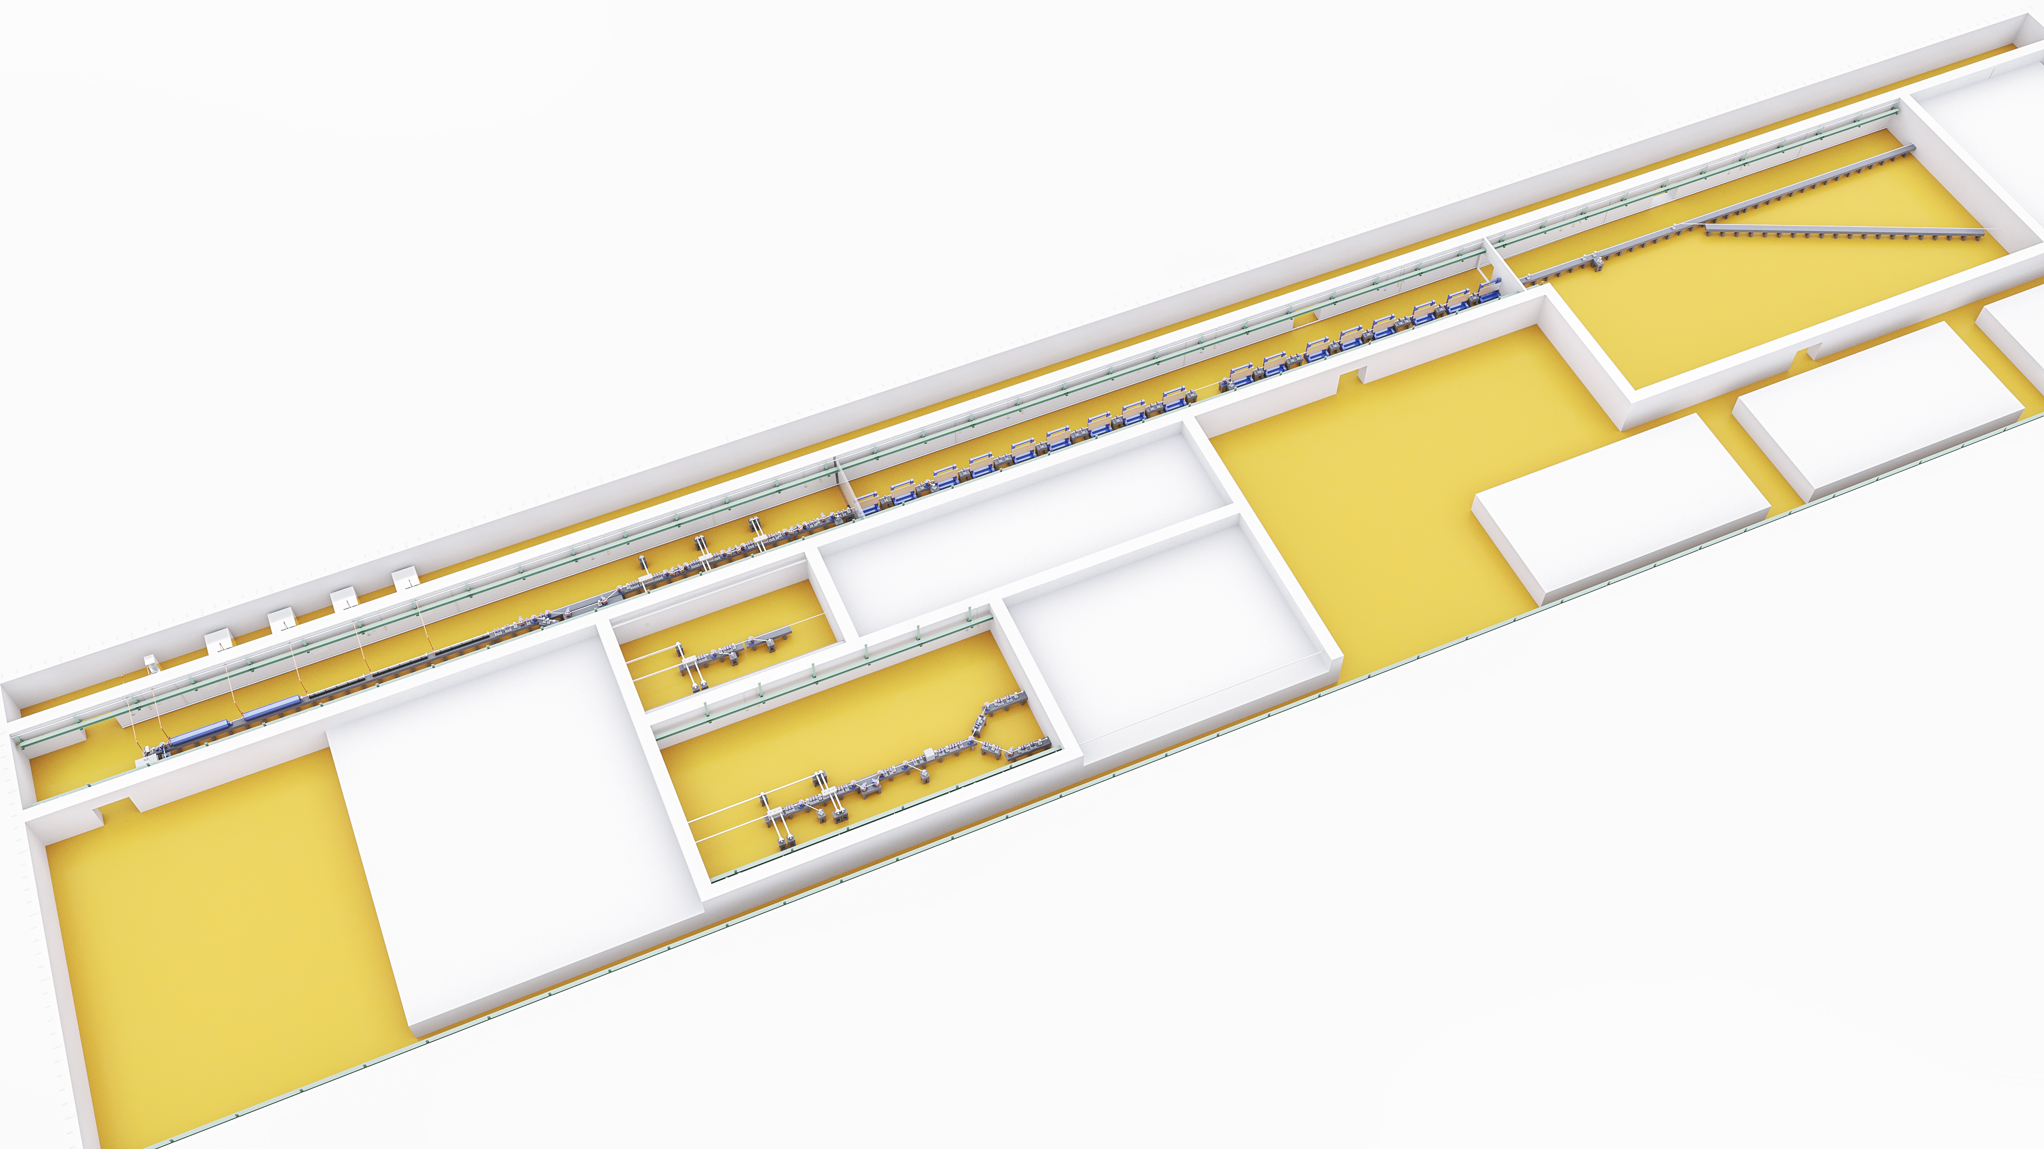
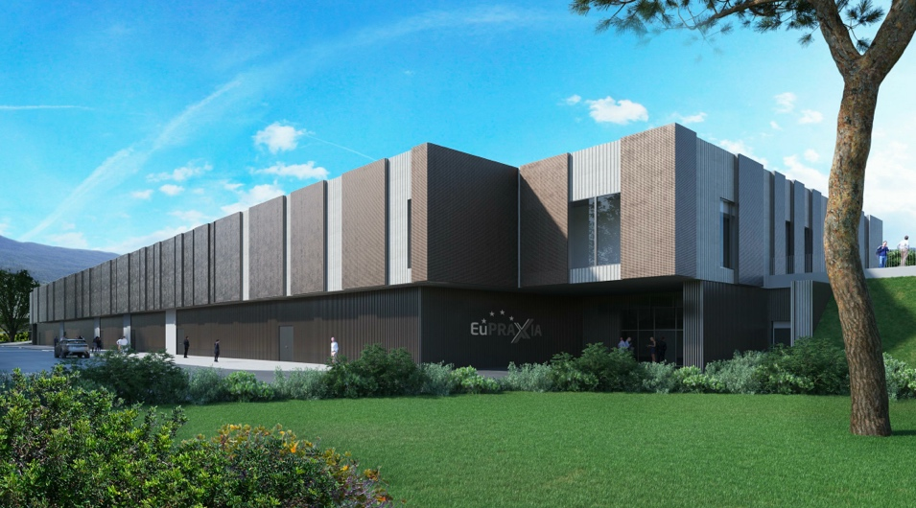
135 – 175 m
∼35 m

Slide 11
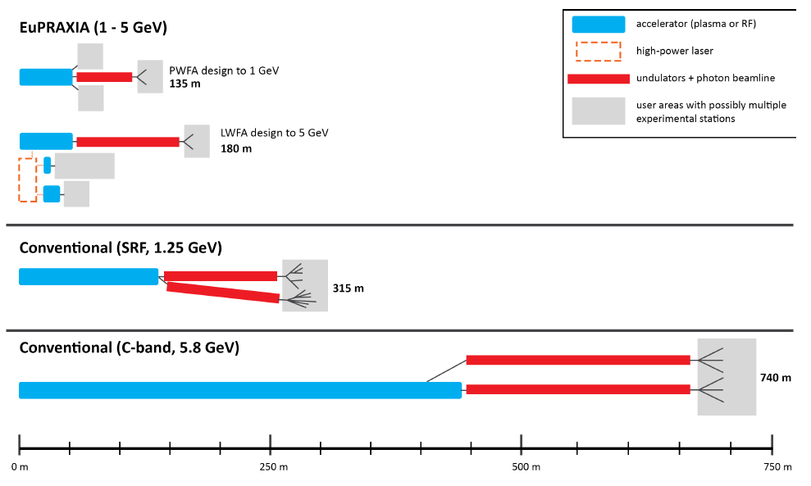
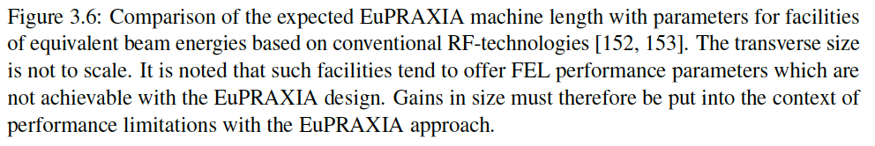
EuPRAXIA Facility Size: C O M P A C T

Slide 12
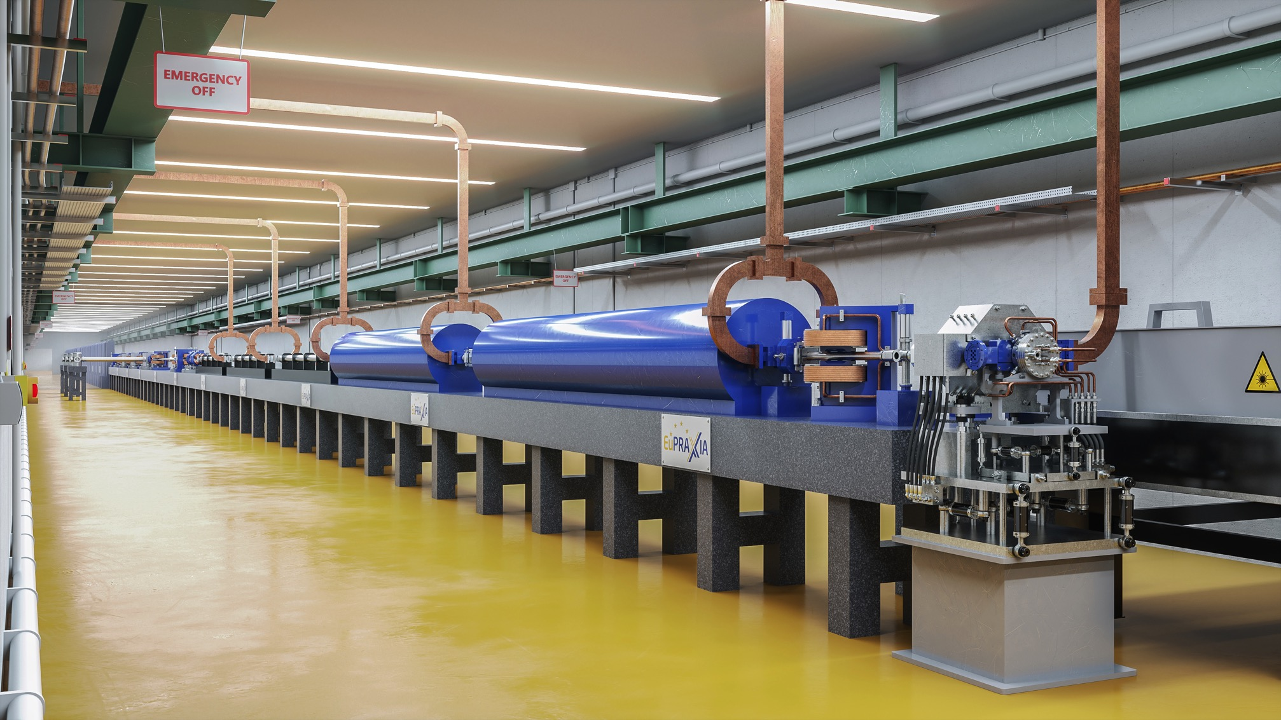
  IMPORTANT: EuPRAXIA design includes
  lab space, RF injectors, transfer lines, undulator lines, shielding, ...

Slide 13
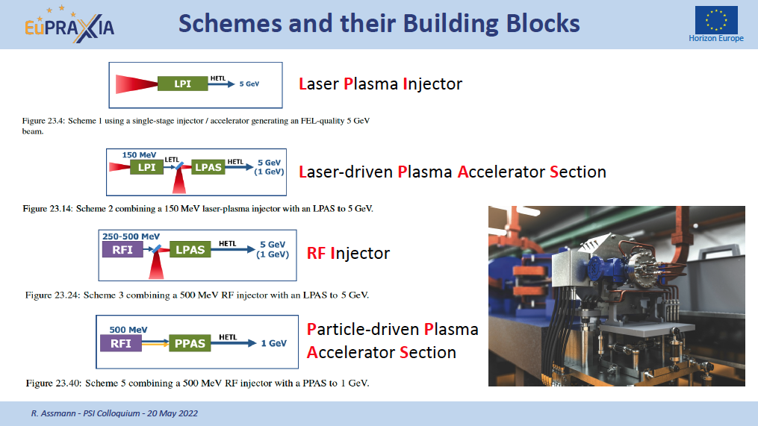
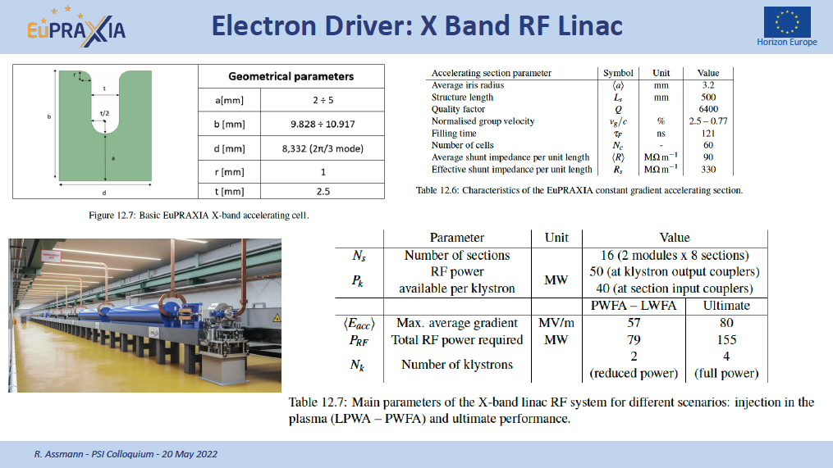
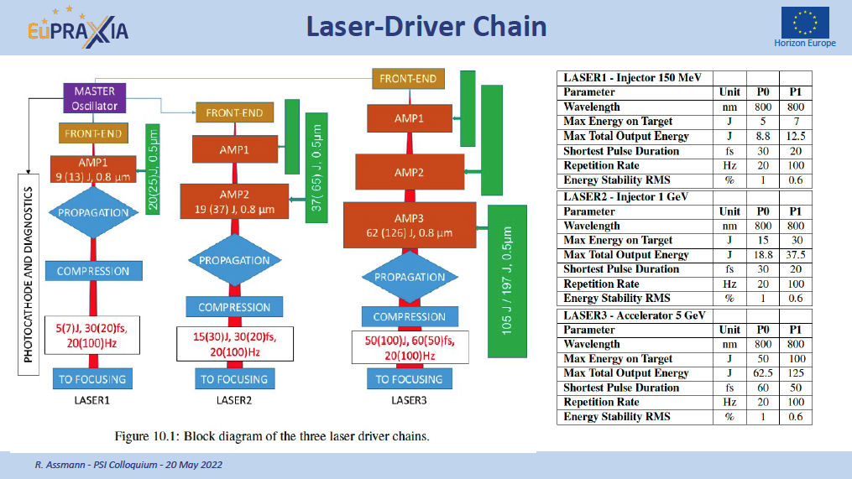
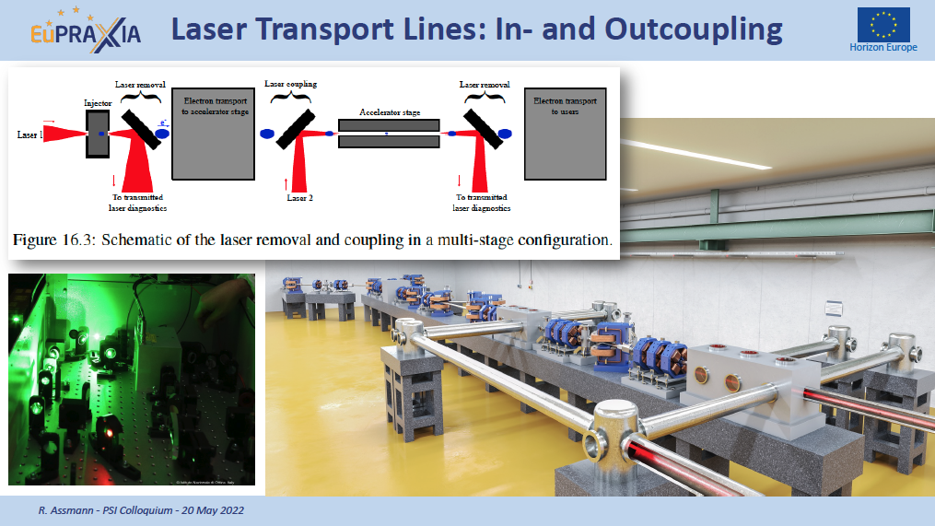

Slide 14
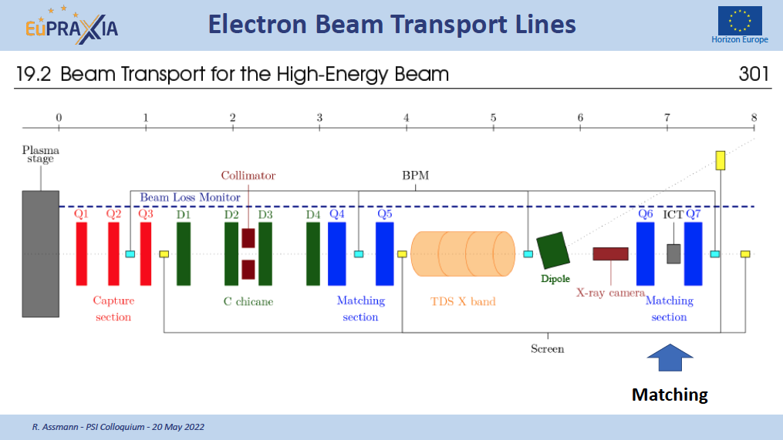
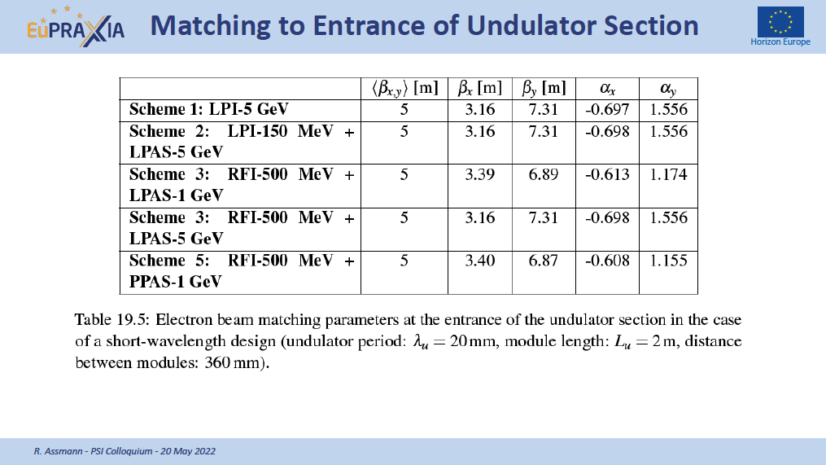
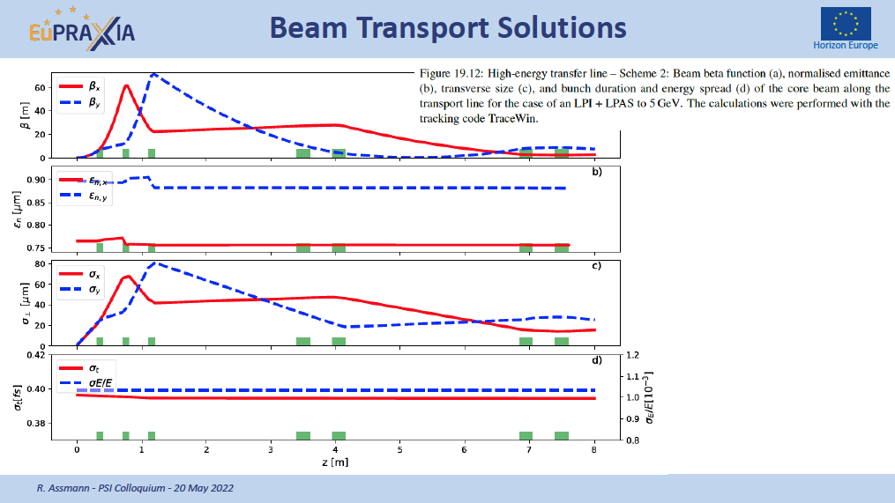
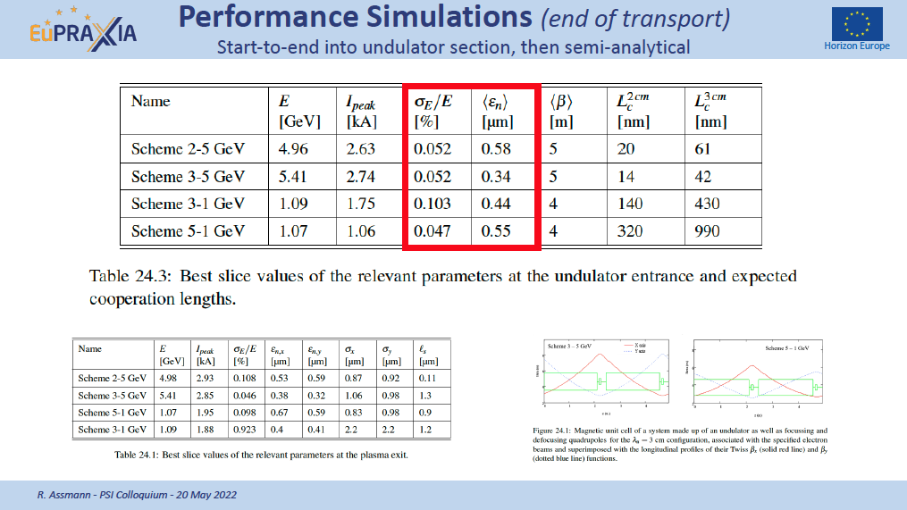

Slide 15
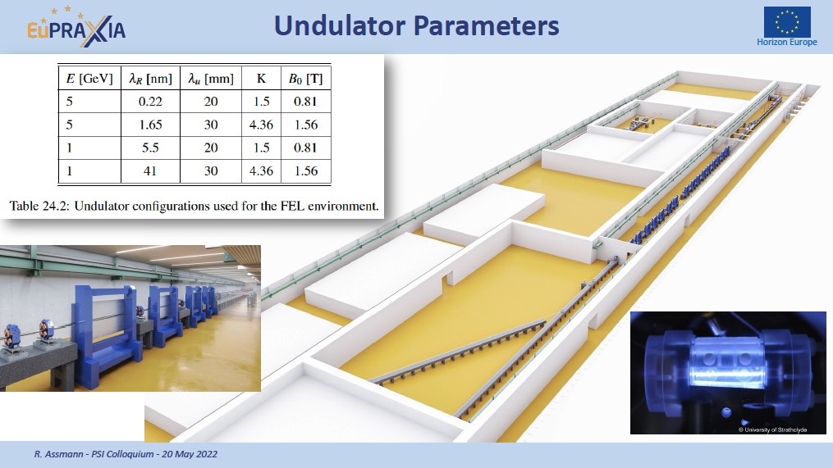
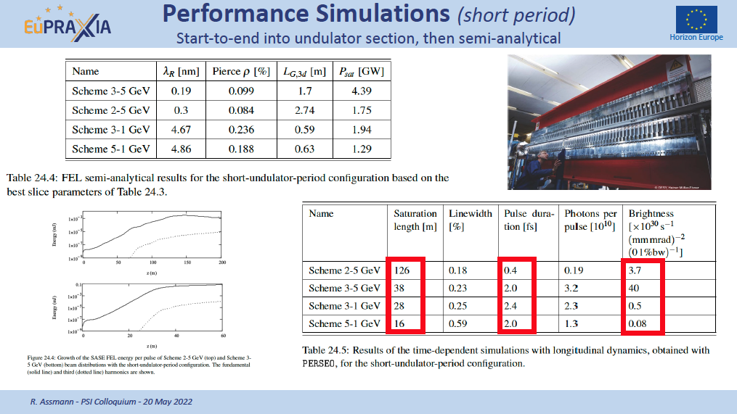
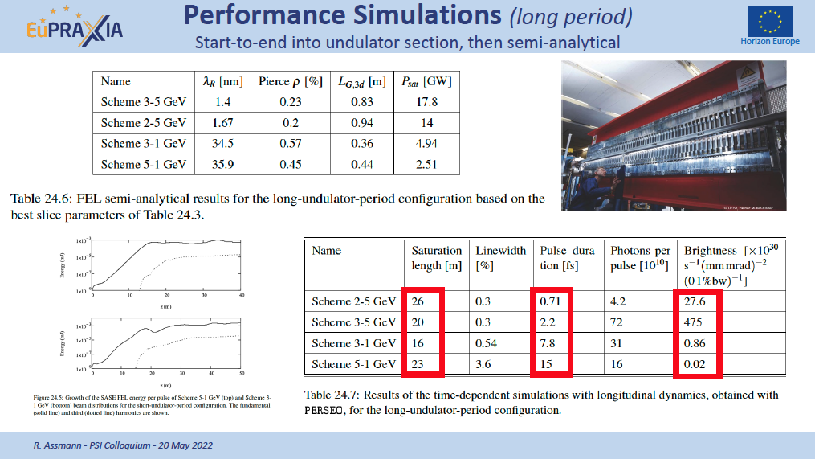
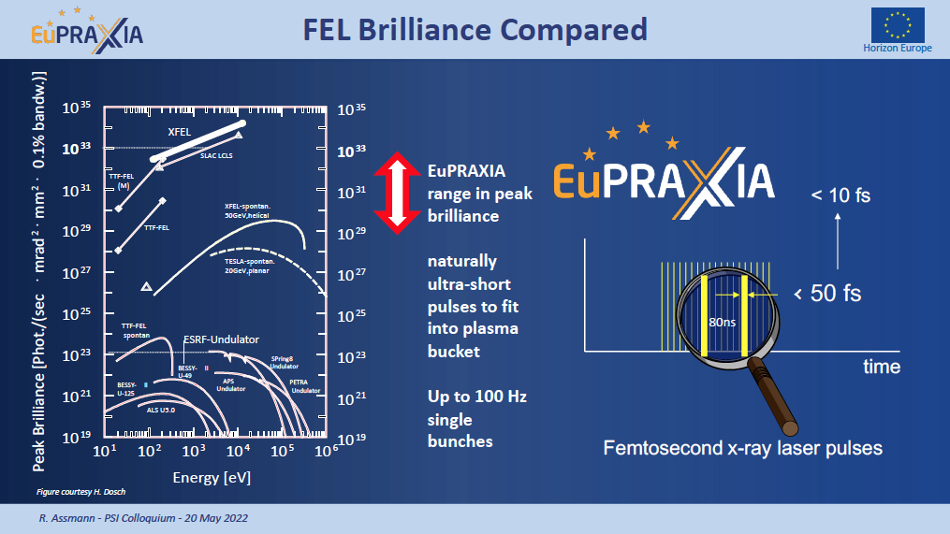

Slide 16

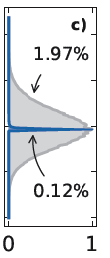
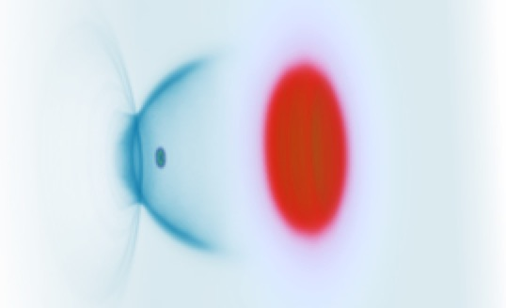






Solving Energy Spread (Touschek Prize 2020)
Electron beam
Ref.: Ferran Pousa, Martinez de la Ossa, Brinkmann, Assmann
PRL 123, 054801 (2019)
Not to scale. Compact setup 1.5 m.
Laser 1
Coherent Synchrotron Radiation (CSR) and Space-Charge checked
Plasma mirror
(coupling of laser 2)
Plasma accel. stage 2
Plasma mirror
(laser 1 removal)
Active plasma lens
Magnetic chicane
Plasma accel. stage 1
Active plasma lens
Laser 2
Accelerating in a plasma stage and...
... flipping phase space in the middle before second plasma stage

Slide 17
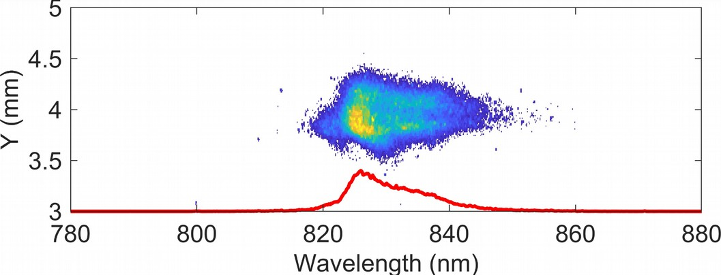
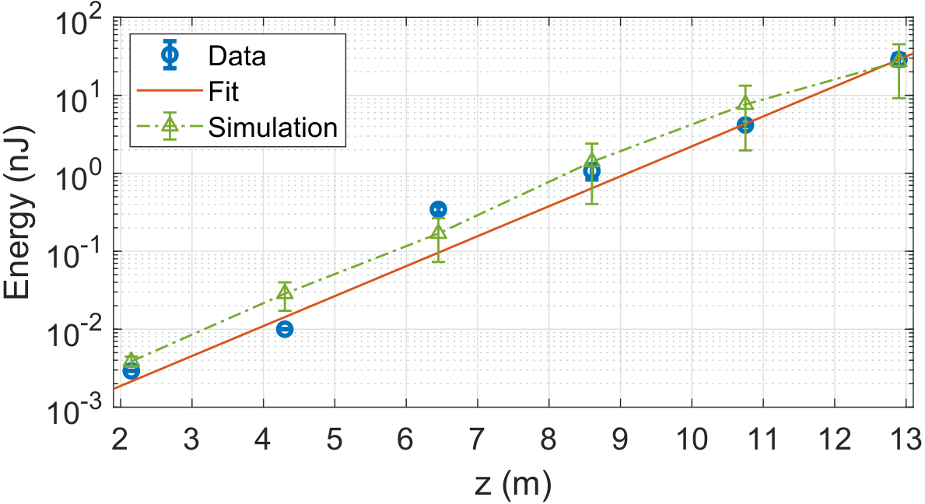
EuPRAXIA FEL: Feasibility Proof Achieved
Single Spike SASE spectrum
Recent ground-breaking results in Frascati:
First FEL lasing from a beam-driven plasma accelerator
Nature 605, 659–662 (2022)

Slide 18
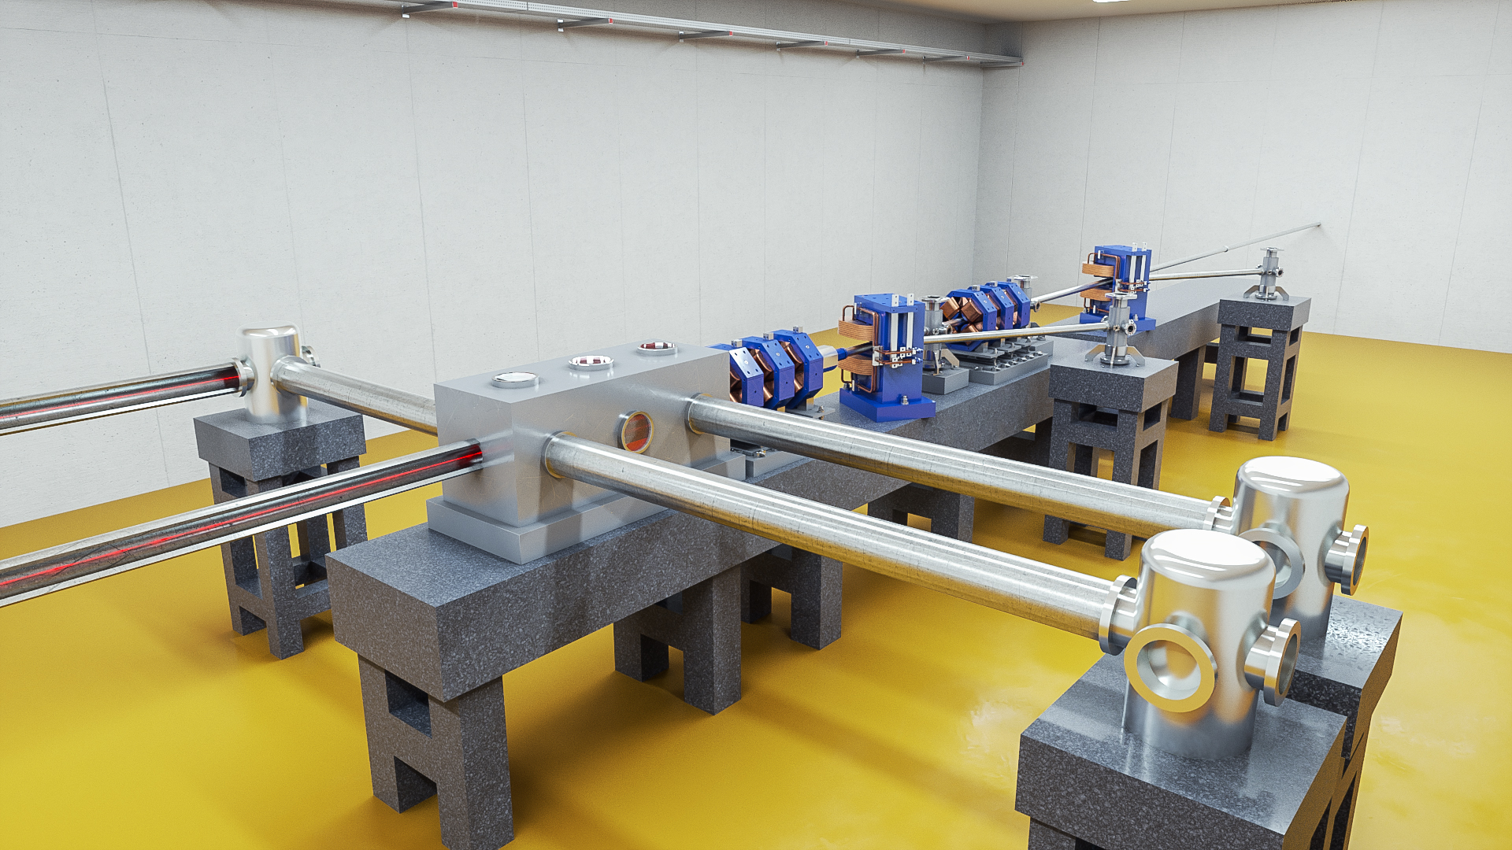
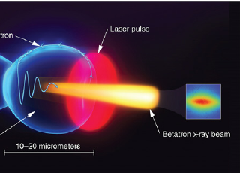

Betatron X Rays: Design Compact Medical Imaging Line
Fully plasma-based beamline for generating betatron radiation as a compact X-ray source for medical imaging and material analysis. The user area is behind the wall on the right.
Added value
It fits new locations, close to users, patients, bridges, …
Strengthening the European research area!
Also: applications cultural heritage (XAS technique), …
Electron beam from this compact setup can be used on longer-term for VHEE radiation therapy involving FLASH and grid mini-beam concepts
EuPRAXIA facility rendering picture
Notes:
Massimo

Slide 19
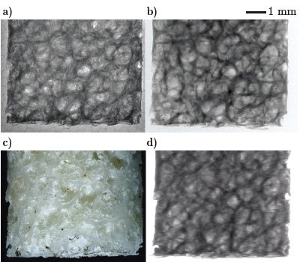
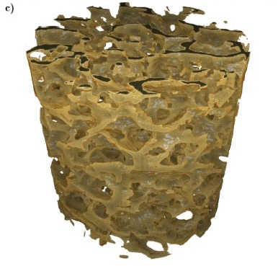
Betatron X Rays: Compact Medical Imaging
J.M. Cole et al, “Laser-wakefield accelerators as hard x-ray sources for 3D medical imaging of human bone”. Nature Scientific Reports 5, 13244 (2015)
Physics & Technology Background:
Small EuPRAXIA accelerator → small emission volume for betatron X rays.
Quasi-pointlike emission of X rays.
Sharper image from base optical principle.
Quality demonstrated and published, but takes a few hours for one image.
Advancing flux rate with EuPRAXIA laser by factor > 1,000!
EuPRAXIA technology
μCT Scanner
Added value
Sharper images with outstanding contrast
Identify smaller features (e.g. early detection of cancer at micron-scale – calcification)
Laser advance in EuPRAXIA → fast imaging (e.g. following moving organs during surgery)
3D tomography of human bone
EuPRAXIA laser advance (industry)
will push rate from 1/min to 100 Hz.
Ultra-compact source of hard X rays → exposing from various directions simultaneously is possible in upgrades
Macro-photography
Radioactive source
FOOD & HEALTH
Notes:
Massimo

Slide 20
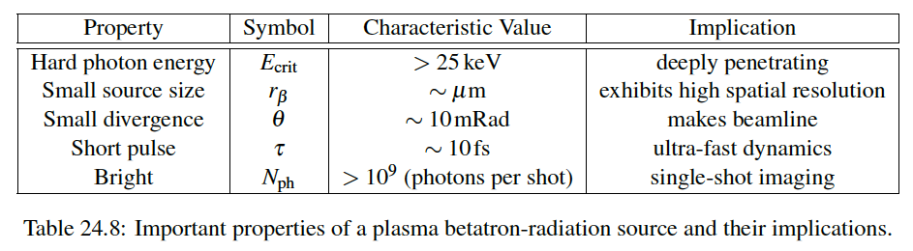
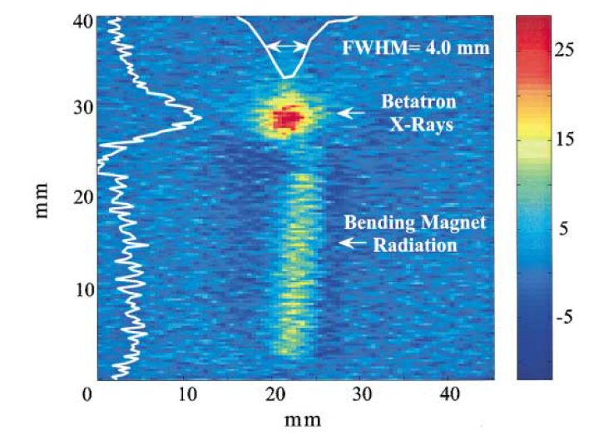
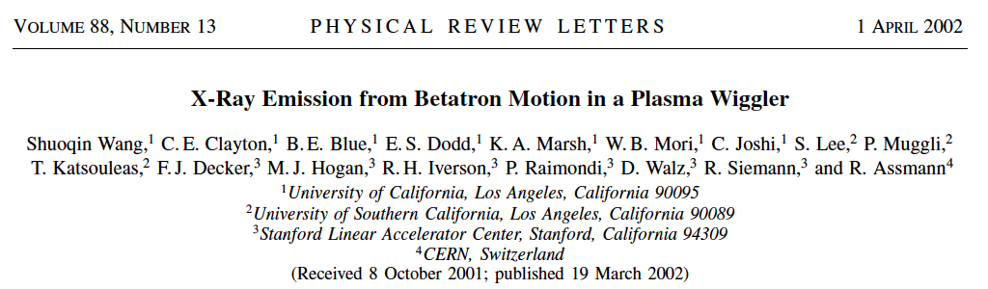
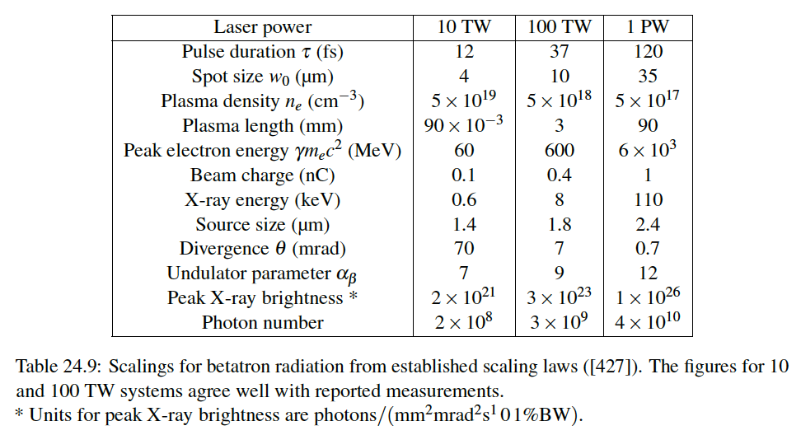
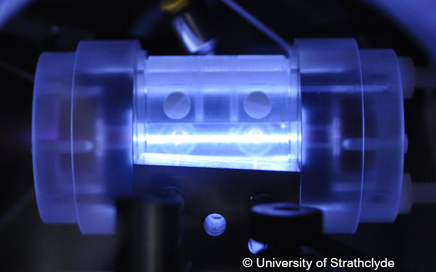
Betatron X Ray Source in Numbers

Slide 21
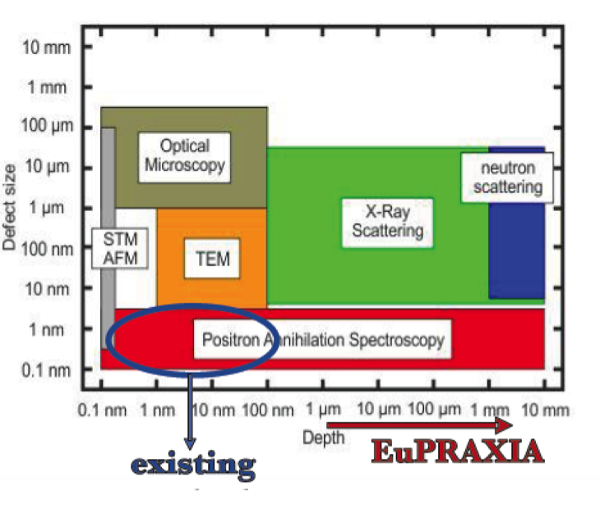
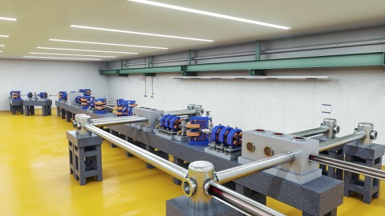
EuPRAXIA Positron Annihilation Spectroscopy
Electron beams from EuPRAXIA (also lower quality) can be used to produce positrons from a beam target.
Relevant here are lower energy positrons. EuPRAXIA:
  Energy: 0.5-10 MeV
  Intensity per pulse: 10⁶ e⁺
Those positrons penetrate deeper → new performance reach material science
Detection of nano
and sub-nano scale
defects.

Slide 22

Distributed RI Concept

Slide 23
Sorry for the very fast run through.
For more details on our innovative concepts, applications and new solutions please refer to our 2020 Conceptual Design Report.
Can we move our idea and our dream into reality?
Can we build this new European Research Infrastructure?
600+ page CDR, 240 scientists contributed

Slide 24
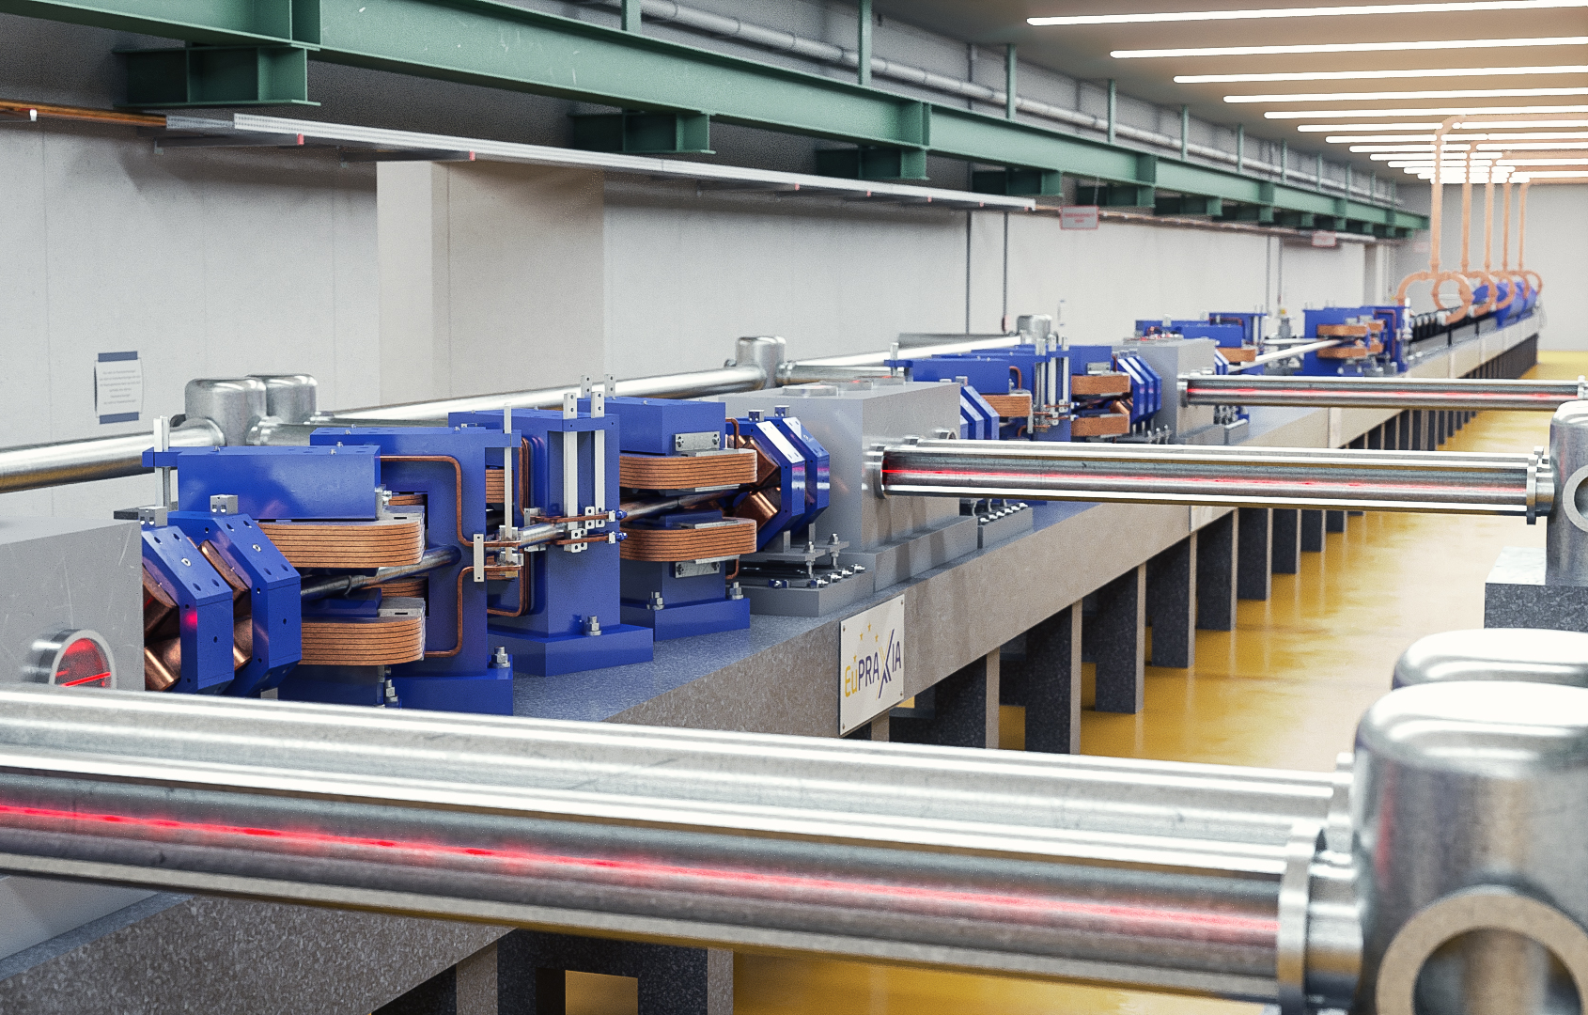
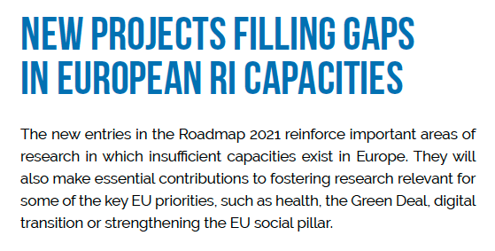
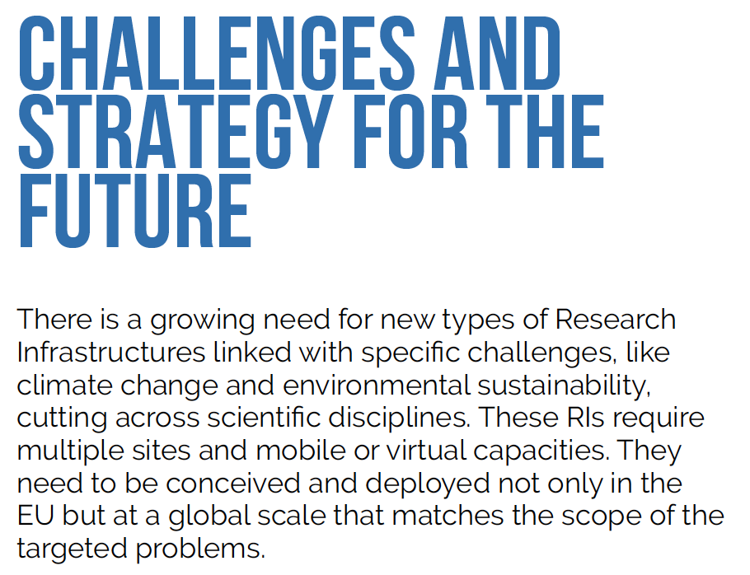
The Next Level: ESFRI Roadmap Update 2021
E uropean
S trategy
F orum on
R esearch
I nfrastructures
https://roadmap2021.esfri.eu
Roadmap projects selected after thorough review by ESFRI committee and approved by EU governments every few years
2006 – 2008 – 2012 – 2016 – 2018 – 2021
EuPRAXIA facility rendering picture

Slide 25
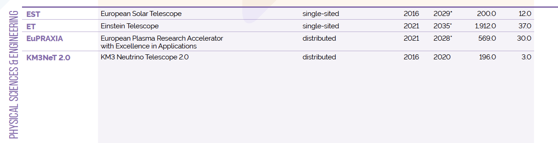

ESFRI Projects Roadmap 2021
https://roadmap2021.esfri.eu
Two new entries in 2021: Einstein Telescope (ET) and EuPRAXIA
EuPRAXIA is the only accelerator facility selected in the last 5 years
EuPRAXIA is the first plasma accelerator facility ever included

Slide 26
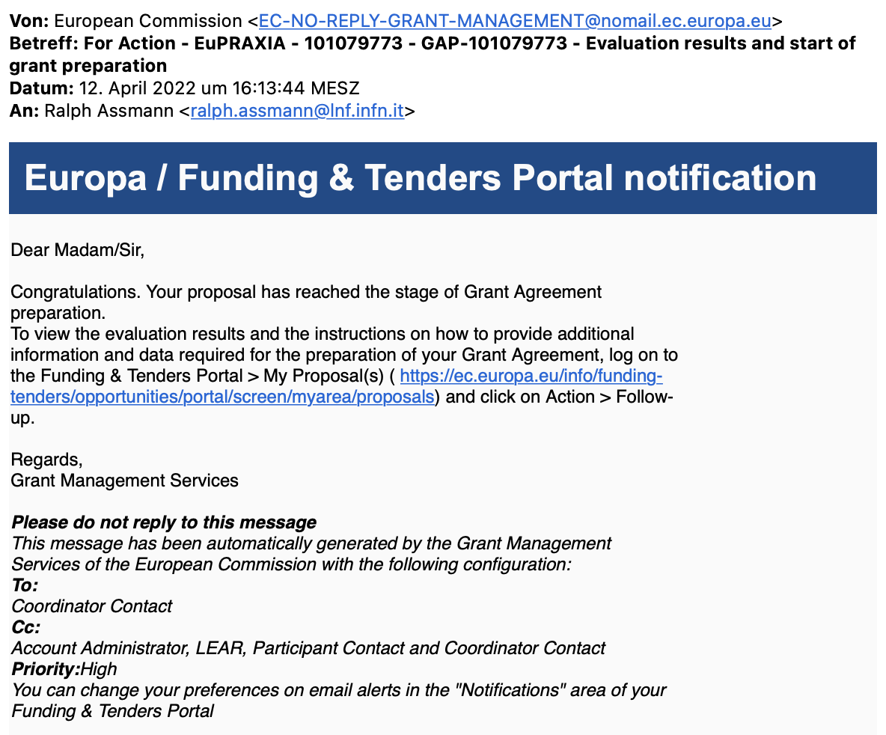

EuPRAXIA-PP (Preparatory Phase) Approved
Complemented by other projects:
EuPRAXIA Doctoral Network (approved)
(2023 – 2027)
2.6 M€ EU funding, 10 MSCA Fellows
Coordinated by U Liverpool (C. Welsch)
Start date: 1 Jan 2023
Others coming (miss no opportunity)

Slide 27
EuPRAXIA-PP (Preparatory Phase) Key Facts
Prepares the implementation of the full RI in Europe
Total project volume (including in-kind): 8.3 M€
  EU funding: 2.49 M€ (plus in-kind)
  Additional funding Switzerland: 0.69 M€
  UK: 0.51 M€
Work organized in 16 Work Packages
Project dates: 1 Nov 2022 – 31 Oct 2026
Coordinator and location of headquarters: INFN
34 participating organizations from 12 countries
Establish, amongst others, “Board of Financial Sponsors“ with representatives of funding agencies.
So far ~ 25% of total M&P funding (569 M€) secured. Site 1 financed.

Slide 28








EuPRAXIA Schedule
↑
European World-Class RI on compact accelerators for the end of the 2020‘s to the beginning of the 2060‘s
More detail in Master Schedule
SUCCESS – ON TRACK

Slide 29













EuPRAXIA-PP Consortium I
Coordinator

Slide 30











EuPRAXIA-PP Consortium II

Slide 31






EuPRAXIA-PP Consortium III

Slide 32





EuPRAXIA-PP Consortium IV
Complemented by institutes in EuPRAXIA ESFRI consortium: additional 17 institutes from France, Germany, Poland, Sweden, United Kingdom, China, Japan, United States . Russian institutes presently suspended.

Slide 33

PP Steering Committee: Leaders Behind EuPRAXIA
WP1 - Coordination & Project Management
R. Assmann, INFN & DESY
M. Ferrario, INFN
WP2 - Dissemination and Public Relations
C. Welsch, U Liverpool
S. Bertellii, INFN
WP3 - Organization and Rules
A. Specka, CNRS
A. Ghigo, INFN
WP4 - Financial & Legal Model. Economic Impact
A. Falone, INFN
WP5 - User Strategy and Services
F. Stellato, U Tor Vergata
E. Principi, ELETTRA
WP6 - Membership Extension Strategy
B. Cros, CNRS
A. Mostacci, U Sapienza
WP7 - E-Needs and Data Policy
R. Fonseca, IST
S. Pioli, INFN
WP8 - Theory & Simulation
J. Vieria, IST
H. Vincenti, CEA
WP9 - RF, Magnets & Beamline
Components
S. Antipov, DESY
F. Nguyen, ENEA
WP10 - Plasma Components & Systems
K. Cassou, CNRS
J. Osterhoff, DESY
WP11 - Applications
G. Sarri, U Belfast
E. Chiadroni,U Sapienza
WP12 - Laser Technology, Liaison to Industry
L. Gizzi, CNR
P. Crump, FBH
WP13 - Diagnostics
A. Cianchi, U Tor Vergata
R. Ischebeck, EPFL
WP14 - Transformative Innovation Paths
B. Hidding, U Strathclyde
S. Karsch, LMU
WP15 - TDR EuPRAXIA @SPARC-lab
C. Vaccarezza, INFN
R. Pompili, INFN
WP16 - TDR EuPRAXIA Site 2
A. Molodozhentsev, ELI-Beamlines
R. Pattahil, STFC
WP’s on coordination & implementation as ESFRI RI (organization, legal model, financing, users)
WPs on technical implementation and sites

Slide 34


Headquarter and Site 1: EuPRAXIA@SPARClab
Frascati`s future facility
> 130 M€ invest funding
Beam-driven plasma accelerator
Europe`s most compact and most southern FEL
The world`s most compact RF accelerator (X band with CERN)

Slide 35




It Fits the Frascati Site
(also fits sites at a large university, hospital, company, …)
Directorate building
Canteen
INFN central administra-tion
SPARClab (seeding with plasma acc.)
Tor Raubenheimer
SLAC, Stanford University, USA
@ SPARClab
(European site 1)
Vladimir Shiltsev, Fermilab National Laboratory, USA

Slide 36























Candidate 2nd Sites from CDR
Prague, Czech Republic
↑
@ EPAC
Rutherford, STFC, UK
PWASC
CNR Campus Pisa
Notes:
Maria

Slide 37
Selection Criteria 2nd EuPRAXIA Site
(from CDR, fulfilled by 1st Site LNF/INFN)
Legal/Political | Technical | Financial
Compliance of host institution with EuPRAXIA Access Policy | Site provides sufficient space (about 175 m x 35 m) | Commitment to sustainability of EuPRAXIA (host lab covers site operation costs)
Compliance of host institution with EuPRAXIA Open Innovation and Open Science Policy | Laboratory has infrastructures in one or several of RF accelerators, laser installations, user access. | Previous investments into local infrastructures of relevance for EuPRAXIA (leverage effect)
Agreement of host institution with the long-term scientific agenda of EuPRAXIA | Site provides required services and facilities for support of external users, including E infrastructure | Existence of one or a mix of funding sources able to finance implementation of the site
Laboratory has existing groups in place to guarantee safety requirements (laser, radio-protection, access control) and rules
Note: approach reduces cost (pre-invest) and risks of cost-overun.
Notes:
Maria

Slide 38
Phased Implementation of Construction Sites
 | Laser-driven | Beam-driven
Phase 1 | FEL beamline to 1 GeV + user area 1 Ultracompact positron source beamline + positron user area | FEL beamline to 1 GeV + user area 1 GeV-class positrons beamline + positron user area
Phase 2 | X-ray imaging beamline + user area Table-top test beams user area FEL user area 2 FEL to 5 GeV | ICS source beamline + user area HEP detector tests user area FEL user area 2 FEL to 5 GeV
Phase 3 | High-field physics beamline / user area Other future developments | Medical imaging beamline / user area Other future developments
INFN (Italy):
Facility for beam-driven plasma accelerators
Beamline BB-A: Radiation sources
FEL user area 1
Undulator
Undulator
1
Plasma Accelerator
FEL user area 2
RF Injector
RF Accelerator
ICS X-ray source user area (BU3)
HEP detector test user area
laser
Plasma Accelerator
Conversion & conditioning
2
GeV-class positron user area
electrons
positrons
Beamline BB-B: GeV-class positrons & HEP detector test stand
Beamline LB-C: X-ray imaging – life sciences & materials
Facility for laser-driven plasma accelerators
Plasma Injector
Life-science & materials X-ray imaging user area
Beamline LB-B: Positron beam source & table-top test beam
Table-top test beam user area
Plasma Injector
Plasma Accelerator
Conversion & conditioning
Ultracompact positron source user area
1: INFN-LNF construction funding 108 M€
2: INFN/CNR/TorVer demo facility 22 M€ (PNRR)
Laser
Plasma Accelerator
FEL user area 1
Undulator
Undulator
RF Injector
Beamline LB-A: FEL
FEL user area 2

Slide 39



Conclusion
We consider it a major success that EuPRAXIA was selected for the 2021 update of the ESFRI Roadmap (besides Einstein Telescope the only project from physical sciences). We think it reflects on quality and readiness of our work and technology.
EuPRAXIA is the first ever plasma accelerator project with a Conceptual Design Report.
EuPRAXIA is the first ever plasma accelerator project on the ESFRI roadmap.
Being on the ESFRI roadmap: Just approved EuPRAXIA-PP project will establish a fully European project, with European shareholders.
Significant funding secured already (160 M€), ca. 25% of full implementation.
We hope to make it an example of European innovation, bringing science to new applications and new areas. Following inspiration of particle physics detectors.
Start-up mode for preparatory phase with 1,550 person months … Two more countries joined: Spain and Greece. Important: Decision 2nd site.

Slide 40

Thank You for Your Kind Attention

Slide 41
Additional Slides

Slide 42





EuPRAXIA is Europe`s Most Recent and Most Innovative Particle Accelerator Project on ESFRI
https://www.esfri.eu/latest-esfri-news/new-ris-roadmap-2021

Slide 43

The ESFRI Roadmap
E uropean
S trategy
F orum on
R esearch
I nfrastructures
https://roadmap2021.esfri.eu
Why do we care? Projects selected after very thorough review of technical readiness, feasibility, user needs, strategic impact, alignment with EU`s grand societal goals. ESFRI delegates from governments. Final roadmap approved by science ministers.

Slide 44

ESFRI Projects Roadmap 2021
https://roadmap2021.esfri.eu

Slide 45


ESFRI Projects Roadmap 2021
https://roadmap2021.esfri.eu

Slide 46
ESFRI Projects Roadmap 2021
https://roadmap2021.esfri.eu
Two new entries in 2021: Einstein Telescope (ET) and EuPRAXIA
EuPRAXIA is the only accelerator facility selected in the last 5 years
EuPRAXIA is the first plasma accelerator facility ever included
EuPRAXIA surrounded by three telescopes…

Slide 47

ESFRI Landmarks Roadmap 2021
(Physical Sciences & Engineering)
https://roadmap2021.esfri.eu

Slide 48

ESFRI Roadmap 2021
(Physical Sciences & Engineering – Projects Red Triangles)
Accelerator Facilities
10.1 B€ invest
730 M€ OP / year
Telescopes
6.0 B€ invest
197 M€ OP / year
Laser Facilities (ELI)
0.85 B€ invest
80 M€ OP / year
Reactor neutrons (ILL)
0.19 B€ invest
100 M€ OP / year
Magnet lab (EMFL)
0.17 B€ invest
20 M€ OP / year
Average project duration: 12.4 years
Average project cost: 1.08 B€

