Slide 1
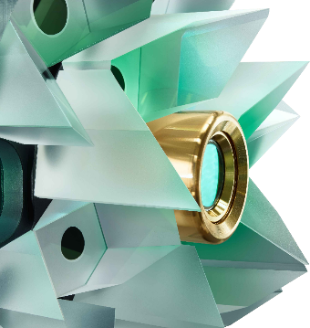
Thin-Disk Amplifiers and Nonlinear Compression
EuroNNAc₄ │ September 21, 2022 │ S-ST3-b #44
Tom Metzger │ TRUMPF Scientific Lasers

Slide 2
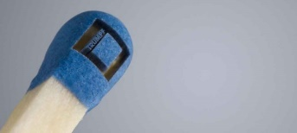
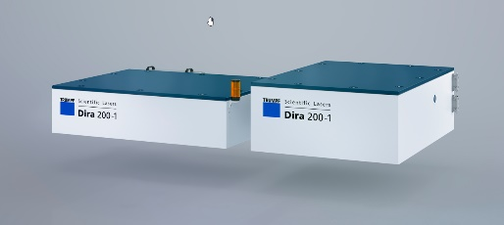
Content
01
Introduction & Motivation
02
Laser Systems
03
Summary

Slide 3
1. Introduction
Tom Metzger │ TRUMPF Scientific Lasers | EuroNNAc

Slide 4
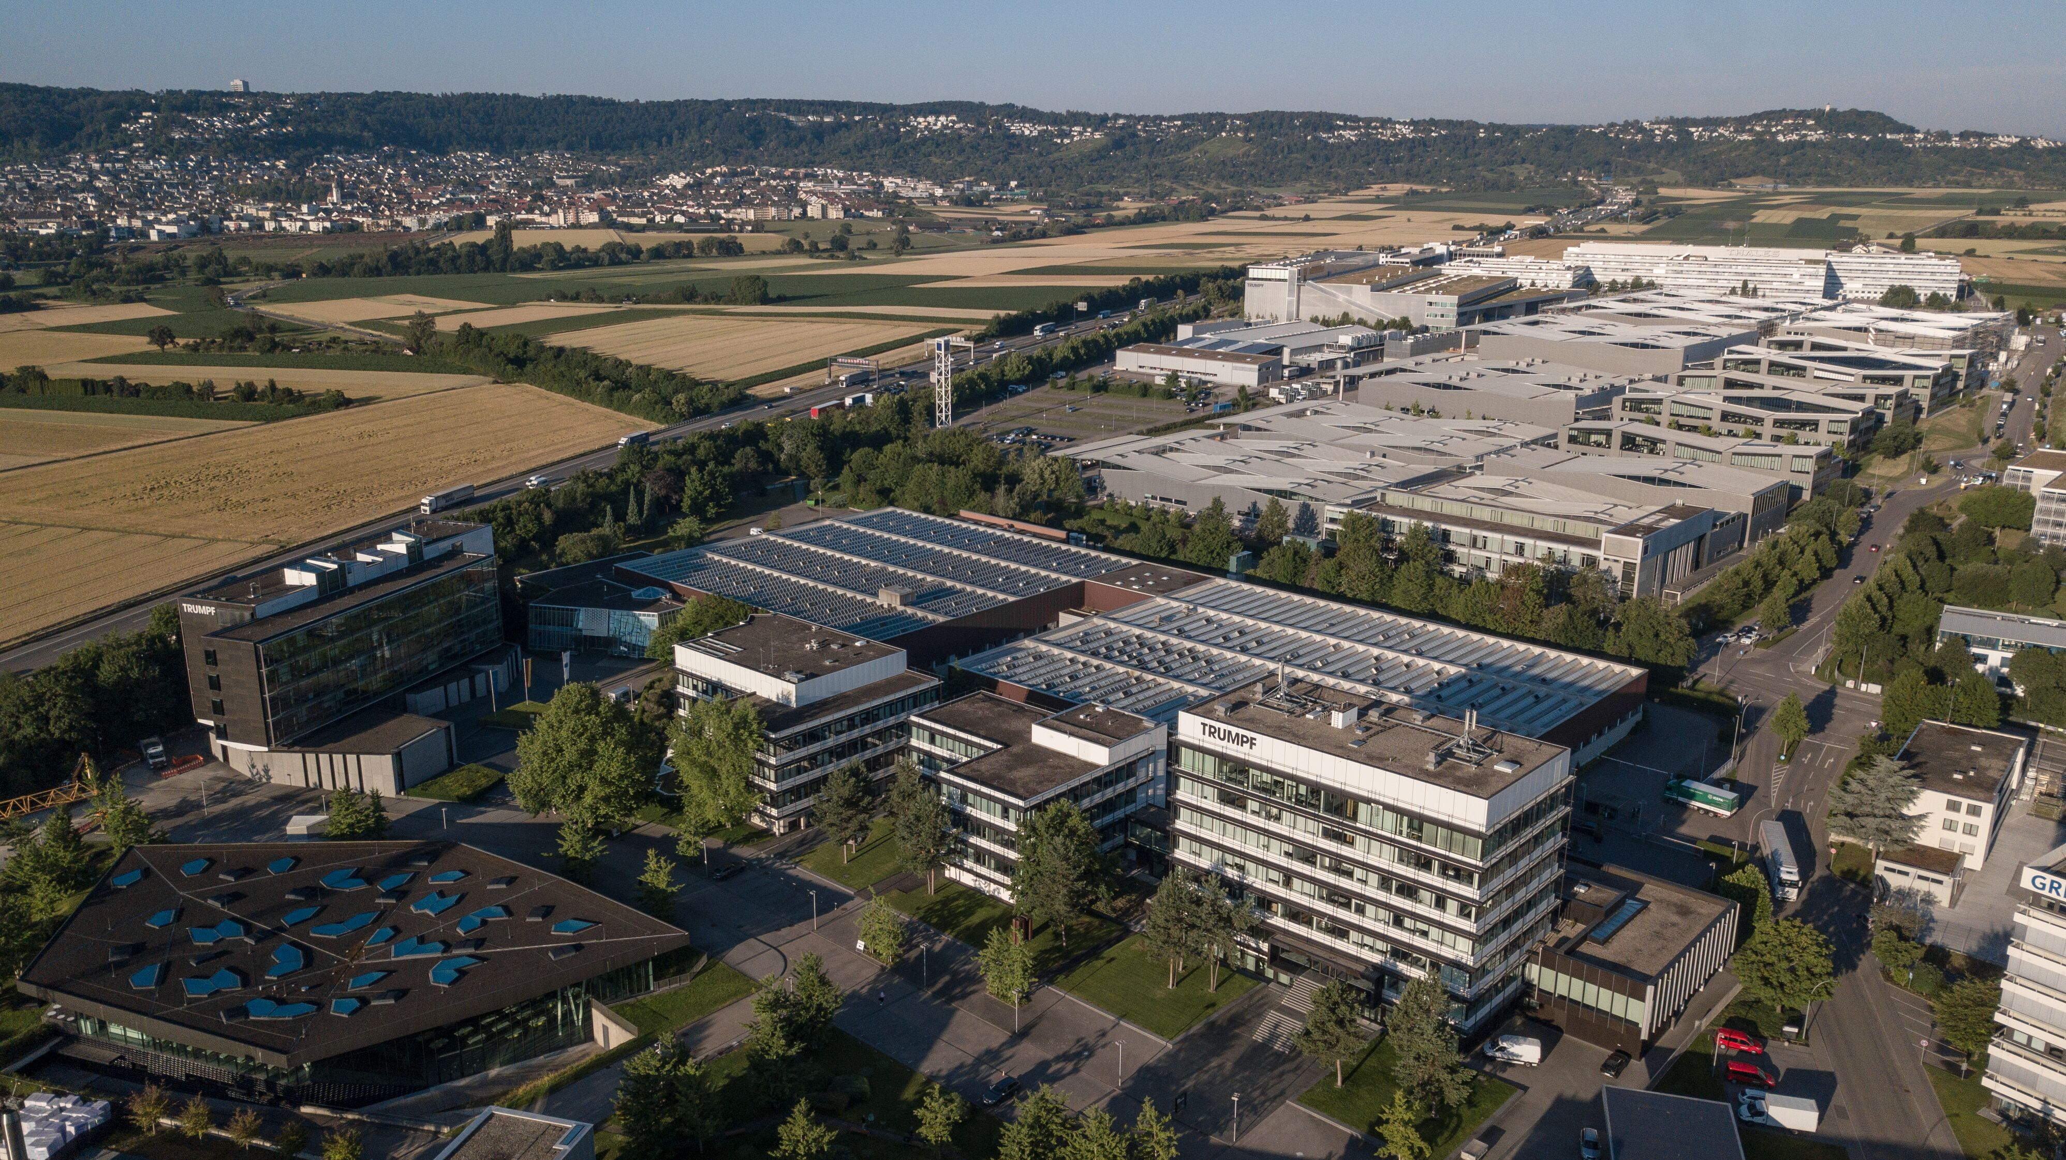
TRUMPF Group Production Technology 2021/22: 4.2 bn. € sales and 16.500 employees
www.trumpf.com
Notes:
The TRUMPF Group is a Production Technology Company and market and technology leaders in machine tools and lasers for industrial manufacturing.

Slide 5
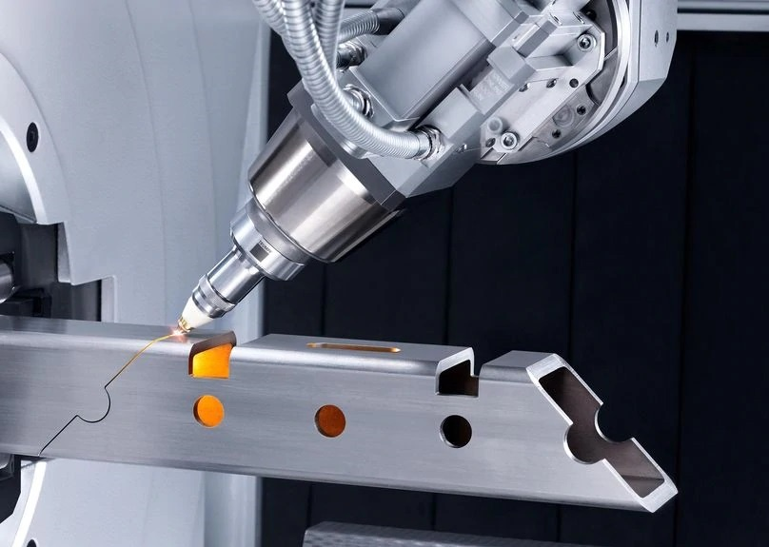
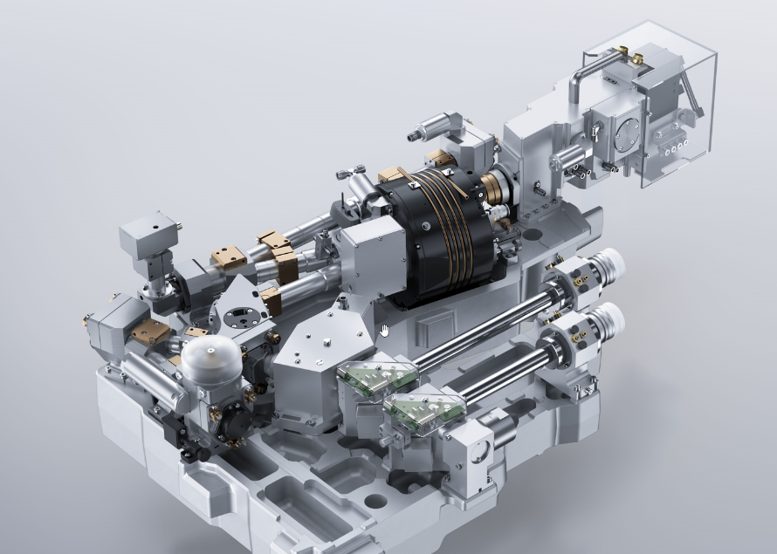
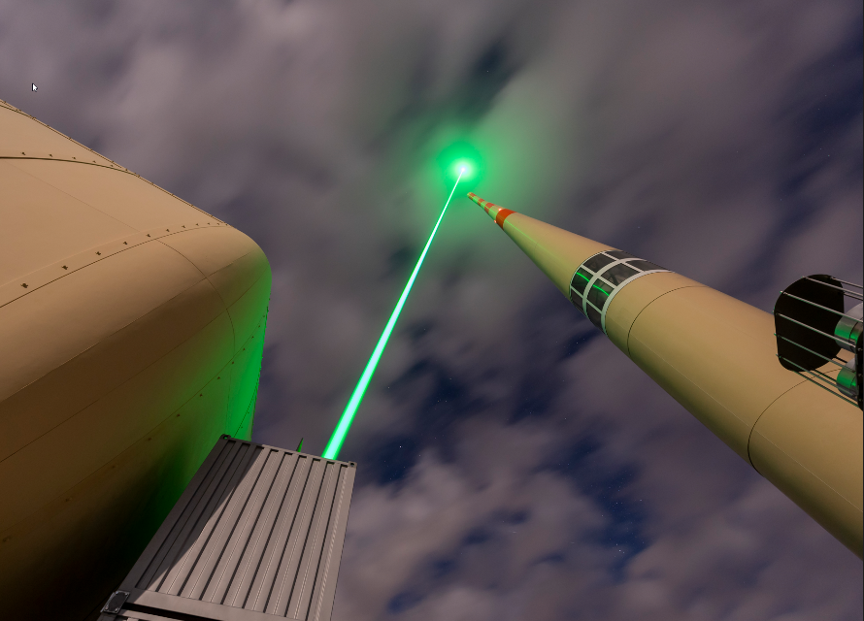
TRUMPF Group Production Technology 2021/22: 4.2 bn. € sales and 16.500 employees
TRUMPF Group
Market and technology leader in machine
tools & lasers for industrial manufacturing.
Machine tools For flexible sheet metal processing.
Laser technology For industrial applications.
TRUMPF Scientific Lasers
Part of Laser Technology Business Division
For scientific applications
16 employees
Located in Munich, Germany
www.trumpf.com
Notes:
The TRUMPF Group is a Production Technology Company and market and technology leader in machine tools and lasers for industrial manufacturing.

Slide 6
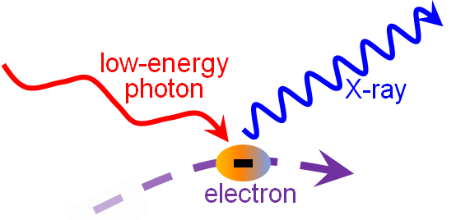
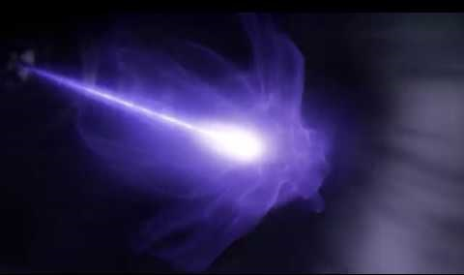
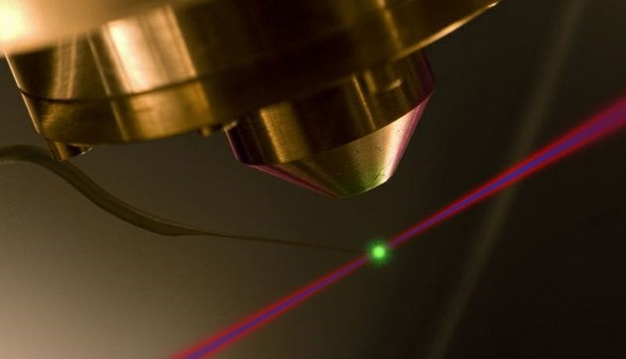
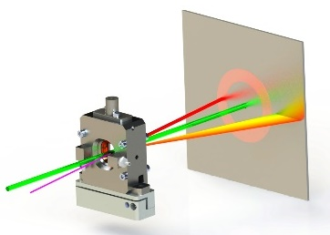
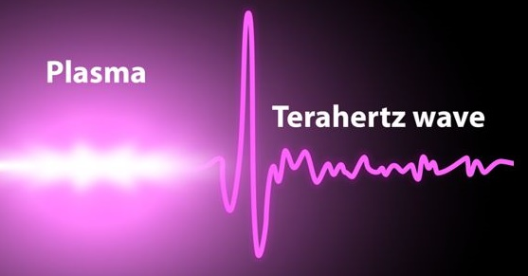
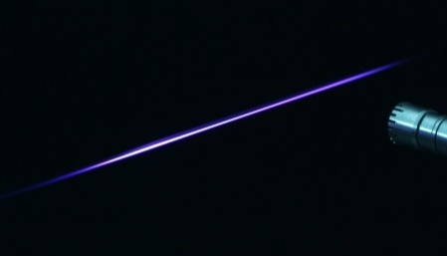
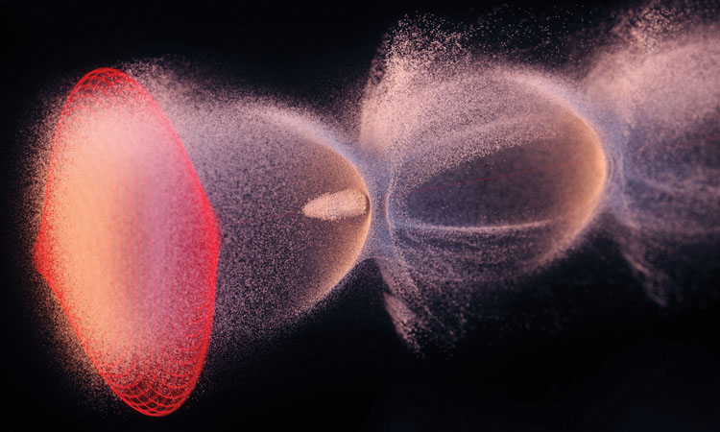
TRUMPF Scientific Lasers
Customer Applications
Inverse Compton Scattering
EUV & X-Ray Generation
Credit:
TRUMPF
High Harmonic Generation
Pumping Ti:Sapphire
J, kHz, kW
Credit:
attoworld.com
Optical Parametric Amplification
THz Generation
Credit:
Uni Rocheter, Michael Osadciw
Filaments
Laser Acceleration
Credit:
LOA, Aurélien Houard
Credit:
SciCom Lab, S. Jalas, M. Kirchen, DESY

Slide 7
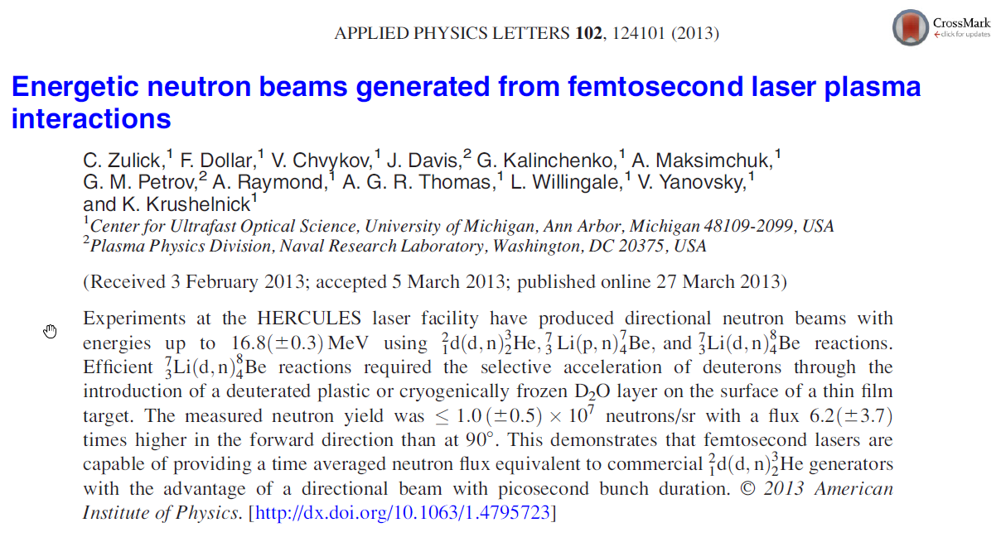
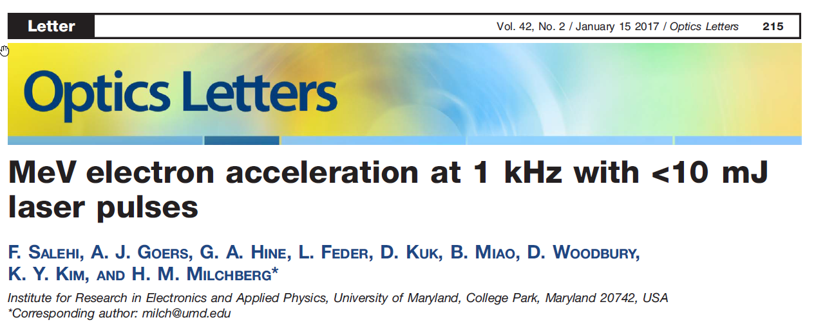
Publications
Laser acceleration of electrons and neutrons

Slide 8
TRUMPF Scientific Lasers 2. Laser Technology

Slide 9
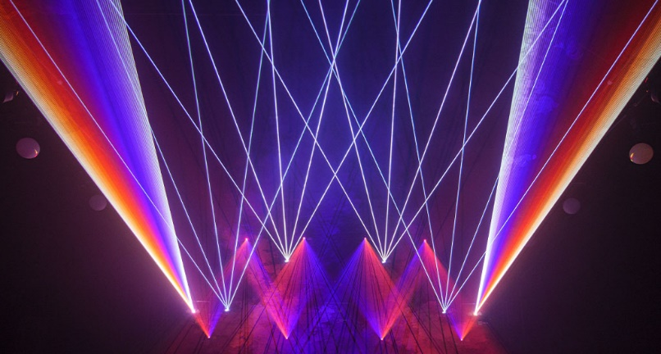
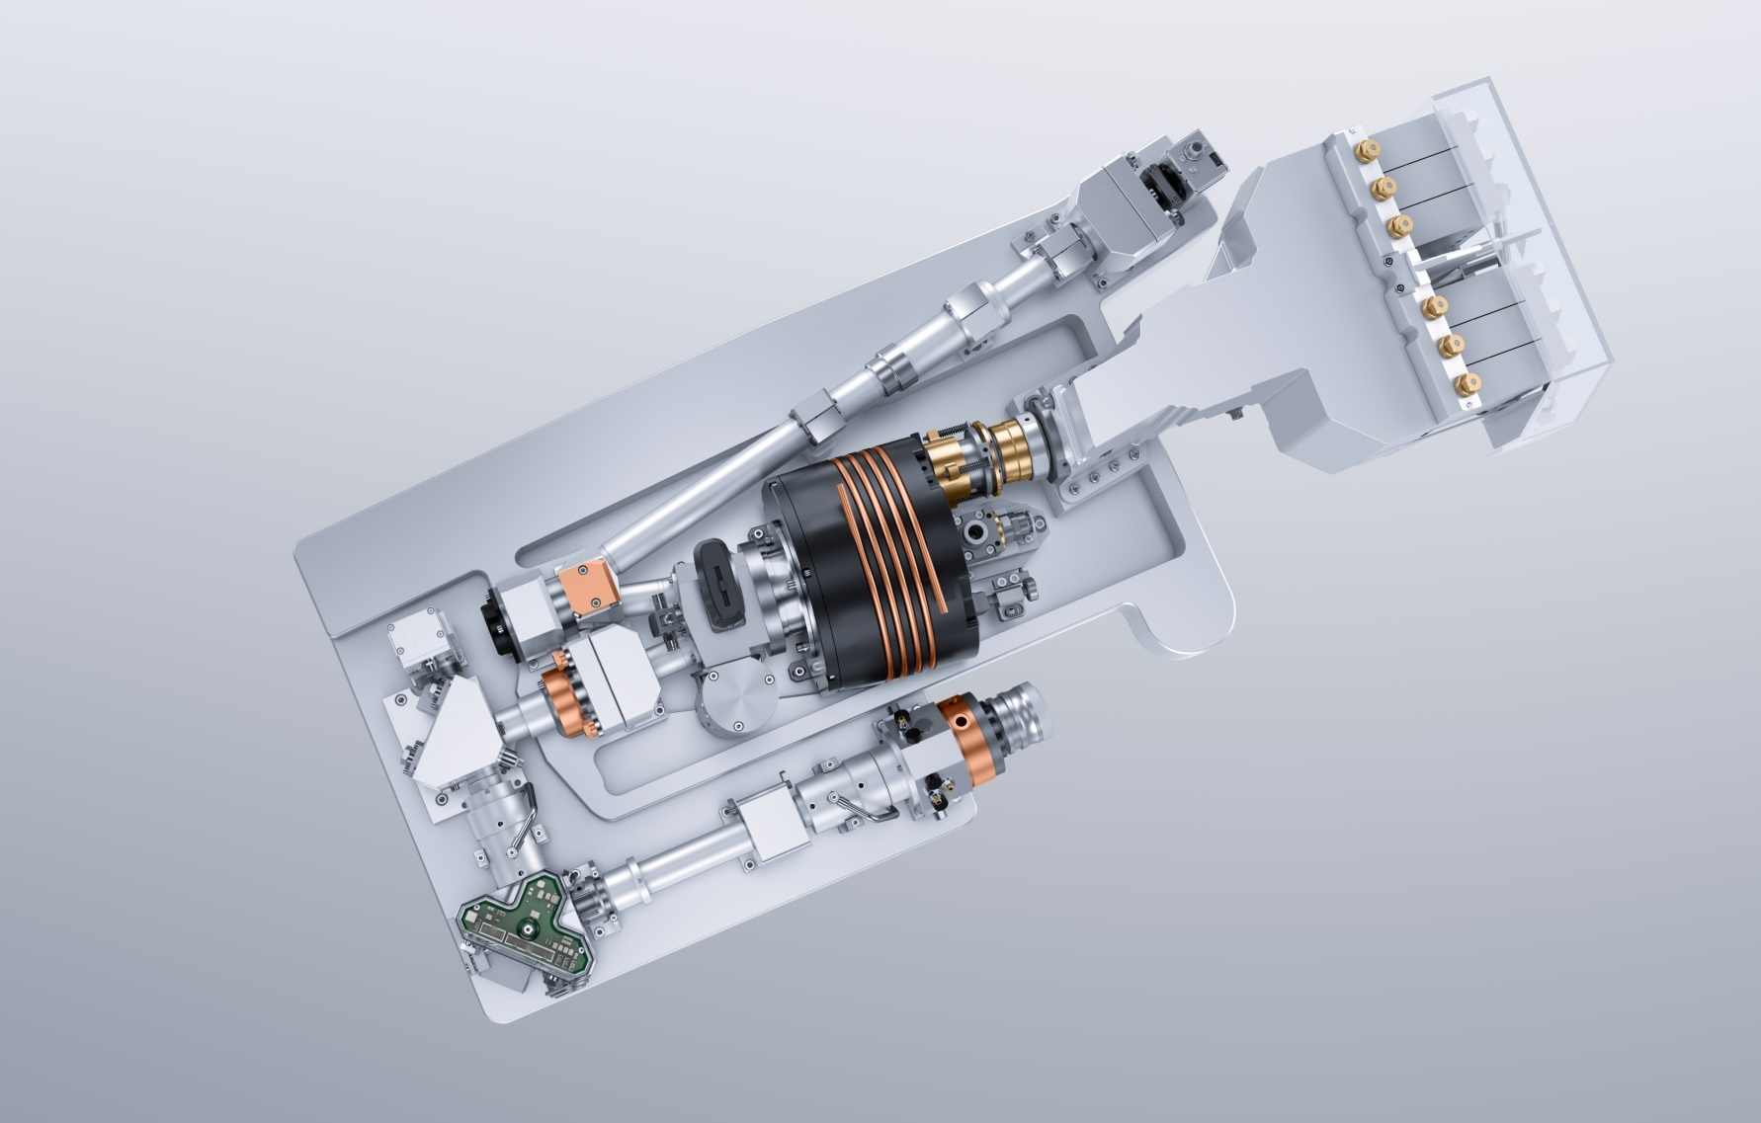
Today’s State-of-the-Art CW Thin-Disk Laser
Yb:YAG
1030nm
~14kW average power
Beam quality: M² ~10
70% opt. efficiency
HR Mirror
Pump Unit
Resonator
OC Mirror
Laser Disk
„Cooling Finger“
„Cavity“ for efficient pump light absorption

Slide 10
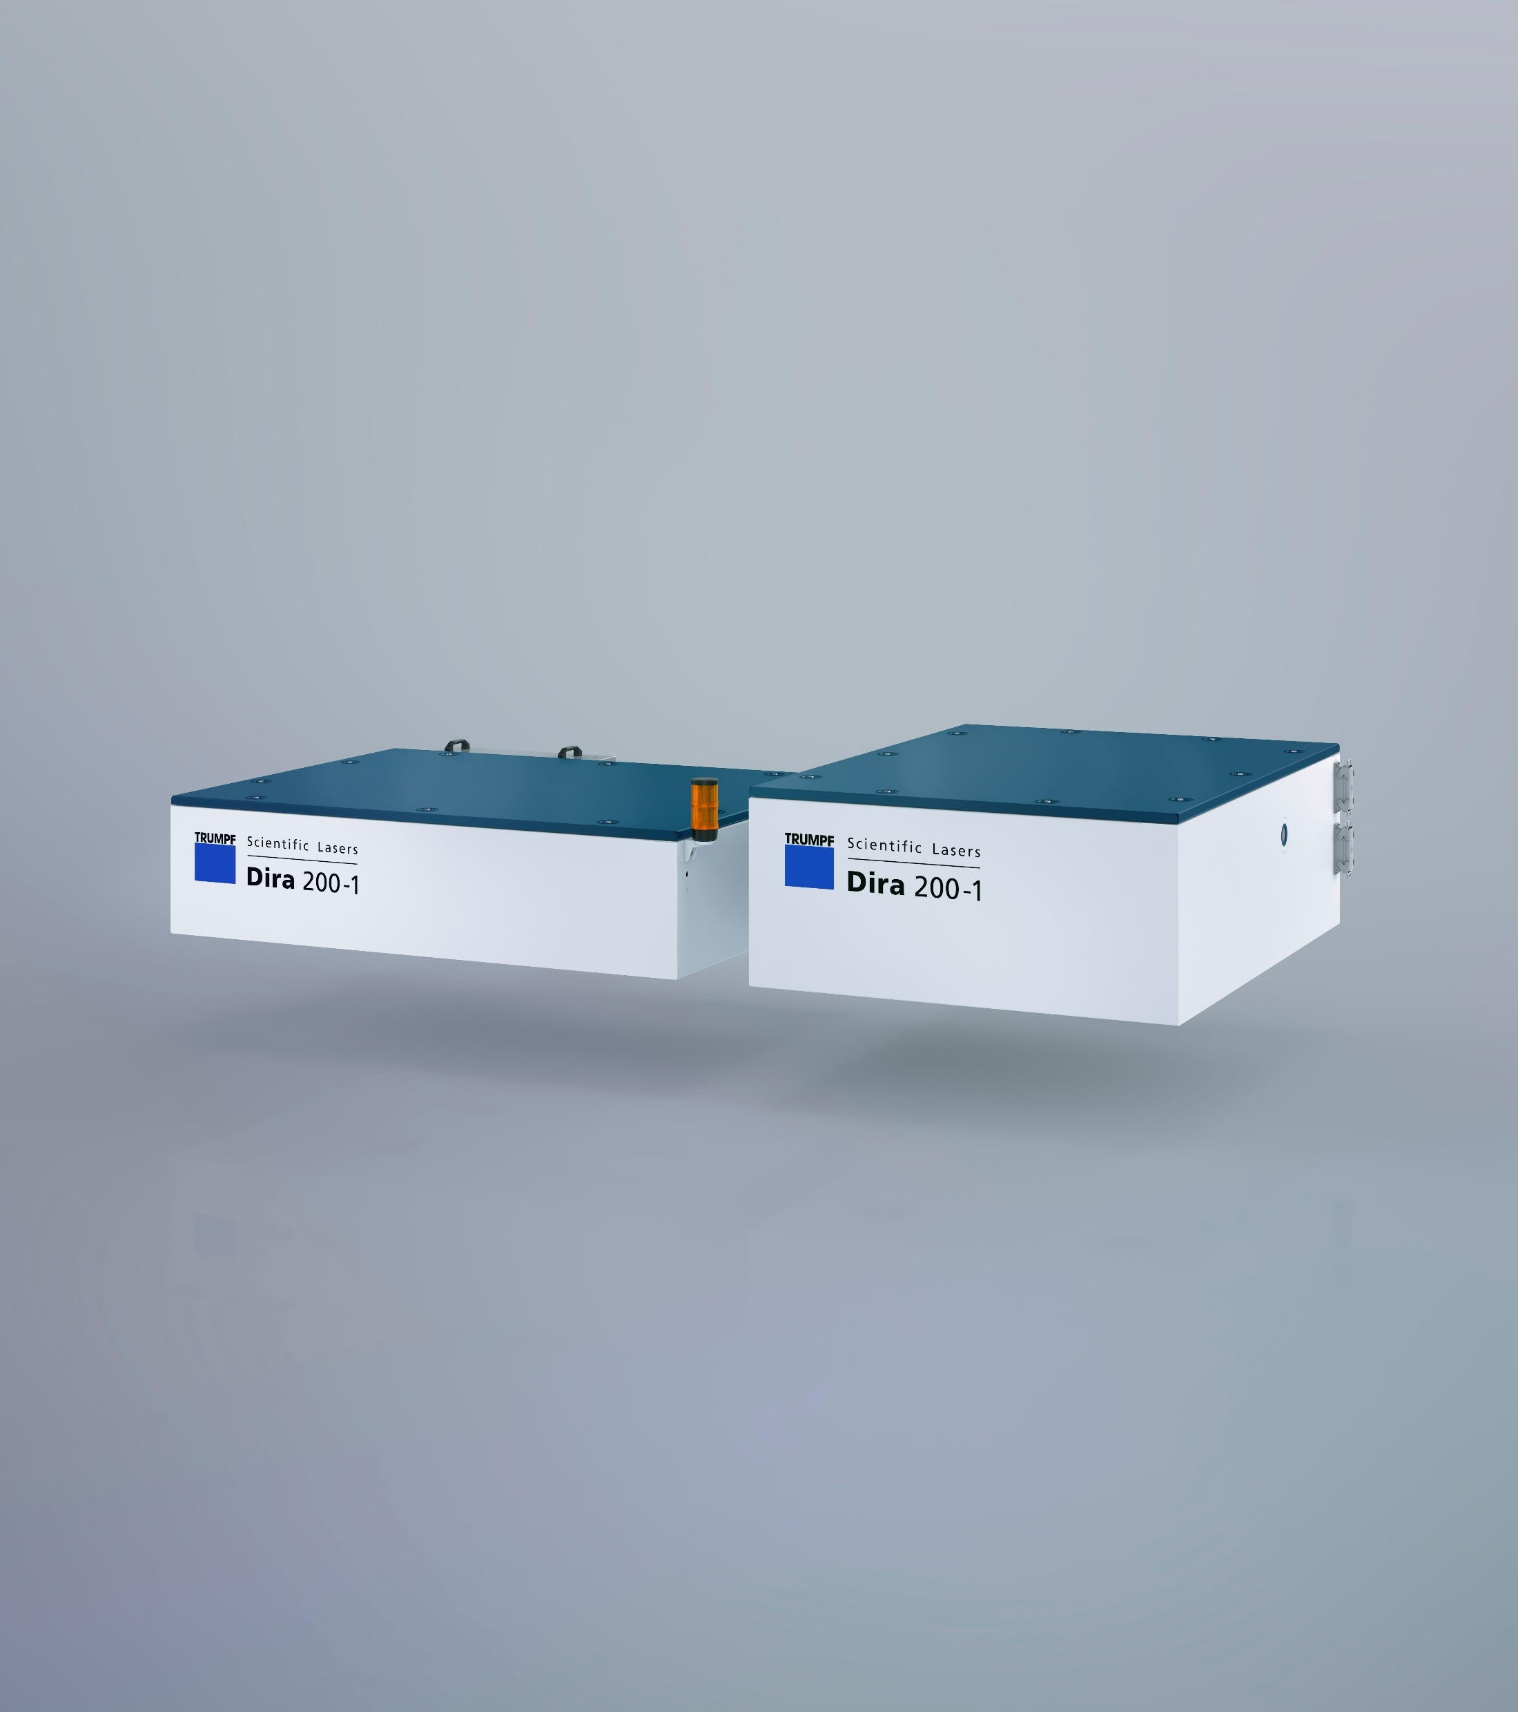
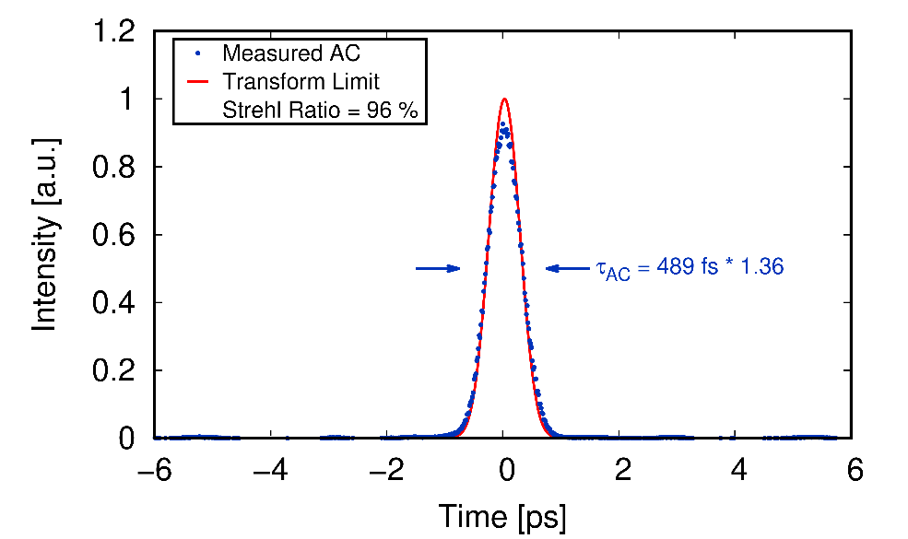
Dira Series
Regenerative amplifiers with high pulse energy and high average power in the 3rd generation
Dira 500-10 (50mJ, 500W, <1ps)
Dira 200-1 (200mJ, 200W, 500fs)
Dira 1000-5 (200mJ, 1kW, 500fs)
Record value: 0.5J, 1kHz, 600fs

Slide 11
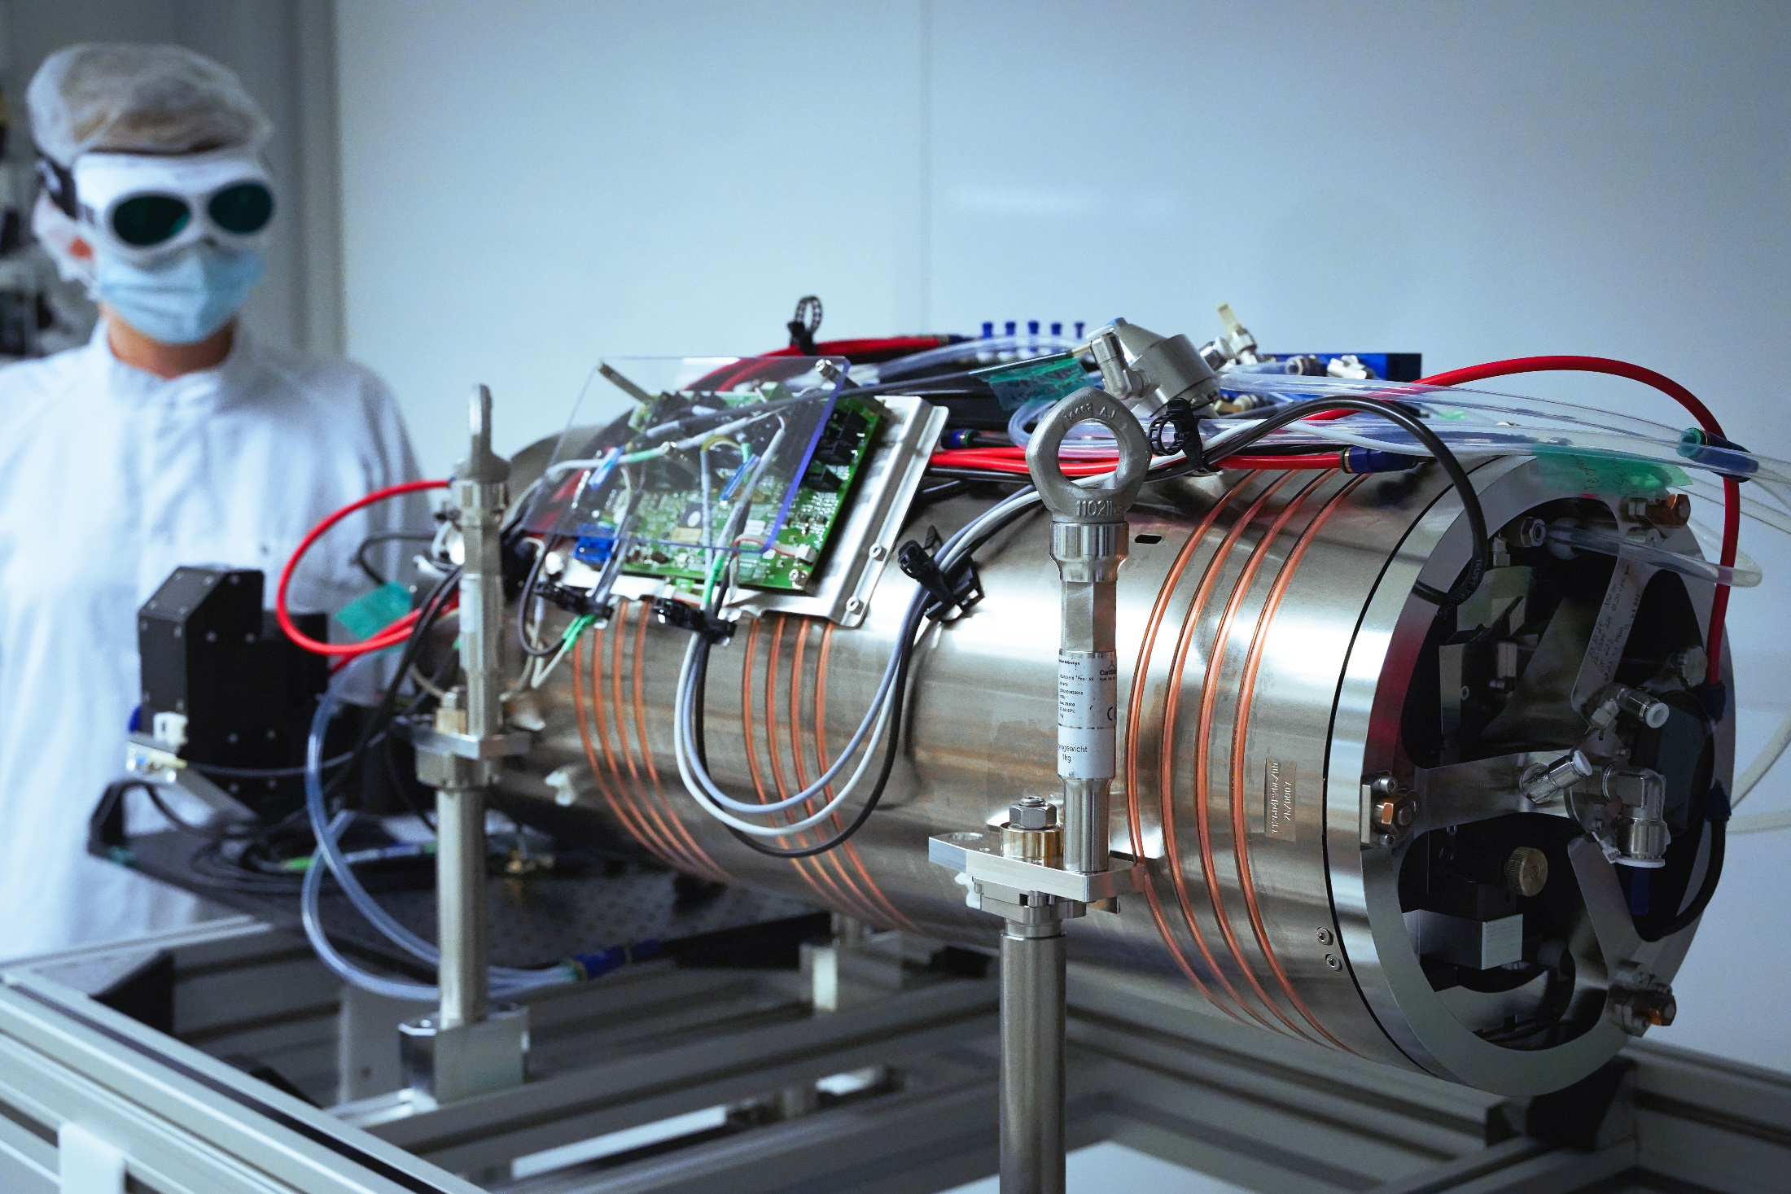
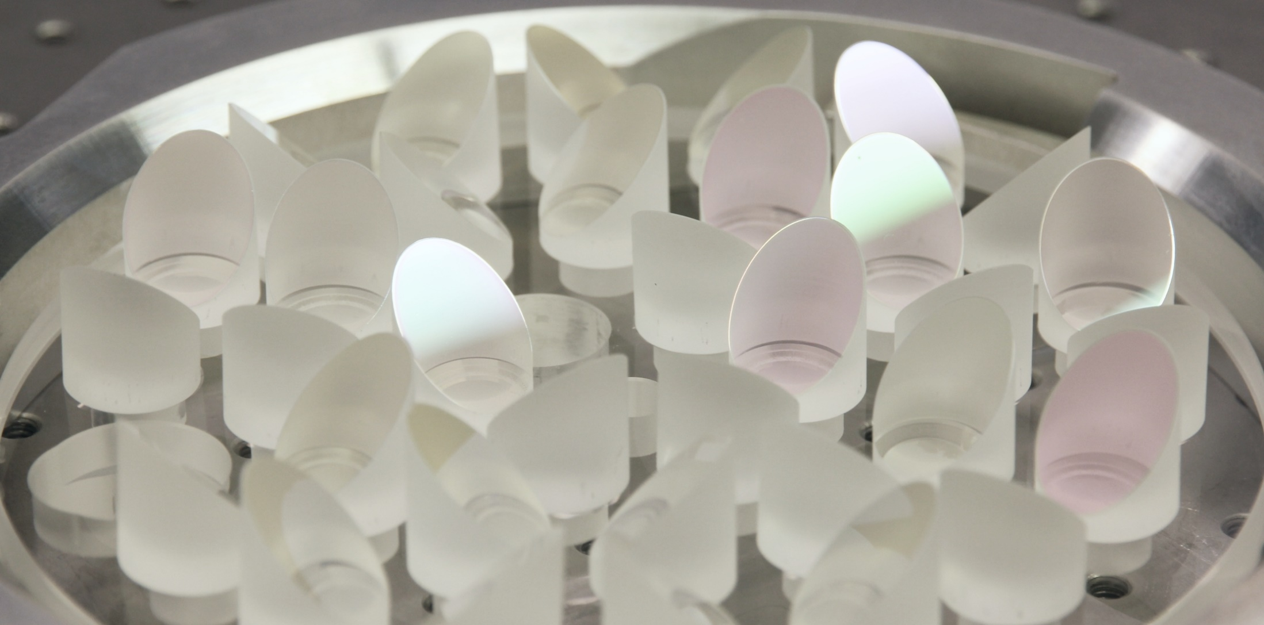
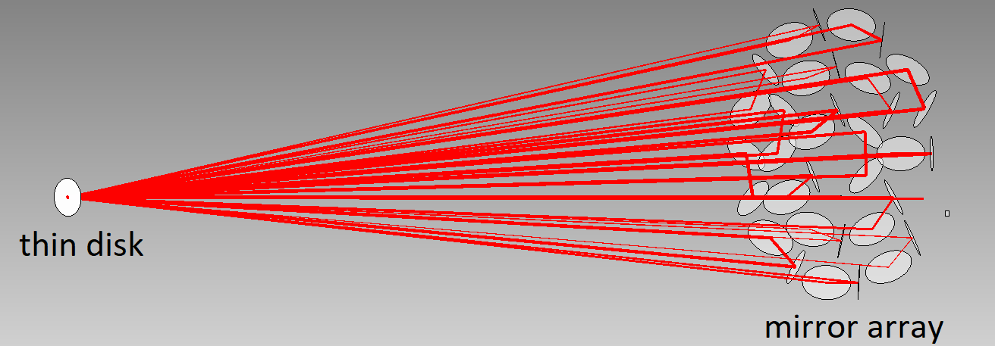
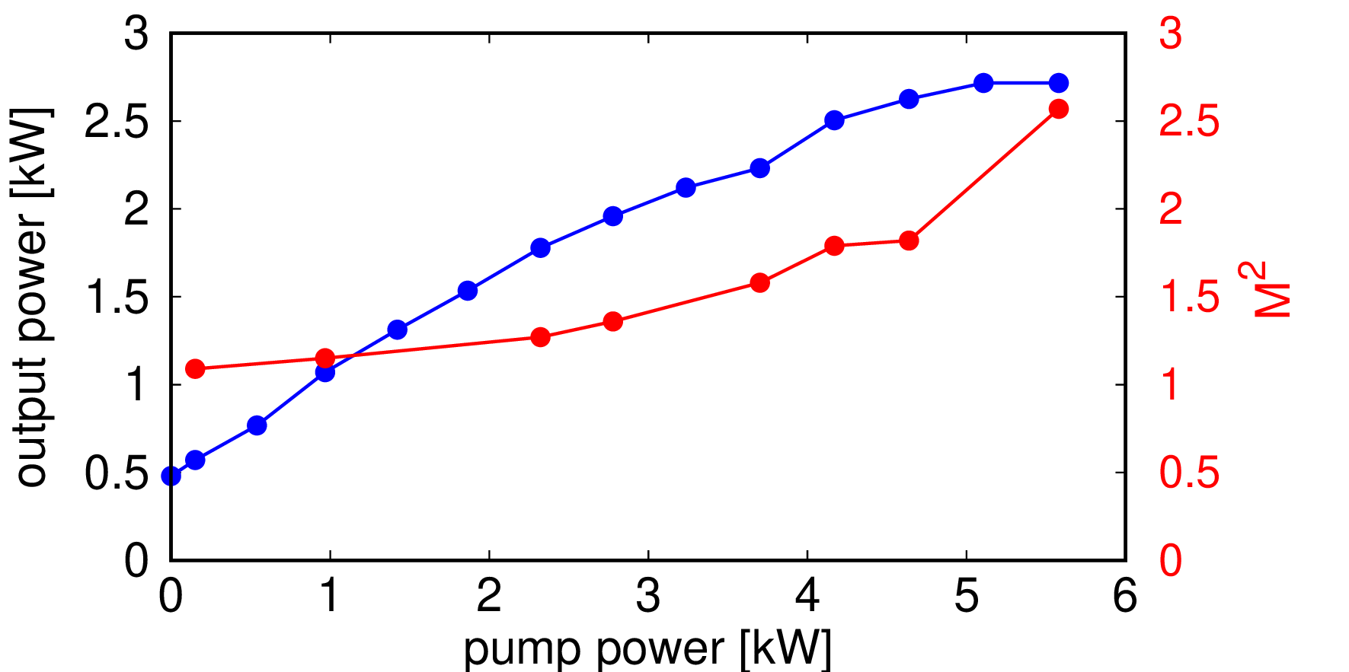
MPZ Series
Compact industrial multipass amplifier with medium pulse energy & extreme average power
cw: 10kW, M² = 1.76
cw: 20kW, M² = 11
10ns: 3kW, 300mJ, M² = 11
100ns: 16kW, 320mJ, M² = 20
As Ultrafast Amplifier:
2.5kW, 25mJ, M² = 1.7 (max. 120mJ)
Potential for 200mJ, >5kW, single mode
27mJ
100kHz
2700W
mirror array

Slide 12
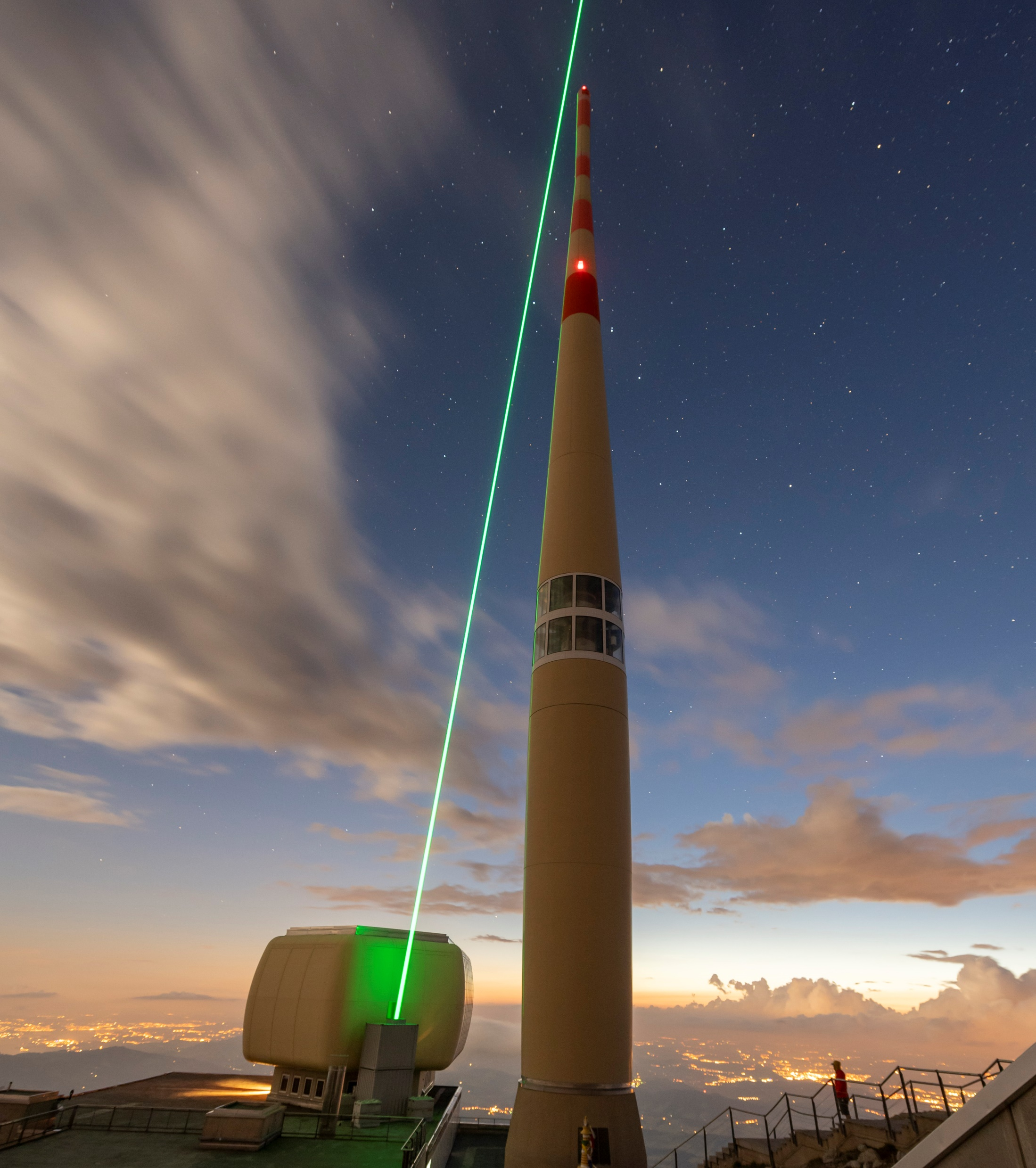
MPA Series
Multipass amplifier with high pulse energy and low repetition rate
Combine regenerative amplifiers (Dira) with thin-disk multipass amplifiers
Developed for the Laser Lightning Rod Project https://llr-fet.eu/
Goal: 1J, 1kHz,<1ps, M² < 2

Slide 13
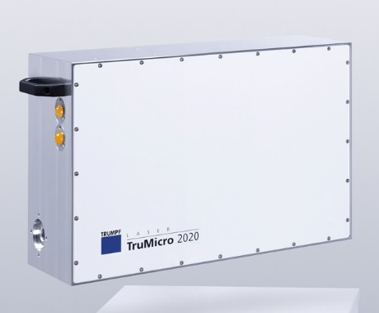
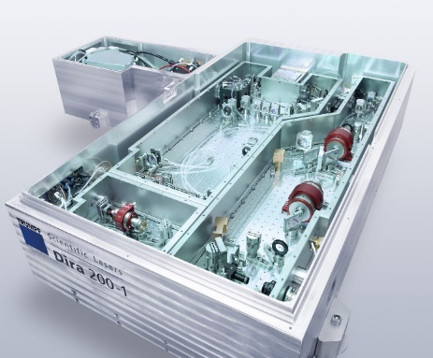
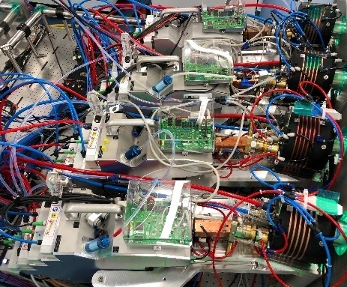
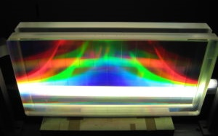
High Energy Thin-Disk Multipass Amplifier
Development for Laser Lightning Rod
TruMicro 2000
100µJ; 20W
Dira 200-1
230mJ; 230W
HETD
>1J; 1.2kW
Compressor
1J; 1kW; <1ps
900fs; 1J
➔ Terawatt

Slide 14
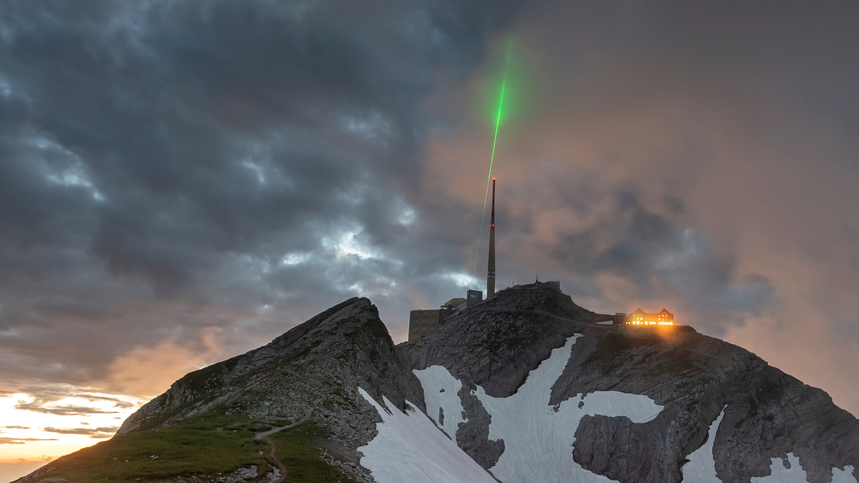
Laser Lightning Rod (LLR): Pulse energy: 0.72J
Pulse duration: 900fs
Rep. rate: 1kHz
Beam Quality: M² < 2
Picture: TRUMPF / Martin Stollberg

Slide 15
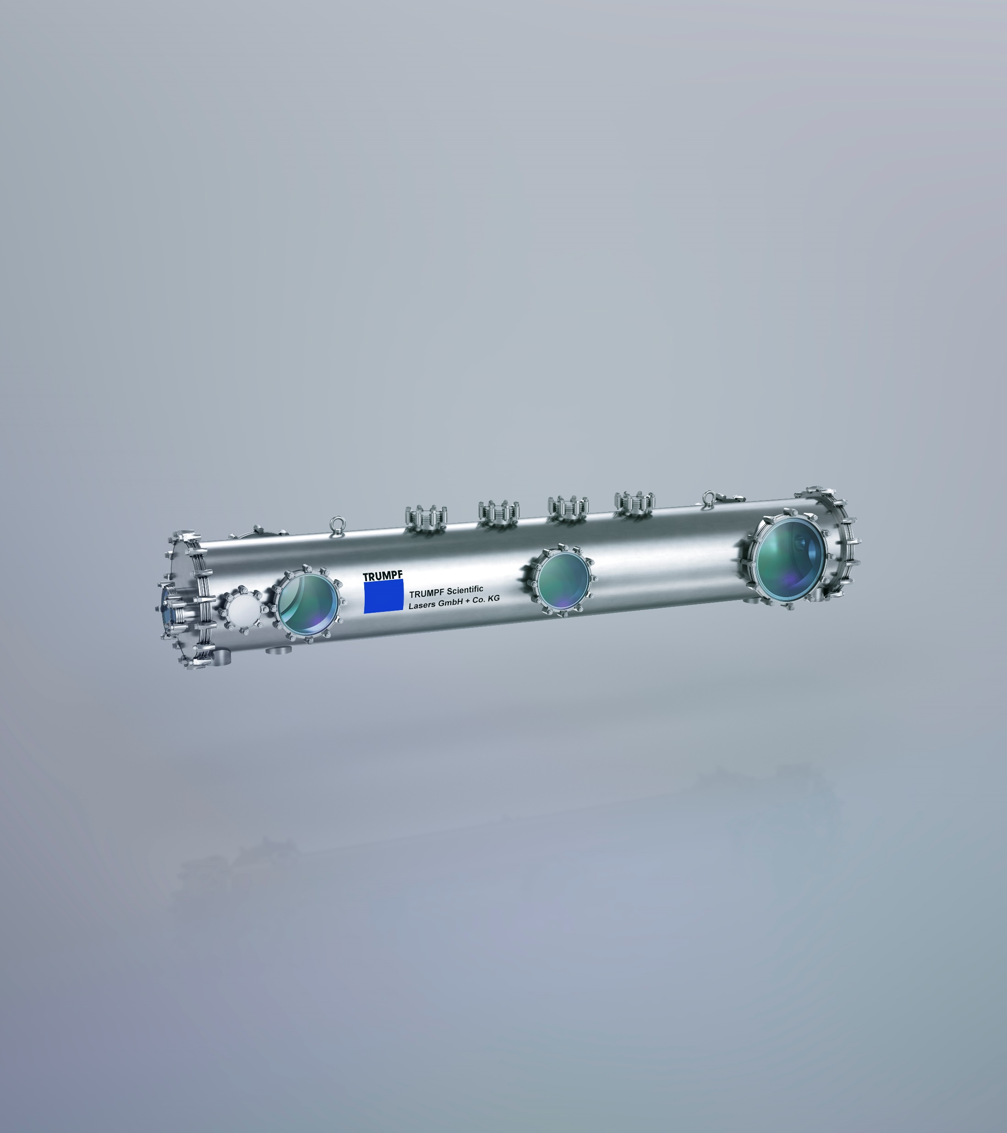
Herz Series
Nonlinear pulse compression with high pulse energy and high average power via Herriott cells
Demonstrated in a first experiment to learn: 10mJ, 36fs, 3kHz
High energy & high average power result: 180mJ, 42fs, 5kHz, 900W
Great efforts towards more compact setups
Nonlinear ellipse rotation can be implemented for pulse contrast enhancement (1000 x)
Combined with MPZ multi-kW, <40fs, 100mJ
Design and customer inquiry for 1kHz, 400mJ, <50fs

Slide 16
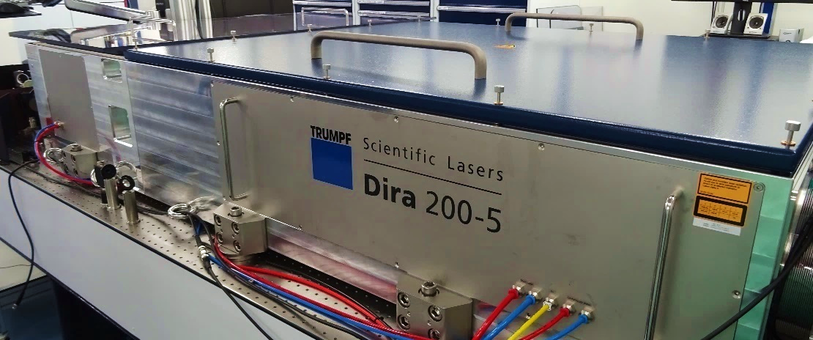
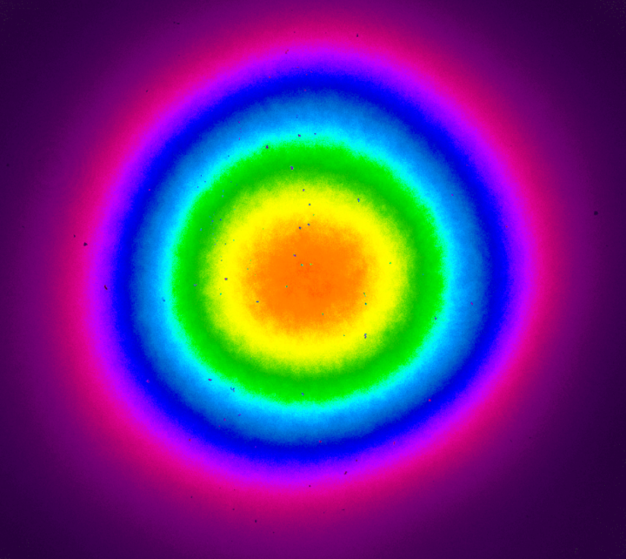
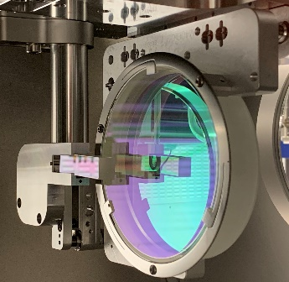
Medium Size Herriott Cell: 10-20mJ
AC: Autocorrelator
PM: Power meter
SP: Spectrometer
: Periscope
: Beamsplitter
Pulse duration: 630fs
Pulse energy: 10mJ
Repetiton rate: 3kHz
Beam Quality: M² = 1.3
SP
- 4500 fs²
PM
$$l$$
HZ
Laser
38 passes
M²
AC

Slide 17
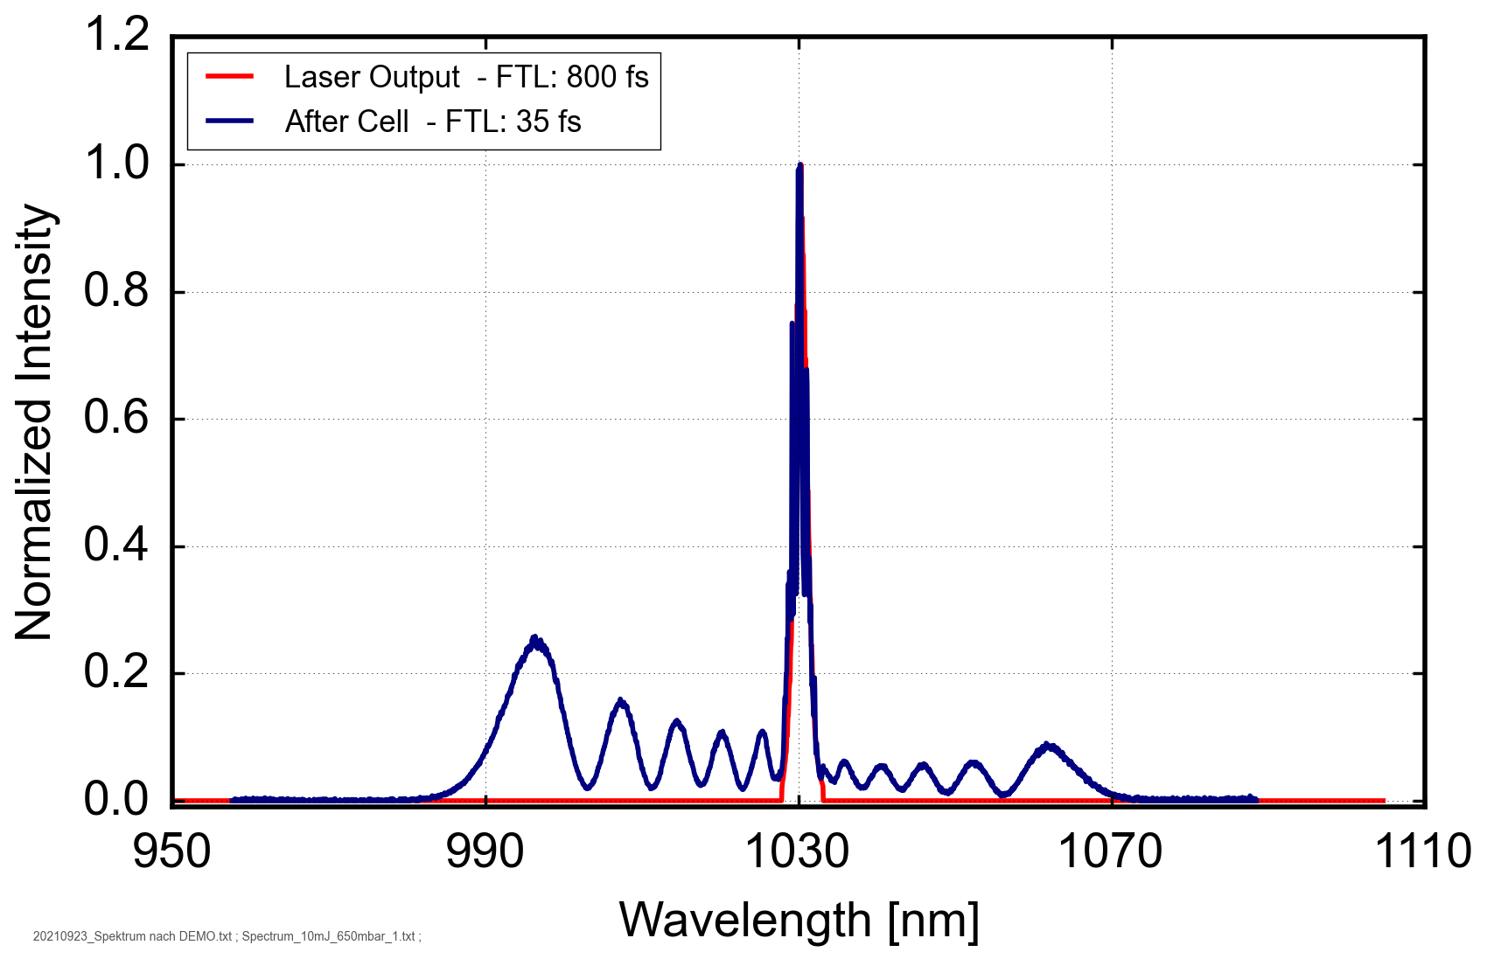
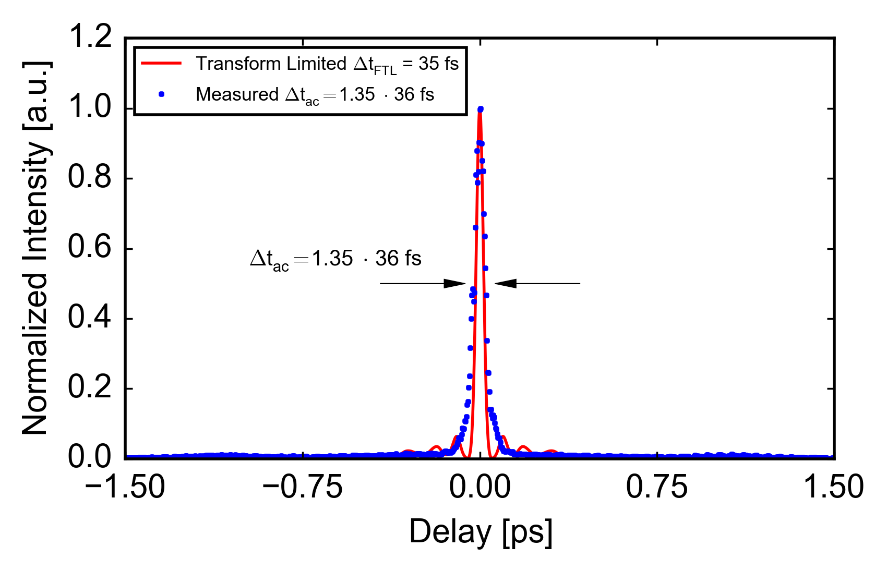
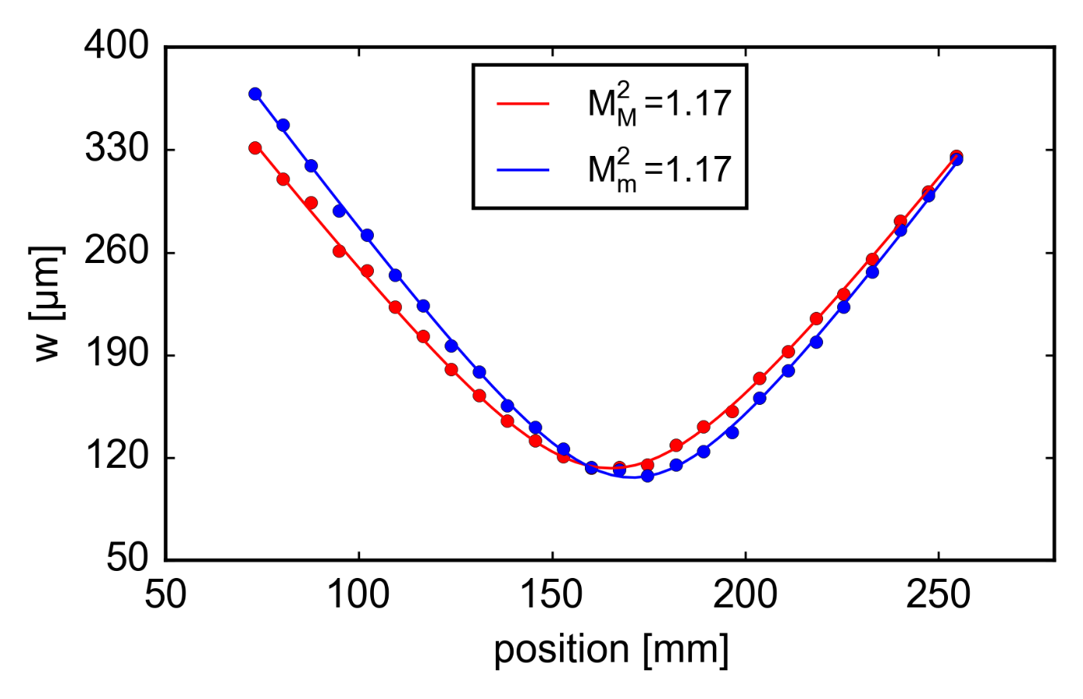
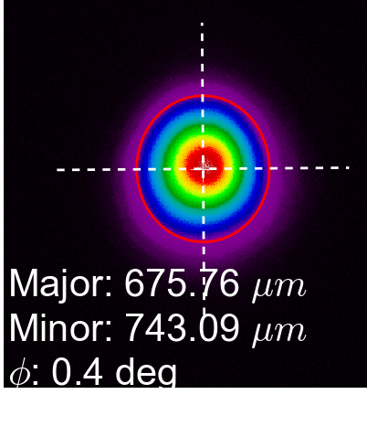
Medium Size Herriott Cell
10mJ (3kHz), 620fs as input parameters
10mJ compressed output
36fs compressed pulse duration
~17 times pulse compression
95.5% optical efficiency
(97% Her; 98.5% CM)
M² < 1.2 excellent beam quality

Slide 18
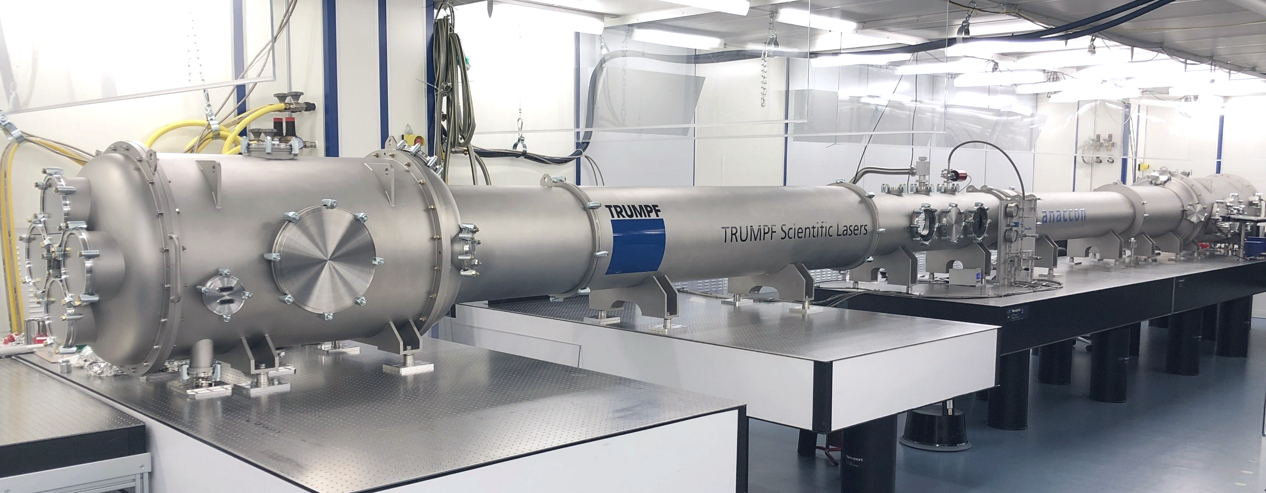
Nonlinear Compression of a Dira 1000-5 (500fs)
Goal: 200mJ; <50fs; 5kHz

Slide 19
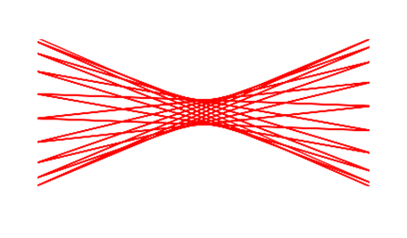
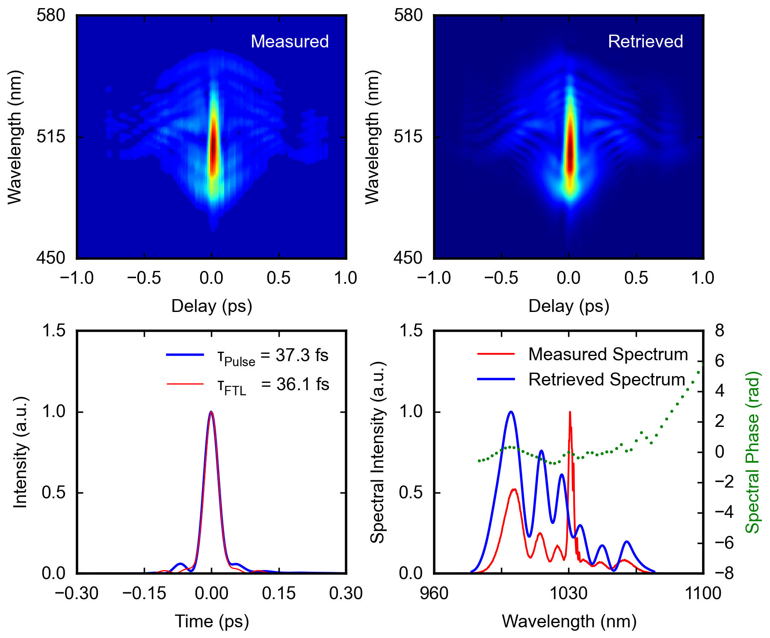
Latest Compression Results
Opt. Efficiency >97%
Compression ratio >13
Status 17th of May 2022
Pulse energy: 150 mJ
Pulse duration: 490 fs Repetiton rate: 5 kHz
Beam Quality: M² ~ 1.4
Input:
Laser
24 passes
E_{p} = 150 mJ
t_{p} = 490 fs
P_{avg} = 750 W
M² = 1.45 / 1.31
700 mbar Helium
~ 1 %
- 2750 fs²
PM
Output:
t_{p} = 37 fs
M² = 1.41 / 1.33

Slide 20
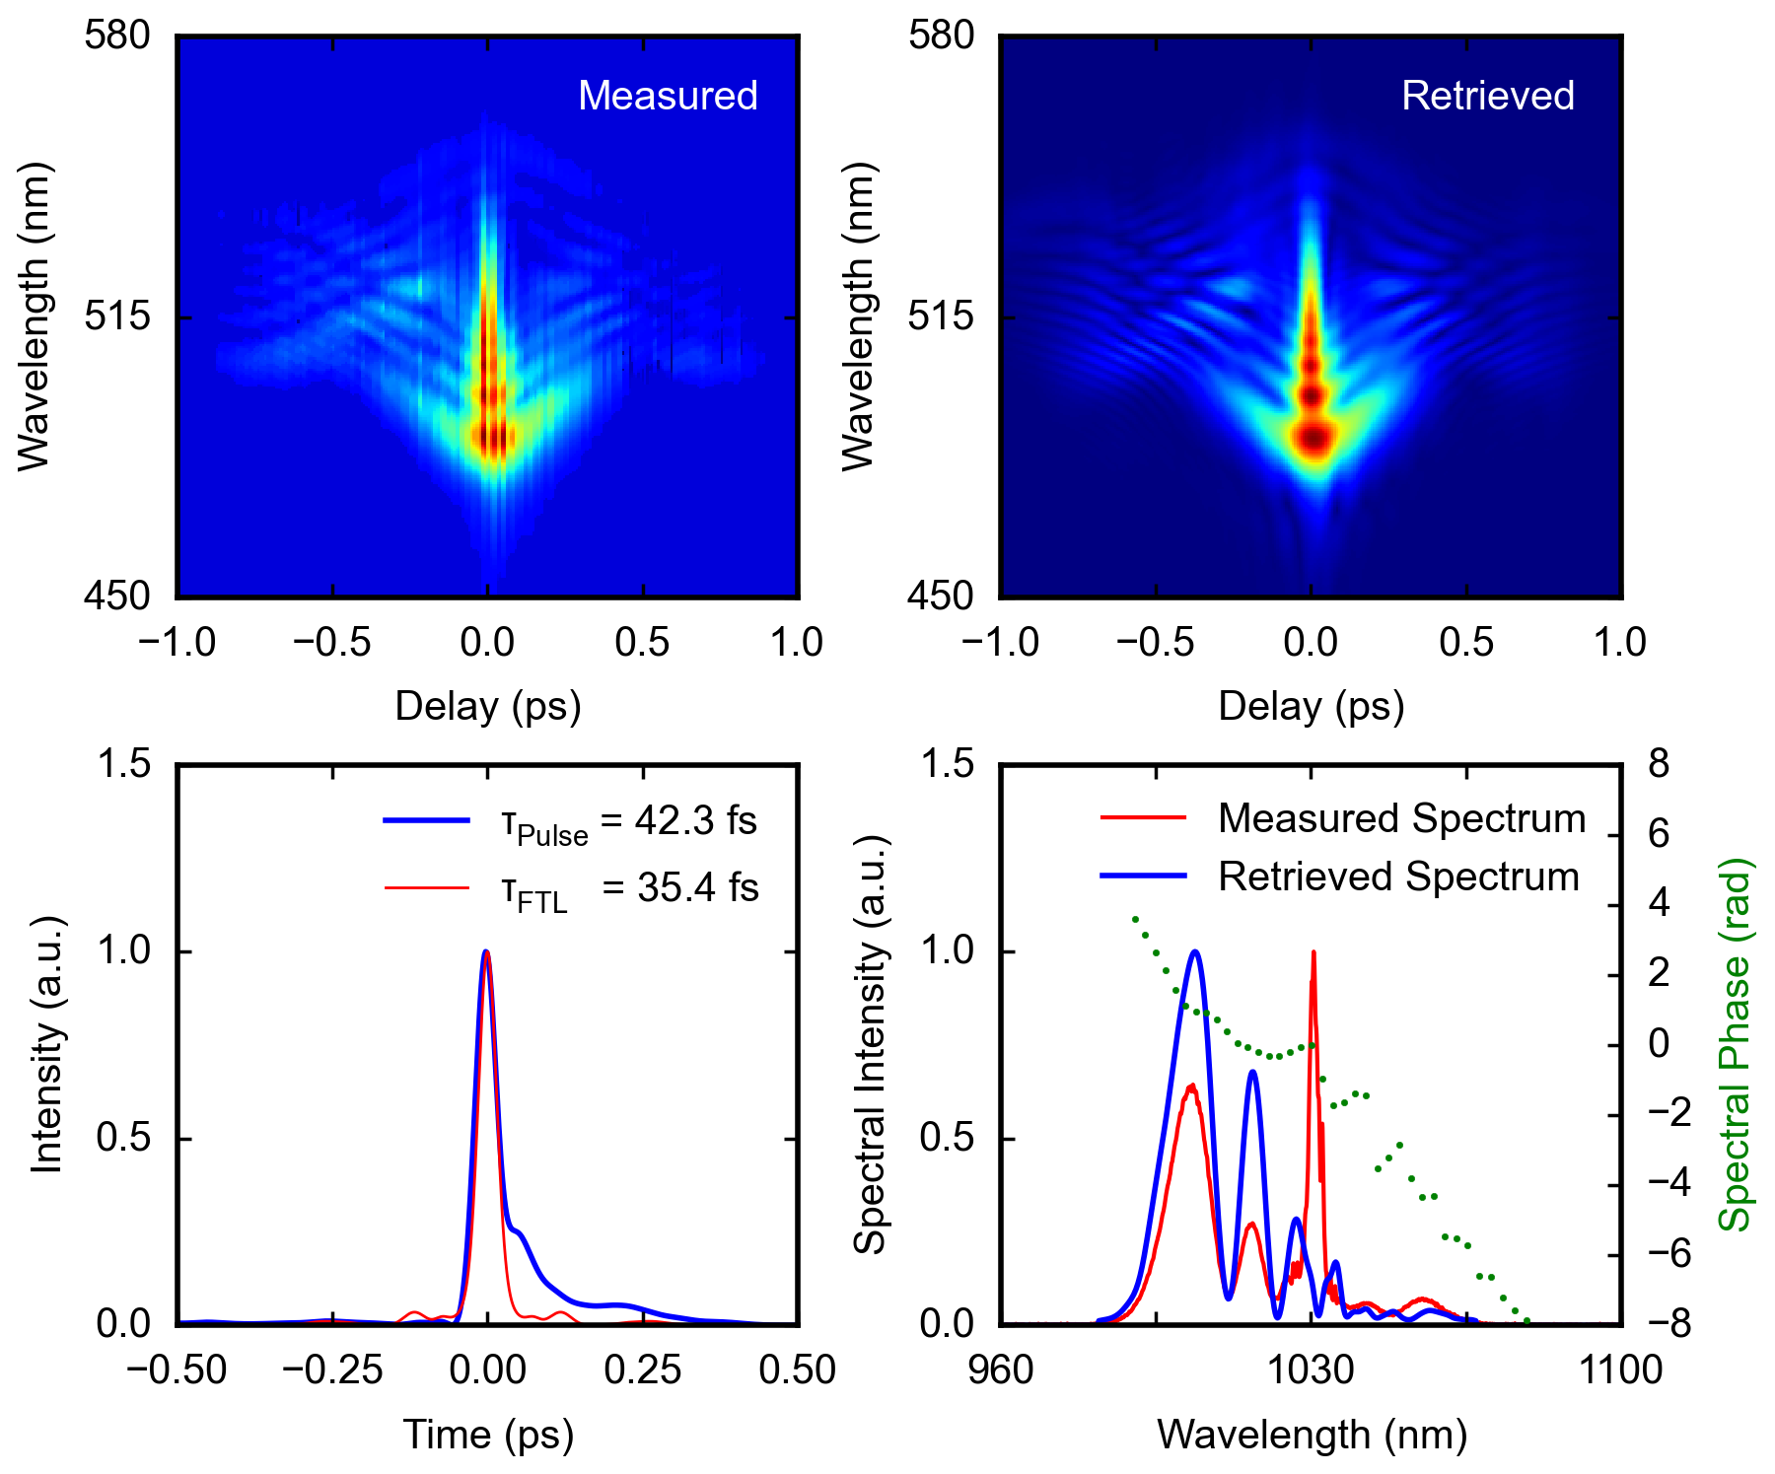
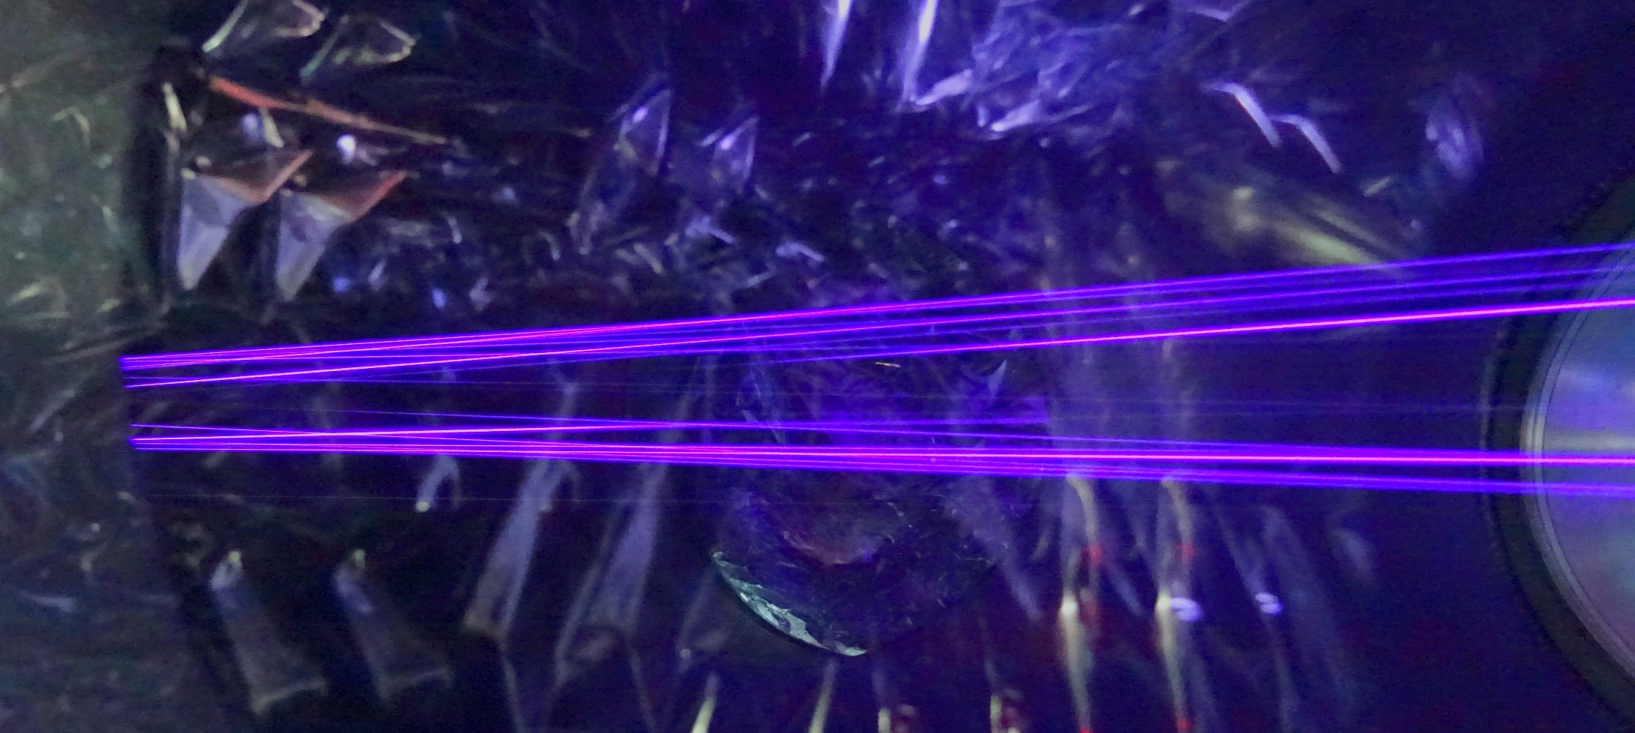
Nonlinear Pulse Compression
Latest result: 180mJ (5kHz), 490fs, 650mbar Helium
τ = 42 fs
Improvement ongoing
Compact (4m) design for
400mJ, 1kHz, <40fs
Notes:
- First results @ 180mJ sub-45 fs

Slide 21
3. Summary

Slide 22
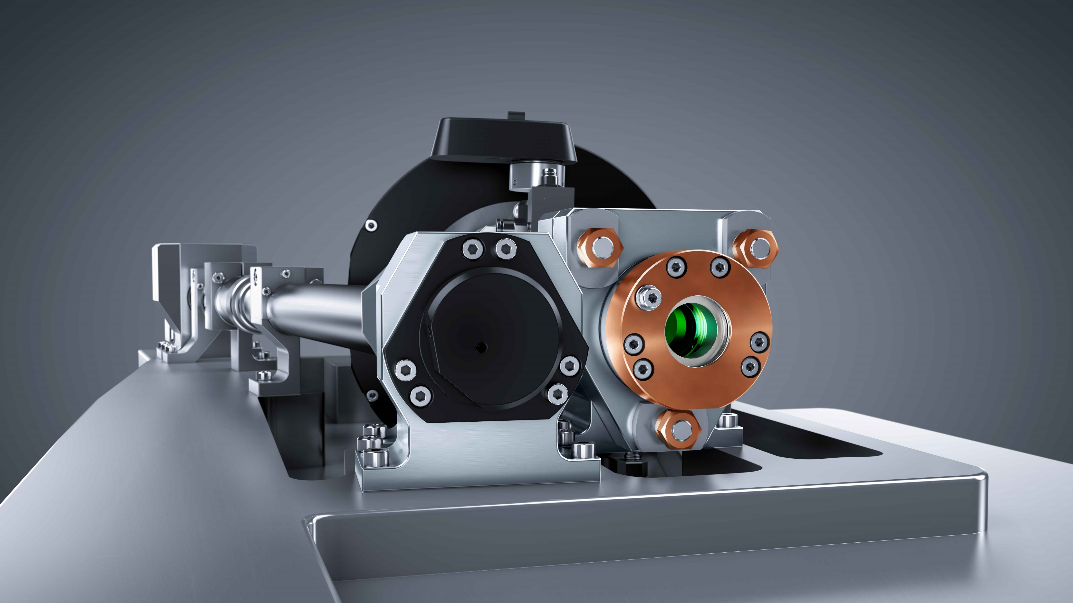
Where can our lasers be used?
Repetition Rate
How high can the average power be. Is the available diagnostic fast enough and which repetition rate is meaningful for feedback loops?
?
Pulse Energy
Which application requires which pulse energy?
?
?
?
Target & Diagnostics
What needs to be developed? Targets and Diagnostic ready for high repetition rates?
?
Pulse Contrast
Which application requires which pulse contrast on a ps and ns scale? ASE level, prepulses, …&
?
?
Applications
Which applications exist and what needs to be done to tackle them?
Future
Where do we need to go? Towards 10J or 100J, 50fs or 1ps? Repetition rate?
Pulse Duration
Which pulse duration is required for which applications. Are 50fs short enough?
Notes:
Where is a laser used?
Body:
TRUMPF offers solutions along the entire process chain in car body construction: With our products, you cut blanks, produce tailored blanks, remove layers, weld and solder components. In addition to process development, TRUMPF is also a partner in component development to enable new designs or optimize components for production.
Interior:
In the interior of the car, the laser offers the possibility of customizing individual parts, even directly at the time of purchase in the dealership. We create real added value for the customer because TRUMPF products can process almost all materials in the interior - from plastic to leather to glass - allowing designers a great deal of creative freedom.
Motorization - battery cell and modules
The range of laser applications at electrode, cell, module and pack level is enormous. Particularly noteworthy are applications such as low-resistance contacting of current-carrying components and gas-tight sealing of battery cells.
Sensors and light systems: Decades of experience in processing the smallest electronic components with lasers
Front and rear seats
Thanks to intelligent laser remote technologies, the flange width can also be effectively reduced. Smaller, lighter and thus more cost-effective components can thus be realized.
To reduce the weight of vehicles, more and more solid components are being replaced by tubular structures. Tubes can now be found in headrests, cross members and seat structures.
Controls
Mechanical controls on the instrument carrier
Power Electronics:
With the laser, you achieve pinpoint contacting in complex electronic control units. With our green wavelength lasers in sufficient power, copper contacts in e-vehicles can be processed highly productively and virtually spatter-free.

Slide 23
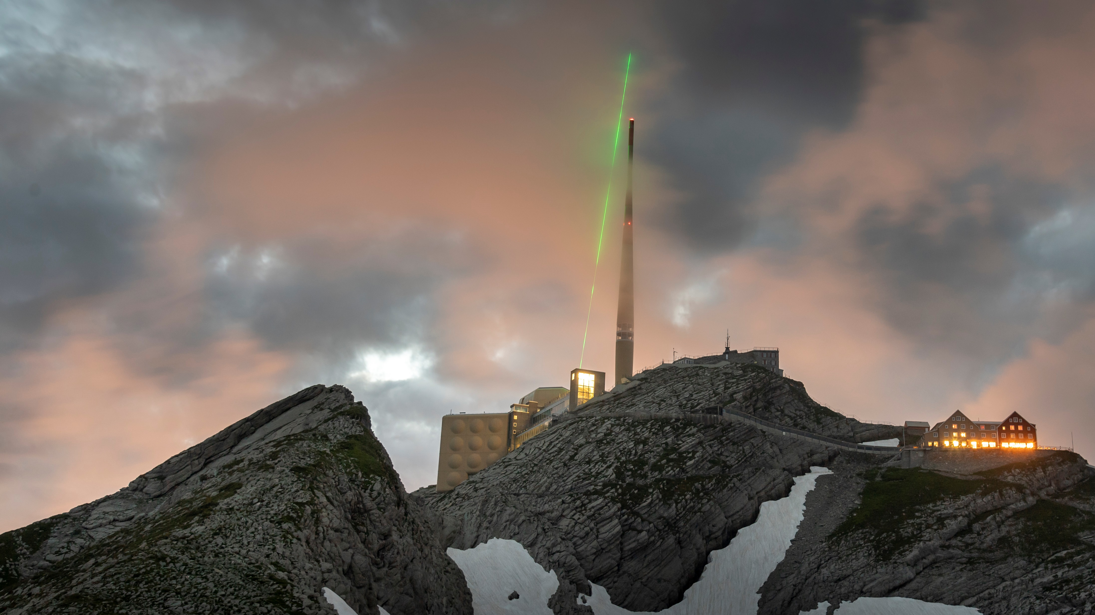
TRUMPF Scientific Lasers
Your Contact
Tom Metzger
Feringastr. 10a
85774 Unterföhring, Germany
thomas.metzger@trumpf.com
www.trumpf-scientific-lasers.com

Slide 24
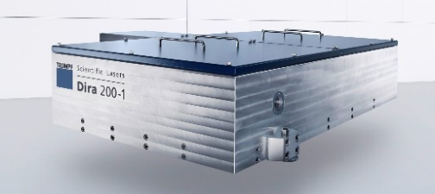
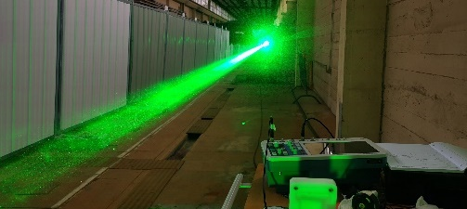
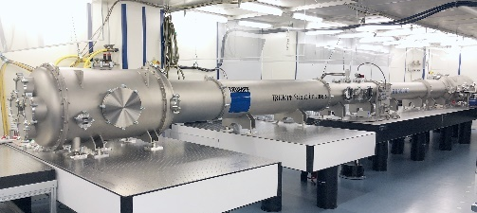
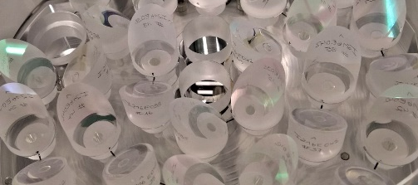
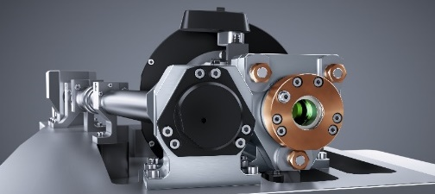
Summary
Dira Series: 200mJ // 1.0kW // 5kHz (standard; few mJ // 200kHz // 1.5kW)
500mJ // 0.5kW // 1kHz (record value)
400mJ // 4.0kW // 10kHz (potential)
Multipass Amplifier: 1J // 1.0kW // 1kHz (Experiments on Mt. Säntis)
Nonlin. Compression: Multiplates: <40-50fs // 90µJ // ~20W
Small Herriott Cell: 36fs // 10mJ // 30W (standard up to 50mJ)
Large Herriott Cell: 200mJ // 1.0kW // 5kHz <40fs (project ongoing)
Multipass Cell: Based on TRUMPF Laser GmbH technology for 10s of kW
120mJ // 0.1kW // 1kHz (~1ns chirped, M² ~1.4)
25mJ // 2500W // 100 kHz (~1ns, M² = 1.5) (potential >5kW, 200mJ)

