Slide 1

Coherent combination of fiber lasers towards drivers for future wakefield accelerators
Jens Limpert, Arno Klenke, Christopher Aleshire, Albrecht Steinkopff, Cesar Jauregui, Johannes Nold, Nicoletta Haarlammert, Ziyao Wang, Tobias Heuermann, Henning Stark, Joachim Buldt, Christian Grebing, Tino Eidam
Friedrich-Schiller-Universität Jena, Institute of Applied Physics
Helmholtz-Institute Jena
Fraunhofer IOF Jena
Active Fiber Systems GmbH
Notes:
1

Slide 2
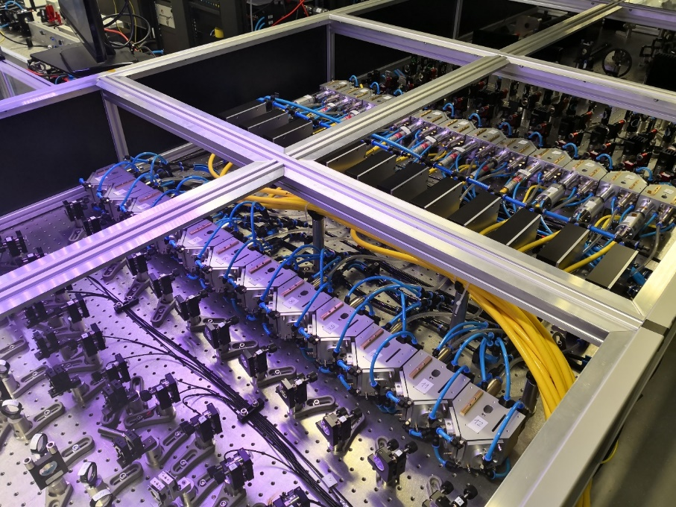
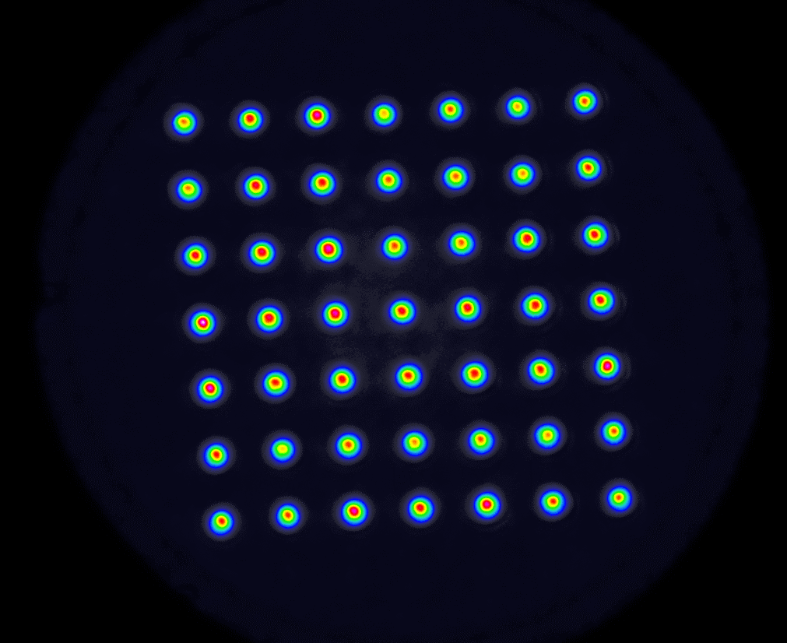
Fiber Laser as Driver for Particle Accelerators
Outline
Brief Motivation
State of the art at 1µm wavelength
State of the art at 2µm wavelength
Contrast considerations and enhancement
Scaling perspectives
Summary and Outlook
[10897-1]
[10897-2]
[10897-3]
Large-pitch fiber

Slide 3

Coherent Addition of Ultrashort Pulses
“Amplifying Interferometer”
Amplifier 1
Artificial Scaling
of Mode Area
Amplifier 2
Front-End
Division Stage
Combining Stage
Compressor
Amplifier N
Use N amplifiers and combine the spatially separated pulses
Best case: Improvement of the pulse energy and average power by a factor of N

Slide 4
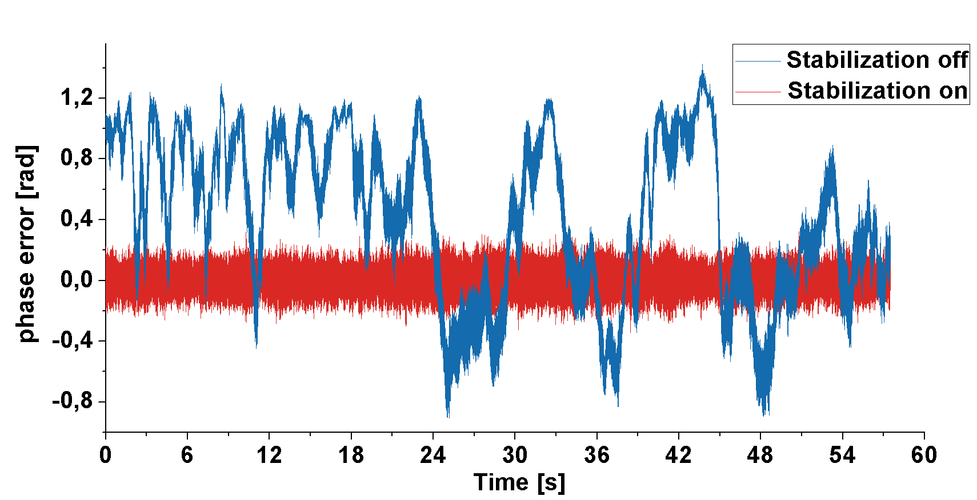
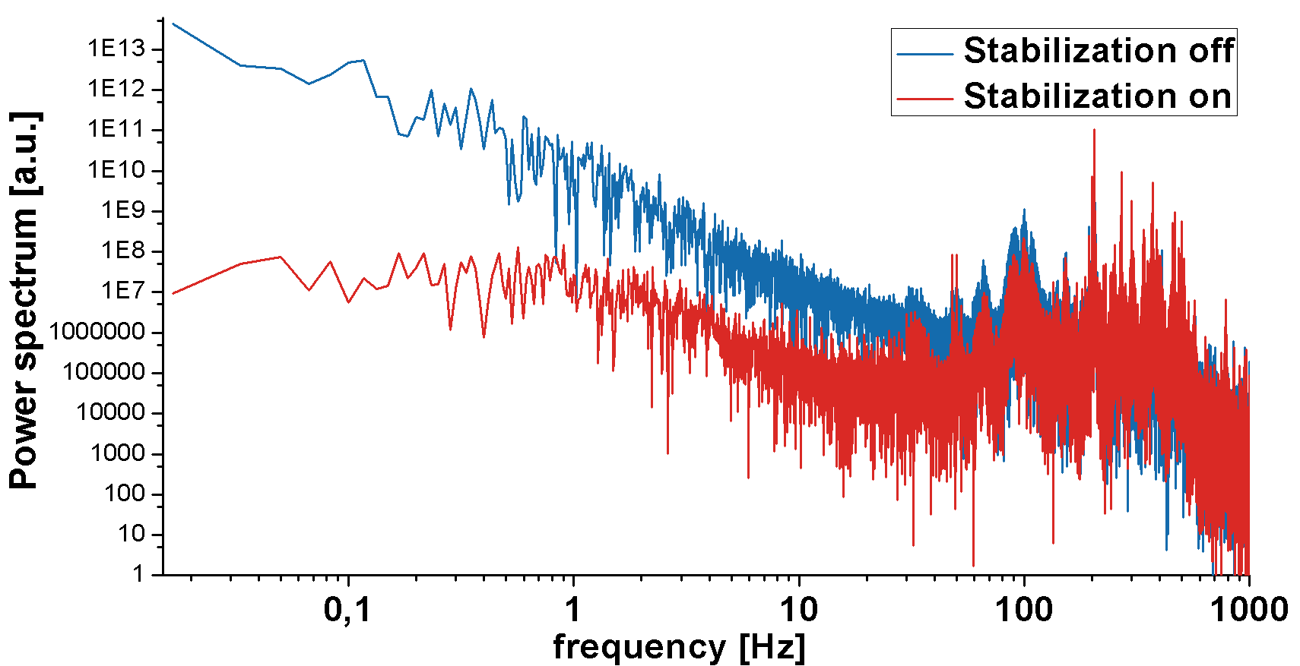
Coherent Addition of Ultrashort Pulses
98.8%
Phase fluctuations are weak and slow.
J. Limpert et al., „Performance Scaling of Ultrafast Laser Systems by Coherent [...],” IEEE J. Sel. Top. Quantum Electron. 20, 1–10 (2014).

Slide 5
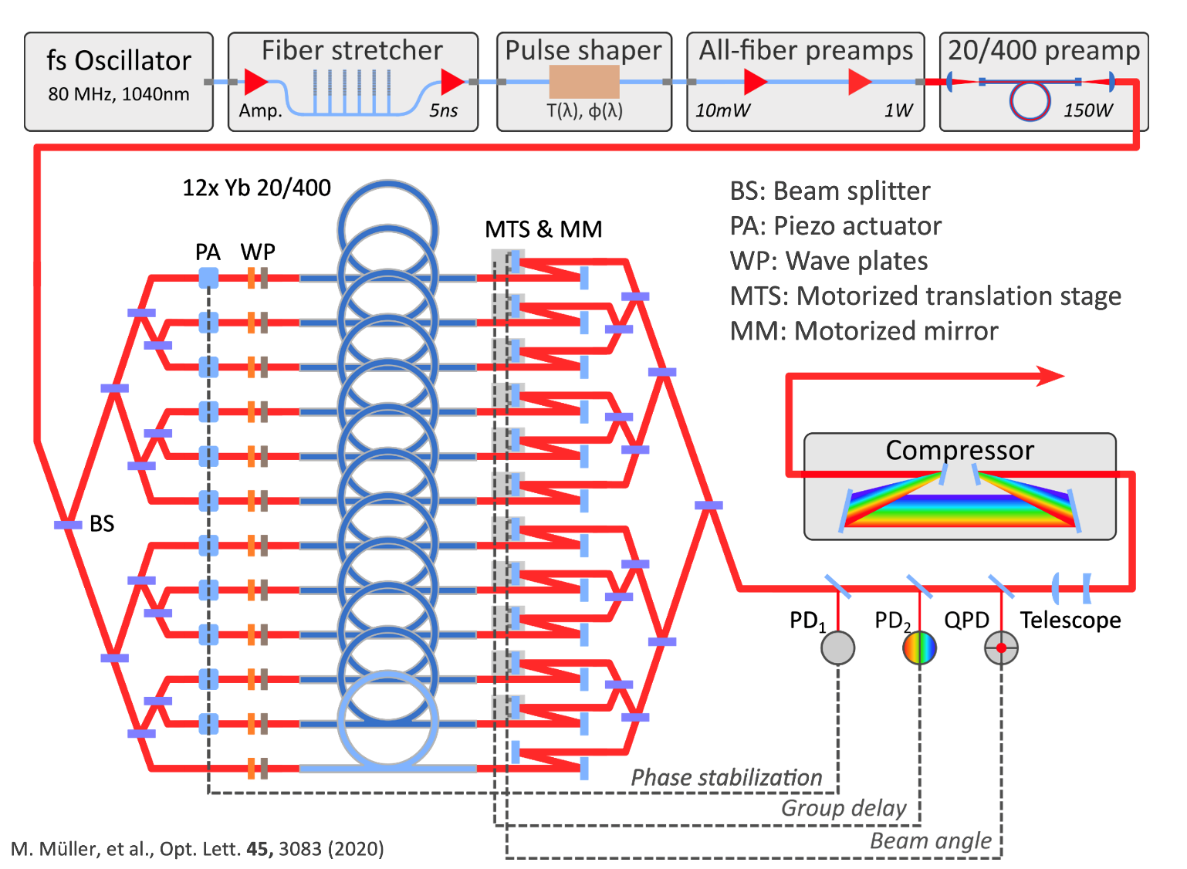
Coherent combination of laser amplifiers
10.4kW average power femtosecond laser
CBC with automated alignment
Best efficiency
remote starting procedure
fail proof

Slide 6
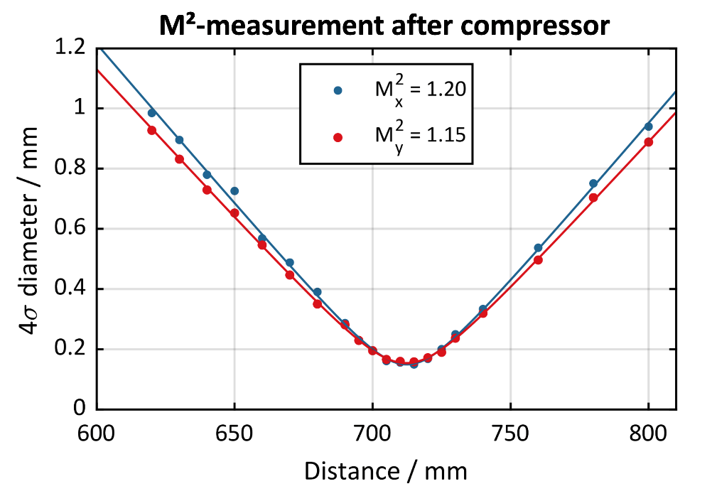
Coherent combination of laser amplifiers
10.4kW average power femtosecond laser
Key specs
96% combination efficiency
240 fs pulse duration
0.56% rms power stability
20% wall-plug efficiency

Slide 7
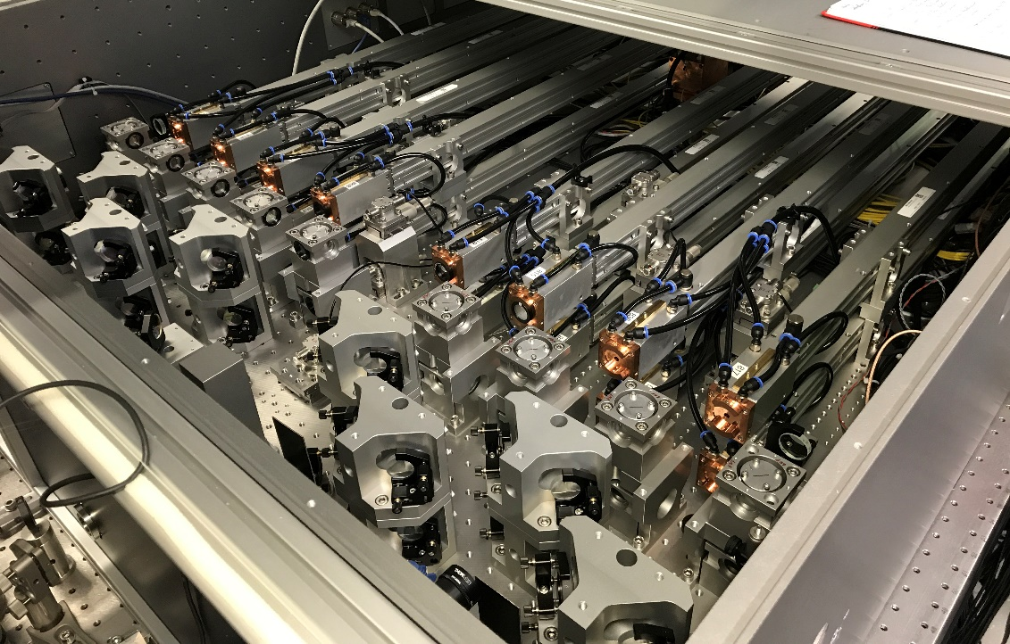
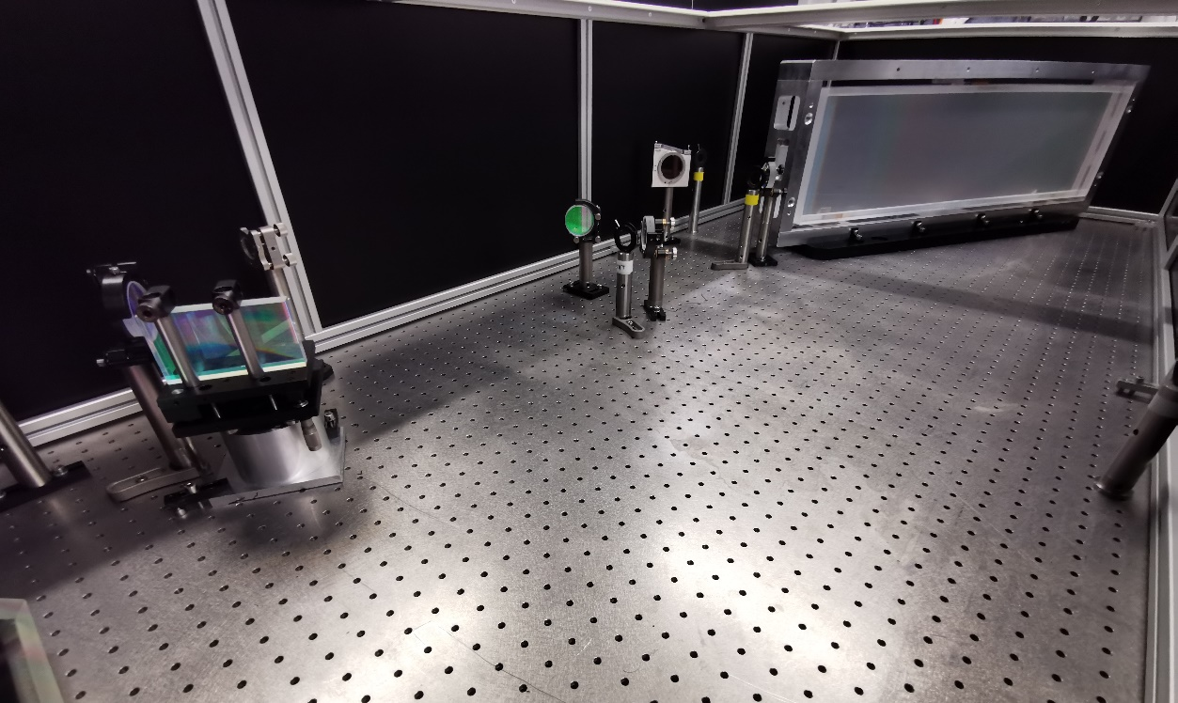
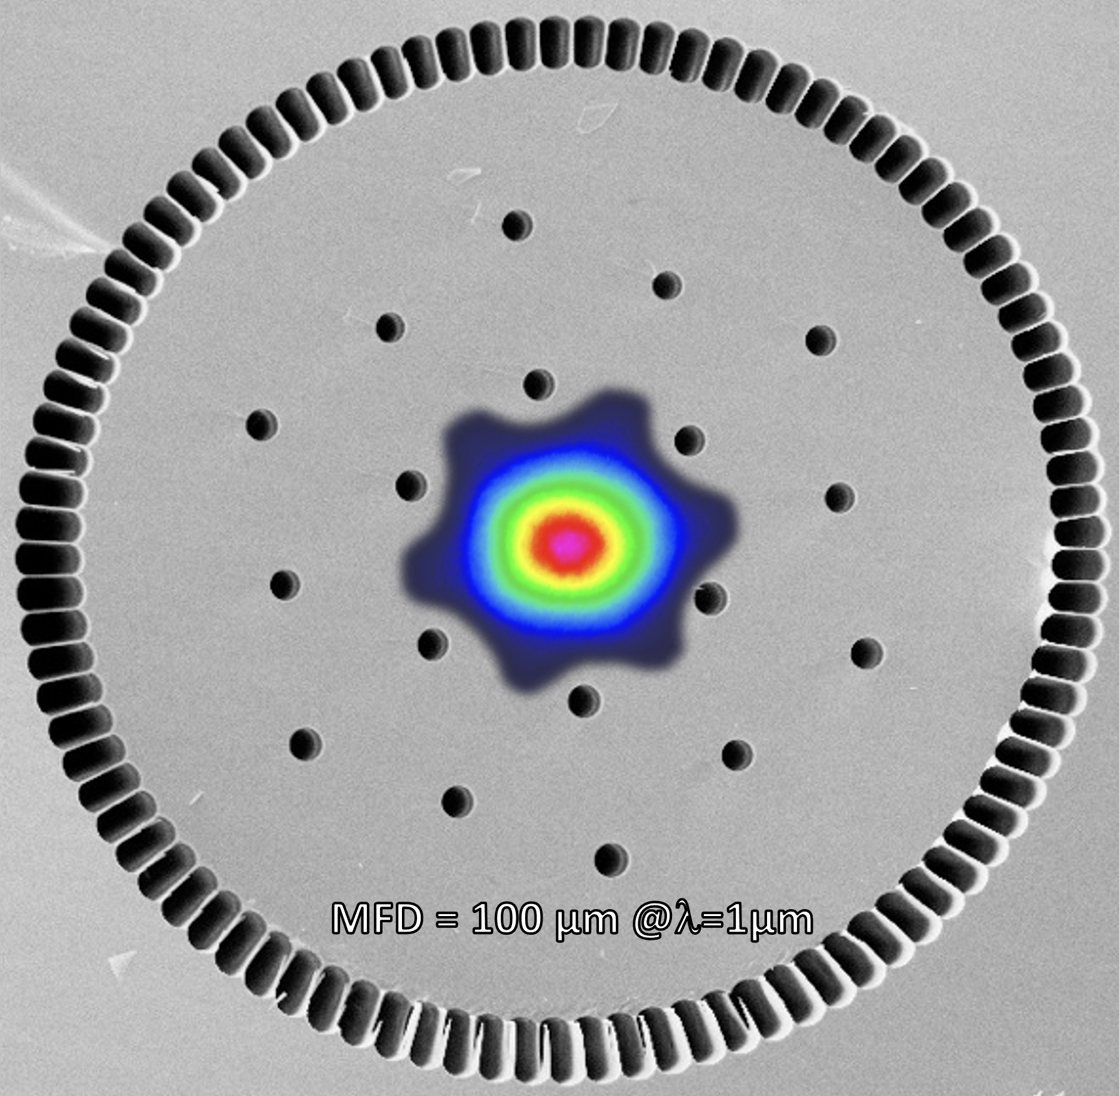
Coherent combination of laser amplifiers
Pushing the pulse energy …
CPA compressor
16-channel Ytterbium-doped rod-type fiber CPA System
J. Limpert et al., “Yb-doped large-pitch fibres: [...],” Light Sci. Appl. 1, 1–5 (2012).

Slide 8
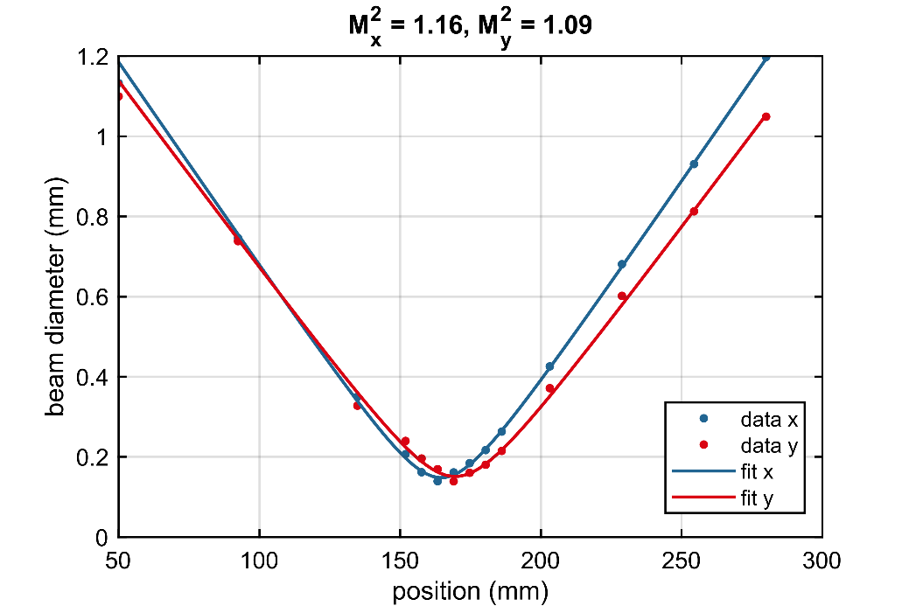
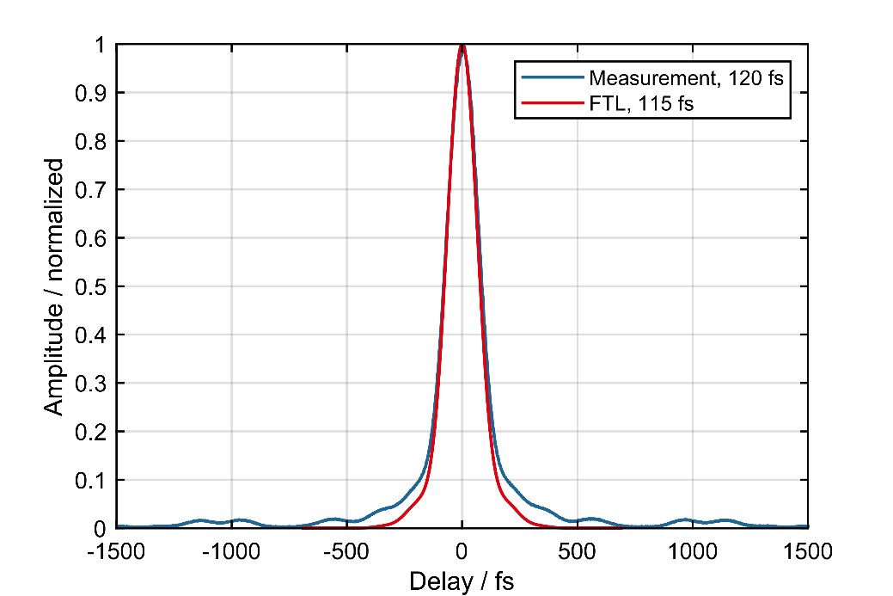
Coherent combination of laser amplifiers
Key specs:
1.0 kW average power
100 kHz repetition rate
10 mJ (23mJ) pulse energy
120 fs pulse duration
Beam quality M²<1.2
Stark, H., Buldt, J., Müller, M., Klenke, A., Tünnermann, A., & Limpert J. (2019), 23 mJ high-power fiber CPA system using electro-optically controlled divided-pulse amplification, Optics Letters 44(22), 5529-5532
Stark, H., Buldt, J., Müller, M., Klenke, A., & Limpert J. (2021), 1 kW, 10 mJ, 120 fs coherently combined fiber CPA laser system, Optics Letters 46(5), 969-972

Slide 9
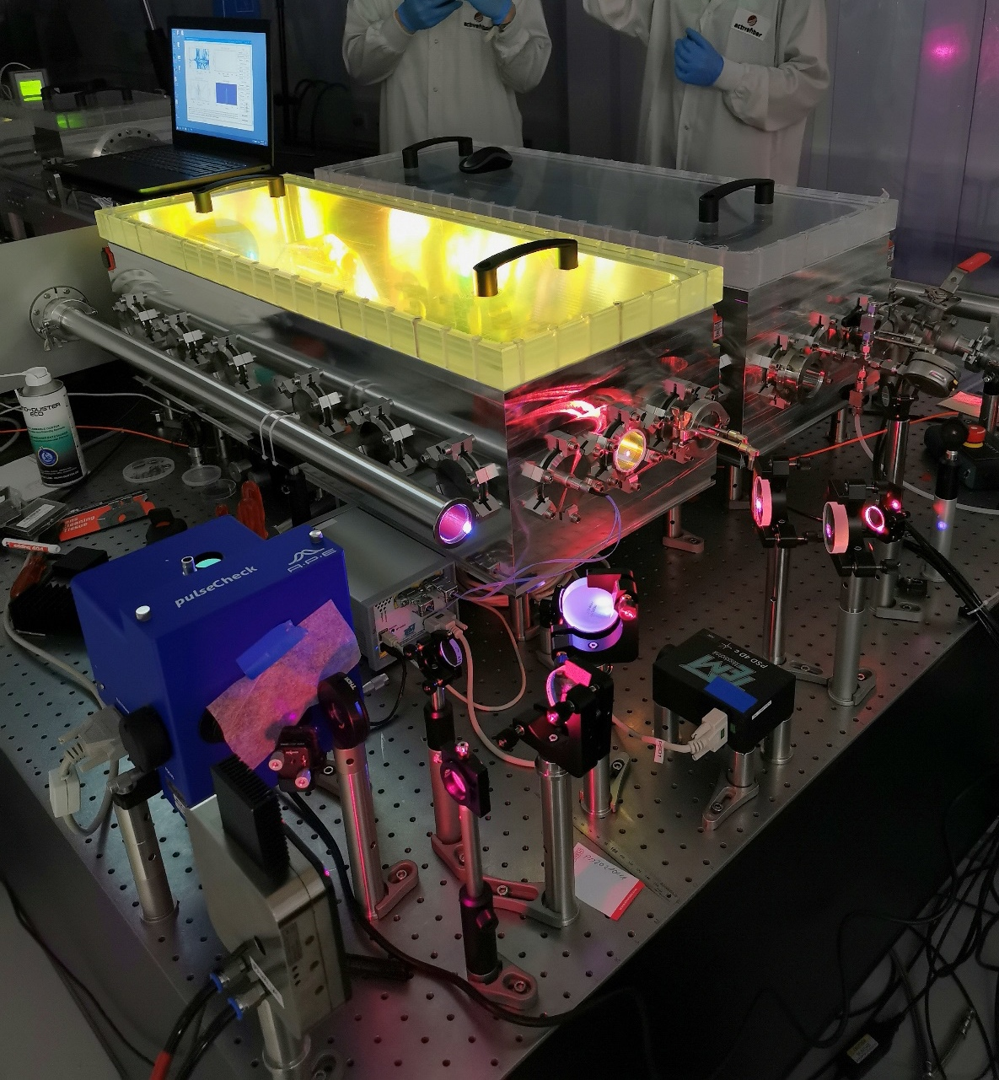
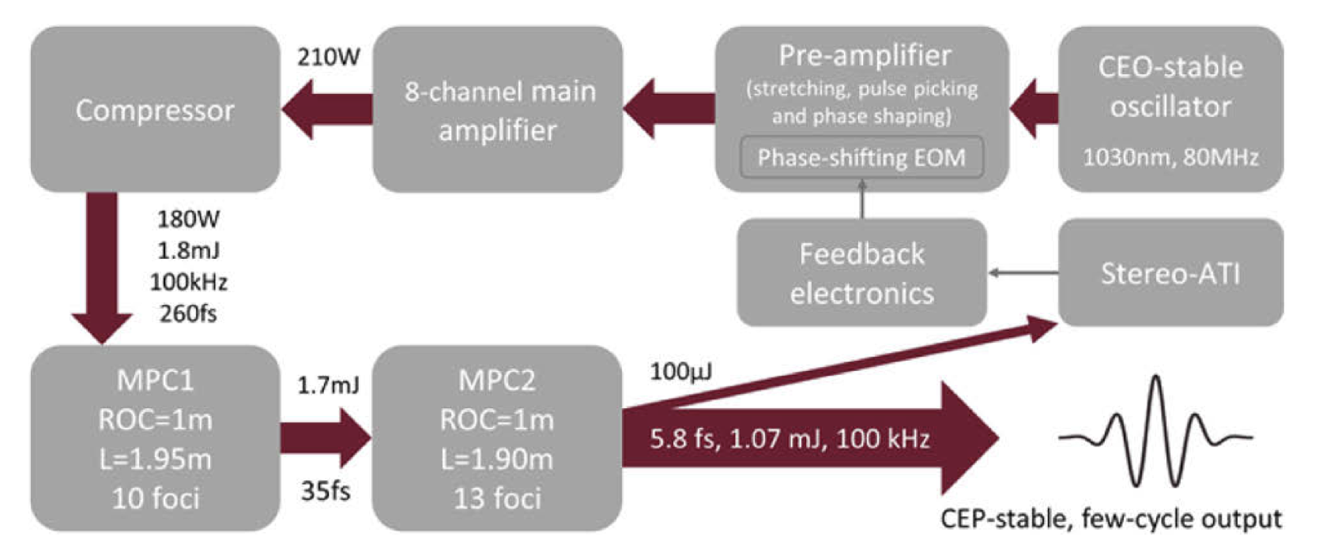
Pulse post-compression in gas-filled MPCs
Steffen Hädrich, et.al., "Carrier-envelope phase stable few-cycle laser system delivering more than 100 W, 1 mJ, sub-2-cycle pulses," Opt. Lett. 47, 1537-1540 (2022)

Slide 10
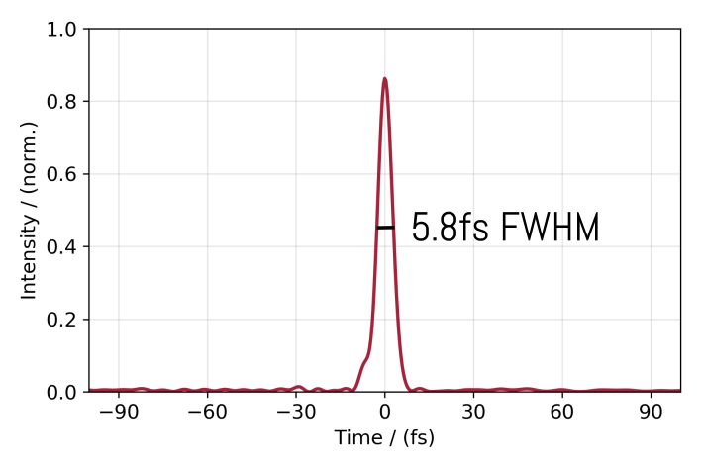
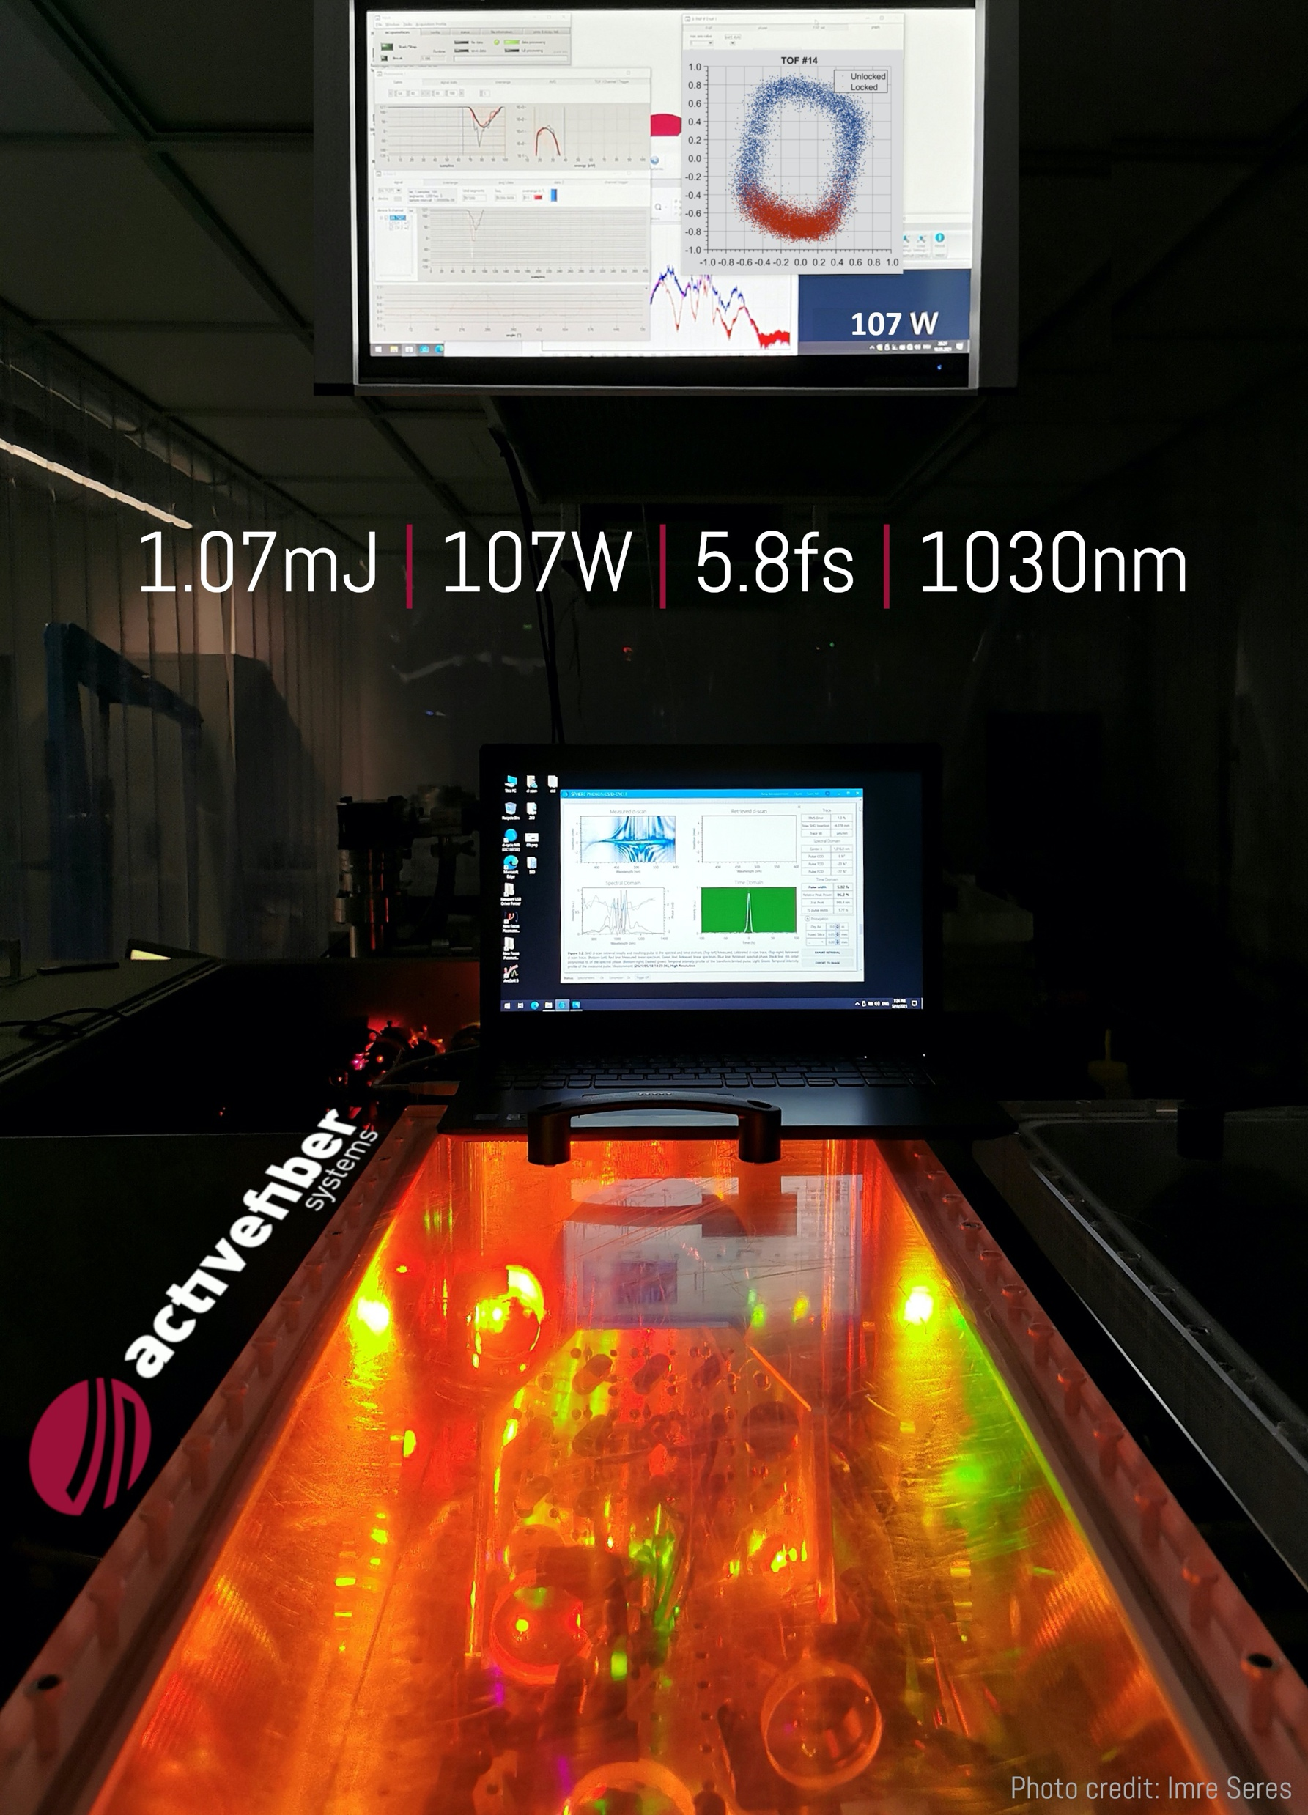
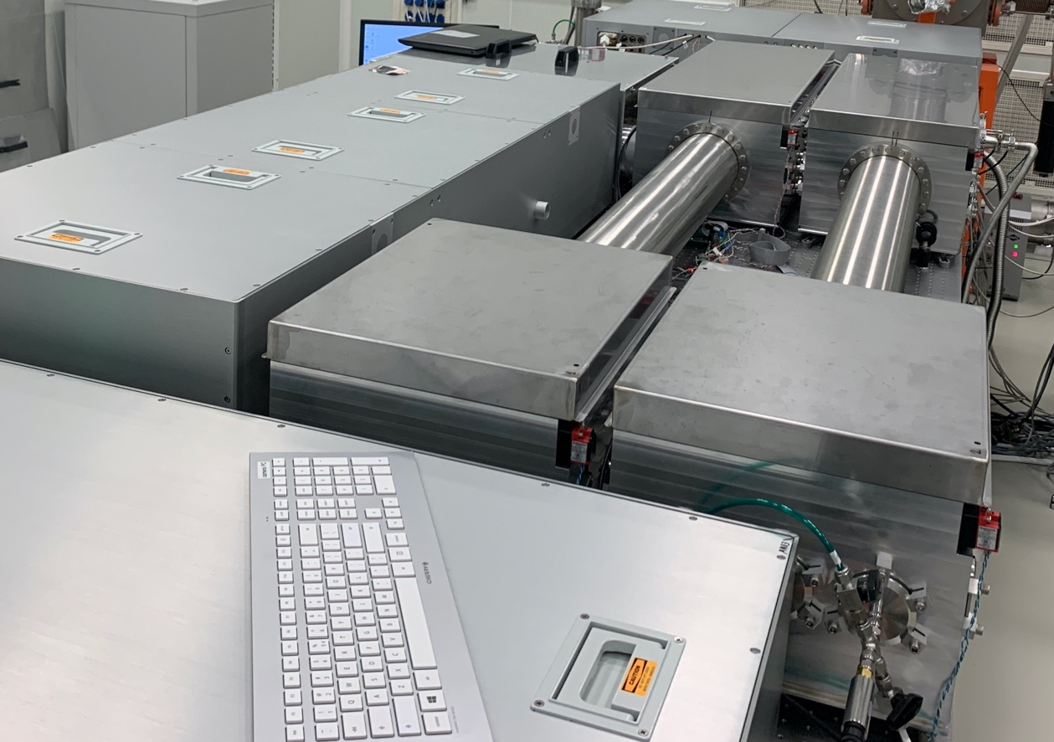
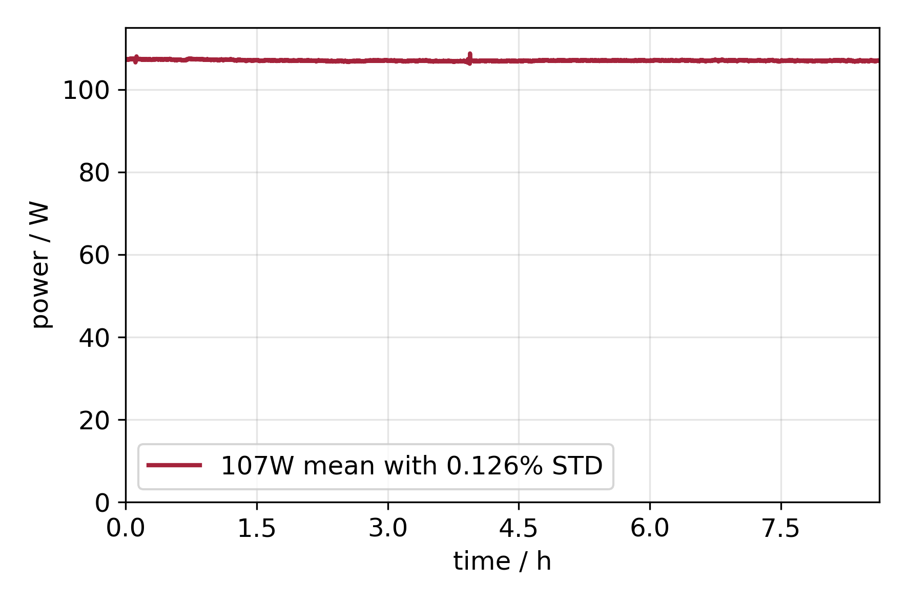
Pulse post-compression in gas-filled MPCs
Sub-2 cycle
Installed at ELI-ALPS (HR1)
Excellent stability
Steffen Hädrich, et.al., "Carrier-envelope phase stable few-cycle laser system delivering more than 100 W, 1 mJ, sub-2-cycle pulses," Opt. Lett. 47, 1537-1540 (2022)

Slide 11
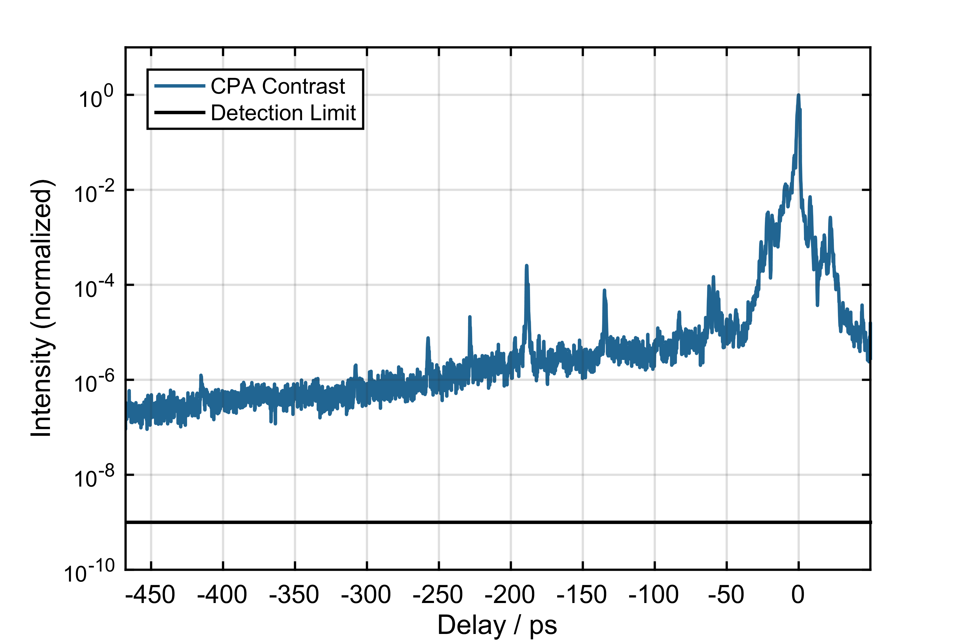
Temporal pulse contrast
Joachim Buldt, Michael Müller, Robert Klas, Tino Eidam, Jens Limpert, and Andreas Tünnermann, "Temporal contrast enhancement of energetic laser pulses by filtered self-phase-modulation-broadened spectra," Opt. Lett. 42, 3761-3764 (2017)
Eidam, Limpert
Short pulse laser with high temporal contrast
DE102017109954B3

Slide 12
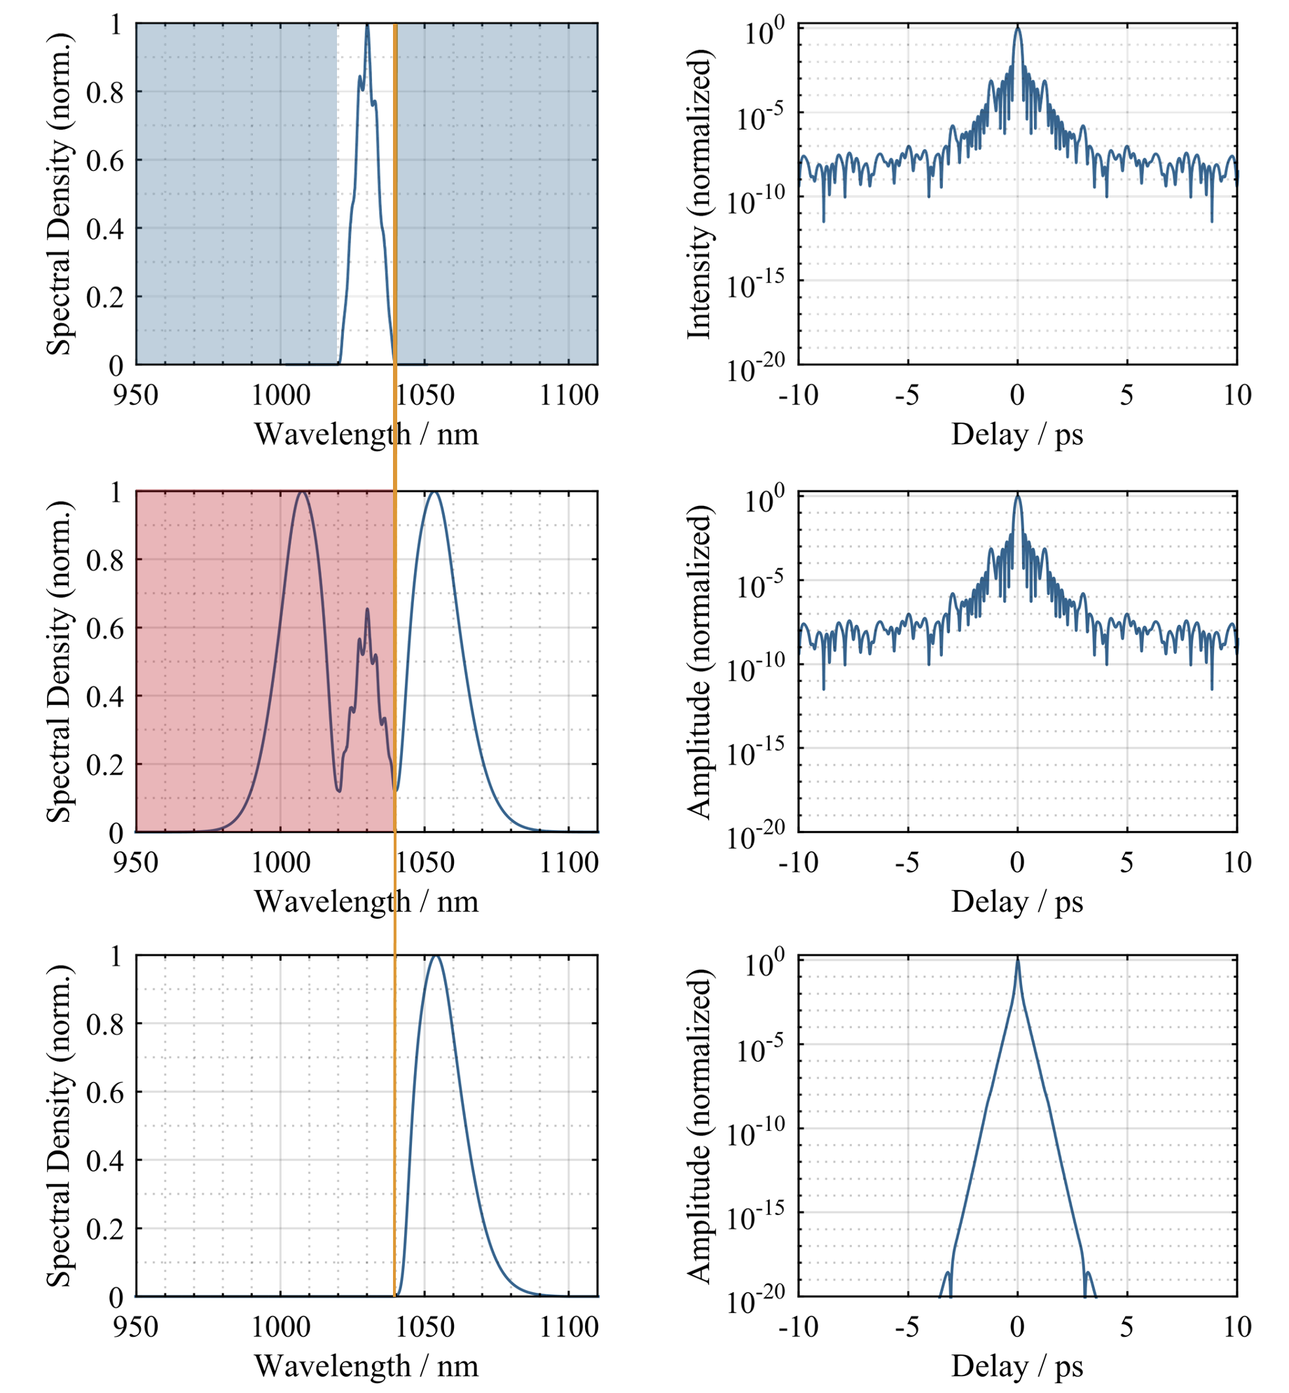
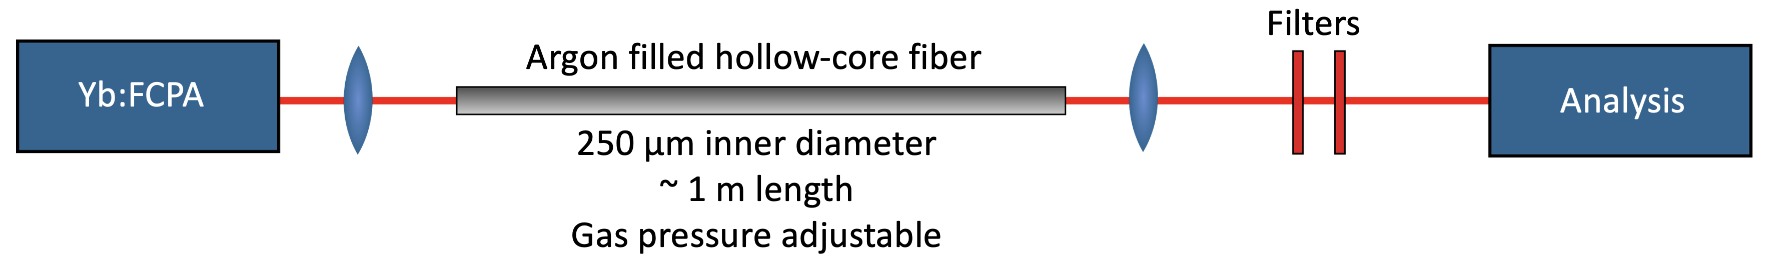
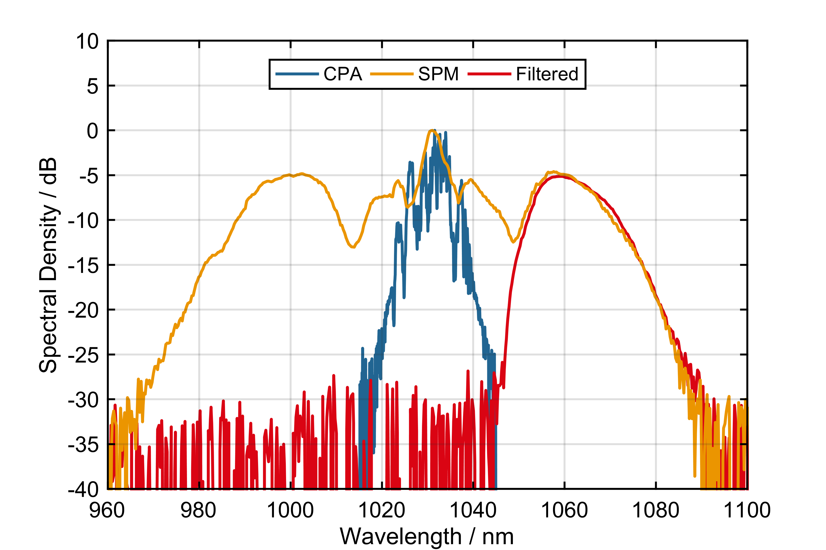
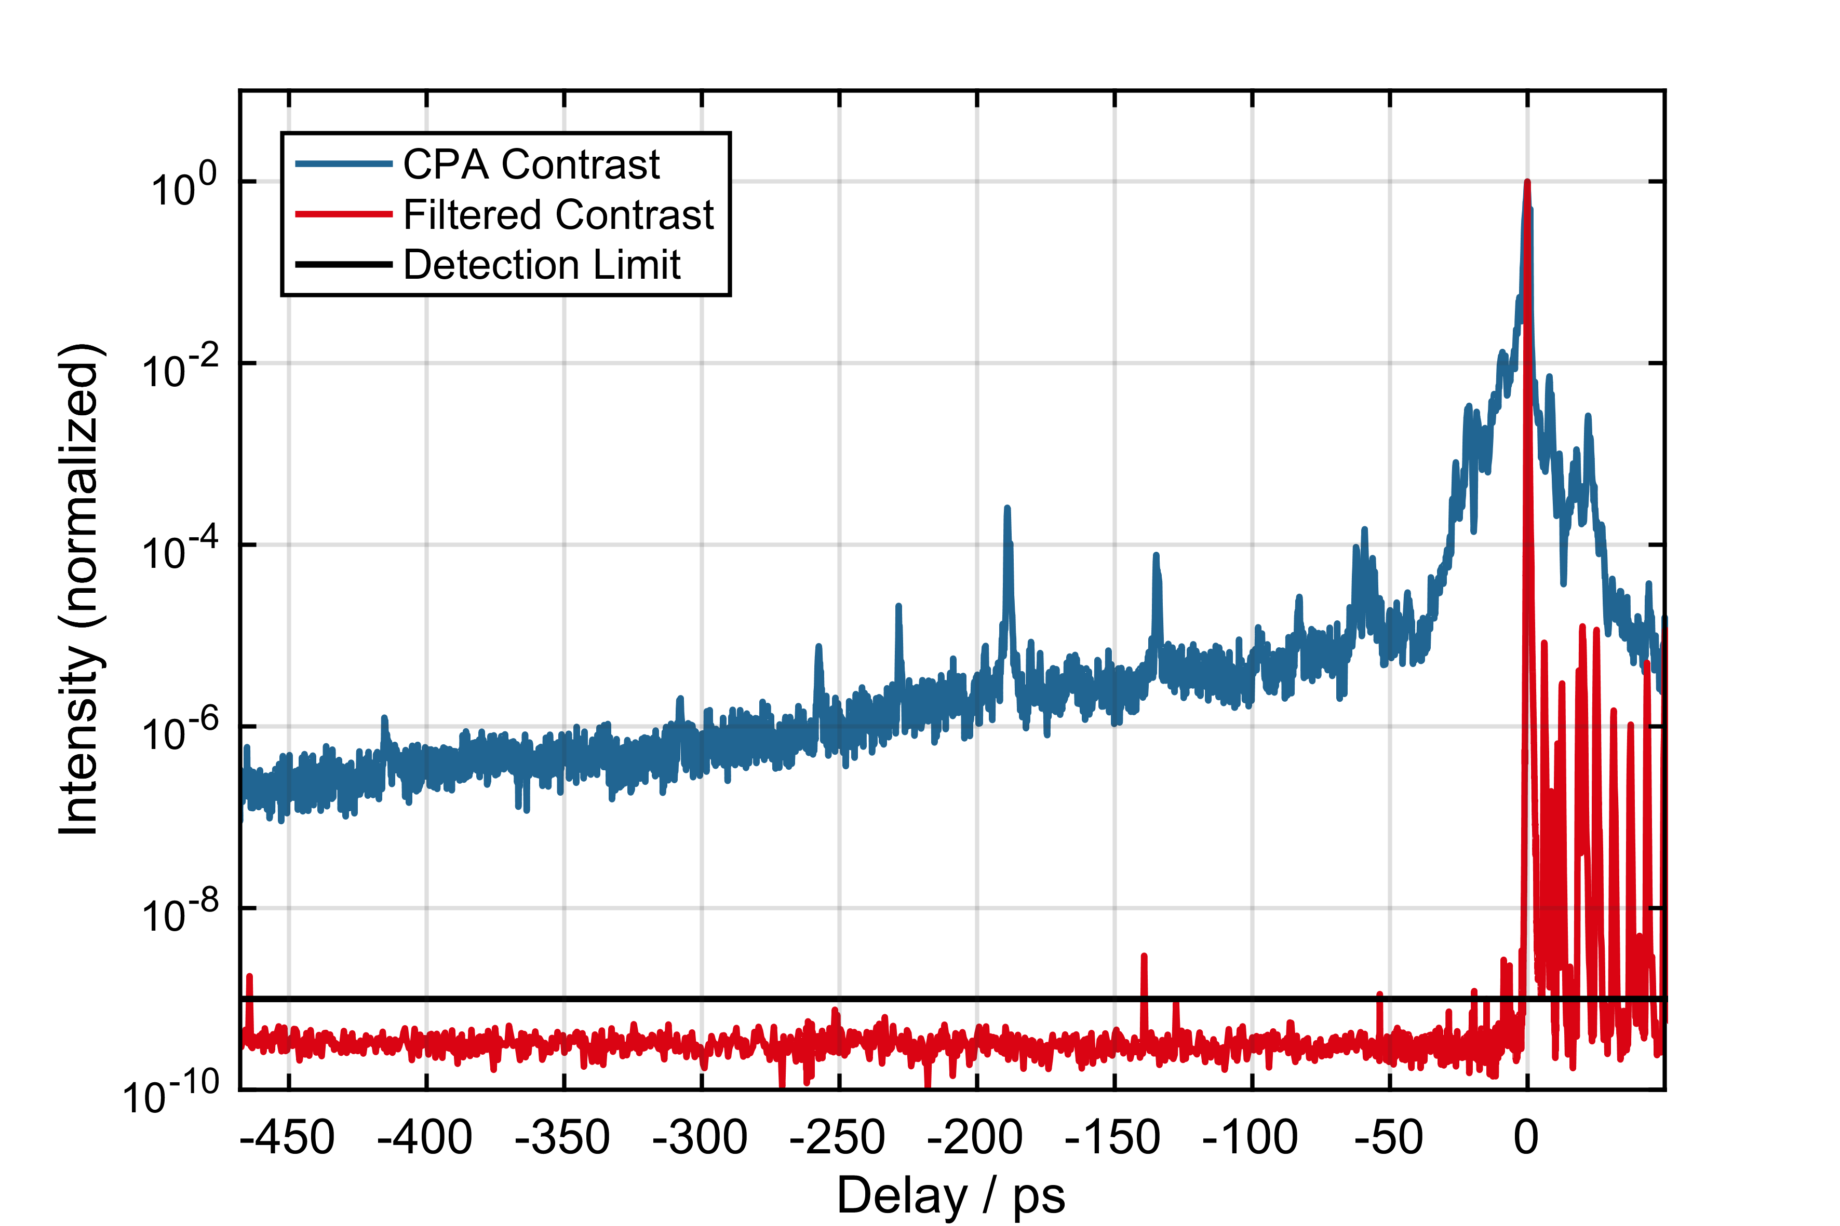
Enhancement of temporal contrast
Eidam, Limpert
Short pulse laser with high temporal contrast
DE102017109954B3
Joachim Buldt, Michael Müller, Robert Klas, Tino Eidam, Jens Limpert, and Andreas Tünnermann, "Temporal contrast enhancement of energetic laser pulses by filtered self-phase-modulation-broadened spectra," Opt. Lett. 42, 3761-3764 (2017)

Slide 13
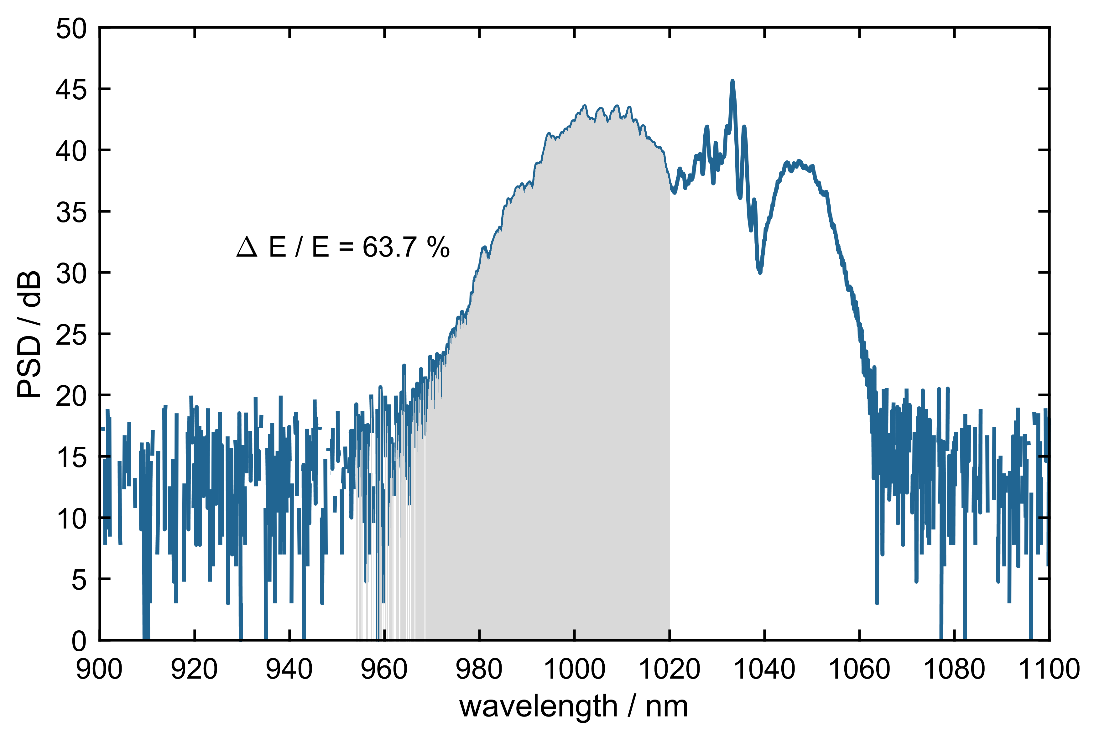
Enhancement of temporal contrast
Efficiency improvement via asymmetric spectral broadening (HR 1 System) => >75% appear feasible
Eidam, Limpert
Short pulse laser with high temporal contrast
DE102017109954B3
Joachim Buldt, Michael Müller, Robert Klas, Tino Eidam, Jens Limpert, and Andreas Tünnermann, "Temporal contrast enhancement of energetic laser pulses by filtered self-phase-modulation-broadened spectra," Opt. Lett. 42, 3761-3764 (2017)

Slide 14
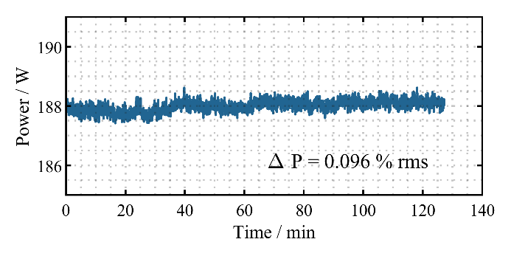
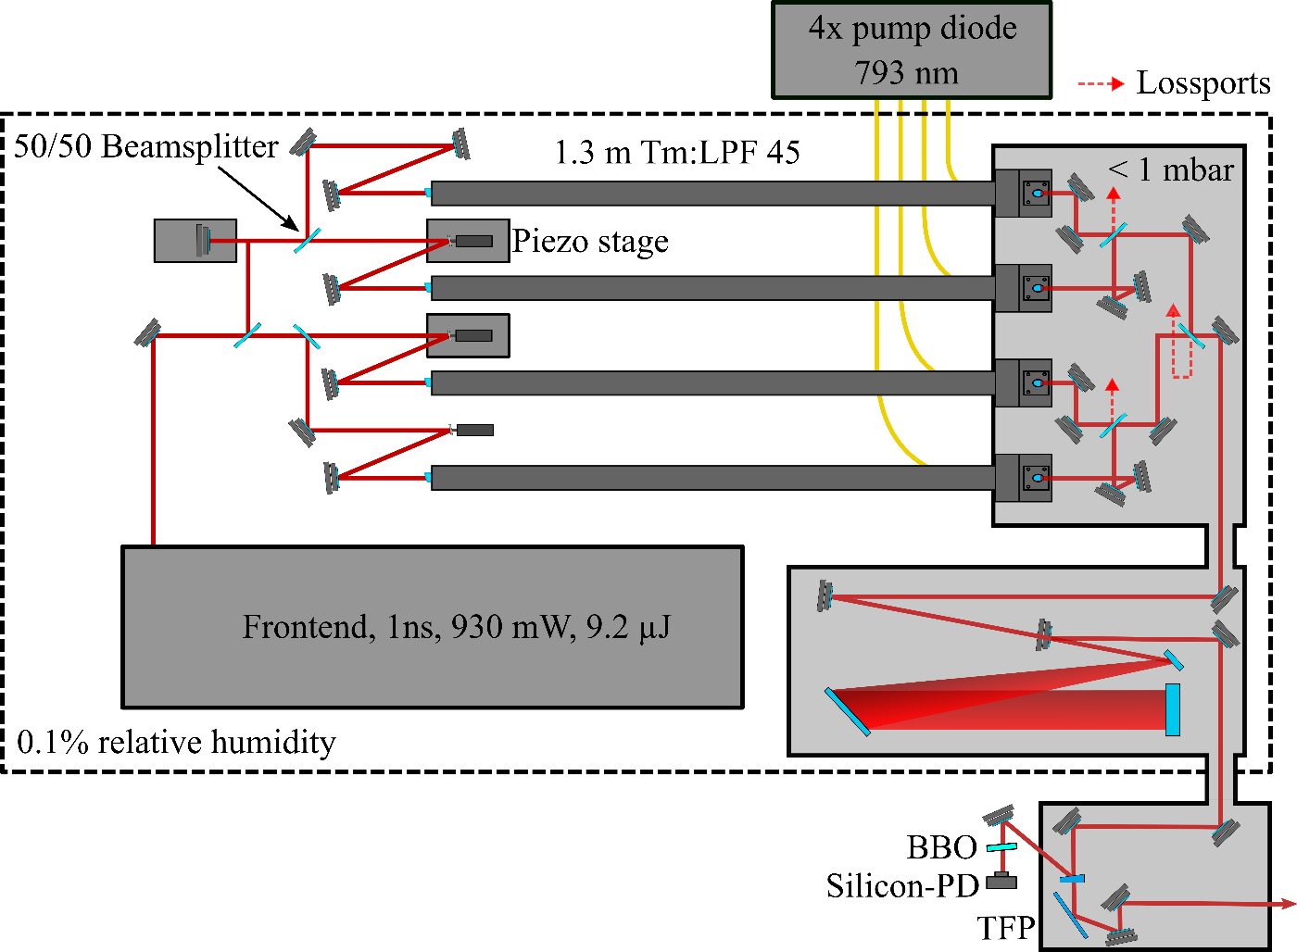
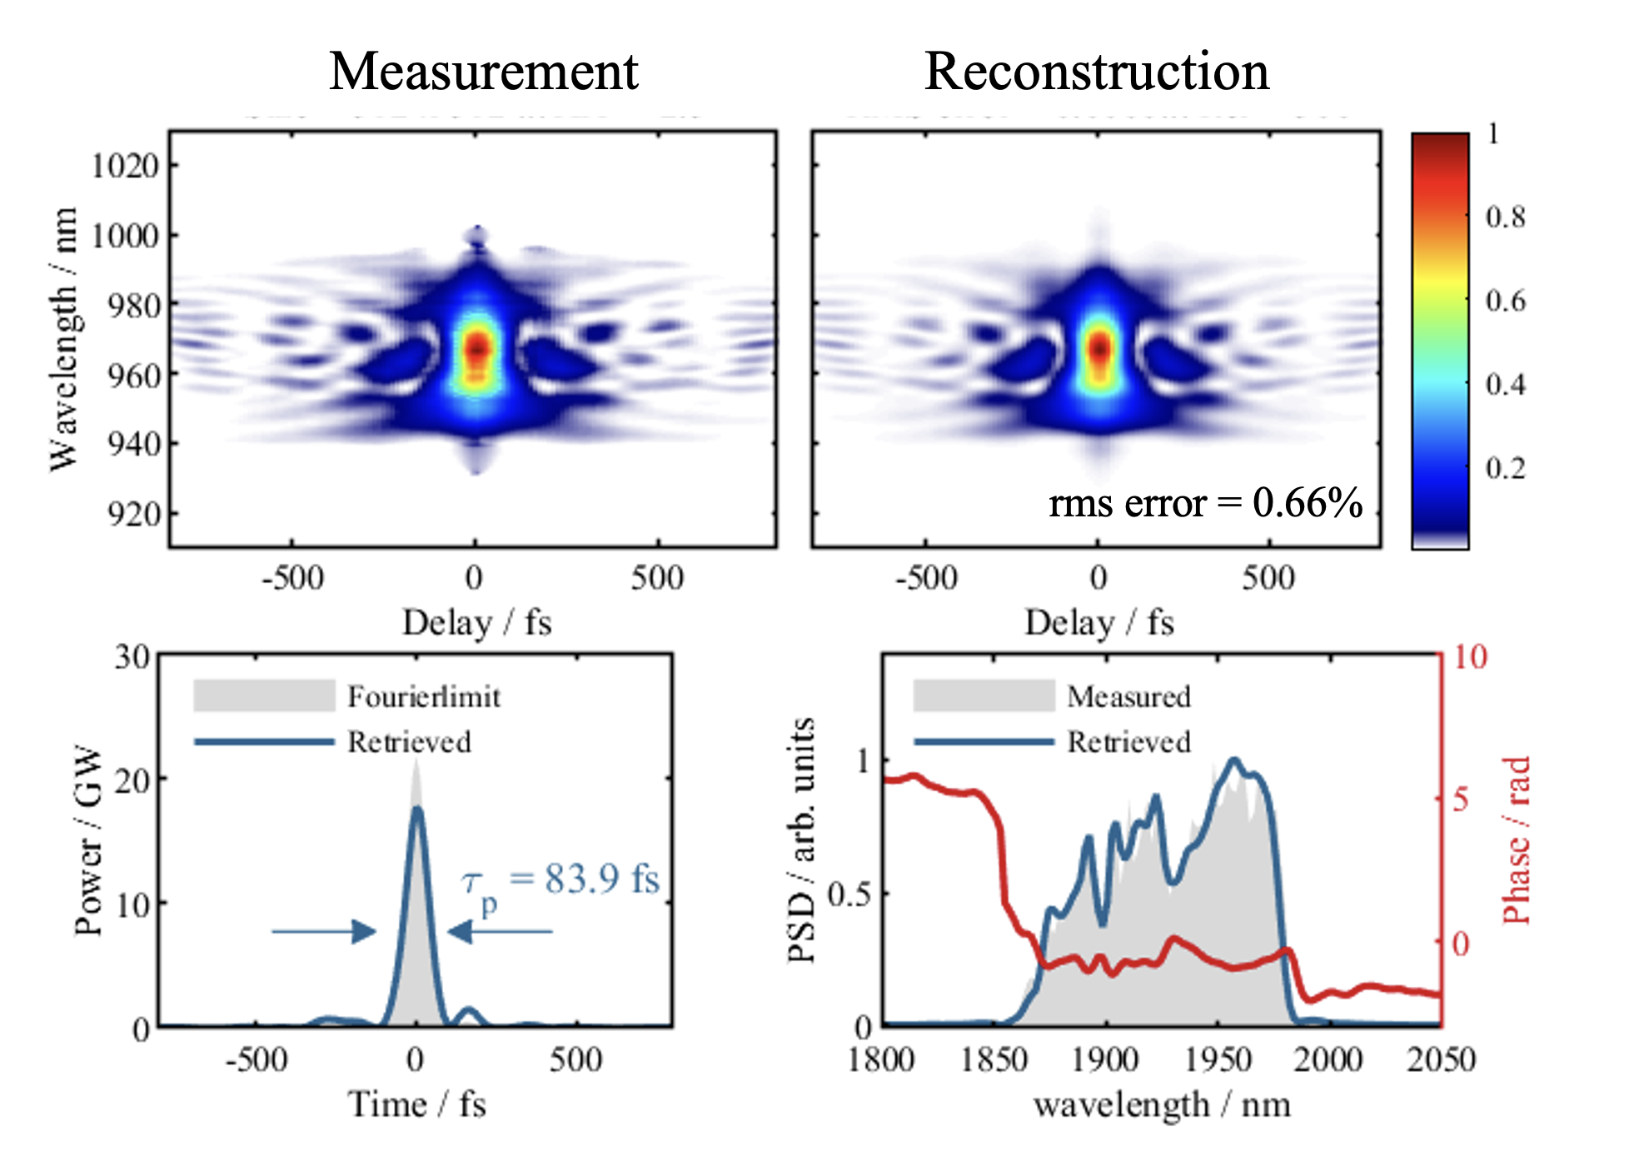

CBC at 2µm wavelength based on Tm-fibers
$$E_{out} =1.86 mJ$$
f_{rep} = 100kHz
$$τ_{out}=84 fs \\ P_{p}=17.7 GW$$
Tobias Heuermann, et.al. "Ultrafast Tm-doped fiber laser system delivering 1.65-mJ, sub-100-fs pulses at a 100-kHz repetition rate," Opt. Lett. 47, 3095-3098 (2022)

Slide 15
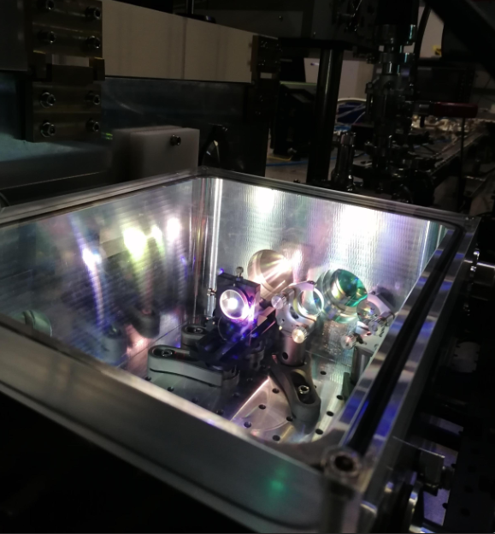
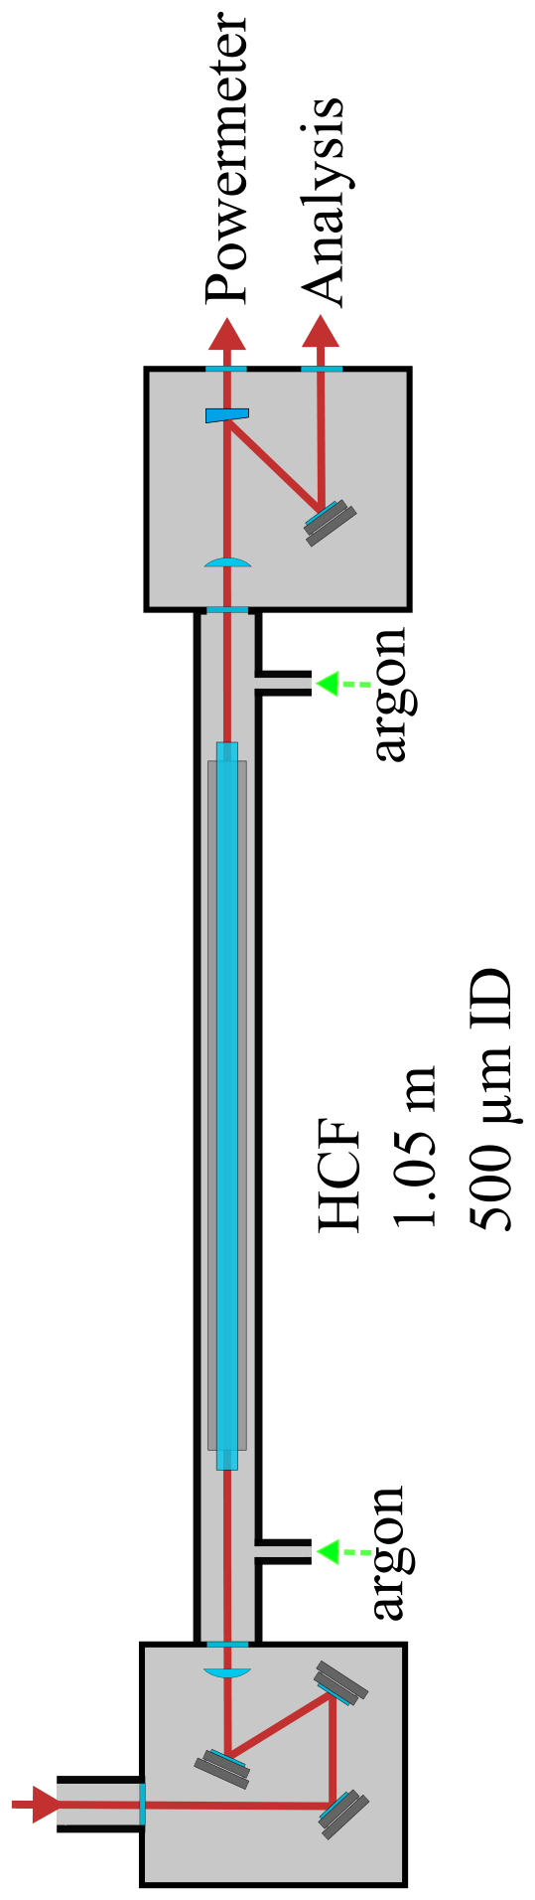
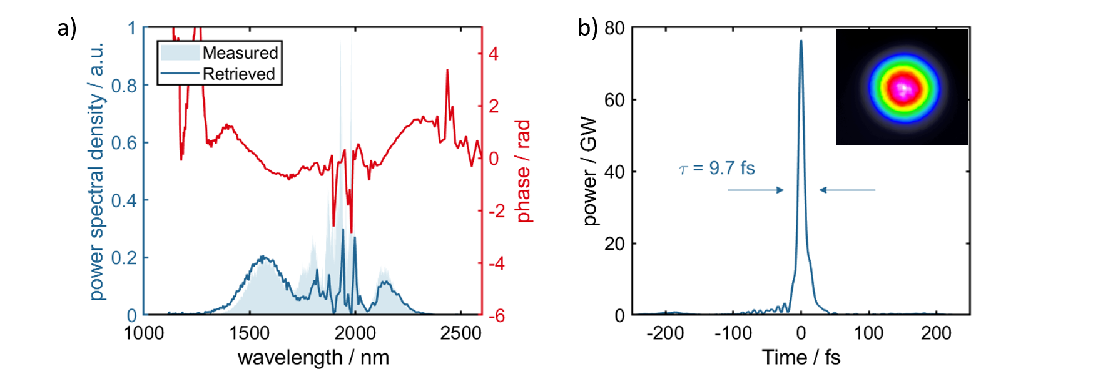
Post-compression at 2µm wavelength
Ar
TIPTOE¹ (SourceLAB)
HCF
1.05 m
500µm ID
70%
Ar
[1] S. B. Park et al.," Optica 5, 402-408 (2018)

Slide 16
Post-compression at 2µm wavelength
Ar
TIPTOE¹ (SourceLAB)
HCF
1.05 m
500µm ID
70%
Ar
[1] S. B. Park et al.," Optica 5, 402-408 (2018)

Slide 17
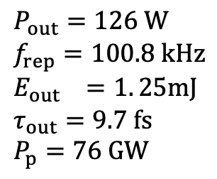
Post-compression at 2µm wavelength
$$P_{out}=126 W$$
$$f_{rep}=100.8 kHz \\ E_{out} =1. 25mJ$$
$$τ_{out}=9.7 fs \\ P_{p}=76 GW$$
~1.5 cycles
@1.83 µm
Ar
TIPTOE¹ (SourceLAB)
HCF
1.05 m
500µm ID
70%
Ar
[1] S. B. Park et al.," Optica 5, 402-408 (2018)

Slide 18
Post-compression at 2µm wavelength
$$P_{out}=126 W$$
$$f_{rep}=100.8 kHz \\ E_{out} =1. 25mJ$$
$$τ_{out}=9.7 fs \\ P_{p}=76 GW$$
~1.5 cycles
@1.83 µm
Ar
TIPTOE¹ (SourceLAB)
HCF
1.05 m
500µm ID
70%
Ar
New average power record of few-cycle SWIR sources !
[1] S. B. Park et al.," Optica 5, 402-408 (2018)

Slide 19
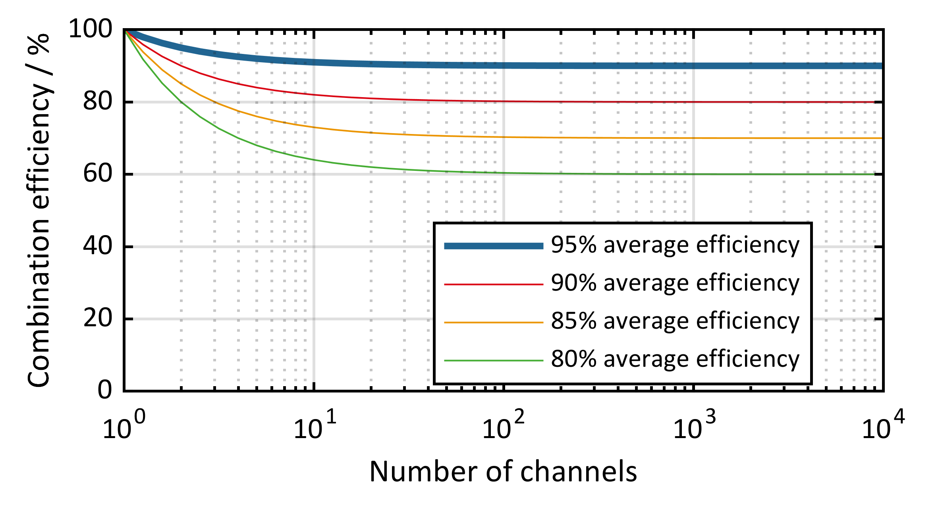
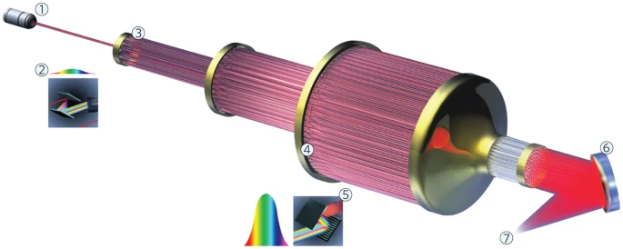
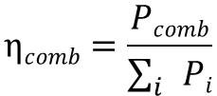
Coherent combination of fiber amplifiers
Proposal: Massive amount of fibers for a high energy system [1]
Theoretical combination efficiency [2,3]
Current
systems
Definition:
$$ηcomb=\frac{Pcomb}{\sum_{i}{Pi}}$$
High channel count theoretically viable, but difficult to realize due to increasing component count
[1] Mourou, G., Brocklesby, B., Tajima, T., & Limpert, J. (2013)., Nature Photonics, 7, 258.
[2] G. D. Goodno, C.-C. Shih, and J. E. Rothenberg, Opt. Express 18, 25403–25414 (2010).
[3] A. Klenke, E. Seise, J. Limpert, and A. Tünnermann, Opt. Express 19, 25379–25387 (2011).

Slide 20
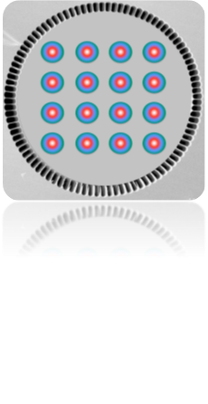
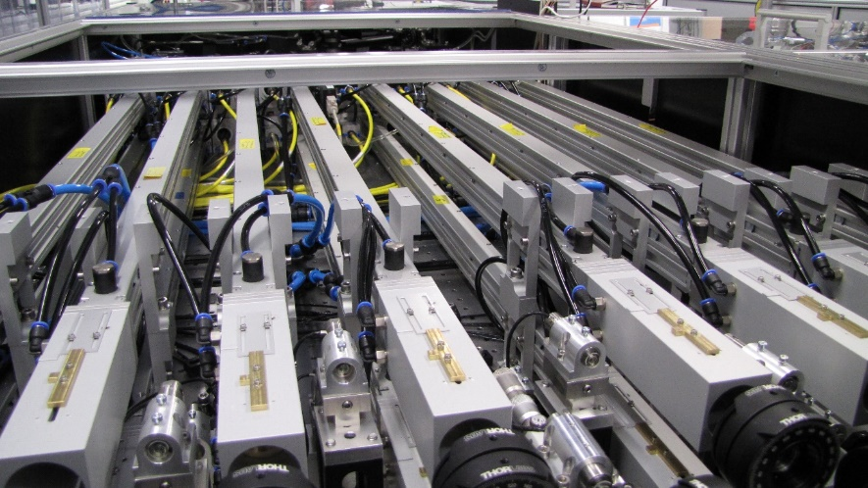
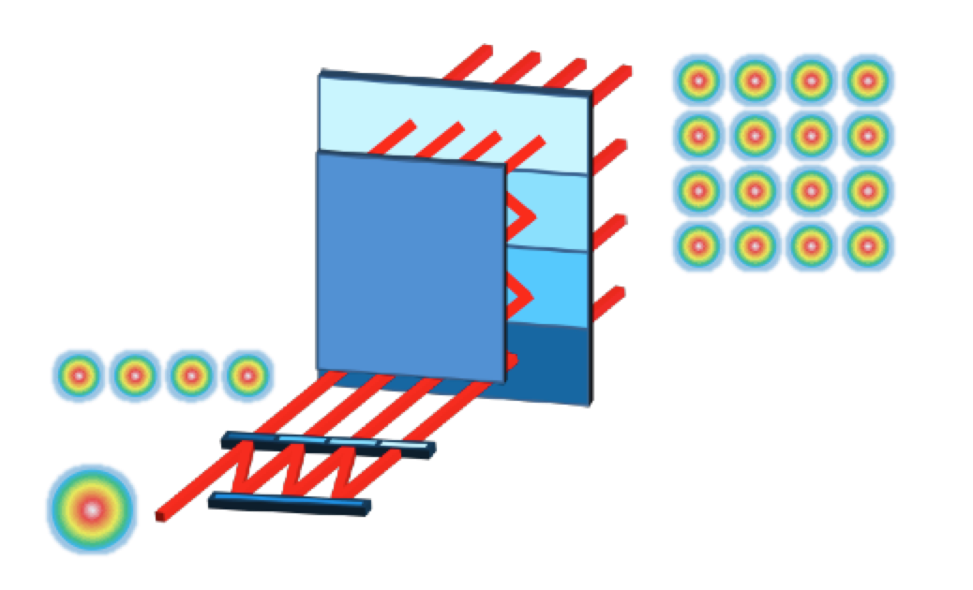
System integration for scalability
N-channel components for coherent beam combination
Multicore fibers
1:N beamsplitters and combiners
ΔΦ
Scalable phase detection and stabilization mechanism

Slide 21
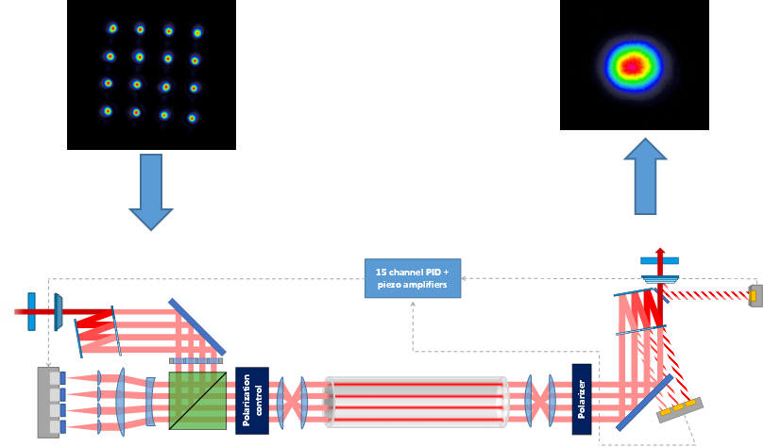
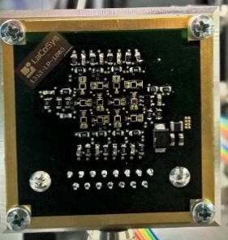
Coherent combination with multicore fibers
Segmented mirror splitter
to generate 4x4 beam array with 4mm pitch
Sequential phase locking scheme [1]
To grating compressor
CPA Frontend
Stretched femtosecond pulses
Path-length compensation
Photodiode arrays
MCF in water-cooled module
Monolithic piezo array with mounted mirrors
[1] A. Klenke, M. Müller, H. Stark, A. Tünnermann, and J. Limpert, Opt. Express 26, (2018)

Slide 22
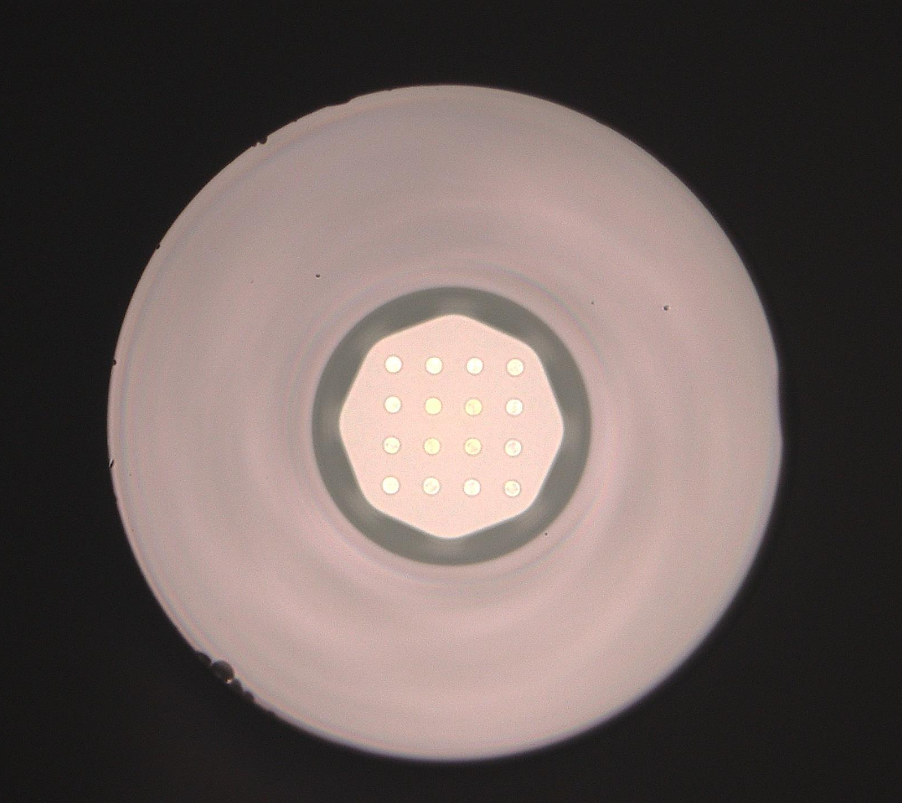
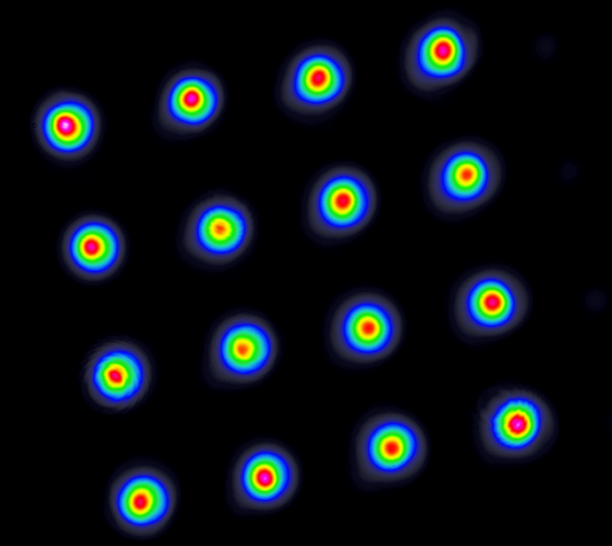
Coherent combination with multicore fibers
4x4 Yb MCF, 21µm cores, 1.0m length
>75% optical-to-optical conversion efficiency
1 kW total output power achieved with 3 W seed power
Ultrafast: >500W, >600µJ, 300fs
Nanosecond: 50mJ extracted from 50µm core version
Arno Klenke, et.al., "500 W rod-type 4× 4 multicore ultrafast fiber laser," Opt. Lett. 47, 345-348 (2022)
Christopher Aleshire, et.al., "High-energy Q-switched 16-core tapered rod-type fiber laser system," Opt. Lett. 47, 1725-1728 (2022)

Slide 23
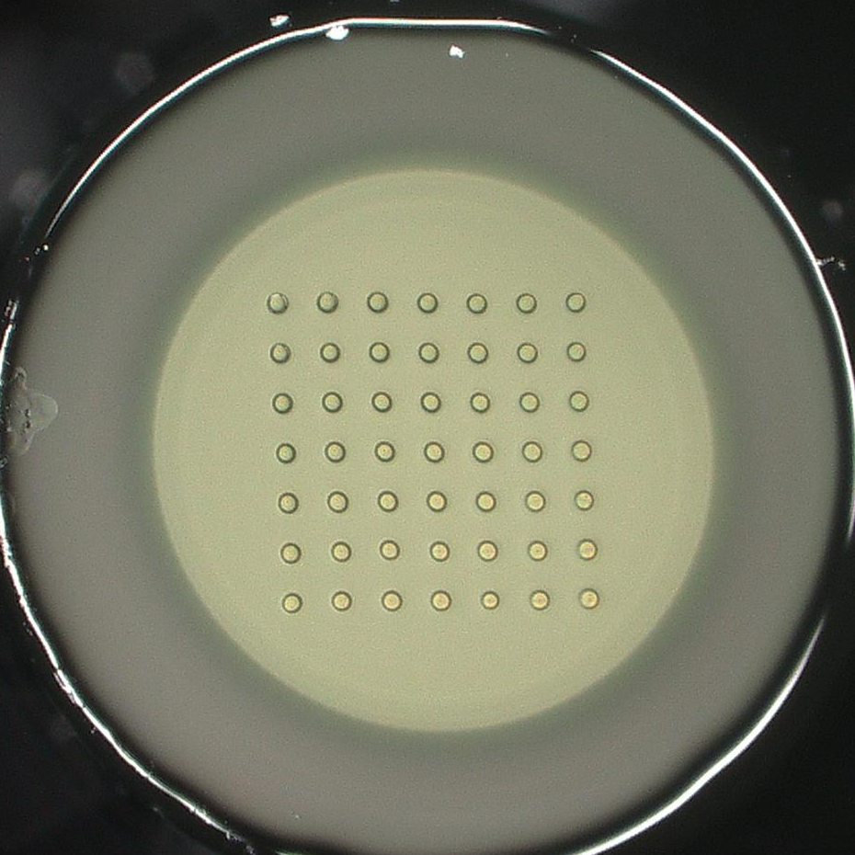
Coherent combination with multicore fibers
4x4 Yb MCF, 21µm cores, 1.0m length
>75% optical-to-optical conversion efficiency
1 kW total output power achieved with 3 W seed power
Ultrafast: >500W, >600µJ, 300fs
Nanosecond: 50mJ extracted from 50µm core version
Arno Klenke, et.al., "500 W rod-type 4 × 4 multicore ultrafast fiber laser," Opt. Lett. 47, 345-348 (2022)
Christopher Aleshire, et.al., "High-energy Q-switched 16-core tapered rod-type fiber laser system," Opt. Lett. 47, 1725-1728 (2022)
7x7 Yb MCF, 32µm cores, 1.2m length

Slide 24
Coherent combination with multicore fibers
4x4 Yb MCF, 21µm cores, 1.0m length
>75% optical-to-optical conversion efficiency
1 kW total output power achieved with 3 W seed power
Ultrafast: >500W, >600µJ, 300fs
Nanosecond: 50mJ extracted from 50µm core version
Arno Klenke, et.al., "500 W rod-type 4 × 4 multicore ultrafast fiber laser," Opt. Lett. 47, 345-348 (2022)
Christopher Aleshire, et.al., "High-energy Q-switched 16-core tapered rod-type fiber laser system," Opt. Lett. 47, 1725-1728 (2022)
7x7 Yb MCF, 32µm cores, 1.2m length
1 kW total output power achieved
Ultrafast: work in progress
>500mJ extractable pulse energy
10x10 Yb MCF preform fabricated

Slide 25
Scaling towards Joule pulse energy
5mJ per single core (80µm core diameter)
7x7 Yb cores, i.e. 245mJ from a single MCF
>200mJ after combination and compression
@10KHz => 2000W
A. Steinkopff, C. Jauregui, C. Aleshire, A. Klenke, and J. Limpert, "The impact of thermo-optical effects in coherently-combined multicore fiber amplifiers," Opt. Express 28, 38093–38105 (2020).
Spatially separated amplification in 16 MCF modules
potentially: >3J, 10kHz, <150fs, >30kW
compact + high wall-plug efficiency

Slide 26








Thank you for your attention!
We acknowledge support by:

