Slide 1
Towards Milestone Report MS21 for EuroNNAc in May 2023
19 – 26 September 2022, Elba, Italy
Ralph Assmann, DESY & LNF/INFN
Massimo Ferrario, LNF/INFN

Slide 2
NPACT/EuroNNAc Meeting Saturday
Saturday will discuss EAAC2023, proposal of a new Bob Siemann prize, how to make our facilities and projects a full success, …
Let us know your proposals for the future of the field.
If you are around, please join us!

Slide 3
WP6 Deliverables
Later (after EAAC 2023)
Nov 2024

Slide 4
WP6 Milestones
Now
May 2023
MS21: Report on the novel accelerator landscape in Europe, facilities, projects and capabilities at the beginning of the 2020’s. Lead – DESY, M24, Publication, website (task 6.1)
MS22: LASPLA Workshop/School. Lead – CNR, M30, Report (task 6.2)
MS23 Target manufacturing and characterization. Lead – CNRS, M12 Report (task 6.3)
MS24: Hypothesis on the causes of the instabilities of the focal spot profile. Lead – CNRS, M24 Publication (task 6.4)
This Special Topics workshop will prepare the milestone MS21. Thanks to all session organizers and participants for your help!

Slide 5
Outcome of Workshop
The special topics (nine, proposed by our community) gave an excellent overview of our field and the activities of network institutes and the network itself.
Talks (almost) all on INDICO. Student and other posters as well.
https://agenda.infn.it/event/28376/timetable/#20220923
Now:
The ST co-cordinators present their short summaries on slides
Slides documented on INDICO
Slides will be used to report WS outcome to I-FAST steering meeting

Slide 6
Producing the MS21 Report
ST co-coordinators prepare a 1.5 – 2 page (can be more) written summary for topic:
NO template required, any format fine.
Text required, readable to EU level reviewers. References to talks and papers OK.
1 Figure plus 1 Table per 2 pages max.
ST co-coordinators distribute to all participants for comments.
Major questions to address for each special topic:
What are facilities available and presented?
What are the major projects presented and discussed?
What are our capabilities – covering what we need or something mentioned as missing?
What are the next steps listed and what is the outlook into the future?
Any important message we want to pass to I-FAST and EU for the specific special topic?
Proposed deadline for sending to RA & MF: 1 Nov 2022 (easier close to WS)
We will assemble it and iterate the report with WS participants.

Slide 7
Thanks to all session organizers and participants for your help!

Slide 8
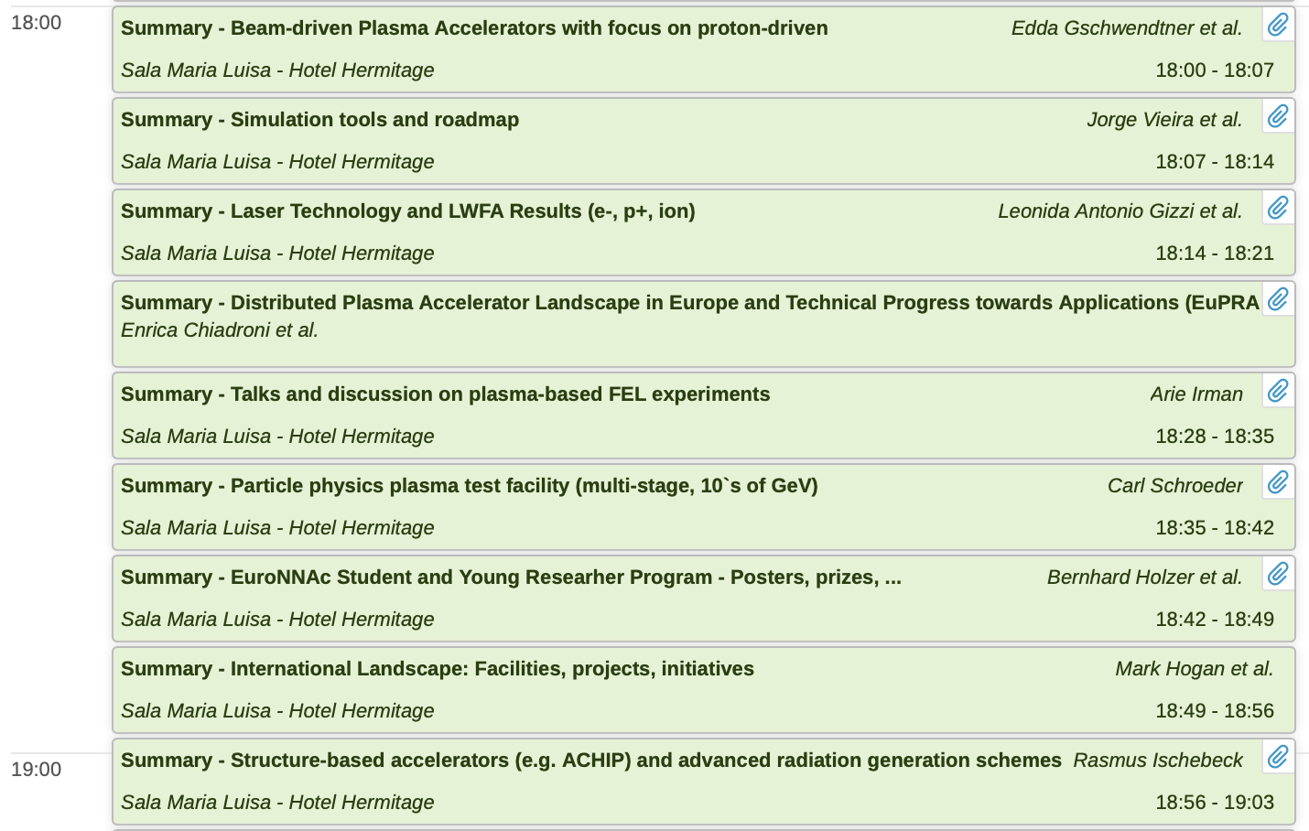
Summaries

