Slide 1
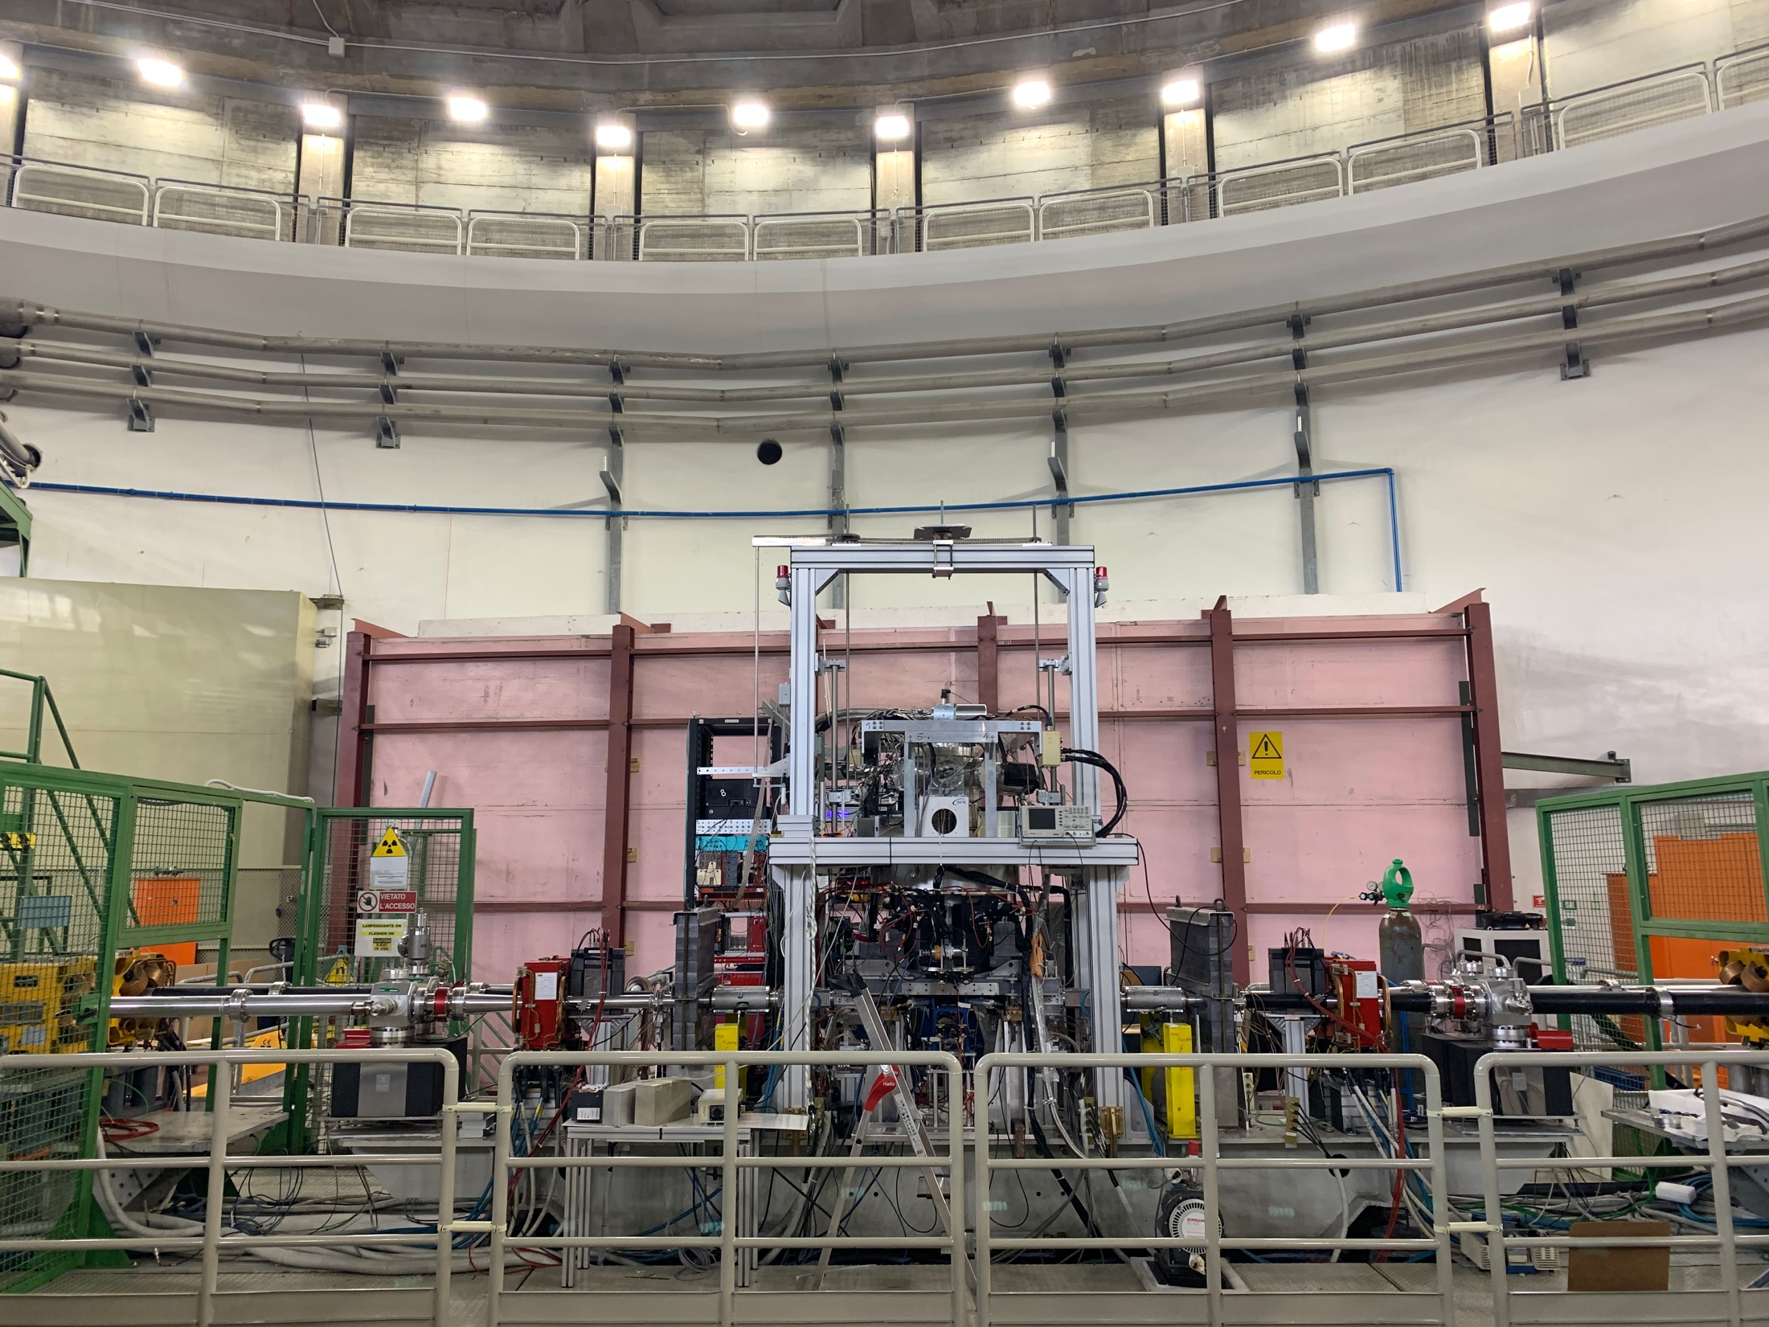
SIDDHARTA-2 status report
Francesco Sgaramella, INFN – LNF
on behalf of the SIDDHARTA-2 collaboration
62nd LNF Scientific Committee Meeting
November 8, 2021

Slide 2






SIDDHARTA-2 Collaboration
Silicon Drift Detectors for Hadronic Atom Research by Timing Application
LNF-INFN, Frascati, Italy
SMI-ÖAW, Vienna, Austria
Politecnico di Milano, Italy
IFIN –HH, Bucharest, Romania
TUM, Munich, Germany
RIKEN, Japan
Univ. Tokyo, Japan
Victoria Univ., Canada
Univ. Zagreb, Croatia
Univ. Jagiellonian Krakow, Poland
ELPH, Tohoku University
2

Slide 3
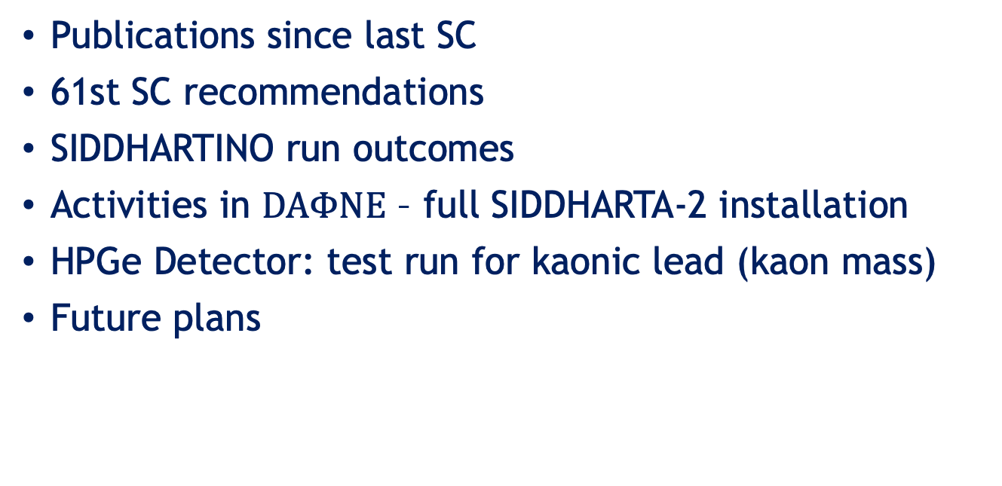
Contents
Publications since last SC
61st SC recommendations
SIDDHARTINO run outcomes
Activities in $DAΦNE$ – full SIDDHARTA-2 installation
HPGe Detector: test run for kaonic lead (kaon mass)
Future plans
3

Slide 4
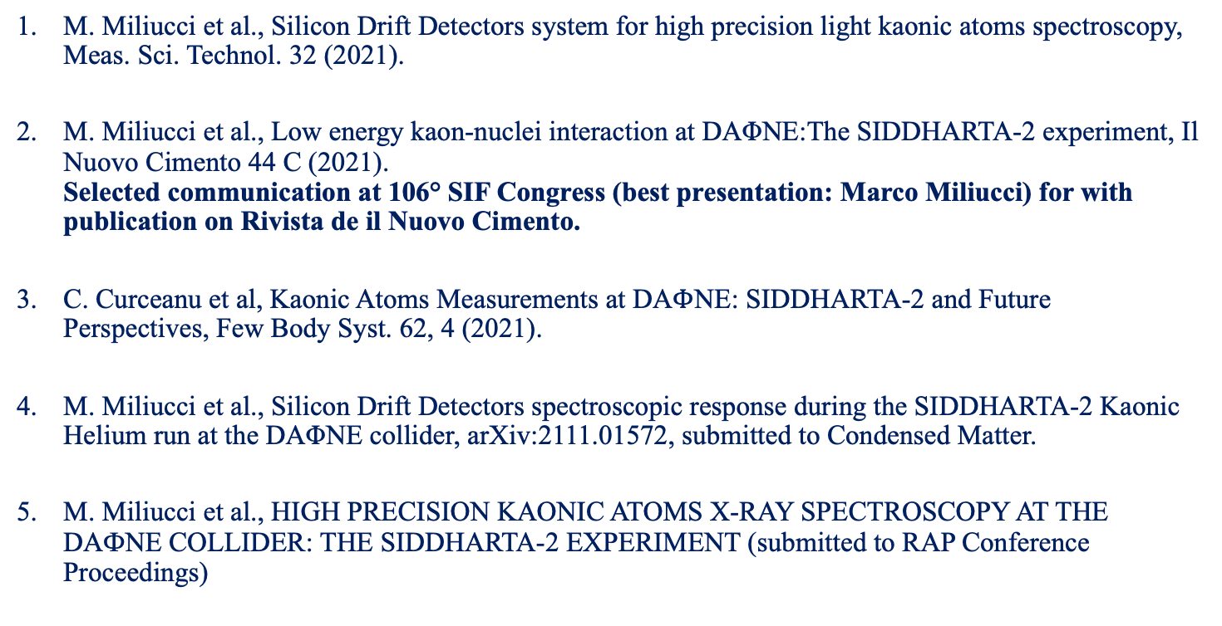
Publications since last SC
M. Miliucci et al., Silicon Drift Detectors system for high precision light kaonic atoms spectroscopy, Meas. Sci. Technol. 32 (2021).
M. Miliucci et al., Low energy kaon-nuclei interaction at DAΦNE:The SIDDHARTA-2 experiment, Il Nuovo Cimento 44 C (2021).
Selected communication at 106° SIF Congress (best presentation: Marco Miliucci) for with publication on Rivista de il Nuovo Cimento.
C. Curceanu et al, Kaonic Atoms Measurements at DA$Φ$NE: SIDDHARTA-2 and Future Perspectives, Few Body Syst. 62, 4 (2021).
M. Miliucci et al., Silicon Drift Detectors spectroscopic response during the SIDDHARTA-2 Kaonic Helium run at the DAΦNE collider, arXiv:2111.01572, submitted to Condensed Matter.
M. Miliucci et al., HIGH PRECISION KAONIC ATOMS X-RAY SPECTROSCOPY AT THE DAФNE COLLIDER: THE SIDDHARTA-2 EXPERIMENT (submitted to RAP Conference Proceedings)
4

Slide 5
Publications since last SC
A. Scordo et al, Efficiency measurements and simulations of a HAPG based Von Hamos spectrometer for large sources, J. Anal. At. Spectrom., 2021, JAAS, 2021, 36, 2485 – 2491,
doi: 10.1039/D1JA00214G.
A. Scordo et al, VOXES: a new HAPG mosaic crystal based Von Hamos spectrometer for millimetric sources, RAP conference proceedings, VOL. 6, PP. 1–5, 2021.
M. Miliucci et al., Silicon Drift Detectors Technology for High Precision Light Kaonic Atoms Spectroscopic Measurements at the DAΦNE Collider, in print on AIP-CP.
V. De Leo et al, Reflection efficiency and spectra resolutions ray-tracing simulations for the VOXES HAPG crystal based Von Hamos spectrometer, arXiv:2111.01572, submitted to Condensed Matter.
Kaonic Helium measure: shift and width, in preparation.
Yield kaonic helium in gas, in preparation.
5

Slide 6
61st LNF Scientific Committee Meeting
Recommendations SIDDHARTA
“Controlling the background is a critical aspect of this experiment and the committee would like to see the details of the interventions planned by SIDDHARTA/DAFNE for moving towards the aimed -for background level. The committee would appreciate getting this written feedback by the end of June.”
This was one of our main goals in the SIDDHARTINO run, up to its end (18 July) – report sent by LNF Director Report on the Dafne-Siddharta operation May-July 2021 together with a competitive measurement of kaonic helium
6

Slide 7
Project timeline – since last SciCom
Analysis of the SIDDHARTINO data.
Start SIDDHARTA-2 Installation
Installation of SDD, veto and electronics. Update of the DAQ….
SIDDHARTINO optimization run
2021, June
SIDDHARTINO K-⁴He run
2021, 24 June – 18 July
Start SIDDHARTA-2 installation: mechanics
2021, August
62nd LNF
SciCom
2021, November
SIDDHARTA-2
Installation
and tests
2021, September -October
61st LNF
SciCom
2021, May
Different combinations of the degrader
thickness
and different gas density
Ready for run
Software and hardware optimization
back. reduction

Slide 8
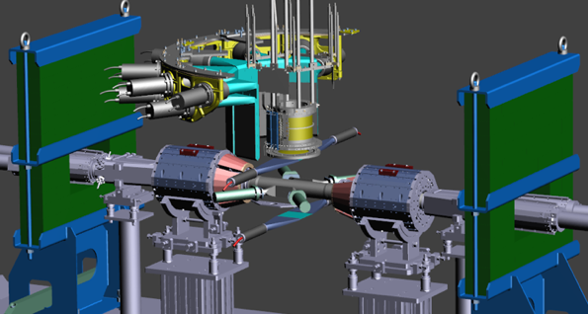
SIDDHARTINO run
Schematic representation of SIDDHARTINO setup
He cooling line
VETO-1
TARGET CELL
Pb LATERAL
SHIELD
VETO-2
8 SDDs arrays
K-TRIGGER
LUMINOMETER
1 Bus
8

Slide 9
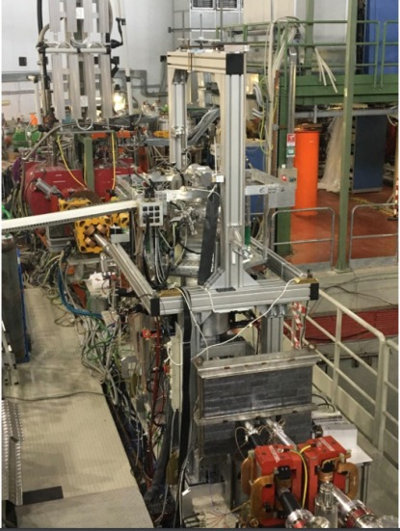
SIDDHARTINO setup (1/6 SDDs)
Phase 1 with SIDDHARTINO:
during the commissioning of DAΦNE:
optimization with the SIDDHARTINO setup
for the K-⁴He measurement
(with 8 SDD arrays)

Slide 10
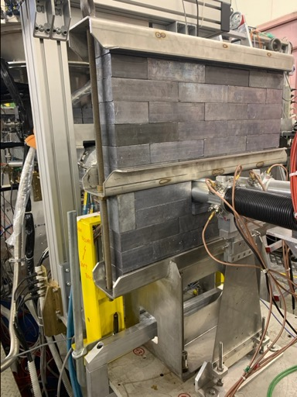
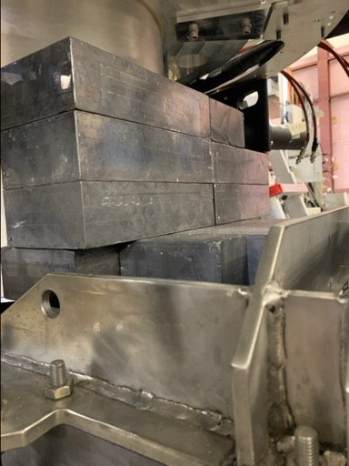
Back. reduction: reinforced shielding around the setup
Lead bricks around the vacuum chamber
Lead foil near the beam pipe
10

Slide 11
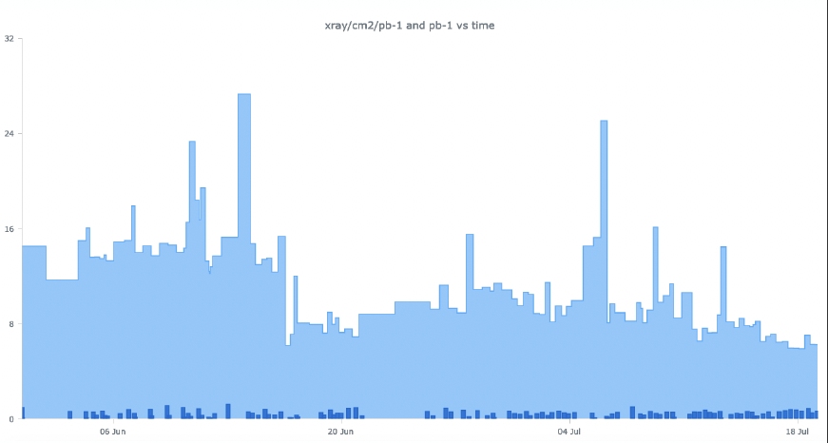
SIDDHARTINO - xray/cm2/pb⁻¹
reinforced shielding around the setup
Background lowered by a factor 2
15 xray/cm2/pb⁻¹
7 xray/cm2/pb⁻¹

Slide 12
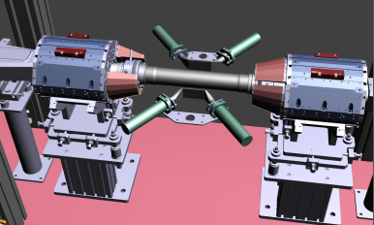
Luminosity measurement to monitor also background
Luminosity detector:
- SIDDHARTA-2 luminometer used for back: kaons/MIPS
- luminosity delivery
Back to plastic scintillators in coincidence with RF/4 signal

Slide 13
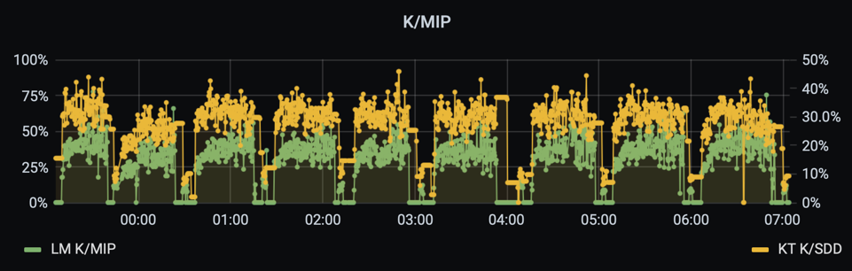
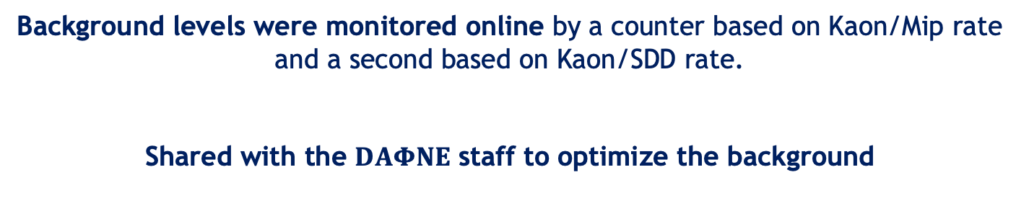
Background levels monitor
Background levels were monitored online by a counter based on Kaon/Mip rate and a second based on Kaon/SDD rate.
Shared with the $DAΦNE$ staff to optimize the background
13

Slide 14
SIDDHARTINO - xray/cm2/pb⁻¹
Optimization of xray/cm2/pb⁻¹ very visible!
6.2 xray/cm2/pb⁻¹
Factor nearly 3
OK for SIDDHARTA-2
15 xray/cm2/pb⁻¹

Slide 15
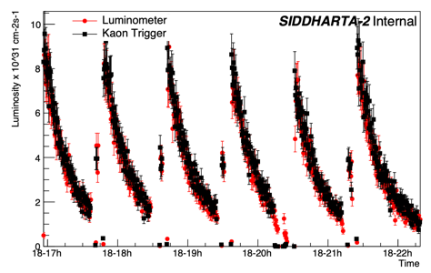
SIDDHARTINO data - Integrated Luminosity
Total integrated luminosity:
54 pb⁻¹
Optimization run:
24 pb⁻¹
Trigger, DAQ, SDD optimization
Kaonic ⁴He
run:
30 pb⁻¹
Degrader optimization, low and high ⁴He density measure
Kaon monitor and Luminometer measure at the end of SIDDHARTINO run

Slide 16
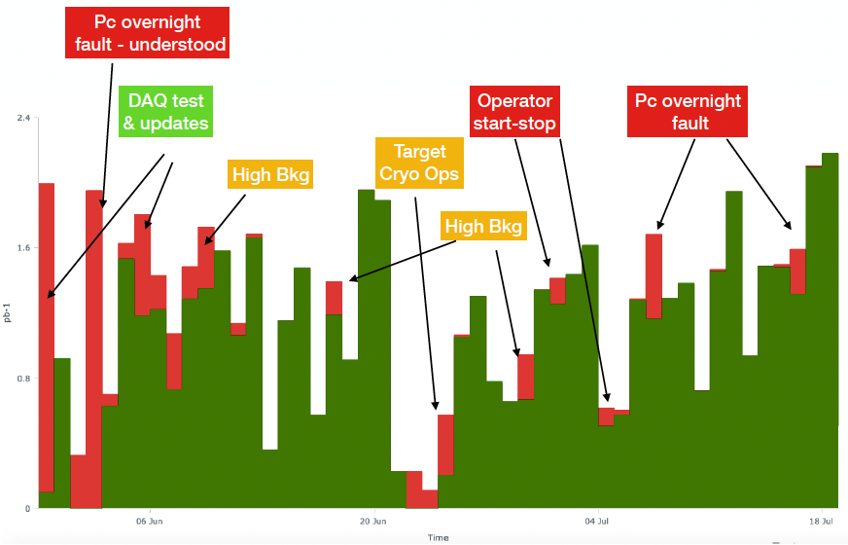
SIDDHARTINO - Integrated Luminosity
86% total efficiency
>95% for K⁴He good runs
86% total efficiency
Pc inefficiency
Total integrated luminosity
luminosity good for physics
Pc inefficiency
Optimization run
K-⁴He run

Slide 17
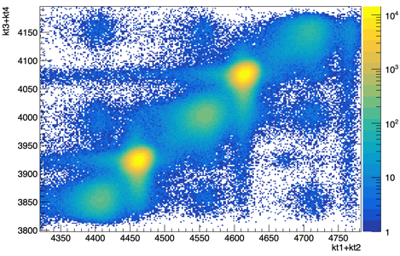
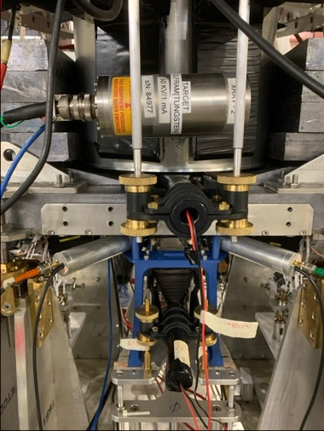
Trigger time window optimization
SIDDHARTINO – Optimization Run
Kaons
MIPS
Kaon monitor up
Kaon monitor down
17

Slide 18
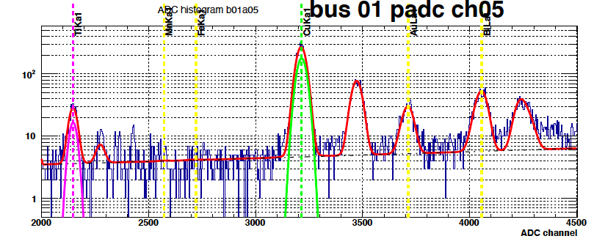
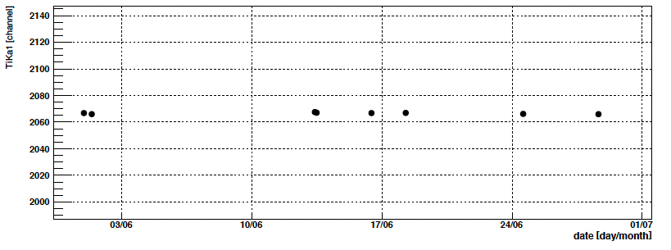
SDD calibration and energy response
SIDDHARTINO – Optimization Run
SDD calibration run
SDD Stability

Slide 19
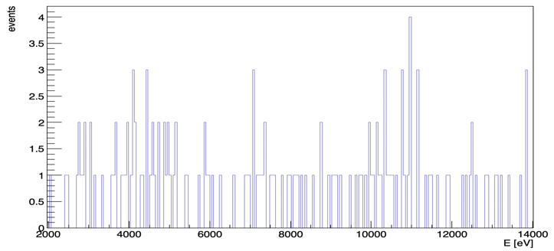

Trigger rejection factor
Sum of all SDDs after individual calibration
Events no trigger (5-10 keV) = 11256611
Triggered rejection factor
$$4.6∗{10}^{−6}$$
Sum of all SDDs after
trigger cut
Events with trigger (5-10 keV) = 52
19

Slide 20
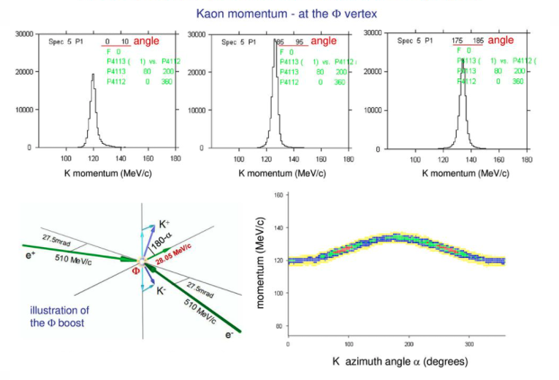
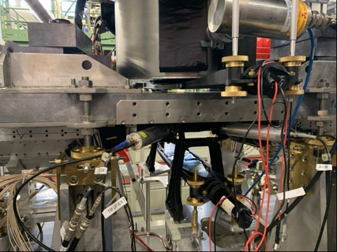
Degrader Optimization
the degrader is composed of mylar foil (micron) and is placed below the kaon monitor up
Kaon monitor up
Degrader thickness optimization is fundamental to maximize the number of stopped kaons in the target
Kaon monitor down
20

Slide 21
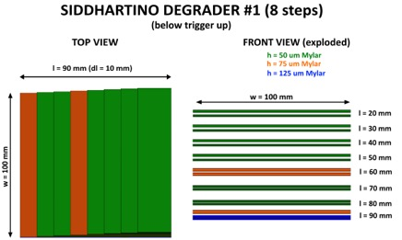


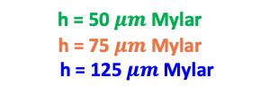
Degrader-1: middle thickness $550 μm$
SIDDHARTINO DEGRADER #1 ( $8 step$ )
h = 50 $μm$ Mylar
h = 75 $μm$Mylar
h = 125 $μm$Mylar
Luminosity integrated = 6.758 pb⁻¹
$K$⁴${He}_{ 3→2}$
(6.4 keV)
Anti Boost
side
Boost side
Degrader
1.67 K-⁴He xrays/cm²/pb⁻¹
21

Slide 22
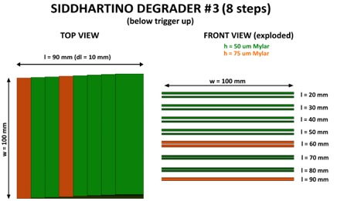



Degrader-2: middle thickness $425 μm$
SIDDHARTINO DEGRADER #2 ( $8 step−125 μm$)
h = 50 $μm$ Mylar
h = 75 $μm$Mylar
Luminosity integrated = 4.577 pb⁻¹
$K$⁴${He}_{ 3→2}$
(6.4 keV)
Anti Boost
side
Boost side
Degrader
1.64 K-⁴He xrays/cm²/pb⁻¹
22

Slide 23


Degrader-3: middle thickness $350 μm$
SIDDHARTINO DEGRADER #3 ( $8 step−125 μm −75 μm$ )
h = 50 $μm$ Mylar
h = 75 $μm$Mylar
Luminosity integrated = 5.219 pb⁻¹
$K$⁴${He}_{ 3→2}$
(6.4 keV)
Anti Boost
side
Boost side
1.3 K-⁴He xrays/cm²/pb⁻¹
Degrader
23

Slide 24


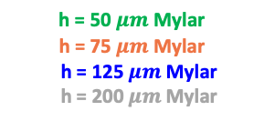
Degrader-4: middle thickness $750 μm$
SIDDHARTINO DEGRADER #4 ( $8 step+200 μm$ )
h = 50 $μm$ Mylar
h = 75 $μm$Mylar
h = 125 $μm$Mylar
h = 200 $μm$Mylar
h = 200 um Mylar
Luminosity integrated = 4.753 pb⁻¹
0.4 K-⁴He xrays/cm²/pb⁻¹
Anti Boost
side
Boost side
Degrader
$K$⁴${He}_{ 3→2}$
(6.4 keV)
24

Slide 25
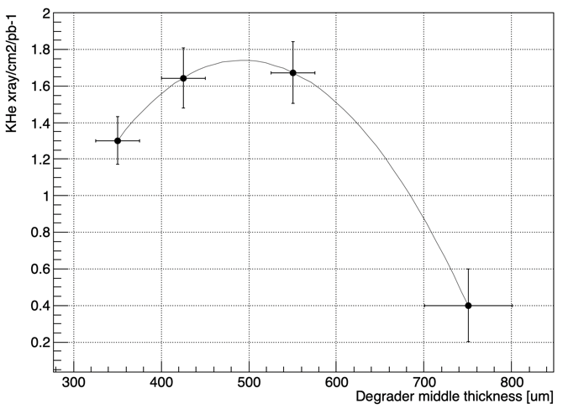




Degrader Curve
Deg-2 $425 μm$
Deg-1 $550 μm$
Deg-3 $350 μm$
Deg-4 $750 μm$
25

Slide 26


K-⁴He low density run: 0.75% liquid helium density -> yields at lowest measured density analyses undergoing -> paper
SIDDHARTINO - K-⁴He run
$K$⁴${He}_{ 3→2}$
$$E_{KHe 3→2}\left(eV\right)=6467.68±6.35 \left(stat\right)$$
0.7 K-⁴He xrays/cm²/pb⁻¹
preliminary
Luminosity integrated = 9.496 pb⁻¹
26

Slide 27
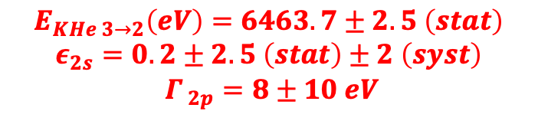
K-⁴He shift and width: the most precise measurement in gas!
SIDDHARTINO - K-⁴He run
$$E_{KHe 3→2}\left(eV\right)=6463.7±2.5 \left(stat\right)$$
$$ε_{2s}=0.2±2.5 \left(stat\right)±2 \left(syst\right)$$
$$Γ_{ 2p}=8±10 eV$$
KHe32
preliminary
Paper in preparation
KHe52
KHe42
Luminosity integrated = 26.05 pb⁻¹
27

Slide 28
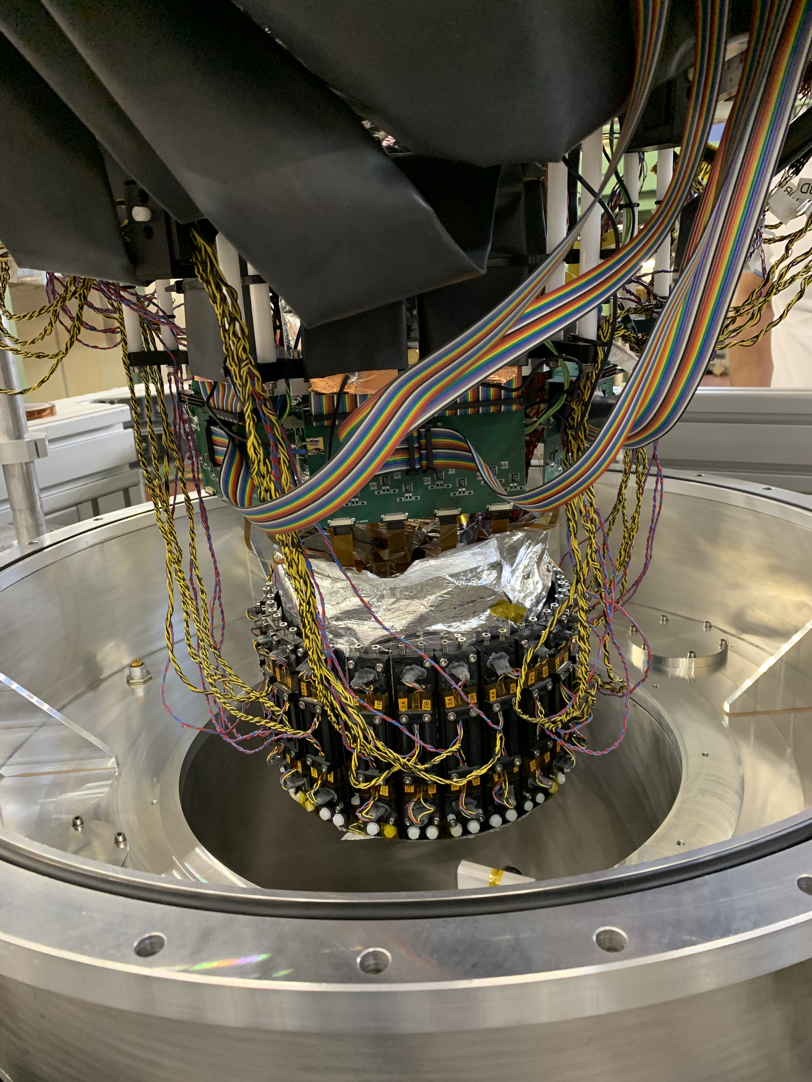

Report on main activities in $DAΦNE$ towards SIDDHARTA-2
SDD detectors installation
Veto-2 installation
Front-end electronic installation
Veto-1 installation
28

Slide 29
SDD installation
calibration target
SDD installed around the target
Kapton wall

Slide 30
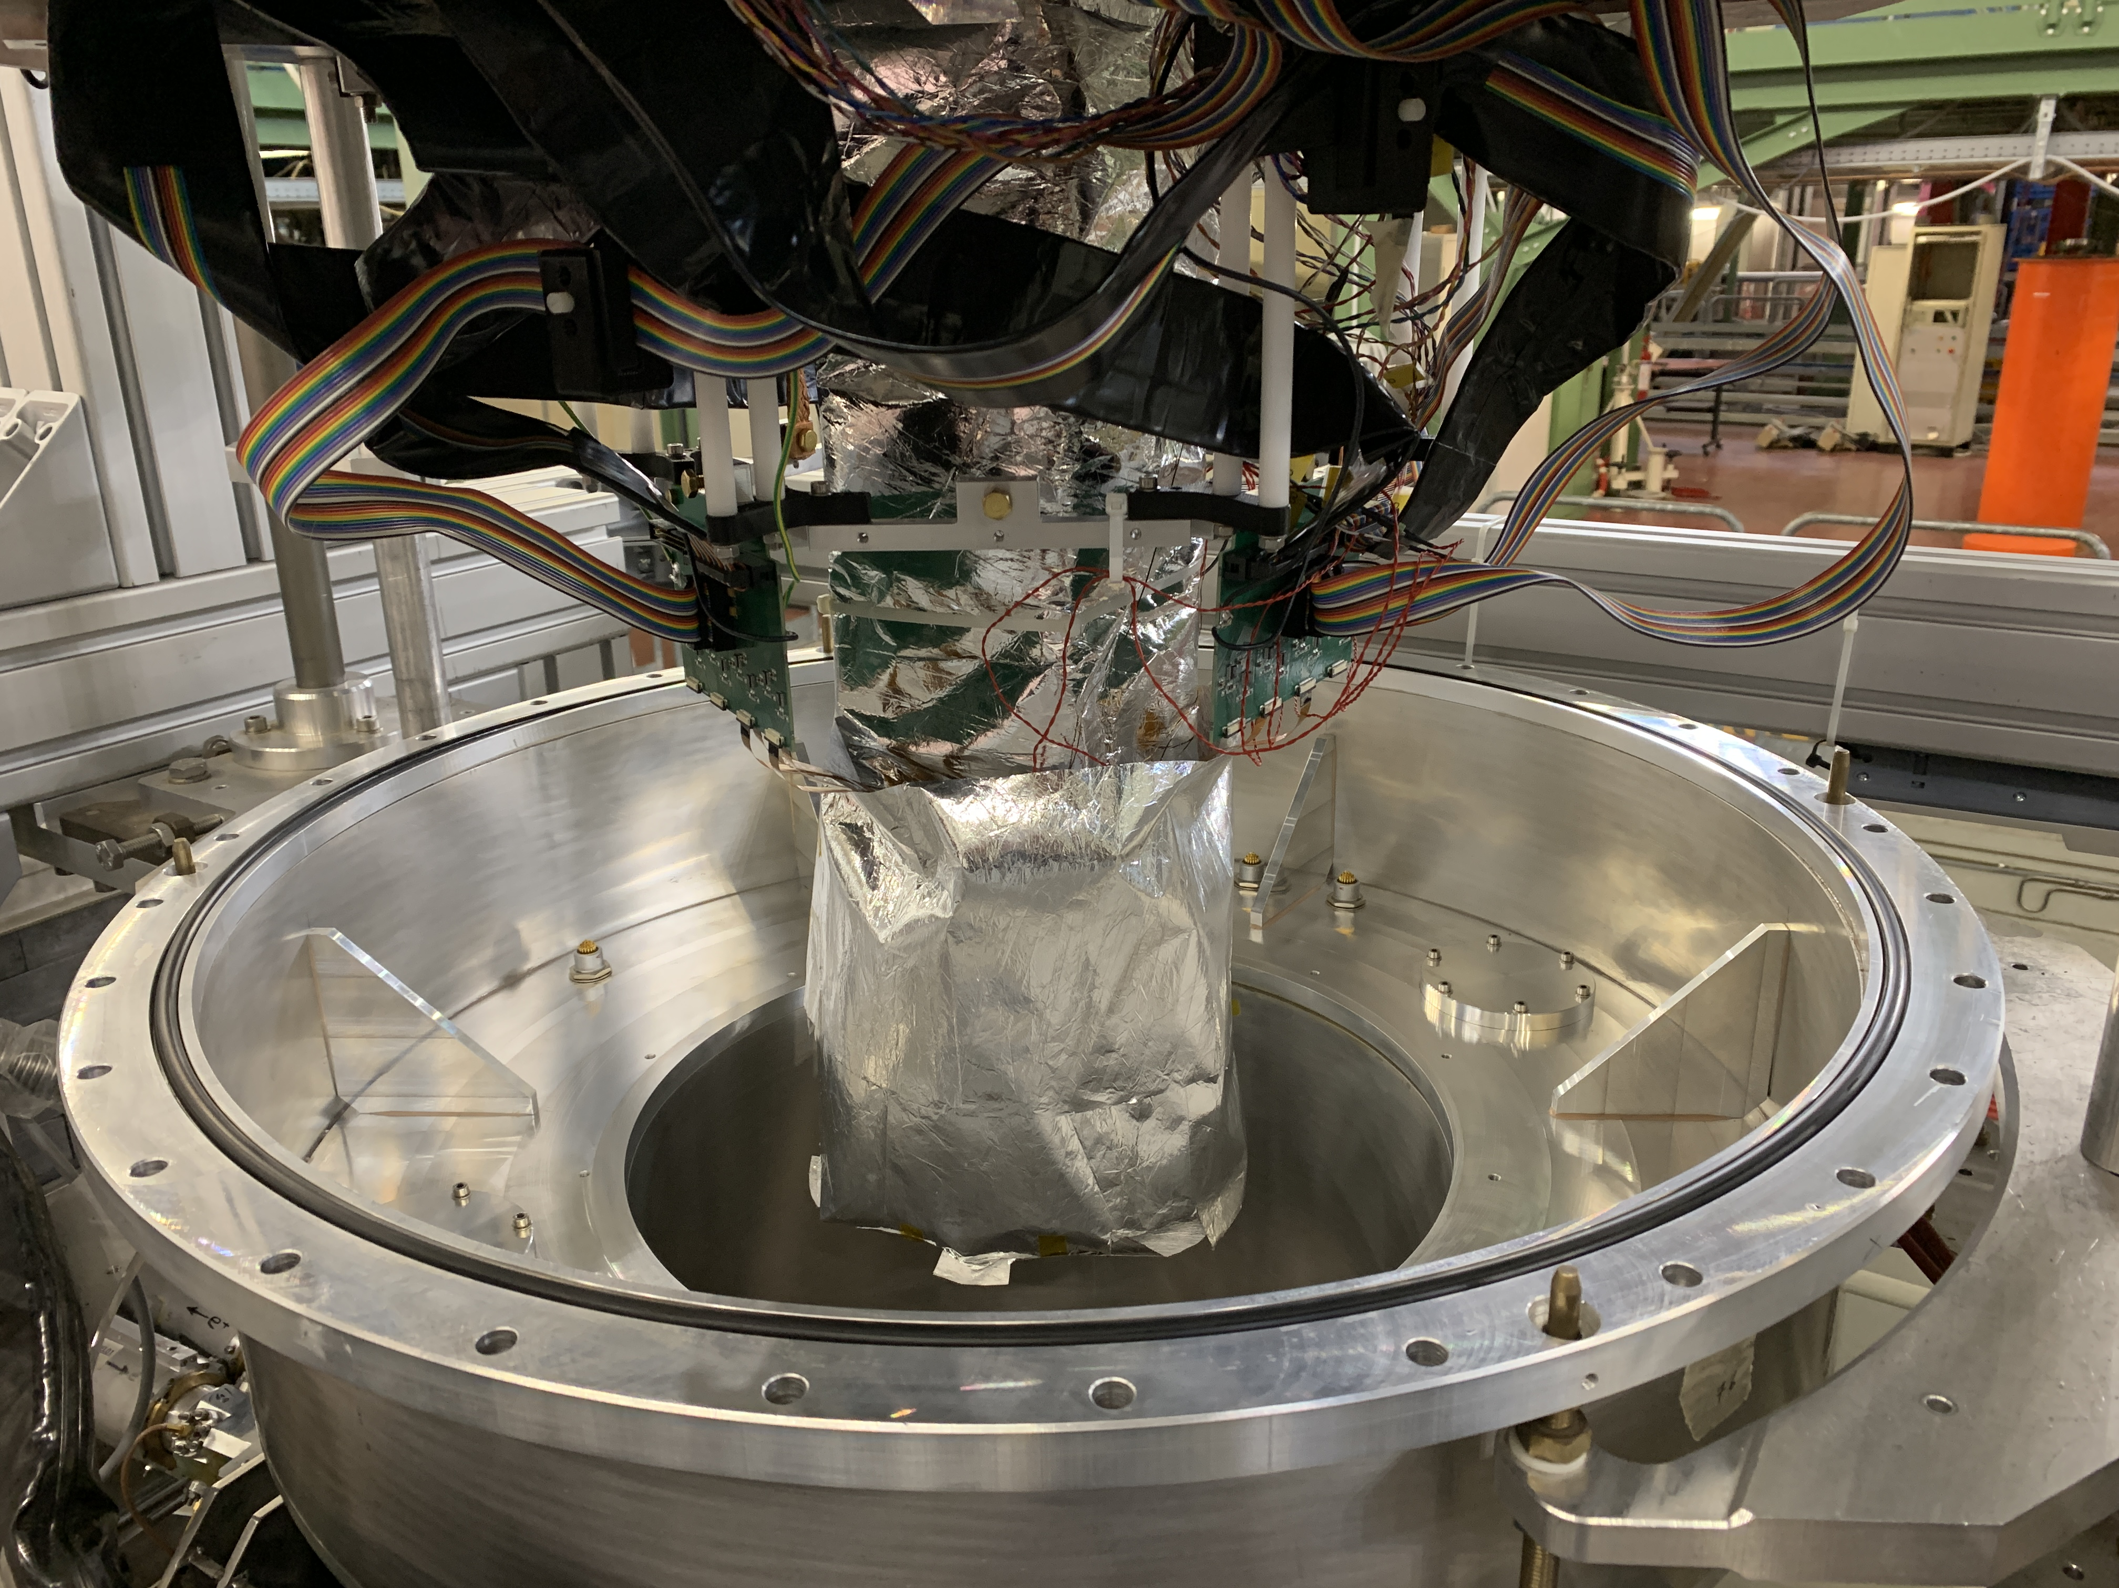
SDD installation
Wrap for thermal isolation
30

Slide 31
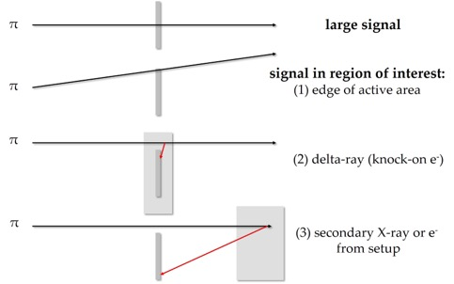
Veto-2 installation
Working principle of veto-2 system
31

Slide 32
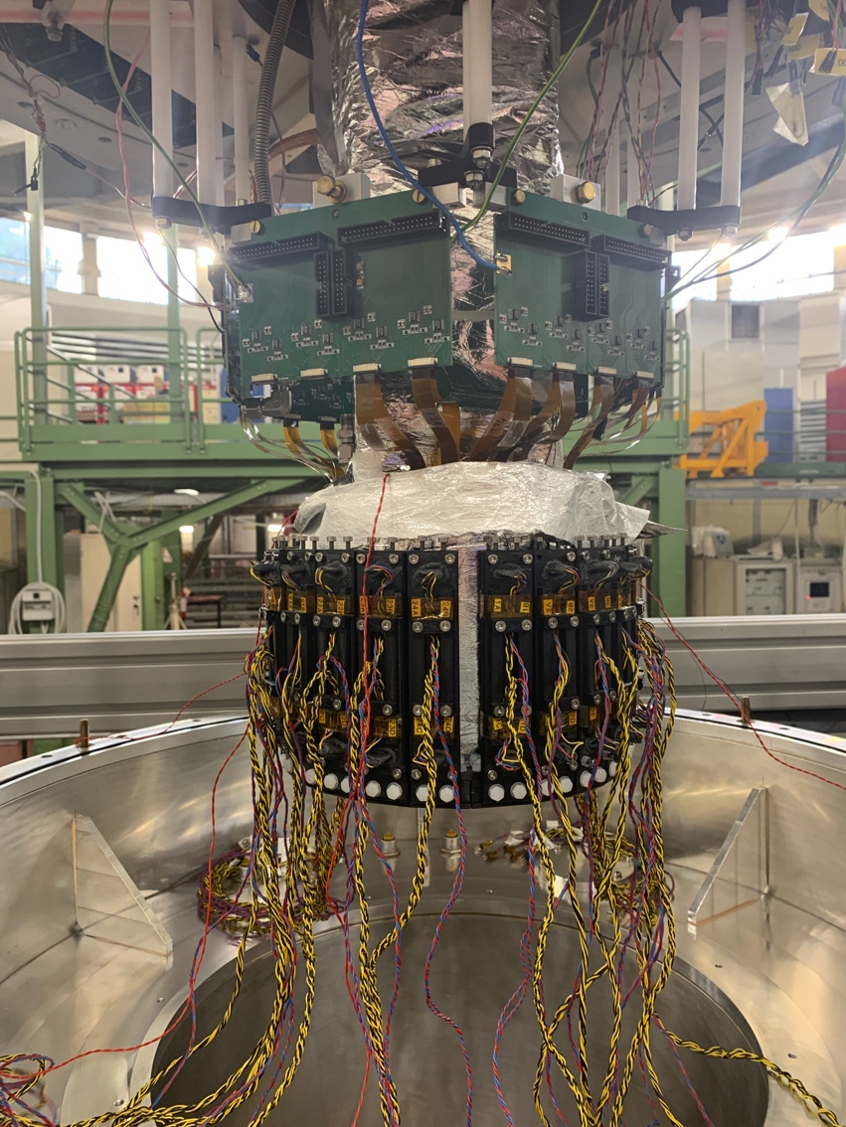
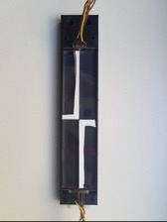
Veto-2 installation
The installation of veto 2 has been completed and the correct operation of each unit has been verified
Each veto-2 unit is equipped with an LED that will allow to calibrate and verify the correct functioning of the system with and without beams
Veto-2 Calibration spectrum
Veto-2 single unit
32

Slide 33
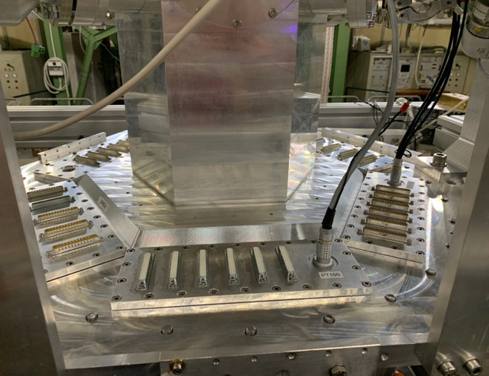
Front-end electronics installation
Veto2
connectors
SDD power supply connector
SIDDHARTA-2 setup before the installation of electronic components
SDD Front-end connector
33

Slide 34
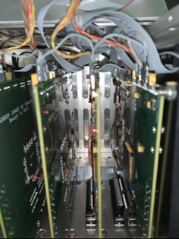
Front-end electronics installation
Electronic Box
SDD Front-end electronics
Veto-2
Front-end electronics
34

Slide 35
Front-end electronics installation
SDD Front-end electronics
SDD power supply
Veto2
electronics
35

Slide 36
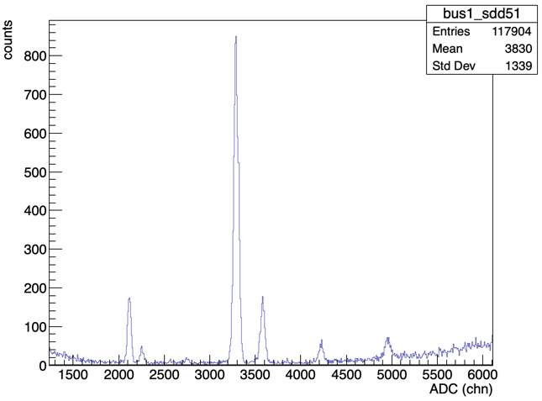






SDD calibration spectrum acquired with SIDDHARTA-2
CuK$α$
Preliminary calibration
29/10/2021
TiK$α$
CuK$β$
TiK$β$
BiL$α$
BiL$β$
36

Slide 37
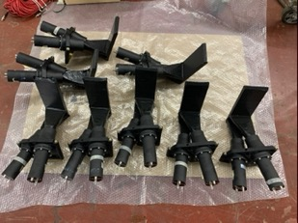
Veto-1 system installation
Veto-1: single unit
Drawing of the veto-1 elements placed around the vacuum
chamber
Veto1: 12 single units
Working principle of veto-1 system
M. Bazzi et al, 2013 JINST 8 T11003
37

Slide 38
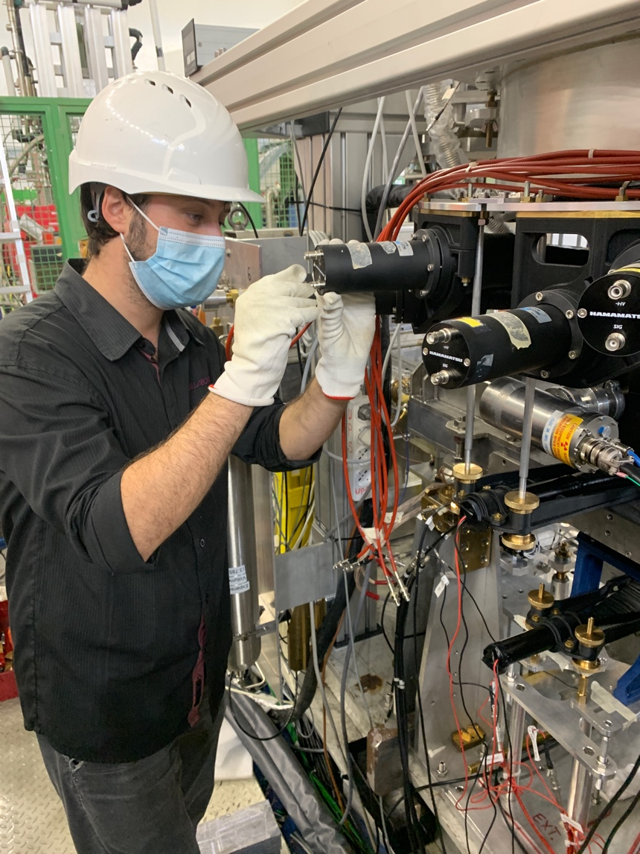
Veto-1 system installation
Veto-1 system installed around the vacuum chamber
38

Slide 39
SIDDHARTA-2 setup
Ready for Run
39

Slide 40
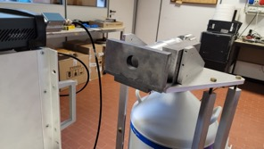
HPGe - feasibility test for the kaonic lead measurement
HPGe detector available,
Funded by University of Zagreb
Croatian Science Foundation project 8570
The HPGe has been transported to LNF from Zagreb
Completed the installation of the support structure and the lead shielding
Lead shielding
support structure
40

Slide 41
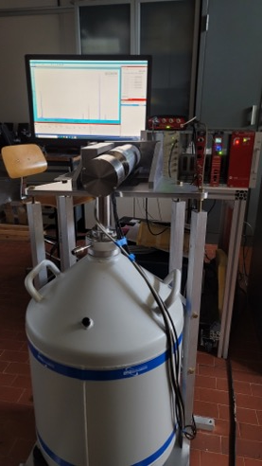
HPGe - feasibility test for the kaonic lead measurement
Test with ¹³³Ba
performed at LNF
41

Slide 42

HPGe - feasibility test for the kaonic lead measure
Test with ¹³³Ba
performed at LNF
Resolution about 1.3 keV $@$303 keV
Test: ¹³³Ba
resolution 1.3 kev at 300 keV
42

Slide 43
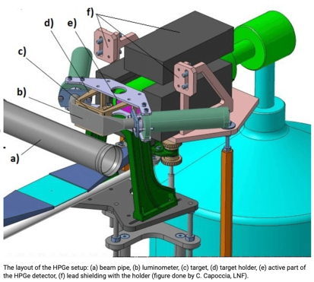
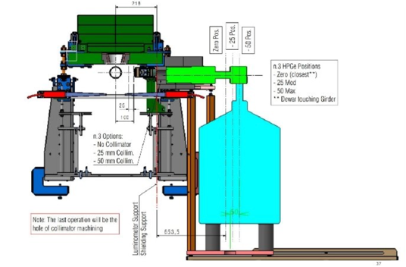

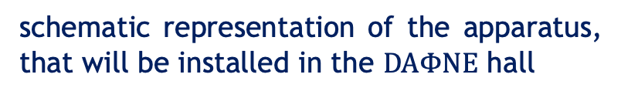
HPGe - feasibility test for the kaonic lead measurement
schematic representation of the apparatus, that will be installed in the $DAΦNE$ hall
HPGe detector ready to be install in the $DAΦNE$ hall
43

Slide 44
Project timeline – future
SIDDHARTA-2 Kd run: run 1 (300 pb⁻¹) run 2 (500 pb⁻¹) with optimized components
Installation of SIDDHARTA-2
setup
2021, September - October
Start Run
SIDDHARTA-2
and
HPGe parasitic test
2021, November
Continue the run
SIDDHARTA-2
Kd
HPGe
2022, from January
through all 2022
$DAΦNE$ shutdown for winter holiday
2021, December
𝐃𝐀𝚽𝐍𝐄 shutdown for winter holiday
2021, December
Start of the data taking with ⁴He
to check run condition with respect to SIDDHARTINO run
44

Slide 45

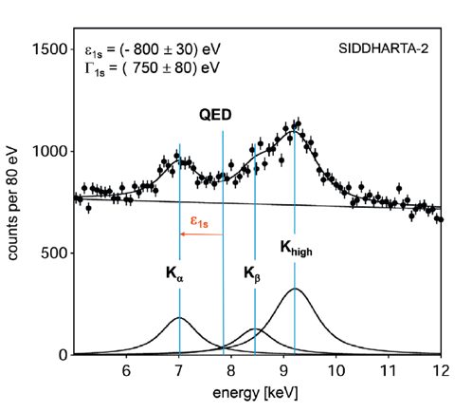
SIDDHARTA-2 K-d measurement
achievable precision
Kaonic deuterium run in (all) 2022
Monte Carlo for an integrated luminosity
of 800 pb⁻¹
to perform the first measurement of the strong interaction induced energy shift and width of the kaonic deuterium ground state
(similar precision as K-p) !
Significant impact in the theory of strong interaction with strangeness

Slide 46
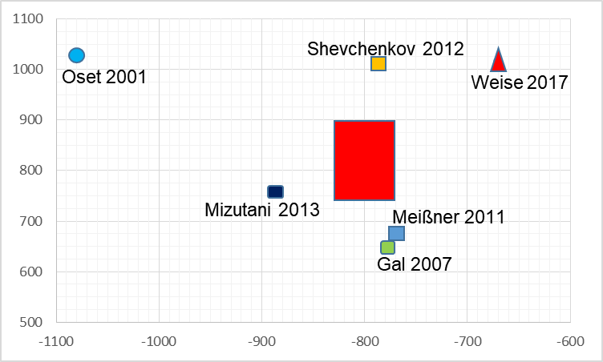
SIDDHARTA-2 kaonic deuterium at $DAΦNE$
width [eV]
shift [eV]

Slide 47
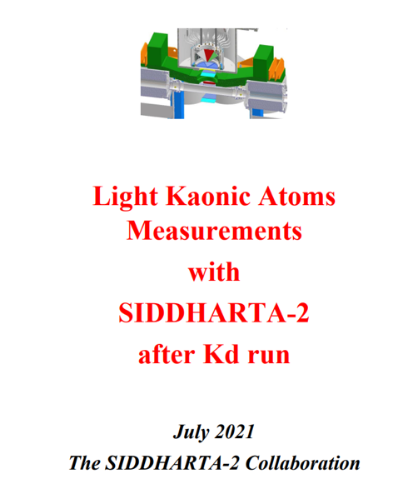
We anticipate the request for an extension of run with same setup
with solid targets
https://www.lnf.infn.it/esperimenti/siddharta/Kaonic-atoms-post-Kd-SIDDHARTA_final.pdf

Slide 48
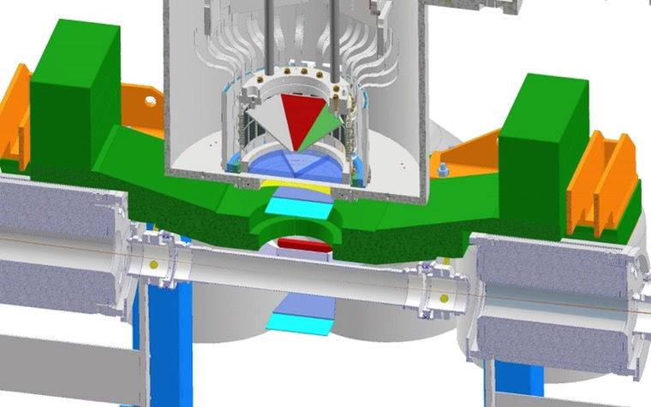
Use of present SDDs: Solid target system for light kaonic atoms: e.g. Li – Be - B financed by INFN Nuclear physics (gr 3) as first step towards Future (see Curceanu talk)
Li
Be
B

Slide 49
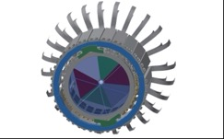
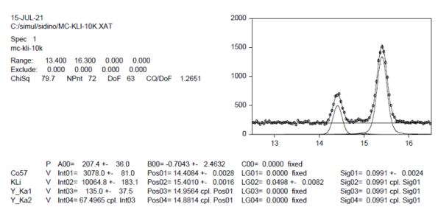
Solid target system for light kaonic atoms: e.g. Li – Be – B
kaonic Li-transitions
3-2 ~15 keV
4-2 ~21 keV
5-2 ~23 keV
4-3 ~ 5 keV
5-3 ~ 8 keV
6-3 ~ 9 keV
5-4 ~2.5 keV
6-4 ~ 4 keV
KLi
⁵⁷Co
The energy spectra of light kaonic atom transitions for Li, Be and B targets below 17 keV can achieve a precision below 2-3 eV, for an integrated luminosity of about 150 pb⁻¹ (including calibrations and test).
We anticipate the request of this additional run post-SIDDHARTA-2

Slide 50
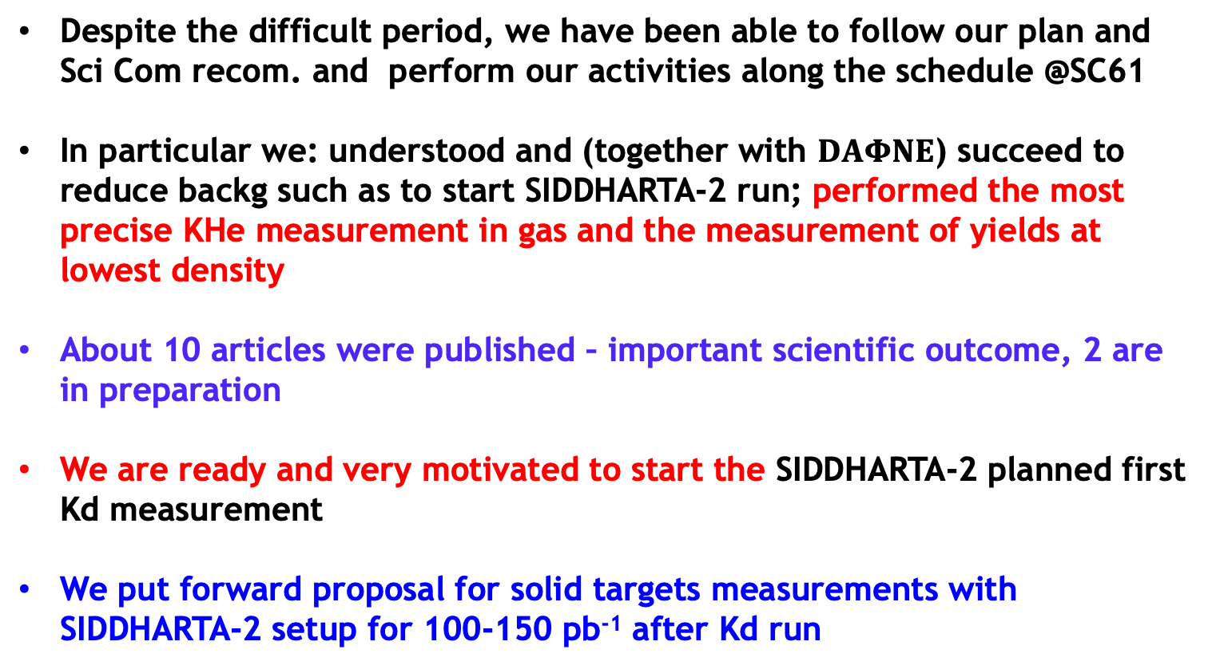
Conclusions
Despite the difficult period, we have been able to follow our plan and Sci Com recom. and perform our activities along the schedule @SC61
In particular we: understood and (together with $DAΦNE$) succeed to reduce backg such as to start SIDDHARTA-2 run; performed the most precise KHe measurement in gas and the measurement of yields at lowest density
About 10 articles were published – important scientific outcome, 2 are in preparation
We are ready and very motivated to start the SIDDHARTA-2 planned first Kd measurement
We put forward proposal for solid targets measurements with SIDDHARTA-2 setup for 100-150 pb⁻¹ after Kd run

Slide 51
Luca de Paolis Ph.D. in physics
eccellente qualità con lode
September 2021

Slide 52
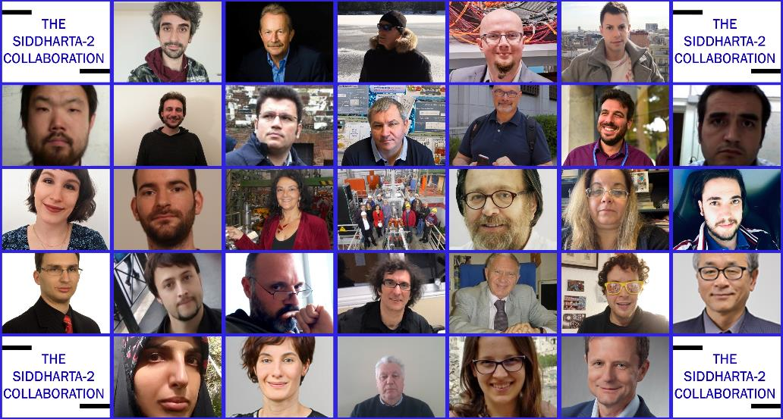
Part of the SIDDHARTA-2 collaboration
Thank you!

Slide 53


Special thanks to the accelerator, research and technical divisions,
and in particular to
the DA$Φ$NE staff and
to the LNF Director

Slide 55
SPARE

Slide 58


Laboratory activity
Discovered a correlation between rise time and drift time for the x-ray
X-ray
$$drift time [ns]$$
New technique to distinguish x-rays from MIP
MIPs
we are studying the feasibility of applying this technique to the SIDDHARTA-2 experiment
$$rise time [ns]$$
M. Iliescu et al, IEEE VOL. 70, 2021. DOI 10.1109/TIM.2021.3068149

Slide 59
Laboratory activity

