Slide 1
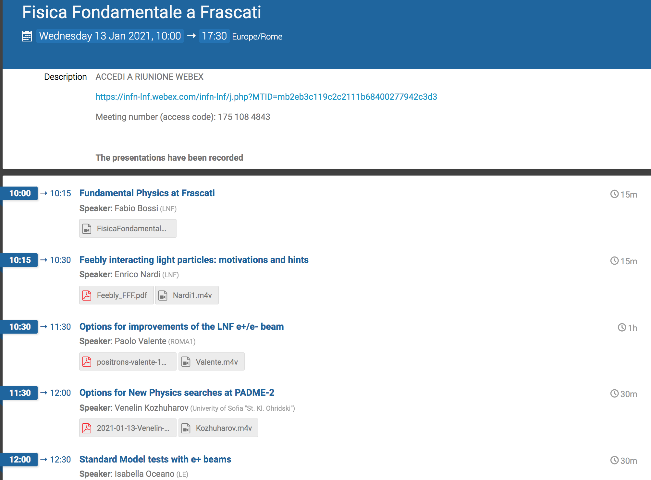
FFF Referee questions
Mauro Raggi and P. Valente, Sapienza Università di Roma e INFN Roma

Slide 2
The questions
In terms of parameter space to be covered, the SC remarks that there is a strong competition elsewhere. Please comment on the issue.
Expert in the SC remark that slow/resonant extraction from an electron storage ring is known to be feasible, yet the question remains if it can be done efficiently at DAFNE. Dedicated tests might be needed to address this question. Please comment.
The background studies for the searches of dark photons/feebly interacting particles should be considerably substantiated, in order to arrive at much firmer conclusions regarding their potential reach. Please comment.

Slide 3
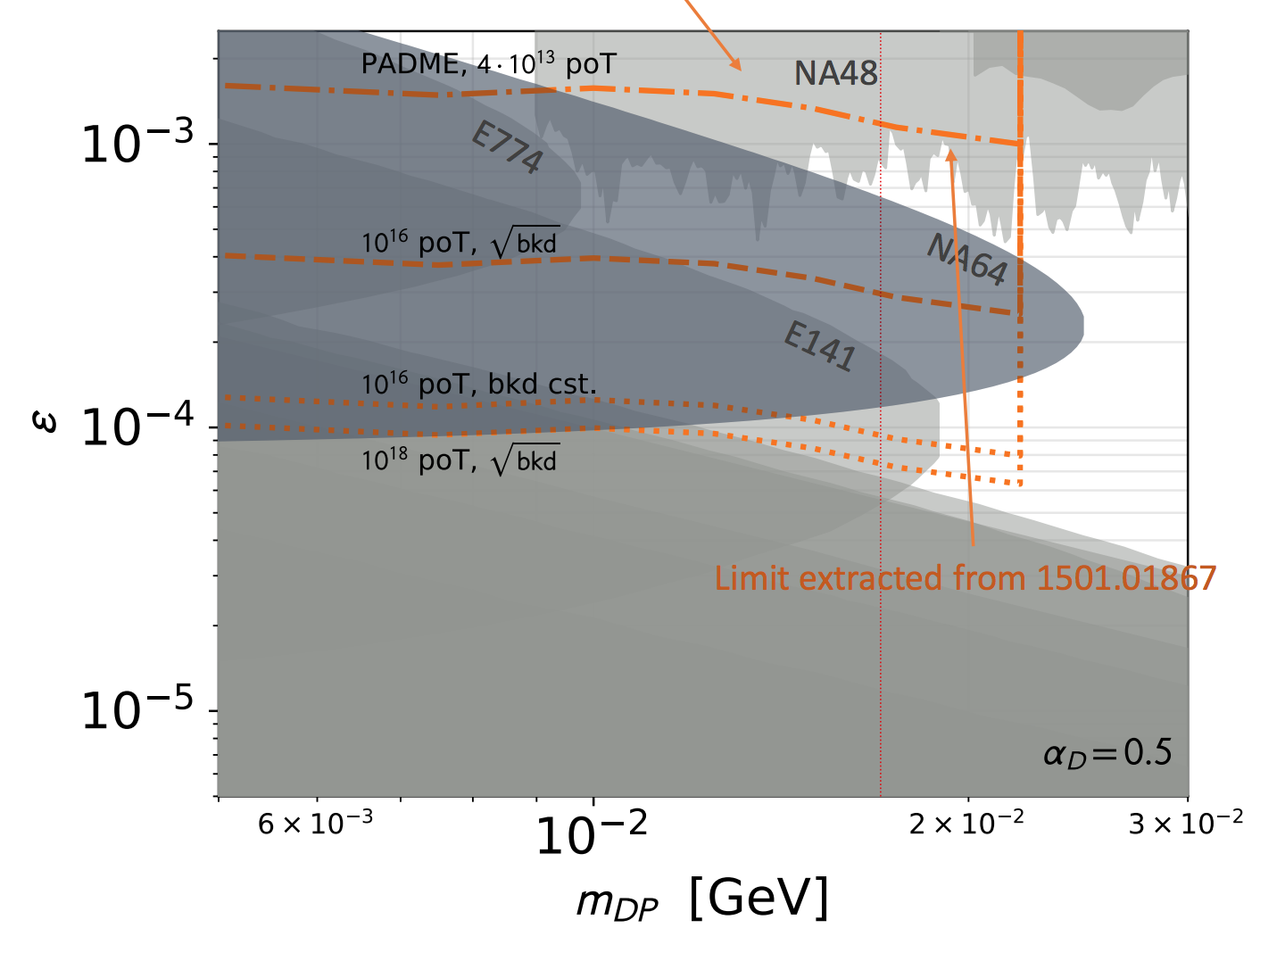
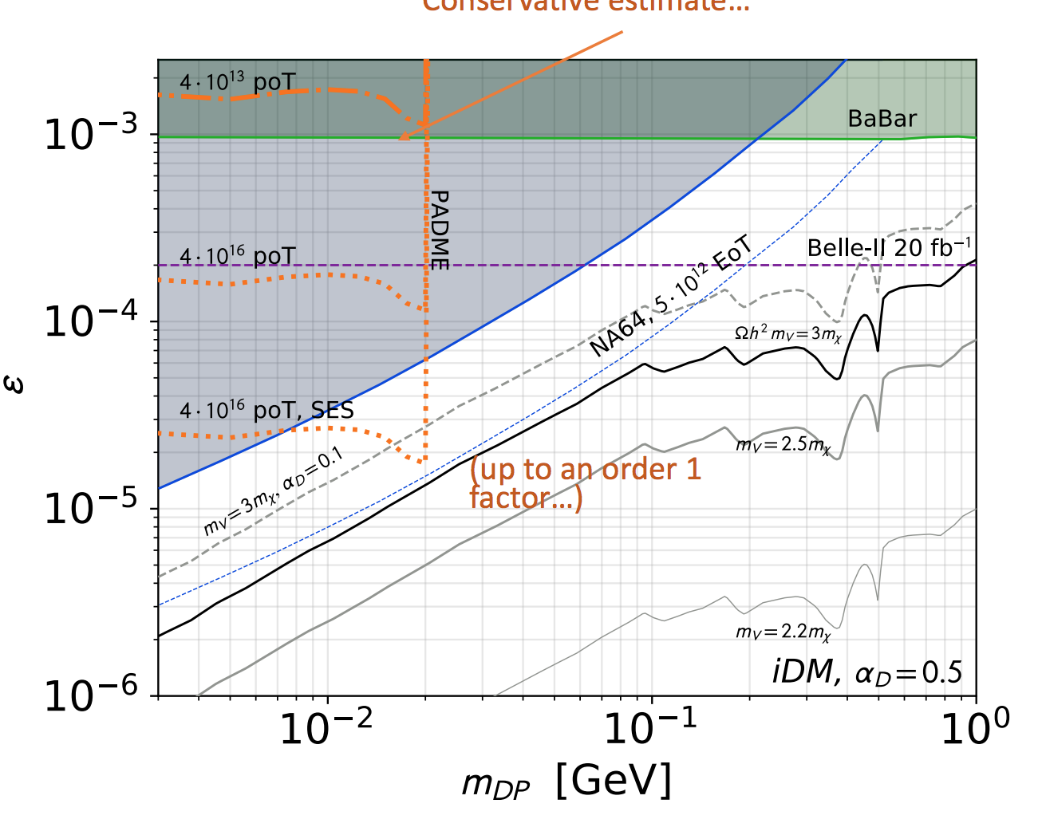
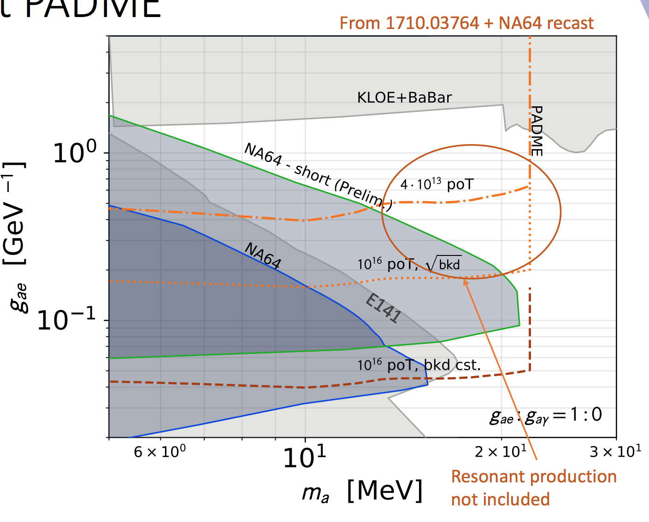
L. Darme’ FFF Jan 2021 status
https://agenda.infn.it/event/25299/contributions/127685/attachments/78132/100857/ProspectsLNF2.pdf
Visible decays
Invisible decays
A’
A’
Best opportunities for the future in visible decays.
Lifetime limits NA64 exclusion power for visible decays.
In ALPs scenario best results in g_{ae} ALPs electron coupling.
Visible decays
ALPs
ALPs

Slide 4
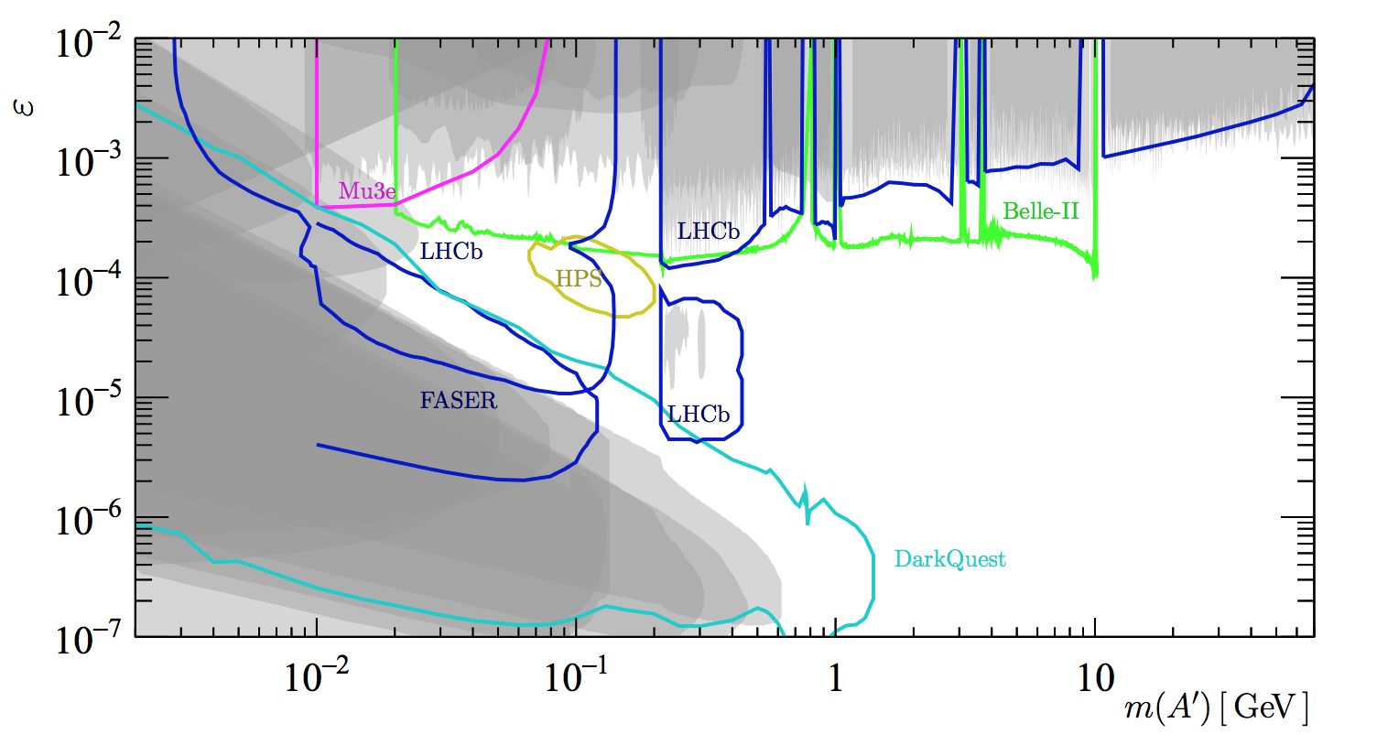
Parameter space A’ visible next 5Y
Region of low masses <20 MeV dominated by NA48/2 and g-2.
Both are model dependent bounds
NA48/2 is using protons
g-2_{e} can be cancelled in more complex dark sectors
conflicting experimental results currently differing at more than 3σ and of opposite sign
arXiv:2104.10280
Main competitors Mu3e and LHCb.
LHCb “Both search strategies rely on the planned upgrade to a triggerless-readout system at LHCb in Run 3” (2015). PhysRevD.92.115017 (meson decays)
Mu3e phase I only will be in next 5 years

Slide 5
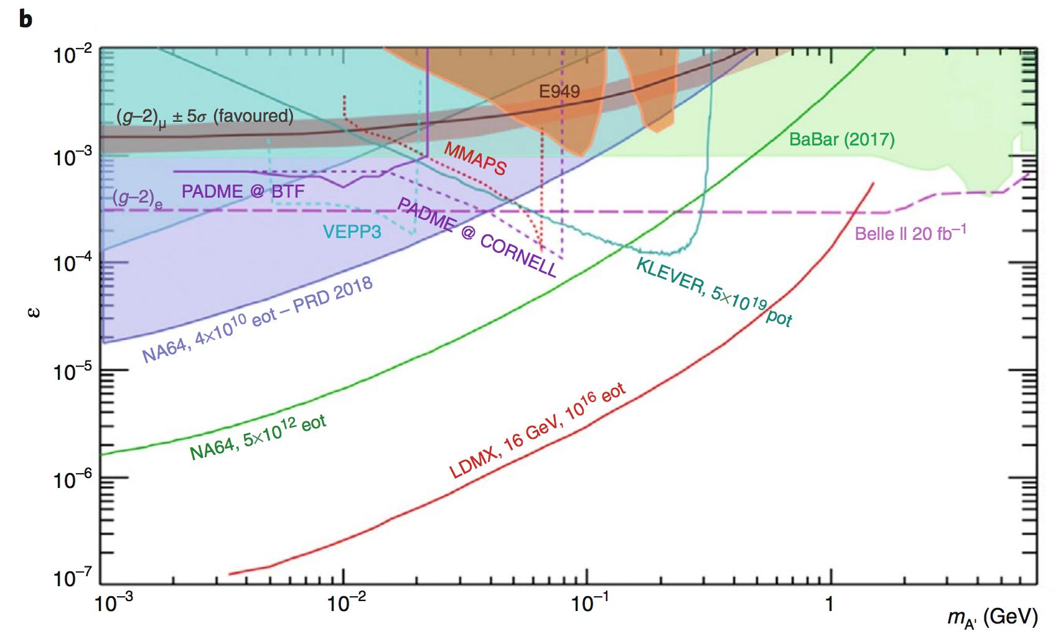
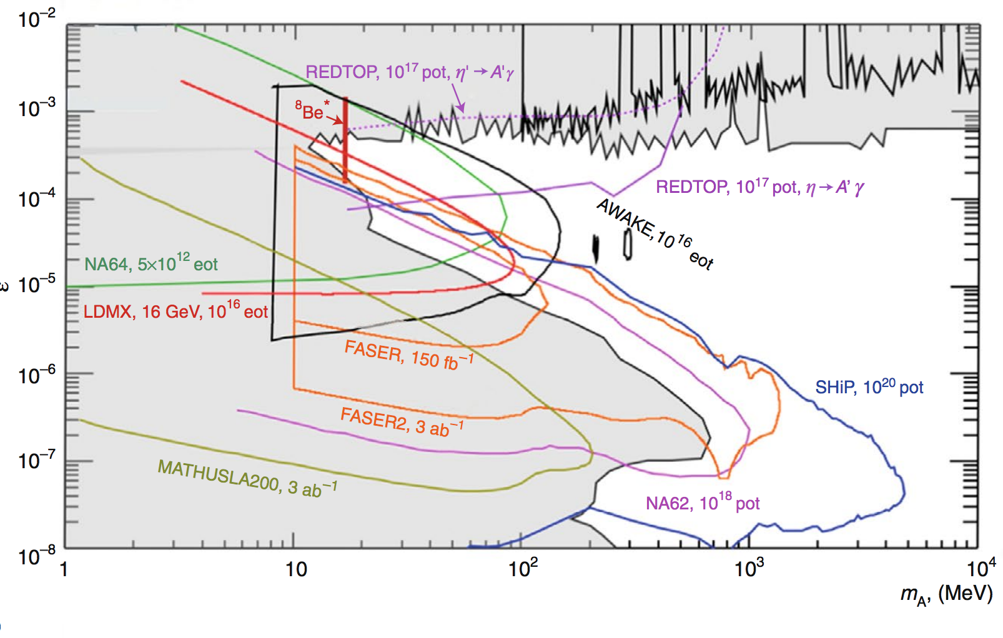
parameter space invisible-visible A’ long term
Invisible
Visible
CERN PBC Nature: https://www.nature.com/articles/s41567-020-0838-4.pdf
Invisible:
Only NA64 and possibly Belle II will have results in the next 5 years
NA64 limits extrapolated to 0 BG with another 2 orders of magnitude increase in statistics! Visible:
Only NA64 may have results in the next 5 years in PADME region
NA64 limits extrapolated to 0 BG. Current mass limit 20 MeV

Slide 6
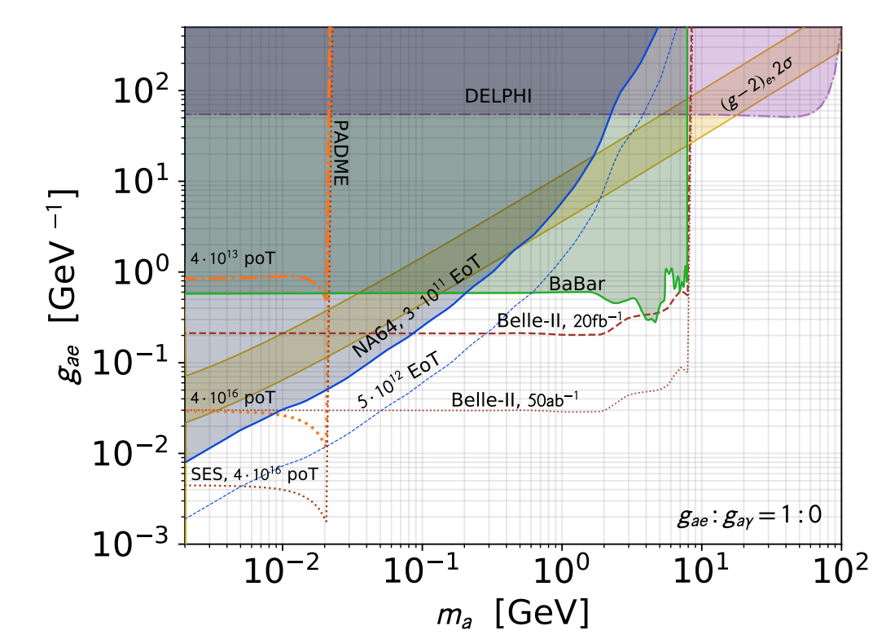
ALPs visible and invisible
Nardi Darme et al. JHEP06(2021)009
Invisible:
Dominated by NA64 and possibly Belle II will have results in the next 5 years
NA64 limits extrapolated to 0 BG with another order of magnitude increase in statistics Visible:
Most of the experiments in the plot are not yet approved
missing NA64 in the projection see previous slides.

Slide 7
Question II
The POSEYDON first idea (S. Guiducci, P. Valente) was assuming a pure 1/3rd of integer resonance-driven extraction from the positron main ring. Crystal-assisted extraction was already mentioned as a possibility in 2017 proposal.
Deeper studies have been performed in the last two years, in the context of the SHERPA grant (M. Garattini, O. Blanco, S. Guiducci, P. Valente) with two significant new elements (https://arxiv.org/abs/2110.02816):
The deflection in a thin crystal is used as a first non-local kick, replacing the electrostatic septum of the “classical” scheme
The idea of using the smaller and simpler accumulator ring has been studied with some detail
The simulations are quite advanced but mainly on the beam dynamics. What is still missing or ongoing:
1) Detailed simulations of coherent processes in the crystal
2) Integration of the crystal effect with the tracking of particles in the ring
Concerning the crystal and its mechanical system, the realization of the first holder+crystal is fairly advanced. To be done:
3) Assemble and bend the crystal inside its dynamic holder, mount it on the existing goniometer
4) Assemble the detectors and the vacuum pipes for measuring the particle deflection
5) Perform the beam-test with 0.5 GeV positrons in the BTF line (backup: MAMI with 0.9 GeV electrons or CERN East Area), characterizing the crystal
On the machine side:
6) Perform a first extraction test without the crystal in the accumulator, downstream of the existing magnetic septum, and compare with simulations
7) Requires additional beam diagnostics/monitoring
8) Modify the goniometer+holder+crystal in the accumulator ring for installation in the accumulator ring
9) Design the vacuum integration of the goniometer+holder+crystal in the accumulator and the modifications to the ring layout
10) Install the system in the accumulator and perform a complete extraction test

Slide 8
Question III: BG estimates
As shown in previous slides the best opportunities are in the future for visible decays.
The present estimates are based on PADME invisible setup and extrapolated to higher number of POTs
Preparing a more solid estimates for visible decays requires the design of a baseline detector for the PADME II runs at extracted line.
An experimental setup dedicated to visible decays might get a better BG rejection with respect to present extrapolations.
Bump hunt technique can be used measuring e⁺e⁻ invariant mass.
As shown by L. Darme’ different technique can be used at an extracted beam line (i.e. missing mass or energy)
The BGs in this configurations are not known but expected to be lower.
The effort of performing more realistic BG studies for future experiments at extracted lines requires man power from outside the presentPAMDE collaboration.

Slide 9
backup slides

Slide 10
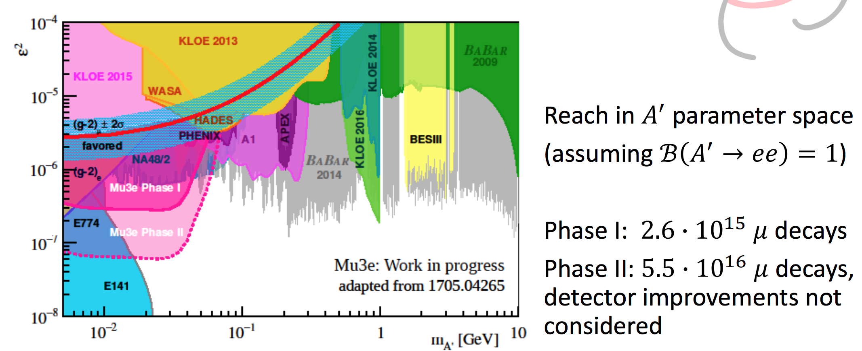
Mu3e at Shedding light
2021 Mu3e update at:
https://agenda.infn.it/event/26303/contributions/135210/attachments/84295/111625/Mu3e_Perrevoort.pdf

Slide 11
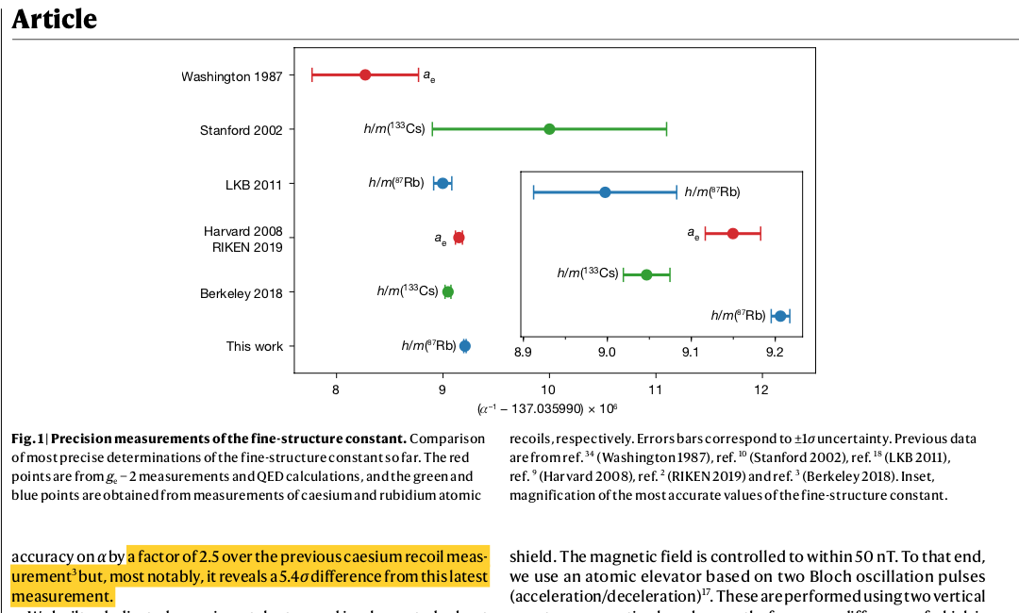
(g-2)_{e} from last measurement
https://www.nature.com/articles/s41586-020-2964-7

