Slide 1
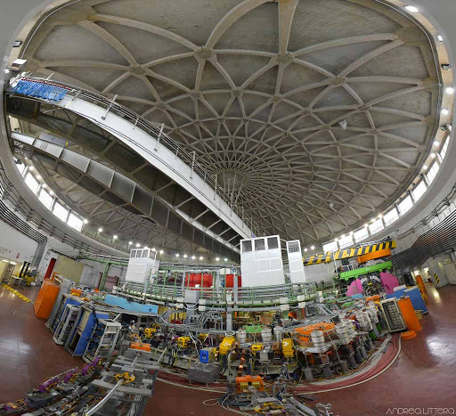
Future plans at DAΦNE
Fundamental Physics at the strangeness frontier:
Proposal for a 3-years period
(post-SIDDHARTA-2)
High Precision Kaonic Atoms Measurements on DAΦNE:
The strangeness Mendeleev table
Catalina Curceanu, INFN-LNF
62nd LNF Scientific Committee Meeting
November 8, 2021

Slide 2
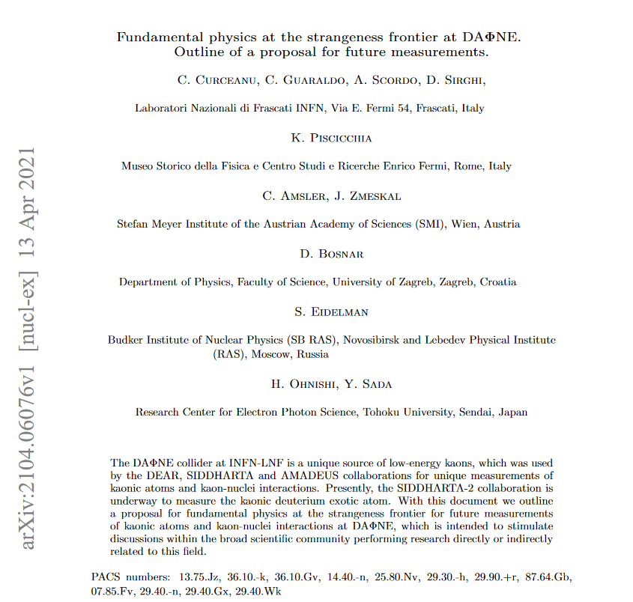
Based on: https://arxiv.org/pdf/2104.06076.pdf
SELECTED PROPOSED MEASUREMENTS:
scientific interest, feasibility, community…
SciCom:
The proponents of the kaonic physics proposal are invited to elaborate an updated scheme with a reduced but realistic scope, in particular in terms of the required integrated luminosity that can realistically be delivered within the upcoming 3-5 years.

Slide 3
Part. and Nuclear physics
QCD @ low-energy (Ph1)
Astrophysics
EOS Neutron Stars (Ph2)
Kaonic atoms high precision measurements
Dark Matter studies (Ph3)
Fundamental physics
New Physics (Ph4)
Theoreticians support from (but not only):
(Ph1) (Ph2) STRONG-2020 EU, i.e. THEIA WP Strange Hadrons and the Equation-of-State of Compact Stars; ISNEUMAT-INFN,…
(Ph3) Merafina, Yamazaki, Akaishi…
(Ph4) Pospelov; Pohl, Indelicato…

Slide 4
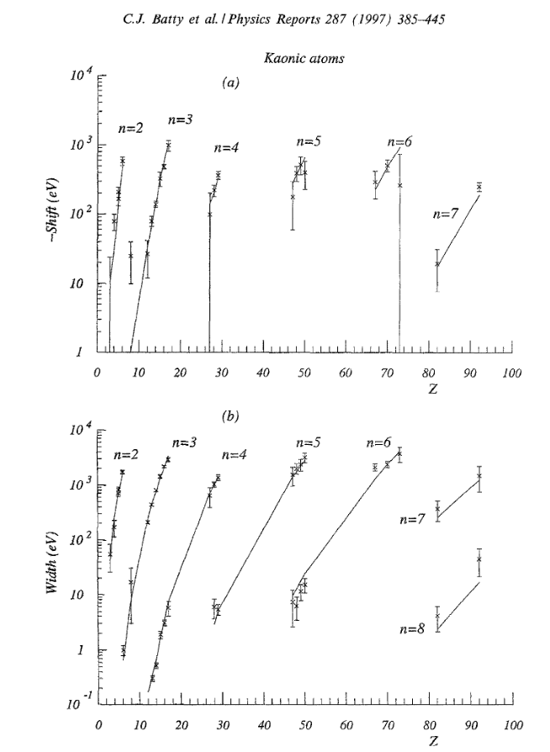
Strangeness precision frontier at DAΦNE: a unique opportunity for measurements of kaonic atoms along the periodic table: will represent a reference in physics with strangeness
Present status: old and very old measurements with low precisison (some even wrong: kaonic helium puzzle)
We propose to do precision measurements along the periodic table at DAΦNE for:
Selected light kaonic atoms
Selected intermediate mass kaonic atoms
Selected heavy kaonic atoms
charting the periodic table

Slide 5
Participating Institutes: (> 50 proponents all experimentalists)
  1) INFN-LNF, Italy: Curceanu, Bazzi, Clozza, Guaraldo, Iliescu, Miliucci, Scordo, D. Sirghi, F. Sirghi, Vazquez Doce; De Paolis, Napolitano, Sgaramella,
  2) Politecnico and INFN Milano, Italy: Fiorini, Carminati, Deda
  3) CNR-IMEM, Parma, Italy: Zappettini, Betteli
  4) INFN Trieste: S. Piano, P. Camerini
  5) INFN Torino: A. Filippi
  6) SMI – OeAW, Vienna, Austria: Amsler, Zmeskal, Shi, Tuechler
  7) RIKEN, Japan: Asano, Itahashi, Iwasaki, Ma, Murayama, Outa, Sakuma, Yamaga
  8) RCNP, Japan: Inoue, Kawasaki, Noumi, Shirotori
  9) ELPH, Japan: Ohnishi, Sada, Yoshida
  10) JAEA, Japan: Hashimoto
  11) Osaka University, Japan: Akaishi
  12) Chubu University, Japan: Okada
  13) Univ. Zagreb, Croatia: Bosnar, Friscic, Makek, Zugec
  14) Jagiellonian Univ.,Poland: Moskal, Khreptak, Niedźwiecki, Skurzok
  15) TUM Munich,Germany: Fabbietti
  16) Univ, Mainz: Pochodzalla, Achenbach
  17) IFIN-HH, Bucharest, Romania: M. Bragadireanu
  18) Sorbonne Université,Campus Pierre et Marie Curie, France: Indelicato
  19) CNRS, Institut des NanoSciences de Paris, France: Trassinelli
  20) Santiago de Compostela, Spain: Romero Vidal
  21) The George Washington University, USA: Strakovsky
  22) Old Dominion University, USA: Moskov
  Plus contacts with other potential participants
  Support from about 50 theoreticians not listed above

Slide 6
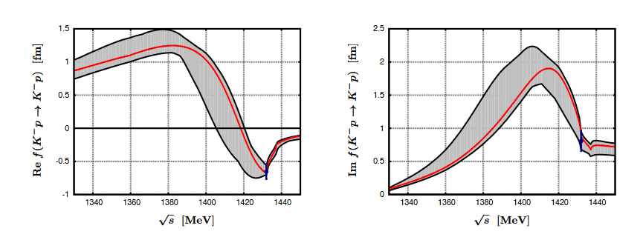
Light and Heavy Kaonic Atoms measurements: LHKA
  KH Kaonic Hydrogen: 200 pb⁻¹ – with SIDDHARTA-2 setup – to get a precision < 10 eV (present precision about 40 eV shift and 90 eV width) very important for theory (QCD at threshold with strangeness – physic below threshold) – as soon as possible! (Weise, Nucl Phya A 2021)
  Ph1, Ph2
  2) Setup with 1 mm SDD detectors:
  Kaonic Li; Be; B; He in the energy region 10-40 keV (see talk Sgaramella for Li case) – precision < 2-3 eV
  SDDs are financed and ordered (FBK)
  Ph1, Ph2, Ph4
  Will be ready within 2022!
  2) Setup with 2 HPGe detectors
  Heavy kaonic atoms: transitions above 70 keV
  Kaonic Pb, W – precision at the level of 3-10 eV
  Ph2, Ph4
  HPGe available (Zagreb) and ready for use
  Total required integrated luminosity: 200 + 400 (200) pb⁻¹
$$E_{KHe 3→2}\left(eV\right)=6463.7±2.5 \left(stat\right)$$
$$ε_{2s}=0.2±2.5 \left(stat\right)±2 \left(syst\right)$$

Slide 7
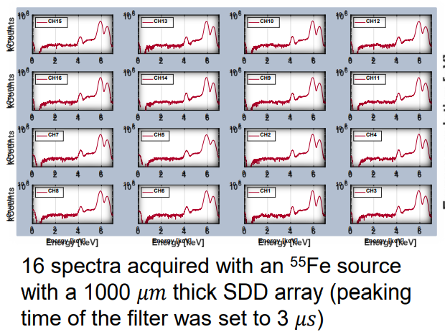
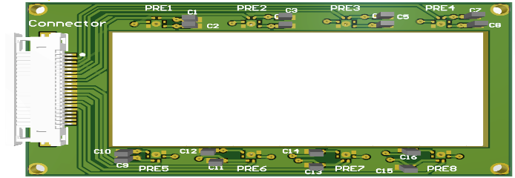
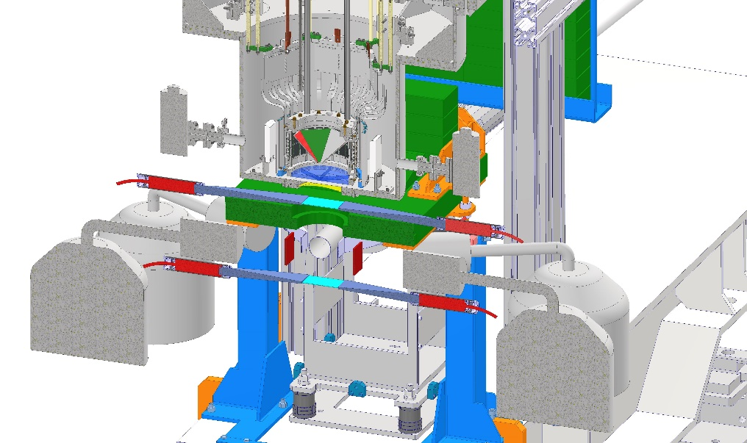
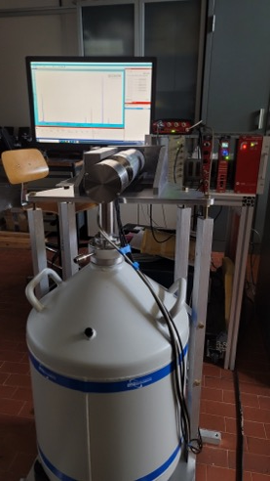
Light and heavy kaonic atoms measurements: LHKA setup
Li, Be, B targets

Slide 8
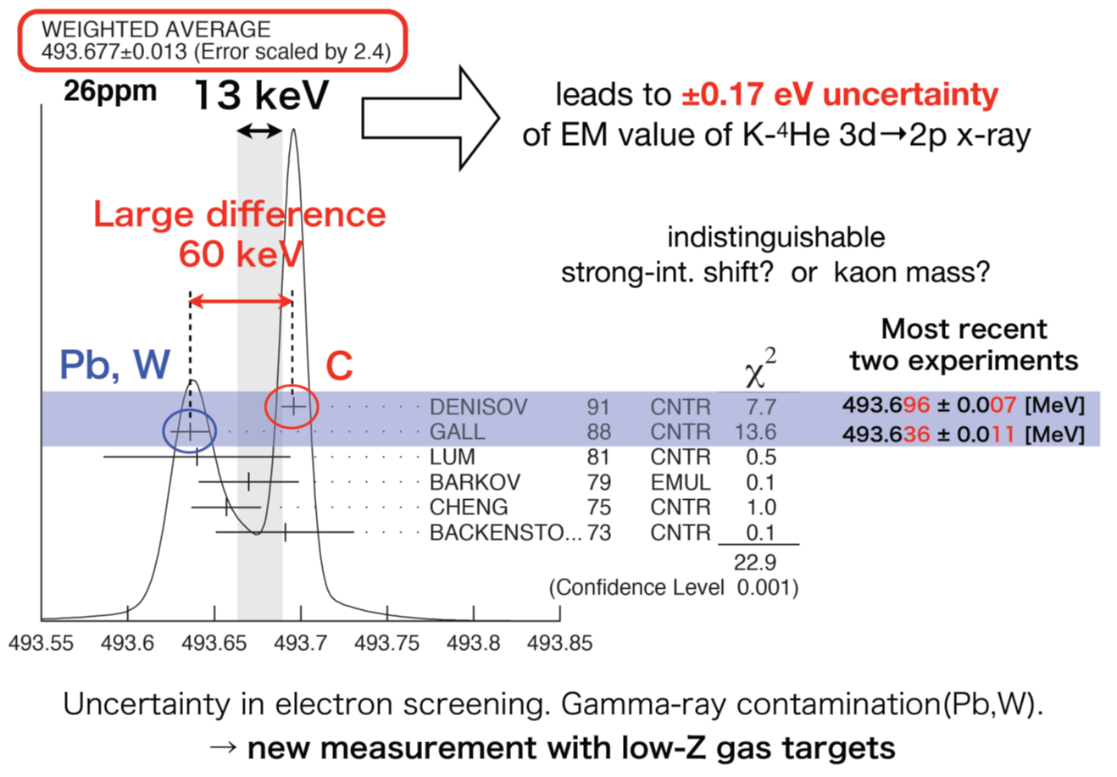
Intermediate and Heavy Kaonic Atoms measurements
IHKA
  Setup with CdZnTe detectors:
  Kaonic Ti, V, Zr, Ag, between 40 and
  200 keV keV – precision 3-5 eV
  CdZnTe are developed within
  ASTRA STRONG-2020 project
  Will be ready within 2023
  Ph1, Ph2, Ph3
  3) Setup with 2 HPGe detectors continued
  Heavy kaonic atoms: transitions above 70/100 keV
  Kaonic Co, Au, Pt – precision at the level of 5-10 eV (depending on energy of transition)
  HPGe available and ready for use (Zagreb Univ. plus Mainz – additional HPGe)
  Ph1, Ph2, Ph3
  Total required integrated luminosity: 400 (200) pb⁻¹

Slide 9
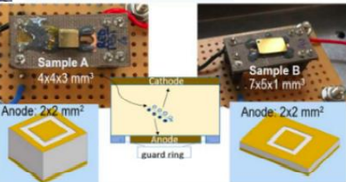
Intermediate and heavy kaonic atoms measurements: IHKA setup
Ti, V, Zr, Ag targets
Cd(Zn)Te
ASTRA STRONG-2020

Slide 10
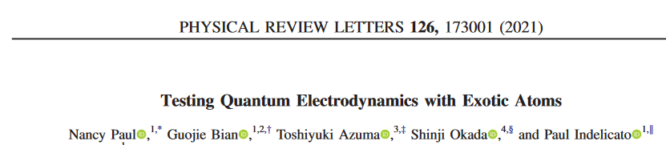
Ultra-High precision measurements of Kaonic Atoms
UHKA
  Setup with 8 VOXES lines (crystal HAPG spectrometer):
  Kaonic C, N, He: precision < 0.5 eV
  VOXES detector developed; financing for building 8 lines required (possibility of external funding)
  Will be ready within early 2025
  Ph4, Ph1, Ph3, Ph2
  2) Feasibility test (measurements) for kaon-nuclei scattering exp.
  With TPG detector
  TPC developed by Sendai ELPH Japan, SMI-Vienna and LNF-INFN (HP2, HP3 EU)
  KP nuclear scattering – feasibility for FUTURE MEASUREMETS (2 years after KA)
  Total required integrated luminosity: 400 pb⁻¹

Slide 11
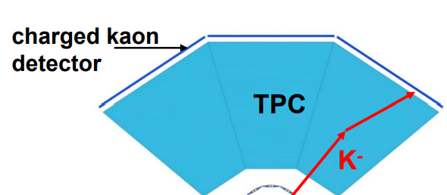
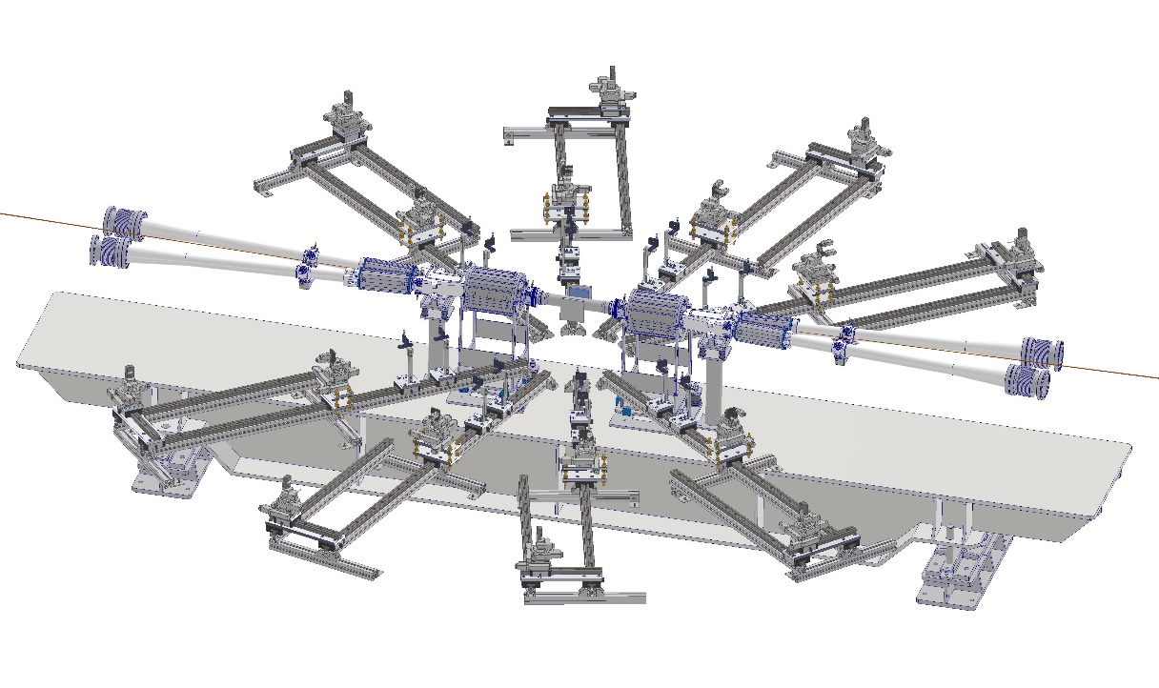
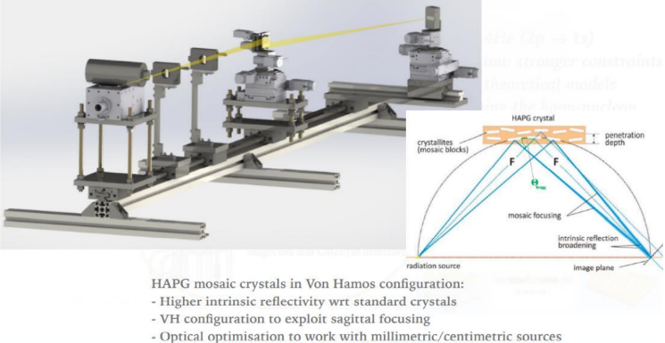
Ultra-high precision measurements of kaonic atoms
UHKA
  Modern Instrumentation, 2015, 4, 32-4
JINST 13 (2018) 04, C04002 CSN5 Young Research (Scordo)

Slide 12
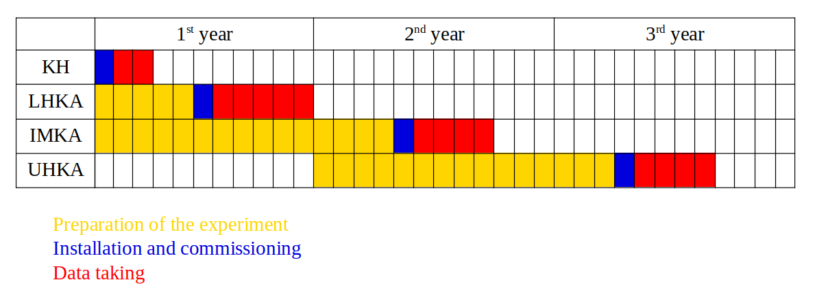
Gantt chart – possible implementation of the kaonic atoms measurements
Total integrated Luminosity:
200 + 400 (200) + 400 (200) + 400 pb⁻¹

Slide 13
In Conclusion, we propose to perform fundamental Physics at the strangeness frontier at DAΦNE studies:
High Precision Kaonic Atoms Measurements on DAΦNE:
The strangeness Mendeleev table
We presented a program for performing unique measurements of kaonic atoms along the periodic table to contributing to understand physics going from the strong interaction (symmetry breaking) to neutron stars, and from Dark Matter to Physics Beyond Standard Model, setting LNF in forefront of these studied.
A strong international community is putting forward this realistic and feasible programme in particular in terms of the required integrated , that can be delivered within the upcoming 3-5 years, with support from National and European projects.

Slide 14
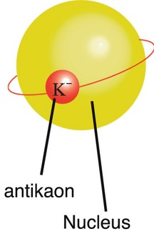
EXtensive Kaonic Atoms research:
from LIthium and Beryllium to Uranium
EXKALIBUR

Slide 15
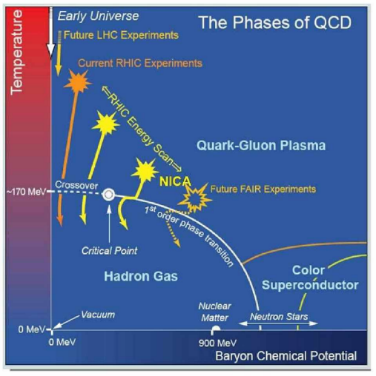
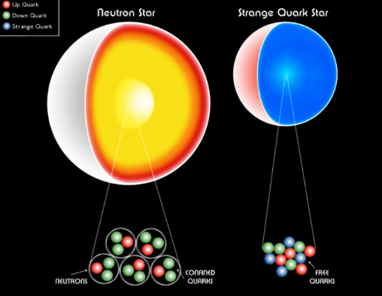
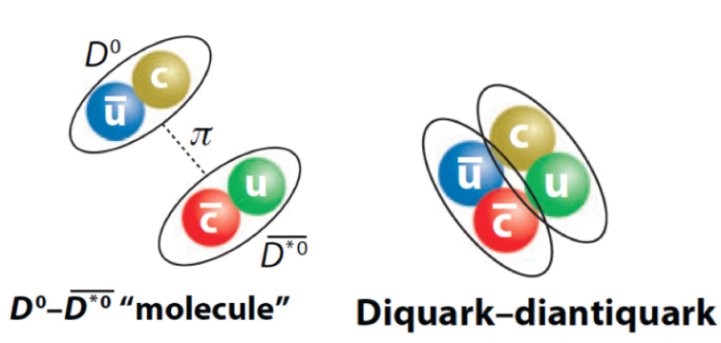
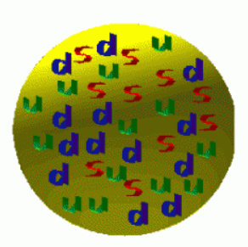
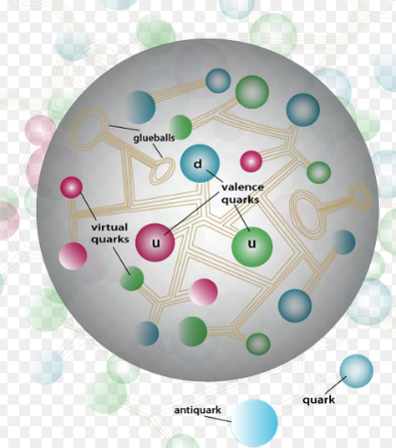
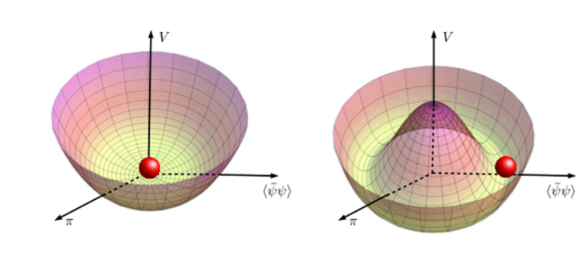
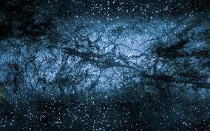
Neutron star EOS
Particles structure
Cold Dense matter
Strangeness Fundamental Physics
Mass generation, visible Universe
QCD
Chiral symm.
Strangelets & Dark Matter

Slide 16
