Slide 1


Slide 2
Conclusions:
General consideration
Special thanks

Slide 3
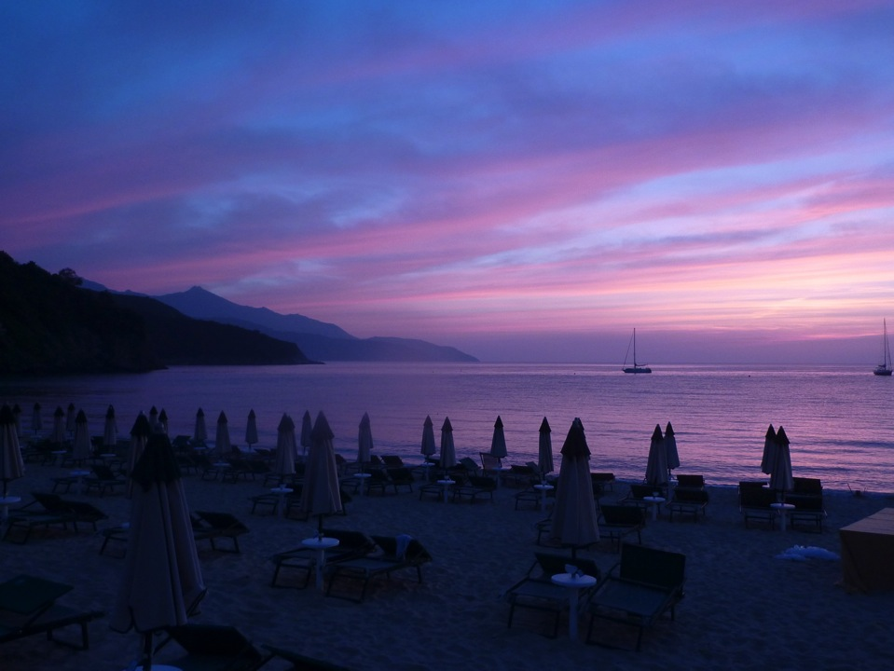
About 50 participants.
A successful meeting:

Slide 4
About 50 participants.
A successful meeting:
Interesting discussion in the audience and outside!
Vacuum issues in the GWD community are of great importance and can significantly profit from other communities experience.
Lot of space for future collaborations!
Need of closer and focused joint efforts

Slide 5
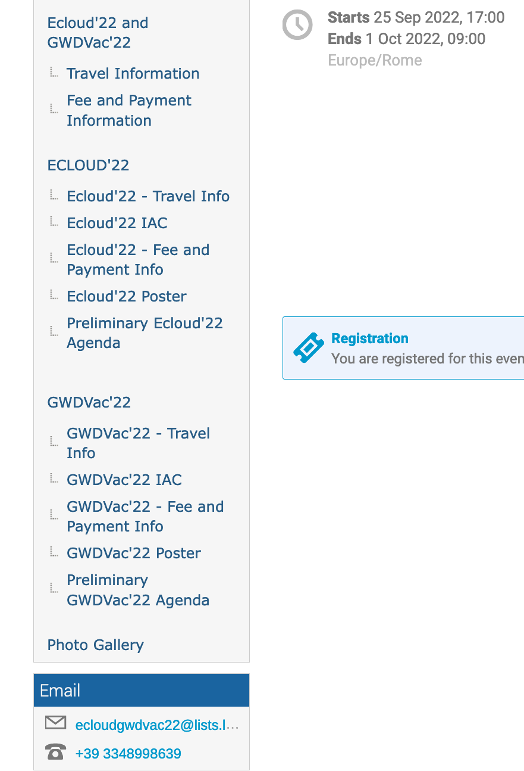
On our web page: https://agenda.infn.it/event/28336/
See conference photos

Slide 6
Some final consideration on GWDVac’22
Very interesting and sometime passionate discussion: maybe the meeting was too short?
We must all decide if this is going to be a first meeting of a series and what additional topics should be included.
Where and when we will have next topical meeting? and what type of meeting will it be?
Given the level of the presentations, the amount of discussions and the number of open questions and challenges we hope that this meeting will consolidate the needed collaborative efforts.

Slide 7
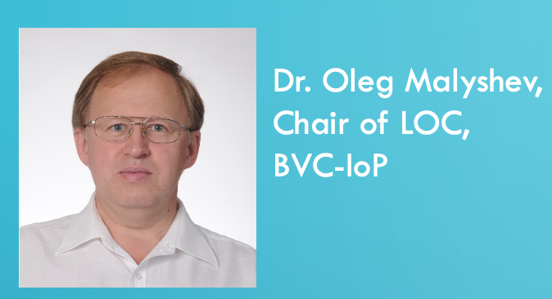

Suggested from Oleg:

Slide 8


Special thanks to:
INFN- Sezione di Pisa
Laboratori Nazionali di Frascati
And:

Slide 9
Preparatory part:
With me:
Local Organizing Committee
Marco Angelucci (INFN - LNF)
Andrea Liedl (INFN - LNF)
Laura Natoli (INFN - LNF)
Luisa Spallino (INFN - LNF)
Vinicio Tullio (INFN - LNF)
PS: I just checked: 2013 mails in our EcloudGWDvac mailbox.....

Slide 10
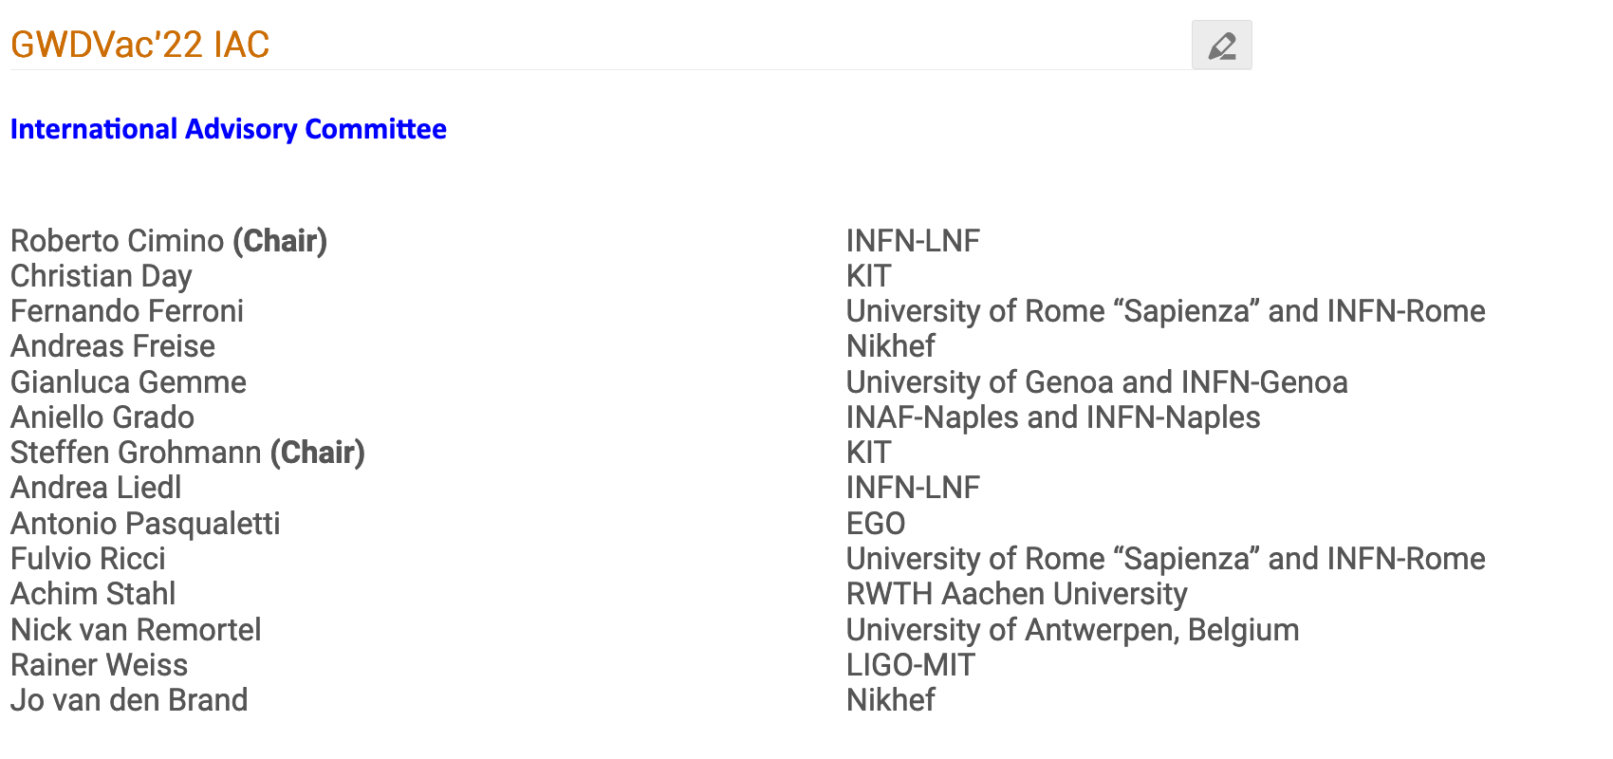
Preparatory part:

Slide 11
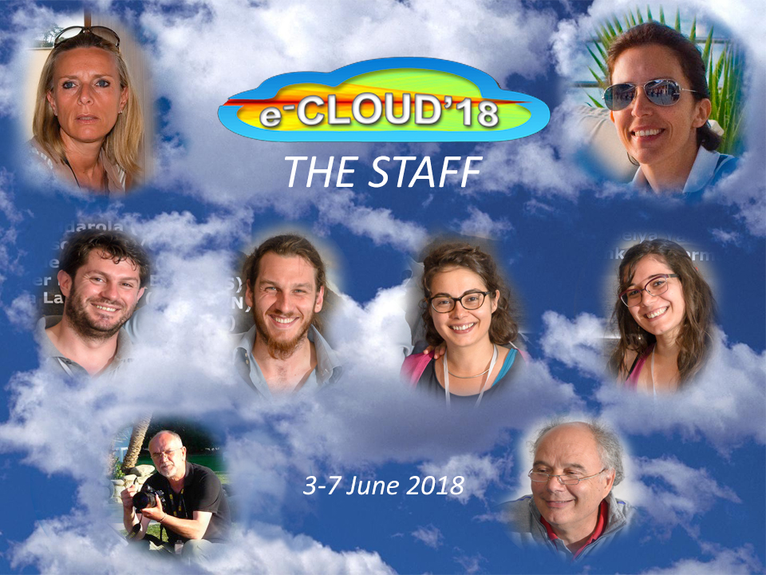
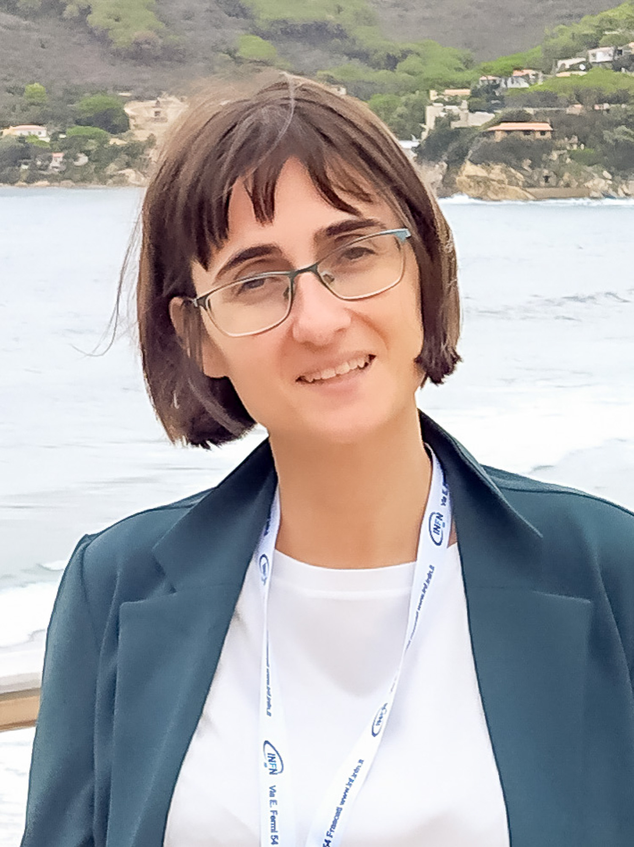
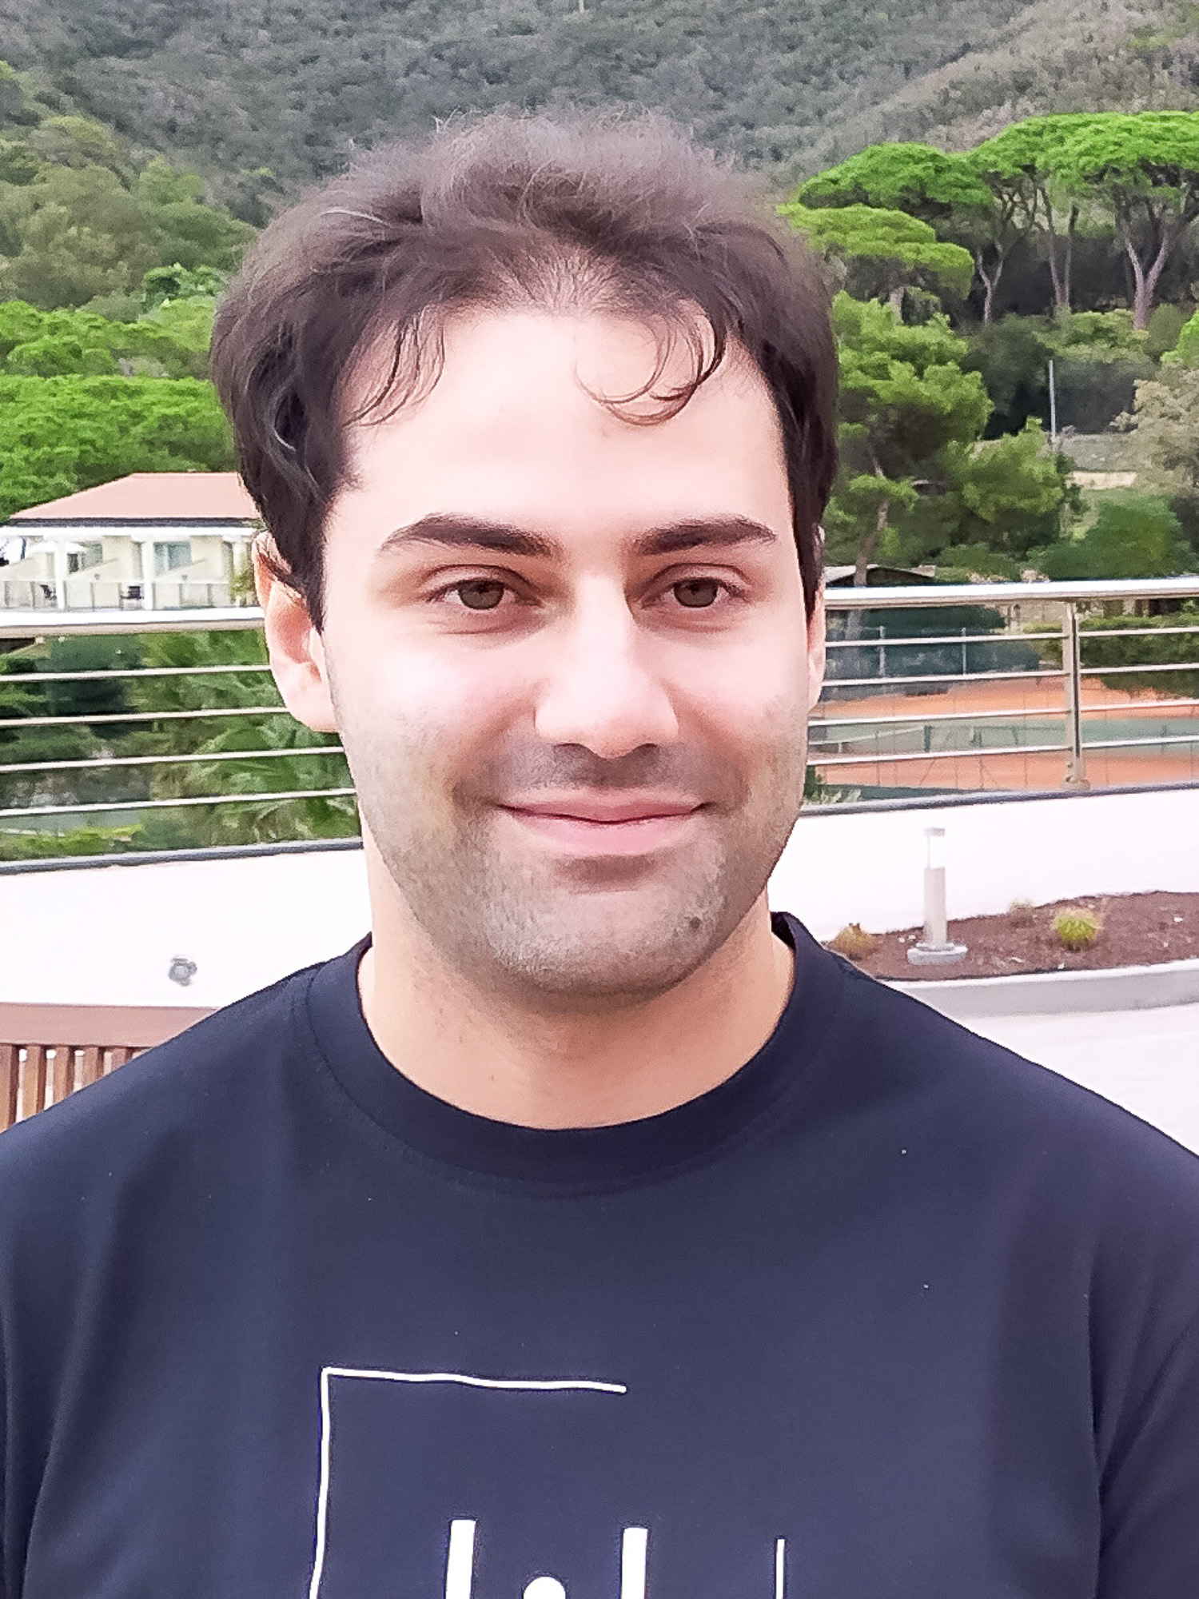
Tanks to
“the team”:

Slide 12
A good workshop is only partially due to the location and organization (it certainly help) but on the participants, their scientific level, their willing to discuss and collaborate ...

Slide 13
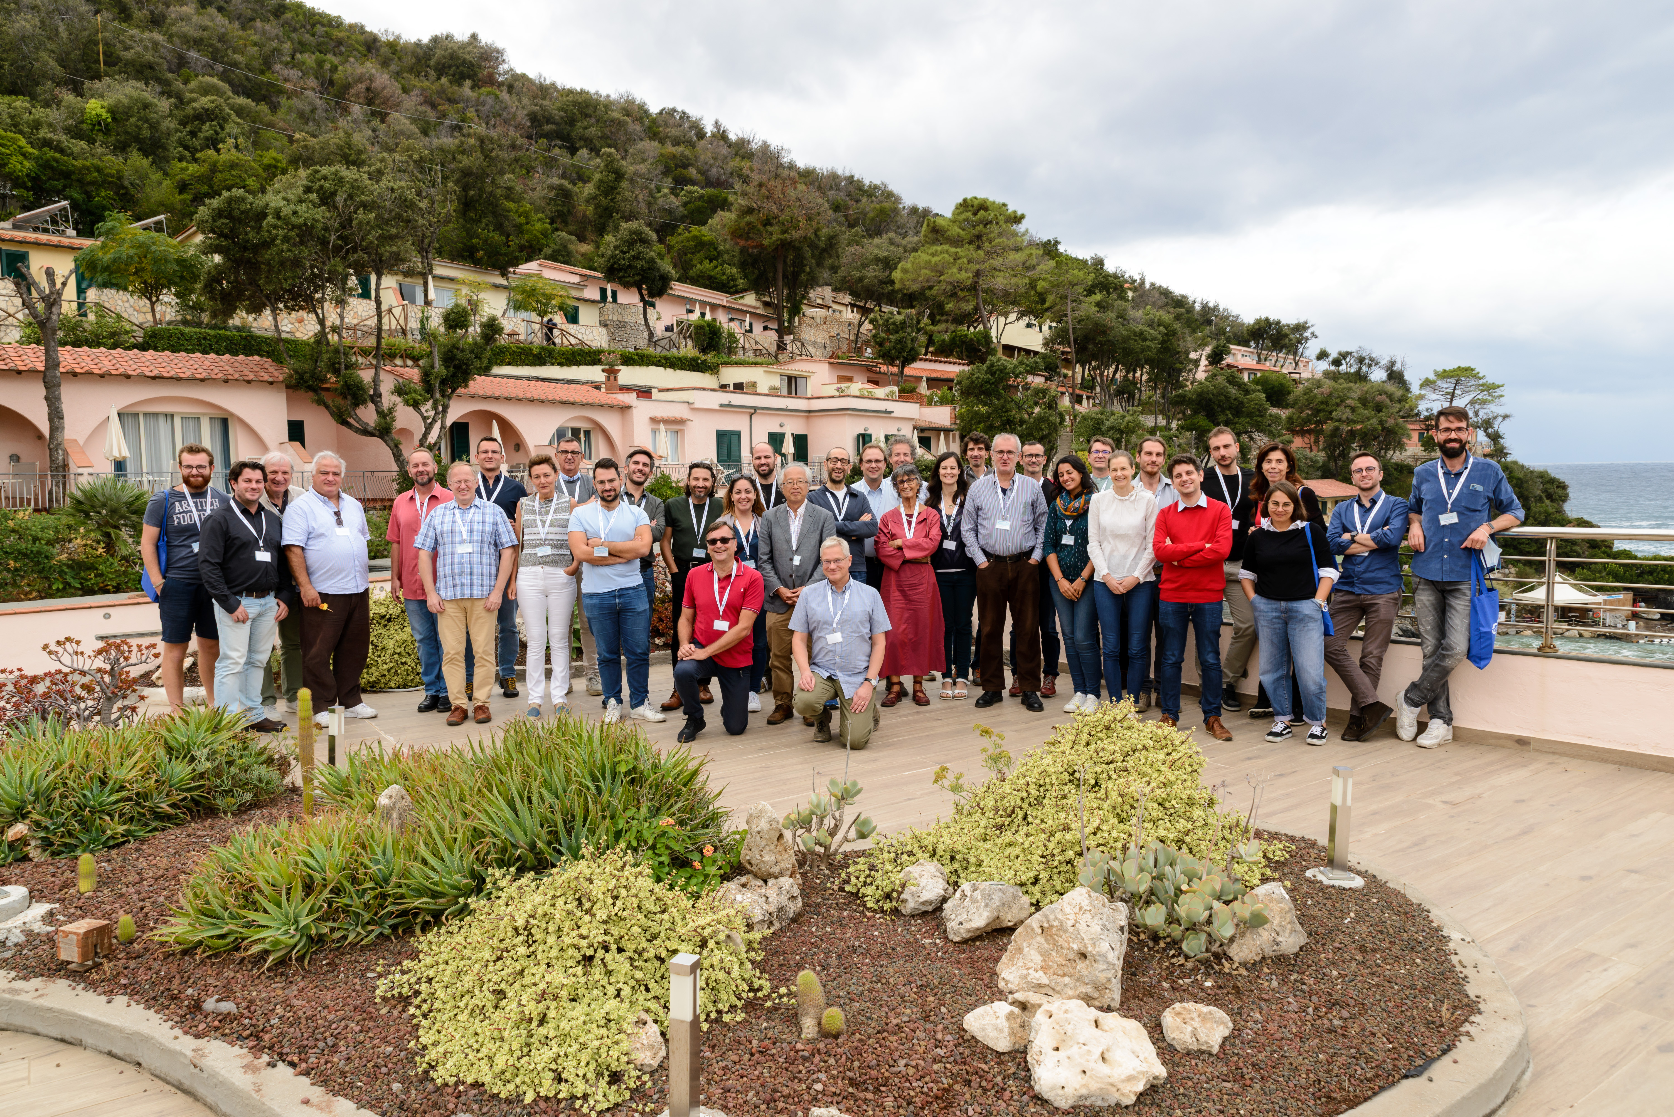
Thanks for coming!!!
Thanks for coming!!!

