Slide 1
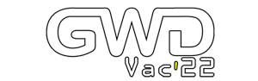

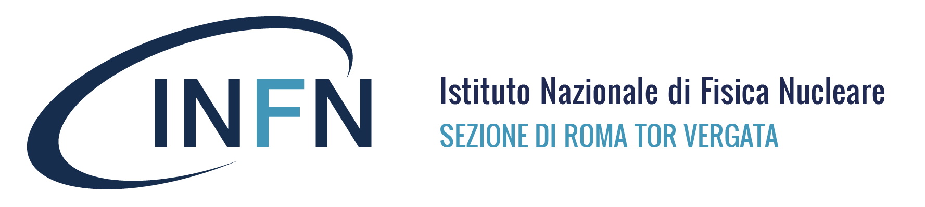


CO₂ laser techniques in the perspective of future gravitational wave detectors
E. Cesarini, M. Cifaldi, V. Fafone, M. Lorenzini, D. Lumaca, Y. Minenkov,
I. Nardecchia, A. Rocchi, C. Taranto
Notes:
Good evening. I’m Diana Lumaca from the Roma Tor Vergata Virgo/ET group and today I’ll show you some CO2 laser techniques in the perspective of future GW detectors.

Slide 2
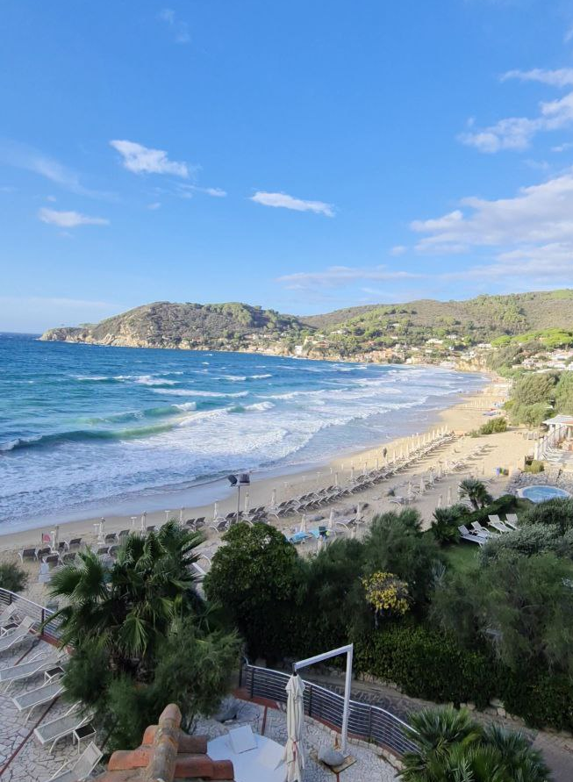
Overview
Einstein Telescope
  Payload cryogenic operation
Mirrors’ surface condition at cryogenic temperatures
Low frequency Versus Cryogenic for ET
Collected experience with CO₂ lasers
  CO₂ laser projectors in Thermal Compensation System
  CO₂ laser polishing in metrology for Coating Research and Development
Notes:
This is the outline of my presentation. I’ll start doing a really brief introduction about Einstein Telescope and cryogenic operation of payload (already well presented earlier) and I’ll focus you attention to the mirror’s surface condition and the main issues known so far and I’ll show you a proposed solution with CO2 laser, exploring its use for ground-based GW interferometer so far.

Slide 3
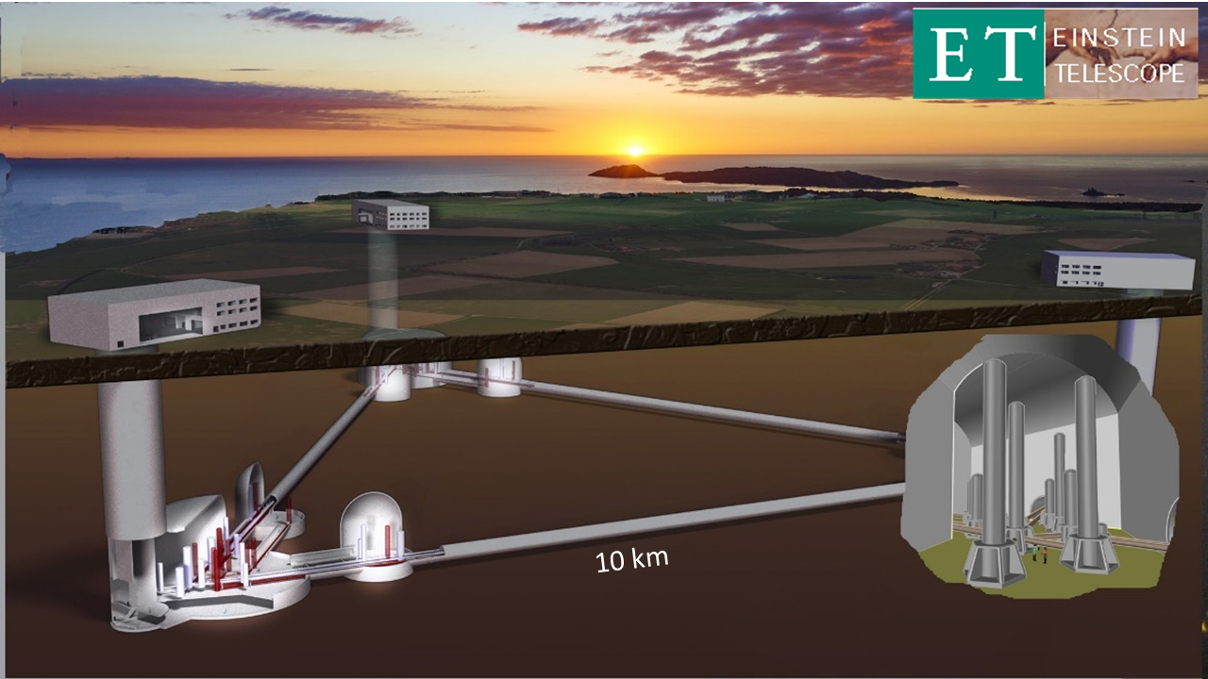
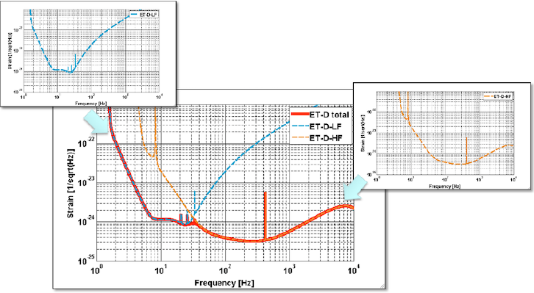
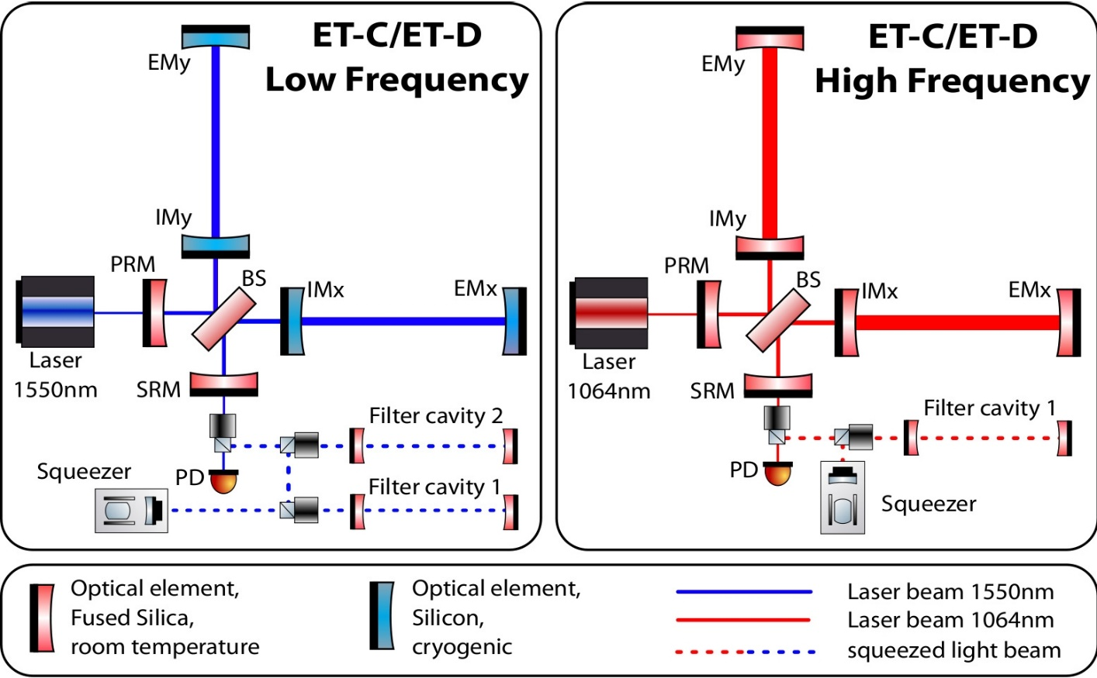
Einstein Telescope
Talk by M. Punturo
Third-generation, gravitational-wave observatory:
a greatly improved sensitivity
underground infrastructure
10km long arms
three nested detector: each will comprise two interferometers, one specialised for detecting low-frequency (ET-LF) gravitational waves and the other one for the high-frequency (ET-HF) part.
cryogenic temperature (down to 10 – 20K)
200 kg, Si or Sapphire substrate
KAGRA (2.5 Gen)
Voyager/Cosmic Explorer
http://www.et-gw.eu/
Notes:
So, ET will be a third generation GW interferometer observatory. Obviously the main goal is to improve the sensitivity and many challenging upgrades wrt nowadays ground-based detectors are foreseen to do that. Between them, ET will be an underground infrastructure, with arm length of 10 km and a triangular configuration with 3 nested detectors each of them made of two interferometers, one specialised in low frequency observation (ET-LF) and the other one in high frequency (ET-HF) observation. In this way the overall sensitivity curve, build by the composition of the sensitivity of the two interferometer, gain a larger and lower bandwidth. From the point of view of ET-LF, also cryogenic and heavy mirrors will be adopted to counteract thermal noise. Some of these upgrade has been already at least partially tested on KAGRA (a 2.5 generation detector), like underground and cryogenic, but in particular the latter will be even more challenging together with vacuum, for ET.

Slide 4
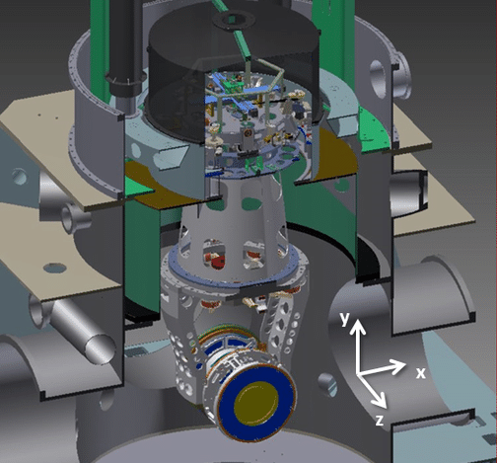
Payload cryogenic operation
Talk by G. Gemme ,
F. Fidecaro and P. Puppo
Steering and controlling the mirrors
Part of the cooling system
Suitable mechanical system hosting the mirrors at cryogenic temperature
https://www.virgo-gw.eu
Position/acceleration sensing and actuation hardware
  Slow-down and align interferometer’s mirrors, driving their dynamics within the gain range of automatic error signals
  Cryogenics and low frequency operation
  Geophones, accelerometers, coil-magnet actuators
Remote diagnostic and conditioning of mirror’s surfaces at low temperature
  Mechanical and thermal observables related to the heat link must be kept under control
  Physical contaminants: electrostatic charge, dust, frost, ….
Notes:
The cryogenic operation of the payload will not be trivial, as already shown by GG FF and I think it will be shown tomorrow by PP. The thing is that the payload will not only need to steer and control the mirror position and orientation, but it will be needed to be part of the cryogenic cooling system. It will be needed to develop a suitable mechanical system hosting the mirrors at cryogenic temperature, able to sense mirror’s position and acceleration, allowing to align it and act if needed through automatic error signals. Furthermore, we’ll need to develop a remote diagnostic and condition system for mirror’s surfaces: to monitor and control mirror’s mechanical and thermal observables. Regarding that…

Slide 5
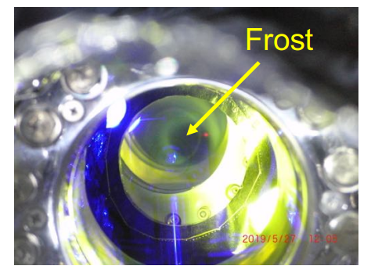
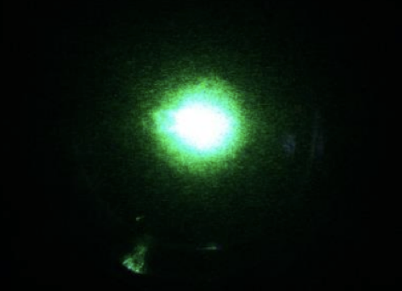
Mirrors’ surface condition at cryogenic temperatures
UHV residual molecules and gas drifting from RT section along with laser radiation:
  Adsorbed layer (adlayer): H₂O, CO₂, CH₄, O₂, N, …
  Affect reflectivity and absorption, compromising cryogenic operation, generating optical losses and worsening TN and overall sensitivity level
Although cryogenic operation is a key feature of KAGRA, one of the first cryogenic tests (2019) suffered from frost on the mirror, which disabled proper operation
K. Hasegawa et al., Molecular adsorbed layer formation on cooled mirrors and its impacts on cryogenic gravitational wave telescopes, Phys. Rev. D, 99, 022003, 2019
J. Steinlechner and I. W. Martin, Thermal noise from icy mirrors in gravitational wave detectors, Phys. Rev. Research 1, 013008, 2019
T. Akutsu et al., Overview of KAGRA: Detector design and construction history, PTEP, Volume 2021, Issue 5, May 2021, 05A101
A beam spot blurred by frost on the mirror.
Talk by K. Yamamoto and N. Kimura
Notes:
We have already seen in many previous presentations which is the issue, let me just recall the main highlights. UHV residual molecules and gas drifting from RT section along with laser radiation represent a really annoying issue, because they generate an adsorber layer on top of mirror’s surface, mainly made of H2O that affect optical properties of the mirror’s coating, compromising cryogenic operation, generating optical losses and worsening TN and overall sensitivity level
The most important feedback came from KAGRA experience, in one of the first cryogenic tests they suffered so much from frost that it affect proper cryogenic operation.
So…

Slide 6
Mirrors’ surface condition at cryogenic temperatures
The problem of adlayer growth on mirrors is a serious issue: a great effort will be required to limit the causes of its formation and mitigation strategies to cure and remove the cryoadsorbed layers.
L. Spallino et al., Cryogenic vacuum considerations for future gravitational wave detectors, Phys. Rev. D, 104, 062001, 2021
Talk by L. Spallino
Passive methods
Reducing the pressure in UHV chamber: trade-off between desire and feasibility
Cold to warm vacuum transition design: decouple the RT vacuum with the one of the cryogenic mirror chambers
Primary laser-beam-induced desorption: IR nonthermal photodesorption (laser-induced additional heat load is already considered in cryogenic budget)
Active methods
Illuminate the cryogenic mirrors with CO₂ laser: adsorbed molecules will obtain kinetic energy and desorb; rising up mirror’s surface temperature
UV photons can stimulate electronic transitions in molecular ice and following relaxation (molecular desorption, surface or bulk chemistry and vibration, phonon excitation,…); efficiency strongly depends on ice morphology and radiation energy
Low energy electrons (<200 eV) can efficiently remove ice layers; induce mirror charging
S. Tanioka et al., Optical loss study of molecular layer for a cryogenic interferometric gravitational-wave detector, Phys. Rev. D, 102, 022009, 2020
Notes:
The problem of adlayer growth on mirrors is a serious issue: a great effort will be required to limit the causes of its formation and mitigation strategies to cure and remove the cryoadsorbed layers.
Strategies can be splitted in passive and active ones…

Slide 7
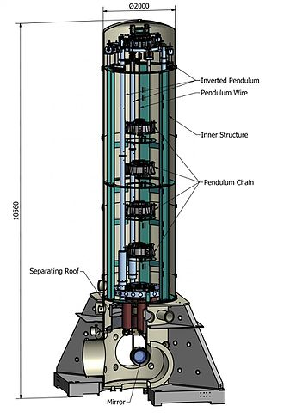
Low-frequency Versus Cryogenics for ET
Viable payload design, compliant with low-frequency sensitivity requirements
Overall feasibility guidelines and achievable technologies
Main features of the cryogenic environment hosting the payload
Actual condition of the mirror’s surface at cryogenic temperature
LoVeC-ET Italian founded project (PRIN 2020, 2020BSYXCB, PI E. Majorana), organized in the following Working Packages:
Coordination
Cryogenic suspension
Cooling technique VS low frequency payload and vibration attenuation
Modelling and design
Sensors and actuators at low temperature
https://www.virgo-gw.eu
Notes:
Before go forward to show you the experience maturated so far with CO2 laser, let me just say that the icing issue specifically and the mirror’s surface sensing and conditioning at cryogenic temperature is a topic framed inside an Italian founded project, named LoVeC-ET.
It aims to develop the most suitable configuration for cryogenic operation of mirror’s payload. The project look to realise a viable payload design, compliant with the low frequency sensitivity requirements, developing some overall guidelines and finding the achievable technologies. One of the most important topic will be to be able to probe the actual condition of the mirror’s surface at cryogenic temperature. Here you can see how the project is organised in working package, and the contribution from Roma Tor Vergata will be mainly in the last one, compreeinding the development of sensors and actuators working at low temperature.

Slide 8
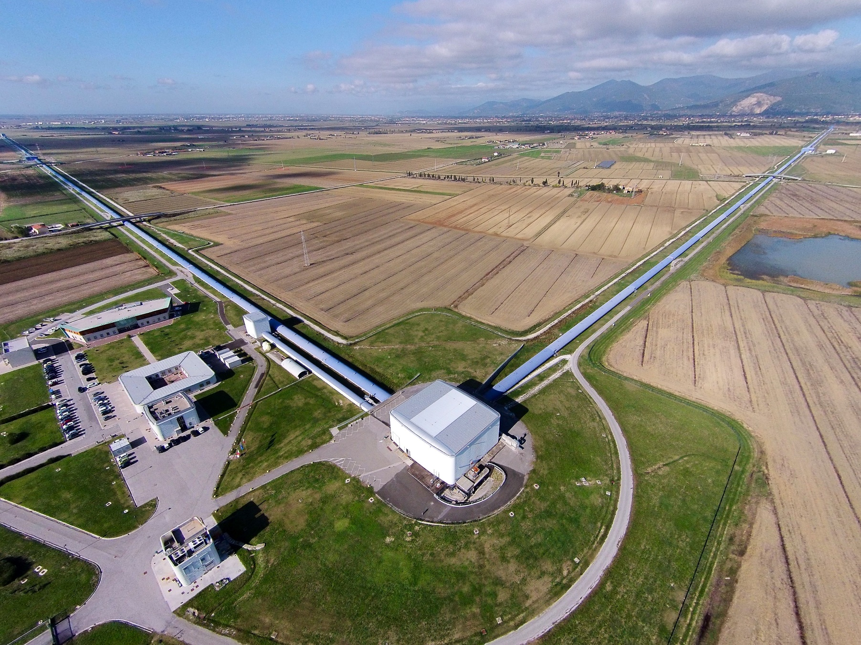
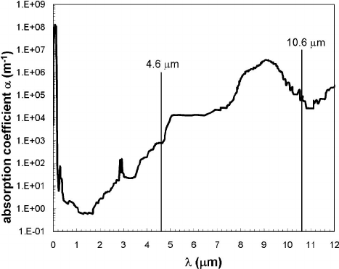
Collected experience with CO₂ lasers
Wavelength = 10.6 um
  Optimally absorbed by SiO₂, GW mirror’s bulk material
In Roma Tor Vergata group, two main use:
CO₂ laser projectors in Thermal Compensation System (TCS)
CO₂ laser polishing and heat treatment in metrology for Coating Research and Development (CRD)
Rei Kitamura et al., Optical constants of silica glass from extreme ultraviolet to far infrared at near room temperature, Appl. Opt., 46, 8118-8133, 2007
Notes:
So, which is the experience gained so far with CO2 laser?
First of all, CO2 laser’s wavelength is optimally absorbed by fused silica, that is the nowadays second generation GW detector mirror’s bulk material. This was a key point that origin the so far use of CO2, so far. In particular, in Roma Tor Vergata made use of CO2 laser to develop, through the use of a suitable optical layout, a co2 laser projector in TCS and we more recently use it to perform polishing in CRD. Let me start from the first,

Slide 9
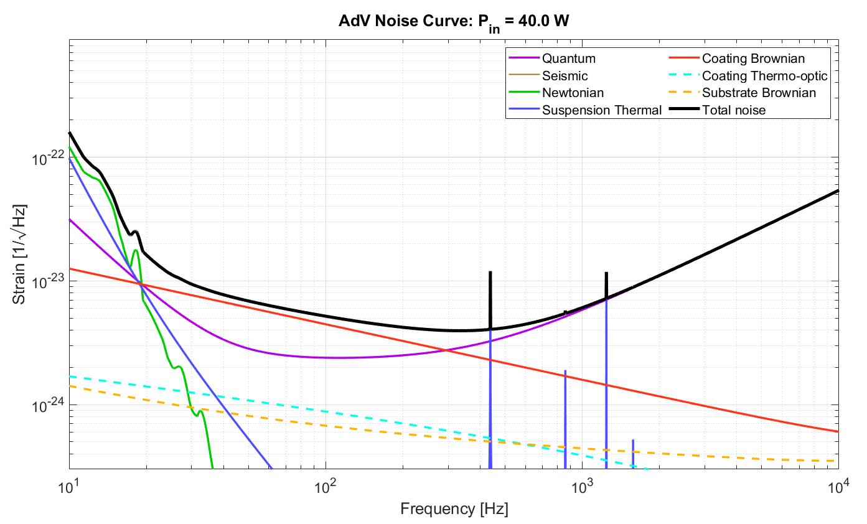
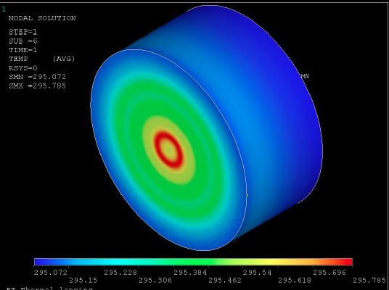
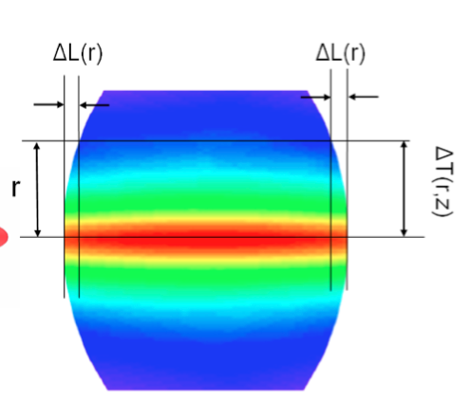
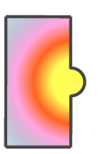
Shot noise, thermal effects and optical aberrations
AdV+ project sensitivity curve
Improve sensitivity at high frequency: the power circulating inside GW detectors is increased through optical cavities in the interferometer’s arm by a factor around 300 with respect to simple Michelson configuration.
Ultra stable YAG @1064 nm laser P_{in} = 200 W
Power circulating in the Fabry-Pérot cavity P = 700 kW
The core optics coating absorptions (of the order of few parts per billion) result in a temperature gradient within the mirrors causing thermal effects:
  thermo-refractive substrate lenses in the recycling cavities, due to the refractive index dependence on the temperature;
  thermo-elastic surface deformation in the Fabry–Perot mirrors, due to a non-zero material’s thermal expansion coefficient.
Cold defects coming from the residual imperfections due to the state of the art of the mirror production procedure.
Optical aberrations: decrease the gain of control signals
Thermal Compensation System
Notes:
… starting from the reason why we need to use a CO2 laser projector system.
In first and second gen. detector, to improve the sensitivity at high frequency, the power circulating is increased through optical cavities in the interferometer’s arm by a factor around 300 with respect to simple Michelson configuration.
Tangled with that, the core optics coating absorptions, though optimized to be just of the order of parts per million, result in a radial temperature gradient within the mirrors causing thermal effects:
thermo-refractive substrate, due to the refractive index dependence on the temperature;
thermo-elastic surface deformation, due to a non-zero material’s thermal expansion coefficient.
All these mechanisms induce optical aberrations, that can decrease the circulating power inside the cavity.
The Thermal Compensation System is designed to contrast the aberrations coming both from cold defects and thermally driven effects

Slide 10
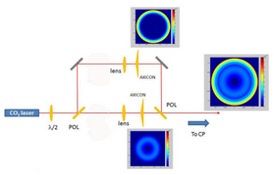
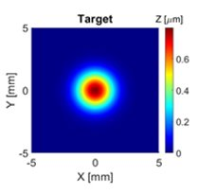
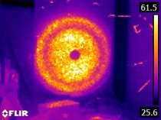
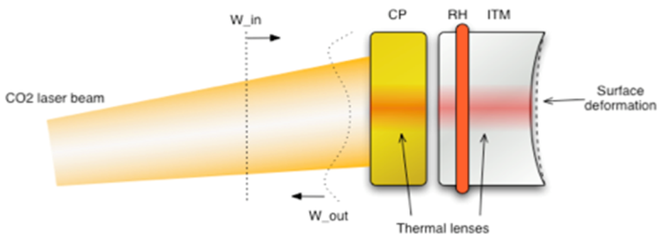
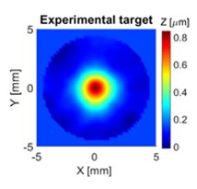
CO₂ laser projectors in Thermal Compensation System
The strategy is to induce in the optics a complementary distortion, with respect to the one given by the aberrations, restoring the nominal optical configuration of the interferometer.
CO₂ laser projectors:
Actuation on dedicated optics before cavity input: compensation plate (CP)
Multi-actuation approach:
  axisymmetric centred pattern
  axisymmetric annular correction
  not axisymmetric residual patterns
The power delivered by each actuator can be controlled and monitored
Projected patterns can be tuned online
Double Axicon System (DAS)
Two annular (axisymmetric) power distributions superimposed
Annuli created using axicons
Optimal heating profile obtained by iterative process with FEA simulations
Deformable Mirror (DM)
Correction of non symmetric residual
Phase imprint on the impinging beam to obtain the desired intensity pattern at a given plane
Notes:
The strategy is to induce in the optics a complementary distortion, with respect to the one given by the aberrations, restoring the nominal optical configuration of the interferometer.
The Advanced Virgo TCS features both new high-performance sensors and actuators, making it a dynamical adaptive optical system.
Between actuators, there are the CO2 laser projectors.
The two example are represented by DAS and DM. The first one is a system that starting from the gaussian shape of the beam, through the use of an appropriate optical layout and conical lens generate two annular power distributions…. The secondo one is composed by a mirror, who’s surface can be properly modified to imprint a phase on CO2 beam

Slide 11
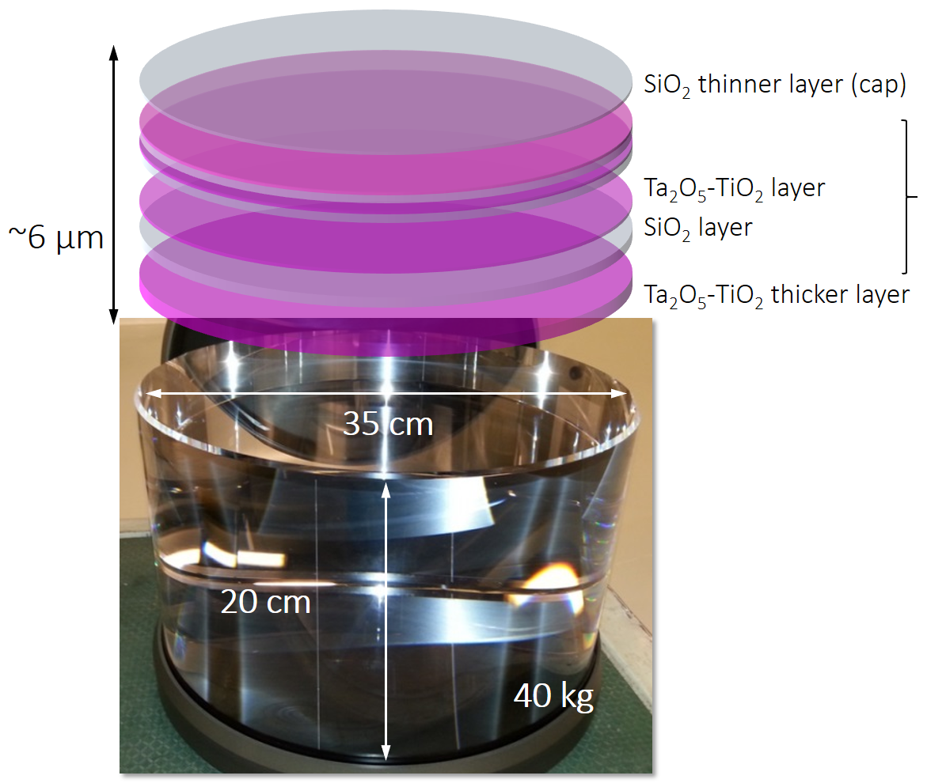

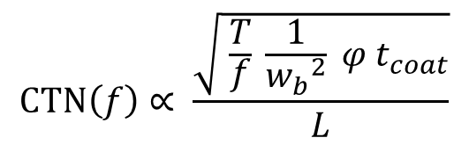
Coating Thermal Noise
AdV+ project sensitivity curve
Coating Thermal Noise (CTN) limits the detection in the middle frequency bandwidth
The key parameters are:
State of the art
Temperature
Mechanical loss
$$CTN\left(f\right)∝ \frac{\sqrt{ \frac{T}{f} \frac{1}{{w_{b}}^{2}} φ t_{coat}}}{L}$$
Coating
thickness
a stack of titania doped tantala and fused silica layers
excellent surface figure
really low absorption
very low scatter
Arm length
Beam-size
Ion Beam Sputtering (IBS) deposition at Laboratoire de Materiaux Avances, in Lyon.
Notes:
Another very stringent problem in GW interferometer detector is represented by CTN, that represents a limit in middle frequency band and need to be reduced.
Currently, coatings are composed by a stack of titania doped tantala and fused silica layers, deposited through IBS at the LMA in Lyon. These coatings are the best optical component ever manufactured so far, in terms of excellent surface figure, really low absorption, very low scatter. But they need to be further improved.
CTN expression presents these main dependences. One of the chosen strategy was to reduce a factor 3 the coating loss angle and to increase the beam size (and also end test masses).
--------
Another important parameter can be defined thinking to the fact that when a system is dissipative, its response to a step solicitation is characterized by a finite relaxation time, so there is a phase lag between an applied input and the system response: this phase lag is represented by the loss angle phi, that at resonance frequencies correspond to the inverse of Q and is an additive quantity.

Slide 12
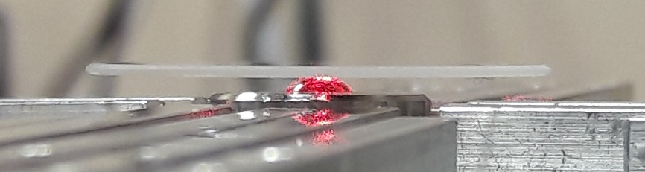
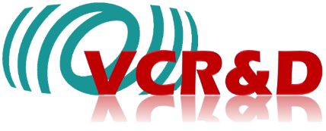
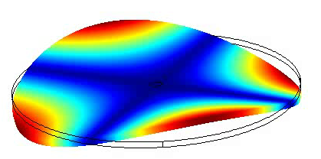
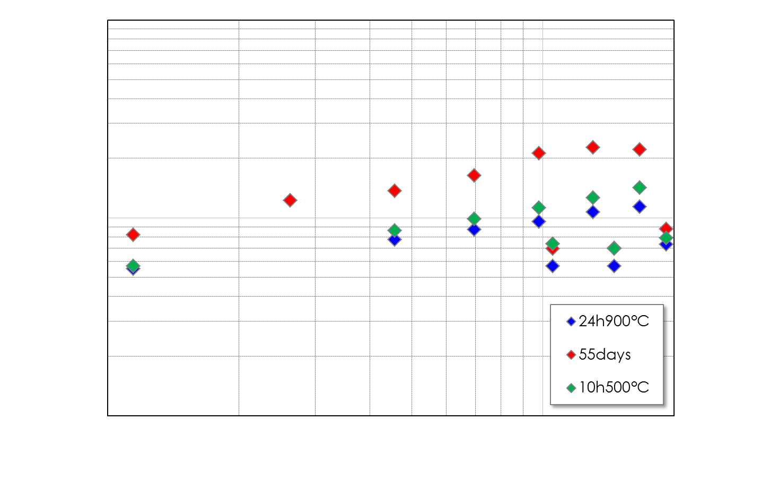
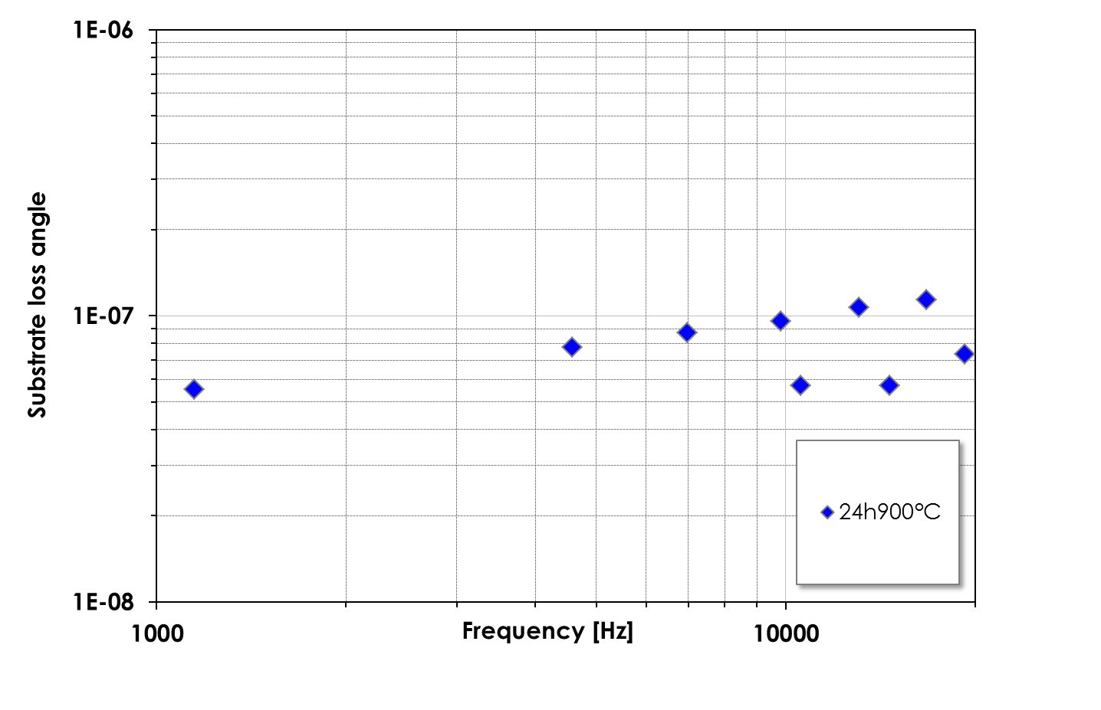
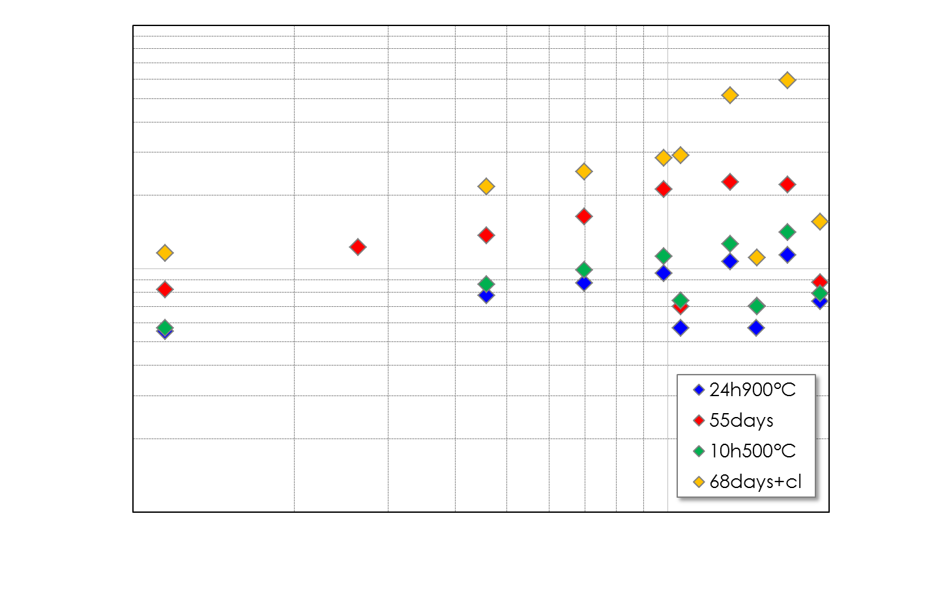
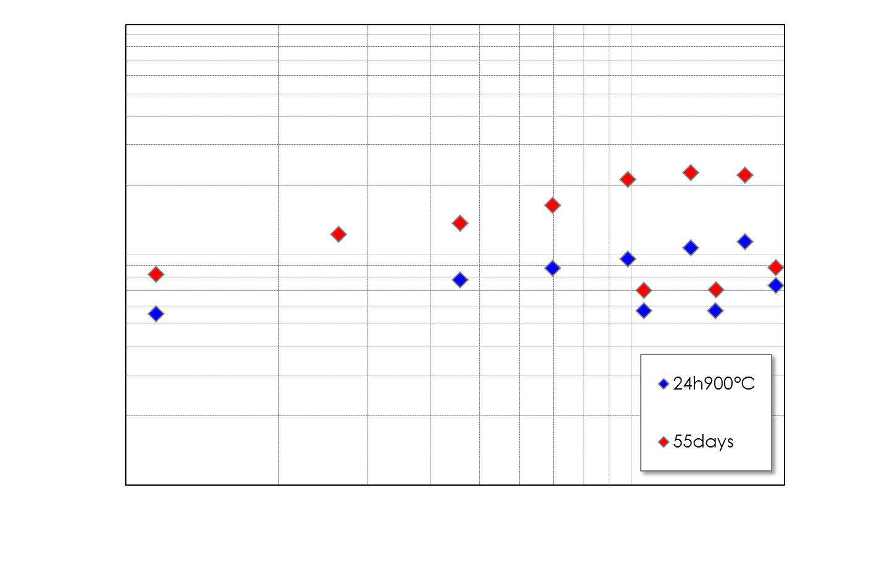
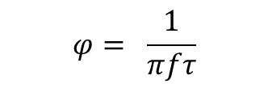
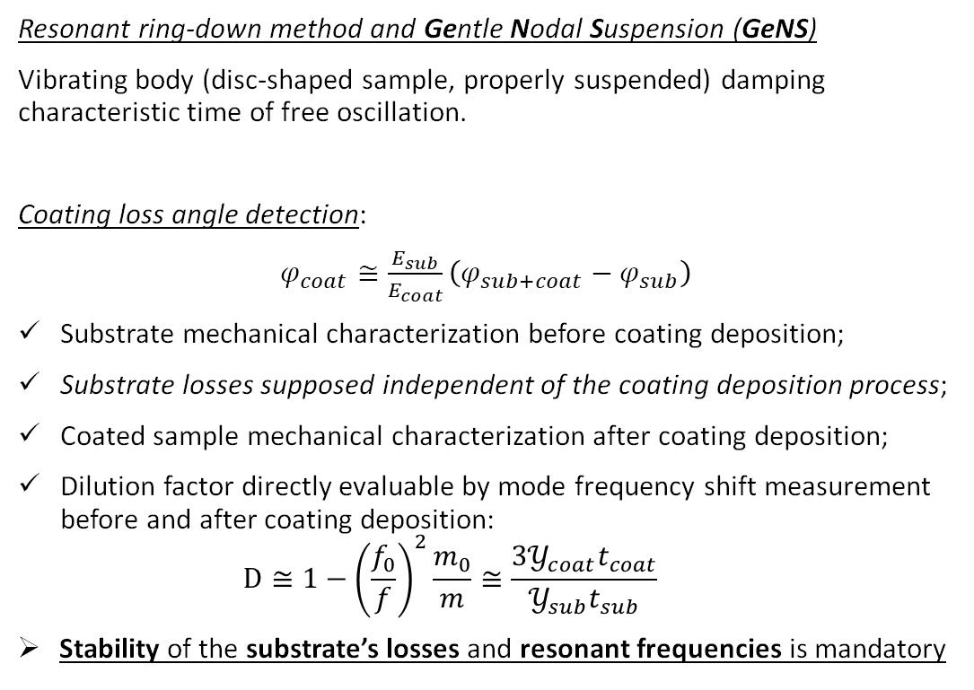
Coating mechanical characterization
Resonant ring-down method and Gentle Nodal Suspension (GeNS)
Vibrating body (disc-shaped sample, properly suspended) damping characteristic time of free oscillation.
Coating loss angle detection:
$φ_{coat}≅\frac{E_{sub}}{E_{coat}}\left(φ_{sub+coat}−φ_{sub}\right)$
Substrate mechanical characterization before coating deposition;
Substrate losses supposed independent of the coating deposition process;
Coated sample mechanical characterization after coating deposition;
Dilution factor directly evaluable by mode frequency shift measurement before and after coating deposition:
  $$D≅1−{\left(\frac{f_{0}}{f}\right)}^{2}\frac{m_{0}}{m}≅\frac{3𝒴_{coat}t_{coat}}{𝒴_{sub}t_{sub}}$$
Stability of the substrate’s losses and resonant frequencies is mandatory
  $$φ= \frac{1}{πfτ}$$
C. Cesarini et al., A "gentle" nodal suspension for measurements of the acoustic attenuation in materials, Rev. Sci. Instr., 80, 053904, 2019.
M. Granata et al. VIR 0499A-16
Sample #9 Corning7980
(3” dia x 1 mm thick)
By measuring different SiO₂ substrates we obtained unexpected results:
loss is shape-dependent → mode families
loss is time-dependent → ageing effect
Notes:
We have seen than CTN depend on coating material mechanical properties, through loss angle.
To make mechanical characterizations, the resonant ring-down method together with a GeNS can be used. A resonator is excited at its resonance frequencies and leaved free to oscillate: measuring the damping period, the loss angle can be extracted.
To obtain the loss angle of a coating film is necessary to make mechanical characterization of a sample before and after coating deposition. In this way, also the dilution factor can be experimentally evaluated, by the frequency shift of the resonant modes and linked to specific elastic properties of the materials.
Therefore, the stability of the substrate’s losses and frequencies is mandatory! From it depends also the coating detectability.
A preferred choice between amorphous materials is fused silica, because it is already the current bulk material in GW detector’s mirrors, it has a really low loss angle @ room T. Studying the fused silica substrate two strange behaviors have been observed:
The losses of the substrates branch out, depending on the family membership: butterfly modes have losses typically higher wrt mixed ones
Furthermore, the losses was not stable in time, get age, and worsen.
Annealing the samples at high temperature seems to restore initial value of losses, but it was not a definitive solution.
Mechanical characterization in this conditions is not trivial.
The Gentle Nodal Suspension offer many advantages: disc-shaped resonators should be used and can be suspended by their centre with no forces applied (but weight), minimum contact area and with a really reduction of coated surfaces damage issue. This kind of suspension guarantee high repeatability and all mode families with nodal lines passing through the centre can be measured.

Slide 13
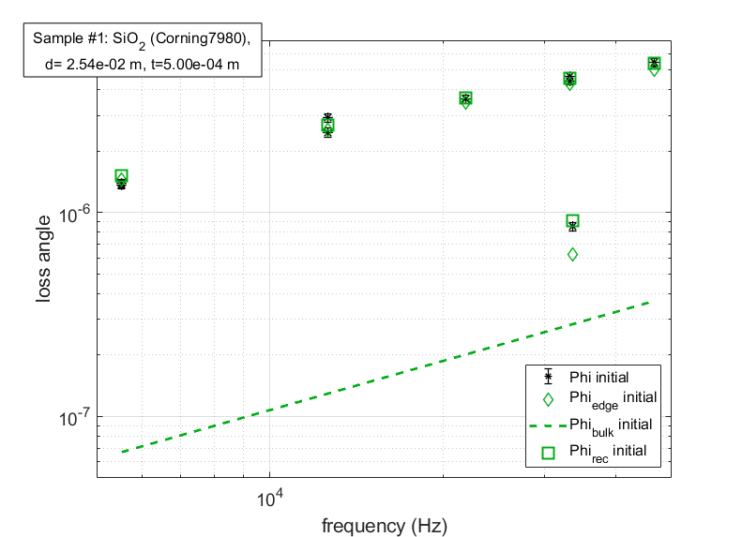
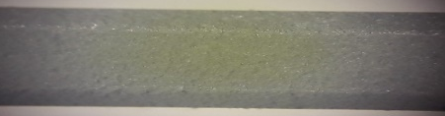

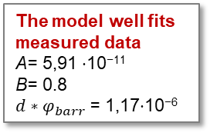
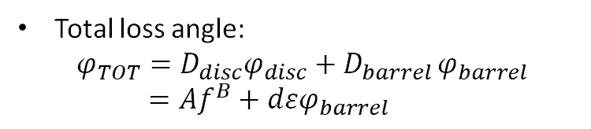

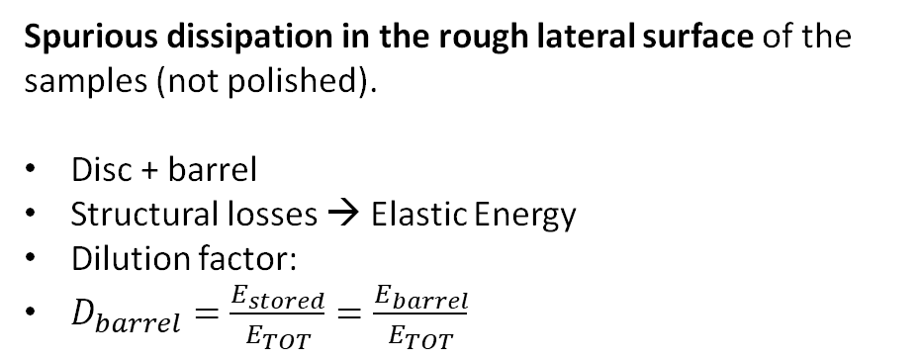
Surface losses model
Spurious dissipation in the rough lateral surface of the samples (not polished).
Disc + barrel
Structural losses → Elastic Energy
Dilution factor:
$D_{barrel}=\frac{E_{stored}}{E_{TOT}}=\frac{E_{barrel}}{E_{TOT}}$
More dissipation on the edge
The model well fits measured data
A= 5,91 ⋅10⁻¹¹
B= 0.8
$d∗φ_{barr}$ = 1,17⋅10⁻⁶
Total loss angle:
  $$φ_{TOT}={D_{disc}φ}_{disc}+D_{barrel }φ_{barrel}$$
  $$={Af}^{B}+dεφ_{barrel}$$
$$d$$
M. Lorenzini et al., Thermo-elastic damping in silicon and metallic discs: the mode-dependent branching effect, GWADW 2016
G. Cagnoli et al., Mode-dependent mechanical losses in disc resonators, Phys. Lett. A (2018), Vol 382, Issue 33, 2165-2173
Notes:
Regarding the branching we think to a very simple model, that is based on the fact that usually commercial samples has a rough not-polished edge surface. In the surface losses model, the sample is considered as composed of two parts: the bulk and the edge, each one with its own losses. In the plot you can see the experimental data (black stars) of a sample sample, but this time the red square reproduce perfectly the behaviour. Also the two different contribution are shown and we can see that the one from the edge is completely dominant and affects more the butterfly modes.

Slide 14

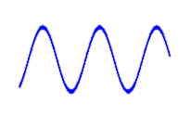
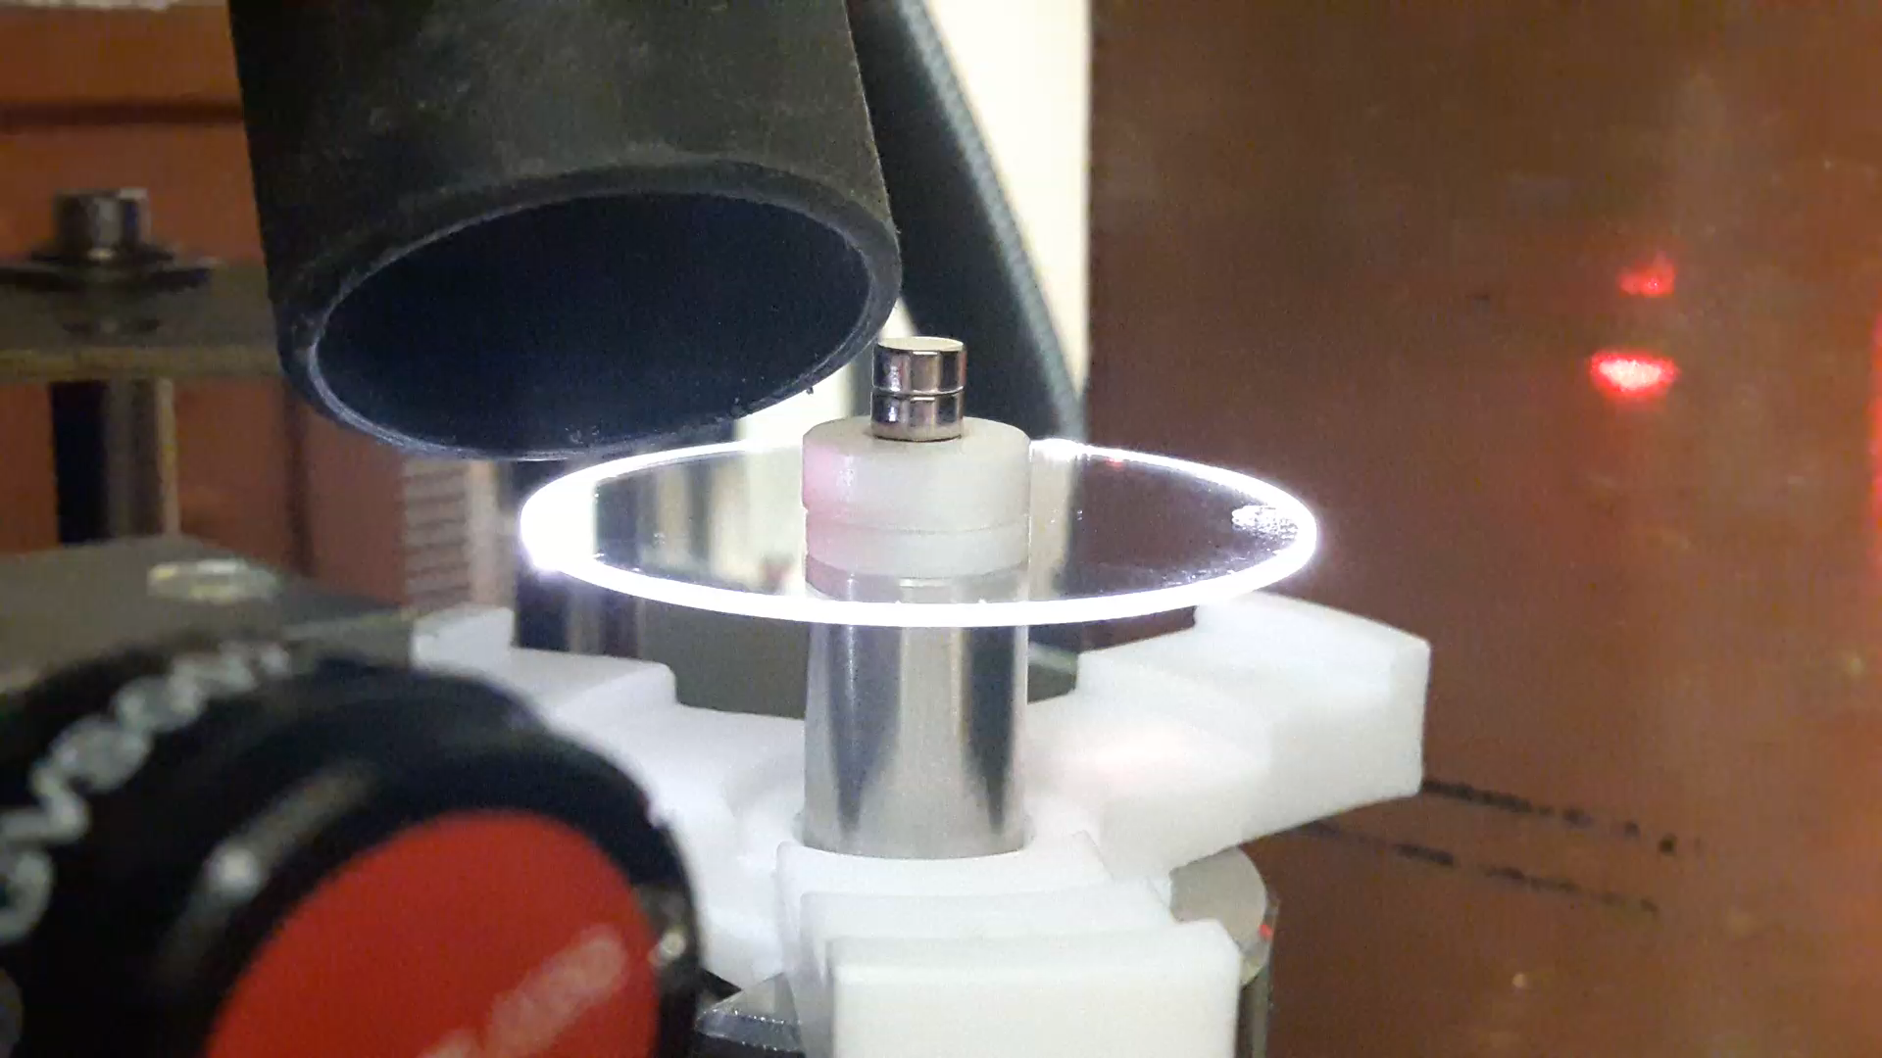
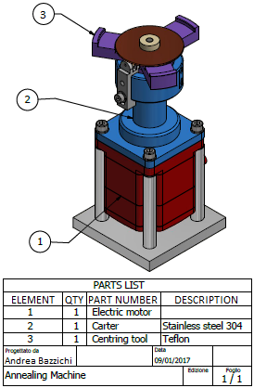
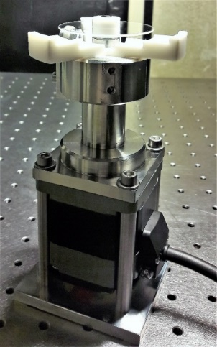
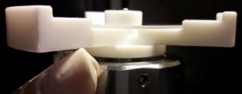
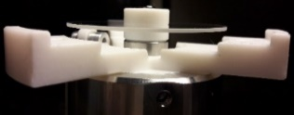
CO₂ laser edge polishing
D. Lumaca et al. Stability of samples in coating research: from edge effect to ageing, submitted to Journal of Alloys and Compounds
@Roma Tor Vergata
CO₂ laser
Lens to adjust the CO₂ beam dimension
Rotary stage with a step motor, to rotate the samples during the polishing procedure
Galvo mirrors
lens
M3
Rotary stage
Beam combiner
M2
LED
The rotary stage
BS
Laser
200 W
Lens
M3
M2
Rotary stage
A teflon centering tool is installed on the rotary stage, to ensure the in-axis positioning of sample discs with diameters up to 3”
M1
@EGO
Notes:
Considering the good results obtained by our model, we thought that a solution could be to polish the sample’s edge, in the attempt to reduce these spurious losses. We designed and realised a CO2 laser polishing facility. The main components are a CO2 laser, an adjustable telescope to obtain the desired beam size and a full-custom rotary stage that rotate the sample during the polishing procedure. Here you can see the full layout of our facility in Tor Vergata University, some detail of the rotary stage and a video of a sample during the procedure.

Slide 15
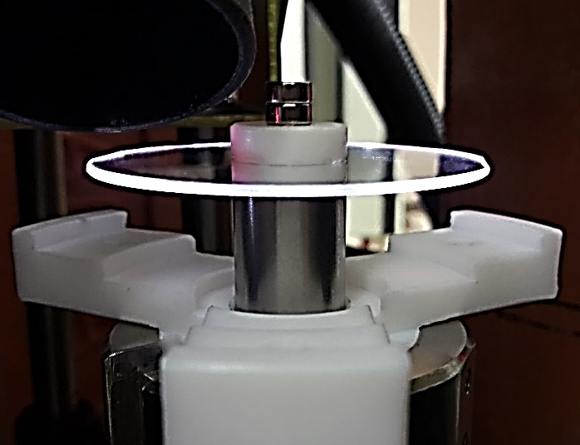
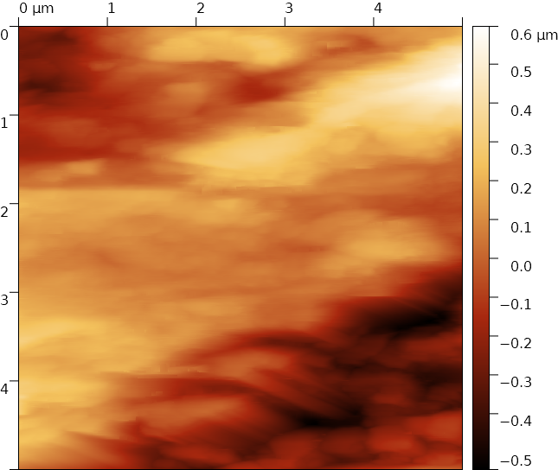
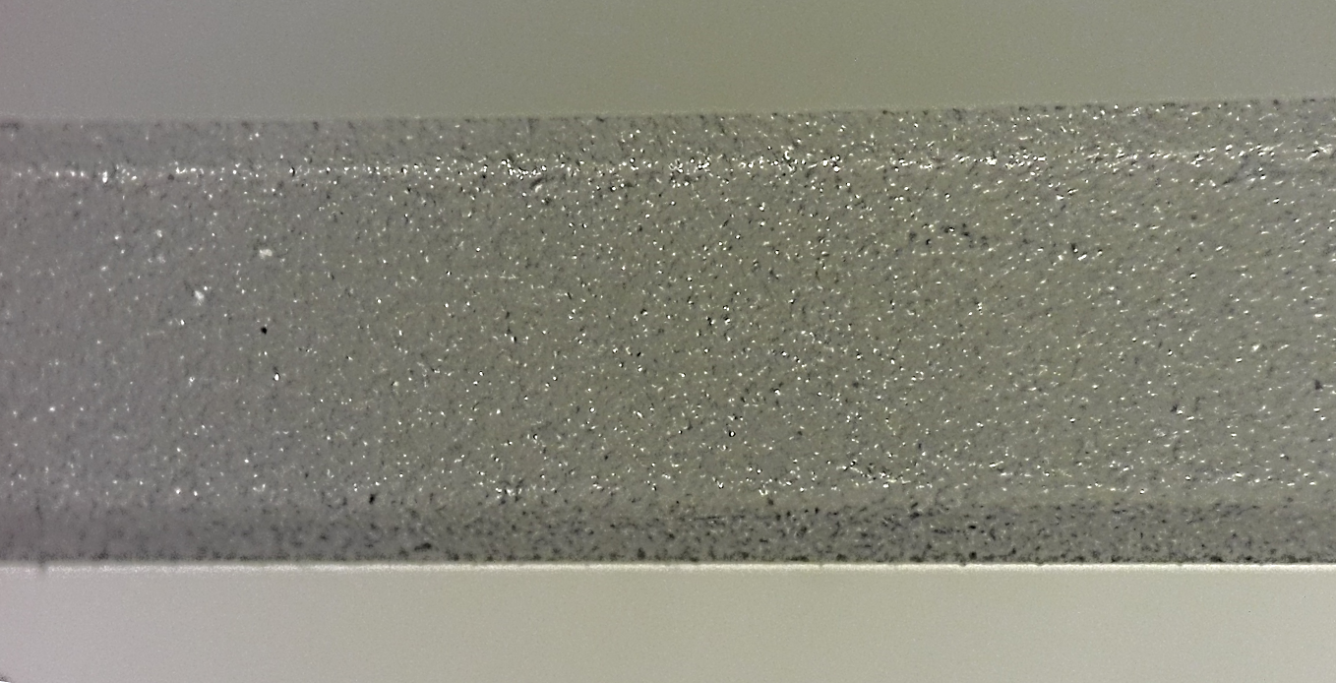
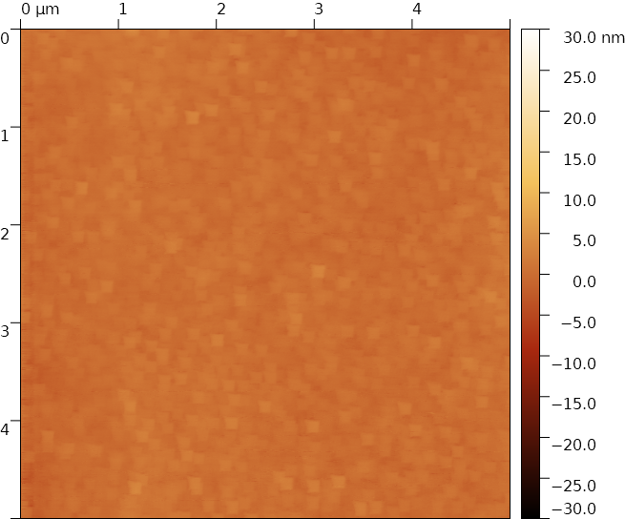
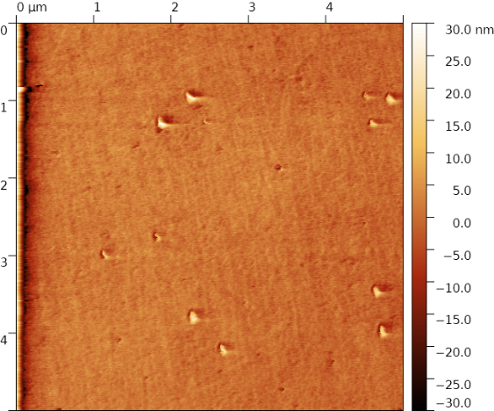
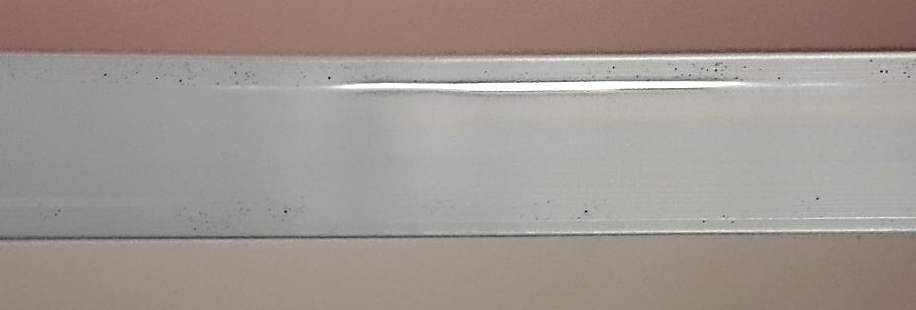
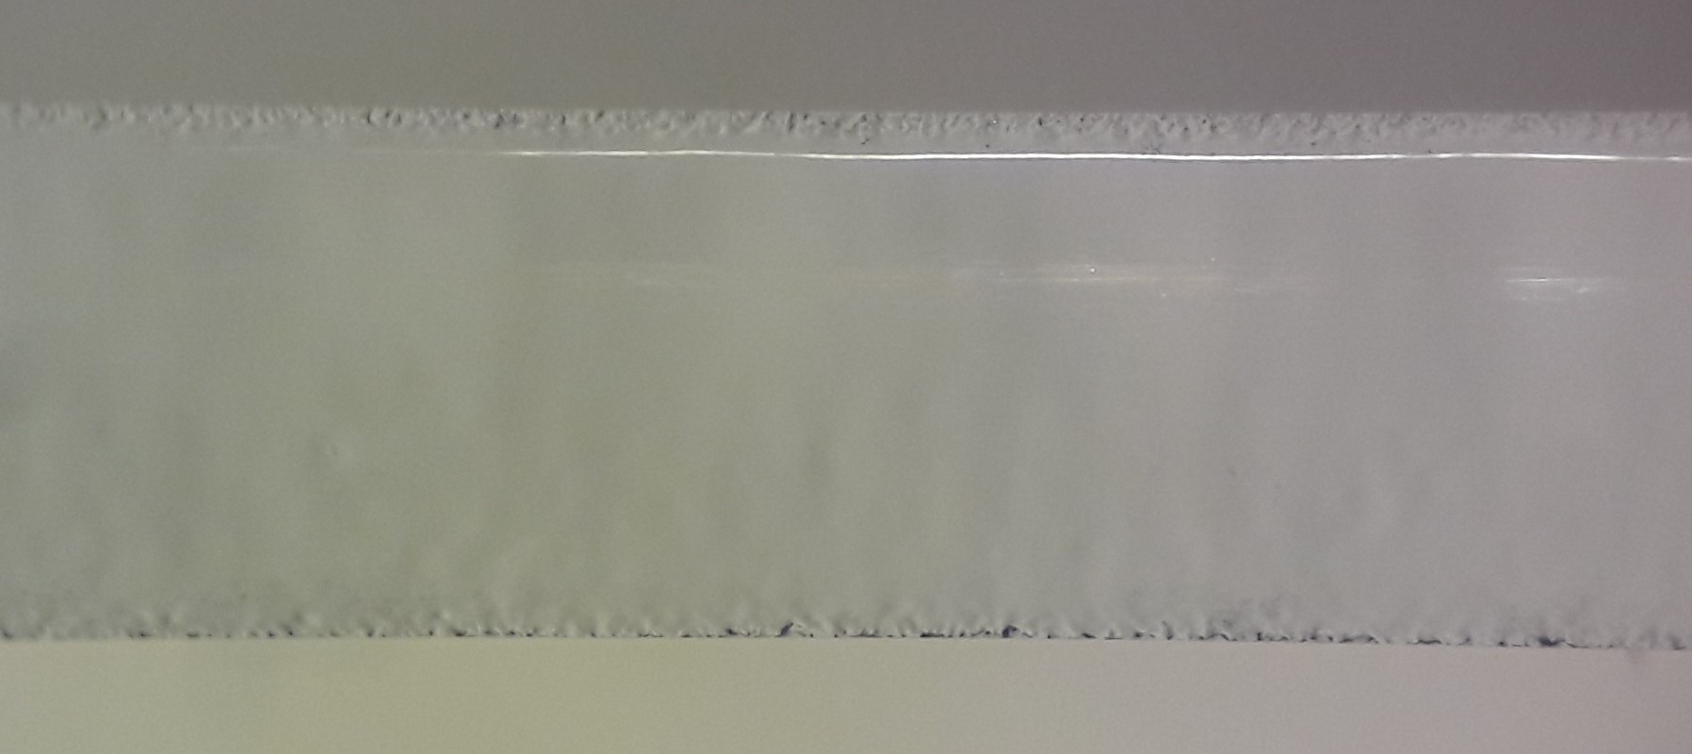
Results: optical and atomic force microscopes
Rough lateral surf.
Rough lateral surf.
RMS ≈ 180 nm
@ Physics Department (U. Roma Tor Vergata)
Polished lateral surf.
Polished lateral surf.
Disc top surf.
4 round
@ ≈ 15 W and 0,24 rpm,
≈ 1 mm spot diam.,
0 mm polishing thick.
250 times reduction of the lateral surface roughness
RMS better than mechanically polished top and bottom surfaces, provided by vendors (RMS ≈ 2,4 nm).
10 round
@ ≈ 15 W and 0,24 rpm,
≈ 0,7 mm spot diam.,
1 mm polishing thick.
RMS ≈ 2,4 nm
RMS ≈ 0,7 nm
Notes:
The first results of the procedure was visible also by eye: the edge of the disc pass from being porous to shiny. The AFM measurement highlight a roughness improvement of 250 times, gentting better than the top and bottom surfaces.

Slide 16









Results: mechanical characterization
 | Initial | After CO₂ pol. | After 1100°C
 |  |  | 1,4 E-7
$${d∗φ}_{edge}$$ | 1,17E-06 | 1,78E-8 | 1,61 E-8
 |  |  | 1,10 E-7
 | Initial
$$φ_{tot}$$ | 3.30 E-6
$$εdφ_{edge}$$ | 3,07 E-06
$φ_{bulk}$ | 2,27 E-7
 | Initial | After CO₂ pol.
 |  | 1,7 E-7
$${d∗φ}_{edge}$$ | 1,17E-06 | 4,94 E-8
 |  | 1,61 E-8
Ageing reduction
Sample: Suprasil impex fused silica
2 inch diam. – 1 mm thick.
CO₂ laser polishing
Ageing effect reduced!
Edge contribution passes from being dominant to be less relevant with respect to bulk one.
Annealing relaxes remaining stresses
Sample mechanical losses stabilised in time: reduction of ageing
International standard procedure for substrate preparation
Notes:
Obviously, also the mechanical characterization was performed.
Those are the losses of sample that I show you before, with the branching issue, and surface model, with the two contribution from the edge and from the bulk. After CO2 laser polishing there is a general reduction of the losses and of the branching, together with the fact that bulk and edge contribution became almost of the same order. Polariscope image highlight some residual stress still present, so we make an annealing at high temperature and obtain the final results in red: the branching was completely deleted and the edge contribution passes from being dominant to be an order of magnitude lower wrt bulk one.
The other issue was the instability of losses in time. We have observed that the edge polishing heal also the ageing: here you can see the losses of another sample that drastically reduce after CO2 polishing and then remain almost constant for at least 10 months.
These results of the polishing are so promising that these steps are going to be part of an international standard procedure for the substrate preparation for the coating deposition and the evaluation of its mechanical losses.

Slide 17
Conclusions
Einstein Telescope (ET)
  10 times sensitivity improvement: underground, cryogenic, nested detectors, xylophone layout, …
  demanding challenge
  significant R&D processes
The Low-frequency Versus Cryogenics for ET (LoVeC-ET) project is framed inside the ET low frequency (ET-LF) instrument
  Provide operative focus on the main features of the cryogenic environment hosting the payload
Notes:
Summarizing, ET is a very demanding challenge, from many point of view, involving significant R&D processes.
One of them is carried out by LOVEC-ET project

Slide 18
Conclusions
The operation of cryogenic payload strongly depends on the actual condition of mirror surfaces at low temperature:
  Mirror’s surface icing impact on coating absorption and reflectivity, mirror’s thermal load and cryogenic system, TN level and overall sensitivity
  A suitable systems dedicated to remote diagnostic and conditioning of mirror surfaces at low temperature is fundamental
CO₂ laser represent a possible solution:
  Gained experience:
    CO₂ laser projectors used in TCS for correction of optical aberrations due to thermal lensing in advanced ground-based GW detectors
    CO₂ laser polishing used in metrology inside CRD, for substrate’s preparation procedure
Notes:
We’ve largely seen that mirror’s surface condition at cryT is fundamental for cryogenic operation.
One of the main issue is represented by frost formation and the design

Slide 19
Thanks for your attention

Slide 20
Backup slides

Slide 21




Slide 22






Interferometric detectors network
KAGRA
LIGO Hanford
VIRGO
LIGO Livingston
Detection bandwidth 10 Hz-10kHz
NS-NS Range: 50-130 Mpc

Slide 23


Advanced Virgo for next observing run
3 km arm Michelson interferometer tuned at dark fringe
Circulating TEM₀₀ mode from CW Nd:YAG source @1064 nm+ injected sidebands
Optical path folding with resonant Fabry Perot arm cavities
Power-recycled/Signal-recycled config
High intracavity power buildup (~ 200 kW)
Shot noise-limited at high frequencies:
$$h_{SN}∝\frac{1}{\sqrt{P_{IN}}}$$

Slide 24


Slide 25



TCS actuators :
CO₂ laser projector (50 W)
Ring Heater
TCS sensing :
HWS-RC
HWS-HR
Phase Cameras

Slide 26




Actuation: CO₂ projectors (thermal lensing)
Axi-symmetric corrections
Residual corrections
DAS (Double Axicon System)
Two annular (axisymmetric) power distributions superimposed
Annuli created using axicons
Optimal heating profile obtained by iterative process with FEA simulations
SS (Scanning system):
Raster scan with variable intensity beam
But: scan frequencies inject noise!
DC correction with deformable mirrors
Statically shape the CO₂ beam in a non axisymmetric heating pattern
Gerchberg-Saxton algorityhm for open loop intensity shaping tested in simulations
Several commercial actuators considered:
  Titan 144 from Adaptica
  Thorlabs
  DM97 from ALPAO
Stability of the phase correction vs hysteresis and relaxation is a key requirement
Is closed loop operation needed?
TARGET
DM 12x12
Simulation of 12x12 DM, heating profile reproduced via Gerchberg-Saxton recursive algorithm

Slide 27
SiO₂ substrates issues
By measuring different SiO₂ substrates we obtained unexpected results:
loss is shape-dependent → mode families
loss is time-dependent → ageing effect
M. Granata et al. VIR 0499A-16
Annealing at high temperature of the SiO₂ substrate restores the initial condition, but (alone) it was not a definitive solution.
Absorption of contaminants trough the rough edge?
Sample #9 Corning7980
(3” dia x 1 mm thick)

Slide 28





Metrology
GeNS @ Roma Tor Vergata
actuators
half-sphere
Acquisition software
R&D in coating thermal noise reduction
sample
Electrostatic actuation
optical lever spot
Notes:
Here I just want to show you two pictures of Tor Vergata GeNS set-up, together with a easy schematization of the excitation and measurement systems. Samples are suspended on top of an half-sphere, over the actuators. Through them the excitation (sinusoidal, at a certain frequency) is transmitted to the disks. The subsequent decay phase is monitored through a laser, with a long optical lever, that hit the sample along the border and, after reflection, goes into a photodiode.
---------------------------------------------------------
Shadowmeter: due fotodiodi, con una gap in mezzo, che misurano la differenza.

Slide 29
abstract
Per il titolo abbiamo pensato a "CO2 laser techniques in the perspective of future gravitational wave detectors". L'idea è di strutturare la presentazione introducendo il progetto del PRIN LoVeC-ET in cui sono entrata e che sta partendo in questi mesi. L'obiettivo generale è fornire un focus operativo sulle caratteristiche principali dell'ambiente criogenico che ospiterà il payload. Il suo funzionamento dipenderà dalle effettive condizioni delle superfici degli specchi a bassa temperatura, pertanto è fondamentale ideare un sistema dedicato alla diagnostica e al condizionamento a distanza delle superfici degli specchi. In particolare citerei il problema già osservato dell'icing degli specchi e introdurrei i laser a CO2 come una possibile soluzione, mostrando come sono già utilizzati (anche se per applicazioni differenti) nell'ambito delle onde gravitazionali (per il polishing dei substrati nello studio delle proprietà meccaniche dei coating e per la correzione delle aberrazioni ottiche axisimmetriche nella TCS). Spero possa tornarti utile per collocare al meglio la presentazione.
The Low-frequency Versus Cryogenics for ET (LoVeC-ET) project is framed inside the Einstein Telescope low frequency (ET-LF) experiment. The focus of the project, that is starting now, is to provide operative focus on the main features of the cryogenic environment hosting the payload. The operation of cryogenic payload strongly depends on the actual condition of mirror surfaces at low temperature [Ha,Ta]: therefore, a suitable systems dedicated to remote diagnostic and conditioning of mirror surfaces at low temperature is fundamental.
It has been observed that residual vacuum gases tend to adsorb on top of the mirror surface, generating an ice layer (frost), noxious for mirror’s performances. Many possibilities have been taken in consideration to reduce, avoid or contrast this issue.
CO2 lasers, already largely used in various aspect in nowadays interferometric detectors, represent a possible solution.
The presentation will resume the CO2 lasers’ use in GW framework until today and
The Einstein Telescope (ET), the European ground-based gravitational wave detector of third-generation, is an evolution of second-generation. In order to achieve the sensitivity which the ET project aims for, at high frequency the light power in the interferometer arms needs to be increased to the Megawatt range, conflicting with the requirements of low radiation pressure noise and cryogenic temperature operation for a good sensitivity in the low frequency range. To fulfil both these requirements in a single detector is beyond the current state of the art, therefore it will be realised in a Xylophone arrangement: a low frequency interferometer (ET-LF) will be operated at low laser power and cryogenic temperatures around 20 K whereas the high frequency interferometer (ET-HF) will be operated at high laser power and room temperature. The resulting total ET sensitivity is a combination of two nominal sensitivities.
Motivated by ET science-case expectations, the Low-frequency Versus Cryogenics for ET (LoVeC-ET) project provide operative focus on the main features of the cryogenic environment hosting the payload. The operation of cryogenic payload strongly depends on the actual condition of mirror surfaces at low T [Ha,Ta]: therefore, a suitable systems dedicated to remote diagnostic and conditioning of mirror surfaces at low temperature is fundamental.
aims at developing specific approaches to sensing and control of the payload degrees of freedom in cryogenic ET-LF and at identifying strategies to restore optimal conditions of the mirror surface against frost and/or electric charge deposition
[Ma] M. Maggiore et al., “Science case for the Einstein telescope”, Jou. of Cosmology and Astrop. Phys., 2020, 03, p 50 (2020).
[Pu] M. Punturo et al., “Einstein gravitational wave Telescope: Conceptual Design Study", http://www.et-gw.eu/index.php/etdsdocument (2011).

