Slide 1
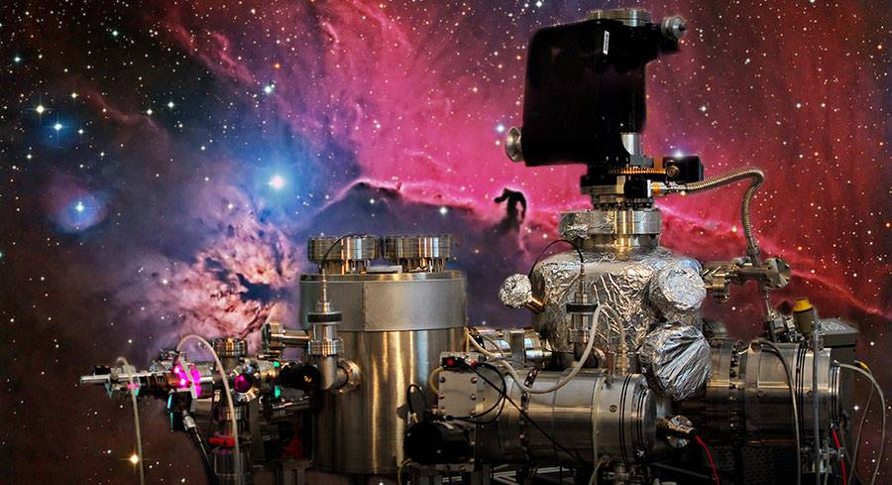
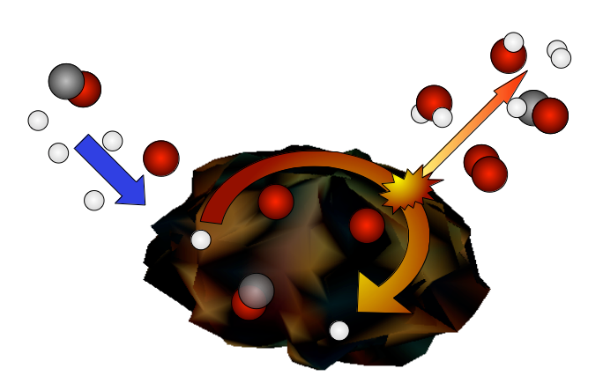
Physical and chemical processes at the surfaces: the viewpoint from the Space
© « Color of hydrogen » E. Congiu
François Dulieu, September 22, Elba, Italia

Slide 2
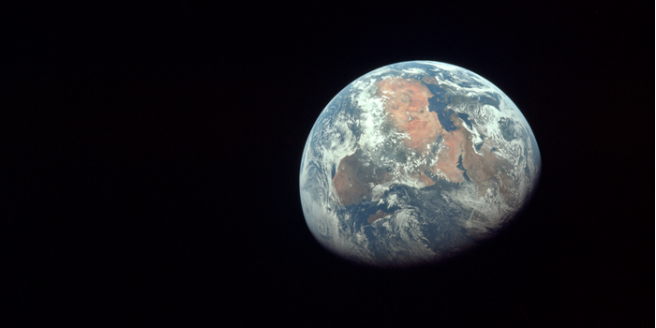
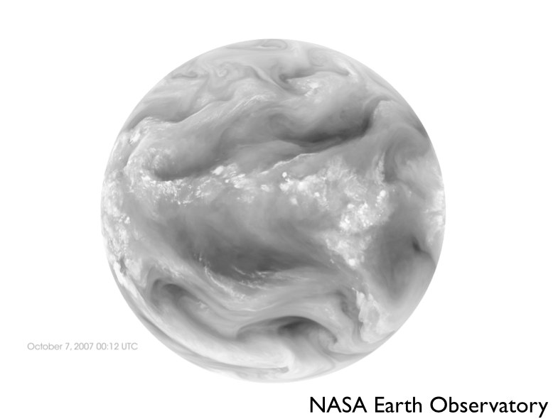
Planets, IR and visible
A planet observed in the Infra Red
The same planet in the visible
(different time and angle)
(1) That’s why telescopes are in altitude !
(2)This is an another view of the green house effect

Slide 3
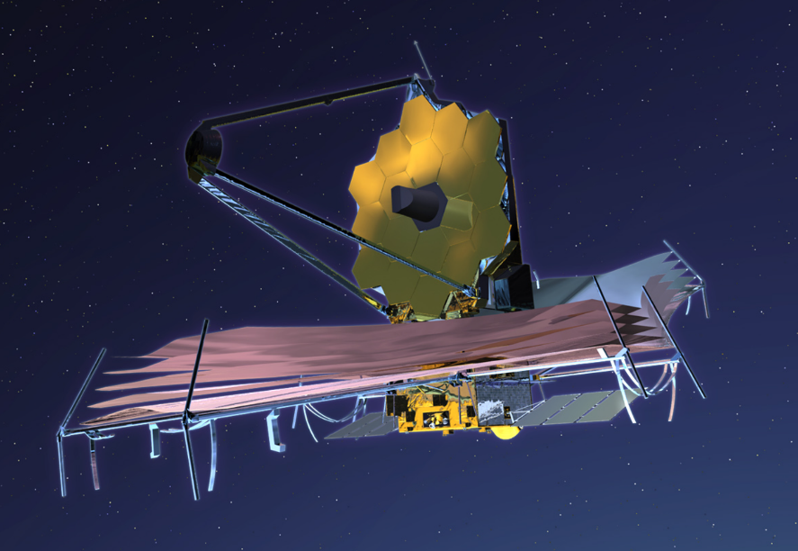
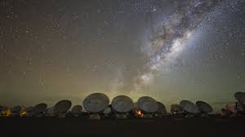
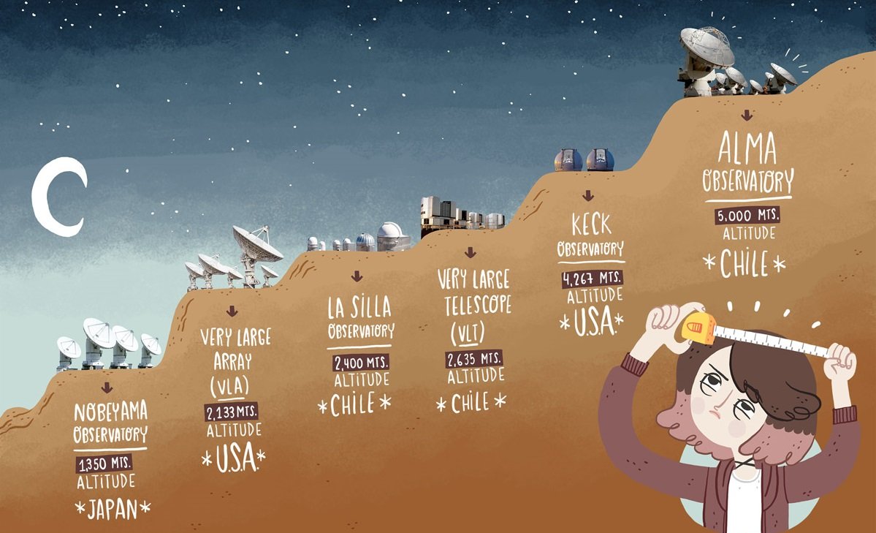
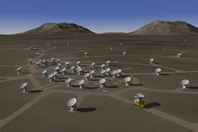
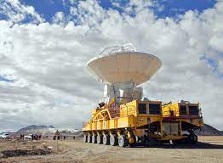

Slide 4
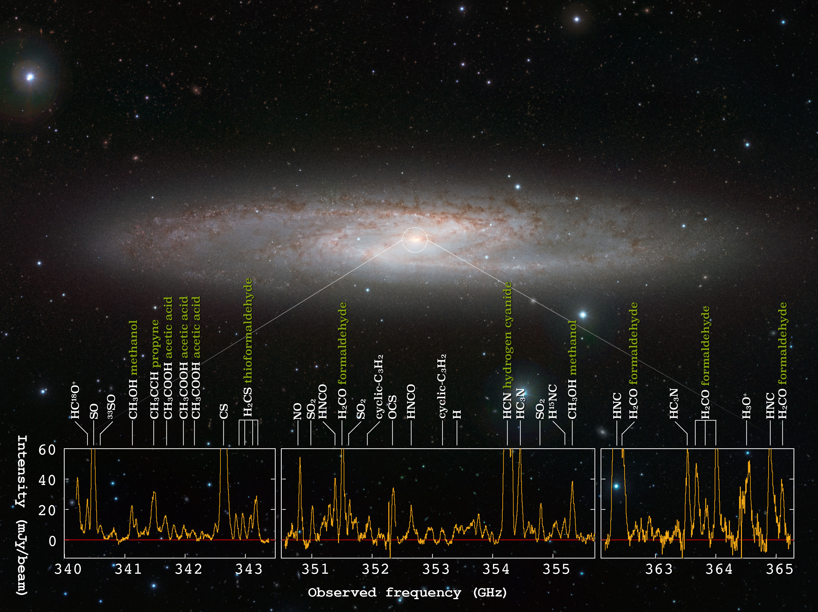
Observation of molecules
with ratio telescopes (ALMA)

Slide 5
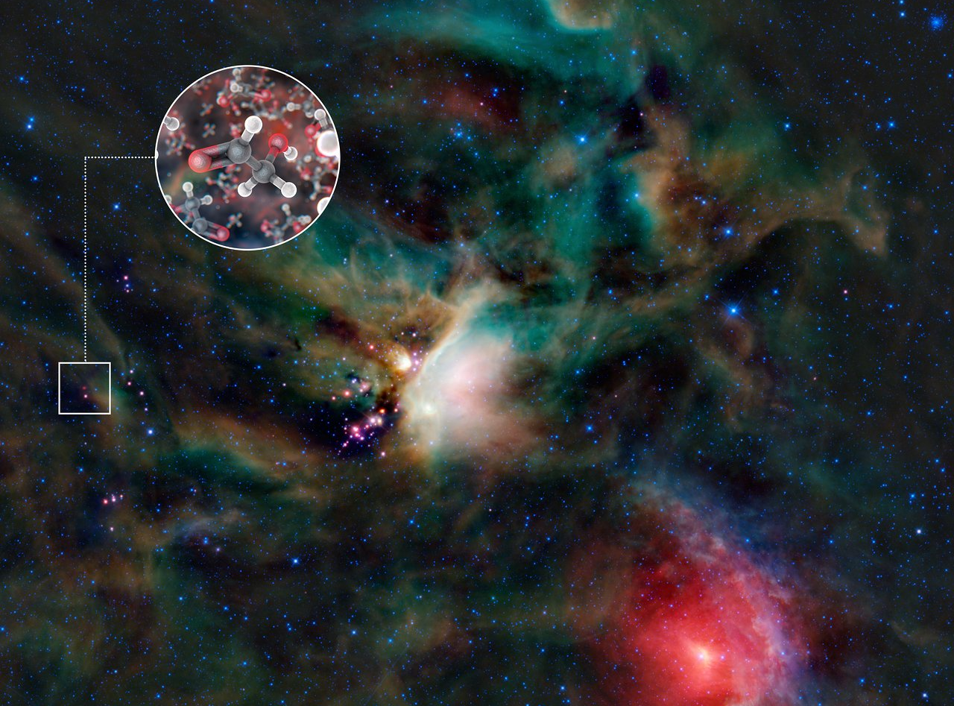
Sugar molecules in a gas surrounding a young Sun-like star
https://www.eso.org/public/france/news/eso1234/
https://cdn.eso.org/videos/hd_and_apple/eso1234a.m4v

Slide 6
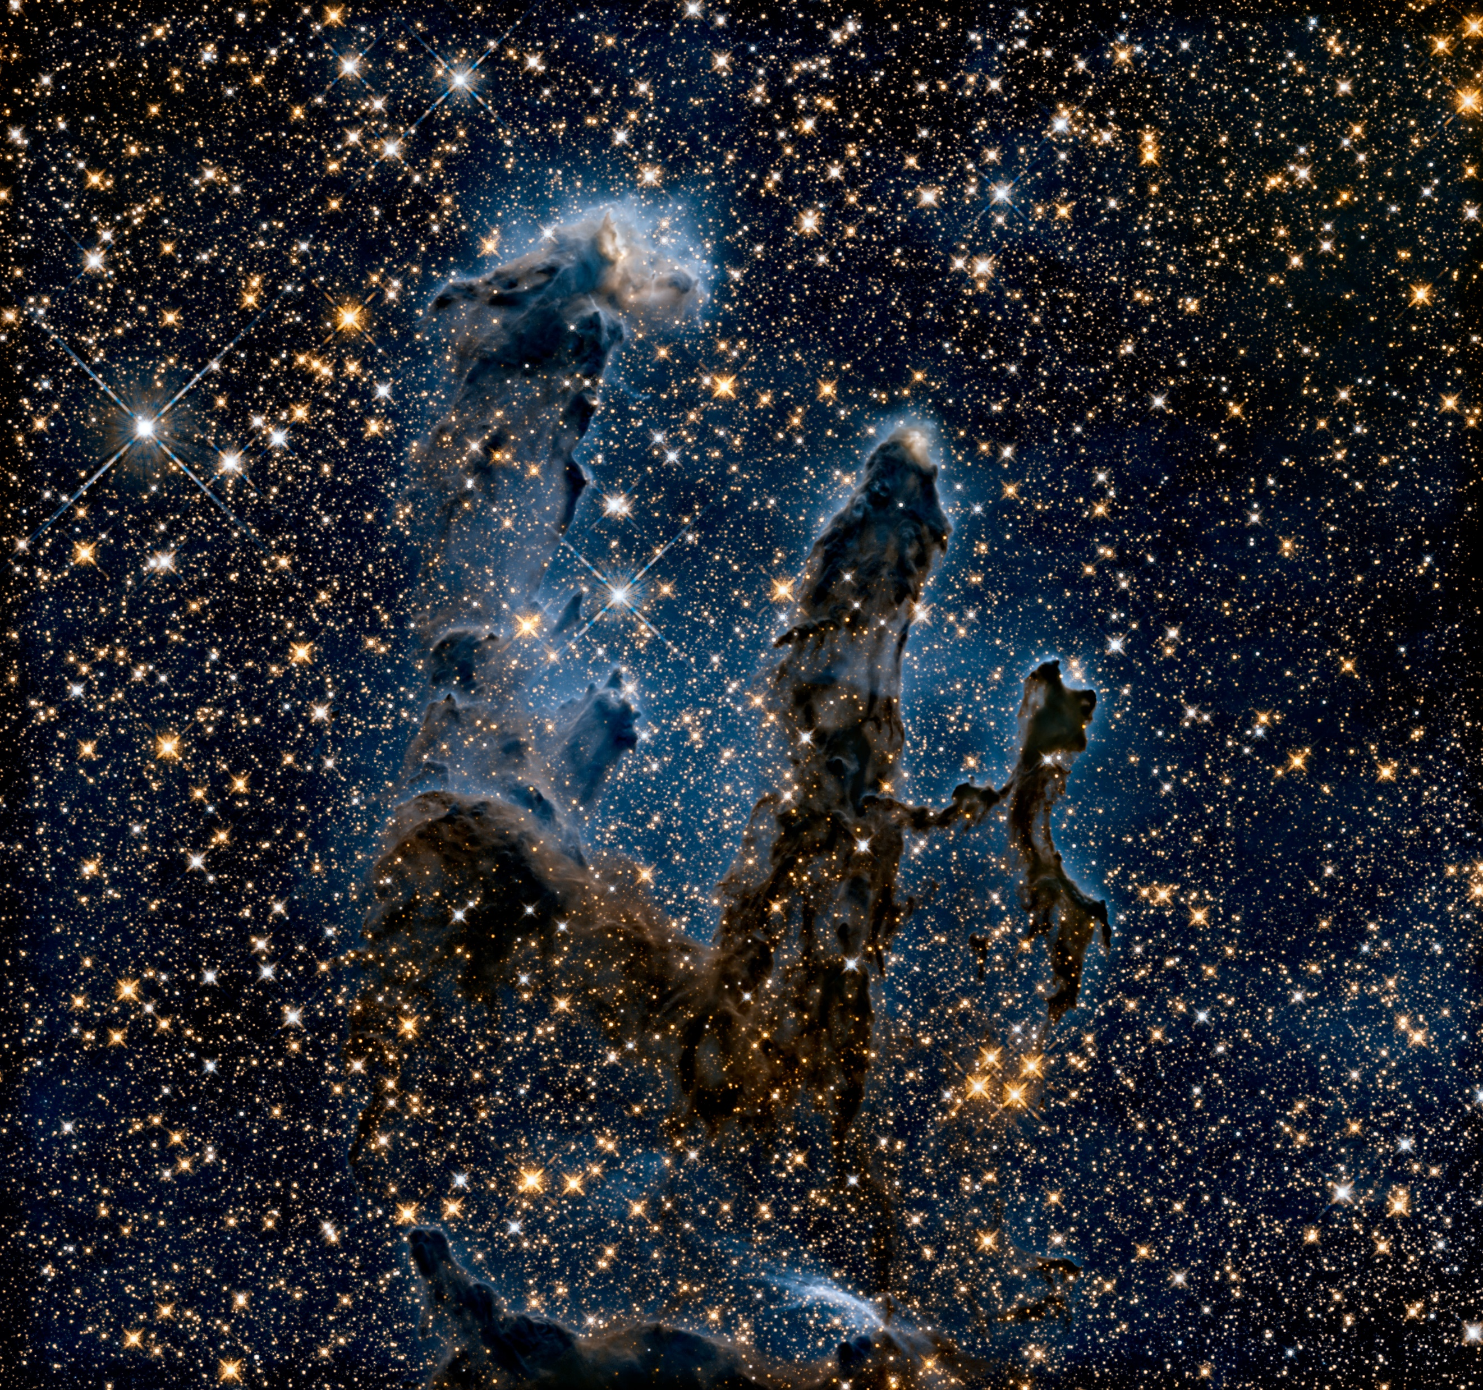
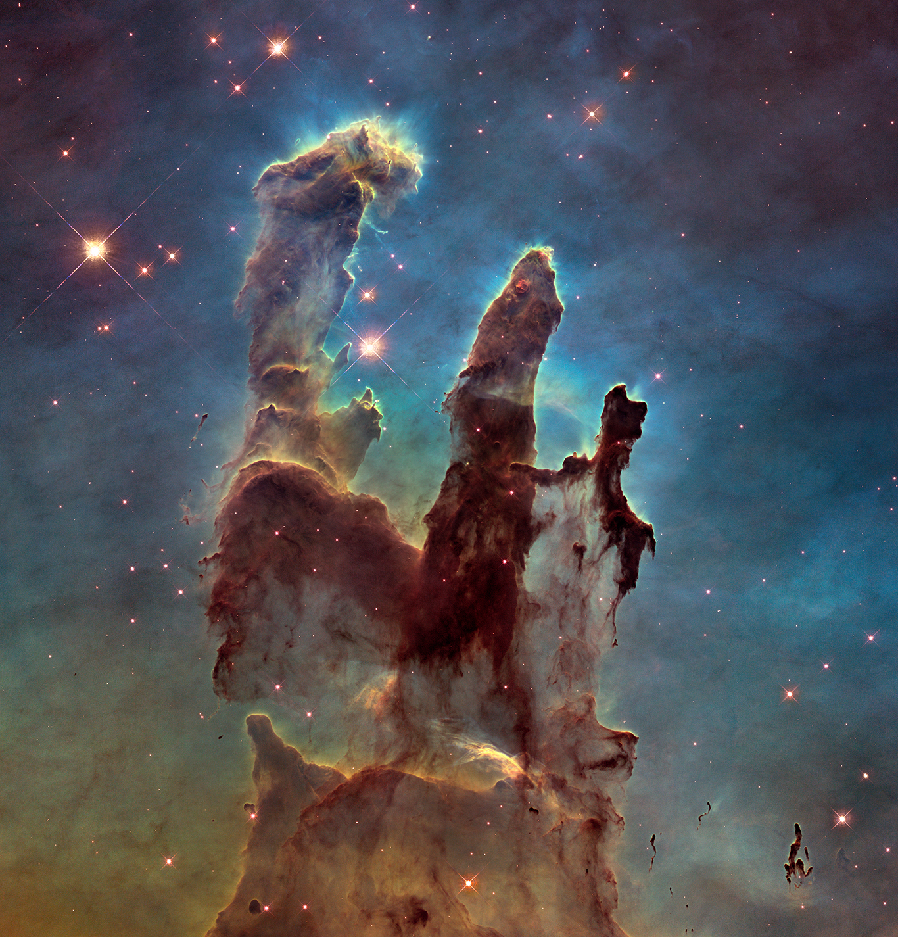
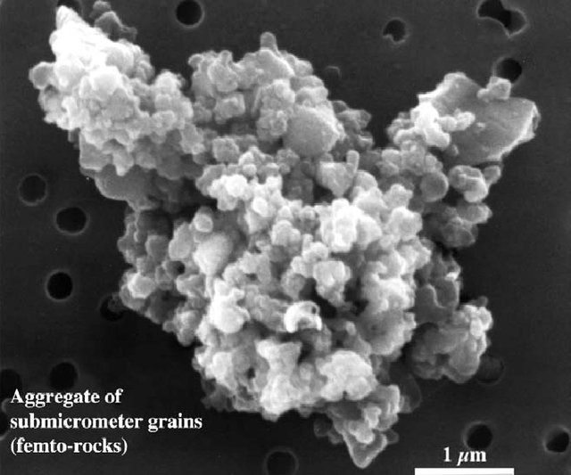
Nebulae, interstellar medium
Ice particles scatter light
https://www.nasa.gov/image-feature/the-pillars-of-creation
Toward Infra Red, dust grains have less opacity
In the visible

Slide 7
Dark (molecular) clouds
Zoom and shift in frequency
Dust obscures the line of sight
Dense (>10⁴ particle / cm³ > 10⁻¹²mbar !)
Cold (T ~10 K)
Source : Spitzer Space Telescope - NASA Caltech
Important step of the star formation where
molecular complexity explodes
Start
From visible to FIR
end
Toward Infra Red, dust grains have less opacity

Slide 8
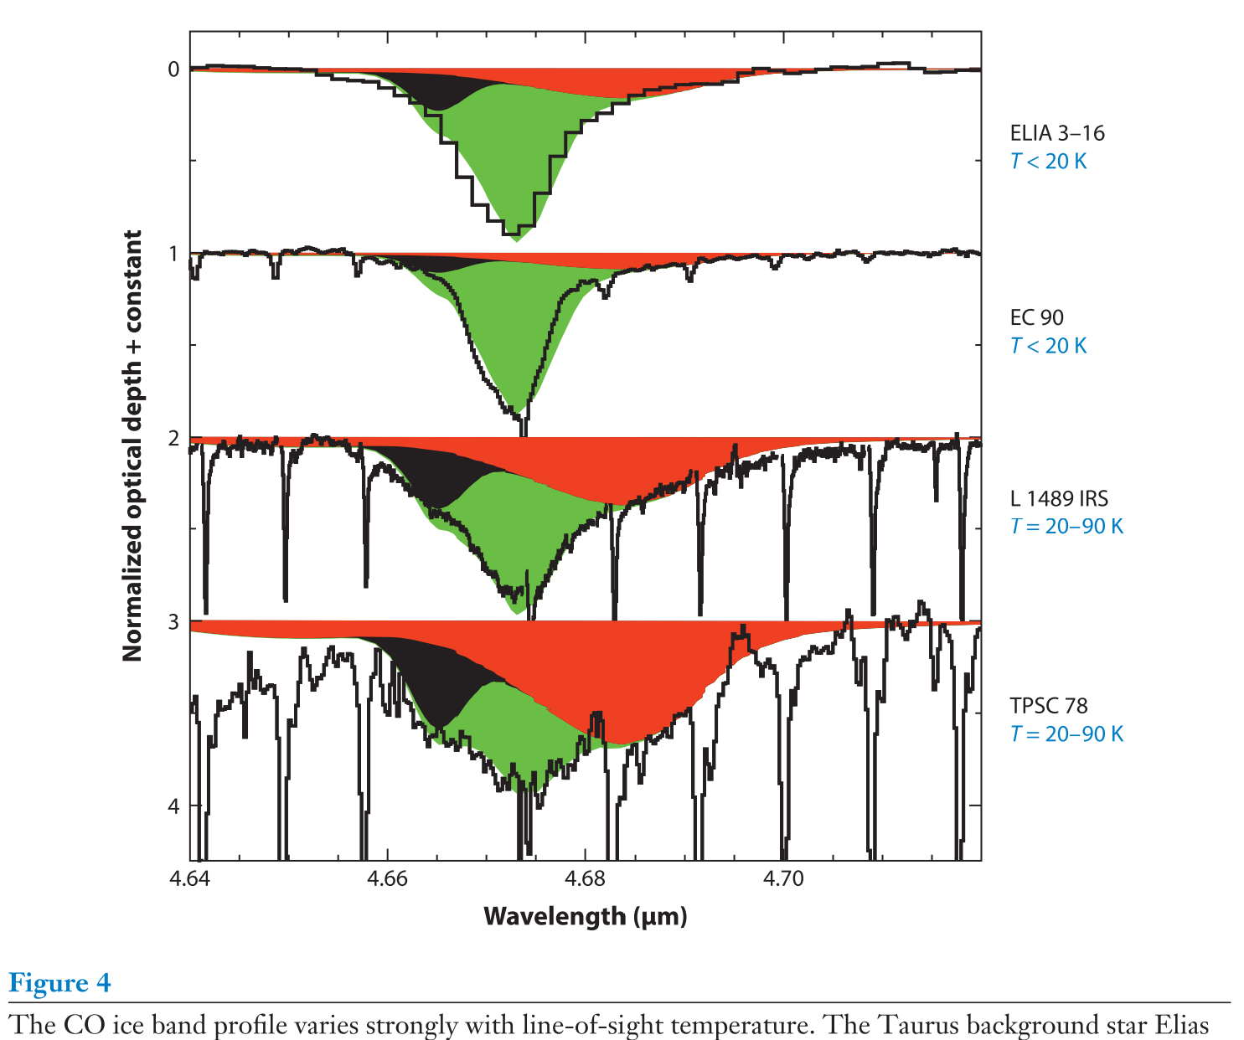
CO solid (broad band) and CO gas (rotation → thin, spaced)
Embeded proto-stars
T >20 K
T ~ 20 -90 K
Both gas
Boogert+2015

Slide 10
Atoms are formed in the interior of stars
Dust grains are formed in outer enveloppe of stars
Molecular complexity can grow in UV- shielded environments
Dense molecular cores evolve in stars and planets
Material is permanently reinjected in the ISM
But UV Shielding implies high densities, and cold T_{dust}
So accretion on grains
Solid phase is the reservoir of molecular complexity

Slide 11
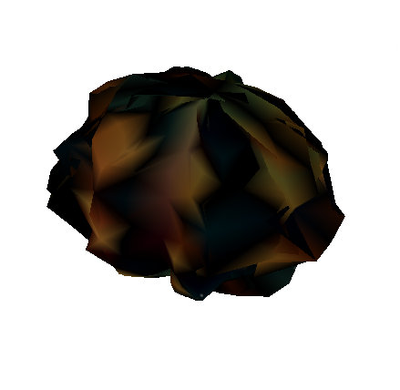
Growth of molecular mantles
Matar+10 JCP, Chaabouni+12 A&A
Matar+08 A&A, Minissale+16 A&A
H atoms
Accrete (sticking <1)
At a rate of ~ per day
Diffusion ~ ms scale at 10 K for H, (N and O)
Gas particules freeze out on cold surfaces
0. 1 μm ~ 10⁶ adsorption sites

Slide 12
Growth of molecular mantles
Matar+10 JCP, Chaabouni+12 A&A
Matar+08 A&A, Minissale+16 A&A
H atoms
Accrete (sticking <1)
At a rate of ~ per day
Dulieu+10 A&A
O + H → OH
OH + H → H₂O
Diffusion ~ ms scale at 10 K for H, (N and O)
Reaction and formation of molecules
Gas particules freeze out on cold surfaces
0. 1 μm ~ 10⁶ adsorption sites

Slide 13
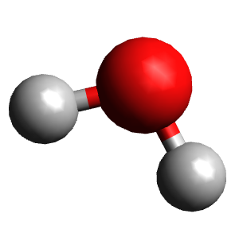
Growth of molecular mantles
Matar+10 JCP, Chaabouni+12 A&A
Matar+08 A&A, Minissale+16 A&A
H atoms
Dulieu+10 A&A, Dulieu+19 MNRAS
Noble+11 MNRAS, Minissale+16 MNRAS…
Accrete (sticking <1)
At a rate of ~ per day
Diffusion ~ ms scale at 10 K for H, (N and O)
Reaction and formation of molecules
Such as H₂O, CO₂, CH₃OH, NH₂CHO…
Ice mantle grows as depletion occurs
~ 100 layers, > 10⁵ years
Gas particules freeze out on cold surfaces
0. 1 μm ~ 10⁶ adsorption sites

Slide 14
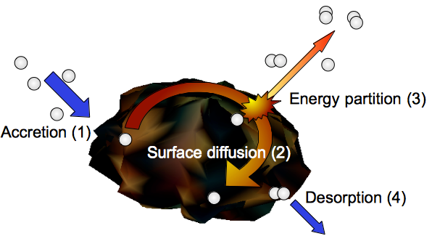
Cergy’s team purpose:
How molecular complexity can develop ?
starting from atoms or small molecules
without external energy
on surfaces
Understand processes, like the return in the gas phase, the diffusion, the isotopic effects or the reactivity

Slide 15
From concept to reality…
On cold surfaces
Put on atoms
Observe the result

Slide 16
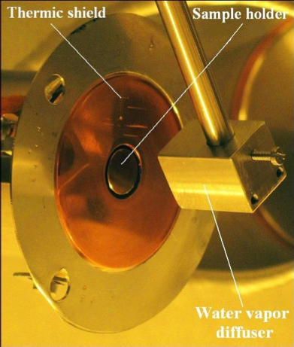
From concept to reality…
on cold surfaces, silicates, graphite or ices
Put on atoms
Observe the result
Thermal control 6.5 - 800K
Balance between He cryocooler (close cycle) and
resistive heater + thermic background

Slide 17
From concept to reality…
Cold surfaces… like ices
Typical Binding energies
1200 K*
100 meV
10 kJ/mol
2.4 kCal/mol
834 cm⁻¹
on cold surfaces, silicates, graphite or ices
Put on atoms
En mesurer le résultat
Typical amount of species
max : 10¹⁴ molecules
> 1 nano-mole
Physisorption is the dominant interaction
Surface model: « egg box, or grid »
One « Monolayer » = 100% occupation
One « Monolayer » = 10¹⁵ sites/cm²
UHV (unless 1 ML growing in 5 minutes @ 10⁻⁸ mbar )
Senevirathne+17

Slide 18
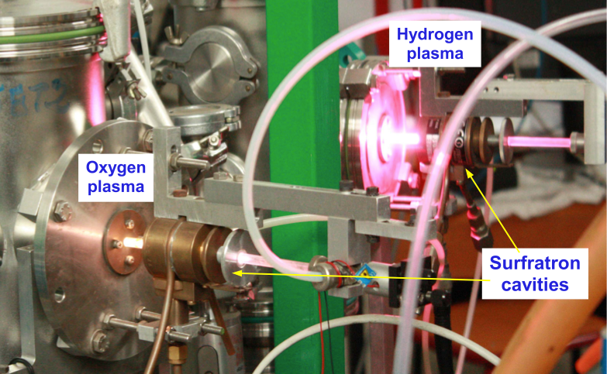
From concept to reality…
on cold surfaces, silicates, graphite or ices
Put on atoms
Observe the result
© Minissale 14

Slide 19
LERMA - Cergy

Slide 20
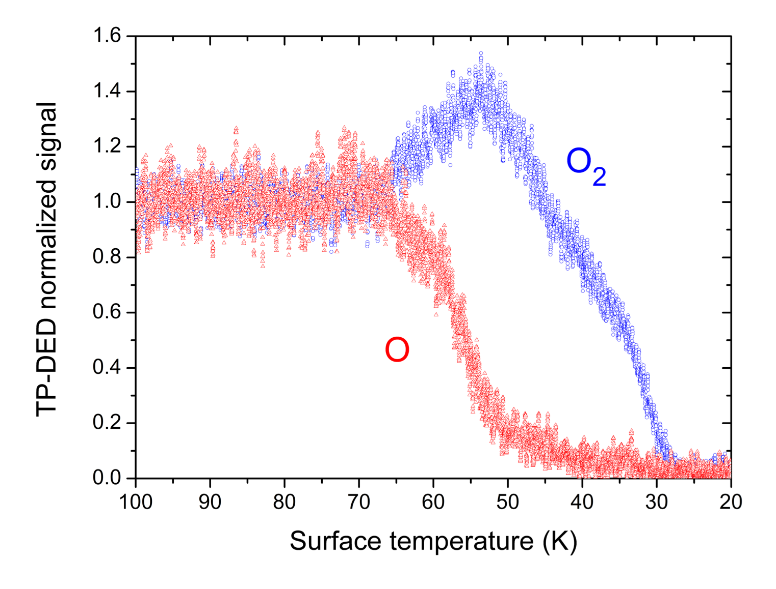
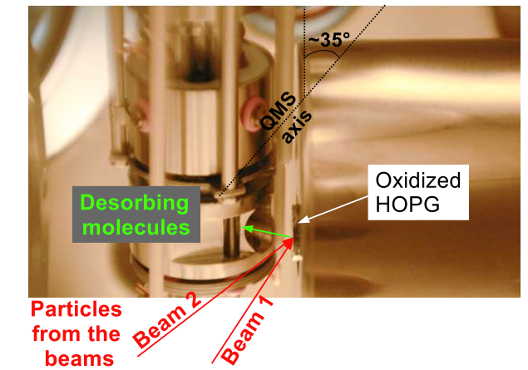
Direct measurement of O in the gas phase
Surface temperature is slowly decreasing (-1K/min) while O are sent on the surface
Minissale , Congiu & Dulieu, A&A 2016
O is disapearing : freezing out !
(at much higher temperature than previously thought)

Slide 21
Direct measurement of O in the gas phase during O exposure
A : O accommodation and desorption compensate
A
B
C
B : O stays long enough so that it reacts and forms O2 that desorbs
C : O2 stays long enoug to react and to form O₃ that stay on the surface (cf IR)
Minissale , Congiu & Dulieu, A&A 2016
Residence time increases with decrease of the temperature

Slide 22
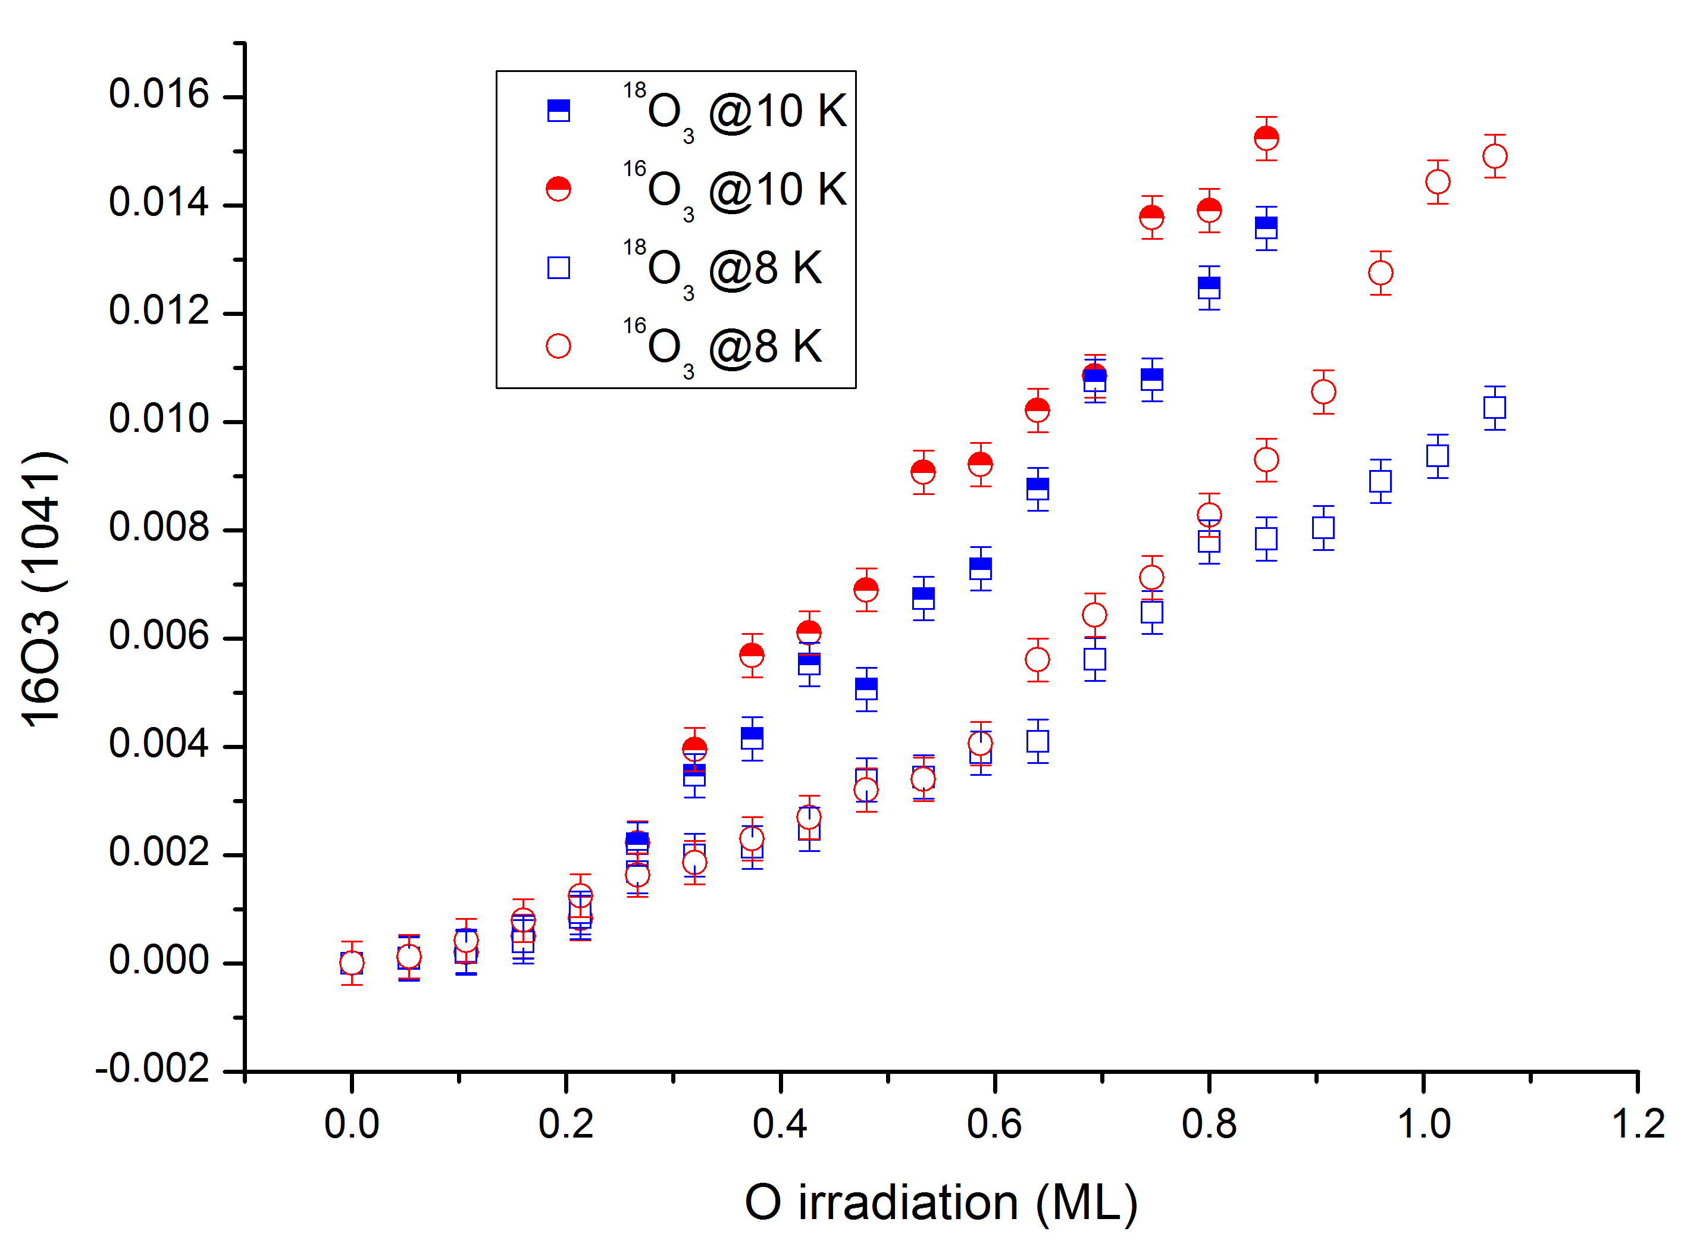
+
O+O —> O2
O+O2 —> O3
O (+O2)
+
O3+O —> 2 O2
IR intensity
¹⁶O
Down to 6.5 K
10 K
¹⁸O
Isotherms at very low T
Ozone is formed !
Only O₃ detectable in IR
8 K
Minissale, Dulieu et al, unpublished
+ some mass effects: ¹⁸O vs ¹⁶O

Slide 23
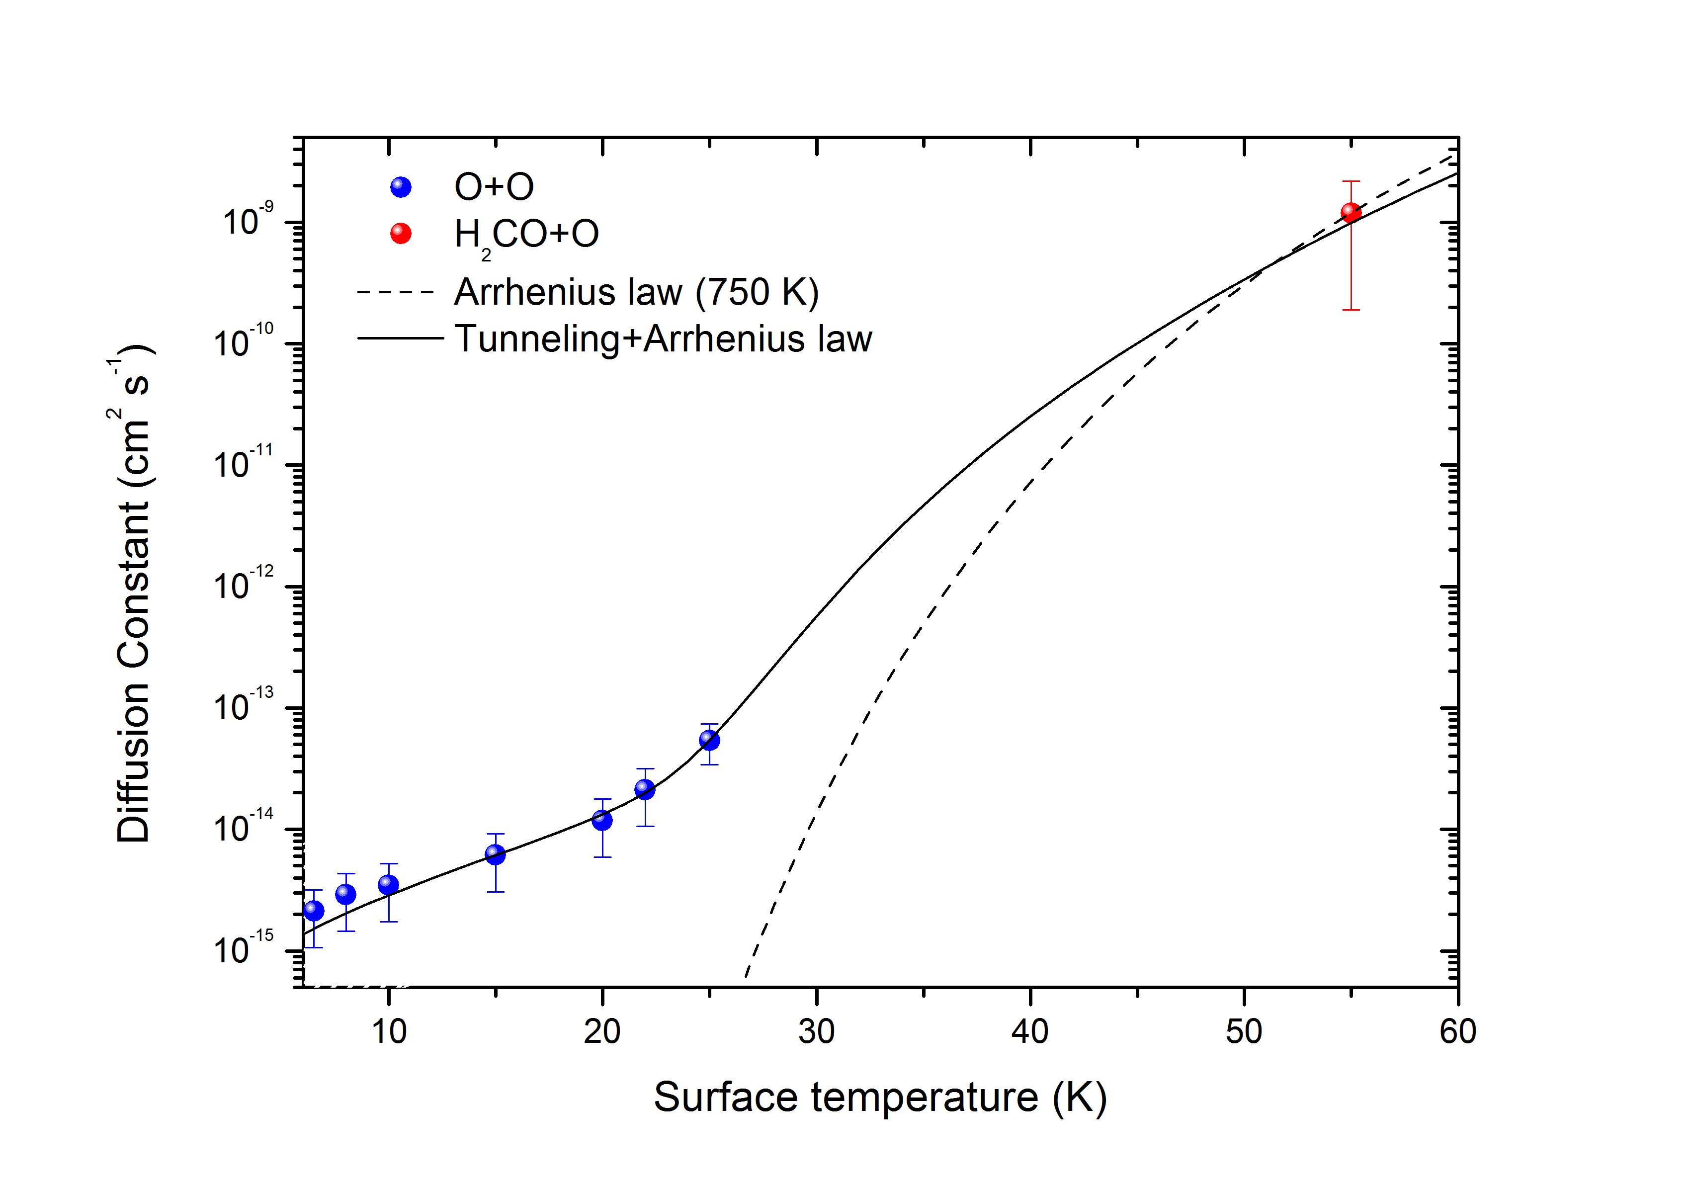
Diffusion dominated by quantum tunneling a low T
de Broglie wavelength:
2.8 A° at 6.5 K
1.5 A° at 20 K
(c) Minissale et al, PRL 2013

Slide 24
And now mixing 2 atoms …
O and H
(c) Minissale

Slide 25
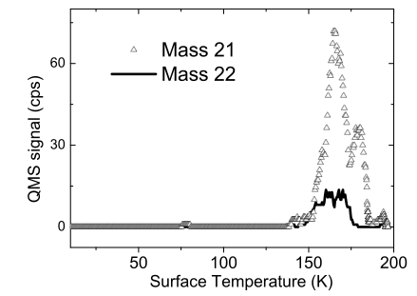
The [O+H] system
first idea
Dulieu et al 2006…2010
+H
O+H —> OH
OH +H —> H2O
(H+H —> H2)
…
+H
Dulieu et al A&A 2010
HD¹⁸O

Slide 26
The [O+H] system
+H
+O
O+H —> OH
OH +H —> H2O
H+H —> H2
O+O —> O2
O+O2 —> O3
O+O3 —> 2 O2
…

Slide 27
The [O+H] system
O+H —> OH
OH +H —> H2O
H+H —> H2
O+O —> O2
O+O2 —> O3
O+O3 —> 2 O2
H+O2 —> HO2
H+O3 —> OH+O2
H+HO2 —> H2O2
H2O2 —> OH +H2O
OH + H2 —> H2O+H
O + H2 —> H2O
…
+H
+O
So one « system » is not one reaction

Slide 28
The [O+H] system
O+H —> OH
OH +H —> H2O
H+H —> H2
O+O —> O2
O+O2 —> O3
O+O3 —> 2 O2
H+O2 —> HO2
H+O3 —> OH+O2
H+HO2 —> H2O2
H2O2 —> OH +H2O
OH + H2 —> H2O+H
O + H2 —> H2O
…
+H
+O
How to understand ?
: Study sub-systems
So one « system » is not one reaction

Slide 29
The [O3+H] system
@ 10 K
+H
+O
H+O3 —> OH+O2
OH +H —> H2O
H+H —> H2
H+O2 —> HO2
H+HO2 —> H2O2
H2O2 —> OH +H2O
Mokrane et al ApjL 2009
How to understand ?
: Study sub-systems
See also Romanzin et al 2011

Slide 30
The [O3+H] system
@ 10 K
@ 45 K
+H
+O
H+O3 —> OH+O2
OH +H —> H2O
H+H —> H2
H+O2 —> HO2
H+HO2 —> H2O2
H2O2 —> OH +H2O
How to understand ?
: Study sub-systems
at different Surface temperatures

Slide 31
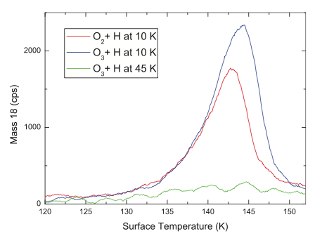
The [O3+H] system
@ 10 K
@ 45 K
Yes, it works, but 80% +/-20
of expected water is missing !
—> « Chemical desorption »
+H
+O
H+O3 —> OH+O2
OH +H —> H2O
H+H —> H2
H+O2 —> HO2
H+HO2 —> H2O2
H2O2 —> OH +H2O

Slide 32
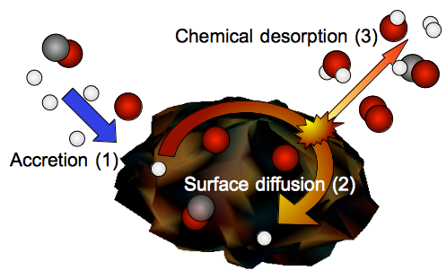
The [O3+H] system
@ 10 K
@ 45 K
Yes, it works, but 80% +/-20
of expected water is missing !
—> « Chemical desorption »
+H
+O
H+O3 —> OH+O2
OH +H —> H2O
H+H —> H2
H+O2 —> HO2
H+HO2 —> H2O2
H2O2 —> OH +H2O
Dulieu, Cazaux et al Nat. Sci. Rep. 2013

Slide 33
O and H reactivity
Dominated by H2O, but H2O2 also formed
Minisale&Dulieu, JCP, 2014
Water is a chemical attactor…
So seems to be peptide bonds
And chemical desorption is important,
morphology is amorphous and compact (Accolla+13)

Slide 34
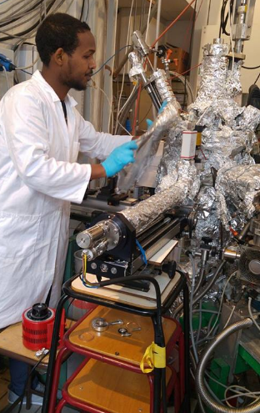
Molecules are remote tracers in space and time
Dusty grains forms planets…
They are also the nanocatalysts of our Universe
Beyond all the molecular complexity reachable,
we follow the « minimum energy path » which seems
to focus on few selected molecules
Hydrogenation is the driver this chemistry
Water has specific catalytic properties
Quantum tunneling domintate at low T

Slide 35
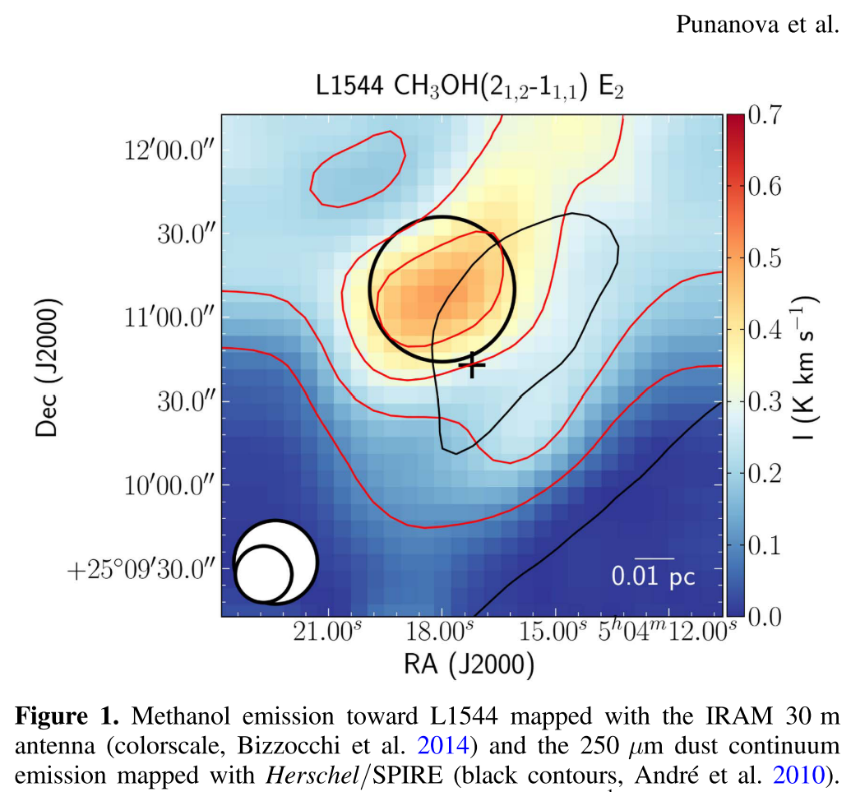
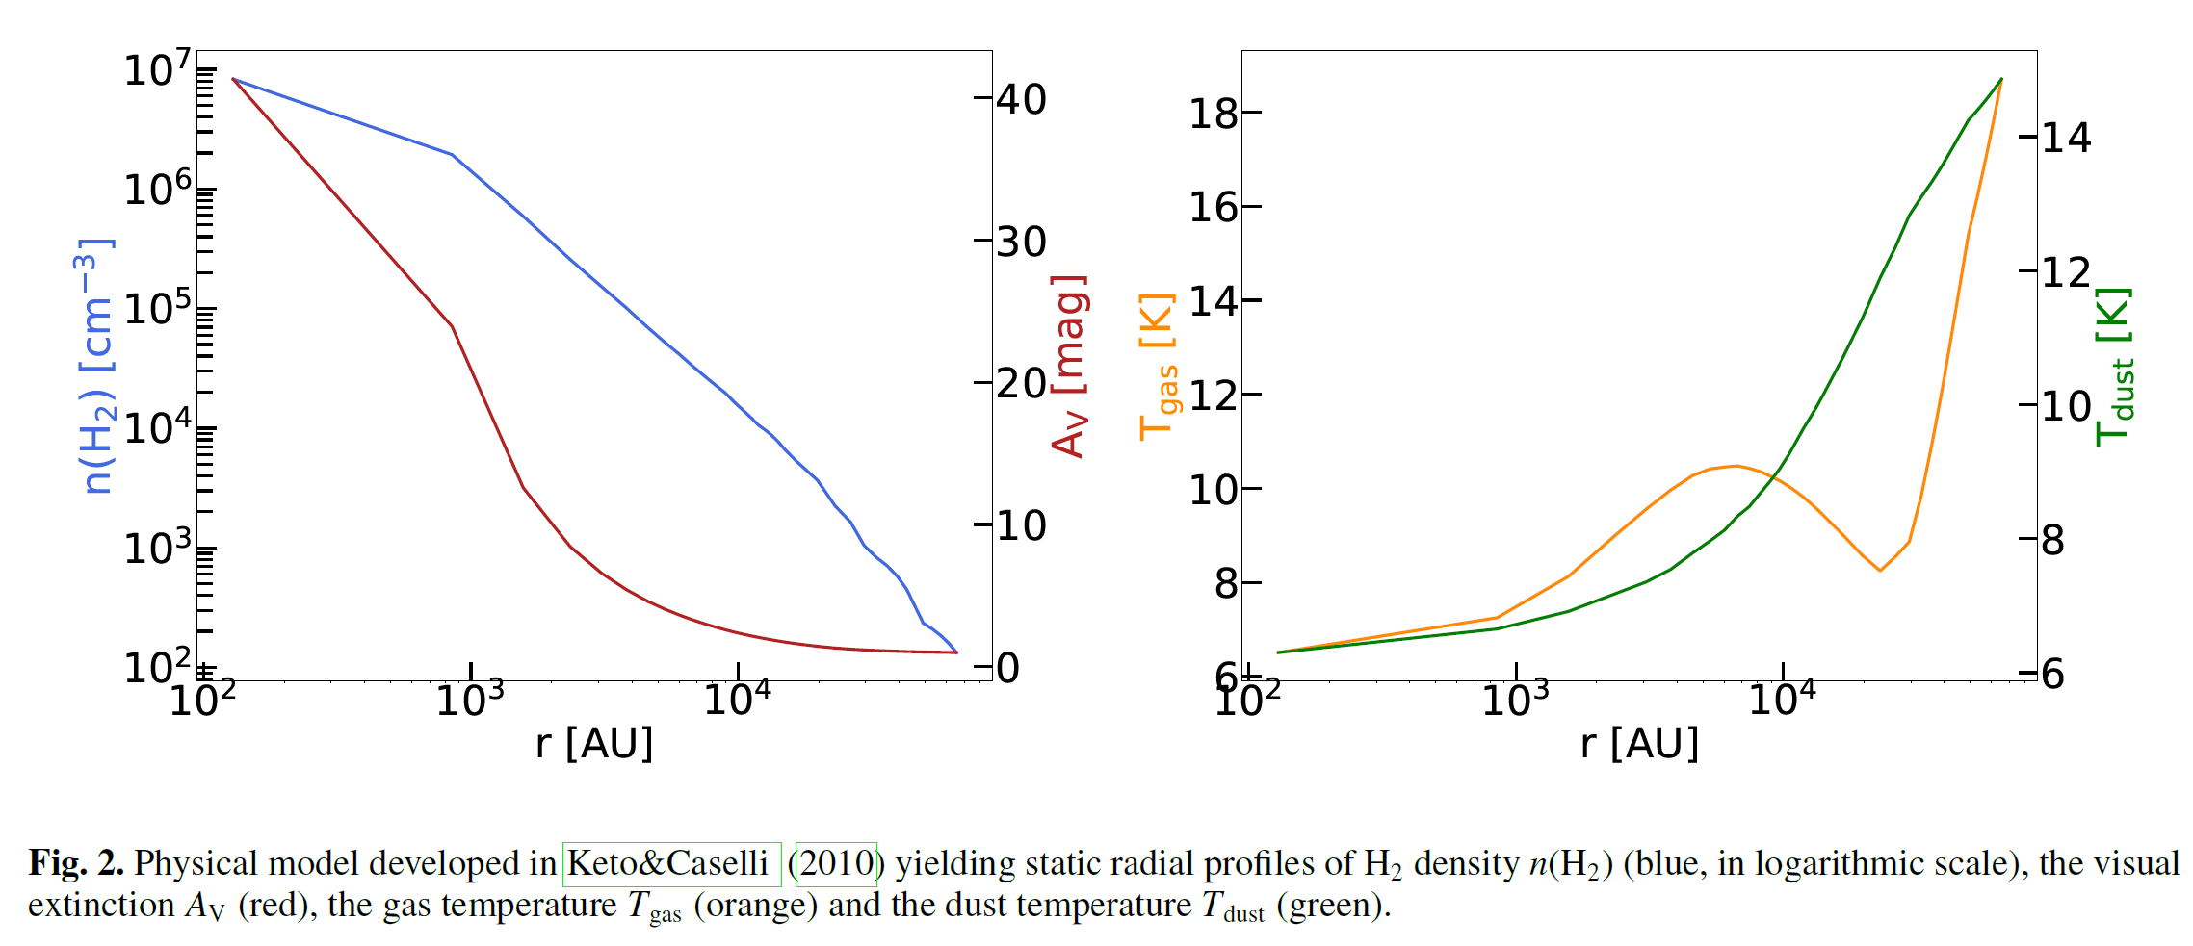
One section of LHC vs the pre-stellard dark core L1544 (in Taurus)
Why gas phase methanol at these low T ?
L ~ 1,5 10^15 m
P ~ 1 10⁻⁸ Pa
Ts= 6 K – 14 K
Ts= 5 K
Ts= 20 K
P ~ 1 10⁻⁸ Pa ?
L ~ 53 m

Slide 36
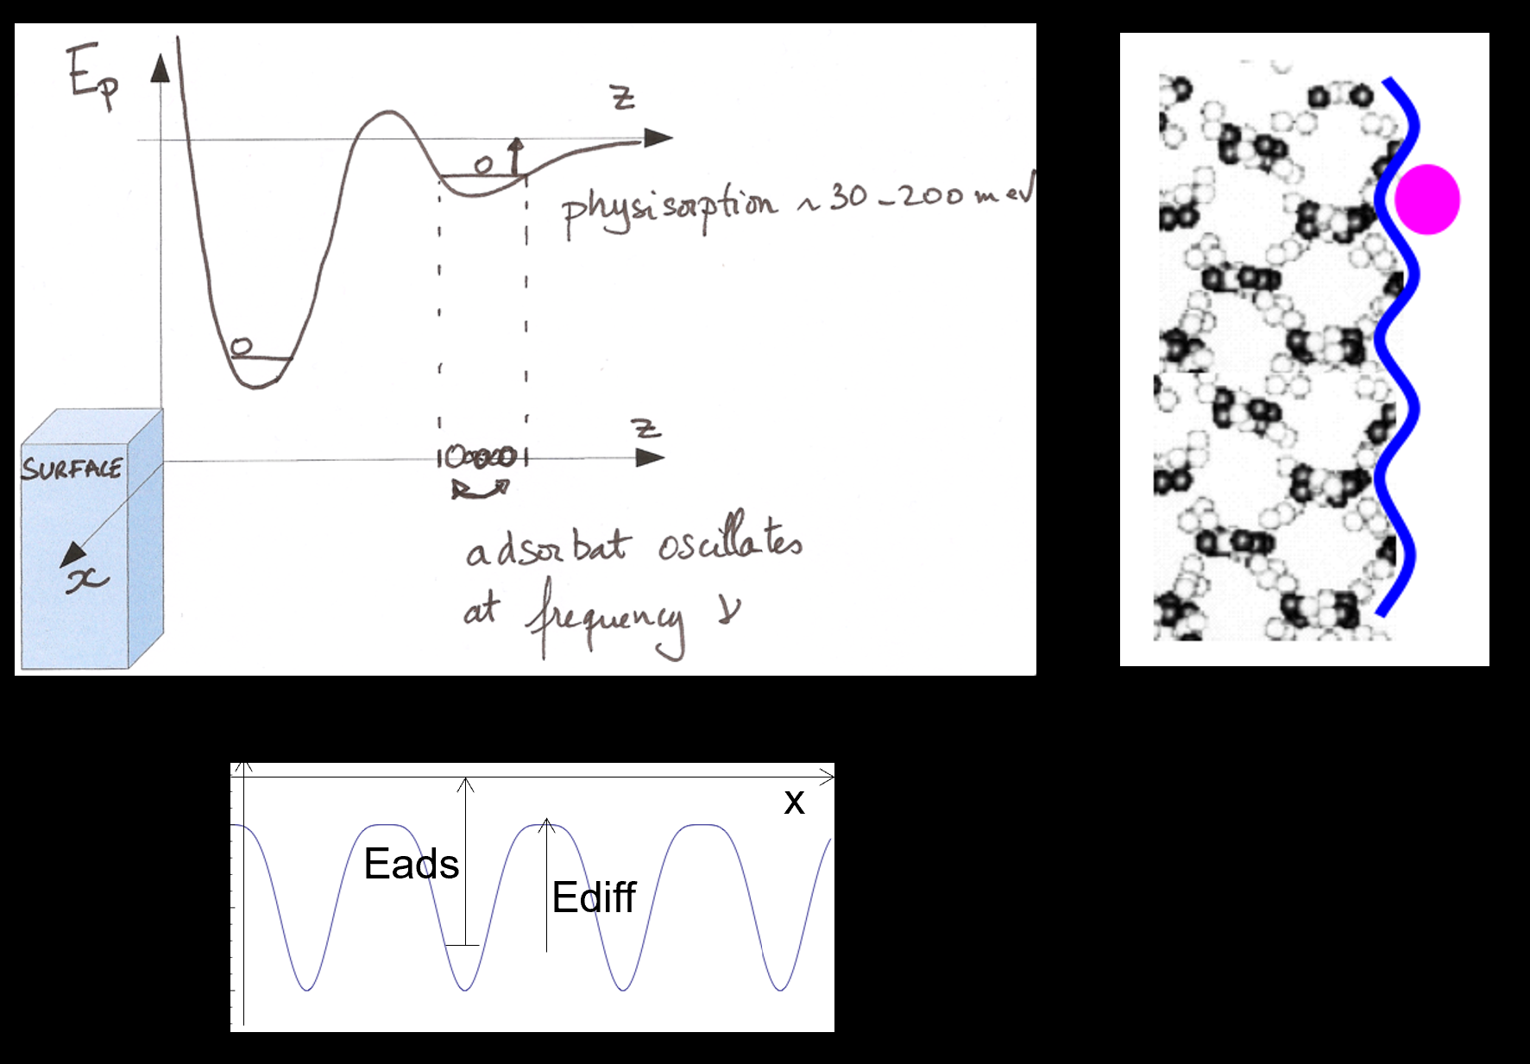
Adsorption on a (crystalline) surface, view point of theory
Desorption (z axis)
Diffusion (x axis)
Desorption rate = N_{s} ν Exp (-E_{ads}/kT)

Slide 37
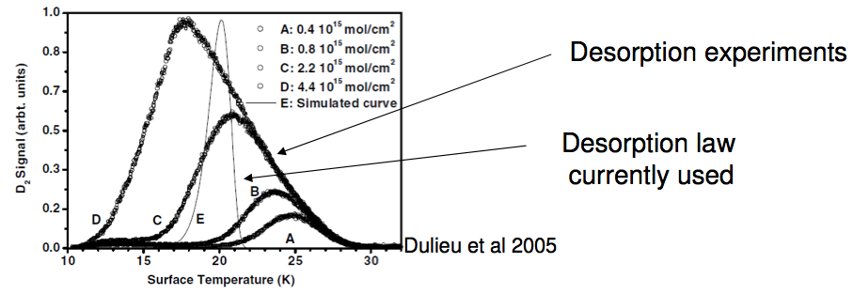
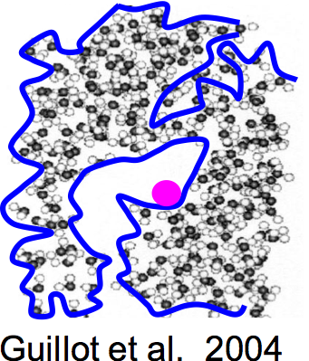
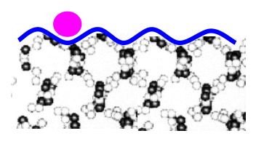
Desorption from an amorphous water ice surface, real life
Desorption rate = N_{s} ν Exp (-E_{ads}/kT)

Slide 38
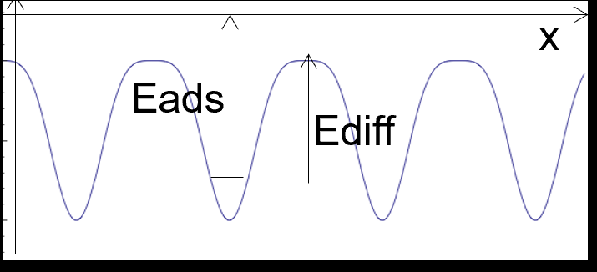
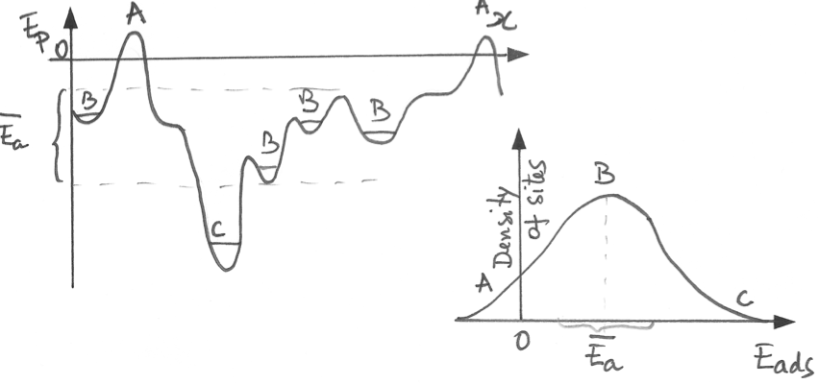
Crystaline Ice (poly, + H disorder)
Amorphous and porous
Ideal single Binding energy
(Not true for water ice)
Binding energies distribution

Slide 39
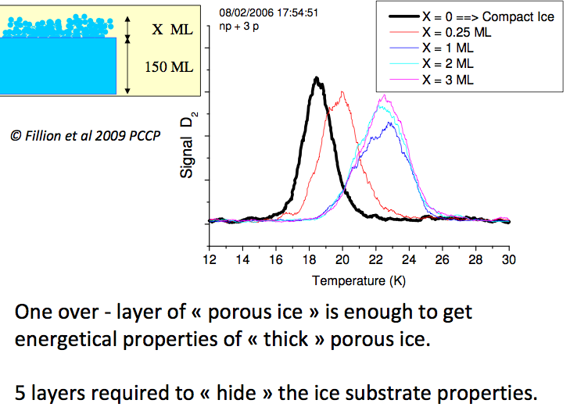
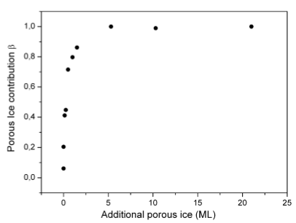
From compact to «porous » ice
BE distribution dominated by topological disorder

Slide 40
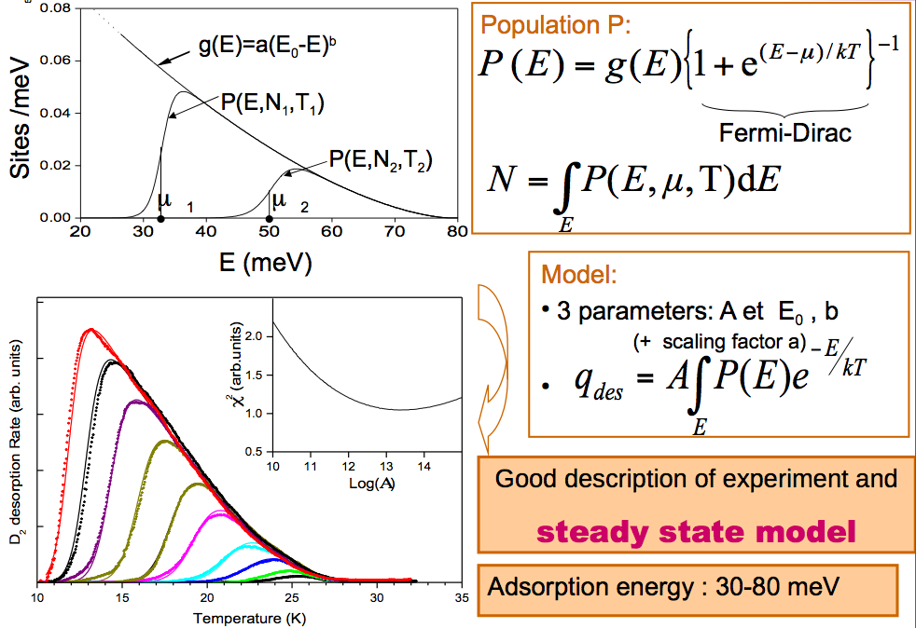
We studied and modelled
From crystalline to amorphous, from amorphous to porous
Binding energies distribution
+ Fermi Dirac Statistics
Solve isotopic effects
Ortho to para H₂ effects
works for N₂/CO mixtures

Slide 41
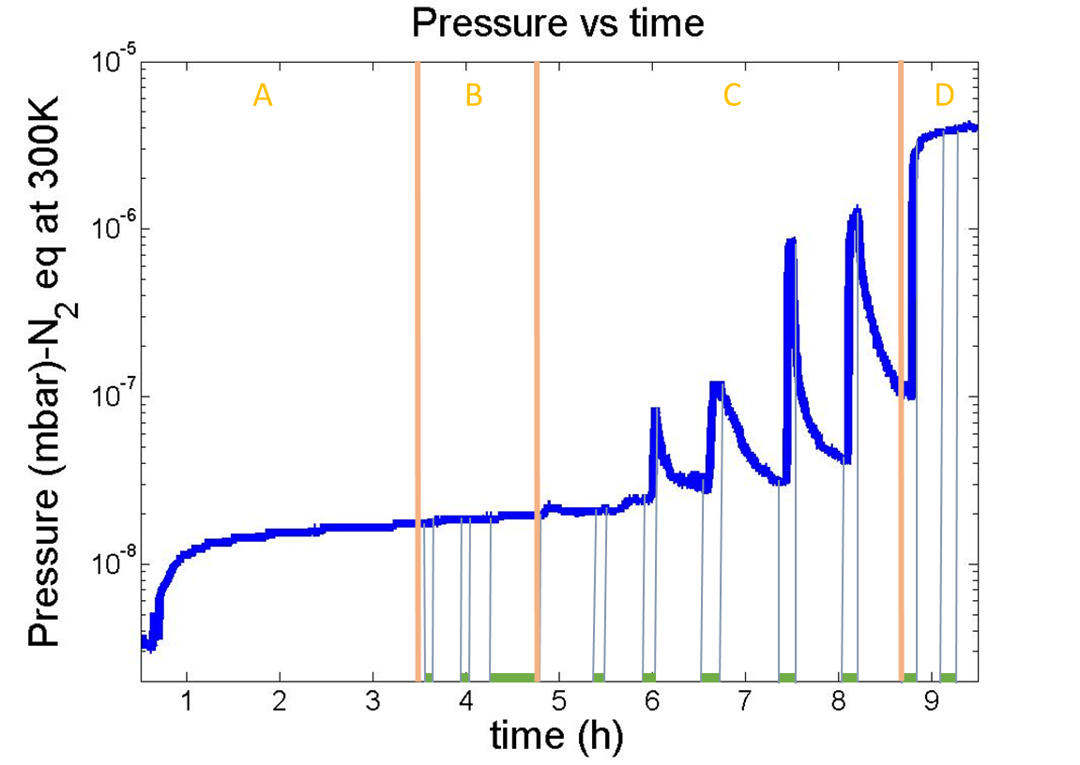
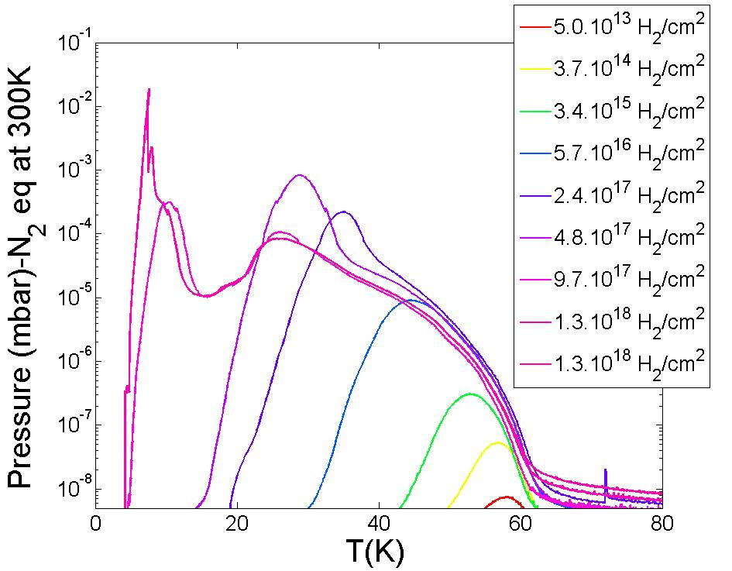
Amorphous carbon coated adsorption/desorption experiments
© A. L Lamure, V. Baglin et al at CERN
H2
H2
Adsorption phase
Desorption phase
60 K !

Slide 42
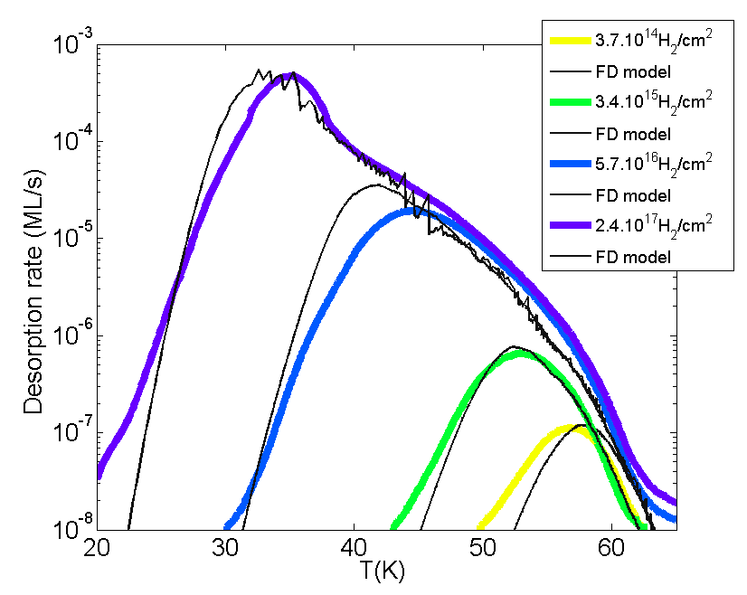
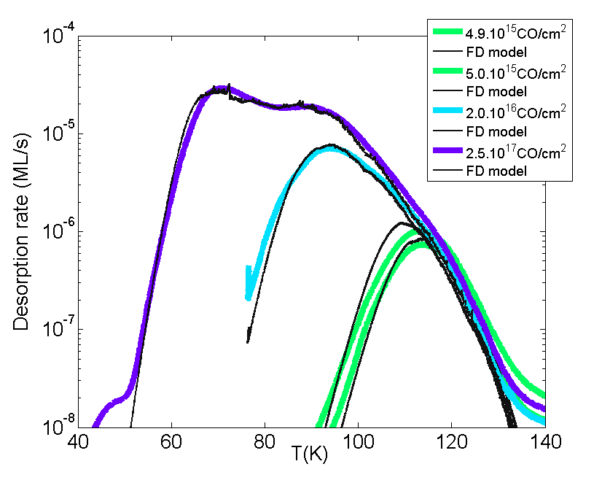
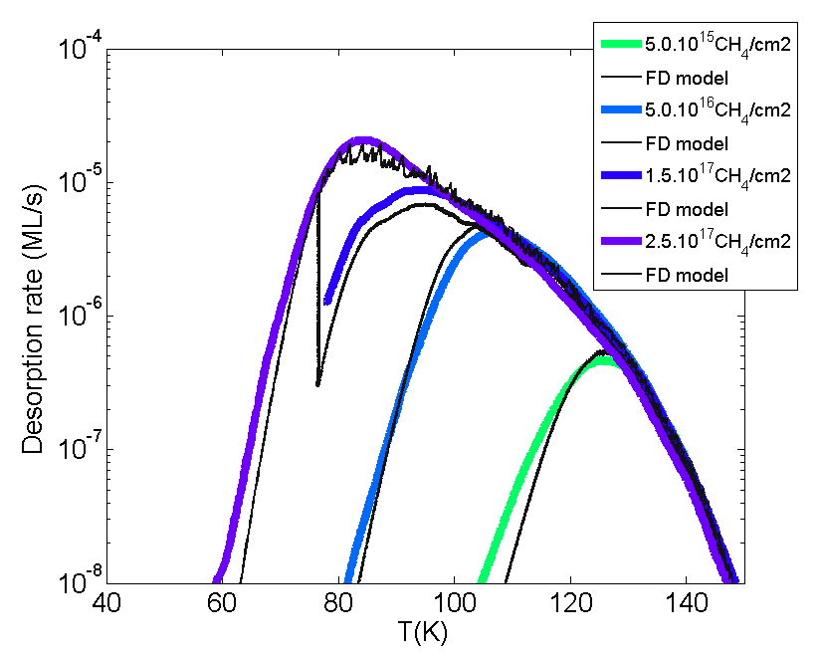
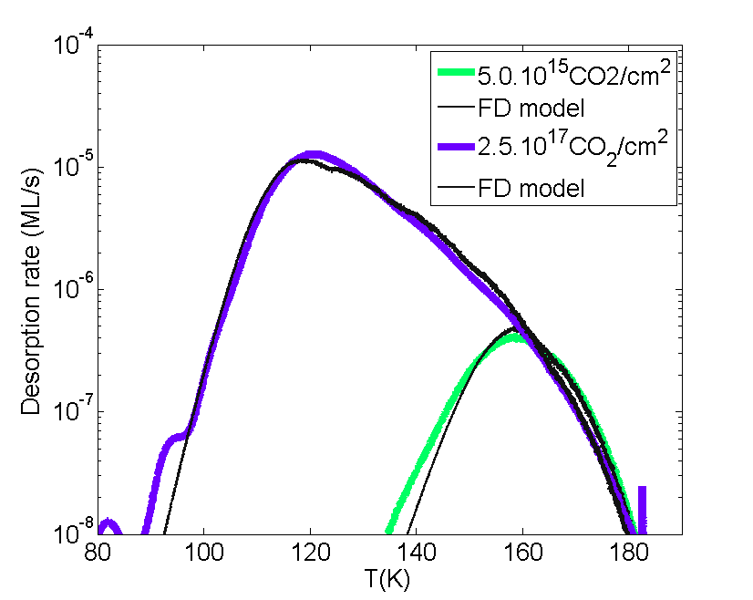
Same model including BE distribution and porosity, FD statistics
CO
H₂
CH₄
CO₂

Slide 43
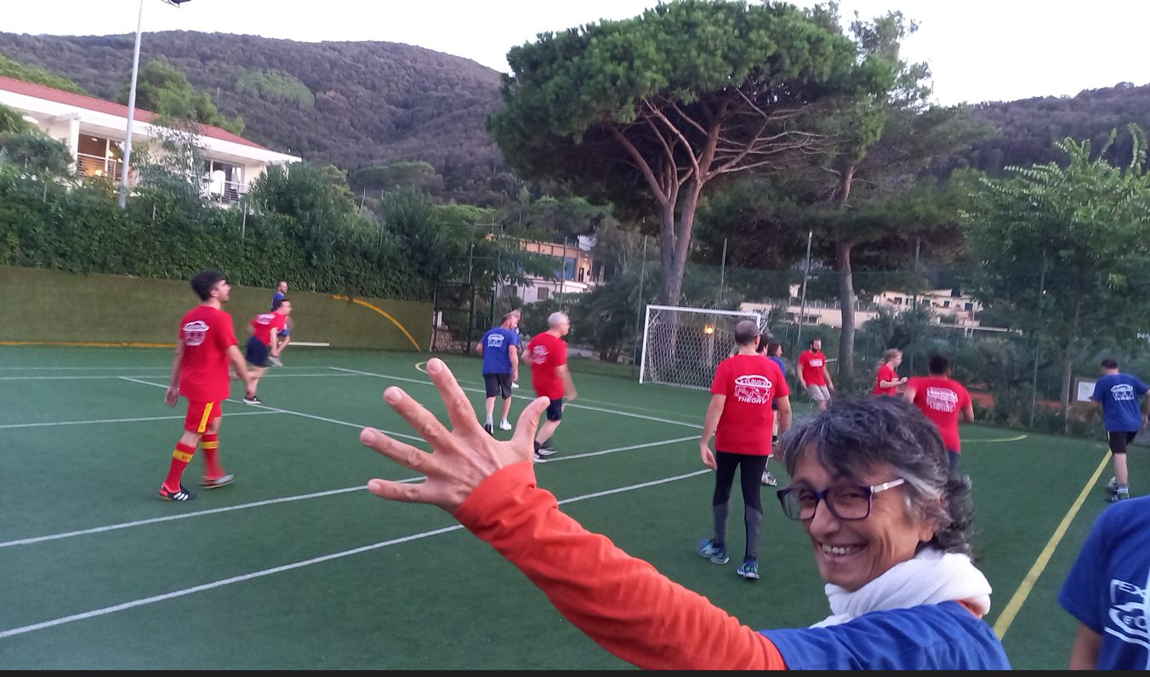
Are you Cu-Lase Team or
Amorphous carbon coating Team ?
NEG team
5-4 , great coach !
From the gas surface interaction they are both
AMORPHOUS AND POROUS
Amorphous : The molecular (atomic) topology provides a distribution of adsorption sites, they are not equivalent : Need BE distribution
Porous : The effective surface area is larger than geometrical area, so the gas surface interaction (and e- also) is delayed/mediated/indirect
surface area
<<

Slide 44
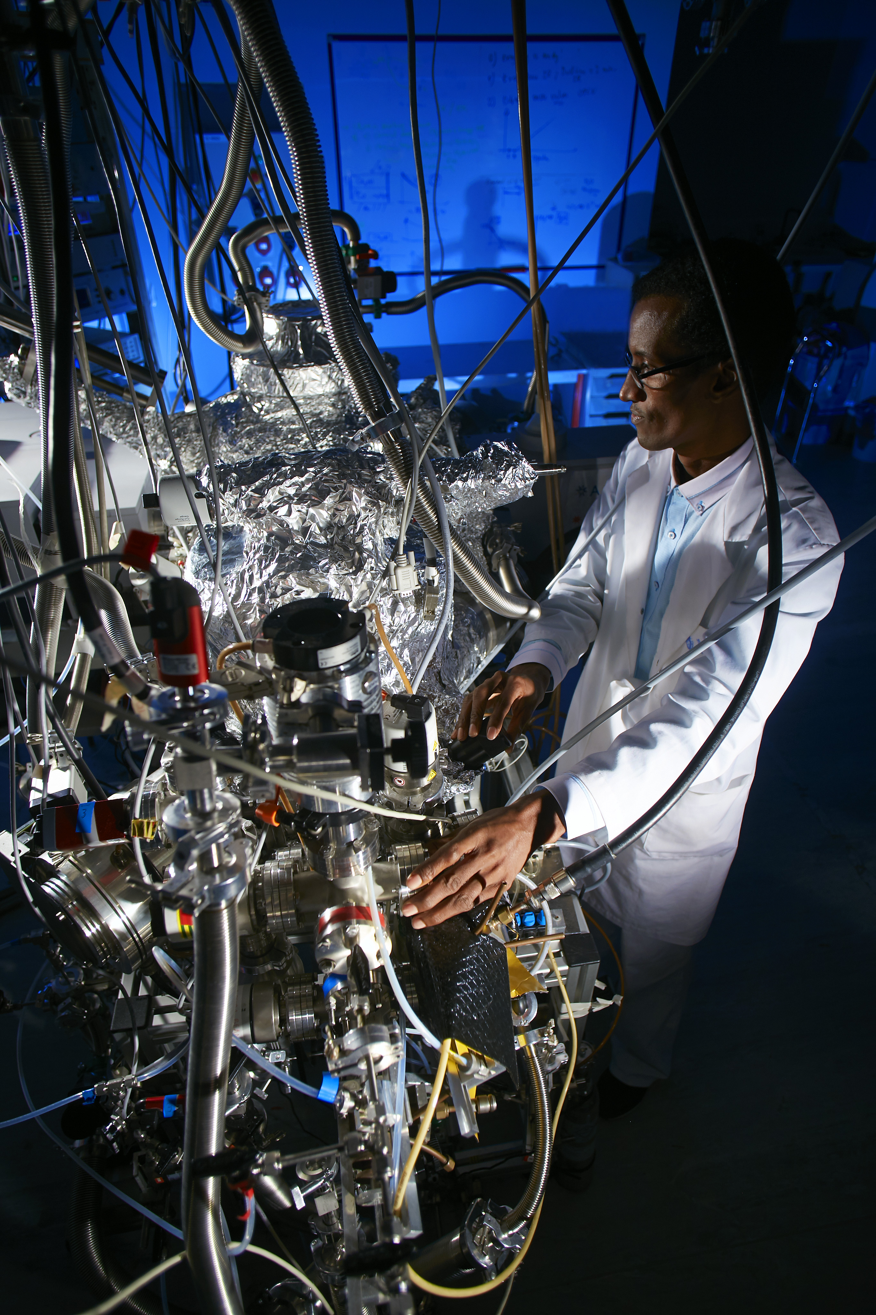
Take home messages…
Abdelahi Sow &
VENUS
We have studied (many) gas – amorphous/porous cold surfaces
Including sticking (Matar+10, Chaabouni+10, Gadallah+20)
Isotopic segregation effects, o/p effects (Dulieu+05, Amiaud+07+15),
BE distributions (Amiaud+06,Noble+12,Ferrero+22)
Mixture segregation effects (Noble+15, Nguyen+18)
Diffusion properties
There are also energetic aspects (4.5 eV vs 60 meV), local heating, restructuration.
Open to any collaboration
In a review paper Minissale et al 2022 (ACS Earth and Space Chemistry)
francois.dulieu@cyu.fr

Slide 45
Some of the references
Amiaud, L., J.-H. Fillion, F. Dulieu, A. Momeni, and J.-L. Lemaire. 2015. “Physisorption and Desorption of H2, HD and D2 on Amorphous Solid Water Ice. Effect on Mixing Isotopologue on Statistical Population of Adsorption Sites.” Physical Chemistry Chemical Physics 17 (44): 30148–57. https://doi.org/10.1039/c5cp03985a.
Amiaud, L., A. Momeni, F. Dulieu, J. H. Fillion, E. Matar, and J.-L. Lemaire. 2008. “Measurement of the Adsorption Energy Difference between Ortho- and Para-D2 on an Amorphous Ice Surface.” Physical Review Letters 100 (5): 056101. https://doi.org/10.1103/PhysRevLett.100.056101.
Amiaud, L, J H Fillion, S Baouche, F Dulieu, A Momeni, and J L Lemaire. 2006. “Interaction of D2 with H2O Amorphous Ice Studied by Temperature-Programmed Desorption Experiments.” The Journal of Chemical Physics 124 (9): 94702. https://doi.org/10.1063/1.2168446.
Chaabouni, H., H. Bergeron, S. Baouche, F. Dulieu, E. Matar, E. Congiu, L. Gavilan, and J. L. Lemaire. 2012. “Sticking Coefficient of Hydrogen and Deuterium on Silicates under Interstellar Conditions.” Astronomy & Astrophysics 538 (February): A128. https://doi.org/10.1051/0004-6361/201117409.
Dulieu, F., L. Amiaud, S. Baouche, A. Momeni, J.-H. Fillion, and J.L. Lemaire. 2005. “Isotopic Segregation of Molecular Hydrogen on Water Ice Surface at Low Temperature.” Chemical Physics Letters 404 (1–3): 187–91. https://doi.org/10.1016/j.cplett.2005.01.044.
Ferrero, S, F Grieco, A-S Ibrahim Mohamed, F Dulieu, A Rimola, C Ceccarelli, C Nervi, M Minissale, and P Ugliengo. 2022. “Acetaldehyde Binding Energies: A Coupled Experimental and Theoretical Study.” Monthly Notices of the Royal Astronomical Society 516 (2): 2586–96. https://doi.org/10.1093/MNRAS/STAC2358.
Fillion, Jean-Hugues, Lionel Amiaud, Emanuele Congiu, François Dulieu, Anouchah Momeni, and Jean-Louis Lemaire. 2009. “D(2) Desorption Kinetics on Amorphous Solid Water: From Compact to Porous Ice Films.” Physical Chemistry Chemical Physics : PCCP 11 (21): 4396–4402.
Matar, E., H. Bergeron, F. Dulieu, H. Chaabouni, M. Accolla, and J. L. Lemaire. 2010. “Gas Temperature Dependent Sticking of Hydrogen on Cold Amorphous Water Ice Surfaces of Interstellar Interest.” Journal of Chemical Physics 133. https://doi.org/10.1063/1.3484867.
Minissale, Marco, Yuri Aikawa, Edwin Bergin, Mathieu Bertin, Wendy A. Brown, Stephanie Cazaux, Steven B. Charnley, et al. 2022. “Thermal Desorption of Interstellar Ices: A Review on the Controlling Parameters and Their Implications from Snowlines to Chemical Complexity.” ACS Earth and Space Chemistry, February, acsearthspacechem.1c00357. https://doi.org/10.1021/ACSEARTHSPACECHEM.1C00357.
Nguyen, T, S Baouche, E Congiu, S Diana, L Pagani, and F Dulieu. 2018. “Astrophysics Segregation Effect and N 2 Binding Energy Reduction in CO-N 2 Systems Adsorbed on Water Ice Substrates.” A&A 619: 111. https://doi.org/10.1051/0004-6361/201832774.
Noble, J. A., E. Congiu, F. Dulieu, and H. J. Fraser. 2012. “Thermal Desorption Characteristics of CO, O2 and CO2 on Non-Porous Water, Crystalline Water and Silicate Surfaces at Submonolayer and Multilayer Coverages.” Monthly Notices of the Royal Astronomical Society 421 (1): 768–79. https://doi.org/10.1111/j.1365-2966.2011.20351.x.
Noble, J. A., S. Diana, and F. Dulieu. 2015. “Segregation of O 2 and CO on the Surface of Dust Grains Determines the Desorption Energy of O 2.” Monthly Notices of the Royal Astronomical Society 454 (3): 2636–46. https://doi.org/10.1093/mnras/stv2157.
Noble, J. A., P. Theule, F. Mispelaer, F. Duvernay, G. Danger, E. Congiu, F. Dulieu, and T. Chiavassa. 2012. “The Desorption of H 2 CO from Interstellar Grains Analogues.” Astronomy & Astrophysics 543 (June): A5. https://doi.org/10.1051/0004-6361/201219437.

Slide 46
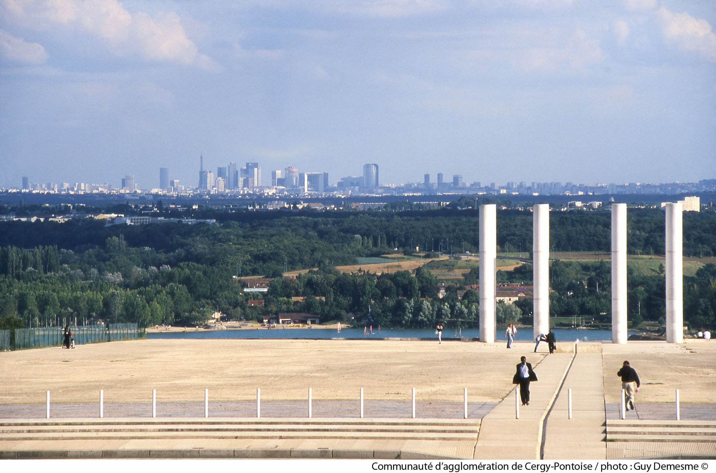
OUr Lab is here! (50km…)
Height: 300 m

Slide 47
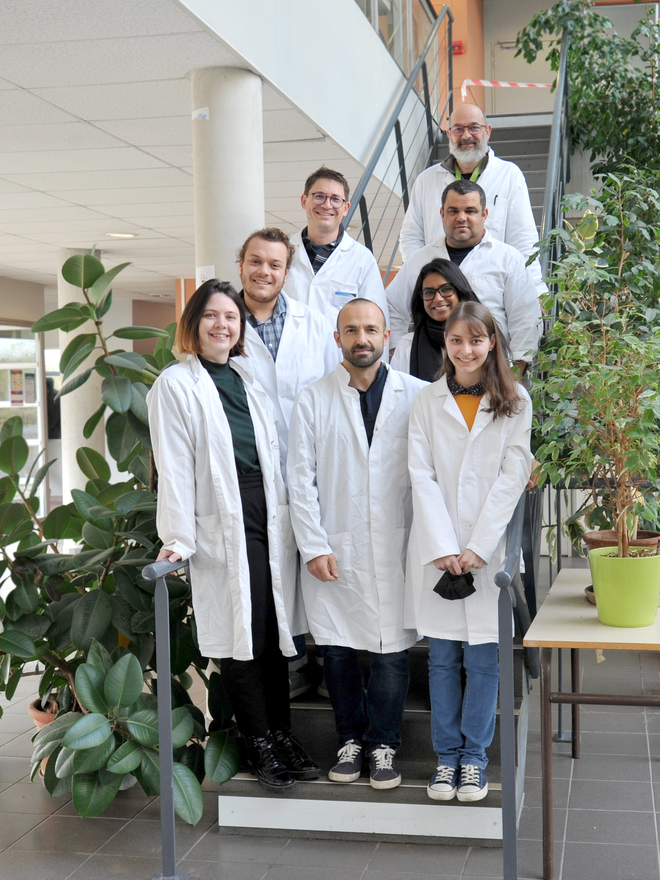
Present or former students
Thank you !
Present or former colaborations
November 2021

Slide 48
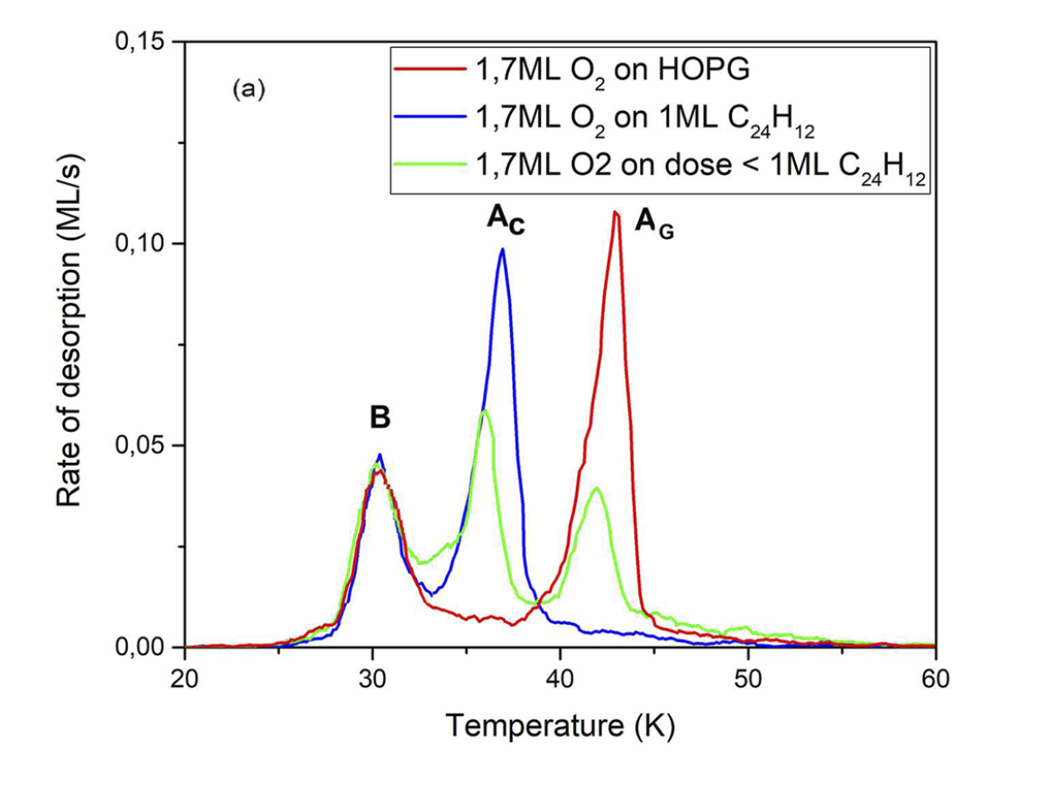
O₂ multilayer
O₂ TPD as a tool to check the morphology of Coronene films
Or have a look on STM images on the posters
O₂ -HOPG
In green half a monolayer of coronene
O₂ -Cor
© Ibrahim Mohamed, Morisset et al 22
See also quantum calculations

Slide 49
Broad binding energy distribution ➔ disordered surface
Only one binding energy ➔ organised layer
?
Cu, polished
Graphite (HOPG)
Have a look on STM images ! (Poster Hopkinson et al, Slumstrup et al)

Slide 50
Desorption of (composite) ice
from amorphous and porous substrates
Succeed to treat :
Isotopic effects,
Mixed ice
Amorphous and porous substrates
Diffusion, filling, wetting…
Classical TPD
Experiments
Various doses of CO and N₂
_{Co-desorbing from}
_{Amorphous ice}
© Noble+15
Need to introduce a binding energy distribution
If composite ice, need for a competion mechanism (Fermi-Dirac statistic)
© Nguyen+15

Slide 51
Accretion, desorption State to State ?
Gaz
Surface
Desorption
Adsorption
Free rotation
Frustrated rotation

Slide 52
Desorption « 1D » ou TST ?
Desorption ∝ Α exp(-E_{des}/kT_{s})
E_{des}
Distance à la surface (~3 A°)
Α
(~10^{12/13} s⁻¹)
Approx. type Hasegawa&Herbst
Kruczkiewicz+2021
(desorption of amonium salts)

Slide 53
Desorption « 1D » ou TST ?
E_{ads}
Other evidence : better match with calculated values (see Ferrero+22)
Distance to the surface (~3 A°)
Α
Α
(from Tait et al 2005)
Minissale et al, 2022

Slide 54
Sticking of methanol
vs surface temperature
Gaz
Surface
Desorption
Adsorption
Reorganisation
e.g. cristallisation
Gadallah+20

Slide 55
Effect of gas on dust : Oxydation of Coronene
C₂₄ H₁₂ mass 300 amu
UV flux
Dense medium
(10⁻¹² mbar !)
Barre d’Orion
Orion bar
See also Hydogenation of PAHs: Pr Liv Hornekear ‘s group (DK)

Slide 56
UV photons excite PAH that relax in IR ( 3.3 µm +)
UV excite (& dissociate) H2 => reformation on grains
CO in ‘shieled’ zone
Coronène
C24H12 masse 300 amu
PAH
UV flux
CO (T~100K)
H2*
Dense medium
(10⁻¹² mbar !)
What happens to PAHs in denser environments?
What is their catalytic role for H₂? Do they react with O ?
[PAH temperature range 10K, gas <300K]
Barre d’Orion
Tielens+93

