Slide 1

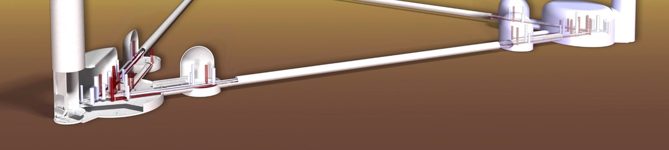
Technical concepts and potential solutions for the vacuum challenges of the LF tower
S. Hanke, K. Battes, C. Day, X. Luo GWDVac‘22 Workshop Elba 30 Sept 2022 stefan.hanke@kit.edu

Slide 2
Gas sources for ET-LF
Next steps: consideration of all gas sources
Find influences and sensitivities
Knowledge where effort is mostly needed
First source – from long beam pipe
Second source – from upper part of tower
Third source – from adjacent tower with much higher flow
All combined flows have to fulfill pressure and adsorption requirements

Slide 3
Second gas source
Reduction of outgassing
Pumping requirements
Minimisation of
conductance
Design of shielding
Frost formation and
recovery
Resulting local
pressures

Slide 4
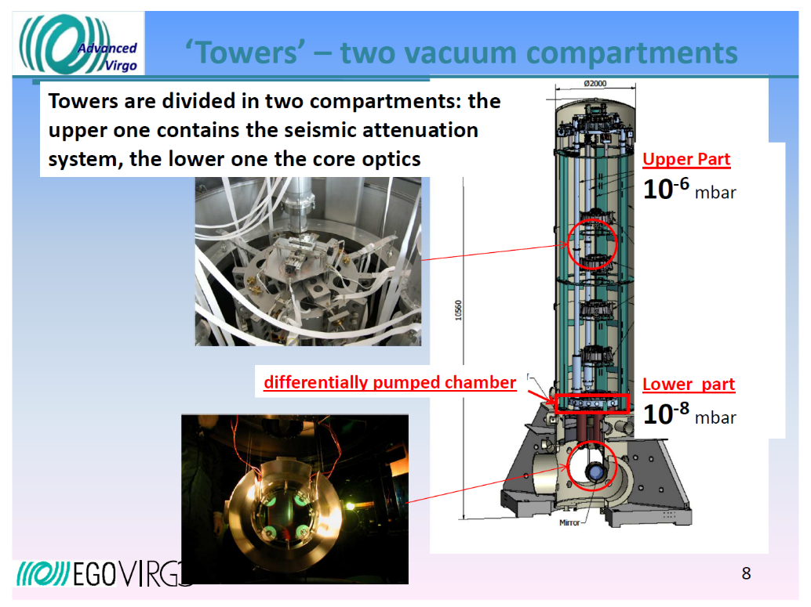

Gas flow from upper tower towards the cryogenic mirror
Tower pressure 10⁻⁸ mbar or higher? (non-bakeable)
For pressure requirement around mirror minimisation of resulting gas flow through opening
Two approaches available:
  drastic conductance reduction
  tower pumping with cryopumps

Slide 5
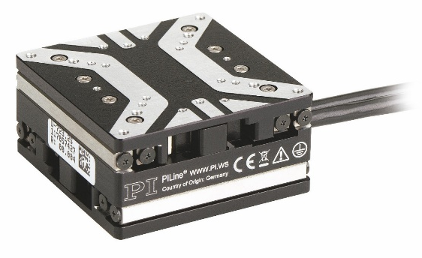
Conductance minimisation – orifice solution
Assumptions
  Suspension diameter: 12 mm
  Orifice thickness: 0.5 mm
  Clearance: 6 mm
  Clearance: 1 mm or 0.5 mm
with positioning apparatus (x/y table) following the actual position of the suspension cable in real-time
Issue of flow through gap or probably due to friction if there is direct contact
Suspension (fibre + cabling + glue)
Opening/clearance needed

Slide 6
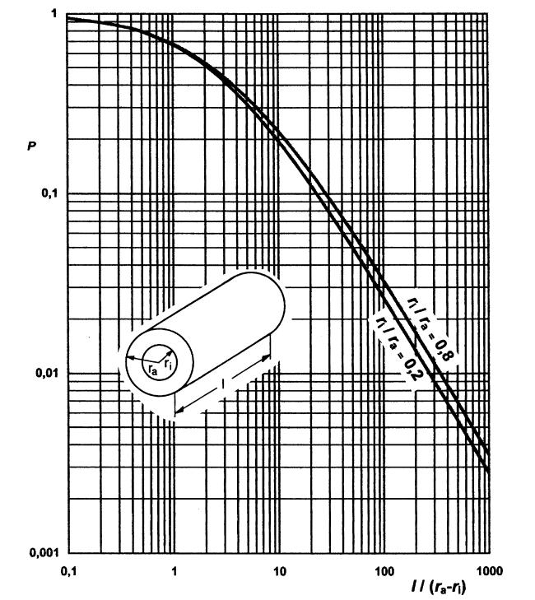
Conductance minimisation – tube solution
Suspension (fibre + cabling + glue)
Tube
Assumptions
  Suspension diameter: 12 mm
  Clearance: 6 mm
  Tube length:
  300 mm, 500 mm, 800 mm
  or 1000 mm
Opening/clearance needed
K. Jousten, Handbuch Vakuumtechnik (2018)

Slide 7
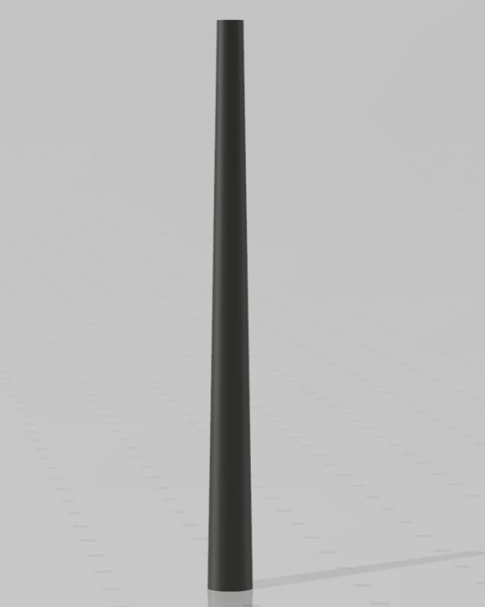
Conductance minimisation – cone solution
Assumptions
  Suspension diameter: 12 mm
  Clearance at bottom: 6 mm
  Tube length:
  300 mm, 500 mm, 800 mm
  or 1000 mm
  Clearance at top:
  1 mm or 0.5 mm
with x/y table moving the smaller opening with the position of the suspension cable
Connected
with x/y table
at top very small clearance
Conical tube
Suspension
(fibre + cabling + glue)
Clearance
much larger since not movable

Slide 8
Calculated gas flows from tower to mirror
 | Radius suspension | Radius opening | Radius opening 2 | Clearance | Orifice/tube length | Transmission surface | Transmission probability | Conductance | Gas flow to mirror
 | r_{i} | r_{o} | r_{o2} | dr | l | A | P | C | Q
 | (mm) |  |  |  |  | (m²) |  | (m³/s) | (Pa m³/s)
orifice | 6 | 12 |  | 6 | 0.5 | 3.39E-04 | 0.95 | 1.41E-01 | 1.41E-06
 | 6 | 7 |  | 1 | 0.5 | 4.08E-05 | 0.80 | 1.43E-02 | 1.43E-07
 | 6 | 6.5 |  | 0.5 | 0.5 | 1.96E-05 | 0.70 | 6.03E-03 | 6.03E-08
tube | 6 | 12 |  | 6 | 300 | 3.39E-04 | 0.055 | 8.19E-03 | 8.19E-08
 | 6 | 12 |  | 6 | 500 | 3.39E-04 | 0.035 | 5.21E-03 | 5.21E-08
 | 6 | 12 |  | 6 | 800 | 3.39E-04 | 0.025 | 3.72E-03 | 3.72E-08
 | 6 | 12 |  | 6 | 1000 | 3.39E-04 | 0.020 | 2.97E-03 | 2.97E-08
cone | 6 | 7 | 12 | 1 | 300 | 4.08E-05 | 0.067 | 1.21E-03 | 1.21E-08
 | 6 | 6.5 | 12 | 0.5 | 300 | 1.96E-05 | 0.070 | 6.01E-04 | 6.01E-09
 | 6 | 6.5 | 12 | 0.5 | 500 | 1.96E-05 | 0.043 | 3.70E-04 | 3.70E-09
 | 6 | 6.5 | 12 | 0.5 | 800 | 1.96E-05 | 0.028 | 2.37E-04 | 2.37E-09
 | 6 | 6.5 | 12 | 0.5 | 1000 | 1.96E-05 | 0.022 | 1.91E-04 | 1.91E-09

Slide 9
Results
Best geometric solution of tower isolation: combination of long conical tube
(1 m) with actively moving orifice of very small clearance (0.5 mm)
→ Gas flow from tower influence still is 1.9.10⁻⁹ Pa.m³/s
Extra pressure reduction by factor 10 in tower required (by additional means to reduce outgassing and/or increase pumping speed, most probably cryopumping)
Next gas source to be implemented

Slide 10
Third gas source
Design of shielding
Pumping requirements &
design of cryopumps
Frost formation and
recovery
Resulting local
pressures

Slide 11
Details of third gas source
Source is adjacent warm tower/optics
Separated by only 50 m from cryogenic mirror
Releasing high gas flow with 10⁻⁷ Pa m³/s for H₂ and 10⁻⁶ Pa m³/s for water
Much higher flow as from other two sources
Cryopump needed to handle H₂ flow
Low temperature cryopump seems indispensable (3.7 K or 10 K with sorbent)
Water trapping than anyway guaranteed

Slide 12
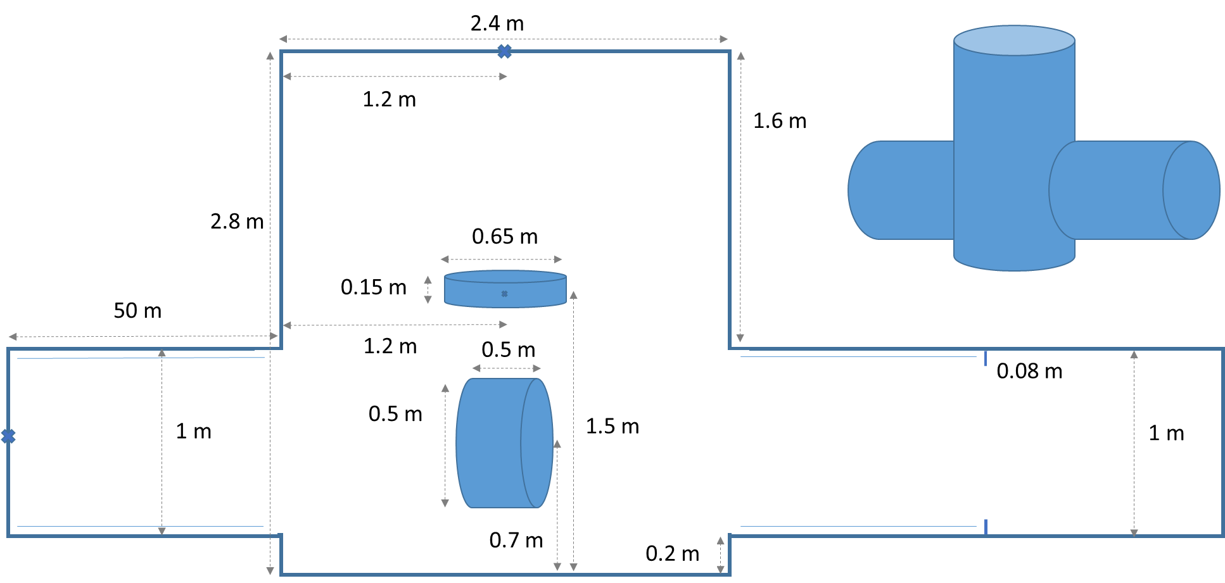
Complete model established
Three sources implemented
First simulations ongoing
With time evolving detailness (cold H₂ pumping marionette, cold shieldings pumping water, inhom. distribution on mirror)

Slide 13
First results
H₂ pressure around mirror (with all gas sources, H₂ pumping left (50 m), water trapping right (30 m), conductance minimisation upwards) lower as needed
Caused by strong pumping from left cryopump
Can now be reduced in length stepwise (for H₂ only, for water full 50 m)
Cold marionette (2 K) influences pressure / pumping (here half p)
For upper tower flow re-justification of minimisation effort

Slide 14
Conclusions
Source 1: cryopump 80 K for water trapping sufficient
10km beam pipe conditions via low outgassing (instead of high pumping speed)
Source 2: conductance minimisation plus cryopumping in upper tower needed to reduce flow according needs
More precision will come with new model (e.g. more pumping by shields)
Source 3: cryopump for hydrogen needed, water trapped anyway
Largest flow → cryopump lengths and C‘s to be varied (Cryopump with 2 diff. Temp.?)
Total pressure around mirror below requirement, water ice build-up 700 d for 1 ML

Slide 15
Conclusions
Homogenous water ML after 700 d
Prevention of risky ice removal methods?
Conductance minimisation plus cryopumping in upper tower
To which extend still open
Taylormade CP with 2 diff. T
CP for H₂ (10 or 3.7 K – w/o sorbent), < 50 m
Water trapped along 50m with 80 K
Warm pumping according low outgassing
80 K CP for water only < 30 m

