Slide 1
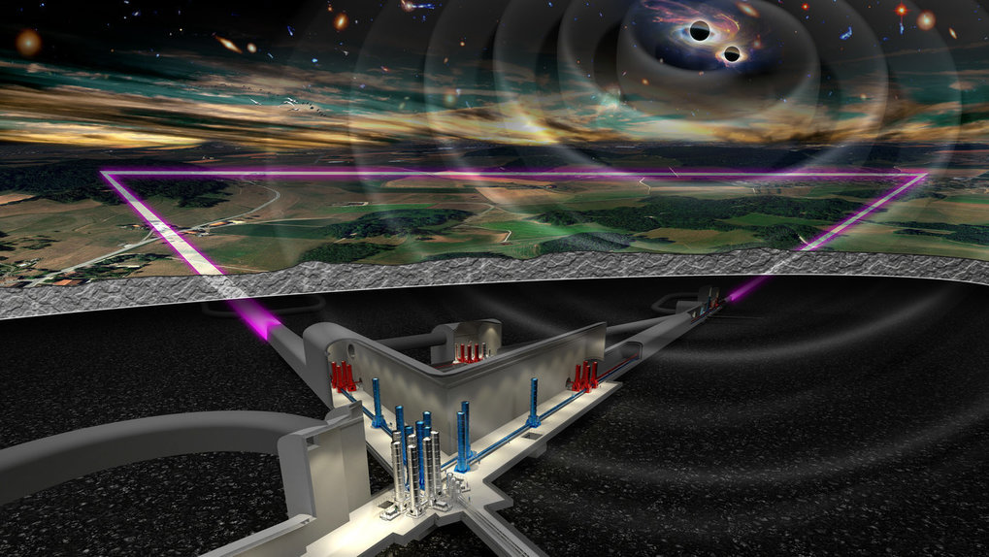
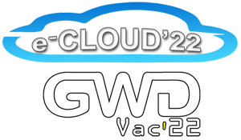

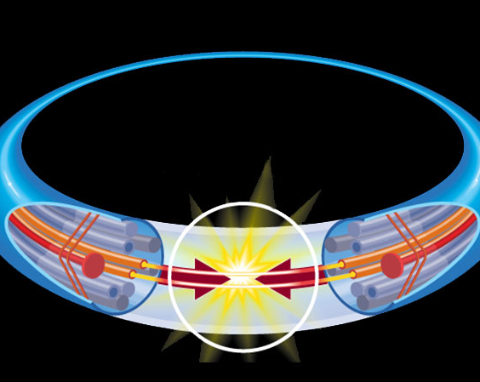
Synergies between dynamic vacuum issues in accelerators and GW instrumentations
ECLOUD’22 & GWDVac’22 workshops
25th September – 1st October 2022
Luisa Spallino, LNF-INFN

Slide 2
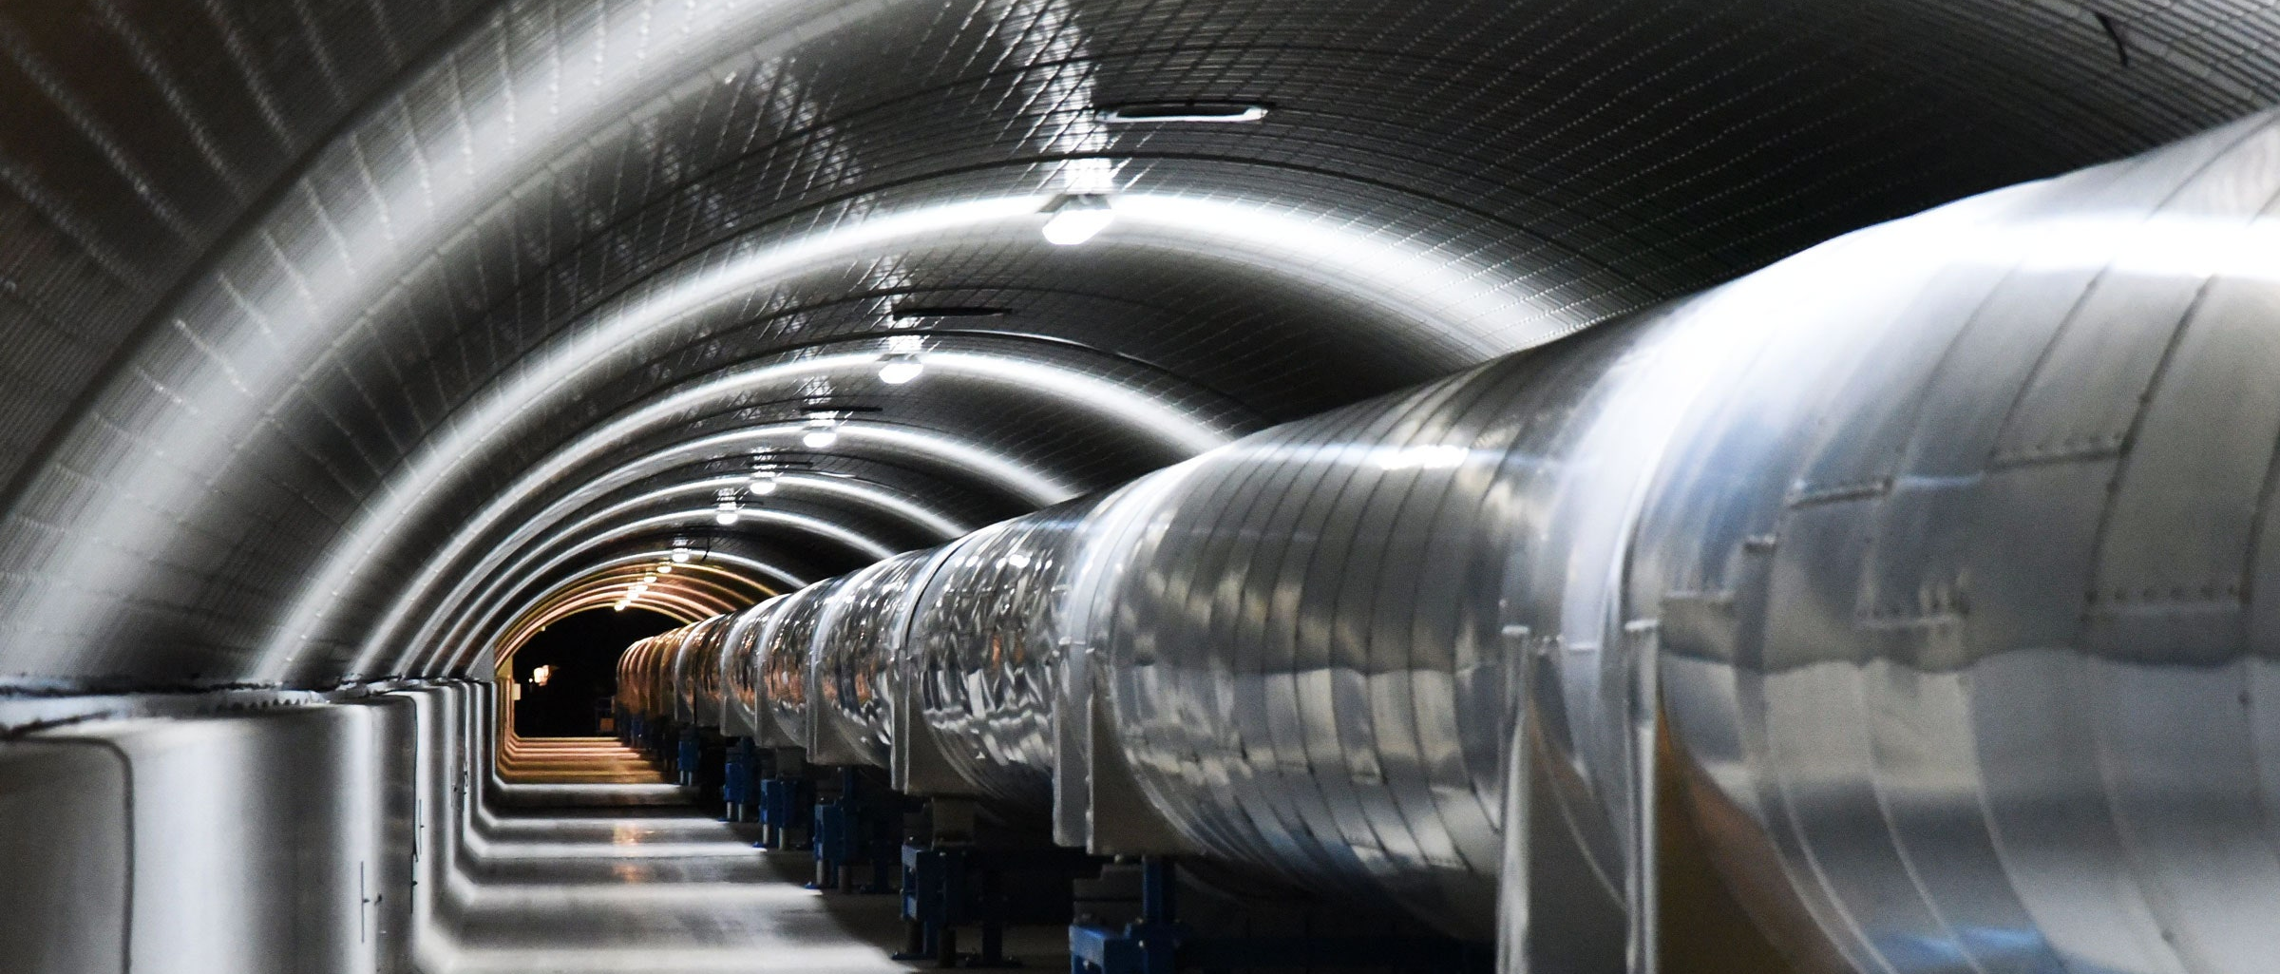
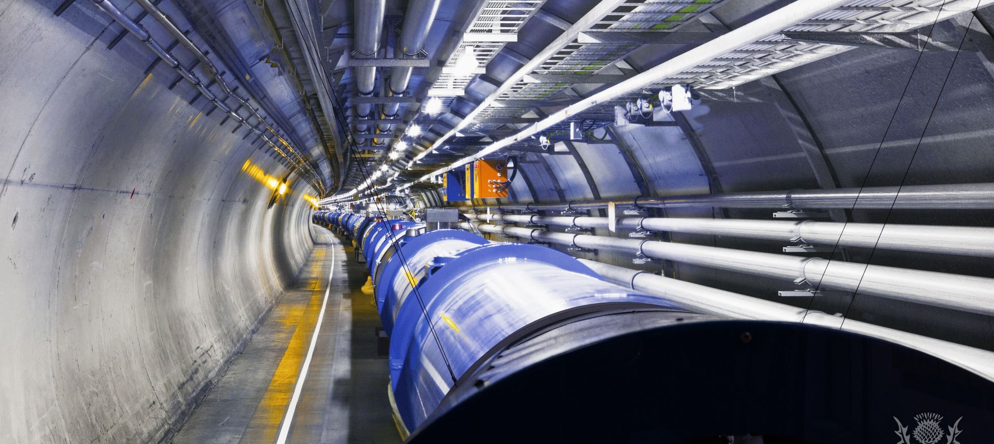
Motivation
Clear synergies in vacuum, cryogenics plants and installation between ultimate accelerators and GW Observatories
Can the competences developed to tackle unconventional “dynamic” vacuum be of some use for the running of existing and future GW interferometers?

Slide 3
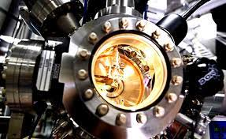
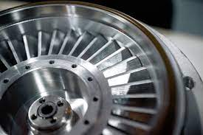
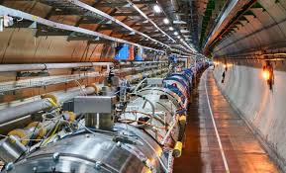
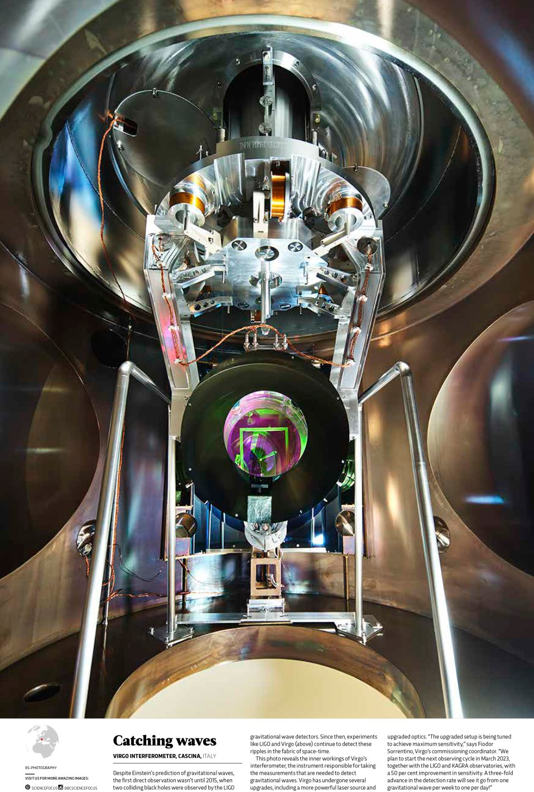
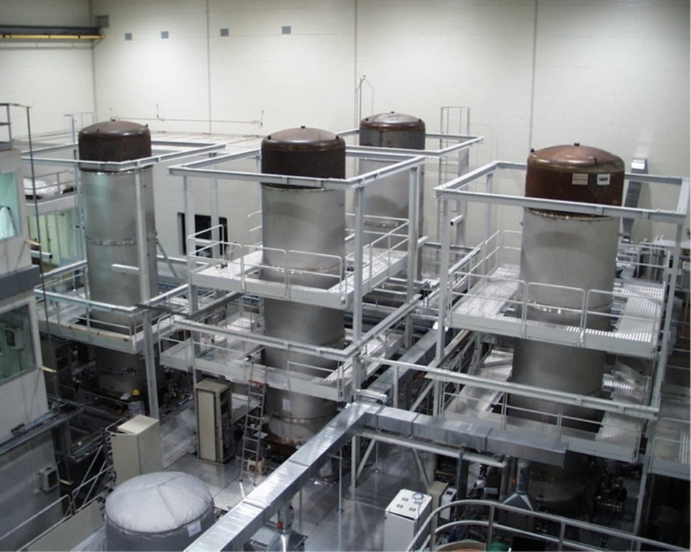
Common standard vacuum issues
Installations and running of huge vacuum and cryogenic systems
Joints, flanges, valves etc. R&D
Pumps and diagnostic (gauges, mass spectrometers and related R&D)
Vacuum calculations
R&D on new materials, material’s coatings and/or surface treatments to reduce surface degassing to limit vacuum pumps and contain vacuum costs!

Slide 4
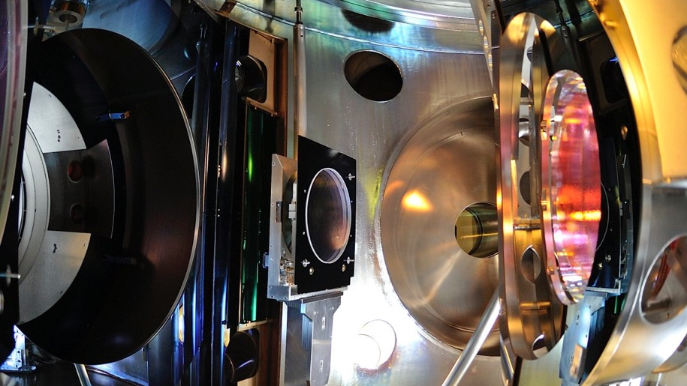
Unconventional GWO issues
Cryosorption on cold optics (frost):
  KAGRA GWO suffers from gas cryosorbed on the mirror surface inducing detrimental effects on the optics.
  Warming up should be avoided (time consuming)
Electrostatic charge of mirrors
  Both VIRGO and LIGO optics undergo to inhomogeneous electrostatic charging of variable (or unknown) sign that may induce unwanted noise.
  procedures are undertaken for neutralization with positive/neg ions

Slide 5
Unconventional GWO issues
Cryosorption on cold optics (frost):
  KAGRA GWO suffers from gas cryosorbed on the mirror surface inducing detrimental effects on the optics.
  Warming up should be avoided (time consuming)
Electrostatic charge of mirrors
  Both VIRGO and LIGO optics undergo to inhomogeneous electrostatic charging of variable (or unknown) sign that may induce unwanted noise.
  procedures are undertaken for neutralization with positive/neg ions

Slide 6
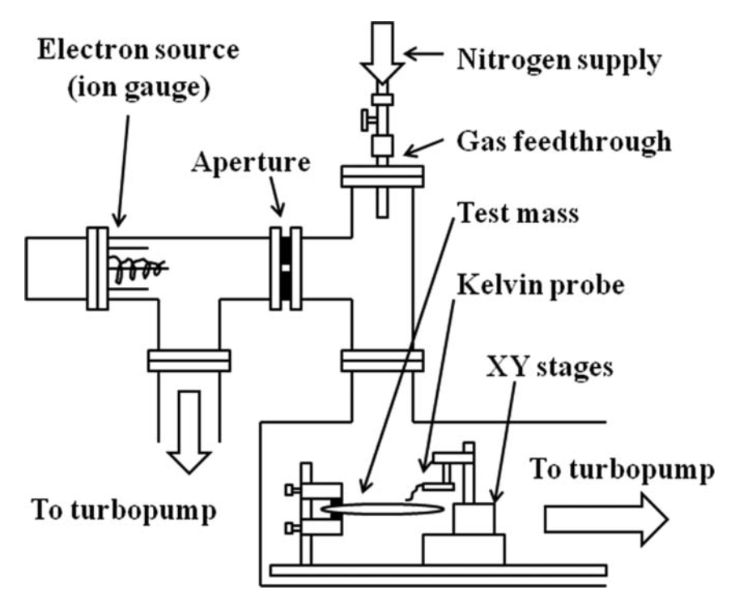
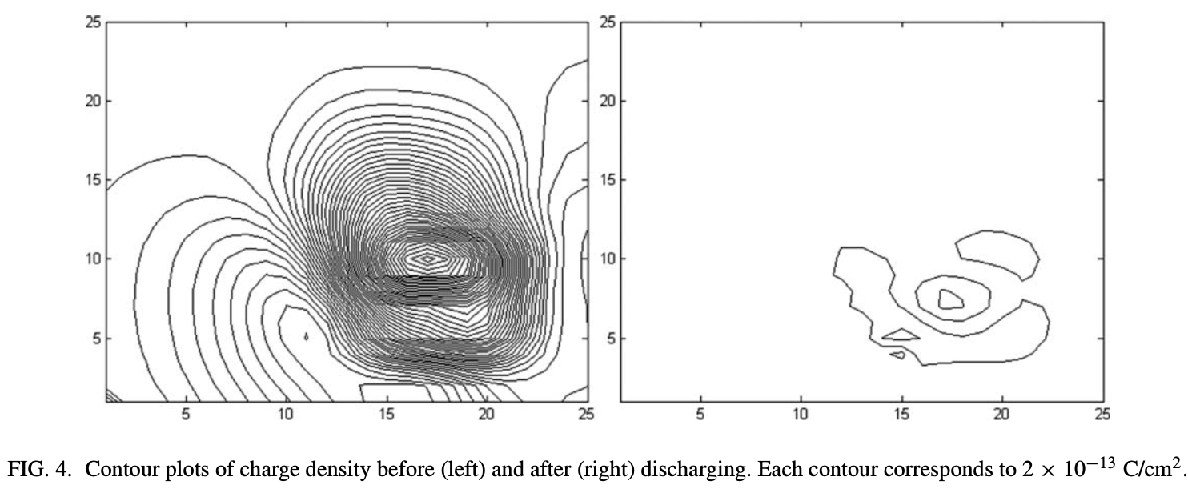
Charging mitigation at a-LIGO (Room Temperature)
Mirror exposure to some tenth of mbar of a N₂ plasma for a long time (~1 h)
D. Ugolini et al., Rev. Sci. Instrum., 82, 046108 (2011)
If the LIGO neutralization method will be applied at cryogenic temperature, a significant layer (~μm) of the injected N₂ will be cryosorbed on the mirror surface

Slide 7
Unconventional GWO issues
Cryosorption on cold optics (frost):
  KAGRA GWO suffers from gas cryosorbed on the mirror surface inducing detrimental effects on the optics.
  Warming up should be avoided (time consuming)
Electrostatic charge of mirrors
  Both VIRGO and LIGO optics undergo to inhomogeneous electrostatic charging of variable (or unknown) sign that may induce unwanted noise.
  procedures are undertaken for neutralization with positive/neg ions (Not applicable at LT )
Anything to do with accelerator dynamic vacuum?

Slide 8
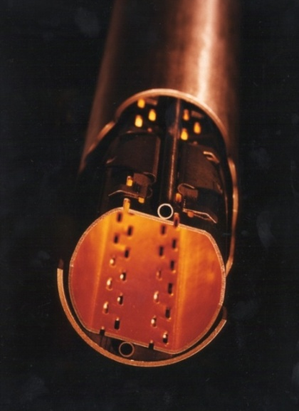
Unconventional accelerators issues: dynamic vacuum
Particles beam interactions with residual gases in the vacuum chamber → reduced beam lifetime and/or emittance
Inner wall surface properties of the vacuum chamber, in particular electron induced desorption and electron yields, are critical:
  High desorption yields → pressure runaway
  High electron yields → electron cloud formation

Slide 9
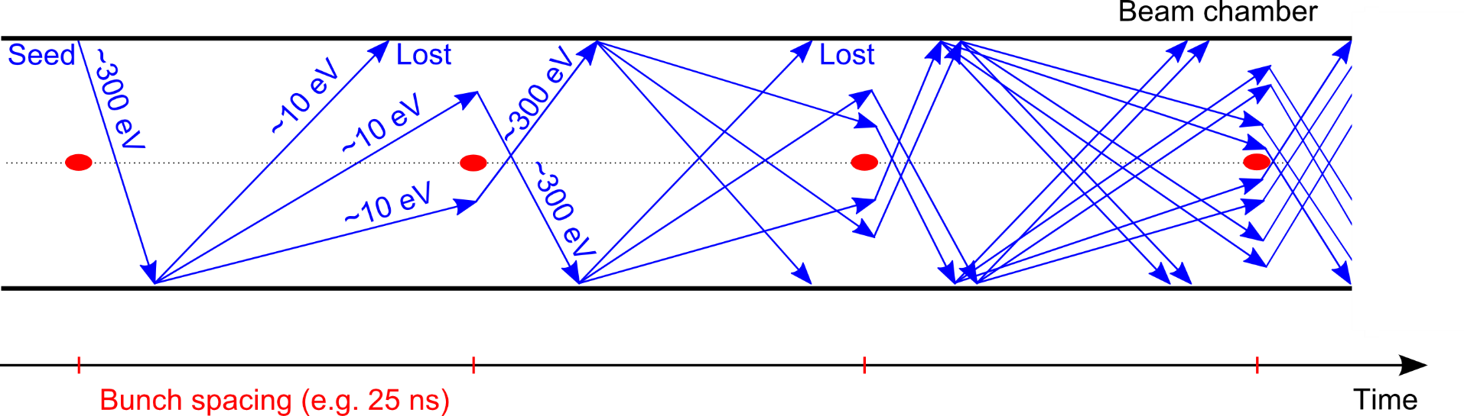
e⁻ cloud formation
Generation of electrons inside the vacuum chamber (primary, or seed, electrons)
Electrons from ion pumps and gauges
Electrons from cosmic rays etc...
Photoelectrons from synchrotron radiation
Desorption from the wall
Residual gas ionization
Acceleration of primary electrons in the beam field
Secondary electron production when hitting the wall
The presence of an e⁻cloud inside an accelerator has consequences on the machine (pressure rise, outgassing, heat load, etc.) and on the beam → Needs to be mitigated!

Slide 10
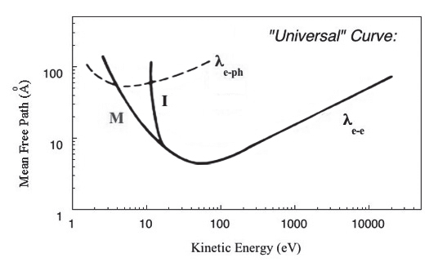
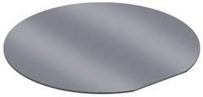
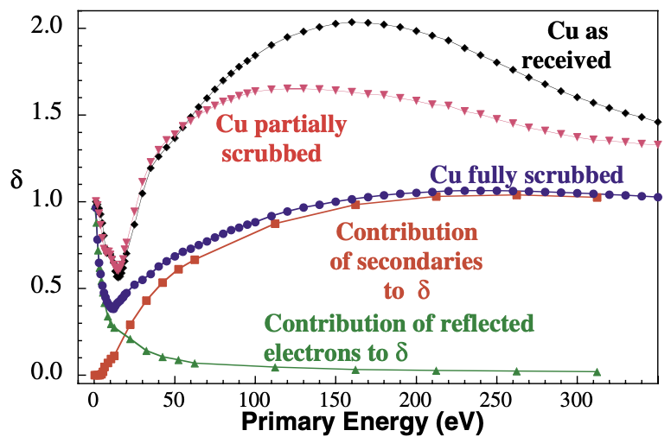
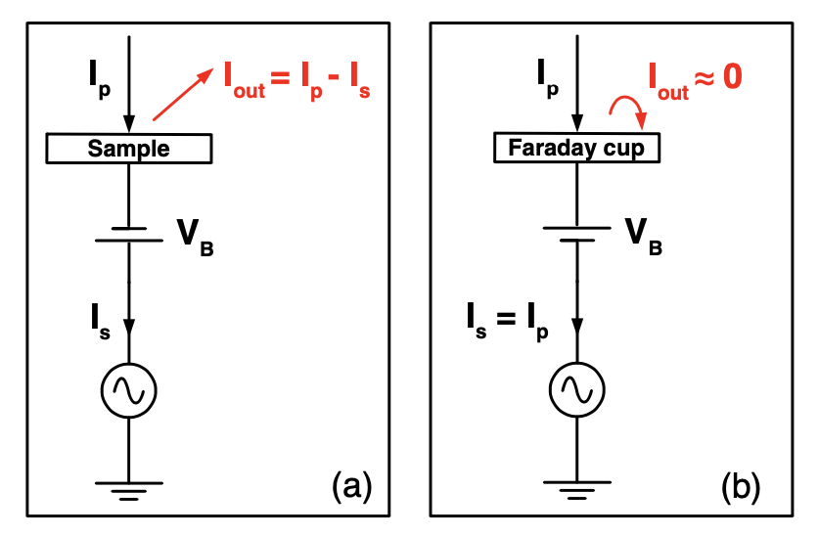
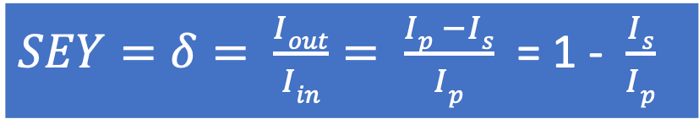
Secondary Electron Yield
$SEY=δ= \frac{Iout}{Iin}= \frac{Ip −Is}{Ip}$ = 1 - $\frac{Is}{Ip}$
SEY is an intrinsic surface property of materials
Incident electrons current (I_{p})
Emitted electrons current (I_{out})
Electron mean free path up to ~10 nm
R.Cimino et al PRL 2004
SEY depends on the electron impinging energy and on surface conditions
see talk of M. Angelucci (27/09/22)

Slide 11
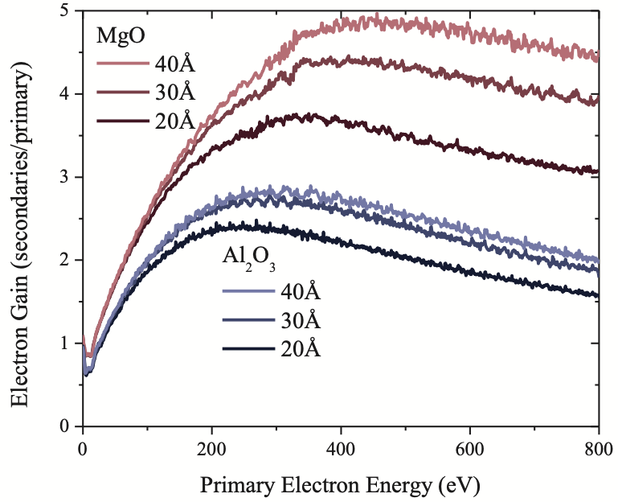
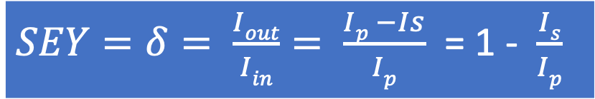
SEY of non-conductive surfaces
On a dielectric, the charge left on the surface depends on the energy of the impinging electrons
Jokela et al. Phys. Procedia (2011)
$SEY=δ= \frac{Iout}{Iin}= \frac{Ip −Is}{Ip}$ = 1 - $\frac{Is}{Ip}$

Slide 12
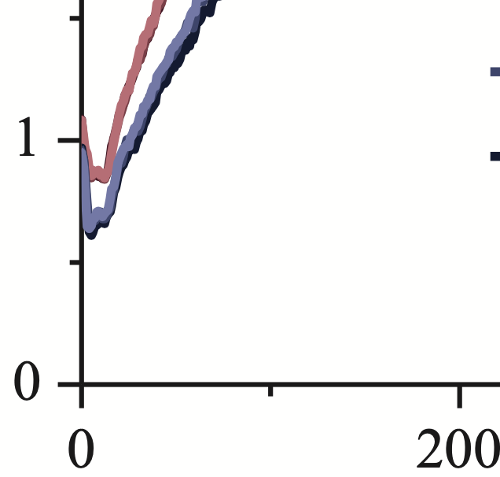
SEY of non-conductive surfaces
On a dielectric, the charge left on the surface depends on the energy of the impinging electrons
Jokela et al. Phys. Procedia (2011)
$SEY=δ= \frac{Iout}{Iin}= \frac{Ip −Is}{Ip}$ = 1 - $\frac{Is}{Ip}$
SEY < 1
200

Slide 13
SEY of non-conductive surfaces
On a dielectric, the charge left on the surface depends on the energy of the impinging electrons
Jokela et al. Phys. Procedia (2011)
$SEY=δ= \frac{Iout}{Iin}= \frac{Ip −Is}{Ip}$ = 1 - $\frac{Is}{Ip}$
This can very well explain the mirrors electrostatic charge, its inhomogeneity and sign uncertainty
SEY < 1
200

Slide 14
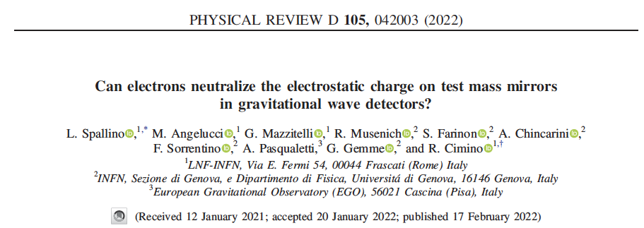
SEY not only can explain the charging phenomenon but suggests how to cure it!
OUR PROPOSAL
We propose to use electrons of variable but low energy (between 10 to 100 eV) to neutralize unwanted electrostatic charge on test mass mirrors. Low energy selected electrons can indeed compensate charges of both polarity on mirror optics.

Slide 15
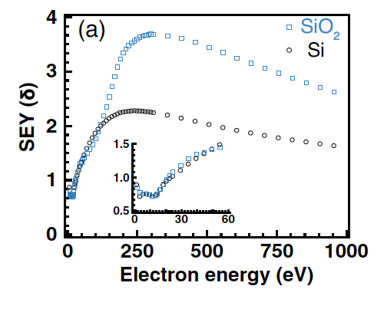
Using low energy electrons to neutralize electrostatic charging: a proof of principle
Secondary Electron Yield
SEY=I_{out}/I_{p}
Incident electrons current (I_{p})
Emitted electrons current (I_{out})

Slide 16
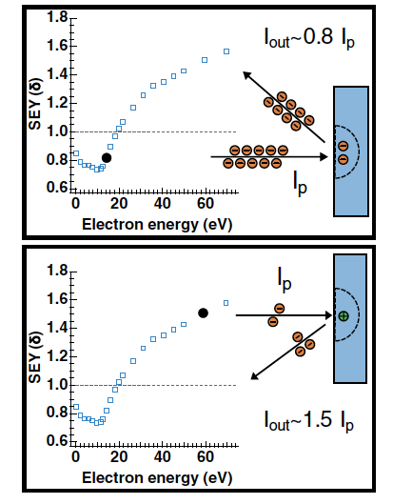
Using low energy electrons to neutralize electrostatic charging: a proof of principle
Secondary Electron Yield
SEY=I_{out}/I_{p}
Incident electrons current (I_{p})
Emitted electrons current (I_{out})
The energy of the incident electrons can be opportunely tuned to neutralize positive and negative charges on the mirror’s dielectric surface

Slide 17
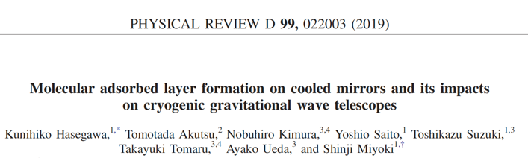
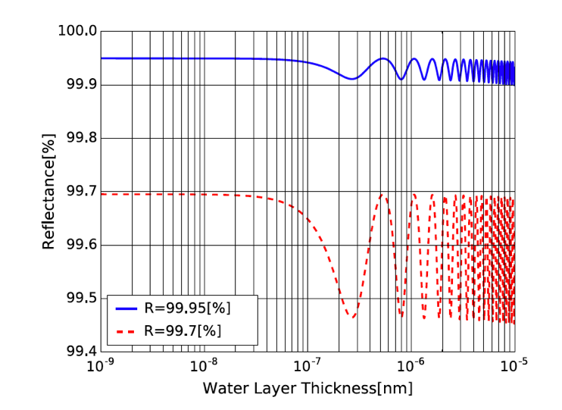
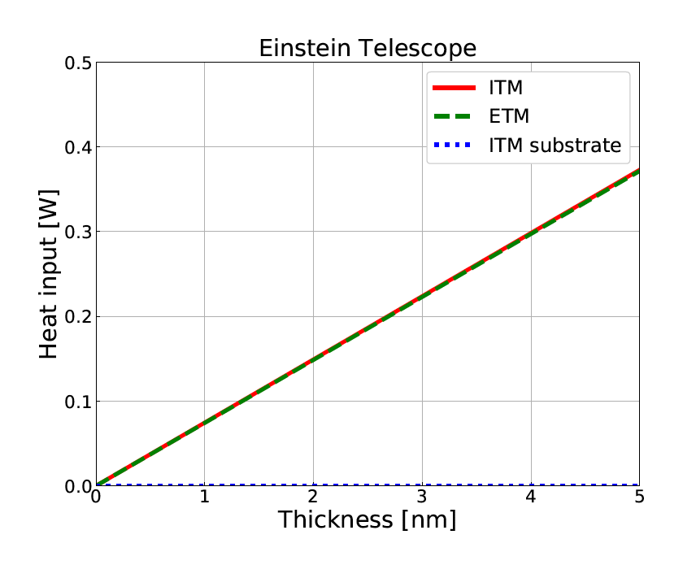
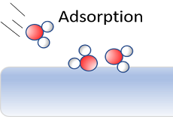
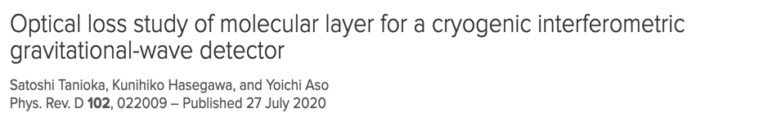
Cryogenic Vacuum Issues on GWD optics
From KAGRA experience, simulations indicate:
reflectivity gets affected, already after 100 nm of H₂O ice
ET maximum thermal budget (~100 mW/ 1 W) is expected to be exceeded already after ~1-10 nm of H₂O ice!!!
Water Layer Thickness [m]
  → Can we cure it?

Slide 18
Residual gas adsorption on cold surfaces
Saturated vapour pressure from Honig and Hook (1960)
Cryosorption depends on:
surface temperature
pressure
gas partial pressures
They have to be correctly evaluated, considering:
P_{RT}≠P_{LT} (thermal transpiration correction)
vacuum history
For T~10 K and p<10⁻¹⁰ mbar, the most common residual gas species in a UHV chamber (except H₂ and He) will be adsorbed, forming a molecular ice (“frost”) on the surface

Slide 19
Residual gas adsorption on cold surfaces
The right evaluation of gas pressure allows to give reliable estimates of ice thickness forming on the cold surface.
Langmuir (L) unit:
1 L = 1x 10⁻⁶ mbar x 1s
gas exposure of a surface (or dosage)
→ In 1x 10⁻¹⁰ mbar, it takes 10.000 s (~3h) to build up a ML.
For sticking coefficient S_{c}= 1:
1 L ~ 1 Monolayer (ML) cryosorbed
for H₂O, 1 ML ~ 0.3 nm

Slide 20
Residual gas adsorption on cold surfaces
The right evaluation of gas pressure allows to give reliable estimates of ice thickness forming on the cold surface.
Langmuir (L) unit:
1 L = 1x 10⁻⁶ mbar x 1s
gas exposure of a surface (or dosage)
For sticking coefficient S_{c}= 1:
1 L ~ 1 Monolayer (ML) cryosorbed
for H₂O, 1 ML ~ 0.3 nm
→ In 1x 10⁻¹² mbar, it takes 1.000.000 s (~300 h) to build up a ML.

Slide 21
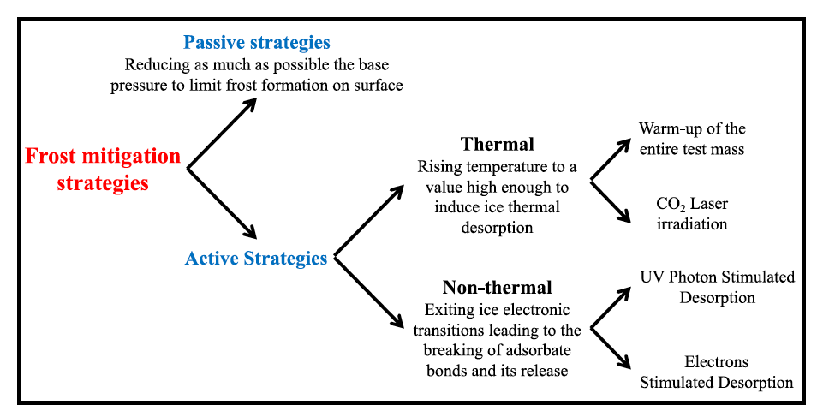
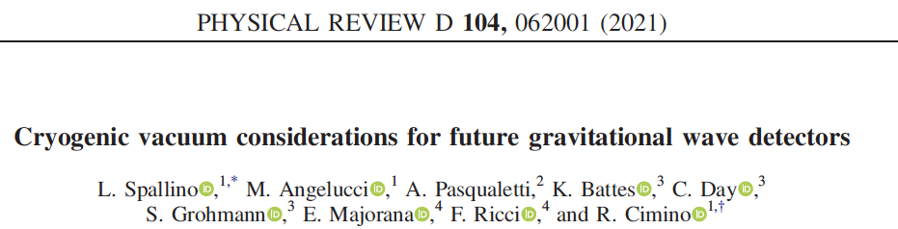
Active mitigation strategies: Wrap-up
A lesson from accelerators’ dynamic vacuum !

Slide 22
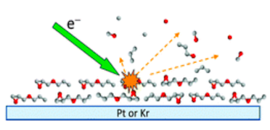
Low energy electrons irradiation
Electrons efficiently induce molecular ice nonthermal desorption!
R. Dupuy et al. J. Appl. Phys. 128, 175304 (2020)
L. Spallino et al., Phys. Rev. D, 062001, 104 (2021)
Mirror

Slide 23
Low energy electrons irradiation
Possible if a charging mitigation method compliant with cryogenics is proved!
R. Dupuy et al. J. Appl. Phys. 128, 175304 (2020)
L. Spallino et al., Phys. Rev. D, 062001, 104 (2021)
Mirror

Slide 24
Low energy electrons irradiation
Mirror
If P_{eff} ∼ 1x10⁻¹⁰ (H₂O,CO,CO₂, etc) mbar; sticking coefficient = 1
1 monolayer (∼ 10¹⁵ mol/cm² ∼ 0.3 nm) will be cryosorbed in 10.000 s.
(∼ 2.5nm/day ∼ 10 times less than in KAGRA)
If we assume a mean ESD η= 0.1 mol./electron (as for H₂O) @ 100eV.
(R. Dupuy et al. J. Appl. Phys. 128, 175304, 2020)
To remove 1 ML we need an el. current of: ~ 1 mAmps/cm² in one second
… depositing less than 100 mW/ML/cm² (not all el. energy goes in thermal heat!)
All in UHV, with marginal heating up of the mirrors and (possibly) reduced downtime.
Deserves further investigation!

Slide 25
Unconventional GWO issues
Anything to do with accelerator dynamic vacuum?
Cryosorption on cold optics (frost):
  KAGRA GWO suffers from gas cryosorbed on the mirror surface inducing detrimental effects on the optics.
  Warming up should be avoided (time consuming)
Electrostatic charge of mirrors
  Both VIRGO and LIGO optics undergo to inhomogeneous electrostatic charging of variable (or unknown) sign that may induce unwanted noise.
  procedures are undertaken for neutralization with positive/neg ions (Not applicable at LT )
Electrons

Slide 26
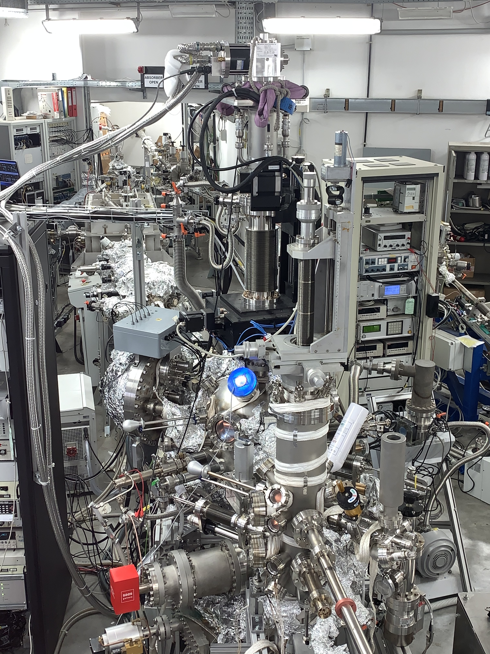
Ongoing studies
LNF-INFN MaSSlab “Material and Surface Science laboratory”
The competences developed to tackle unconventional “dynamic” vacuum can of some use for the running of existing and future GW interferometers!

Slide 27
Summary
There are many conventional vacuum issues in common between GWO and Accelerators
There are also some “unconventional” vacuum studies where both communities can learn from each other
A lot of R&D is ahead and have to be tackled as soon as possible to be included in the final design of new GWO

Slide 28
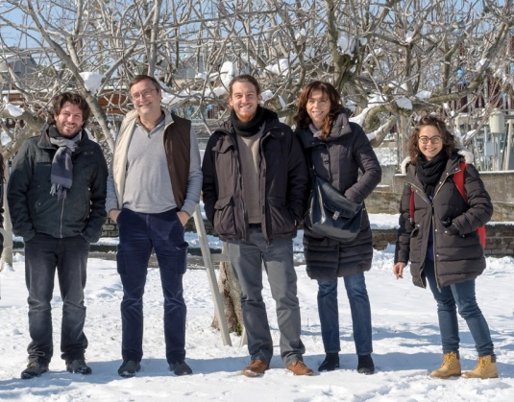
Thank you for your attention!
Thanks to the low temperature team at LNF
R. Cimino
R. Larciprete
M. Angelucci
A. Liedl

