Slide 1
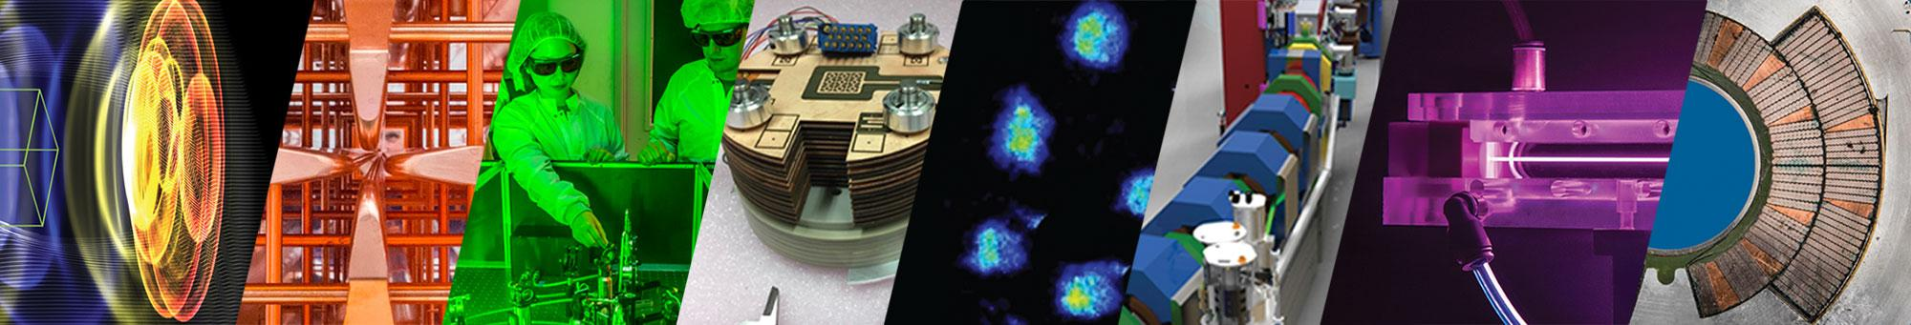
Next Generation Simulation Tools for the Modeling of
Beam Dynamics and Electron Clouds in Particle Accelerators
Jean-Luc Vay
Accelerator Modeling Program Head
ECLOUD’22 Workshop
September 25-28, 2022 – Italy, La Biodola Bay, Isola d’Elba

Slide 2
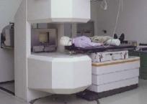
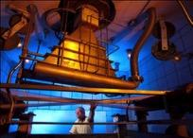
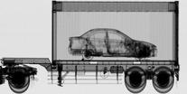
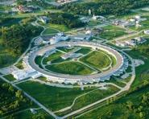

Particle Accelerators are Essential Tools in Modern Life
Medicine
Industry
National Security
Discovery Science
~9,000 medical accelerators in operation worldwide
10’s of millions of patients treated/yr
50 medical isotopes, routinely produced with accelerators
~20,000 industrial accelerators in use
  Semiconductor manufacturing
  cross-linking/ polymerization
  Sterilization/ irradiation
  Welding/cutting
Annual value of all products that use accel. Tech.: $500B
Cargo scanning
Active interrogation
Stockpile stewardship: materials character- ization, radiography, support of non- proliferation
~30% of Nobel Prizes in Physics since 1939 enabled by accelerators
4 of last 14 Nobel Prizes in Chemistry for research utilizing accelerator facilities
Next generation of accelerators needs
next generation of HPC modeling tools!
Modeling: Understanding → Exploration → Design
Notes:
Accelerator Modeling and LBNL’s Position in it.
Key question: why does this area position the lab for important work, not just in simulations but in accelerators more broadly, and via collaborations advancing our other computation areas? Noting connections with other divisions, areas, and Labs will be important.

Slide 3
Outline
Community planning
  U.S. DOE-HEP GARD Accelerator & Beam Physics (ABP) Roadmap
  Snowmass21 Beam & Accelerator Modeling Interest Group Community Paper
Berkeley Lab Accelerator Modeling Program & modeling ecosystem
  BLAST
  WarpX DOE Exascale Computing Project application
  ImpactX
  HiPACE++
Larger community effort
  SciDAC-5 Collaboration on Advanced Modeling of Particle Accelerators
  End-to-end Virtual Accelerator (EVA) with on-the-fly tunability
  Community ecosystem with standardized Inputs & Outputs
  Synergies with CERN modeling ecosystem plans & tools (Xsuite)
Summary & Outlook
3

Slide 4
Outline
Community planning
  U.S. DOE-HEP GARD Accelerator & Beam Physics (ABP) Roadmap
  Snowmass21 Beam & Accelerator Modeling Interest Group Community Paper
Berkeley Lab Accelerator Modeling Program & modeling ecosystem
  BLAST
  WarpX DOE Exascale Computing Project application
  ImpactX
  HiPACE++
Larger community effort
  SciDAC-5 Collaboration on Advanced Modeling of Particle Accelerators
  End-to-end Virtual Accelerator (EVA) with on-the-fly tunability
  Community ecosystem with standardized Inputs & Outputs
  Synergies with CERN modeling ecosystem plans & tools (Xsuite)
Summary & Outlook
4

Slide 5
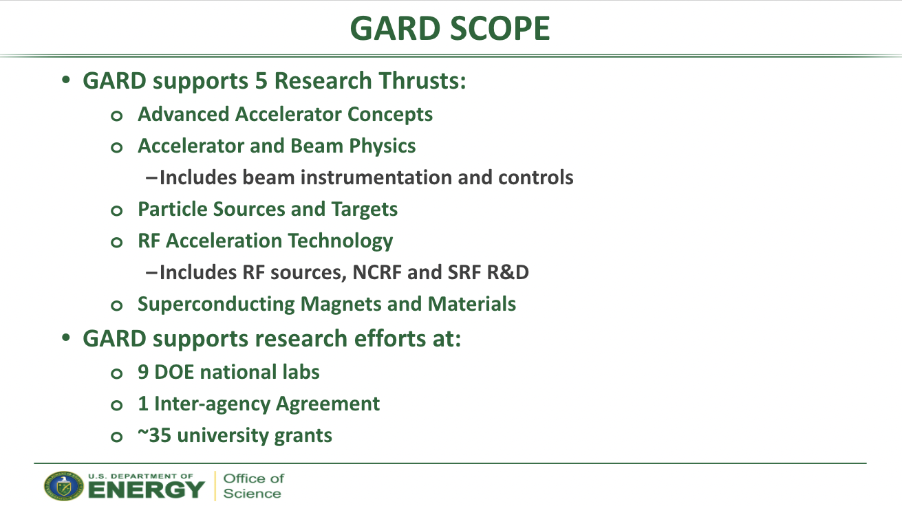
U.S. DOE-HEP General Accelerator Research & Development program supports research at DOE labs & University grants
Ken Marken
GARD Accelerator and Beam Physics Roadmap Workshop
Bethesda, MD, USA – Sept. 6-8, 2022
2 preparatory workshops
LBNL: 2019
FNAL (virtual): 2020
+ Sept. 6-8, 2022 meeting
➔ Roadmap on 4 grand challenges

Slide 6


US DOE-HEP GARD Accelerator and Beam Physics Thrust guided by four Grand Challenges
Grand challenge #1 (beam intensity): How do we increase beam intensities by orders of magnitude?
Grand challenge #2 (beam quality): How do we increase beam phase-space density by orders of magnitude, towards the quantum degeneracy limit?
Grand challenge #3 (beam control): How do we control the beam distribution down to the level of individual particles?
Grand challenge #4 (beam prediction): How do we develop predictive “virtual particle accelerators”?
Particle Physics Project
Prioritization Panel (P5)
Report
AMP is actively involved in the Snowmass process.
S. Nagaitsev et al, “Accelerator and Beam Physics: Grand Challenges and Research Opportunities,” Snowmass 2021 LOI.

Slide 7

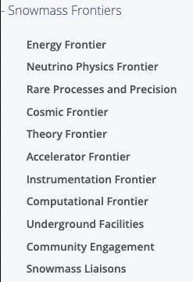


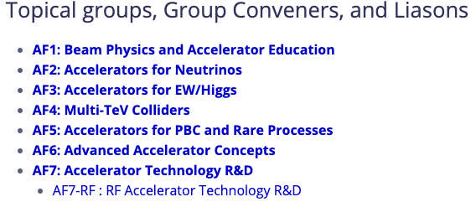
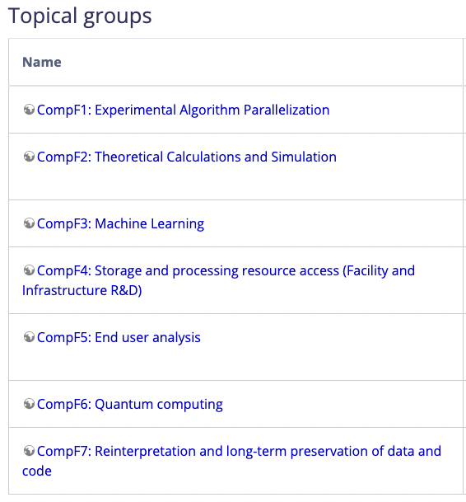
Snowmass21 was massive multiyear effort
Liaison AF-CompF: J.-L. Vay

Slide 8
A Beam & Accelerator Modeling Interest Group (BAMIG) was formed
Beam and Accelerator Modeling Interest Group (BAMIG)
  In CompF2: Theoretical Calculations and Simulation
  Homepage: snowmass-compf2-accbeammodel.github.io
  Coordinators: Jean-Luc Vay (LBNL) - CompF-AF liaison & Axel Huebl – Early Career–CompF
Multi-year effort with regular bi-weekly meetings
  >80 people in our mailing list, at least 1/3rd regularly active
  26 LOIs (2020) snowmass-compf2-accbeammodel.github.io/loi/submitted.html
  LOIs material largely reported in two community papers in Journal of Instrumentation (JINST), ICFA Beam Dynamics Newletters #82: Advanced Accelerator Modeling (2021):
    Simulations of Future Particle Accelerators: Issues and Mitigations by D. Sagan, et al. DOI:10.1088/1748-0221/16/10/T10002
    Modeling of Advanced Accelerator Concepts by J.-L. Vay, et al. DOI:10.1088/1748-0221/16/10/T10003
  Decided to distill all inputs and topics into one community whitepaper for Snowmass
    Content was then distilled by Ji Qiang in the CompF2 & CompF reports

Slide 9
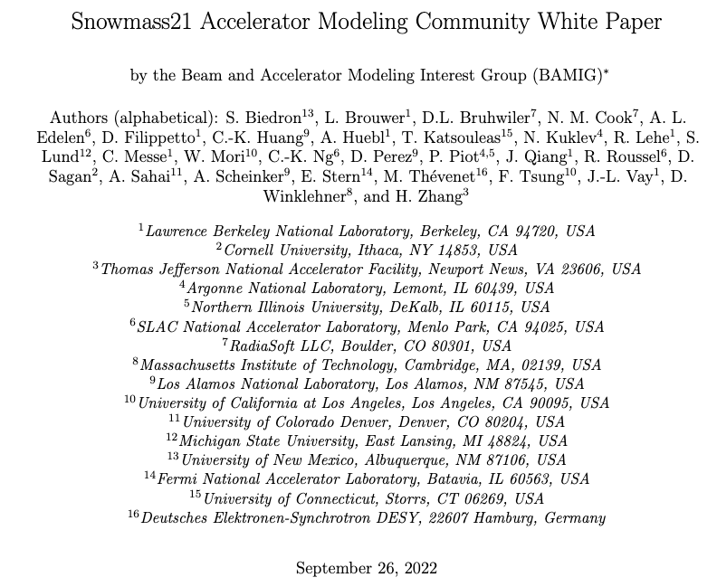
BAMIG developed Accelerator Modeling Community Whitepaper
  arXiv:2203.08335 (2022)

Slide 10
Key observations from Accelerator Modeling Community Whitepaper
Computer modeling is essential to beam & accelerator physics research, as well as to the design, commissioning and operation of particle accelerators
Large, complex endeavor, with expanding range of intertwined physics topics
Rapidly changing & disruptive computing hardware and software environments: from CPUs, GPUs over FPGAs to Quantum + AI/ML
Contrary to machines & accelerator complexes, development of beam & accelerator physics codes often largely uncoordinated

Slide 11
Community reported on a very comprehensive list of key topics
Modeling needs
RF-based acceleration; Plasma-based wakefield acceleration; Structure-based wakefield acceleration; PetaVolts per meter plasmonics and Plasmonic acceleration; Materials modeling for accelerator design; Structured plasmas; Superconducting magnets
To the next frontier: ultraprecise, ultrafast virtual twins of particle accelerator
Interdisciplinary simulations; End-to-end Virtual Accelerators (EVA); Virtual twins of particle accelerators
Cutting-edge and emerging computing opportunities
Advanced algorithms; Artificial intelligence; machine learning, and differentiable simulations; Quantum computing; Storage ring quantum computers
Computational needs
Hardware: CPU/GPU time, memory, archive; Software performance, portability and scalability; Scalable I/O and in-situ analysis
Sustainability, reliability, user support, training
Code robustness, validation & verification, benchmarking, reproducibility; Usability, user support and maintenance; Training and education
Toward community ecosystems & data repositories
Loose integration: Integrated workflows; Tighter integration: Integrated frameworks; Data repositories; Centers & consortia, collaborations with industry

Slide 12
Leading to 6 high-level recommendations
Develop a comprehensive portfolio of particle accelerator and beam physics modeling tools in support of achieving Accelerator & Beam Physics Thrust Grand Challenges on intensity, quality, control, and prediction.
Develop software infrastructure to enable end-to-end virtual accelerator modeling and corresponding virtual twins of particle accelerators.
Develop advanced algorithms & methods, including AI/ML modalities and quantum computing technologies.
Develop efficient and scalable software frameworks and associated tools to effectively leverage the next generation of high-performance and high-throughput computing hardware.
Develop sustainable and reliable code maintenance practices, community benchmarking capabilities, and training opportunities to foster the cooperative application of accelerator software.
Foster an open community that spans academia, national labs and industry to (a) develop software ecosystems, libraries, frameworks and standards, (b) curate data repositories, and (c) establish dedicated centers and distributed consortia with open governance models.

Slide 13
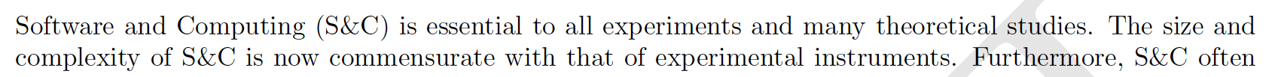
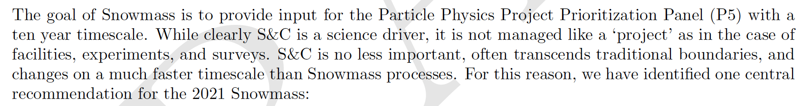
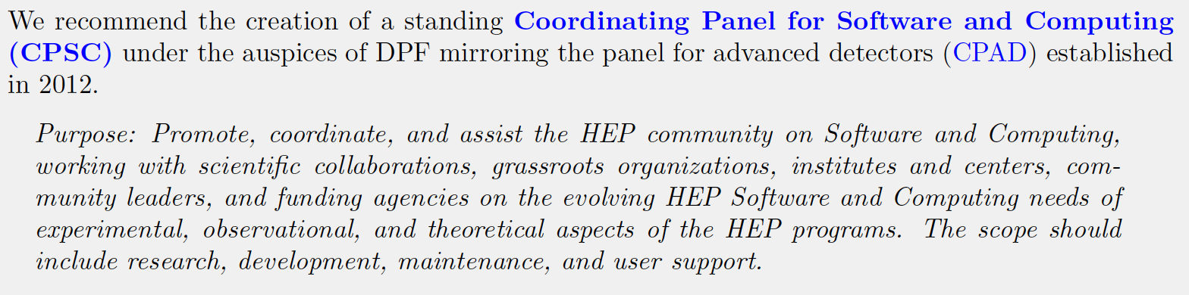
Snowmass21: Computational Frontier (CompF) report executive summary

Slide 14
Outline
Community planning
  U.S. DOE-HEP GARD Accelerator & Beam Physics (ABP) Roadmap
  Snowmass21 Beam & Accelerator Modeling Interest Group Community Paper
Berkeley Lab Accelerator Modeling Program & modeling ecosystem
  BLAST
  WarpX DOE Exascale Computing Project application
  ImpactX
  HiPACE++
Larger community effort
  SciDAC-5 Collaboration on Advanced Modeling of Particle Accelerators
  End-to-end Virtual Accelerator (EVA) with on-the-fly tunability
  Community ecosystem with standardized Inputs & Outputs
  Synergies with CERN modeling ecosystem plans & tools (Xsuite)
Summary & Outlook
14

Slide 15


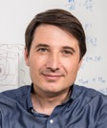
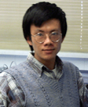



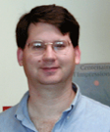

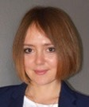


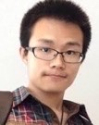
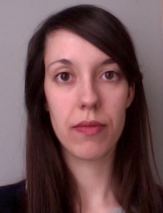
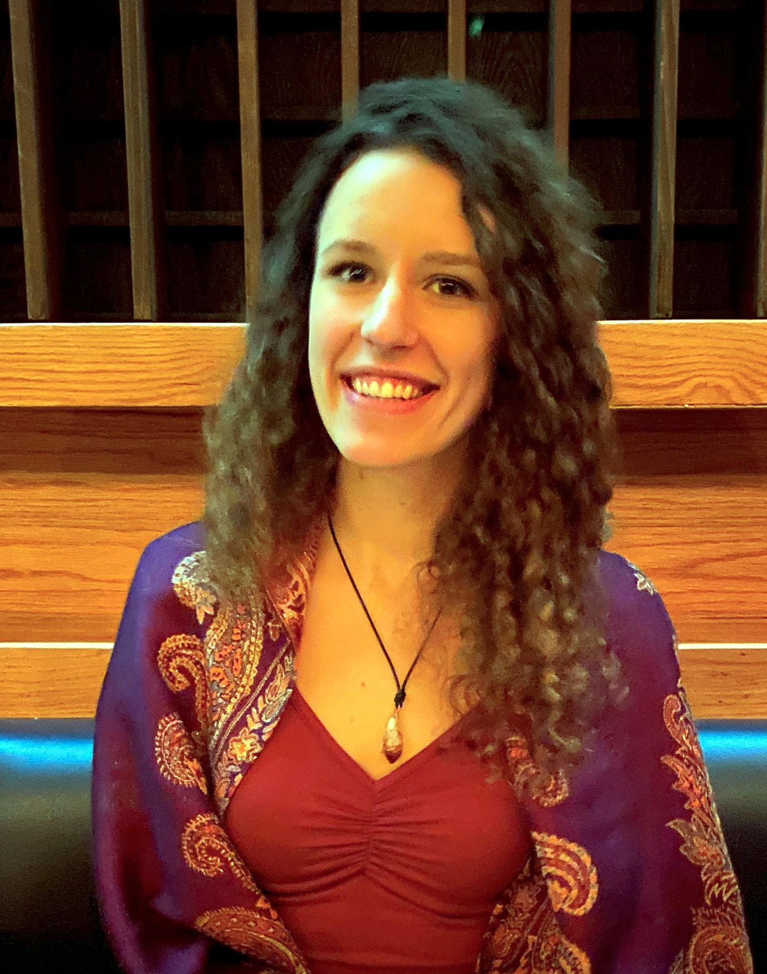
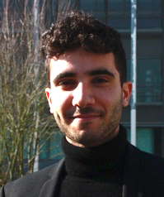
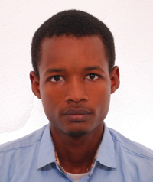

ATAP’s Accelerator Modeling Program offers broad range of computational tools & expertise in particle accelerator modeling
Team
New generation accelerator codes
Maintains toolset of
cutting-edge,
open-source,
high-performance codes
Jean-Luc Vay (lead)
Ji
Qiang (deputy)
Axel
Huebl
Rémi
Lehe
WarpX, IMPACTX, HiPACE++, …
Developed by tightly integrated team of physicists + applied mathematicians + computer scientists
Built around common library
Single code on CPUs & GPUs
Developed & used by growing US+internatio. community from, labs, academia & industry
Multi-physics frameworks: IMPACT(X), Warp*(X).
Specialized codes: BeamBeam3D, FBPIC, HiPACE++, Posinst.
Libraries & standards: PICSAR, openPMD, PICMI.
with a broad range of physics & applications
beams, plasmas, lasers, structures, beam-beam, e⁻ clouds, ...
linacs, rings, injectors, traps, plasma/dielectric accelerators, …
and many original algorithms
Mesh refinement, secondary electron emission (Furman-Pivi), specialized Poisson solvers, particle pushers, boosted frame, spectral Maxwell solvers, numerical Cherenkov instability control, ...
Staff
Chad
Mitchell
Greg
Penn
Edoardo
Zoni
Olga Shapoval
Marco Garten
Ryan Sandberg
Yinjian
Zhao
Arianna
Formenti
Postdocs
Dec. 2022
Camille Woicekowski
Thierry
Antoun
Amadou
Diallo
Joey
Zhu
Students
*Warp+Posinst or Warp+pyCloud can perform self-consistent ecloud studies

Slide 16


Novel BLAST integrated ecosystem of accelerator (& more) codes
BLAST Particle-in-cell Codes
WarpX: t-based EM & ES PIC + lattice
ImpactX: s-based ES + lattice
HiPACE++: Quasistatic PIC (similar to QuickPIC, pyHeadtail, …)

Slide 17

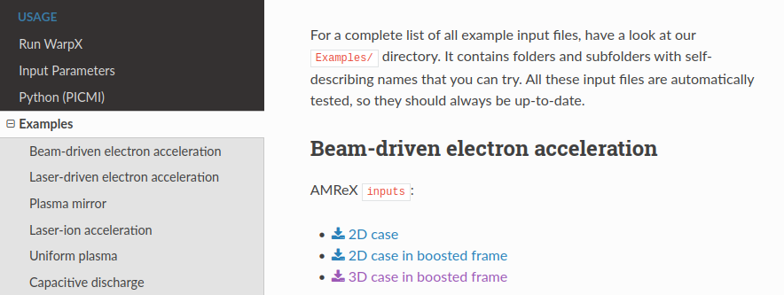
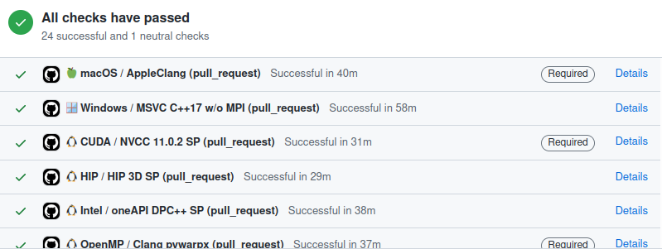


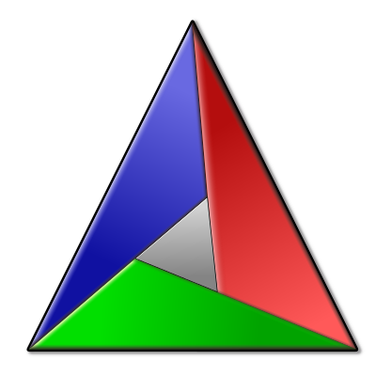


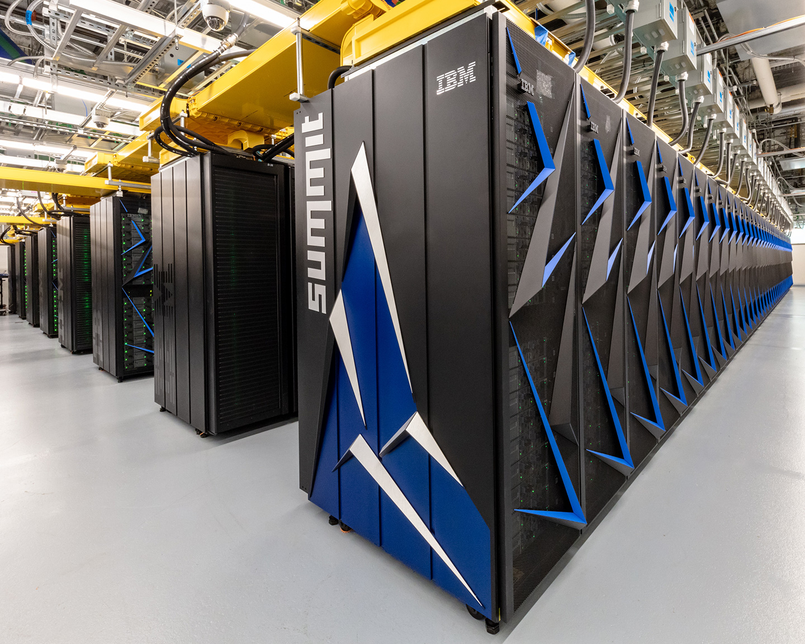




Effort to develop extensive documentation, tests & ease of use
Online Documentation:
warpx|hipace|impactx.readthedocs.io
Open-Source Development & Benchmarks:
github.com/ECP-WarpX
Rapid and easy installation on any platform:
188 physics benchmarks run on every code change of WarpX
8 physics benchmarks + 32 tests for ImpactX
brew tap ecp-warpx/warpx
brew install warpx
cmake -S . -B build
cmake --build build --target install
python3 -m pip install .
conda install
-c conda-forge warpx
spack install warpx
spack install py-warpx
module load warpx
module load py-warpx

Slide 18
Novel BLAST integrated ecosystem of accelerator (& more) codes
BLAST Particle-in-cell Codes
WarpX: t-based EM & ES PIC + lattice
ImpactX: s-based ES + lattice
HiPACE++: Quasistatic PIC (similar to QuickPIC, pyHeadtail, …)

Slide 19





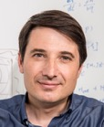
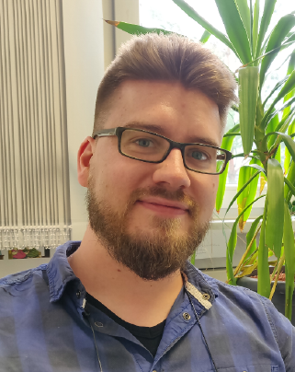









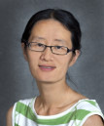





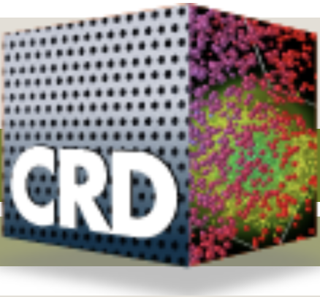






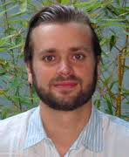
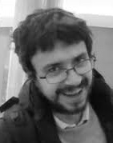
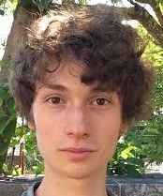
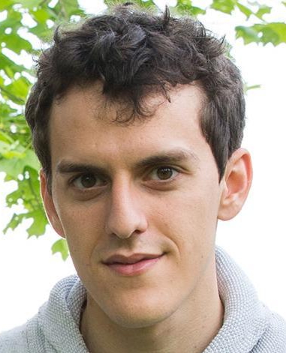


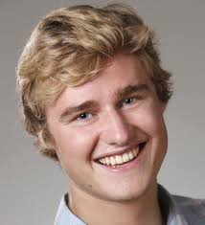









AMP leads WarpX, a Multi-Institutional, Multidisciplinary Team
Jean-Luc Vay (ECP PI)
Marco Garten
Axel
Huebl
Rémi
Lehe
Chad
Mitchell
Ji
Qiang
Ryan
Sandberg
Olga Shapoval
Yinjian
Zhao
Edoardo
Zoni
Ann Almgren
(ECP coPI)
John
Bell
Kevin
Gott
Junmin
Gu
Revathi
Jambunathan
Hannah Klion
Prabhat Kumar
Andrew
Myers
Weiqun
Zhang
AM
David Grote
(ECP coPI)
(NESAP)
a growing list of contributors
Henri
Vincenti
Luca
Fedeli
Antonin
Sainte-Marie
Neïl
Zaim
Maxence Thévenet
Severin Diederichs
Alexander
Sinn
Marc Hogan
(ECP coPI)
Lixin
Ge
Cho
Ng
CEA Saclay (France)
Lorenzo
Giacomel
DESY (Germany)
Peter Scherpelz, Michael Kieburtz, Kevin Zhu, Roelof E. Groenewald
Phil Miller
Most at a fraction of time on WarpX
CERN (Switzerland)

Slide 20
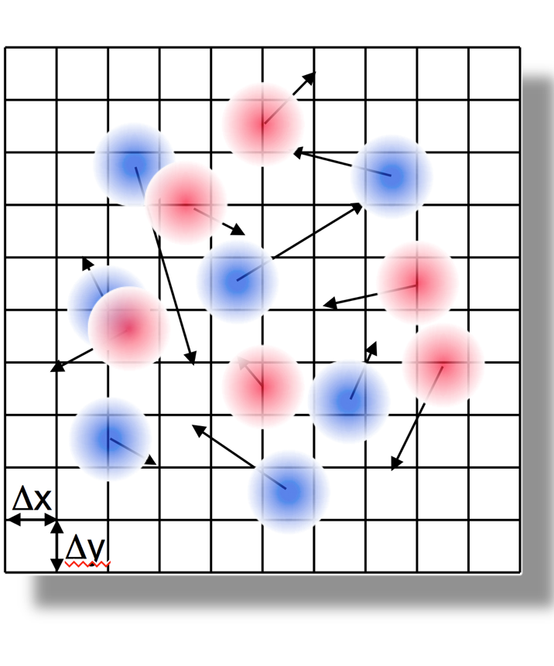
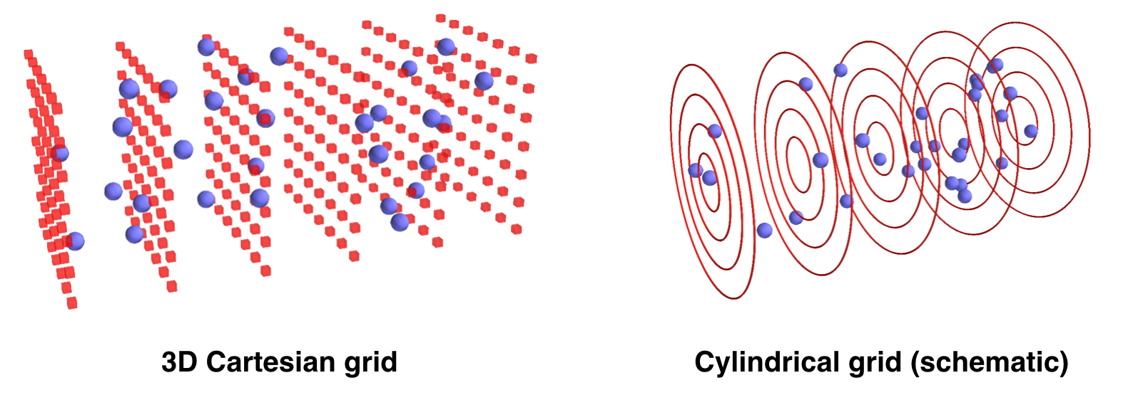
WarpX: Multi-Physics Particle-in-Cell Code for Exascale
Particle-in-Cell
Geometries
1D3V, 2D3V,
3D3V and
RZ (quasi-
cylindrical)
Multi-Node parallelization
MPI: 3D domain decomposition
dynamic load balancing
On-Node Parallelization
GPU: CUDA, HIP and SYCL
CPU: OpenMP
Scalable, Parallel I/O
AMReX plotfile and
openPMD (HDF5 or ADIOS)
in situ diagnostics
macro-
particles
electro-
magnetic (EM) fields on a grid
Advanced Algorithms Pioneered by our Team
boosted frame, spectral solvers, Galilean frame, MR, ...
Multi-Physics Modules
field ionization of atomic levels, Coulomb
collisions, QED processes (e.g. pair creation), macroscopic materials, embedded boundaries + CAD, …

Slide 21


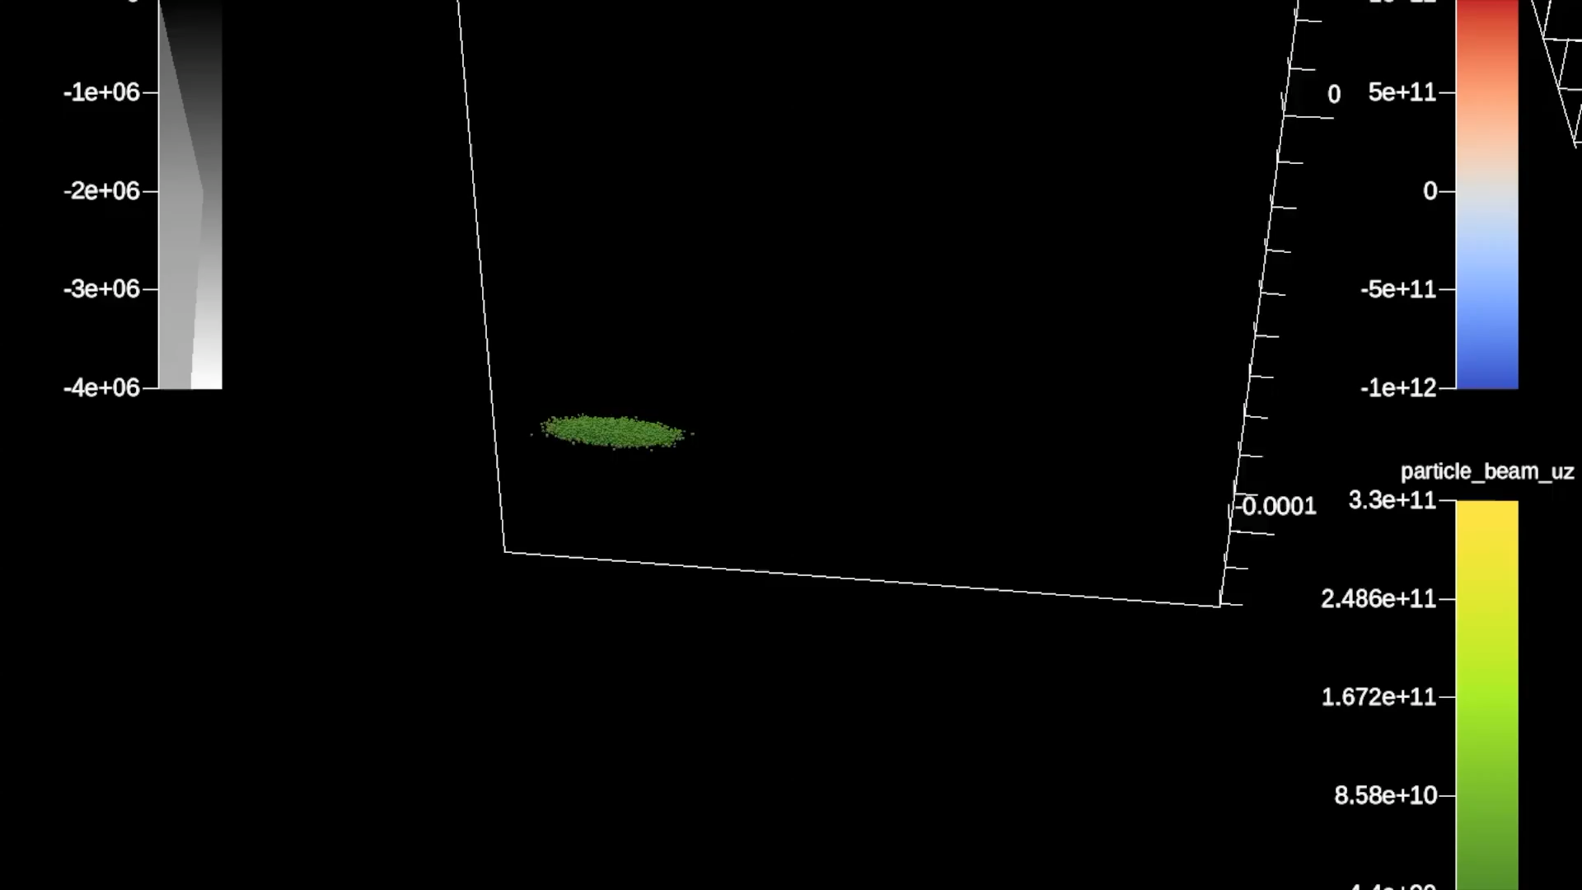
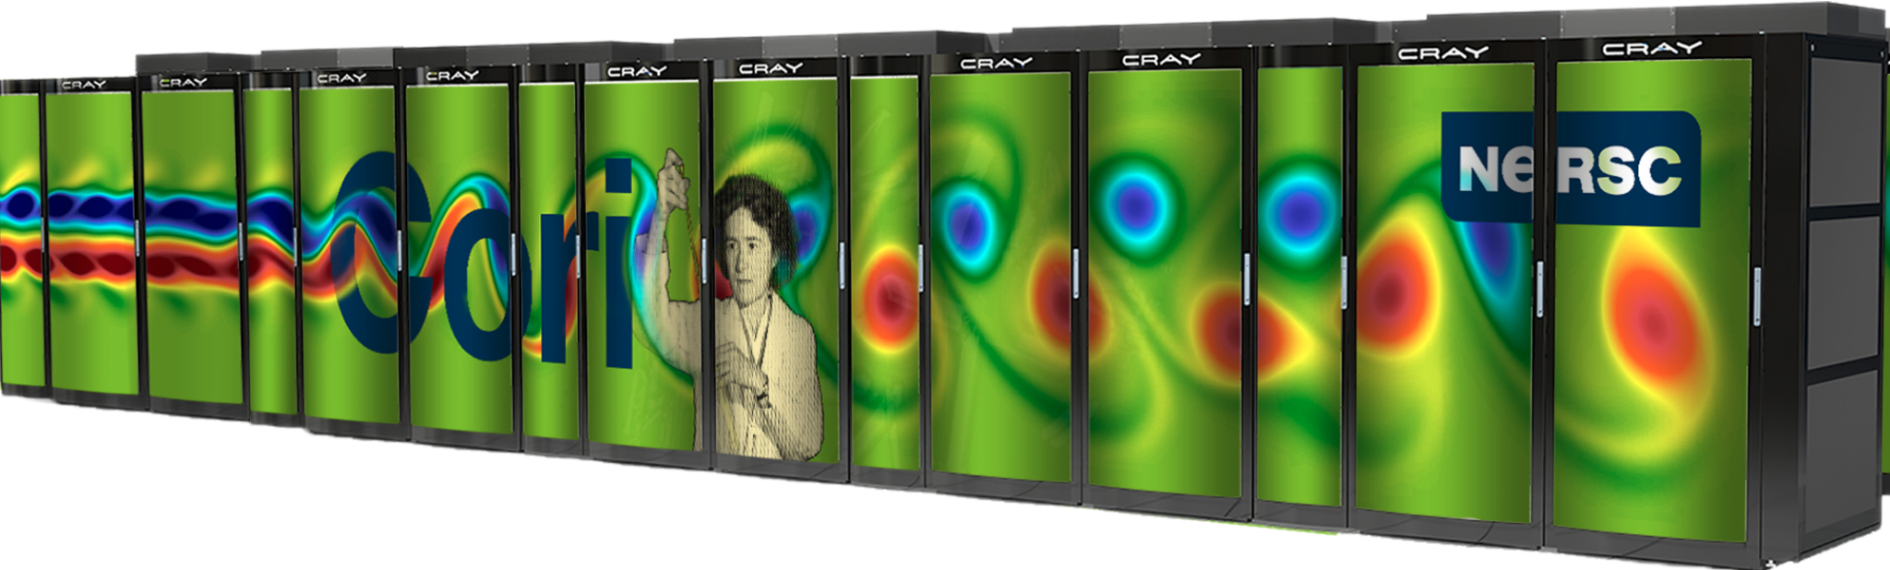
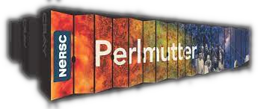
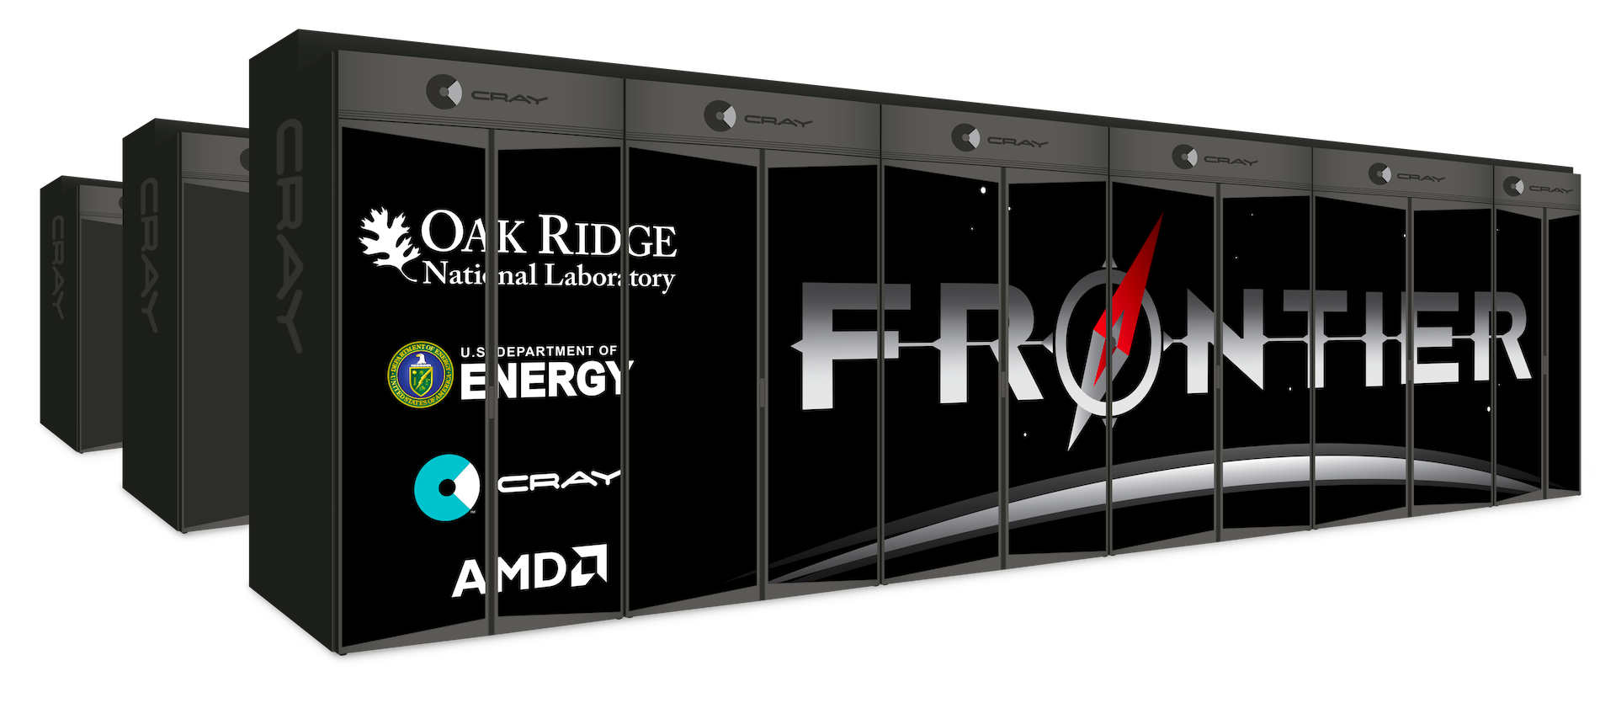

WarpX: Application in the DOE Exascale Computing Project (ECP)
ECP Goal: deliver & scientifically use the U.S. first Exascale systems (ExaFLOP: 10¹⁸ FLOP/second)
WarpX ECP science case:
3D simulations of chains of plasma accelerator stages for future colliders
Challenge: single source code on various platforms:
NERSC (Intel, then NVIDIA), OLCF (NVIDIA)→Exascale: OLCF (AMD), ALCF (Intel)
✓
✓
✓
next
Intel KNL CPUs
NVIDIA V100 GPUs
NVIDIA A100 GPUs
AMD MI200 GPUs
Intel Ponte Vechio GPUs
ECP hardware & software co-design paid off:
WarpX is 500x more performant than the pre-ECP baseline
WarpX first ECP app to run at scale on Frontier
Notes:
The PIC loop, field solver, and parallelization are different enough that it makes sense to have separate

Slide 22
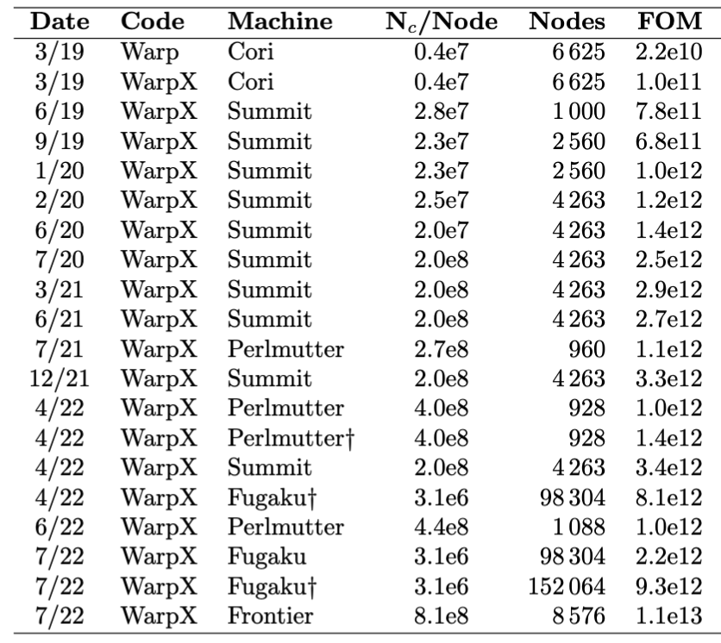
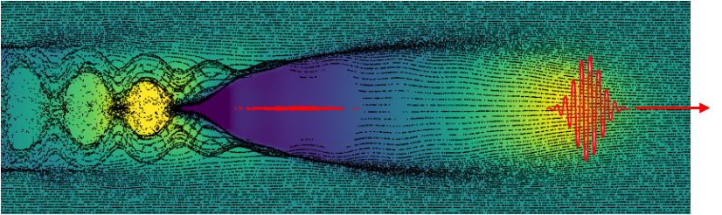

Frontier: 1st Exascale supercomputer
from a full stage simulation
WarpX on Frontier: x500 over Baseline on Cori
Figure-of-Merit over time
$$FOM= \frac{\# \left(grid points, particles\right)× \# time steps }{runtime}$$
KPP: 1000 steps of plasma acc. stage with prefilled plasma
from a full stage simulation
500x
110x
FOM: 1000 steps of plasma acc. stage with prefilled plasma
J.-L. Vay, A. Huebl et al., PoP 28.2, 023105 (2021); L. Fedeli, A. Huebl et al., SC22 (2022)

Slide 23
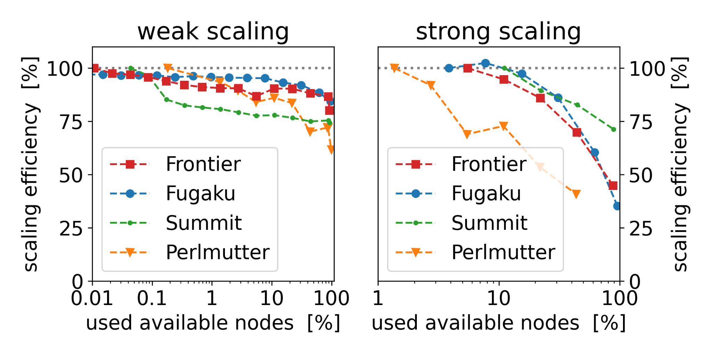
Good scaling on 4-5 orders of magnitude on various machines

Slide 24





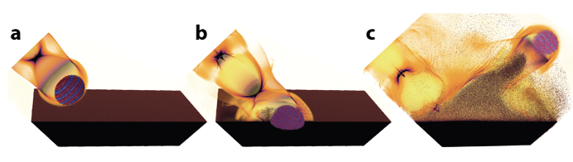
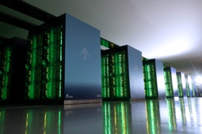
Part of multinational team selected as 2022 Gordon Bell Award* Finalist
Multidisciplinary, multi-institutional international team!
Modeling of laser impacting solid target in gas, extracting & accelerating e- beam
April-July 2022: WarpX on world’s largest HPCs
#1 Frontier (USA)
#2 Fugaku (Japan)
#4 Summit (USA)
#7 Perlmutter (USA)
L. Fedeli, A. Huebl et al., accepted in Supercomputing22, 2022
Like on particle accelerators, core team had long 8-12 hours shifts with continuous exchanges on Zoom and Slack at any times of day/night across many time zones (US, Europe, Japan).
*Gordon Bell Award is considered the “Oscars of Supercomputing”

Slide 25
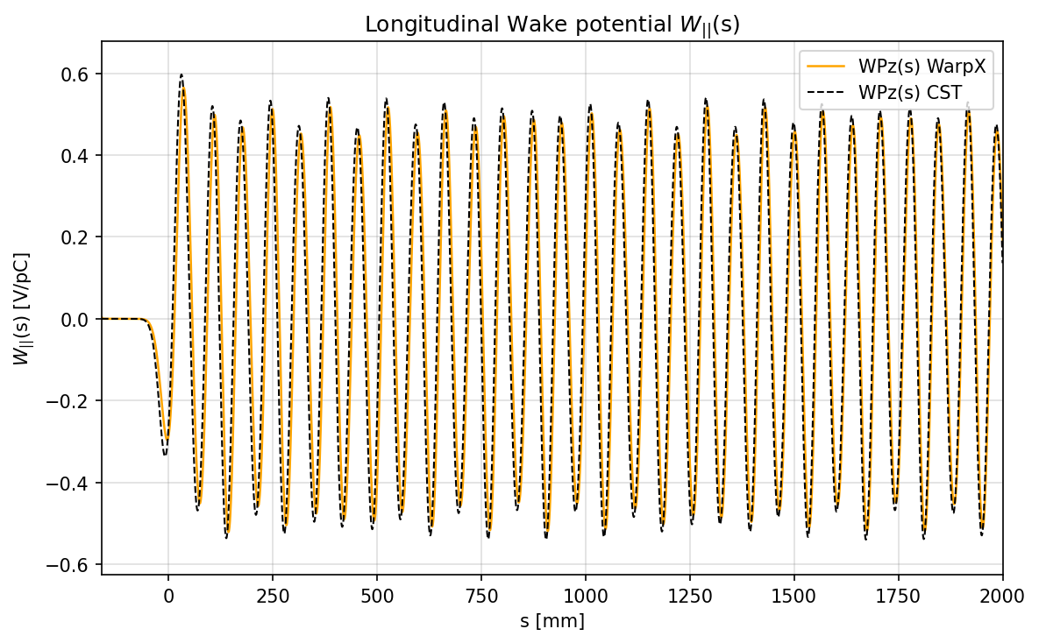
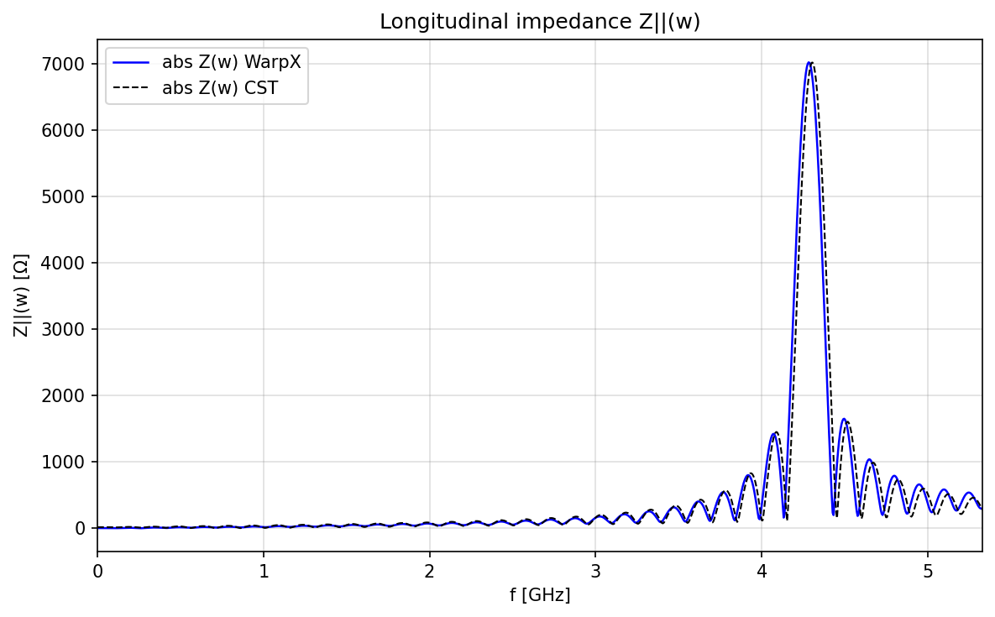
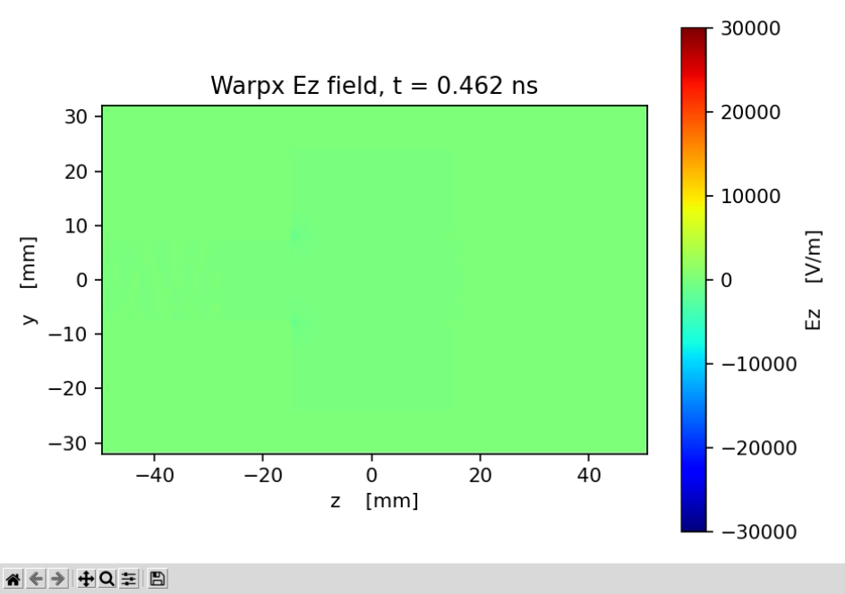
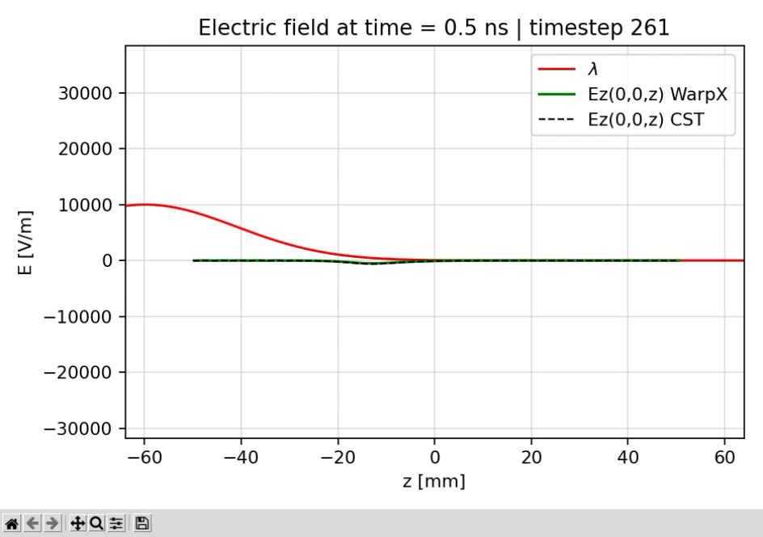
Collaboration with CERN on modeling of cavities
WarpX simulations of a cubic cavity resonator.
Comparisons with CST
Credits: Lorenzo Giacomel, Elena de La Fuente Garcia, Carlo Zannini

Slide 26


Work planned on hollow electron lens but descoped from HL-LHC baseline for now
Still of general interest to community
Protons
Electrons
Plan: simulate the “impedance” of the e- beam on proton beam, i.e., effect of proton bunch on following though e- ebeam.
Bunch #1 ➔ e- beam oscillation ➔ radiation kicks bunch #2
Credit: Lorenzo Giacomel, Stefano Redaelli
Notes:
From Lorenzo email:
In one you have the actual piece of hardware with sketched in red the proton beam and in yellow the hollow electron beam.
In the other you have the transverse section of the two beams.
What we cannot simulate at the moment is the “impedance” of the electron beam on the proton beam or, if you prefer, the effect of a proton bunch on the following one through the electron beam. I.e. a bunch makes the electron beam oscillate -> the electron beam starts radiating -> the following bunch is kicked by this field.
This for now cannot even be done with CST, since it’s a "non-conventional" simulation

Slide 27
Novel BLAST integrated ecosystem of accelerator (& more) codes
BLAST Particle-in-cell Codes
WarpX: t-based EM & ES PIC + lattice
ImpactX: s-based ES + lattice
HiPACE++: Quasistatic PIC (similar to QuickPIC, pyHeadtail, …)

Slide 28

ImpactX: GPU-, AMR- & AI/ML-Accelerated Beam Dynamics
Particle-in-Cell Loop
electrostatic
  with space-charge effects
s-based
  relative to a reference particle
  elements: symplectic maps
User-Friendly
single-source C++, full Python control
fully tested
fully documented
Multi-Node parallelization
MPI: 2D/3D domain decomposition
dynamic load balancing (in dev.)
On-Node Parallelization
GPU: CUDA, HIP and SYCL
CPU: OpenMP
Scalable, Parallel I/O (in dev.)
openPMD
in situ analysis/visualization
Fireproof Numerics
based on IMPACT suite of codes, esp. IMPACT-Z and MaryLie (in dev.)
Triple Acceleration Approach
GPU support
Adaptive Mesh Refinement (in dev.)
AI/ML & Data Driven Models (in dev.)
github.com/ECP-WarpX/impactx
LDRD

Slide 29
ImpactX: Physics Benchmark Examples
FODO cell
magnetic bunch compression chicane
stationary beam in a const. focusing channel
Kurth-distr. beam in periodic isotropic focusing channel
stable FODO cell + short RF (buncher) cavities for longitudinal focusing
chain of thin multipoles
nonlin. focusing channel (IOTA nonlin. lens)
Fermilab IOTA storage ring (linear optics)
LDRD

Slide 30




ImpactX: FODO cell example
💡 Same Script
CPU/GPU & MPI
LDRD

Slide 31




ImpactX: IOTA (v8.4) Lattice Benchmark @2.5 MeV protons
bare (linear) lattice of the Fermilab IOTA storage ring; an rms-matched proton beam with an un- normalized emittance of 4.5 μm propagates over a single turn
Preservation of Second Moments validated with Impact-Z
nnl. element: conserve invariants of motion
check emittance preservation
rms beam size evolution: IMPACT-Z vs ImpactX
Preliminary Performance
on Perlmutter (NERSC) CPU / GPU
1 node: 2 GPUs ~6.3x faster than 32 cores
Reference Orbit
LDRD

Slide 32
Novel BLAST integrated ecosystem of accelerator (& more) codes
BLAST Particle-in-cell Codes
WarpX: t-based EM & ES PIC + lattice
ImpactX: s-based ES + lattice
HiPACE++: Quasistatic PIC (similar to QuickPIC, pyHeadtail, …)

Slide 33

HiPACE++: Quasistatic PIC code developed by DESY with LBNL
Developed for plasma-based particle accelerators
e- cloud
Could be applied to e-cloud studies

Slide 34


Co-developed in BLAST ecosystem: share base & modules with WarpX
About x10 faster and energy efficient on GPUs vs CPUs
Benchmarked with WarpX

Slide 35
Outline
Community planning
  U.S. DOE-HEP GARD Accelerator & Beam Physics (ABP) Roadmap
  Snowmass21 Beam & Accelerator Modeling Interest Group Community Paper
Berkeley Lab Accelerator Modeling Program & modeling ecosystem
  BLAST
  WarpX DOE Exascale Computing Project application
  ImpactX
  HiPACE++
Larger community effort
  SciDAC-5 Collaboration on Advanced Modeling of Particle Accelerators
  End-to-end Virtual Accelerator (EVA) with on-the-fly tunability
  Community ecosystem with standardized Inputs & Outputs
  Synergies with CERN modeling ecosystem plans & tools (Xsuite)
Summary & Outlook
35

Slide 36
Outline
5-year DOE SciDAC-5 multi-institutional project to develop coherent ecosystem
SciDAC: Scientific Discovery through Advanced Computing (2000➔)
SciDAC-HEP: partnership between HEP & ASCR (DOE Computing office)
5 Projects selected for funding (announced Sept. 21, 2022)
Collaboration for Advanced Modeling of Particle Accelerators
  will develop simulations for traditional and advanced particle accelerator concepts in a coherent software framework
  Responsive to topic I of DOE call: Integrated end-to-end simulation of conventional, hybrid, or “virtual” accelerators using DOE HPC to target Grand Challenges to advance the P5 Science Drivers.
  Partners: LBNL [Lead*] + FNAL + SLAC + UCLA + ORNL + ANL
  Accelerator codes: BLAST (WarpX, ImpactX, HiPACE++), Synergia, PICKSC (Osiris, QuickPIC, QPAD)
*PI: JL Vay
36

Slide 37

Ultimate goal: End-to-end Virtual Accelerator (EVA) with on-the-fly tunability of physics & numerics complexity to users
Speed
Great for ensemble runs for design studies
Fidelity
Great for detailed runs for physics studies
Reduced physics
Full physics
1D-1V
3D-3V
Low resolution
High resolution
Surrogate models
First principles
Present state of the art: complicated command-line workflows; each lab or group has its own code(s)

Slide 38




















Complexities in accelerator modeling require us to work together
With standards
Simulation code
Particle-In-Cell
Modeling Interface
Code A
open Particle Mesh Data standard
Code B
...
Facilitates:
Chaining of codes for multiphysics workflow.
Cross-benchmarking, verification, comparison.
Interfacing with ensemble optimization, AI/ML software.
Integration into a framework.

Slide 39
Outline
Community planning
  U.S. DOE-HEP GARD Accelerator & Beam Physics (ABP) Roadmap
  Snowmass21 Beam & Accelerator Modeling Interest Group Community Paper
Berkeley Lab Accelerator Modeling Program & modeling ecosystem
  BLAST
  WarpX DOE Exascale Computing Project application
  ImpactX
  HiPACE++
Larger community effort
  SciDAC-5 Collaboration on Advanced Modeling of Particle Accelerators
  End-to-end Virtual Accelerator (EVA) with on-the-fly tunability
  Community ecosystem with standardized Inputs & Outputs
  Synergies with CERN modeling ecosystem plans & tools (Xsuite)
Summary & Outlook
39

Slide 40


Slide 41


Slide 42


Slide 43

Synergy with “Virtual accelerators”

Slide 44

Integrated ecosystem

Slide 45

Summary & outlook
Community planning in US is advocating the development of integrated modeling ecosystems toward “virtual accelerators”
Berkeley Lab AMP program leads development of an ecosystem that exploits Exascale supercomputers technologies
Larger community effort is also underway to develop community-wide End-to-end Virtual Accelerator (EVA) with on-the-fly tunability
  standardized Inputs & Outputs are key
Great synergies with CERN modeling ecosystem plans & tools (Xsuite)
Let’s work together to build integrated ecosystems that realize …
F. Zimmermann, 2004
CARE HHH-2004 dream:
complete e-cloud simulation?
45

Slide 46
Summary & outlook
Thank you!
46

Slide 47
Summary & outlook
Extras
47

Slide 48

Many beam dynamics codes
Mostly single developers; a few teams, some large
Beam dynamics codes section from Accelerator Handbook (A. Chao, 2013)
Duplication?

Slide 49

Many electromagnetic PIC codes
Mostly single developers; a few teams, some large
Plasma accelerator codes
From J.-L. Vay, R. Lehe,
RAST 9 (2016)
Definitely some duplication.

Slide 50


Accelerator modeling: the norm used to be life without standards
No standards
Simulation codes
Input code A
Code A
Output Code A
Different input formats
Different output formats
Input code B
Code B
Output Code B
Input …
...
Output …
Difficult for benchmarks, workflows, optimization or AI/ML engines, …
Fun comparison! Imagine:
the car makers not following standards
➔ drivers having to learn “from scratch” to drive each car

