Slide 1


Slide 2
Conclusions:
General consideration
The “football match”
Special thanks

Slide 3
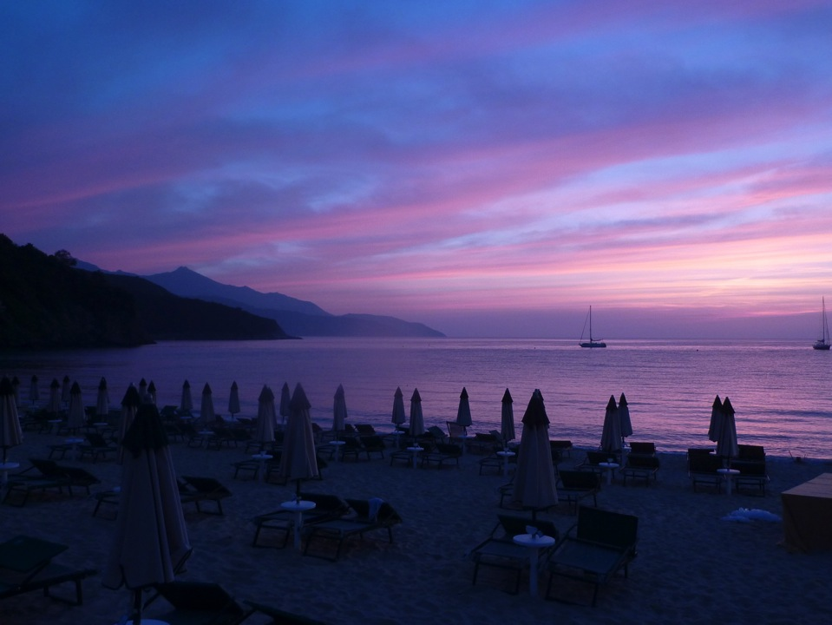
About 50 participants.
Very successful meeting:

Slide 4
About 50 participants.
Very successful meeting:
(Most of them in the audience all the time, a clear “cloud” effect!)

Slide 5
About 50 participants.
Very successful meeting:
(Most of them in the audience all the time, a clear “cloud” effect!)
Interesting discussion in the audience and outside!
E-cloud seems to be again an hot topic (thanks to the great results from LHC and the number of new projects pushing the limit)
Lot of space for future collaborations!

Slide 6
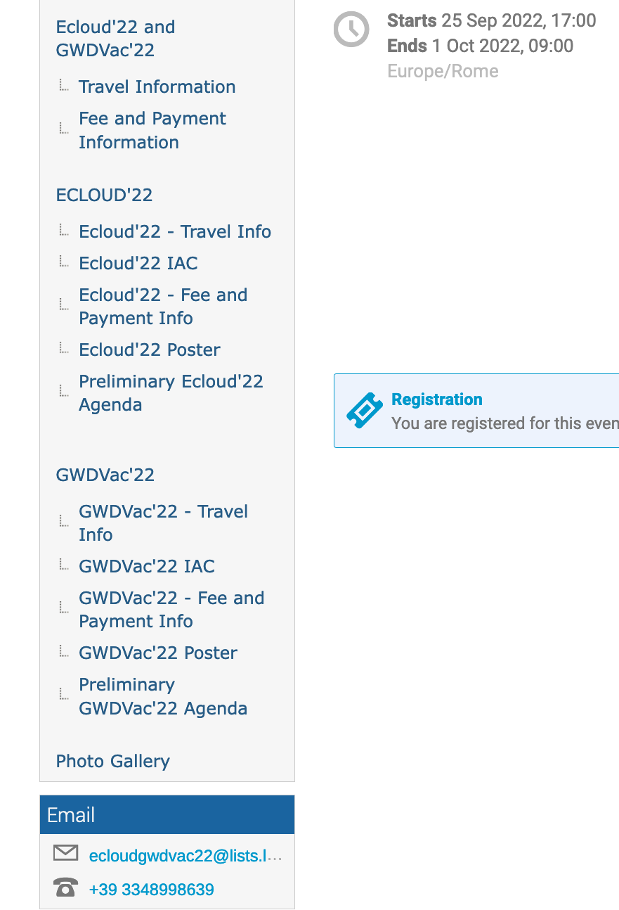
On our web page: https://agenda.infn.it/event/28336/
See conference photos

Slide 7
Some final consideration on Ecloud’22
The quality and the improvements in all fields discussed in this Ecloud22 edition in respect to Ecloud18 workshop is indeed enormous!
Maybe too much time passed between the two events.
What, where and when next e-cloud meeting?
Will we have CERN YELLOW BOOK? It will be an effort for everybody but worth doing it... We should decide it soon and decide it together.

Slide 8
Some final consideration on Ecloud’22
If I have to extract a word summarizing this workshop is:
Synergy!
Synergy not only among different Labs and accelerators, but among very different research fields! (Space, GWD etc.)
Synergy also in research: e-cloud mitigation tools has to be compliant with Impedance budget, Vacuum stability and compatibility, etc.
“ Synergy” with test machines to validate codes and Laboratory results.
A lot of collaborative work ahead of us!

Slide 9
The football game !
 | Theory | Exp.
(Heavily) injured | 1 +/- 2 | 0 +/- 1
LOST | Some | Many
Final result: | 4 | 5

Slide 10
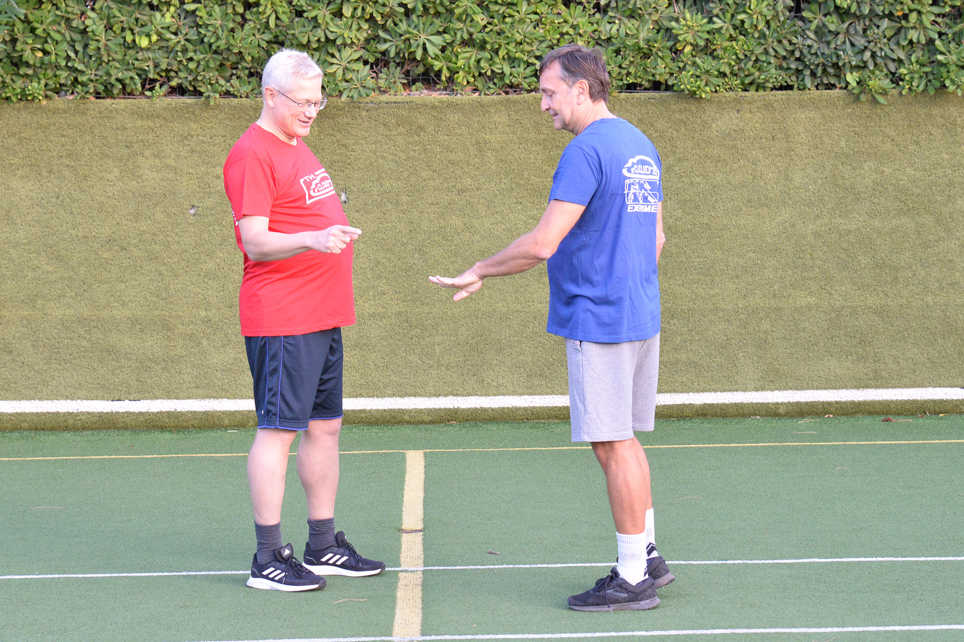
The football game !
Collaborative spirit:
It all started with “pari o dispari”

Slide 11
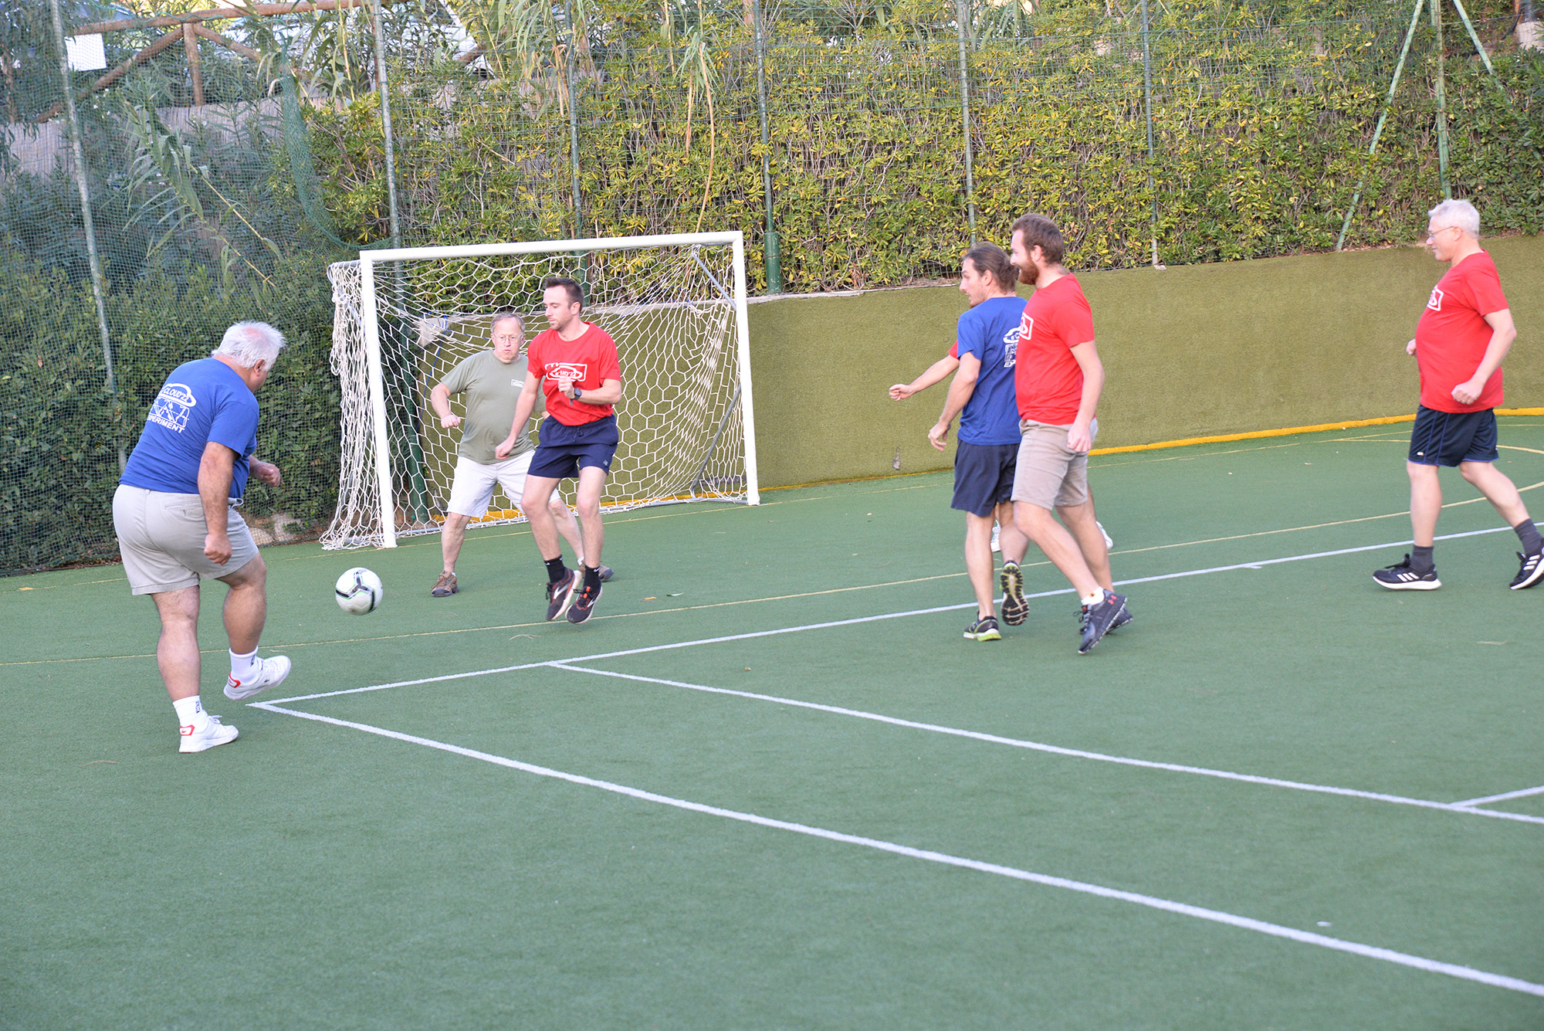
The football game !
Collaborative spirit:

Slide 12
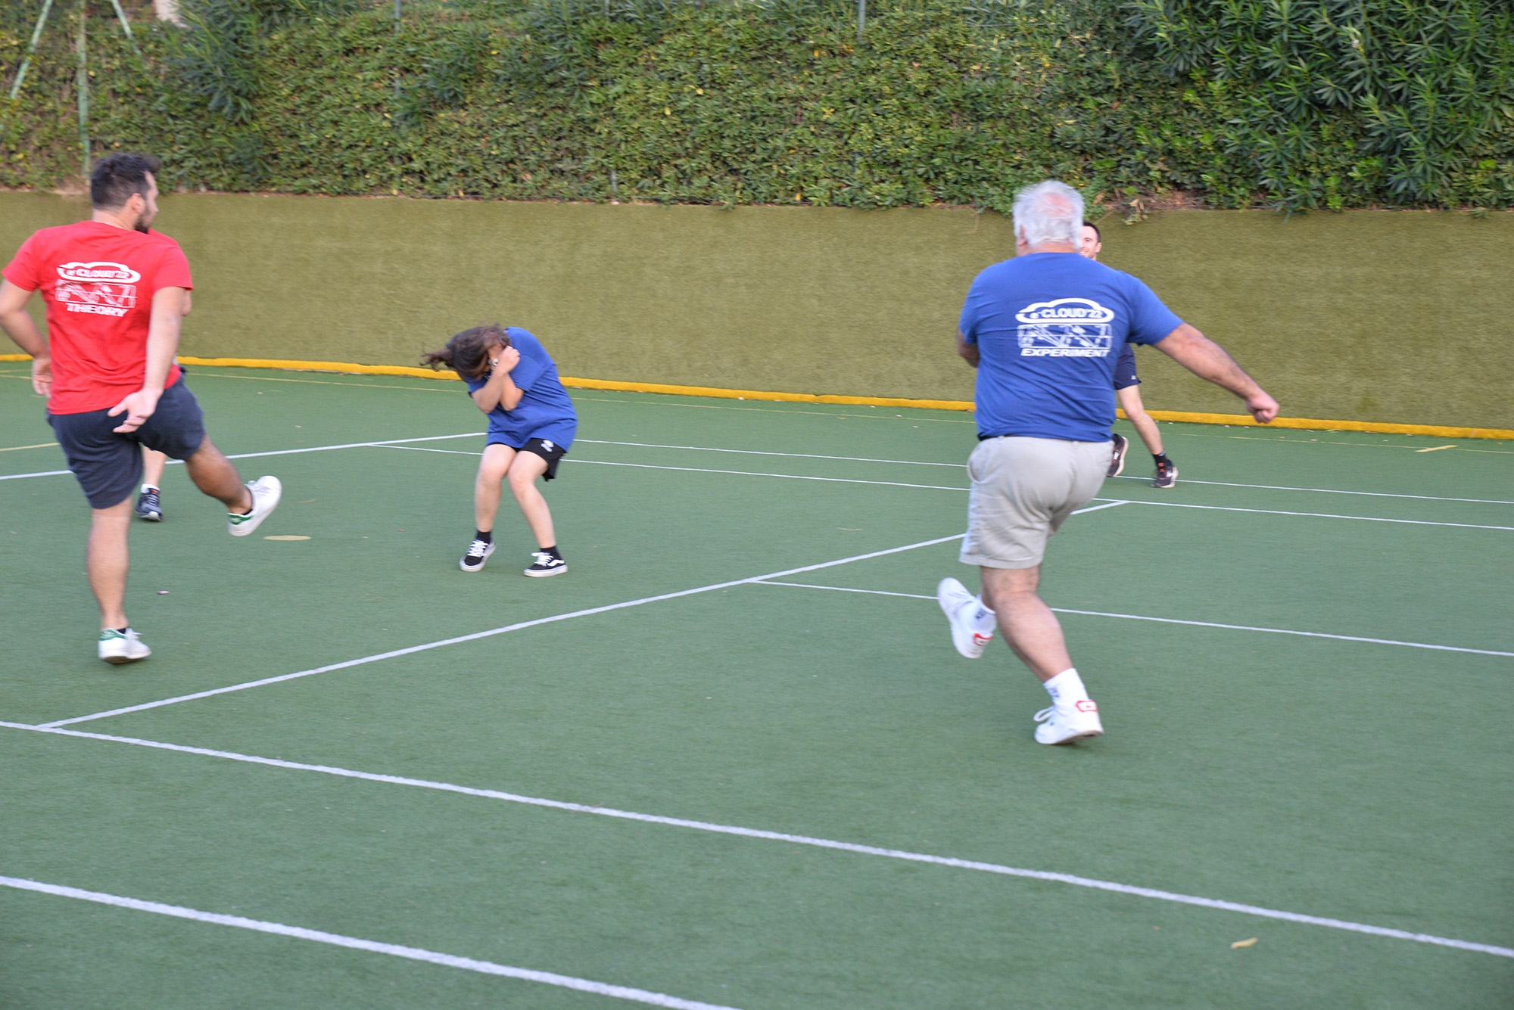
The football game !
Collaborative spirit:

Slide 13
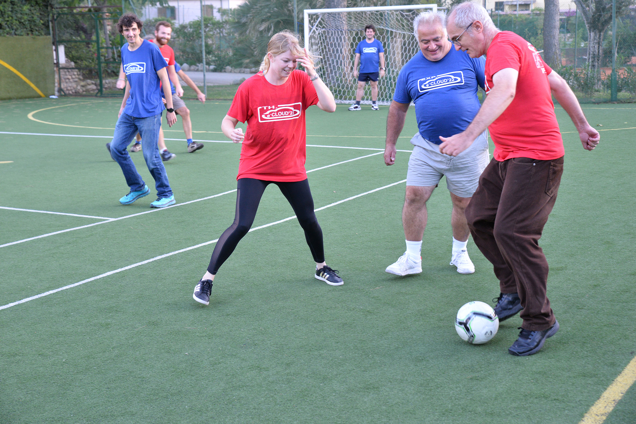
The football game !
Collaborative spirit:

Slide 14
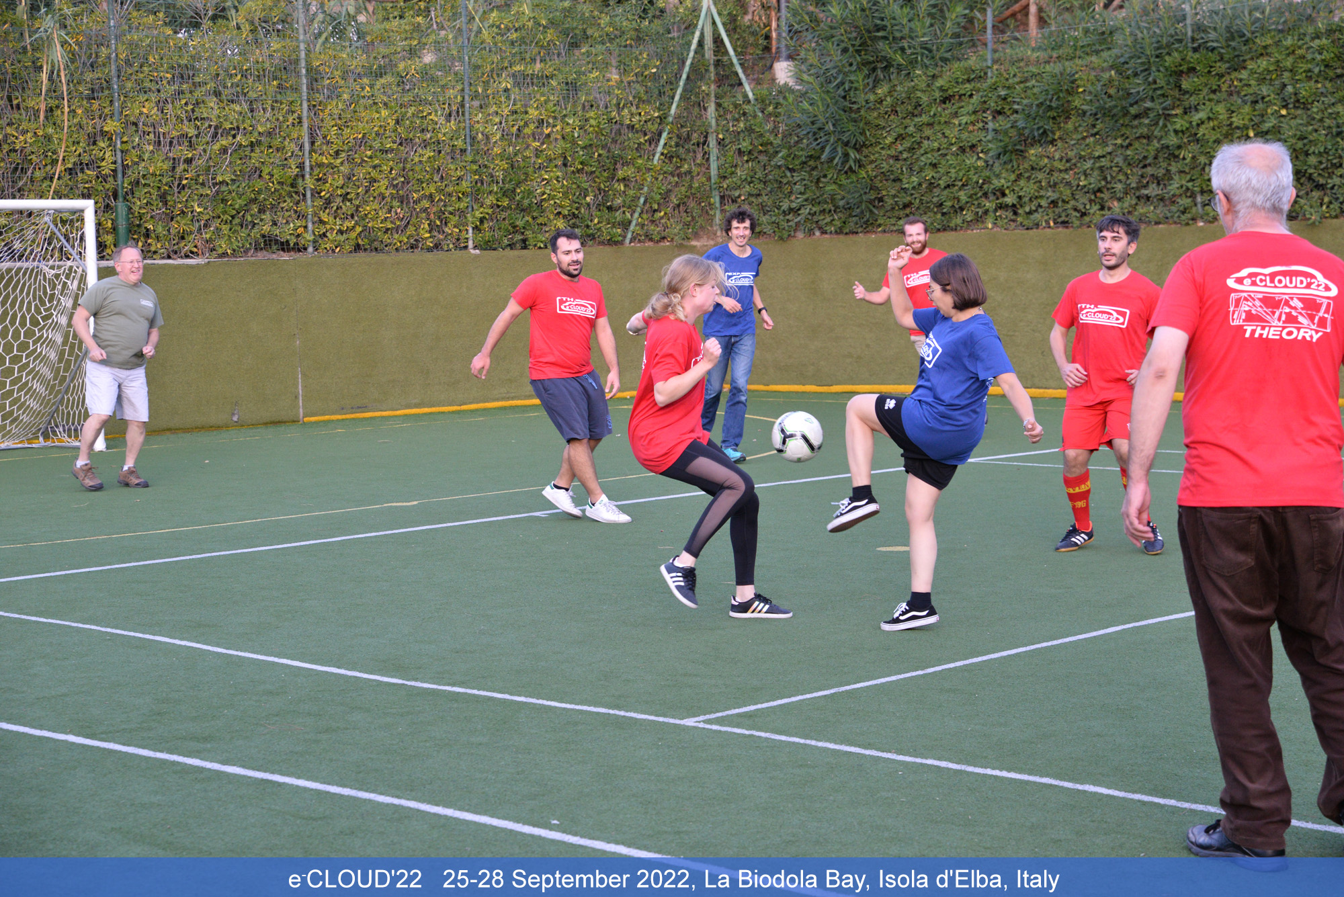
The football game !
Collaborative spirit:

Slide 15
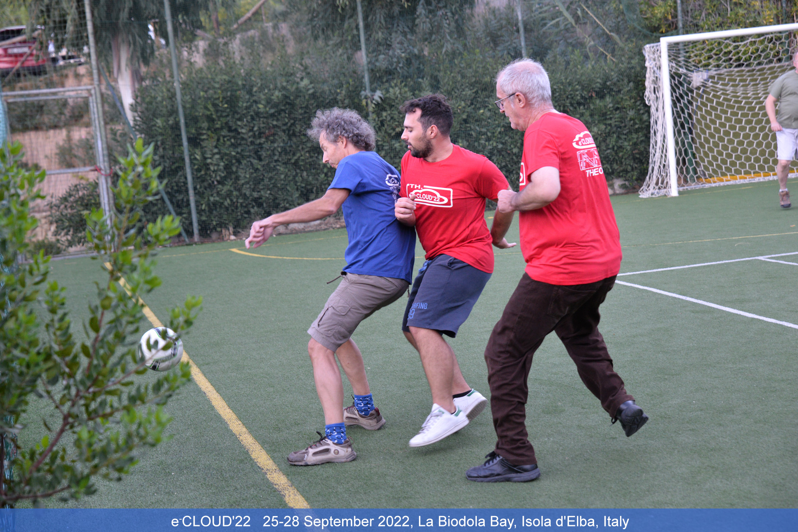
The football game !
Collaborative spirit:

Slide 16
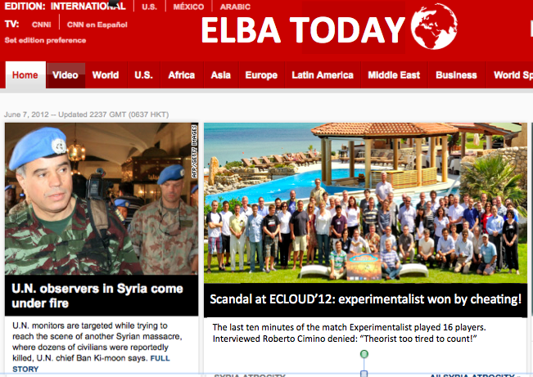
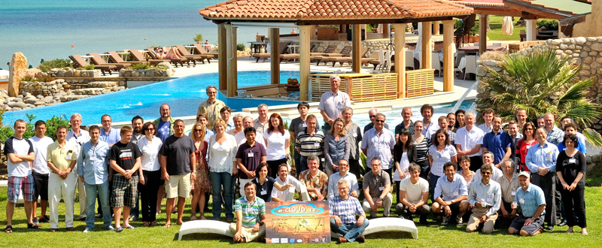
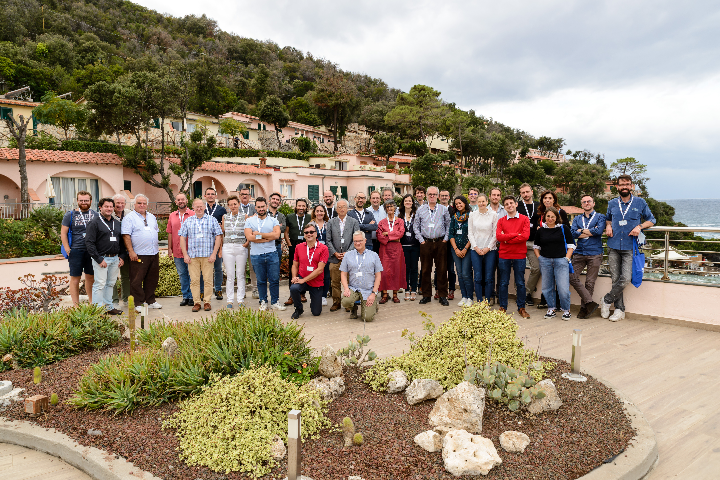
Ecoud22:

Slide 17
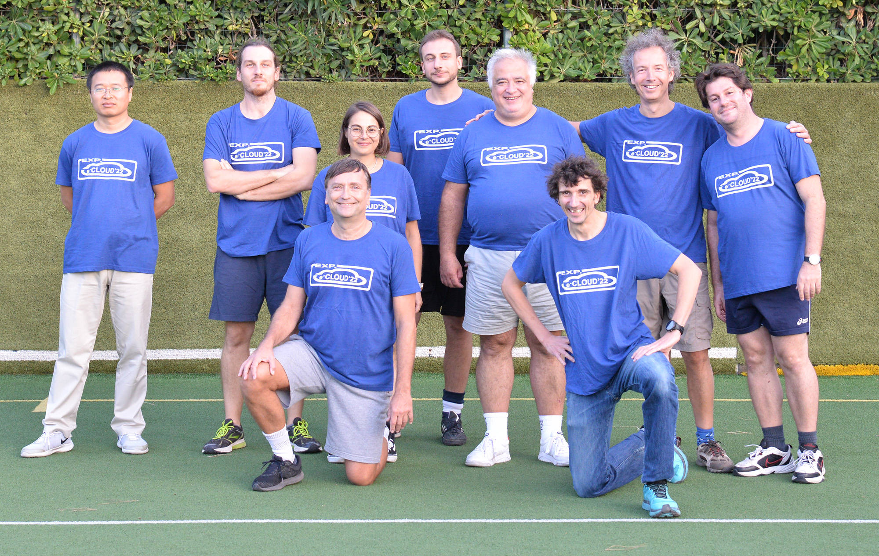
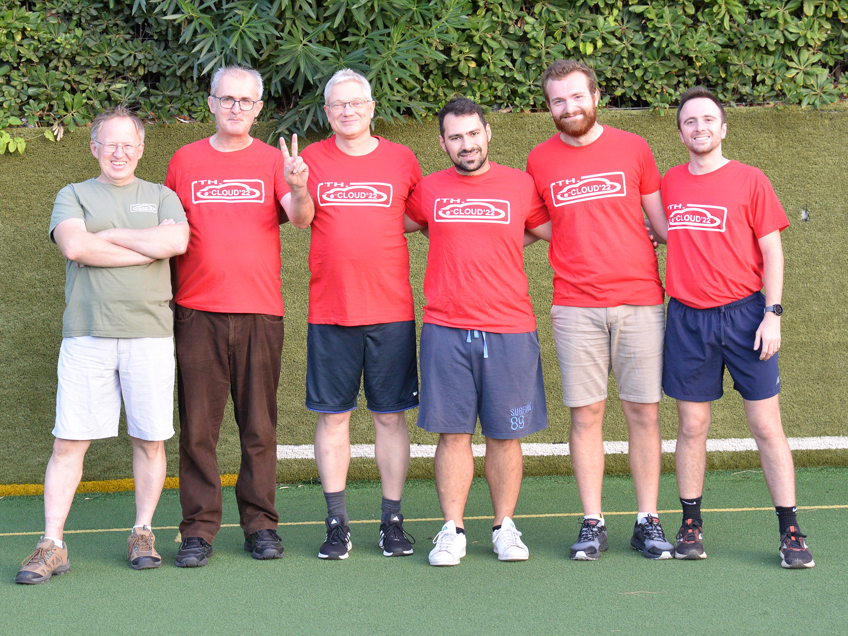
Red T shirt more blue ones!
Collaborative spirit:
Fake pictures

Slide 18
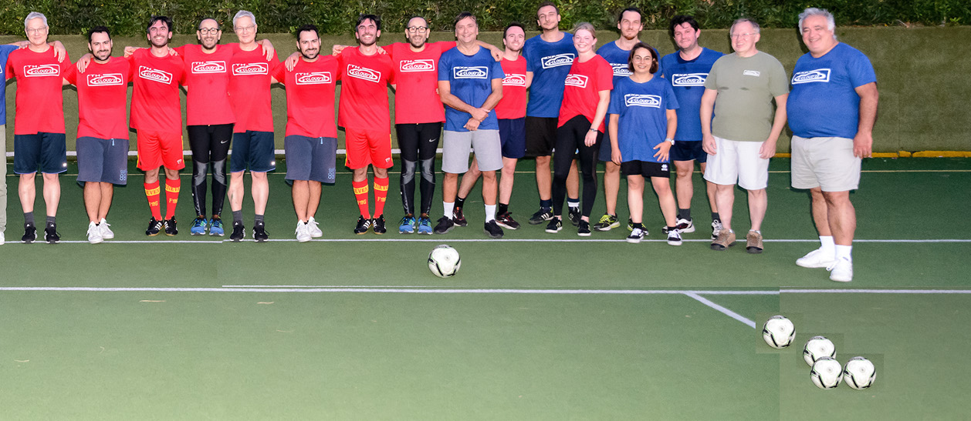
Red T shirts more blue ones!
Collaborative spirit:

Slide 19


Special thanks to:
INFN- Sezione di Pisa
Laboratori Nazionali di Frascati
And:

Slide 20
Preparatory part:
With me:
Local Organizing Committee
Marco Angelucci (INFN - LNF)
Andrea Liedl (INFN - LNF)
Laura Natoli (INFN - LNF)
Luisa Spallino (INFN - LNF)
Vinicio Tullio (INFN - LNF)
PS: I just checked: 1993 mails in our EcloudGWDvac mailbox.....

Slide 21
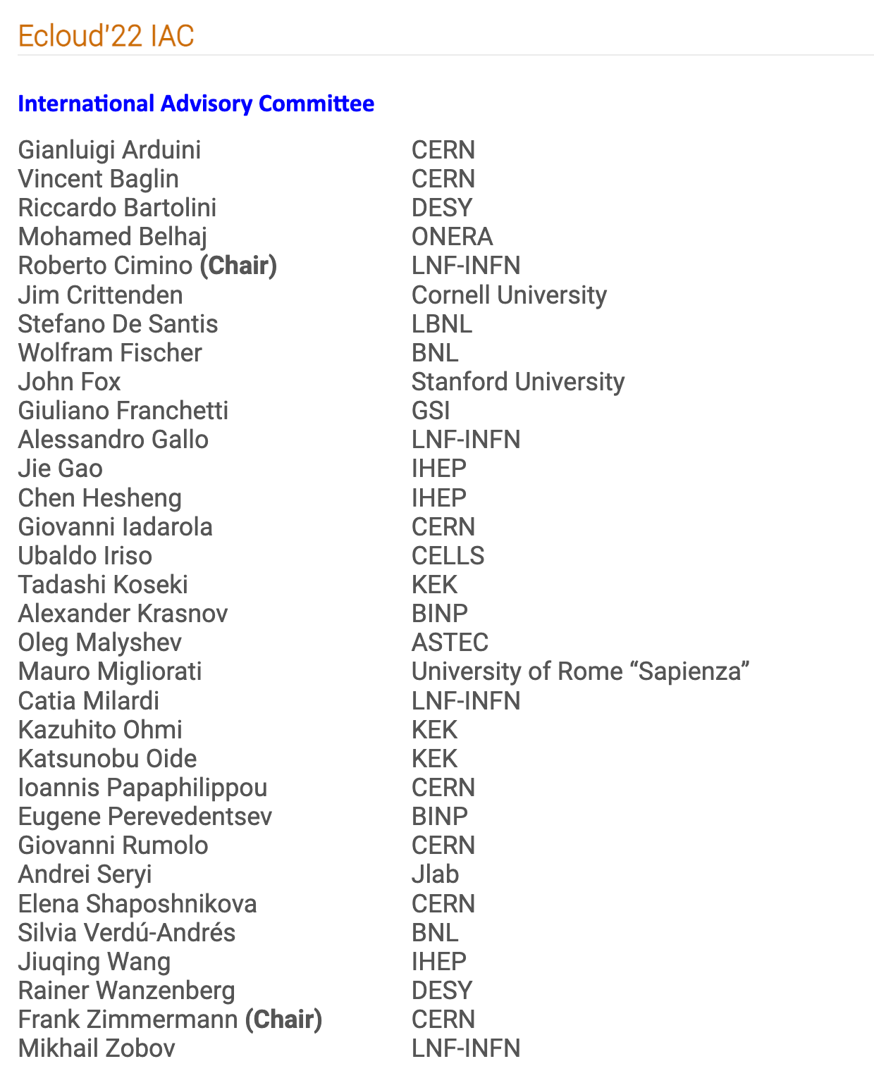
Preparatory part:

Slide 22
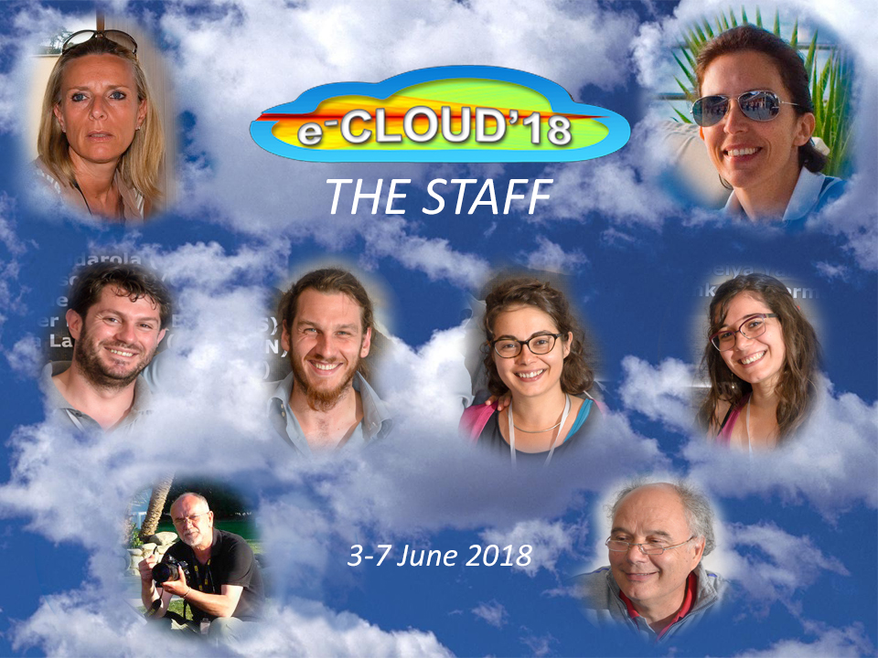
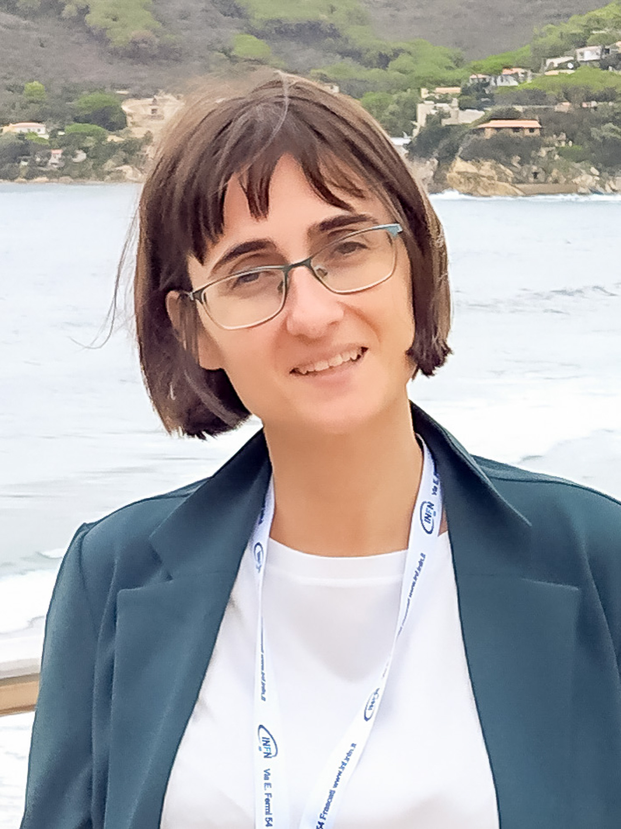
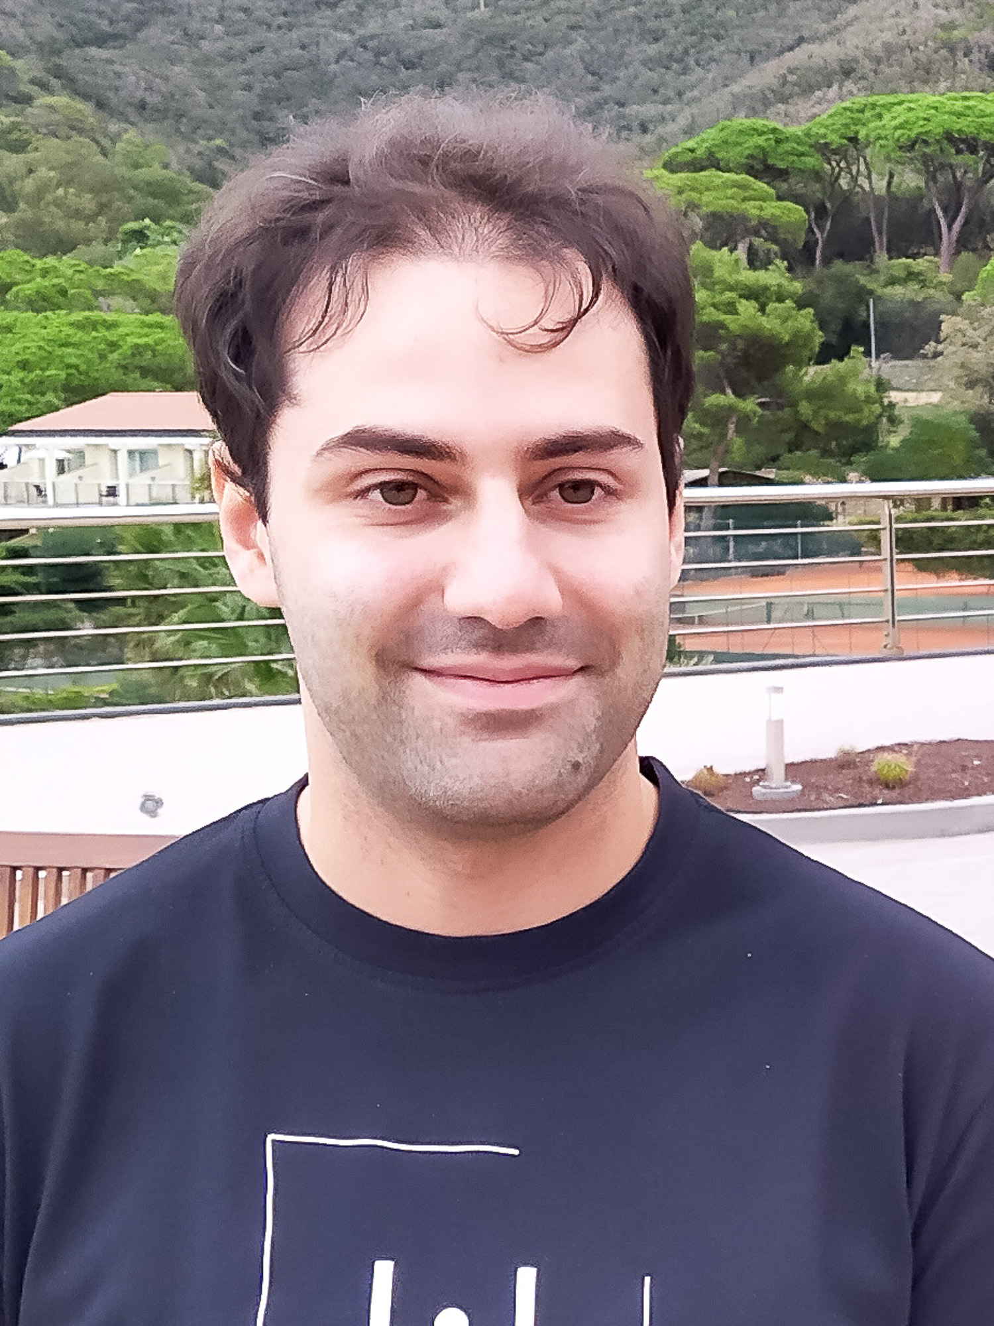
Tanks to
“the team”:

Slide 23
Thanks for coming!!!
A good workshop is only partially due to the location and organization (it certainly help) but on the participants, their scientific level, their willing to discuss and collaborate , their football and dancing ability...

Slide 24
Thanks for coming!!!

