Slide 1

“conclusions”
“there were so many talks !” Vincent Baglin
Frank Zimmermann

Slide 2

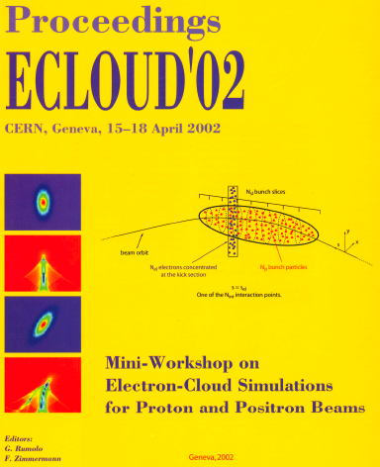
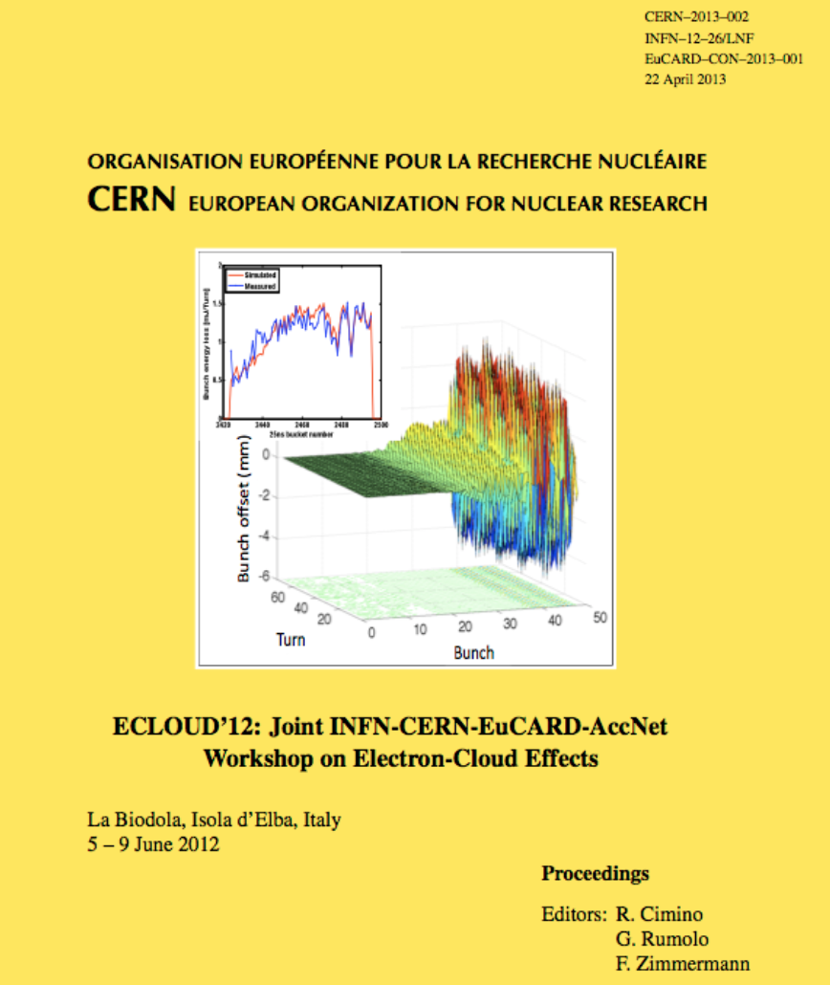

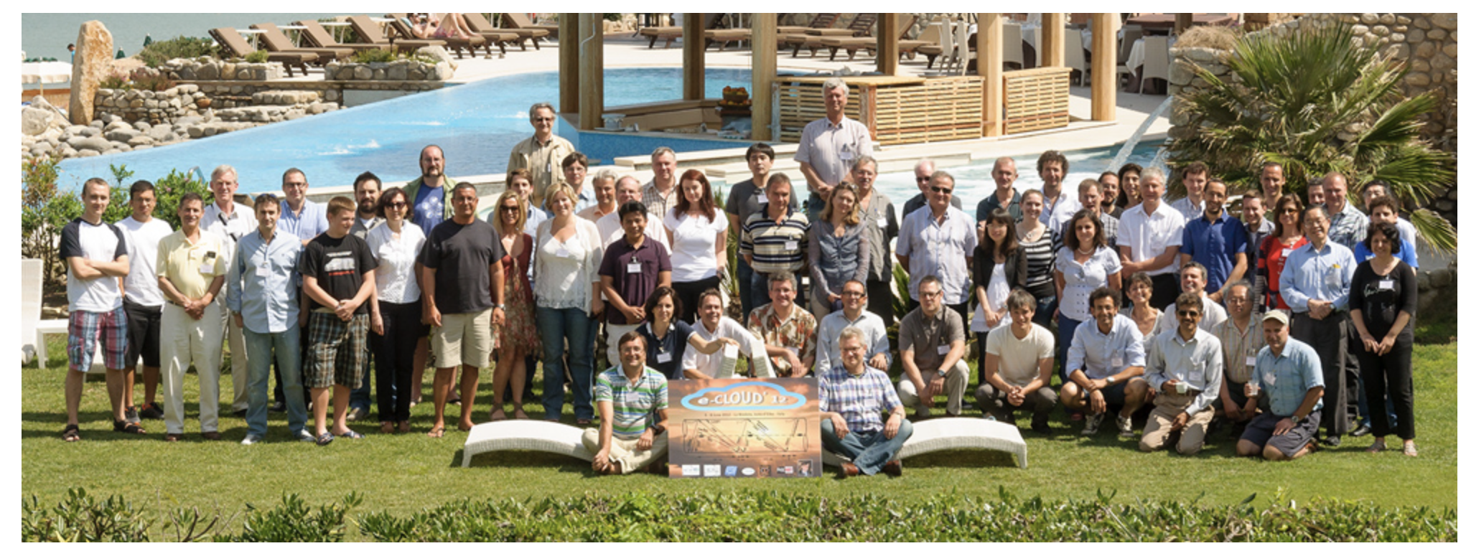
20 years since 1st ECLOUD Workshop ever …
10 years since 1st ECLOUD Workshop in La Biodola
R. Cimino
G. Rumolo

Slide 3
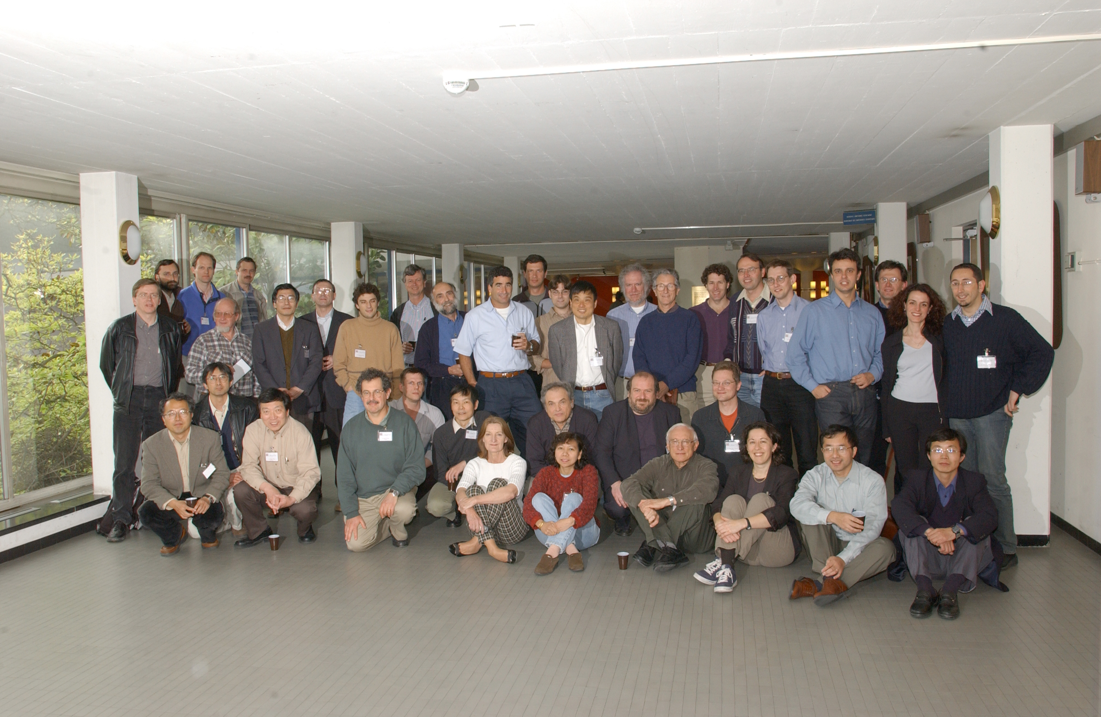
ECLOUD’02 at CERN

Slide 4
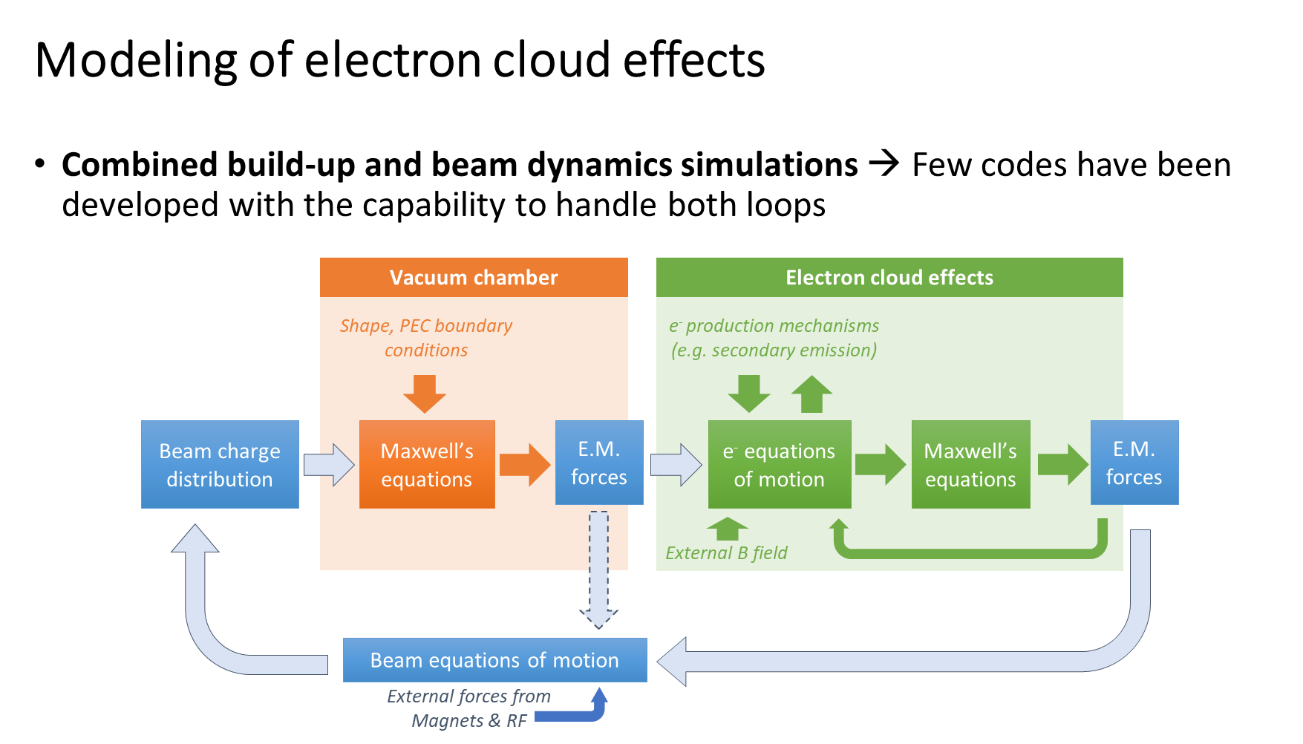
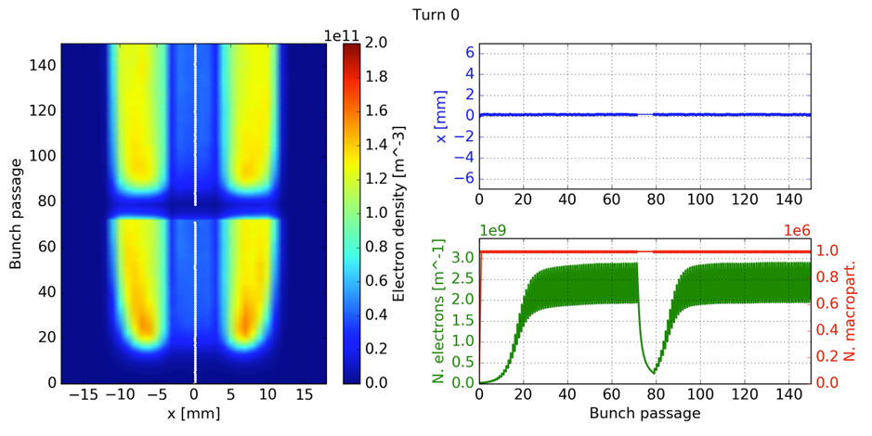
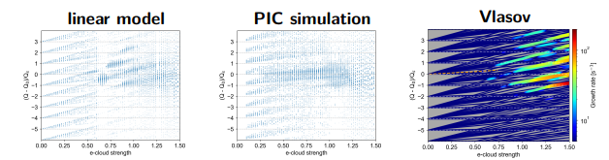
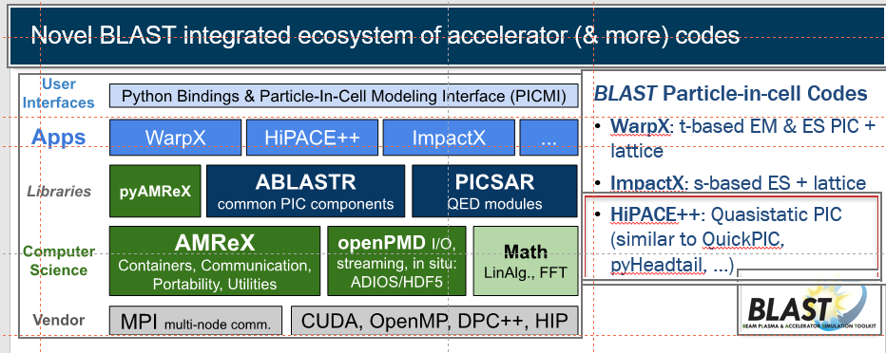
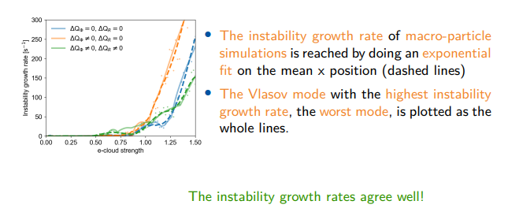
Ex.: PyECLOUD-PyHEADTAIL
  Coupled-bunch instability from e-cloud in LHC dipole on CERN HPC cluster (2019-20)
G. Rumolo
J.-L. Vay
S. Johannesson

Slide 5
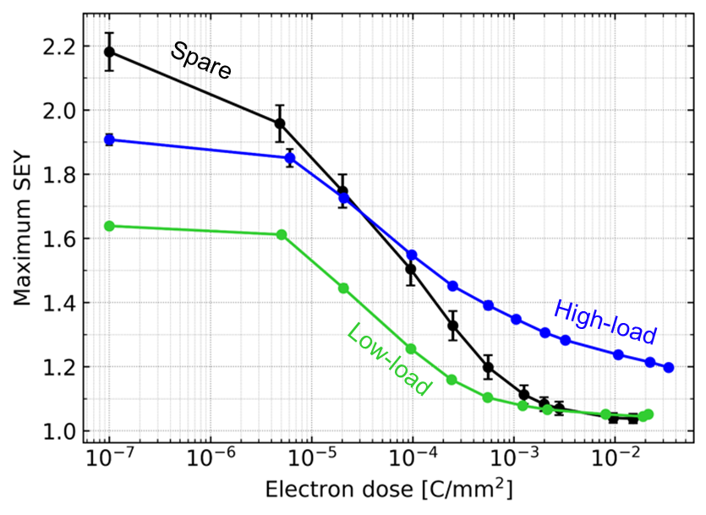
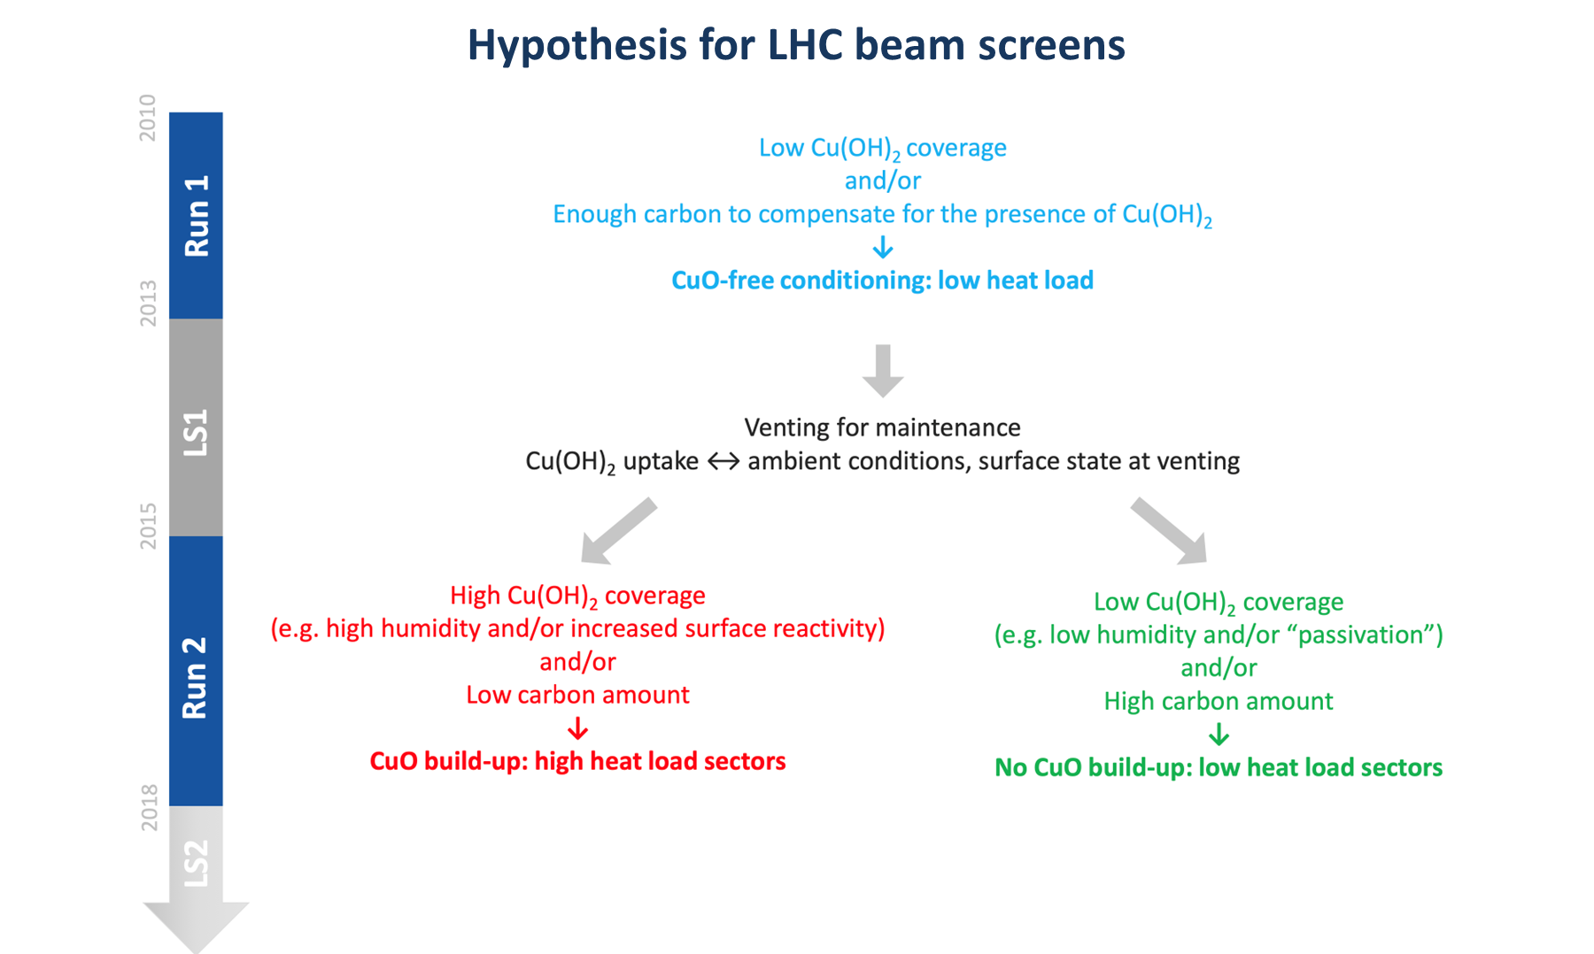
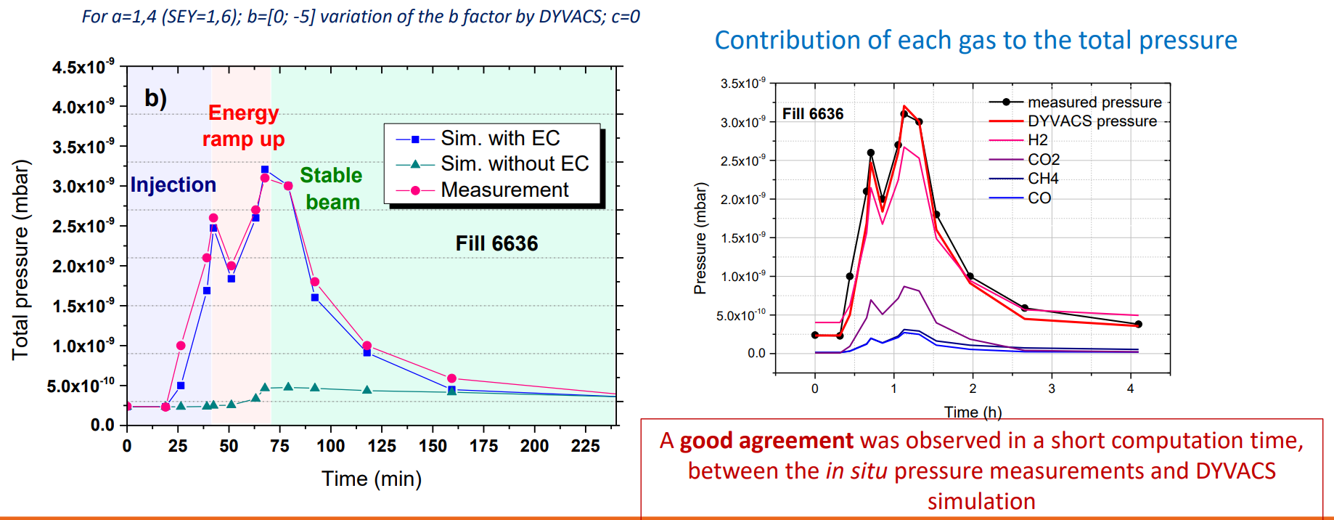
e-cloud in the LHC
L. Mether
L. Mether
S. Bilgen

Slide 6
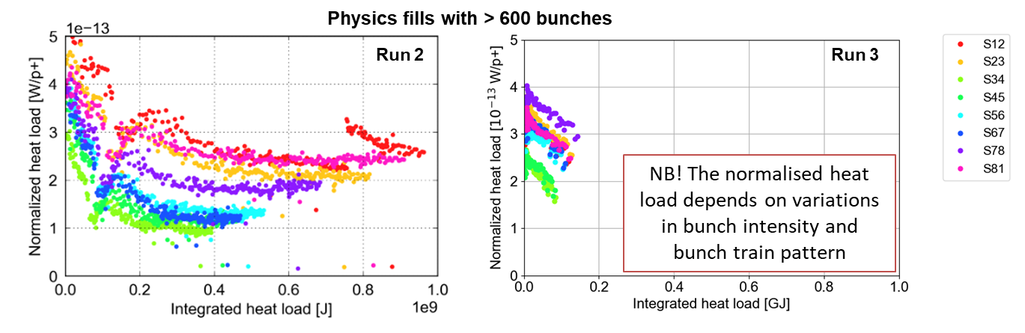
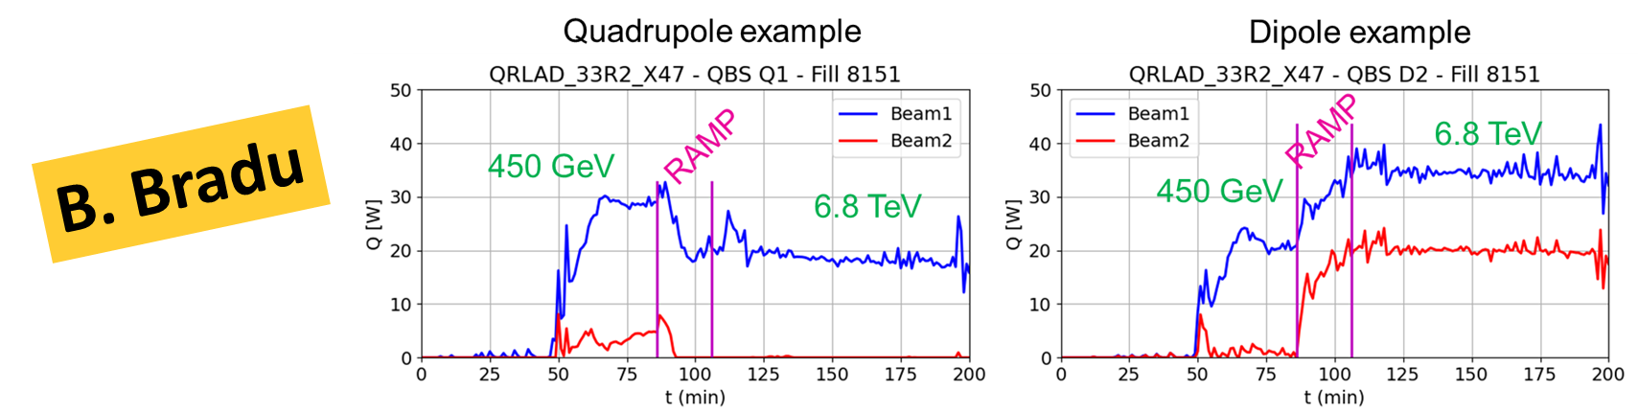
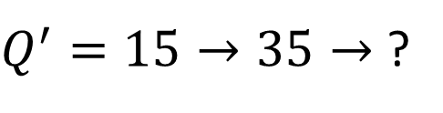
e-cloud in the LHC cont’d
L. Mether
$Q^{′}=15→35→$ ?

Slide 7
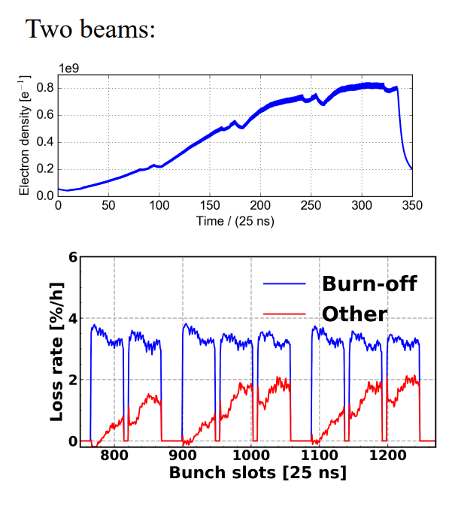
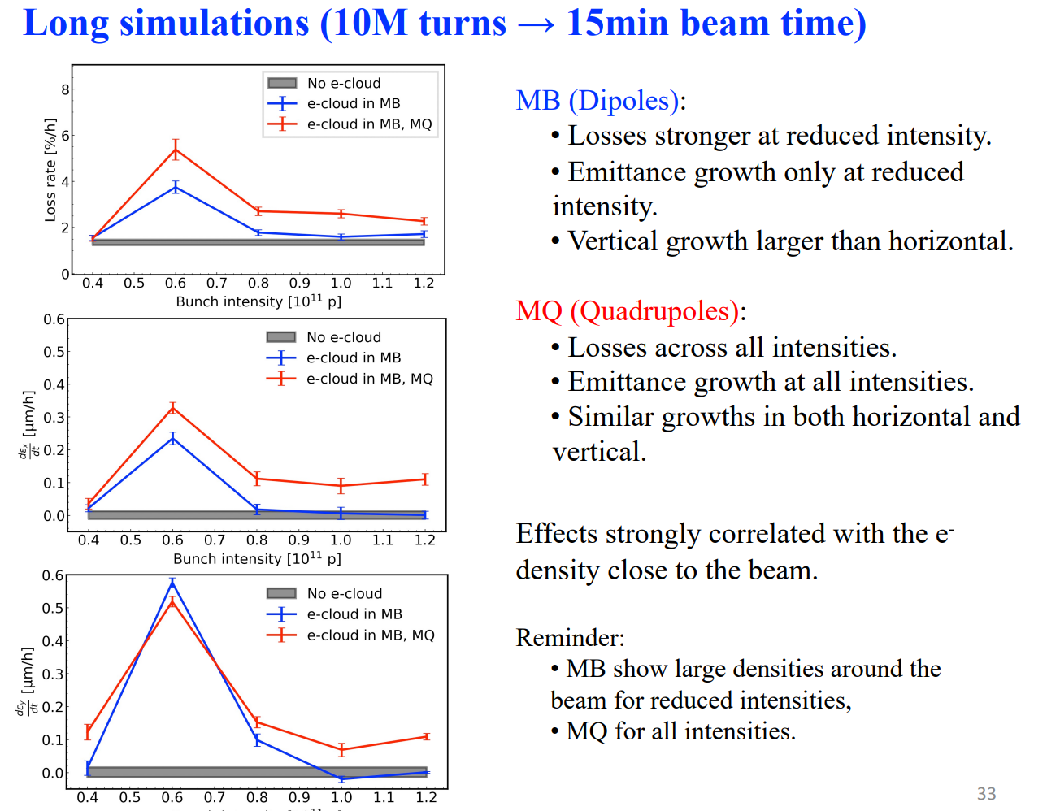
e-cloud incoherent effects – observations & simulations
K. Paraschou

Slide 8
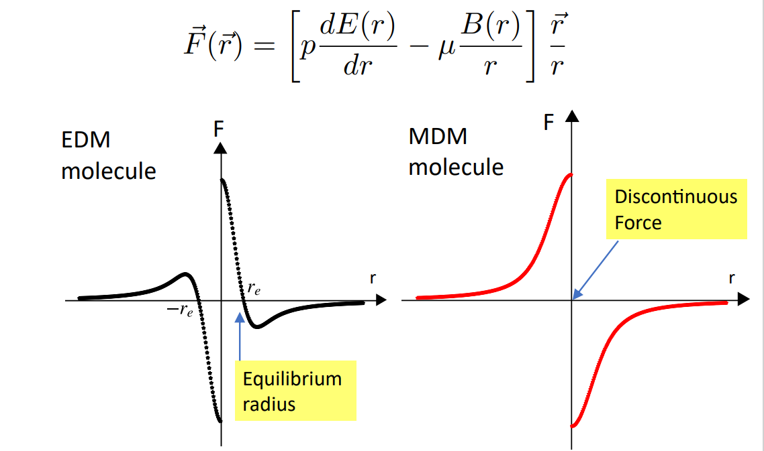
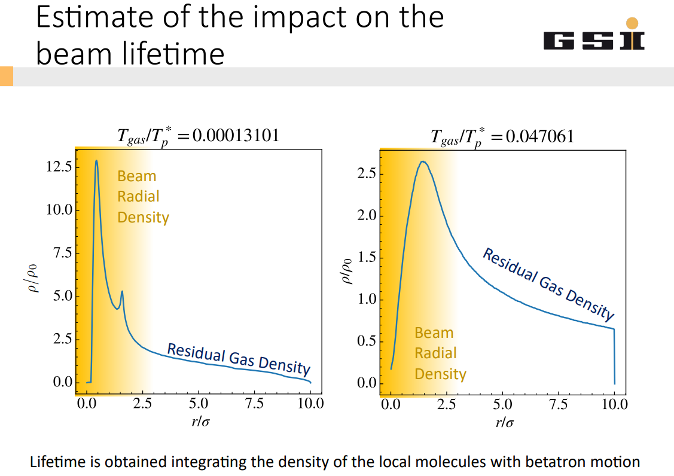
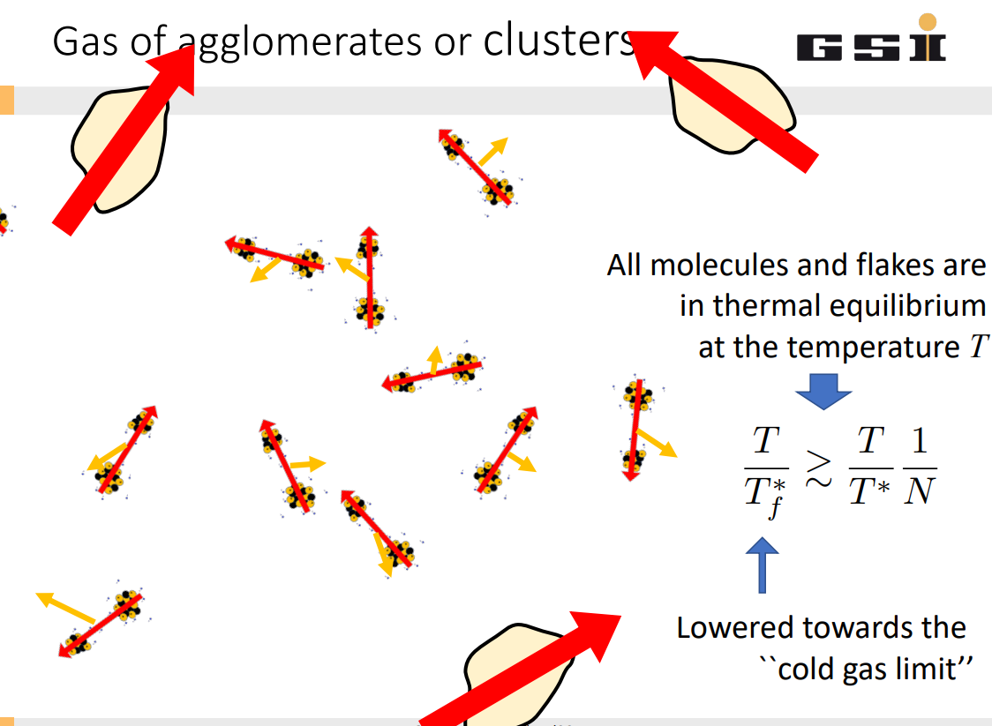
dipolar or paramagnetic flakes in the LHC?
G. Franchetti

Slide 9
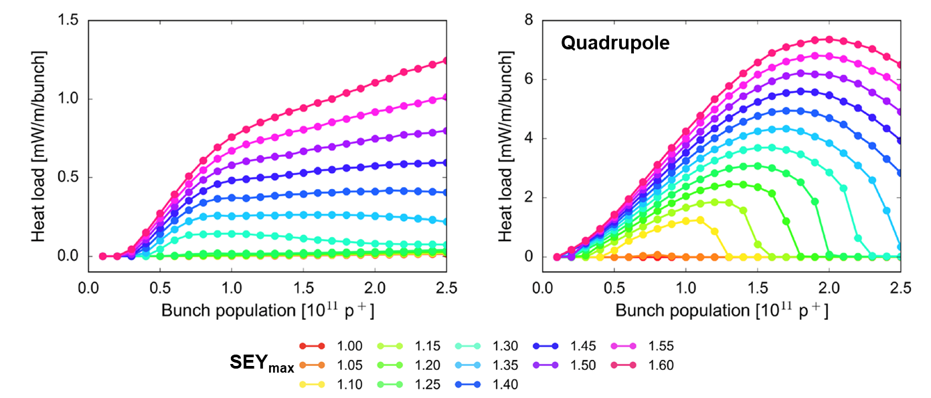
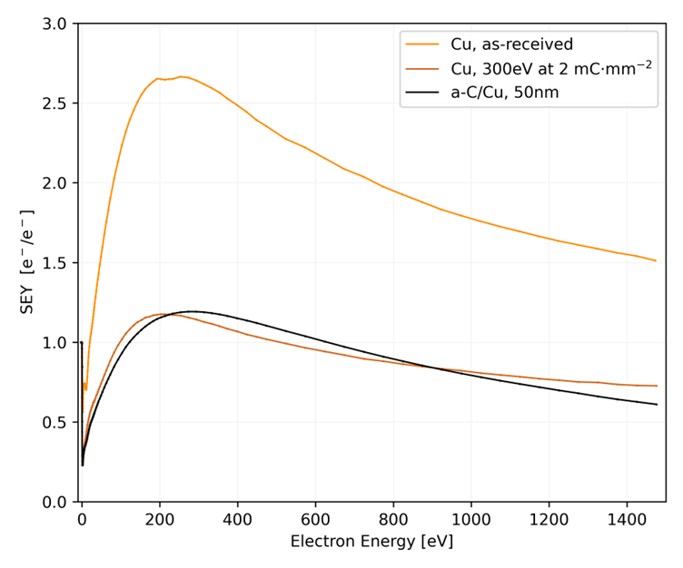
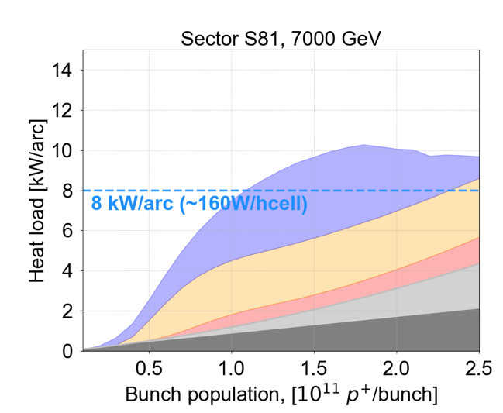
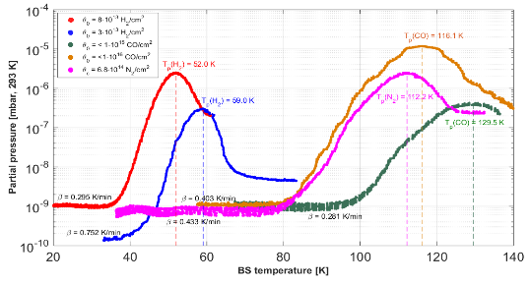
e-cloud for the HL-LHC
100-200 nm thick a-C coated onto 80 μm copper co-laminated beam screen of Inner Triplet
V. Baglin
Forecast for scrubbed machine
N₂
e-cloud in dipoles
e-cloud in quadrup.
e-cloud in drifts
H₂
Optimized cryo configuration
Impedance
10 kW/arc (~200 W/hcell)
Synch. rad.
CO
G. Iadarola
The HL-LHC beam screen operating temperature must be optimised
7 TeV, 5 x 48 b

Slide 10
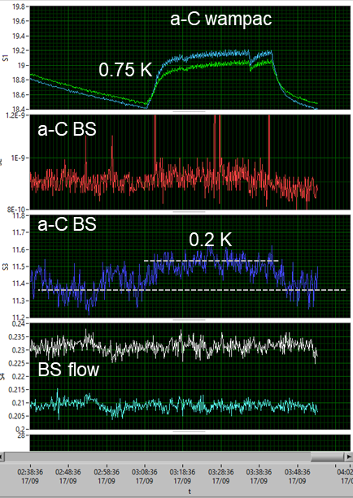
HL-LHC
“Thin“ a-C coating performance at cryogenic temp
Preliminary results !
4x72 bunches at 1.3 10¹¹ ppb, 25 ns bunch spacing
With BS at 10 K, CB at 3 K, a slight temperature increase (corresponding to ~ 50-100 mW/m) together with pressure increase is observed on the BS at 10 K, but ΔP < 10⁻¹⁰ mbar (H₂, CO)
  ➔ this would correspond to SEY_{max} ~ 1.3
Room temperature calorimeter:
  609 mW/m measured on aC coating
RT and cryogenic have different heat load
But possible impact of impedance and different RRR !
V. Baglin
➔ More studies needed
V. Baglin, B. Jenninger

Slide 11
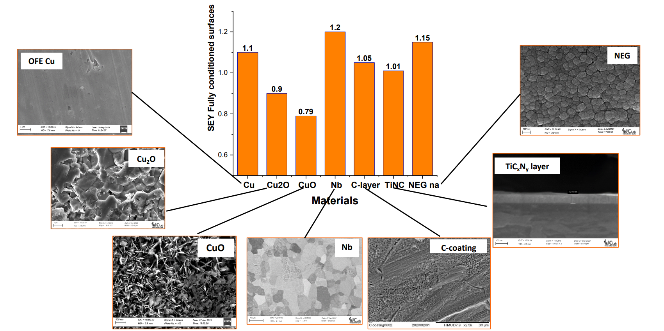

surface layers for HL-LHC and others
$$LESS ≠\text{LASE}$$
$$CuO ≠\text{CuO}$$
G. Sattonnay

Slide 12
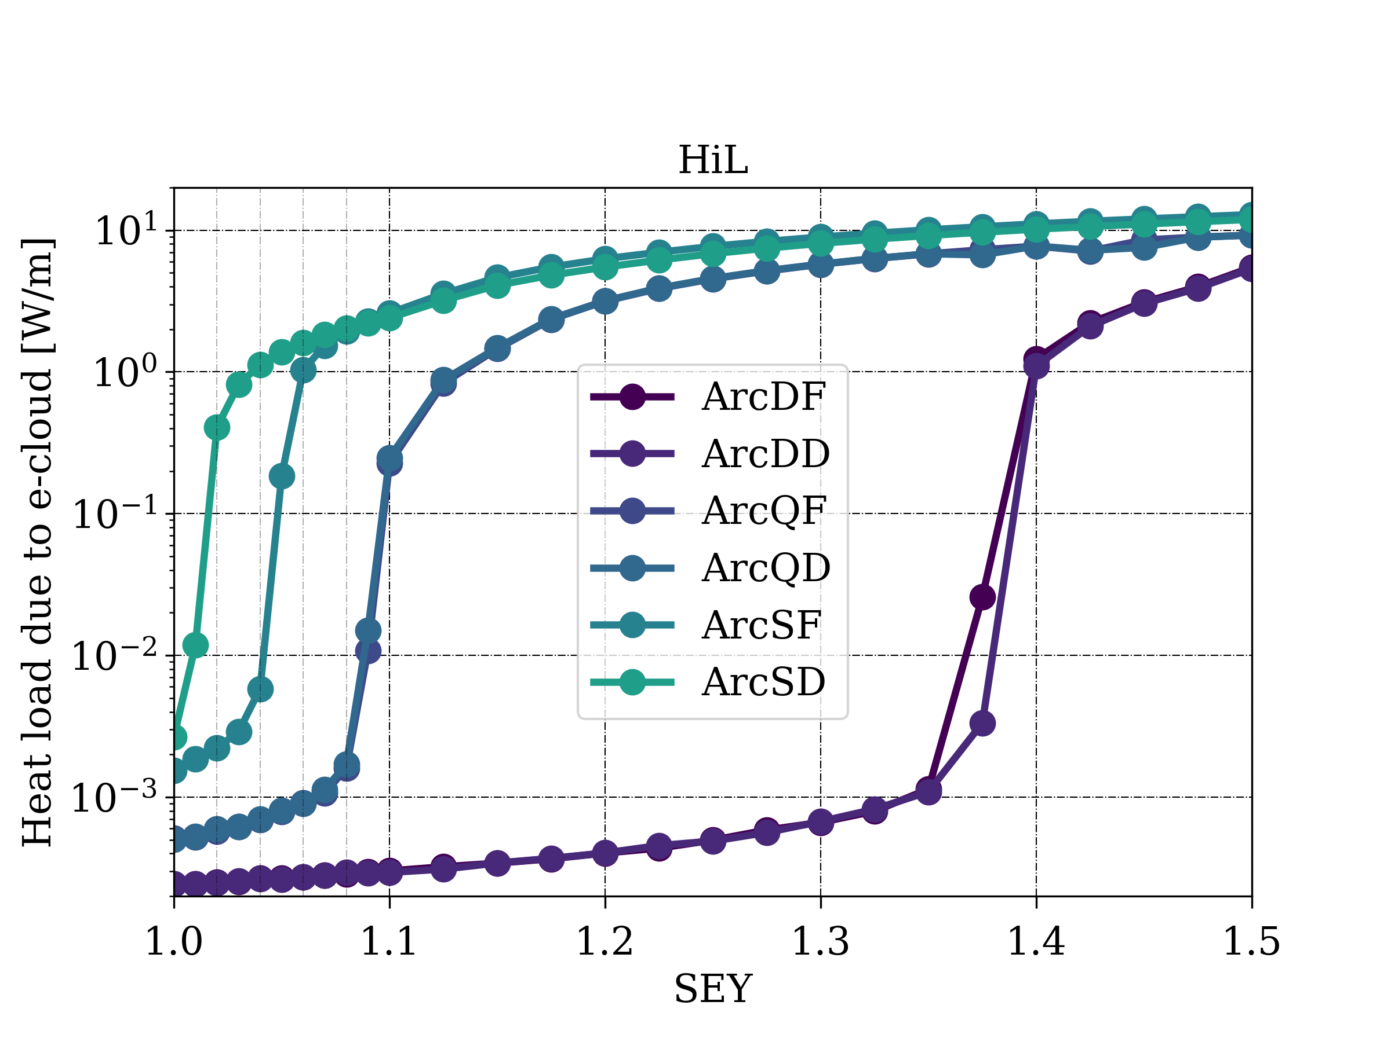
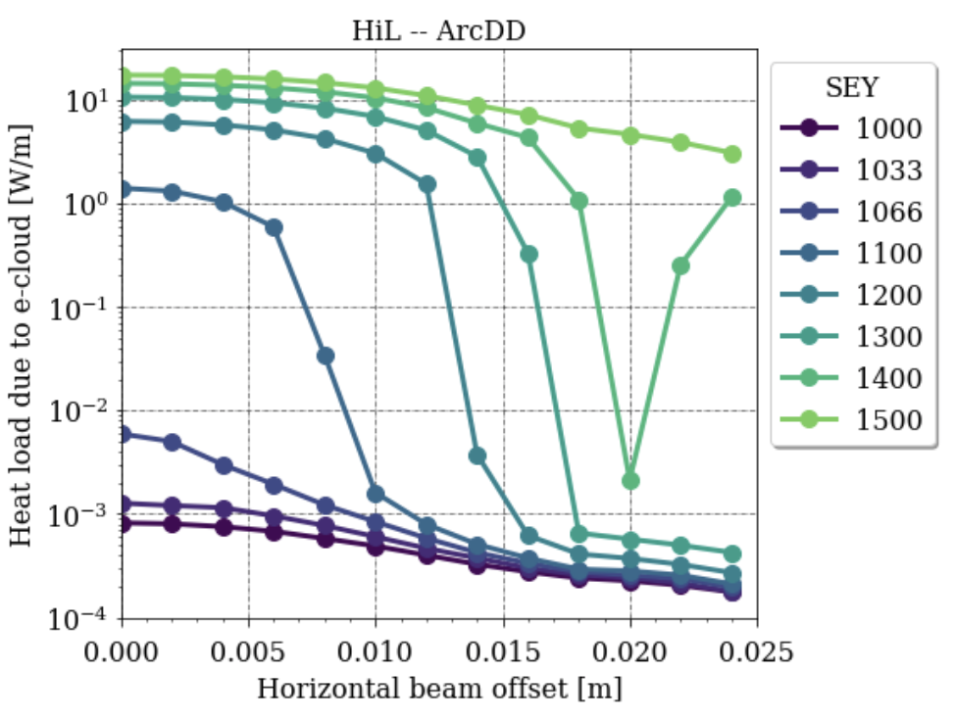
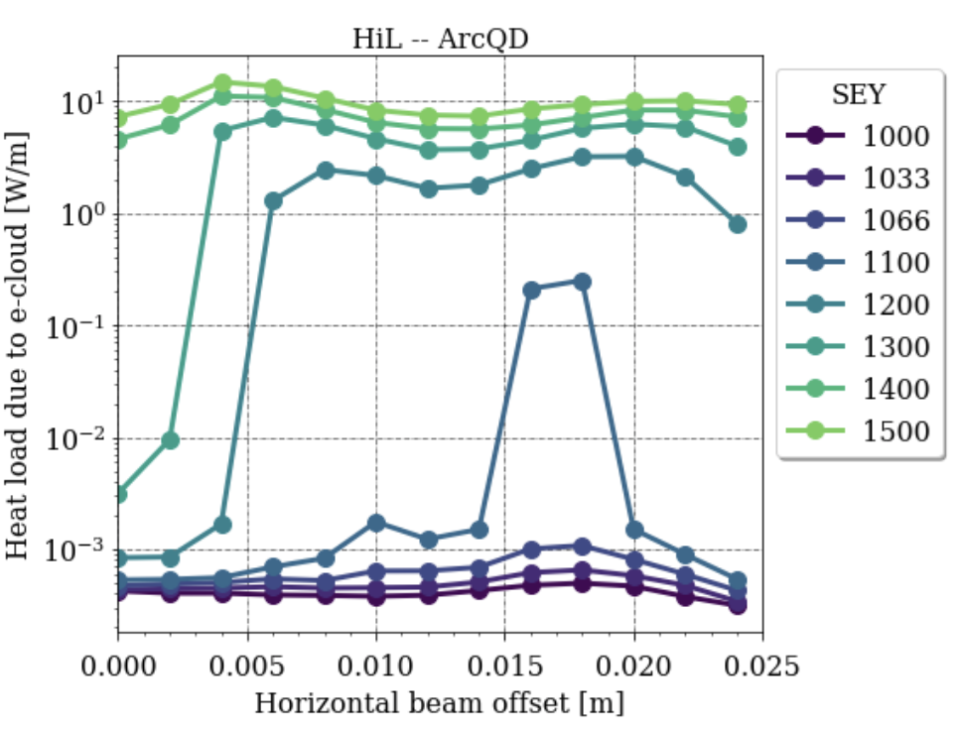
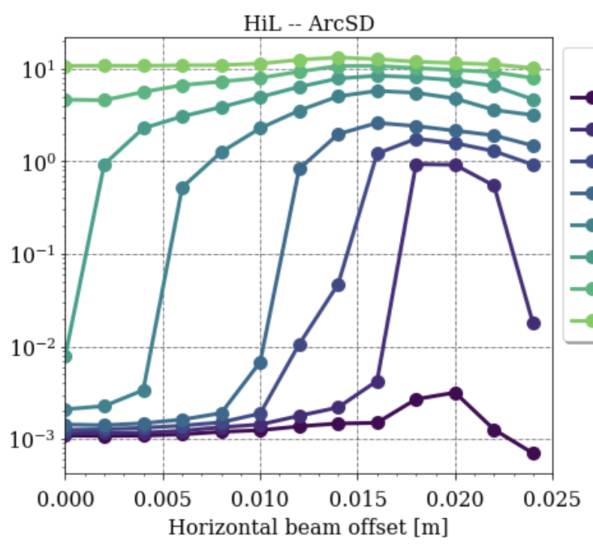
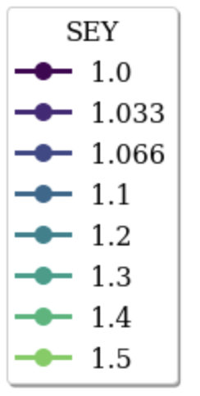
e-cloud in the EIC
SEY<1.02 needed
 | RHIC | LHC | EIC HSR
Bunch spacing (ns) | 108 | 50* -- 25 | 10.15
Bunch charge (x10¹⁰ ppb) | 13.5 | 11.5 | 6.9
& 6 cm bunch length
lowest for all hadron machines!
+ changing horizontal offset
S. Verdu-Andres

Slide 13
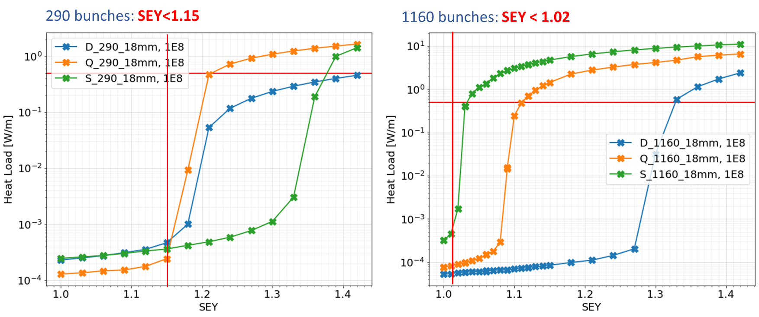
e-cloud in the EIC cont’d
X. Gu
  For a good copper surface, we expect 0.37W/m from wall resistance, then 0.13W/m cooling available for e-cloud

Slide 14
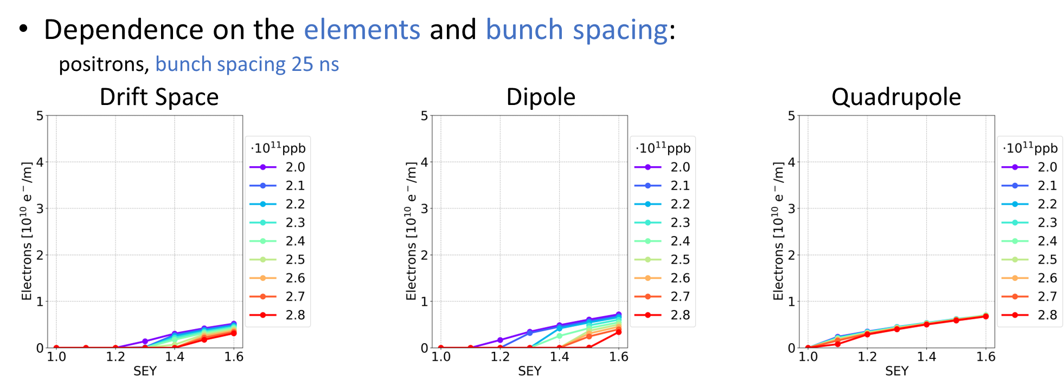
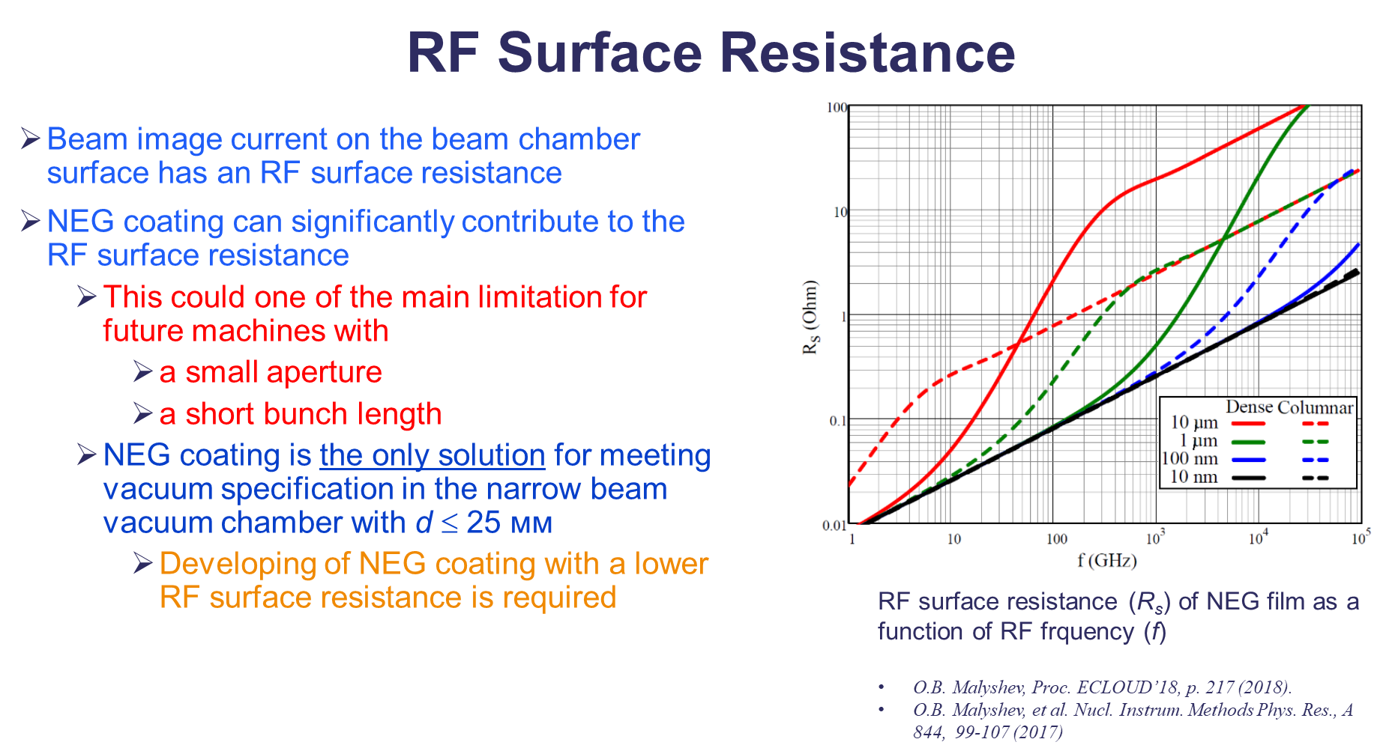
e-cloud mitigations for FCC-ee
L. Sabato
R. Valizadeh

Slide 15
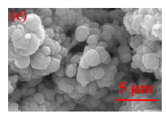
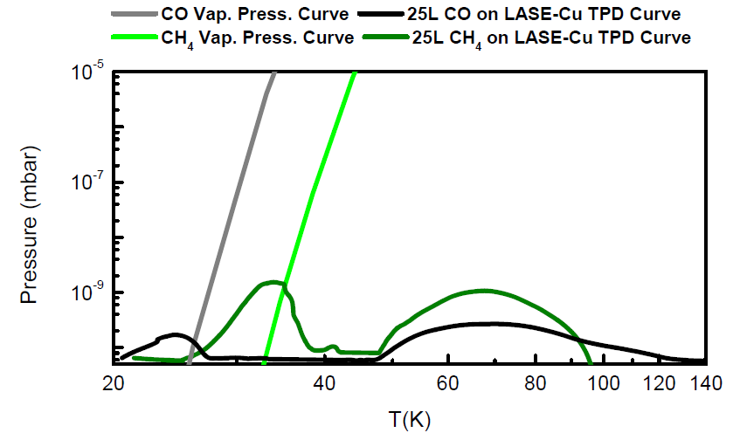
LESS for FCC-hh (?) – pressure transients? resistivity ? dust ?
LASE-Cu
Morphology effects on thermal desorption
TPD from LASE-Cu for temperature induced vacuum transient study
Impact on the working conditions
Working temperature range foreseen for FCC-hh
~500 h beam lifetime
L. Spallino
L. Spallino et al. Appl. Phys. Lett. (2019); L. Spallino, J. Vac. Sci. Technol. B (2020); L. Spallino et al., Phys. Rev. Accel. Beams (2020)

Slide 16
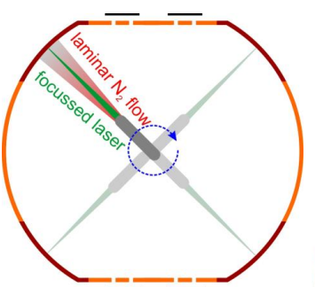
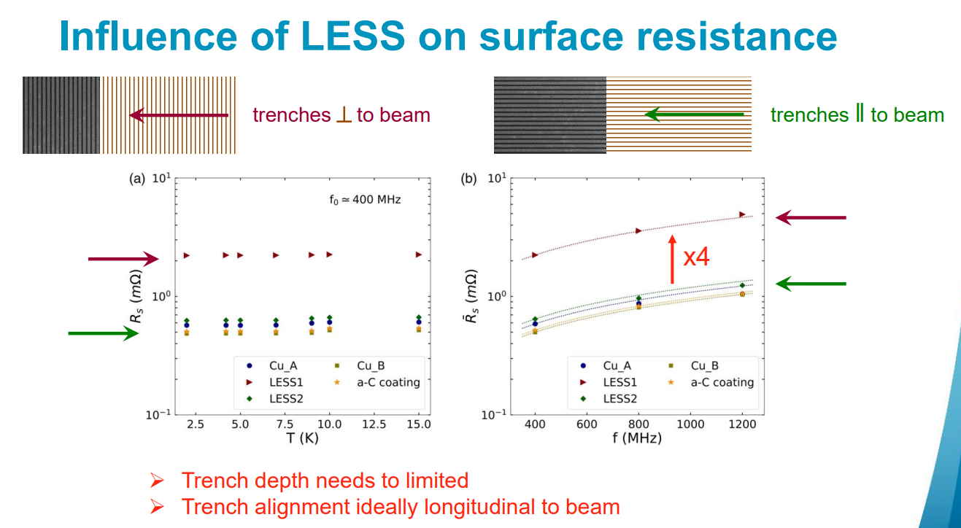
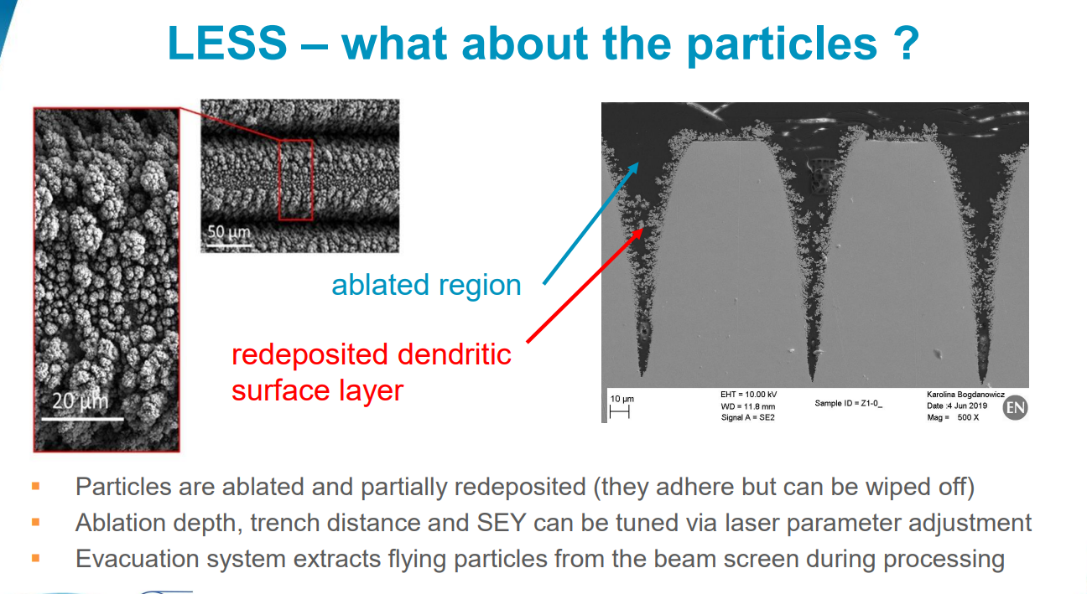
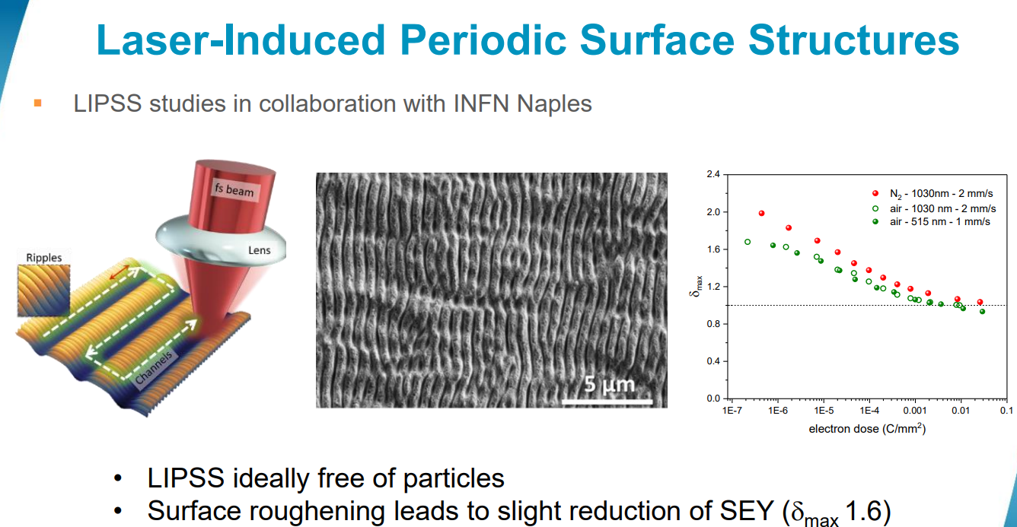
M. Himmerlich
A. Passarelli

Slide 17
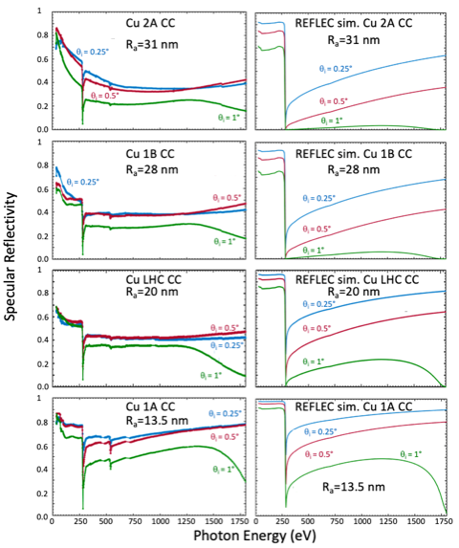
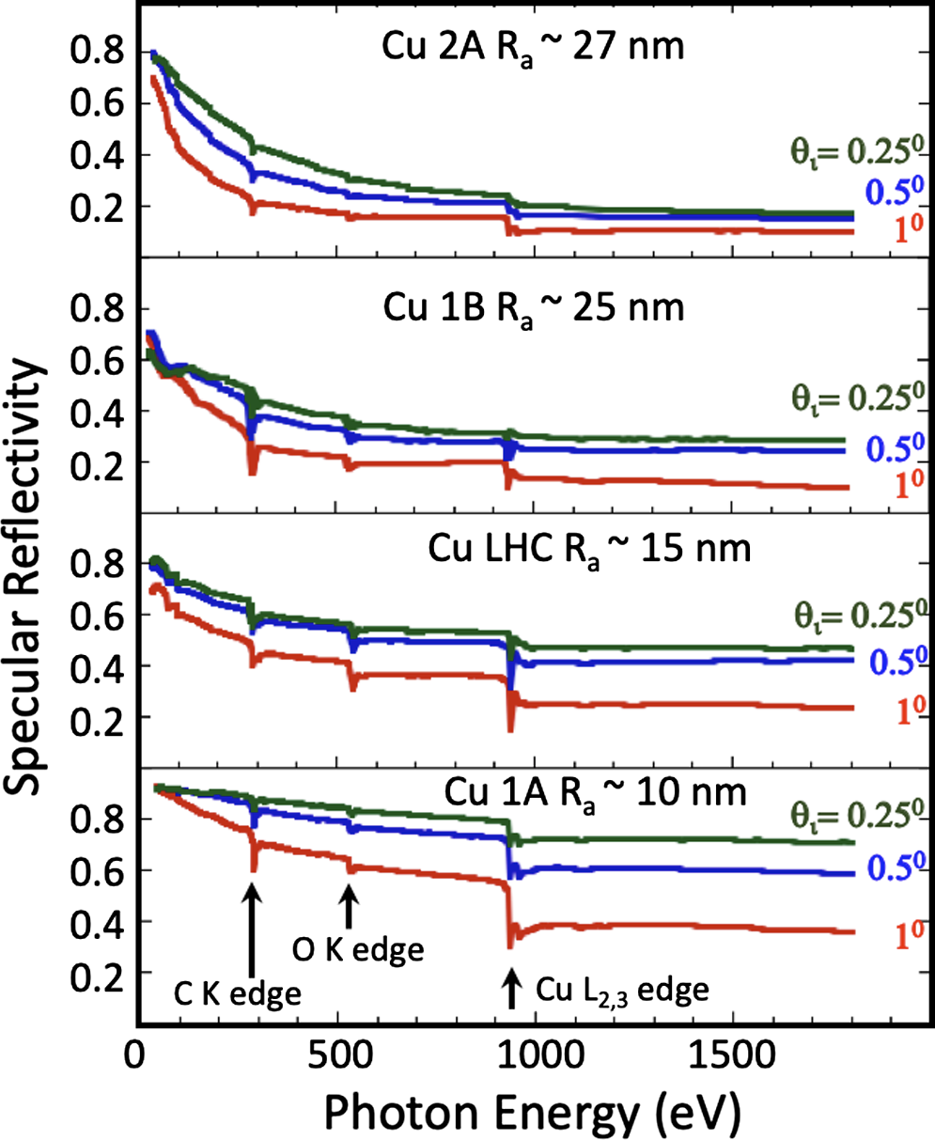
alternative mitigations
for FCC-hh
Carbon-Coated Copper
A. Liedl

Slide 18
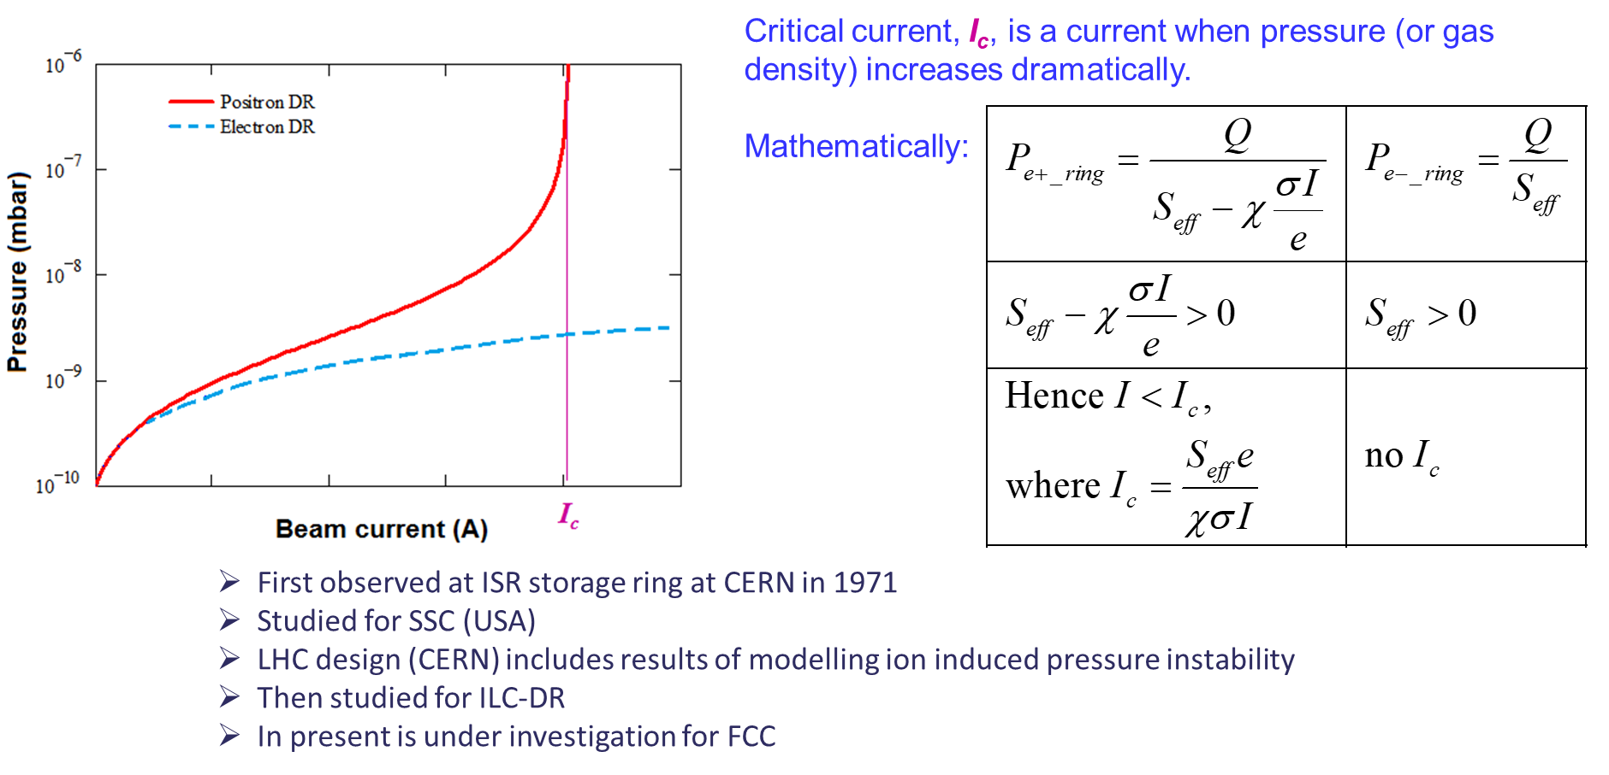
ion induced pressure - another concern for FCC-hh
O. Malyshev

Slide 19
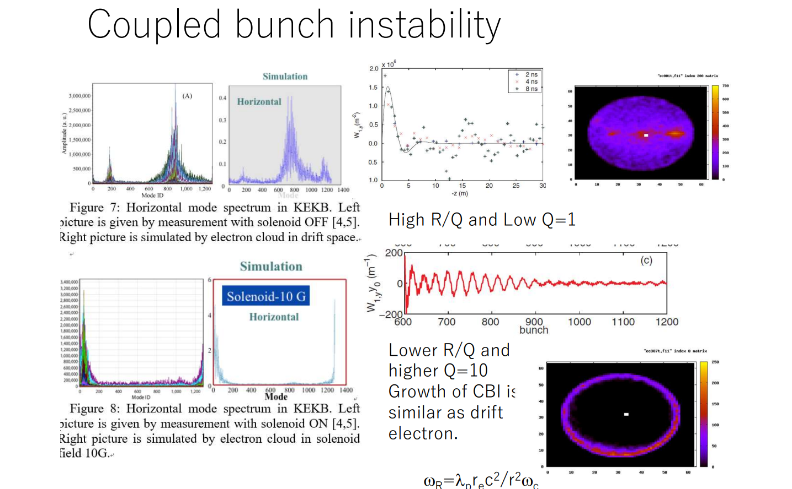
e-cloud at former KEKB
K. Ohmi

Slide 20
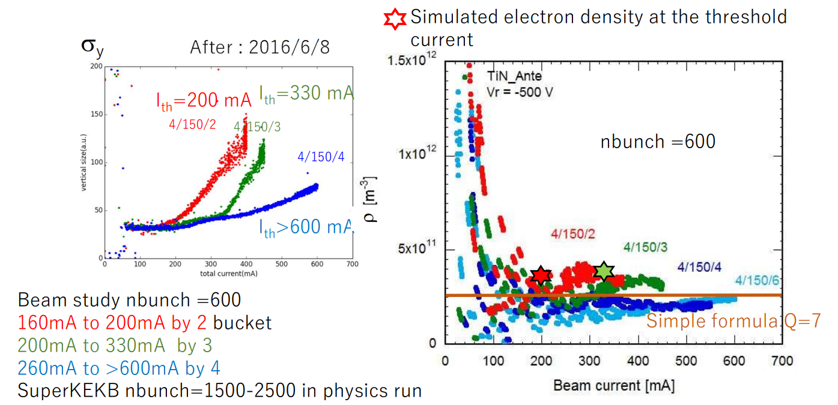
e-cloud at SuperKEKB
K. Ohmi

Slide 21
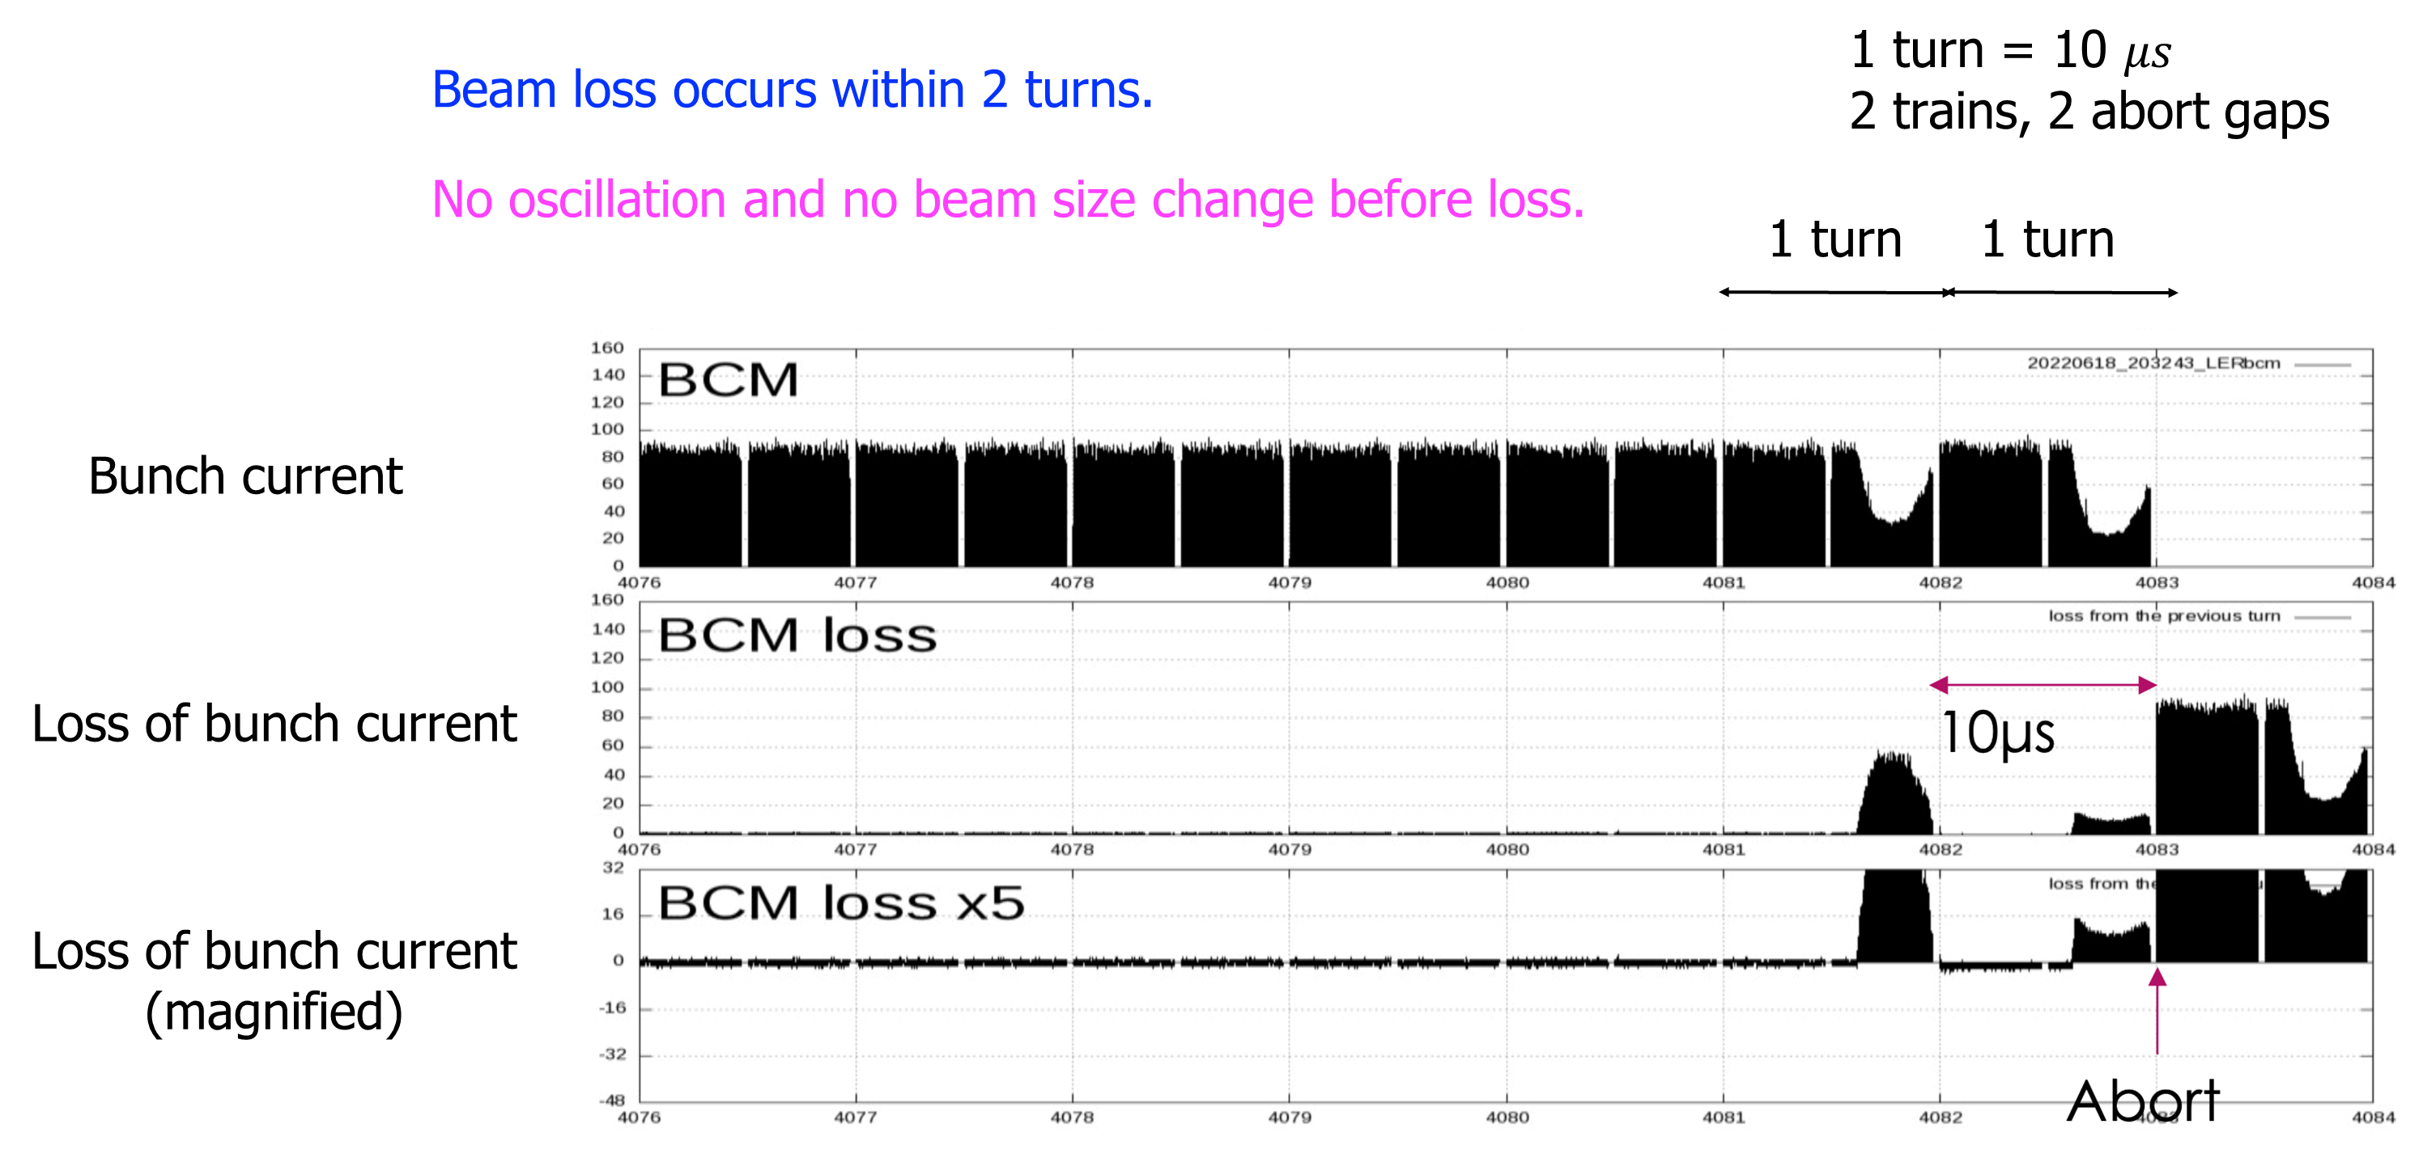
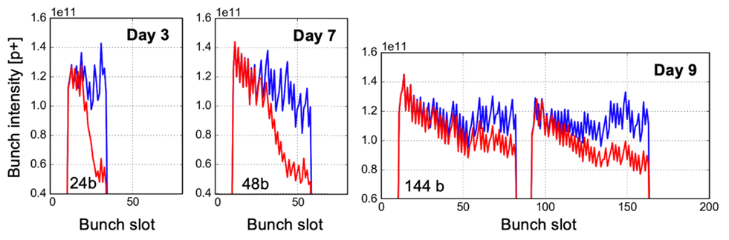
sudden beam loss at SuperKEKB
Y. Ohnishi
eeFACT’22
local e-cloud ?
dust ?
LHC e-cloud effect
L. Mether

Slide 22
next ECLOUD workshop?
ECLOUD’24, ECLOUD’25, ECLOUD’26 ?
two candidate sites proposed

Slide 23
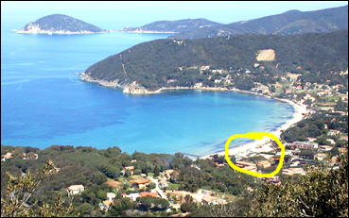
Candidate 1: La Biodola
Cimino theorem:
La Biodola = the best place for ECLOUD’XX
(where XX is any pair of integers)

Slide 24

Candidate 2: Yucatan
Gerardo Guillermo (CSNS),
Humberto Maury (UGTO),
Karla Cantún (UADY)
2024

Slide 25
