Slide 1
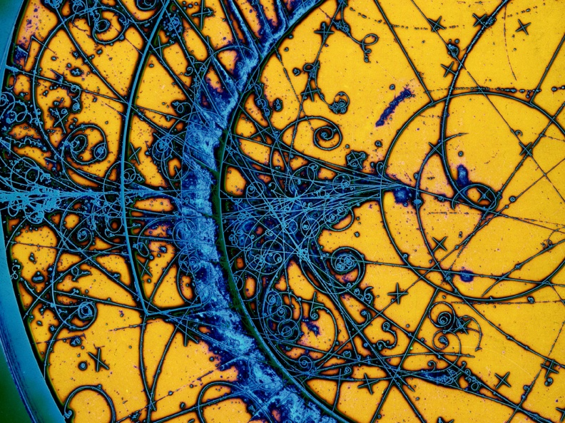
Impedance characterization of laser structured and coated surfaces
28/09/2022
Istituto Nazionale di Fisica Nucleare
The Italian National Institute for Nuclear Physics
Andrea Passarelli

Slide 2
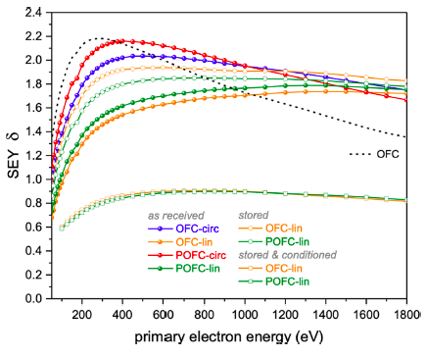
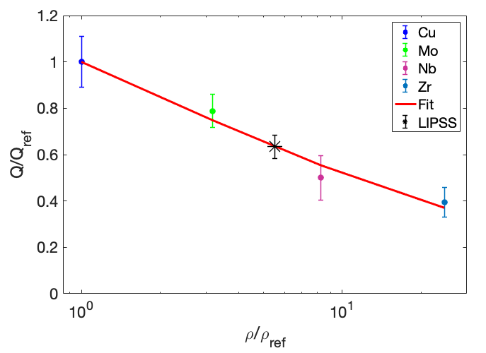
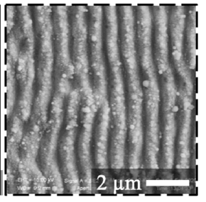
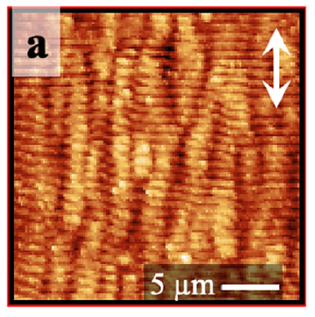
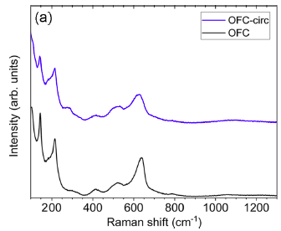
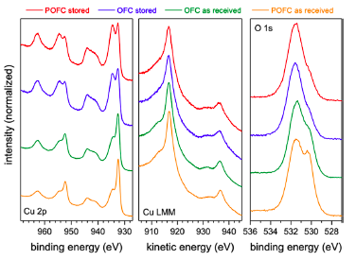
Laser structured and coated surfaces
To avoid undesirable effects on the beam and maximize machine performance
Laser Induced Periodic Surface Structures (LIPSS): e-cloud
Non-Evaporable Getter (NEG): ultrahigh vacuum and e-cloud
Amorphous Carbon (a‐C): e-cloud
Functional characterization
Electromagnetic characterization in sub-THz region
SEY = I_{out}/I_{in}
Sample characterization
Morphological
Chemical
SEM
AFM
Raman
XPS
Electromagnetic

Slide 3
CERN and Naples collaboration
Ongoing collaboration among CERN TE-VSC and INFN-Napoli, Napoli University, CNR-SPIN Salerno – Reduction of SEY through Laser Induced Periodic Surface Structures
TEAM COORDINATORS
Sergio Calatroni, Marcel Himmerlich (CERN), Carlo Altucci, Salvatore Amoruso, Antonello Andreone (Napoli University) and Maria Rosaria Masullo (INFN-Napoli)
Laser Surface Structuring (Napoli University):
Jijil JJ Nivas
Mohammadhassan Valadan
Meilin Hu
XPS analysis, SEY measurements and sample conditioning (CERN):
Sergio Calatroni
Marcel Himmerlich
Martino Rimoldi
Elena Annelie Bez
SEM measurements (CNR-SPIN Salerno)
Rosalba Fittipaldi
Antonio Vecchione
Electromagnetic characterization (INFN-Napoli):
Andrea Passarelli
Maria Rosaria Masullo
AFM and Raman measurements (Napoli University):
Marcella Salvatore
Stefano Luigi Oscurato

Slide 4
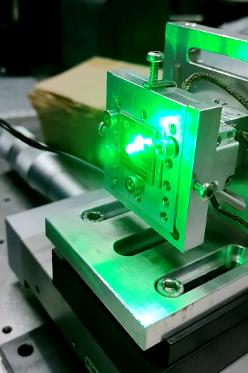
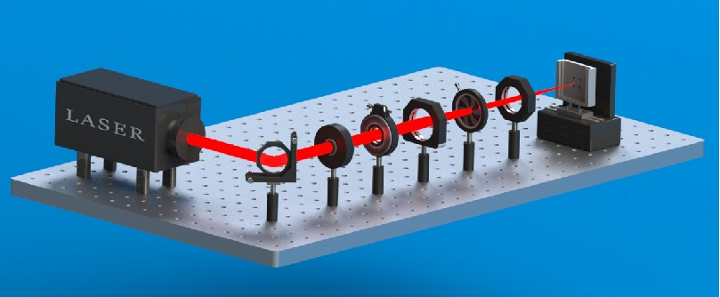
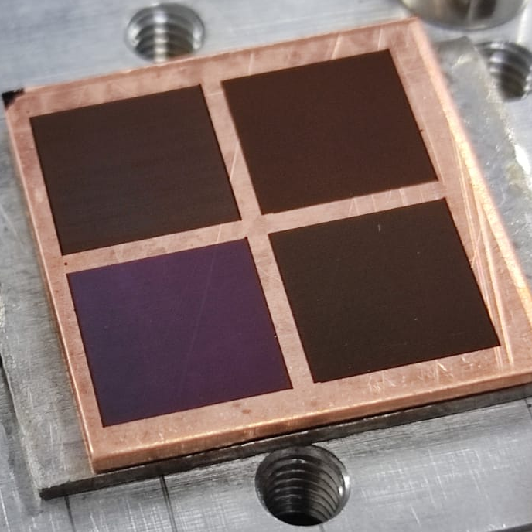
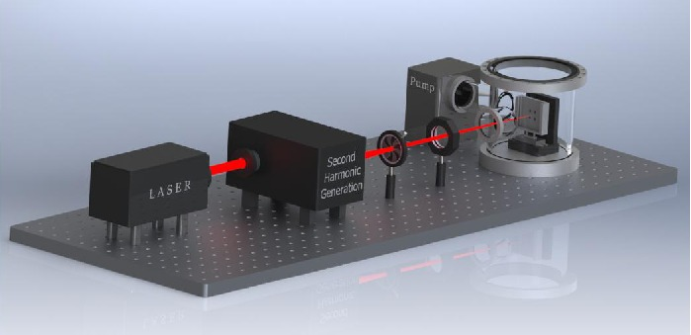
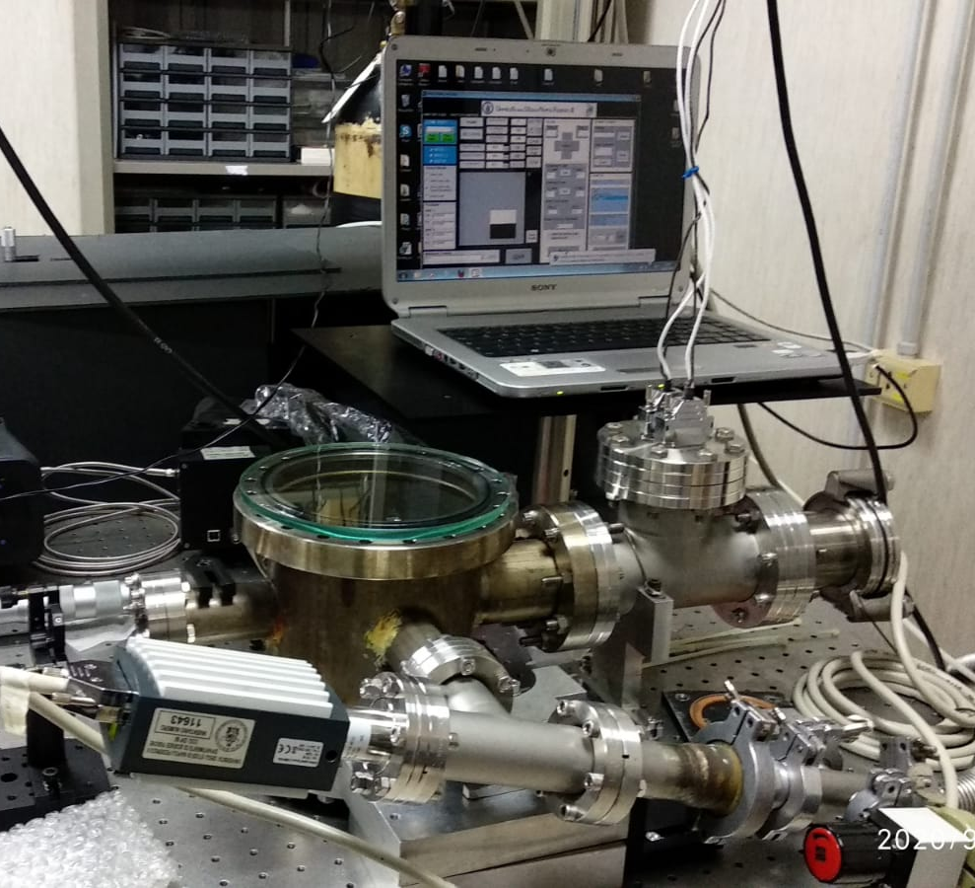
Naples laser setup
Chirped pulse amplification Yb:KGW laser source
central wavelength 1030 nm
pulse duration ≈180 fs
maximum rep. rate 200 kHz
Processing in vacuum
Target is mounted on a computer controlled XY-translation stage (PP- 20, Micronix USA) working synchronously with the laser.

Slide 5
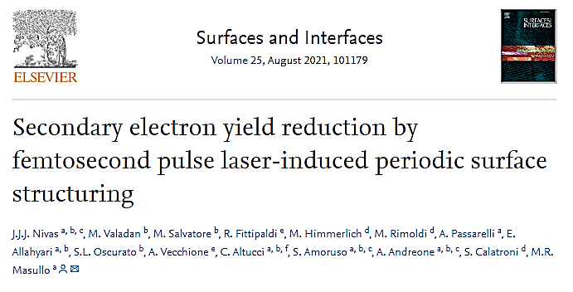
FIRST SET
laser process for different light polarizations and sample conditions (passivation)
Sample Code | Processing conditions (large area raster scanning in ambient air)
Sample Code | Laser Polarization | Power [mW] | Energy/pulse [µJ] | Scan velocity [mm/s] | Steps between adjacent lines [µm]
OFC-circ | Circular | 150 | 30 | 1 | 75
OFC-lin | Linear | 200 | 40 | 2 | 110
POFC-circ | Circular | 150 | 30 | 1 | 75
POFC-lin | Linear | 200 | 40 | 2 | 110
Laser: Yb:KGWsystem
λ = 1030 nm
Pulse duration :180 fs
Repetition rate : 5 kHz
Beam radius on target ω₀ ≈ 40 µm

Slide 6
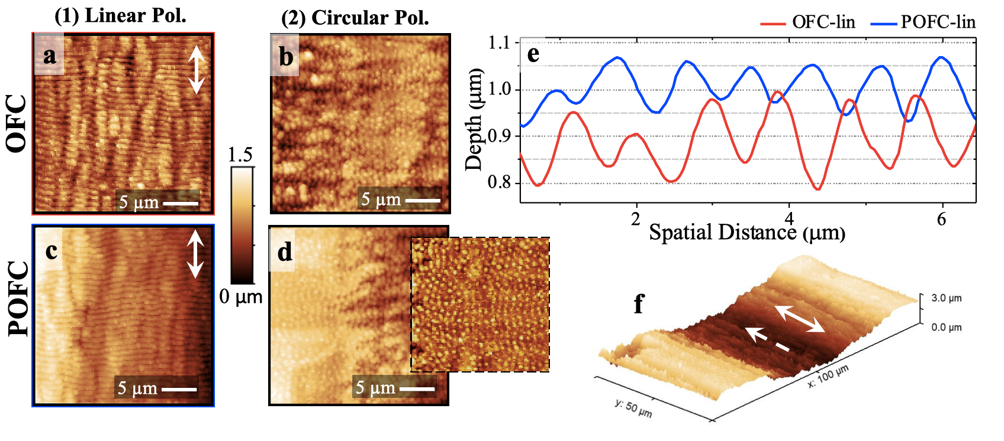
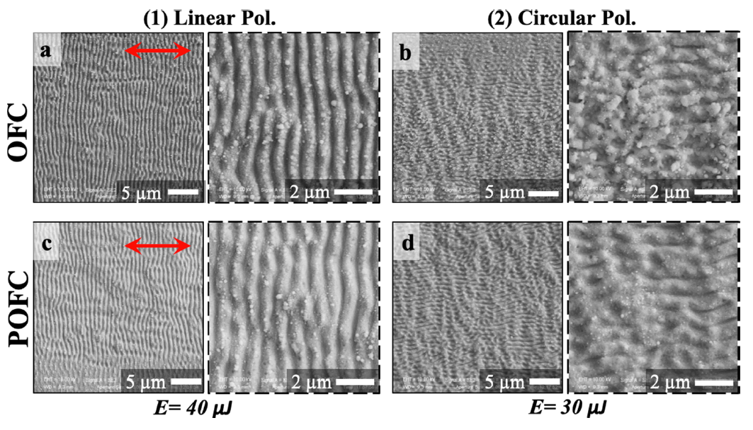
FIRST SET: Morphological & chemical characterization
OFC and P(assivated)OFC copper samples structured with linearly (a, c) and circularly (b, d) polarized fs laser pulses.
Direction of linear polarization is red/white arrow.
Pulse energy:
Linear E = 40 μJ (Fp=1.6 J/cm²), v_{s}= 2 mm/s, N₀=200
Circular E = 30 μJ (Fp=1.2 J/cm²),v_{s}= 1 mm/s , N₀=400
AFM images: larger scale surface modulation (channels) induced by the scanning procedure.
Periodicity matches line separation in scanning process (110 µm for linear and 75 µm for circular).
Raman: minimal change to surface composition.
XPS: laser structuring removes the surface passivation.
After 9 months: increase of the hydroxide content and a further uptake of hydrocarbon surface impurities.
SEM images: ripple periods from OFC-lin(a) and POFC-lin(c) are of the same order (~800 nm)

Slide 7
FIRST SET: SEY measurements
Conditioning with a beam of 250 eV electrons.
δmax tends to decrease < 1.0 with an electron dose of ~1 × 10⁻³ C/mm², compared with the maximum surface dose of ~5 × 10⁻³ C/mm² during 10 days scrubbing procedure at the beginning of LHC Run 2
SEY measurements: OFC-lin and POFC-lin reduced SEY for primary electron energies <~1000 eV.
After 9 months: SEY increased (>50 and <1000 eV)

Slide 8
FIRST SET: Conclusion
Parallel oriented grating structure (linear polarization) better supress the secondary electron emission with respect to randomly oriented arrangements (circular polarization);
ripples with height of ~200/300 nm and periods of ~800 nm + channels with 2µm height and 110 µm periodicity, generates a surface with higher SEY values compared to laser processing at higher pulse energy (classical LESS process);
the ripples are comparatively cleaner, with less abundance of nanoparticles compared to LESS;
conditioning tests demonstrated that the SEY<1 for an electron dose of ~1×10⁻³ C/mm²;
surface passivation is not mandatory.

Slide 9
SECOND SET
laser process in different ambient, wavelength and scanning velocity (article in progress )
λ [nm] | E [µJ] | Δ [µm] | w₀ [µm] | F_{th} [J/cm²] | f_{p} [kHz] | v [mm/s] | Ambient
515 | 16 | 30 | 35 | 0.14±0.04 | 5 | 1 1.5 2 | Ambient air Vacuum (4×10⁻³ mbar) Nitrogen
1030 | 84 | 40 | 91 | 0.24±0.03

Slide 10
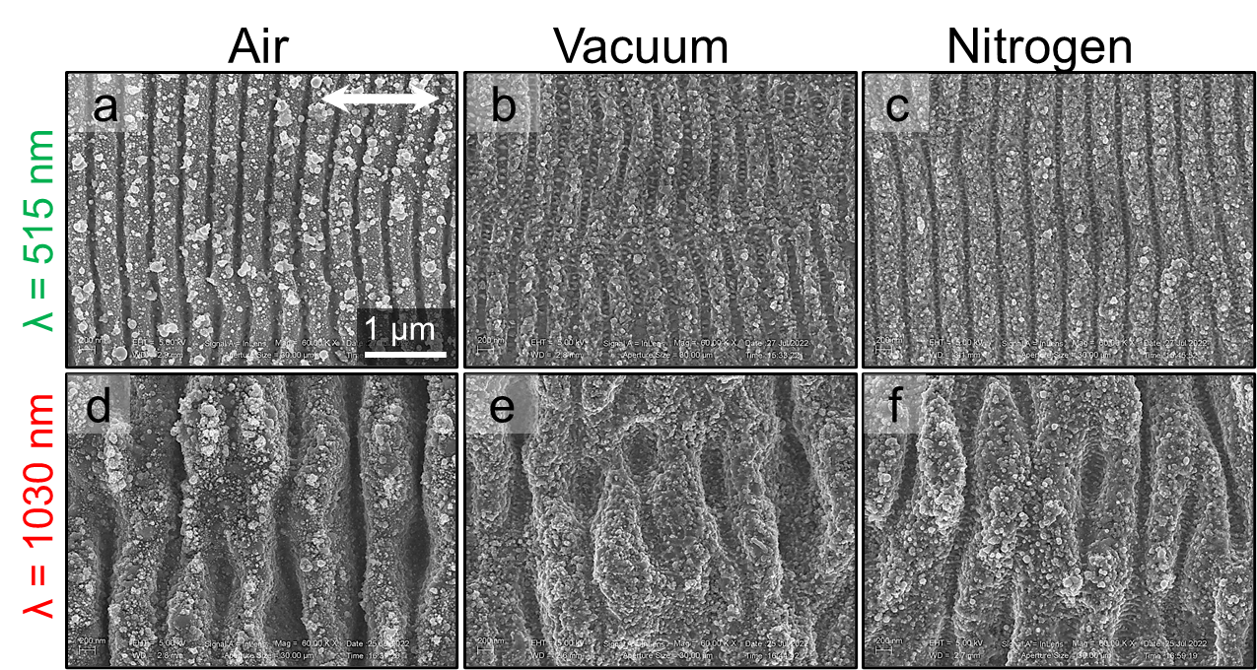
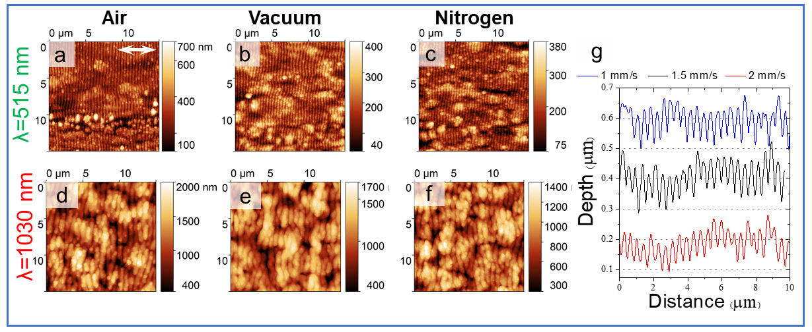
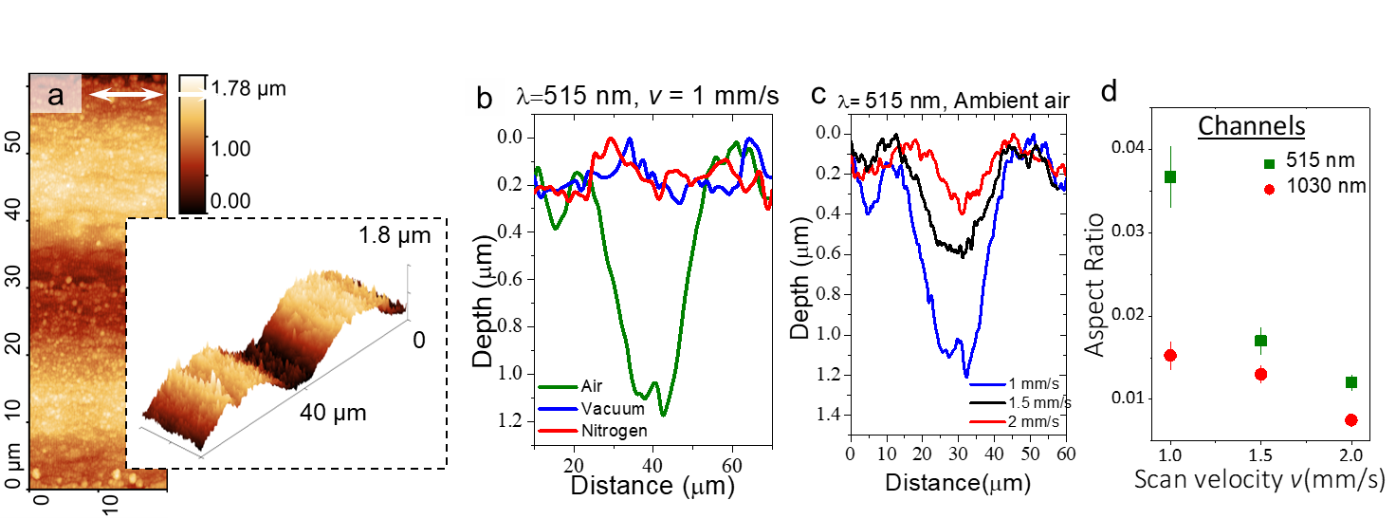
SECOND SET: Morphological characterization
SEM images: λ≈515 nm, rougher surface for air, maybe due to nanoparticles redeposition. In vacuum and nitrogen, rippled surface looks cleaner from nanoparticles redeposition, but ripples very shallow.
λ≈1030 nm, all three cases, rather free from nanoparticulate debris.
AFM images: ripples have no trend with respect to scanning speed. The depth of large scale channels increases reducing beam scanning velocity (j). Channels very shallow for irradiation in vacuum and nitrogen(i).
J. JJ Nivas, et al. Appl. Phys. A Mater. Sci. Process. 124 (2018) 198
J. JJ Nivas, et al., Appl. Surf. Sci. 417 (2017) 149–154
JJ Nivas, et al. Opt. Lett. 42 (2017) 2710

Slide 11
SECOND SET: SEY measurements
Conditioning with a beam of 250 eV electrons.
Air: δmax tends to decrease < 1.0 with an electron dose of ~1 × 10⁻² C/mm²
Nitrogen: (initial δmax > 2), the SEY stabilized at 1.04 at a dose > 2×10⁻² C /mm²
SEY measurements: laser processing in air is most efficient to form LIPSS lower scanning velocity (high aspect ratio)

Slide 12
SECOND SET: Conclusion
Better work in air ambient. In vacuum and nitrogen ambient, roughness parameter does not show any significant pattern and the same is reflected in the aspect ratio.
For decreasing the δmax we have to lower the scan velocity (increasing in the aspect ratio both of channels and ripples) as a greater number of pulses interact with the surface.
Best result: air, at 515nm, v=1mm/s, these working conditions are feasible to be implemented in long vacuum chamber. Simpler with respect into vacuum or nitrogen ambient.
Electromagnetic characterization: See next slides
FUTURE : understand the influence of ripples and channels

Slide 13
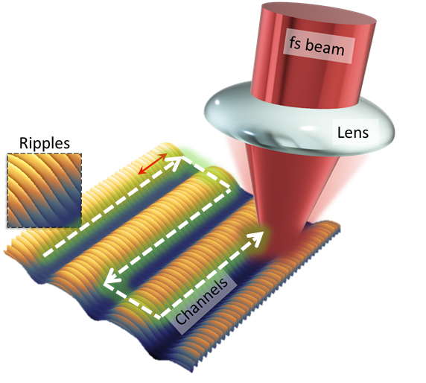
THIRD SET
Processing in air with different lenses and scanning steps at different wavelenght and repetition rate and scanning steps in order to understand the role of surface waviness(channels) and ripples(LIPSS)

Slide 14
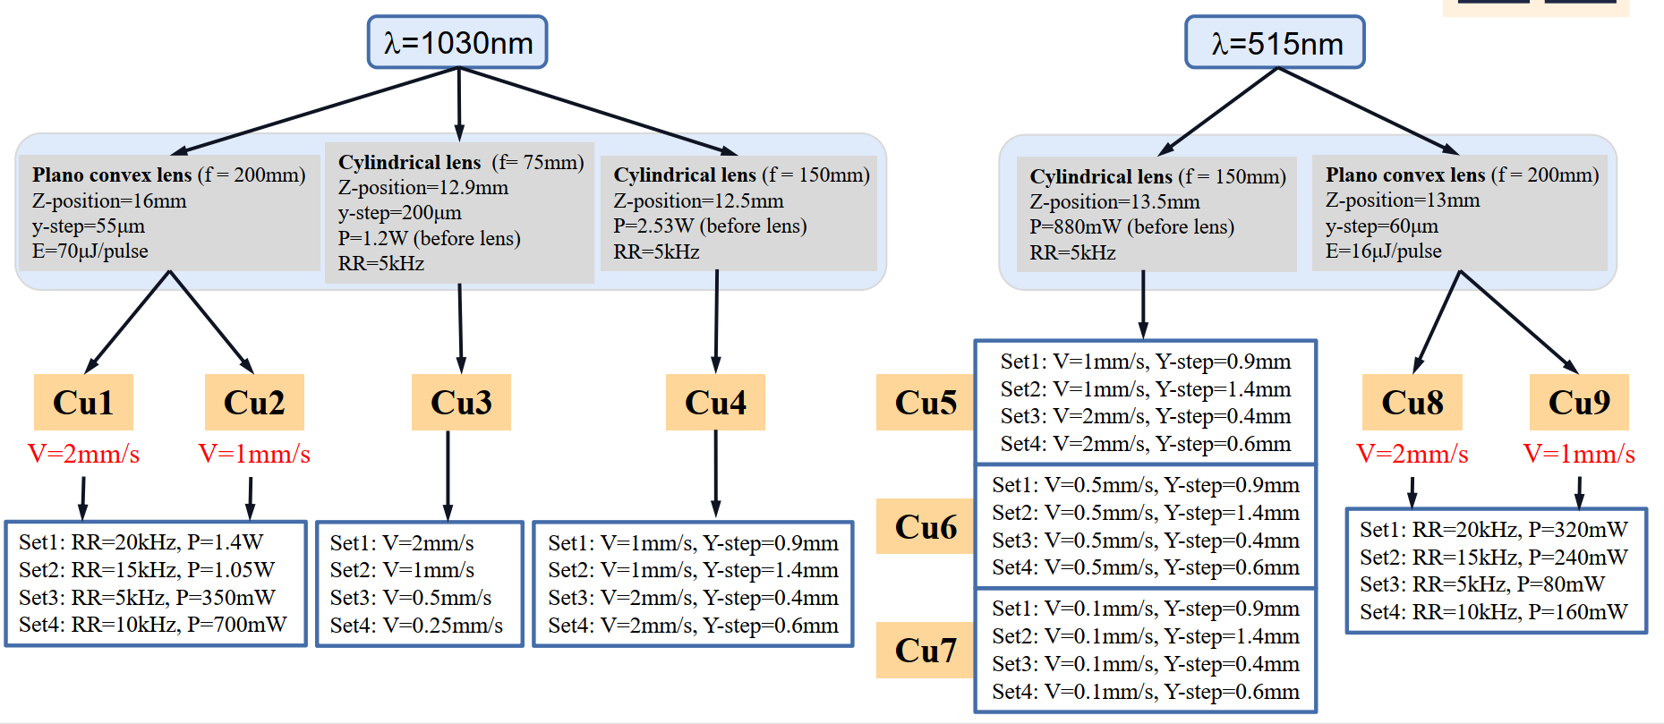
THIRD SET
Spherical
Spherical

Slide 15
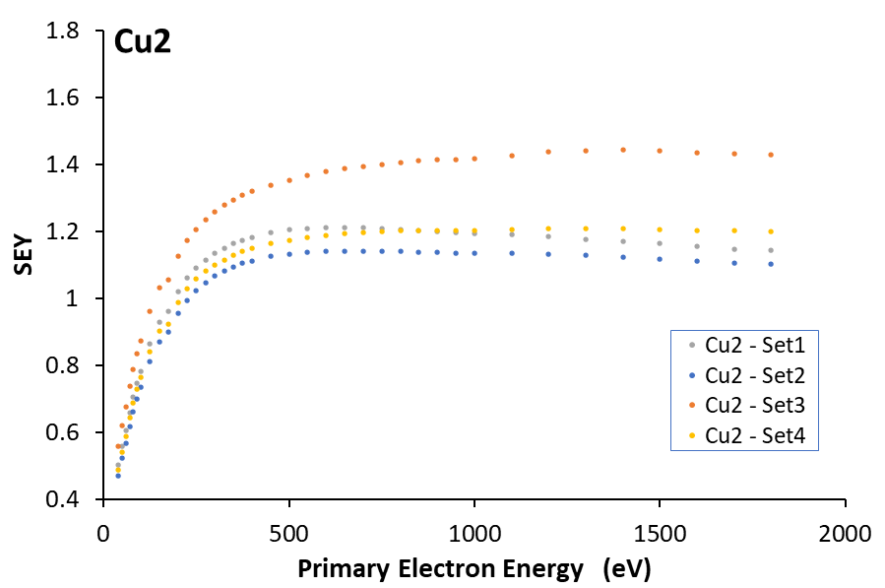
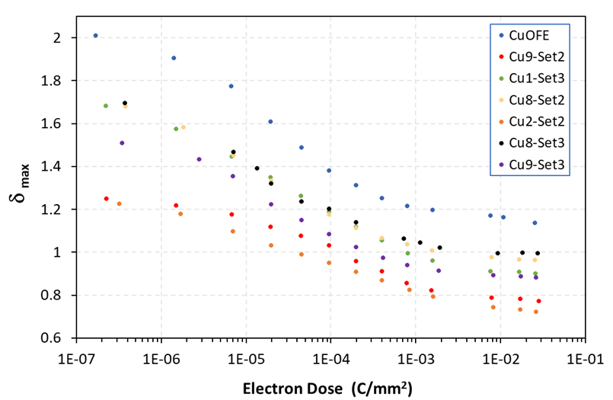
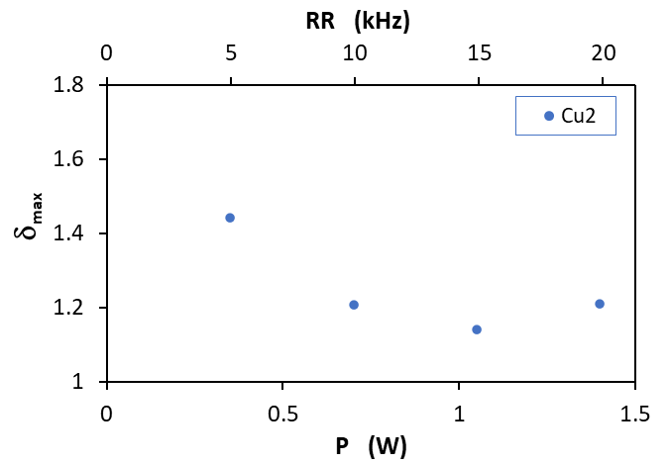
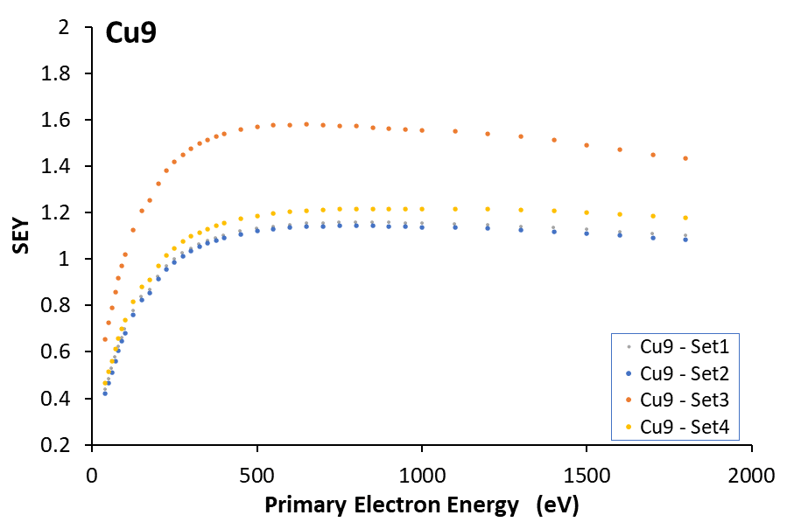
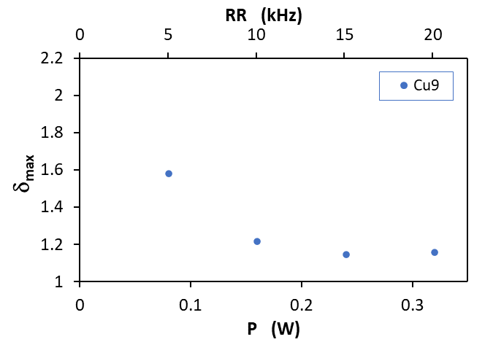
THIRD SET: spherical lens
For both wavelength
Repetition Rate can be increased up to 15kHz, after which the SEY and δ_{max} starts to rise again.
May be seen as a shielding effect due to the plasma formation over the surface during the laser processing.
Effect evident at 1030 nm.
Conditioning: δ_{max} < 1.0 with dose of ~5 × 10⁻⁴ C/mm²
SEY curves and correlation of δ_{max} with the repetition rate for samples Cu2 (1030 nm) and Cu9 (515 nm)

Slide 16
THIRD SET
Spherical
Spherical
Only ripples, no channels

Slide 17
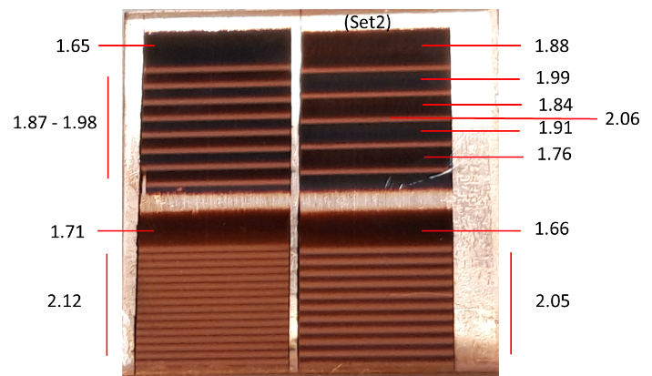
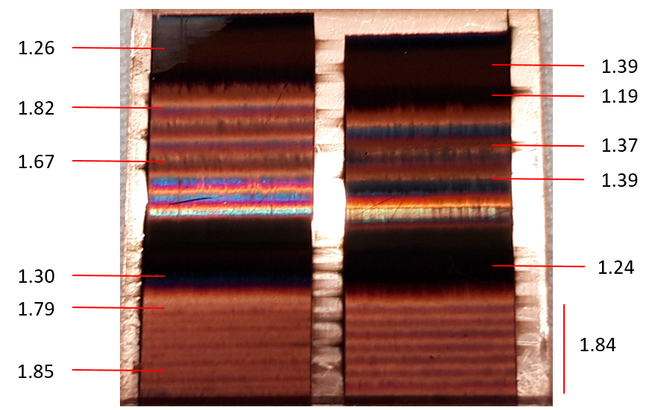
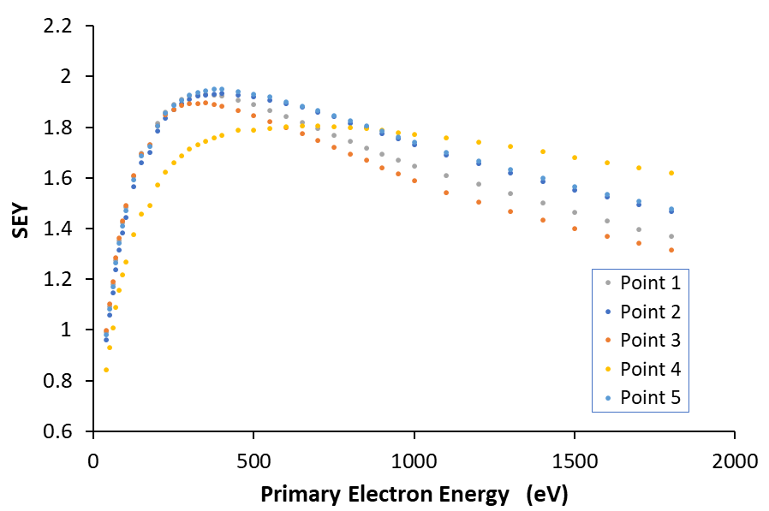
THIRD SET: cylindrical lens
δ_{max} on Cu4
Multiple pass for having more homogeneous structured region.
SEY measurements: not able to lower δ_{max}
Cu14
δ_{max} on Cu7
Bright
Dark
SEY measurements: dark region (ripples + redeposited particles) with δ_{max} lower than bright region (only ripples)

Slide 18
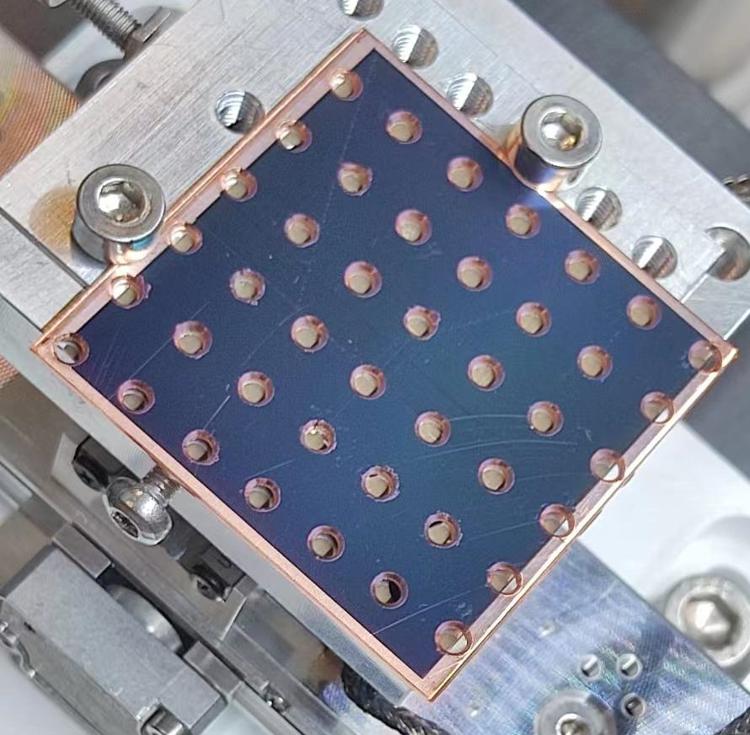
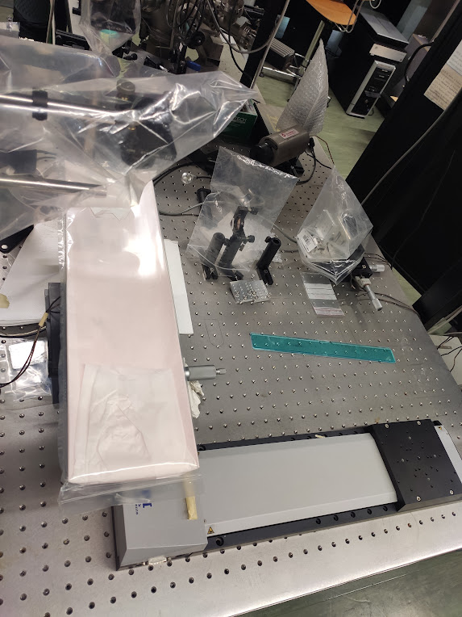
FOURTH SET
New big samples
40 mm x 40 mm pieces of CuOFE with hole pattern: large scale scanning and if holes induce problems
6 hours
Upgrade the experimental set-up with the new stage
Foreseen a test with the beam at SPS with a bigger piece
50 cm x 14 cm

Slide 19
Electromagnetic characterization: Two different methods
Dielectric resonator
Sub-THz waveguide
• high sensitivity
• small skin-depth
LESS (Laser engineered surface structures)
NEG (Non-Evaporable Getter)
a-C (Amorphous carbon)
• conductivity compared with copper
• small samples
• homogeneous coating
• coating thickness issues

Slide 20
First method
Dielectric resonant cavity
5
20
100
300
f [GHz]
𝝀 [mm]
60
15
3
1

Slide 21
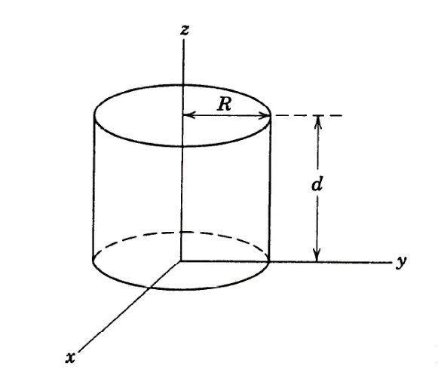
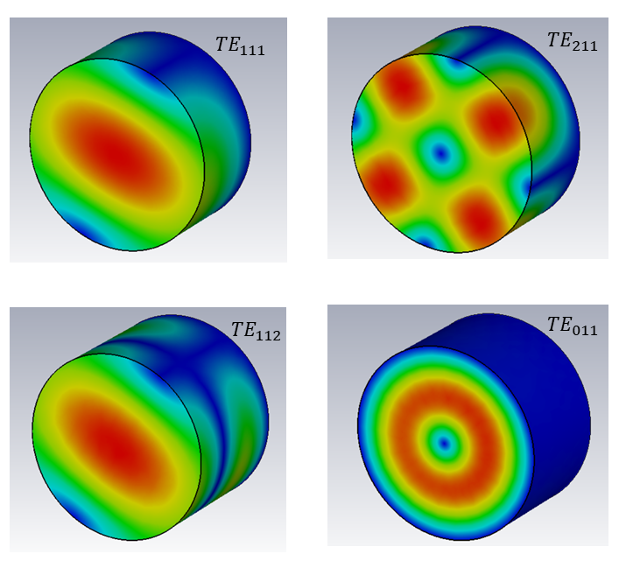
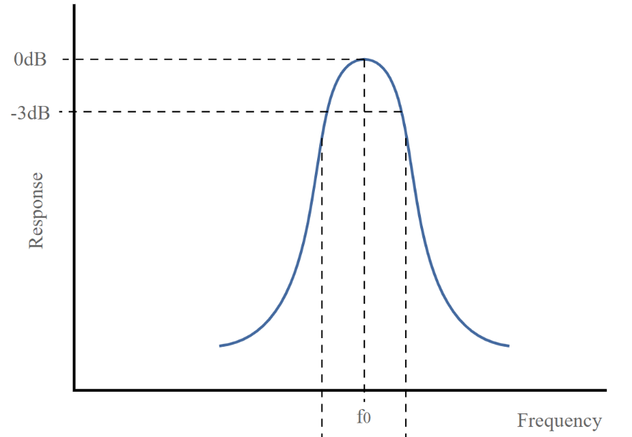
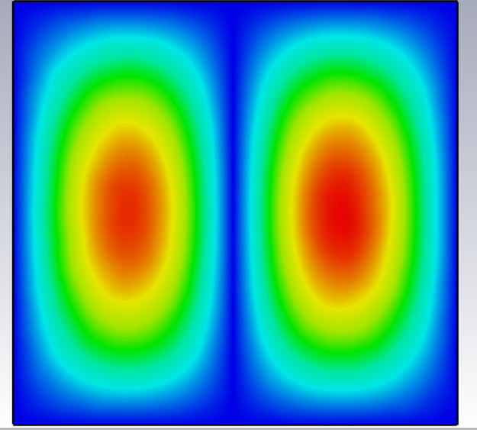
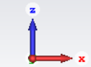
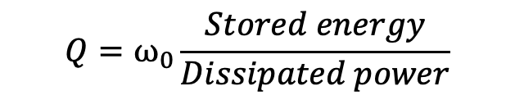
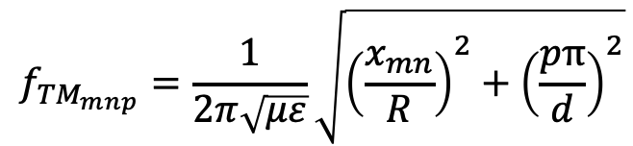

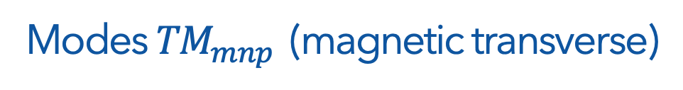

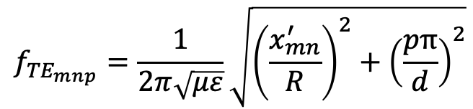
Resonant cavity
Electric field
Cut along z
Modes ${TE}_{mnp}$(electric transverse)
$$f_{{TE}_{mnp}}=\frac{1}{2π\sqrt{με}}\sqrt{{\left(\frac{x_{mn}^{′}}{R}\right)}^{2}+{\left(\frac{pπ}{d}\right)}^{2}}$$
Modes ${TM}_{mnp}$(magnetic transverse)
$$f_{{TM}_{mnp}}=\frac{1}{2π\sqrt{με}}\sqrt{{\left(\frac{x_{mn}}{R}\right)}^{2}+{\left(\frac{pπ}{d}\right)}^{2}}$$
$${TE}_{011}$$
$$Q=ω_{0}\frac{Stored energy}{Dissipated power}$$
Cut along y

Slide 22
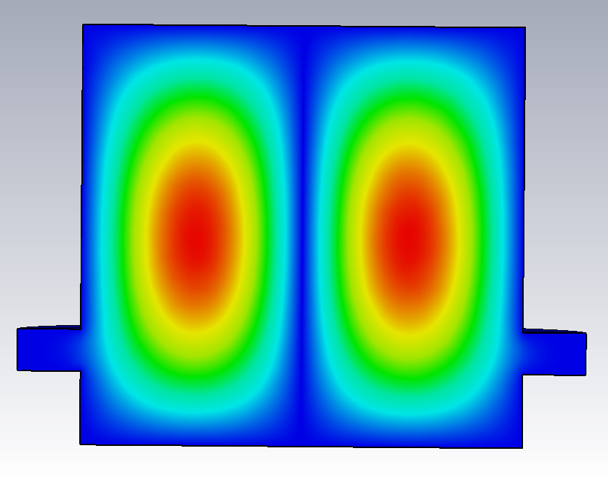
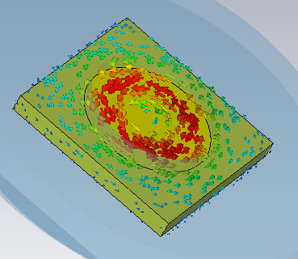
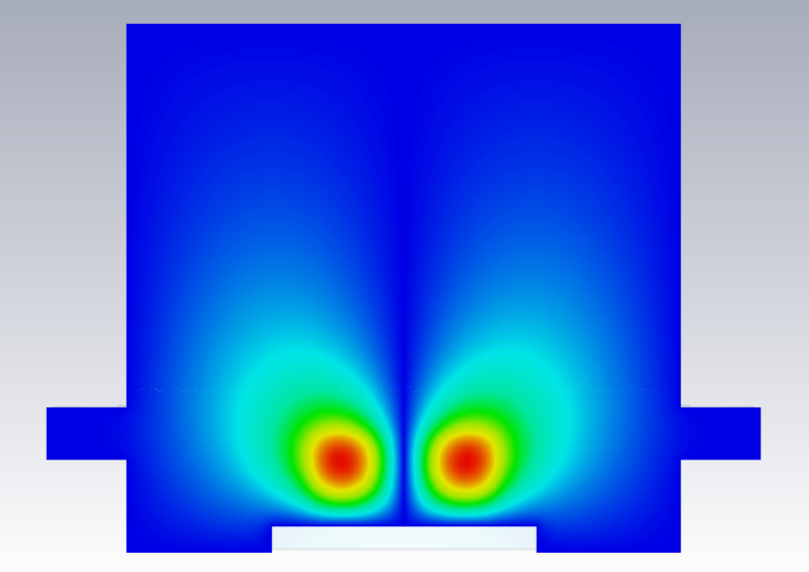
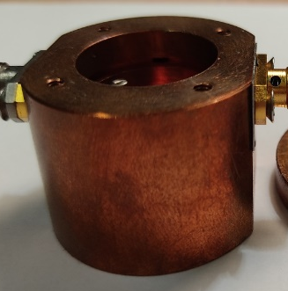
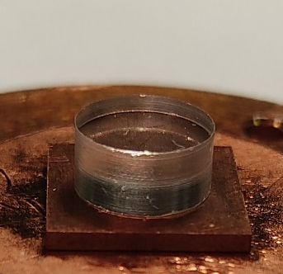
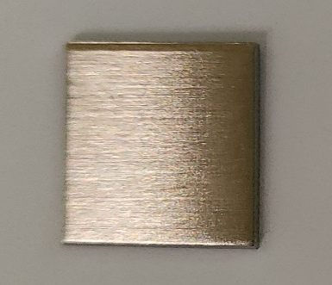
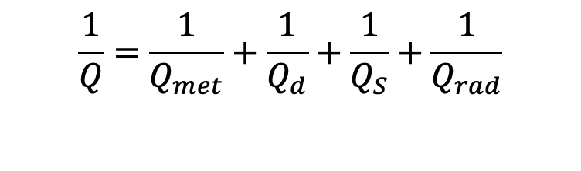
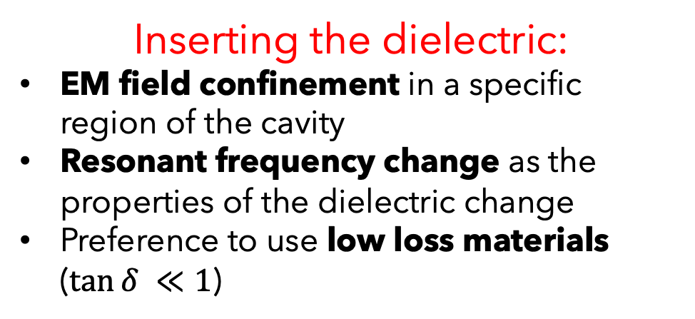
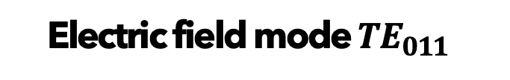
Dielectric resonator cavity
Electric field mode ${TE}_{011}$
Inserting the dielectric:
EM field confinement in a specific region of the cavity
Resonant frequency change as the properties of the dielectric change
Preference to use low loss materials ($\tan{δ }≪1$)
Without dielectric
current on sample
Cut along y axis
$$\frac{1}{Q}=\frac{1}{Q_{met}}+\frac{1}{Q_{d}}+\frac{1}{Q_{S}}+\frac{1}{Q_{rad}}$$
With dielectric
Internal walls
Inside dielectric
On sample

Slide 23

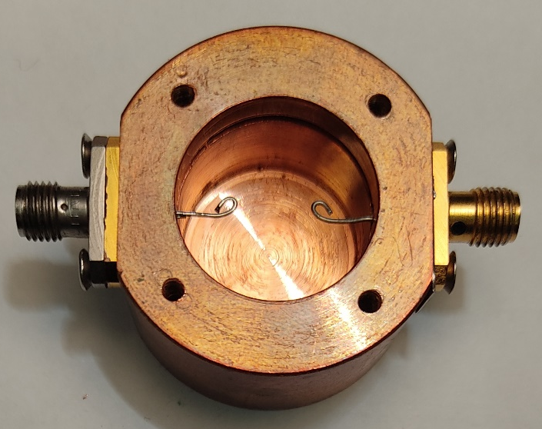
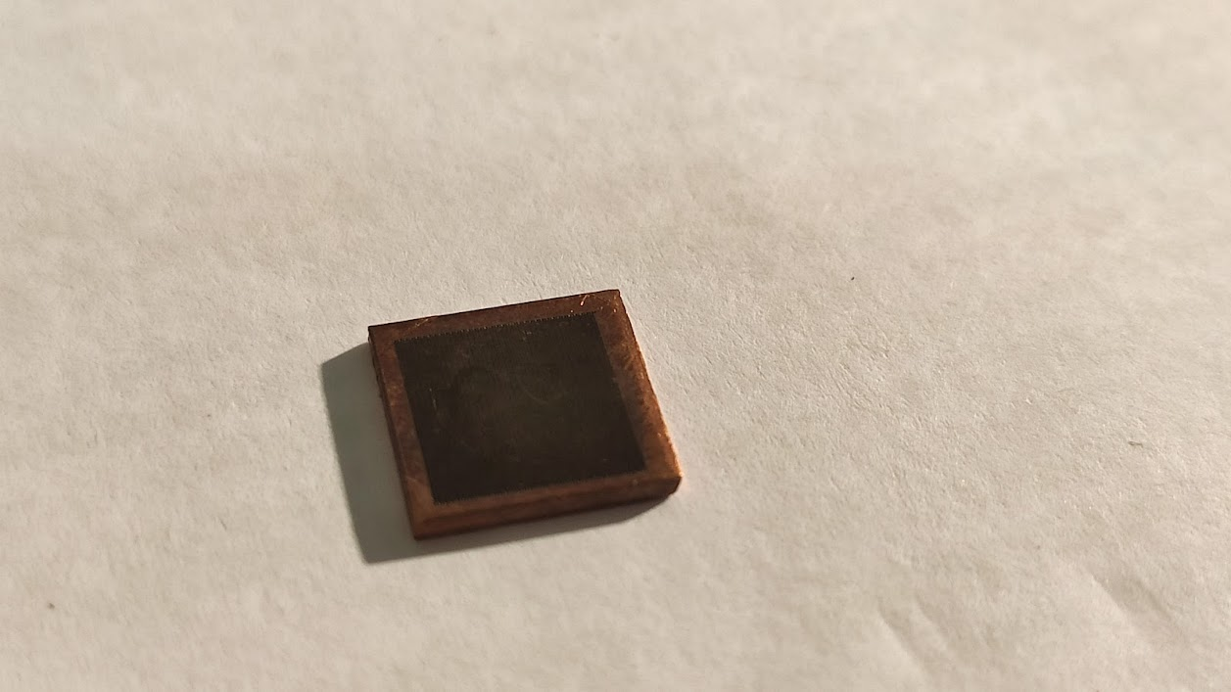

Our methodology and characterized material
Cylindrical copper cavity
Magnetically coupled antennas
LIPSS:
Laser Induced Periodic Surface Structure
Copper sample $10×10 mm^{2}$, with thickness $1 mm$
Laser structuring with parallel lines over an area of $8×8 mm^{2}$
Average processing depth of the order of $2 μm$
Sapphire as dielectric: $ε=9.9$ e $\tan{δ }=$ ${10}^{−4}$

Slide 24



Simulations: optimization of the cavity structure
Comparison
copper / molybdenum
Dielectric radius
$$σ_{Cu}=5,80 S/m$$
$$σ_{Mo}=1,82 S/m$$

Slide 25





Simulation results using a calibration curve
$$a \text{∝} \frac{1}{Q_{S}}$$
Losses on the sample
$$b \text{∝}\frac{1}{Q_{met}}+\frac{1}{Q_{d}}$$
Losses in the rest
of the cavity
Sensitivity in the variation of the quality factor Q is greater for the dielectric with $r_{d}=3,5 mm$
$$\frac{Q}{Q_{ref}}=\frac{a+b}{a∙\sqrt{\frac{ρ}{ρ_{ref}}}+b}$$
Pure copper as reference material

Slide 26



Measurements
ROHDE& SCHWARZ ZNB 20 - Vector Analyzer 100 kHz-20 GHz

Slide 27


Measurement results

Slide 28





Measurement results
LIPSS conductivity value
$$σ_{exp} (S/m)$$ | $$σ_{rough}(S/m)$$
$${1.05±0.30∙10}^{7}$$ | $${1.40∙10}^{7}$$
Estimated average roughness
$$Δ≈2μm$$
LIPSS surface resistance R_{s} = 76 mΩ
Skin depth = 1.25 μm at 15GHz
$$\frac{Q}{Q_{ref}}=\frac{a+b}{a∙\sqrt{\frac{ρ}{ρ_{ref}}}+b}$$
$$δ=\sqrt{\frac{2}{σμω}}$$
LIPSS: Linear polarization $λ≈1030nm$, $v_{s}=2 mm/s$ in air

Slide 29
Second method
Sub-THz waveguide attenuation
5
20
100
300
f [GHz]
𝝀 [mm]
60
15
3
1

Slide 30

The proposed method
Evaluation of the signal attenuation inside a DUT with coating deposited.
Electromagnetic characterization
of coating material.

Slide 31






The Device Under Test
1
2
3
Copper foil
as
reference
4
5
6
Coated foil
to measure
Methodology advantages: 1)Homogeneous deposition 2)System reusability 3)Large area coating

Slide 32



Analytical evaluations
In-house retrieval method
Waveguide of length l_{g} (TE_{1,1} mode) + pyramidal transitions of length l_{t} (TE_{1,0} TE_{0,1} modes)
$$A_{DUT}=αl_{g}+2\int_{0}^{l_{t}}{α(z) dz}=\frac{1}{2}Re\left(Z_{s}\right)\frac{\int_{l}{{\left|n×H_{1,1}\right|}^{2}dl}}{Z_{1,1}{\left|I_{1,1}\right|}^{2}}l_{g}+\int_{0}^{l_{t}}{Re\left(Z_{s}\right)\frac{\int_{l}{{\left|n×\left(H_{1,0}+H_{0,1}\right)\right|}^{2}dl}}{Z_{1,0}{\left|I_{1,0}\right|}^{2}+Z_{0,1}{\left|I_{0,1}\right|}^{2}}}dz$$
Reliable analytical tool
$$Z_{s}=Z_{coat}\frac{Z_{Cu}+jZ_{coat}tan\left(k_{coat}d\right)}{Z_{coat}+jZ_{Cu}tan\left(k_{coat}d\right)}$$

Slide 33




Measurement system upgrade
System specifications:
Spectral Range: > 3 THz
Dynamic Range > 70 dB
Scanning Range ~ 300 ps
Spectral Resolution < 3.5 GHz
Upgrade:
> 5 THz
> 90 dB
~ 850 ps
< 1.5 GHz
More accurate guiding system manufacturing

Slide 34

Measurement results on a-C
Two samples with 3 μm of Amorphous carbon on copper bulk
Mechanical stress a-C coating on Cu slab

Slide 35
Thank you

Slide 36



Skin depth
NEG 8e⁵ S/m
a-C 2.2e³ S/m
$$δ=\sqrt{\frac{2}{σμω}}$$

Slide 37
Measurement system upgrade
σ_{NEG1} = (7.7 ± 1.1) × 10⁵ S/m
σ_{NEG2} = (4.2 ± 0.5) × 10⁵ S/m
σ_{a-C} = (2.2 ± 0.7) × 10³ S/m

Slide 38


Before LIPSS - History of LESS
Laser Engineered Surface Structures
Nanosecond or picosecond pulse duration
Beam screen
max.
100 µm
Ablation depth in the order of ~25 μm may be too high, its reduction could be beneficial for surface Impedance
Beam screen SEY higher compared to LESS flat samples, conditioning to SEY<1 for electron doses <10⁻⁴ C/mm²
Risk of particle release, that may be source of UFOs in the LHC giving origin to quenches
ablated region
redeposited dendritic
surface layer
Thanks to S. Calatroni

Slide 39
FIRST SET: Chemical characterization
XPS spectra of the Cu 2p, Cu LMM and O 1s emission.
No Cr signal: laser structuring also removes the surface passivation from POFC samples.
After 9 months: increase of the hydroxide content and a further uptake of hydrocarbon surface impurities.
Raman spectra, minimal change to the surface composition induced on the laser irradiated area with respect to the untreated one.

Slide 40



SECOND SET: Morphological characterization
$$\frac{\text{channel} \text{depth}}{\text{hatch} \text{distance} \text{of} \text{the} \text{channels}\text{ (}\text{Δ}\text{)}}$$
$$\frac{\text{RMS} \text{roughness}\text{ (}\text{Sq}\text{)}}{\text{spatial} \text{period}\text{ (}\text{Λ}\text{)}}$$
Aspect ratio reported only for air, since the channels are shallow for vacuum and nitrogen.
For channels (a) shows a clear drop as the scanning velocity increases, evident in the case of λ≈515 nm.
For ripples (b), shows a clear drop as the scanning velocity increases, evident in the case of λ≈1030 nm.

Slide 41

SECOND SET: Chemical characterization
Raman spectra, for v_{s}=1.5 mm/s.
Air: peaks closely allied the reported peaks of Cu₂O are identified. Broad band within 400–600 cm⁻¹ may indicates an amorphous phase or structural defects.
Nitrogen: no considerable oxidation. Peak at 282 cm⁻¹ could indicates CuO nanocrystals formed after the agglomeration of nanoparticles.
Vacuum: induced only a nominal change to surface composition on the laser irradiated area.
The spectra confirm the XPS data: oxide content is maximum when treatment is done in air.
XPS spectra for v_{s}=1.5 mm/s λ = 515 nm. With 1030 nm same trends. Air: higher oxygen content at the surface, either for oxidation during laser processing or oxidization of nanoparticles back-deposited onto surface. The surface mainly composed of Cu₂O and slight amount of copper hydroxides.
Vacuum: a partially metallic surface remained.
Nitrogen: reduced surface oxidation, surface hydroxyls is lower and exhibits a proportion of Cu atoms in metallic state. Incorporation of nitrogen at a level of 2-3 at.%.
Similar oxygen content as vacuum case, maybe due to oxidation upon air exposure after the laser treatment, a fraction of the surface atoms remains in metallic state.

Slide 42


THIRD SET: Conclusion
FLAT SURFACE
δ_{max} ≈ 2.2
ONLY RIPPLES
bright region with cylindrical lens
δ_{max} ≈ 1.9
RIPPLES + NANOPARTICLES
dark region with cylindrical lens
δ_{max} ≈ 1.6
RIPPLES + NANOPARTICLES + CHANNELS
spherical lens
δ_{max} ≈ 1.2
Conditioning: δ_{max} < 1.0 with dose of ~5 × 10⁻⁴ C/mm²

Slide 43





SECOND SET: Electromagnetic characterization
Electric field
mode ${TE}_{011}$
Current on sample
Without dielectric
Losses on the sample
$$a \text{∝} \frac{1}{Q_{S}}$$
$$\frac{Q}{Q_{ref}}=\frac{a+b}{a∙\sqrt{\frac{ρ}{ρ_{ref}}}+b}$$
With dielectric
Losses in the rest
of the cavity
$$b \text{∝}\frac{1}{Q_{met}}+\frac{1}{Q_{d}}$$
$$σ_{exp} (S/m)$$ | $$σ_{rough}(S/m)$$
$${1.05±0.30∙10}^{7}$$ | $${1.40∙10}^{7}$$
Cylindrical copper cavity
Magnetically coupled antennas
Sapphire as dielectric: $ε=9.9$ e $\tan{δ }=$ ${10}^{−4}$
LIPSS: $λ≈1030nm$, $v_{s}=2 mm/s$ in air
LIPSS surface resistance R_{s} 76 mΩ
Skin depth=1.25 μm at 15GHz

