Slide 1
SEY dependence on overlayer thickness and its relevance for e-cloud studies at various temperatures
M. Angelucci
Ecloud’22 – La Biodola Bay (26-28/09/22)

Slide 2
Outline
Introduction
Secondary Electron Yield of different surfaces
Structural/Morphological changes
Chemical changes (Cu and SS)
Thickness dependence – Carbon
Cryogenic surface: contamination and SEY changes

Slide 3
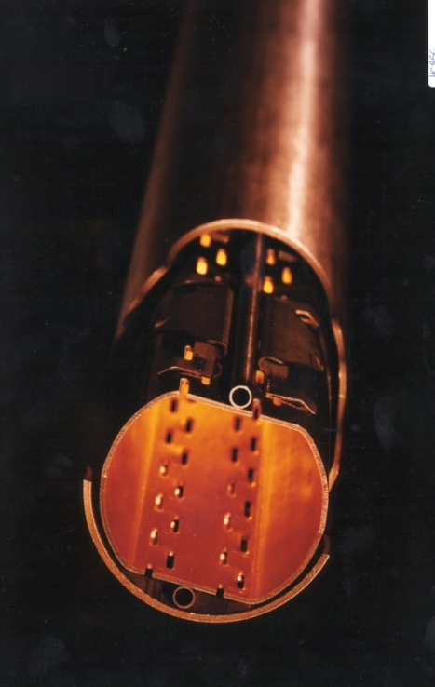
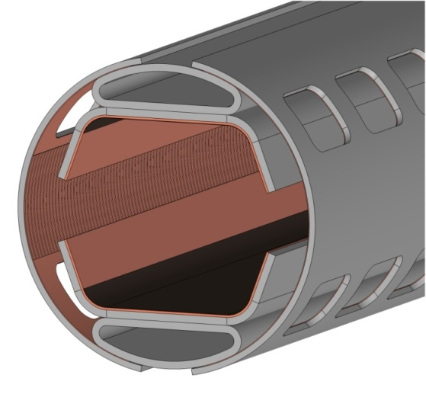
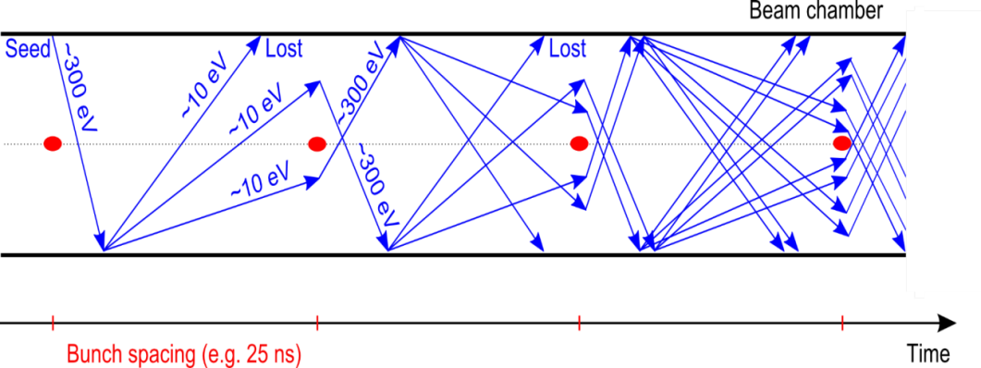
Introduction
cooling channels
LHC BS
Low temperature
(LHC beam screen T~5-20 K)
UHV (P <10⁻¹¹ mbar)
Different Surface characteristics
FCC-hh BS
e⁻ cloud phenomenon
LASE-Cu
    Secondary Electron Emission can drive an avalanche multiplication effect filling the beam chamber with an electron cloud
sawtooth
surface finishing
perforated baffles
LHC
    e⁻ is emitted (photoelectric effect)
    Proton bunch
    Secondary Electron Emission

Slide 4
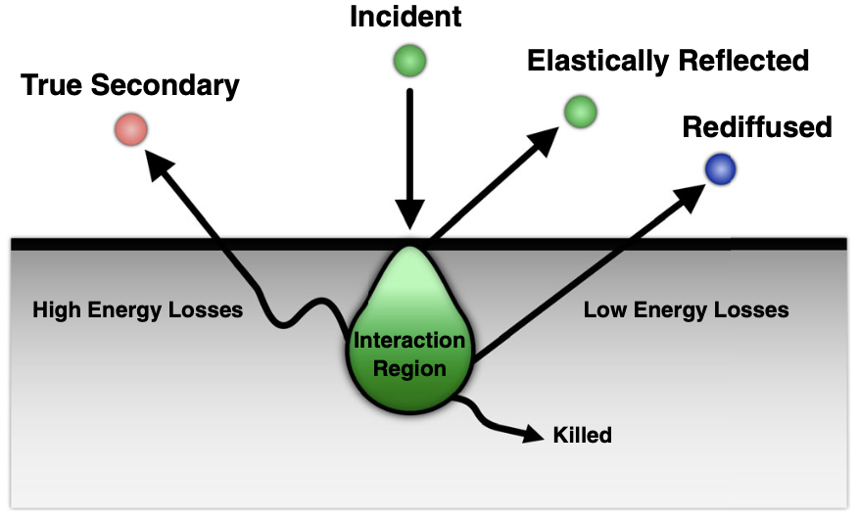
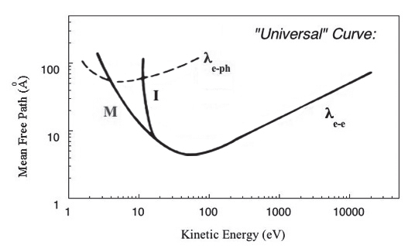
Introduction
Secondary Electron Emission
Electron mean free path up to ~10 nm
(few monolayers)
Three-step process:
• Production of SE at a depth z
• Transport of the SE toward the surface
• Emission of SE across the surface barrier

Slide 5
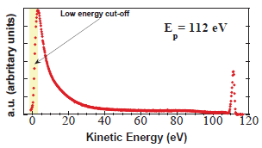
Introduction
Secondary Electron Emission
Surface conditions
influence SEY measurements
Three-step process:
• Production of SE at a depth z
• Transport of the SE toward the surface
• Emission of SE across the surface barrier
R. Cimino & T. Demma, Int. J. Mod. Phys. A (2014)
Energy Distribution Curve (EDC) of the electrons produced by a 112 eV primary energy electron beam impinging on a Cu technical surface

Slide 6
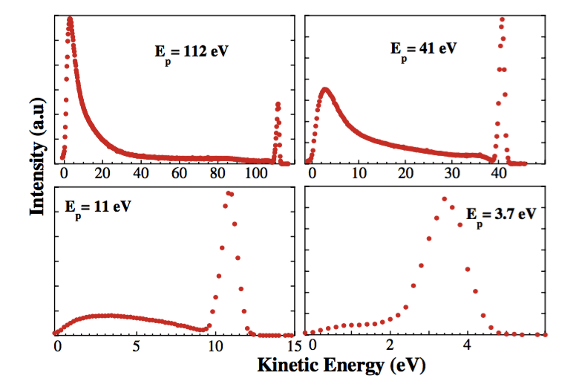
SEY of materials
Energy Distribution Curves at different Primary Energy
A
B
SE
SE
R
R
R
D
D
R
SE
SE
Cimino et al., PRL 93 (2004)

Slide 7
SEY of materials
Energy Distribution Curves at different Primary Energy
A
B
SE
SE
R
R
R
D
D
R
SE
SE
Cimino et al., PRL 93 (2004)

Slide 8
SEY of materials
Cimino et al., PRL 93 (2004)
Energy Distribution Curves at different Primary Energy
A
B
SE
R
SE
R
R
D
D
R
SE
SE
Low-Energy Range
Reflected electron component
Sensitive to surface variation

Slide 9
SEY of materials
Cimino et al., PRL 93 (2004)
Energy Distribution Curves at different Primary Energy
A
B
SE
R
SE
R
R
D
D
R
SE
SE
Total amount of emitted secondary electrons
High-Energy Range
Sensitive to thick layer

Slide 10
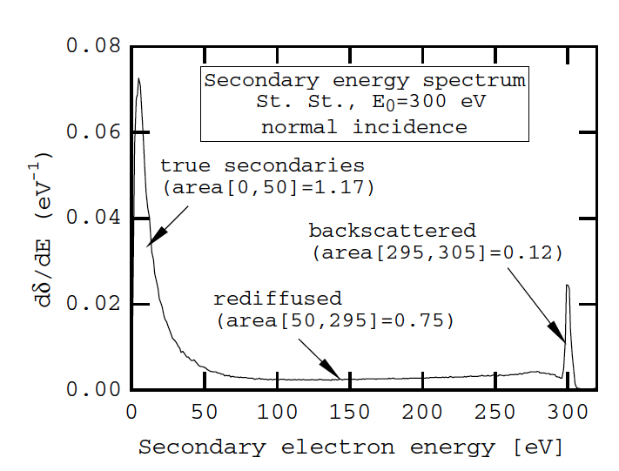
SEY of materials
HOPG
By normalizing to 1 spectra taken with E_{p} - E_{bias} < W_{f} and than plotting together all EDC of clean oriented HOPG

Slide 11
SEY of materials
HOPG
SEY
SEY
Secondaries
Secondaries
Rediffused
Backscattered
Rediffused
Backscattered

Slide 12
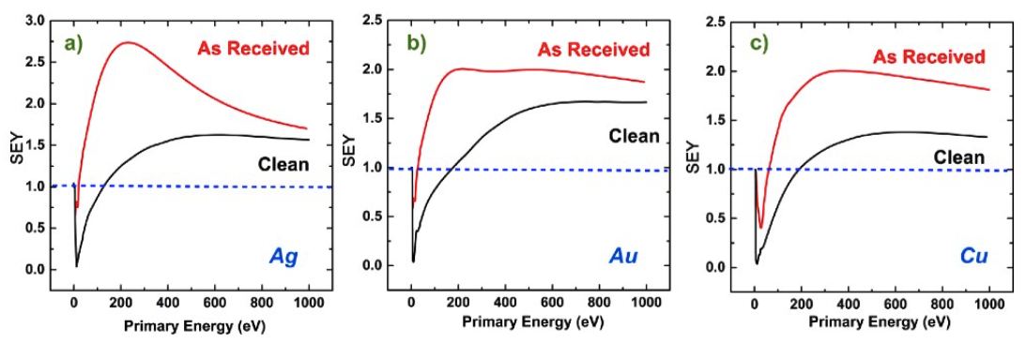
SEY of materials
Differences between “As Received” and Atomically Clean Metals
Ag
Au
Cu
AIP Advances 7, 115203 (2017)
High-Energy SEY dependence
Contaminants (as received)
Materials (clean)
Lower SEY
Characteristic Curves
General High SEY

Slide 13
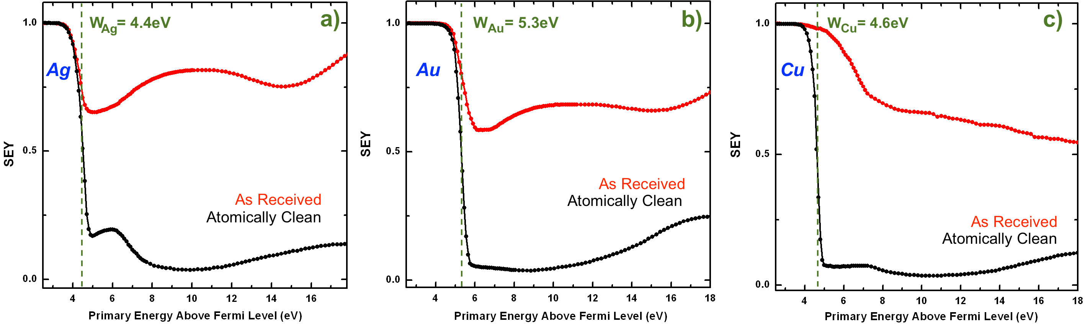
SEY of materials
Differences between “As Received” and Atomically Clean Metals
in the Low-Energy range
Ag
Au
Cu
General Behaviour
in all clean metals
Evaluation of Work Function
AIP Advances 7, 115203 (2017)

Slide 14
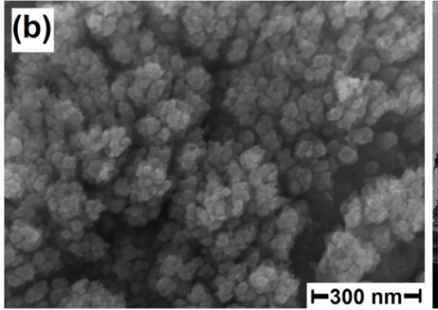
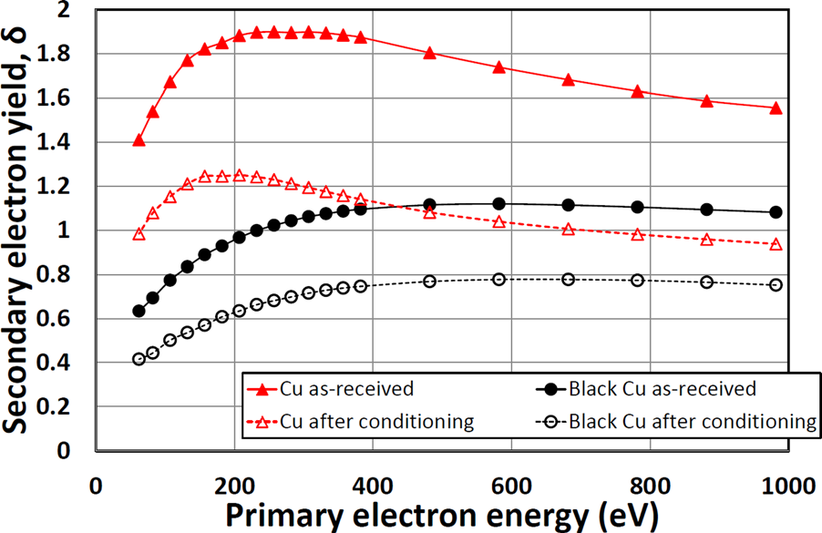
SEY variation
Modification of surface
Engineering the surface morphology
Laser ablation and conditioning
R. Valizadeh et al. , Appl. Phys. Lett. (2014)
Morphological
Changes
R. Cimino et al. PR ST (2015)

Slide 15
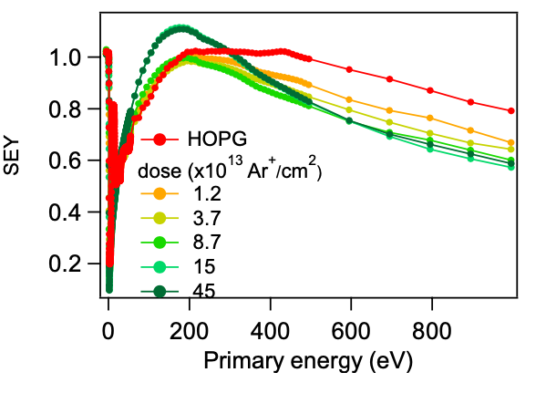
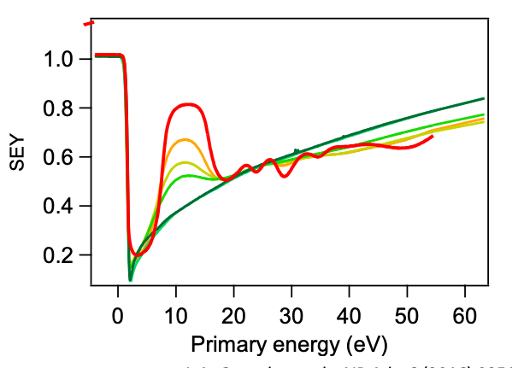
SEY variation
Modification of surface
HOPG
Structural modification
Ar⁺ Sputtering
L.A. Gonzalez et al., AIP Adv. 6 (2016) 095117

Slide 16
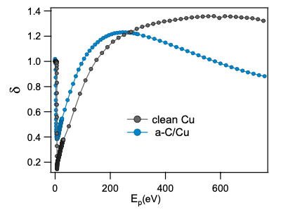
SEY variation
Modification of surface
Chemical modification
Amorphous C-coating
ultra high vacuum
RF magnetron sputtering 50W p(Ar) 6x10-2 mbar
a-C (~ 20 nm)/poly Cu
R. Larciprete et al., Appl. Surf. Sci. (2015)

Slide 17
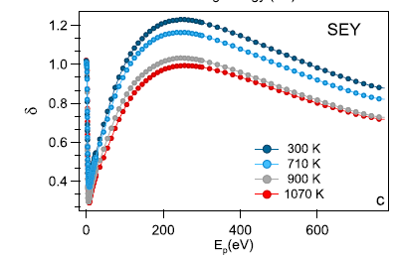
SEY variation
Modification of surface
Chemical modification
Amorphous C-coating
Thermal graphitization of thin amorphous C layers deposited by magnetron sputtering on Cu substrates
R. Larciprete et al., Appl. Surf. Sci. (2015)

Slide 18
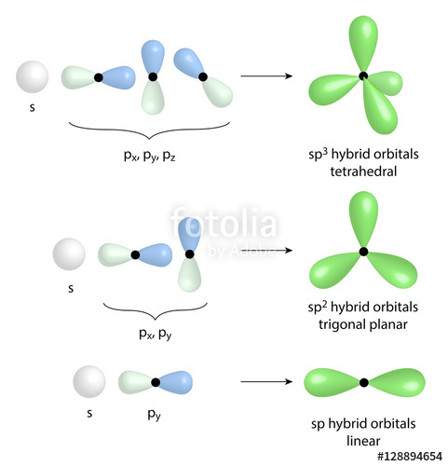
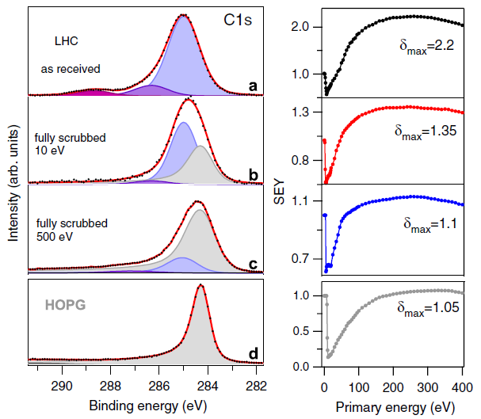
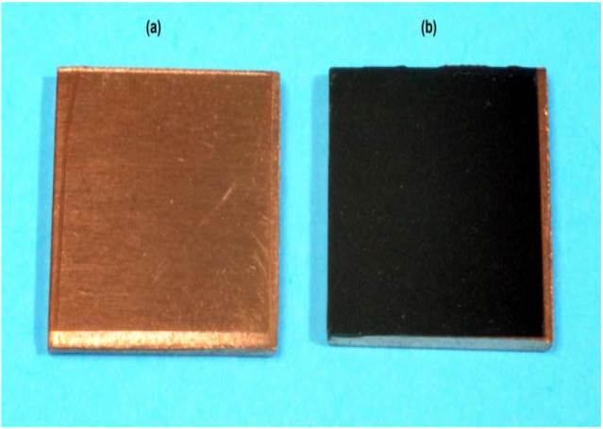
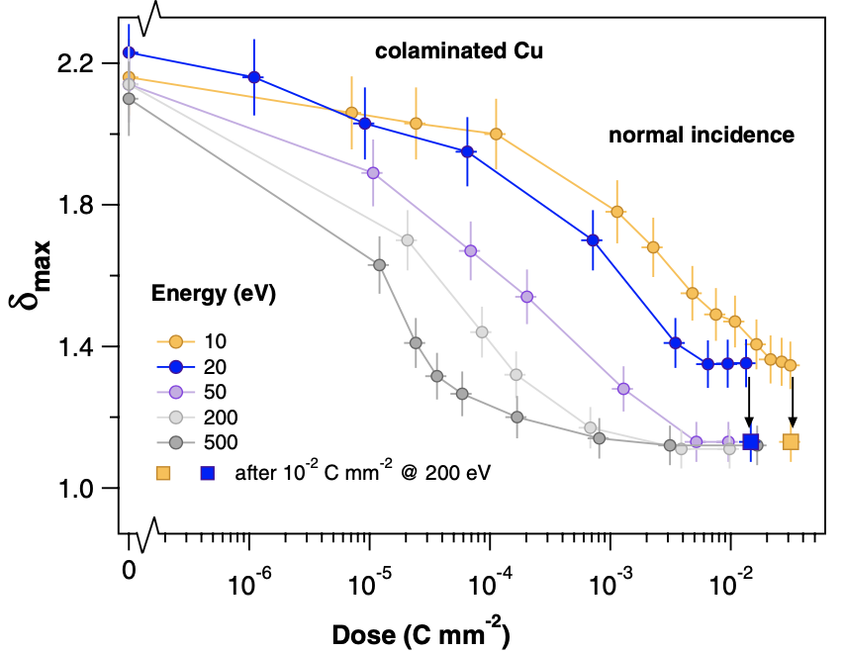
SEY Variation
Chemical variation induced by electron irradiation
Copper
sp³ → sp² carbon surface contamination conversion
e⁻
SEY depends on the surface chemical state
R. Cimino et al., Phys. Rev. Lett. (2012)

Slide 19
SEY Variation
Chemical variation induced by electron irradiation
ST. ST.
max

Slide 20
SEY Variation
Chemical variation induced by electron irradiation
ST. ST.
max

Slide 21
SEY Variation
Chemical variation induced by electron irradiation
ST. ST.

Slide 22
SEY Variation
Chemical variation induced by electron irradiation
ST. ST.
The As received St. St. shows some C in the Bulk + The typical C in sp³ form.
The Semi scrubbed St. St. shows some C in the bulk + most C already in sp² form.
After
10⁻¹ C/mm²
After
1 C/mm²
The fully scrubbed St. St. shows some C in the bulk+ most C already in sp² form. Identical to the Semi scrubbed
After Ar
Sputtering
The St. St. shows that C is in the Bulk.
HOPG Graphite reference
The HOPG Graphite shows the C in sp² form as a reference.

Slide 23
SEY Variation
Chemical variation induced by electron irradiation
St. St.
Secondary Electron emission
ST. St.
C
ST. St.
δ_{max}=1.3
δ_{max}=1.55
Three-step process:
Production of SE at a depth z
Transport of the SE toward the surface
Emission of SE across the surface barrier
SEY electrons are produced within a semi-sphere of about few nm radius
C
C
ST. St.
δ_{max}=1.14
SEY
δ_{max}=1.05

Slide 24
Secondary Electron Yield Reduction
Carbon minimum thickness
e-beam evaporation from graphite rod
XPS analysis
(Coverage Estimation)
SEY measurements
Cu KLL
Minimum thickness evaluation
M. Angelucci et. al; Phys. Rev. Research Rapid comm. 2, 032030(R) (2020)

Slide 25
Secondary Electron Yield Reduction
Carbon minimum thickness
Conversion of deposition time to Carbon Coverage (nm)
Cu KLL
M. Angelucci et. al; Phys. Rev. Research Rapid comm. 2, 032030(R) (2020)

Slide 26
Secondary Electron Yield Reduction
Carbon minimum thickness
M. Angelucci et. al; Phys. Rev. Research Rapid comm. 2, 032030(R) (2020)

Slide 27
Secondary Electron Yield Reduction
Carbon minimum thickness
Low coverage (<6nm): Strong SEY modification
M. Angelucci et. al; Phys. Rev. Research Rapid comm. 2, 032030(R) (2020)

Slide 28
Secondary Electron Yield Reduction
Carbon minimum thickness
High coverage (>6nm): Stable δ_{max} <1
M. Angelucci et. al; Phys. Rev. Research Rapid comm. 2, 032030(R) (2020)
Low variation in the low ( <50 eV) and high (>500 eV) regions

Slide 29
Secondary Electron Yield Variations
at Cryogenic Temperatures
Induced SEY variation by external contaminants
Sub-Monolayer Contaminations
High-Energy Range
Low Variations
(SEY Max from 1.4 to 1.3)
Variation Dependence on Gas contaminant
Low-Energy Range
Strong Variations
(SEY @10eV from 0.05 to 0.25)
New characteristic structures
AIP Advances 7, 115203 (2017)

Slide 30
Secondary Electron Yield Variations
at Cryogenic Temperatures
Induced SEY variation by external contaminants
Sub-Monolayer Contaminations
High-Energy Range
Low Variations
(SEY Max from 1.4 to 1.3)
Variation Dependence on Gas contaminant (?)
Low-Energy Range
Strong Variations
(SEY @10eV from 0.05 to 0.25)
New characteristic structures
AIP Advances 7, 115203 (2017)

Slide 31
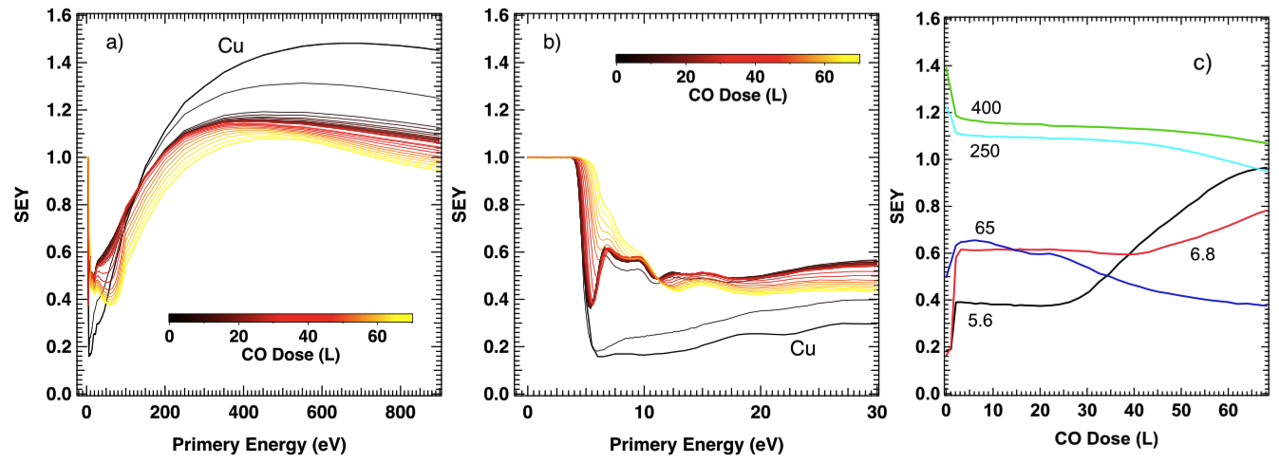
Secondary Electron Yield Variations
at Cryogenic Temperatures
Adsorption process of Carbon Monoxide on Cu sample at 10K
General behaviour
Low-Energy
Evolution
SEY @ 900 eV decreases during adsorption from 1.4 to 1.1
Formation of CO Thick Film (TF)
Characteristic peak of TF at 65 eV
Characteristic peaks at different low energies
Formation of CO Single Layer (SL)

Slide 32
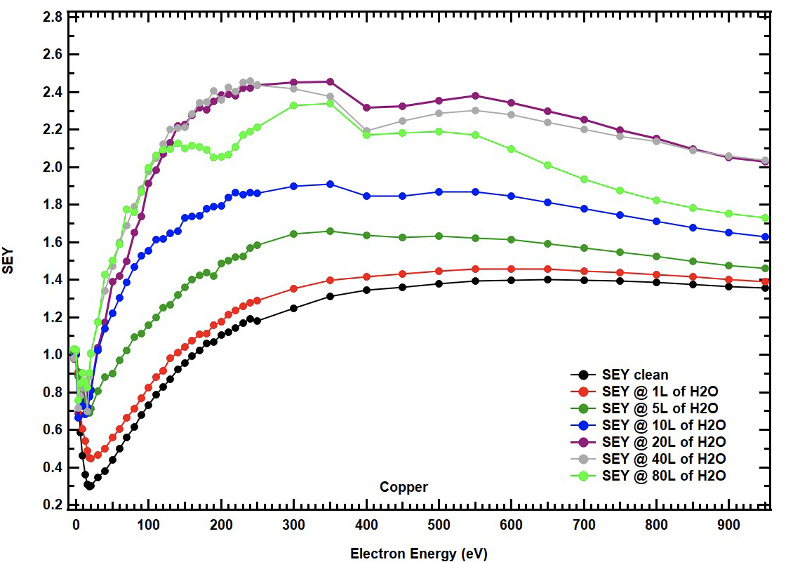
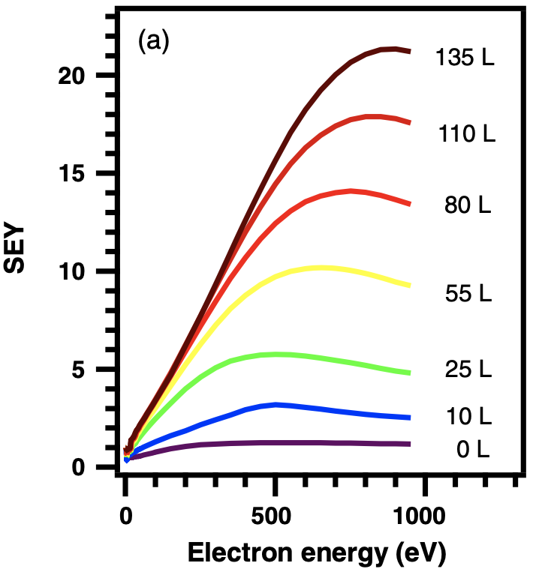
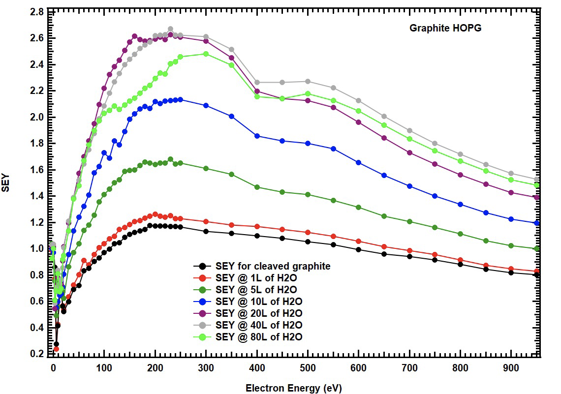
Secondary Electron Yield Variations
at Cryogenic Temperatures
Induced SEY variation by external contaminants
SEY of gas condensed on a cryogenic surface
L. Spallino et al., Phys. Rev. Accel. Beams (2020)
Ar on Cu
H₂O on Graphite HOPG
H₂O on Cu
Not published data

Slide 33
Conclusions
Each system has a different SEY depending on the chemistry and morphology
Overlayers plays a crucial role
The overlayer thickness can induce significant variation in SEY
Contaminant Layer thickness could be responsible of the different sectors behaviour in accelerators

Slide 34
Thank you for your attention

