Slide 1


Morphology effects on desorption processes at cryogenic temperatures
e-cloud’22 workshop
25th – 28th September 2022
Luisa Spallino, LNF-INFN

Slide 2
Outline
Introduction
Morphology effects on thermal desorption
Morphology effects on electron stimulated desorption: a case of study
Summary and open issues

Slide 3
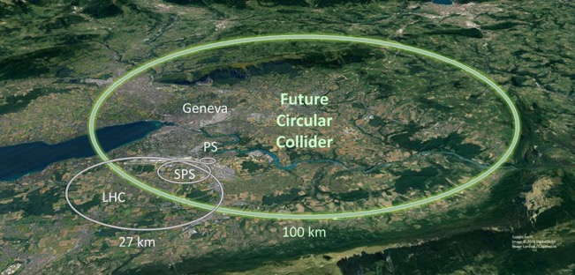


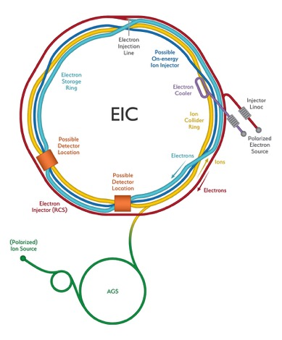
Introduction
Conditions inside accelerators (HL-LHC,FCC, EIC)
Advanced technological solutions to match e-cloud, impedance, ...etc
requirements must be compliant with the required cryogenic vacuum
Extremely Low Pressure (<10⁻¹¹ mbar) inside beam-pipe
Extremely Low Temperature (40 K /60 K for FCC-hh beam screen)

Slide 4
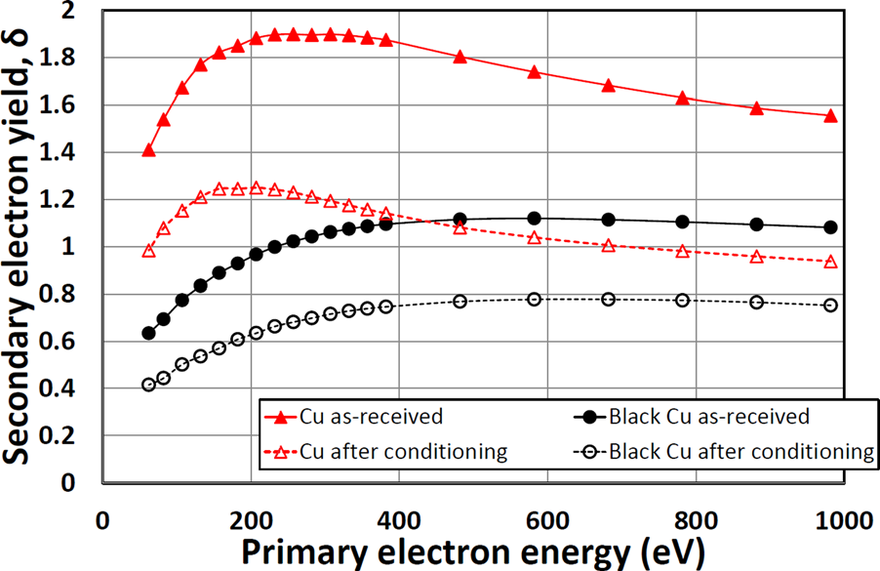
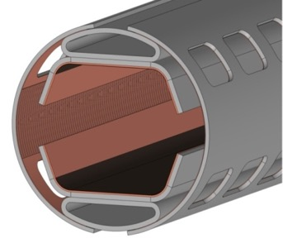
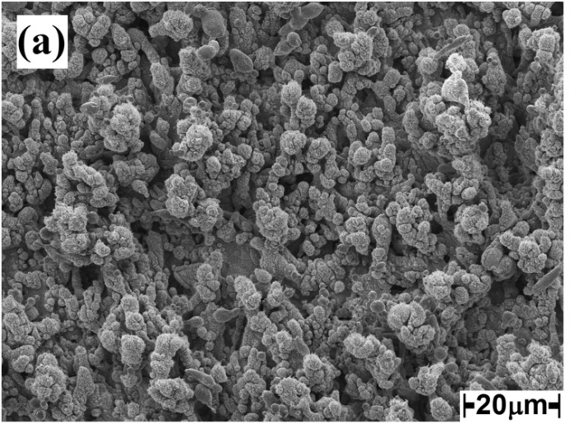
Introduction
Engineering the surface morphology
to reduce SEY
(Laser Ablation Surface Engineering -LASE)
FCC-hh BS
R. Valizadeh et al. , Appl. Surf. Sci. (2017)
Low SEY is a
morphological effect
LASE-Cu to mitigate e-cloud effects
LASE-Cu

Slide 5
Introduction
At cryogenic temperature, not only intrinsic properties of surface but also the effects of:
Temperature transients
Photons, Electrons and Ions-surface interaction
Gas Desorption → Pressure transients

Slide 6
Introduction
At cryogenic temperature, not only intrinsic properties of surface but also the effects of:
Temperature transients
Photons, Electrons and Ions-surface interaction
Gas Desorption → Pressure transients
Independently on the substrate treatment, vacuum stability has to be granted!

Slide 7
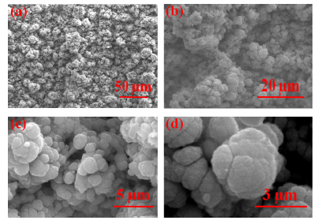
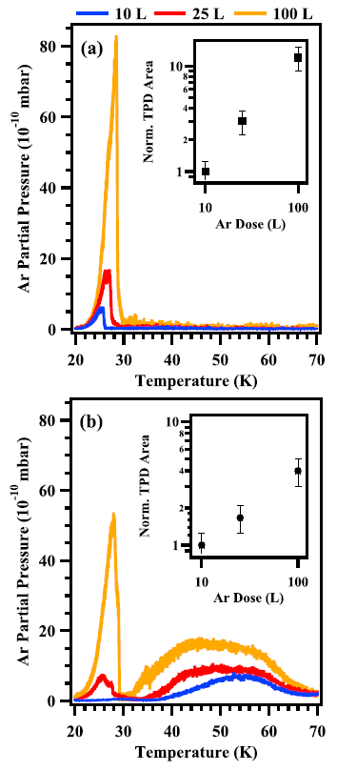
Morphology effects on thermal desorption
LASE-Cu
TPD from Cu and LASE-Cu for temperature induced vacuum transient study: Ar
Single TPD peak at ~30 K corresponding to the desorption of a condensed thick Ar layer
Desorption temperature determined by the weak Ar-Ar van der Waals interaction energies
TPD peak at ~30 K corresponding to the desorption of a condensed thick Ar layer together with a broad TPD profiles, whose peak temperatures and widths depend on the Ar dose
L. Spallino et al. Appl. Phys. Lett. (2019)

Slide 8
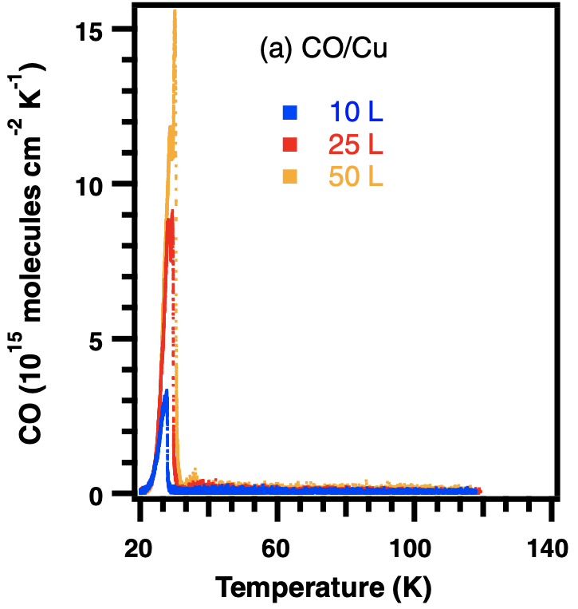
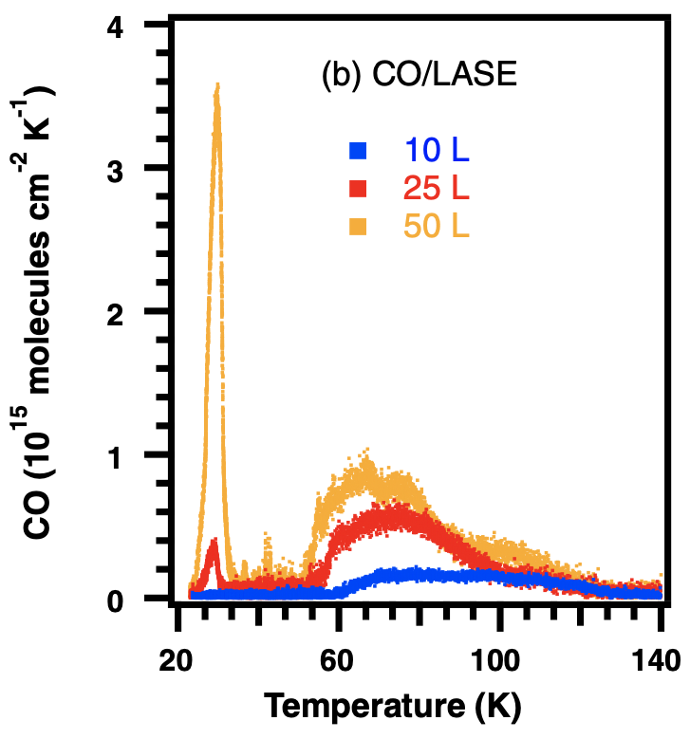
Morphology effects on thermal desorption
LASE-Cu
TPD from Cu and LASE-Cu for temperature induced vacuum transient study: CH₄
TPD characteristics of LASE-Cu independent from gas species and determined by sponge-like structural features
TPD from Cu and LASE-Cu for temperature induced vacuum transient study: CO
L. Spallino, J. Vac. Sci. Technol. B (2020); L. Spallino et al., Phys. Rev. Accel. Beams (2020)

Slide 9
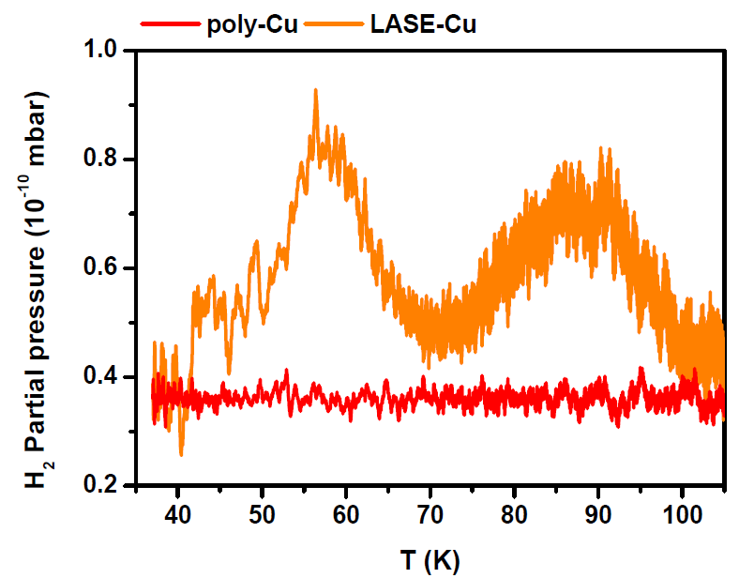
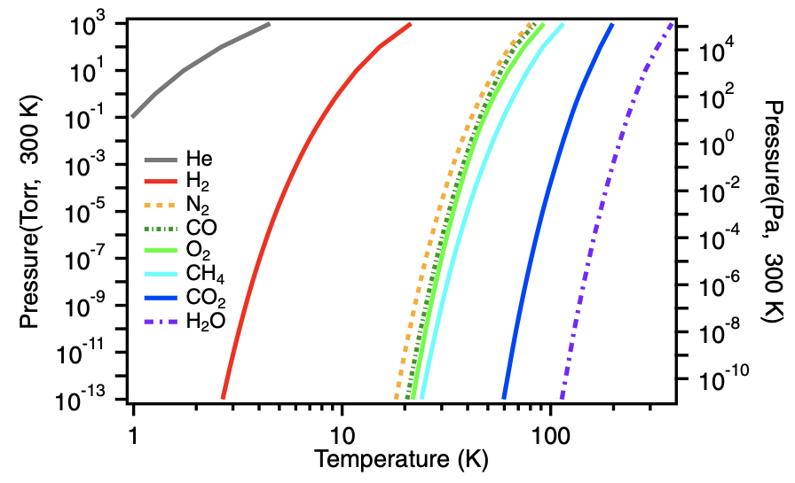
Morphology effects on thermal desorption
LASE-Cu
TPD of 100 L H₂ dosed on poly-Cu and LASE-Cu samples held at T~15-18 K
No TPD signal should be observed by considering the H₂ vapor suture pressure curve!!!
L. Spallino et al., Phys. Rev. Accel. Beams (2020)
The wide distribution of high energy adsorption sites within the inner pore is responsible for the H₂ TPD signal from LASE-Cu sample
Conceptually identical to Ar, CH₄ and CO results

Slide 10
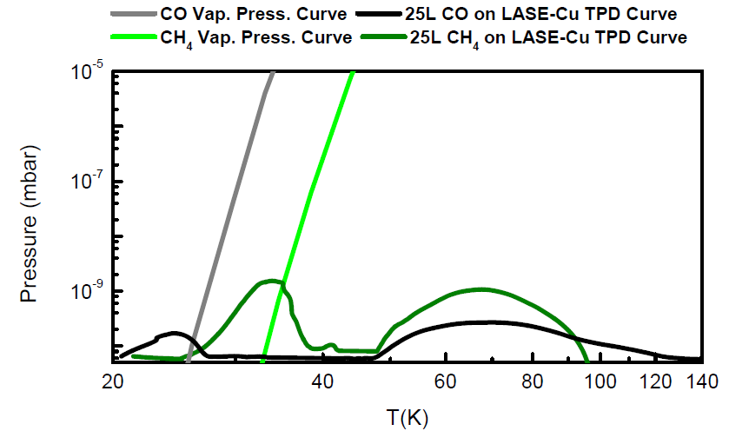
Morphology effects on thermal desorption
LASE-Cu
TPD from LASE-Cu for temperature induced vacuum transient study
Impact on the working conditions
Working temperature range foreseen for FCC-hh
~500 h beam lifetime
L. Spallino et al. Appl. Phys. Lett. (2019); L. Spallino, J. Vac. Sci. Technol. B (2020); L. Spallino et al., Phys. Rev. Accel. Beams (2020)

Slide 11

Morphology effects on thermal desorption
LASE-Cu
TPD from LASE-Cu for temperature induced vacuum transient study
Impact on the working conditions
Working temperature range foreseen for FCC-hh
~500 h beam lifetime
L. Spallino et al. Appl. Phys. Lett. (2019); L. Spallino, J. Vac. Sci. Technol. B (2020); L. Spallino et al., Phys. Rev. Accel. Beams (2020)
Further studies on dynamic vacuum behaviour at cryogenic temperature are necessary to completely validate/optimize LASE-Cu

Slide 12
Does the morphology affect electron desorption?
Electron Stimulated Desorption (ESD)
e
proton bunches
p
e
e
Beam ionizes residual gas
Electrons (also coming from e-cloud) impact the beampipe

Slide 13
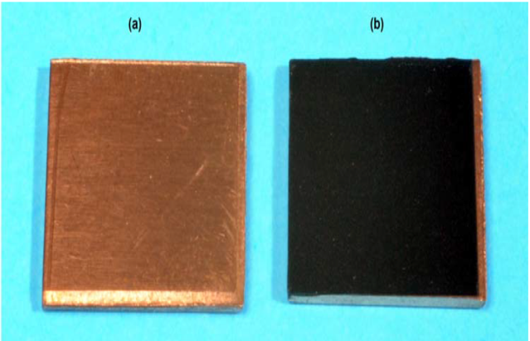
Morphology effects on electron stimulated desorption: a case of study
Comparative study of ESD at 500 eV from different Ar doses delivered on flat poly-Cu and LASE-Cu samples
poly-Cu
LASE-Cu

Slide 14
Experimental set-up at LNF-INFN
Ultra high vacuum systems
Secondary Electron Yield (SEY) measurements
Equipment : Electron gun, Faraday cup
preparation
chamber
main chamber
fast-entry lock
X-Ray Photoelectric Spectroscopy (XPS) Equipment : Omicron EAC125 electron analyzer, Mg Kα source (hν = 1253.6 eV)
LNF-cryogenic manipulator
Sample at 15-300 K
Temperature Programmed Desorption (TPD) and Residual Gas Analysis (RGA) measurements
Equipment : QMS (Hiden HAL 101 Pic)

Slide 15

Electron stimulated desorption yield (η)
$$η= \frac{n_{M}}{n_{e}}$$
Number of desorbed species
Number of incident electrons
The direct determination of η is a non-trivial task, requiring
high sensitivity RGA measurements
complex calibration procedures
e
LASE-Cu sample

Slide 16
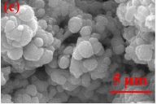
Morphology effects on Ar adsorption
Porous morphological effects
Electrons, both primary and secondary, are “trapped” by the LASE-Cu highly porous structure

Slide 17
Morphology effects on Ar adsorption
Porous morphological effects
Sub-micrometric structural features
LASE-Cu sample
SEY contribution of Ar layer adsorbed on the top-most surface
Electrons, both primary and secondary, are “trapped” by the LASE-Cu highly porous structure
High specific surface accessible to Ar atoms, also inside pores

Slide 18
Morphology effects on ESD
M. Angelucci, Il Nuovo Cimento 45 C, 198 (2022)
On increasing
Ar dose
4 L
8 L
40 L
η from Cu is always higher than η from LASE-Cu
The higher the Ar coverage, the higher is η

Slide 19
Morphology effects on ESD
Morphological effects of surfaces
LASE-Cu have much greater physical area than that of untreated surfaces where to host gas
One should expect that porous surface adsorbs (desorbs) more than flat substrates
ESD is a surface process mainly governed by the transport of secondary electrons
R. Dupuy et al. , J. Appl. Phys. (2020)
Electrons, both primary and secondary, are “trapped” by the highly porous structure thus leading to a very low LASE-Cu SEY
The lower the SEY, the lower ESD

Slide 20
A. N. Hannah et al. , Vacuum (2021)
From LASE-Cu the desorption is less efficient, but does it last longer?
The difference in η decreases on increasing the electron dose (scrubbing)
Useful information for vacuum analysis during operation

Slide 21
Summary and open issues
Porous materials show high pumping capacity
Electron Desorption Yield of porous materials is lower than the one observed from the same dose of gas condensed on the flat counterpart
The Electron Desorption Yield depends on SEY
All these aspects are advantageous for the use of such materials in future accelerators beam screens
Temperature Programmed Desorption shows different desorption temperature range
Further studies are mandatory testing gas species usually composing residual vacuum in accelerators

Slide 22
Thank you for your attention!

