Slide 1
Electron Cloud Simulation for the EIC
Xiaofeng Gu, Silvia Verdu Andres
Sep. 26-28, 2021

Slide 2
Outline:
EIC introduction
E-cloud Buildup and Simulation Setup
Simulations for EIC

Slide 3
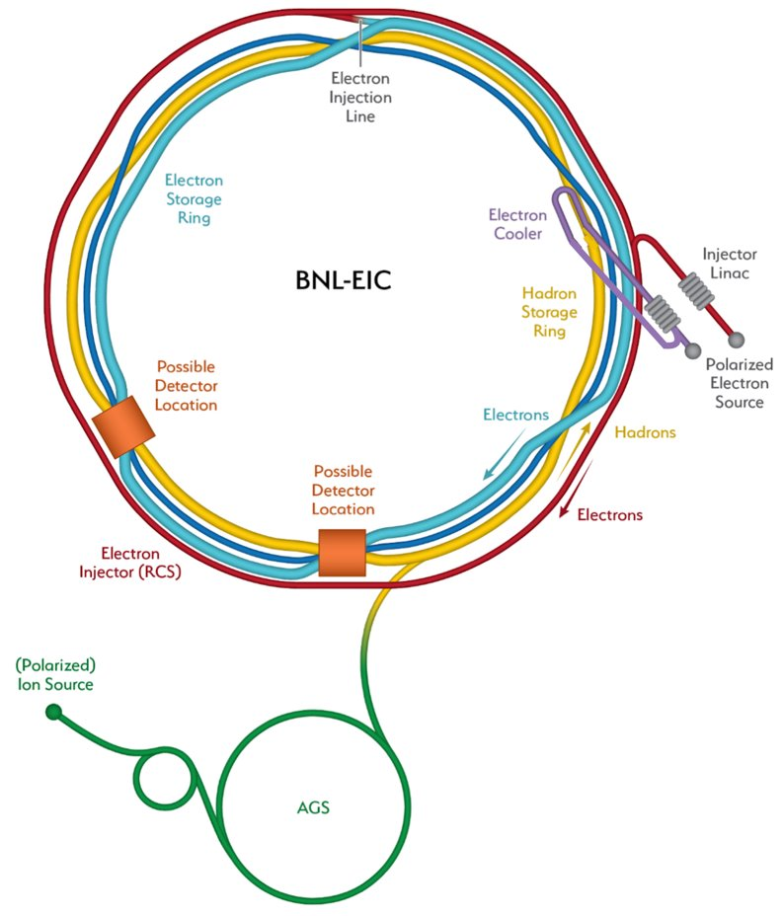
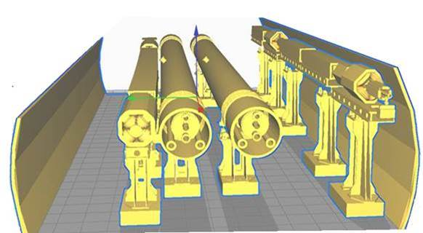
1) EIC Introduction
Five accelerators:​
Electron Storage Ring (ESR)​
Hadron Storage Ring (HSR)​
Rapid Cycling Synchrotron (RCS)​
​
RCS Injection Linac​
Energy Recovery Linac (ERL)
eSR
RHIC
RCS
HSR

Slide 4
1) Motivation and Solutions
Motivation:
Suppress the e-cloud induced instability in the EIC hadron ring:
Completely suppress the e-cloud buildup, therefore the instability from the e-cloud.
EIC arc cryostat heat load requirement:
The total EIC beam pipe heat load should be less than 0.5 W/m in the cryostat.
For a good copper surface, we expect 0.37W/m from wall resistance, then 0.13W/m for e-cloud.
Solutions:
Arc Section: Amorphous C (a-C) is chosen as a baseline for the arc beam pipe coating with SEY < 1.02 (with beam conditioning).
Warm (drift) Section: NEG coating, currently installed in straight warm sections with SEY < 1.25.
Simulation Code: PyEcloud
Thanks Giovanni Iadarola for his valuable support!
Thanks to the LHC recent a-C coating progresses.
Electron cloud Simulation

Slide 5
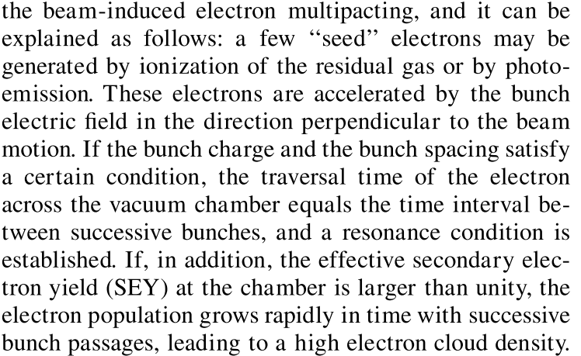
2) Ecloud Buildup: Beam-Induced Electron Multipathing
Roberto. Cimino, et al, Phys. Rev. Lett. 93, 014801
Why 290 bunches fill pattern has a higher heat load than the 1160 bunches fill pattern?
Why the sextupole has a higher heat load, compared with Quadrupole, Dipole, and Warm section? (18 mm offset)
Why sometimes a larger vacuum pipe radius has a higher heat load?
Condition1: Traversal Time (transverse) ~ Time Interval (longitudinal)
Radius (beam pipe), Magnets (type and strength), Energy, Intensity ~ Bunch Space
Condition2: SEY>1
O
A
B

Slide 6
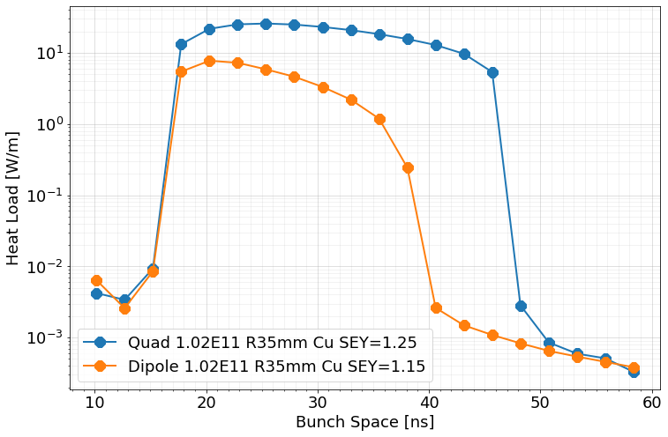
2) Ecloud Buildup: Bunch Space [Heat Load]
1160 bunches
290 bunches
Condition1: Traversal Time ~ Time Interval
Radius, Magnets, Energy, Intensity ~ Bunch Space
Longer bunch space could have a higher heat.
(40ps ~ 10ps, or 290 bunches ~ 1160 bunches, same e-bunch intensity)

Slide 7
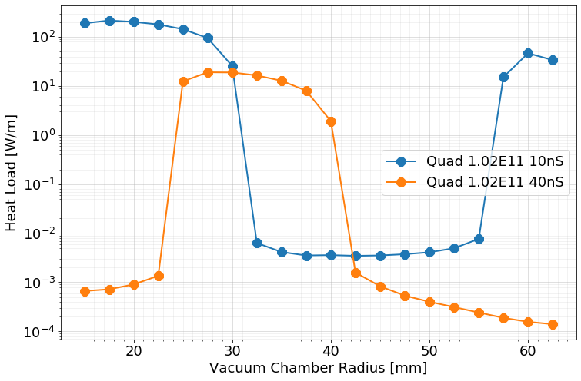
2) Ecloud Buildup: Beam Pipe Radius [Heat Load]
Condition1: Traversal Time ~ Time Interval
Radius, Magnets, Energy, Intensity ~ Bunch Space
Larger radius also could have a higher heat load.

Slide 8
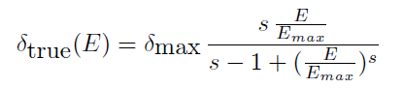
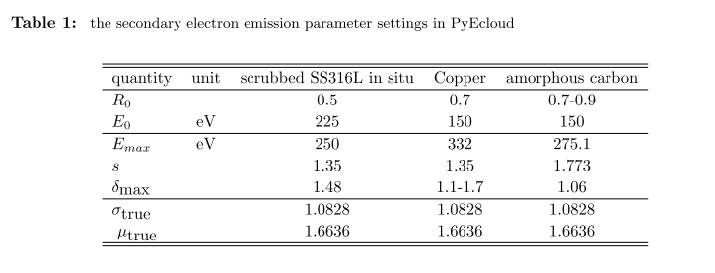
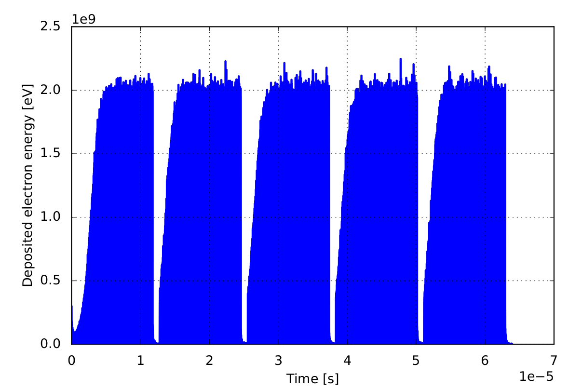
2) Simulation Setup: SEY Model [1] and PyEcloud [2]
1. SEY Model
2. PyEcloud Simulation parameters setups:
5Turns (long enough to buildup)
Time step Dt: 10 ps
Initial e-intensity:1E8
Pressure: 1 nTorr
$$\frac{dn_{true}}{dE}=\frac{1}{Eσ_{true}\sqrt{2π}}e^{−\frac{{\left(ln\left(E\right)−μ_{true}\right)}^{2}}{2{σ_{true}}^{2}}}$$

Slide 9
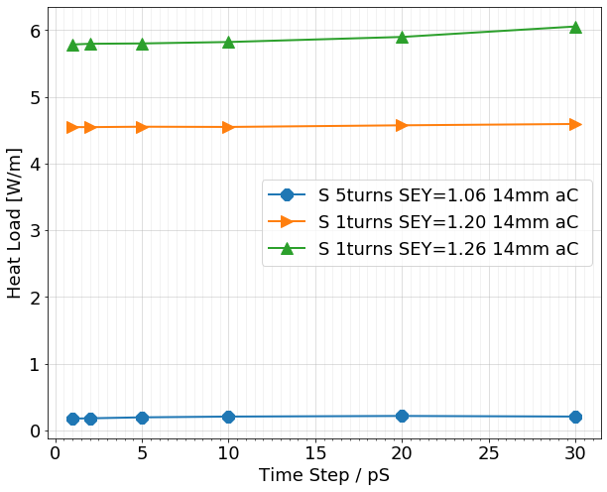
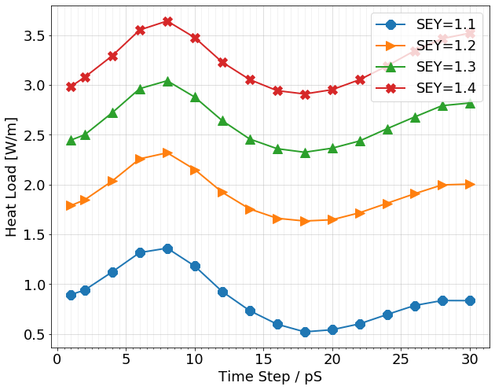
2) Simulation Setup: PyEcloud [2] - dt
Sextupole, aC
Quad, Cu, dt = 10 ps for nominal simulation

Slide 10
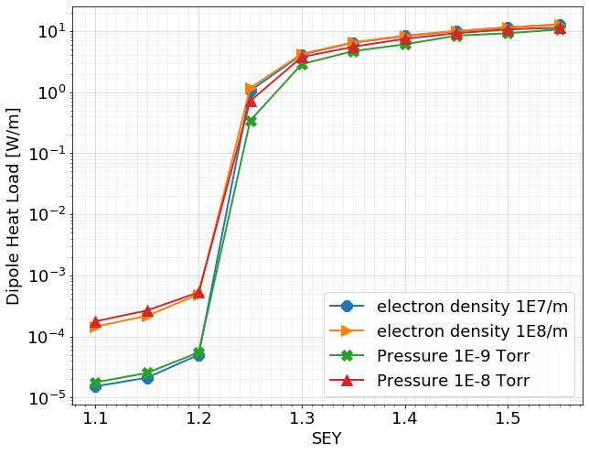
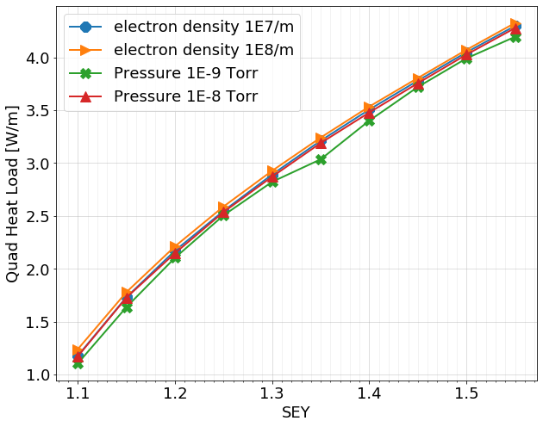
2) Simulation Setup: PyEcloud [2] – pressure and intensity
Dipole
Quadrupole
No significant difference for:
Pressure: 1 nTorr vs 10 nTorr
e-Intensity: 1E7 vs 1E8

Slide 11
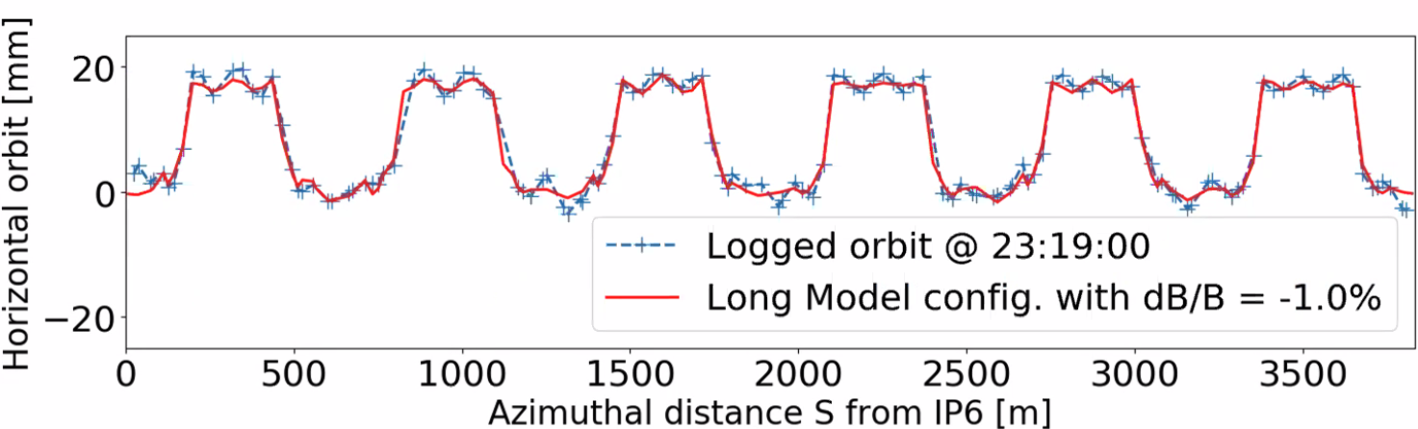
2) Simulation Setup: Beam [3] Radial Shift
To adjust the hadron path length to synchronize collisions over a broad range of hadron energies, a large radial shift (+-18 mm) the HSR Arc is required
Courtesy of Guillaume ​

Slide 12
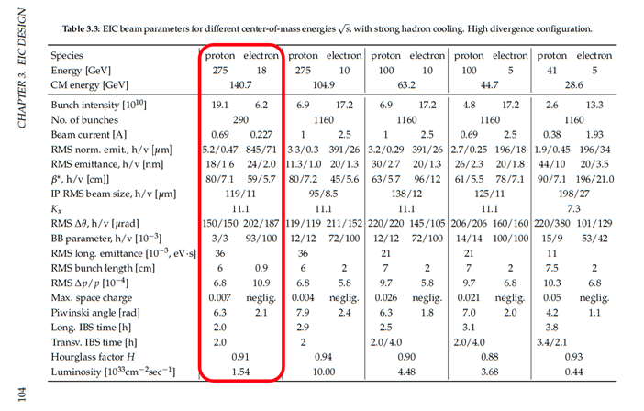
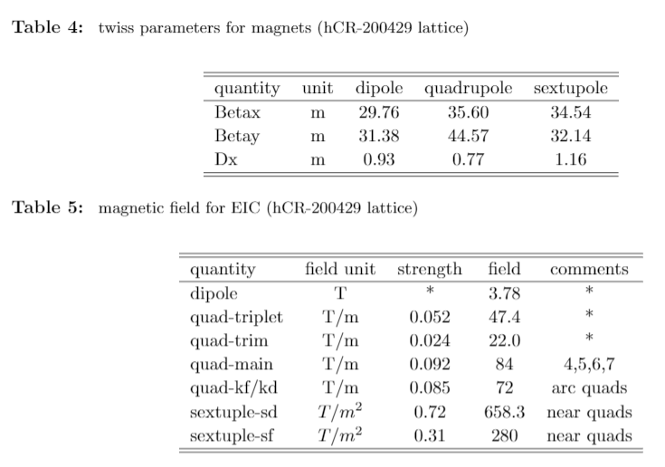
2) Simulation Setup: Beam [3] and Machine Setup [4]
3. Beam Parameters Setup: 290 and 1160
4. Machine Setup

Slide 13
3) Simulations for EIC: Stainless Steel [0 mm offset]
To evaluate whether the existing RHIC stainless steel can be used for EIC without any coating​.
Bunches | Dipole[W/m] | Quadrupole [W/m]
290* | 0.78 | 3.94
1160* | 9.92 | 27.26
The total EIC beam pipe heat load should be less than 0.5 W/m in the cryostat.
SS316L is not suitable for EIC vacuum pipe.

Slide 14
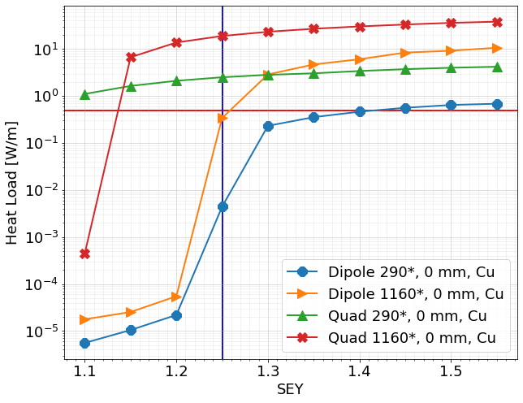
3) Simulations for EIC: Copper Coating[0 mm offset]
To evaluate whether the copper vacuum chamber can be used for EIC without any coating​.
The vertical blue line: SEY = 1.25, the horizontal line: heat load = 0.5 W/m.
According to the LHC (copper) head load simulation, the SEY of about half cells is higher than 1.25.
Copper Coating (SEY>1.25 even after LHC Run1 and Run2) is not suitable for the EIC vacuum pipe.
Amorphous carbon coating is adopted as the baseline among several choices (next several slides).
290 bunches fill pattern or the longer bunch space (40 ps > 10 ps) has a higher heat load for quadrupole magnet with SEY = 1.1.

Slide 15
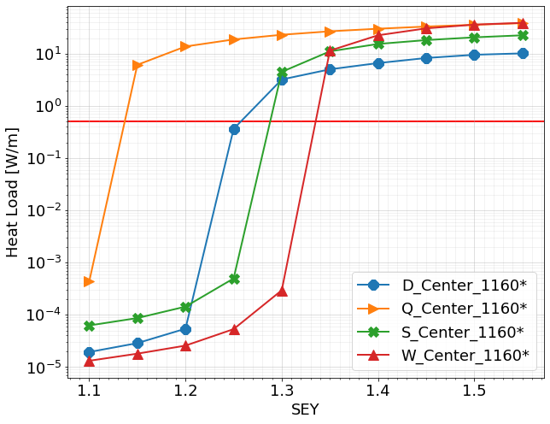
3) Simulations for EIC: a-C Coating [0 mm offset]
The horizontal line: heat load = 0.5 W/m.
Quadrupole has e-cloud buildup at SEY = 1.15.
SEY < 1.1 should be fine without beam offset

Slide 16
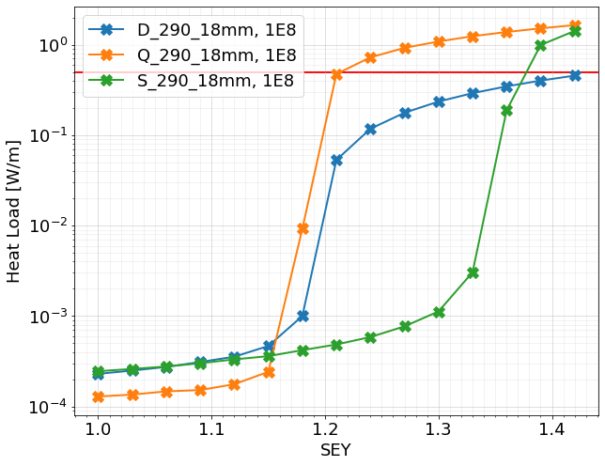
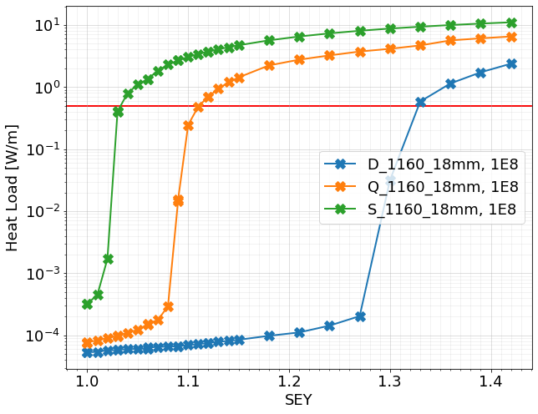
3) Simulations for EIC: a-C [18 mm offset]
290 bunches: SEY<1.15
1160 bunches: SEY < 1.02
Max. SEY <1.15 by quad for 275 GeV p with 290 bunches, 19.1e10 ppb, 18 mm offset.
Max. SEY <1.02 by sext for 275 GeV p with 1160 bunches, 6.9e10 ppb, 18 mm offset.
Why sextupole?

Slide 17
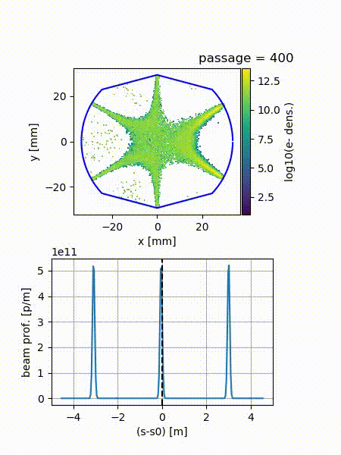
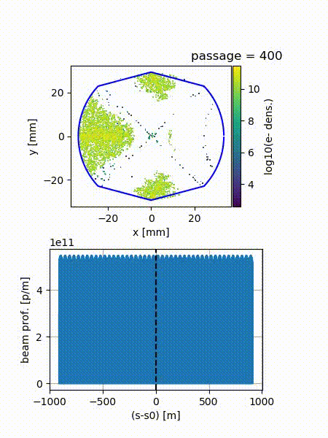
3) Simulations for EIC: Quadrupole and Sextupole
S, SEY=1.06, Offset = +18mm, 1160
Q, SEY=1.06, Offset = +18mm, 1160

Slide 18
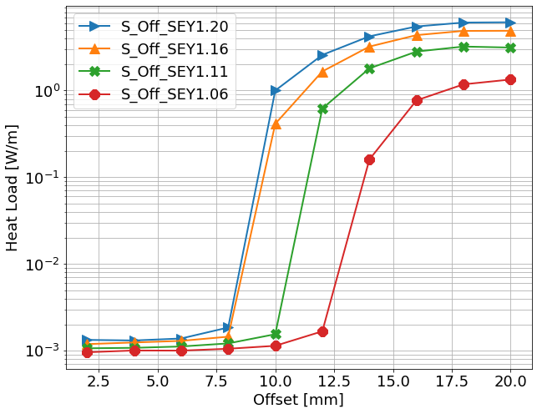
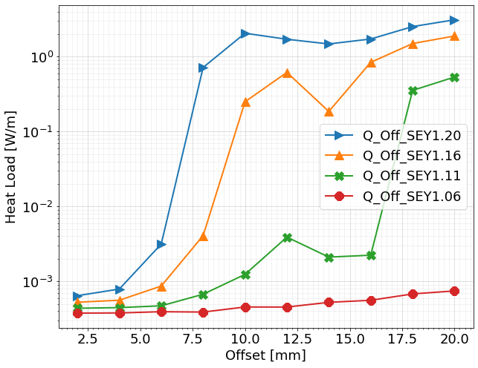
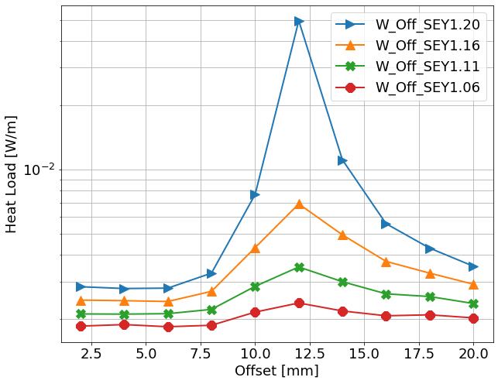
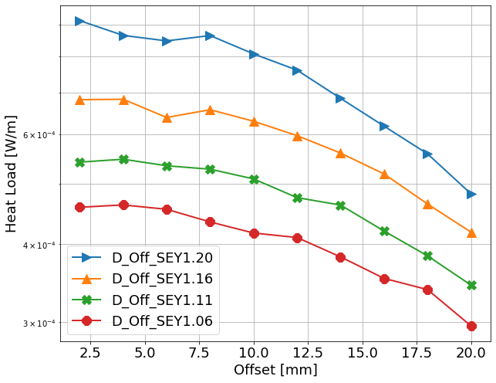
3) Simulations for EIC: Offset Scan [a-C, SEY]
sextupole
Quadrupole
Warm/drift
Dipole
Transverse offset affects the sextupole and quadrupole more than drift/warm/straight and dipole.

Slide 19
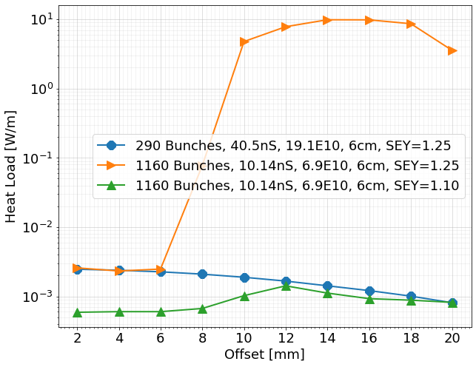
3) Simulations for EIC: Warm section with NEG coating
What is the offset limit with copper coating in the straight warm section/drift space?
Heat load scan with different beam.
SEY < 1.25 should be fine if there is a 6 mm offset in the warm section/drift space.
NEG coating, currently is installed in straight warm sections, shows SEY < 1.25 when baked > 2h above 160$°$C (Silvia).

Slide 20
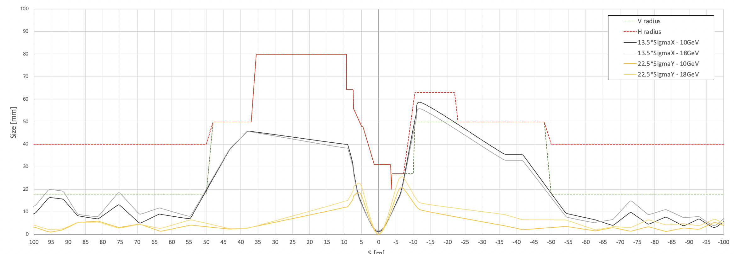
3) Simulations for EIC: : Interaction Region (IR)
Courtesy of Alexei Blednykh ​

Slide 21
3) Simulations for EIC: : Interaction Region (IR)
 | Length[m] | IR1[cm] | Pole tip field R1[T] | Dipole Field[T] | Gradient[T/m]
B0pF | 1.2 | 17 |  | -1.3
B0ApF | 0.6 | 4.3 |  | 3.3
Q1ApF | 1.46 | 5.6 | 4.07 | 0 | -77.903
Q1BpF | 1.61 | 7.8 | 5.16 | 0 | -63.028
Q2pF | 3.6 | 11.3 | 5.36 | 0 | 39.736
B1pF | 3 | 13.5 |  | 3.4
B1ApF | 1.5 | 16.8 |  | 2.7
 | Length[m] | IR1[cm] | IR2[cm] | Pole tip field R1[T] | Pole tip field R2[T] | Gradient[T/m]
Q1ApR | 1.8 | 2.0 | 2.56 | 1.56 | 2. | 78
Q1BpR | 1.4 | 2.8 | 2.8 | 2.184 | 2.184 | 78
Q2pR | 4.5 | 5.4 | 5.4 | 1.84 | 1.84 | 34

Slide 22
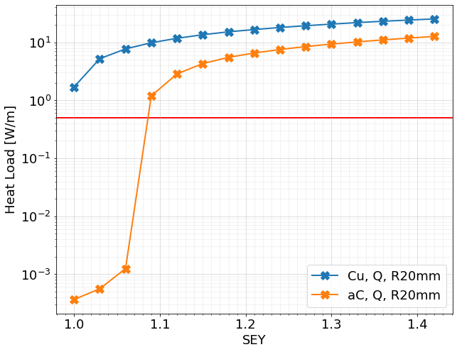
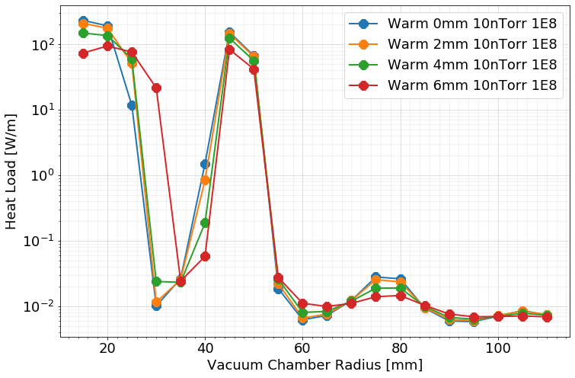
Q1ApR: 0mm offset, 20 mm radius
3) Simulations for EIC: : a-C and Copper [IR]
Radius scan with SEY=1.25 copper, warm section.
a-C coating is still needed for the IR region.

Slide 23
Summary
Summary:
PyECloud was used for EIC e-cloud evaluation.
Amorphous carbon coating is chosen for the EIC beam pipe coating in the arc. And SEY < 1.02 is required for the sexupole region.
NEG coating with SEY < 1.25 is required for the warm/straight section. NEG coating is already installed in the straight sections, it only needs to be activated.
Identified some possible high heat load magnets in the IR region, a-C is still needed for the IR region.
More information or simulation, please check Silvia’s presentation.

Slide 24
Acknowledgements
We would like to thank Mike Blaskiewicz, Steve Peggs, Guillaume Robert-Demolaize, Alexei Blednykh for their help.
We would like to thank Giovanni Iadarola with his help about the PyEcloud code.
Thanks to the Ecloud22 committee for their invitation and help.

Slide 25
References:
Most SEY model and PyEcloud material are from:
1. Secondary Emission Models in e-cloud buildup simulations: from the lab to the code
L. Bitsikokos, G. Iadarola, L. Sabato (CERN BE - ABP Group), P. Dijkstal
2. Electron cloud challenges for future circular colliders
E. Belli, L. Mether, P. Dijkstal, G. Iadarola, G. Rumolo
3. Electron cloud studies for CERN particle acclerators and simulation code development
Doctoral Thesis by: Giovanni Iadarola
4. Beam-induced heat loads on the LHC arc beam screens with diﬀerent beam and machine conﬁgurations: experiments and comparison against simulations
G. Iadarola, G. Skripka, M. Albert, et al.
5. R. Cimino, et al ,Phys. Rev. Lett. 93, 014801
https://agenda.infn.it/event/13351/timetable/#all.detailed
3-7 June 2018, Italy, La Biodola Bay, Isola d'Elba
Thank the above authors!

