Slide 1
Electron cloud incoherent effects
Konstantinos Paraschou, Giovanni Iadarola
Accelerator and Beam Physics group, CERN
Acknowledgements: G. Arduini, H. Bartosik, R. De Maria, S. Fartoukh, L. Giacomel, S. Kostoglou, L. Mether, E. Métral, Y. Papaphilippou, G. Rumolo, L. Sabato, M. Schwinzerl, G. Skripka, F. Van der Veken
ECLOUD’22 Workshop
Italy, La Biodola Bay, Isola d’Elba
26 September 2022

Slide 2
Outline
Introduction
Observations in LHC during Run 2
Progress in simulations
Description of e-cloud interaction
Simulation results

Slide 3
Outline
Introduction
Observations in LHC during Run 2
Progress in simulations
Description of e-cloud interaction
Simulation results

Slide 4
Buildup example
E-cloud buildup is a multi-bunch effect.
Incoherent e-cloud effect concerns the motion of single beam particles as they encounter these electrons.
Single particles stay inside the same bunch

Slide 5
Pinch
Motion of electrons is very complex
Complex electron densities → complex induced forces.
Betatron oscillations: up-down, left-right
Synchrotron oscillations: back-forth in “time”
Non-linear forces + betatron/synchrotron oscillations can lead to oscillation amplitude increase → losses + emittance growth.

Slide 6
Outline
Introduction
Observations in LHC during Run 2
Progress in simulations
Description of e-cloud interaction
Simulation results

Slide 7
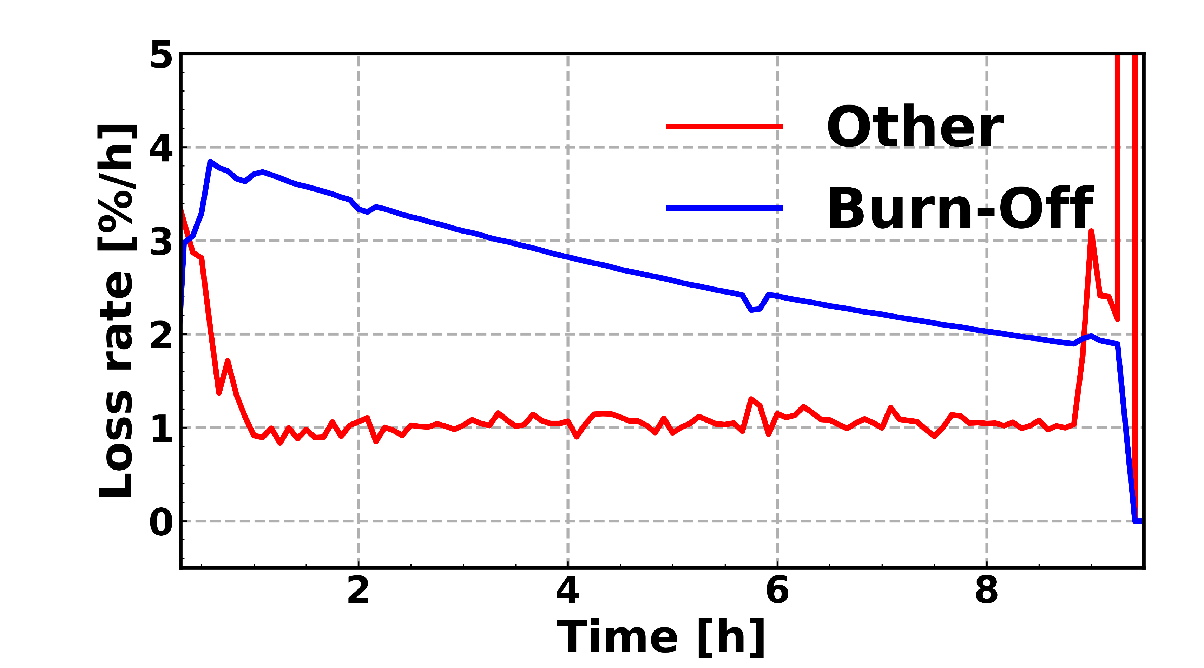
Motivation
Losses come from:
Luminosity burn-off that decreases gradually.
Continuous rate of additional losses.

Slide 8
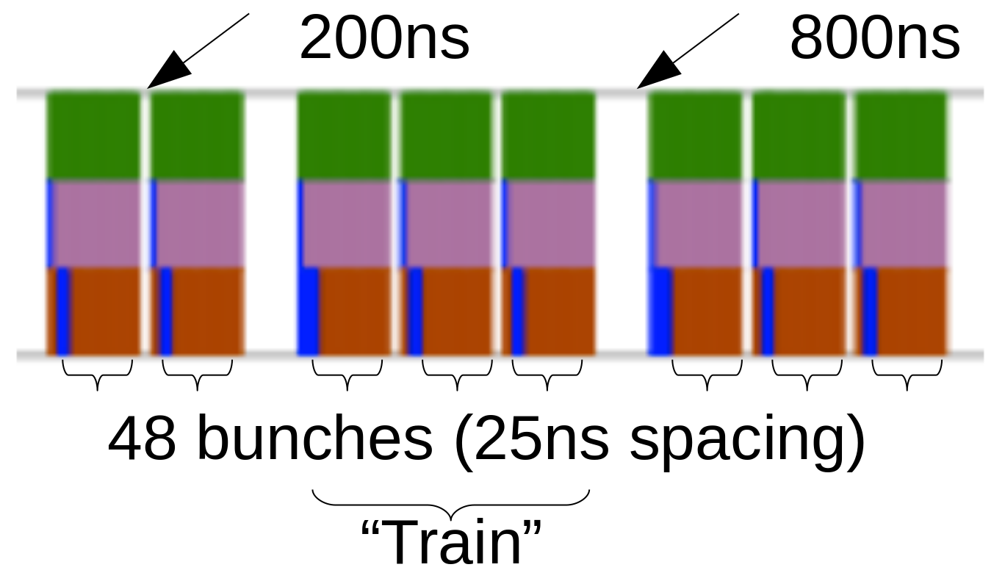
Filling scheme
Standard 2018 Physics filling scheme (2556 bunches) [lpc.web.cern.ch]
Magnification:
Beam is composed of repeating patterns (trains):
2x48 bunches,
3x48 bunches.

Slide 9
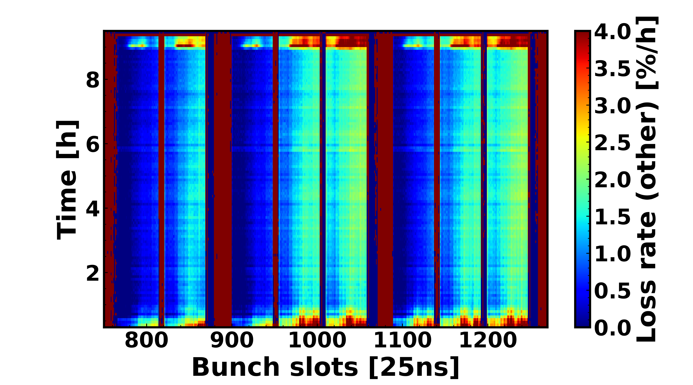
All bunch-by-bunch losses
Global picture: Fairly constant loss rate (Corrected for burn-off).
Grows from head to tail of each train

Slide 10
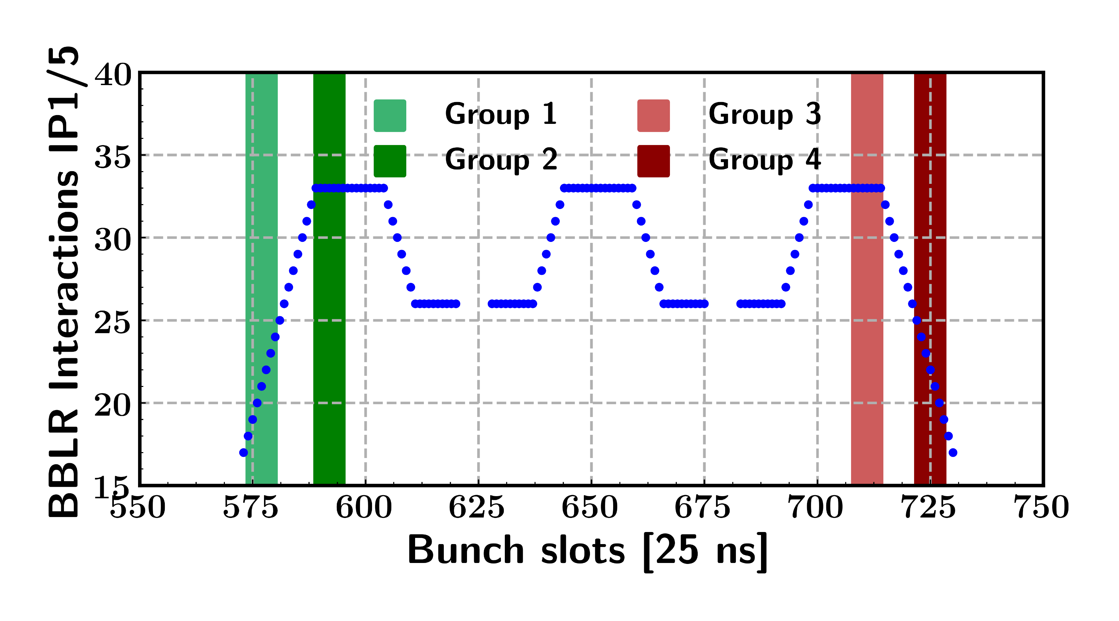
Number of BBLR interactions
Number of Beam-Beam Long-Range interactions changes for each bunch in the filling scheme.
Group 1: Few BBLR, reduced e-cloud effects
Group 2: Max BBLR, reduced e-cloud effects
Group 3: Max BBLR, stronger e-cloud effects
Group 4: Few BBLR, stronger e-cloud effects

Slide 11
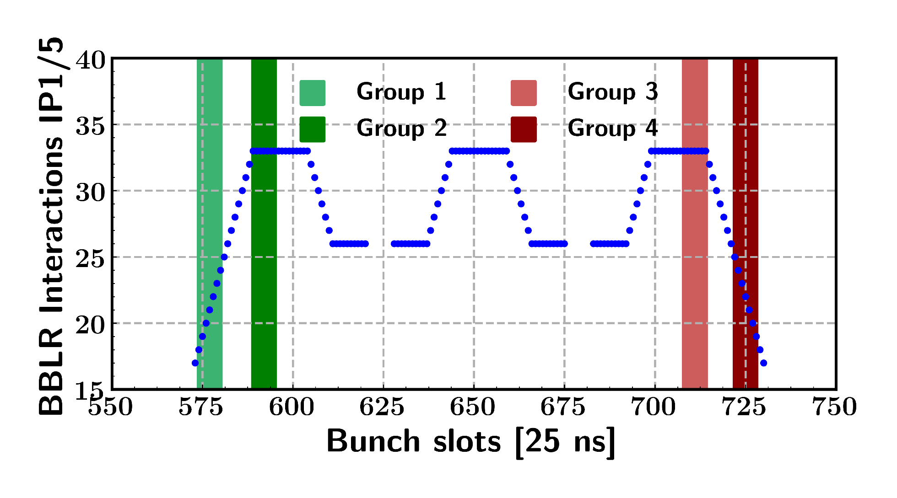
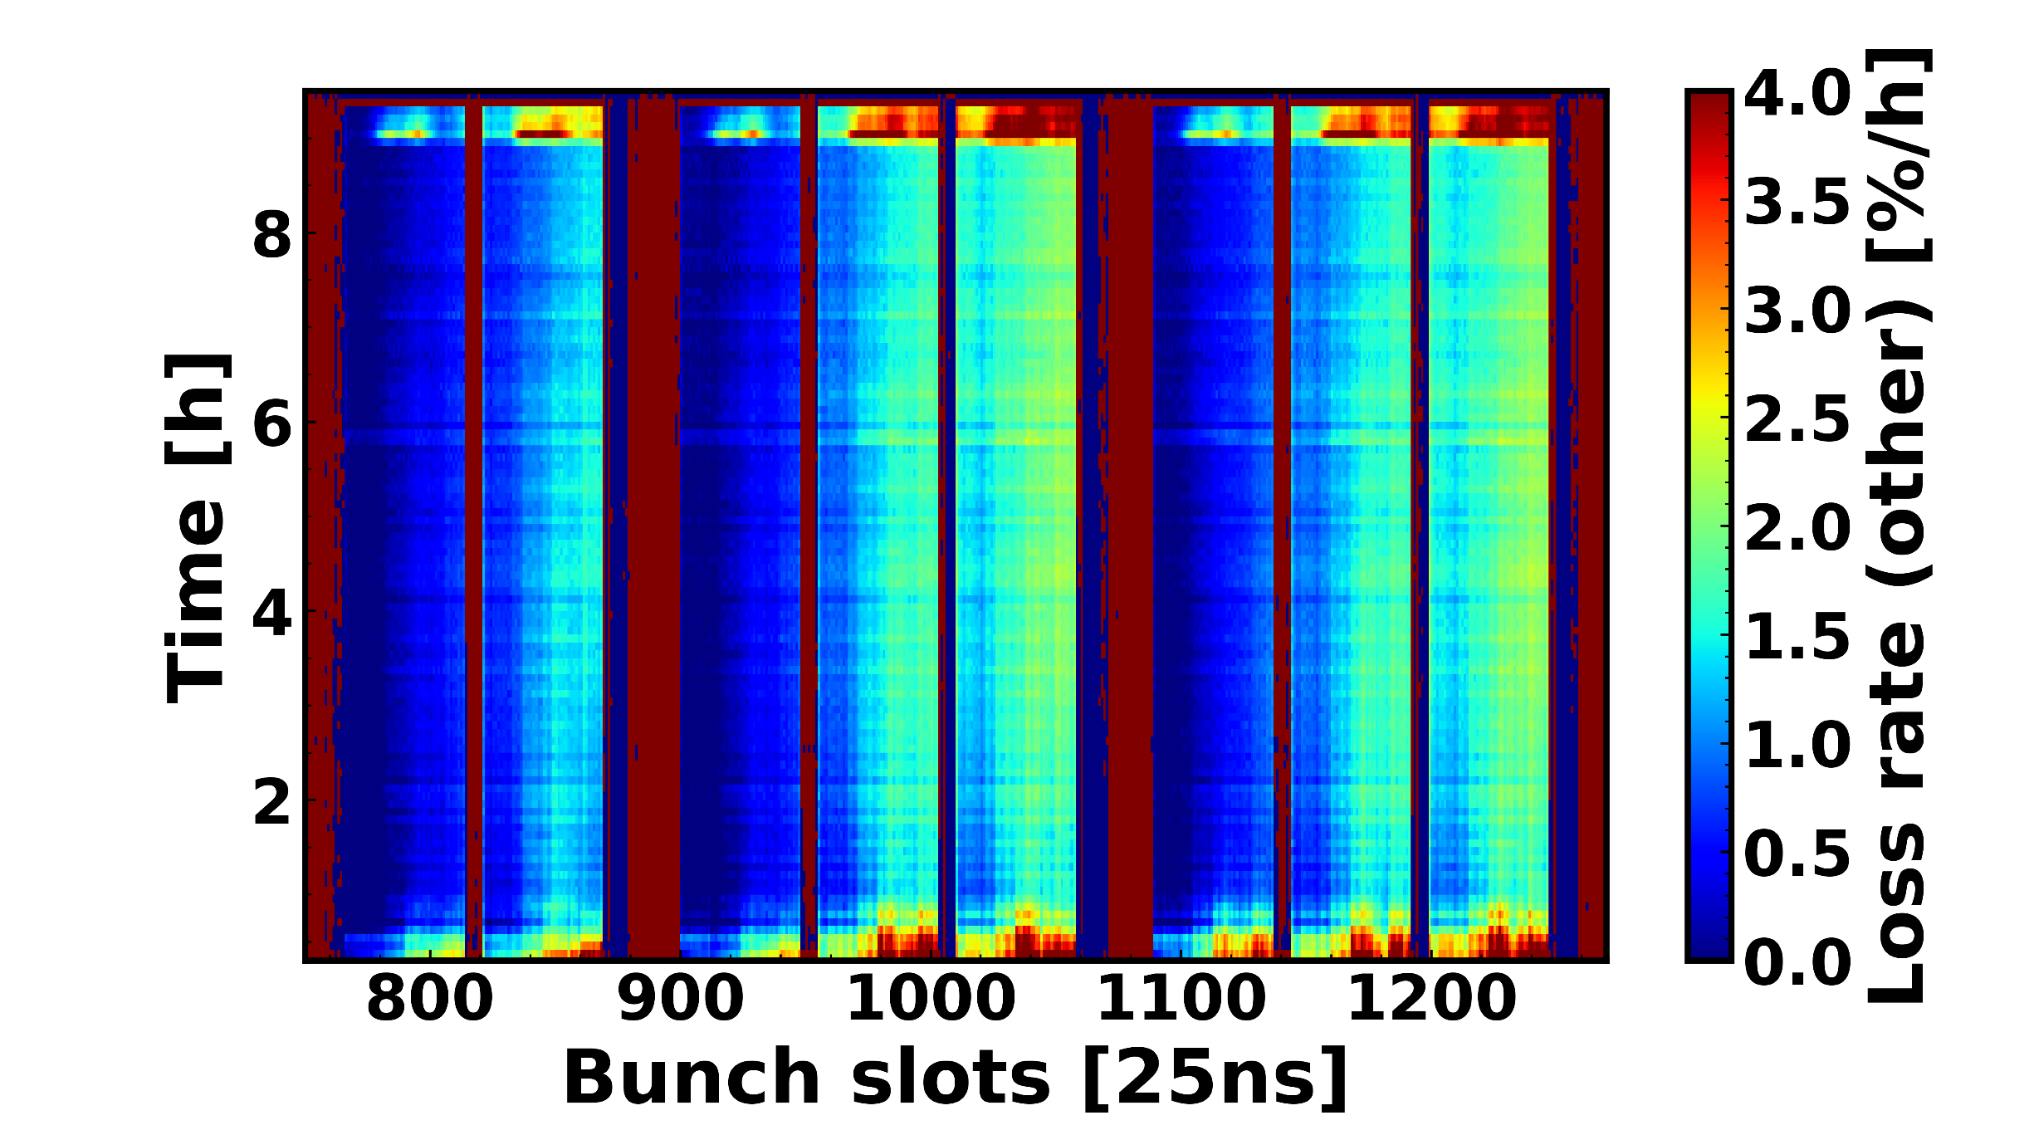
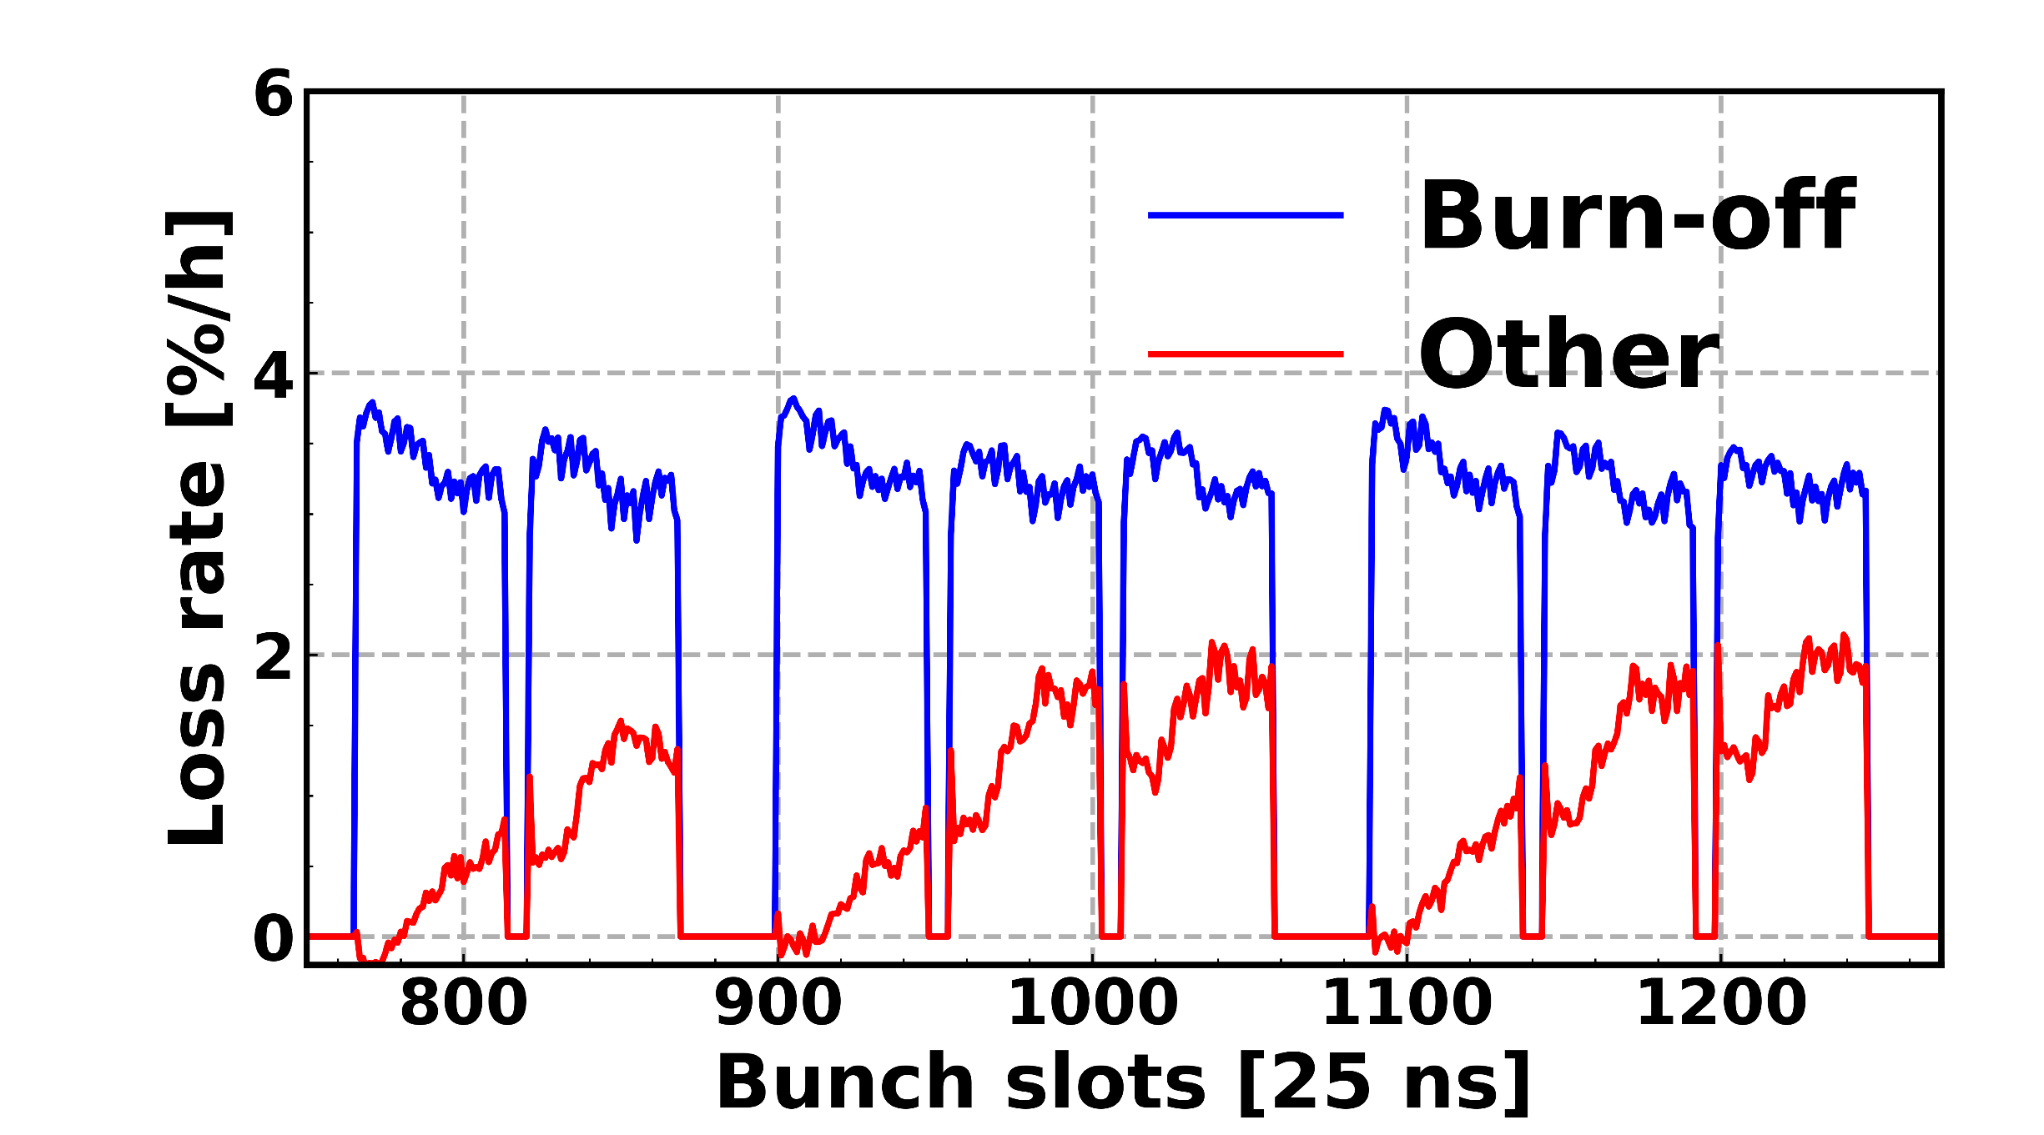
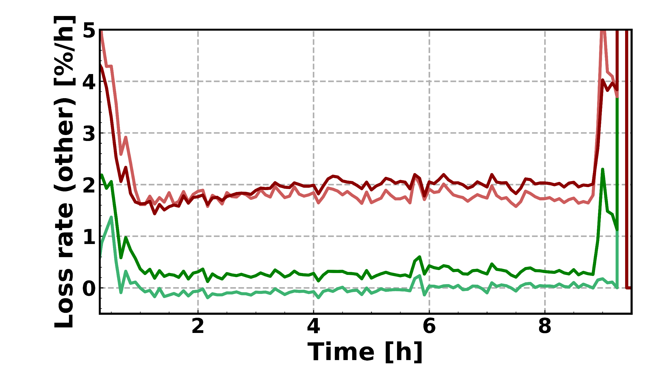
Example #1: Physics fills
Bunch-by-bunch pattern emerges
Reminds of e-cloud buildup behaviour.
Beam-beam effects alone cannot explain behaviour

Slide 12
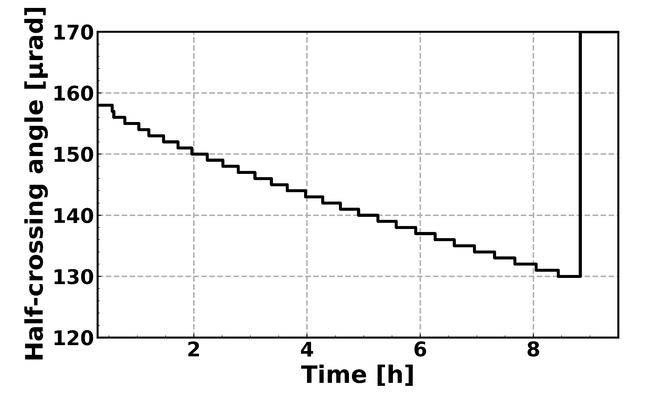
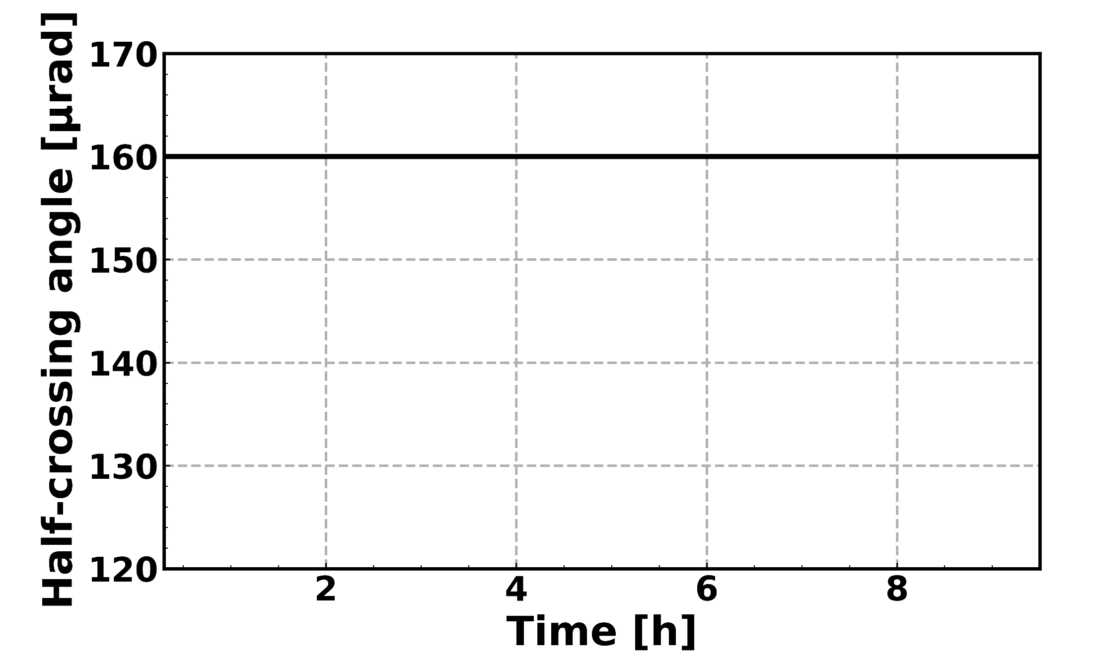
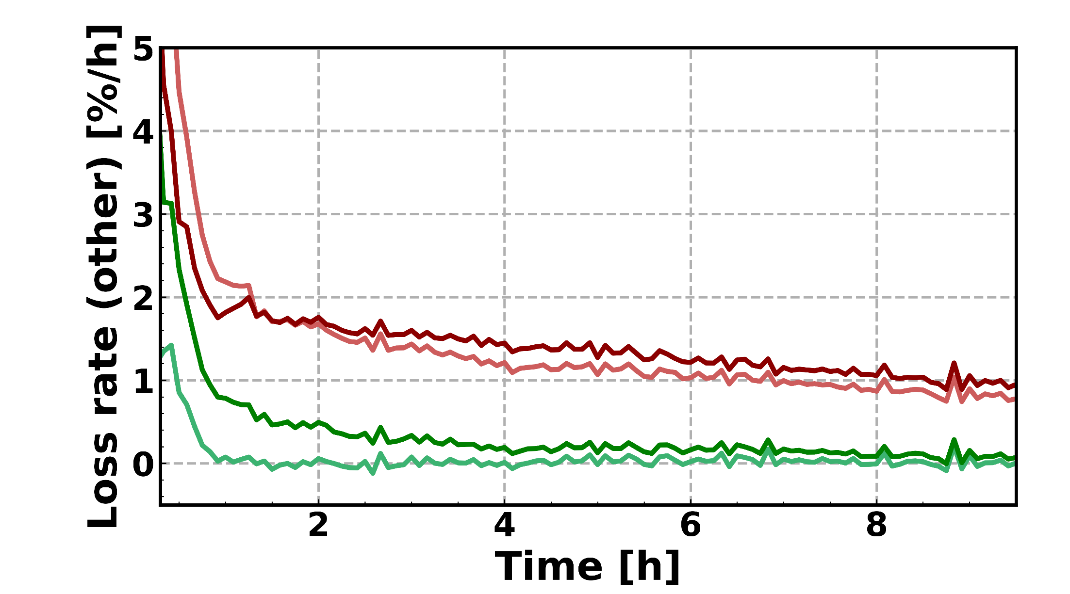
Example #2: Crossing angle
Typical physics fill:
Special test:
A reduced crossing angle typically enhances BBLR interactions.
In this case, it enhances the e-cloud pattern losses.

Slide 13
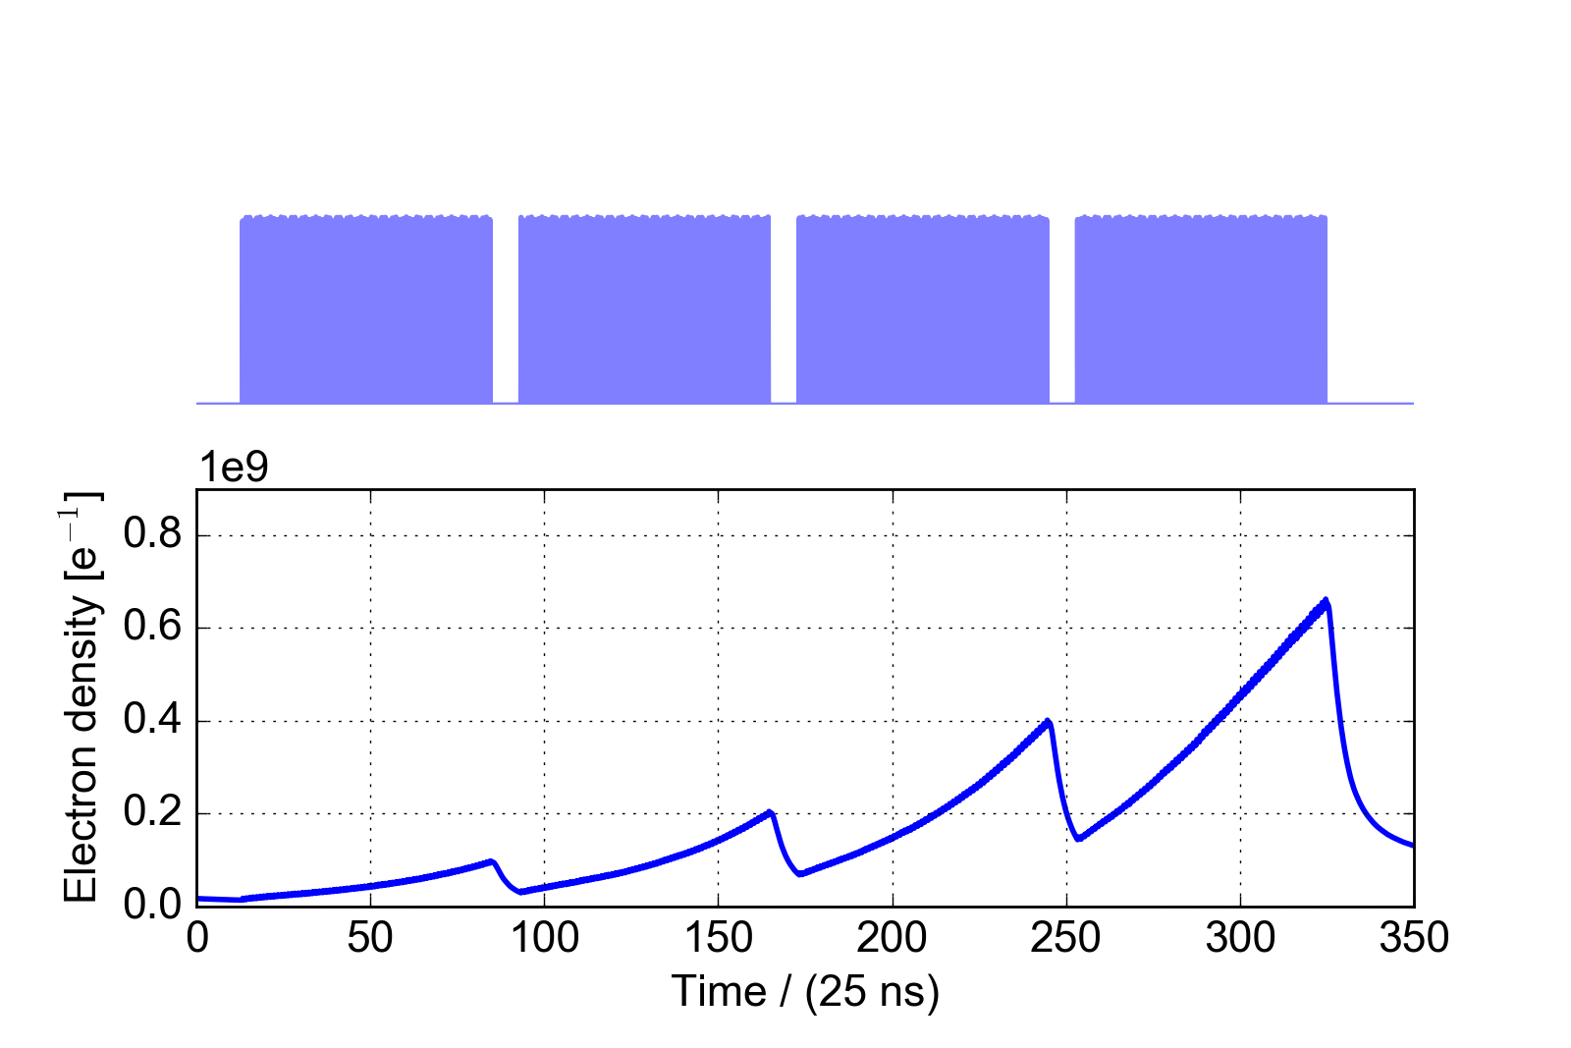
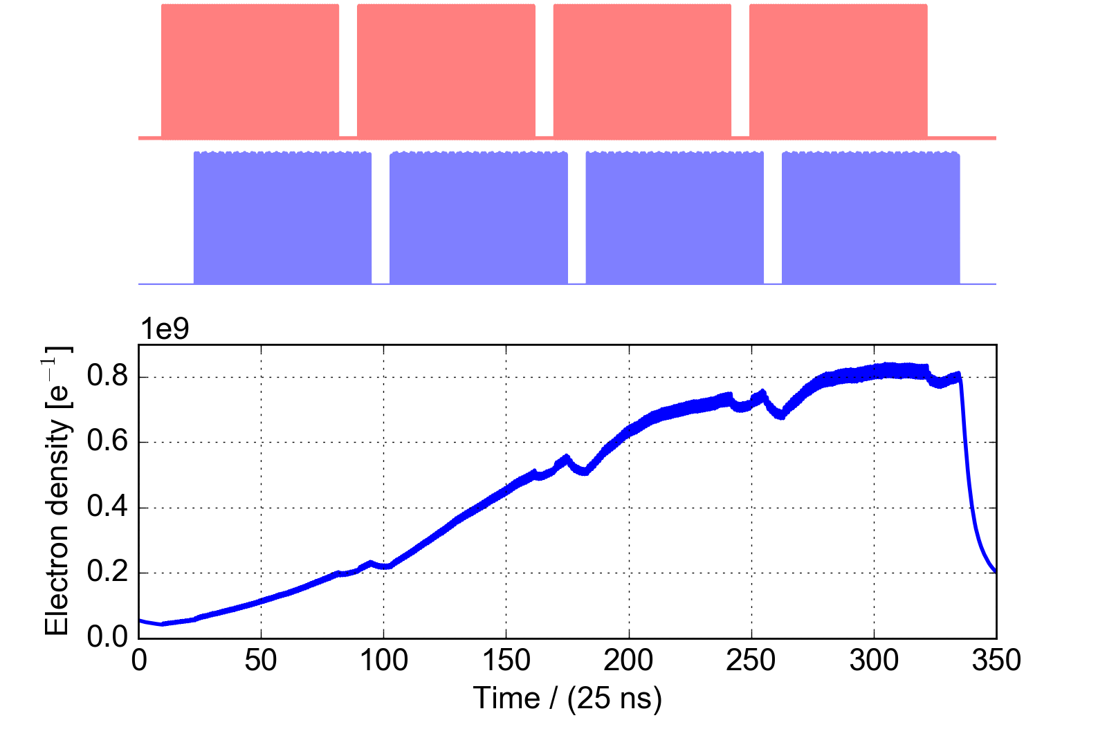
Example #3: Buildup simulations in Inner Triplet quadrupoles
One beam:
Two beams:
One beam: In the small 200 ns between batches, the electron cloud decays significantly.
Two beams: Beams are not synchronized and the e-cloud does not decay.

Slide 14
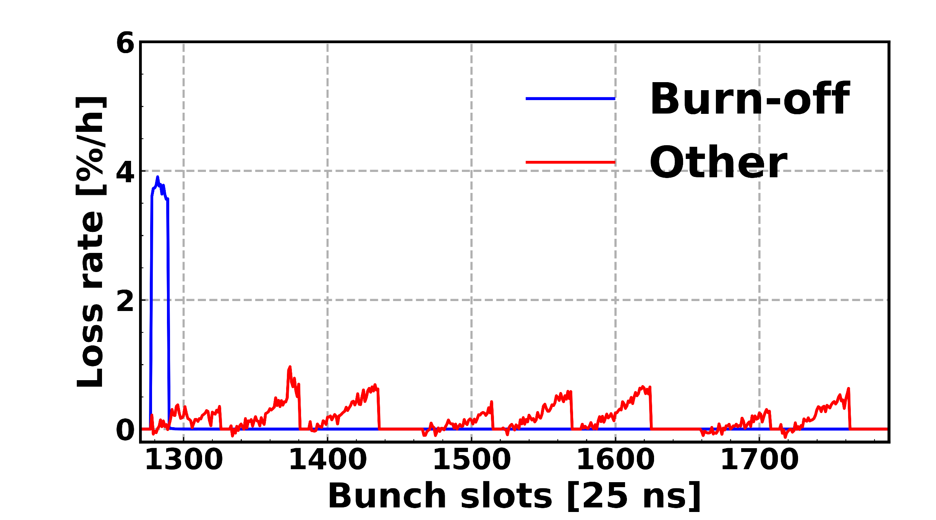
Example #3: Buildup simulations in Inner Triplet quadrupoles
One beam:
Two beams:
The bunch-by-bunch pattern of the losses resembles the e-cloud buildup simulations of the Inner Triplet quadrupoles.

Slide 15
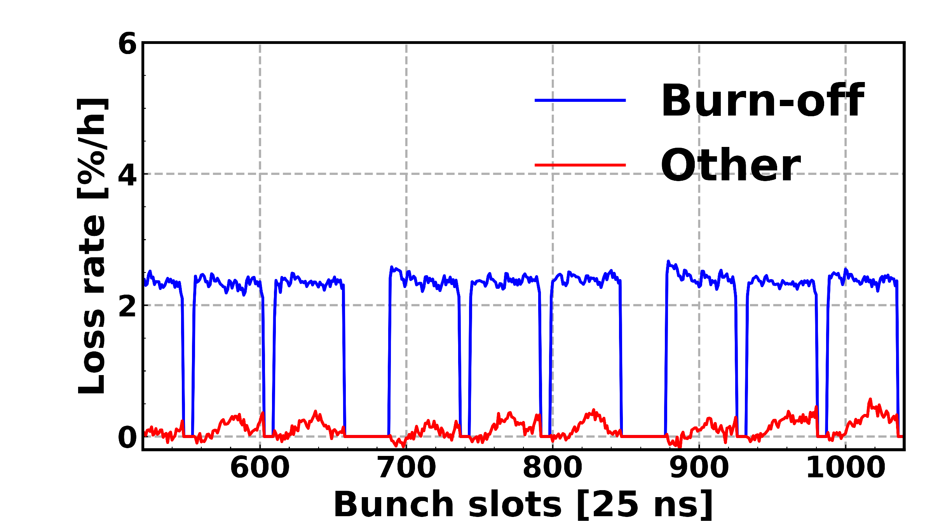
Example #4: Measurements with different betatron functions
β* = 65 cm, φ = 120 μrad
Large ATS telescope¹ →
→ enhancement of arc beta functions
β* = 30 cm, φ = 150 μrad
Moderate ATS telescope
Decreasing β in the inner triplet quadrupoles should reduce effect of the e-cloud in the inner triplet.
Increasing β in arcs should enhances e-cloud effect:
no significant losses.
¹For more details, see S. Fartoukh: https://indico.cern.ch/event/772189/contributions/3209049/

Slide 16
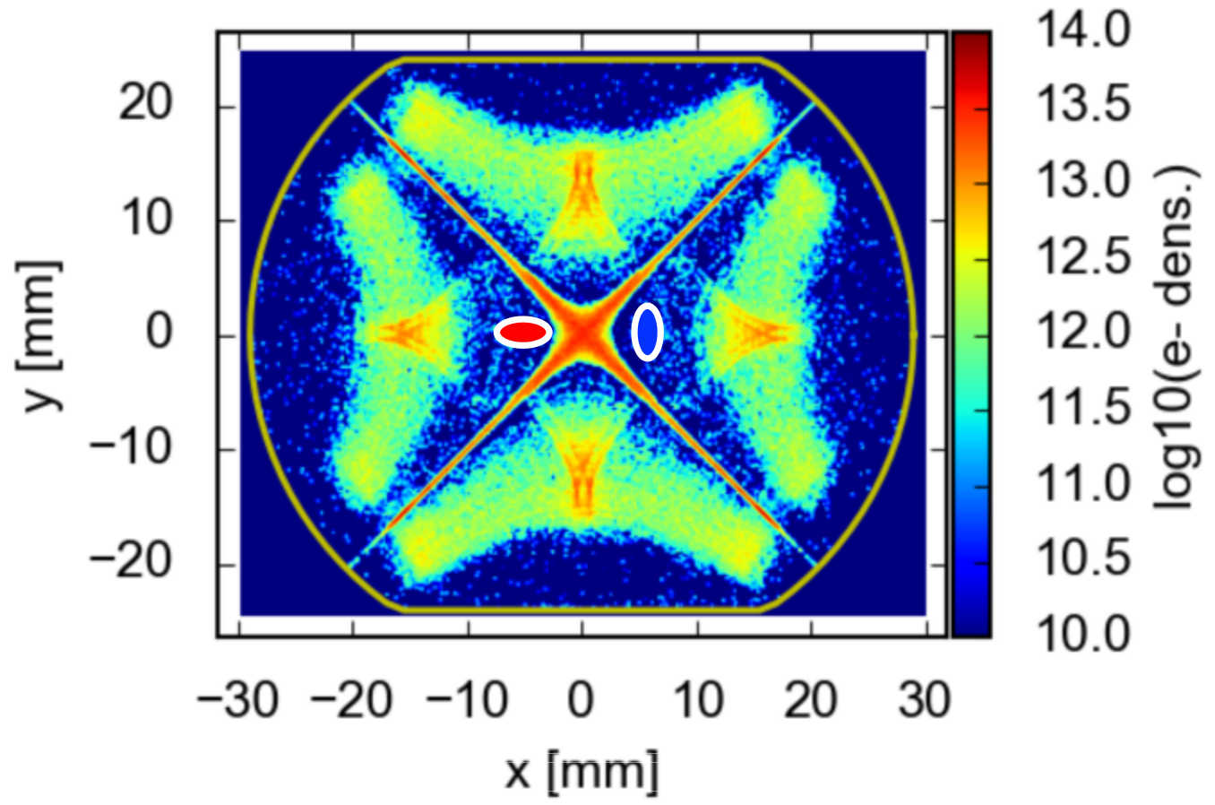
Summary - Observations
Electron cloud related losses are enhanced when:
reducing β* (increasing β in IT)
reducing crossing angle (changes closed orbit in IT)
Two beams are present (enhanced buildup in IT)
but not when:
Increasing β in arcs
All observations point to the Inner Triplet Quadrupoles.

Slide 17
Outline
Introduction
Observations in LHC during Run 2
Progress in simulations
Description of e-cloud interaction
Simulation results

Slide 18
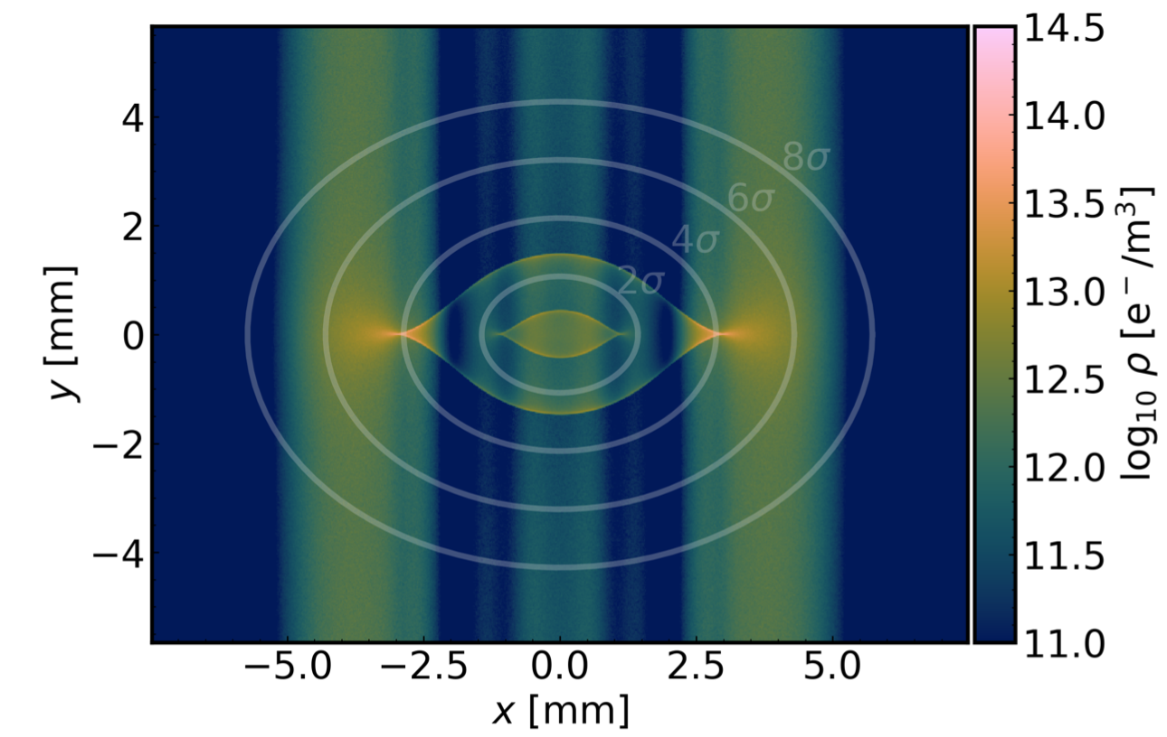
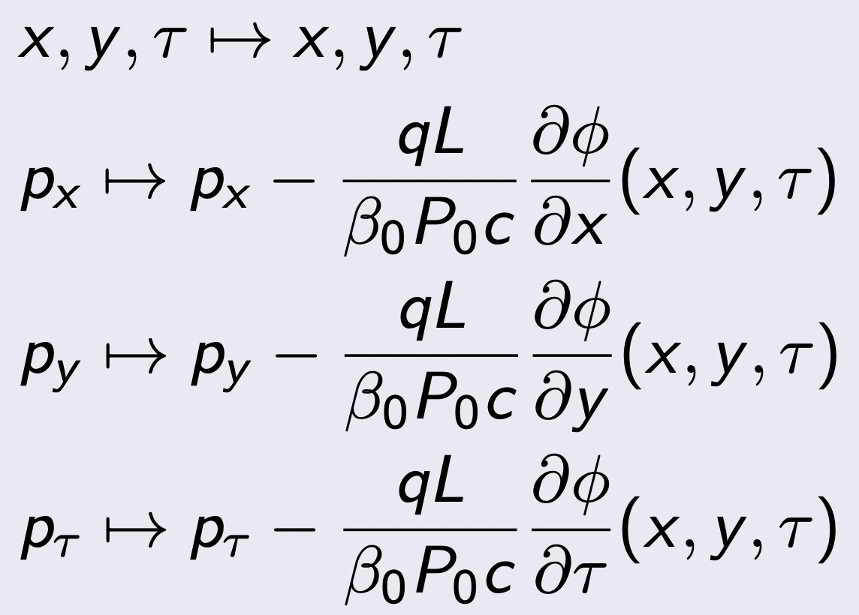
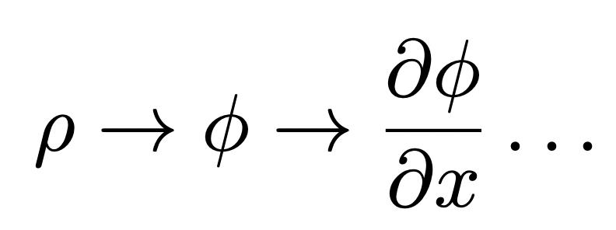
Introduction to simulations
[G. Iadarola, CERN-ACC-NOTE-2019-0033]
Complex time-dependent e-cloud density → complex time-dependent forces
Slow incoherent effects → e-cloud can be re-used = weak-strong approximaton (no self-consistency)
But: e-cloud potential (PIC) is defined on a 3D grid. Needs to be interpolated.

Slide 19
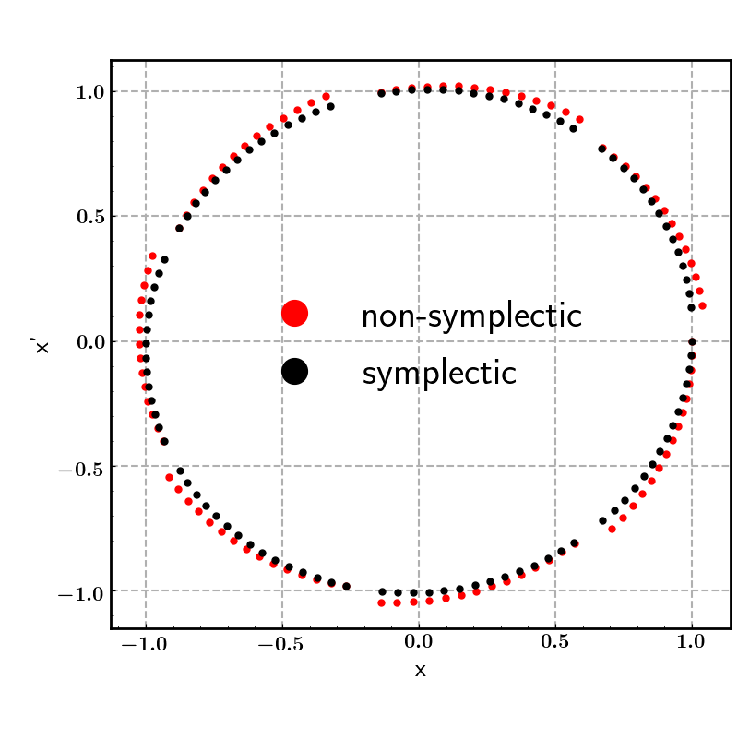
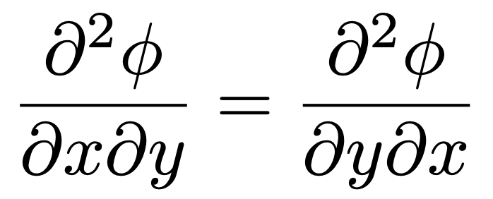
Symplecticity
Numerical methods in solving Hamiltonian systems can break the symplectic condition, making them less accurate at long timescales. (Millions of turns)
Typically important to preserve symplecticity, even at the expense of accuracy.
Interpolation scheme should guarantee symplecticity.
Linear interpolation is not symplectic.
In our case, symplecticity:

Slide 20
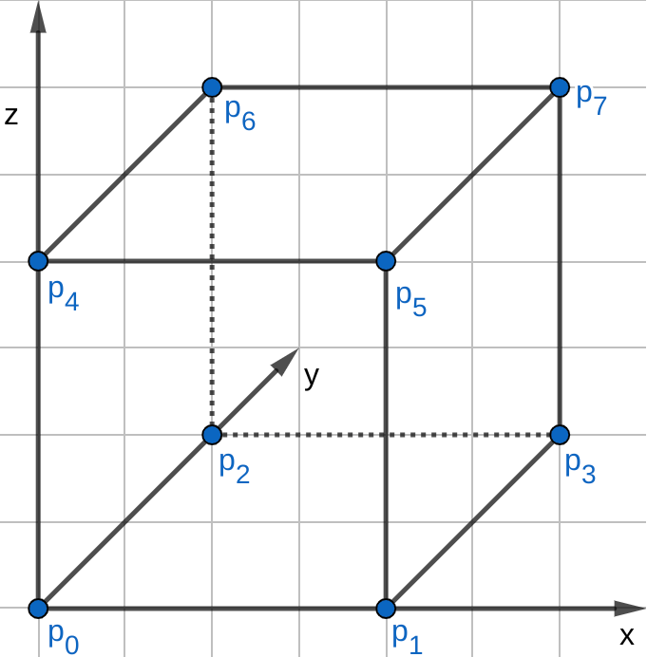
Tricubic interpolation
Given a regular 3D grid of any function f^{ijk}, we interpolate locally in a way that the following quantities are continuous globally.
Lekien and Marsden* proved that it is possible to meet this condition by using a tricubic interpolation scheme.
The coefficients a_{ijk} change from cell to cell but required quantities stay continuous across the cells.
Analytical derivatives for interaction.
*F. Lekien and J. Marsden, “Tricubic interpolation in three dimensions”. https://doi.org/10.1002/nm2.1296

Slide 21
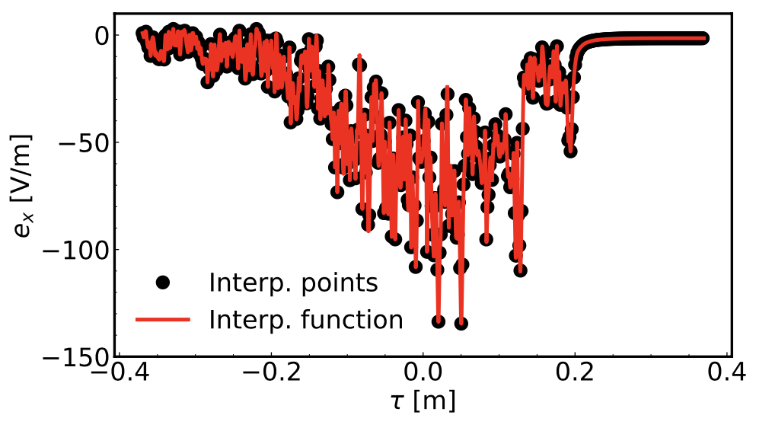
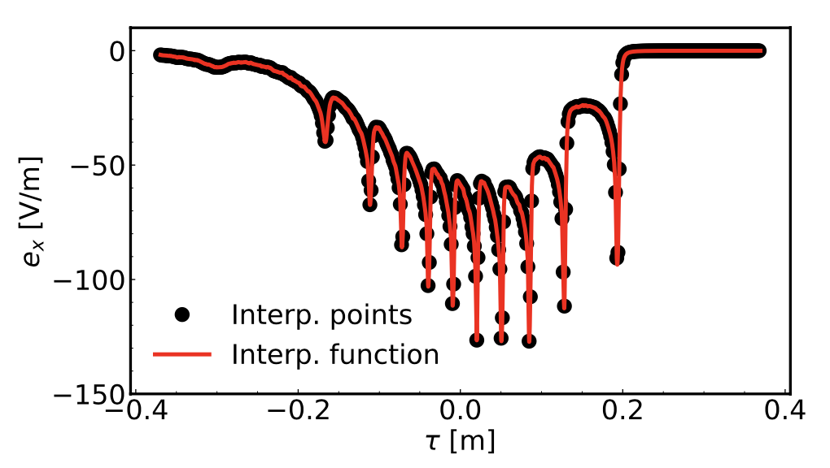
Issue with PIC potential
One simulation
4000 simulations
PIC simulation suffers from macroparticle noise.
Can be reduced by averaging many simulations.
Averaging 4000 reveals the physical structures in the induced forces.

Slide 22
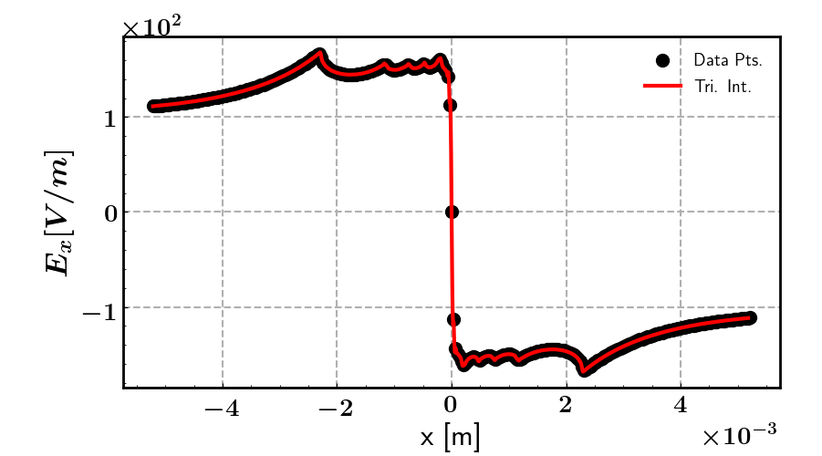
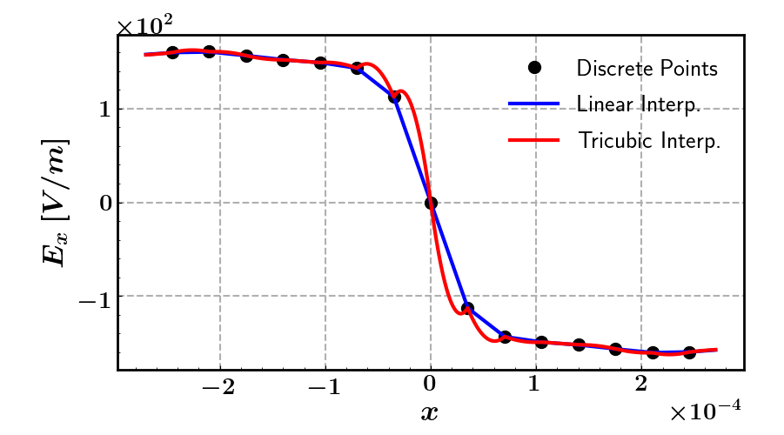
Issue with cubic interpolator
[zoom of left figure]
Close look reveals irregularities from Tricubic interpolation.
Inaccuracies are correlated with discontinuity of second derivative accross cells.

Slide 23
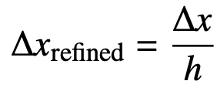
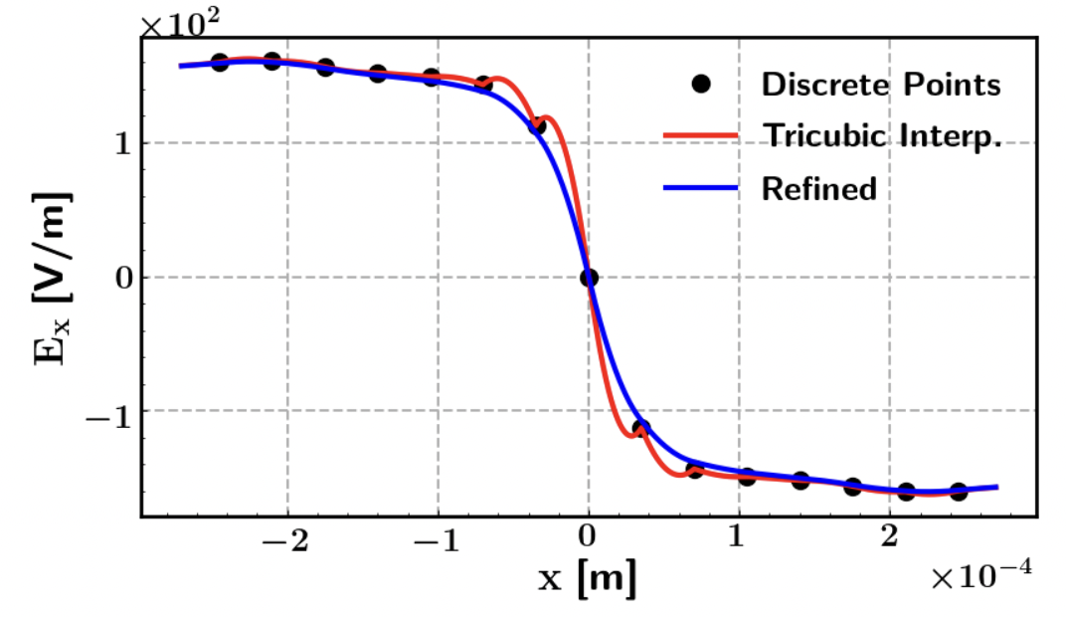
Refinement of potential
We found that we can treat our potential by:
Interpolate charge density on an auxilliary finer grid (by factor h).
Recalculate φ and derivatives in the finer grid.
Store recalculated φ and derivatives on original grid.
Minimal expense on memory and speed (performed during pre-processing)
Proved analytically that error becomes:
Complete mitigation of the irregularities.

Slide 24
Quick recap
Analytical form of e-cloud kick.
Used a high-order interpolation scheme (tri-cubic) to preserve symplecticity everywhere in phase space.
Averaged multiple Particle-In-Cell e-cloud simulations to reduce macroparticle noise in the interpolated data.
Solved Poisson’s equation in a finer auxiliary grid (done only once) to improve performance of the interpolation scheme.
Next:
Direct tracking simulation results of the incoherent effect of electron clouds in the main dipole and quadrupole magnets of the LHC at injection energy.
Simulations were performed with SixTrackLib (predecessor to XSuite) using GPUs and including the full thin lattice model of the LHC.
In SixTrackLib/XSuite, protons are tracked through each element of the lattice using symplectic maps.

Slide 25
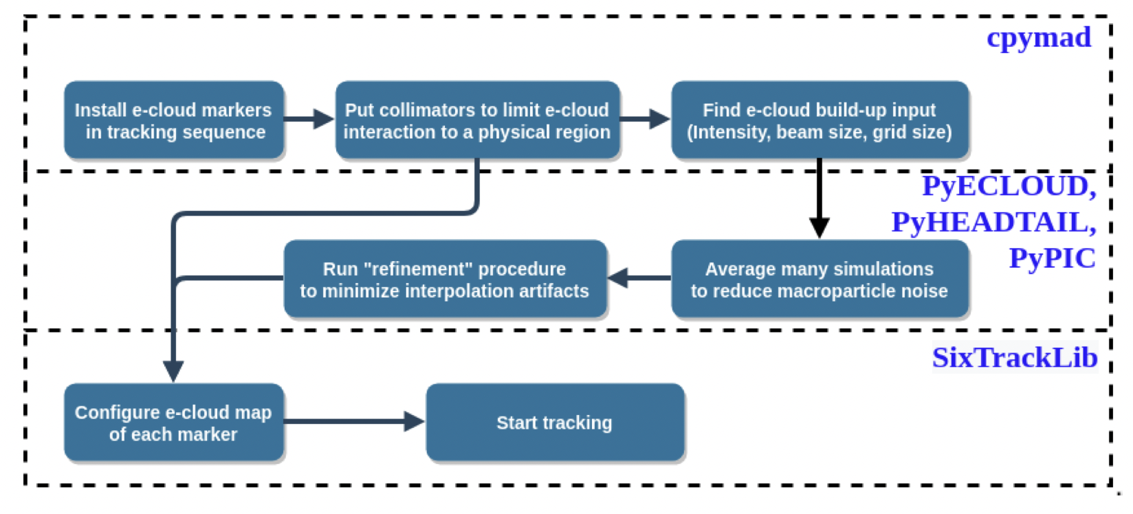
General procedure for the simulation
Optics code (MAD-X)
Electron cloud code (PyECLOUD)
Particle tracking code (SixTrackLib)

Slide 26
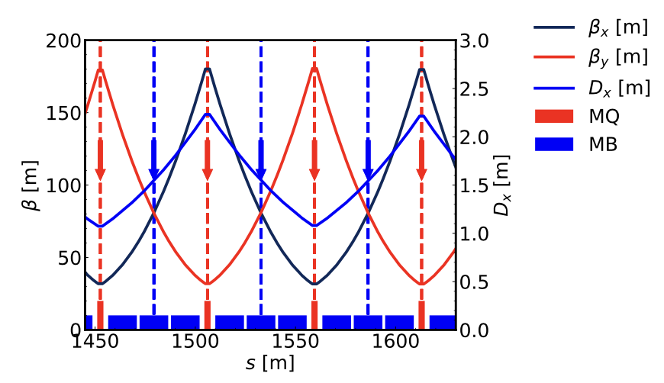
E-cloud setup
E-cloud exists across the full length of the LHC beam pipe.
Different magnetic fields lead to completely different e-clouds.
Most significant contributors:
E-cloud in arc dipoles (MB) (66%)
E-cloud in arc quadrupoles (MQ) (7%)
We place one interaction for each three dipoles and each quadrupole.
Betatron and dispersion functions stay the same between each cell.
Approximate SEY as uniform everywhere. Large fluctuations in reality.
Effect from saturated e–cloud.
LHC FODO Cell

Slide 27
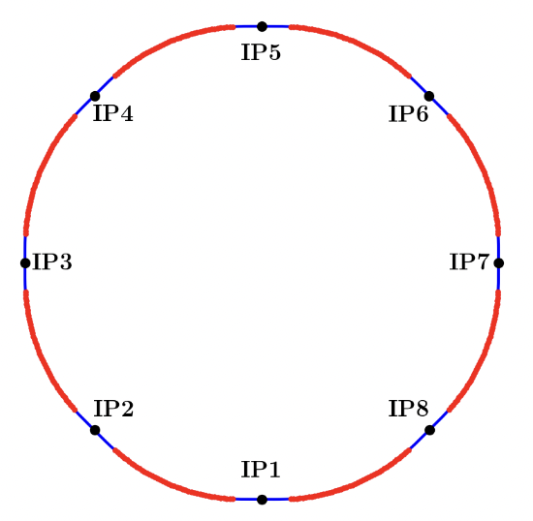
E-cloud setup
One MB e-cloud per half-cell
→ 46 interactions per arc
→ 368 interactions.
One MQ e-cloud per half-cell
→ 45 interactions per arc
→ 360 interactions.
Tracking time per e-cloud type (~360 interactions) is about as much as rest of the lattice
(11k tracking elements).

Slide 28
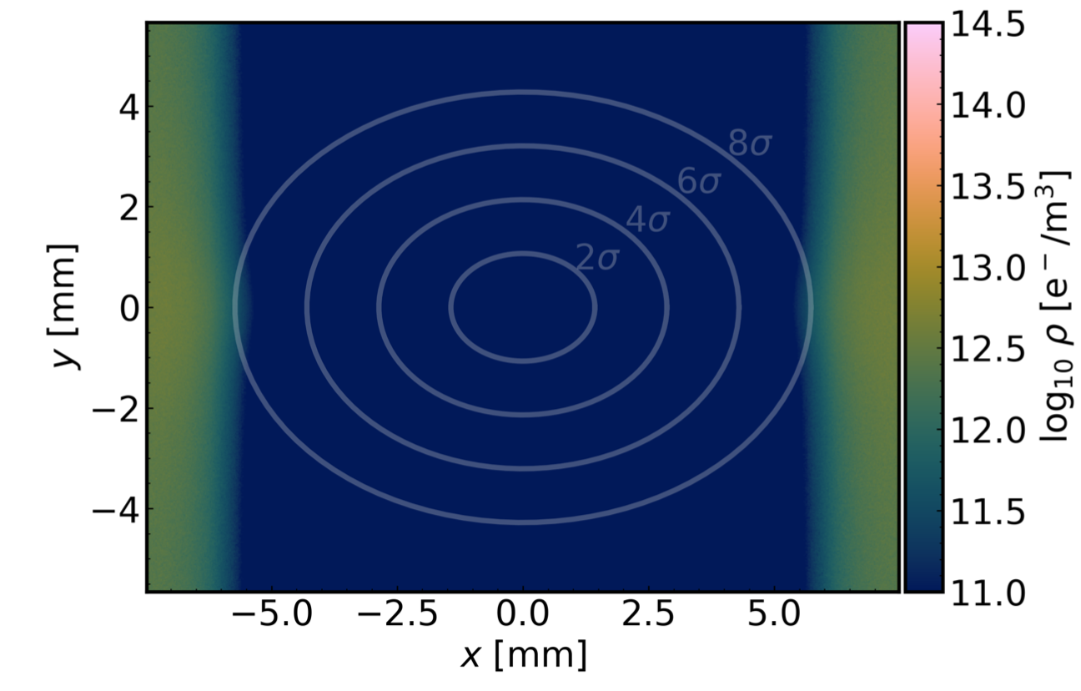
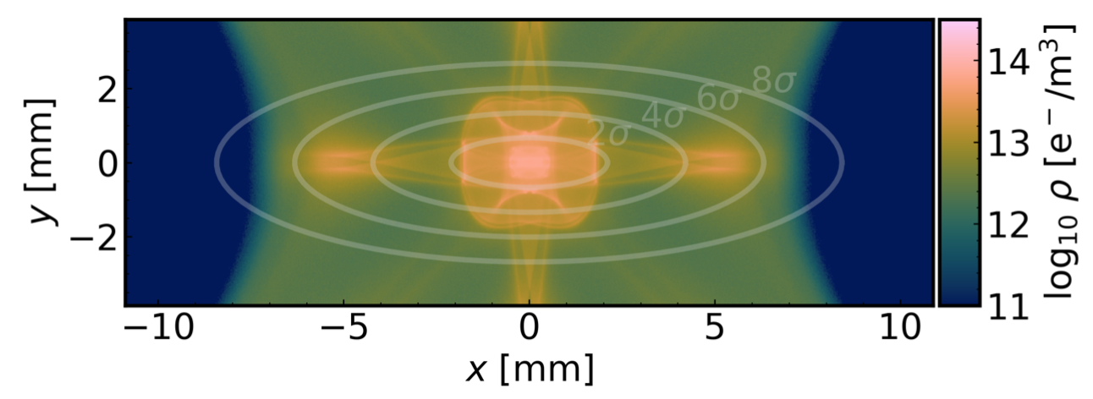
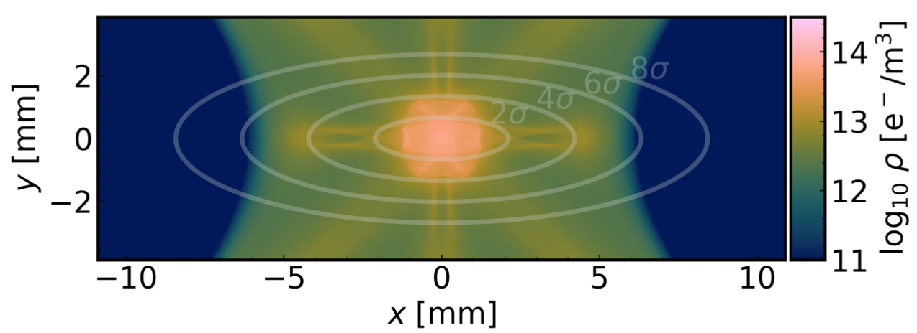
E-cloud setup
Nominal intensity (1.2 10¹¹ p/bunch)
Reduced intensity (0.6 10¹¹ p/bunch)
Dipoles
Quadrupoles
Dipoles: Reduced bunch intensity leads to larger e⁻ density close to the beam.
Quadrupoles: Small dependence on bunch intensity, large e⁻ densities close to beam.

Slide 29
E-cloud setup
Nominal intensity (1.2 10¹¹ p/bunch)
Reduced intensity (0.6 10¹¹ p/bunch)
Dipoles
Quadrupoles
Dipoles: Reduced bunch intensity leads to larger e⁻ density close to the beam.
Quadrupoles: Small dependence on bunch intensity, large e⁻ densities close to beam.

Slide 30
Simulation Parameters
Typical LHC at injection, 2018
Bunch intensity : 1.20 10¹¹ protons
Energy : 450 GeV
Chromaticity : 15/15
Octupole magnet’s current : 40 A
Bunch spacing : 25 ns
Transverse norm emittances : 2 μm/ 2 μm
R.M.S. bunch length : 0.09 m
Betatron tunes : 62.270/60.295
RF voltage : 6 MV
The three primary collimators (TCP) in IR7 (as black absorbers) are included in the lattice at their typical configuration (5.7 “collimation” σ → 7.5 beam σ).
There is no uncorrected linear coupling, magnet field imperfections, magnet misalignments or beam-beam interactions in the lattice.

Slide 31
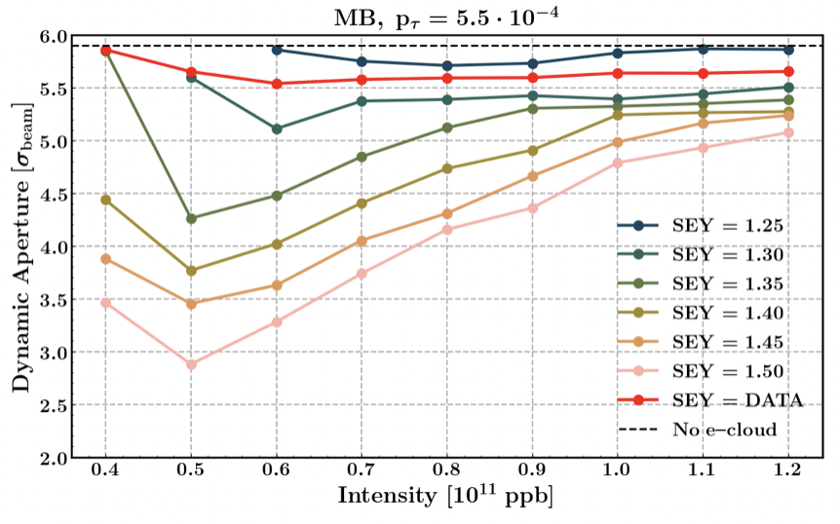
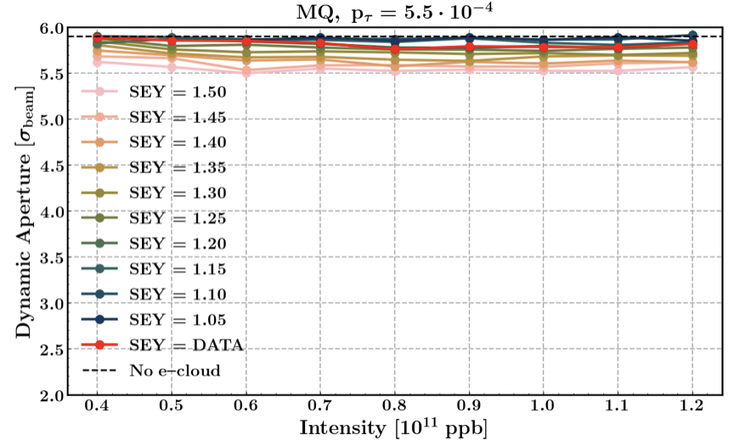
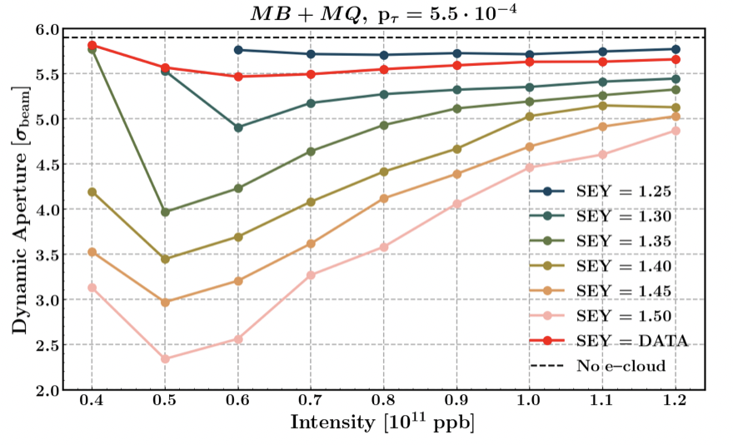
Secondary Emission Yield (SEY) - Intensity scan
Larger Secondary electron Emission Yield (of beam pipe) →
→ stronger e-cloud → less DA
Dipoles (MB): strong dependence with bunch intensity, correlated to e⁻ density close to the beam.
Quadrupoles (MQ): weak dependence with bunch intensity

Slide 32
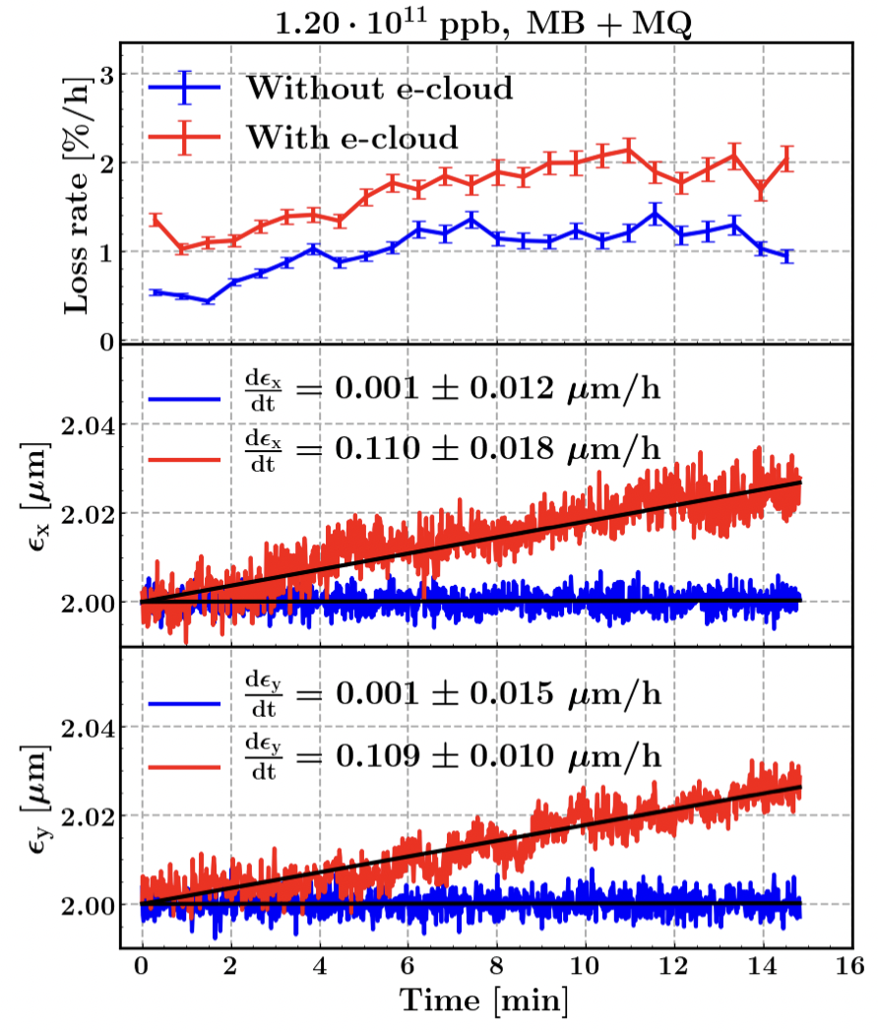
Long simulations (10M turns → 15min beam time)
Incoherent effects in the LHC are typically very slow processes. Need to simulate long timescales.
Recent advances (SixTrackLib/XSuite) allow the direct simulation of particle distributions with GPUs for such times.
Simulation using a V100 GPU took
1 week / 20 000 particles / 10 M turns.
Specific study used 6 GPUs at the same time to simulated more particles.
In long term simulations we observe:
small increase of losses
horizontal emittance growth,
vertical emittance growth,
when e-clouds are included.
Experimental observations show emittance growth in the same order of magnitude.
For quantitative comparisons we have planned dedicated MDs in Run 3.

Slide 33
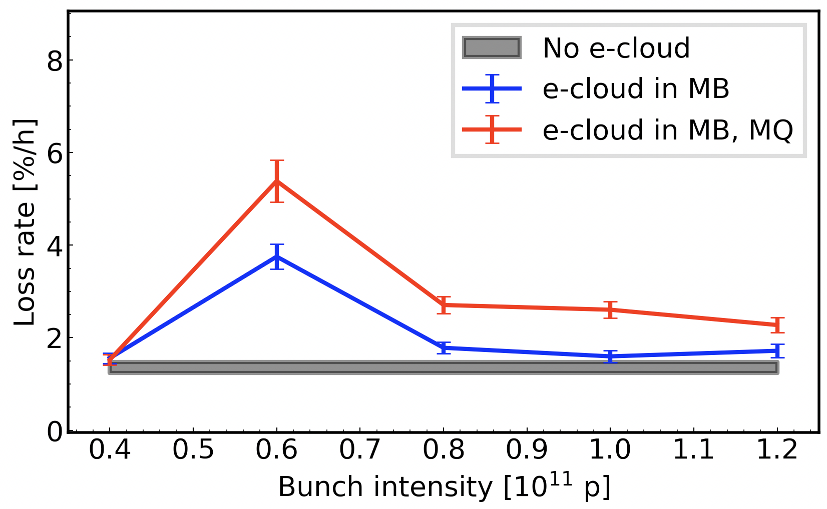
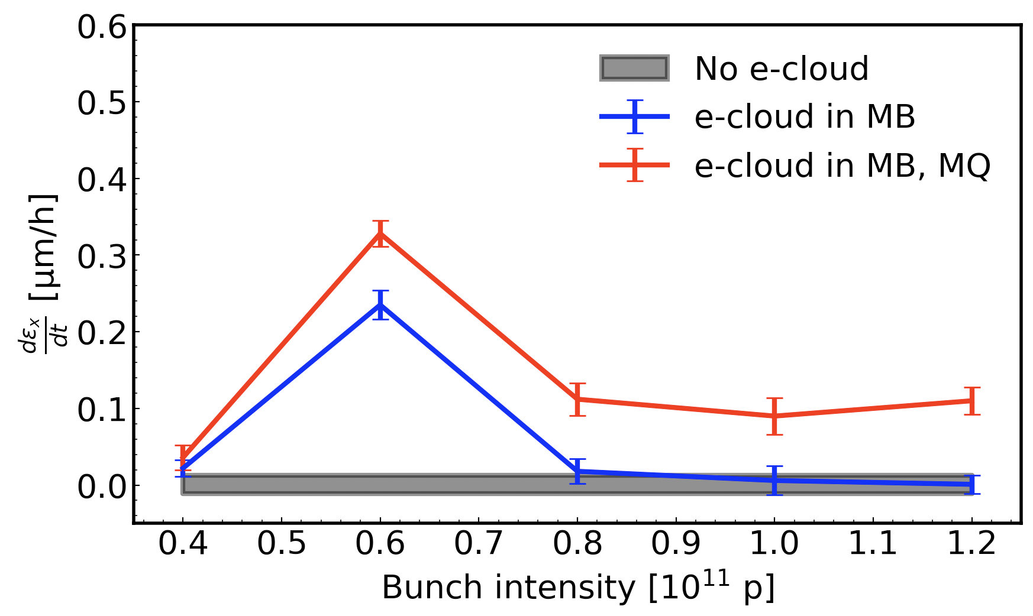
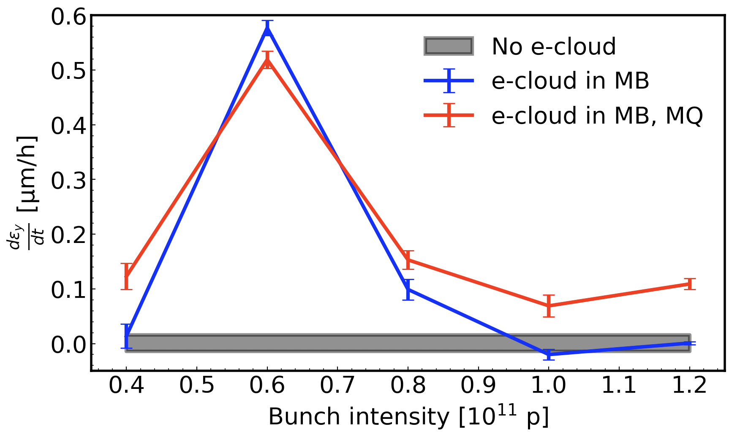
Long simulations (10M turns → 15min beam time)
MB (Dipoles):
Losses stronger at reduced intensity.
Emittance growth only at reduced intensity.
Vertical growth larger than horizontal.
MQ (Quadrupoles):
Losses across all intensities.
Emittance growth at all intensities.
Similar growths in both horizontal and vertical.
Effects strongly correlated with the e⁻ density close to the beam.
Reminder:
MB show large densities around the beam for reduced intensities,
MQ for all intensities.

Slide 34
Conclusion and Remarks
Observations:
Electron cloud in the insertion region quadrupoles is significant. Reduces integrated luminosity.
Simulations:
We can do particle tracking simulations with arbitrarily complex e-clouds in arbitrarily complex lattices for millions of turns.
Simulated simplified scenario at injection energy. Interplay with non-linear magnetic imperfections expected.
Simulations have reproduced the expected qualitative behavior.
Very long simulation timescales (several minutes) are in reach. (Using GPUs)
Outlook for the future:
Comparison with experimental measurements needs specialized tests.
→ Soon to be carried out in the LHC.
Simulate scenario during collisions: Strong electron clouds in the Insertion Region quadrupoles + strong beam-beam effects.
Thank you for your attention!
Konstantinos Paraschou

Slide 35
Backup slides

Slide 36
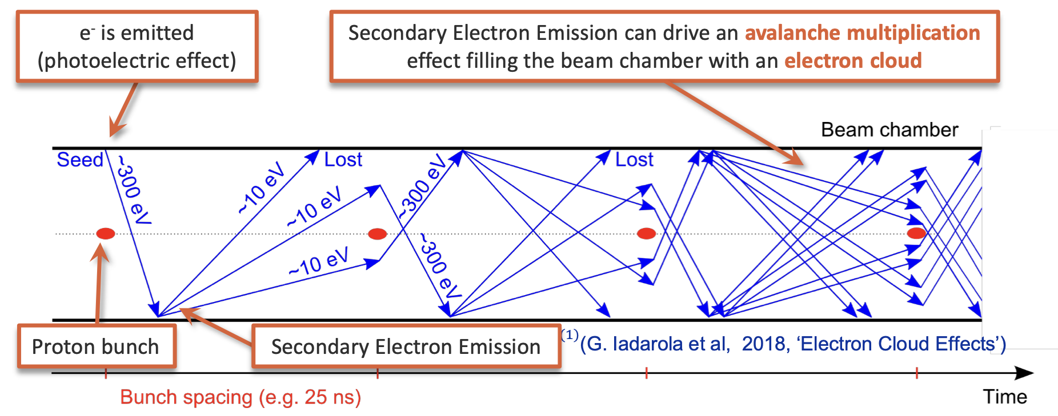
Spare slide

Slide 37
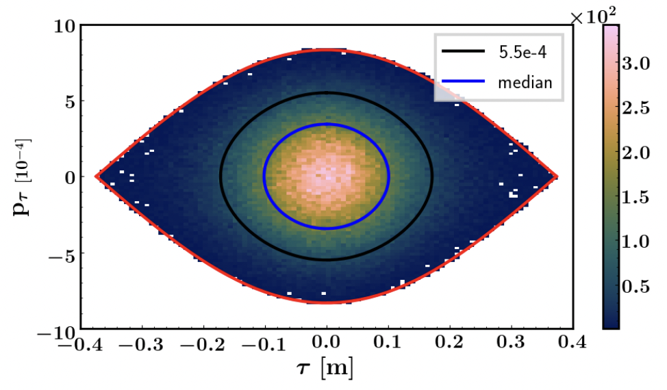
The RF bucket
DA simulations done for off-momentum particles (p_{τ} = 5.5 10⁻⁴).
FMA simulations done for on-momentum particles (p_{τ} = 0).
Long-term tracking simulations with particles across the full bucket.
Work in progress: FMA with off-momentum particles.

Slide 38
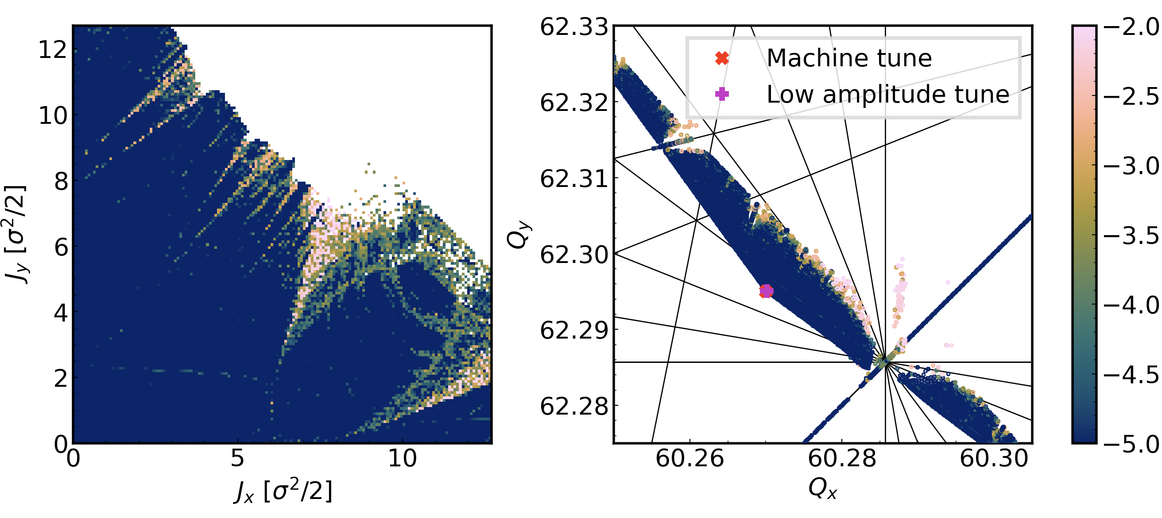
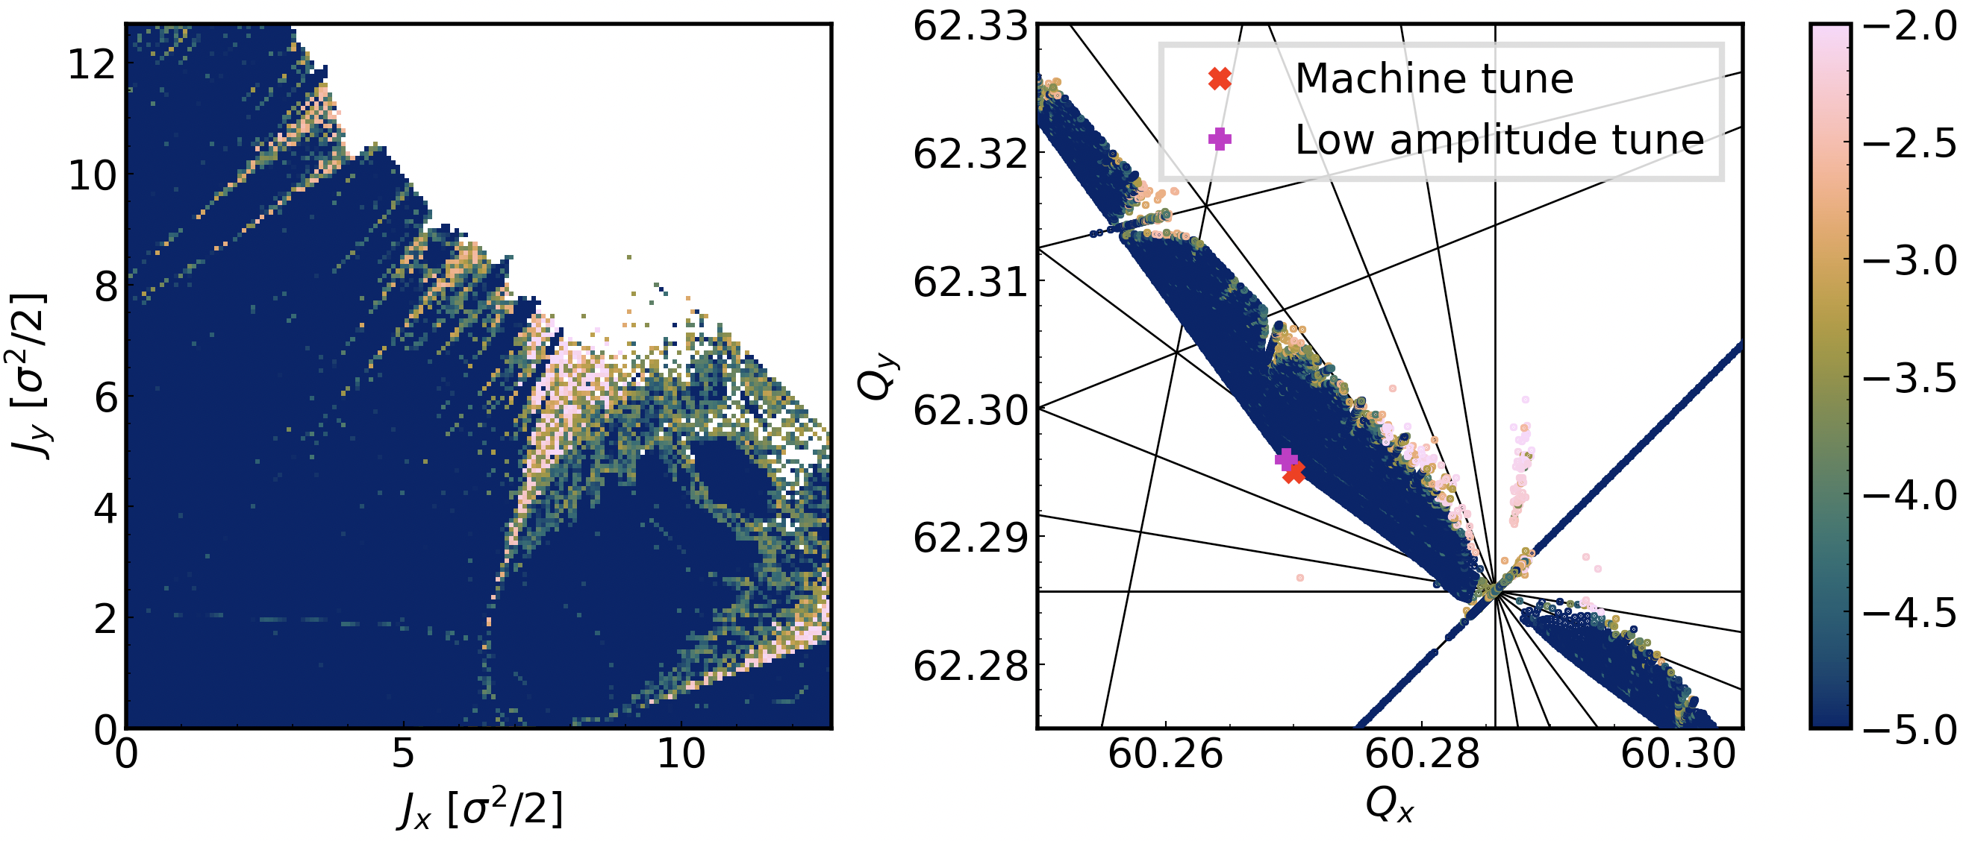
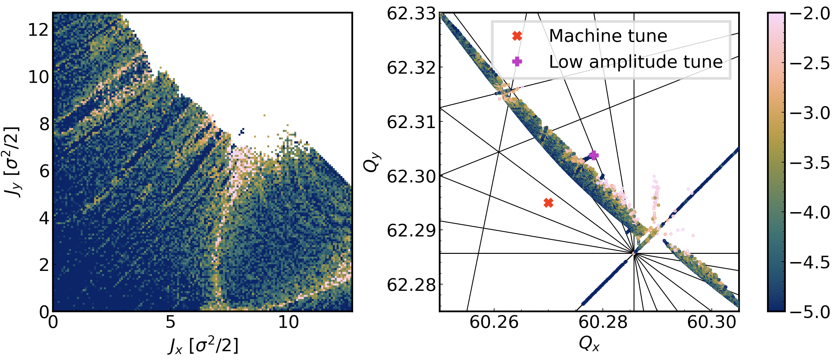
Frequency Map Analysis – Nominal intensity (0.6 10¹¹ p/b)
No e-cloud
Nominal intensity
Dipoles (MB):
→ tiny tune-shift
→ negligible effect
Quadrupoles (MQ):
→ large tune-shift
→ more resonances
E-cloud in MB
E-cloud in MB, MQ

Slide 39
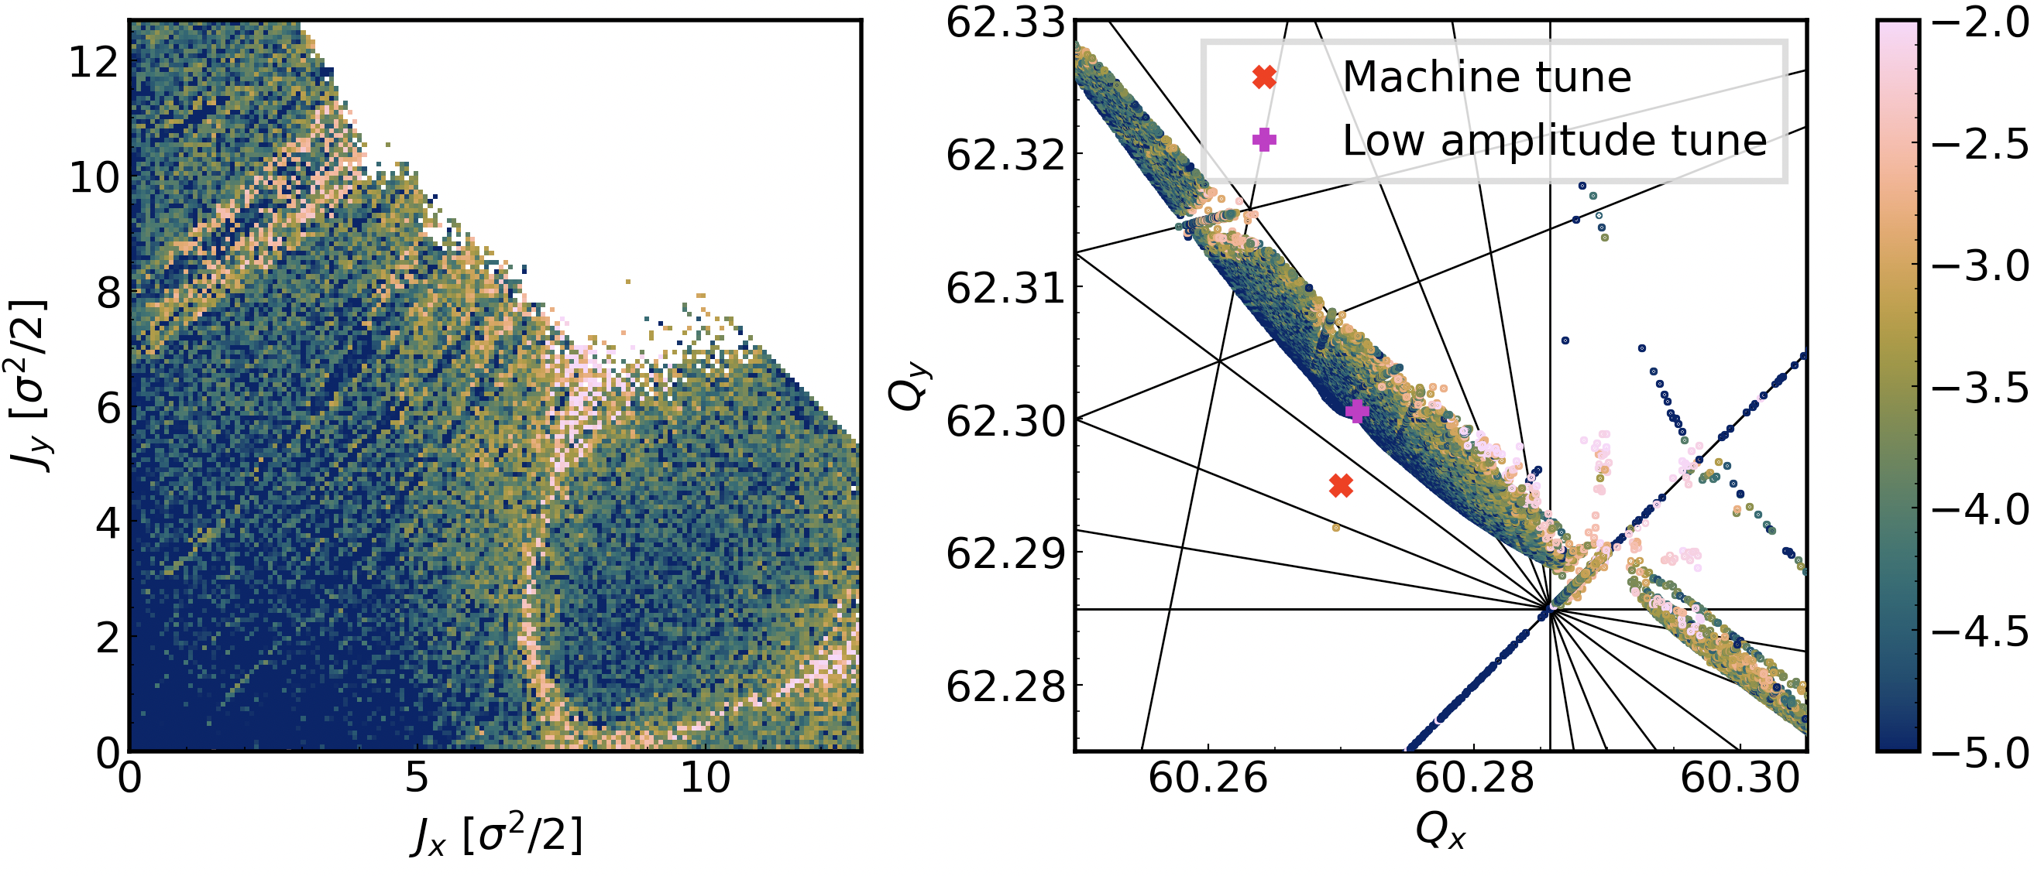
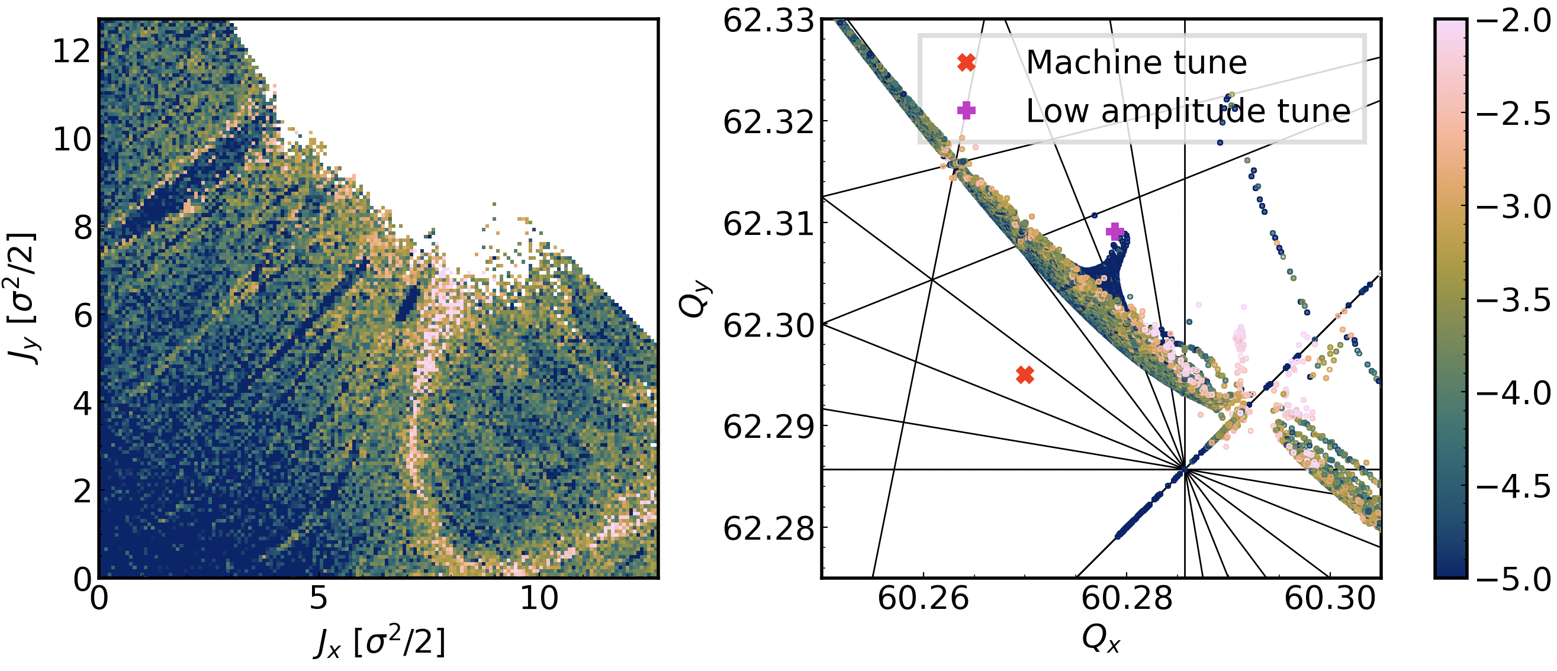
Frequency Map Analysis – Reduced intensity (0.6 10¹¹ p/b)
No e-cloud
Reduced intensity
Dipoles (MB):
→ larger tune-shift
→ more resonances
Quadrupoles (MQ):
→ large tune-shift
→ more resonances
E-cloud in MB
Particles are on-momentum,
picture is not yet complete.
Work in progress to try identify synchro-betatron resonances.
E-cloud in MB, MQ

Slide 40
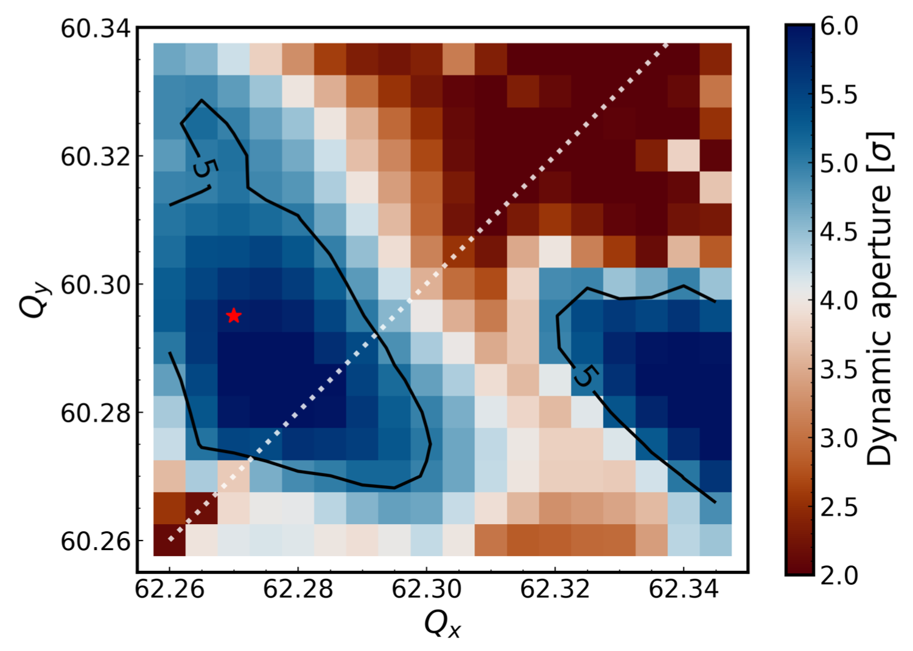
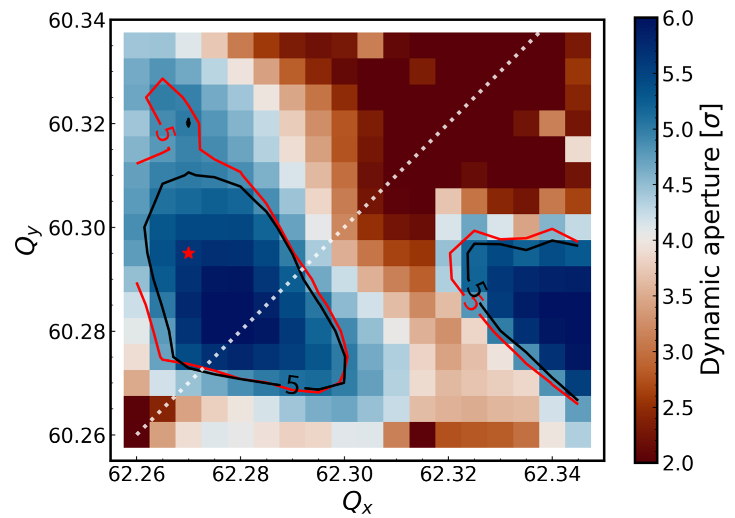
Tune scan
No e-cloud
MB
E-cloud reduces available tune space.
Still dominated by strong octupoles and chromaticity.
No better working point without approaching diagonal.
MQ
MB, MQ
(SEY_{MB} : 1.3, SEY_{MQ} : 1.3)

Slide 41
Why symplectic?
Symplecticity is a property closely related to Hamiltonian mechanics and the associated integrals of motion. If the numerical method for solving Hamilton’s differential equations is not symplectic, e.g. 4th order Runge-Kutta method, quantities which would otherwise stay constant will grow in time.
Consider the Hamiltonian: with
These quantities are conserved:
(along with the Hamiltonian)
We can numerically solve the equations of motion with the method:
The potential is discretized on a grid and the two interpolation methods are used.

Slide 42
Why symplectic?
Non-symplectic method: Use (bi)linear interpolation on the derivatives
of .
Symplectic method: Use (bi)cubic interpolation on .
The relative error on the integrals of motion does not grow with a symplectic method,
While it grows for non-symplectic methods.

Slide 43
Impact of tricubic interpolation irregularities
Simple tracking of linear 2D phase space rotation and an e-cloud symplectic kick.
Very important to minimize irregularities.
By reducing them, there is significant impact on the particle motion.

Slide 44
Induced forces
Dipole magnet:
Quadrupole magnet:

