Slide 2

Amorphous carbon coating qualifications for the HL-LHC vacuum system
V. Baglin
CERN TE-VSC, Geneva
https://agenda.infn.it/event/28336/

Slide 3
Outline
HL-LHC vacuum system
a-C coating laboratory properties
a-C coating characterisation with proton beams
Summary

Slide 4
1. HL-LHC

Slide 5
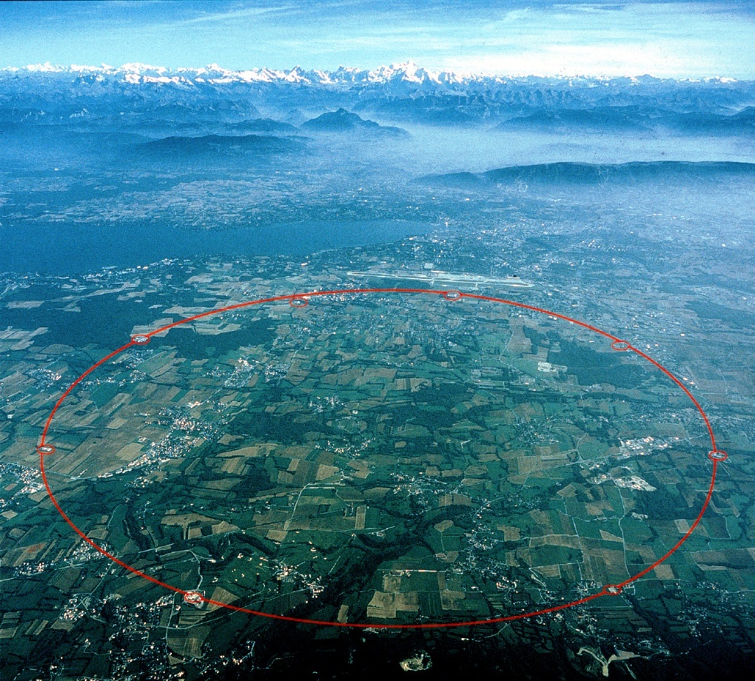
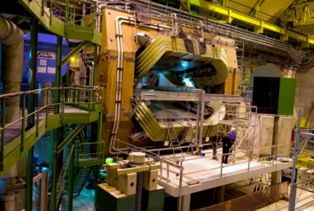

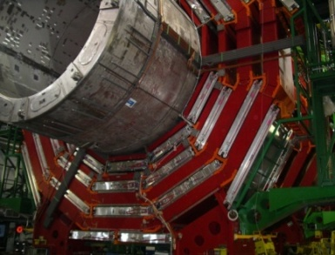
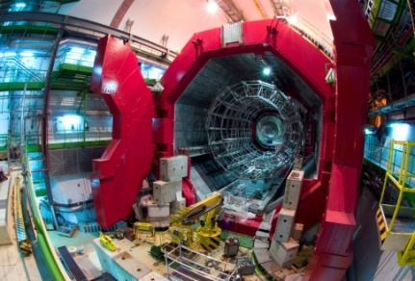
The CERN Large Hadron Collider (LHC)
LHCb
26.7 km circumference
8 arcs of 2.8 km
8 long straight sections of 575 m
4 experiments
7 TeV / beam
90% of the machine is held at cryogenic temperature: 1.9-20K
ATLAS
CMS
ALICE

Slide 6

HL-LHC Project
  The HL-LHC Project is a program which consists of multiplying by ~ 5 the LHC luminosity with an objective of 3 000 fb⁻¹ accumulated by 2040.
  ➔ ~ 1.1 millions Higgs bosons produced with HL-LHC (vs 0.2 with LHC)
  For this purpose, the optics, the matching section and the inner triplet (IT) around ATLAS and CMS are completely rebuilt and shall be ready for operation by ~ 2029.
 | LHC Design |  |  | HL-LHC
 | Nominal |  | Ultimate | Nominal
Energy [TeV] | 7
Luminosity [x10³⁴ cm⁻².s⁻¹] | 1.0 | 2.3 |  | 5*
Current [mA] | 584 | 860 |  | 1090
Proton per bunch [x10¹¹] | 1.15 | 1.7 |  | 2.2
Number of bunches | 2808 |  |  | 2736
Bunch spacing [ns] | 25
Minimum β* [m] | 0.55 |  |  | 0.15
Normalized emittance [μm] | 3.75 |  |  | 2.5
* Using luminosity leveling to control pile-up in the experiments
Qualifications for the HL-LHC Vacuum System, V. Baglin, ISSS9, Japan (online) 29 November 2021

Slide 7
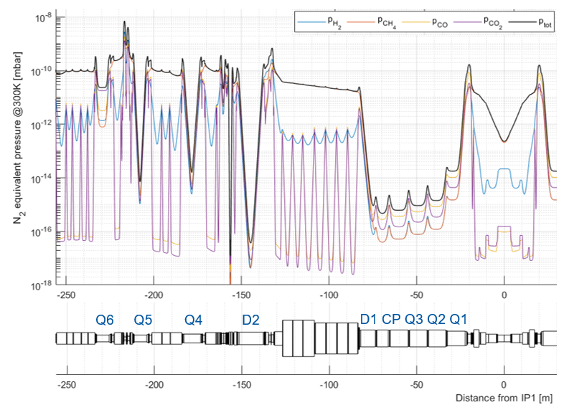
HL design value: a challenge with circulating beams
Arcs: lifetime limit due to nuclear scattering ~ 200 h
  n ~ 6 10¹⁴ H₂/m3
  <P_{arc}> < 6 10⁻⁹ mbar H₂ equivalent
  ~ 80 mW/m heat load in the cold mass due to proton scattering
Minimise background to the LHC experiments
 | H2_eq / m3 | mbar
<LSS_{1 or 5}> | ~ 3 10¹² | 1 10⁻¹⁰
<ATLAS> | ~ 8 10¹⁰ | 3 10⁻¹²
<CMS> | ~ 2 10¹² | 7 10⁻¹¹
HL-LHC Technical Design Report, CERN 2020-10.
➔ Gas load from cryogenic vacuum system reduced thanks to aC coating
A. Galloro, 56th HL-LHC WP12 Meeting, May 2022.

Slide 8
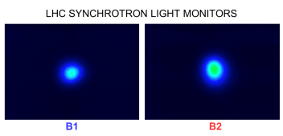
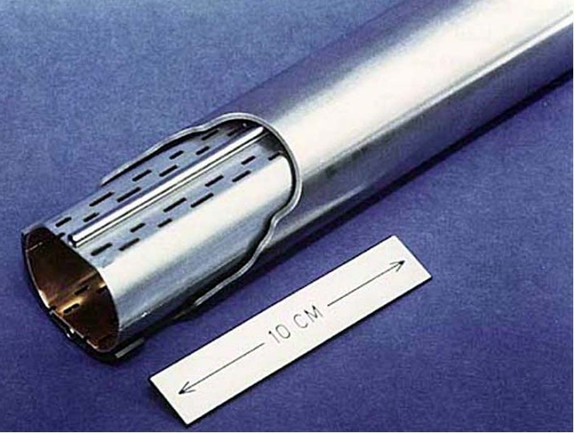
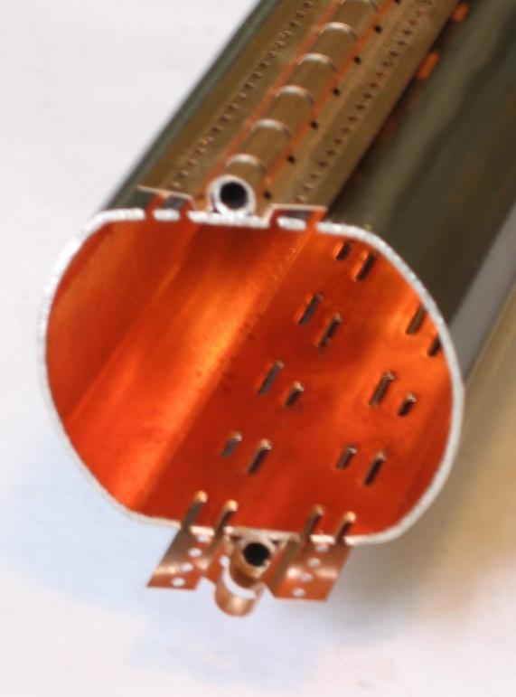
Synchrotron radiation
In a synchrotron, relativistic charged particles produce in the transverse plane and within a small vertical angle, photon radiation in the meV to MeV range
For HL-LHC:
  Ec = 44 eV i.e vacuum ultraviolet range (< 1 keV)
  Photon flux = 2 10¹⁷ ph/m/s
  Power = 0.4 W/m i.e. 22 kW for the full ring
Photons stimulate desorption of neutrals
yield, η_{photons}:
CERN Control Centre LHC beams SR displays
LHC beam screen at 5-20 K to
protect the 1.9 K cold bore

Slide 9
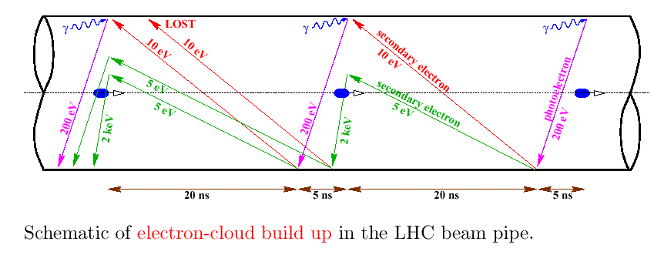
Electron Cloud Mechanism in LHC
F. Ruggiero et al., LHC Project Report 188 1998, EPAC 98
Electron cloud:
- gas desorption
- heat load
- beam emittance growth
Key parameters:
- beam structure
- bunch current
- vacuum chamber dimension
- secondary electron yield
- photoelectron yield
- electron and photon reflectivities
…

Slide 10
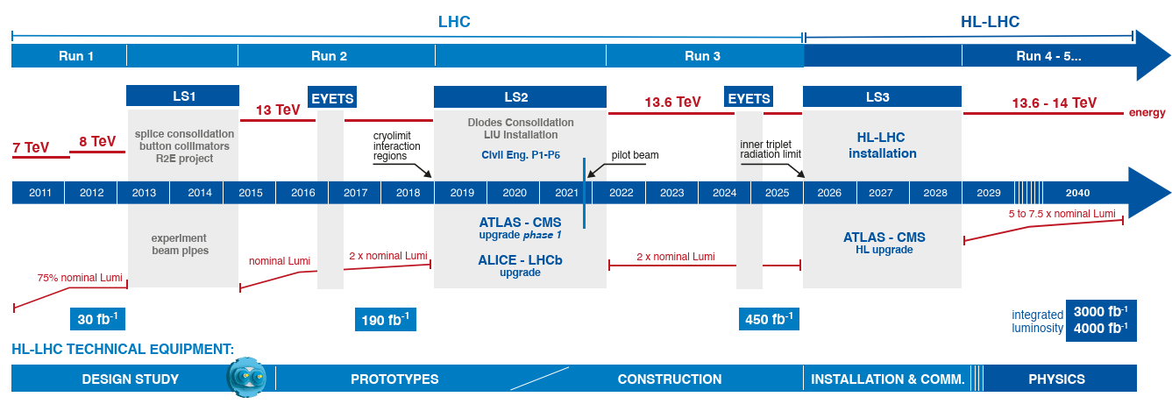
HL-LHC Project Roadmap
Today
2024-25: radiation limit of the
final focusing system
Qualifications for the HL-LHC Vacuum System, V. Baglin, ISSS9, Japan (online) 29 November 2021

Slide 11
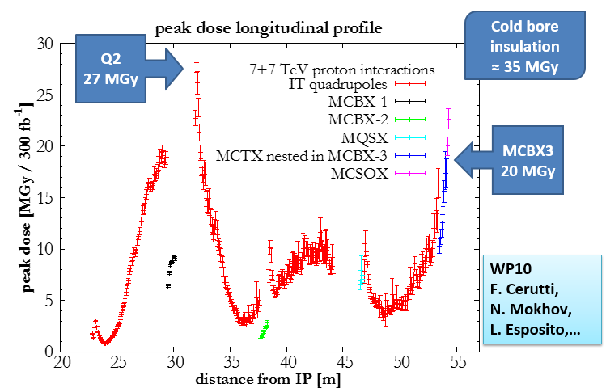
The 1st technical trigger of the upgrade:
Radiation damage in low-beta triplet region
L. Rossi
The Shielded Beam Screens (BS) are key devices of the HL-LHC project
Qualifications for the HL-LHC Vacuum System, V. Baglin, ISSS9, Japan (online) 29 November 2021

Slide 12
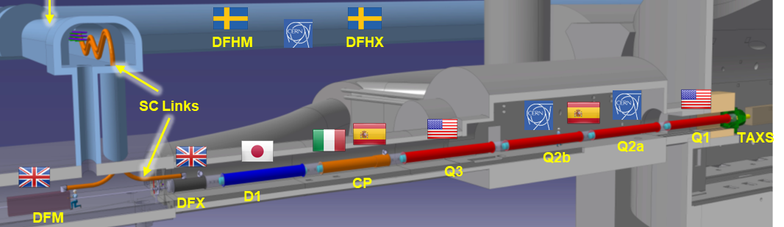
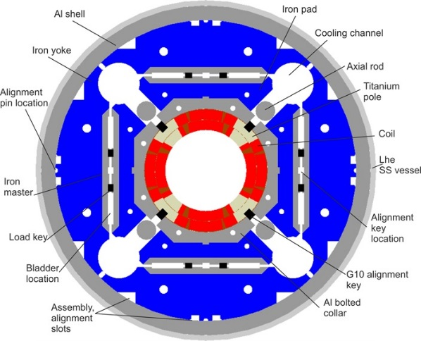
New Inner Triplet
Decrease beta (i.e beam size) at collision point (beta*) from 55 cm to 15 cm
All superconducting magnets at 1.9 K with a beam screen at 60-80K
Q1, Q2, Q3, CP (corrector package)
  Nb₃Sn (new technology)
  150 mm ID, gradient = 132.6 T/m, peak field 11.4 T
D1 NbTi (classical technology)
  150 mm, 5.6 T
Length ~60 m
HL-LHC Technical Design Report, CERN 2020-10.
Qualifications for the HL-LHC Vacuum System, V. Baglin, ISSS9, Japan (online) 29 November 2021

Slide 13
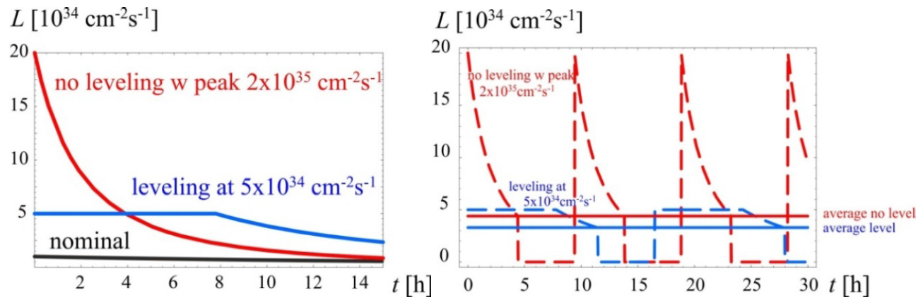
The ingredients
After LS2, LIU provide from the SPS to the LHC new bunch intensities and smaller emittance: 2.3 10¹¹ p/bunch and 2.1 µm
Using the larger IT aperture, the Achromatic Telescopic Squeezing optics gives smaller beam size at the collision point: ~ 6 µm vs 14 µm today
Doing so, the number of collision at the interaction point, increase to about 400 events/crossing. That may hamper the operation of the detector (pile-up)
Using bunch crabbing, crab cavities are used to reduce the number of events/crossing to an acceptable value for the experiments (~120 events/crossing)
Good AVAILABILITY of the machine will give INTEGRATED luminosity

Slide 14
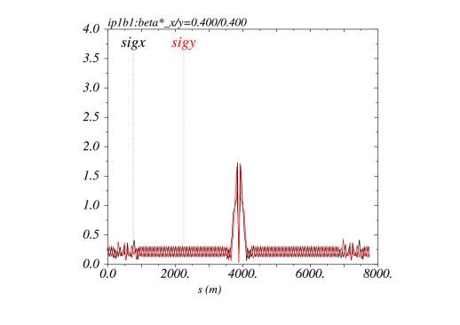
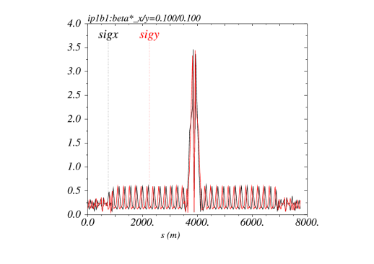

Achromatic Telescopic Squeezing (ATS)
New optic scheme deployed in LHC since Sep 2017 with low telescopic index (2.2) due to limited IT aperture
Use of the available aperture to blow-up the β function in the arcs in order to reduce further β* at the collision point
MD studies have shown that β* =12 cm could be reached with probe beams
MD studies are ongoing to further increase the luminosity with flat beams:
  ➔ 2.5 10³⁴ Hz/cm² could be reached during RUN3
LHC: 40 cm
Beam size ~14 µm
HL-LHC: 10 cm
Beam size ~ 6 µm
S. Fartoukh

Slide 15
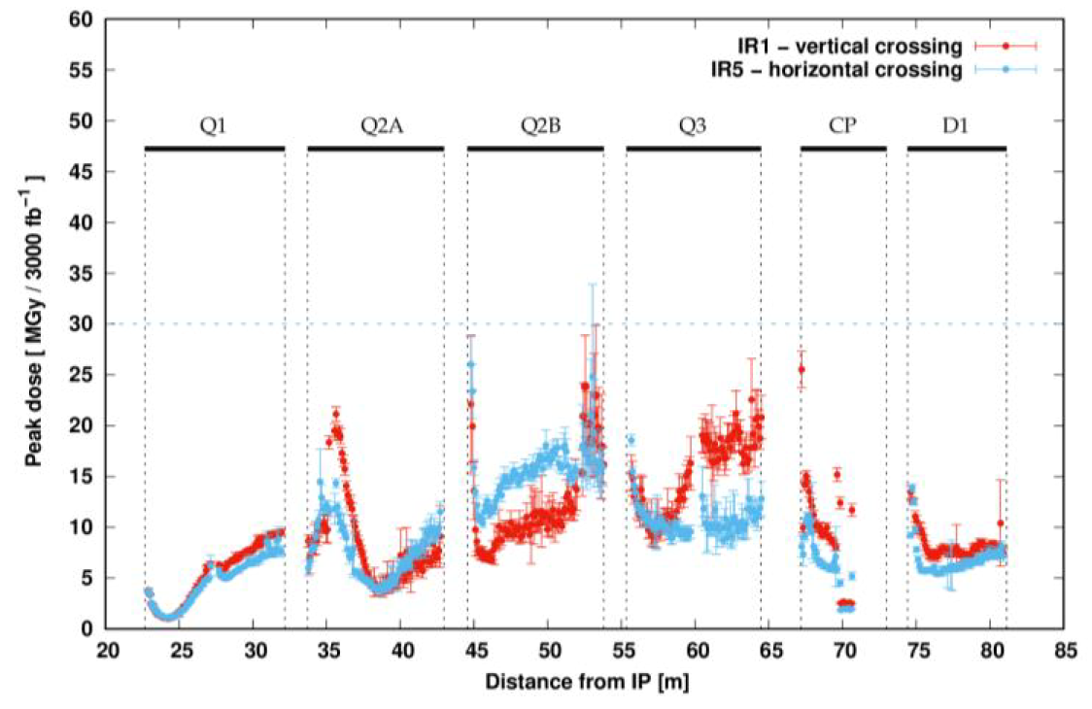
Impact of collision debris onto IT+D1
700 MJ per beam (7 TeV, 2.2 10¹¹ ppb, ~ 2800 b)
14 kW delivered in collisions, on each side:
  TAXS absorber with aperture, 60 mm, takes 750 W
  3.8 kW impact the machine ➔ shielding is needed to protect the magnet cold mass
Target :
  < 3 mW/cm³
  < 30 MGy
Mainly Q3 affected
1 kW in the cold mass
800 W in the beam screen
HL-LHC Technical Design Report, CERN 2020-10.

Slide 16
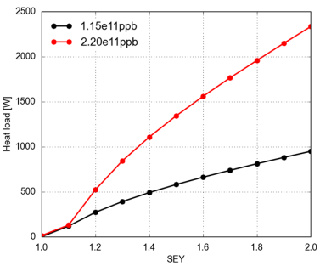
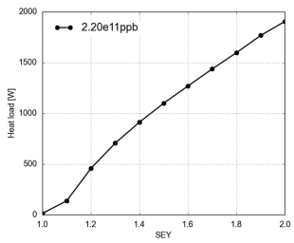
Heat load
Heat load working group to be resumed in 2015 (WP9)
  defines necessity on a-C coating with WP2 and WP12
  Total heat load on the beam screen cooling circuit IT+D1
  LHC: IR2 and 8
  HL-LHC: IR1 and 5
Acceptable
Limit = 100W ?
G. Iadarola
Need for heat load reduction for the triplets & D1 of IR1/ and IR2/8
Study in-situ coating and clearing electrodes
Optimise cooling efficiency
Identify beam screens to be treated for electron cloud

Slide 17
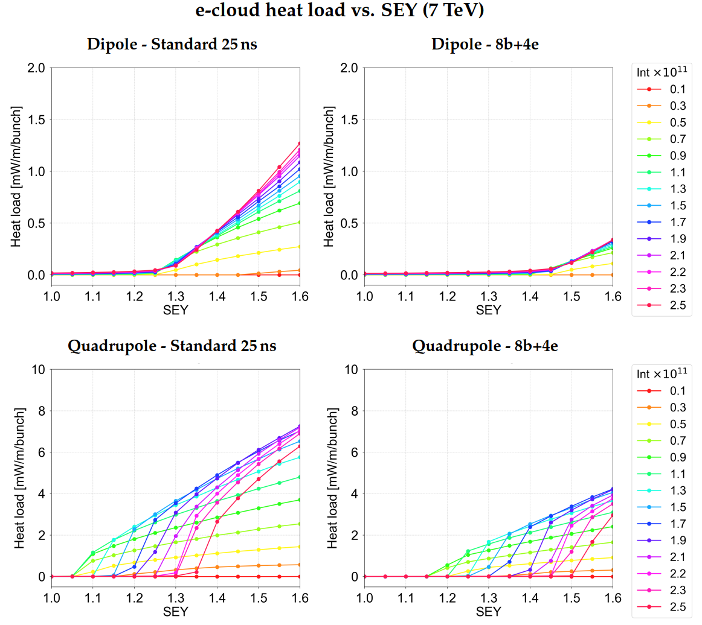
Heat load versus SEY
CERN-ACC-2019-0041, G. Skripka et al.

Slide 18
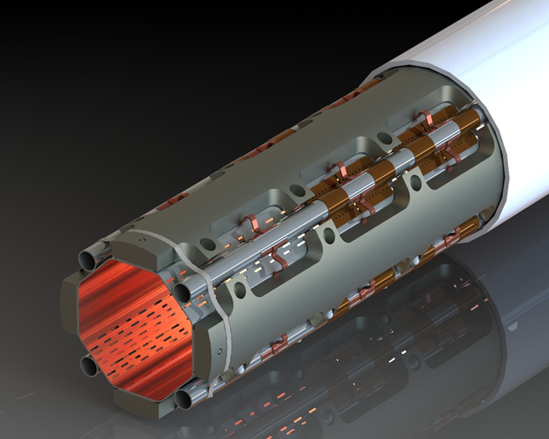
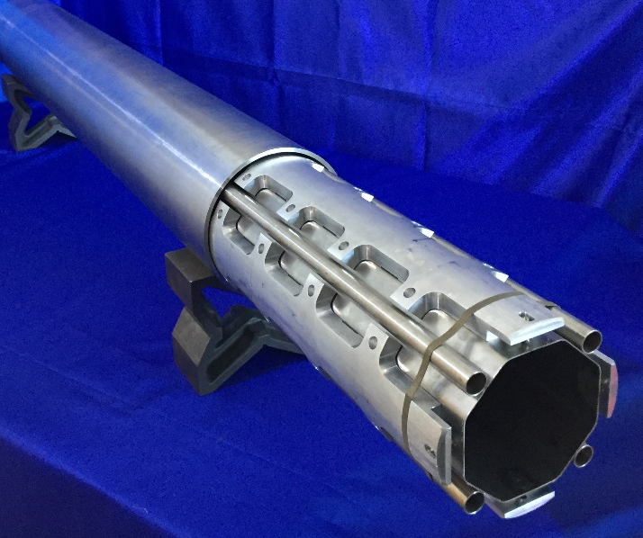
Triplet beam screens
Triplets beam screens are shielded with tungsten to intercept the debris produced at the interaction point, protecting thus the magnet cold mass
Nominal heat load on the beam screen = 15 W/m in Q2-Q3, 25 W/m in Q1.
Four cooling tubes extract the beam induced heating and maintain the beam screen temperature along the Triplet string in the 60-80 K temperature range
100-200 nm thick a-C coated onto 80 μm copper co-laminated beam screen
Length ~ 10 m, weight ~ 500 kg , transparency for pumping ~ 2 %
Cold bore
Tungsten
shielding
Cooling
tube
HL-LHC Technical Design Report, CERN 2020-10.
Courtesy C. Garion

Slide 19
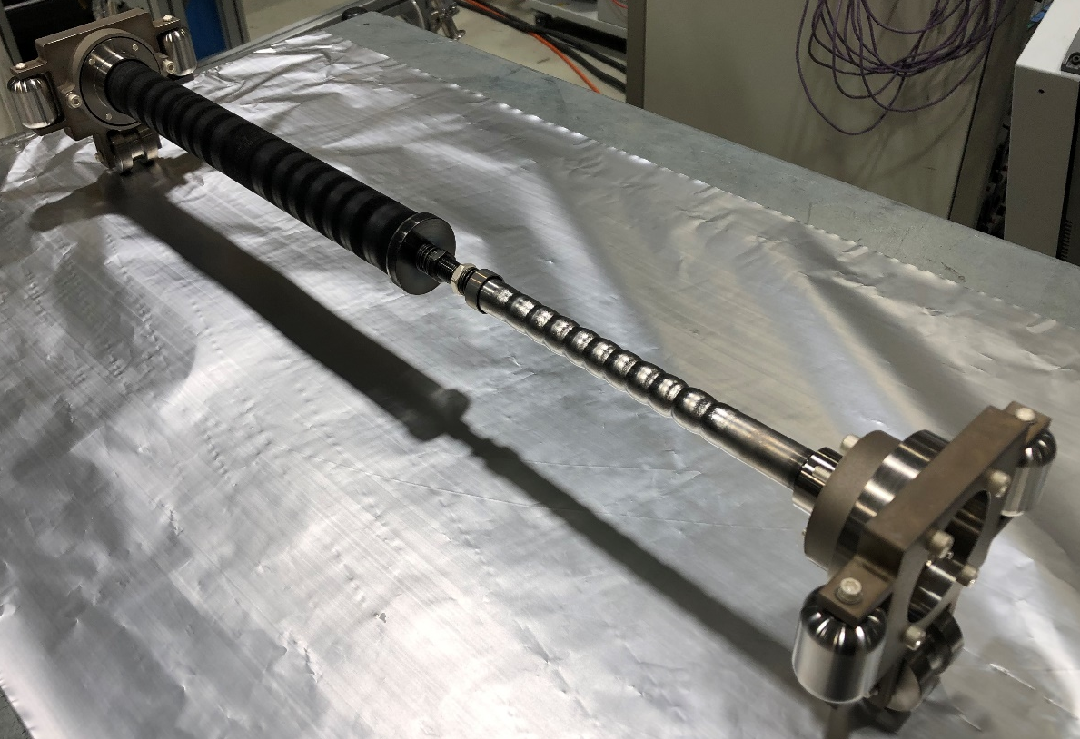
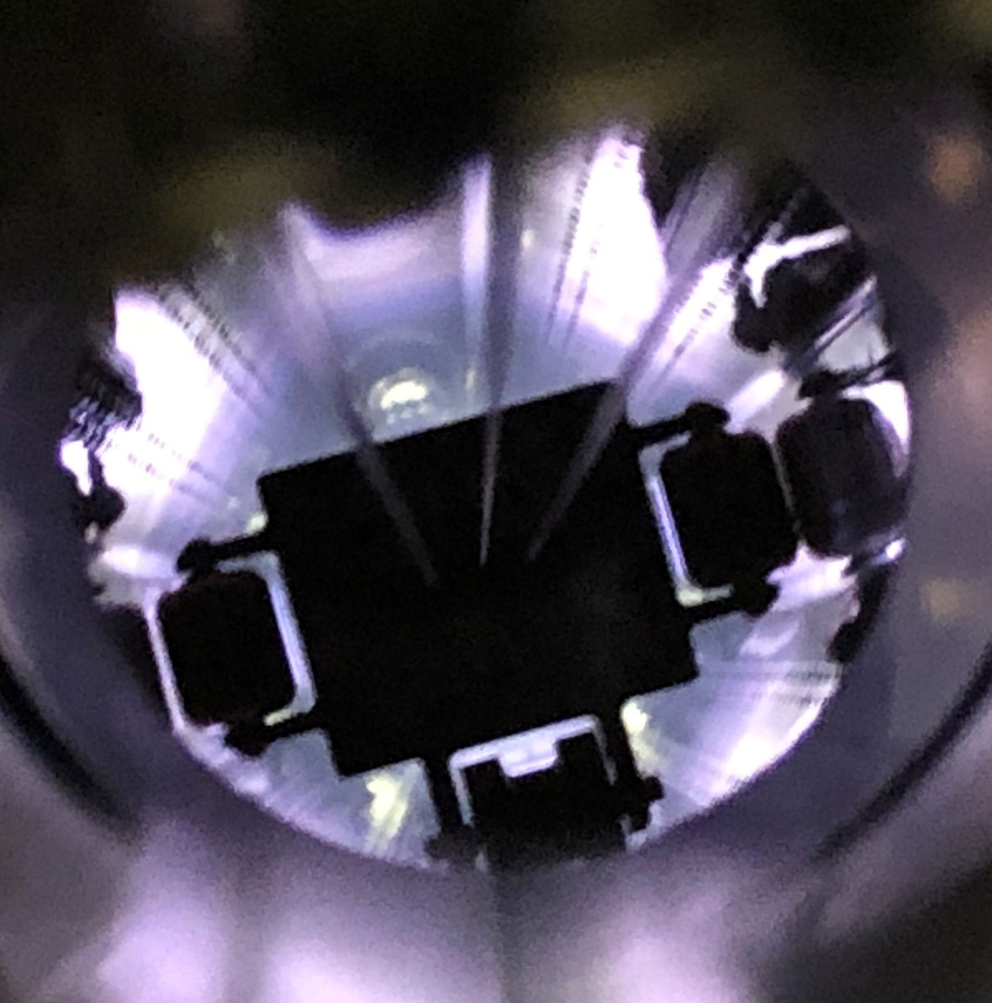
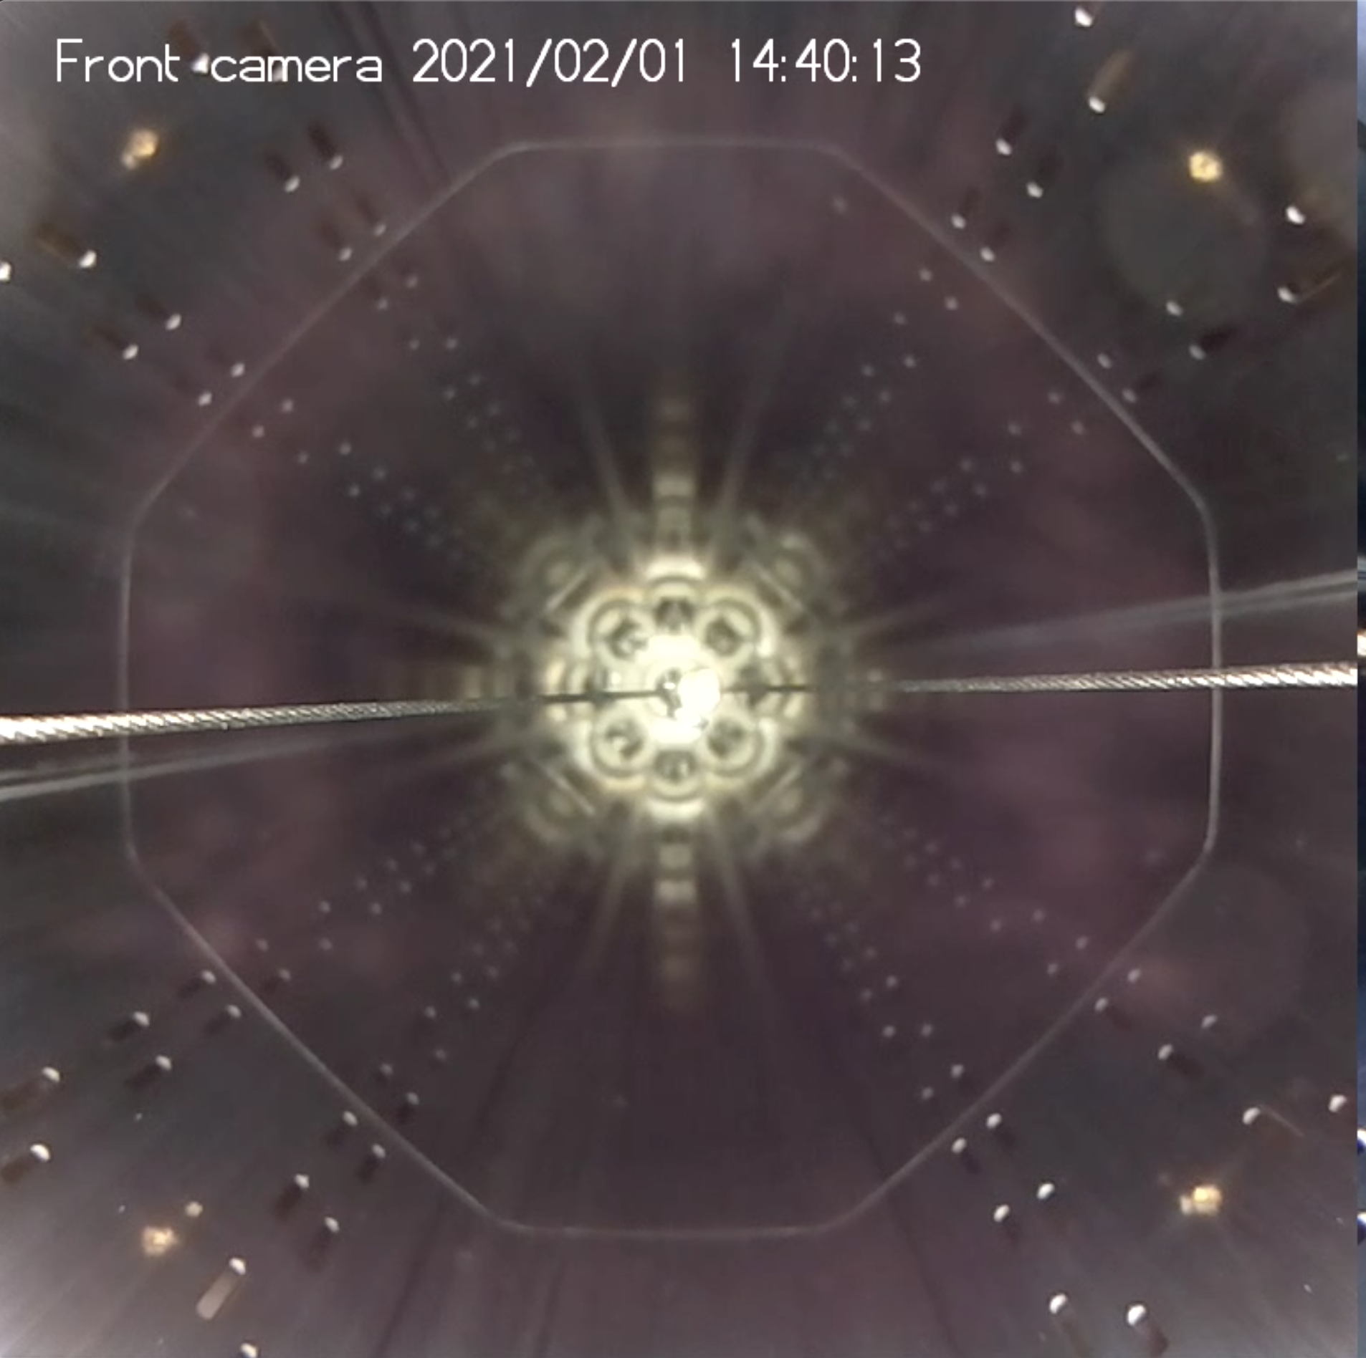
a-C coating on HL-LHC beam screen Cu surface
  Too large heat load (>600 W) originating from electron cloud are predicted for the HL-LHC IT beam screens. It will be associated with much larger than LHC background to the experiments.
  a-C coating is proposed to mitigate electron multipacting reducing electron cloud to acceptable values (P. Costa Pinto et al. Vacuum 98 (2013) 29-36).
    It has a maximum SEY of 1 +/- 0.1 ➔ no or little multipacting is expected
    Two types of coating
      “Thick” a-C coating of ~ 500 nm
      “Thin” a-C coating of ~ 50 nm with 150 nm Ti underlayer to improve adherence
  In this talk, the coating is evaluated at cryogenic temperature in the laboratory and with LHC type proton beams.
  Performance at cryogenic temperature of a-C shall be compatible with HL-LHC parameters.
Courtesy P. Costa Pinto
Qualifications for the HL-LHC Vacuum System, V. Baglin, ISSS9, Japan (online) 29 November 2021

Slide 20
2. a-C properties

Slide 21
A. Basic properties

Slide 22
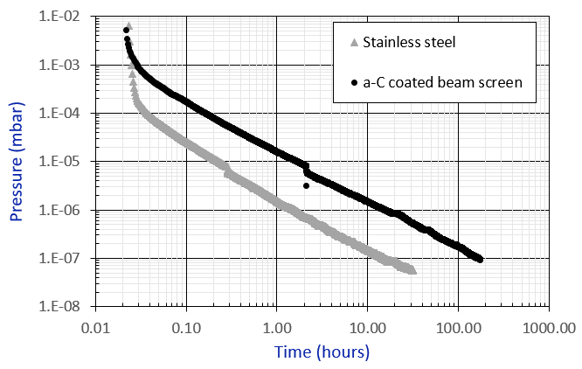
“Thin” a-C coating thermal outgassing
Unbaked 2.2 m long a-C coated Cu tube, 50 nm a-C with 130 nm Ti underlayer:
  Mass spectrum is water dominated
  x 10 unbaked stainless steel
After 10h pumping:
  Stainless steel = 3 10⁻¹⁰ mbar.l/s/cm²
  a-C coating = 3 10⁻⁹ mbar.l/s/cm²
*
x 10
*COLDEX beam screen
V. Badin, unpublished.
➔ The coating is porous
Qualifications for the HL-LHC Vacuum System, V. Baglin, ISSS9, Japan (online) 29 November 2021

Slide 23
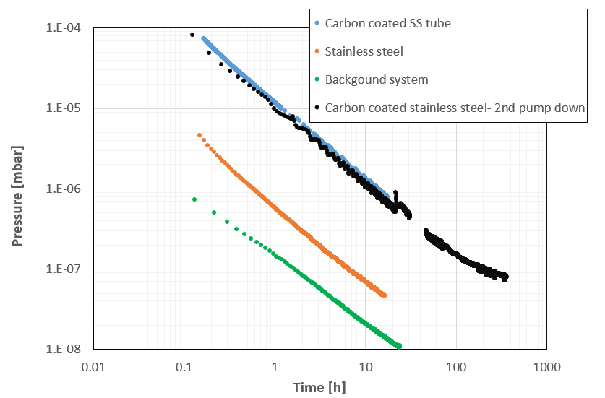
“Thick” a-C Coating and Thermal Outgassing
Unbaked a-C coated stainless steel tube, 450-500 nm thick:
  Mass spectrum is water dominated
  x 30 unbaked stainless steel
  2nd pump down very similar to 1st one
After 10h pumping:
  Stainless steel = 2 10⁻¹⁰ mbar.l/s/cm²
  a-C coating = 6 10⁻⁹ mbar.l/s/cm²
x 30
I. Wevers

Slide 24
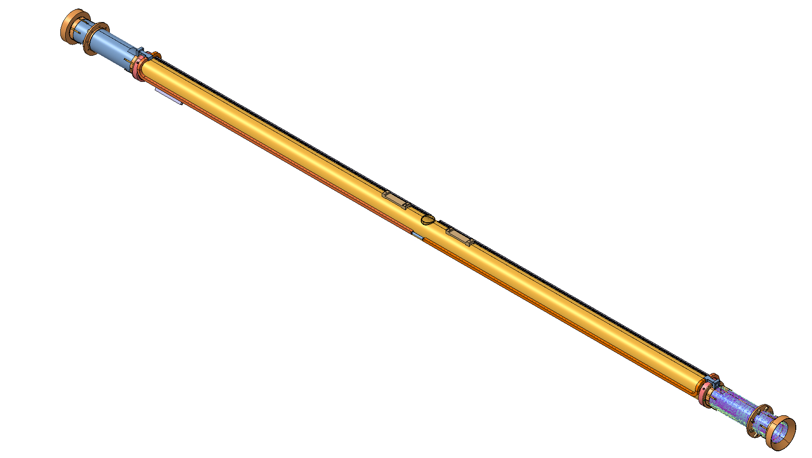
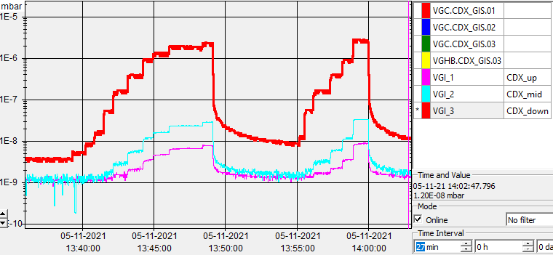
“Thin” a-C coating sticking probability
The sticking probability was measured by gas transmission along a 2.2 m long for “thin” a-C coated Cu tube* (50 nm a-C with 130 nm Ti underlayer).
Using monte carlo computation the following sticking probabilities are obtained
Upstream
mid
Downstream
RT Gas injection
Downstream
mid
Upstream
T(K) | 10 | 20 | 40 | 60 | 90
H₂ | 0.2 | 0.2 | 0 | 0 | 0
CO | 1 | 1 | 1 | 1 | 0
*COLDEX beam screen

Slide 25
B. Defining the operating temperature: Isotherms

Slide 26
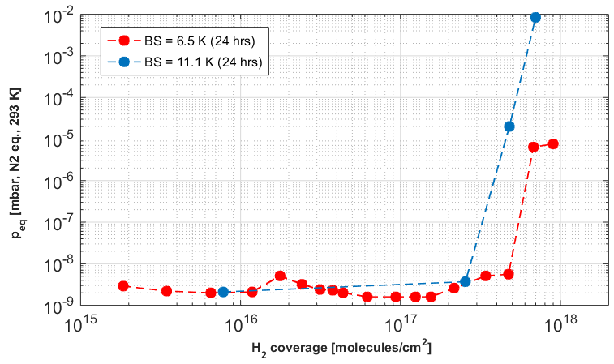
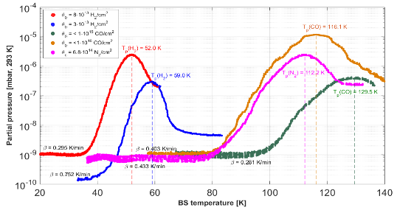
Impact of porosity
Adsorption isotherm and thermal desorption spectroscopy of a 2.2 m long “Thick” a-C coating beam pipe (COLDEX beam screen)
N₂
H₂
CO
R. Salemme et al. Proc. of IPAC2016, Busan, Korea.
R. Salemme. PhD Thesis La Sapienza University, Roma, Oct 2016.
The cryosorption capacity for H₂ is
    ≥ 2∙10¹⁷ H₂/cm² below 10 K
It is intermediate between metallic surfaces and common cryosorbers
H₂ is physisorbed below 35 K
N₂ and CO are adsorbed below 80 K
The activation energy for desorption is dependent on the surface coverage
➔ The HL-LHC beam screen operating temperature must be optimised
Qualifications for the HL-LHC Vacuum System, V. Baglin, ISSS9, Japan (online) 29 November 2021

Slide 27
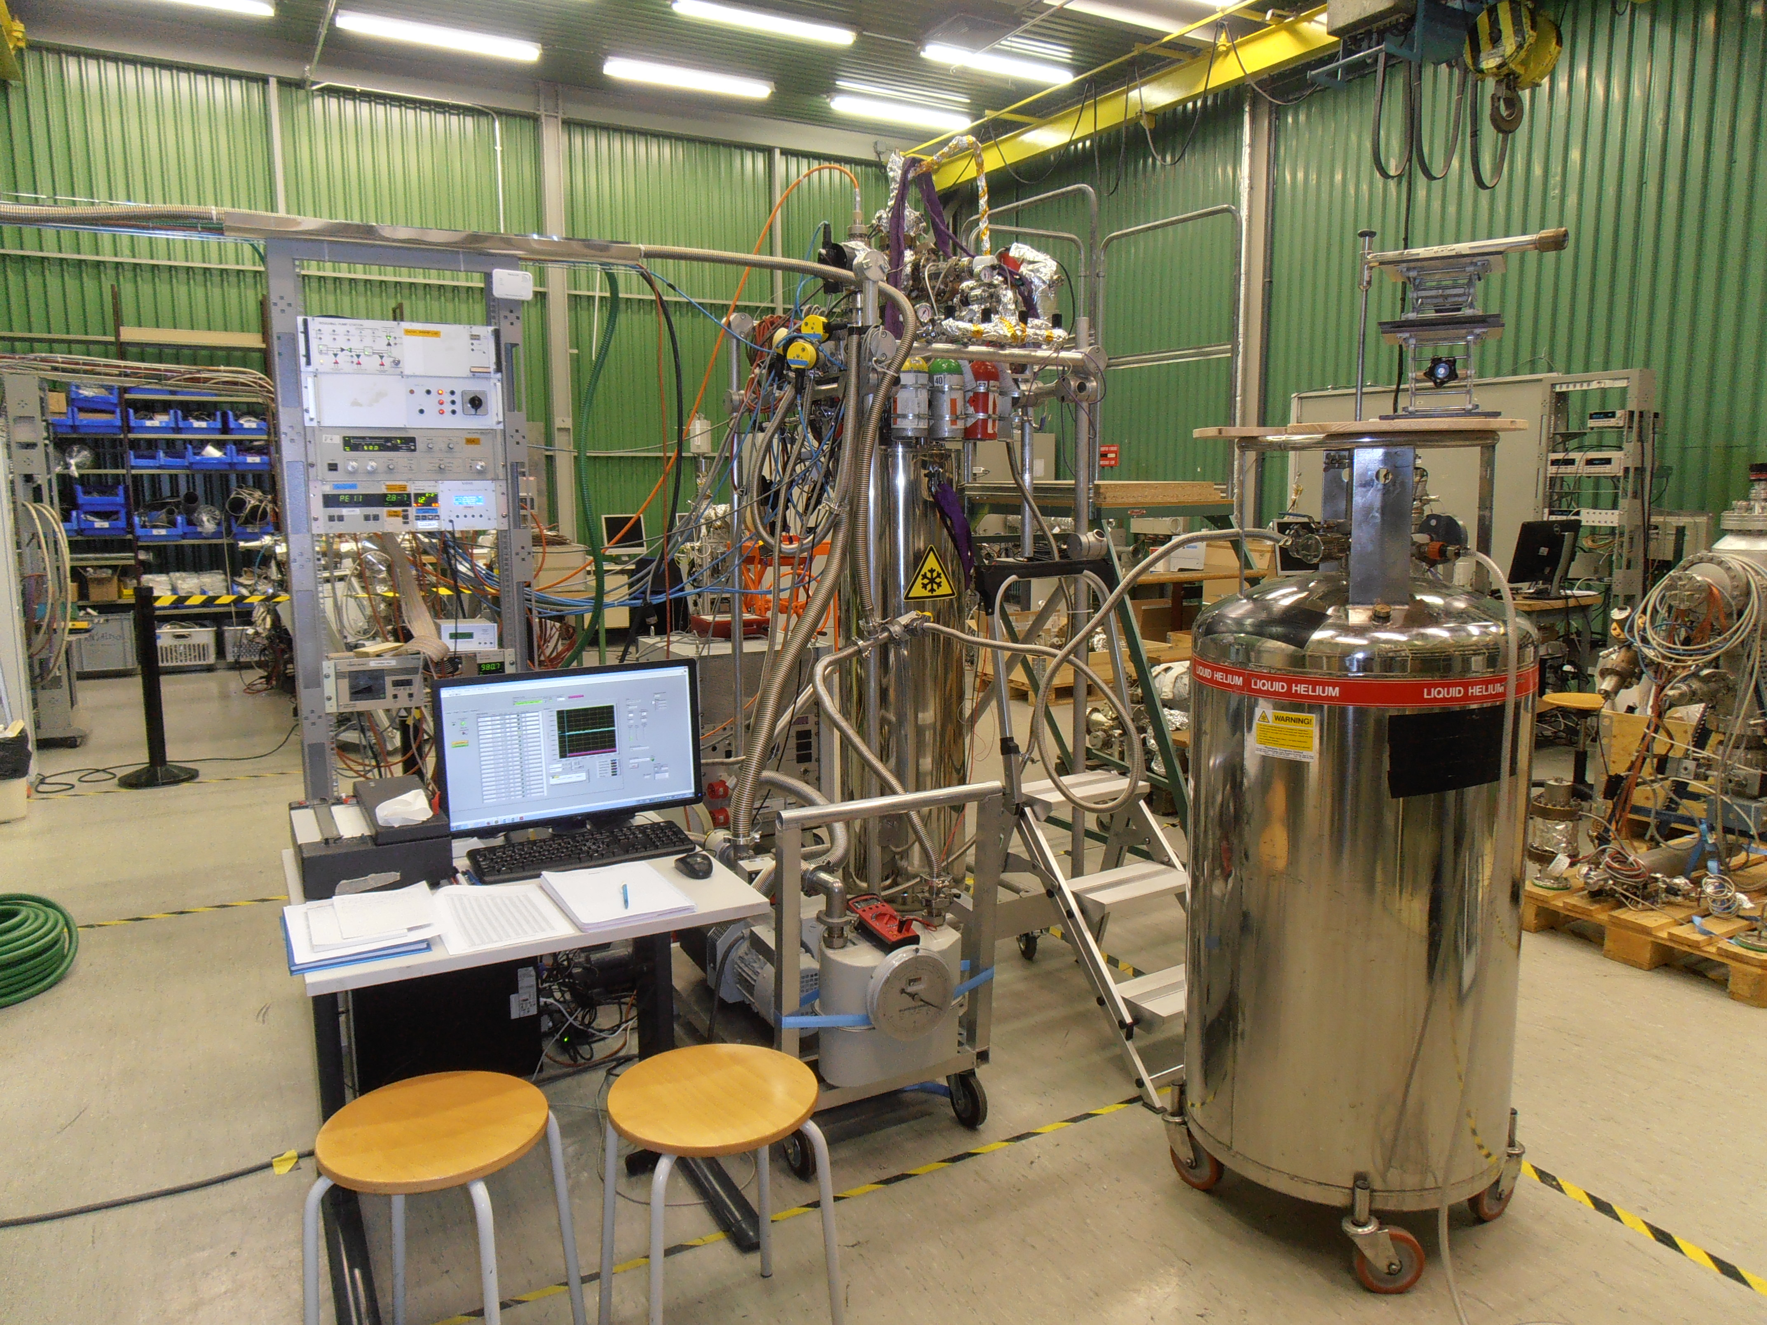
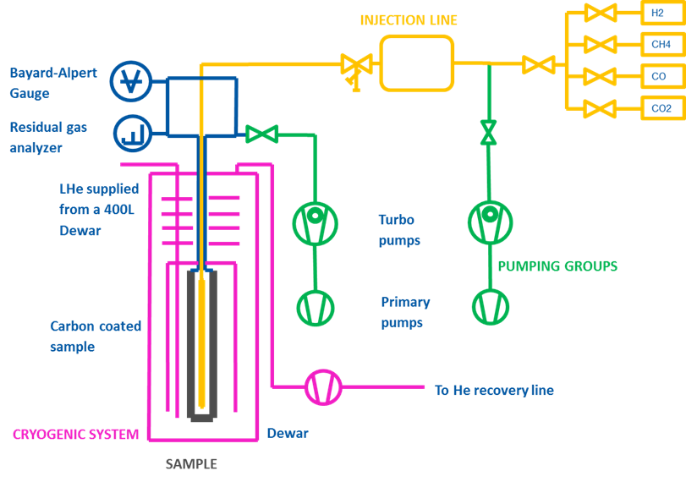

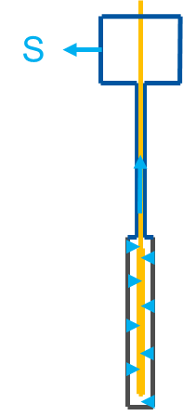
ADsorption Isotherm & thermal desorption Spectroscopy:
ADIS
A 67 cm long bottle-like a-C coated Cu sample is immersed in a cryogen
Adsorption isotherms are obtained at 4,2 or 77 K by measure of the equilibrium pressure as a function of the admitted quantity of gas via a tube
A thermal desorption spectrum is obtained by letting the system warming up while under external pumping
“thick” a-C coating of 500 nm were qualified

Slide 28
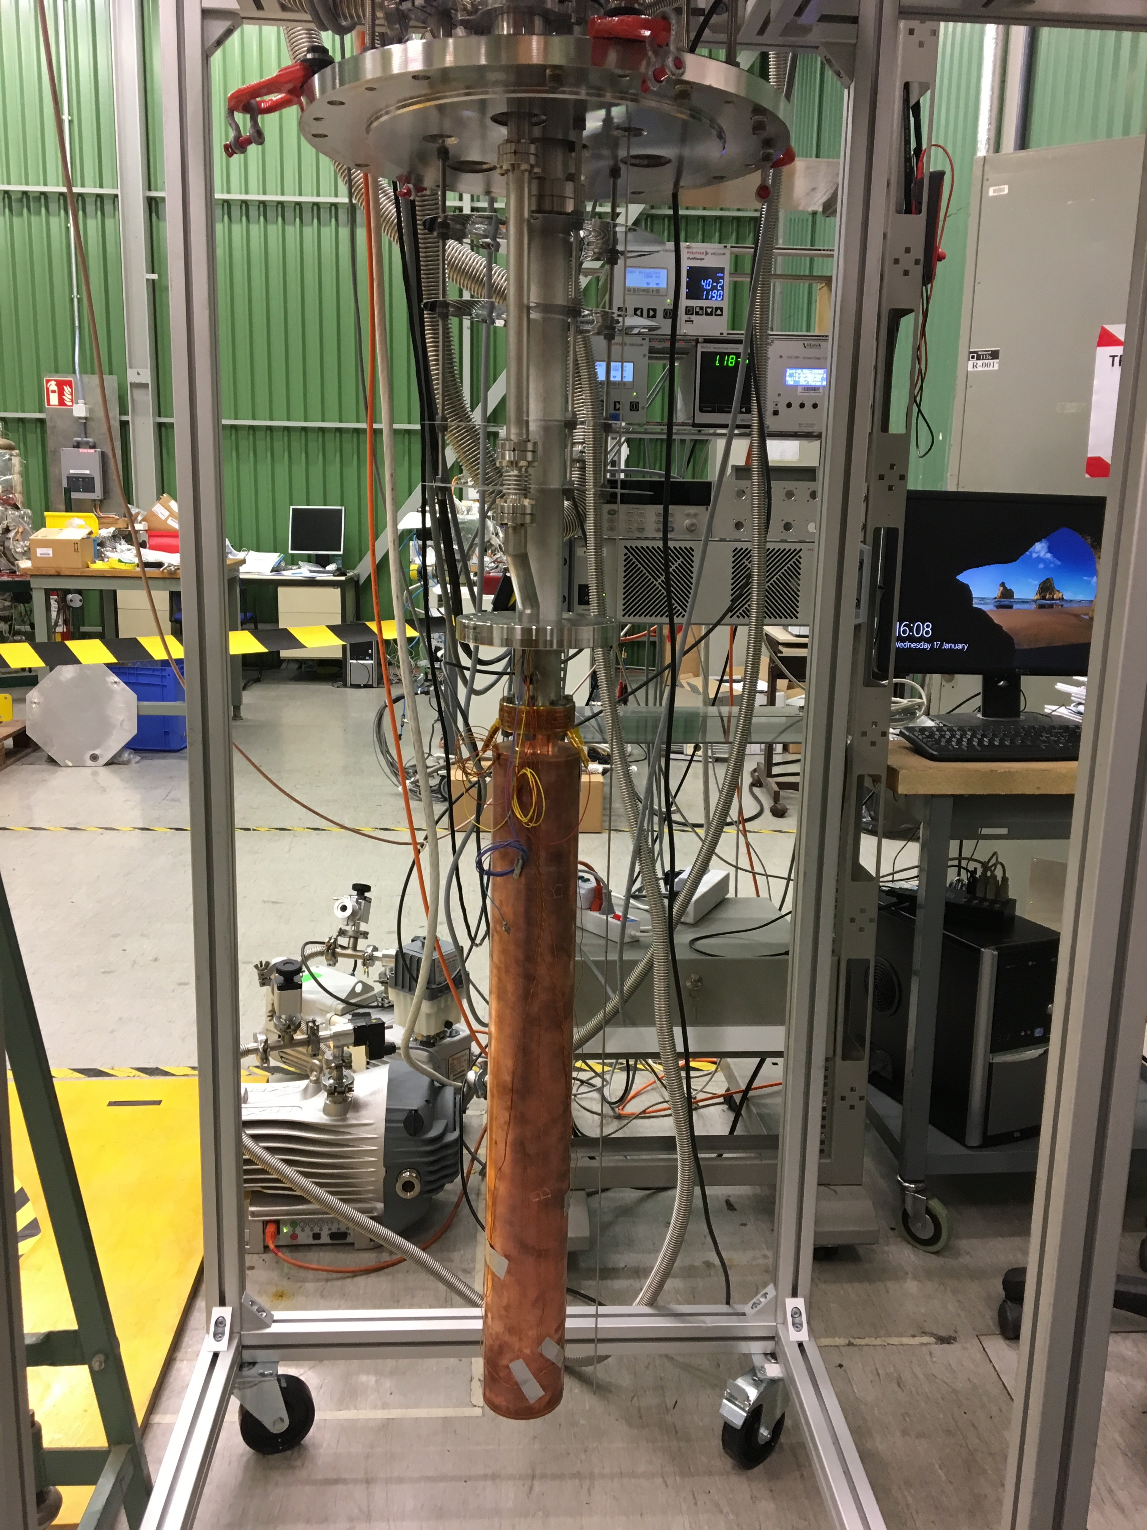
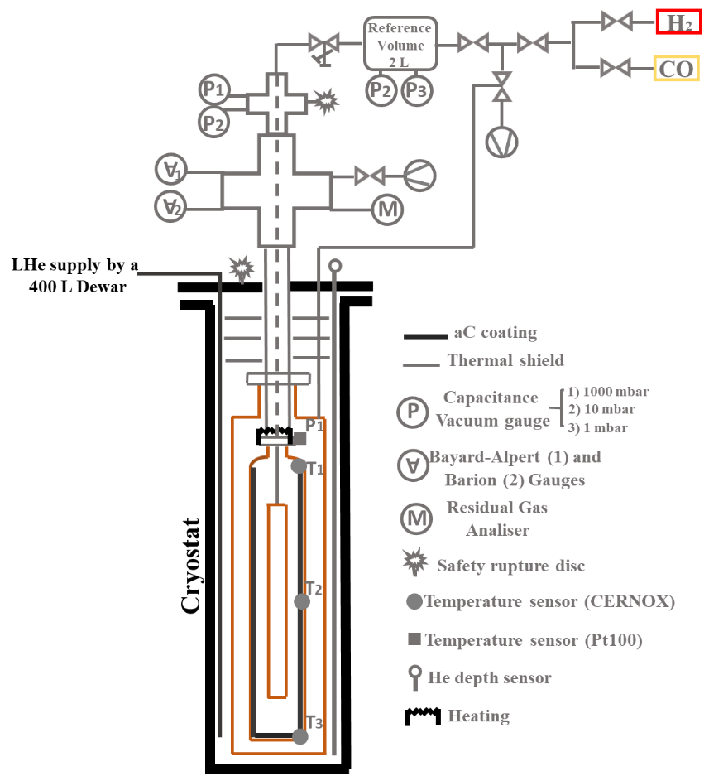
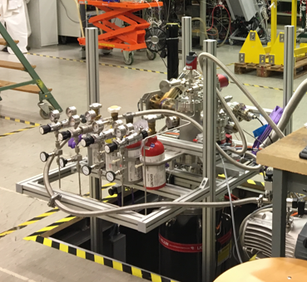
Cryogenic Isotherms and Thermal desorption Measurements:
CISTM
The sample is inserted in a secondary vacuum vessel, thus screened from the cryogen. By acting on the secondary vacuum level and a heater, the sample temperature can be controlled in the 4 to 100 K range
Adsorption isotherms for “thick” and “thin” a-C coating (resp. 100, 500 nm) were obtained for H₂ and CO.

Slide 29
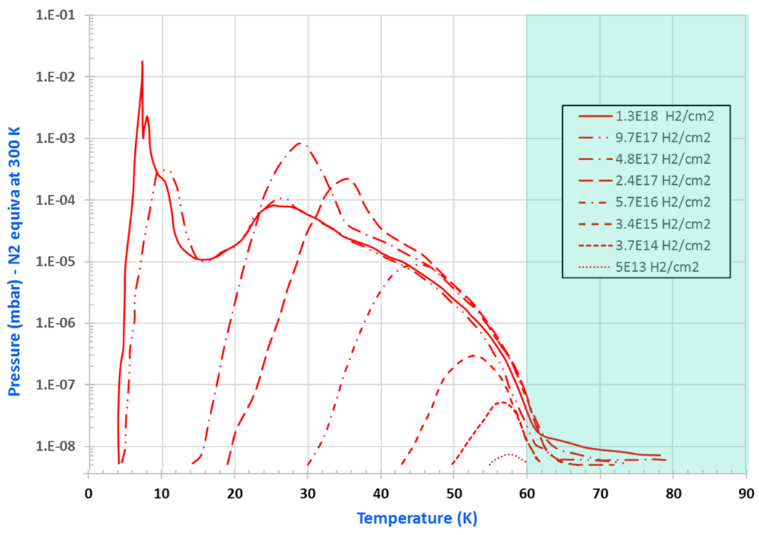
“Thick” a-C coating
  The H₂ saturated vapour pressure is reached when more than one monolayer of gas is physisorbed
  At 4.2 K, the monolayer capacity of a-C is
  much more than the one of Cu (3×10¹⁵ H₂/cm²)
  Thermal desorption spectra for different surface coverages of thick aC coating suggest an operating temperature above 60 K
 | Cu | “Thin” a-C | “Thick a-C
× 3 10¹⁵ H₂/cm² | 1 | 10 | 330
Peak | 40-60 K (molecule/cm²) | 60-80 K (molecule/cm²)
H₂ | Any coverage | No coverage
CH₄ | > 10¹⁷ CH₄/cm² | > 5 10¹⁶ CH₄/cm²
CO | > 2 10¹⁶ CO/cm² | > 5 10¹⁵ CO/cm²
CO₂ | > 10¹⁸ CO₂/cm² | > 10¹⁷ CO₂/cm²
A-L. Lamure et al., 64th AVS, Tampa, FL, USA, 2017

Slide 30
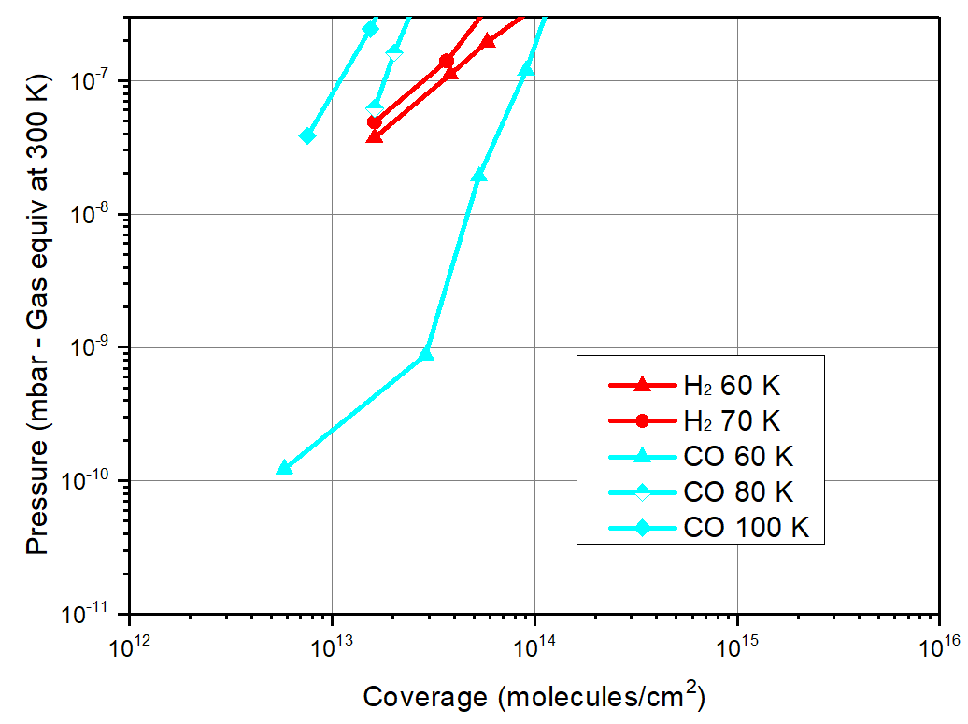
“Thin” a-C coating
Adsorption isotherms of “thin” aC coating in the 60-80 K range confirms that, under UHV conditions, the surface coverage remains < 10¹³ molecules/cm²
R. Cabezas, V. Baglin, unpublished
➔ The HL-LHC beam screen will operate in the 60-80 K range

Slide 31
C. Electron-surface interaction at cryogenic temperature

Slide 32
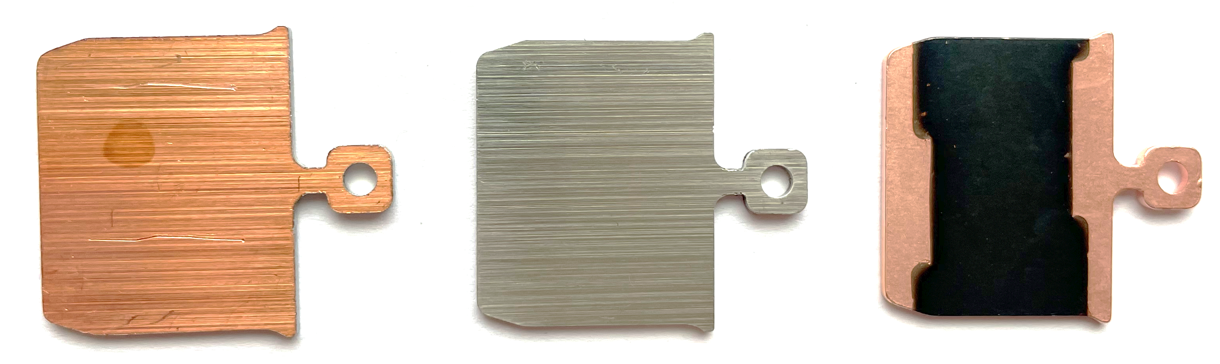
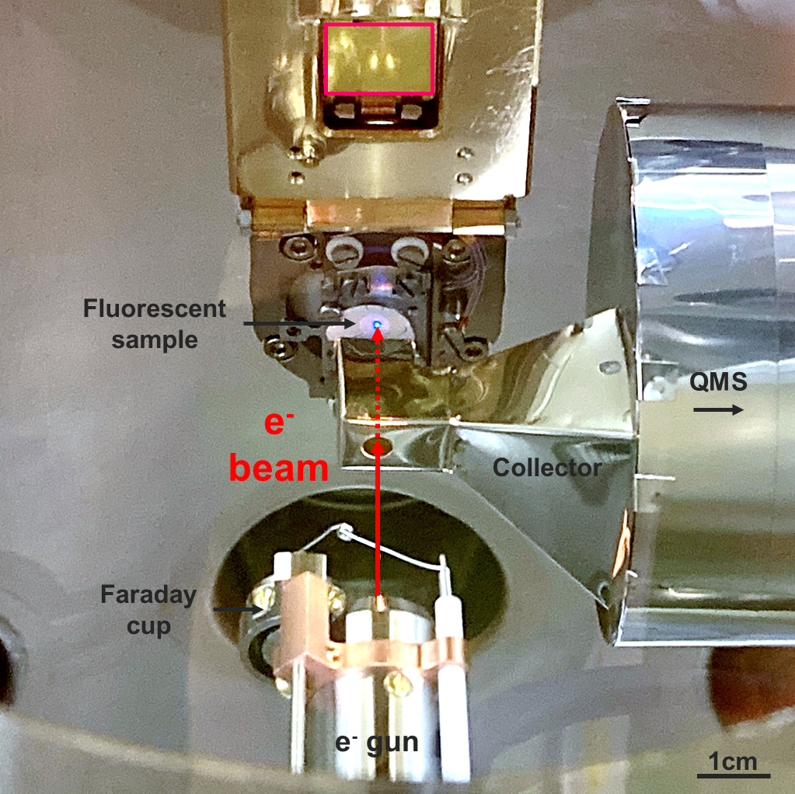
Multisystem description
Cu
SS
a-C
  Load lock: unbaked samples!
  P = 10⁻¹¹ mbar
  mu-metal chamber
  Sample at 10-300 K
  Two Faraday cups
  Electron gun:
    0-1.5 keV
    1 mm²
  ESD, SEY measurement
B. Henrist et al. CERN-2020-007, Proc. Of Ecloud’18, Isola d’Elba, Italy, 2018.

Slide 33
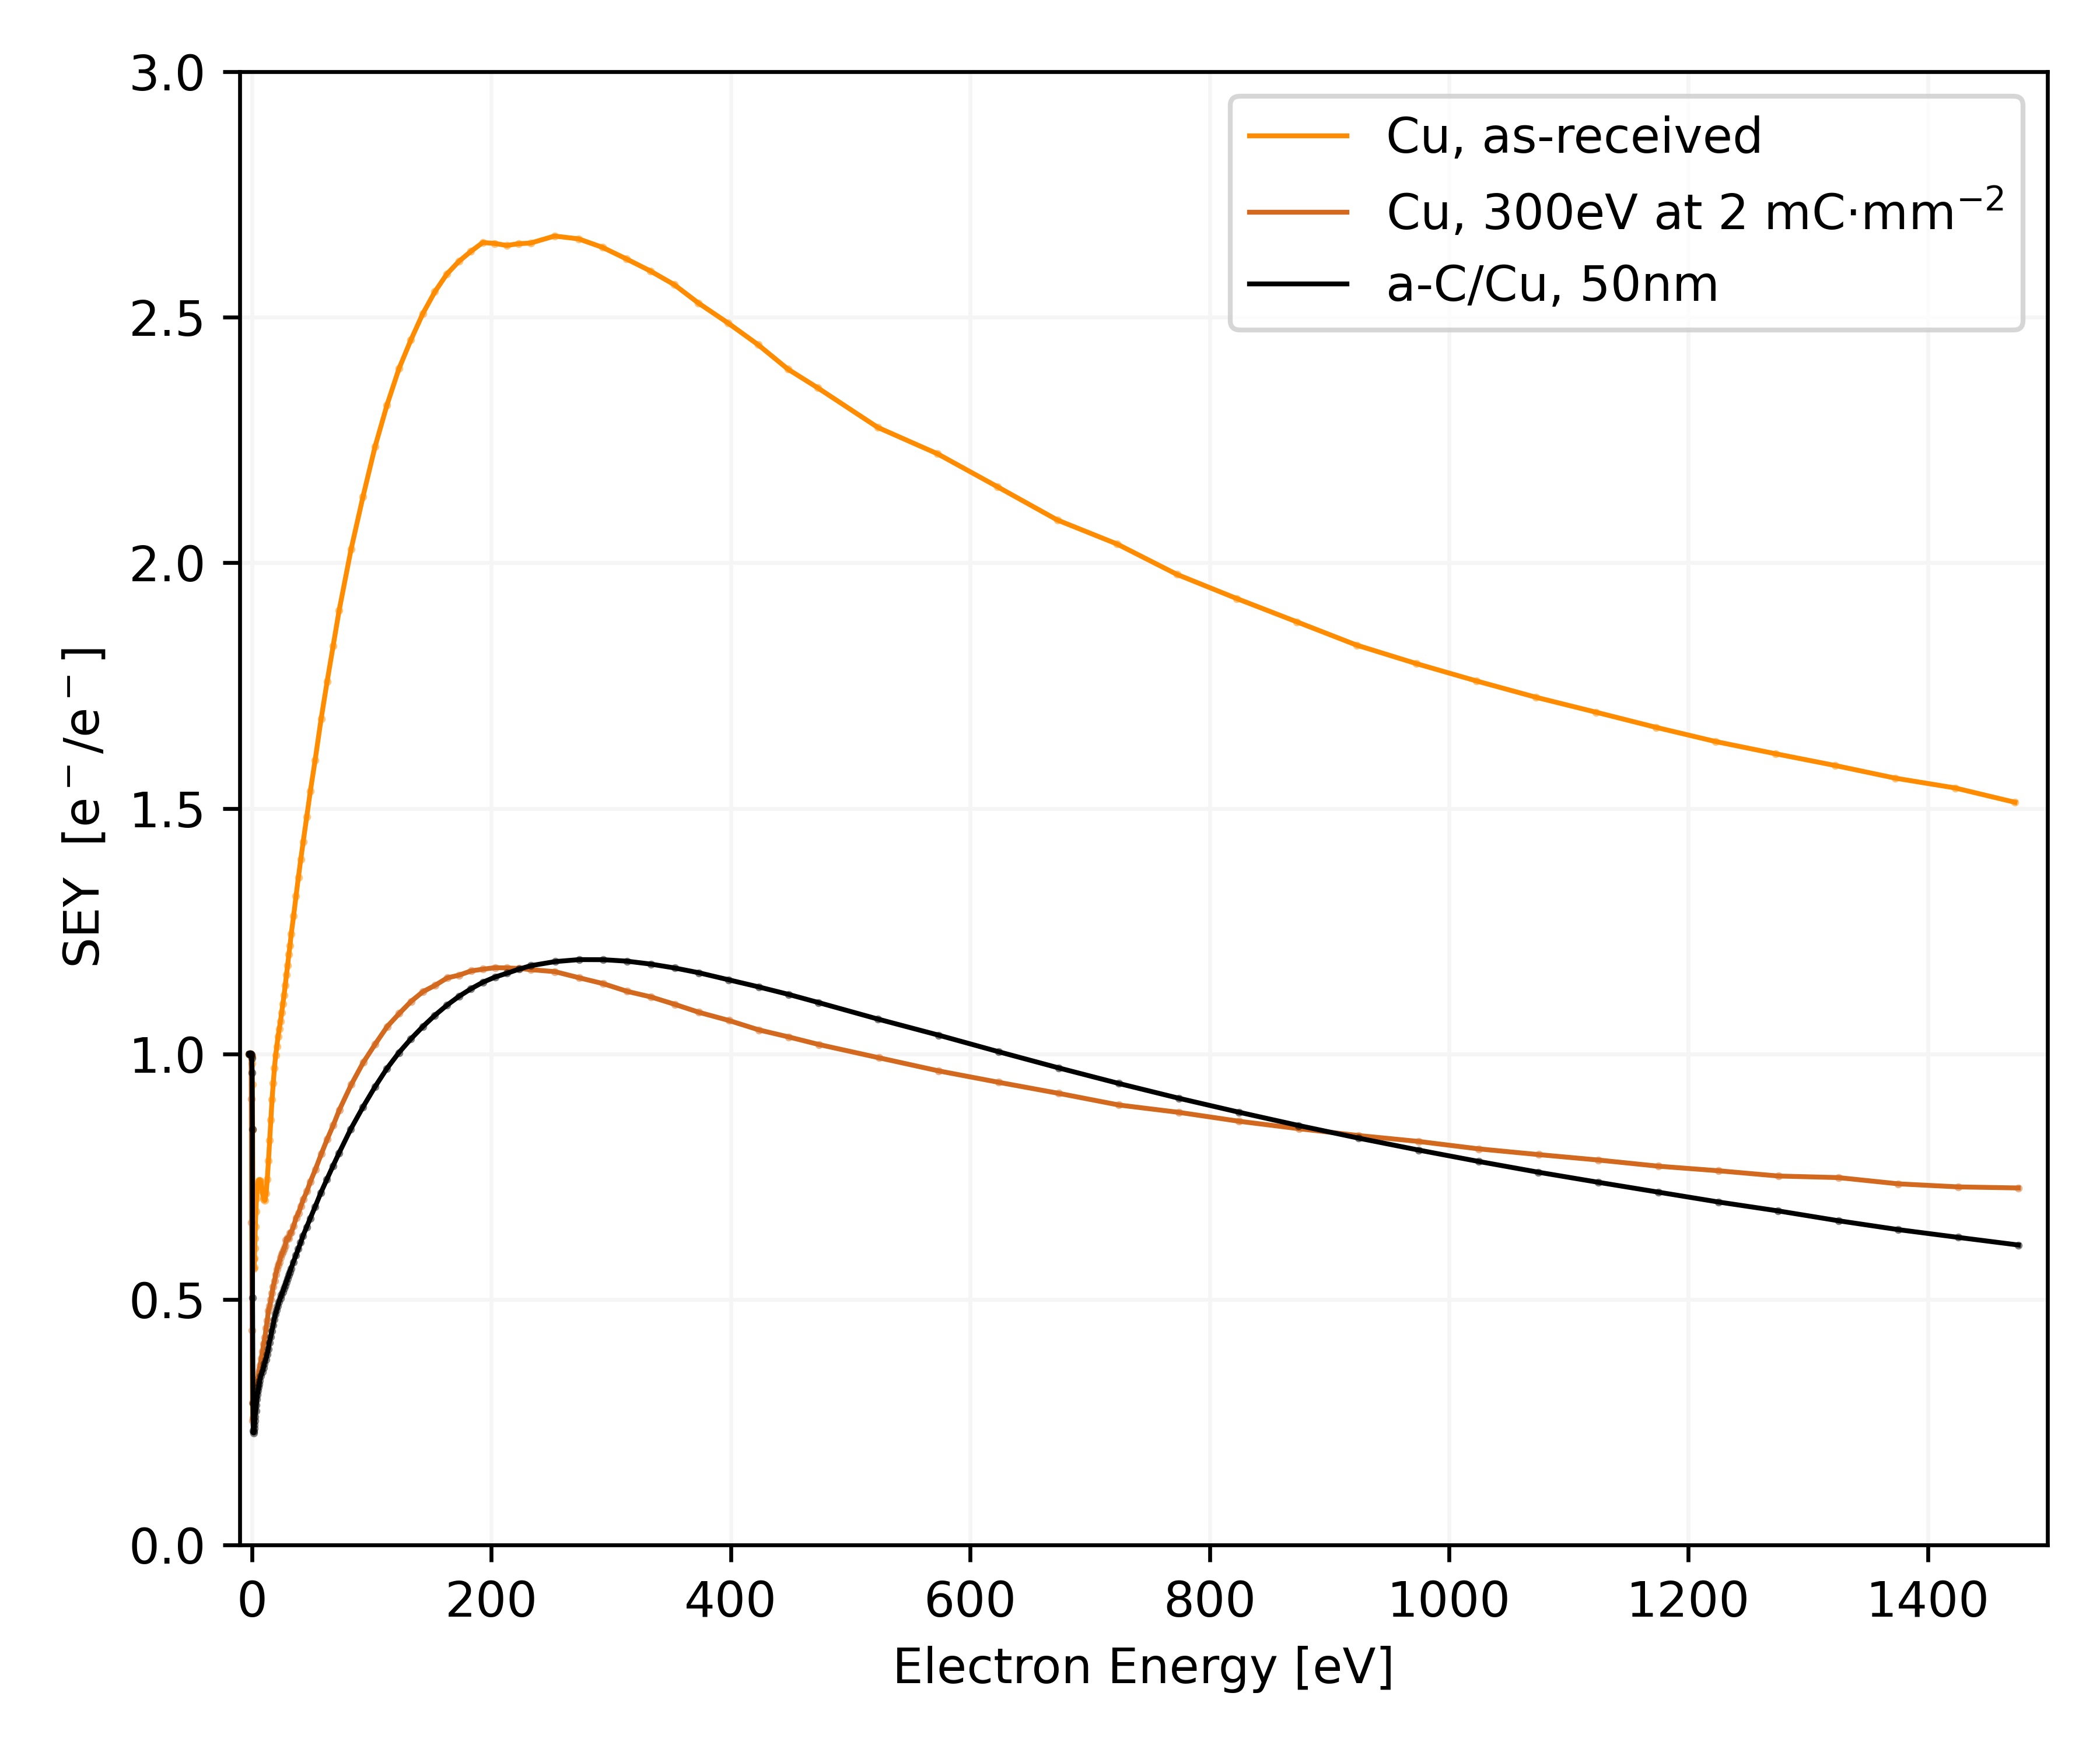
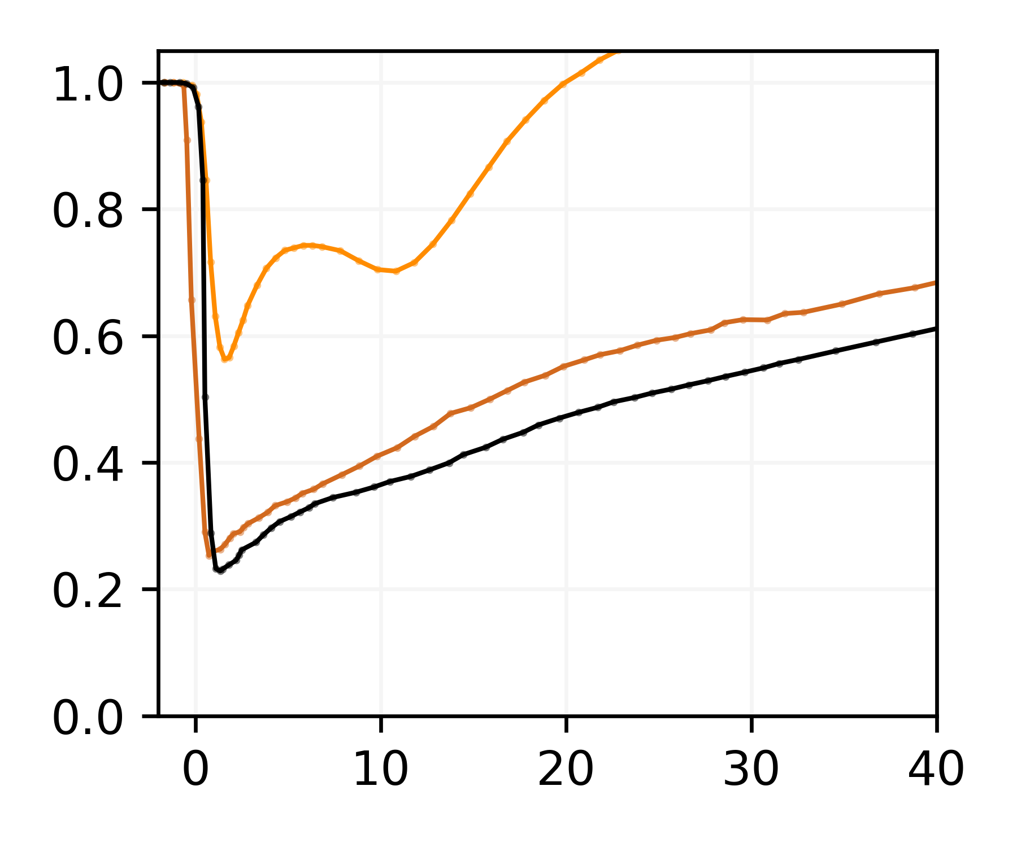
Secondary Electron Yield at 15 K
Cu is conditioned under electron bombardment: graphitisation process
“Thin” a-C coated δ_{max} = 1.15
No structure at low energy
δ_{max}=1.15
M. Haubner et al. EVC-16, Marseille, Nov. 2021
*a-C/Cu = COLDEX-witness
  ➔ “Thin” a-C coating can be used as an anti-multipactor treatment for accelerator operation at cryogenic temperature

Slide 34
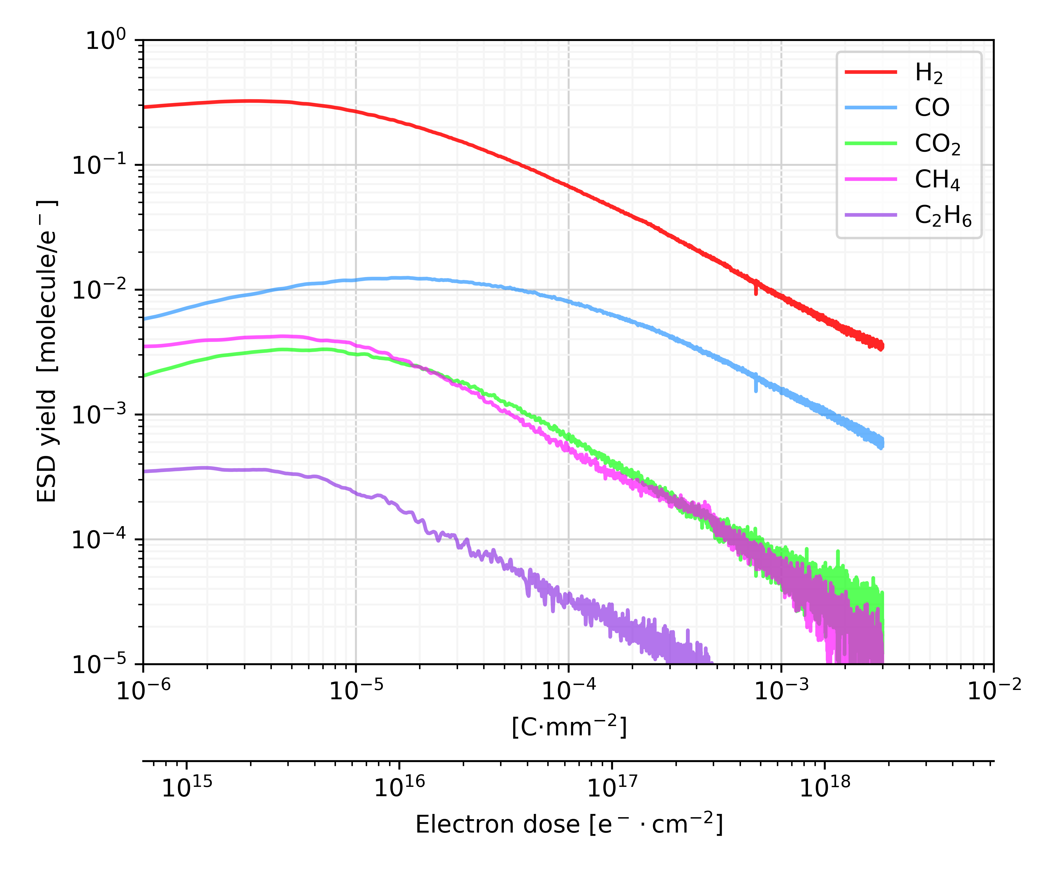
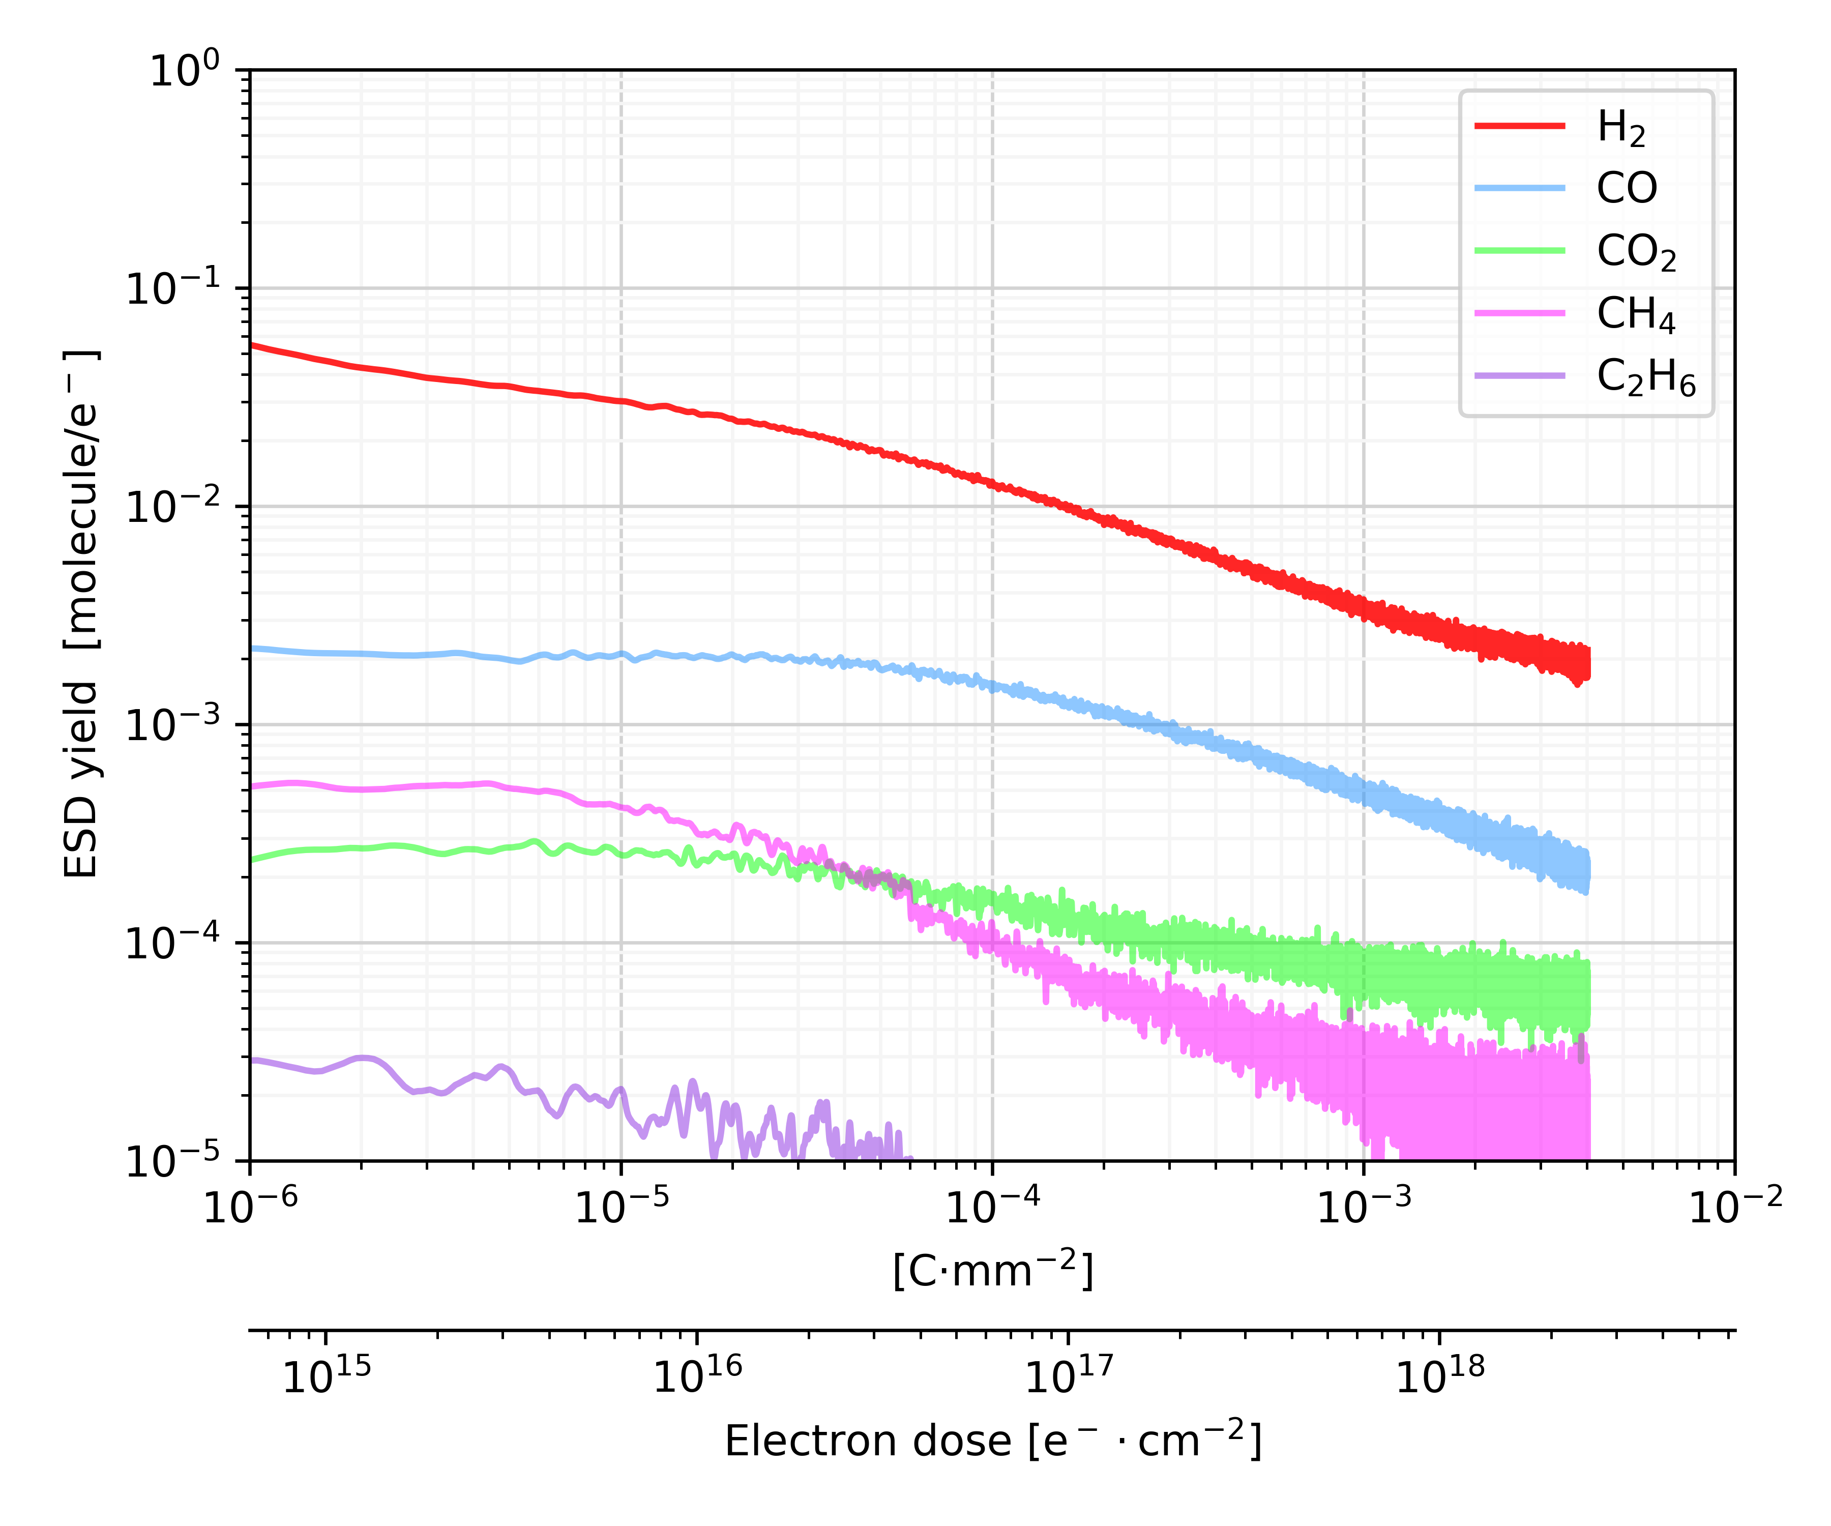
Electron Stimulated Desorption yield at 15 K
H₂, CH₄, CO, CO₂ desorbs under 300 eV electron bombardment
“Thin” a-C has smaller yields than Cu that also reduce under electron bombardment
Cu
a-C/Cu
M. Haubner et al. EVC-16, Marseille, Nov. 2021
*a-C/Cu = COLDEX-witness
  ➔ At cryogenic temperature, gas loads for Cu and “Thin” a-C coating are similar

Slide 35
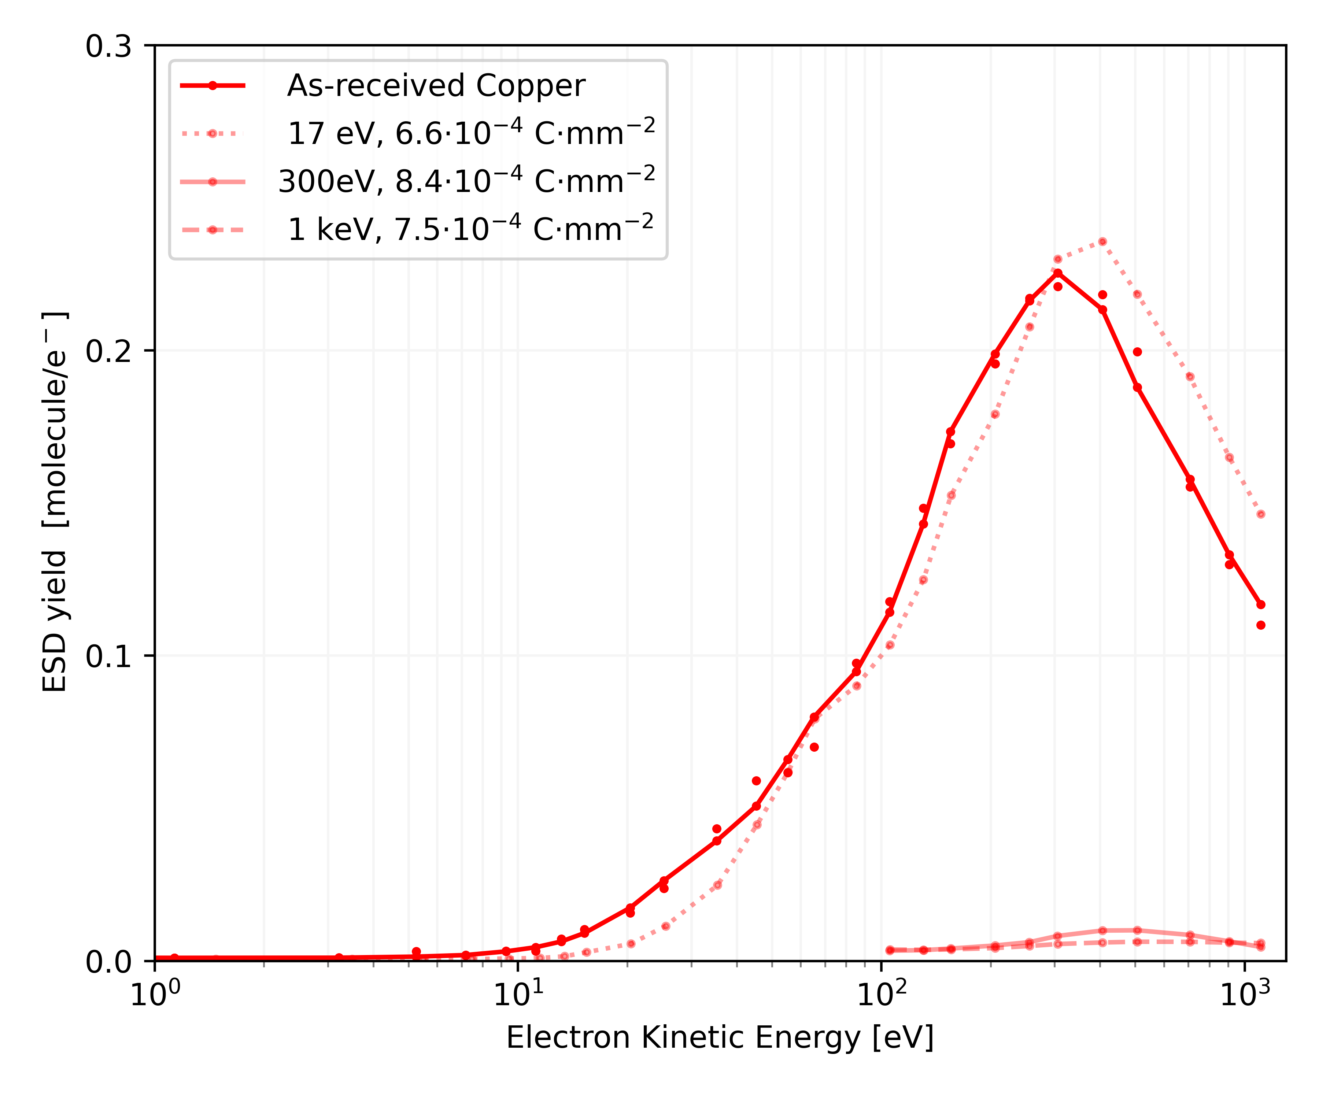
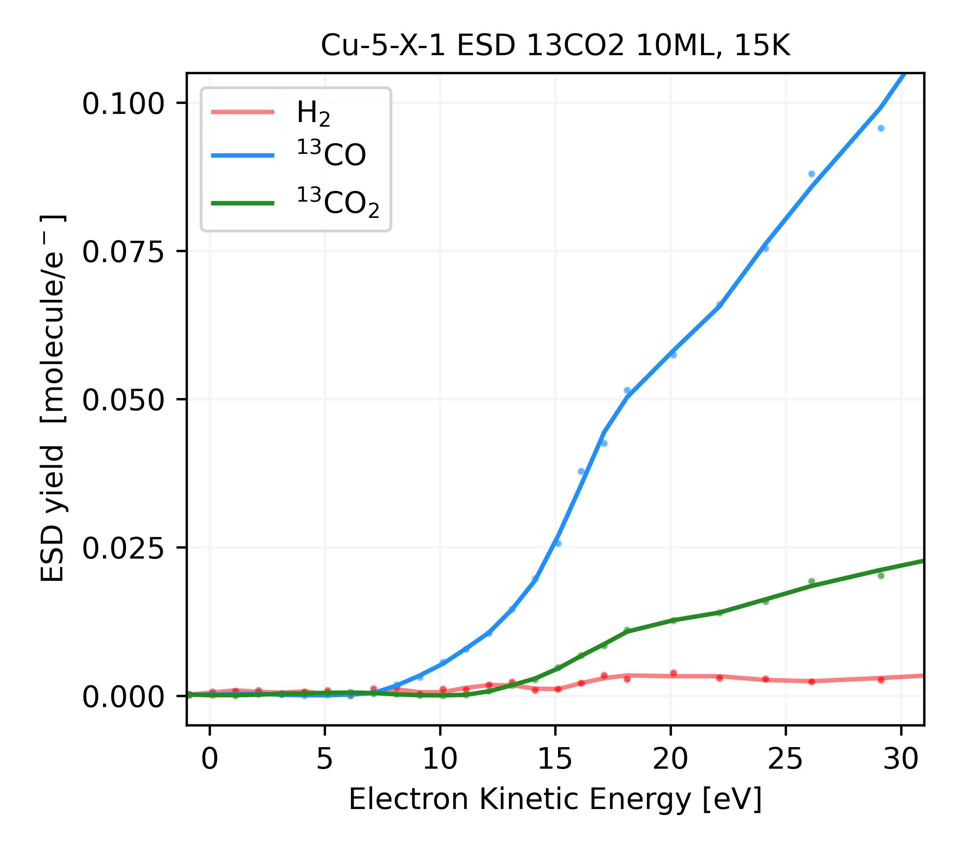
ESD threshold at 15 K
Desorption threshold is at ~ 10 eV for H₂ from Cu and ¹³CO₂ ice
¹³CO₂ dissociates into ¹³CO under electron irradiation
H₂
¹³CO
Fragment
Parent
¹³CO₂
M. Haubner et al, Int. Conf. Thin Films & Joint Vac. Conf., Praha, Nov. 2020.
M. Haubner et al. EVC-16, Marseille, Nov. 2021
  ➔ Electron with energy < 10 eV (e.g. secondary electrons), do not stimulate molecular desorption

Slide 36
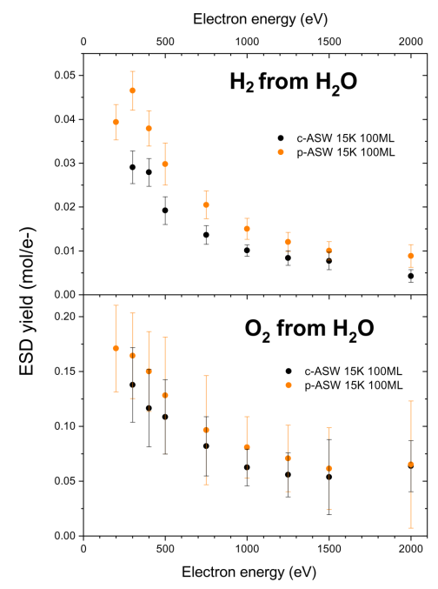
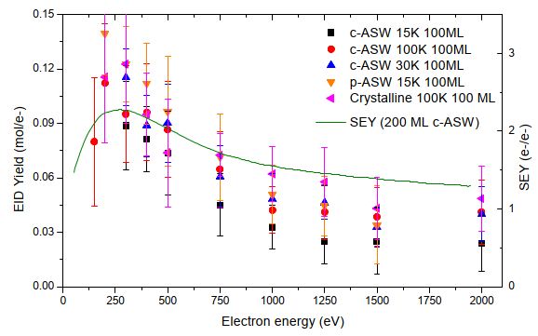
Electron interaction with condensed H₂O
Yield ~ 0.1 molecule/e, temperature independent for compact, porous amorphous and crystalline water
H₂O desorbs contemporary with H₂ and O₂
R. Dupuy et al. J. Appl. Phys. 128, 175304 (2020)
R. Dupuy. PhD Thesis, Sorbonne University, Paris, October 2019.
  ➔ Specific studies shall be conducted for physisorbed/condensed molecules

Slide 37
D. Interaction with photons

Slide 38

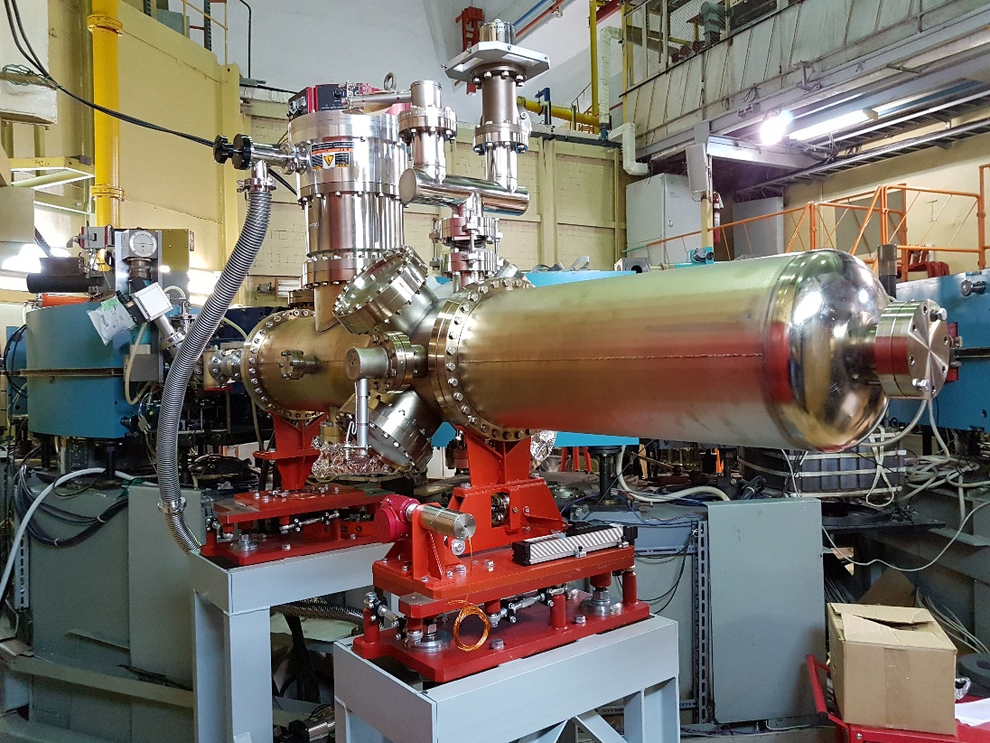
BEP electron storage ring
  E_{c} = 100 eV
  With scans at critical energy of:
    12.5, 25, 50, 200, 400, 800, 1250 eV
  13 mrad incidence angle
  Accumulated dose 10 ²³ ph/m
  ➔ one year for IT of HL-LHC
Parameter | min | nominal | max
E [MeV] | 193 | 390 | 899
Beam current [A] | 0.2 | 0.5 | 0,05
Bending magnet radii [mm] | 1280
SR critical energy [eV] | 12,5 | 100 | 1250
SR flux [ph/mrad/s] | 1.1 10¹⁵ | 1.5 10¹⁶ | 4,7 10¹⁵
SR power [W/mrad] | 0.009 | 0.045 | 3.6
SR vertical divergence at Ec [mrad] | 2.5 | 1.7 | 0.56
A. Krasnov et al. 8th HL-LHC Collaboration Meeting, CERN, 15-18th October 2018

Slide 39
“Thick” aC coating in HL-LHC Inner Triplets (IT)
Long term irradiation reduce PSD by ~ 10
With 12.5 eV critical energy at 13 mrad incidence
  PSD at 10²³ ph/m
  Forward reflectivity = 1.3 % (Cu > 75 %)
H₂ | CH₄ | CO | CO₂
1 10⁻⁵ | < 1 10⁻⁶ | 8 10⁻⁶ | 1 10⁻⁶
A. Krasnov et al. Int. Vac. Congress, IVC-21, Malmoe, Sweden, 1-5 July 2019,
  ➔ Minor contribution of beam-gas background to the experiment

Slide 40
3. a-C characterisation
with proton beams

Slide 41
A. Room temperature

Slide 42





Vacuum pilot sector
  Total and partial pressure, photoelectron current, electron cloud flux pick-ups, calorimetry etc. for electron cloud characterisation
Liners can be modified : Cu, NEG, a-C coating, laser treated samples etc.
VQM
BA
Heat load
Electron collection

Slide 43




The LHC Vacuum Pilot Sector at RT
LHC Long Straight Section, LSS 8L
Field free
Room temperature ex-changeable liners, 1.3 m long, ID 80
Diagnostics (electron, gauges, analysers, calorimeters etc.)
B. Henrist et al. Proc. of IPAC 2014, Dresden, Germany

Slide 44






Electron Cloud (EC) signatures
Linear build up with number of bunches
Multipacting threshold with
bunch population
Energy spectrum
(secondaries+beam kicked e⁻)
Fill 5800
Fill 5800
Fill 4528
SEY
SEY
Electron signal around the ring (fill 5878, 6.5 TeV): electron cloud in equilibrium, 6-8 bunches to reach it
EC equilibrium
E. Buratin. PhD Thesis 8571, EPFL, Lausanne, December 2020

Slide 45






Beam conditioning during 2017-2018
Both Cu and a-C exhibit photoelectron signals
Cu beam scrubbing: reduction of electron cloud signal with time
a-C do not develop electron cloud build up
Fill 5887
2 weeks after the scrubbing 2017
Fill 5979
5 weeks after the scrubbing 2017
Fill 7334
last physics fill of 2018
Copper
a-C
E. Buratin. PhD Thesis 8571, EPFL, Lausanne, December 2020
  ➔ a-C coating is an anti-multipactor, stable in time, compatible with LHC beams

Slide 46

For an electrode biased at V<-600 V
The positive ion current correspond to ~2.5 % of the electron current
The electrons along their path length, L_{e}, ionise also the residual gas (σ_{e})
2nd source of ion flux to the wall (ion/s/m)
➔ May affect the vacuum stability
The presence of the electron cloud reduces the stability limit and
hence the critical current
Evidence of ions in the LHC VPS
Vacuum in Particle Accelerators. O.B Malyshev, Wiley-CH, 2019.
S. Bilgen et al.
Phys.Rev. Accel. Beams 25, 083101 (2022)
  ➔ Further studies with ions are required to understand their role in the EC process

Slide 47
B. Cryogenic temperature

Slide 48


COLDEX: a bench to study electron cloud
The COLDEX set up is installed in a bypass of SPS BA4 since 2002 to study electron cloud effects with LHC type beams
It mimics a LHC type cryogenic beam vacuum system (no magnetic field)
OFE beam screen a-C coated
V. Baglin. CERN-2020-007, Proc. Of Ecloud’18, Isola d’Elba, Italy, 2018.
Studies in:
  2015-2016 with “thick” a-C coating ~500 nm thick
  2017-2018 with laser treated
  Since 2021 with “thin” a-C coating ~50 nm thick with Ti underlayer

Slide 49
Experimental set up
COLDEX cryostat:
  A 2.2 m long LHC type cryogenic beam vacuum system
  A beam screen temperature from 5 to ~ 100 K and a cold bore temperature from 3 to 4.5 K
  Circular OFE Cu beam screen (ID 67 mm), with 1 % transparency, slots of 2x7.5 mm
Measurement of total and partial pressure, heat load and electron activity without and with gas condensates and/or electron injection
RT Chimney
Solenoids
Electron gun
RT calorimeter
(a-C WAMPAC)
RT calorimeter
(Laser Treated WAMPAC)
Electrodes

Slide 50








Instrumentation
A RT chimney, located in the middle of COLDEX, collected the gas from the BS held at cold
Electrodes are placed into the chimney and behind the BS slots
Solenoids are wrapped at the COLDEX extremities
Room temperature calorimeters (WAMPAC) measure heat load for comparison
an e-gun can inject electrons in the cold BS
WAMPAC position
Chimney
Chimney
electrode
Electron
gun
Chimney
port
Solenoids
BS electrode

Slide 51

Observation of Beam-Gas Ionisation !!!
COLDEX’s electrode is sensitive enough to measure beam gas ionisation!
Sensitivity ~ 0.1 nA i.e. ~4∙10⁶ e⁻/(mm² s)
Beam
circulating
intensity
P at extremities
a-C,
pressure bump
Electron/ion
current
R. Salemme et al. Proc. of IPAC2015, Richmond, VA, USA.
R. Salemme. PhD Thesis La Sapienza University, Roma, Oct 2016.

Slide 52
“Thick” a-C coating behaviour with LHC type beams
Long term operation with 4x72 bunches, 25 ns, up to 1.5∙10¹¹ ppb:
  BS at 10 K, CB from 4.5 to 3 K
  No pressure rise larger than a few 10⁻¹⁰ mbar
  No significant heat load (≤0.2 W/m compared to 1.4 W/m for scrubbed Cu)
  No significant current on pick-up (<5 nA compared to >1000 nA for copper)
Effect of operating temperature and gas adsorption:
  No dynamic pressure larger than 10⁻⁹ mbar due to ESD is observed for:
    bare surface at 10, 50 or 80 K
    surface coverages of:
      ~3 10¹⁶ H₂/cm² , ~2 10¹⁶ CO/cm^{2,} ~3 10¹⁶ CO₂/cm²
  Measured dynamic heat load are within:
    0.2 +/- 0.1 W/m for all studied cases
  No multipacting electron activity is measured above 0.1 nA
R. Salemme. PhD Thesis La Sapienza University, Roma, Oct 2016.
➔ Excellent behavior at cryogenic temperature of the “Thick” a-C coating in the studied range

Slide 53


“Thick“ a-C coating performance at cryogenic temp
Current measurements are more sensitive than heat load measurements
No multipacting electron activity is measured above 0.1 nA
The secondary electron yield can be estimated from simulations:
δ_{max} < 1.1
➔ In agreement with lab measurements
R. Salemme et al. Proc. of IPAC2015, Richmond, VA, USA.
R. Salemme. PhD Thesis La Sapienza University, Roma, Oct 2016.

Slide 54

“Thin“ a-C coating performance at cryogenic temp
Preliminary results !
4x72 bunches at 1.3 10¹¹ ppb, 25 ns bunch spacing
With BS at 10 K, CB at 3 K, a slight temperature increase (corresponding to ~ 50-100 mW/m) together with pressure increase is observed on the BS at 10 K, but ΔP < 10⁻¹⁰ mbar (H₂, CO)
  ➔ this would correspond to SEY_{max} ~ 1.3
Room temperature calorimeter:
  609 mW/m measured on aC coating
RT and cryogenic have different heat load
But possible impact of impedance and different RRR !
➔ More studies needed
V. Baglin, B. Jenninger

Slide 55
4. Conclusions

Slide 56
Conclusion
The HL-LHC vacuum system design of the final focussing magnets requires the production of new beam screen that are:
  Operating at 60-80 K
  Tungsten shielded to protect the magnet cold masses from the collision debris
  a-C coated to mitigate multipacting reducing heat load and beam-gas background to the experiments
a-C coating was studied at room and cryogenic temperature in the laboratory and with protons beams, it showed:
  a porosity (x10-300 Cu)
  SEY < 1.1
  ESD & PSD yields similar to Cu
  Excellent robustness against multipacting for LHC beams
  ➔ a-C coating is a suitable base line for the HL-LHC vacuum system

Slide 57
Acknowledgments
The work presented here was supported by the HL-LHC Project with the contributions of:
  R. Salemme, A-L. Lamure, E. Buratin, R. Cabezas, V. Badin, M. Haubner from CERN
  R. Dupuy from LERMA, Paris,
  S. Bilgen from IJCLAB, Paris
  A. Krasnov and collaborators from BINP, Novosibirsk
with scientific supports from B. Henrist, B. Jenninger and P. Costa Pinto for providing samples and the
Continuous support for the TE management and the HL-LHC Project office

Slide 58

Thank you for your attention !!!

Slide 60
Back up slides

Slide 61

LHC Dipole Vacuum System
Cold bore (CB) at 1.9 K which ensures leak tightness
Beam screen (BS) at 5-20 K which intercepts thermal loads (~ 1.4 kW/arc for SR + Resistive wall)
Courtesy N. Kos CERN AT/VAC

Slide 62


LHC Beam Screens Functionalities
An innovative and complex system, produced at several 10 km scale !
Intercept the heat load induced by the circulating beam (impedance, synchrotron radiation, electron cloud)
Operate between 5 and 20 K (high RRR)
Pumping holes to control the gas density
Functional design map of beam screen
Courtesy N. Kos CERN TE/VSC
P. Lebrun et al.
CERN ATS 2013-006

Slide 63

Vacuum Instability : the Effect
In circular machine with large proton current :
    Intersecting Storage Rings (routine 40 A, record 57 A), LHC (0.6 A)
current
Beam current stacking to 1 A
Pressure increases to 10⁻⁶ Torr (x 50 in a minute)
Beam losses
pressure
First documented pressure bump in the ISR
E. Fischer/O. Gröbner/E. Jones 18/11/1970

Slide 64


Vacuum Instability : Mechanism
Origin is ions produced by beam-gas ionisation
Ions provoke molecular desorption
Desorbed molecules are subsequently ionised
Feedback loop
Reduction of the effective pumping speed, S_{eff}
Quasi-static solution:
O. Grobner, R. Calder,
IEE Trans. Nucl. Sci. NS-20, 760 (1976)
W.C. Turner.
J. Vac. Sci.Technol. A. 14(4) , Jul/Aug 1996
When the beam current approach the critical current, the pressure increases to infinity
A model that includes the variation of surface mole-cules with time reproduces the ISR pressure bump
K.-i. Kanazawa. Vacuum 101 (2014) 142-145

Slide 65



LHC case
Ion energy in thew keV range
Desorption yields
Unbaked stainless steel
N₂⁺
η_{H2} ~ 5
η_{CO2} ~ 1
@ 1 keV
O. Gröbner, CERN 99-05
A.G. Mathewson, CERN ISR-VA/76-5
Yields at cryogenic temperature
Critical currents:
  Non perforated BS: beware with low α and large η’ !!!
  Perforated BS: perforation provides constant pumping
A multi-gas model is needed for accurate computation
(see O.B. Malyshev, Vacuum in Particle Accelerators, Wiley-VCH, 2020)
H₂⁺, 3.2 K
➔ L_{noBS}<1 m
$$(η_{i}I)_{\text{crit}}=\frac{e}{σ}C$$
N. Hilleret, R. Calder, IVC, 1977
 | H₂ | CH₄ | CO | CO₂
(ηI)_{crit} [A] | 1300 | 80 | 70 | 35
η’_{H2} ~ 1000
η’_{CO2} ~ 2
@ 1 keV and 1 monolayer

Slide 66

At cryogenic temperature
Desorption of physisorbed gas
H₂⁺, 3.2 K
(N. Hilleret, R. Calder, IVC, 1977)
η’_{H2} ~ 2000
η’_{CO2} ~ 2
@ 5 keV and 1 monolayer
J. Barnard et al., Vacuum 47 (4), 347, (1996)
Critical current is changed to
It is a function of the geometry, the gas specie, the sticking coefficient and of the 2 desorption yields

Slide 67

Electron Cloud and Vacuum Stability
The electrons along their path length, L_{e}, ionise also the residual gas (σ_{e})
2nd source of ion flux to the wall (ion/s/m)
Electron cloud can trigger vacuum instability
Quasi stationary long tube (C=0)
Handbook of vacuum Technology, ed by K. Jousten, 2008
The presence of the electron cloud reduces the stability limit and hence the critical current

