Slide 1
Electron Cloud Effects at SuperKEKB
K. Ohmi (KEK)
ECLOUD’22, Sep. 26-28, 2022
d’Elba, Italy

Slide 2
SuperKEKB
C=3016.3m, e⁺(4GeV)-e⁻(7GeV) circular collider
Half crossing angle, φ_{c}=41.5mrad, σ_{z}=6/5mm.
 | Phase 2 (May 2018) |  | Phase 3 2021-2022 |  | Design
 | LER | HER | LER | HER | LER | HER
β_{x}*[mm] | 200 | 200 | 80 | 60 | 32 | 25
β_{y}*[mm] | 4 | 4 | 1 | 1 | 0.27 | 0.30
ε_{x} [nm] | 2.1 | 4.6 | 4.0 | 4.6 | 3.2 | 4.6
ε_{y} [pm] | 5 |  | 25 |  | 0.27 | 0.28
I_{b} [mA] | 340 | 285 | 1 | 0.8 | 1.44 | 1.04
ξ_{x} |  |  | 0.0** | 0.0* | 0.0028 | 0.0012
ξ_{y} | 0.019 | 0.013 | 0.0** | 0.03 | 0.088 | 0.081
N_{bunch} | 788 |  | 1576 |  | 2500
L [cm⁻²s⁻¹] | 1.3x10³³ |  | 4.6x10³⁴ |  | 8x10³⁵
PA Φ_{c} | 10 | 8 | 15.2 | 9.7 | 24.7 | 19.4

Slide 3
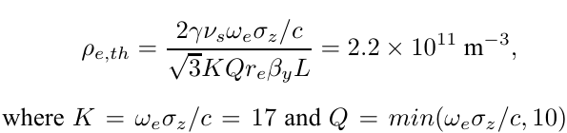
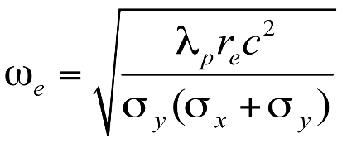
Instability simulation at SuperKEKB design stage
Using code PEHTS
ρ_{e}=4.2x10¹¹ at 4000-th turn
Simulation, ρ_{eth}=3.8x10¹¹ m⁻³.
K=ω_{e}σ_{z}/c=
Q=min(ω_{e}σ_{z}/c,Q_{nl})
Design target for vacuum system: ρ_{e}<10¹¹ m⁻³ in average of whole ring

Slide 4
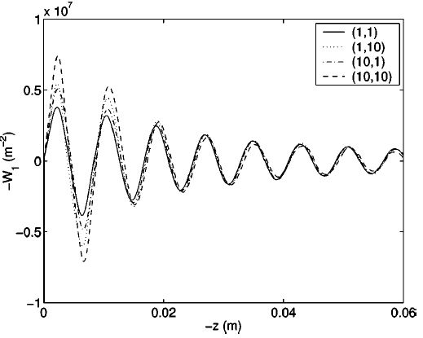
Wake force induced by electron cloud
Discuss later in detail.
Q_{nl}=7

Slide 5
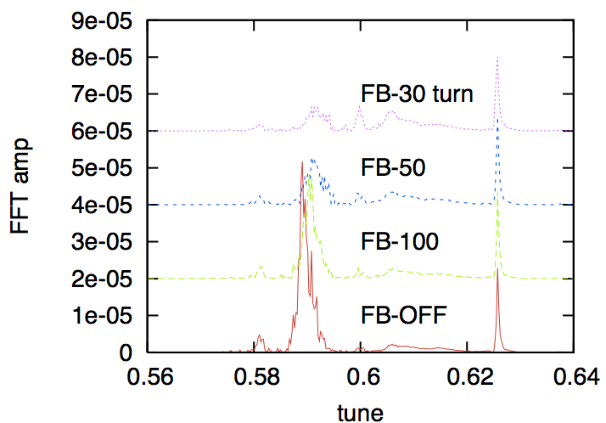
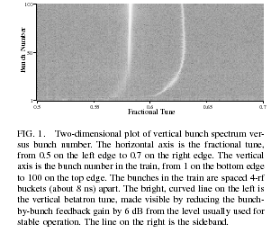
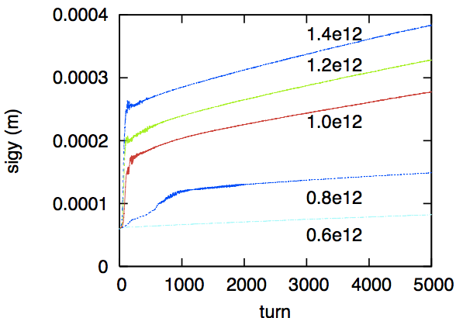
KEKB: measurement and simulation of fast head-tail instability
Simulation (PEHTS)
HEADTAIL gave similar results (E. Beneditto showed large cloud gave nice sideband signal)
Beam size blow up observed, and simultaneously synchro-beta sideband observed.
J. Flanagan et al., PRL94, 054801 (2005)
Betatron sideband
Tail of train
>νs
Measurement at KEKB
Head of train
ρe,th=0.8x10¹²m⁻³

Slide 6
Phase I commissioning
2017 Feb.-June
No collision. Test as two storage rings, e+(LER) and e-(HER).
I=1A(e+) and 0.8A(e-) were stored.
Electron cloud studies were performed.
  Beam size blow-up caused by electron cloud was seen, but was recovered by permanent solenoid magnets.

Slide 7
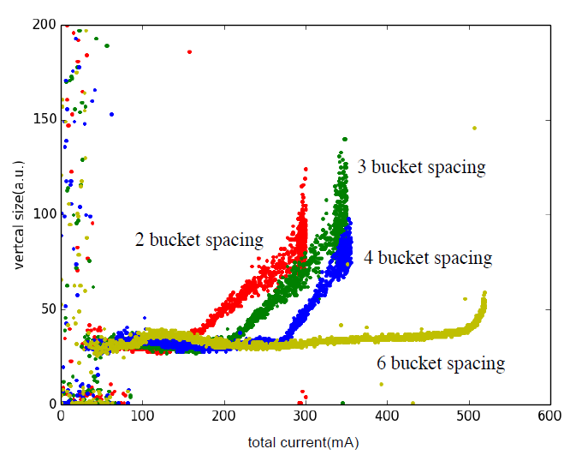
Beam size blow-up in LER
Beam-size blowup observed in KEKB had been seen in early stage of SuperKEKB commissioning
Threshold I~300mA in Apr 19
Electron cloud has been monitored at AL chamber w and w/o TiN coating
Aluminum bellows, which were not coated by TiN, were suspected as an electron source.
Permanent magnets were installed at the aluminum bellows.(Y. Suetsugu et al.)
The blow up was suppressed.
Systematic studies were done in 1 June before PM and in 8 July after PM installation.
σ_{y}
Before perm. mag installation
June 1, 2016
4 train x150 bunches, N_{bunch}=600
Threshold beam current
160, 200, 260,500 mA for 2, 3, 4, 6 bucket spacing

Slide 8
Simulation studies using beam study condition
Threshold of the electron density
ε_{x}=2nm, ε_{y}=15pm, σ_{z} =6mm, ν_{s}=0.019
Np=1.6x10¹⁰
I_{th}=160mA, 4ns spacing
Np=2.7x10¹⁰
I_{th}=260mA, 8ns spacing
Np=3.65x10¹⁰,
I_{th}=350mA, 6ns
Np=6.25x10¹⁰,
I=600mA, 8ns
Np=2.1x10¹⁰
I_{th}=200mA, 6ns spacing
Np=5.2x10¹⁰
I_{th}=500mA, 8ns spacing

Slide 9
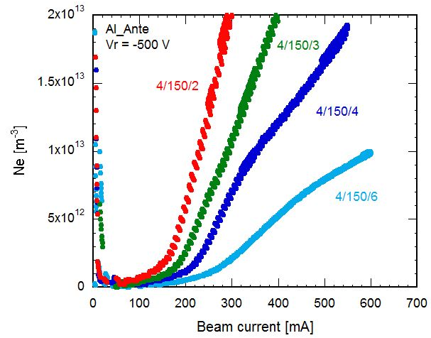
Electron density at the blow-up threshold
Simulated electron density at the threshold current
Measured threshold current and density
Local density at Al chamber
Al part (bellow) occupies only 5% of whole ring, but dominant for ecloud instability.
Discrepancy in ★ and 〇 is seen at narrow bunch spacing.
Electrons in antechamber part (95%) contributes the instability, especially large bunch spacing.
Overall density contributes at narrow bunch spacing.
ρ
Simple formula Q=7
Overall average density=0.05x
nbunch =600

Slide 10
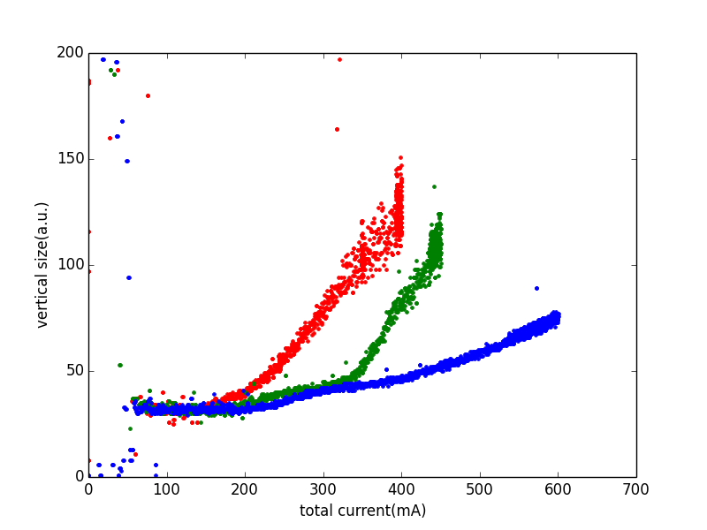
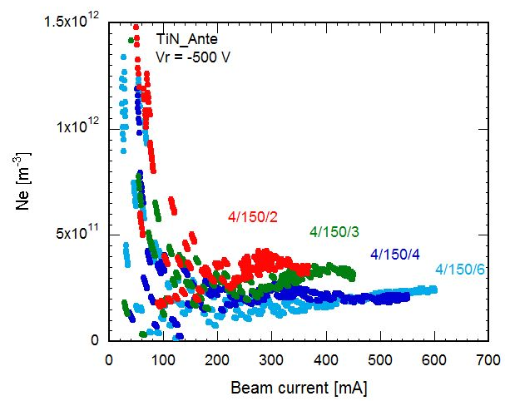
After installation of permanent solenoid at Al bellows
The density at Al bellows is not dominant for the instability.
Threshold is determined by the overall averaged density.
Simulated electron density at the threshold current
σ_{y}
After : 2016/6/8
I_{th}=200 mA
I_{th}=330 mA
4/150/2
4/150/3
nbunch =600
4/150/4
ρ
I_{th}>600 mA
Beam study nbunch =600
160mA to 200mA by 2 bucket
200mA to 330mA by 3
260mA to >600mA by 4
SuperKEKB nbunch=1500-2500 in physics run
Simple formula Q=7

Slide 11
Summary of measurement and simulation
Before PM installation Assume simulation is correct
ρ_{th}(by 2)=2x10¹²x0.05+ρ₂(160mA), ρ₂(160mA)=2.25x10¹¹
ρ_{th}(by3)=3x10¹²x0.05+ρ₃(200mA), ρ₃(200mA)=1.75x10¹¹
ρ_{th}(by4)=6x10¹²x0.05+ρ₄(260mA), ρ₄(260mA)=1.25x10¹¹
ρ_{th}(by6)=8x10¹²x0.05+ρ₆(500mA), ρ₆(500mA)=0.75x10¹¹
After PM installation Assume linear increase for I
ρ_{th}(by2)= ρ₂(200mA) ρ₂(200mA)=2.8x10¹¹ 3,4
ρ_{th}(by3)= ρ₃(330mA) ρ₃(330mA)=2.9x10¹¹ 3,8
ρ_{th}(by4)= ρ₄(>600mA) ρ₄(600mA)=2.9x10¹¹ 4.2
ρ₆(600mA)=0.9x10¹¹
Operation with 600 bunches

Slide 12
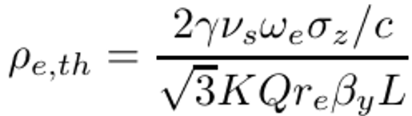
Finding
ρ_{th} given by simulation can explain measurement.
In the formula, ,
  Q=min(ω_{e}σ_{z}/c,Q_{nl}), Q_{nl} is around ~6.
Q is lower for higher bunch current, I>0.5mA.
The formula works well as a first step evaluation.

Slide 13
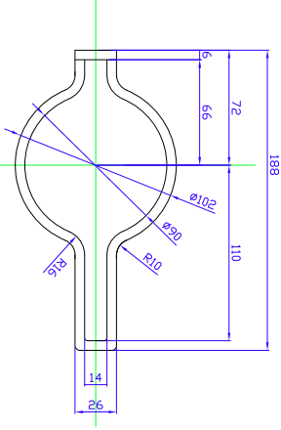

Electron buildup simulation in ante-chamber
Band matrix solver for electric field induced by electron cloud.
Beam force, combination of Basetti-Erskine formula (r<10σ_{x}) and potential solver (r>10σ_{x}).
Synchrotron light is assumed to illuminate innermost of the ante-slot.
Electron production, cos(θ) distribution for normal direction.

Slide 14
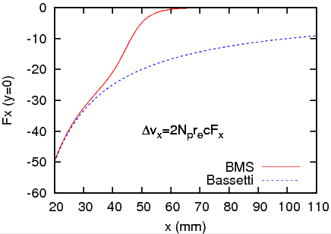
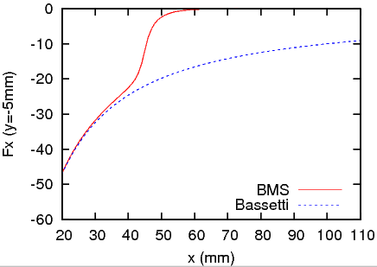
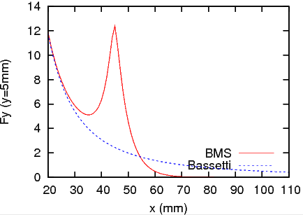
Beam force near ante-slot
inside slot x>45mm
inside slot x>45mm

Slide 15
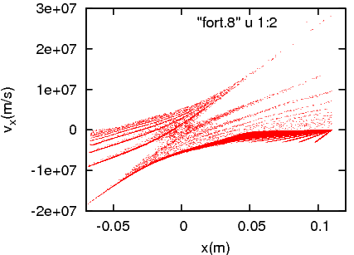
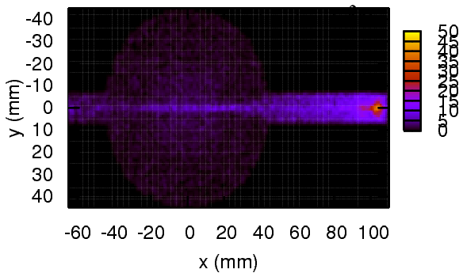
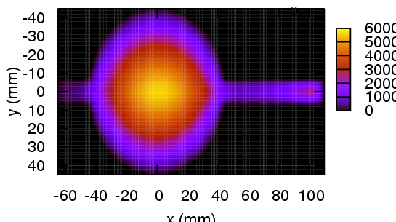
Electron distribution, potential and motion
Weak space charge limit. Production rate 0.8x10⁵m⁻¹/bunch, beam line density 2x10¹⁰ m⁻¹.
No secondary no reflected electron
Phase space distribution of electrons
Electron distribution
2 bunch before
1 bunch before
potential

Slide 16
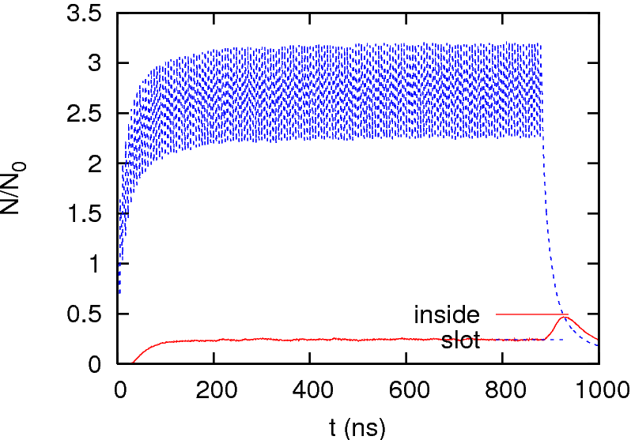
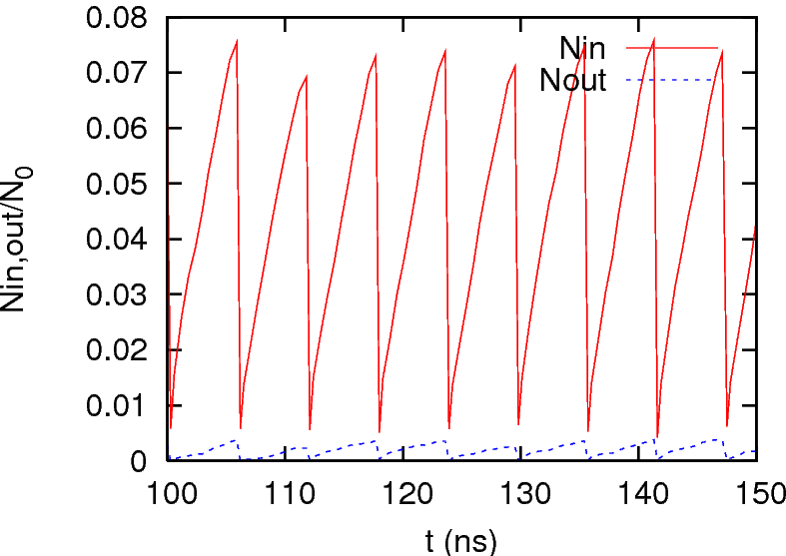
Ecloud Simulation in antechamber
N₀: Number of electron created at illuminated point (slot end), N_{in}: #electron go inside the beam area, N_{out}: go out to the slot area.
N_{p}=6.26x10¹⁰ (1mA/bunch), 6ns spacing, λ_{p}=3.48x10¹⁰ m⁻¹.
Weak space charge limit, production rate 5x10⁵m⁻¹/bunch
No secondary, no reflected electrons.
Far downsream, straight section
integrated during the bunch separation

Slide 17
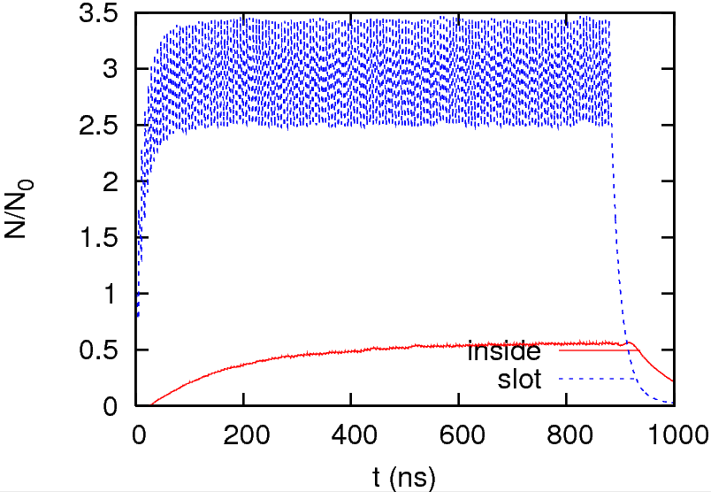
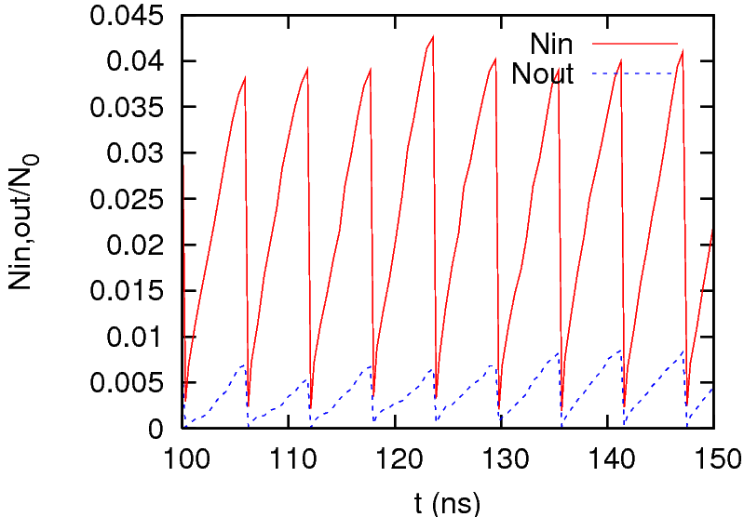
Ecloud Simulation in antechamber
N₀: Number of electron created at illuminated point (slot end), N_{in}: #electron go inside the beam area, N_{out}: go out to the slot area.
N_{p}=6.26x10¹⁰ (1mA/bunch), 6ns spacing, λ_{p}=3.48x10¹⁰ m⁻¹.
Production rate, 0.016 e-/m/e+, 10x10⁸m⁻¹/bunch.
Secondary SEY=1.2, reflected electrons 0.7.
integrated during the bunch separation

Slide 18
Finding in ecloud simulation in the antechamber
Beam force arrives only 5mm inside of slot.
Number of electrons coming from the slot is 7% of created electron at slot end for weak electron density. The number is reduced to 3-4% for average electron production.
The number change a little for the bunch current 0.5 or 1mA.

Slide 19
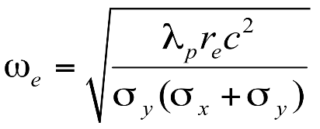
Electron cloud Wake model (single bunch)
Electron cloud
Positron bunch (~10ps)
Uniform distribution for z.
Assume a part of bunch shifts positive direction.
Electron cloud is kicked positive direction
Electron cloud oscillates with ω_{e}.
  Positron bunch is kicked by the deviation of the electron cloud.
  Electron cloud is pinched, then the density increases.
<1ps
λ_{p}: Positron line density in a bunch

Slide 20



Example of wake force
K.Ohmi, F. Zimmermann, E. Perevedentsev, PRE65, 016502 (2001)
For small x-y size of electron cloud,
Q_{nl}=7

Slide 21
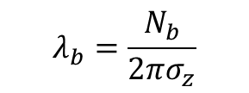
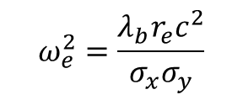
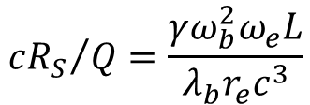
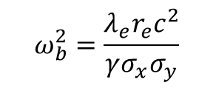


Instability threshold for coasting beam model
Instability threshold in coasting model (A. Chao’s textbook Chap 5)
  Coherent growth due to the wake force
  Decoherence due to the longitudinal slippage
Wake is terminated by the bunch length, Q=Min(ω_{e}σ_{z}/c,Q_{nl}=7).
Number of electrons, which contributes to the instability, depends on ω_{e}σ_{z}/c. The enhancement K is chosen K= ω_{e}σ_{z}/c.
Stability condition
$$\frac{cR_{S}}{ω_{e}}=\frac{γLη_{p}ω_{e}σ_{δ}}{\sqrt{3}N_{b}r_{e}βω_{0}}$$
$${cR_{S}}/Q=\frac{γω_{b}^{2}ω_{e}L}{λ_{b}r_{e}c^{3}}$$
$$ω_{b}^{2}=\frac{λ_{e}r_{e}c^{2}}{γσ_{x}σ_{y}}$$
$$ω_{e}^{2}=\frac{λ_{b}r_{e}c^{2}}{σ_{x}σ_{y}}$$
$$λ_{b}=\frac{N_{b}}{2πσ_{z}}$$
$$λ_{e}=K×2πσ_{x}σ_{y}$$

Slide 22
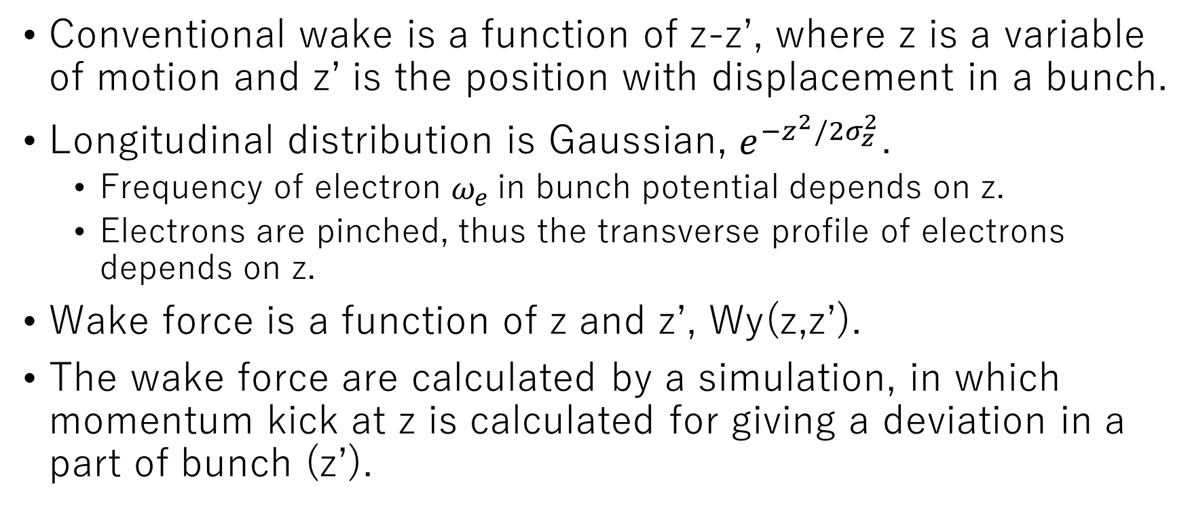
Realistic model: Gaussian distribution for z
Conventional wake is a function of z-z’, where z is a variable of motion and z’ is the position with displacement in a bunch.
Longitudinal distribution is Gaussian, $e^{−z^{2}/2σ_{z}^{2}}$.
  Frequency of electron $ω_{e}$in bunch potential depends on z.
  Electrons are pinched, thus the transverse profile of electrons depends on z.
Wake force is a function of z and z’, Wy(z,z’).
The wake force are calculated by a simulation, in which momentum kick at z is calculated for giving a deviation in a part of bunch (z’).

Slide 23
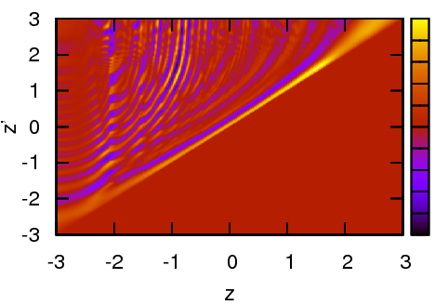
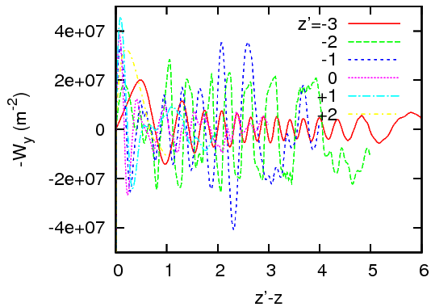


Wake force induced by electron cloud
Wy(z,z’) depends on z and z’.
2D plot for W_{y}(z,z’) W_{y}(z-z’;z’) (σ_{z} unit)
$W_{Q,y}\left(z\right)$: diagonal component of Wy(z,z)
$W_{y}\left(z,z′\right)≠0$ for z’>z.

Slide 24


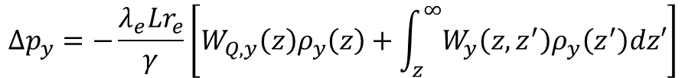

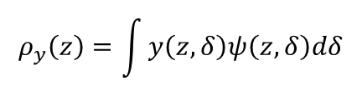
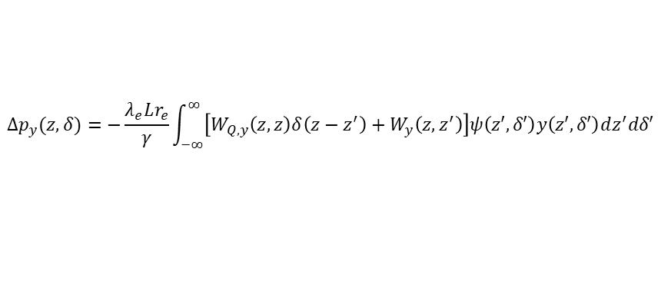
How to treat this wake force in Vlasov solver
Momentum kick induced by electron cloud
Expression by longitudinal phase space variables
Azimuthal mode expansion
$$ρ\left(z\right)=\int{ψ\left(z,δ\right)dδ}$$
$$∆p_{y}=−\frac{λ_{e}Lr_{e}}{γ}\left[W_{Q,y}\left(z\right)ρ_{y}\left(z\right)+\int_{z}^{∞}{W_{y}\left(z,z^{′}\right)ρ_{y}\left(z^{′}\right)dz′}\right]$$
$$ρ_{y}\left(z\right)=ρ(z)y(z)$$
$$ρ_{y}\left(z\right)=\int{y\left(z,δ\right)ψ\left(z,δ\right)dδ}$$
$$∆p_{y}(z,δ)=−\frac{λ_{e}Lr_{e}}{γ}\int_{−∞}^{∞}{\left[W_{Q,y}\left(z,z\right)δ\left(z−z^{′}\right)+W_{y}\left(z,z^{′}\right)\right]ψ\left(z′,δ′\right)y\left(z′,δ′\right)dz^{′}dδ′}$$
$$∆p_{y}(J,φ)=−\frac{λ_{e}Lr_{e}}{γ}\int_{−∞}^{∞}{\left[W_{Q,y}\left(z\right)δ\left(z−z^{′}\right)+W_{y}\left(z,z^{′}\right)\right]ψ\left(J′\right)y\left(J′,φ′\right)dJ′dφ′}$$

Slide 25

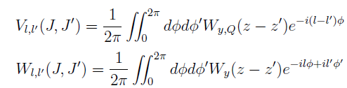


Reduce to the Eigenvalue problem
Momentum kick for azimuthal mode
Discretizing for J, the transformation is expressed by matrix.

Slide 26
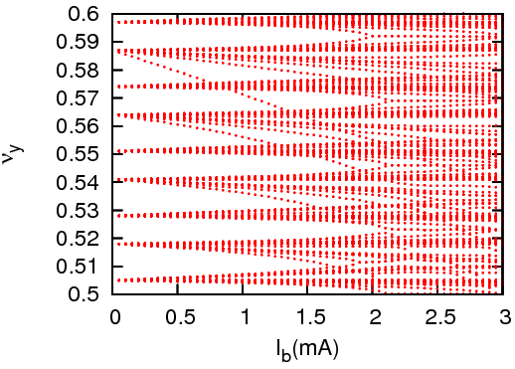
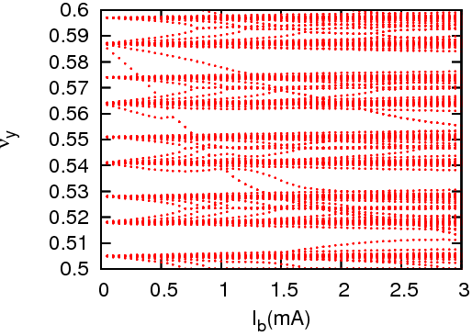
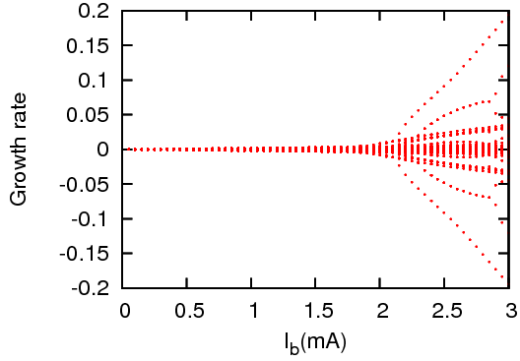
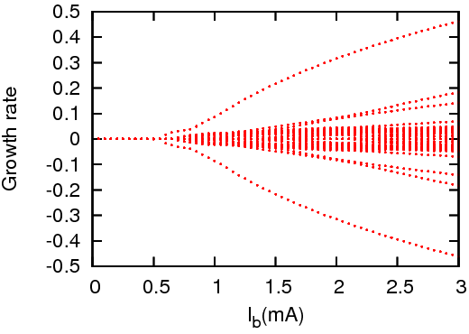
Eigen mode analysis for W(z,z’)
One turn Matrix with the size (2xn_{J}x(2l_{max}+1))² is constructed by multiplication of syncho-beta and the wake transformations.
Preliminary
W(z,z’)
W(z-z’;-3)
Decoherence of Wy may raise the threshold.

Slide 27
Electron cloud Wake model (multi-bunch)
Electron cloud
Positron bunch train
Positron bunch starts to create electron cloud.
A bunch shift positive in stationary formed electron cloud.
  Electron cloud start to move positive.
  The bunch is kicked positive.
Electrons in cloud
~ns

Slide 28
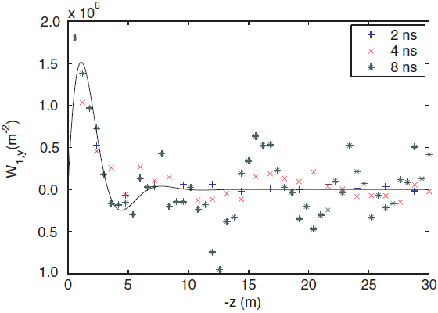
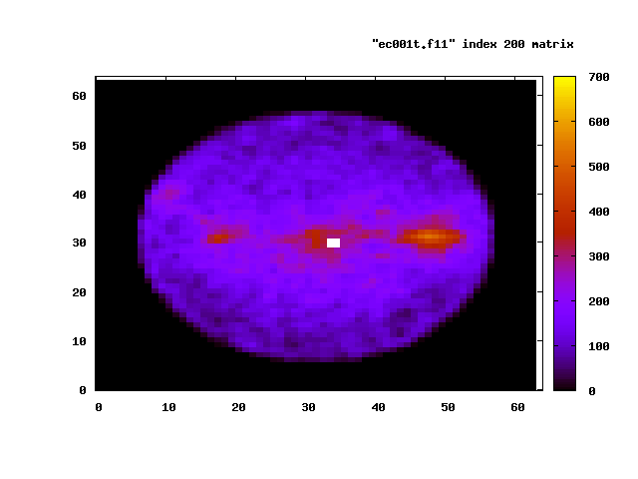
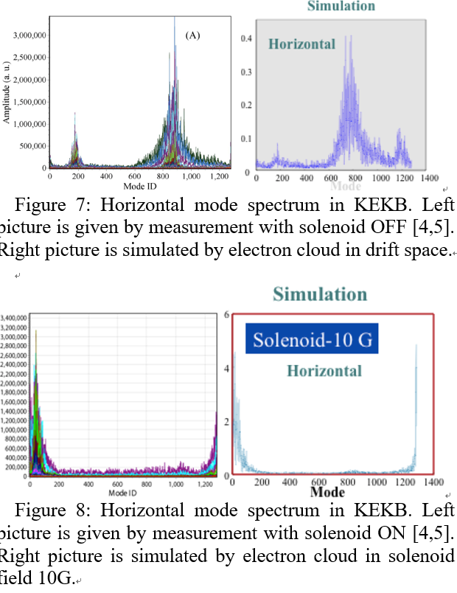
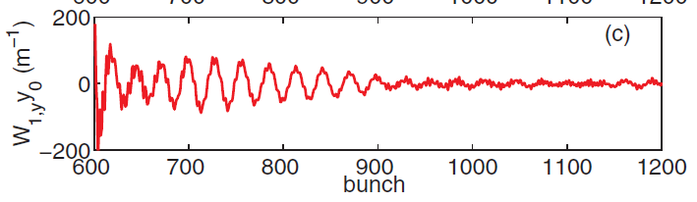
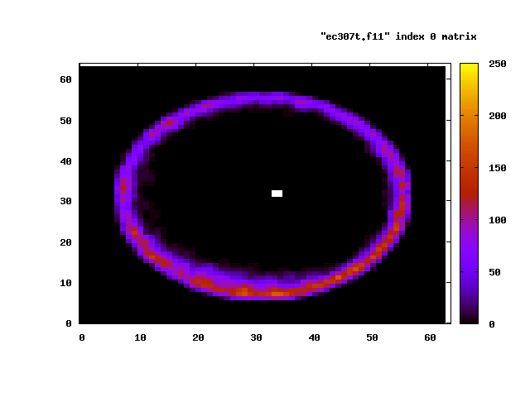
Coupled bunch instability
High R/Q and Low Q=1
Lower R/Q and higher Q=10
Growth of CBI is similar as drift electron.
ω_{R}=λ_{p}r_{e}c²/r²ω_{c}

Slide 29
Summary
Electron cloud instability had been seen in early stage of SuperKEKB commissioning (Phase I, 2016).
The instability was cured by installation of weak solenoids at aluminum bellow section.
The density of instability threshold is almost consistent with simulation and theory.
In recent measurement (June, 2022), any beam size blow up was not observed.
Specific luminosity did not depend on the number of bunches in physics and machine experiments. No electron effects in luminosity.
Electron leakage from antechamber slot was estimated as several, 3-7 %.
TMCI analysis for W(z,z’) is available.

Slide 30
Thank you for your attention

Slide 31
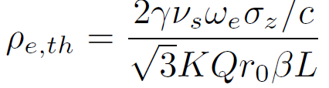
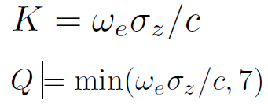
Simulated threshold electron density (before/after permanent magnet installation)
N_{b}=600, ε_{x}=2nm, ε_{y}=15pm, σ_{z} =6mm, ν_{s}=0.019
N_{p,th} (10¹⁰) | ω_{e}/2π (GHz) | ω_{e}σ_{z}/c | ρ_{eth} (Q=10) (10¹¹m⁻³) | ρ_{eth} (Q=6) (10¹¹m⁻³) | ρ_{eth} (Simu) (10¹¹m⁻³) | spacing | I_{p,th} (mA)
1.6 | 61 | 7.7 | 1.91 | 2.45 | 3.2 | 2 (4ns) | 160
2.1 | 71 | 8.9 | 1.65 | 2.45 | 3.4 | 3 (6ns) | 200
2.7 | 80 | 10.1 | 1.47 | 2.45 | 3.6 | 4 (8ns) | 260
5.2 | 111 | 14.0 | 1.47 | 2.45 | 4.0 | 6 (12ns) | 500
2.1 | 71 | 8.9 | 1.65 | 2.45 | 3.4 | 2 (4ns) | 200
3.65 | 91 | 11.5 | 1.47 | 2.45 | 3.8 | 3 (6ns) | 350
6.25 | 122 | 15.3 | 1.47 | 2.45 | 4.2 | 4 (8ns) | >600
6

Slide 32

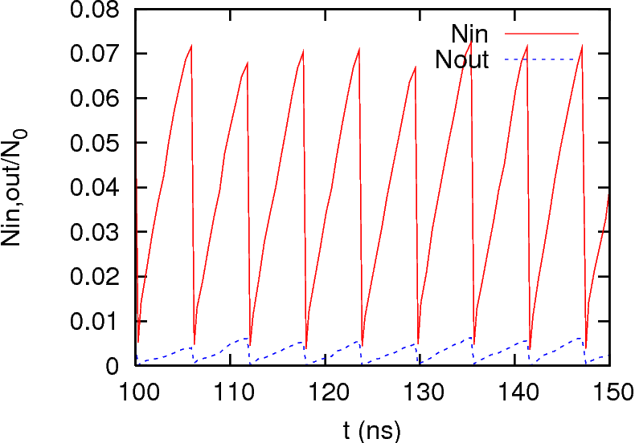
チェンバー内の電子数シミュレーション
放射光が当たっている場所（アンテチェンバースロット最奥部)から電子が放出される。数を1単位とする。
N_{p}=3.13x10¹⁰ (0.5mA/bunch), 6ns spacing, λ_{p}=1.74x10¹⁰ m⁻¹.
Weak space charge limit, production rate 5x10⁵m⁻¹/bunch
No secondary, no reflected electrons.

Slide 33
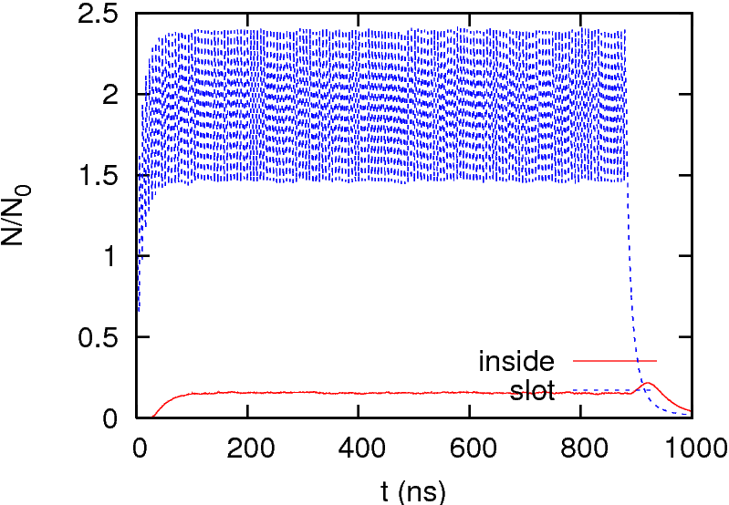
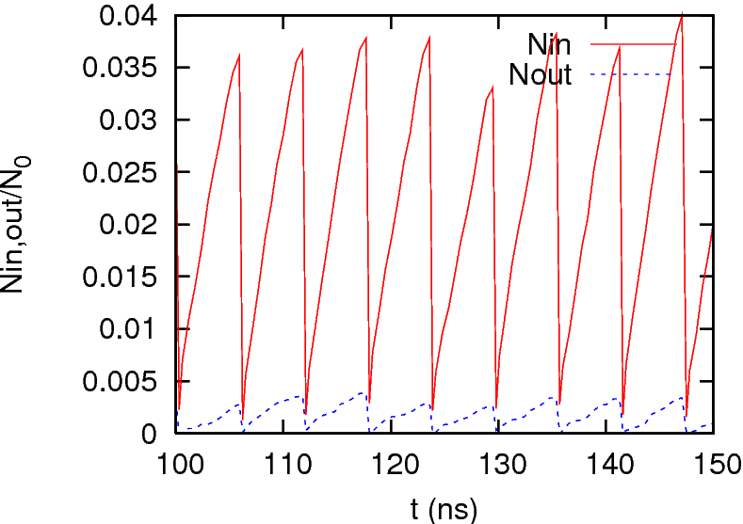
チェンバー内の電子数シミュレーション
放射光が当たっている場所（アンテチェンバースロット最奥部)から電子が放出される。数を1単位とする。
N_{p}=3.13x10¹⁰ (0.5mA/bunch), 6ns spacing, λ_{p}=1.74x10¹⁰ m⁻¹.
Production rate, 0.016 e-/m/e+, 5x10⁸m⁻¹/bunch.
No secondary, no reflected electrons.

Slide 34


チェンバー内の電子数シミュレーション
放射光が当たっている場所（アンテチェンバースロット最奥部)から電子が放出される。数を1単位とする。
N_{p}=3.13x10¹⁰ (0.5mA/bunch), 6ns spacing, λ_{p}=1.74x10¹⁰ m⁻¹.
Production rate, 0.016 e-/m/e+, 5x10⁸m⁻¹/bunch.
Secondary SEY=1.2, reflected electrons 0.7.

Slide 35


チェンバー内の電子数シミュレーション
放射光が当たっている場所（アンテチェンバースロット最奥部)から電子が放出される。数を1単位とする。
N_{p}=6.26x10¹⁰ (1mA/bunch), 6ns spacing, λ_{p}=3.48x10¹⁰ m⁻¹.
Production rate, 0.016 e-/m/e+, 10x10⁸m⁻¹/bunch.
No secondary, no reflected electrons.

