Slide 1
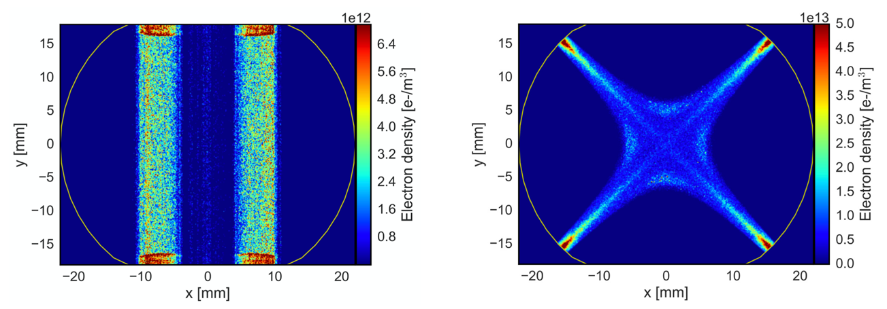

Electron cloud effects in accelerators
Giovanni Rumolo
ECLOUD22 Workshop, 25-29 September 2022
https://agenda.infn.it/event/28336/
Thanks to: G. Arduini, H. Bartosik, E. Belli, L. Giacomel, A. Huschauer, G. Iadarola, S. Johannesson, K. Li, L. Mether, N. Mounet, K. Paraschou, L. Sabato, C. Zannini, F. Zimmermann

Slide 2



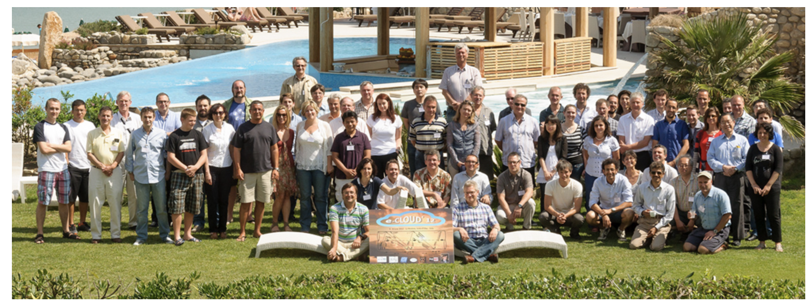
We can celebrate
20 years from the first ECLOUD Workshop ever …
10 years from the first ECLOUD Workshop in
La Biodola

Slide 3
Outline
Basics of e-cloud formation and associated effects
Brief history of e-cloud observations in accelerators
Progress in modeling over the years
Limitations from e-cloud: Some lessons learnt after Long Shutdown 2 (LS2)
Conclusions

Slide 4
Outline
Basics of e-cloud formation and associated effects
Brief history of e-cloud observations in accelerators
Progress in modeling over the years
Limitations from e-cloud: Some lessons learnt after Long Shutdown 2 (LS2)
Conclusions

Slide 5
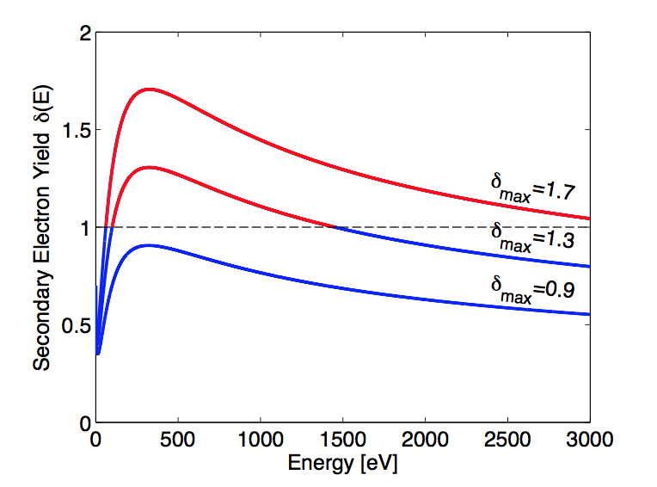
Electron cloud build-up
Seed electron
(e.g. photoemission)
~300 eV
~10 eV
Proton bunch
~50 eV
~5 eV
SEY (or δ_{max}) > 1
SEY Curves for different surfaces
25 ns
time
Notes:
T

Slide 6
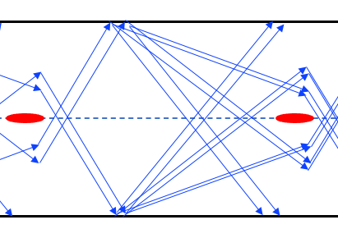
Electron cloud build-up
In the first phase of build-up the space charge of the electrons is negligible
  All electrons emitted with energy below the value needed to fly across the chamber before the next bunch comes survive
R
T_{s}

Slide 7
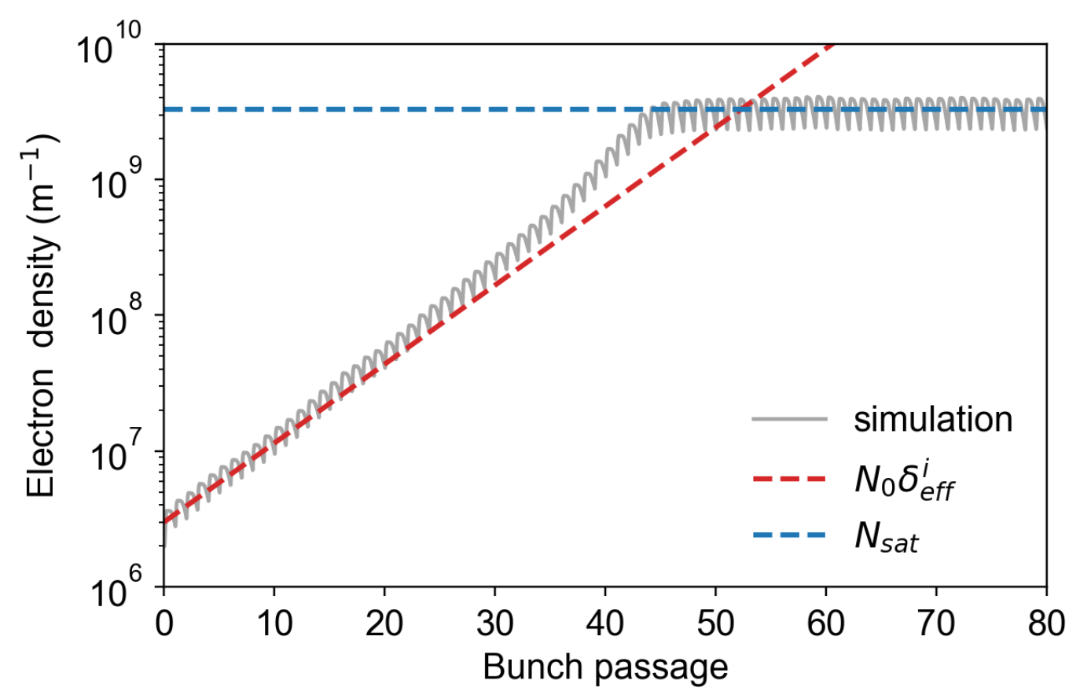
Electron cloud build-up
Exponential growth

Slide 8
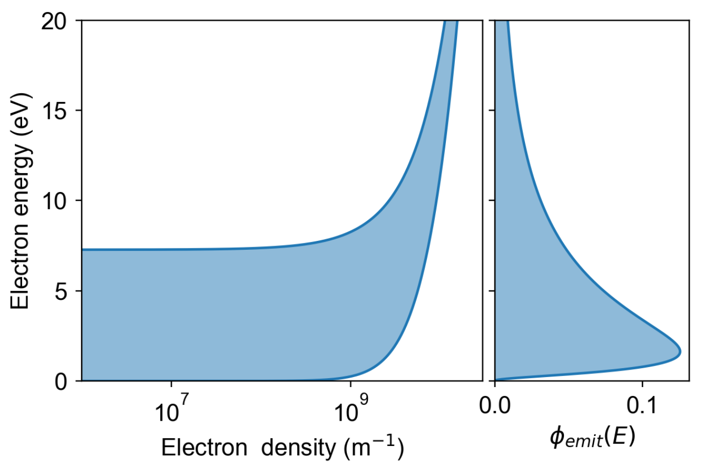
Electron cloud build-up
As electron space charge increases, electrons emitted at the surface can get quickly repelled back if they do not have enough energy
  The range of energies allowing for electron survival
  gradually moves to a less populated area of the
  emission spectrum
R
T_{s}

Slide 9
Electron cloud build-up
Saturation: Production and absorption rates of electrons are equal

Slide 10
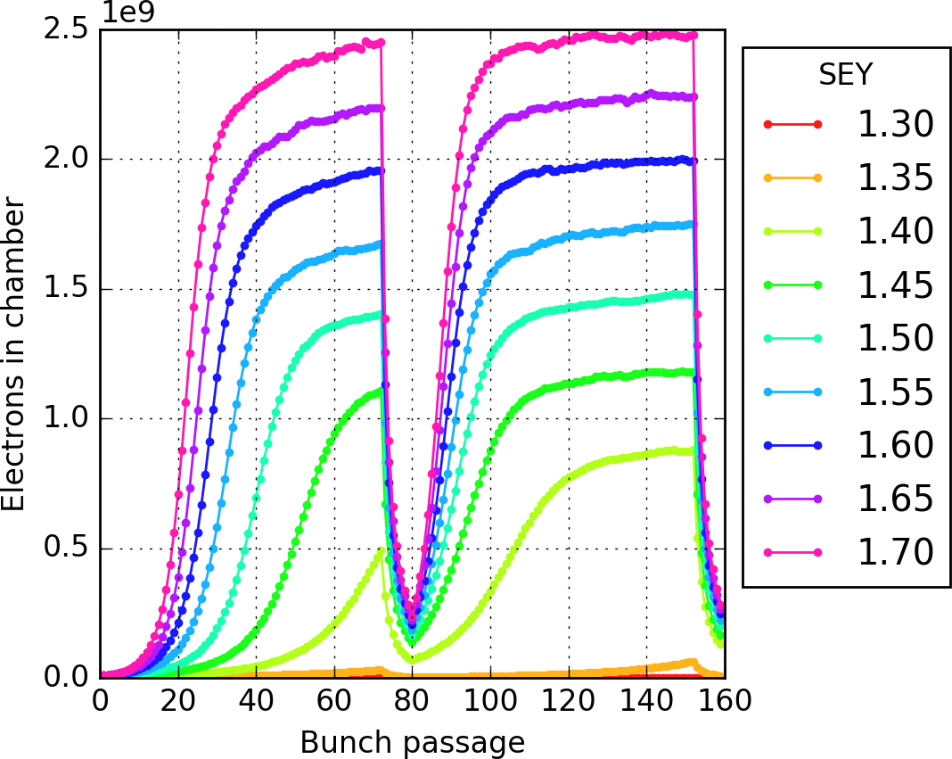
Electron cloud build-up
N_{b}, T_{s}, σ_{z}, ε_{x,y}, …
E-cloud exists when the beam is in the machine and builds up over circulating bunch train
Phase of decay with no beam → depends on elastic reflection and other possible trapping mechanisms (unbunched beam, ions, …)
Once fixed chamber geometry and beam parameters, there is typically an SEY threshold above which the e-cloud forms
Beam chamber
N_{sat}
SEY threshold
SEY

Slide 11
Electron cloud build-up
Seed electron
(e.g. photoemission)
~300 eV
~10 eV
Proton bunch
~50 eV
~5 eV
SEY (or δ_{max}) > 1
25 ns
time
This electron flux to the wall is responsible for:
Dynamic pressure rise
Heat deposition
Synchronous phase shift due to beam energy loss
Spurious signal for beam instrumentation
e⁻
e⁻
beam
e⁻
Notes:
T

Slide 12
Electron cloud build-up
Seed electron
(e.g. photoemission)
~300 eV
~10 eV
Proton bunch
~50 eV
~5 eV
SEY (or δ_{max}) > 1
25 ns
time
A significant electron density inside the vacuum chamber causes:
Tune shift along the train
Coherent instabilities (both single and coupled bunch)
Poor beam lifetime and emittance growth
beam
Notes:
T

Slide 13
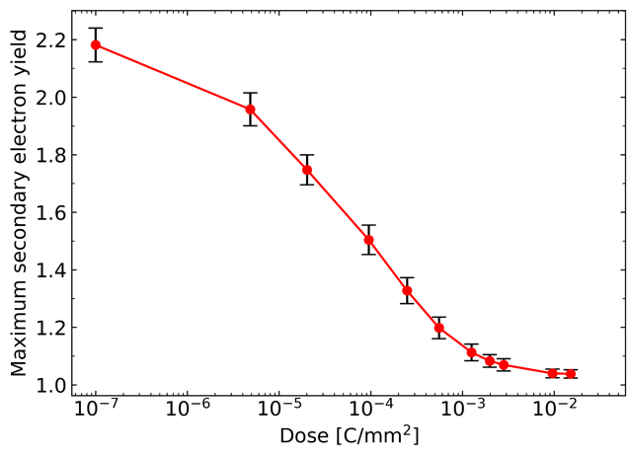
Beam induced scrubbing
But there is a silver lining …
  The SEY of a surface is known to decrease under
  electron bombardment (scrubbing)
  Running an accelerator with electron cloud will
  then gradually reduce the electron cloud itself
  E-cloud eventually ‘turns off’ if we can scrub to an
  SEY below the threshold value
SEY reduction on copper surface by e⁻ bombardment (lab. experiment)
Beam induced scrubbing

Slide 14
Beam induced scrubbing
Beam-induced scrubbing is different from lab scrubbing
  Beam needs to be stabilized to guarantee a good electron flux over a long time
  It becomes even slower while it progresses, due to the decrease of the electron flux as the SEY decreases
'Scrubbed’ value from lab
LHC dipole magnet beam screen

Slide 15
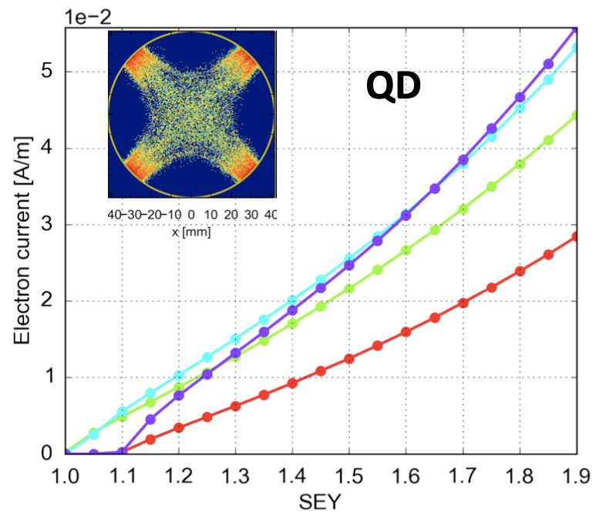
Beam induced scrubbing
Beam-induced scrubbing is different from lab scrubbing
  Beam needs to be stabilized to guarantee a good electron flux over a long time
  It becomes even slower while it progresses, due to the decrease of the electron flux as the SEY decreases
'Scrubbed’ value from lab
2.5 10¹¹ p/b
1.5 10¹¹ p/b
10¹¹ p/b
2 10¹¹ p/b

Slide 16
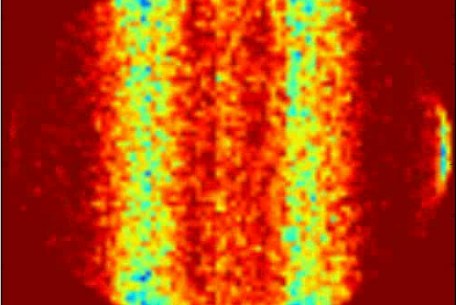
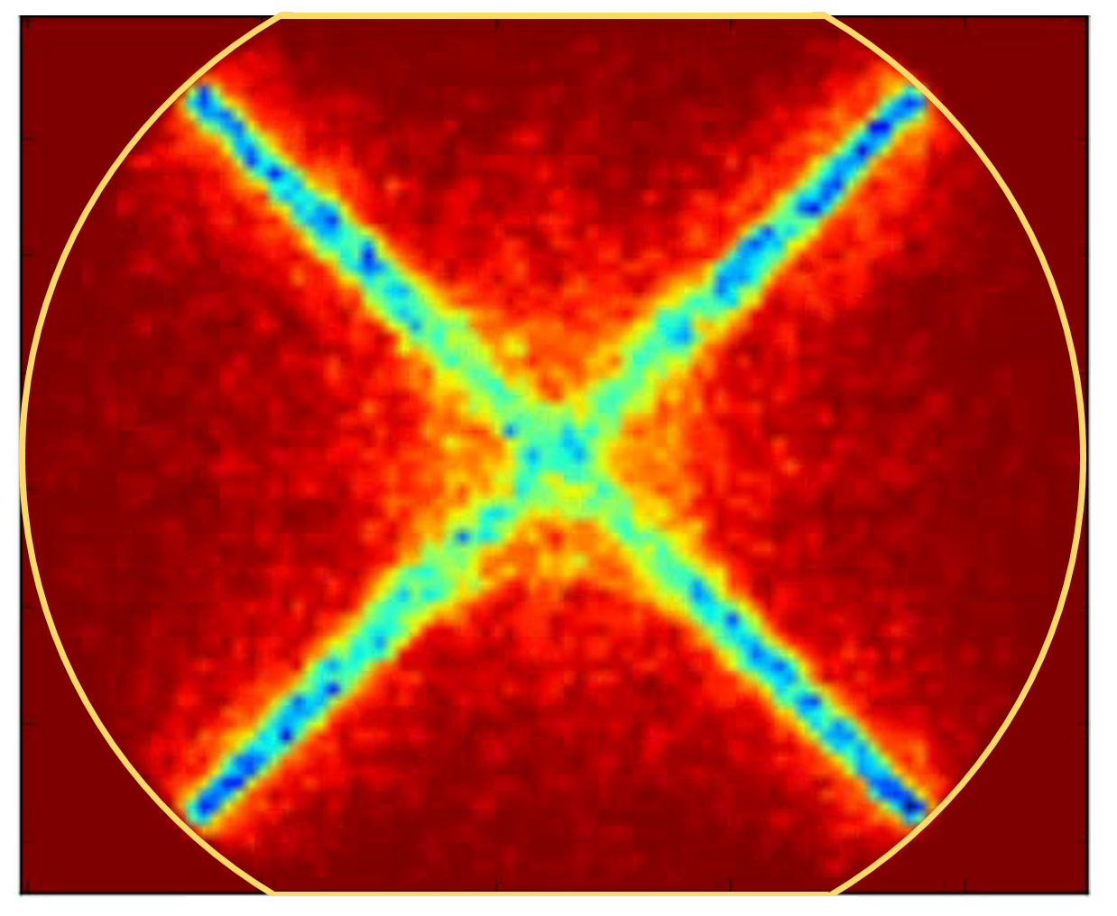
Beam induced scrubbing
Beam-induced scrubbing is different from lab scrubbing
  Beam needs to be stabilized to guarantee a good electron flux over a long time
  It becomes even slower while it progresses, due to the decrease of the electron flux as the SEY decreases
  It happens in the vacuum chamber of an accelerator
    It is localized according to e-cloud distribution pattern and may be affected when beam properties or magnetic field change
    It may be affected by other mechanisms (e.g., synchrotron radiation, surface properties, vacuum composition)
Dipole
Quadrupole

Slide 17
Beam induced scrubbing
But there is a silver lining …
  The SEY of a surface is known to decrease under
  electron bombardment (scrubbing)
  Running an accelerator with electron cloud will
  then gradually reduce the electron cloud itself
  E-cloud eventually ‘turns off’ if we can scrub to an
  SEY below the threshold value
Unfortunately, surfaces may (partially) lose scrubbing, mainly when they are exposed to air but not only
  Seems to be fine in warm machines, more complicated in cold machines …
SEY reduction on copper surface by e⁻ bombardment (lab. experiment)
Courtesy: V. Petit
Beam induced scrubbing

Slide 18
Outline
Basics of e-cloud formation and associated effects
Brief history of e-cloud observations in accelerators
Progress in modeling over the years
Limitations from e-cloud: Some lessons learnt after Long Shutdown 2 (LS2)
Conclusions

Slide 19
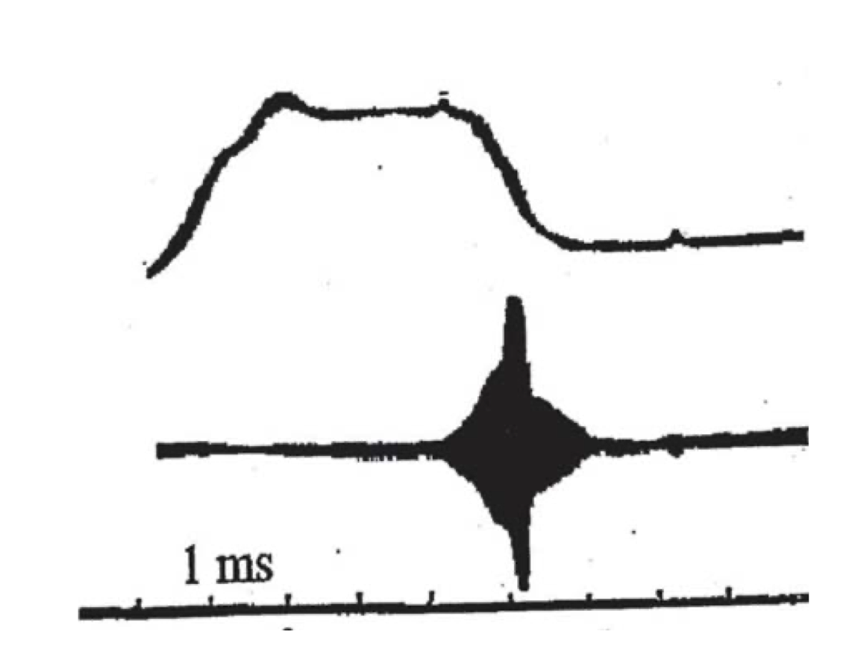
Electron cloud observations: a historical excursus
1965-67: Nobosibirsk Proton Storage Ring (PSR)
  Bunched beam becoming unstable above 1 – 1.5 10¹⁰ p → Coherent betatron oscillation and beam losses attributed to electrons ad cured with a feedback system
  Coasting proton beam becoming unstable above 1.2 10¹¹ p, compensation through fast accumulation of secondary plasma by gas ionization
Mid 60’s: Argonne ZGS
  Instability with a growth time of ms above
  ~ 1 10¹¹ p/b (8 bunches, uncorrelated motion).
  Needed a wideband feedback system
1965: BNL AGS
  Vertical instability and beam loss above 3 10¹⁰ p/b
  in conditions of degraded vacuum, needed high
  chromaticity and feedback system

Slide 20
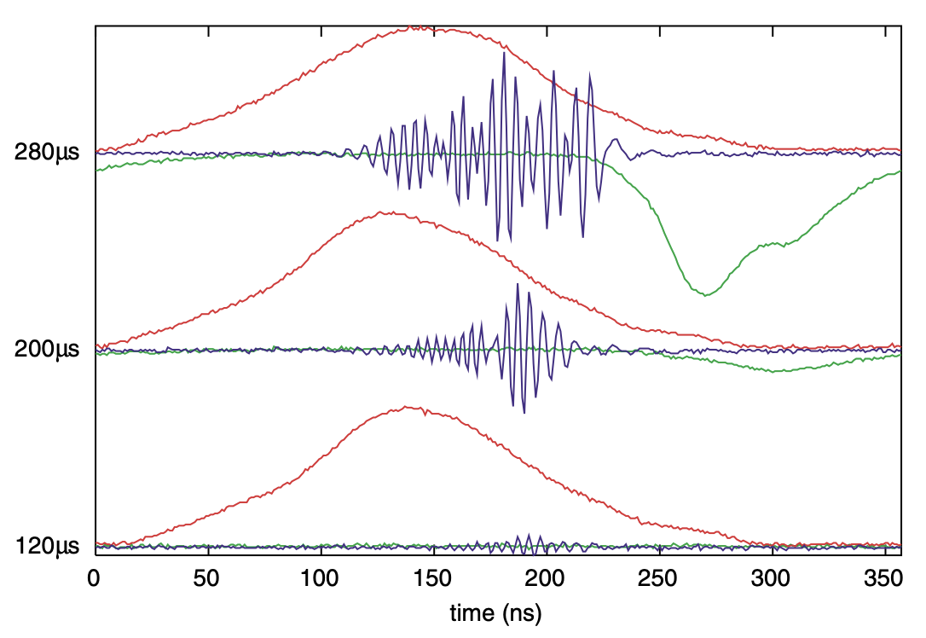
Electron cloud observations: a historical excursus
Early 70’s: CERN Intersecting Storage Ring (ISR)
  Coasting beam instability, fast rise time (<1 ms), repeating itself every 1-2 s. Clearing electrodes were installed to reduce the neutrilisation level
  Fast pressure rise with bunched proton beams
1988: Los Alamos PSR
  E-p type coherent vertical instability and beam loss
  above ~ 1.5 10¹³ p with one bunch in the machine.
  Intra-bunch motion with 10 MHz at the tail of the bunch
  Observation of large electron flux to the wall at the end
  of each bunch passage
1989: KEK Photon Factory
  When switching from e- to e+ a new vertical coupled bunch instability was observed, an improvement was observed applying a bias to the 88 BPMs
Σ
Δ_{y}
Electron current
to the wall

Slide 21
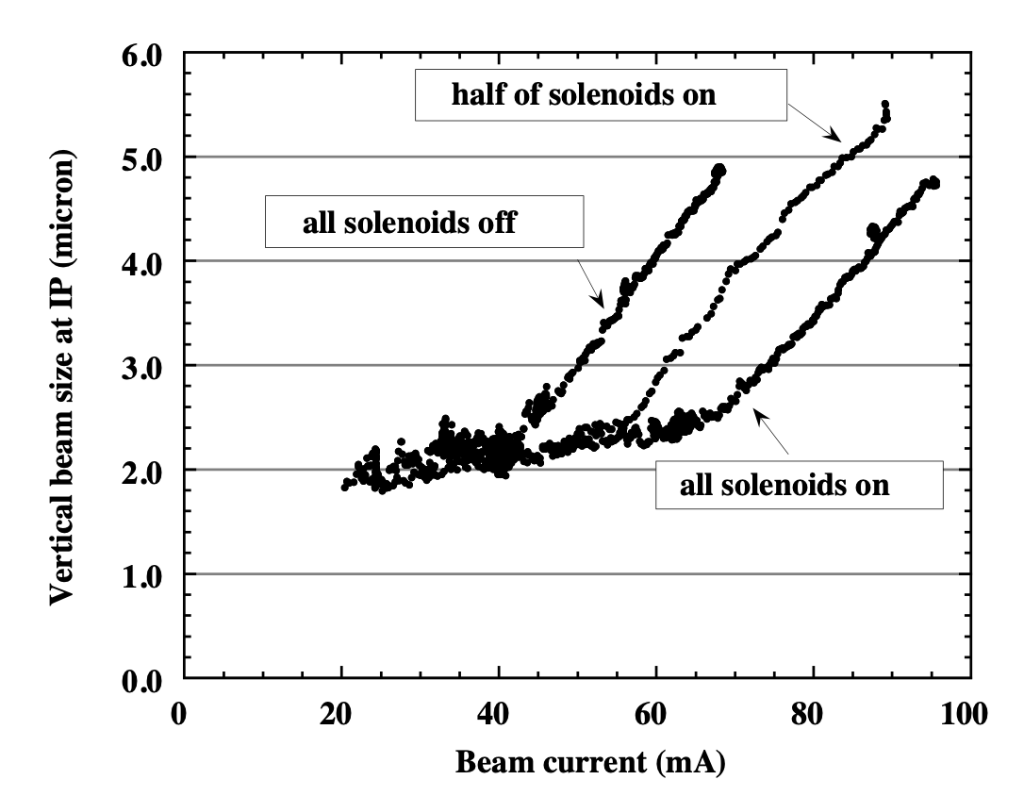
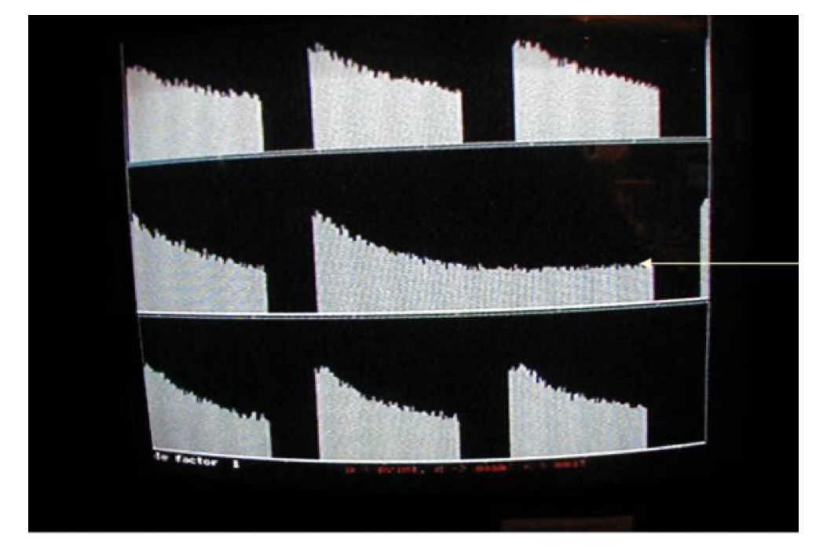
Electron cloud observations: a historical excursus
1999: KEKB Low Energy Ring
  Single bunch instability at the tail of the trains with head-tail tilt above a certain threshold
  Slow emittance growth below threshold
  Solenoids in field-free regions increased the threshold
1999: SLAC PEP-II B factory
  Blow-up of positron beam in both planes
  Luminosity drop at the end of the trains
Luminosity versus bunch number recorded at the PEP-II B factory in July 2000 for a bunch spacing of 4 rf buckets with 8 large gaps

Slide 22
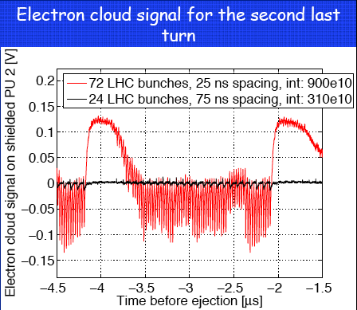
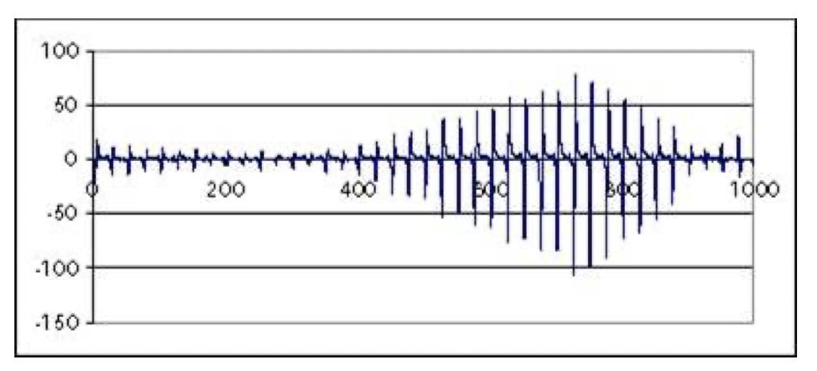
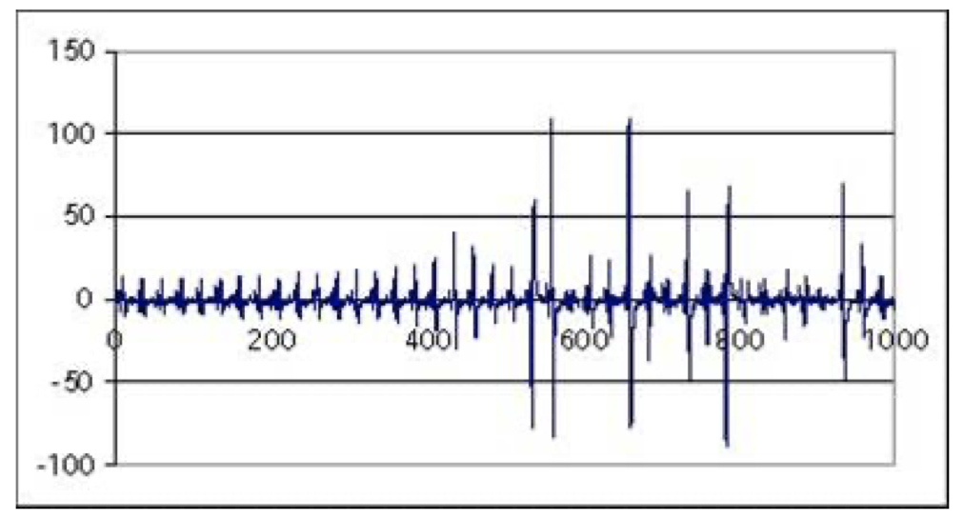
Electron cloud observations: a historical excursus
2000: CERN PS and SPS
  Large pressure ruse when running LHC-type beams
  Signal at pick-up electrodes
  Strong instabilities
SPS <x>
SPS <y>
Measurement with shielded electrode at CERN-PS

Slide 23
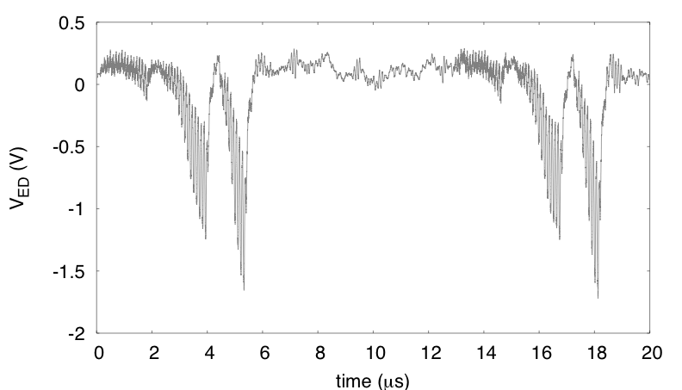
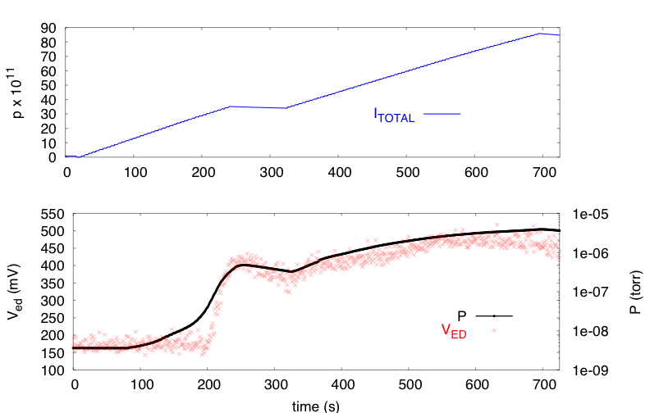
Electron cloud observations: a historical excursus
2002: RHIC
  Pressure rise
  Instabilities at transition
  Direct measurements through e-detectors
1 turn

Slide 24
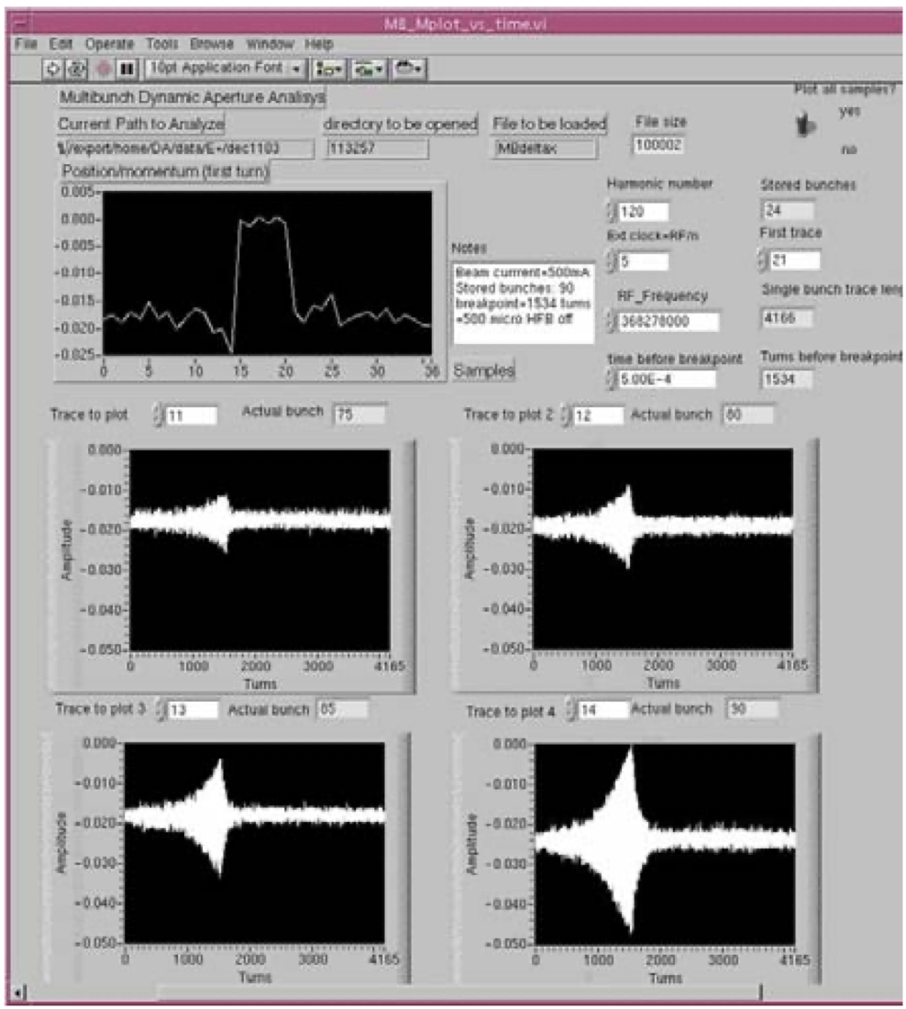
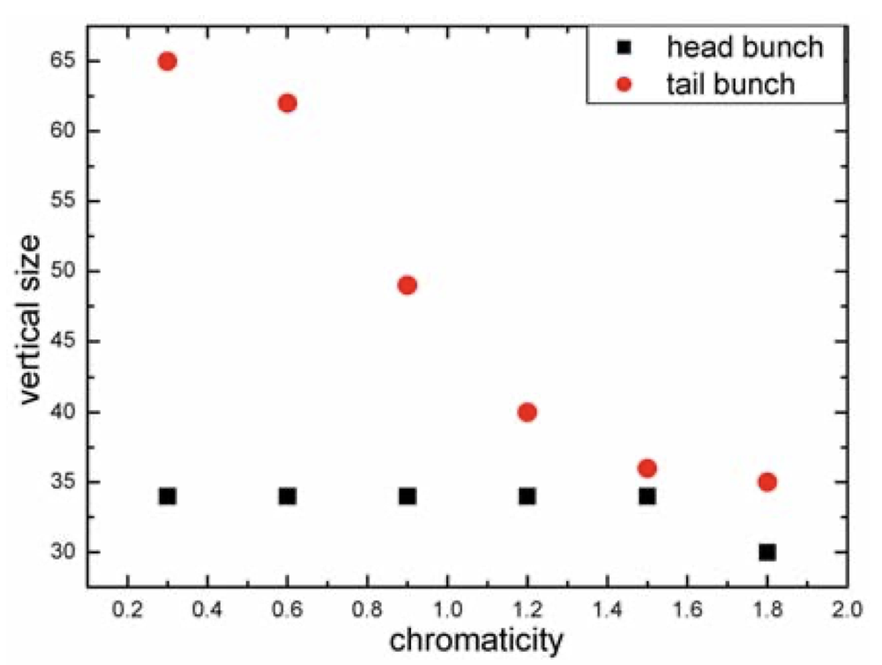
Electron cloud observations: a historical excursus
2003-2010: Miscellaneous
  Colliders: BEPC, Tevatron and DaΦne all exhibit signs of electron cloud (pressure rise, instabilities) in high intensity operation
Vertical beam size of the first and last bunch in a train
as a function of chromaticity at BEPC in 2004
horizontal oscillations for bunches
75, 80, 85 and 90 at DaΦne in 2004

Slide 25
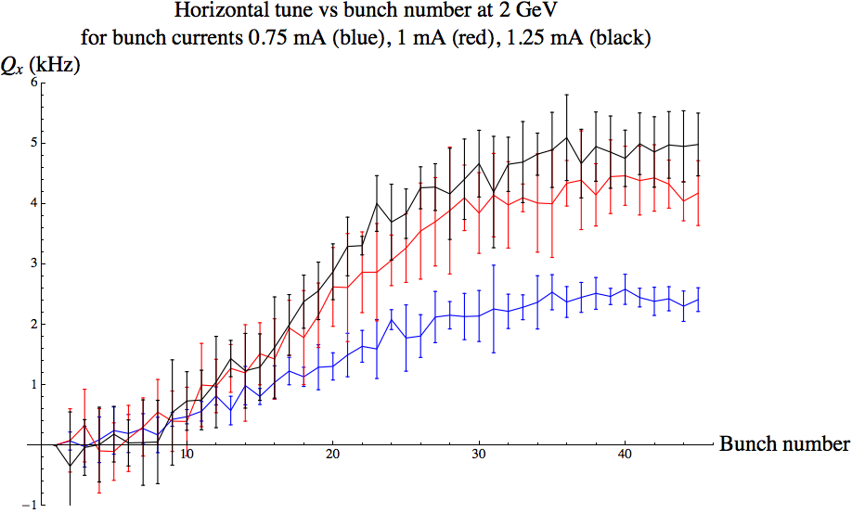
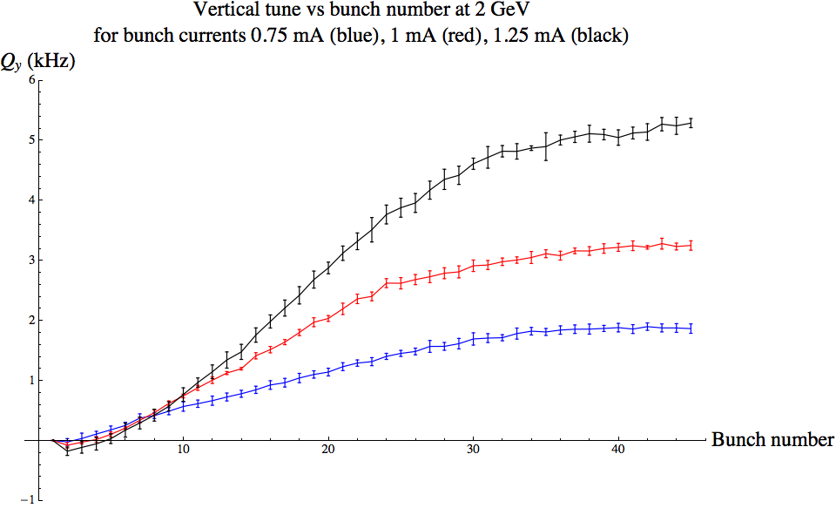
Electron cloud observations: a historical excursus
2003-2010: Miscellaneous
  Colliders: BEPC, Tevatron and DaΦne all exhibit signs of electron cloud (pressure rise, instabilities) in high intensity operation
  Even ANKA, an electron ring, suspects electron cloud to explain vacuum degradation and heating in the superconducting wiggler
  Cesr-TA starts a program to study specifically e-cloud issues. Thanks to its tunability, the ring is used with positrons to study e-cloud and benchmark simulation codes.

Slide 26
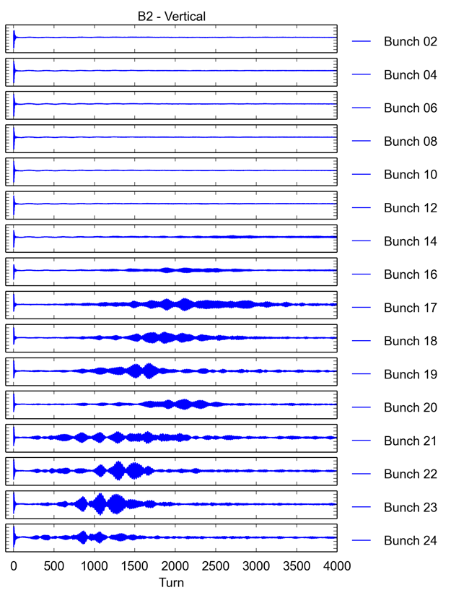
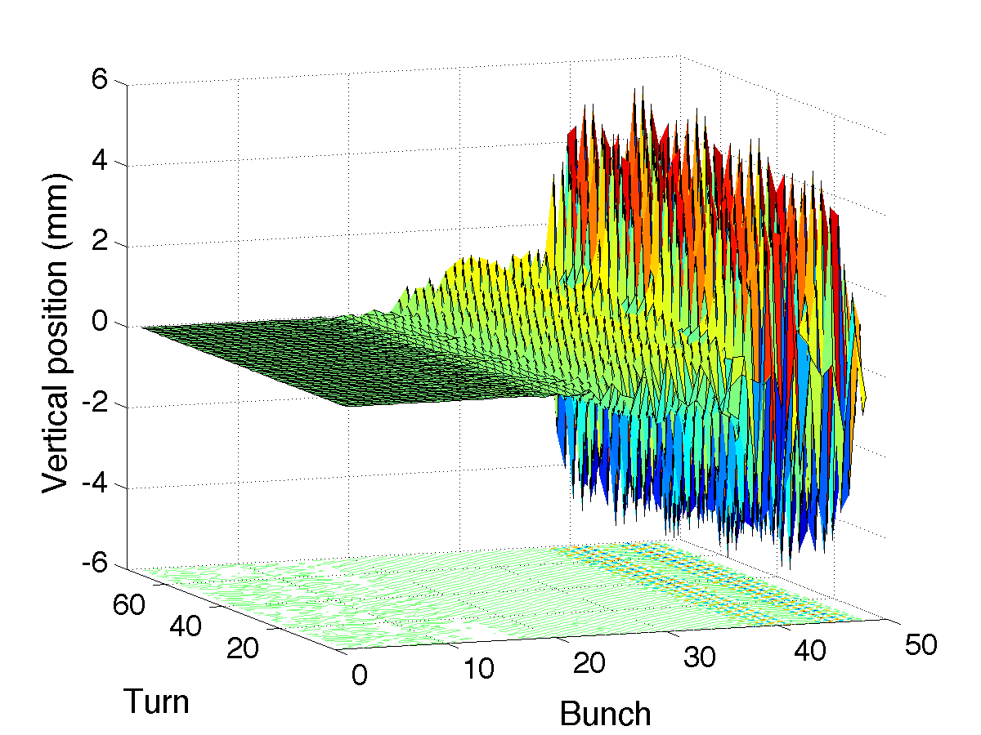
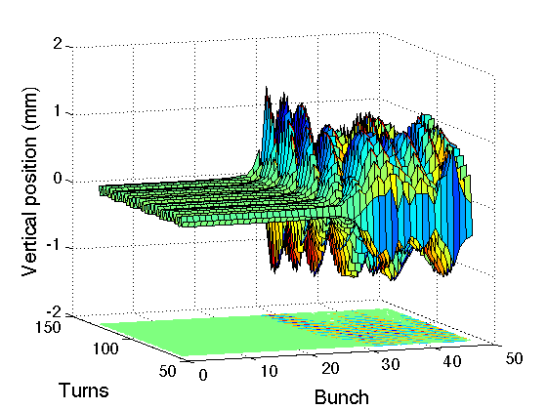
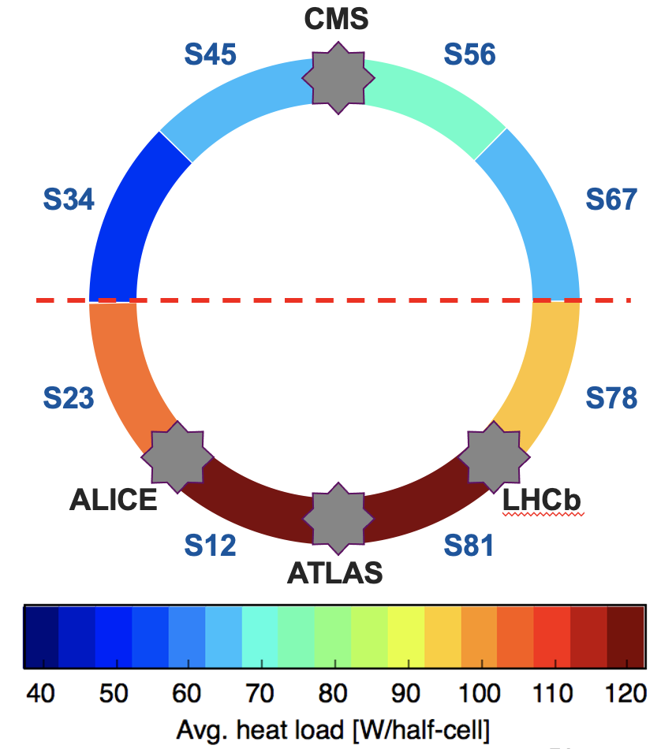
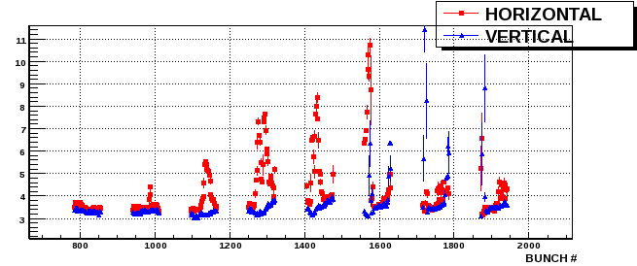
LHC e-cloud observations
Today
2010
2013
2015
2019
2022
Run 1
LS1
Run 2
LS2
Run 3
First injection of 48 bunches with 25 ns spacing
Run 1 - data taking with:
Beam energy: 3.5 - 4 TeV
Bunch spacing: 150 – 50 ns
Max # of bunches: 1380
Bunch intensity: 1.7e11p
Run 2 - data taking with:
Beam energy: 6.5 TeV
Bunch spacing: 25 ns
Max # of bunches: 2556
Bunch intensity: 1.2e11p
Run 3:
Beam energy: 6.8 TeV
Bunch spacing: 25 ns
Max # of bunches: 2700
Bunch intensity: 1.8e11p
Measurement
Simulation
Long Shutdown 1:
No beam
Consolidation and maintenance
All arcs were warmed up and vented
Long Shutdown 2:
No beam
Consolidation and maintenance for LHC
All arcs were again warmed up and vented
LHC injectors were upgraded to produce beams twice as intense and as bright
Scrubbing day 1, 50 ns beam – 300 bunches

Slide 27
Outline
Basics of e-cloud formation and associated effects
Brief history of e-cloud observations in accelerators
Progress in modeling over the years
Limitations from e-cloud: Some lessons learnt after Long Shutdown 2 (LS2)
Conclusions

Slide 28
Modeling of electron cloud effects
A complex problem involving two sets of particles mutually interacting
Vacuum chamber
Electron cloud effects
Shape, PEC boundary conditions
e⁻ production mechanisms
(e.g. secondary emission)
Beam charge distribution
Maxwell’s equations
E.M.
forces
e⁻ equations of motion
Maxwell’s equations
E.M.
forces
External B field
Beam equations of motion
External forces from
Magnets & RF

Slide 29
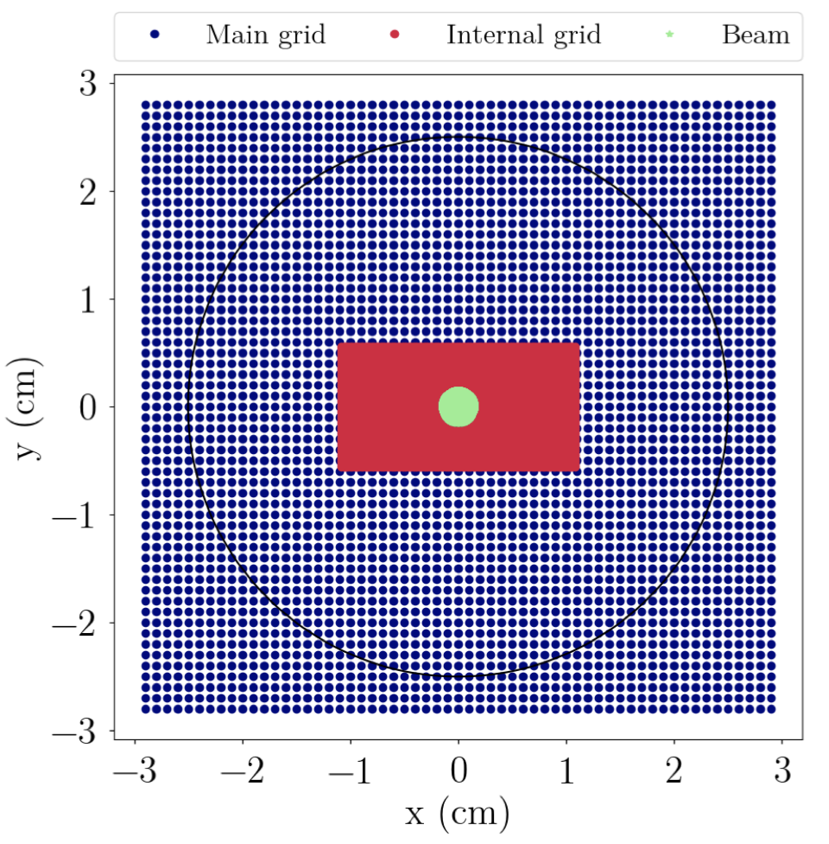
Modeling of electron cloud effects
A complex problem involving two sets of particles mutually interacting
A multi-scale problem
  In space: A small beam in a big chamber (e.g., ~100 μm beam radius in a 4 cm chamber for LHC, even more extreme ratios for positron machines like FCC-ee)
  In time: Fractions of ns for the e- motion, 1 to 10 s for instability development
For years the problem has been mainly modeled via
macro-particle simulations and split into two blocks,
independently solved and only interfaced through
the e-cloud density value

Slide 30
Modeling of electron cloud effects
E-cloud build-up → Solely focuses on electron dynamics with an unperturbed beam distribution to determine how the e-cloud forms and where it saturates
Vacuum chamber
Electron cloud effects
Shape, PEC boundary conditions
e⁻ production mechanisms
(e.g. secondary emission)
External EM fields
in RF cavity
Pre-calculated forces from unperturbed beam distribution
Beam charge distribution
Maxwell’s equations
E.M.
forces
e⁻ equations of motion
Maxwell’s equations
E.M.
forces
External B field
Beam equations of motion
External forces from
Magnets & RF

Slide 31
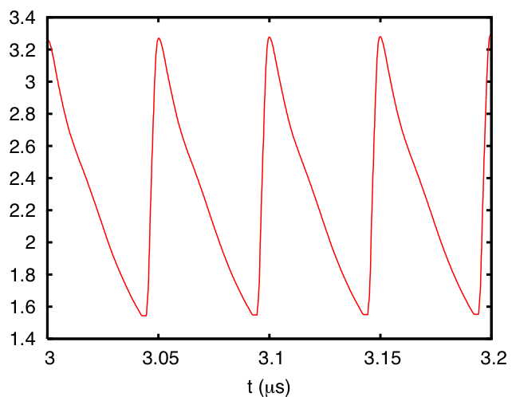
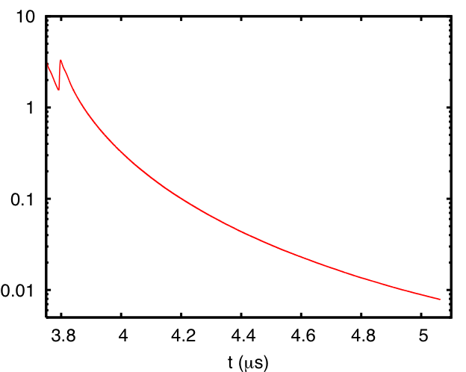
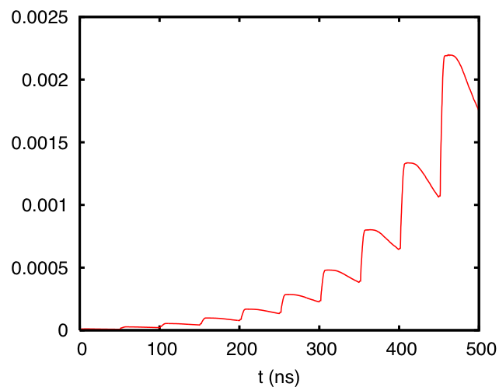
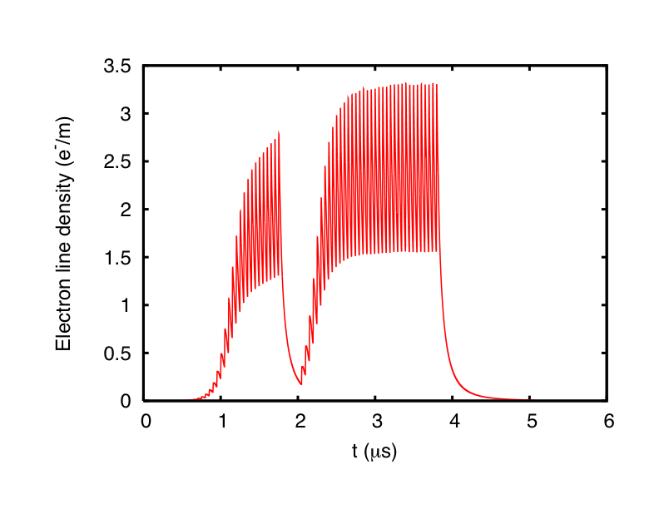
Modeling of electron cloud effects
E-cloud build-up → Solely focuses on electron dynamics with an unperturbed beam distribution to determine how the e-cloud forms and where it saturates
Saturation
x 10⁹
Decay
Exponential rise

Slide 32
Modeling of electron cloud effects
E-cloud build-up → Solely focuses on electron dynamics with an unperturbed beam distribution to determine how the e-cloud forms and where it saturates
Many codes developed over the years
  ECLOUD [CERN, Zimmermann et al.,Crittenden (Cornell)]
  POSINST [LBNL, Furman, Pivi]
  CLOUDLAND [BNL-SLAC, Wang]
  CSEC [BNL, Blaskiewicz]
  PEI [KEK, Ohmi]
  FAKTOR2 [CERN, Bruns]
  PyECLOUD [CERN, Iadarola, Mether, Belli, Dijkstaal, Wulf, ...] – an evolution of ECLOUD able to deal also with ions and several species
  WARP-PyECLOUD [CERN-LBL, Giacomel, Vay, Iadarola] – to include RF fields

Slide 33
Modeling of electron cloud effects
Beam dynamics simulations → Model the interaction of the beam (typically a single bunch) with a given initial electron distribution
Vacuum chamber
Electron cloud effects
Shape, PEC boundary conditions
e⁻ production mechanisms
(e.g. secondary emission)
Beam charge distribution
Maxwell’s equations
E.M.
forces
e⁻ equations of motion
Maxwell’s equations
E.M.
forces
External B field
Beam equations of motion
External forces from
Magnets & RF

Slide 34
Modeling of electron cloud effects
Beam dynamics simulations → Model the interaction of the beam (typically a single bunch) with a given initial electron distribution
Vacuum chamber
Electron cloud effects
Shape, PEC boundary conditions
Pre-calculated initial electron distribution
e⁻ production mechanisms
(e.g. secondary emission)
Beam charge distribution
Maxwell’s equations
E.M.
forces
e⁻ equations of motion
Maxwell’s equations
E.M.
forces
External B field
Beam equations of motion
External forces from
Magnets & RF

Slide 35

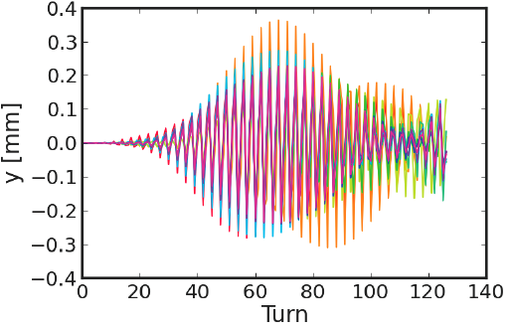
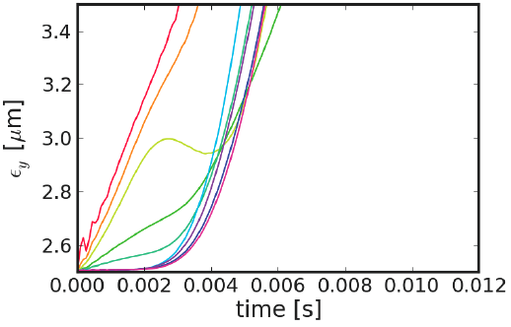
Modeling of electron cloud effects
Beam dynamics simulations → Model the interaction of the beam (typically a single bunch) with a given initial electron distribution

Slide 36
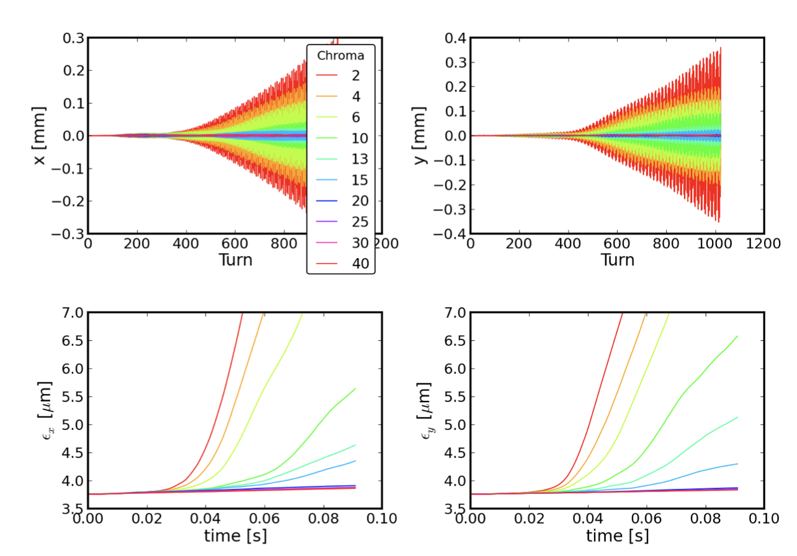
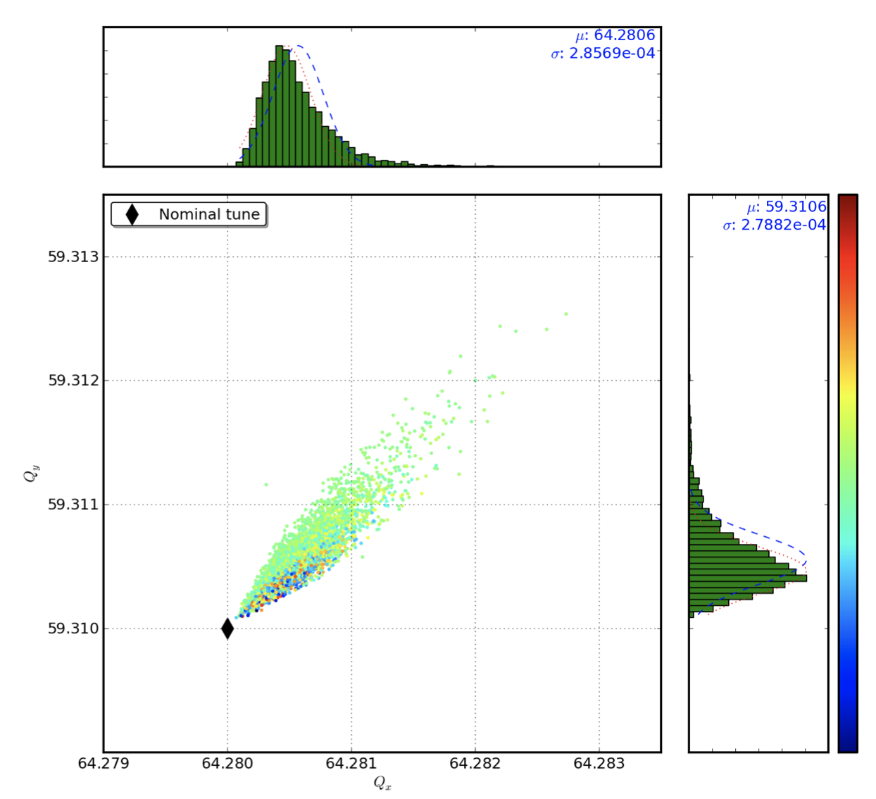
Modeling of electron cloud effects
Beam dynamics simulations → Model the interaction of the beam (typically a single bunch) with a given initial electron distribution

Slide 37
Modeling of electron cloud effects
Beam dynamics simulations → Model the interaction of the beam (typically a single bunch) with a given initial electron distribution
Several codes developed over the years
  HEADTAIL [CERN, Rumolo, Zimmermann, Li, Mounet]
  PEHTS [KEK, Ohmi]
  QuickPIC [USC-GSI, Katsouleas, Ghalam, Rumolo, Benedetto, Beng]
  CMAD [SLAC, Pivi]
  PyHEADTAIL [CERN, Li, Oeftiger, Iadarola, Mether, Schenk, ...] – an evolution of HEADTAIL allowing for modularity, flexibility, easy to interface with PyECLOUD and other Python tools

Slide 38
Modeling of electron cloud effects
Combined build-up and beam dynamics simulations → Few codes have been developed with the capability to handle both loops
Vacuum chamber
Electron cloud effects
Shape, PEC boundary conditions
e⁻ production mechanisms
(e.g. secondary emission)
Beam charge distribution
Maxwell’s equations
E.M.
forces
e⁻ equations of motion
Maxwell’s equations
E.M.
forces
External B field
Beam equations of motion
External forces from
Magnets & RF

Slide 39
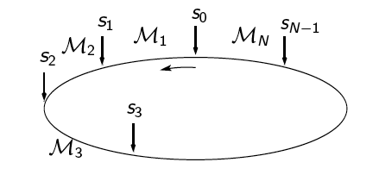
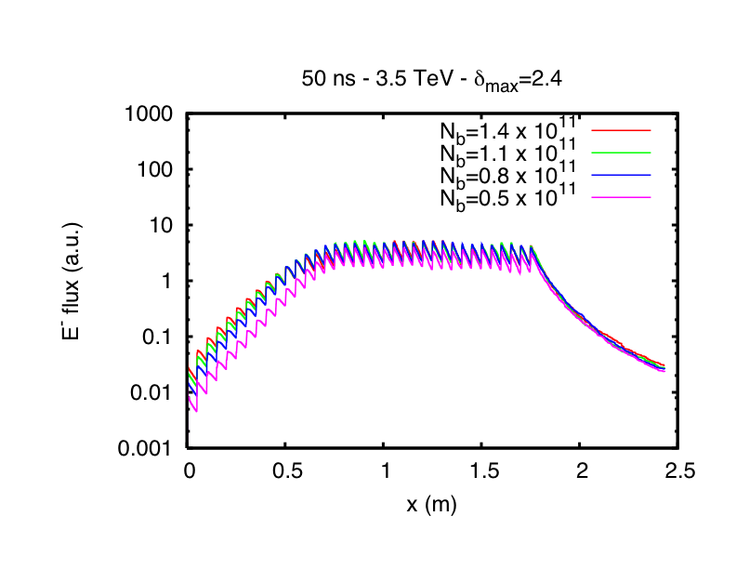
Modeling of electron cloud effects
Self-consistent build up electron cloud at each kick point
Every bunch interacting with the forming electron cloud
Would require approximately the time of (n_{turn}*n_{kick}) ECLOUD simulations plus n_{bunch} HEADTAIL simulations

Slide 40
Modeling of electron cloud effects
Combined build-up + beam dynamics codes, requiring advanced computing techniques based on parallel computing and running on powerful HPC clusters
  WARP-POSINST (LBNL, Vay, Furman)
  PyECLOUD + PyHEADTAIL (CERN, Iadarola, Mether)

Slide 41
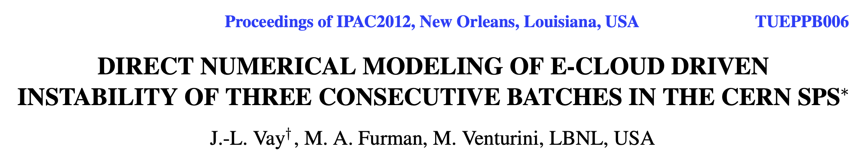
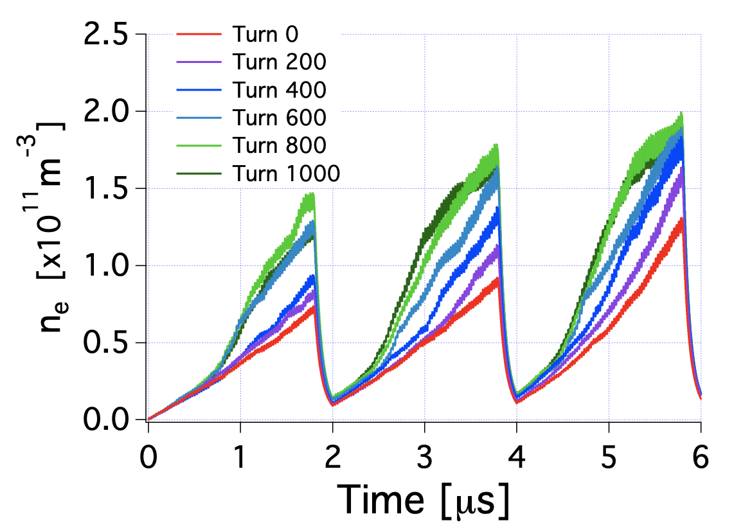
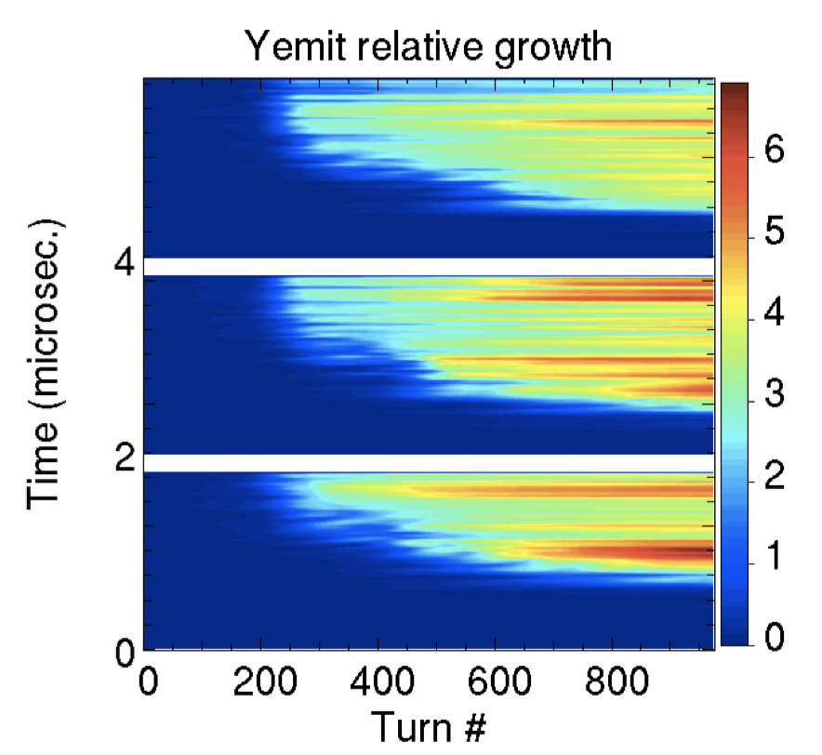
Modeling of electron cloud effects
Ex.: WARP-POSINST
  The simulation was performed on a NERSC
  parallel supercomputer using 9600 CPUs
3 SPS trains with 72b

Slide 42
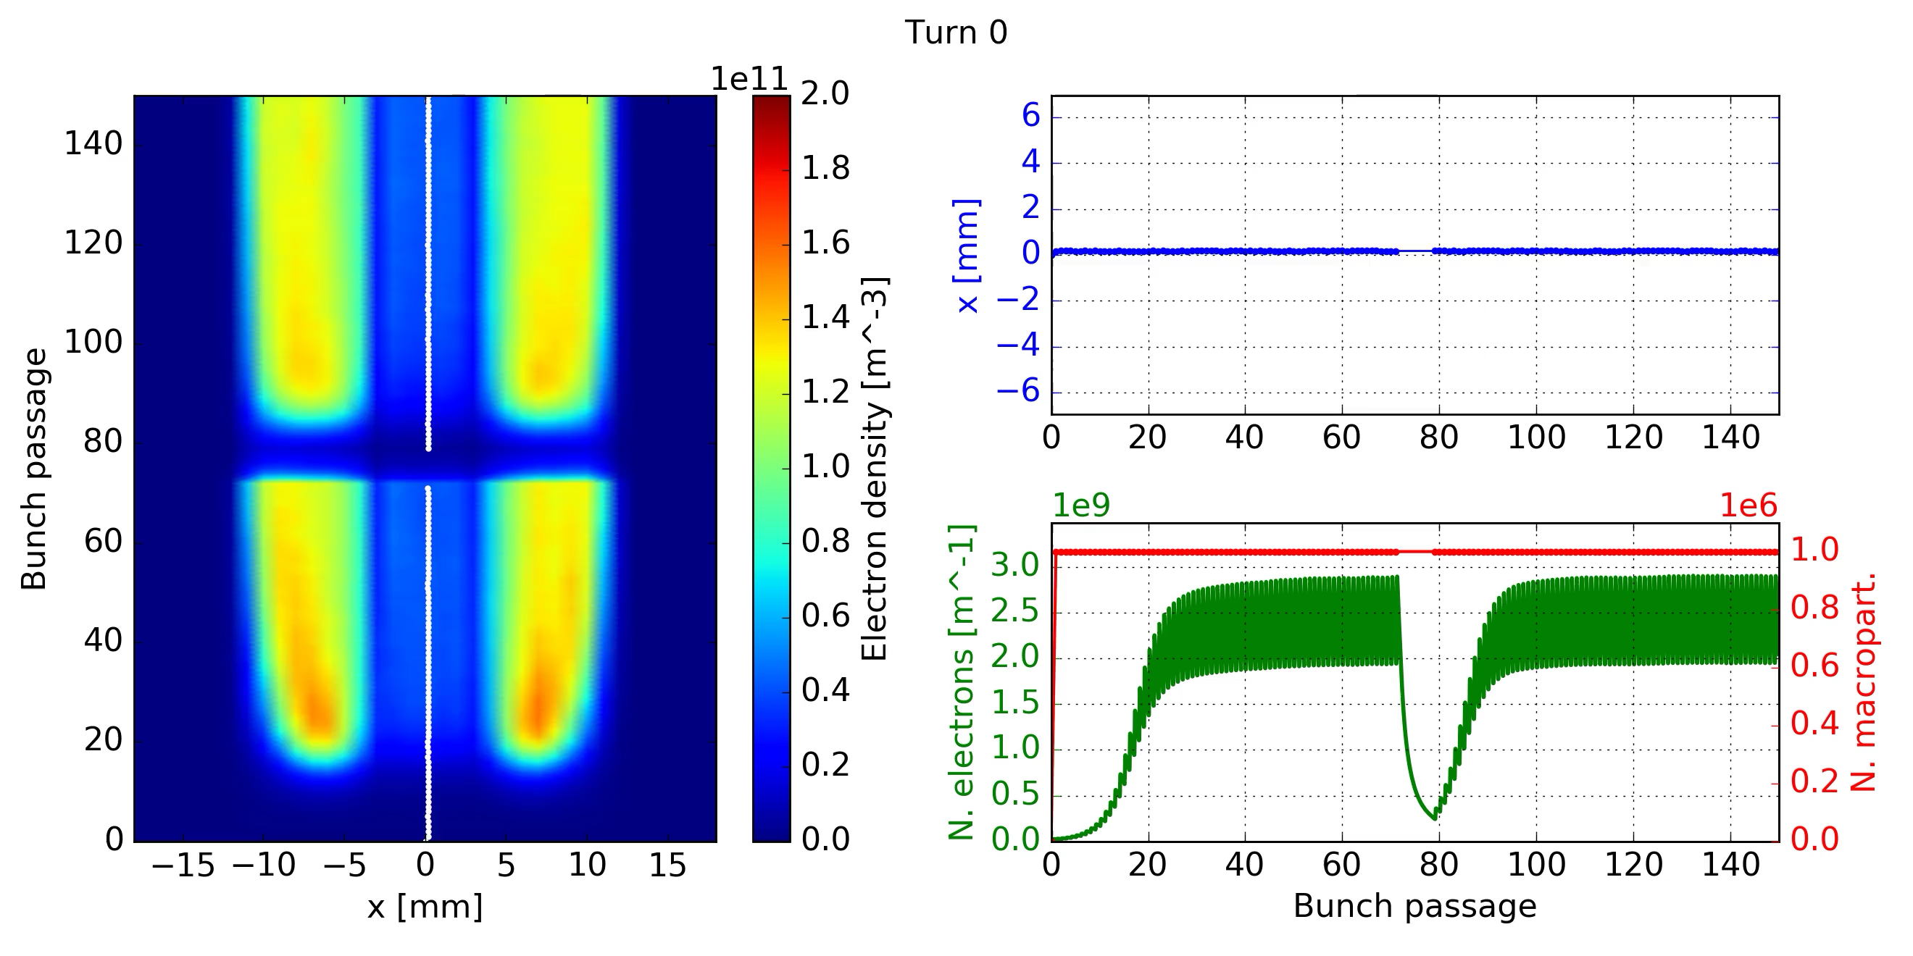
Modeling of electron cloud effects
Ex.: PyECLOUD-PyHEADTAIL
  Coupled-bunch instability from e-cloud in LHC dipole on CERN HPC cluster (2019-20)
# bunches | 144
# interactions/turn | 8
# macroprotons/bunch | 10⁶
# CPU cores | 800
Simulation speed (turns/day) | 100
Simulated turns | 1000
Output (GB) | 15 – 20

Slide 43
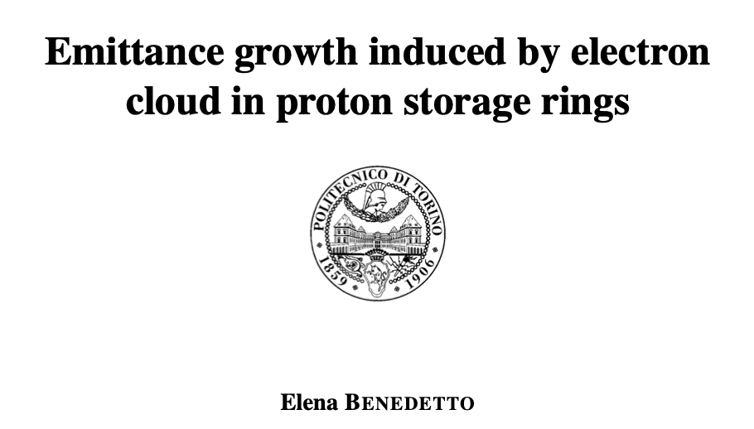
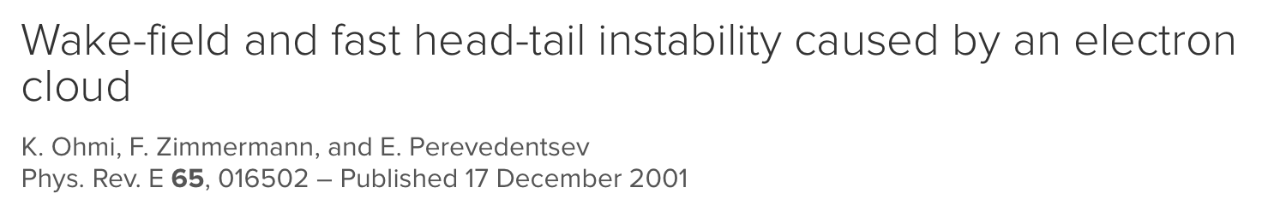
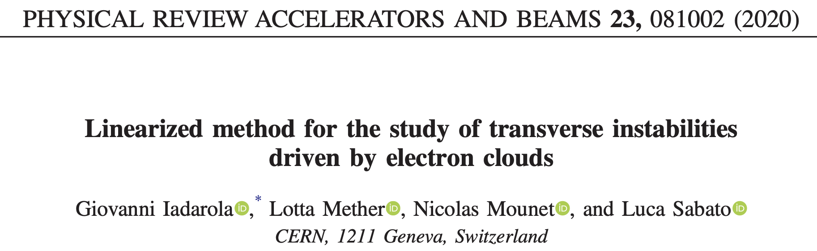
Modeling of electron cloud effects
Semi-analytical approach for instability study
  Broad-band resonator (CERN & KEK, Zimmermann,
  Ohmi, Perevedentsev, Benedetto)
  Vlasov equation (CERN, Iadarola, Mether, Mounet, Sabato
  → S. Johannesson‘s talk)

Slide 44
Modeling of electron cloud effects
Semi-analytical approach for instability study
  Broad-band resonator (CERN & KEK, Zimmermann,
  Ohmi, Perevedentsev, Benedetto)
The resonator frequency is the linear electron oscillation frequency at the center of the bunch
The shunt impedance is calculated considering an initial cloud of Gaussian transverse shape and of the same size as the beam, with an empirical factor H_{enh} to represent the contribution from electrons at larger amplitudes
The effective quality factor Q is assumed to be 1
Notes:
It reflects damping from the nonlinear force acting between the beam and the electrons as well as from the frequency spread due to the variation of the beta functions around the ring and due to the longitudinal variation of the beam line density along the bunch

Slide 45
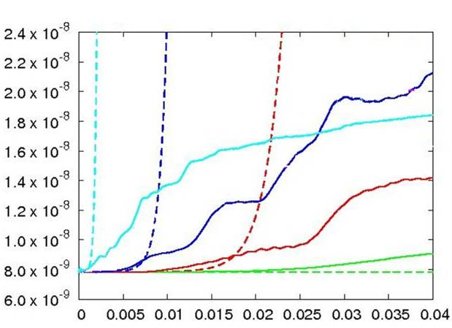
Modeling of electron cloud effects
Semi-analytical approach for instability study
  Broad-band resonator (CERN & KEK, Zimmermann,
  Ohmi, Perevedentsev, Benedetto)
ρ = 9 x 10¹¹ m⁻³
ρ = 3 x 10¹² m⁻³
ρ = 6 x 10¹¹ m⁻³
ρ = 4 x 10¹¹ m⁻³

Slide 46
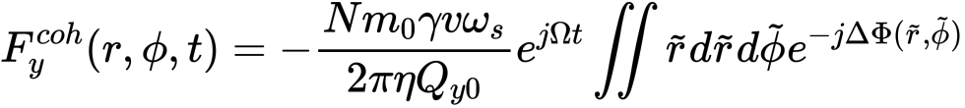
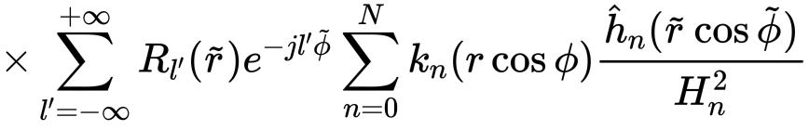
Modeling of electron cloud effects
Semi-analytical approach for instability study
  Vlasov equation (CERN, Iadarola, Mether, Mounet, Sabato
  → S. Johannesson‘s talk)
Generalised detuning term

Slide 47


Modeling of electron cloud effects
Semi-analytical approach for instability study
  Vlasov equation (CERN, Iadarola, Mether, Mounet, Sabato
  → S. Johannesson‘s talk)
Example of result for dipolar force only from e-cloud and comparison with PyHEADTAIL
(Q-Q₀)/Q_{s}
(Q-Q₀)/Q_{s}
e-cloud strength factor
e-cloud strength factor

Slide 48
Outline
Basics of e-cloud formation and associated effects
Brief history of e-cloud observations in accelerators
Progress in modeling over the years
Limitations from e-cloud: Some lessons learnt after Long Shutdown 2 (LS2)
Conclusions

Slide 49

Electron cloud resurgence after a long stop: the PS
The PS ring after the Long Shutdown 2 (LS2) for the LIU upgrades came back to operation limited by e-cloud induced pressure rise
  Dynamic pressure rise observed basically on all gauges around the machine
  Vacuum interlock for injection kicker triggered at basically every cycle, even at an intensity well below nominal
  Vacuum activity would not be triggered if dump anywhere before second double splitting
E.g. dump just after the first double splitting on the flat top

Slide 50

Electron cloud resurgence after a long stop: the PS
A dedicated scrubbing run (ca. 5 days) was needed
  Put in the machine as much beam as the kicker interlock level would permit
  Trade-off ad readjustment on number of cycles, number of bunches, bunch length and total intensity to push the performance to the limit and therefore optimise the scrubbing speed
  Finally gain one order of magnitude with scrubbing at constant conditions

Slide 51




Electron cloud resurgence after a long stop: the PS
Same scrubbing behaviour observed all around the machine
  Only few exceptions, in particular PR.VGP88 and neighboring gauges
  We then quickly learnt that the pressure rise there indeed wasn’t dominated by e-cloud …
Sponge-like protection piece from LS2 obstructed lower half of beam pipe in MU87 – Left in from MU renovation
Beam
270 μS/h max.

Slide 52




Electron cloud resurgence after a long stop: the SPS
Recovering the SPS performance for LHC-type beams after LS2
  Several weeks to lower pressure to acceptable values in sensitive elements, e.g., MKDV
  Beam suffering e-cloud instabilities and emittance growth during this time
  Only after a month a pre-LS2 beam could be successfully accelerated to 450 GeV
Vertical dump kicker (MKDV) pressure
Interlock value in operation

Slide 53

Electron cloud resurgence after a long stop: the SPS
However, performance limited to 1.1e11 p/b throughout 2021 due to deconditioning and pressure degradation in the region of the vertical dump kicker
  Maybe due to bulk pollution in porous ferrite?
  Problem exacerbated by low pressure interlock value required by equipment experts due to module non-conformity
Fixed target operation with little or
no LHC-type beam
Scrubbing
Interlock value in operation

Slide 54



Electron cloud resurgence after a long stop: the SPS
In 2022, the vertical dump kicker problem was solved (module exchanged)
Beam with 5x 48 bunches could be successfully accelerated to 450 GeV
  1.8e11 p/b @450 GeV
  95% transmission
  Beam transversely and longitudinally stable

Slide 55

Electron cloud resurgence after a long stop: the SPS
With this high intensity beam, other issues have come to surface (I)
Vacuum spikes in horizontal dump kicker (MKDH) as bunches become short
Number of bunches
MKDH pressure
1 batch
  Spikes below 1.6 ns
2 batches
  High spikes for 1.6 ns
3 batches
  Interlocked for 1.6 ns
4 batches
  Interlocked for 1.7 ns
5 batches
  Didn’t explore below 1.8 ns
Bunch length
Could it be electron cloud in the kicker???
5x 48b
1.6 ns
4x 48b
3x 48b
2x 48b
1x 48b

Slide 56

Electron cloud resurgence after a long stop: the SPS
With this high intensity beam, other issues have come to surface (II)
Vacuum spikes also in injection kicker (MKP4) as bunches become short
Number of bunches
MKP4 pressure
A combined e-cloud and impedance issue …
  Large dynamic pressure rise due to e-cloud
  Rapid rise of baseline pressure due to impedance heating
  High spiking with high intensity and short bunches comes on top of both these effects …
Bunch length

Slide 57
Electron cloud resurgence after a long stop: the LHC
The e-cloud has been present, and often a limiting factor, in LHC since the start of its multi-bunch operation
Unlike the PS and SPS, e-cloud effects have become ever more prominent in LHC operation, due to both moving towards more challenging beam configurations and a visible degradation of the e-cloud activity over long venting
Nowadays the LHC observables include
  Instabilities (at injection, @stable beams) – mitigated with high chroma and octupoles
  High high load on the beam screen of the magnets (arcs, SAMs)
  High vacuum pressure around sensitive zones (e.g., injection kickers)
  Incoherent losses and emittance growth especially triggered by e-cloud in common chambers
  Stable phase shift along the trains
No spoiler now, the upcoming talks will cover most of these aspects in detail and highlight the challenges for High Lumi (HL) and future machines

Slide 58

Summary and closing remarks
The e-cloud remains a very fashionable subject, having affected a number of running machines and expected to limit future machines
  Unless suppression measures are correctly included in the design phase and weighed against other performance considerations (e.g., vacuum, impedance)
Example: Effect of NEG coating in FCC-ee on threshold for microwave instability

Slide 59
Summary and closing remarks
The e-cloud remains a very fashionable subject, having affected a number of running machines and expected to limit future machines
  Unless suppression measures are correctly included in the design phase and weighed against other performance considerations (e.g., vacuum, impedance)
The ‘self-healing’ scrubbing mechanism represents an important mitigation, but it has its limits (scrubbing time, potential extent of scrubbing, deconditioning)
Modeling of e-cloud phenomena in accelerators has progressed enormously over the last two decades
  Excellent level of development of both build-up and instability (or combined) tools reached including most of the cases of interest
  More and more fine examples of successful benchmark against machine data, even when the parameter dependence is not completely intuitive
  Essential input for machine operation and run planning

Slide 60
References (and references therein) for more details
G. Rumolo et al. “Electron cloud effects at the LHC and LHC injectors”, MOZA1 in IPAC 2017
G. Iadarola and G. Rumolo, “Electron cloud effects”, CERN Yellow Rep. Conf. Proc. CERN-2018-003-CP, p. 49-56, 2018
F. Zimmermann, “Review of single bunch instabilities driven by an electron cloud”, Phys. Rev. Spec. Top. Accel. Beams 7, 124801, 2004
G. Iadarola et al. “Progressing in mastering electrons clouds at the Large Hadron Collider”, TUXA03 in IPAC 2021
L. Mether et al., “Self-consistent electron cloud simulations to study coupled bunch instabilities”, in HPC user workshop, CERN, 9 June 2020
E. Belli, “Coupling impedance and single beam collective effects for the future circular collider (lepton option)” CERN-THESIS-2018-381, 2019
G. Iadarola, “A simplified analytical model for the electron cloud build-up process”, CERN-ACC-NOTE-2021-0029, 2021

Slide 61

Thanks for your attention

Slide 62
LHC e-cloud observations – Run 1
Today
2010
2013
2015
2019
2022
Run 1
LS1
Run 2
LS2
Run 3
Run 1 - data taking with:
Beam energy: 3.5 - 4 TeV
Bunch spacing: 150 – 50 ns
Max # of bunches: 1380
Bunch intensity: 1.7e11p
Run 2 - data taking with:
Beam energy: 6.5 TeV
Bunch spacing: 25 ns
Max # of bunches: 2556
Bunch intensity: 1.2e11p
Run 3 - forecast:
Beam energy: 6.8 TeV
Bunch spacing: 25 ns
Max # of bunches: 2556
Bunch intensity: 1.8e11p
Long Shutdown 1:
No beam
Consolidation and maintenance
All arcs were warmed up and vented
Long Shutdown 2:
No beam
Consolidation and maintenance for LHC
All arcs were again warmed up and vented
LHC injectors were upgraded to produce beams twice as intense and as bright

Slide 63

LHC e-cloud observations – Run 1
LHC showed first signs of e-cloud with 150 ns beams (2010), but only in the form of pressure rise in the interaction regions
150 ns - 450 GeV
Beam 1
Beam 2
ΔP₁
ΔP₂

Slide 64

LHC e-cloud observations – Run 1
LHC showed first signs of e-cloud with 150 ns beams (2010), but only in the form of pressure rise in the interaction regions
  Solenoids were therefore applied at some
  locations of the common chamber

Slide 65

LHC e-cloud observations – Run 1
LHC showed first signs of e-cloud with 150 ns beams (2010), but only in the form of pressure rise in the interaction regions
  Solenoids were therefore applied at some
  locations of the common chamber
  They were seen to work effectively to
  suppress locally the e-cloud in
  operation
Solenoid ON
A4L1
Solenoid ON
A4R1
Beam Intensity
After 20 min
ΔP ≈10⁻⁸
After 20 min
ΔP ≈8·10⁻⁹
Remove multipacting
Still primary electrons

Slide 66


LHC e-cloud observations – Run 1
It was with 50 ns beams (2011) that clear signs of beam degradation from e-cloud appeared
  Visible effect in the emittance blow up along the trains
  Dedicated scrubbing run was necessary at the beginning of 2011 to go in physics production with 50 ns beams
Day 1 – 300 bunches
Day 3 – 800 bunches

Slide 67
LHC e-cloud observations – Run 1
It was with 50 ns beams (2011) that clear signs of beam degradation from e-cloud appeared
  Visible effect in the emittance blow up along the trains
  Dedicated scrubbing run was necessary at the beginning of 2011 to go in physics production with 50 ns beams
  Scrubbing clear in the evolution of the slope of the
  RF phase shift vs. beam intensity fill after fill

Slide 68
LHC e-cloud observations – Run 1
When first injecting 25 ns beams (2011) the beam showed immediately a strong instability even with relatively short trains (48 bunches)
  High chromaticity was needed to inject and keep 25 ns beams in the LHC, albeit with very poor lifetime especially at the beginning
First injection of 48 bunches with 25 ns spacing
Measurement
Simulation

Slide 69

LHC e-cloud observations – Run 1
A few machine development sessions took place with 25 ns beams (2011) during which a measurable surface conditioning was observed
  The evolution of the average SEY in the arcs was reconstructed using heat load data and PyECLOUD simulations

Slide 70
LHC e-cloud observations – Run 1
A few machine development sessions took place with 25 ns beams (2011) during which a measurable surface conditioning was observed
  The evolution of the average SEY in the arcs was reconstructed using heat load data and PyECLOUD simulations
Tests with 25 ns beams in the course of 2011 already provided enough ‘conditioning margin’ in the arcs to run stably 50 ns beams for physics throughout 2011 and 2012, even increasing the bunch intensity to 1.7e11 p/b, without ever requiring additional dedicated scrubbing runs
At the end of 2012 there was also another dedicated scrubbing run with 25 ns beam to allow for a pilot run with 25 ns beams (3 fills with up to 800 bunches per beam) just before the long shutdown 1 (LS1 )

Slide 71
LHC e-cloud observations – Run 2
Today
2010
2013
2015
2019
2022
Run 1
LS1
Run 2
LS2
Run 3
Run 1 - data taking with:
Beam energy: 3.5 - 4 TeV
Bunch spacing: 150 – 50 ns
Max # of bunches: 1380
Bunch intensity: 1.7e11p
Run 2 - data taking with:
Beam energy: 6.5 TeV
Bunch spacing: 25 ns
Max # of bunches: 2556
Bunch intensity: 1.2e11p
Run 3 - forecast:
Beam energy: 6.8 TeV
Bunch spacing: 25 ns
Max # of bunches: 2556
Bunch intensity: 1.8e11p
Long Shutdown 1:
No beam
Consolidation and maintenance
All arcs were warmed up and vented
Long Shutdown 2:
No beam
Consolidation and maintenance for LHC
All arcs were again warmed up and vented
LHC injectors were upgraded to produce beams twice as intense and as bright

Slide 72
LHC e-cloud observations – Run 2
The conditioning state achieved until end 2012 was
undone when LHC was basically fully vented during
Long Shutdown 1 (LS1)
In 2015 the beams exhibited at the beginning strong
e-cloud instabilities causing severe losses even with
short bunch trains injected

Slide 73

LHC e-cloud observations – Run 2
The conditioning state achieved until end 2012 was
undone when LHC was basically fully vented during
Long Shutdown 1 (LS1)
In 2015 the beams exhibited at the beginning strong
e-cloud instabilities causing severe losses even with
short bunch trains injected
Instabilities and slow losses due to e-ecloud could
be only gradually improved over several days of
dedicated scrubbing at 450 GeV
During this time, the length of the bunch trains and
the total number of bunches was gradually increased
in the machine and the lifetime kept improving
Right after injection 10 min after injection

Slide 74


LHC e-cloud observations – Run 2
Scrubbing 2015: It took 24 days of patient and gradual scrubbing to feel confident that LHC start physics production with 25 ns beams
An average SEY in the arcs could be reconstructed from heat load data
Scrubbing Run 1
Scrubbing Run 2
Beam 1
Beam 2

Slide 75

LHC e-cloud observations – Run 2
Even after scrubbing and going into operation, the e-cloud kept affecting the beam dynamics
  Machine settings: Need to run with high chromaticity
  (Q’ up to 20 units) & large octupole currents for stability,
  adjust tunes to accommodate the large tune footprint
  and preserve beam lifetime
PyECLOUD-PyHEADTAIL simulation

Slide 76


LHC e-cloud observations – Run 2
Even after scrubbing and going into operation, the e-cloud kept affecting the beam dynamics
  Instabilities during store due to build-up of central stripe for lower beam intensity
Observations
Simulations

Slide 77

LHC e-cloud observations – Run 2
Even after scrubbing and going into operation, the e-cloud kept affecting the beam dynamics
  Slow beam losses during store mainly affecting bunches at the end of trains

Slide 78

LHC e-cloud observations – Run 2
The heat load in the arcs showed persisting e-cloud and also – surprisingly – reached different levels in different arcs
Scrubbing Run 2

Slide 79

LHC e-cloud observations – Run 2
The heat load in the arcs showed persisting e-cloud and also – surprisingly – reached different levels in different arcs
  Additional heat load ranging by a factor 3 or more
  for typical 2015 physics fill
  Clearly due to e-cloud as only measured with
  25 ns bunch spacing

Slide 80

LHC e-cloud observations – Run 2
The heat load in the arcs showed persisting e-cloud and also – surprisingly – reached different levels in different arcs
  Additional heat load ranging by a factor 3 or more
  for typical 2015 physics fill
  Clearly due to e-cloud as only measured with
  25 ns bunch spacing
The LHC appeared divided into a ‘lower’ half with
high-load sectors and an ‘upper’ half with low-load
sectors
CMS
S45
S56
S34
S67
S23
S78
ALICE
LHCb
S12
S81
ATLAS

Slide 81

LHC e-cloud observations – Run 2
The heat load in the arcs showed persisting e-cloud and also – surprisingly – reached different levels in different arcs
  Limited operation in 2015 and beginning of 2016
Cooling capacity

Slide 82


LHC e-cloud observations – Run 2
The heat load in the arcs showed persisting e-cloud and also – surprisingly – reached different levels in different arcs
  Limited operation in 2015 and beginning of 2016
  Fortunately, additional parasitic scrubbing during physics alleviated the problem in Run 2, but the difference between arcs remained till the end
25 ns physics fills with >600b
2015
2016
2017
2018
S12
vented
Highest load sectors
SEY ≃ 1.35
Low load sectors
SEY ≃ 1.25

Slide 83
LHC e-cloud observations – LS2
Today
2010
2013
2015
2019
2022
Run 1
LS1
Run 2
LS2
Run 3
Run 1 - data taking with:
Beam energy: 3.5 - 4 TeV
Bunch spacing: 150 – 50 ns
Max # of bunches: 1380
Bunch intensity: 1.7e11p
Run 2 - data taking with:
Beam energy: 6.5 TeV
Bunch spacing: 25 ns
Max # of bunches: 2556
Bunch intensity: 1.2e11p
Run 3 - forecast:
Beam energy: 6.8 TeV
Bunch spacing: 25 ns
Max # of bunches: 2556
Bunch intensity: 1.8e11p
Long Shutdown 1:
No beam
Consolidation and maintenance
All arcs were warmed up and vented
Long Shutdown 2:
No beam
Consolidation and maintenance for LHC
All arcs were again warmed up and vented
LHC injectors were upgraded to produce beams twice as intense and as bright

Slide 84


LHC e-cloud observations – LS2
During the last shutdown, direct inspection of the beam screens took place to try explaining the different behaviour of the LHC arcs
  Magnets showing very high and very low heat loads were extracted from the ring
  Their beam screens were removed from the magnet and underwent laboratory analysis

Slide 85


LHC e-cloud observations – LS2
From measurements of SEY and conditioning behavior at room temperature:
  High-load beam screen exhibited a higher SEY after venting compared to low-load magnets
  High-load beam screen shows worse conditioning behavior upon e- irradiation compared to the low-load magnet and to a spare beam screen (never installed)
SPECS measurement system (CERN TE-VSC)
Spare
High-load
Low-load

Slide 86


LHC e-cloud observations – LS2
The chemistry of the surface was analyzed using X-ray photoelectron spectroscopy (XPS)
  Low-load beam screen shows Copper(I) oxide (Cu2O) → native copper oxide
  High-load beam screen shows Copper(II) oxide (CuO) → unexpected!
  High-load beam screen shows a surprisingly low concentration of carbon
These chemical alterations are
likely the cause of the different
SEY and conditioning behaviour
XPS spectrum
Notes:
Though we now understand the origin of the different SEYs, we do not know what caused the growth of CuO in the first place and we can’t predict what the LHC beam screens will look like after LS2 …

Slide 87
LHC e-cloud projections – Run 3 (and beyond)
Today
2010
2013
2015
2019
2022
Run 1
LS1
Run 2
LS2
Run 3
Run 1 - data taking with:
Beam energy: 3.5 - 4 TeV
Bunch spacing: 150 – 50 ns
Max # of bunches: 1380
Bunch intensity: 1.7e11p
Run 2 - data taking with:
Beam energy: 6.5 TeV
Bunch spacing: 25 ns
Max # of bunches: 2556
Bunch intensity: 1.2e11p
Run 3 - forecast:
Beam energy: 6.8 TeV
Bunch spacing: 25 ns
Max # of bunches: 2556
Bunch intensity: 1.8e11p
Long Shutdown 1:
No beam
Consolidation and maintenance
All arcs were warmed up and vented
Long Shutdown 2:
No beam
Consolidation and maintenance for LHC
All arcs were again warmed up and vented
LHC injectors were upgraded to produce beams twice as intense and as bright

Slide 88


LHC e-cloud predictions – Run 3 (and beyond)
We can sum up contributions to e-cloud from all parts of the arc assuming SEY from latest 2018 heat load measurements (SEY=1.25 – 1.35)
  No margin during Run 3, any further deterioration of high load sectors not tolerable!
Low-load sectors
High-load sectors
e-cloud in dipoles
SEY=1.35
e-cloud in quadrupoles
e-cloud in drifts
  Run 2
  Run 3
  HiLumi
  HiLumi
Impedance
  Run 3
Synchrotron radiation
  10 kW/arc (~200W/hcell)
SEY=1.25
Heat load [kW/arc]
Heat load [kW/arc]
  Run 2
Bunch intensity [10¹¹ p/bunch]
Bunch intensity [10¹¹ p/bunch]

Slide 89
Closing remarks
The LHC has been suffering electron cloud issues when operating with closely spaced intense proton bunches
  Especially critical with 25 ns beams both in terms of beam dynamics (WP optimization, instability mitigation, lifetime in collision) and beam screen heating
Dedicated scrubbing runs have been necessary, and successful, after every partial or total machine opening, as conditioning is lost with venting
  Additional scrubbing takes place during physics operation but levels off
Different scrubbing efficiency for different sectors investigated and found to be caused by different chemical compositions of the screen inner surface
  Still investigating underlying reason and if anything can be done to ‘reverse’ the processes
If no further degradation, cooling capacity of cryogenic system expected to be just sufficient for Run 3 and High Luminosity (HiLumi) operation of LHC

Slide 90
Electron cloud build-up
Seed electron
(e.g. photoemission)
~300 eV
~10 eV
Proton bunch
~50 eV
~10 eV
SEY_{max} > 1
25 ns
time
This electron flux to the wall is responsible for:
Dynamic pressure rise
Heat deposition
Synchronous phase shift due to beam energy loss
Spurious signal for beam instrumentation
e⁻
e⁻
beam
e⁻
Notes:
T

Slide 91


The Large Hadron Collider (LHC)
8-fold symmetric structure
  8 Long Straight Sections (LSS) to host experiments and other equipment
  8 Arcs (2.45 km each - Periodic magnet lattice, to bend and focus the beams)
  Main magnets
  (superconducting)
  8.33 T dipoles
  223 T/m quadrupoles

Slide 92

What the LHC beam mainly sees: The LHC beam screen
To avoid too high-power deposition on the superconducting coils a beam screen is inserted inside the 1.9 K cold bore
  The beam screen intercepts beam-induced
  heat sources (EM, synch. radiation, e-cloud)
  It is held by low conductivity supports and is
  actively cooled with a helium flow to operate in
  the range 5-20 K
  By measuring the thermodynamic properties of
  helium, the heat load on the screen is inferred
  Magnets in each “half-cell” share same cooling
  circuit → Heat load is measured per half-cell
  Section of a main dipole
    Beam screen cooling circuit
    (helium)
    Superconducting coils (1.9 K)
    Beam screen
    (5 – 20 K)
Half-cell (53.4 m)
Half-cell (53.4 m)
Half-cell (53.4 m)
Quad
(3.1 m)
Dipoles (3 x 14.3 m)
Quad
(3.1 m)
Dipoles (3 x 14.3 m)
Quad
(3.1 m)
Dipoles (3 x 14.3 m)
Quad
(3.1 m)

Slide 93
A glimpse on the history (and near future) of LHC
Today
2010
2013
2015
2019
2022
Run 1
LS1
Run 2
LS2
Run 3
Run 1 - data taking with:
Beam energy: 3.5 - 4 TeV
Bunch spacing: 150 – 50 ns
Max # of bunches: 1380
Bunch intensity: 1.7e11p
Run 2 - data taking with:
Beam energy: 6.5 TeV
Bunch spacing: 25 ns
Max # of bunches: 2556
Bunch intensity: 1.2e11p
Run 3 - forecast:
Beam energy: 6.8 TeV
Bunch spacing: 25 ns
Max # of bunches: 2556
Bunch intensity: 1.8e11p
Long Shutdown 1:
No beam
Consolidation and maintenance
All arcs were warmed up and vented
Long Shutdown 2:
No beam
Consolidation and maintenance for LHC
All arcs were again warmed up and vented
LHC injectors were upgraded to produce beams twice as intense and as bright

