Slide 1
Electron Cloud Studies for the Future Circular Collider
Sabato Luca¹, Mether Lotta²
Acknowledgement: Pieloni Tatiana¹, Iadarola Giovanni²
¹ ²
E⁻CLOUD’22 Workshop
26th September 2022
This work was performed under the auspices and with support from the Swiss Accelerator Research and Technology (CHART) program (www.chart.ch).

Slide 2
Outline
Introduction
Background
Simulation Results
Conclusions and Outlook
E⁻CLOUD’22 Workshop 26/09/2022

Slide 3
Outline
Introduction
FCC
FCC-ee
First e-cloud studies
Recent e-cloud studies
On-going e-cloud studies
Background
Simulation Results
Conclusions and Outlook
E⁻CLOUD’22 Workshop 26/09/2022

Slide 4
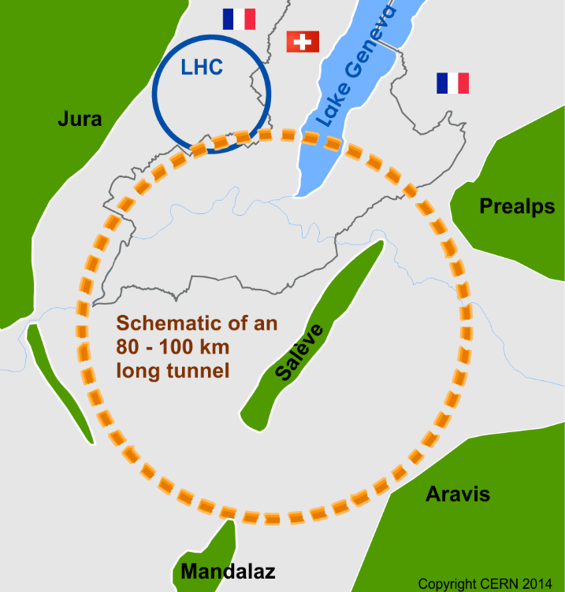
Introduction: FCC
The research project is in the framework of long term coherent stability for the Future Circular Collider (FCC)
FCC study is developing designs for a new research infrastructure to host the next generation of higher performance particle colliders to extend the research currently being conducted at CERN
The goal of the FCC is to push the energy and intensity frontiers of particle colliders, with the aim of reaching collision energies of 100 TeV, in the search for new physics
E⁻CLOUD’22 Workshop 26/09/2022

Slide 5
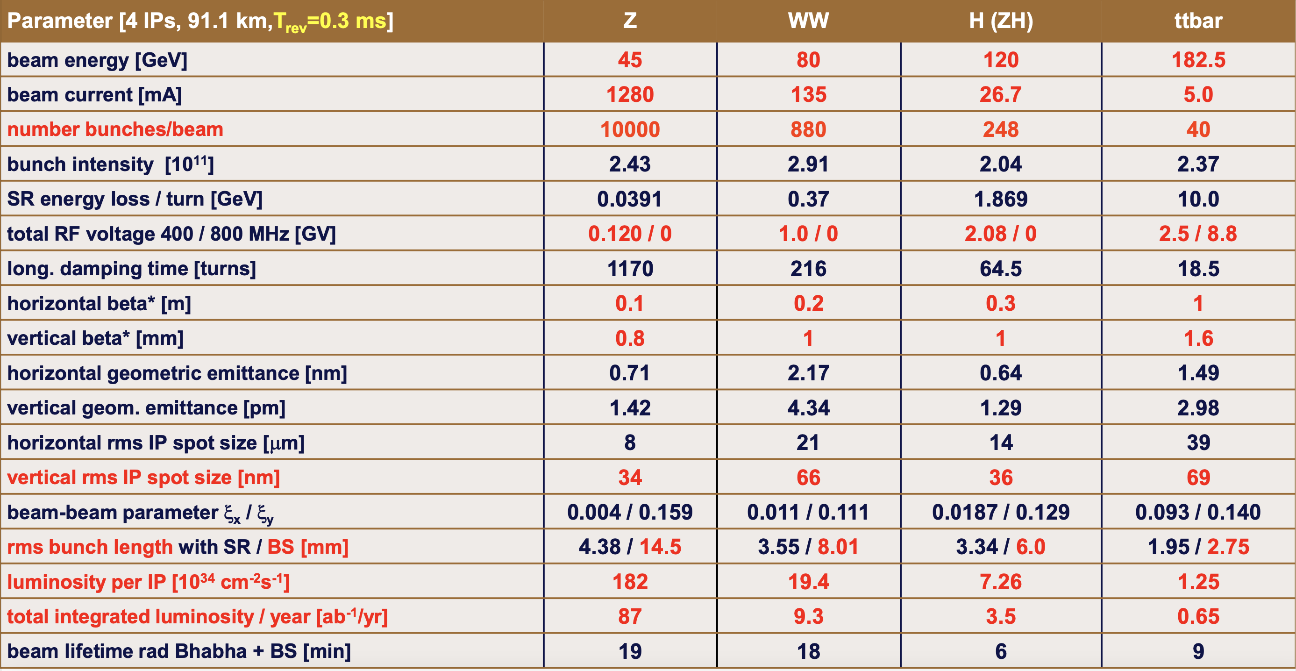
Introduction: FCC-ee
FCC-ee is a circular electron-positron collider, the first stage towards a 100 TeV proton-proton collider FCC-hh
[] FCC week 2022, “Accelerator overview”, Frank Zimmermann, Tor Raubenheimer
The Z configuration has been investigated, because the strongest electron cloud (e-cloud) effects are foreseen for this configuration due to the highest number of bunches (smallest bunch spacing)
E⁻CLOUD’22 Workshop 26/09/2022

Slide 6
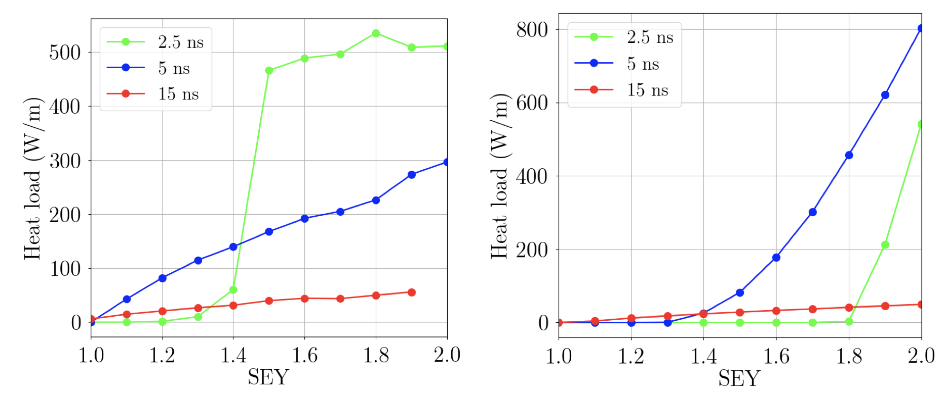
Introduction: First E-Cloud Studies
The first e-cloud studies for FCC-ee Conceptual Design Report (CDR) were carried out by Eleonora Belli
In particular, e-cloud build-up studies were carried out in the arcs and IR region in function of bunch spacing
Multipacting threshold were evaluated for different bunch spacing
In these studies, larger bunch spacing were found to be the preferable option (15 ns)
Higher thresholds in the IR (SEY < 1.2 to run the IR without electron cloud)
Heat load within acceptable limit in the arcs (< 100 W/m)
[] FCC week 2018, “Impedance model and single beam collective effects for FCC-ee”, E. Belli
[] PhD thesis, “COUPLING IMPEDANCE AND SINGLE BEAM COLLECTIVE EFFECTS FOR THE FUTURE CIRCULAR COLLIDER (LEPTON OPTION) ”, E. Belli
Arc quadrupole
Drift Space
E⁻CLOUD’22 Workshop 26/09/2022

Slide 7
Introduction: Recent E-Cloud Studies
These studies were performed with the FCC-ee CDR parameters (old)
E-cloud is sensitive to the parameters, therefore the studies have to be carried out with the latest FCC-ee parameters
Different studies have been done in the different arc elements with the latest parameters by Fatih Yaman et al. and Karla Cantùn Avila et al.
These studies show that the latest parameters mitigate the e-cloud build-up
[] Abada, Asmâa, et al., "FCC-ee: the lepton collider”, The European Physical Journal Special Topics 228 (2019)
E⁻CLOUD’22 Workshop 26/09/2022

Slide 8
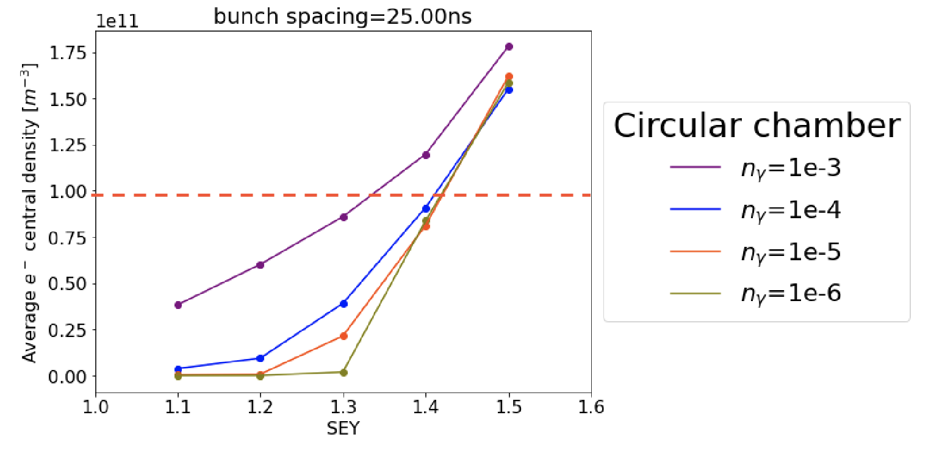
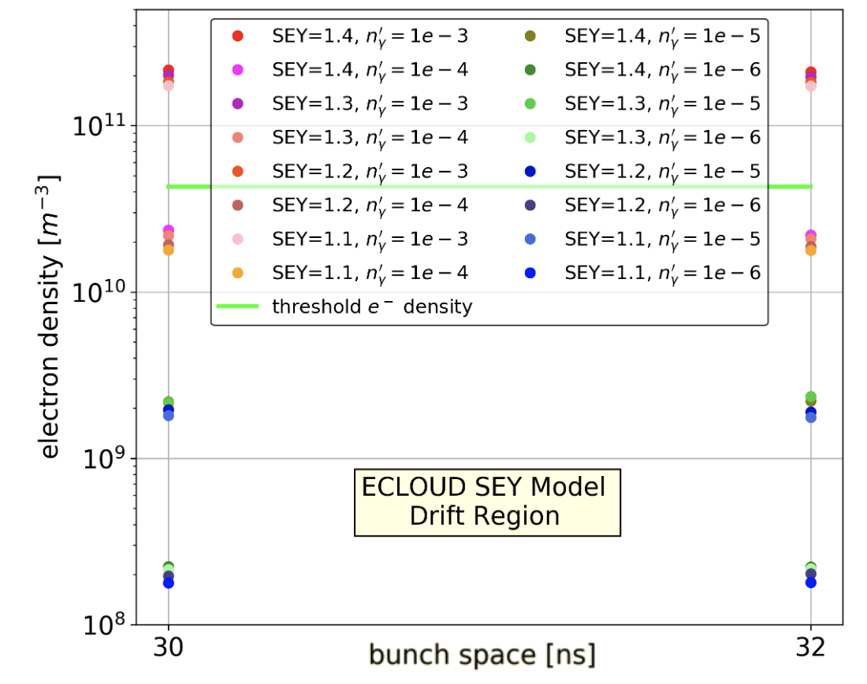
Introduction: Recent E-Cloud Studies
The central electron density has been estimated as a function of the photoemission rate for different SEY with the aim of investigating the beam stability
A first estimation of the beam stability region (SEY, photoemission rate) has been obtained by comparing the central electron density from PyECLOUD simulations with the analytically estimated instability threshold density
[] FCCIS WP2 Workshop 2021, “Electron Cloud in the Arc Quadrupoles”, Karla Cantùn Avila; “Electron Cloud in the Arcs”, Fatih Yaman
[] 65th ICFA Advanced Beam Dynamics Workshop on High Luminosity Circular e+e- Colliders (eeFACT2022), “Studies and possible mitigation of electron cloud effects in FCC-ee”, Fatih Yaman
Courtesy of
K. Cantùn
Courtesy of
F. Yaman
E⁻CLOUD’22 Workshop 26/09/2022

Slide 9
Introduction: On-Going E-Cloud Studies
The scientific goal of my research activity is to check the stability limits by means of self-consistent beam stability simulations for the different arc elements with realistic e-cloud distributions obtained from build-up simulations
Comparison between the analytical central electron density threshold for single bunch instability and the simulation results
The beam stability simulations are heavy from the computational point of view
For this reason, a preliminary study to identify the parameters, in the range of the values of FCC-ee case, which play a significant role in the e-cloud formation has been performed
[] K. Ohmi et al., “Study of Electron Cloud Instabilities in FCC-hh”, Proc. of IPAC2015
E⁻CLOUD’22 Workshop 26/09/2022

Slide 10
Outline
Introduction
Background
E-Cloud Formation
Case Study
Simulation Results
Conclusions and Outlook
E⁻CLOUD’22 Workshop 26/09/2022

Slide 11
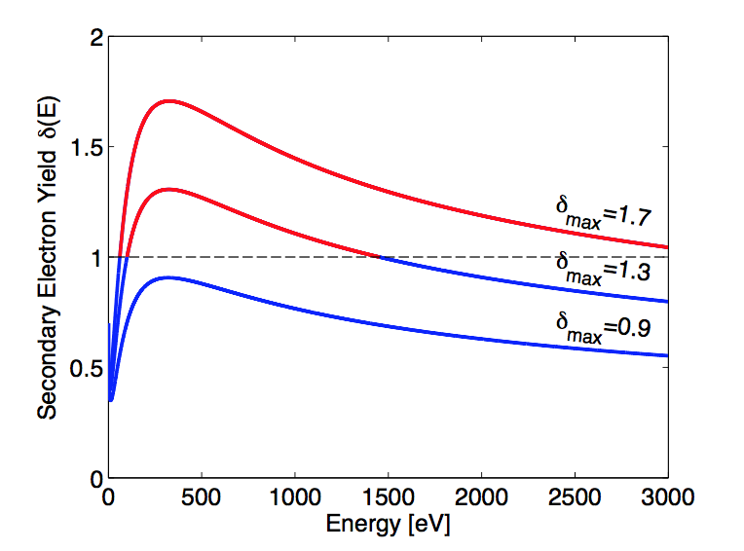
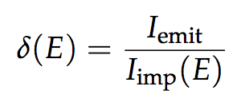
Background: E-Cloud Formation
The chamber geometry influences e- acceleration and time of flight
Surface properties have a primary role in the e- multiplication process
The main quantity involved is the Secondary Electron Yield (SEY):
The SEY is the ratio between emitted and impacting electron current as a function of the energy of the impinging electrons
It depends on surface chemical properties
Courtesy of
G. Iadarola
it depends on the history of the surface, in particular on accumulated electron dose -> to a certain extent the e-cloud cures itself (beam induced scrubbing)
E⁻CLOUD’22 Workshop 26/09/2022

Slide 12
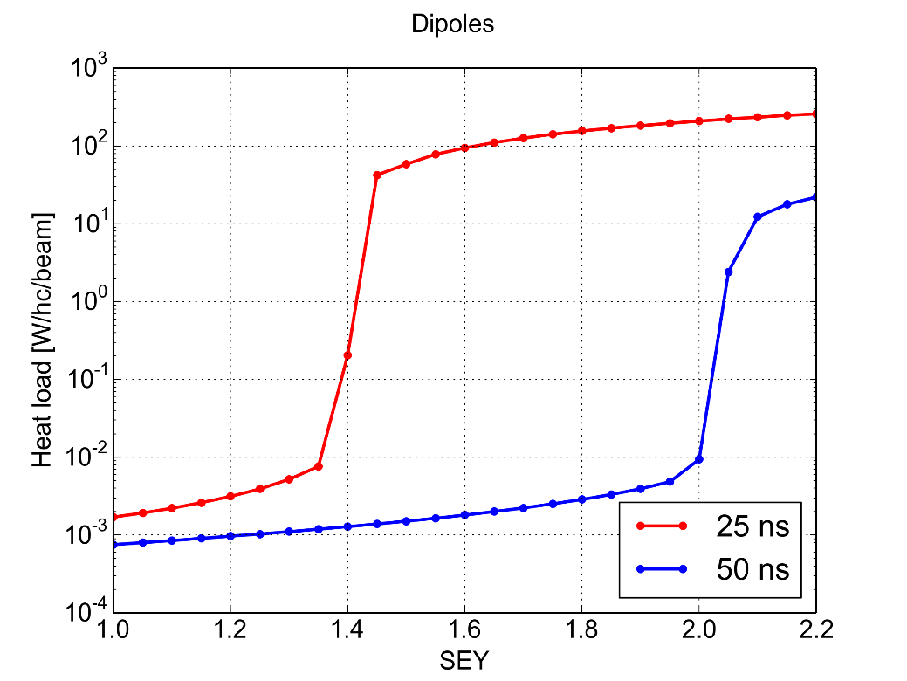
Background: E-Cloud Formation
A key ingredient is the bunch spacing:
It determines how many electrons survive between consecutive bunch passages
Significant impact on multipacting threshold, i.e. SEY above which avalanche multiplication (multipacting) is triggered
Bunch intensity and bunch length also have an important effect as they affect the acceleration received by the electrons
PyECLOUD simulations – LHC arc dipole
Courtesy of
G. Iadarola
Multipacting
Multipact.
Accumulation of primary e⁻
Accumulation of primary e⁻
Maximum Secondary Electron Yield (δ_{max})
E⁻CLOUD’22 Workshop 26/09/2022

Slide 13
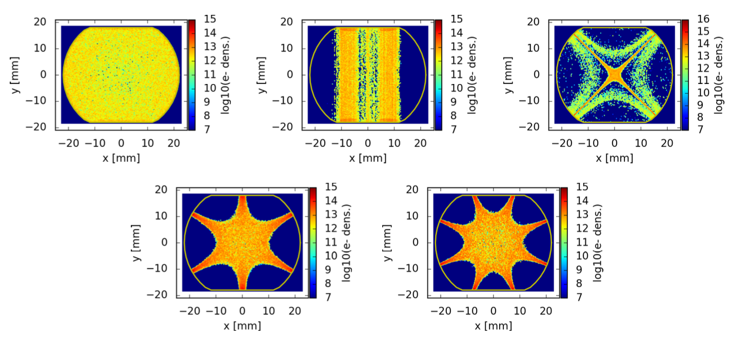
Background: E-Cloud Formation
Electron trajectories are strongly influenced by externally applied magnetic fields (Electrons spin around the field lines)
e-cloud distribution in the LHC arc magnets
Courtesy of
P. Dijkstal
E⁻CLOUD’22 Workshop 26/09/2022

Slide 14
Background: Case Study
In the study, the latest version (V22.2) of the parameters of the FCC-ee configuration Z has been used
[] FCC week 2022, “Accelerator overview”, Frank Zimmermann, Tor Raubenheimer
[] https://acc-models.web.cern.ch/acc-models/fcc/fccee/V22.2/z/
E⁻CLOUD’22 Workshop 26/09/2022

Slide 15
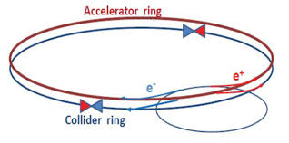
Background: Case Study
Parameter Overview
Particles: positron, electron
E⁻CLOUD’22 Workshop 26/09/2022

Slide 16
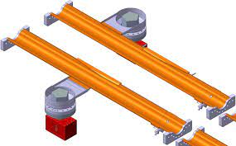
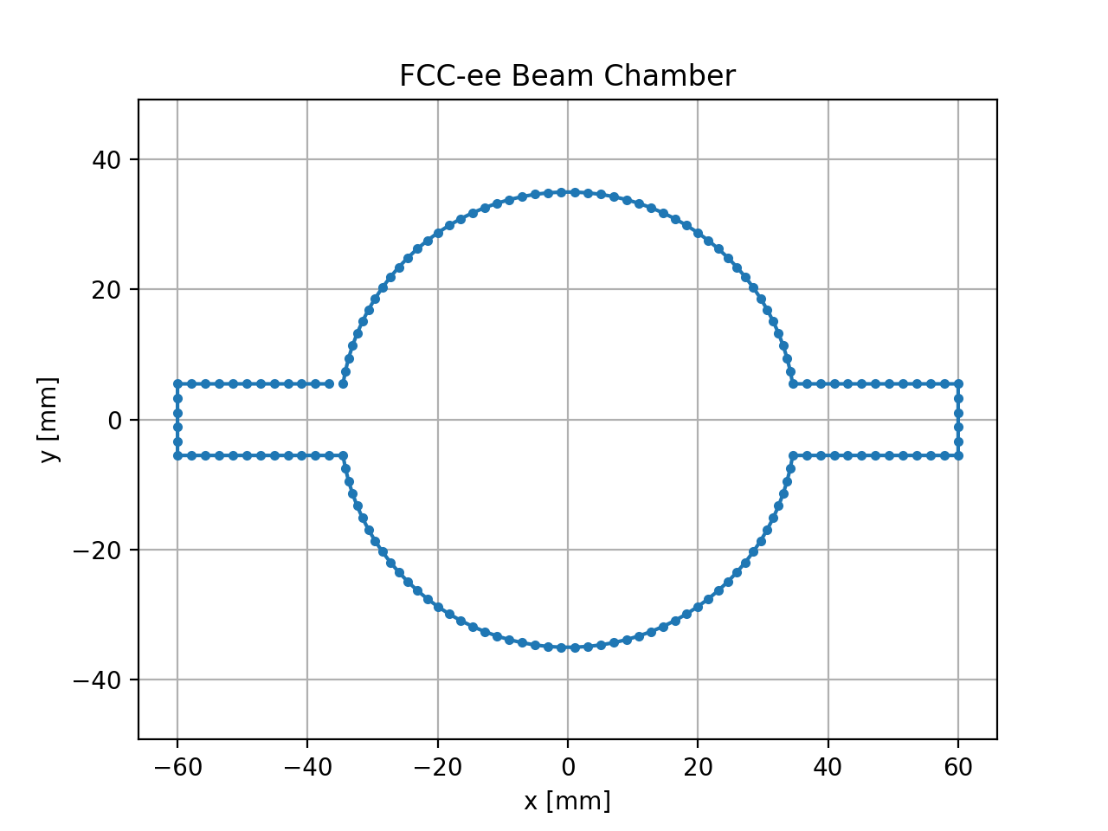
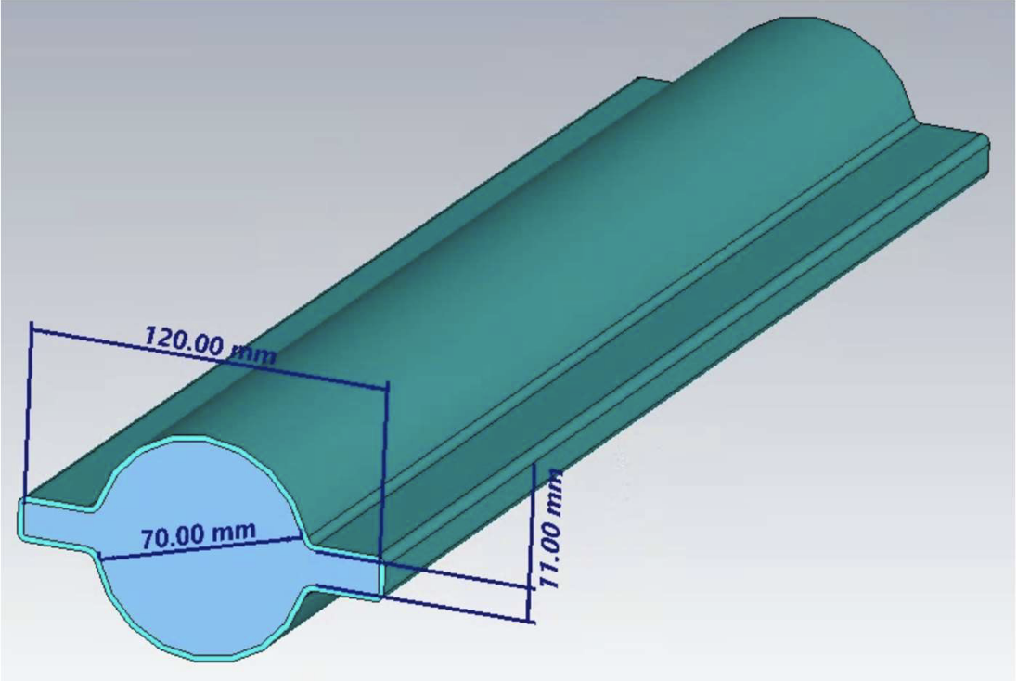
Background: Case Study
Courtesy of
R. Kersevan
Parameter Overview
Beam chamber winglet geometry
a = 9 mm
a = 10 mm
a = 11 mm
Design in PyECLOUD
a
E⁻CLOUD’22 Workshop 26/09/2022
Courtesy of
M. Migliorati

Slide 17
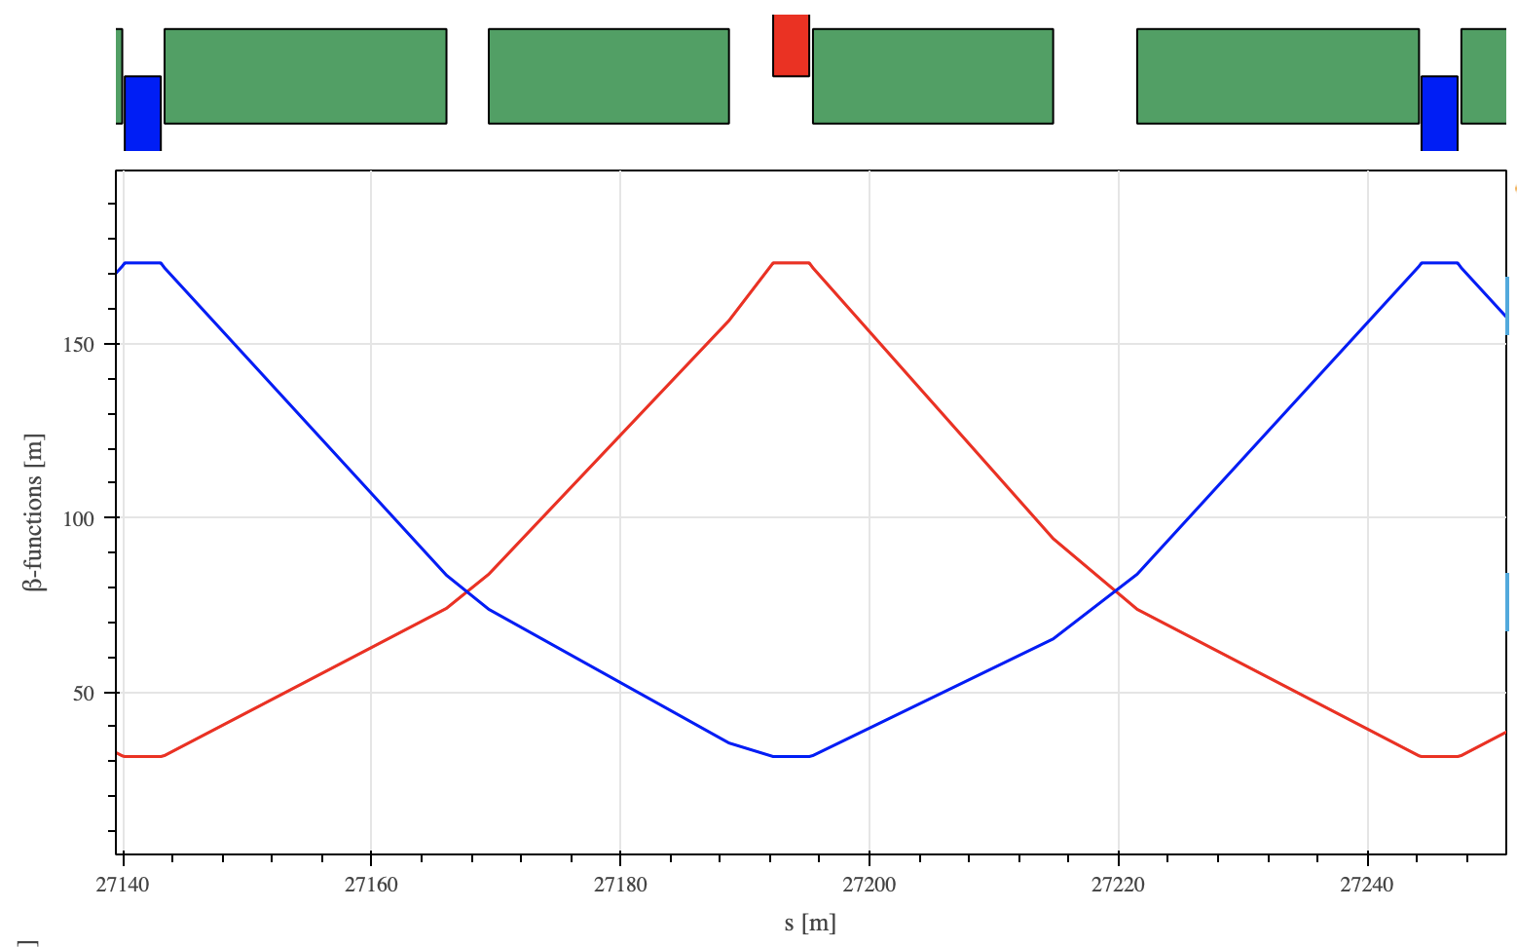
Background: Case Study
Focusing
quadrupole
Defocusing
quadrupole
Parameter Overview
Element:
Drift space
Quadrupole (5.65 T/m)
focusing
defocusing
Dipole (1.415 mT)
close to focusing quadrupole
close to defocusing quadrupole
Defocusing
quadrupole
Drift space
Drift space
Dipole
Dipole
Dipole
Dipole
β_{y}
β_{x}
E⁻CLOUD’22 Workshop 26/09/2022

Slide 18
Background: Case Study
Parameter Overview
Particle
Beam chamber winglet geometry
Element
Bunch spacing: 10 – 30 ns (step 5 ns)
Bunch intensity: 2.0 – 2.8e11 (step 0.1e11)
SEY: 1.0 – 1.6 (step 0.1)
Total: 9,450 simulations
E⁻CLOUD’22 Workshop 26/09/2022

Slide 19
Outline
Introduction
Background
Simulation Results
Negligible parameters
Other parameters
Conclusions and Outlook
E⁻CLOUD’22 Workshop 26/09/2022

Slide 20
Simulation Results
The first step to analyse the simulation results: to check if there were some parameters which gives a negligible contribution to the e-cloud formation
The electron density versus the bunch passage has been analysed to check if there is the multipacting effect
The synthetic parameter that has been used for the global analysis was the total number of electrons in the beam chamber
E⁻CLOUD’22 Workshop 26/09/2022

Slide 21
Simulation Results: Negligible Effect
Dependence on the:
Element
(in particular focusing and defocusing)
Beam chamber geometry winglet
a = 9 mm
a = 10 mm
a = 11 mm
β_{y}
a
β_{x}
E⁻CLOUD’22 Workshop 26/09/2022

Slide 22
Simulation Results: Negligible Effect
Dependence on the element:
Arc quadrupole
(positrons, beam chamber 9 mm, bunch spacing 10 ns, intensity 2.4e11 ppb, SEY 1.6)
Focusing Defocusing
The electron density versus the bunch passage has a similar behaviour in both the cases focusing and defocusing quadrupole
Synthetic parameter
Synthetic parameter
E⁻CLOUD’22 Workshop 26/09/2022

Slide 23
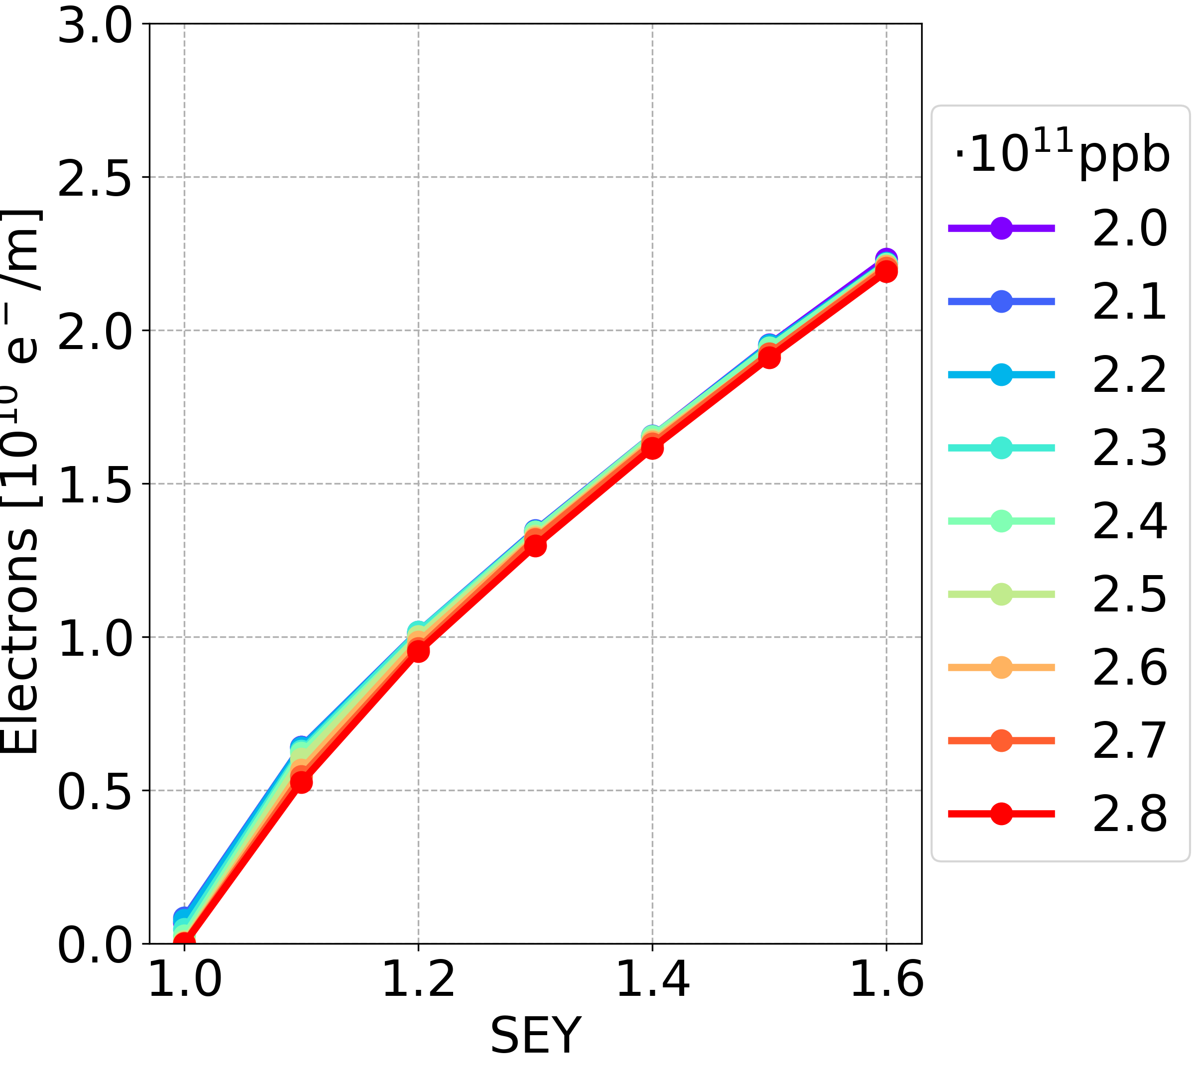
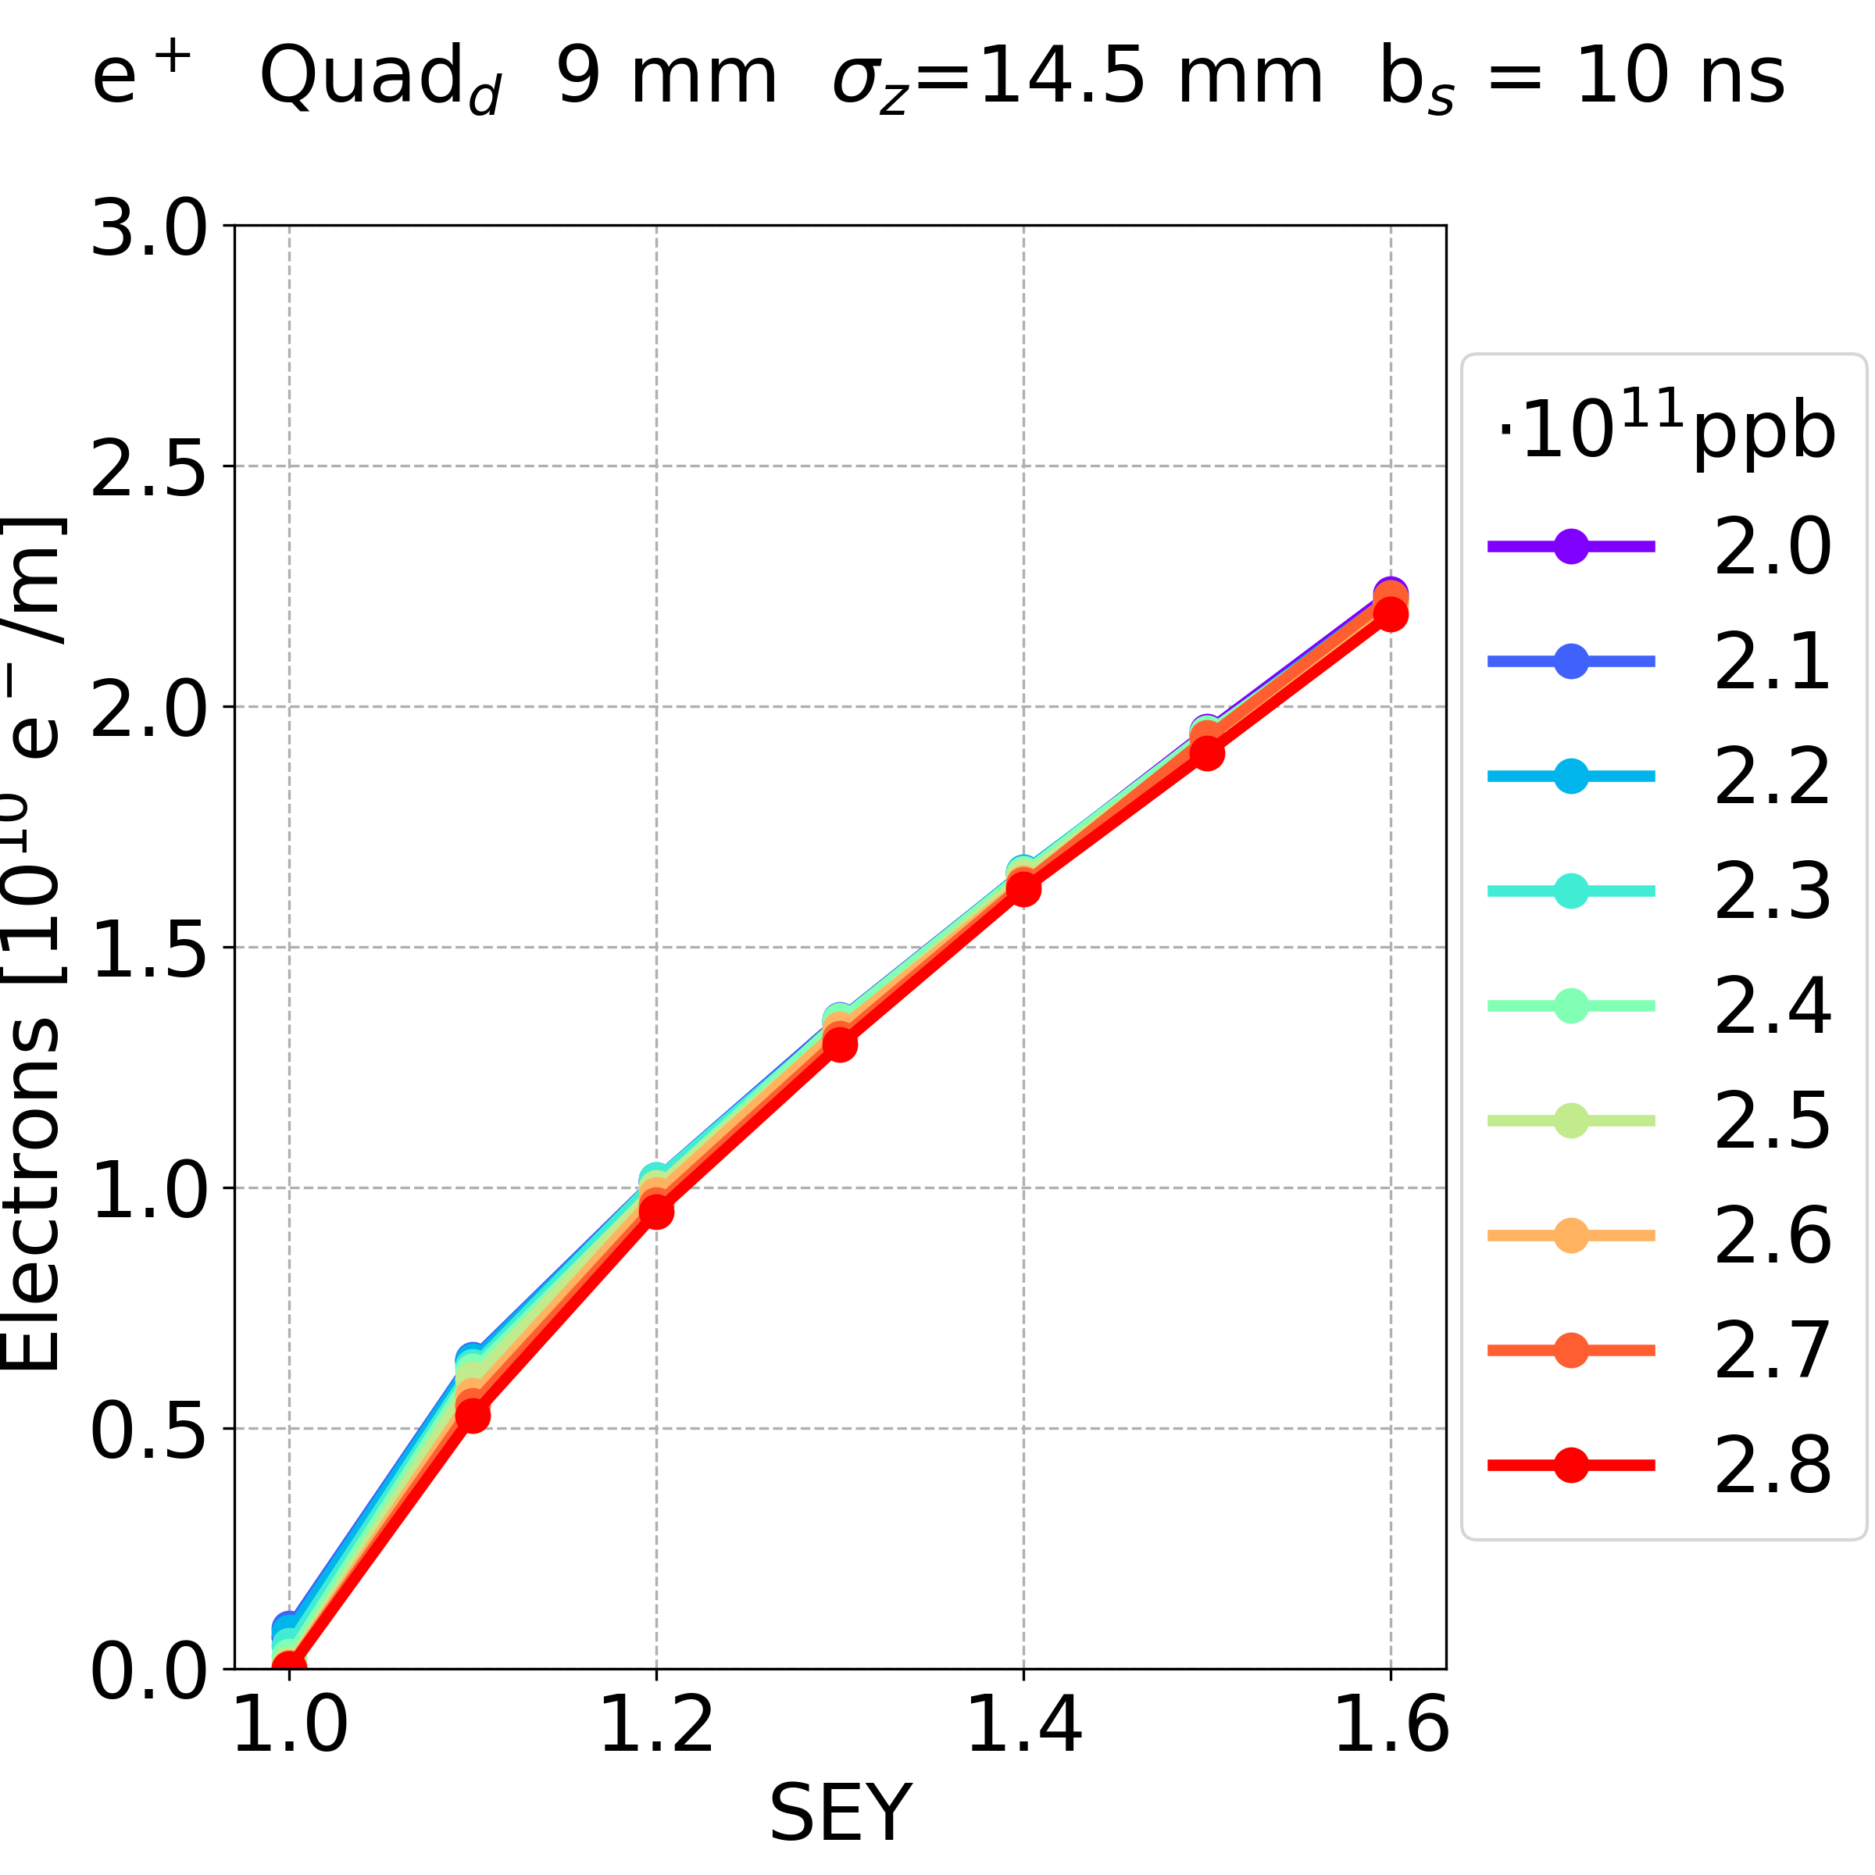
Simulation Results: Negligible Effect
Dependence on the element:
Arc quadrupole
(positrons, beam chamber 9 mm, bunch spacing 10 ns)
Focusing Defocusing
The electron density has a similar behaviour in both the cases focusing and defocusing quadrupole
This behaviour has been observed in all the cases
E⁻CLOUD’22 Workshop 26/09/2022

Slide 24
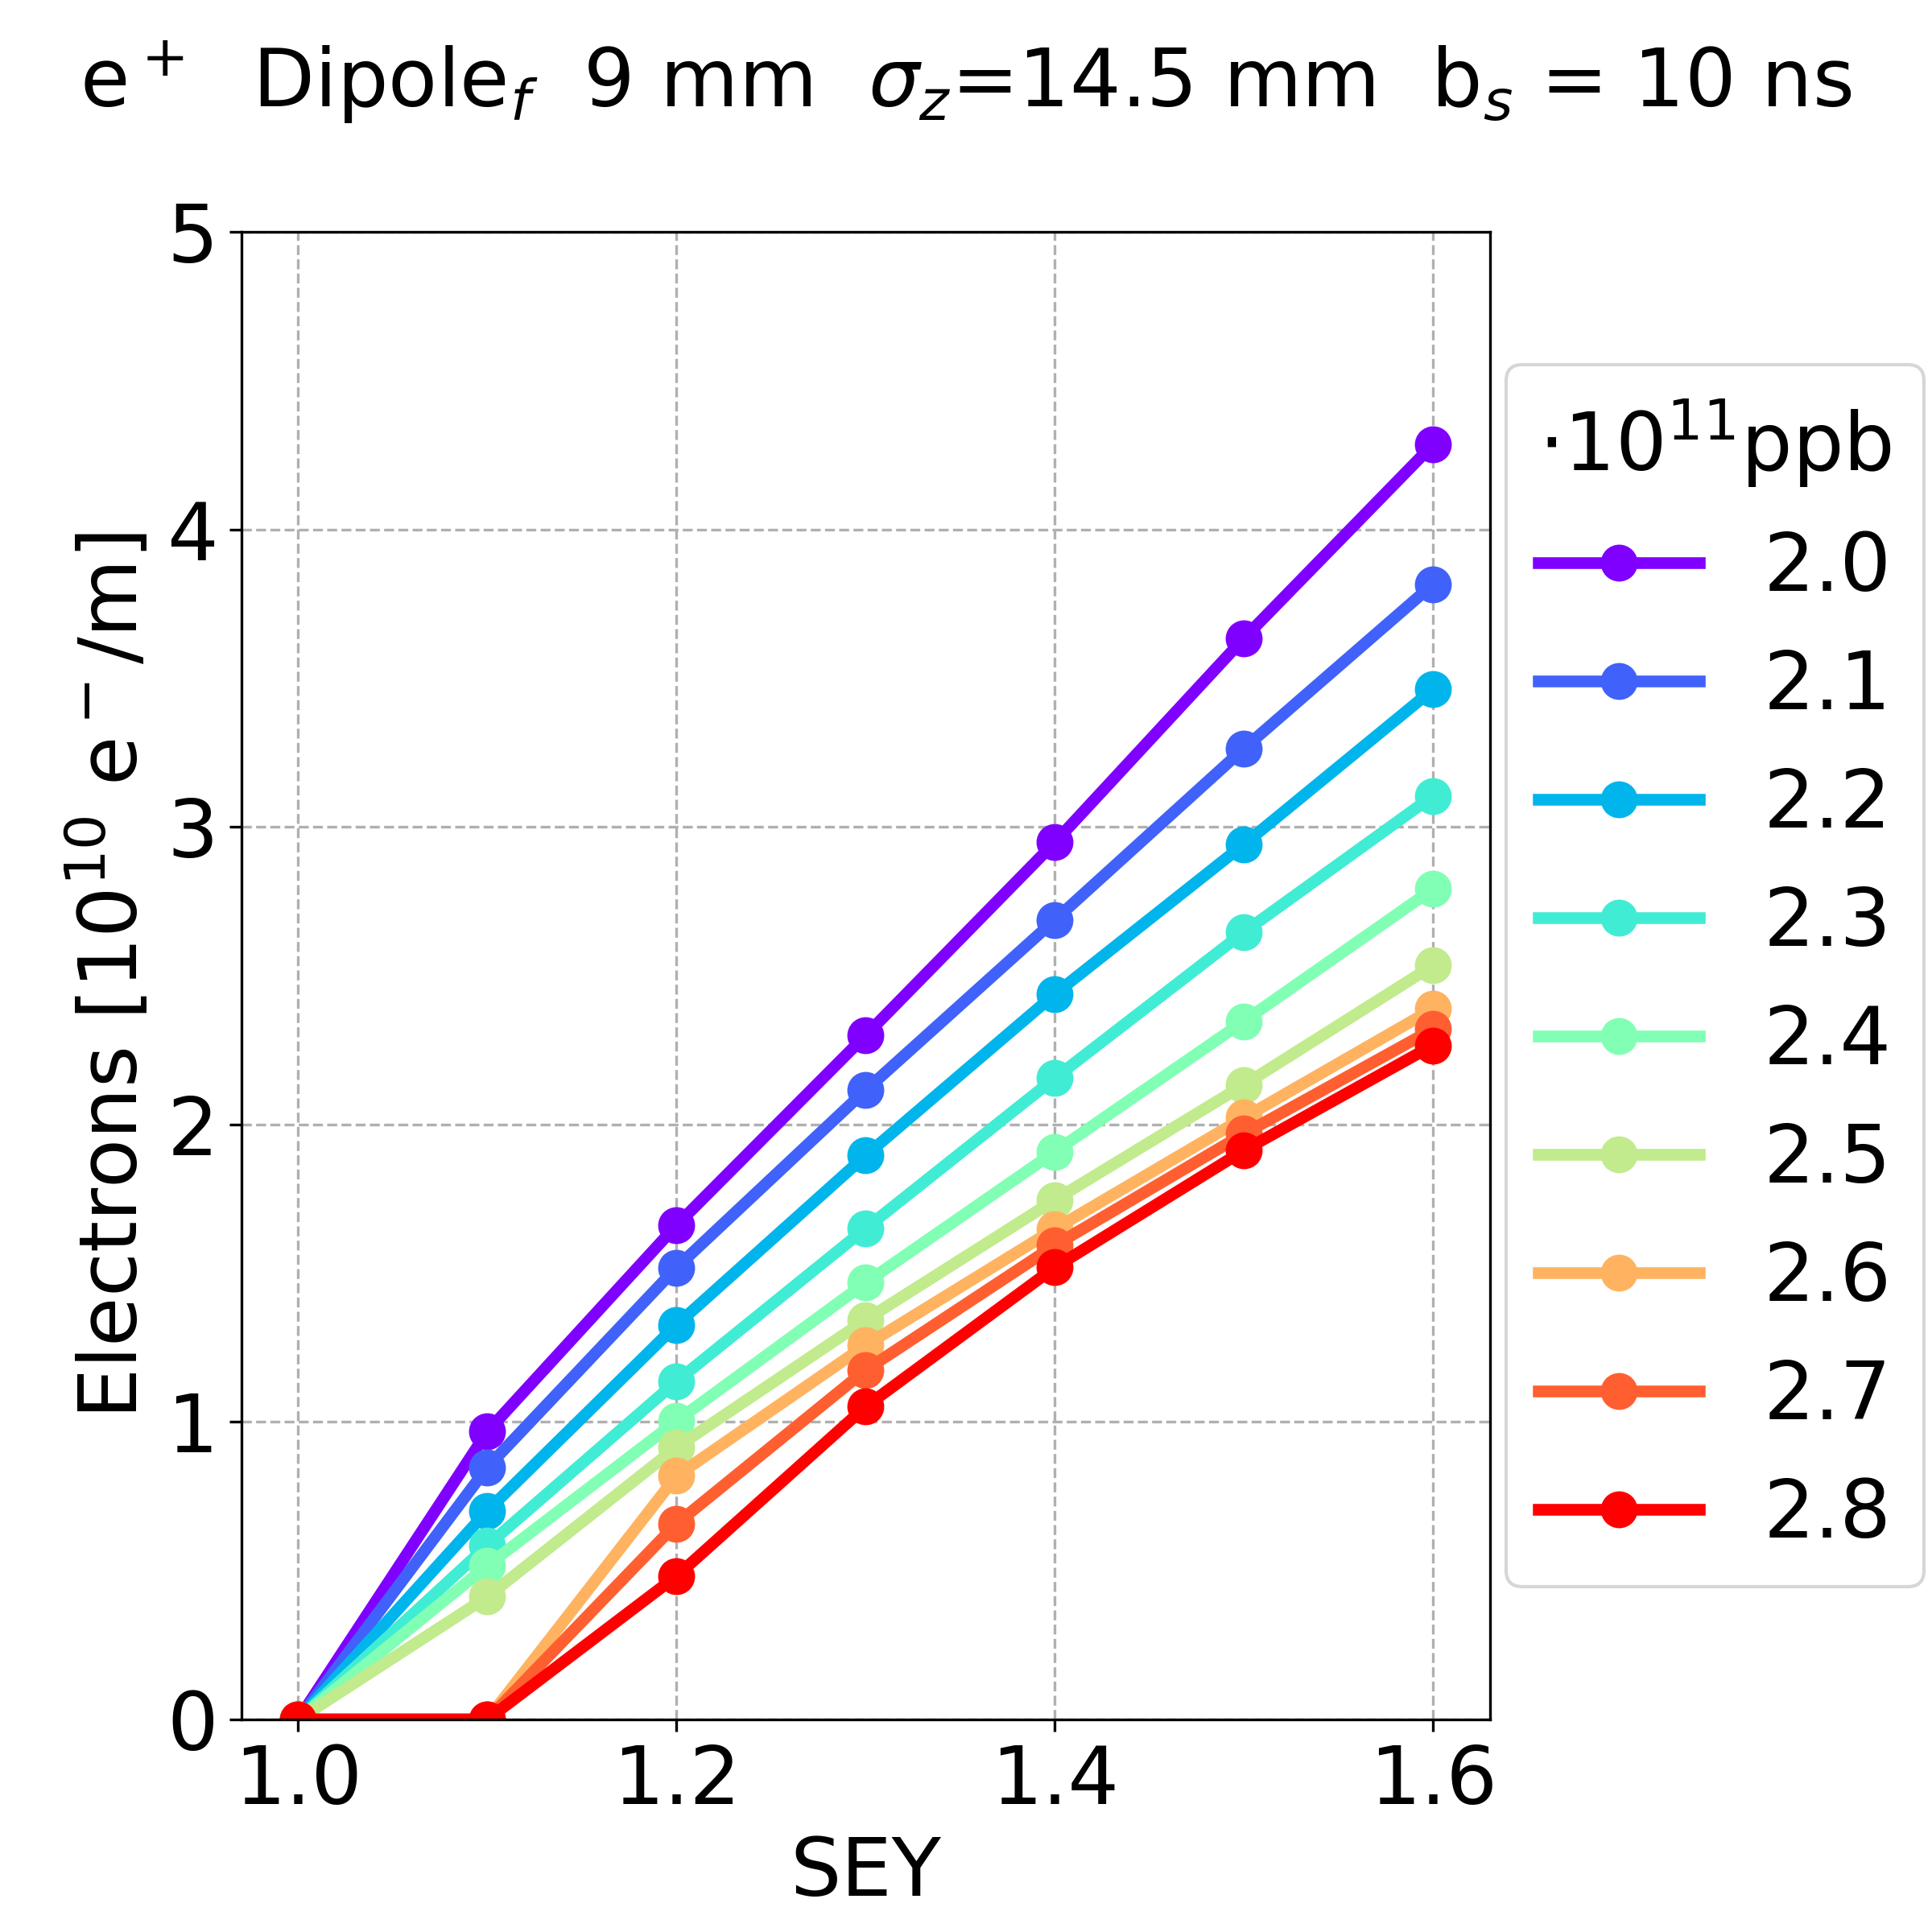
Simulation Results: Negligible Effect
Dependence on the element:
Dipole
(positrons, beam chamber 9 mm, bunch spacing 10 ns)
Close to Close to
focusing defocusing
quadrupole quadrupole
The electron density has a similar behaviour in both the cases dipole close to the focusing and defocusing quadrupole
This behaviour has been observed in all the cases
E⁻CLOUD’22 Workshop 26/09/2022

Slide 25
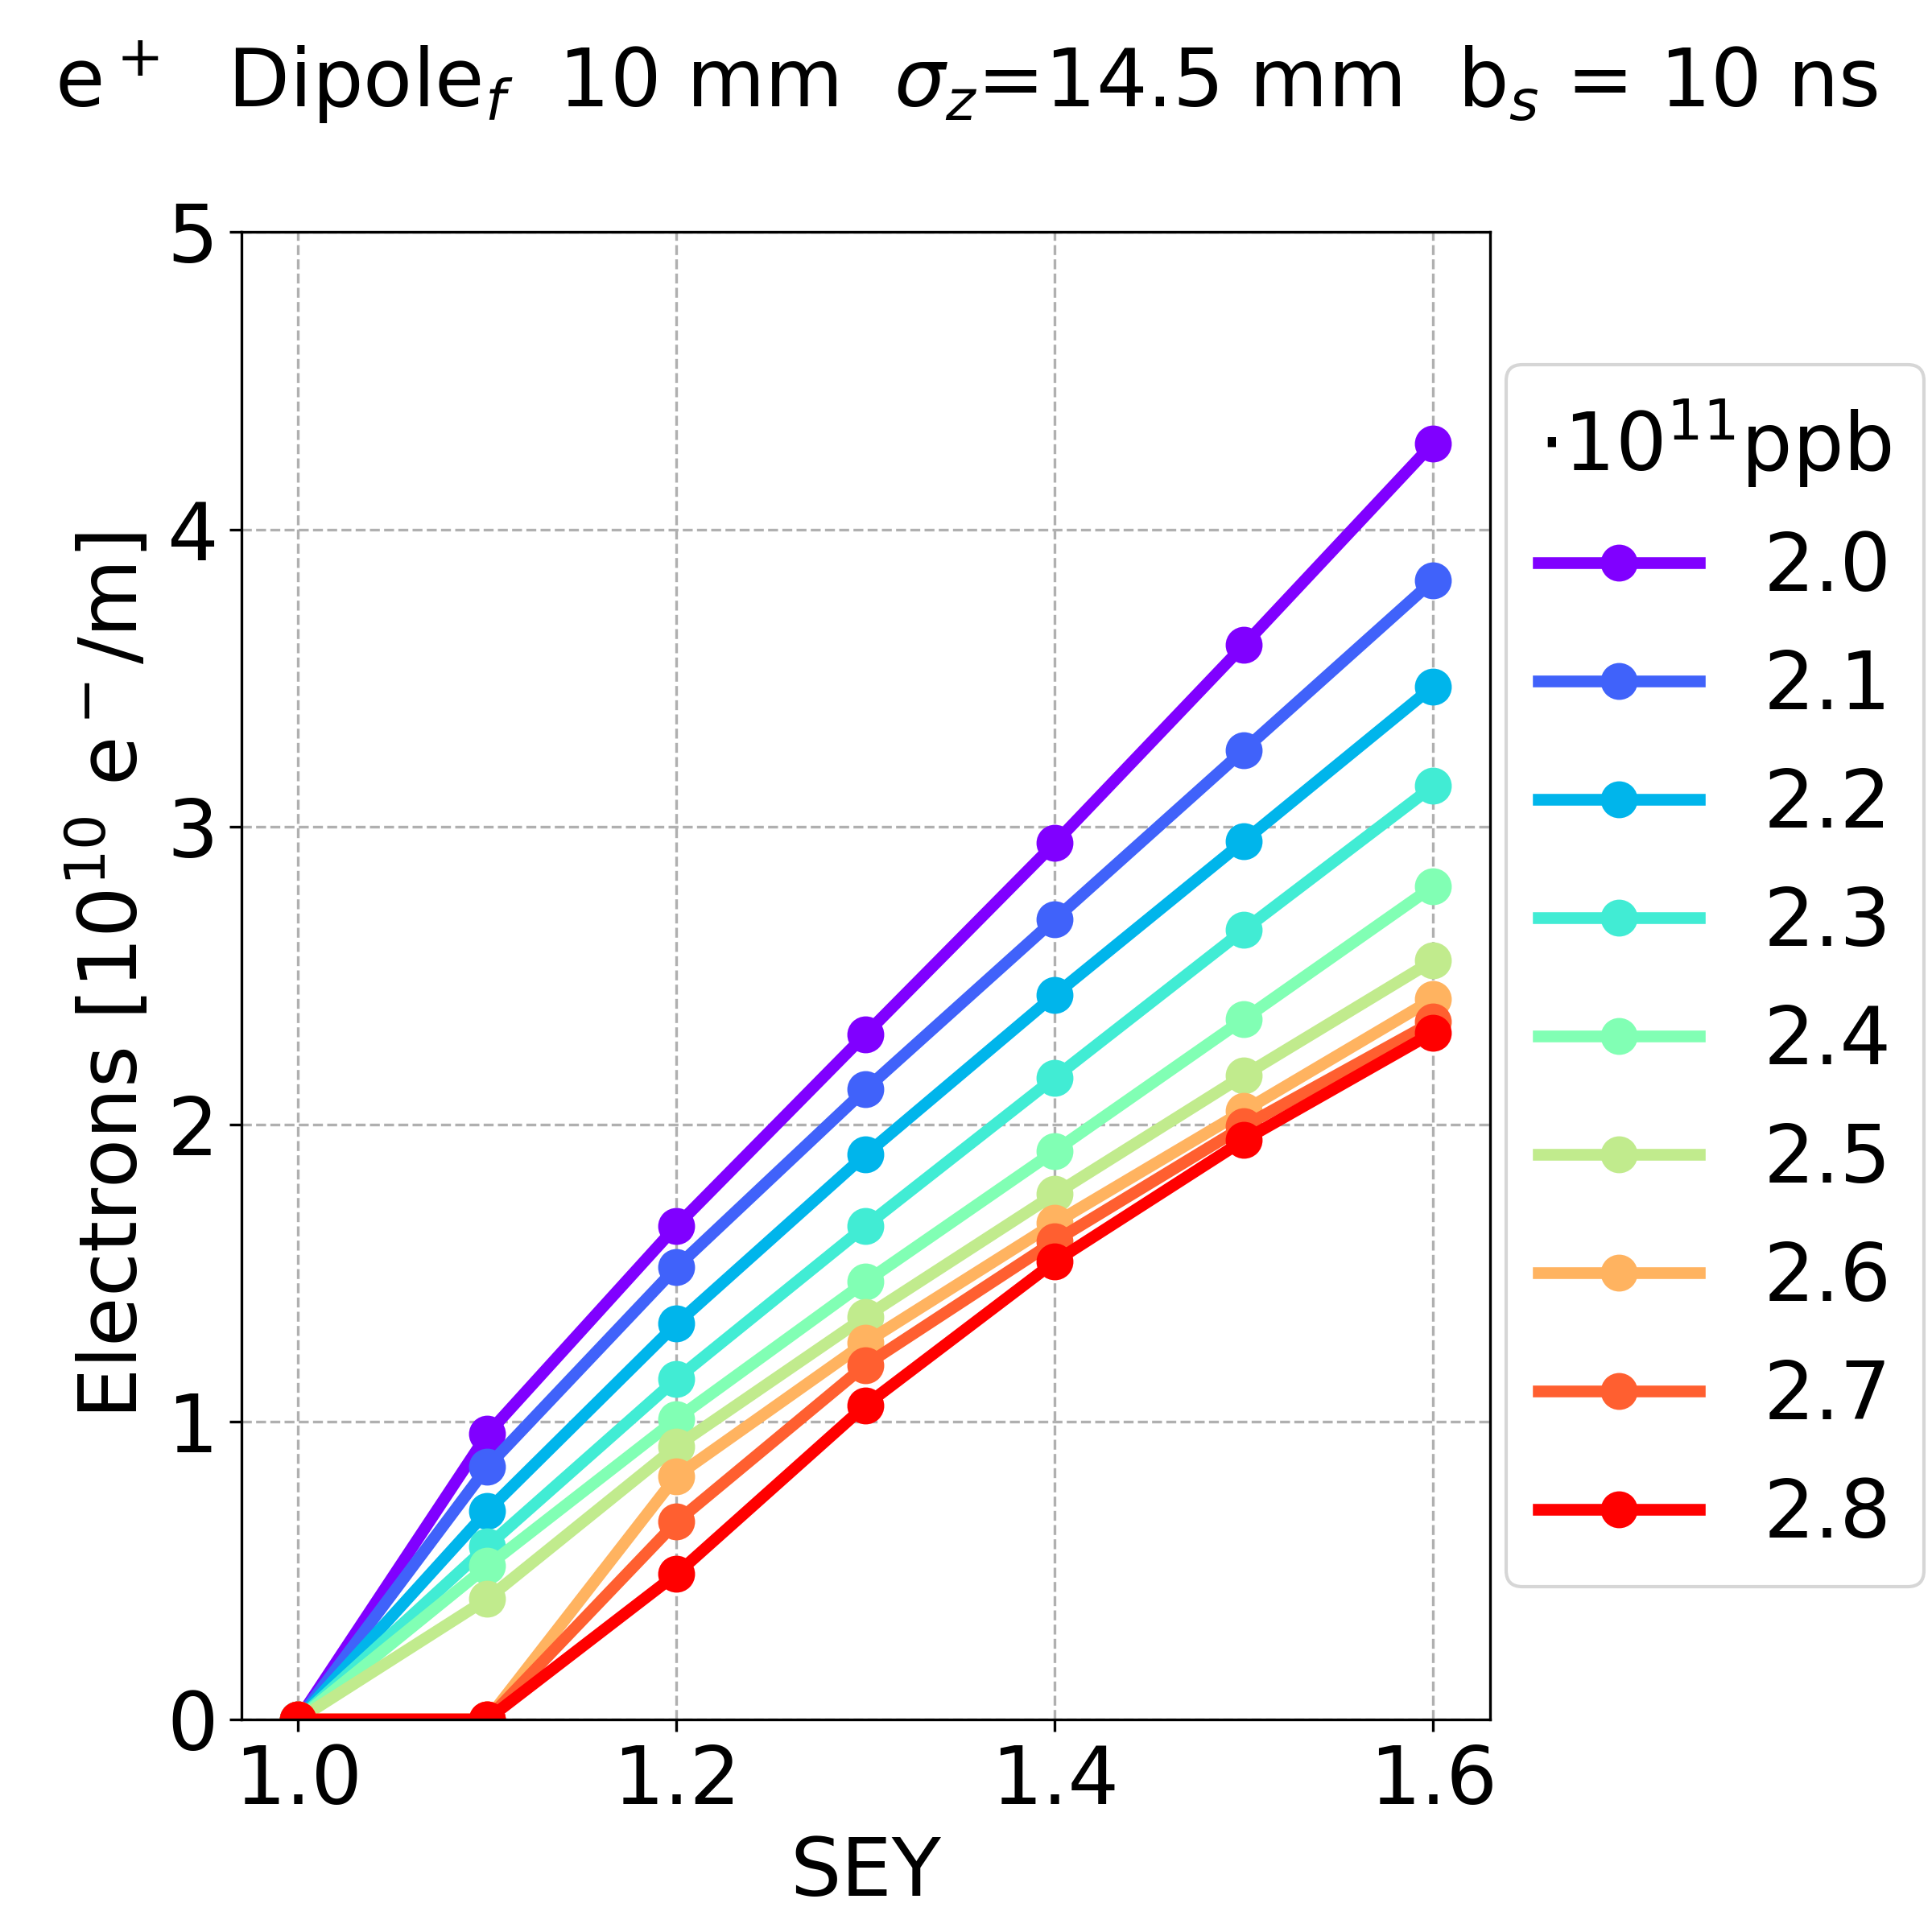
Simulation Results: Negligible Effect
Dependence on the beam chamber geometry:
(positrons, dipole, bunch spacing 10 ns)
9 mm 10 mm 11 mm
The electron density has a similar behaviour in all the three cases of beam chamber geometries
This behaviour has been observed in all the cases
E⁻CLOUD’22 Workshop 26/09/2022

Slide 26
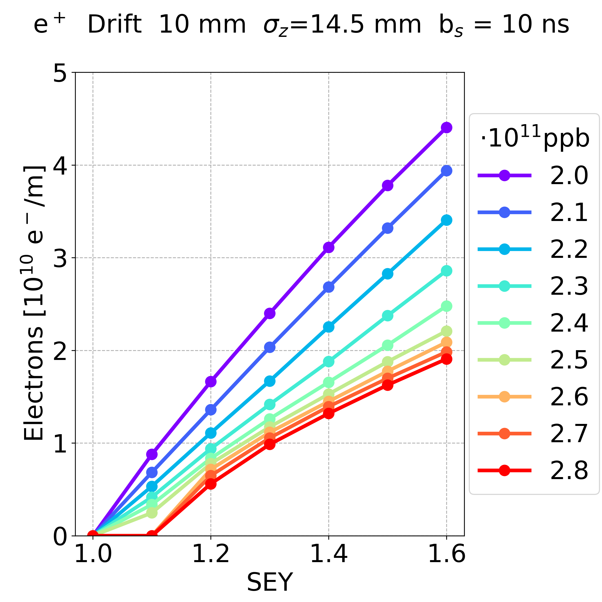
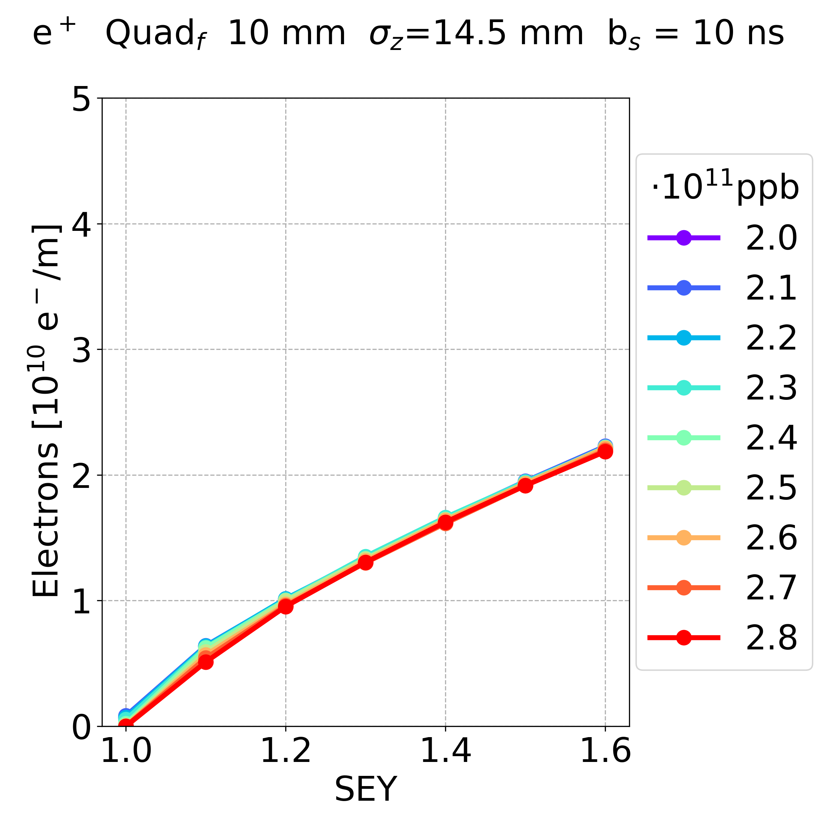
Simulation Results: Other Parameters
Dependence on the elements and bunch spacing:
positrons, bunch spacing 10 ns
Drift Space Dipole Quadrupole
In the quadrupole,
the electron density is lower (for lower bunch intensity)
the bunch intensity has a negligible effect on the electron density
In the drift space and dipole, the electron density has a similar behaviour with respect to the bunch intensity
less bunch intensity more electron density
E⁻CLOUD’22 Workshop 26/09/2022

Slide 27
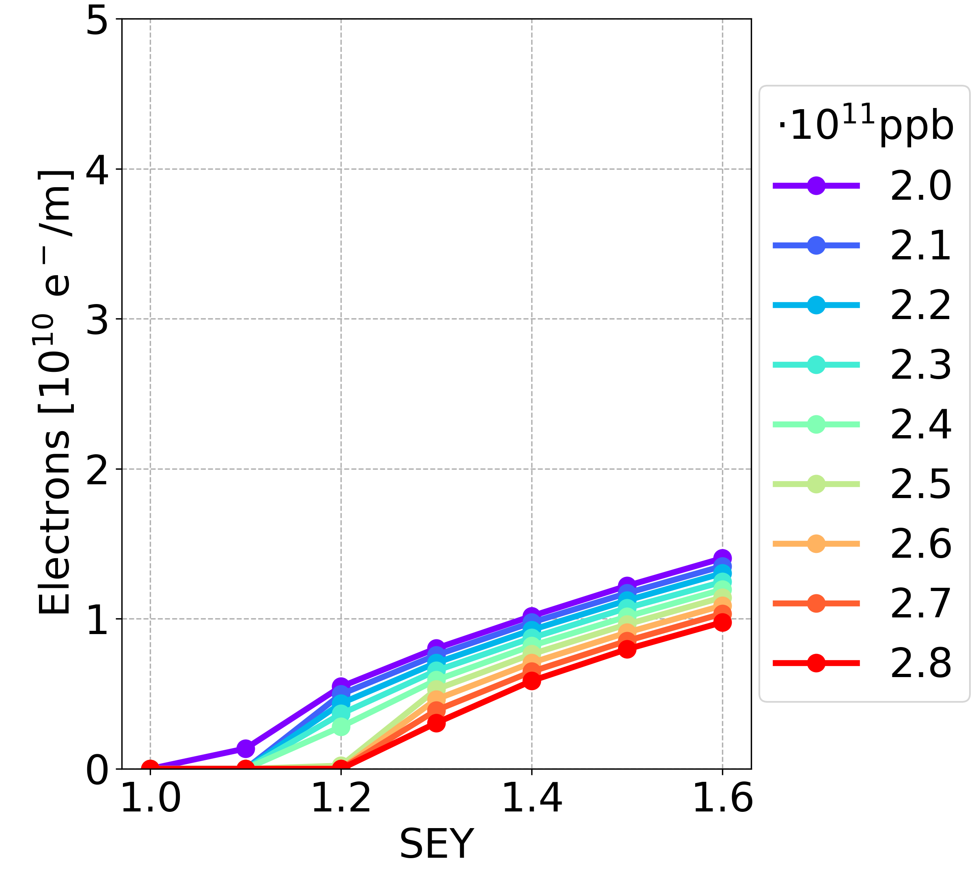
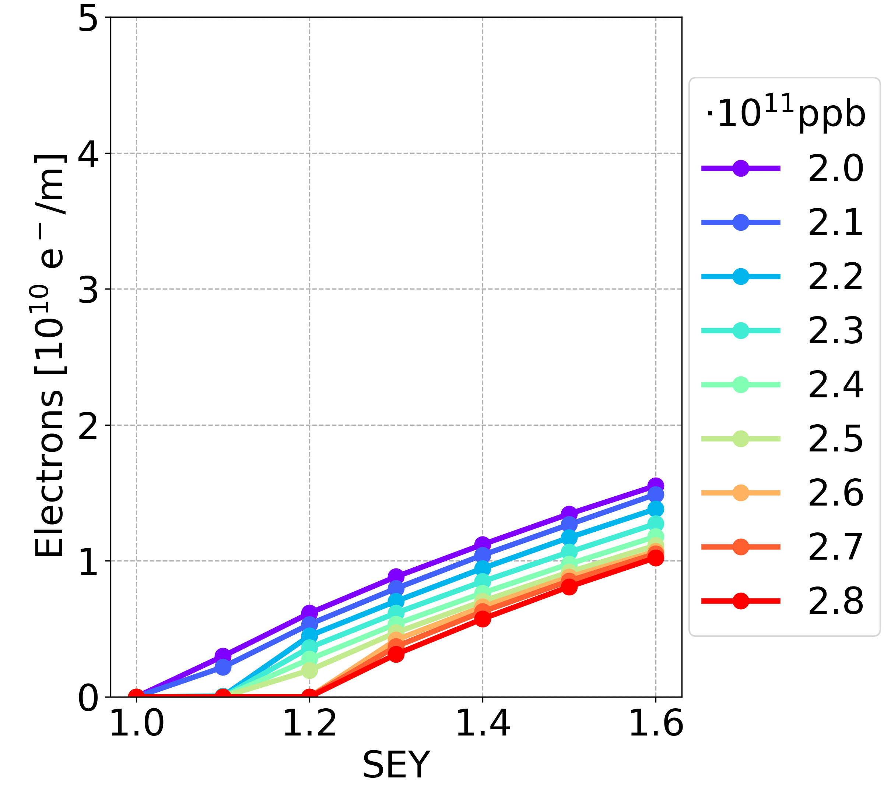
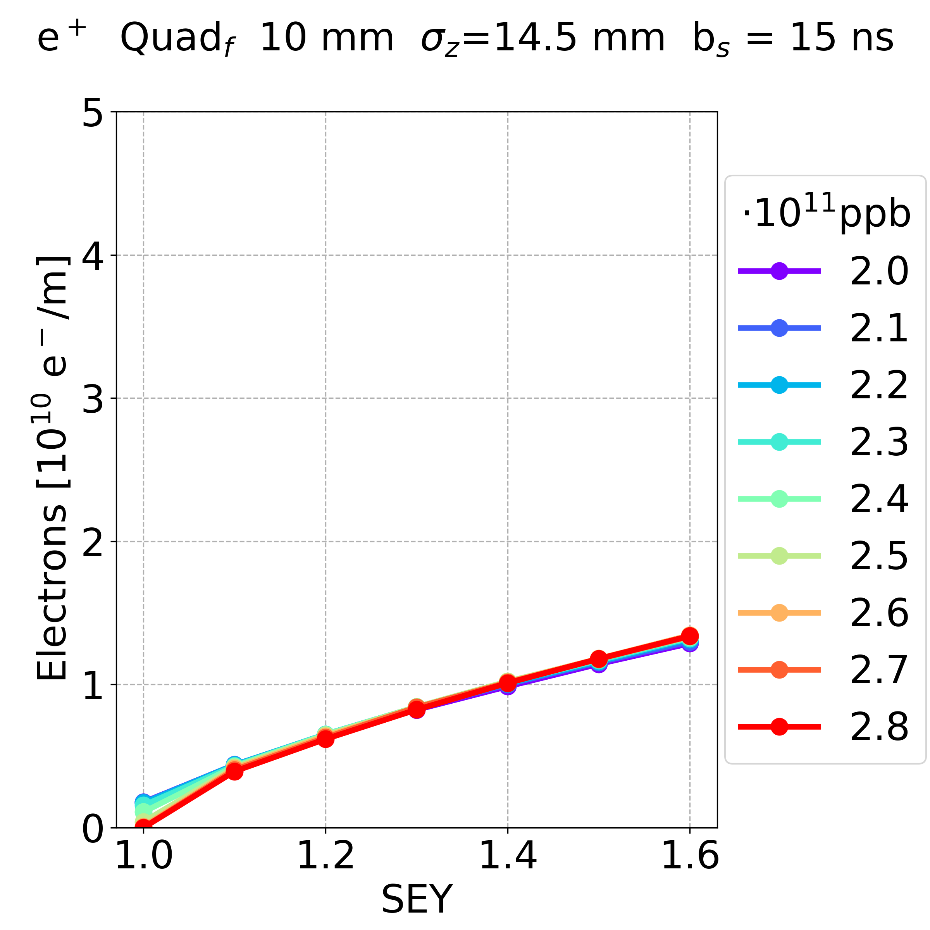
Simulation Results: Other Parameters
Dependence on the elements and bunch spacing:
positrons, bunch spacing 15 ns
Drift Space Dipole Quadrupole
In all elements, increasing the bunch spacing the electron density decreases
In the drift space and dipole, the dependence on the bunch spacing is stronger (for some cases there is no multipacting)
When the bunch spacing is 15 ns, the electron density
is closer among the different elements
has a weaker dependence on the bunch intensity
E⁻CLOUD’22 Workshop 26/09/2022

Slide 28
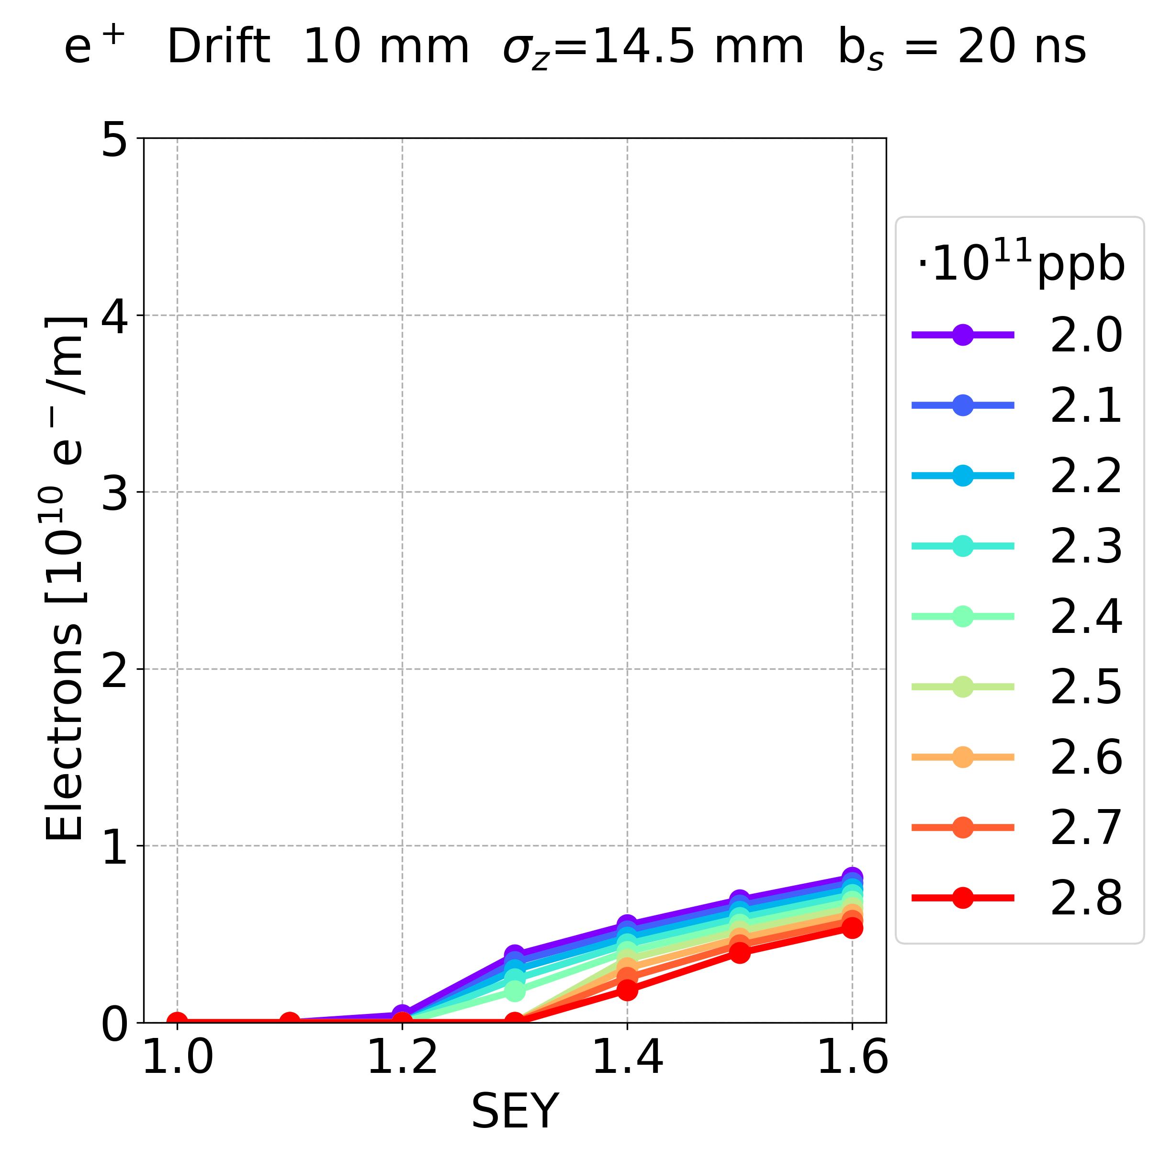
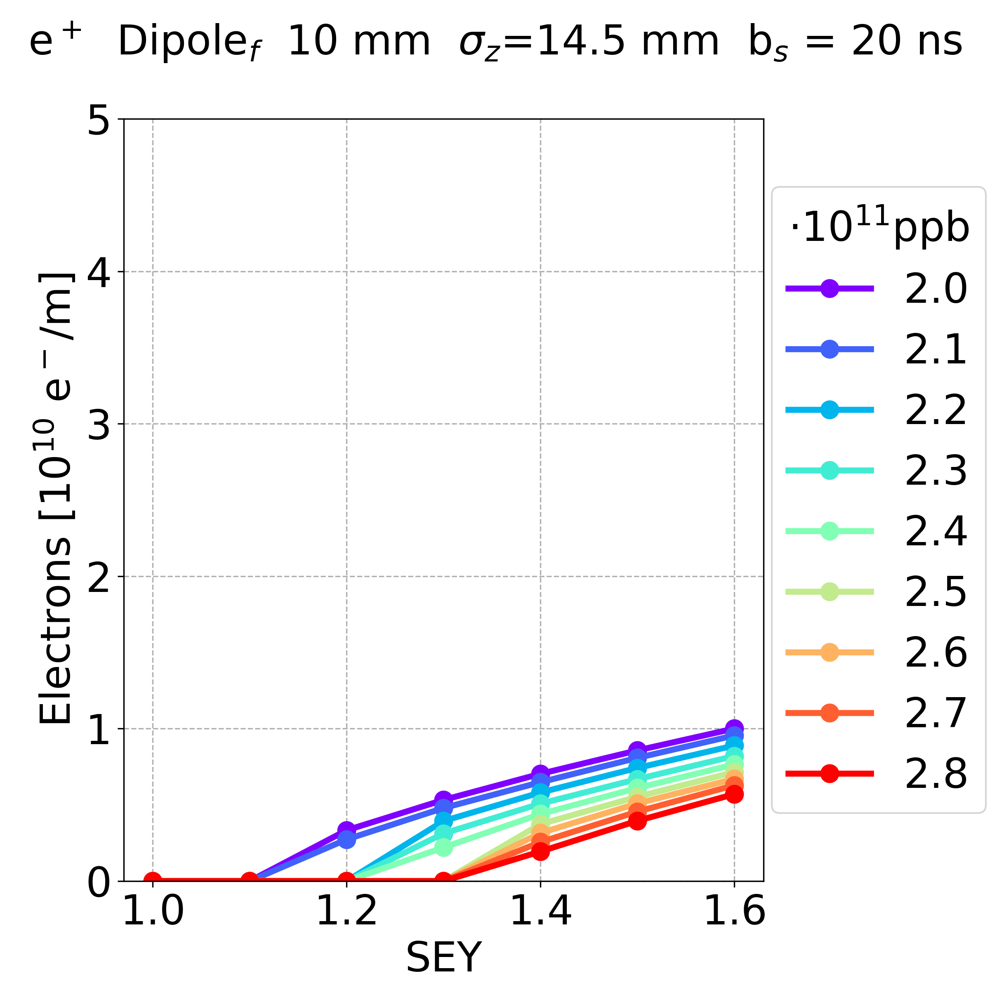
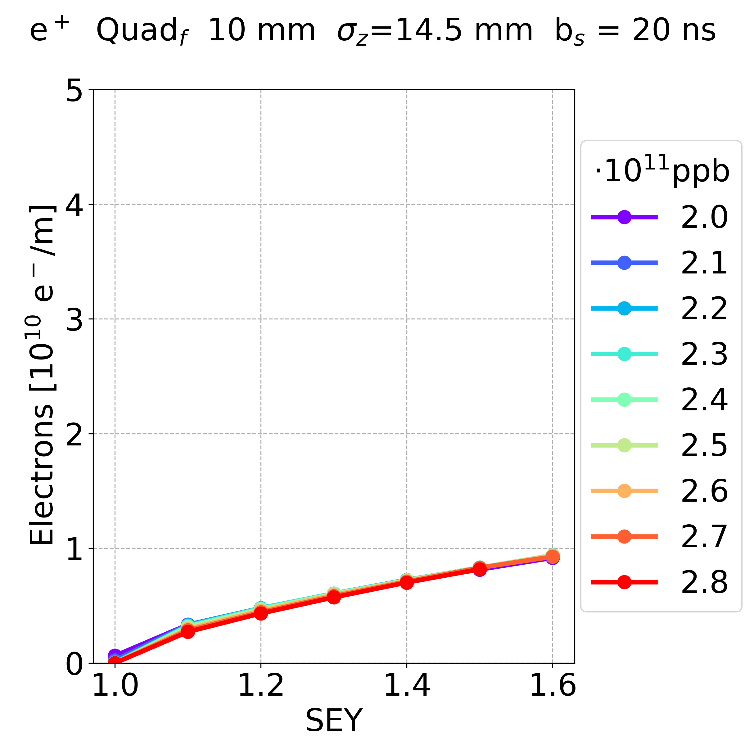
Simulation Results: Other Parameters
Dependence on the elements and bunch spacing:
positrons, bunch spacing 20 ns
Drift Space Dipole Quadrupole
In all elements, increasing the bunch spacing the electron density decreases
In the drift space and dipole, the dependence on the bunch spacing is stronger (for more cases there is no multipacting)
E⁻CLOUD’22 Workshop 26/09/2022

Slide 29
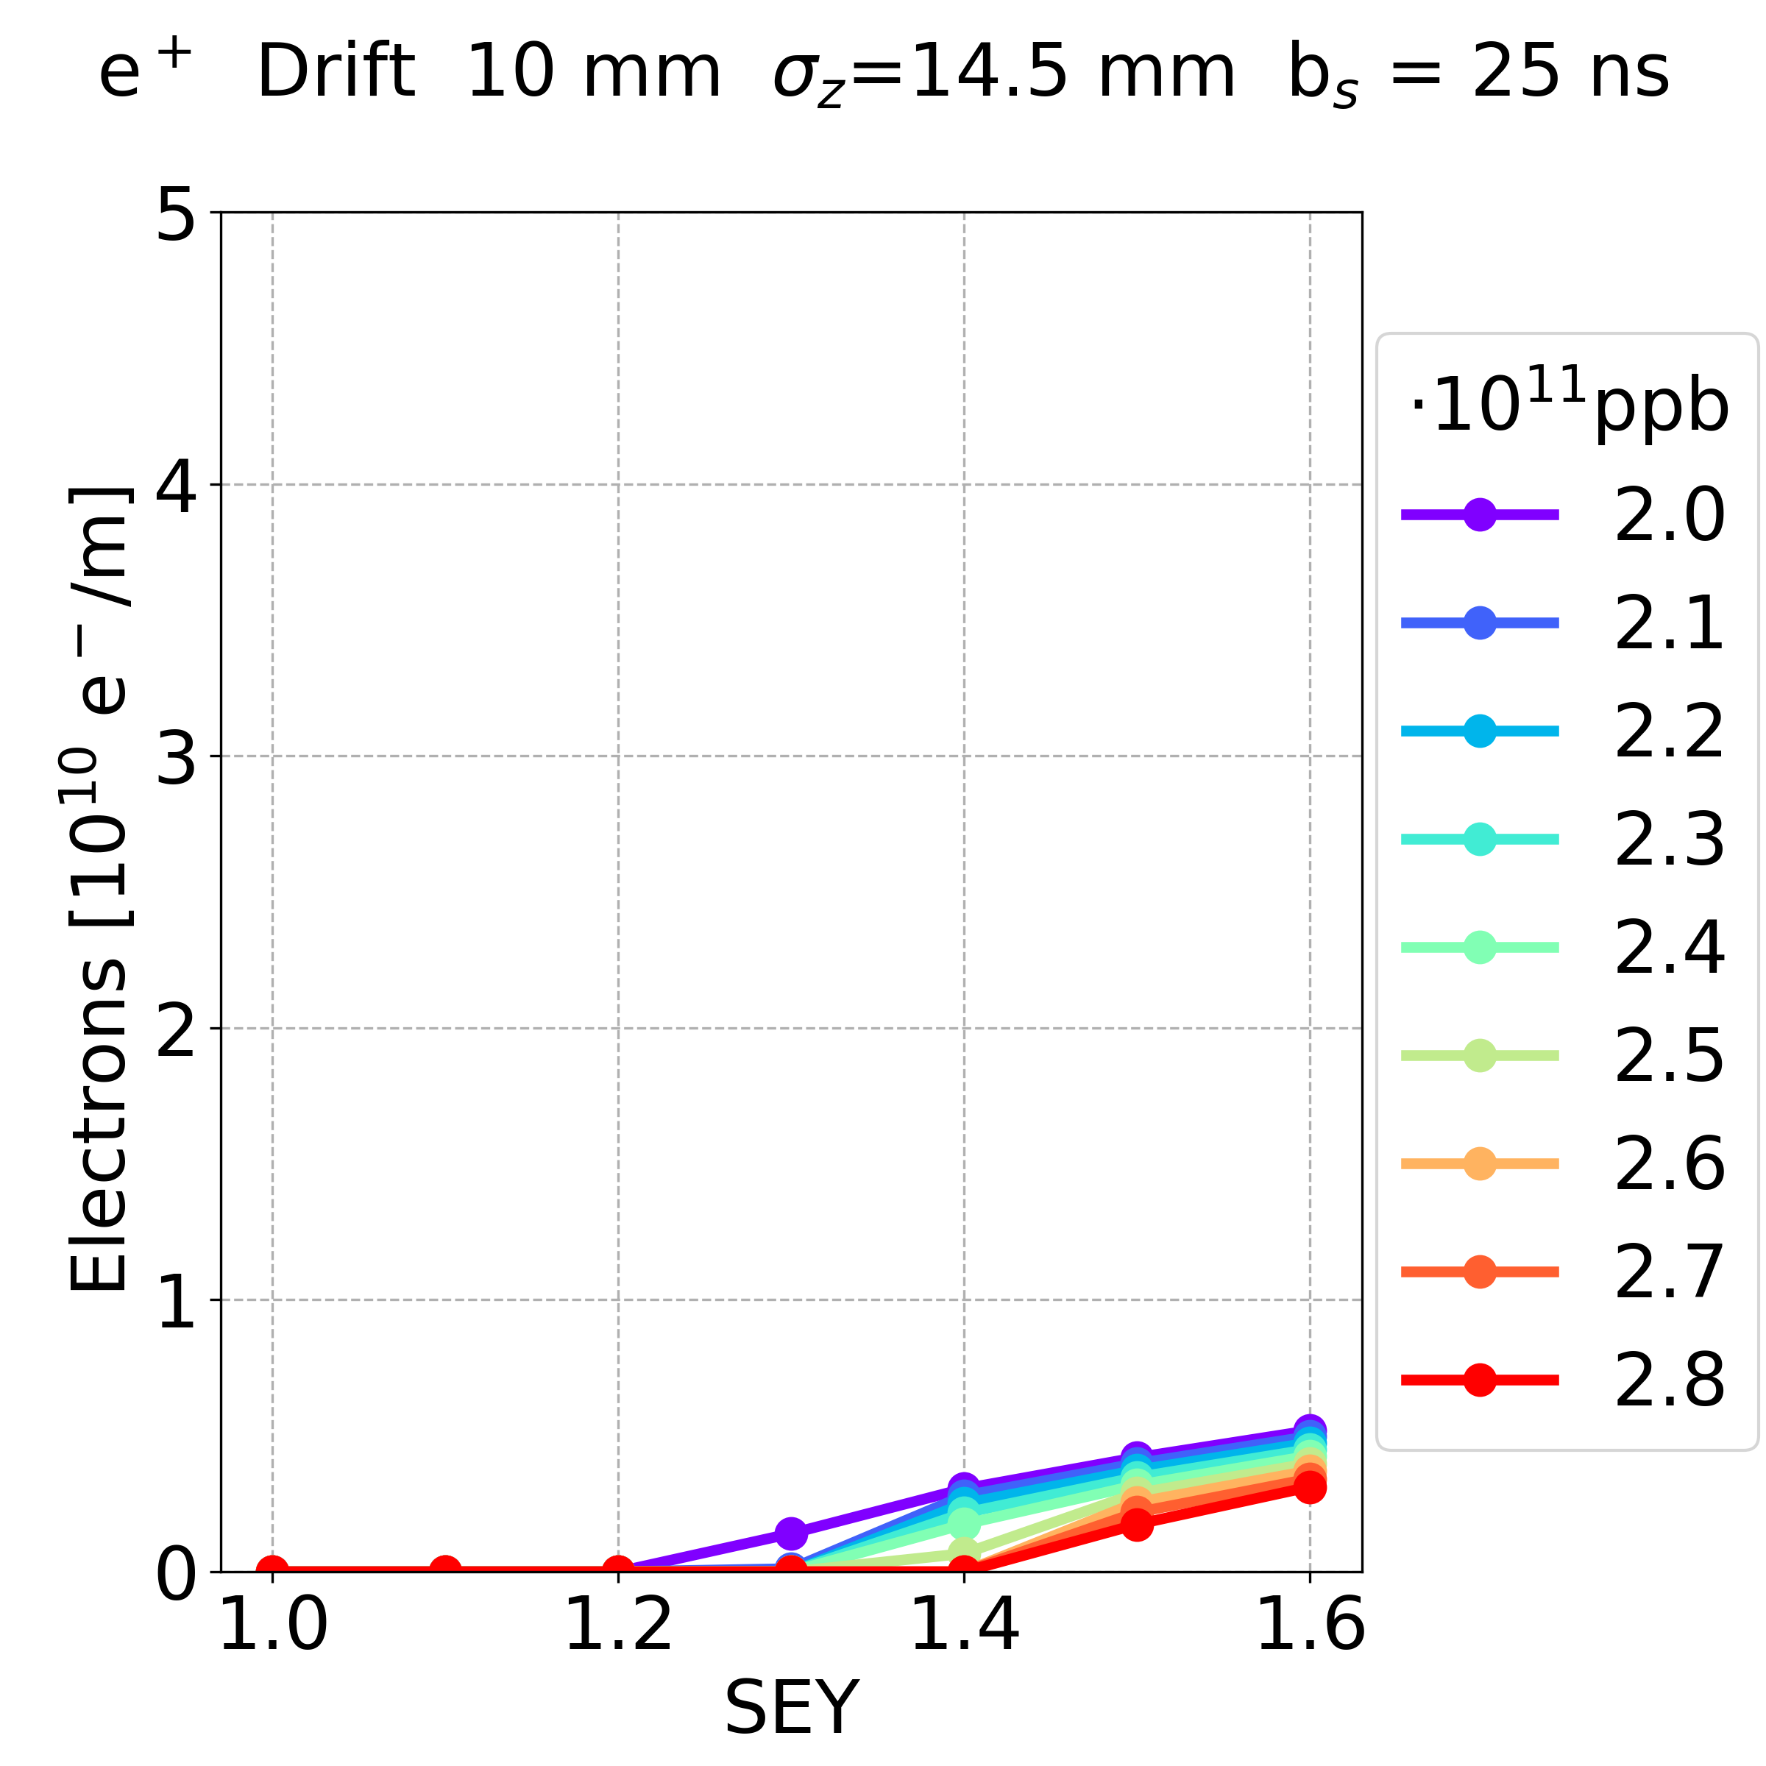
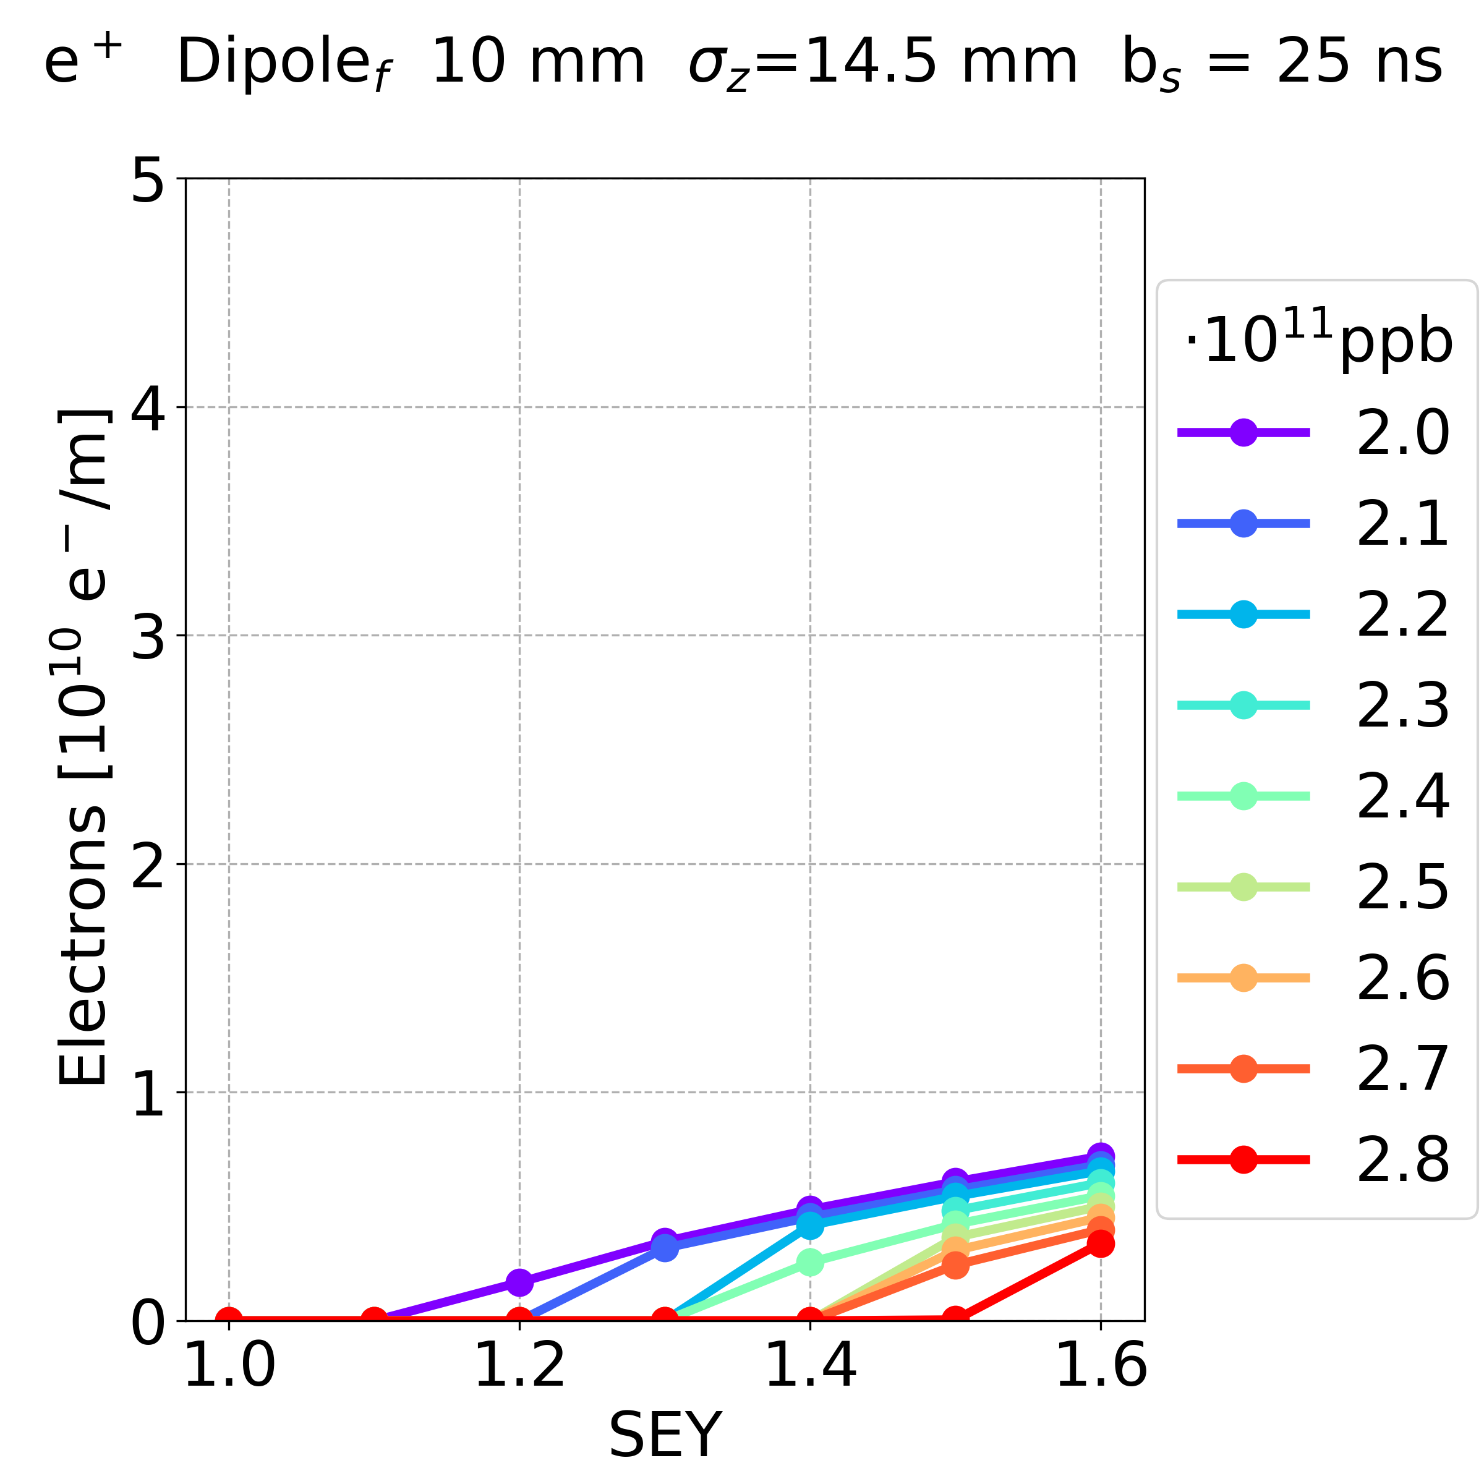
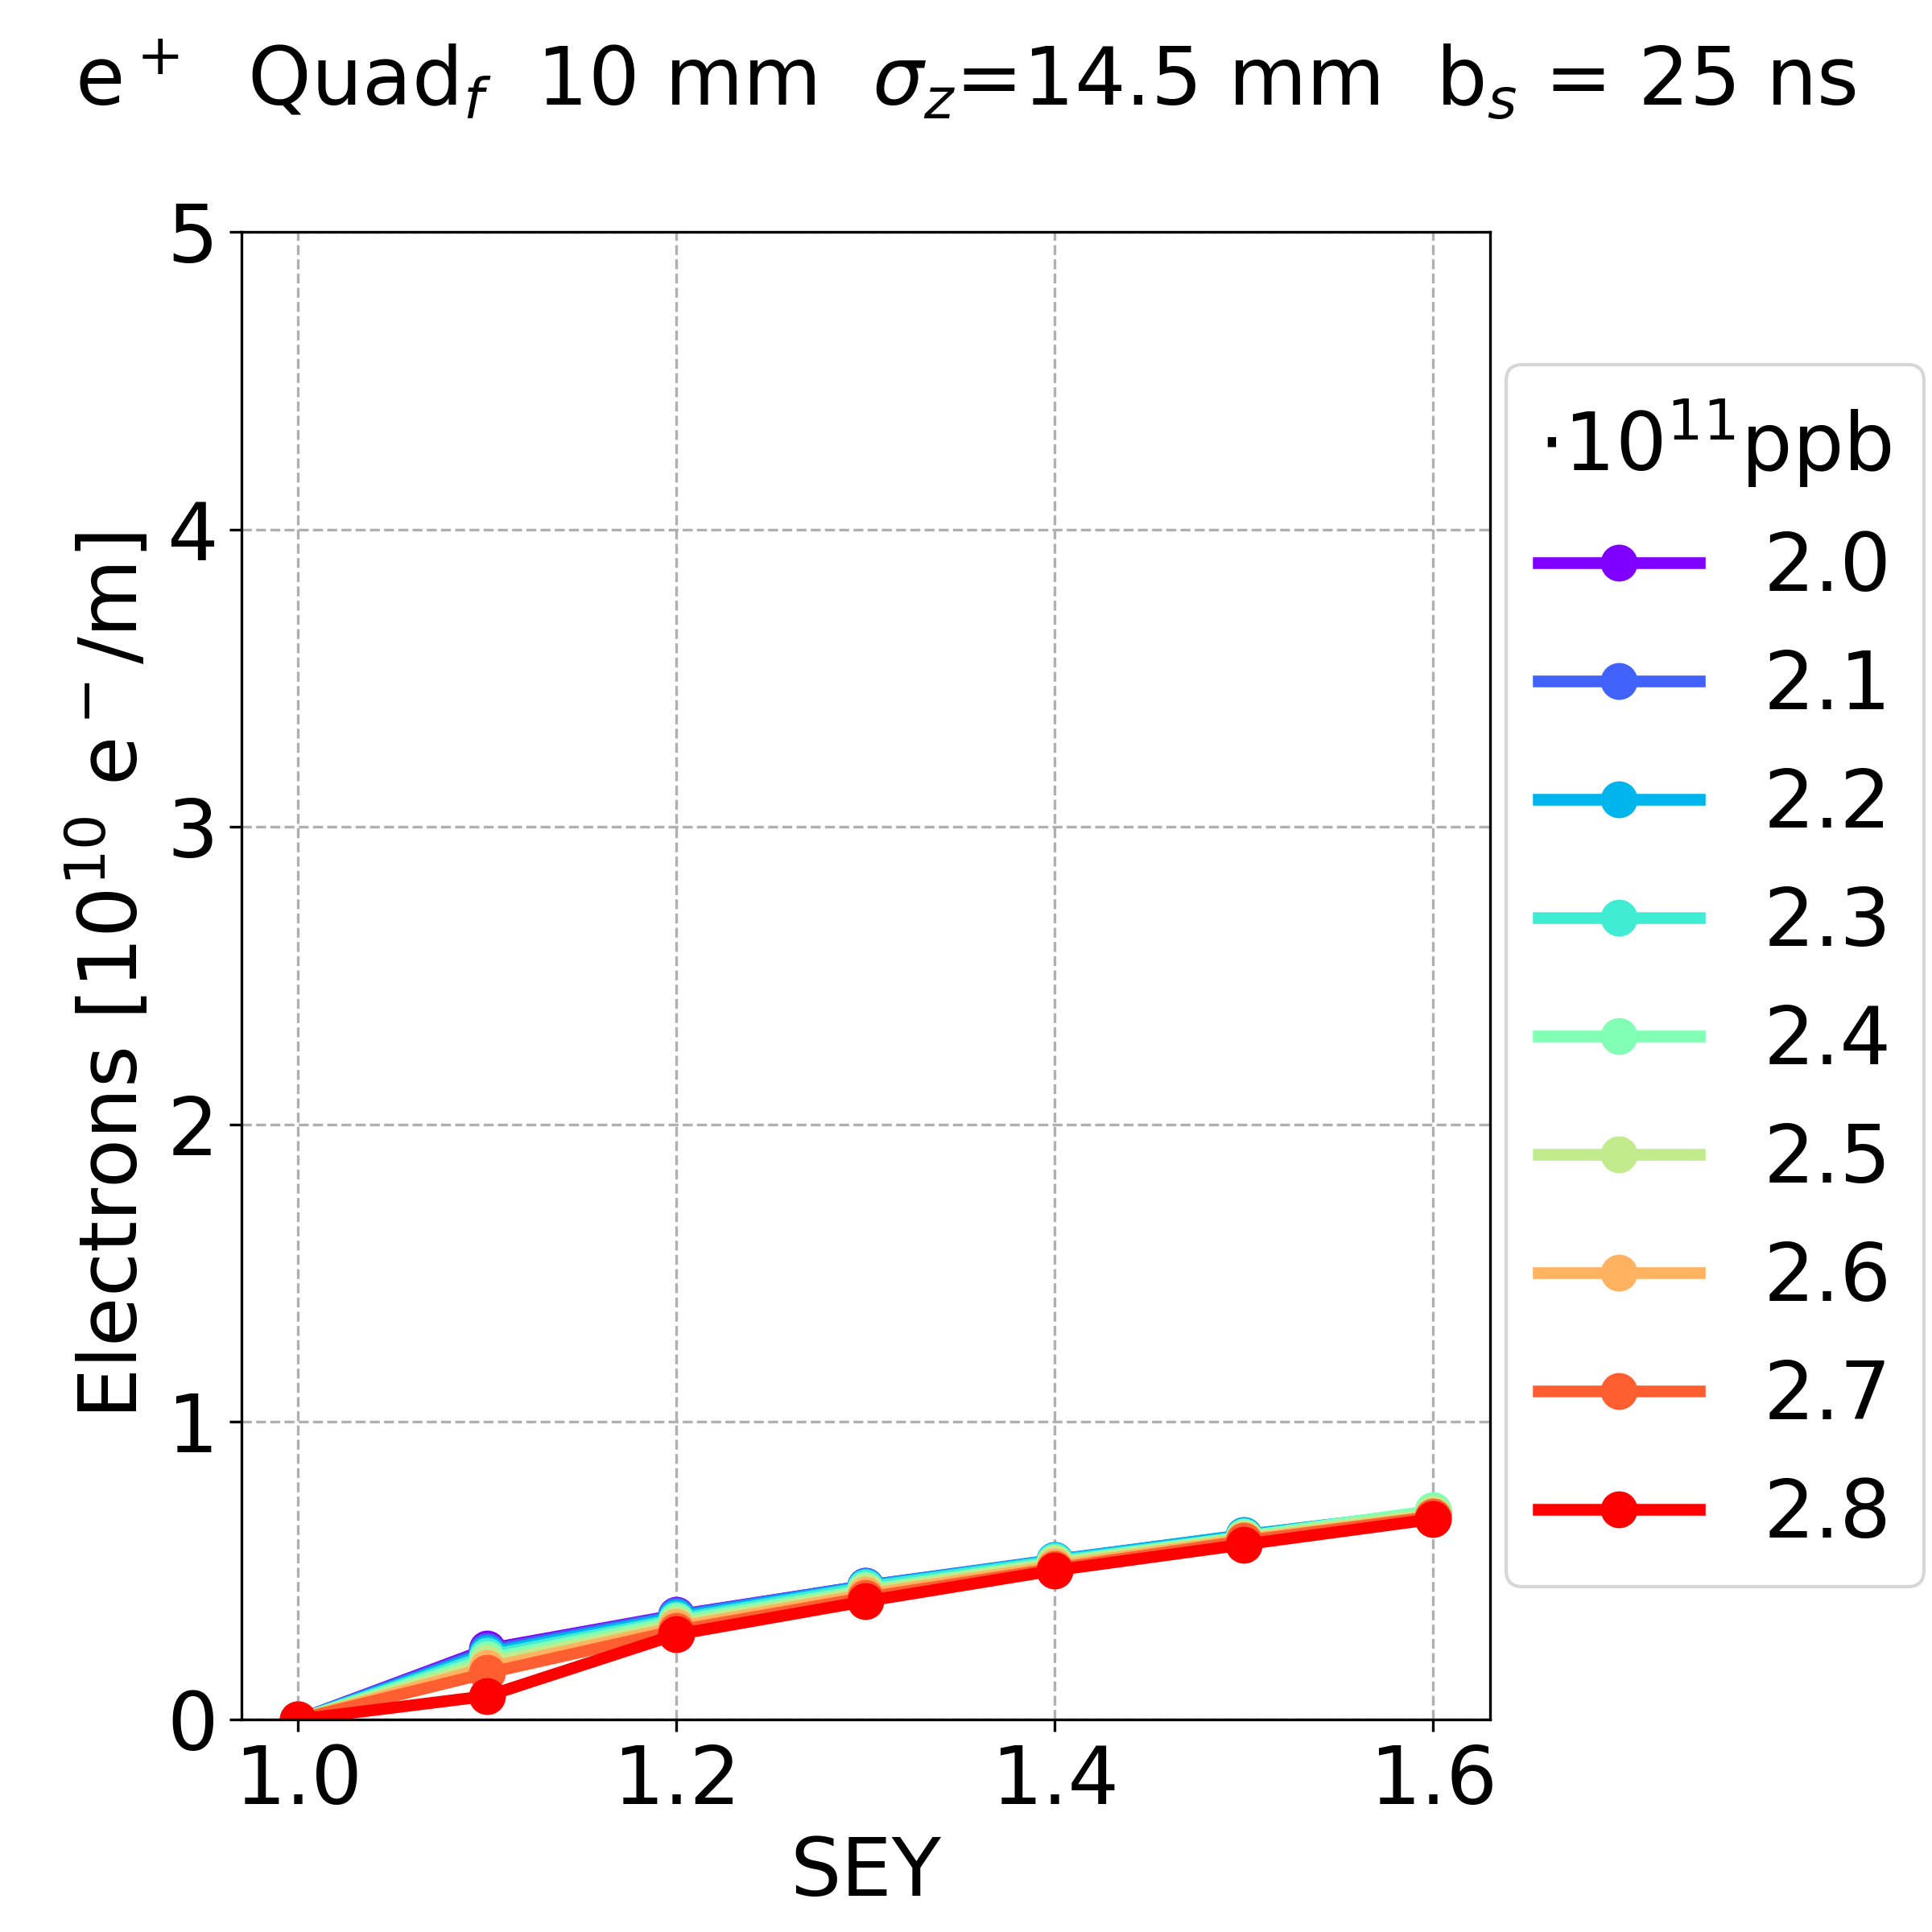
Simulation Results: Other Parameters
Dependence on the elements and bunch spacing:
positrons, bunch spacing 25 ns
Drift Space Dipole Quadrupole
In all elements, increasing the bunch spacing the electron density decreases
In the drift space and dipole, the dependence on the bunch spacing is stronger (for more cases there is no multipacting)
E⁻CLOUD’22 Workshop 26/09/2022

Slide 30
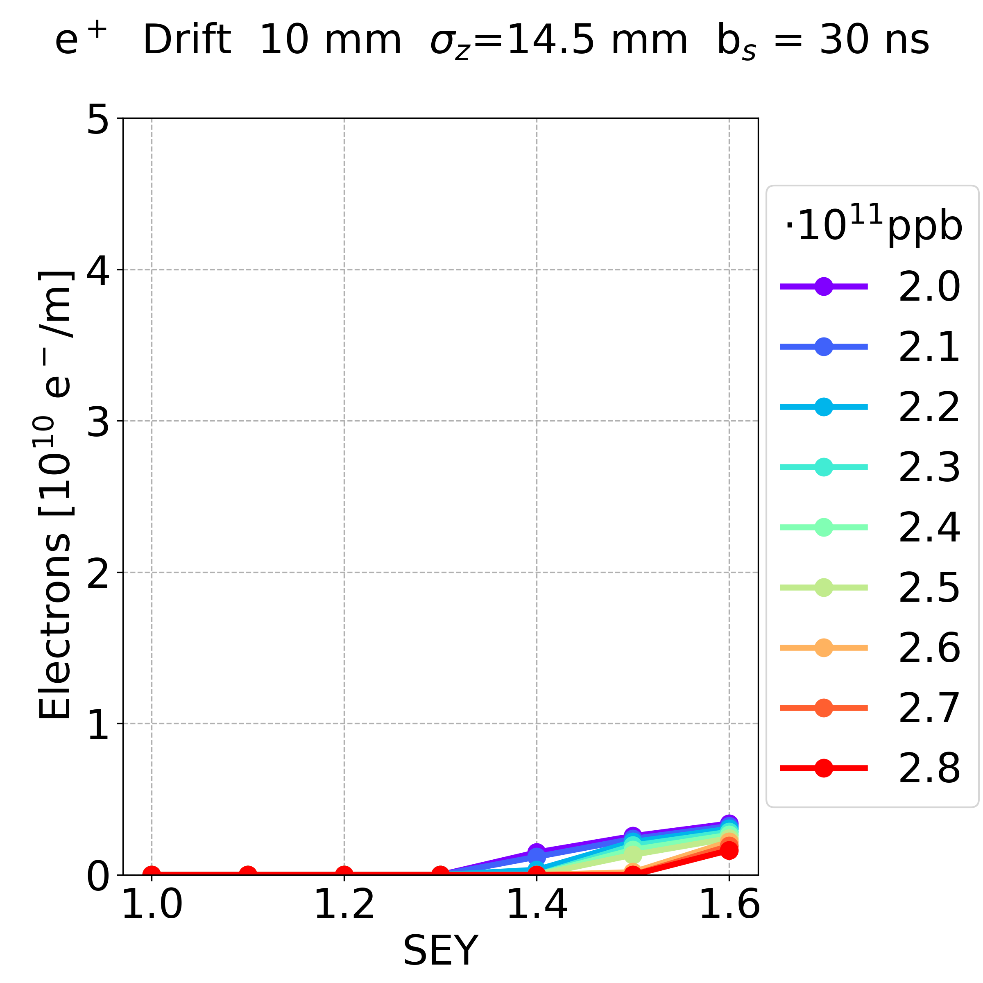
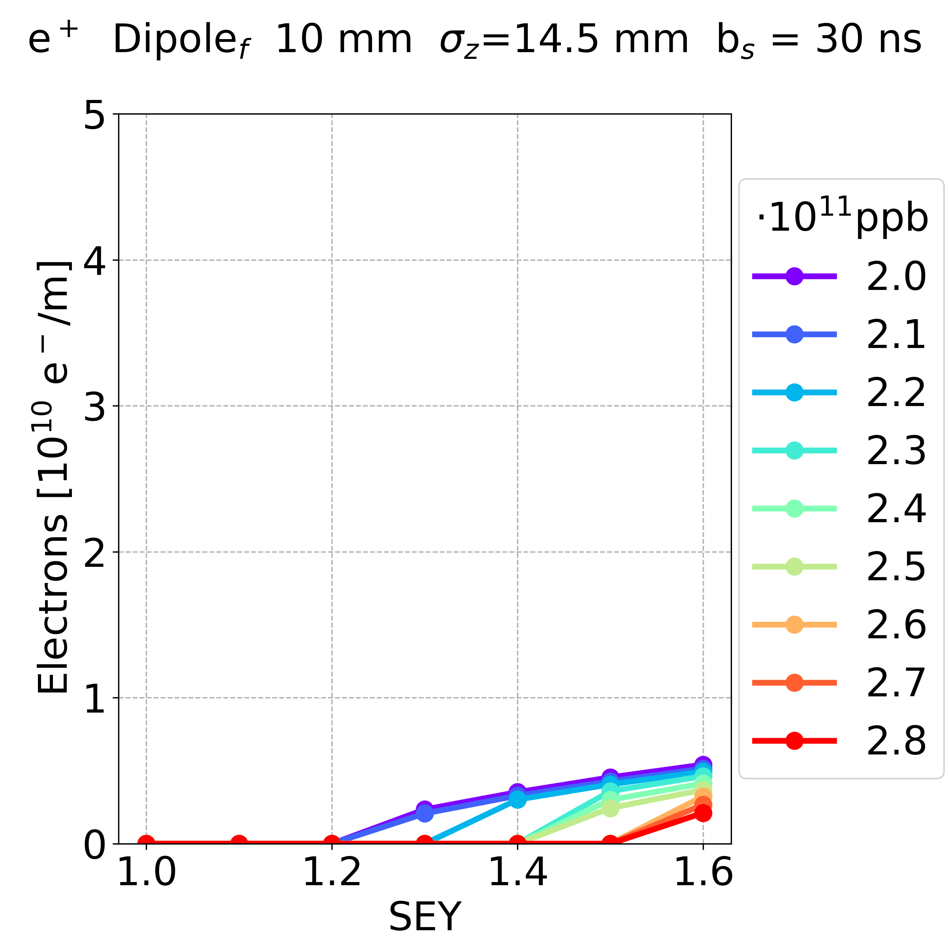
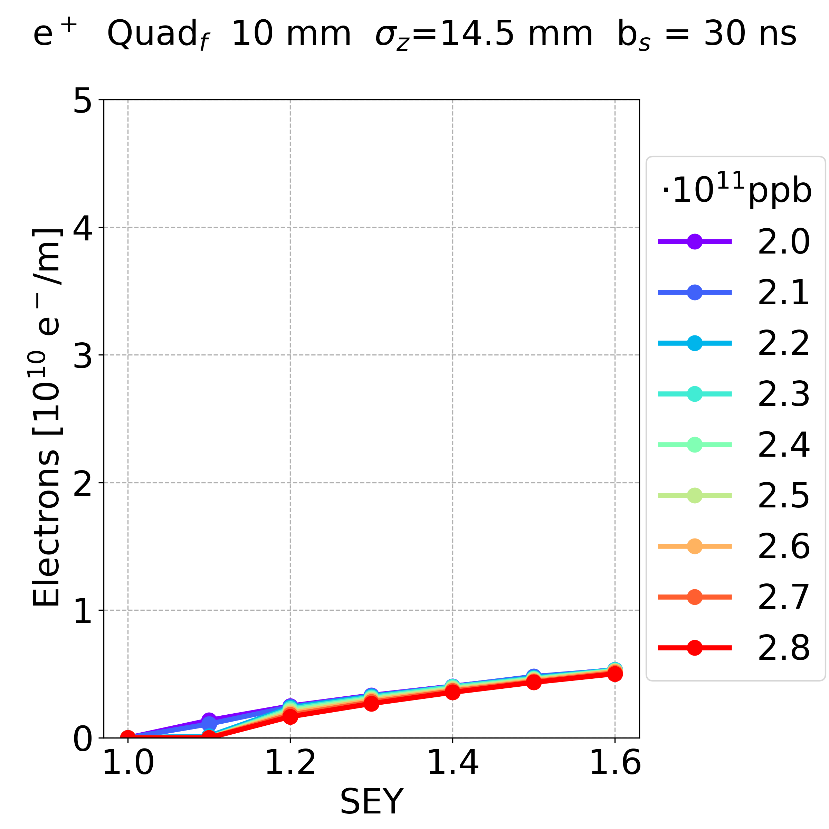
Simulation Results: Other Parameters
Dependence on the elements and bunch spacing:
positrons, bunch spacing 30 ns
Drift Space Dipole Quadrupole
In all elements, increasing the bunch spacing the electron density decreases
In the drift space and dipole, the dependence on the bunch spacing is stronger (for more cases there is no multipacting)
In the drift space and the dipole, the SEY threshold for multipacting increases with the bunch spacing more than quadrupole case
E⁻CLOUD’22 Workshop 26/09/2022

Slide 31
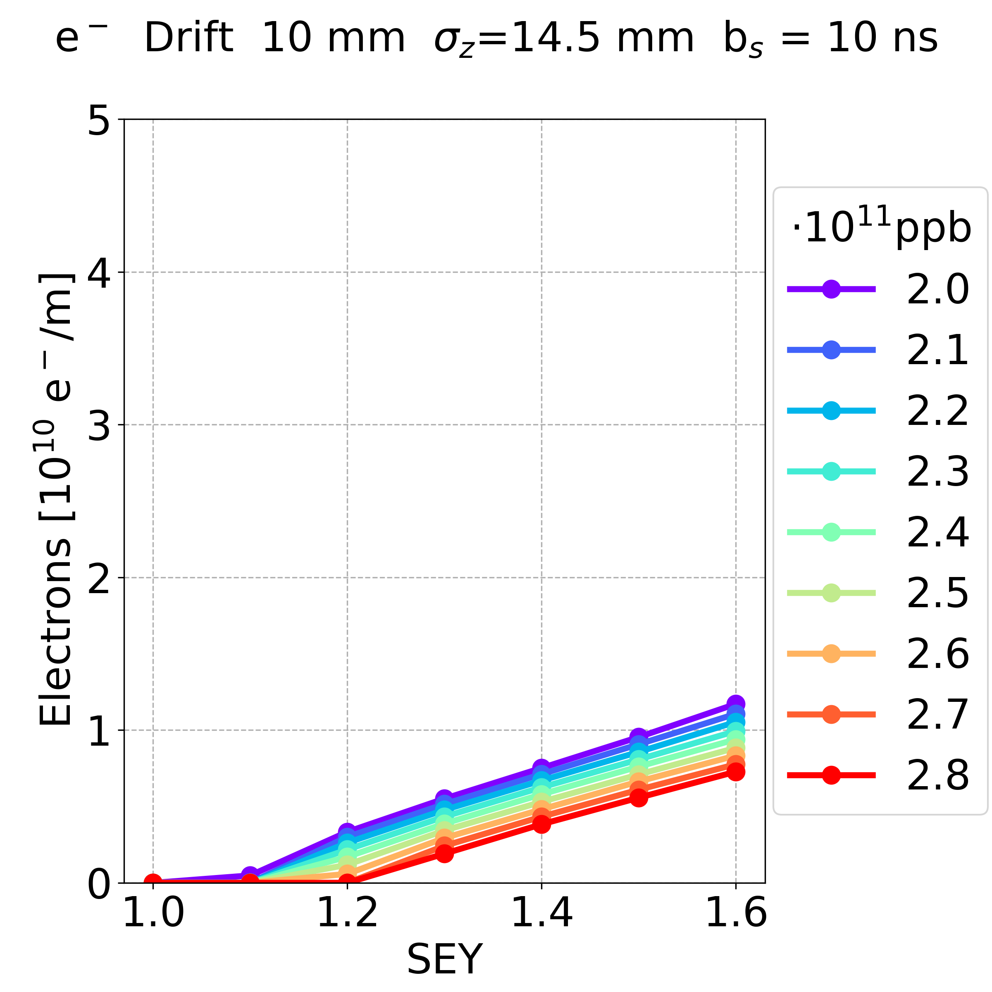
Simulation Results: Other Parameters
Dependence on the bunch charge:
(Drift space, bunch spacing 10 ns)
Positron Bunches Electron Bunches
Central density?
In the case of electron bunches, the e-cloud density is smaller
This behaviour has been observed in all the cases
Multipacting occurs in a few cases
E⁻CLOUD’22 Workshop 26/09/2022

Slide 32
Simulation Results: Other Parameters
Dependence on the bunch charge:
(Drift space, bunch spacing 10 ns, bunch intensity 2.0e11 ppb, SEY 1.6)
Positron Bunches Electron Bunches
In the case of electron bunches, the electrons are mainly located far from the beam chamber centre
This behaviour has been observed in all the cases
E⁻CLOUD’22 Workshop 26/09/2022

Slide 33
Outline
Introduction
Background
Simulation Results
Conclusions and Outlook
E⁻CLOUD’22 Workshop 26/09/2022

Slide 34
Conclusions and Outlook
The FCC-ee in the Z configuration has been investigated, because the strongest electron cloud effects are foreseen for this configuration, due to the highest number of bunches (smallest bunch spacing)
One of the main concerns is the e-cloud effect on the beam stability
A first estimation of the beam stability region has been obtained by comparing the central electron density as a function of the photoemission yield rate from PyECLOUD simulations with the analytically estimated instability threshold density
Further studies will be performed in order to check the stability limits by means of self-consistent beam stability simulations for the different arc elements with realistic e-cloud distributions obtained from build-up simulations
As a precursor, an extensive e-cloud build-up study has been carried out, with the aim of estimating the sensitivity to a range of beam and machine parameters
E⁻CLOUD’22 Workshop 26/09/2022

Slide 35
Conclusions and Outlook
Some parameters, in the range of considered values, give a negligible contribution to the e-cloud formation
Beta functions (focusing-defocusing) in quadrupoles and dipoles
Beam chamber winglet geometry
In the quadrupole, the bunch intensity has a negligible effect on the build-up
Increasing the bunch spacing, the electron density decreases in all elements (for more cases there is no multipacting)
In the drift space and dipole, the dependence on the bunch spacing is stronger
In the drift space and the dipole, the SEY threshold for multipacting increases with the bunch spacing more than quadrupole case
In some cases multipacting can occur even with electron bunches
The e-cloud density is smaller compared with the positron bunches
The electrons are mainly located far from the beam chamber centre
E⁻CLOUD’22 Workshop 26/09/2022

Slide 36
Thank you for your attention
E⁻CLOUD’22 Workshop 26/09/2022

Slide 37
E⁻CLOUD’22 Workshop 26/09/2022

Slide 38
E⁻CLOUD’22 Workshop 26/09/2022

Slide 39
Spare Slides
E⁻CLOUD’22 Workshop 26/09/2022

Slide 40
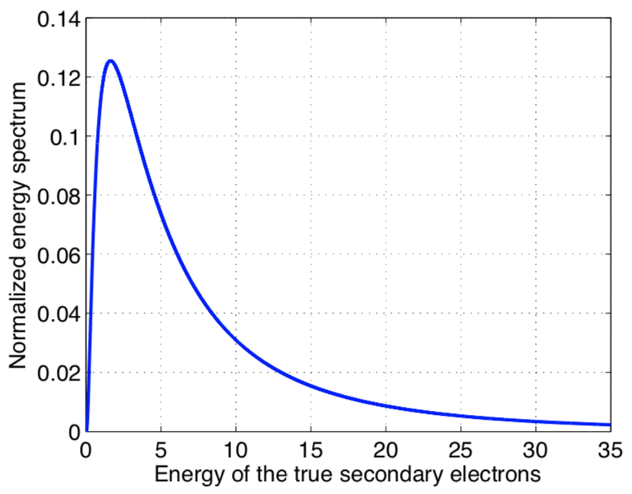
Background: Case Study
Parameter Overview
Secondary emission model:
LHC beam chambers:
$σ_{true}$ = 1.0828
$μ_{true}$ = 1.6636
$\frac{dn_{true}}{dE}=\frac{1}{Eσ_{true}\sqrt{2π}}e^{−\frac{{\left(ln\left(E\right)−μ_{true}\right)}^{2}}{2{σ_{true}}^{2}}}$
[eV]
[] B. Henrist et al., “Secondary Electron Emission Data for the Simulation of Electron Cloud”, cds 2002.
E⁻CLOUD’22 Workshop 26/09/2022
[] B. Henrist et al., “Secondary Electron Emission Data for the Simulation of Electron Cloud”, cds 2002.

Slide 41
Project Goals
The goal is to go below the SEY threshold for instabilities driven by e-cloud
Comparison between the analytical central electron density threshold for single bunch instability and the simulation results
Analytical equation
[] K. Ohmi et al., “Study of Electron Cloud Instabilities in FCC-hh”, Proc. of IPAC2015
Single-bunch stability simulations in dipoles
Courtesy of
L. Mether
E⁻CLOUD’22 Workshop 26/09/2022

Slide 42
Background: Case Study
The SEY can be decomposed in two main components:
$δ\left(E\right)=δ_{elas}\left(E\right)+δ_{true}(E)$ (2)
Electrons interact elastically by the chamber’s wall
(same energy, no deposition of energy in the surface)
true secondary electrons created by inelastic scattering (photoemission)
with a fraction of the impacting energy
[] R. Cimino, I. R. Collins, M. A. Furman, M. Pivi, F. Ruggiero, G. Rumolo, and F. Zimmermann, “Can Low-Energy Electrons Affect High-Energy Physics Accelerators?,” Phys. Rev. Lett., vol. 93, p. 014801, Jun 2004.
E⁻CLOUD’22 Workshop 26/09/2022

Slide 43
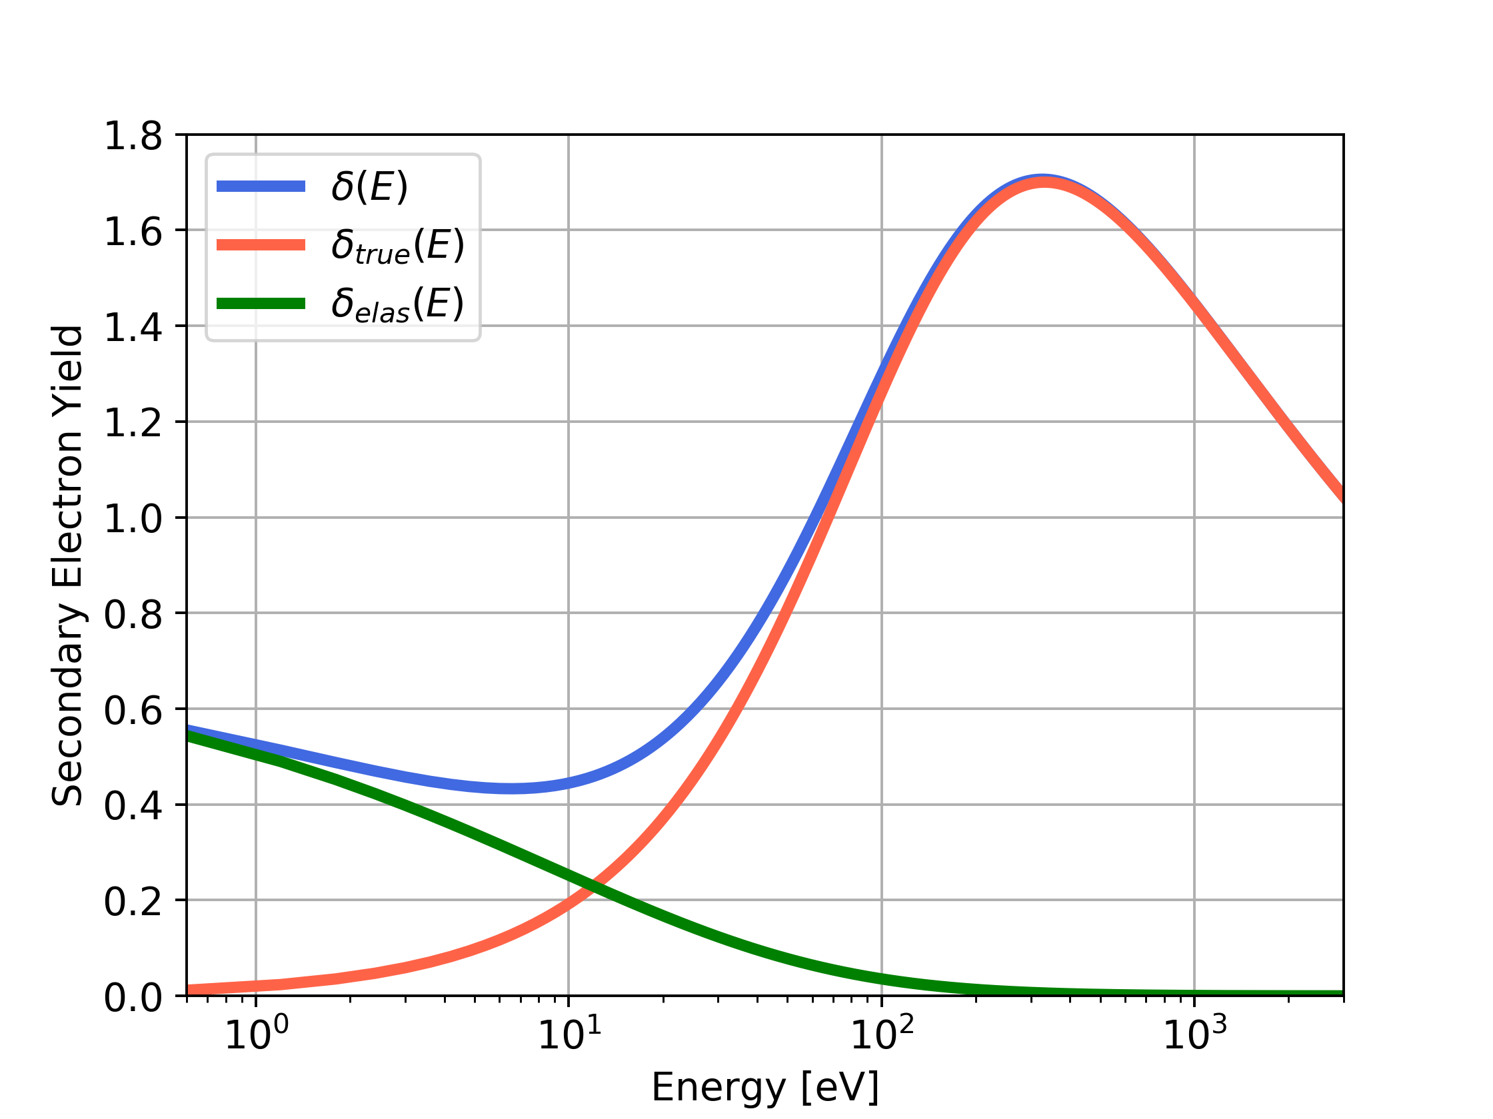
Background: Case Study
$δ\left(E\right)=δ_{elas}\left(E\right)+δ_{true}(E)$ (2)
$δ_{elas}\left(E\right)=R_{0} {\left(\frac{\sqrt{E} −\sqrt{E+E_{0}}}{\sqrt{E}+\sqrt{E+E_{0}}}\right)}^{2}$ (3)
E₀ and R₀: shape parameters.
For the LHC beam chambers:
E₀ = 150 eV
R₀ = 0.7
(2)
(3)
E⁻CLOUD’22 Workshop 26/09/2022

Slide 44
Background: Case Study
$δ\left(E\right)=δ_{elas}\left(E\right)+δ_{true}(E)$ (2)
$δ_{true}\left(E\right)=δ_{max}\frac{s \frac{E}{E_{max}}}{s−1+{\left(\frac{E}{E_{max}}\right)}^{s}}$ (4)
s: shape parameter;
$δ_{max}$: maximum of the SEY curve dependent on the surface material, roughness and history
E_{max}: electron energy, where the SEY reach the maximum 𝛿_{𝑚𝑎x}:
$$δ\left(E_{max}\right) ≅δ_{true}\left(E_{max}\right)=δ_{max}$$
For the LHC beam chambers:
s = 1.35
E_{max} = 332 eV
𝛿_{𝑚𝑎x}
(2)
(4)
(3)
$$E_{max}$$
E⁻CLOUD’22 Workshop 26/09/2022

Slide 45
Background: Case Study
Focusing
quadrupole
Defocusing
quadrupole
Parameter Overview
Element:
Drift space (β_{x} = 99 m, β_{y} = 99 m)
Quadrupole (5.65 T/m)
focusing (β_{x} = 173 m, β_{y} = 30.8 m)
defocusing (β_{x} = 30.8 m, β_{y} = 173 m)
Dipole (1.415 mT)
close to focusing quadrupole
(β_{x} = 142,5 m, β_{y} = 65.5 m)
close to defocusing quadrupole
(β_{x} = 65.5 m, β_{y} = 142.5 m)
Defocusing
quadrupole
Drift space
Drift space
Dipole
Dipole
Dipole
Dipole
β_{y}
β_{x}
E⁻CLOUD’22 Workshop 26/09/2022

Slide 46
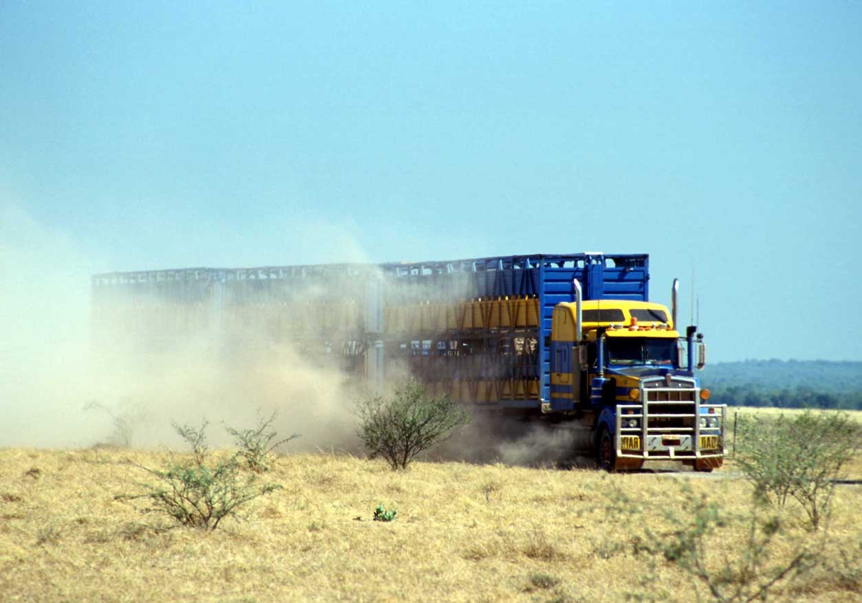
Background: E-Cloud Formation
e⁻ is emitted (photoelectric effect)
Secondary Electron Emission can drive an avalanche multiplication effect filling the beam chamber with an electron cloud
Trailing bunches of the train are in a dense electron-cloud (e-cloud)
Transverse instabilities
Transverse emittance blow-up
Particle losses
Proton bunch
Secondary Electron Emission
e-cloud induces other unwanted effects like:
Heat load on the beam chambers
Vacuum degradation
Affects mainly machine operating with positively charged particles (p⁺, e⁺, positive ions…)
Something like this…
Courtesy of
G. Iadarola
E⁻CLOUD’22 Workshop 26/09/2022

Slide 47
E⁻CLOUD’22 Workshop 26/09/2022

