Slide 1
Electron cloud effects at the LHC: status and prospects
L. Mether
with input from:
Electron Cloud Working Group
Beam Induced Heat Load Task Force

Slide 2
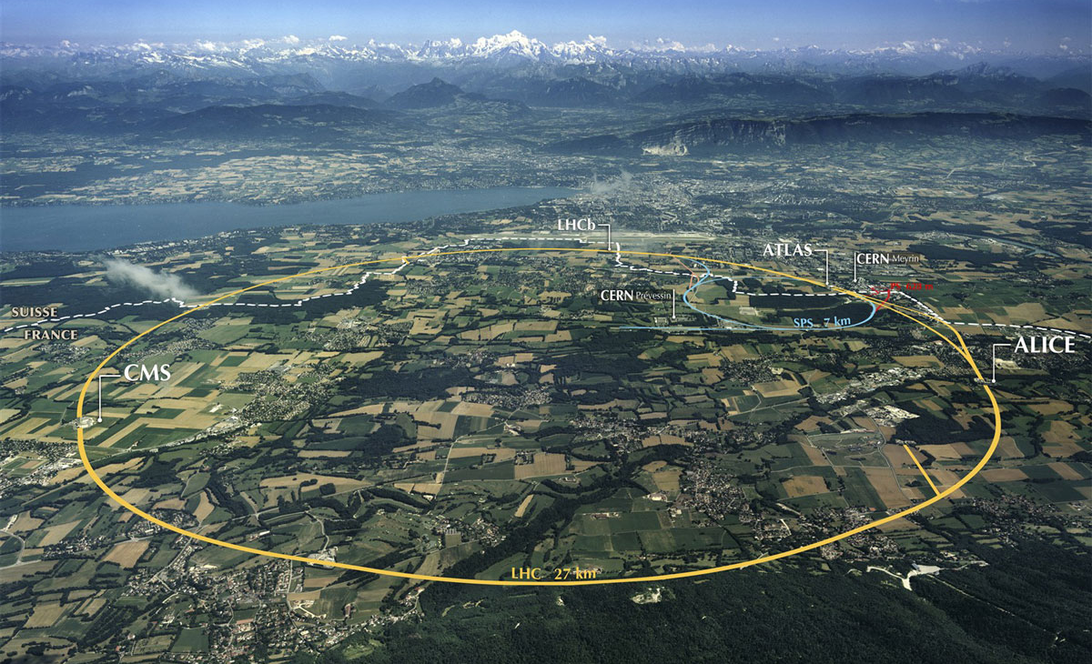
The Large Hadron Collider (LHC)
  The LHC is a 27-km proton (and ion) collider
Main design parameters
Circumference | 27 km
Injection energy | 450 GeV
Collision energy | 7 TeV
Bunches/beam | 2800
Bunch spacing | 25 ns

Slide 3
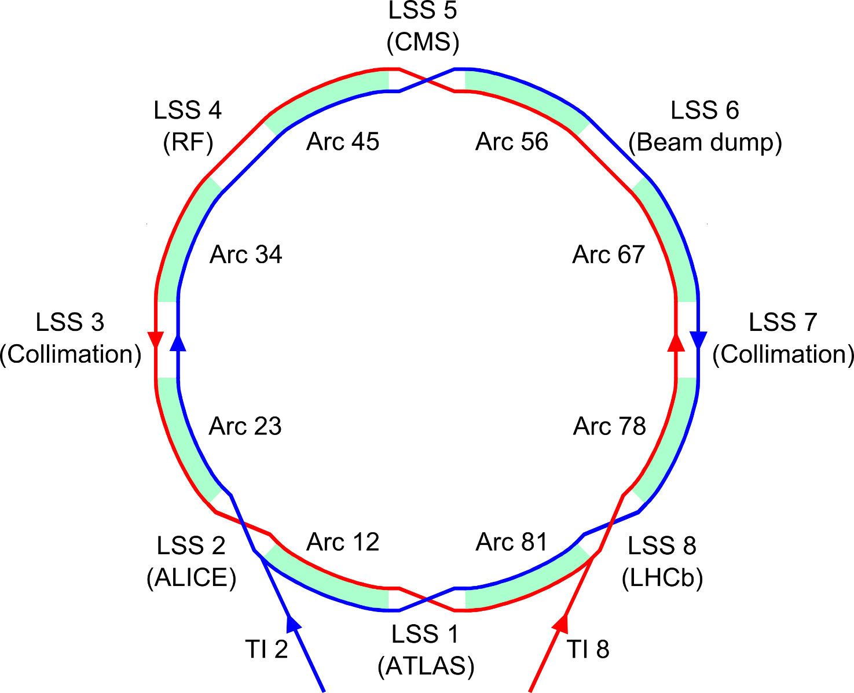
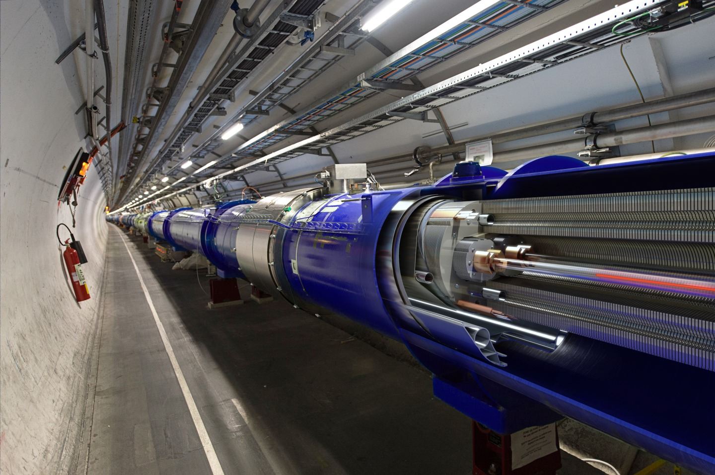
The Large Hadron Collider (LHC)
  The machine consists of 8 arcs containing the periodic superconducting magnet lattice and 8 long straight sections (LSS) for detectors and other equipment
Beam 1
Beam 2

Slide 4
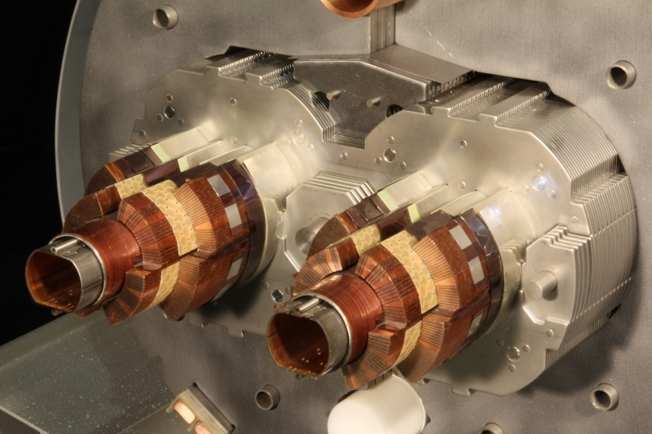
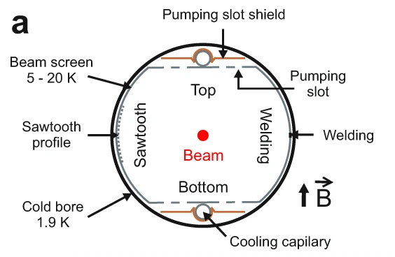
The LHC beam-screen
The beam screen protects the cold bore of the superconducting magnets (1.9 K) from heating due to e.g., impedance, synchrotron radiation and electron cloud
A saw-tooth surface on the side of the synchrotron radiation impact reduces photon reflectivity in order to contain photoemission (at collision energy)
Reduction of the secondary emission yield of the beam screen surface relies on beam-induced scrubbing
  Section of main dipole
    Beam screen cooling circuit
    (helium)
    Superconducting coils (1.9 K)
co-laminated Cu on StSt
    Beam screen
    (5 – 20 K)

Slide 5
LHC operation schedule
2010
2013
2015
2019
2022
2026
Run 1
LS1
Run 2
LS2
Run 3
LS3
We are here!
HL-LHC installation
The long-term LHC schedule alternates between physics runs and shutdown periods
Runs:
  Periods of predominantly physics operation
  Typically 6-8 months/year of luminosity production
Long Shutdowns (LS):
  Extended maintenance periods without beam
  Machine (arcs) opened and exposed to air → reset of beam screen conditioning

Slide 6
LHC Run 1
2010
2013
2015
2019
2022
2026
Run 1
LS1
Run 2
LS2
Run 3
LS3
Bunch spacing | 150 – 50 ns
Bunches/beam | < 1400
Bunch intensity | 1.1 – 1.7e11 p⁺
Collision energy | 3.5 – 4 TeV
In Run 1, the LHC operated with relaxed conditions

Slide 7
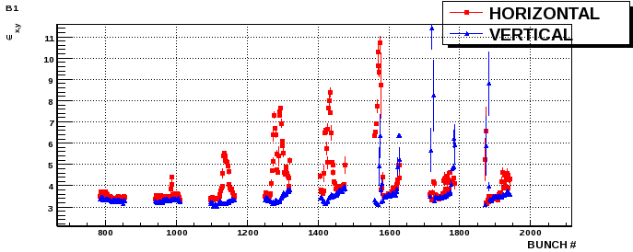
Electron cloud in Run 1
First signs of electron cloud: pressure rise in interaction regions with 150 ns spacing
Clear signs of beam degradation with first 50 ns beams
  After a week-long scrubbing run, smooth physics operation with 50 ns beams without significant e-cloud effects
Electron flux in dipole magnet
Day 1 of scrubbing – 300 bunches
Multipacting threshold in LHC dipoles significantly higher for 50 ns compared to 25 ns beam

Slide 8
LHC Run 2
2010
2013
2015
2019
2022
2026
Run 1
LS1
Run 2
LS2
Run 3
LS3
Bunch spacing | 25 ns
Bunches/beam | 2556
Bunch intensity | 1.15e11 p⁺
Collision energy | 6.5 TeV
In Run 2, the LHC switched to operation with the design bunch spacing of 25 ns

Slide 9
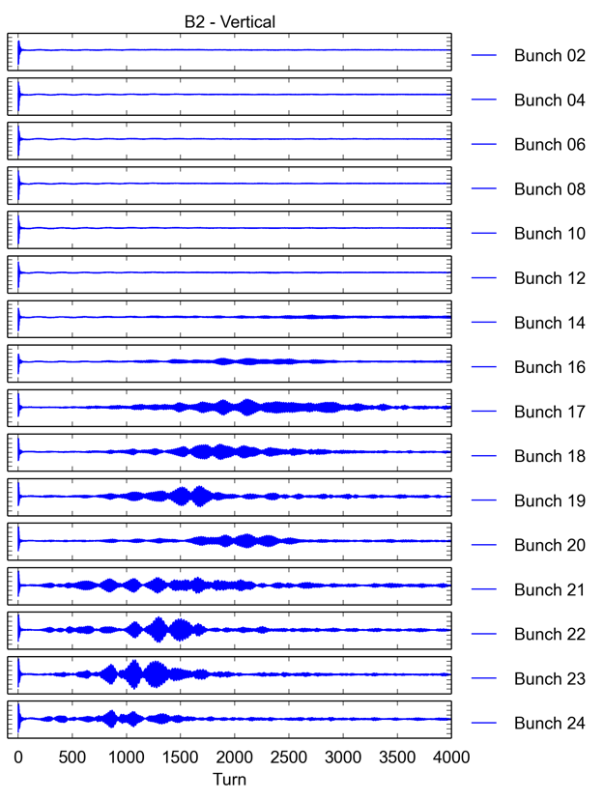
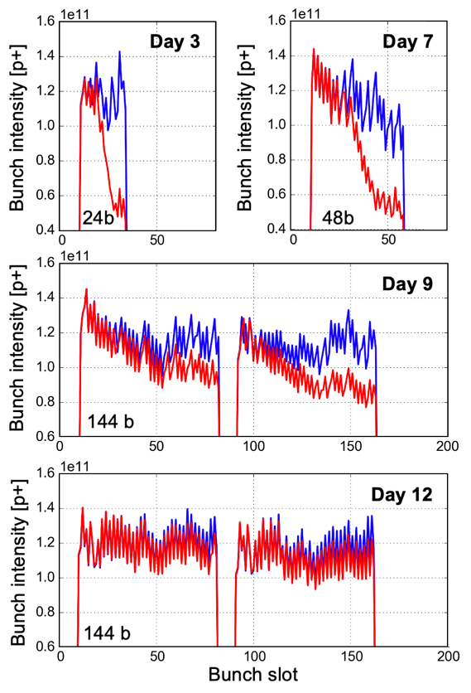
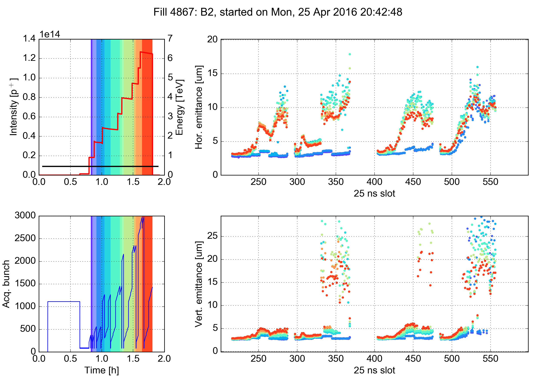
Electron cloud in Run 2
Significantly increased electron cloud production compared to Run 1
  Degradation of beam quality
Transverse instabilities
Beam loss and emittance growth
At injection
10 min later

Slide 10
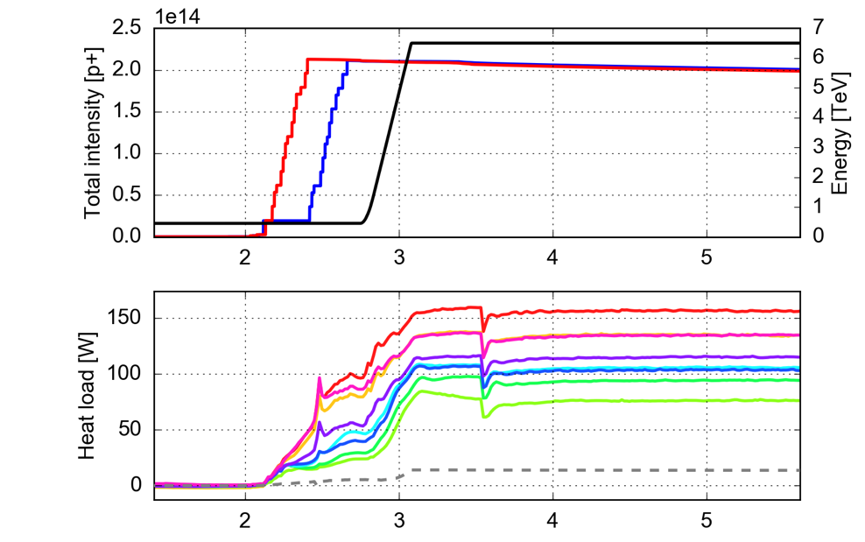
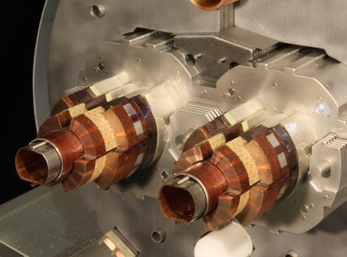







Electron cloud in Run 2
Significantly increased electron cloud production compared to Run 1
  Degradation of beam quality
  Power deposition on the arc beam screens
Heat load in the cryogenic magnets
Fill 4485 (Oct 2015)
25 ns, 1825b, 72b-trains, 1.15e11 p/bunch
Average per half cell

Slide 11
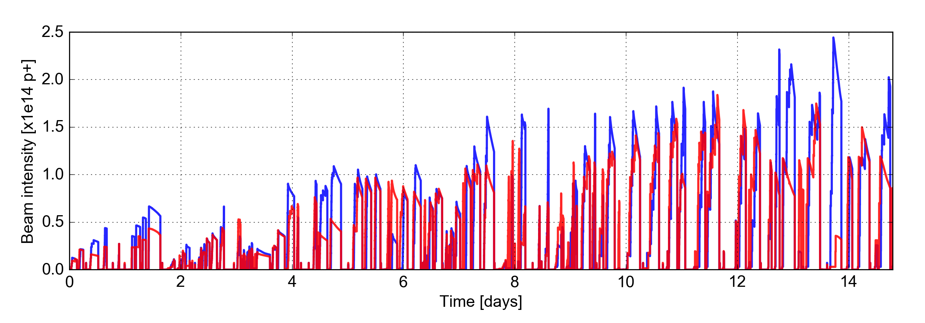
2015 scrubbing runs
[50 ns]
24
36
48
60
72
144
Train length
Beam 1
Major faults, tests and commissioning activities removed from the day count
Beam 2
Extensive scrubbing took place at the start of Run 2 to enable operation for physics
16 days of dedicated scrubbing were required to achieve reasonable beam quality
Scrubbing progress in 2015
Right after injection
10 min after injection

Slide 12
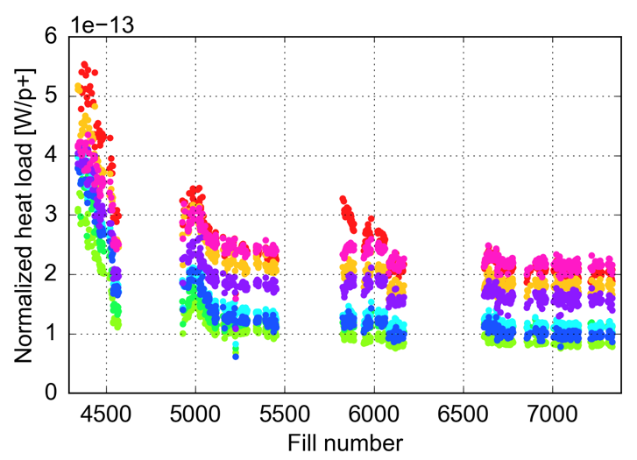
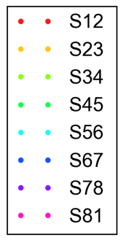
Conditioning during operation for physics
Continued scrubbing during physics mitigated electron cloud to a large extent
A strong reduction of the arc heat loads observed in 2015 and first part of 2016
  Allowed a satisfactory exploitation of 25 ns beams for physics
However, it was not possible to fully mitigate electron cloud through scrubbing
  From mid-2016 until the end of Run 2, the heat loads stayed practically constant and e-cloud effects remained present in the machine
25 ns physics fills with >600b
2015
2016
2017
2018
S12
vented

Slide 13
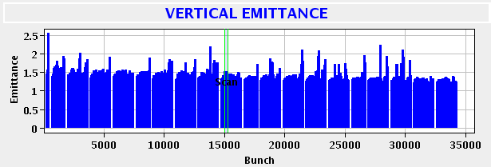
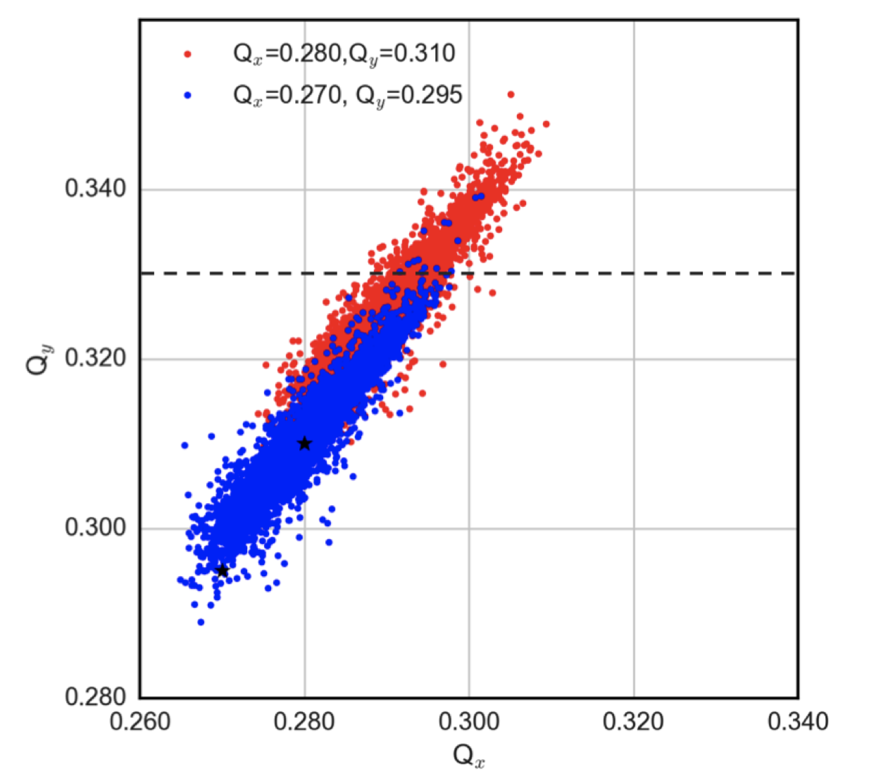
Beam degradation at 450 GeV
Instabilities could be mitigated by using high chromaticity,
strong octupoles and high feedback gain and bandwidth,
but could not be fully suppressed
Throughout the run, the tunes at injection
needed to be shifted to accommodate the
large tune footprint caused by the e-cloud,
in order to preserve the beam lifetime
Q’ > 15, I_{oct} > 50 A
~20 turns damping time
Emittances at start-ramp for a typical 2018 fill
PyECLOUD-PyHEADTAIL simulation
For more details, see: A. Romano et al, IPAC2017 (TUPVA018)

Slide 14
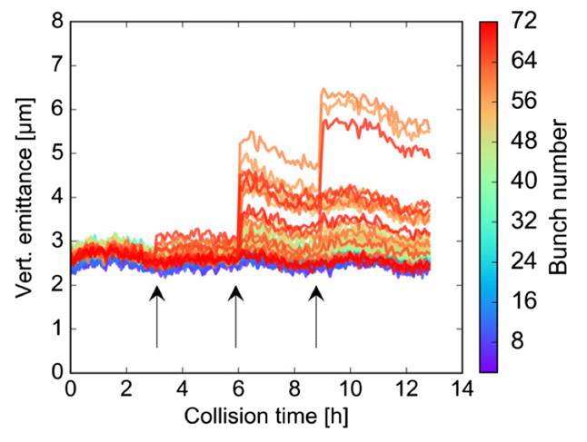
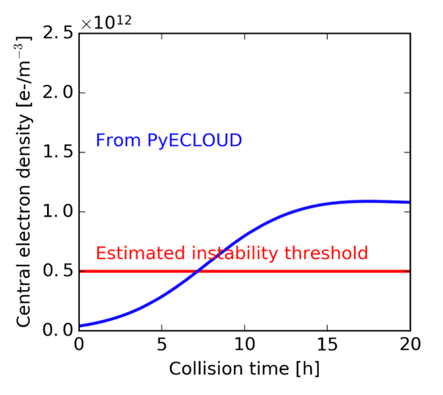
Beam degradation at collision energy
At collision energy the effects of the e-cloud on the beams are much weaker, thanks to the increased beam rigidity
In 2016, instabilities at end of fills occurred due to growth of central electron stripe in dipoles with decreasing bunch intensity – not observed later with shorter bunch trains
Observations
Simulations
For more details, see: A. Romano et al, Phys. Rev. Accel. Beams 21, 061002

Slide 15
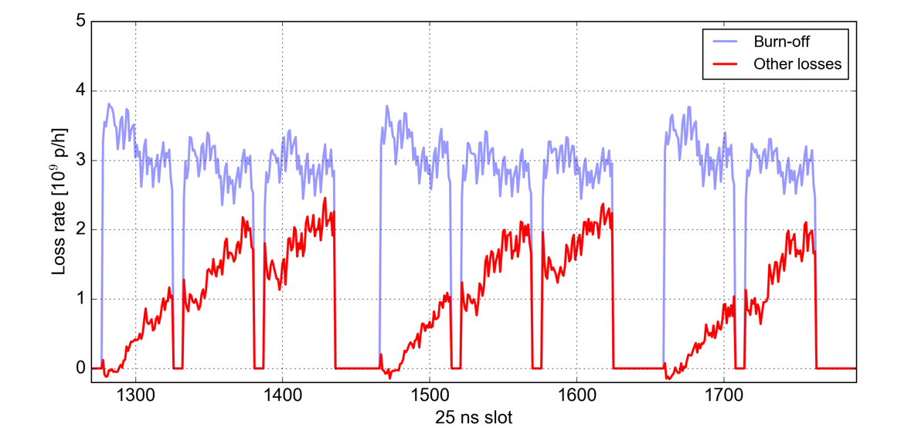
Beam degradation at collision energy
At collision energy the effects of the e-cloud on the beams are much weaker, thanks to the increased beam rigidity
In 2016, instabilities at end of fills occurred due to growth of central electron stripe in dipoles with decreasing bunch intensity – not observed later with shorter bunch trains
Even when beams were stable, slow beam losses were observed in collision
  Caused mainly by e-cloud in the Inner Triplets, enhanced by the large beta functions
For more details, see: K. Paraschou, ECLOUD’22, K. Paraschou et al., DOI: 10.23732/CYRCP-2020-009.249

Slide 16
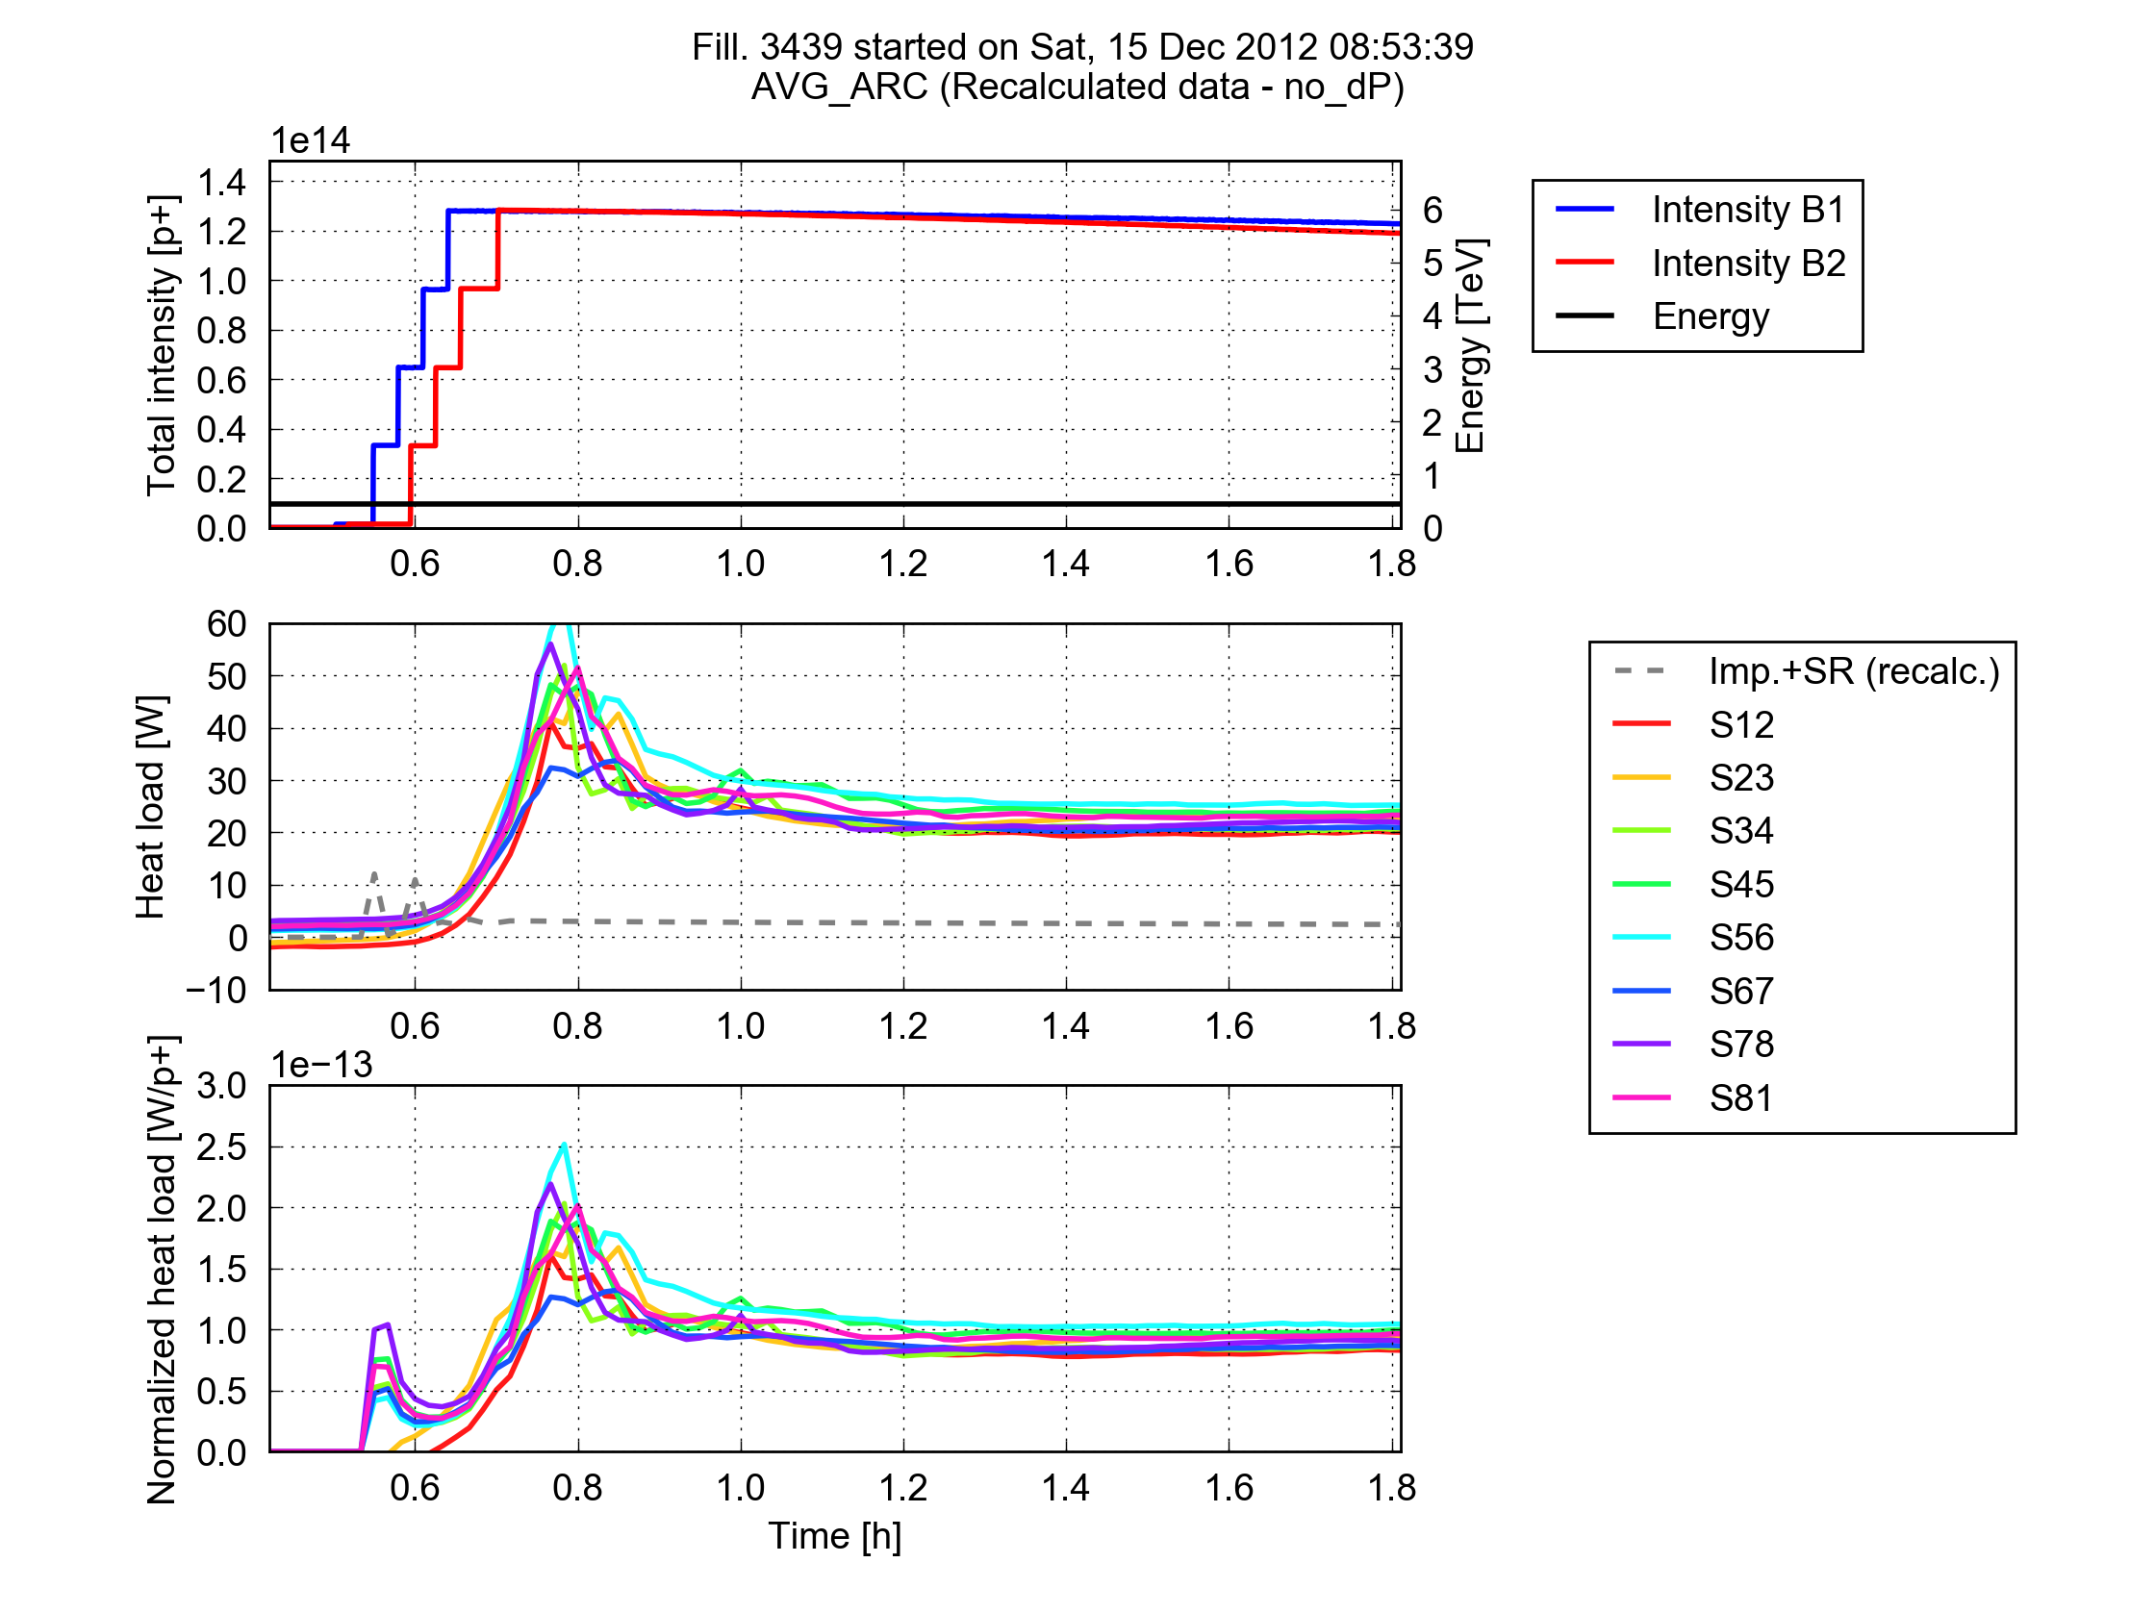
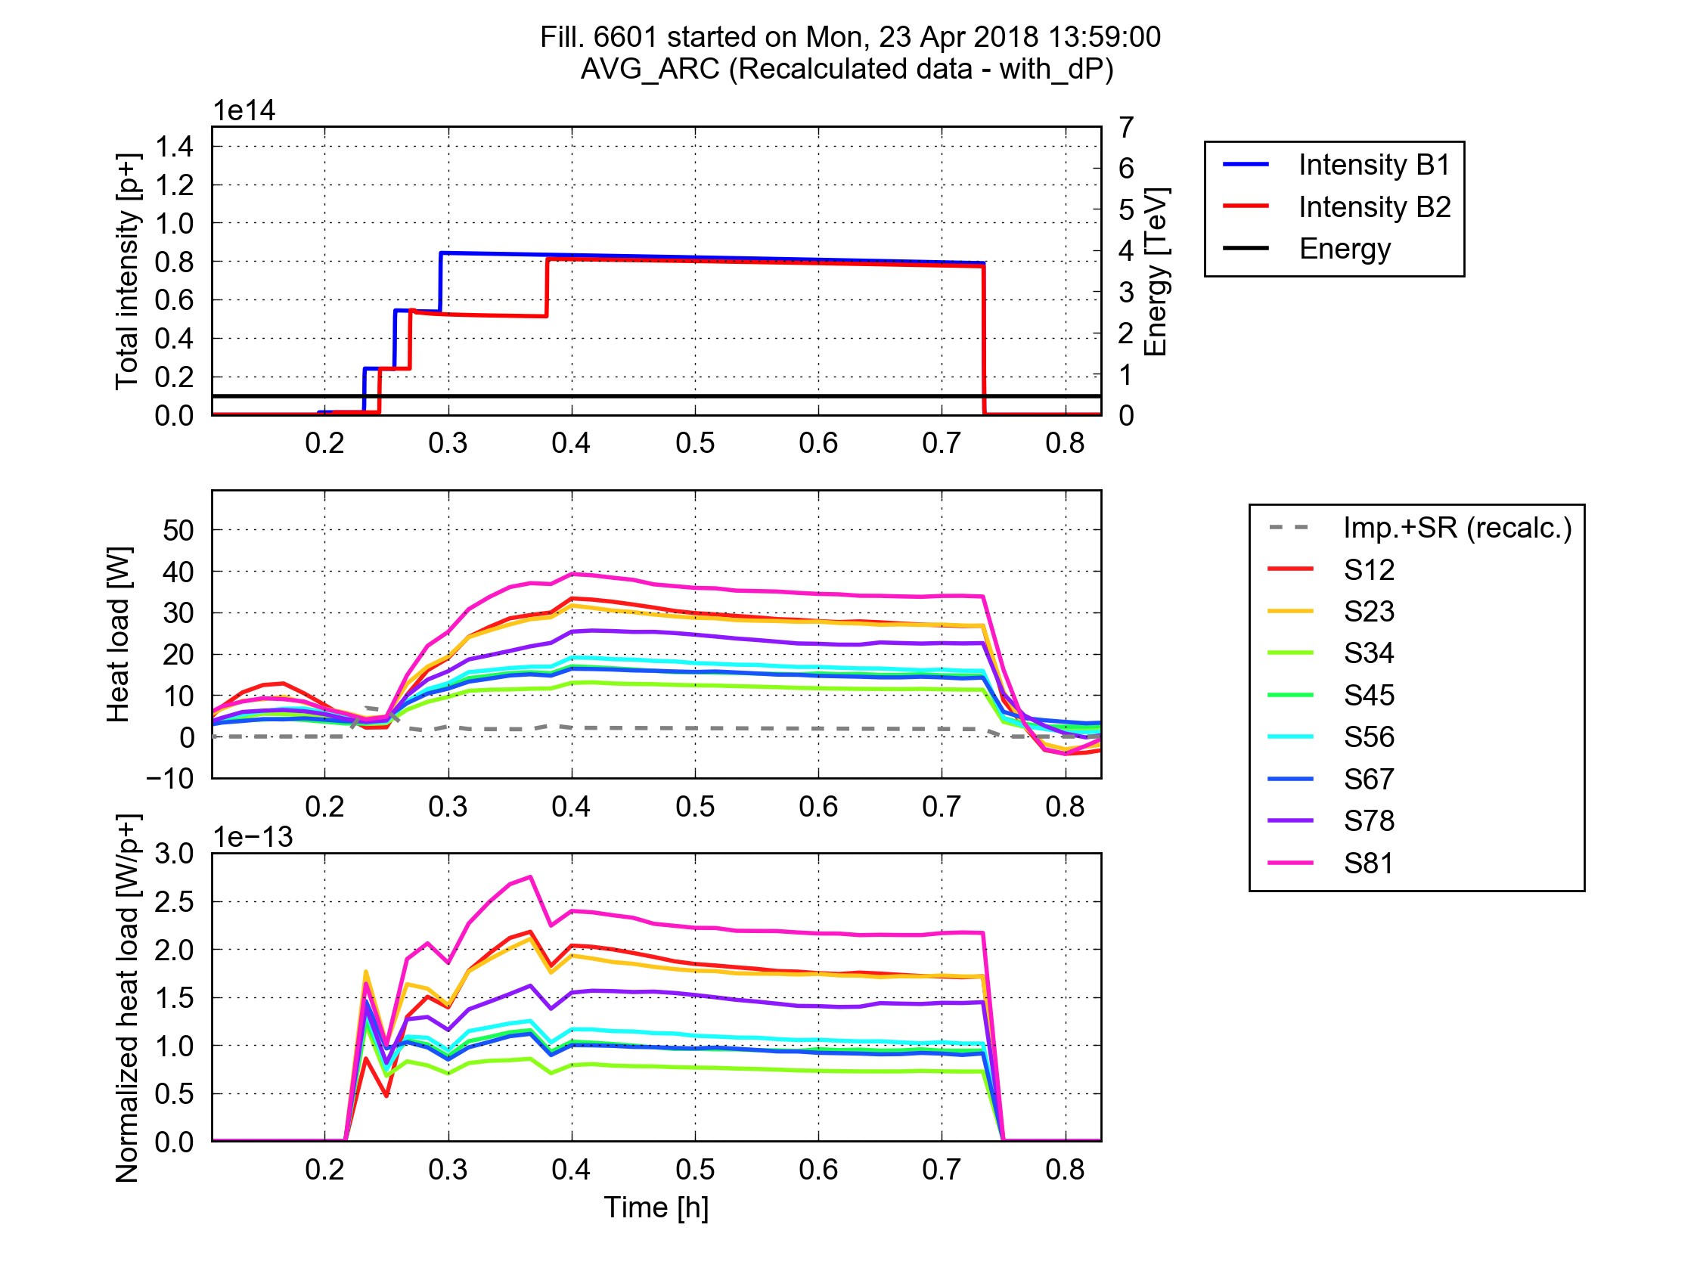
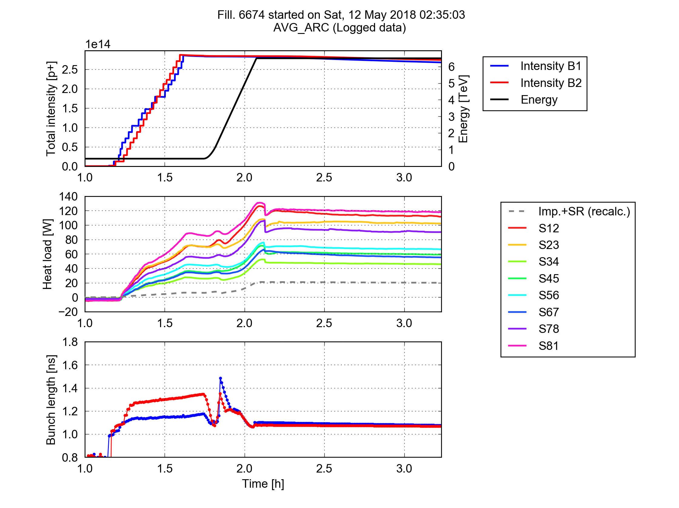
Heat load differences
Unexpectedly, the heat loads in the eight sectors showed large differences (up to factor 3)
The differences were highly reproducible over all 25 ns fills in Run 2
They were not present in Run 1 → degradation occurred between Run 1 and Run 2!
Addressed by dedicated Beam-Induced Heat Load Task Force since 2017
2012 (25 ns test, end of Run 1)
2018 (25 ns, during scrubbing)
Trains of 288b
Trains of 288b
Average per half cell
S81
S34
For more details, see: G. Iadarola, LHC Machine Committee, 12 Sep 2018

Slide 17
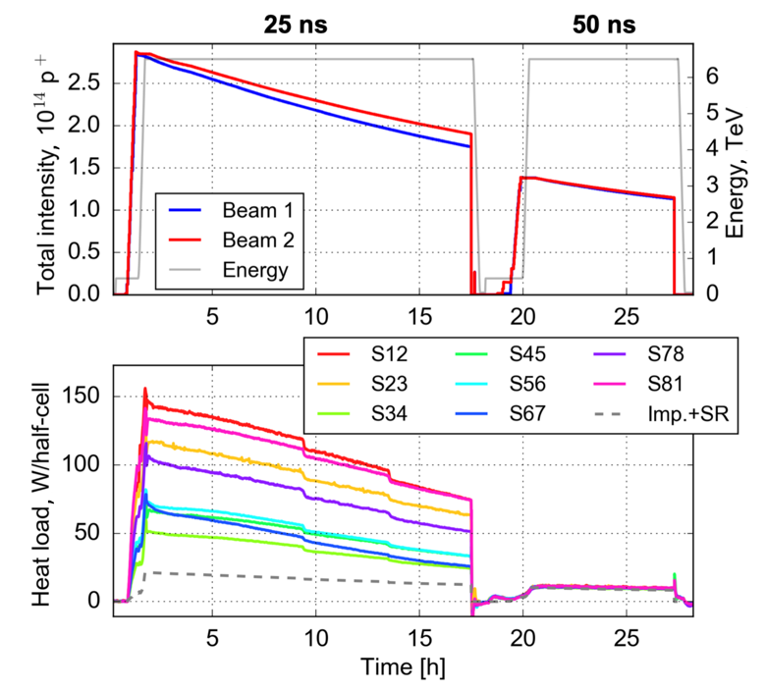
Heat load dependence on bunch spacing
Several beam studies performed in 2017-2018 to investigate behaviour of the heat loads
Different mechanisms that could transfer energy from the beam to the beam-screen were reviewed – only e-cloud effects couldn’t be excluded based on the observations
While the heat load differences were
observed with 25 ns bunch spacing,
they disappeared with 50 ns bunch
spacing
  Clear electron cloud signature!
With the 25 ns beam, the measured
heat loads were much larger than
estimated for impedance and
synchrotron radiation in all sectors
  Significant contribution from
  electron cloud
For more details, see: G. Skripka et al., CERN-ACC-NOTE-2019-0041

Slide 18
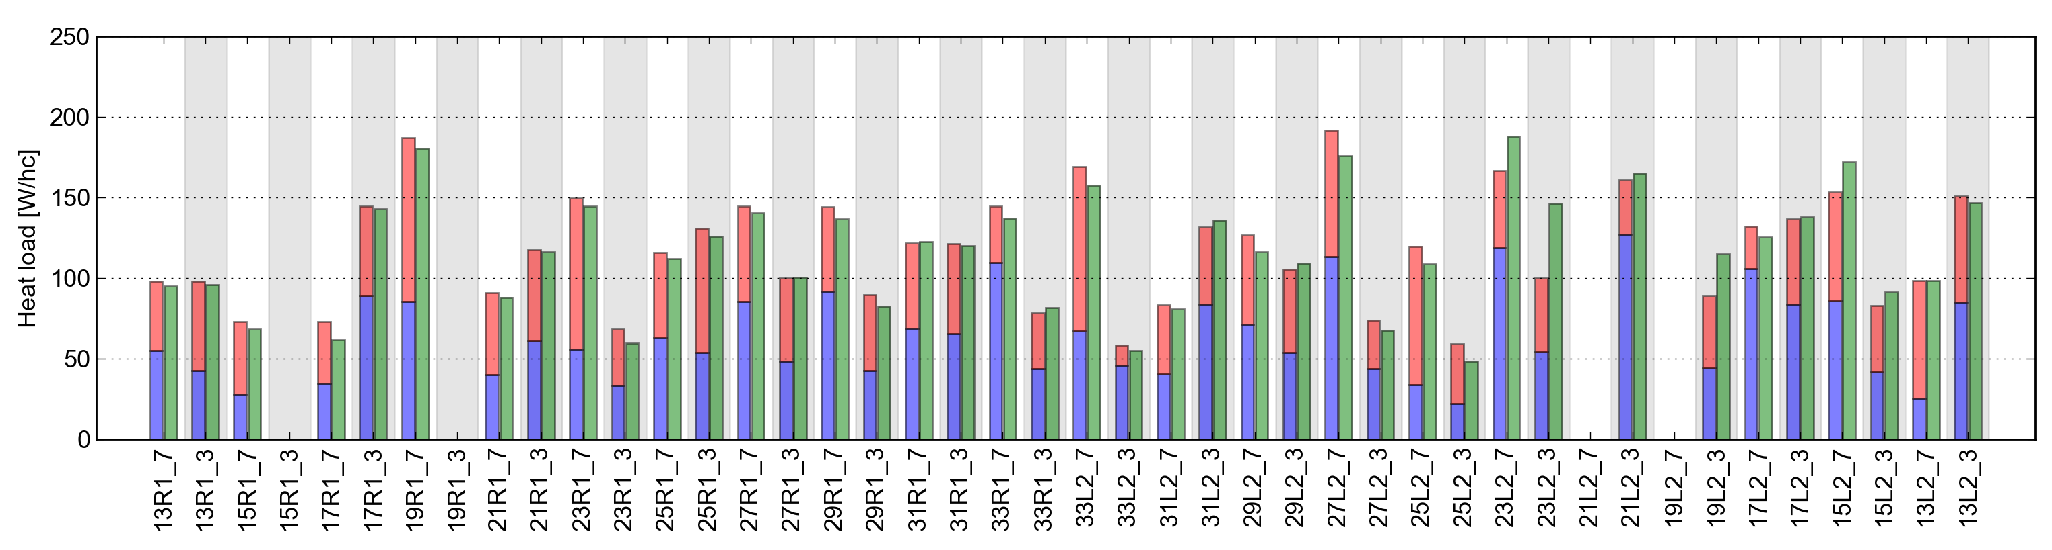
Heat load distribution
Differences in heat load were not only observed between sectors, they also appeared:
  From cell to cell, especially in the high load sectors
  For the two apertures in a single cell
  Among magnets in a single cell
Working hypothesis: heat load differences due to different SEY
Cell-by-cell heat load in Sector 12 (MD 2018)
B1 alone B2 alone B1&B2
Cell 31L2 (equipped with extra thermometers within the cell)
At 450 GeV:
25 W
20 W
50 W
3 W
Q
Dipole
Dipole
Dipole
At 6.5 TeV:
5 W
30 W
70 W
8 W

Slide 19
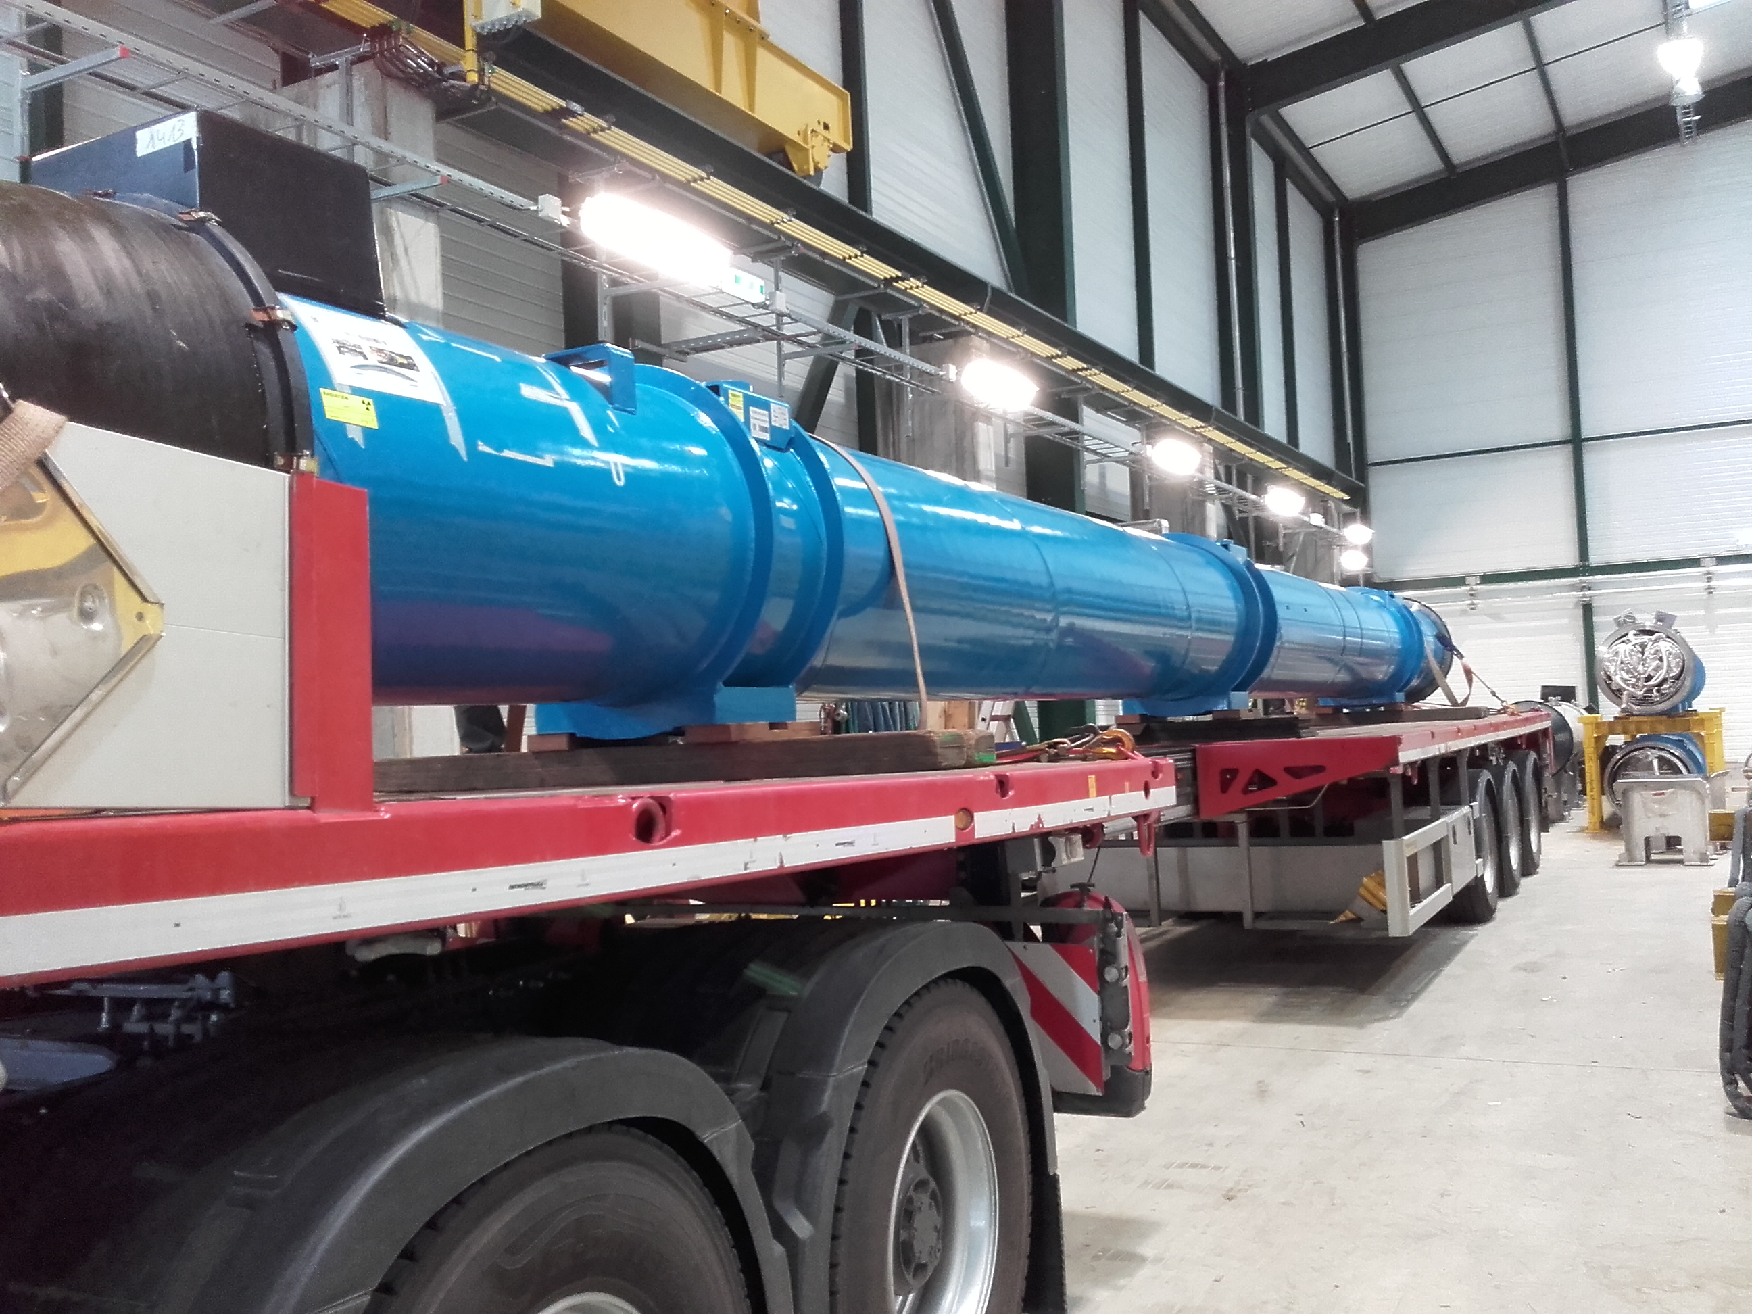
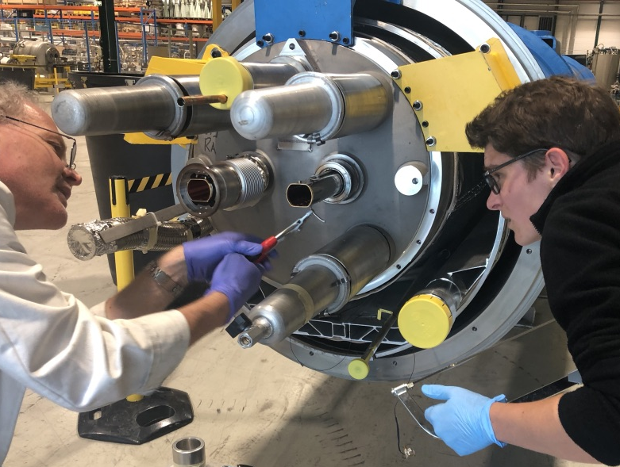
Beam screen extraction and analysis
2010
2013
2015
2019
2022
2026
Run 1
LS1
Run 2
LS2
Run 3
LS3
During LS2, the hypothesis that the high heat loads are driven by a higher SEY could be investigated by direct inspection of beam screens removed from the tunnel
Among the magnets extracted during LS2, two were initially selected for analysis:
  One showing a high heat load
  One showing a low heat load
The beam screens were extracted, cut in shorter sections, stored under vacuum and then underwent lab analysis (led by TE-VSC)
For more results and details, see:
V. Petit, presentation at LHC Performance Workshop 2022
V. Petit et al., Commun Phys 4, 192 (2021)

Slide 20
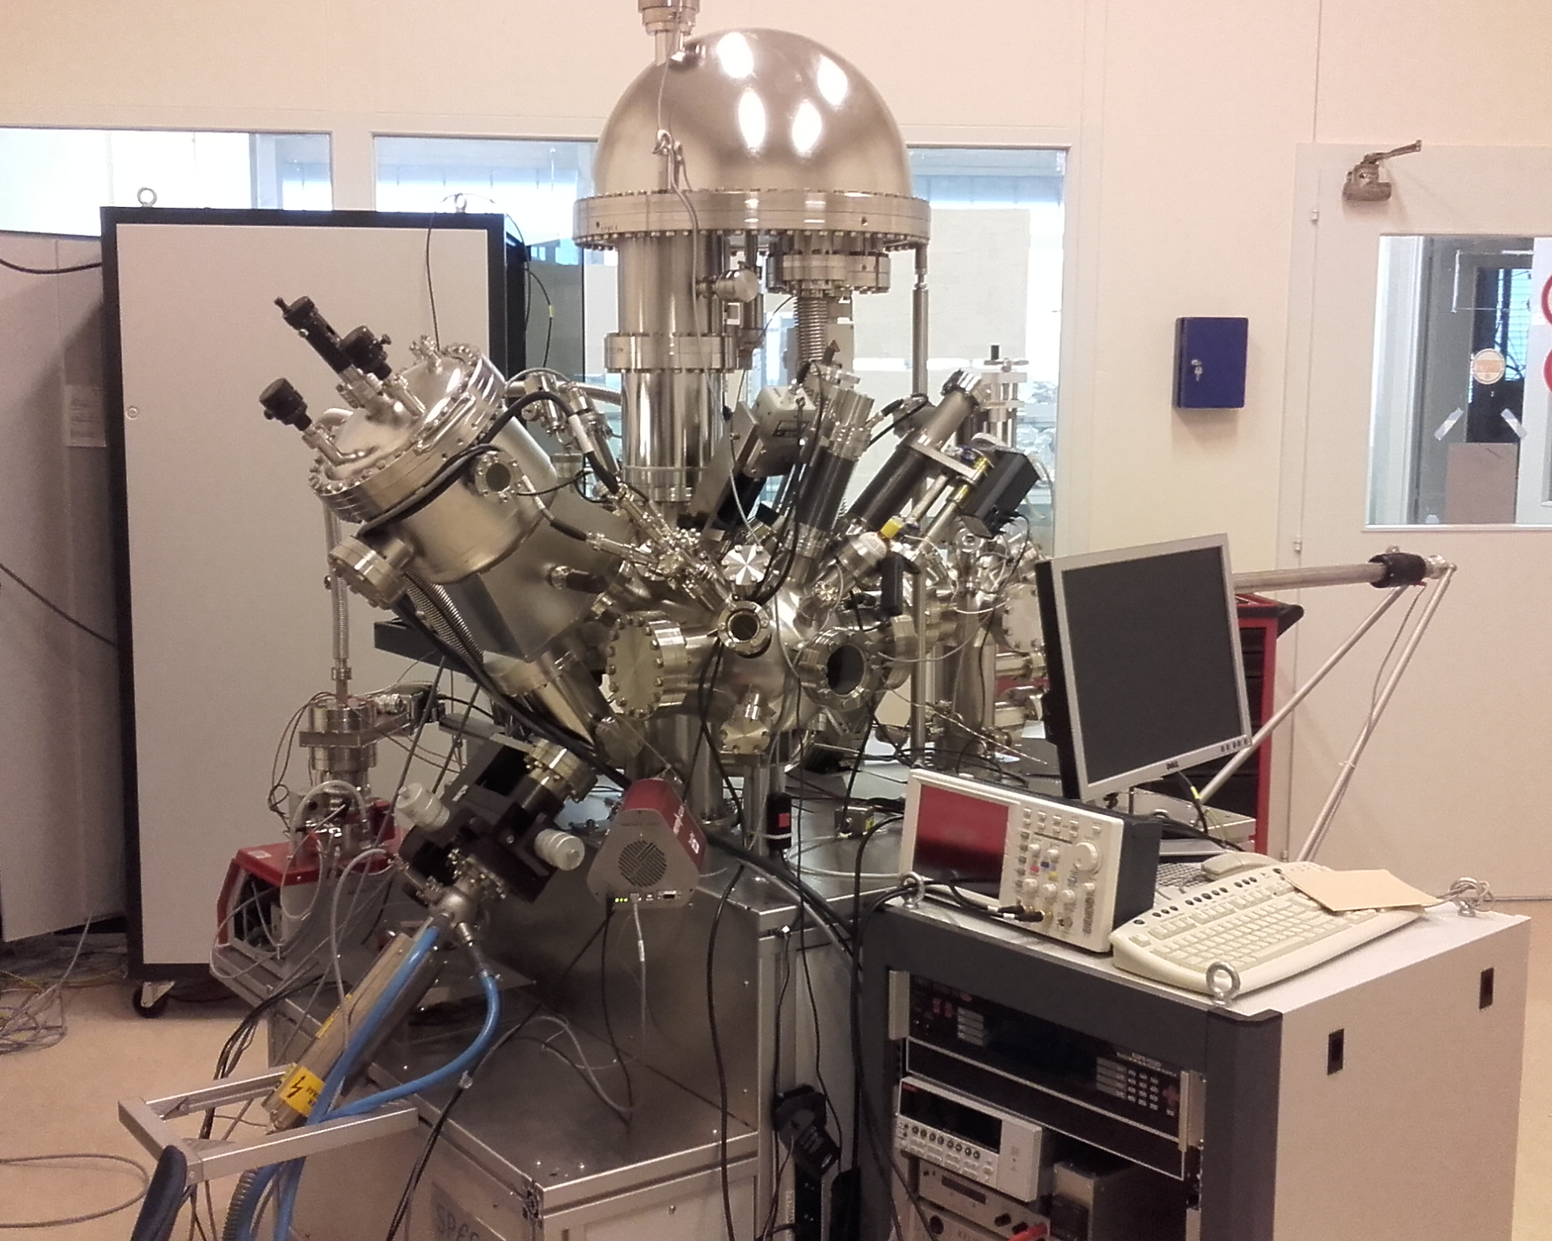
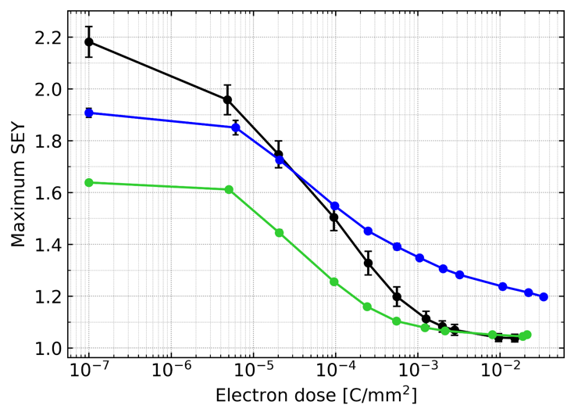
Results from SEY and conditioning analysis
The SEY and conditioning behaviour at room temperature of the two beam screens were measured and compared
The high-load beam screen shows a higher SEY after air exposure
The high-load beam screen shows worse conditioning behaviour with electron irradiation (compared both to the low-load one and to a spare beam screen)
SPECS measurement system (TE-VSC)
Spare
At room temperature
High-load
Low-load
For more details, see: V. Petit, presentation at LHC Performance Workshop 2022; V. Petit et al., Commun Phys 4, 192 (2021)

Slide 21
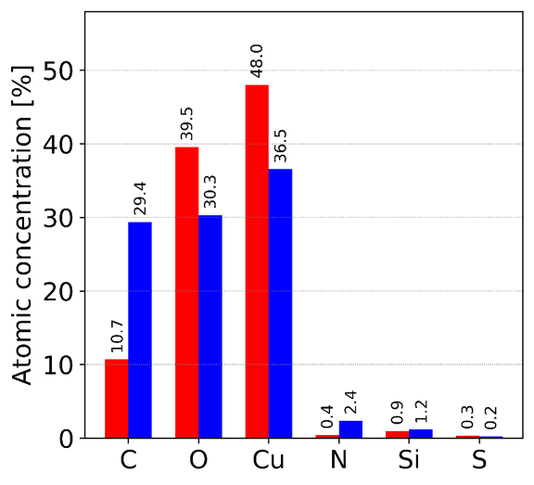
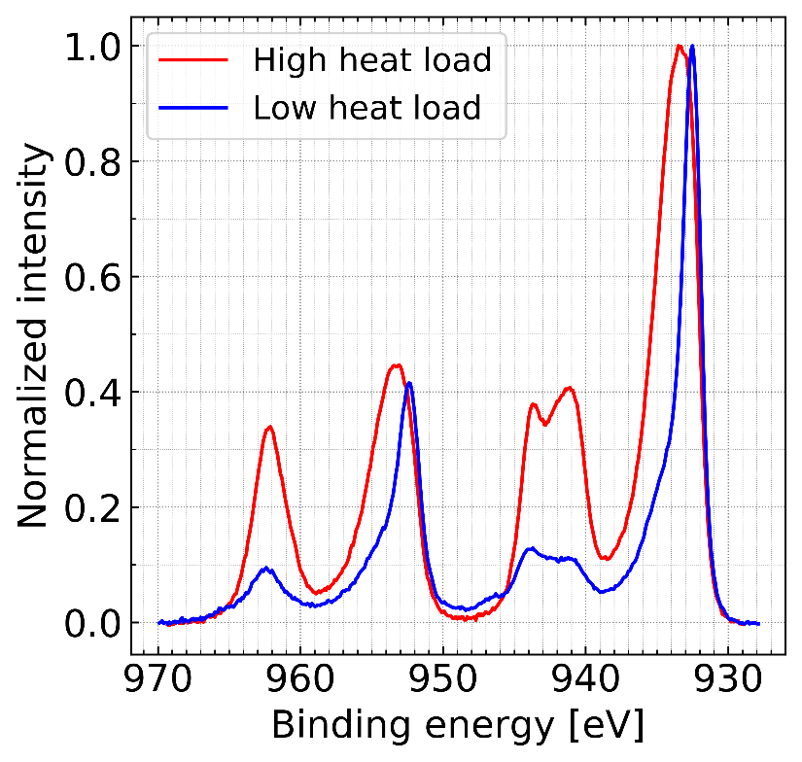
Results from XPS analysis
Surface chemistry analysis using X-ray photoelectron spectroscopy (XPS) revealed different oxidation states in the low- and high-load magnets
  Low-load magnets show cuprous oxide (Cu₂O) → native copper oxide
  High-load magnets show cupric oxide (CuO) → unexpected!
High-load beam screens also show a surprisingly low concentration of carbon
These chemical alterations, observed on several high-load beam screens, but not found on beam screens extracted during LS1, are very likely the cause of the different SEY and conditioning behaviour!
XPS spectrum
CuO signature
For more details, see: V. Petit, presentation at LHC Performance Workshop 2022; V. Petit et al., Commun Phys 4, 192 (2021)

Slide 22
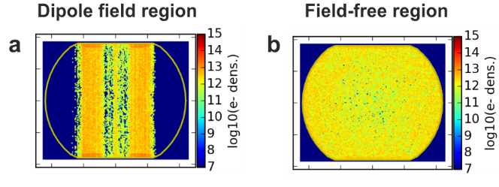
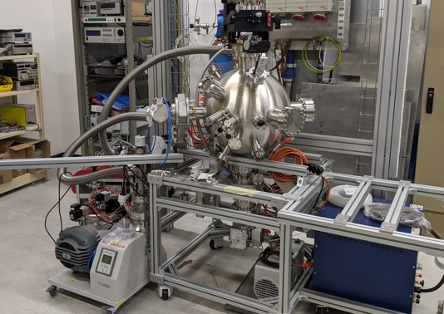
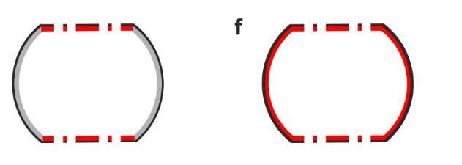

Results from XPS analysis
The angular distribution of CuO matches the expected distribution of the e-cloud in both dipole fields and field-free regions
Likely formed under the effect of electron bombardment during post-LS1 beam operation
CuO production under electron irradiation is not expected based on conditioning studies in the lab at room temperature
  New dedicated cryogenic XPS/SEY measurement system constructed for studying effects at low temperature
e-cloud
simulations
XPS
measurements
For more details, see: V. Petit, presentation at LHC Performance Workshop 2022; V. Petit et al., Commun Phys 4, 192 (2021)

Slide 23
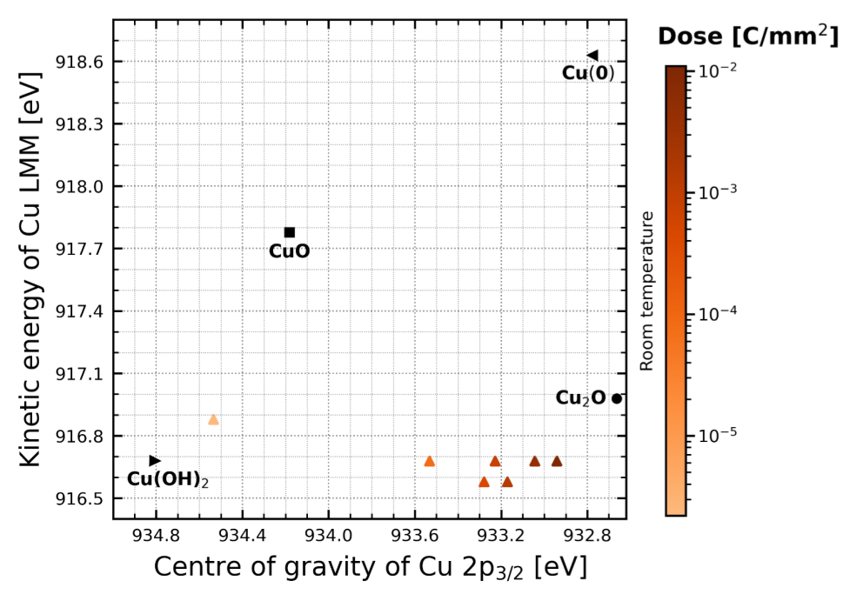
CuO formation
Airborne Cu(OH)₂ could be a precursor for CuO build-up by electron irradiation
At room temperature, Cu(OH)₂ is reduced to Cu₂O
For more details, see: V. Petit, LHC Machine Committee #444, July 2022

Slide 24
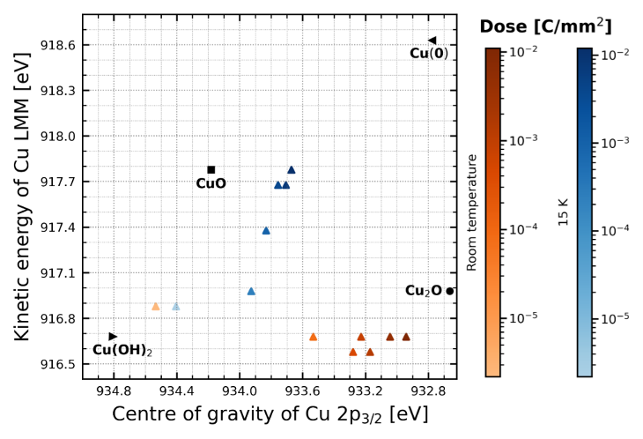
CuO formation
Airborne Cu(OH)₂ could be a precursor for CuO build-up by electron irradiation
At room temperature, Cu(OH)₂ is reduced to Cu₂O
At cold (15 K) Cu(OH)₂ acts as precursor for CuO build-up
For more details, see: V. Petit, LHC Machine Committee #444, July 2022

Slide 25
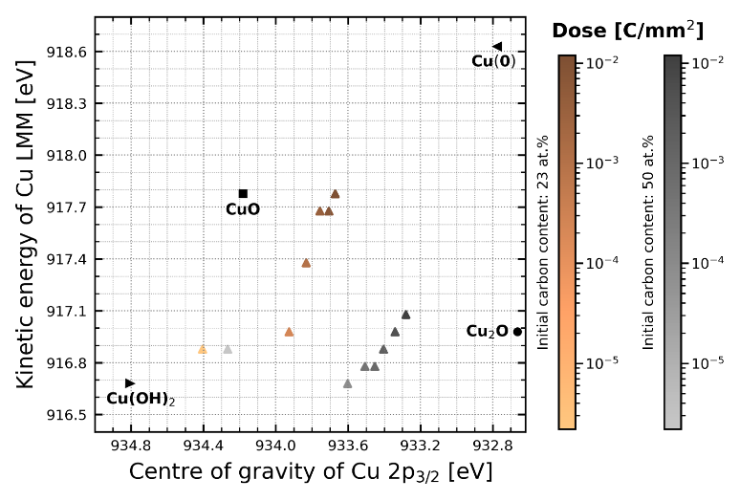
CuO formation
Airborne Cu(OH)₂ could be a precursor for CuO build-up by electron irradiation
At room temperature, Cu(OH)₂ is reduced to Cu₂O
At cold (15 K) Cu(OH)₂ acts as precursor for CuO build-up
  Presence of carbon limits the conversion of Cu(OH)₂ into CuO
For more details, see: V. Petit, LHC Machine Committee #444, July 2022

Slide 26
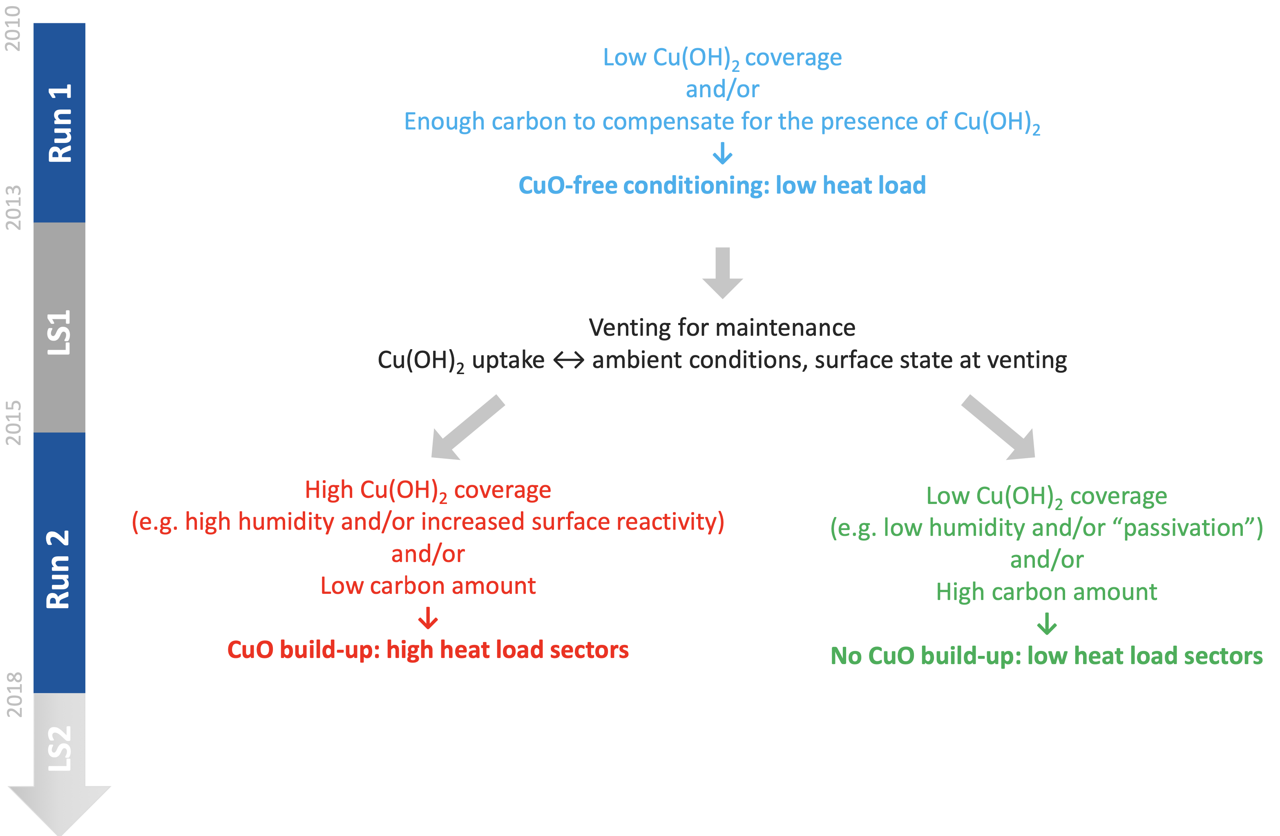
Hypothesis for LHC beam screens
For more details, see: V. Petit, LHC Machine Committee #444, July 2022

Slide 27
Hypothesis for LHC beam screens
For more details, see: V. Petit, LHC Machine Committee #444, July 2022

Slide 28
Hypothesis for LHC beam screens
For more details, see: V. Petit, LHC Machine Committee #444, July 2022

Slide 29
Hypothesis for LHC beam screens
For more details, see: V. Petit, LHC Machine Committee #444, July 2022

Slide 30
LHC Run 3
2010
2013
2015
2019
2022
2026
Run 1
LS1
Run 2
LS2
Run 3
LS3
We are here!
Bunch spacing | 25 ns
Bunches/beam | 2748
Bunch intensity | 1.2-1.8e11 p⁺
Collision energy | 6.8 TeV
In Run 3, increased luminosity production with 25 ns beams
  Gradual ramp-up of bunch intensity up to 1.8e11 p⁺ foreseen
    Possible after conclusion of LHC Injectors Upgrade (LIU) project during LS2
    In preparation for HL-LHC (to be installed in LS3)

Slide 31
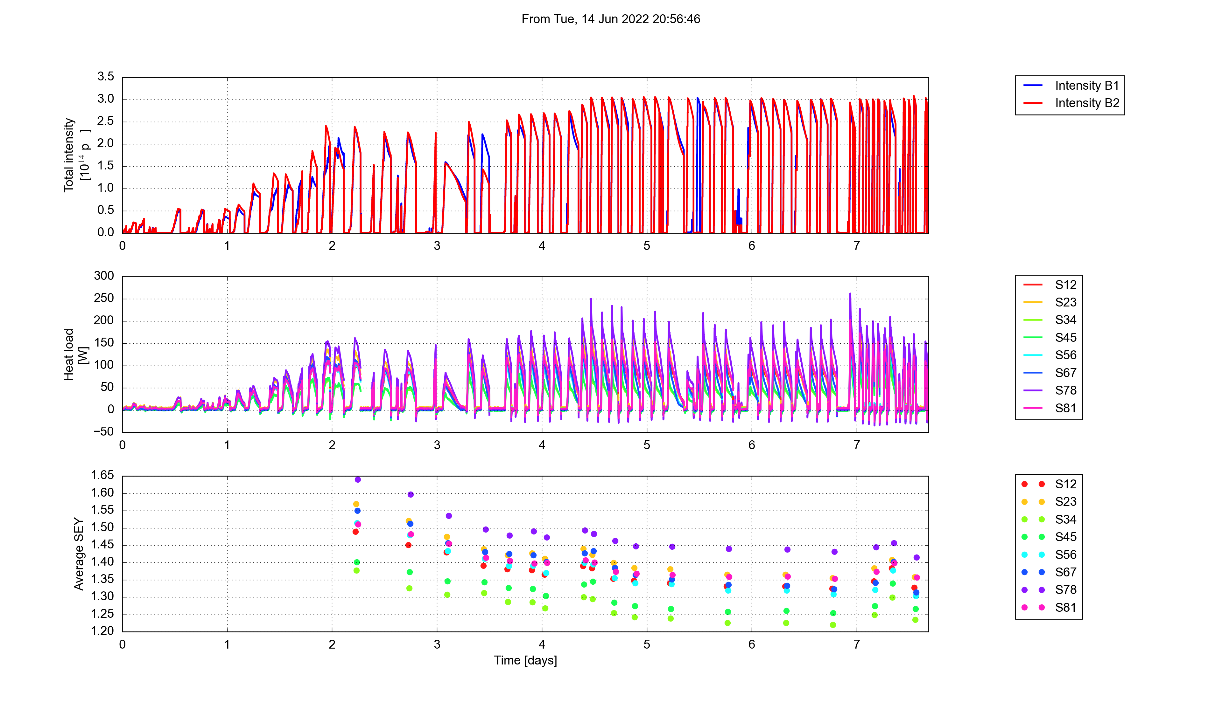
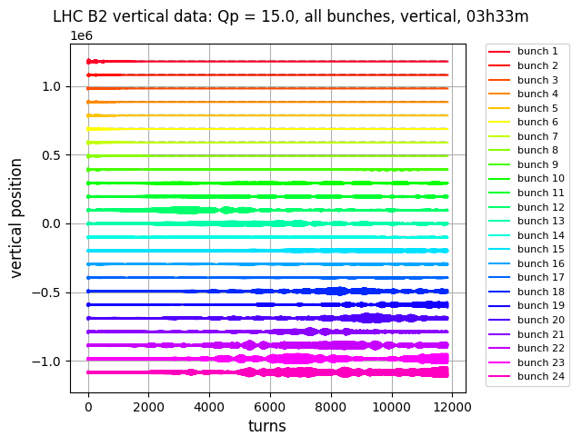
2022 scrubbing run
Train length
12
24
36
48
144
288
Scrubbing at 450 GeV took place in June-July to recondition the machine for physics
Although early scrubbing was strongly limited by e-cloud instabilities, good beam control was achieved after roughly a day using mitigation techniques learned in Run 2
In addition, upgrades/improvements w.r.t. 2015
allowed for a faster scrubbing pace, e.g.,
  Mitigation of pressure bottlenecks
  Improved cryogenics feed-forward
Sufficient beam quality for physics operation
achieved in 8 days of scrubbing
Optimized betatron tunes
Q’ = 35
I_{oct} = 40 A
~10 turns damping time

Slide 32
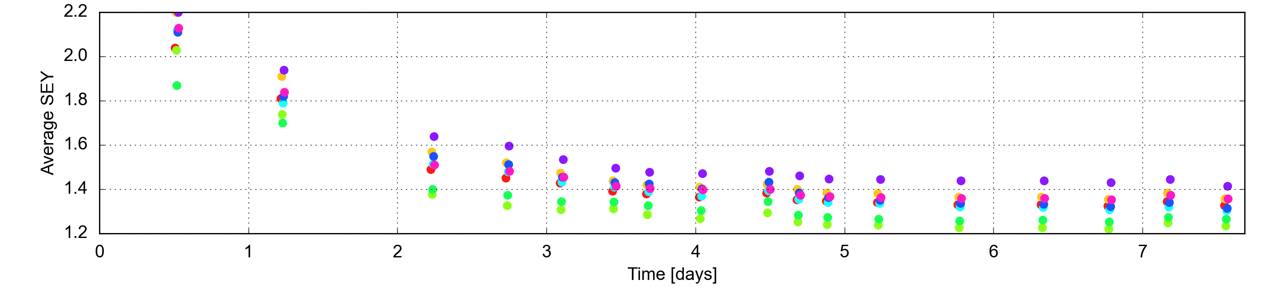
SEY evolution during scrubbing run
Fill 7956
Train length
12
24
36
48
144
288
Highest SEY in S78
The evolution of the SEY over the scrubbing run has been evaluated for each half-cell by comparing cell-by-cell heat load measurements to dedicated PyECLOUD simulations
A clear reduction of the average SEY is observed in every sector
The sectors with the highest SEY/heat load are not the same as in Run 2
For more details on heat load evolution, see: B. Bradu, ECLOUD’22

Slide 33
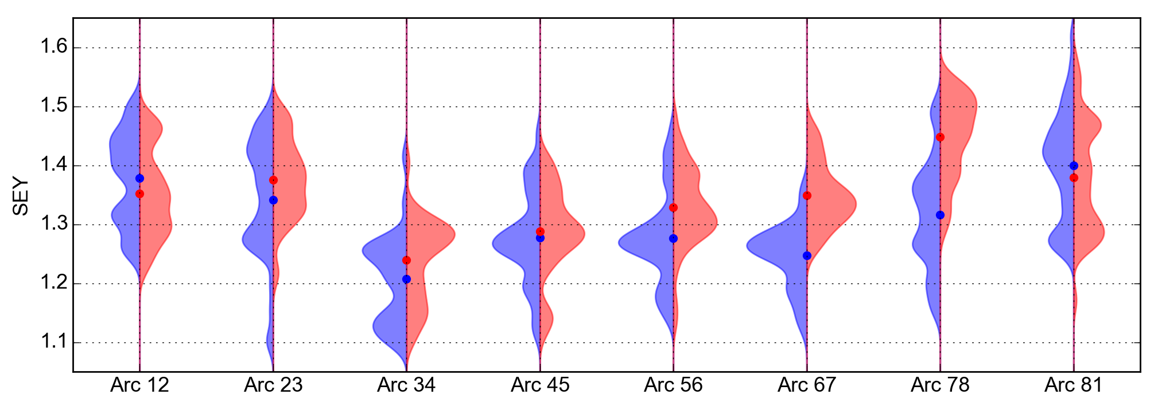
SEY comparison to 2018
A preliminary analysis was performed to compare the SEY at the end of scrubbing to 2018
In most sectors, the SEYs were very close to their 2018 values (at 450 GeV)
  The differences are within the error bars of the analysis
  Further scrubbing still to be done during operation at collision energy
Sectors 78 and 67 and to a lesser extent S56 show much higher SEY than in 2018
Fill 6605
2018
Fill 7956
10 July
For more details on heat load evolution, see: B. Bradu, ECLOUD’22

Slide 34
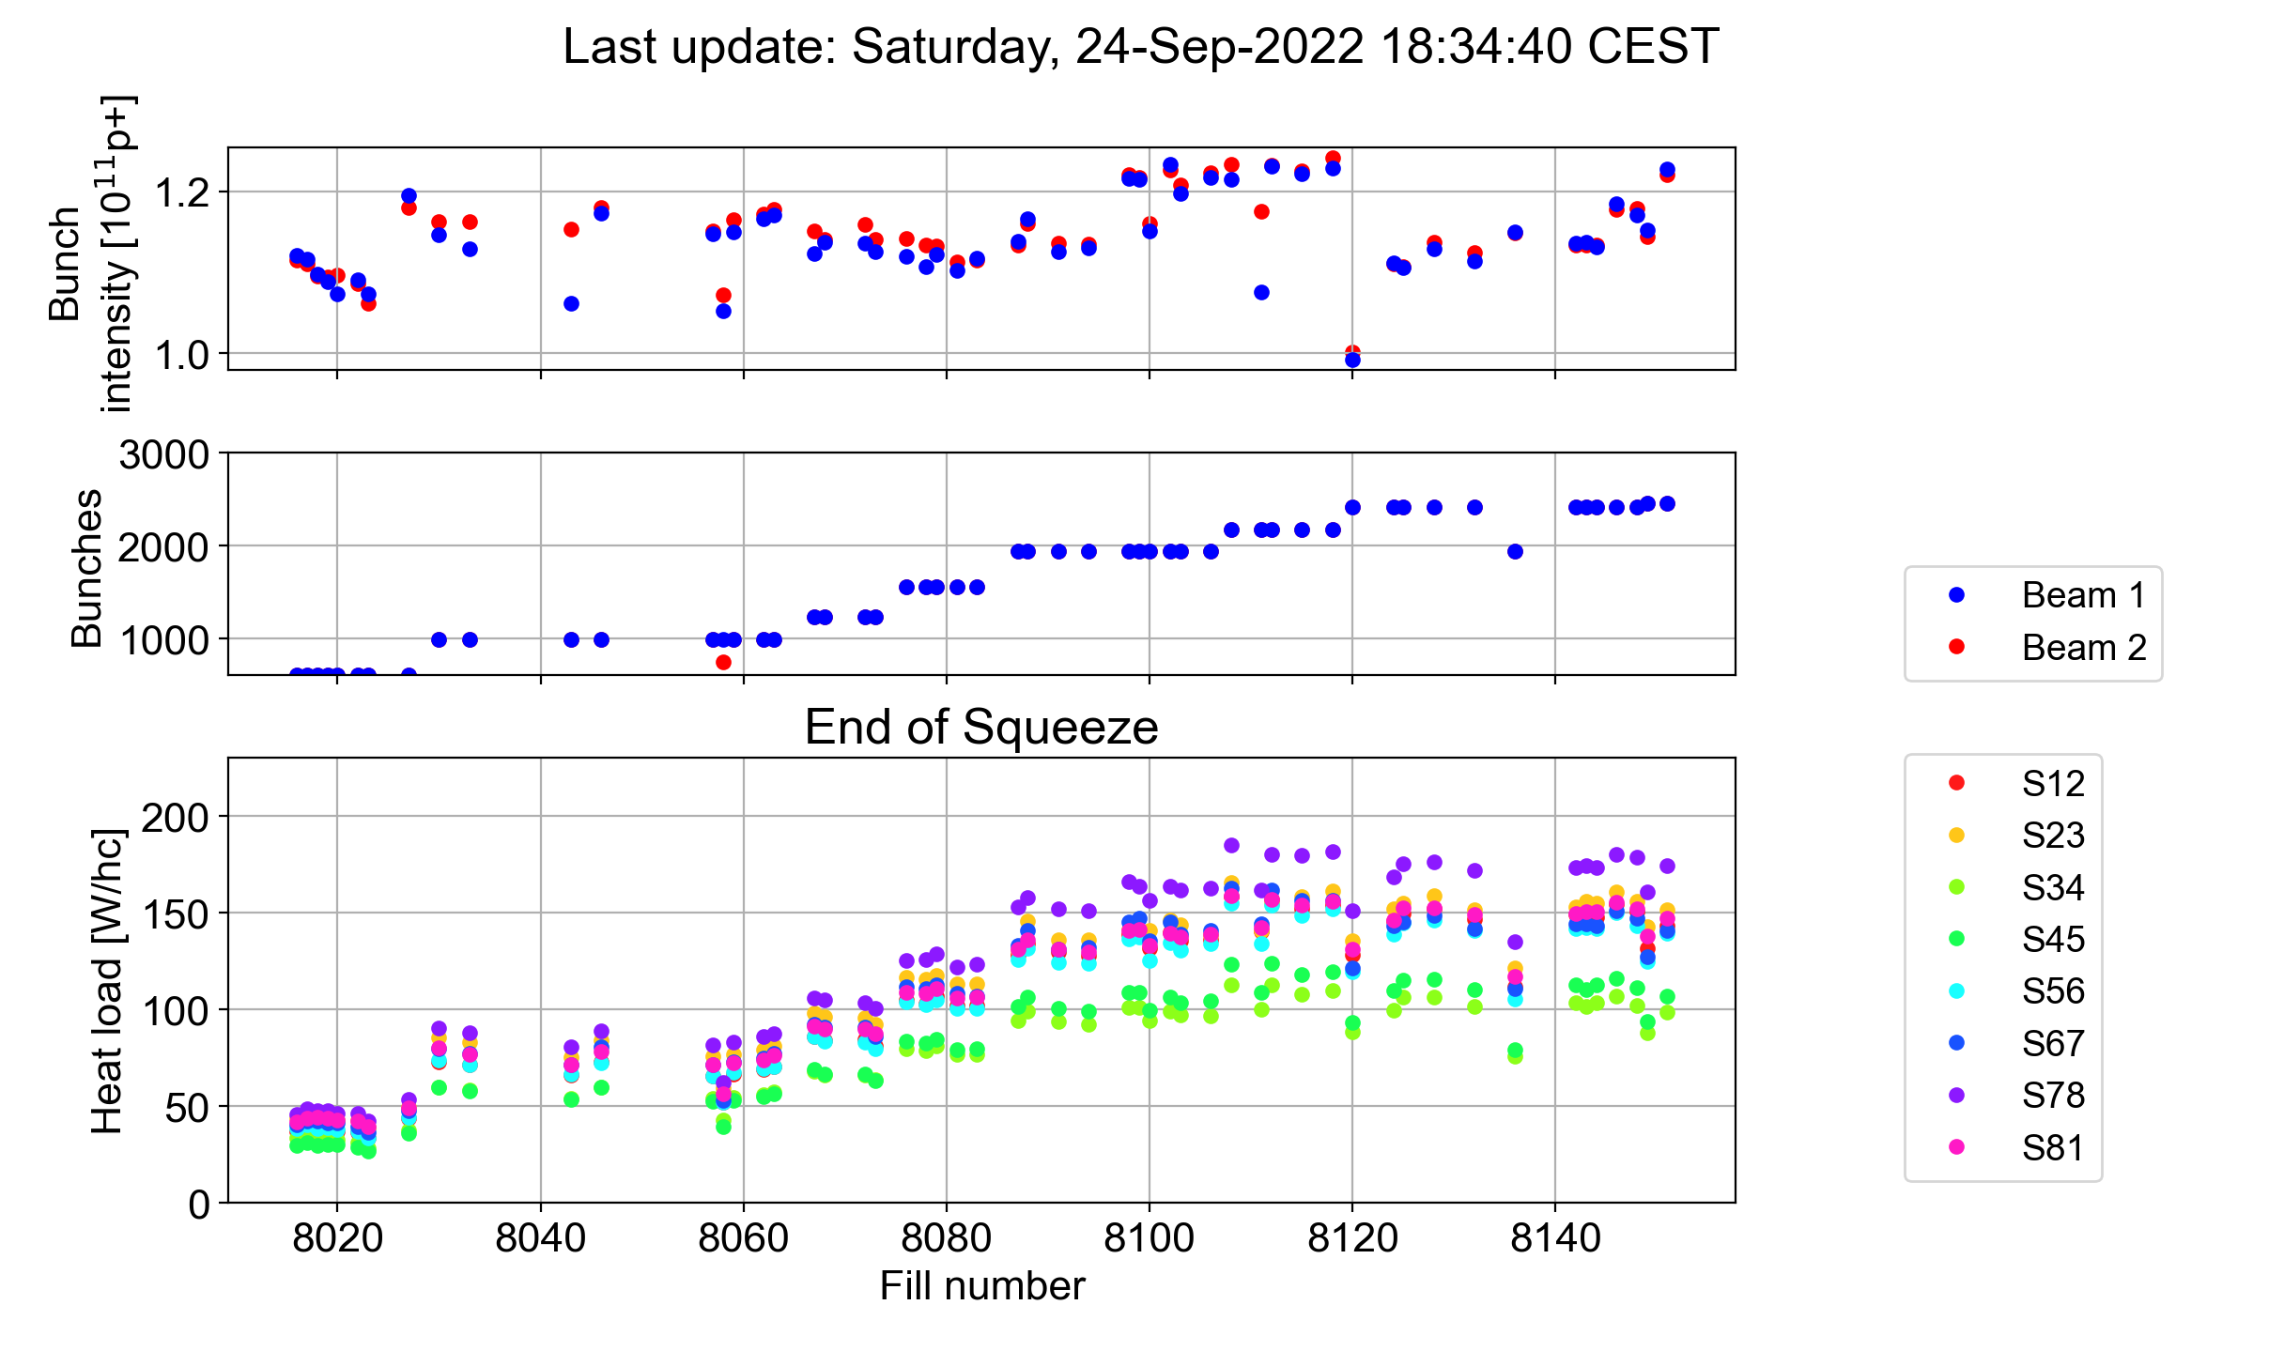
2022 intensity ramp up
Physics operation with gradual increase in number of bunches/beam
With 2173 bunches/beam in trains of 5x48 bunches and ~1.22e11 p/b, encountered limitation from the heat load in sector 78 (limited at ~195 W/hc)
  Reached 2413 bunches/beam in trains of 5x48 bunches, with ~1.15e11 p/b
19th July
Physics fills with > 600 bunches
22nd August
No fills with > 600 bunches since then due to major fault

Slide 35
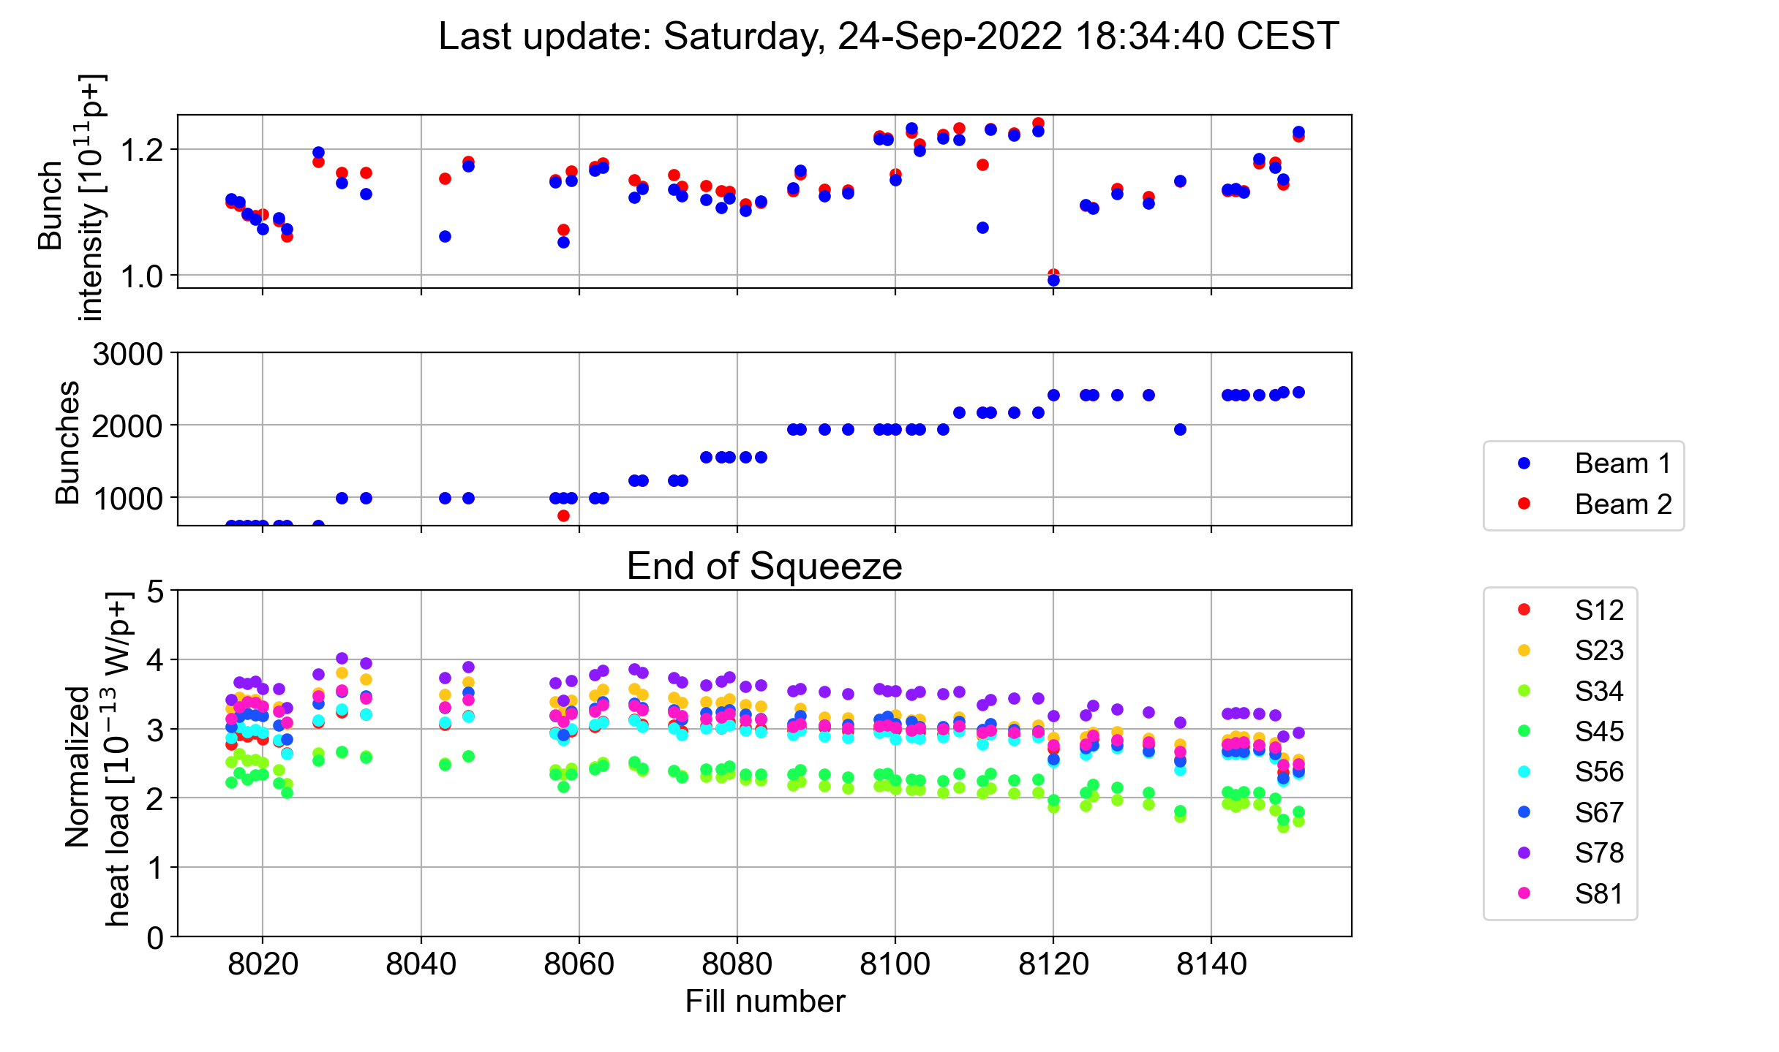
2022 intensity ramp up
Physics operation with gradual increase in number of bunches/beam
With 2173 bunches/beam in trains of 5x48 bunches and ~1.22e11 p/b, encountered limitation from the heat load in sector 78 (limited at ~195 W/hc)
  Reached 2413 bunches/beam in trains of 5x48 bunches, with ~1.15e11 p/b
  Reached 2461 bunches/beam in trains of 5x36 bunches, with ~1.22e11 p/b
19th July
Physics fills with > 600 bunches
22nd August
No fills with > 600 bunches since then due to major fault
~10% reduction in heat load/bunch

Slide 36
Cell-by-cell SEY estimation model
The SEY is inferred by comparing heat load measurements to simulation results with matching beam and machine parameters for different arc elements
Bunch length, emittance, energy,
filling scheme
Arc elements:
Magnetic field, beta functions
Photoemission parameters
PyECLOUD simulations

Slide 37
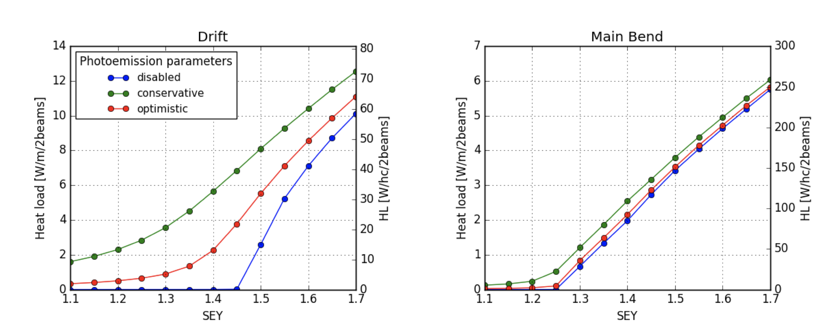



Cell-by-cell SEY estimation model
The SEY is inferred by comparing heat load measurements to simulation results with matching beam and machine parameters for different arc elements
Bunch length, emittance, energy,
filling scheme
During Run 2, two PEY parameter sets were identified¹ based on measurements for the LHC²
  For scrubbed (optimistic) and un-scrubbed (conservative) surfaces
Arc elements:
Magnetic field, beta functions
Photoemission parameters
un-scrubbed (conservative) surfaces
SEY
Bunch intensity
PyECLOUD simulations
Measurements:
Bunch intensity,
cell-by-cell heat load
Cell-by-cell SEY
(machine model)
Heat load vs bunch intensity, SEY database
P. Dijkstal et al., CERN-ACC-NOTE-2017-0057.
V. Baglin et al., EPAC’98, Stockholm, Sweden, June 1998; V. Baglin et al., 11th Chamonix – LHC workshop, Jan 2001;
N. Mahne et al., Applied Surface Science vol 235, no 1–2, pp. 221–226, 2004.

Slide 38

Cell-by-cell SEY estimation model
The SEY is inferred by comparing heat load measurements to simulation results with matching beam and machine parameters for different arc elements
Bunch length, emittance, energy,
filling scheme
Arc elements:
Magnetic field, beta functions
Photoemission parameters
SEY
Bunch intensity
PyECLOUD simulations
Measurements:
Bunch intensity,
cell-by-cell heat load
Cell-by-cell SEY
(machine model)
Heat load vs bunch intensity, SEY database
Heat load scaling with intensity

Slide 39
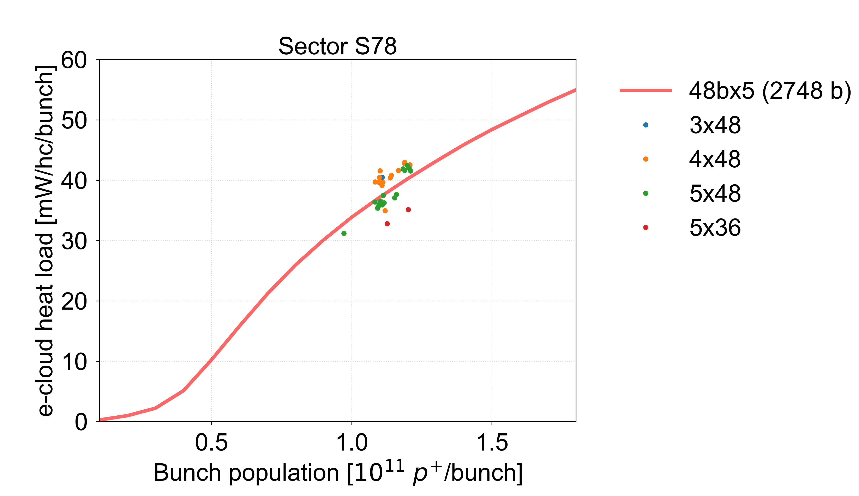
Heat load fit vs measurements
Heat load scaling with intensity estimated from one of the latest LHC fills – current LHC status
Reasonable agreement with 2022 fill data with more than 1500 bunches
  Earlier fills show higher heat loads per bunch → consistent with scrubbing evolution
Time

Slide 40
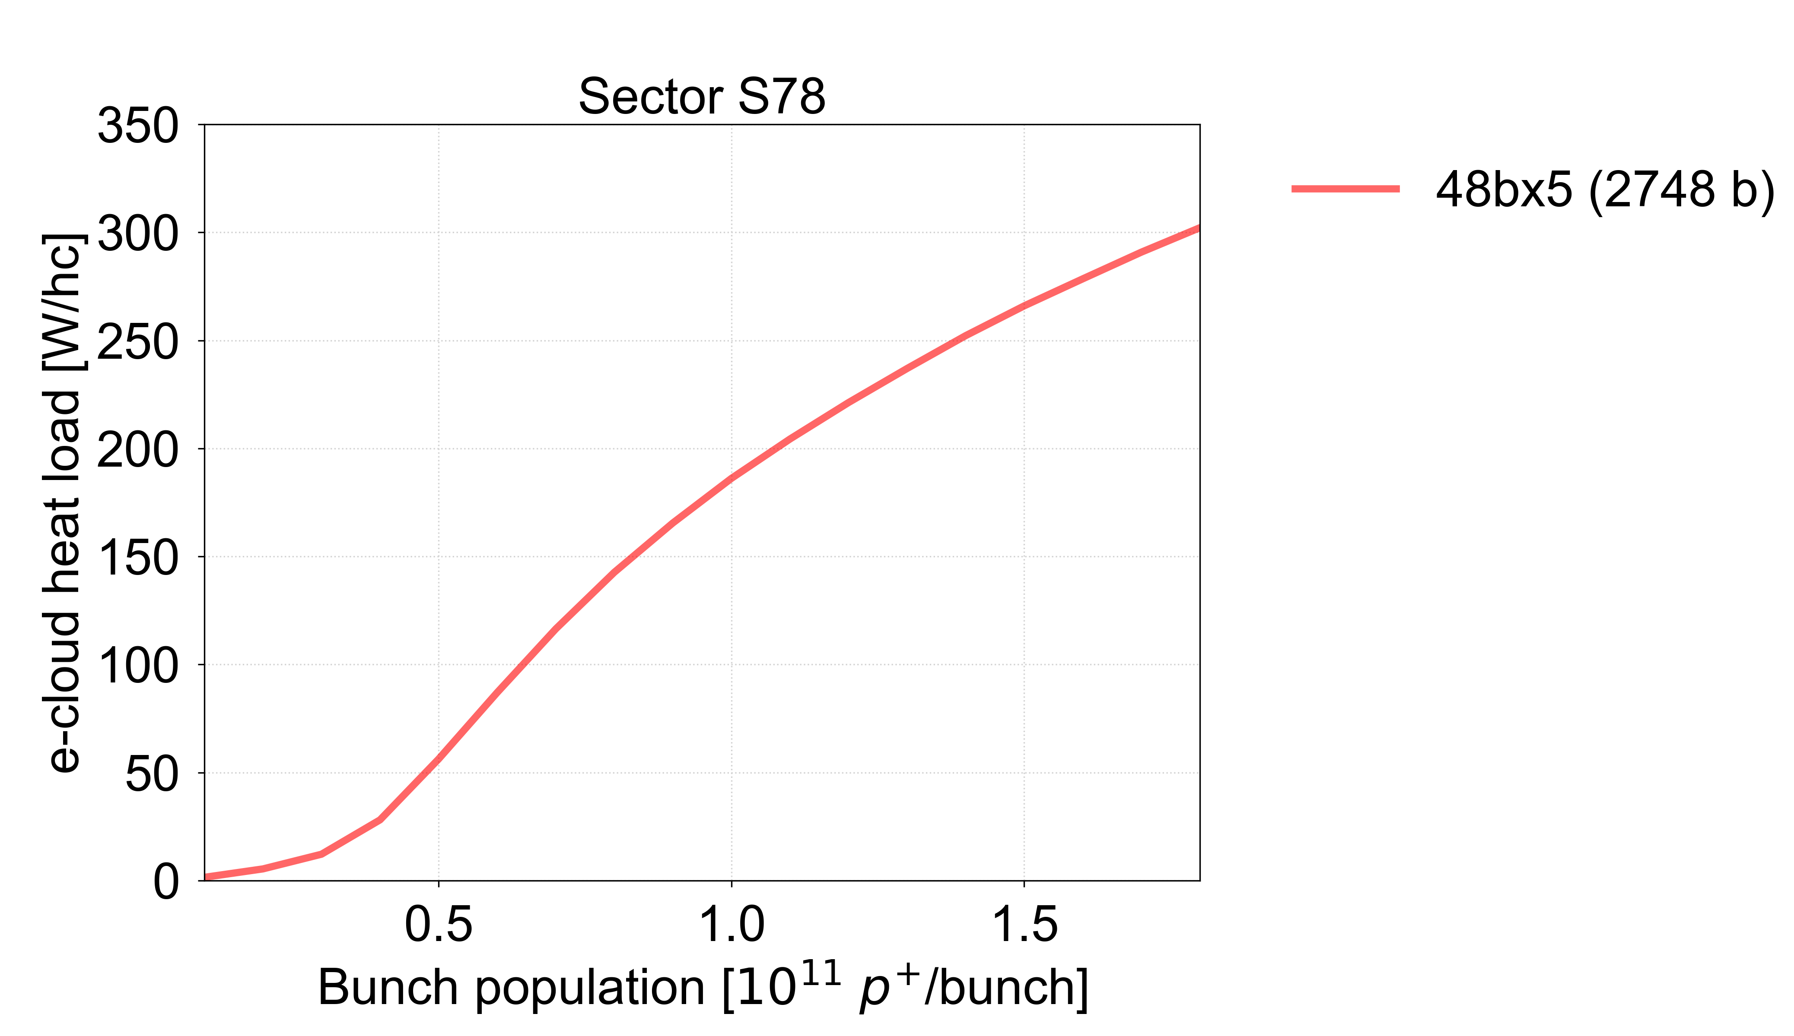
Heat load fit vs measurements
Heat load scaling with intensity estimated from one of the latest LHC fills – current LHC status
Reasonable agreement with 2022 fill data with more than 1500 bunches
  Earlier fills show higher heat loads per bunch → consistent with scrubbing evolution
The goal for Run 3, to run with 2748 bunches/beam with 1.8e11 p/bunch, is currently far out of reach
Time
Cryo limit

Slide 41
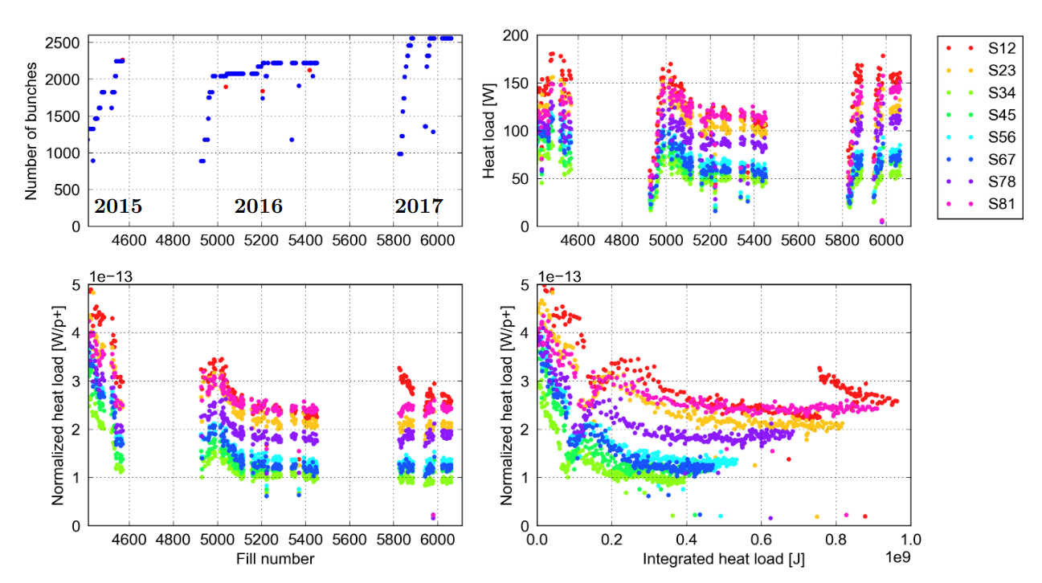
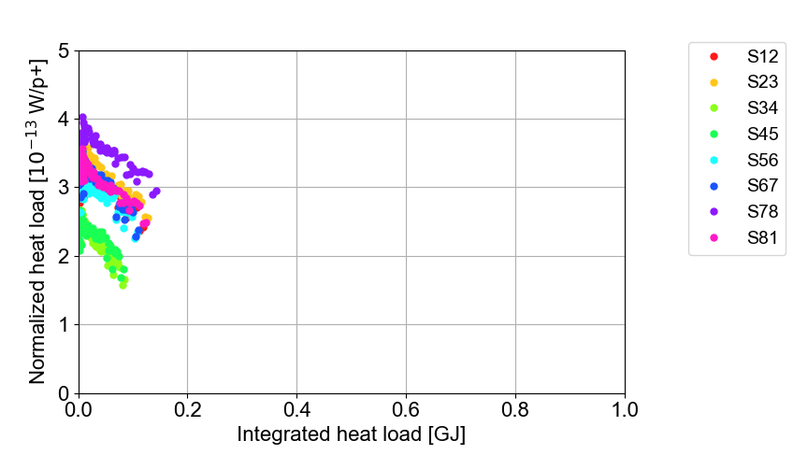
Outlook
Based on the heat load evolution, the beam screen surfaces are currently conditioning
  Conditioning is expected to continue until some time in 2023
We don’t have means to predict the levels where the heat loads will eventually settle
  The conditioning slope of sectors 56, 67 and 78 is significantly changed wrt. 2015, and more similar to S12 in 2015 → a sign of further beam screen degradation?
  Significant implications for intensity reach in Run 3 (and HL-LHC) if the heat loads don’t condition to the Run 2 levels
Physics fills with > 600 bunches
Run 2
Run 3
NB! The normalised heat load depends on variations in bunch intensity and bunch train pattern
For more details on heat load evolution, see: B. Bradu, ECLOUD’22

Slide 42
Conclusions
Electron cloud effects remained present in the LHC throughout Run 2, when the machine was routinely operated with 25 ns beams for the first time
  It was not possible to fully mitigate electron cloud through scrubbing
  Large differences in heat load observed between beam screens (sectors, cells, magnets,…) which can only be explained by electron cloud through different SEY
Surface measurements indicate that the high heat loads observed in some sectors, cells and magnets, are due to higher SEY and poor conditioning behaviour
  Caused by different surface characteristics: low carbon content and non-native CuO oxide, formed during operation with beam after LS1
  Copper hydroxide Cu(OH)₂ is very likely the precursor for CuO build-up in the LHC
Run 3 is currently in the intensity ramp-up phase
  The highest SEY/heat loads are observed in different sectors than in Run 2, with sector 78 currently limiting the progress of the intensity ramp-up
  Beam screen conditioning is ongoing – expected to know only in 2023 (or later) at what levels (and in which order) the heat loads settle
  Significant further scrubbing will be needed to reach the intensity goals set for the run
    Mitigation strategies envisaged → see following presentation!

Slide 43
Thank you for your attention!

Slide 44
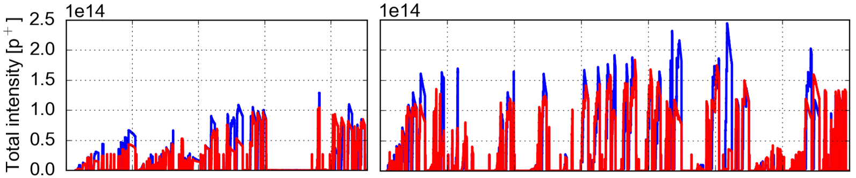
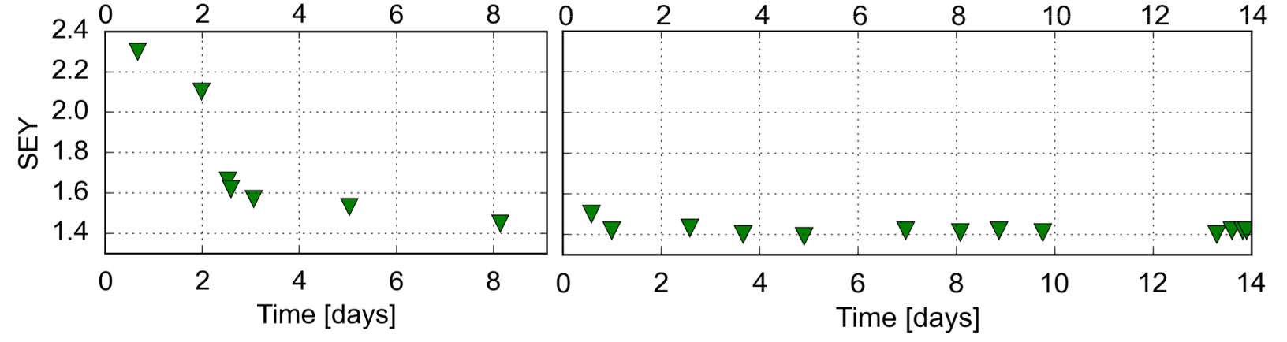
2015 scrubbing runs
Extensive scrubbing took place at the start of Run 2 to enable operation for physics
Scrubbing Run 1
Scrubbing Run 2
Beam 1
Beam 2

Slide 45
Conditioning in Run 2
In Run 2, clear conditioning occurred during 2015 and the beginning of 2016, after which the heat loads didn’t change much anymore

Slide 46



Heat load dependence on bunch intensity
The heat load displays a functional dependence on bunch intensity that is neither linear nor quadratic, as would be expected for synchrotron radiation and beam-coupling impedance respectively
  An intensity threshold can be observed around 4 $×$ 10¹⁰ p/b, as expected for electron cloud
Trains of 48 bunches
Trains of 12 bunches
Expected contribution from impedance and synchrotron radiation subtracted
For more details, see: G. Iadarola et al., CERN-ACC-NOTE-2019-0057

Slide 47
Underlying mechanisms
Several mechanisms that could transfer energy from the beam to the beam-screen were reviewed and their compatibility with observations was evaluated
Only e-cloud effects cannot be excluded based on the observations
Beam
Observations
Total power of beam intensity loss is less than 10% of measured heat load
Heat load increases only moderately during the energy ramp
Radiation (synchrotron radiation)
e⁻/ions in the pipe
Beam particles (losses)
Electromagnetic coupling
Heat loads with 25 ns are up to 10 times larger than with 50 ns
Measured dependence on bunch intensity is not linear nor quadratic
= Excluded
Beam screen

Slide 48











Comparing simulations with measurements
Simulations were compared against measurements to assess whether the high heat loads could be ascribed to a larger Secondary Emission Yield (SEY) of the corresponding surfaces
A single measurement point was used to infer the SEY for the simulations (cell by cell)
All other measurements, covering several different beam conditions: energy, bunch intensity and bunch-train length, were used as a crosscheck
  Very good agreement found!
  Observations are compatible with larger SEY in the high-load arcs!
Simulations
Measurements
450 GeV
S81
6.5 TeV
S81
48-bunch
trains
Point used to infer SEY
48-bunch trains
8b+4e
12 b
For more details, see: G. Iadarola et al., CERN-ACC-NOTE-2019-0057

Slide 49
Underlying mechanisms
Several mechanisms that could transfer energy from the beam to the beam-screen were reviewed and their compatibility with observations was evaluated
Only e-cloud effects cannot be excluded based on the observations
Beam
Observations
Total power of beam intensity loss is less than 10% of measured heat load
Heat load increases only moderately during the energy ramp
✓
Radiation (synchrotron radiation)
e⁻/ions in the pipe
Beam particles (losses)
Electromagnetic coupling
Heat loads with 25 ns are up to 10 times larger than with 50 ns
✓
Measured dependence on bunch intensity is not linear nor quadratic
✓
= Excluded
✓
Beam screen
= Good quantitative agreement
(assuming different SEY per sector/cell)

Slide 50

Results from XPS analysis
The angular distribution of CuO matches the expected distribution of the e-cloud in both dipole fields and field-free regions
Likely formed under the effect of electron bombardment during post-LS1 beam operation
CuO production under electron irradiation is not expected based on conditioning studies in the lab at room temperature
  New dedicated cryogenic XPS/SEY measurement system constructed for studying effects at low temperature
  First results show strong suppression of CuO reduction under electron bombardment at cryogenic temperatures
CuO signature
CuO signature
V. Petit

Slide 51


Conditioning cycle with Cu(OH)₂
Conditioning and reconditioning of Cu(OH)₂ at 15 K (2.5 months storage in humid air)
First conditioning: CuO-free, partial carbon depletion
Increased surface reactivity → massive Cu(OH)₂ uptake in humid atmosphere
CuO build-up during reconditioning and further carbon depletion, compatible with high heat load beam screen observations

Slide 52


Conditioning cycle without Cu(OH)₂
Conditioning and reconditioning of Cu(OH)₂ at 15 K (2.5 months storage in dry air)
Two CuO-free conditionings, compatible with low heat load beam screen observations

Slide 53
Implications for Run 3
Once formed, CuO is very stable → there is very little hope for a spontaneous improvement
Methods for actively removing or covering the CuO in-situ are under investigation
  Possible test on half-cell in LS3
Precautions were taken during LS2 to minimize risk of further degradation e.g.,
  Initial venting with controlled gas composition
  Attention to cooldown slope to avoid condensation on the beam screens
However, many open questions remain regarding the degradation process e.g.,
  Why were some sectors/magnets affected by CuO formation and others not
  Why did degradation occur during/after LS1, but not during/after installation, nor during/after the venting of Sector 12 in EYETS 2016-2017
As long as our understanding of the full process is incomplete, it is difficult to predict whether the taken precautions are guaranteed to prevent further CuO formation

Slide 54



Beam quality evolution
Emittance blow-up significantly decreased over the scrubbing run
48 bpi
Scrubbing day 3
Fill 7800
288 bpi
Scrubbing day 5
Fill 7933
288 bpi
Scrubbing day 7
Fill 7956

Slide 55


Beam quality evolution
Losses over ~1 h of store significantly improved over the scrubbing run, despite increased bunch train length
48 bpi
Scrubbing day 2
288 bpi
Scrubbing day 7

Slide 56


Instabilities
With the strong losses, the bunch intensity
eventually reaches the instability threshold
leading to sudden emittance growth,
especially on the trailing bunches
Vertical instability (ADTObsBox)
B2, bunch slots 1300 - 1500

Slide 57

SEY evolution over scrubbing run
Significant conditioning has taken place in every sector
Sector 78 showed significantly higher SEY than the other sectors from the beginning, and stays higher even after conditioning
Sectors 34 and 45 continue to show the lowest SEYs, as in Run 2
Fill 7800
18 June
Fill 7956
10 July

Slide 58



Photoemission parameters
The heat load scaling with intensity for trains of 5x48 bunches estimated from fill 8142 with photoemission parameters for un-scrubbed vs scrubbed surfaces
Heat load scaled to 2748 bunches/beam
Un-scrubbed photoemission
Heat load scaled to 2748 bunches/beam
Scrubbed photoemission

Slide 59


Quadrupole/dipole fraction
The scaling of the heat load with intensity depends strongly on the fraction of quadrupole vs dipole estimated by the fitting mainly for intensities above 2e11
Heat load scaled to 2748 bunches/beam
Heat load scaled to 2748 bunches/beam

