Slide 1

^{Nuclear Physics at INFN-LNS:}
Emphasys on the research at the Tandem accelerator
M. La Cognata
Laboratori Nazionali del Sud - INFN, Catania, Italy

Slide 2
GR3 @ LNS
Nuclear physics activities at LNS are carried out in the framework of the INFN 3° division. It is made up of different research lines:
Line 1 (QUARKS AND HADRON DYNAMICS)
JLAB12
EIC_NET
Line 3 (NUCLEAR STRUCTURES AND REACTIONS DYNAMICS)
CHIRONE
NUMEN_GR3
Line 4 (ASTROPHYSICS AND INTERDISCIPLINARY RESEARCHES)
ASFIN
n_TOF
PANDORA

Slide 3
GR3 @ LNS
In this talk I will focus mostly on the activities using the beams from LNS Tandem accelerator
Line 1 (QUARKS AND HADRON DYNAMICS)
JLAB12
EIC_NET
Line 3 (NUCLEAR STRUCTURES AND REACTIONS DYNAMICS)
CHIRONE
NUMEN_GR3
Line 4 (ASTROPHYSICS AND INTERDISCIPLINARY RESEARCHES)
ASFIN
n_TOF
PANDORA

Slide 4
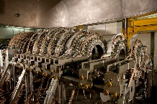
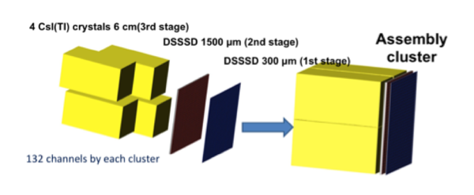
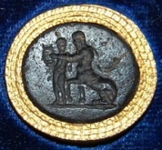
CHIRONE
CHIMERA
The CHIRONE experiment carries out world-renown research in many areas (at LNS and abroad):
EOS and symmetry energy
Reaction mechanisms (influence of isospin and clustering)
Nuclear astrophysics
Detector development, for charged particles and neutrons
CHImera
R3B
hOdoscopes
Neutrons
Experiment
One FARCOS cluster
National responsibles: Sara Pirrone & P. Russotto
LNS responsible: Emanuele Pagano

Slide 5
CHIRONE
CHIMERA
The CHIRONE experiment carries out world-renown research in many areas (at LNS and abroad):
EOS and symmetry energy
Reaction mechanisms (influence of isospin and clustering)
Nuclear astrophysics
Detector development, for charged particles and neutrons
CHImera
R3B
hOdoscopes
Neutrons
Experiment
One FARCOS cluster
National responsibles: Sara Pirrone & P. Russotto
LNS responsible: Emanuele Pagano

Slide 6
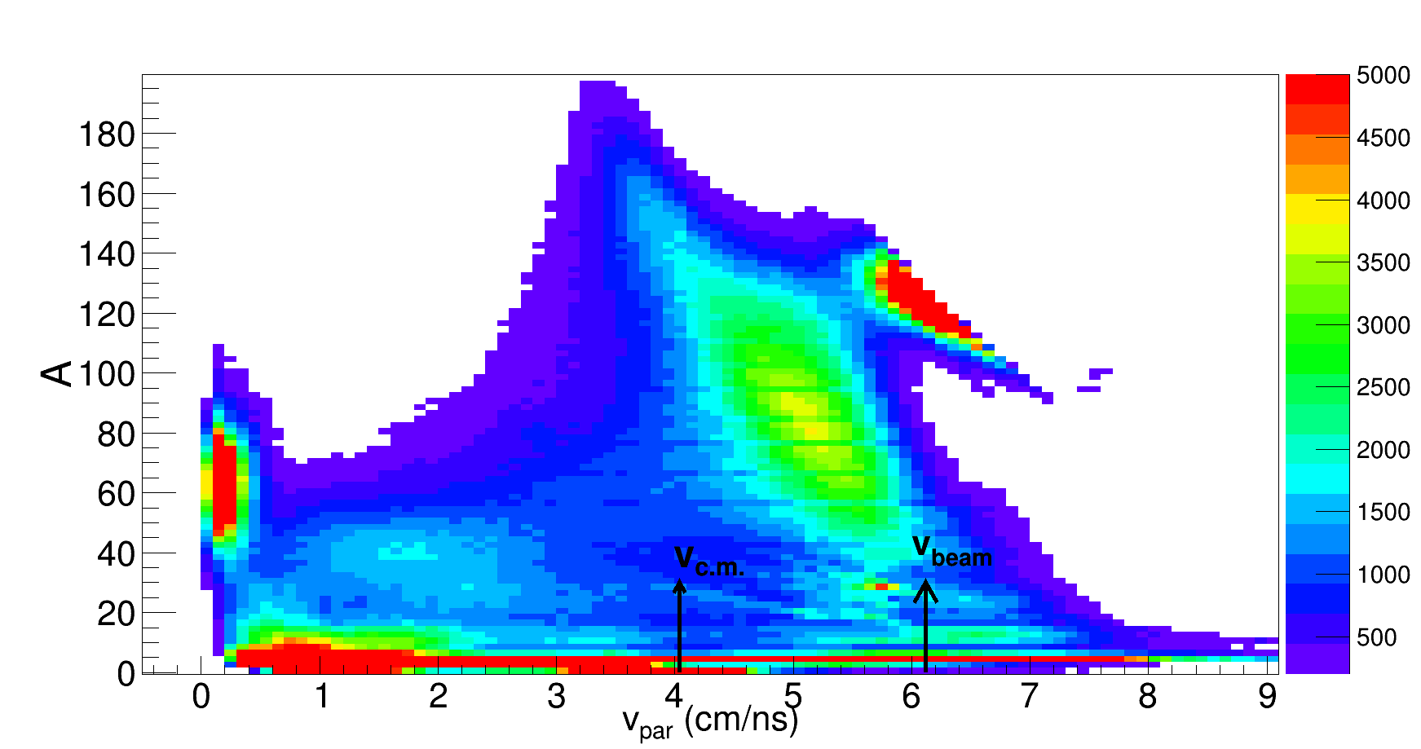
CHIRONE
CHIMERA
The CHIRONE experiment carries out world-renown research in many areas (at LNS and abroad):
EOS and symmetry energy
Reaction mechanisms (influence of isospin and clustering)
Nuclear astrophysics
Detector development, for charged particles and neutrons
CHIFAR EXPERIMENT (E.V.Pagano, E.De Filippo, P. Russotto)
Low-energy extension of the studies on the competition of the dynamic and statistical components and on the influence of isospin in the break-up of the projectile.
¹²⁴Sn+⁶⁴Ni, ¹¹²Sn+⁵⁸Ni, ¹²⁴Xe+⁶⁴Zn @ 20 AMeV CHIMERA+10 FARCOS TELS (NOV. 2019)
Calibration (almost) completed: ready to extract physical info
CHImera
R3B
hOdoscopes
Neutrons
Experiment
One FARCOS cluster
National responsibles: Sara Pirrone & P. Russotto
LNS responsible: Emanuele Pagano

Slide 7
CHIRONE
CHIMERA
The CHIRONE experiment carries out world-renown research in many areas (at LNS and abroad):
EOS and symmetry energy
Reaction mechanisms (influence of isospin and clustering)
Nuclear astrophysics
Detector development, for charged particles and neutrons
CHImera
R3B
hOdoscopes
Neutrons
Experiment
One FARCOS cluster
National responsibles: Sara Pirrone & P. Russotto
LNS responsible: Emanuele Pagano

Slide 8
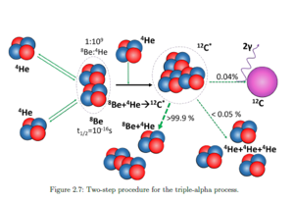
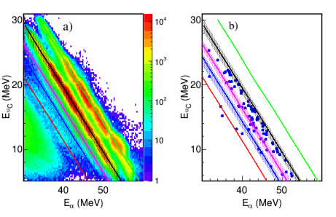
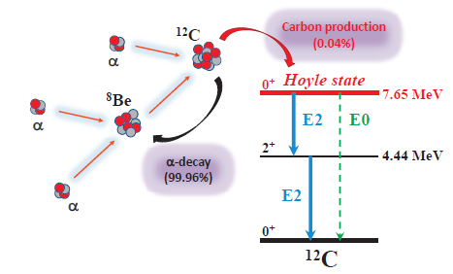
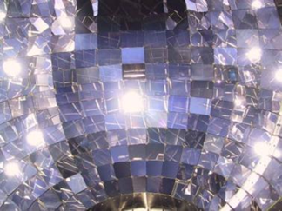
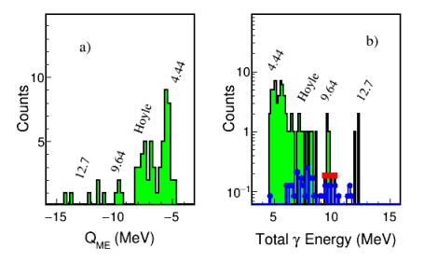
CARBON PRODUCTION IN STARS
For the first time directly measured the γ-decay of the 9.64 MeV level measuring in coincidence two γ rays – recoiling carbon and scattered beam in the a+¹²C reaction at 64 MeV
7.65 MeV
T₉>1
9.64 MeV
E₁
E₃
9.64 MeV
7.65 MeV
gammas and particles detected in the chimera sphere
4.44 MeV
NOT ONLY the Hoyle state
Decay probability for the Hoyle state Γ_{2γ}/Γ = 1.8 ± 0.6 × 10⁻³ (possible presence of EFIMOV state increasing the yield)
For the 9.64 MeV, the relative yield value is Γ_{2γ}/Γ = 6.4 ± 5.1 × 10⁻⁵ → first direct measurement of the γ decay cascade of this level. Our result is consistent with the recent result of M. Tsumura et al., Physics Letters B 817, 136283 (2021) with kinematical coincidence only

Slide 9
CHIRONE
CHIMERA
The CHIRONE experiment carries out world-renown research in many areas (at LNS and abroad):
EOS and symmetry energy
Reaction mechanisms (influence of isospin and clustering)
Nuclear astrophysics
Detector development, for charged particles and neutrons
CHImera
R3B
hOdoscopes
Neutrons
Experiment
One FARCOS cluster
National responsibles: Sara Pirrone & P. Russotto
LNS responsible: Emanuele Pagano

Slide 10
CHIRONE: Detectors R&D
Development of a neutron hodoscope
Further tests with sources and beam for the arrary: towards a prototype of (4 x 4 x 4) cm³ 64 cells structure of EJ276G by Scionix
Solid angle ≈ 14 msr
Angular resolution ≈ 2°
100 cm
VETO detector
Target/Source
50 cm
Development of a new Rad-Hard and fast tagging system for RIBs produced by FraISe
- 100 µm thick fully depleted SiC rad-hard multi-pad sensors in a sandwich configuration: up to 10⁷ pps over ≈ 100 channels with Δt ≈ 100 ps (≈0.1% precision on energy for 20 m base-of-flight), with 200 µm inter-pad dead zone, 10% dead area
- Front-end: Custom multi/channel ASIC
- Full waveform digitizers and TimeStamping synchronization with CHIMERA DAQ
Front View
Side View
5 mm
30 mm
60 mm

Slide 11



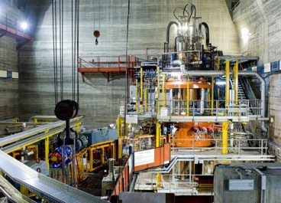
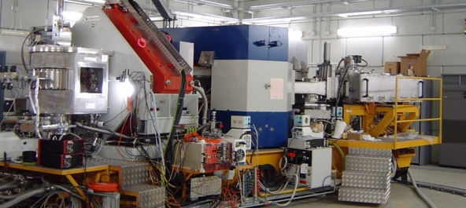
NUMEN
NURE
Extraction from measured cross-sections of “data-driven” information on Nuclear Matrix Elements for all the systems candidate for 0νββ
Use of nuclear reactions (Double Charge Exchange reactions) to stimulate in the laboratory the same nuclear transition occurring in 0νββ
Phase space factor
contains the average neutrino mass
0νββ decay half-life
Nuclear matrix element
A challenging perspective at LNS in nuclear science
MAGNEX magnetic spectrometer
K800 Superconducting Cyclotron
National responsibles: Clementina Agodi & Francesco Cappuzzello
LNS responsible: Clementina Agodi & Manuela Cavallaro

Slide 12
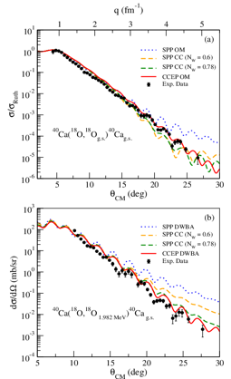
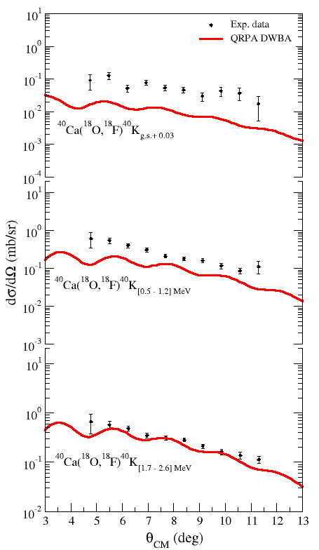
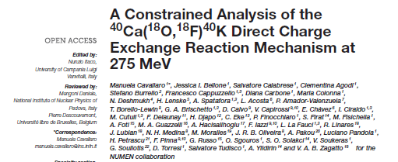

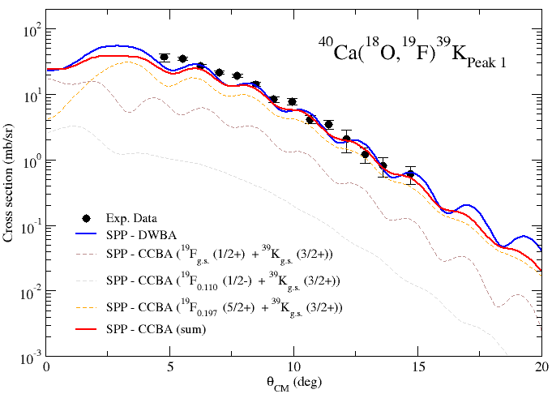
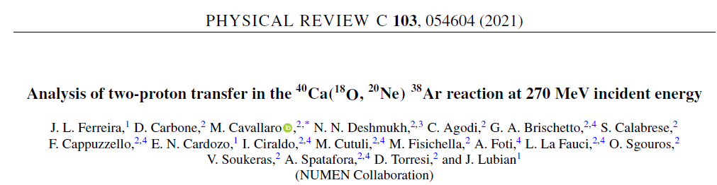
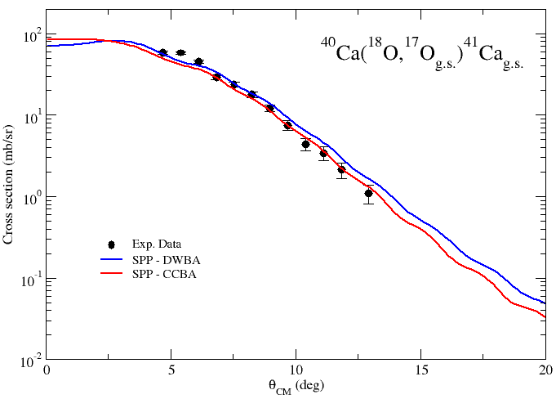
A multi-channel approach to nuclear reactions
J.L. Ferreira et al., PRC (2021)
Consistent study (experimental and theoretical) of all the reaction channels competing with the double charge exchange to obtain a reliable description of the reaction mechanism and structure
M. Cavallaro et al., Front. Astr. Sp. Sc. (2021)
⁴⁰Ca
⁴²Ca
³⁸Ar
⁴⁰Ar
F. Cappuzzello, et al., EPJA (2015)
H. Lenske, et al., PPNP (2019)
S. Calabrese et al. (to be submitted)
Notes:
the transfer to the excited states proceeds, preferably, by the sequential process, especially in the transitions to the vibrational states of the ejectile. In these cases, the high collectivity of such 20Ne states seems to break the correlation of both transferred protons reducing the direct two-proton transfer contribution to the cross section.
In the ground state the contribution of ic=direct two prot transfer is equal to the contribution of the two step process

Slide 13
A multi-channel approach to nuclear reactions
J.L. Ferreira et al., PRC (2021)
Consistent study (experimental and theoretical) of all the reaction channels competing with the double charge exchange to obtain a reliable description of the reaction mechanism and structure
M. Cavallaro et al., Front. Astr. Sp. Sc. (2021)
⁴⁰Ca
⁴²Ca
³⁸Ar
⁴⁰Ar
F. Cappuzzello, et al., EPJA (2015)
H. Lenske, et al., PPNP (2019)
S. Calabrese et al. (to be submitted)
Notes:
the transfer to the excited states proceeds, preferably, by the sequential process, especially in the transitions to the vibrational states of the ejectile. In these cases, the high collectivity of such 20Ne states seems to break the correlation of both transferred protons reducing the direct two-proton transfer contribution to the cross section.
In the ground state the contribution of ic=direct two prot transfer is equal to the contribution of the two step process

Slide 14
Sensitivity to different nuclear structure models (IBM, QRPA, Large-scale SM)
First comparison study with experimental data of 2p- and 2n-transfer with spectroscopic amplitudes derived from different nucler structure models
2p-transfer
2n-transfer
Notes:
The comparison involves not only the transfer mechanism, but also nuclear structure models. Different models were used to calculate the spectroscopic amplitudes

Slide 15
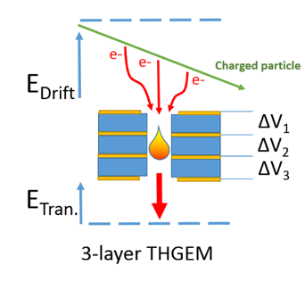

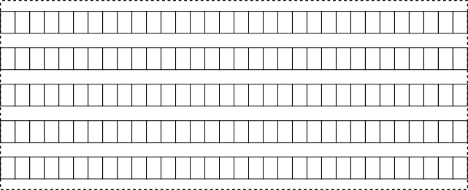
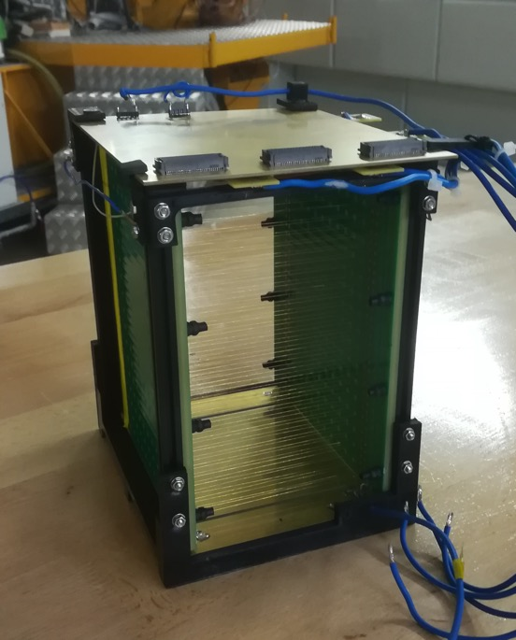
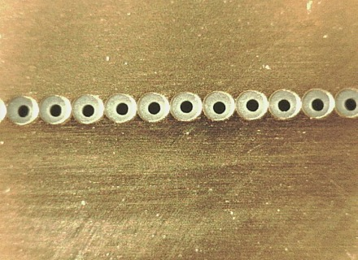
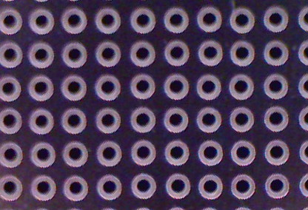
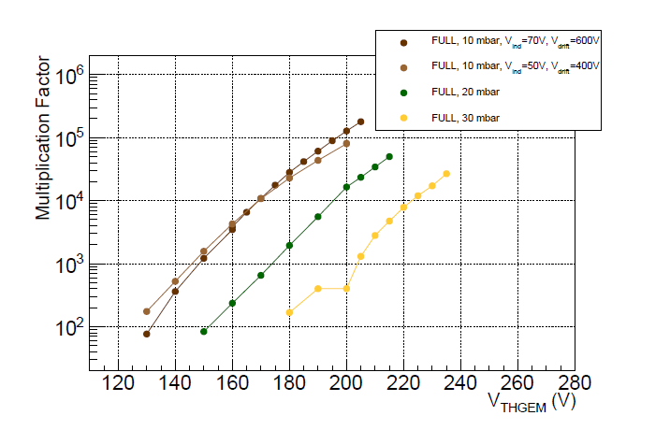
R&D activity: development of the tracker to stand high intentity beams
Multiple Thick Gas Electron Multiplier (M-THGEM)
RATE from few kHz to MHz
preserving low-pressure operation
→ Simple & Robust
Strip-based anode
Pad- based anode
Stripped
Anode
M-THGEM
180 mm
Row THGEM
Full THGEM
Test (with source and with beam) on the tracker and on the other detectors expected in 2022
100 mm
Cathode
High gain at low voltage and pressure
100 mm

Slide 16
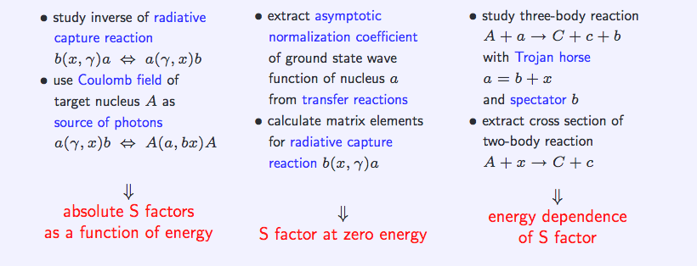

ASFIN
Major research field: indirect methods for nuclear astrophysics
National responsibles: Livio Lamia & Rosario Gianluca Pizzone
LNS responsible: Pierpaolo Figuera

Slide 17

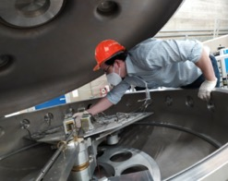
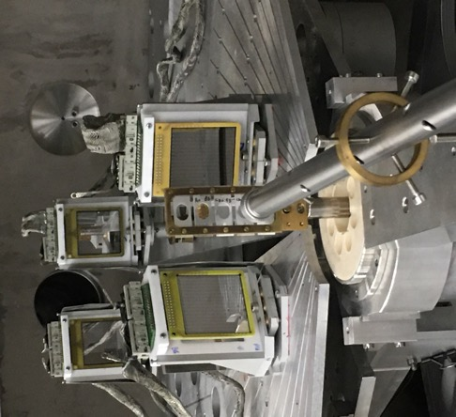
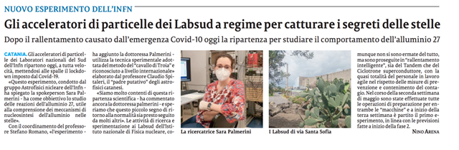
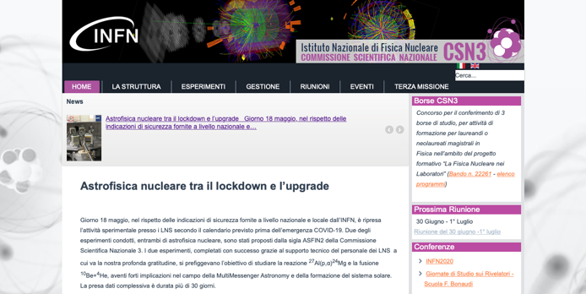
The experiment at LNS (right after the end of national 2020 lockdown)
PI: F. Hammache (Orsay) – S. Palmerini (PG)
²⁴Mg
CD₂ target
⁴He
The experiment was carried out by local people only, though the proposal included 25 people from 7 countries → international effort
²⁷Al @ 80 MeV
From LNS Tandem

Slide 18
Gamow window for 50 MK
MgAl cycle in massive stars and the synthesis of Mg and Al isotopes
It is ignited at temperatures > 0.03 GK and it is important to determine the abundances of medium mass nuclei
Temperatures of interest for massive stars hydrostatic H-burning
First time observation of a 80 keV resonance occurring exacting at the Gamow energy makes it possible to calculate a factor of 3 lower rate than presently used in nucleosynthesis models

Slide 19
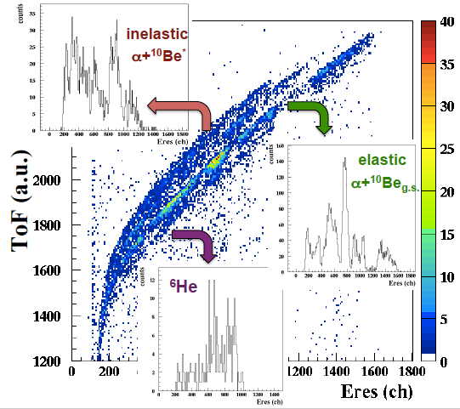
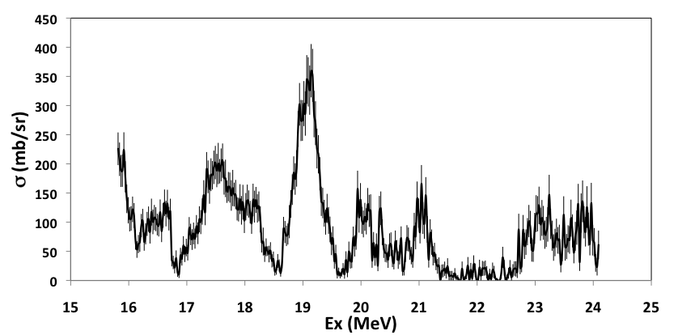
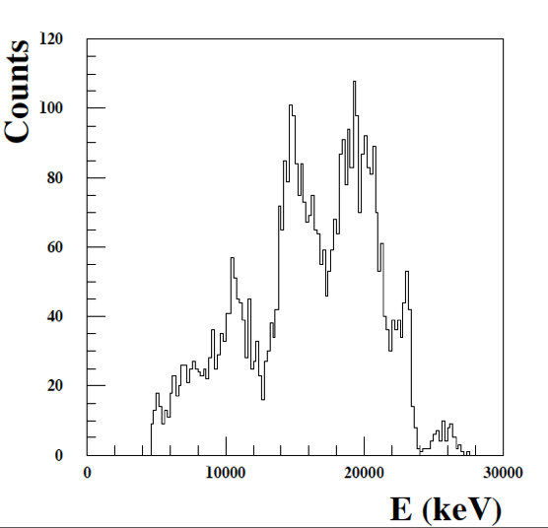
¹⁰Be+⁴He→^{4,6}He+^{8,10}Be: CHAIN experiment @ LNS (June 2020)
¹⁰Be+⁴He→⁴He+¹⁰Be
¹⁰Be+⁴He→⁶He+⁸Be
Experiment performed in June 2020
Investigation of cluster stuctures in ¹⁴C decaying ⁴He+¹⁰Be and ⁶He+¹⁰Be
Astrophysical application: planet formation
First experiment with a RIB at the LNS tandem in batch mode

Slide 20
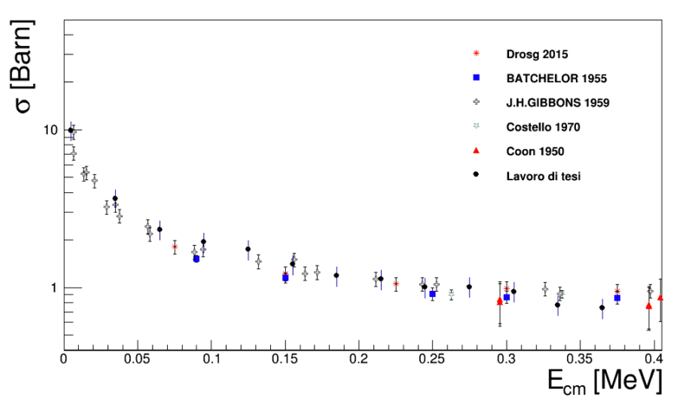
R&D: new stable and unstable tandem beams
Stable beams of NOBLE GASES (LOI approved by LNS)
- Test of the THM method with d and 3He
- Measurements of reactions for the Big Bang (e.g. ³He(n, p)³H)
- Measurements of reactions induced by deuterium
- Implantation (using the source itself) + low energy reactions
Long-life radioactive beams
- Average half lives > 10⁵ years (low activity)
- Test carried out successfully with ¹⁰Be
- From MultiMessenger Astronomy to studies on the formation of the Solar System
Examples:
¹⁰Be (Half life: 1.51 My)
²⁶Al ( 0.72 My)
³⁶Cl ( 0.30 My)
⁴¹Ca ( 0.10 My)
⁵³Mn ( 3.47 My)
⁶⁰Fe ( 2.62 My)
Possibility of production at PSI/ATOMKI/iThemba labs (with which we have a MOU)
We could be the only lab in the world with the availability of these radioactive beams with intensities approaching those of stable beams
Preliminary measurement of the ³He(n,p)³H reaction with ³He beam and CD₂ target at ND (USA)

Slide 21
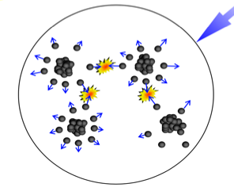
Nuclear astrophysics with hp lasers
Fusion in laser induced plasmas may help to extend direct measurements to lower energy increasing “beam” intensities and to measure cross sections in the presence of electron screening
Features of THM measurements:
Possibility to reach astrophysical energies
No electron screening
However:
Indirect measurements rely on nuclear reaction theory
possible model dependence
In stars we do have electron screening, though different from the one in the laboratory
Direct measurements:
Limit in the beam intensity
Different screening from the one in the laboratory
Background very important
Signal-to-noise → 0 since signal vanishes

Slide 22
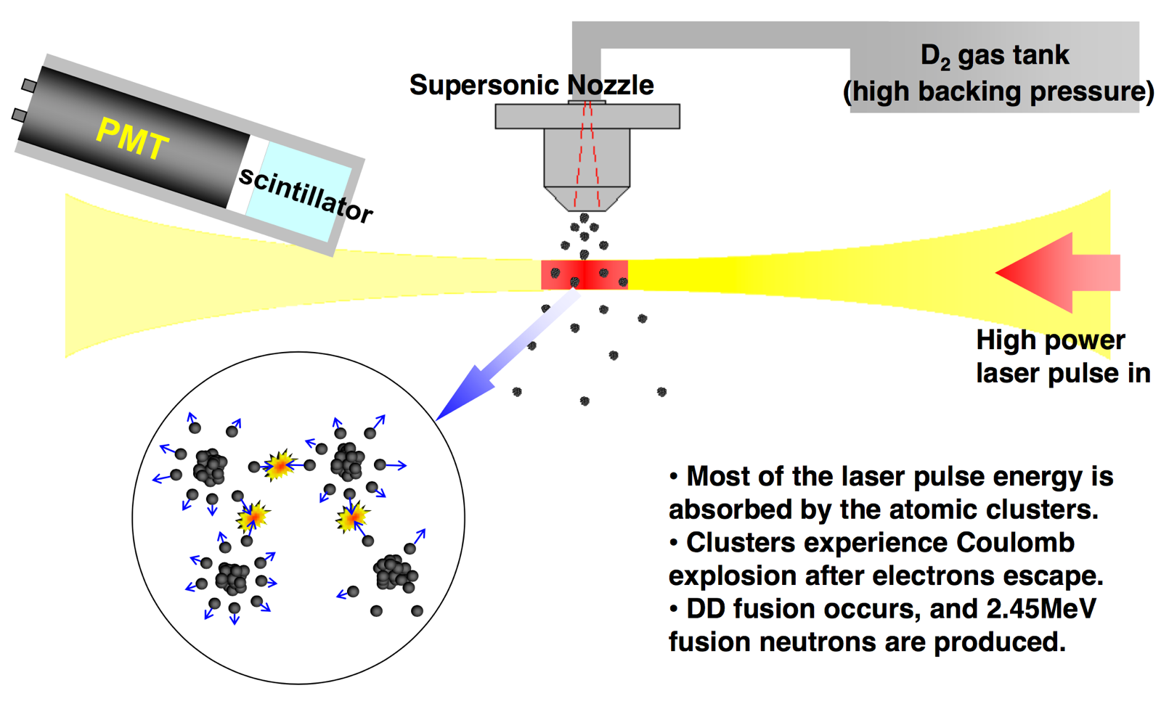
Nuclear astrophysics with hp lasers

Slide 23
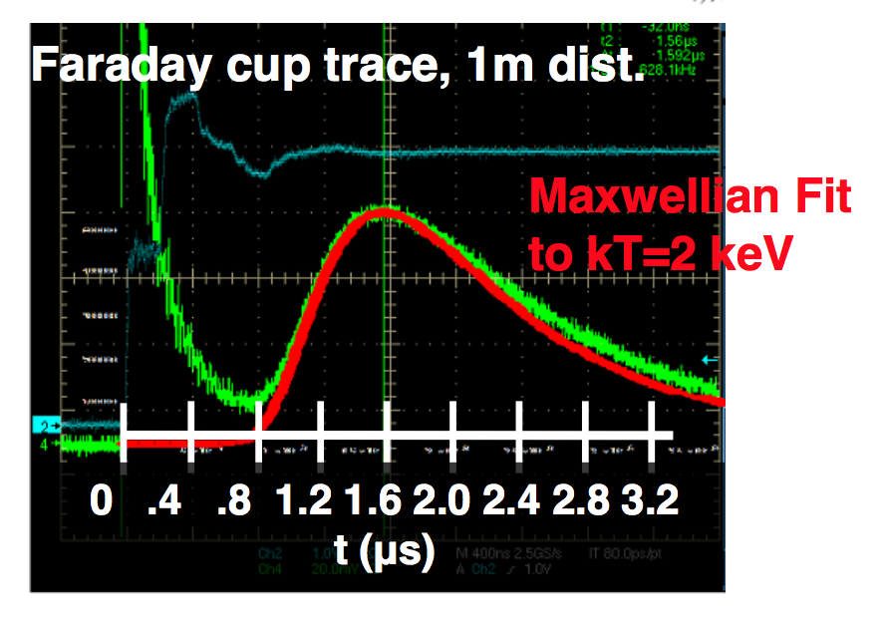
Nuclear astrophysics with hp lasers

Slide 24
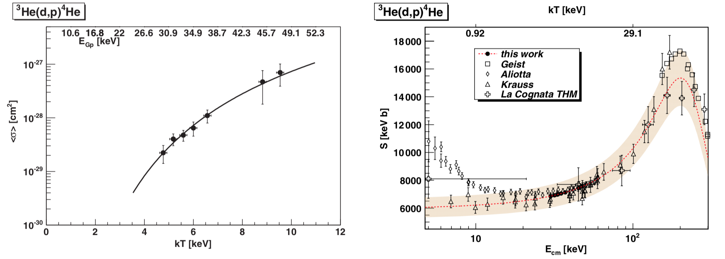
Nuclear astrophysics with hp lasers
M. Barbui et al., Phys. Rev. Lett. 111, 082502 (2013)

Slide 25
Nuclear astrophysics with hp lasers
LASER → aneutronic fusion for energy production
  The ¹¹B(p,3α) is considered a
promising reaction for energy production
in fusion reactors and was studied largely
at LNS
  It does not emit neutrons
  High energy output (8.59 MeV)
  However: ¹⁰B is 20% natural boron
Possible idea: study of the p-¹¹B fusion in plasmas
  Evaluation of electron screening
  Synergy between THM and direct measurements in “stellar” environment
  Continuation of research on electron screening by ASFIN

Slide 26
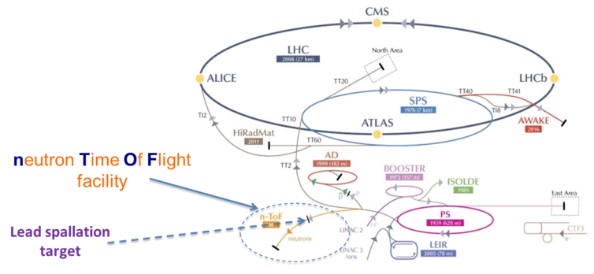
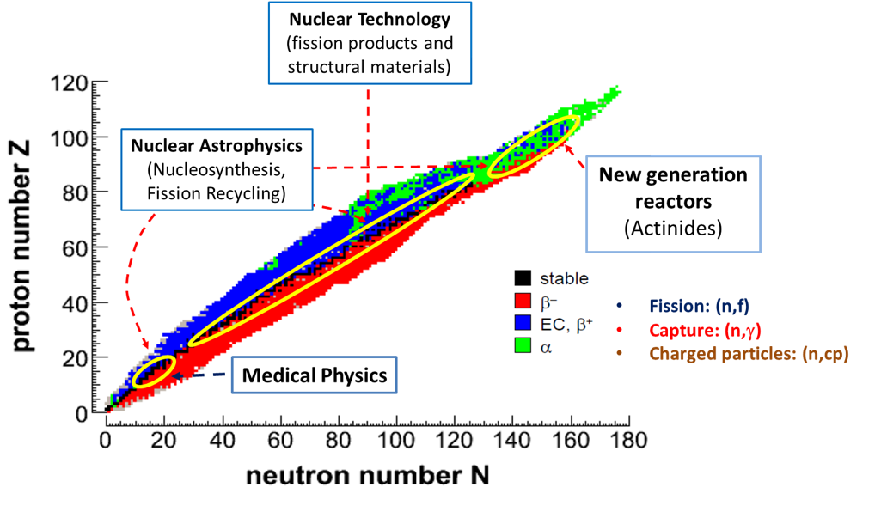
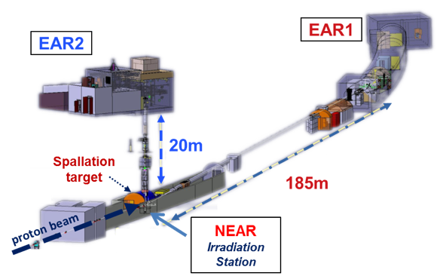


n_TOF
Data taking @ CERN
→ The LNS group is active in data analysis and detector development
National responsibles: Cristian Massimi
LNS responsible: Gianluigi Cosentino

Slide 27
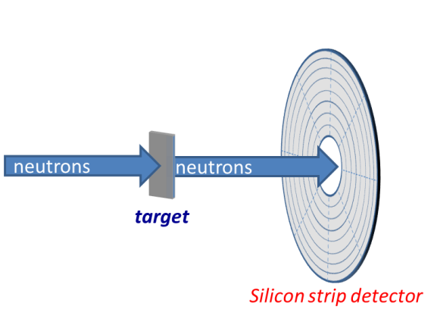
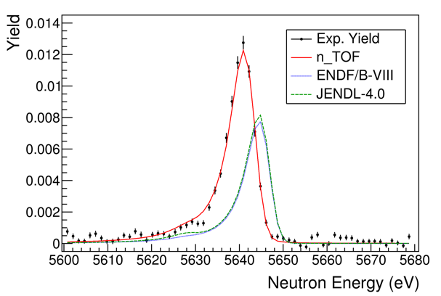
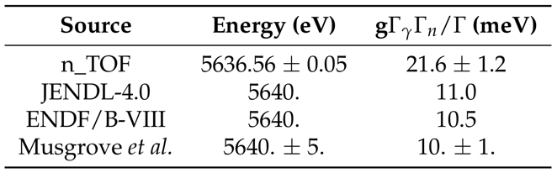
n_TOF
In the next future: measurement of (n,charged particles) reactions such as the ¹⁶O(n,a)¹³C
Example of data analysis: ¹⁴⁰Ce(n,γ) and the s-process
Example of analysis for a a p-wave resonance. The n_TOF fit of the capture yield shows large discrepancies compared to JENDL-4.0 and ENDF/B-VIII libraries.
Annular silicon detector using PSA for PID under test at CERN → low detection threshold for e.g. endoenergetic rections
Many physical cases from chromium to tungsten and beam energies lower than 14 MeV
The table reports the width and centroid of the resonance. The n_TOF value is a factor 2 larger than libraries and transmission (Musgrove) data.

Slide 28
SUMMARY
Nuclear physics at LNS covers a broad range of physical cases
Many experiments (CHIRONE, NUMEN, ASFIN) are focused on the CS and on the TANDEM
Nuclear astrophysics is a key research fields, from dark matter to multimessenger astronomy, with a strong connection with international laboratories
The Tandem program for the next years is very broad and full of exciting and highly competitive physical cases
THANKS FOR YOUR ATTENTION

Slide 29
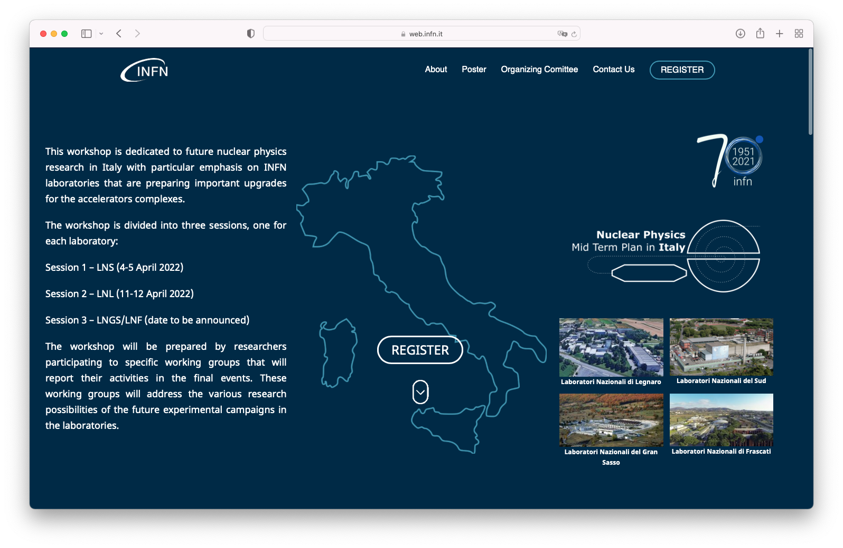

https://web.infn.it/nucphys-plan-italy/

Slide 31
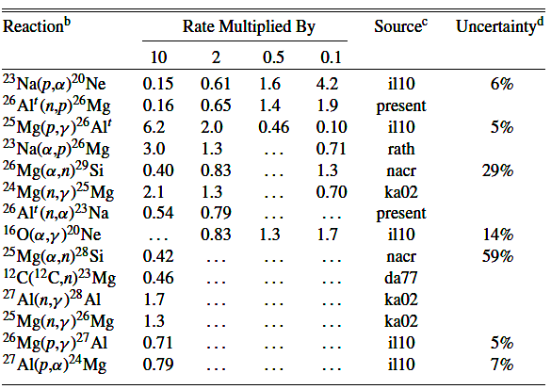

^{What next at the LNS Tandem}
“NaMES”: Natrum for MassivE Stars (postponed due to COVID emergency)
to be performed 2022-2023?
Experimental study of the ²³Na(α,p)²⁶Mg at astrophysical energies by means of the Trojan Horse Method applied to the ⁶Li(²³Na, p ²⁶Mg)d reaction.
The ²⁶Al (t_{1/2}=7.2∗10⁵ y) nucleosynthesis is one of the most challenging issues for astrophysics and nuclear astrophysics
Its presence has been detected in different sites: Galactic interstellar medium (via the 1809 keV γ-ray line detection), in meteorites (via the presence of the daughter ²⁶Mg nucleus) and in presolar grains
In massive stars, the ²³Na(α,p)²⁶Mg is the second most important proton source [1]
Direct measurements of the ²³Na(α,p)²⁶Mg reaction are difficult to be performed due to of a series of experimental problems such as: the height of the Coulomb barrier (∼ 5.5 MeV) well above the energy of astrophysical interest, use of gas-targets, the contamination from competing channels, etc.
[1] Sensitivity study for ²⁶Al production. Iliadis C. et al, ApJ Supp. Ser., 193, 16 (2007)

Slide 32
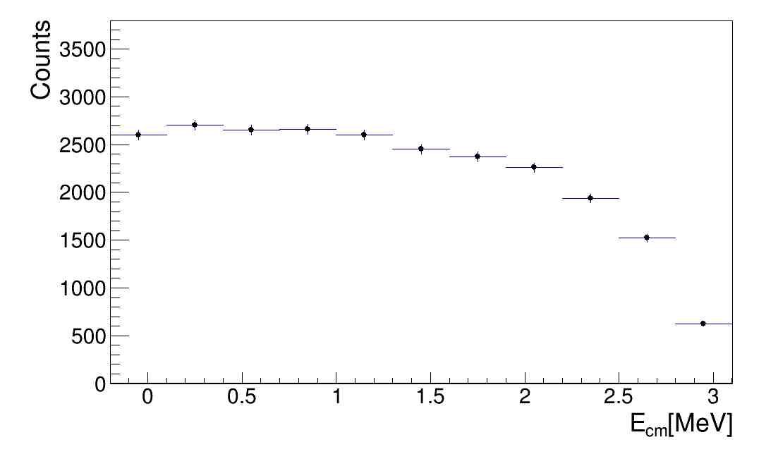
Cosmological Lithium problem investigated via ³He break-up @ LNS & pole invariance test LOI LITHE
We plan to investigate by means of THM the ⁷Li(p,α)4He via ³He breakup at astrophysical energies. Up to now this has been done only for energies above 1 MeV (see Pizzone et al. PRC 2011).
This will allow a better calculation of reaction rate in the BBN
Gamow window. The same will be extended to ⁶Li(p,α)³He as
Well with the same methodology.
Key-role of the NESTOR noble gas source
From Pizzone et al. 2011: pole invariance test with ³He and d breakup.
Expected energy range to be investigated in the new experiment. The BBN Gamow window is reported.

