Slide 1
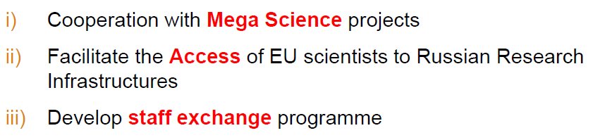
Project CREMLINplus
1. Scientific and Research Reactor Complex PIK
2. Nuclotron-based Ion Collider Facility NICA
3. 4th Generation Synchrotron Radiation Source USSR (LNF)
4. Super Charm-Tau Factory SCT (LNF, Ferrara, Lecce, Bari)
5. Exawatt Center for Extreme Light Studies XCELS
Call INFRASUPP-01-2018-2019 (Horizon 2020)
Project Start: 1 Febbruary 2020
Allocated 25 MEuro

Slide 2
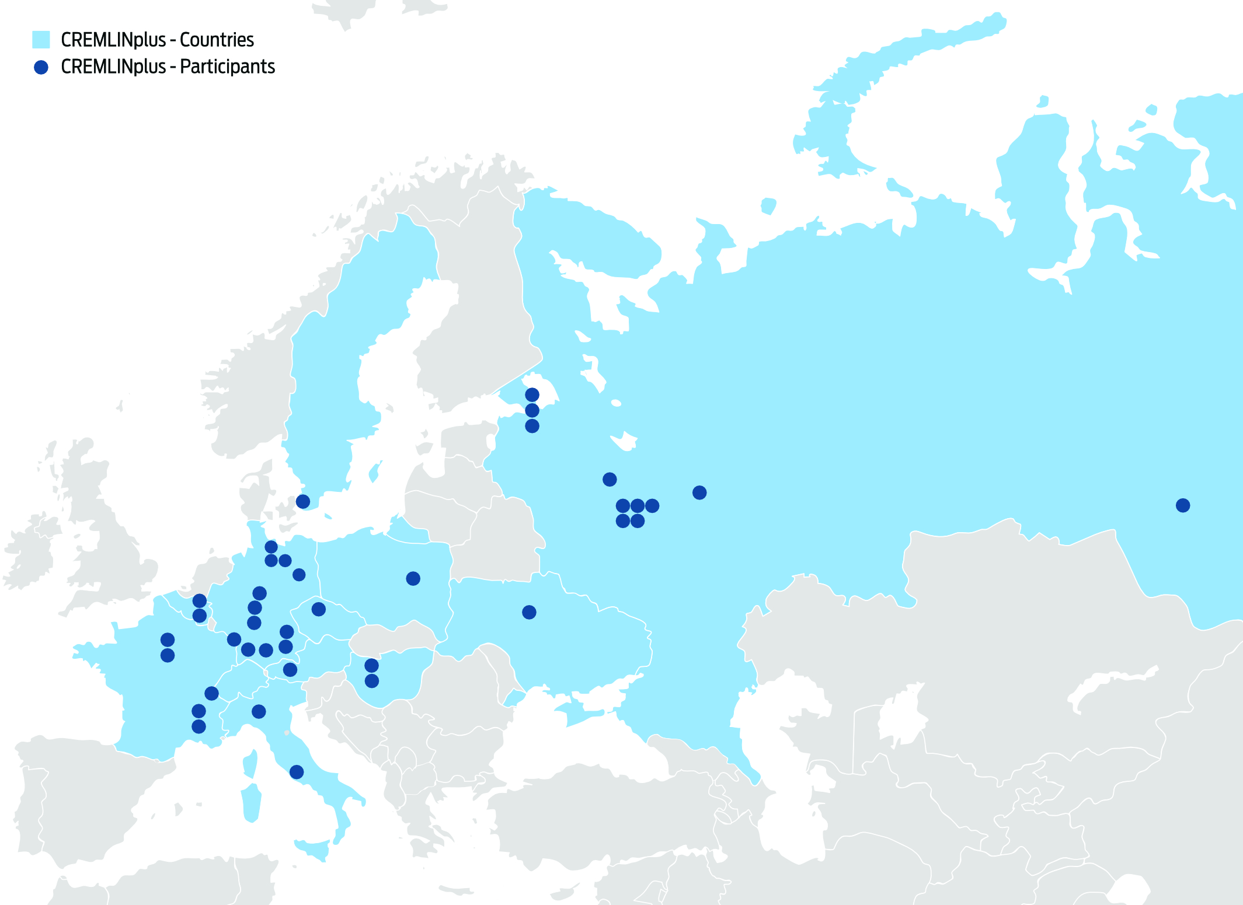
Participating Countries
35 partners, 10 from Russia and 25 from EU

Slide 3

CREMLINplus at LNF
WP5
Super Charm Tau Factory
Detector
DR
CREMLINplus
DA
Accelerator
USSR
WP4

Slide 4
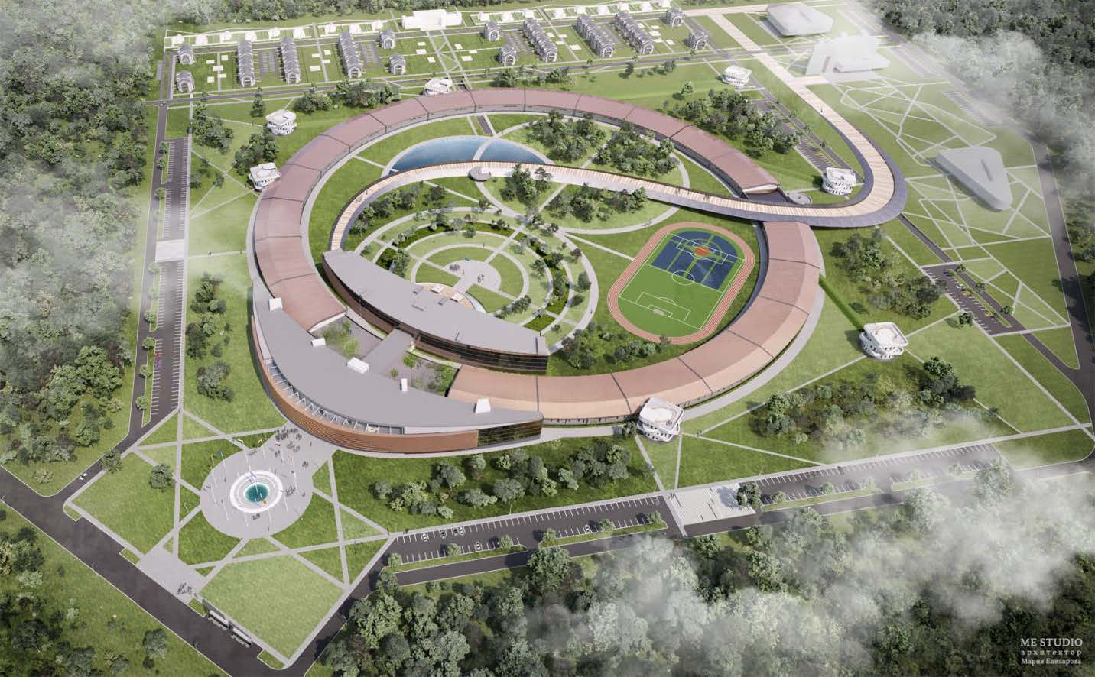
USSR (Baseline option)
Courtesy S.M.Polozov

Slide 5
Main Topics of Task 4.3: Resp. Mikhail Zobov
vacuum chamber impedances, beam-chamber interactions, instabilities
Analysis of the best experience in the vacuum chamber design of the modern synchrotron light sources and high intensity particle colliders (factories)
Choice of the vacuum beam pipe shape and dimensions (together with lattice design group)
Low impedance design of the principal vacuum chamber components/hardware such as RF cavities, kickers, bellows, flanges, valves, BPMs, pumping ports etc.
Elaboration of the impedance model including geometric, resistive-wall and roughness effects
Determination of beam parameters such as bunch length, energy spread, emittance, and lifetime including IBS and harmonic cavity
Study of the single bunch instabilities (particularly important for the timing mode) and measures for their mitigation: microwave instability in the longitudinal plane and turbulent mode coupling instability (TMCI) in the transverse plane
LNF INFN, DESY, ESRF, KI

Slide 6
Main Topics of Task 4.3: Resp. Mikhail Zobov
vacuum chamber impedances, beam-chamber interactions, instabilities
7. Study of multi-bunch instabilities and effects and measures for their mitigation
Shift of the betatron frequencies due to the quadrupolar resistive wall wake fields
Resistive wall multi-bunch instability
Instabilities due to the beam interaction with higher order modes trapped in the vacuum chamber components
d) Ion instabilities: trapped ions, fast ion instability, emittance growth.
Transient beam loading effects of non-uniform fill pattern including the harmonic cavities
8. Analysis of the vacuum chamber heating due to the beam coupling impedance

Slide 7
Main Topics of Task 4.4: Resp. Cristina Vaccarezza
Top-up Linac development including RF-guns and diagnostics system
Elaboration of the linear accelerator layout
Choice of the working frequency (S-band, C-band, other)
Choice of the accelerator structures
Analysis of the acceleration regimes (injection into the storage ring, topping up, FEL regime)
Beam dynamics simulation in the Linac guns, RF sections and transport channels.
Start-to-end beam dynamics simulations.
Beam diagnostics development

Slide 8
Partecipanti DA
Participant | FTE, % | Rendicontazione
Zobov Mikhail | 40 | dal 01/02/2020
Vaccarezza Cristina | 20 | dal 01/05/2020
Giribono Anna | 20 | Dal 01/01/2021
Bilanishvili Shalva | Assegno di Ricerca | dal 01/09/2021
Shpakov Vladimir | - | Started working
Buonomo Bruno | 10 | Not yet, disponibile
Gallo Alessandro | 10 | Not yet, disponibile
Ferrario Massimo | 10 | Not yet, disponibile
Milardi Catia | 20 | Not yet, disponibile
Andato a vuoto AR “Study of multi-bunch instabilities in circular accelerators” (non hanno preso servizio E.Buratin (vincitrice), S.Caschera (idoneo))
Danilo Quartullo has left for CERN (Switzerland)
Marco Diomede has left for DESY (Hamburg)
Jessica Scifo has left for ENEA (Italy)

Slide 9

Reporting Periods
August 2021 - 1st CREMLINplus Periodic Report (18 months)
a) Interim Technical Report (WPs)
b) Financial Statement (about 300 kEuro INFN)
c) Questionnaire for beneficiaries
2. January 2022 - Scientific Reports of Task 4.3 and Task 4.4
(M24 Deliverable)

