Slide 1
MPGD-based HCAL
MuColl Meeting
September 9 2021 Anna Colaleo, Filippo Errico, Marcello Maggi, Antonello Pellecchia, Raffaella Radogna, Federica Simone, Anna Stamerra, Rosamaria Venditti, Piet Verwilligen, Angela Zaza INFN sezione di BARI
with intellectual support from other INFN researchers
Online, September 14th 2021

Slide 2
Proto-MC Detector (under optimization)
CLIC detector adopted with some modifications for muon collider detector needs
CLIC: HCAL from CALICE R&D: mainline option is Scintillator + SiPM
CALICE alternative: FE absorber + Gaseous Detector (glass RPC)
More detailed beam background simulations in Fluka are ongoing
Preliminary studies indicate:
HCAL: 10¹¹ – 10¹⁵ 1MeV n-equiv /cm² per year;
Machine Parameters:
3 TeV c.o.m.
2x10¹² mu/bunch
200 days operation/year
100kHz bunch crossing
We want to propose a more RAD-hard HCAL detector

Slide 3
Gaseous Imaging Calorimeters
Gaseous detectors are naturally radiation hard. Can they provide equally good performance?
Lot of work done within CALICE collaboration:
AHCAL Scint+SiPM 30 x 30 mm² granularity
DHCAL glass RPC 10 x 10 mm² granularity
SDHCAL RPC 10 x 10 mm² granularity also with few Micromegas
Gaseous Detectors provide high readout granularity ($σxy$ = 50um, $σt$ = 5ns) at low cost
Energy resolution in 10x10 granularity is better w.r.t 30x30 granularity
10x10 will allow also better imaging & better topological background removal
Studies show that Energy resolution obtained Semi-Digital HCAL is as good as AHCAL with software compensation (but note this is for 10x10 granularity!)
=> 10x10 SDHCAL with gaseous detector is interesting option
=> we want to propose more radiation hard, 4D, low-cost HCAL detector.

Slide 4
Where does this proposal come from?
Historically: CALICE
SDHCAL w/ RPC obtains same resolution as AHCAL (but with reduced cost)
However: RPCs operate with non-environmentally safe gas (R&D ongoing – but detector constraints increase)
Some Micromegas modules built and inserted
Show better performance w.r.t. RPC: better rate capability, smaller clustersize, very radiation hard and Energy measurements are possible
CEPC: R&D ongoing for Calorimeter with Resistive MPGD (concentrated on RP-WELL Weissmann (Israel) USTC (China))
We would like to propose R&D effort on resistive MPGD
Timing measurements of Gaseous detectors were not used
Interesting road to study shower development & remove backgrounds
RPCs naturally fast detectors, in MPGDs R&D is ongoing to improve on timing
Unifies INFN groups working on resistive MPGDs (Na,LNF,Ba)
Submitted Common Project for add. RD51 funding (15kEUR/anno)

Slide 5
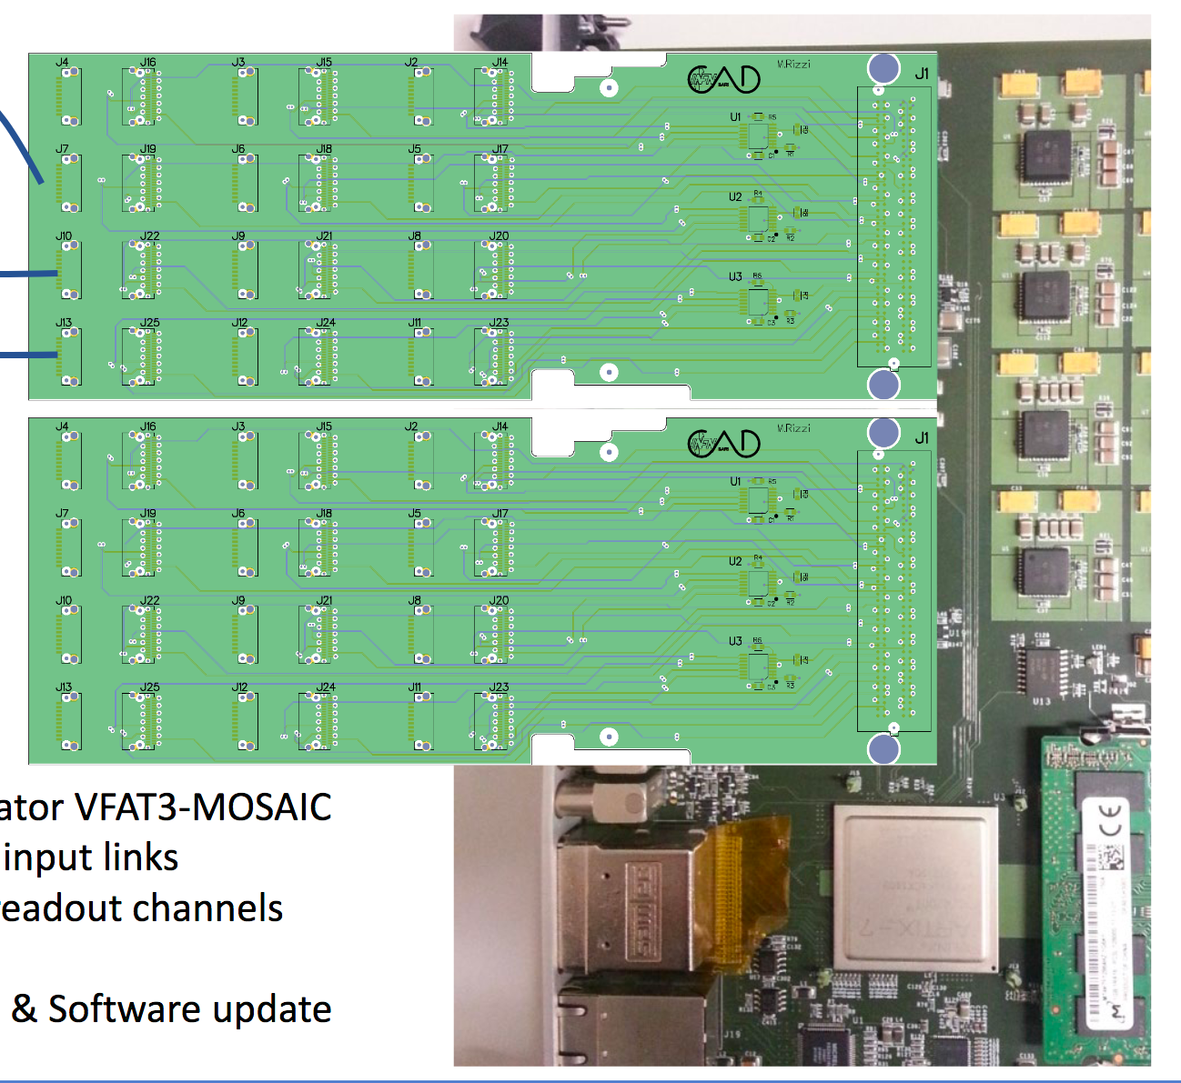
Design of MPGD-based HCAL cell
We would like to propose a R&D program to validate the best technology in the next years.
simulation studies – GEANT implementation
test different MPGD technologies in a small-size stack with stainless steel absorbers:
Resistive Micromegas
Resistive micro-RWELL
Leave room for future resistive MPGDs with improved timing response
Read out all detectors with same FE electronics. Exploit new Front-End asic designed for FTM: FATIC (Time measurement + Charge measurement)
absorber
mpgd
absorber
absorber
mpgd
absorber
absorber
mpgd
mpgd
1
2
3
4
New concentrator boards for MOSAIC
MPGD 10 x 10 cm² - uRWELL - MM-resistivo
- GEM
4 FATIC₂
Plugincards with 4 FATIC2 chips
connector
LV
4 FATIC₂
connector
LV
MOSAIC FPGA-board
connector
connector
8 LVDS: 1RX 1Clk 4TX 1 F-OR 1 Reset

Slide 6
Financial Requests
RD_Mucoll:
10kEUR for 2 resistive Micro-Megas (MM)
Need 10x10mm² pixel size
Design provided by Mauro Iodice (RM3)
7kEUR for Electronics to read-out 2 MM: Note: 30kEUR of ASIC already spent in CSN-V
4kEUR for 10 plugincards would be the first major use of FATIC chip
2kEUR for concentrator board (also considered for LHCb uRWELL readout R&D)
1kEUR for high-speed cables
3kEUR for Mechanics
Fe absorber plates
Bosh profile structure
RD51 Common Project:
Ask small extra funding to RD51 collaboration through “Common Project”
Will allow to make modifications to the prototypes – change Readout board for GEMs …
Collaborating institutes: Roma 3 (ATLAS MM) & LNF (LHCb uRWELL)
Can however not pledge officially FTE to MuCOL but are very interested in the development of the hadron collider with MPGD readout
… remake of ALEPH PF-Calorimeter with state of the Art MPGDs …

Slide 7
BACKUP
Online, September 14th 2021

