Slide 1
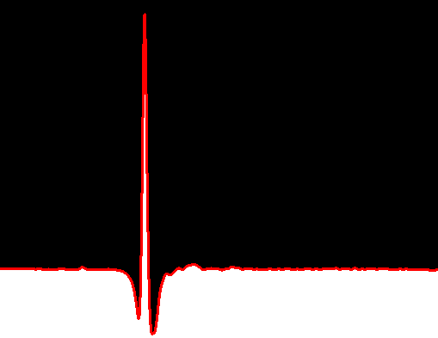


"Characterization of materials and realization of components in the GHz and THz domain"
Can Koral
15
13 September 2021
Meeting on “radio frequency activities in the INFN”

Slide 2
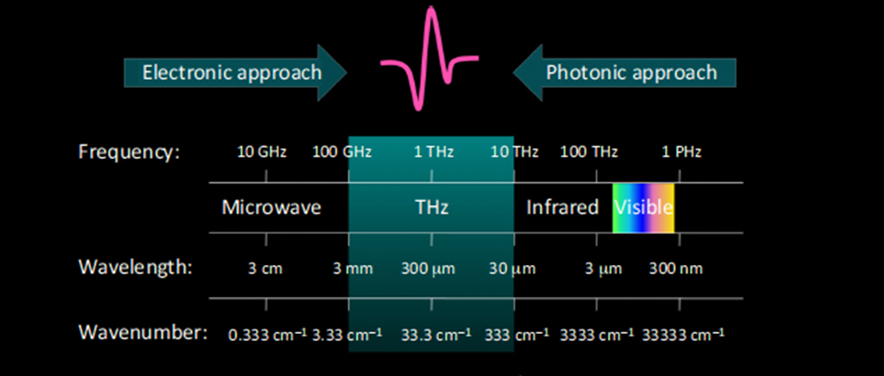
mm-wave technologies
Frequency:
0.1 THz➔10 THz ➔30THz
Wavelength:
3 mm ➔30 µ m➔ 10 µm
Energy:
0.41meV ➔41 meV➔ 124meV
Wavenumber:
3.3 cm⁻¹➔333 cm⁻¹ ➔1000 cm⁻¹
Spectral Fingerprint The photon energy of the THz wave largely coincides with energy levels corresponding to low-frequency motions
Strong Absorption by Polar molecules
(the hydration levels, Icing effects ….)
Time and Spatial Resolution THz spectroscopy permits time-resolved investigations with high sensitivity
Transparency of Materials Nonpolar Materials which are opaque to visible and near-infrared waves, are transparent in the THz range.
Noninvasive and Nonionizing Properties The low-energy photons of THz radiation are suitable for the noninvasive characterization in vivo real-time diagnosis without causing ionization damage.
C.Koral,PhD/THz Devices & Characterization/13-09-2021

Slide 3
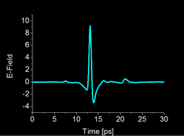
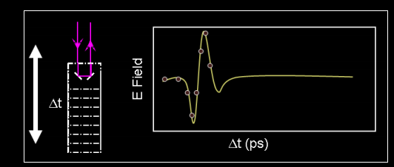
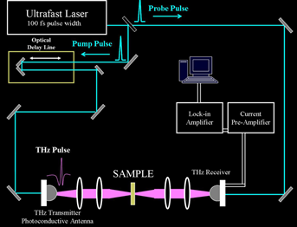
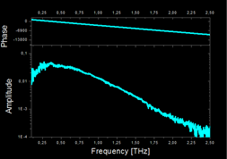
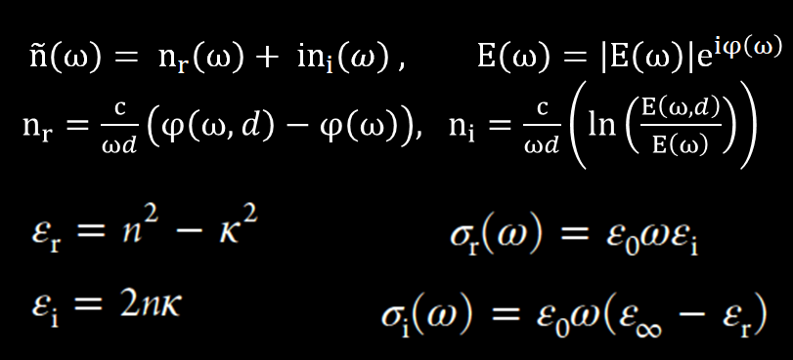
THz Time Domain Spectroscopy
The time dependency of the incoming THz electric field is measured by sampling it by a very short optical pulse.
C.Koral,PhD/THz Devices & Characterization/13-09-2021

Slide 4
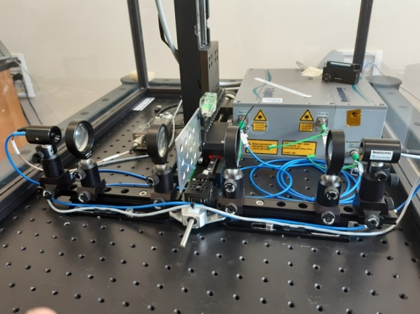
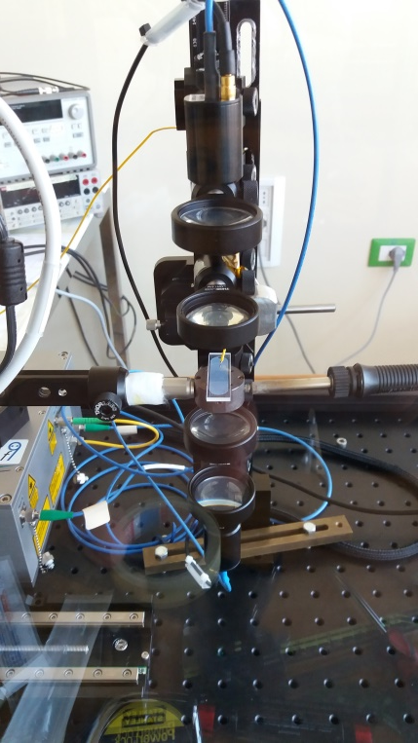
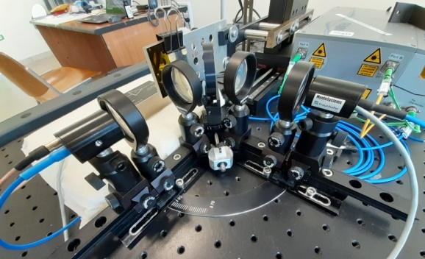
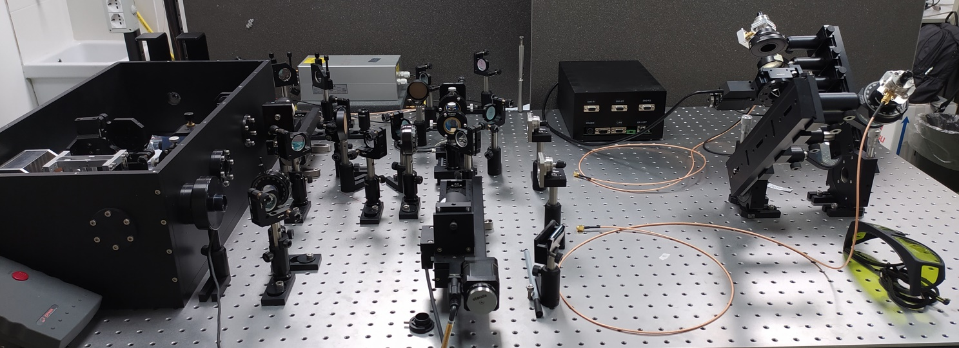
THz-Time Domain Spectroscopy
(Transmission mode and Reflection Mode)
THz Fast Mapping and Imaging
THz-Ellipsometry
(Angular Reflection measurements)
THz Wave-Guide Spectroscopy
Material characterization (dielectrics, doped semiconductors, phase transition and 2D materials, liquid crystals from cryogenic (2 K) to high (700 K) temperatures.
Metamaterial-based and plasmonic devices design and testing
C.Koral,PhD/THz Devices & Characterization/13-09-2021

Slide 5
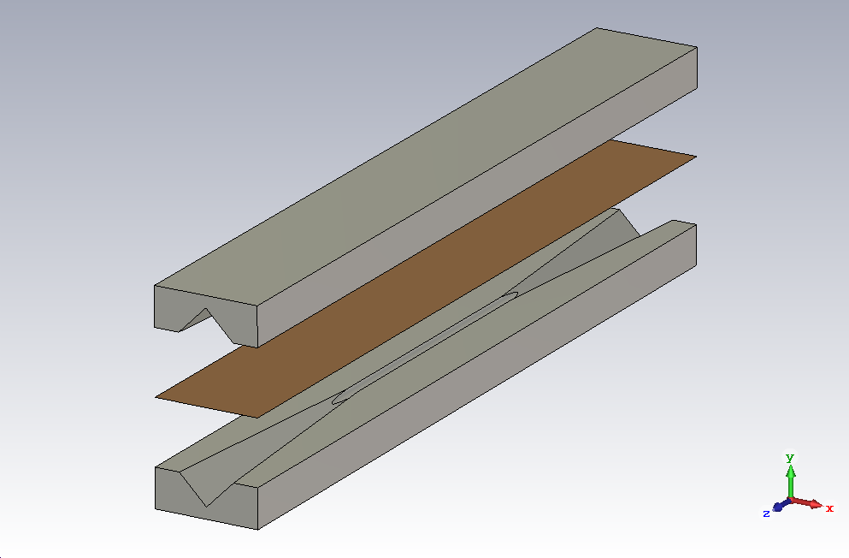
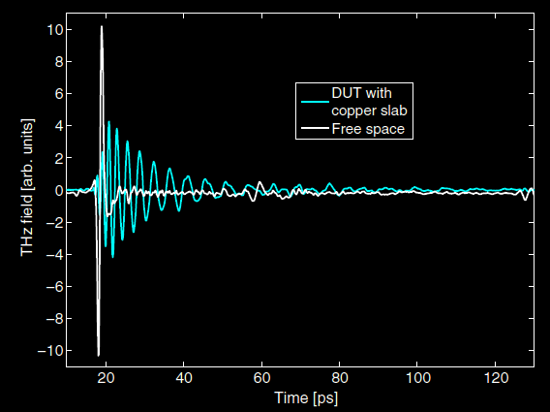
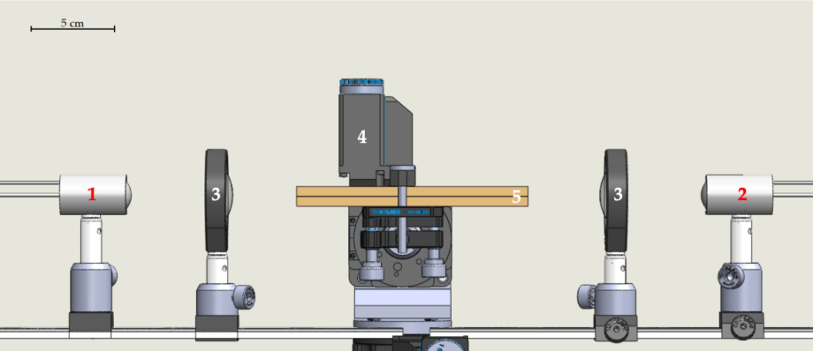
The THz WAVE-GUIDE SPECTROSCOPY as a novel approach for the evaluation of the surface impedance of coatings in accelerator beam pipes in the sub-THz range.
The electromagnetic characterization of coating materials in the Sub-THz frequency for particle accelerators range used in the accelerators and pipe lines :
Materials for the improvement of ultra-high vacuum(NEG / non evaporable getters)
The reduction of the secondary electron yield(a-C / amorphous carbon)
C.Koral,PhD/THz Devices & Characterization/13-09-2021

Slide 6
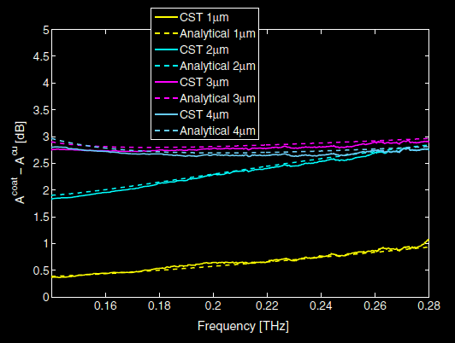
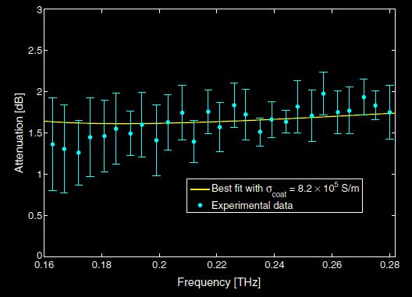



Analytical evaluations (In-house retrieval method)
Waveguide of length l_{g} (TE_{1,1} mode)
+
pyramidal transitions of length l_{t} (TE_{1,0} TE_{0,1} modes)
$$A_{DUT}=αl_{g}+2\int_{0}^{l_{t}}{α(z) dz}=\frac{1}{2}Re\left(Z_{s}\right)\frac{\int_{l}{{\left|n×H_{1,1}\right|}^{2}dl}}{Z_{1,1}{\left|I_{1,1}\right|}^{2}}l_{g}+\int_{0}^{l_{t}}{Re\left(Z_{s}\right)\frac{\int_{l}{{\left|n×\left(H_{1,0}+H_{0,1}\right)\right|}^{2}dl}}{Z_{1,0}{\left|I_{1,0}\right|}^{2}+Z_{0,1}{\left|I_{0,1}\right|}^{2}}}dz$$
$$Z_{s}=Z_{coat}\frac{Z_{Cu}+jZ_{coat}tan\left(k_{coat}d\right)}{Z_{coat}+jZ_{Cu}tan\left(k_{coat}d\right)}$$
$$σ_{coat}$$
$$Z_{s}$$
C.Koral,PhD/THz Devices & Characterization/13-09-2021

Slide 7
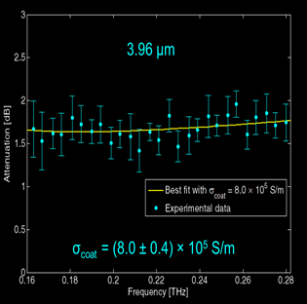
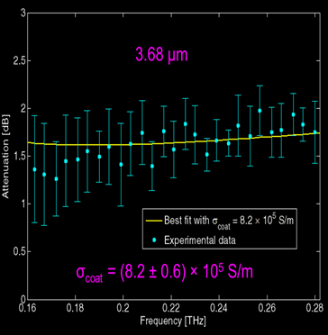
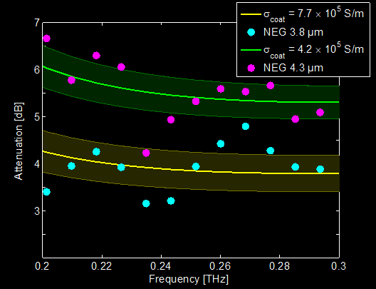
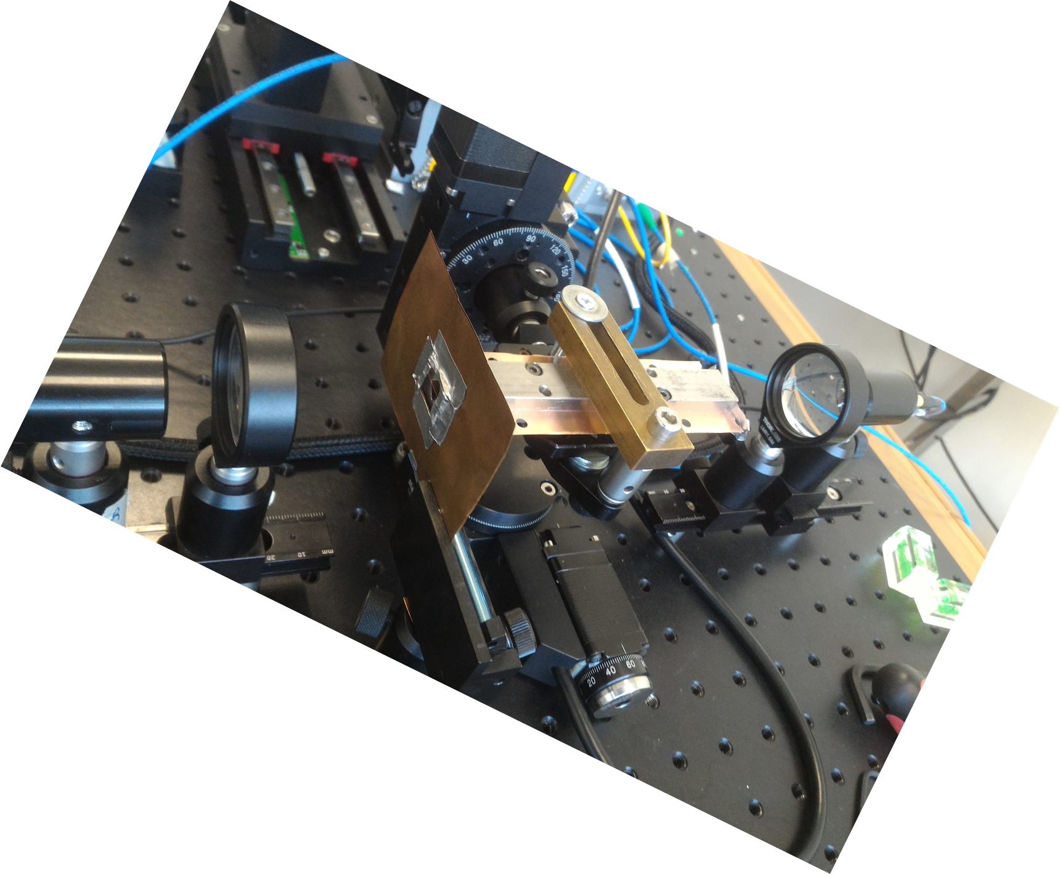
NEG coatings

Slide 8
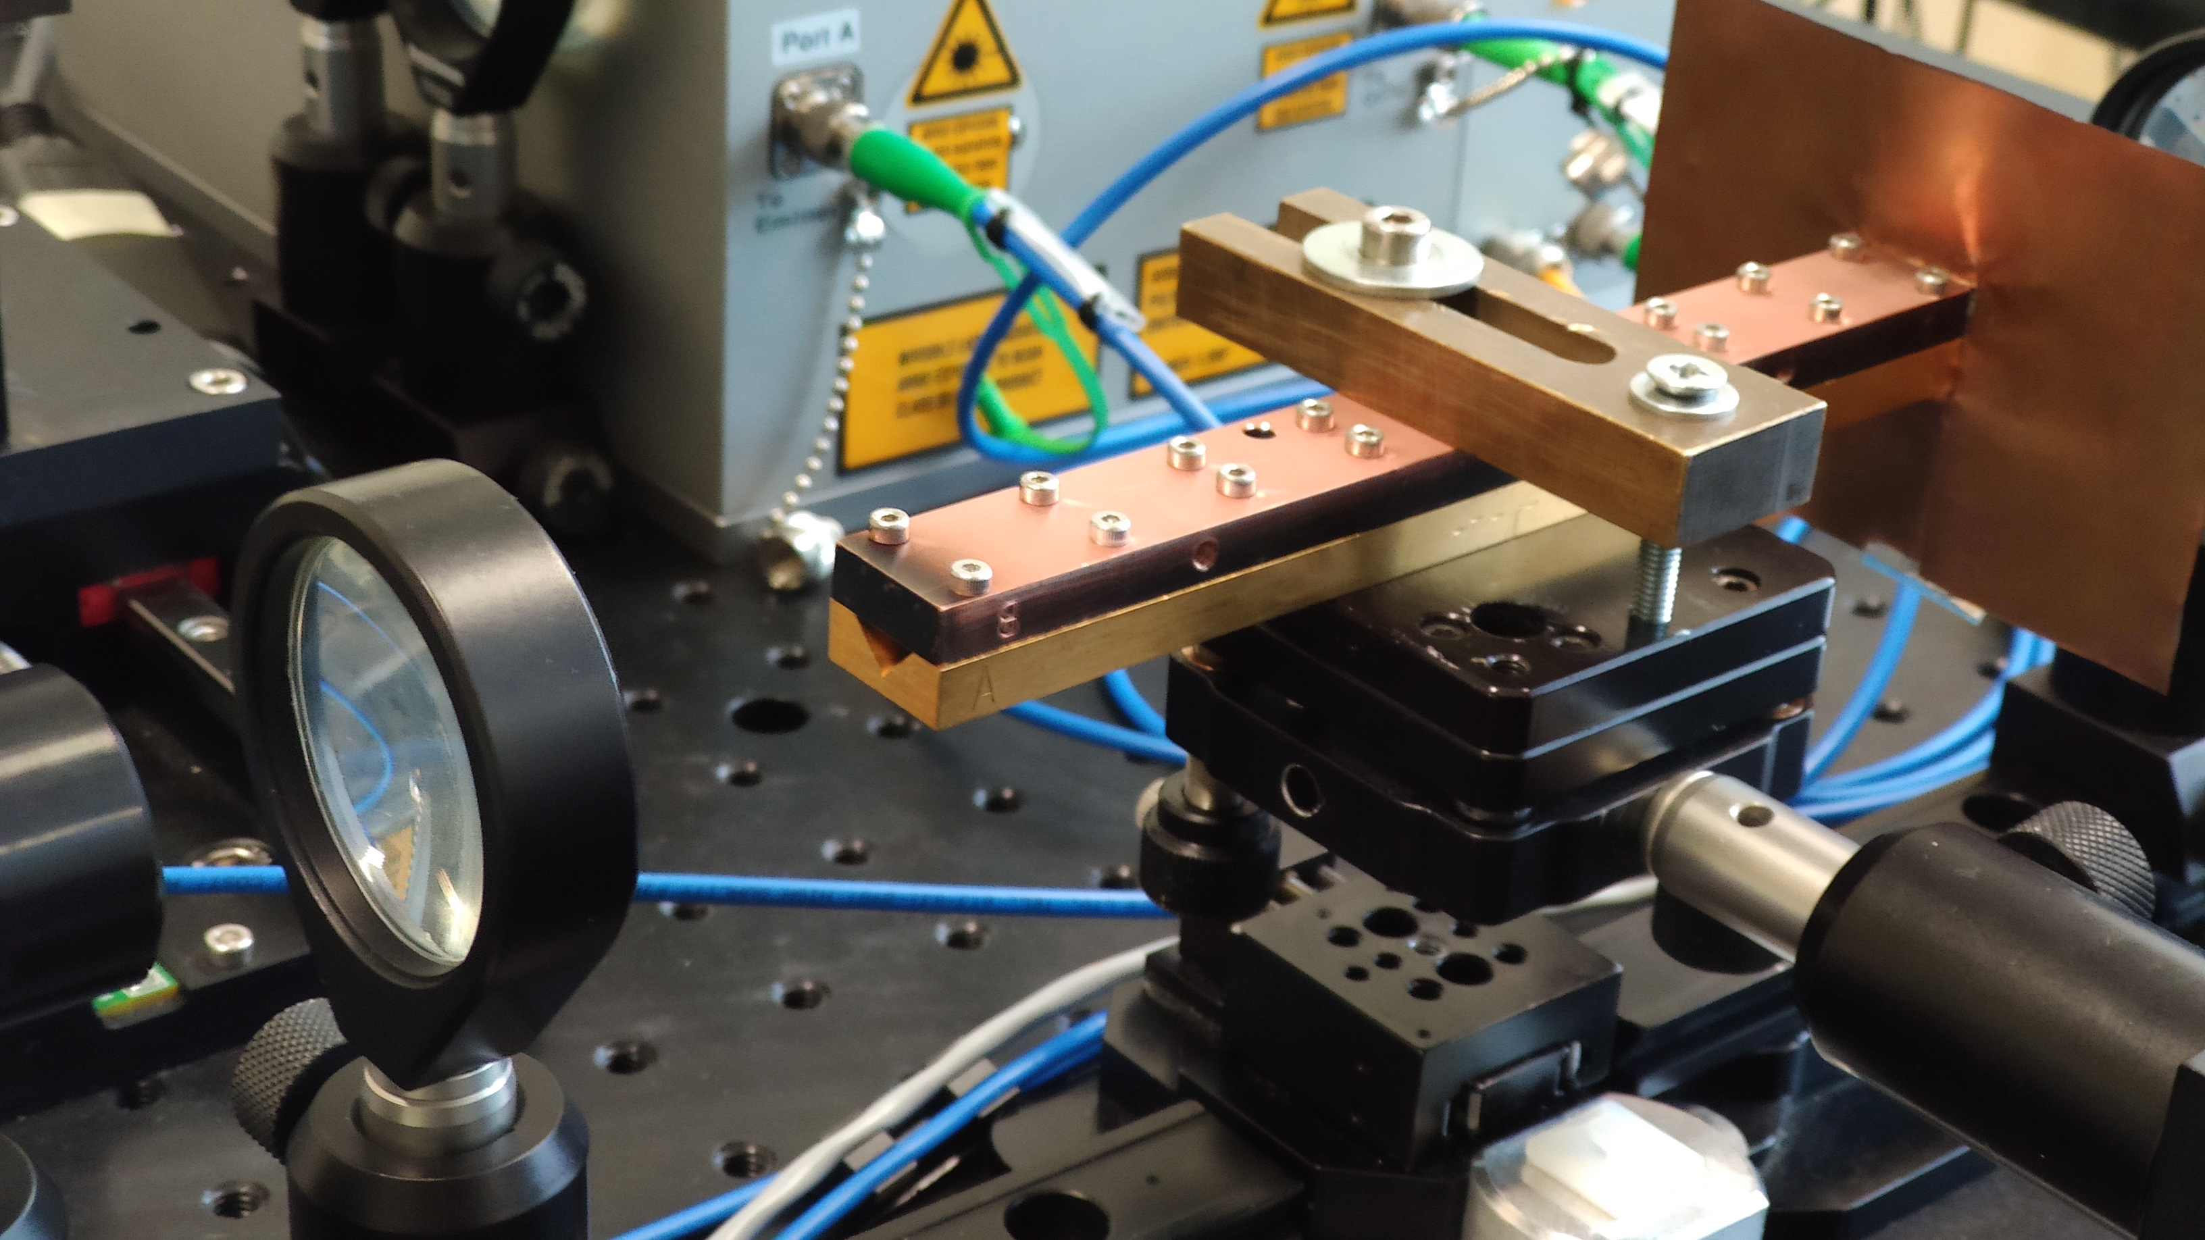
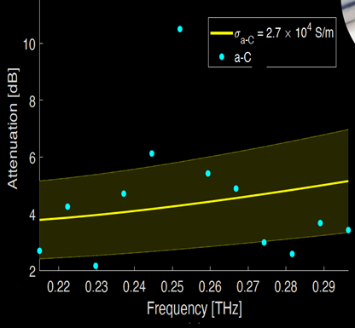
Measurement results on Amorphous Carbon Coatings
Mechanical stress a-C coating on Cu slab
3 μm of
Amorphous Carbon
on copper bulk
C.Koral,PhD/THz Devices & Characterization/13-09-2021

Slide 9
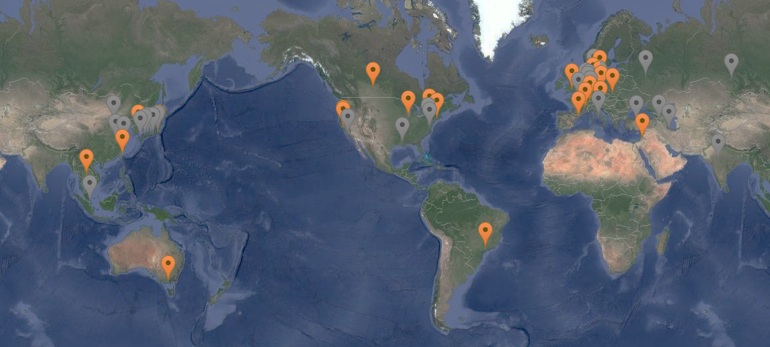




Key Novelty:
Experimentation using electron bunch triggered radiation is that the intense THz emission becomes self-synchronized with all radiation types (from IR to X-ray) emitted with the same electron bunch.
Accelerator Based
THz Generation
The use of coherent THz pulses for electron beam diagnostics and to reconstruct the charge distribution of the electron bunch.
A facile combination of
THz/X-ray pump/probe experiments.

Slide 10
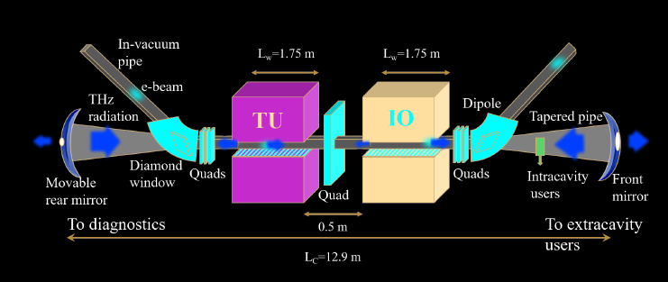
The BriXSino Project
Developed by INFN -Milan in collaboration with Italian National Institutions and Universities, and will be located at LASA (Laboratori Acceleratori e Superconduttività Applicata).
TU (Terahertz Undulator) and IO (Infrared Oscillator) at BriXSino.
The BriXSino project exhibits strong potentiality as user facility for both X-rays and THz radiation.
C.Koral,PhD/THz Devices & Characterization/13-09-2021

Slide 11
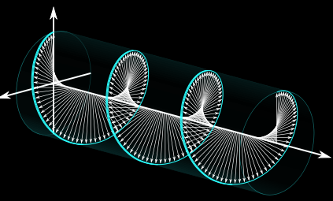
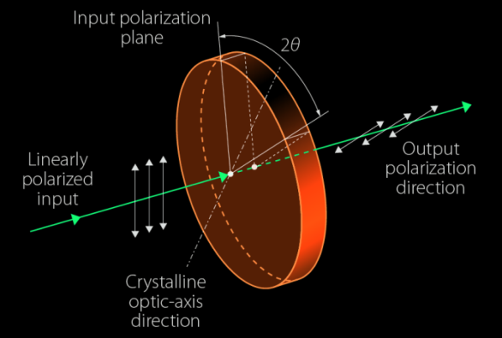
THz/GHz optics and devices(Devices for THz/GHz beam manipulation)
The polarization of light is an important parameter
entering in many applications.
In the THz range also a simple circular polarization is difficult to obtain due to the lack of efficient wave-plates
The technology of active wave-plates based on liquid crystals and operating in the visible/near-infrared
are shifted at THz/GHz frequencies
C.Koral,PhD/THz Devices & Characterization/13-09-2021

Slide 12
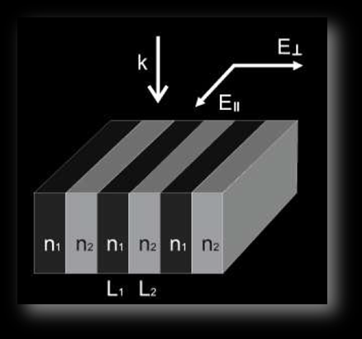
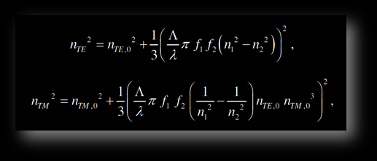
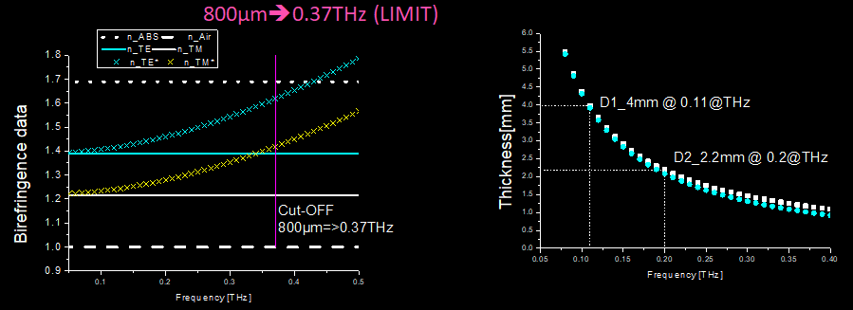
TERAHERTZ FORM BIREFRINGENCE
2nd order EMT which describes
the effective optical material parameters:
+Maik Scheller, Christian Jördens, and Martin Koch, "Terahertz form birefringence," Opt. Express 18, 10137-10142 (2010)

Slide 13
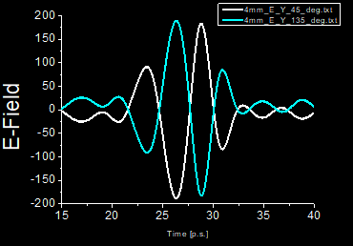
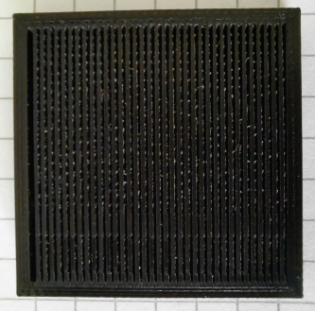
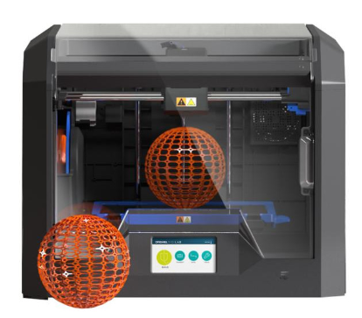
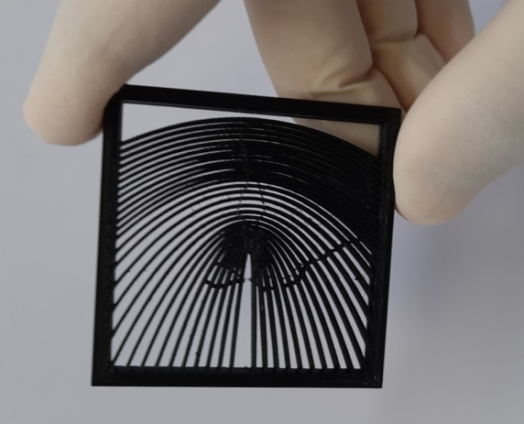
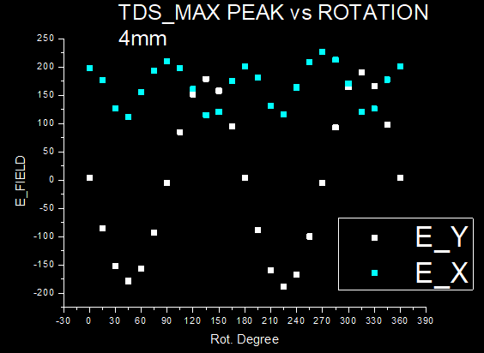
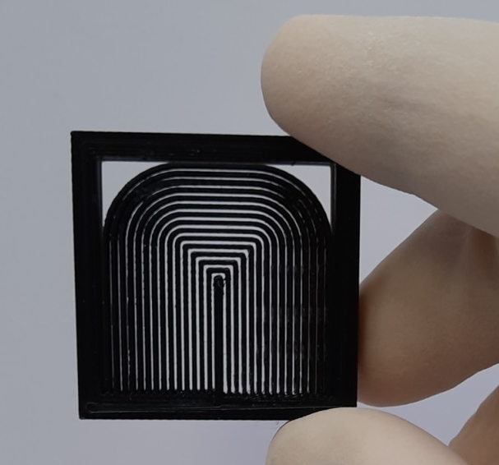
3D Printed THz & GHz Wave Plates
C.Koral,PhD/THz Devices & Characterization/13-09-2021

Slide 14
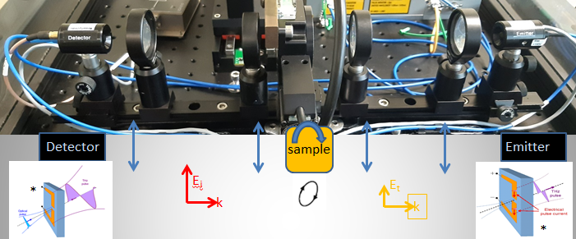
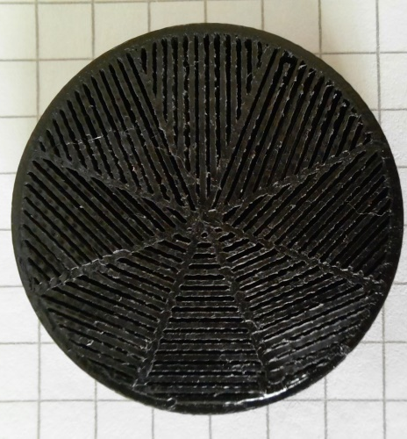
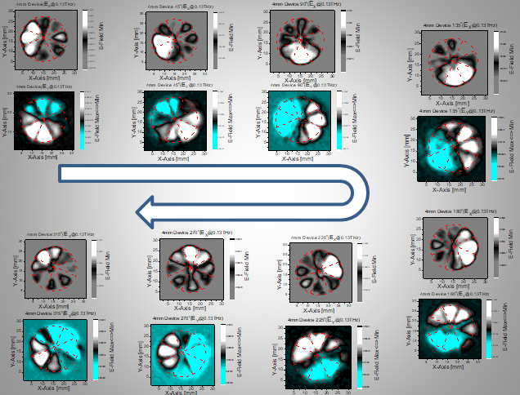
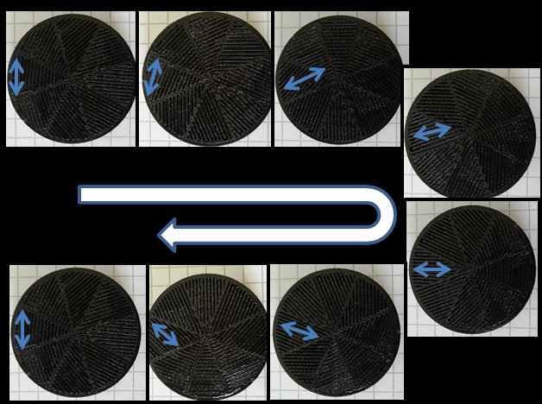
3D Printed Segmented Wave-Plate (THz &GHz )Design consisting of several specially oriented half-wave plates allows getting radiation with radial and azimuthal polarization from linearly polarized one.
C.Koral,PhD/THz Devices & Characterization/13-09-2021

Slide 15
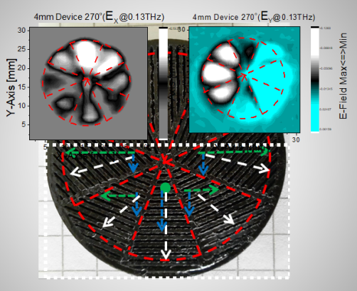
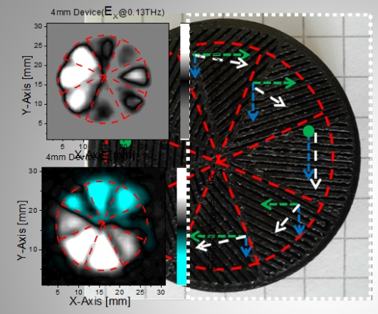
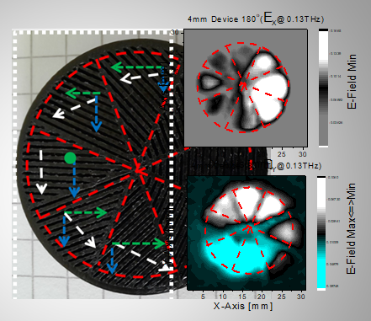
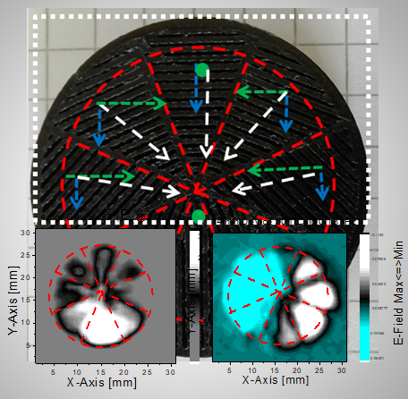
3D Printed Segmented Wave-Plate (THz &GHz )Design consisting of several specially oriented half-wave plates allows getting radiation with radial and azimuthal polarization from linearly polarized one.
RADIAL(Out-Ward)
AZIMUTHAL (Counter-Clock-Wise)
AZIMUTHAL
(Clock-Wise)
RADIAL (In-Ward)

Slide 16
"Characterization of materials and realization of components in the GHz and THz domain"
Can Koral
15
13 September 2021
Meeting on “radio frequency activities in the INFN”

