Slide 1
Metamaterials

Slide 2
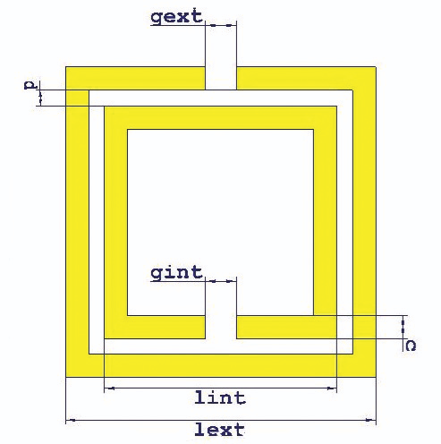
Proposed solutions
Metamaterials
Engineered material
multiple element assemblies
repeating patterns
properties from new structure
Their smart properties capable of manipulating EM waves: by blocking, absorbing, enhancing, or bending waves, to achieve benefits that go beyond conventional materials.

Slide 3
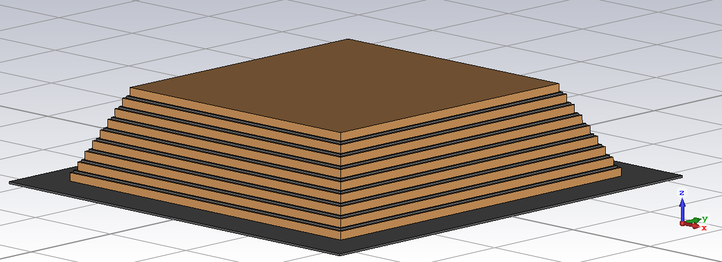
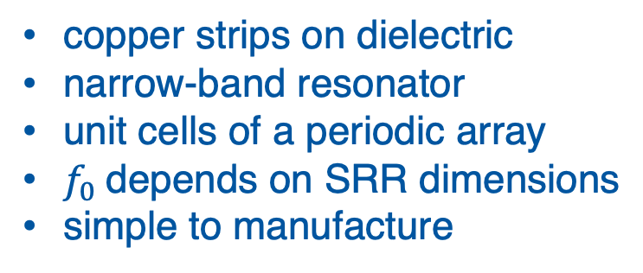
Proposed solutions
Split Ring Resonator
copper strips on dielectric
narrow-band resonator
unit cells of a periodic array
$f_{0}$depends on SRR dimensions
simple to manufacture
Pyramidal structures
stacked copper-dielectric layers
broadband response
strong absorption of EM waves
low weight
small volume

Slide 4
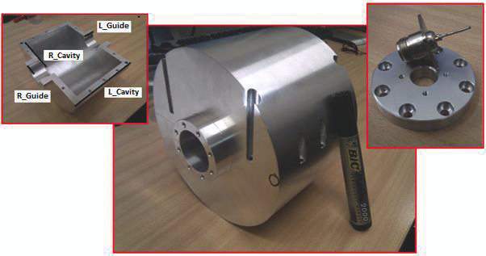
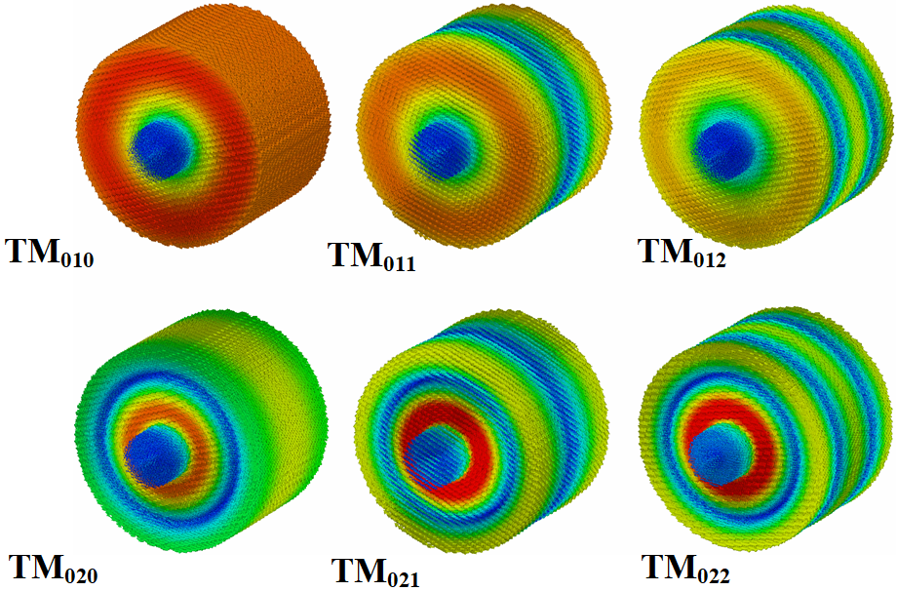
Our pillbox cavity
Pill-box material | Aluminium
Cavity length | 100 mm
Cavity radius | 75 mm
Pipe length | 15 mm
Pipe radius | 20 mm
Pipe TM cut-off | 5.73 GHz

Slide 5
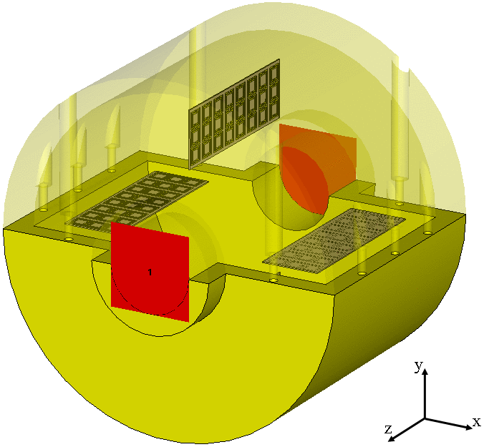
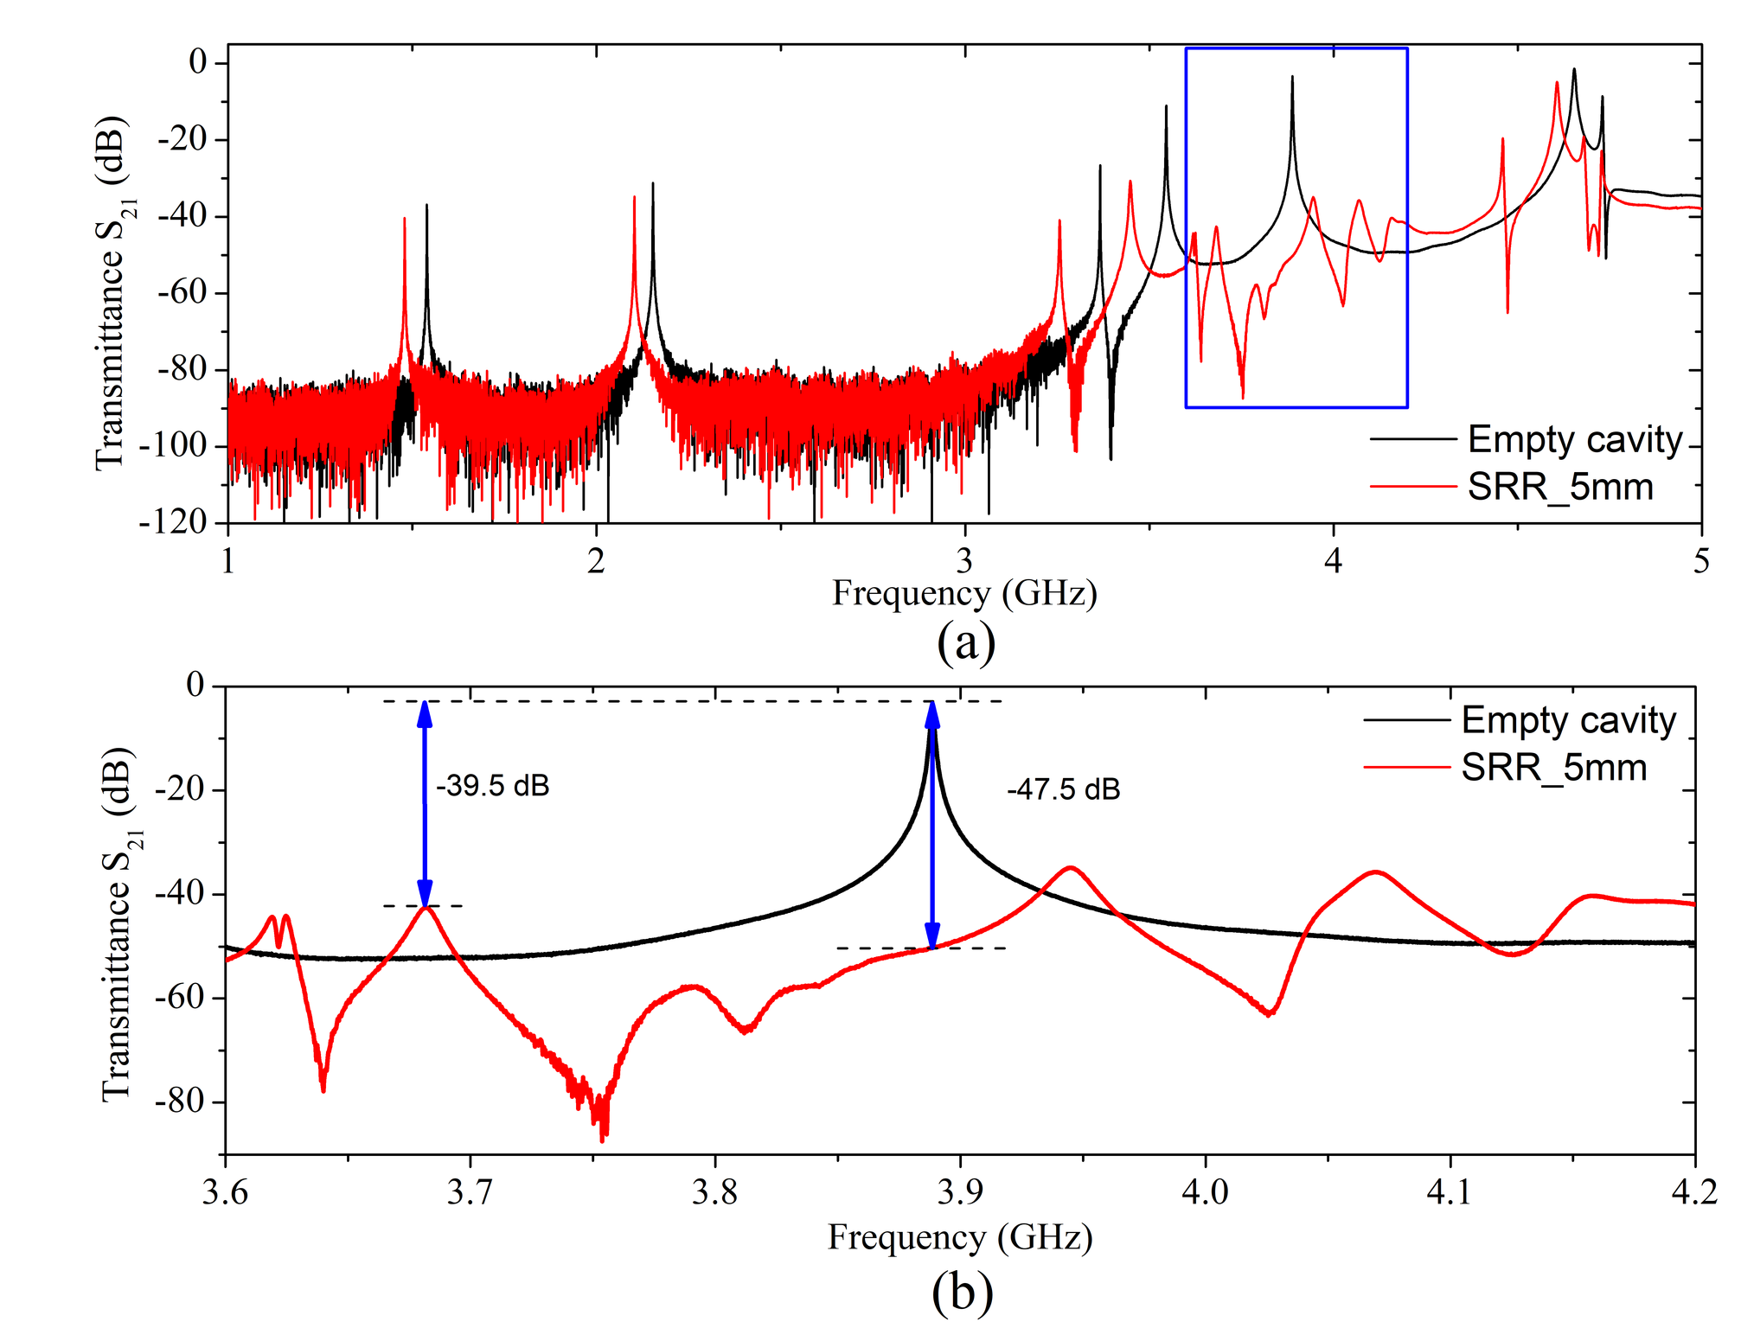
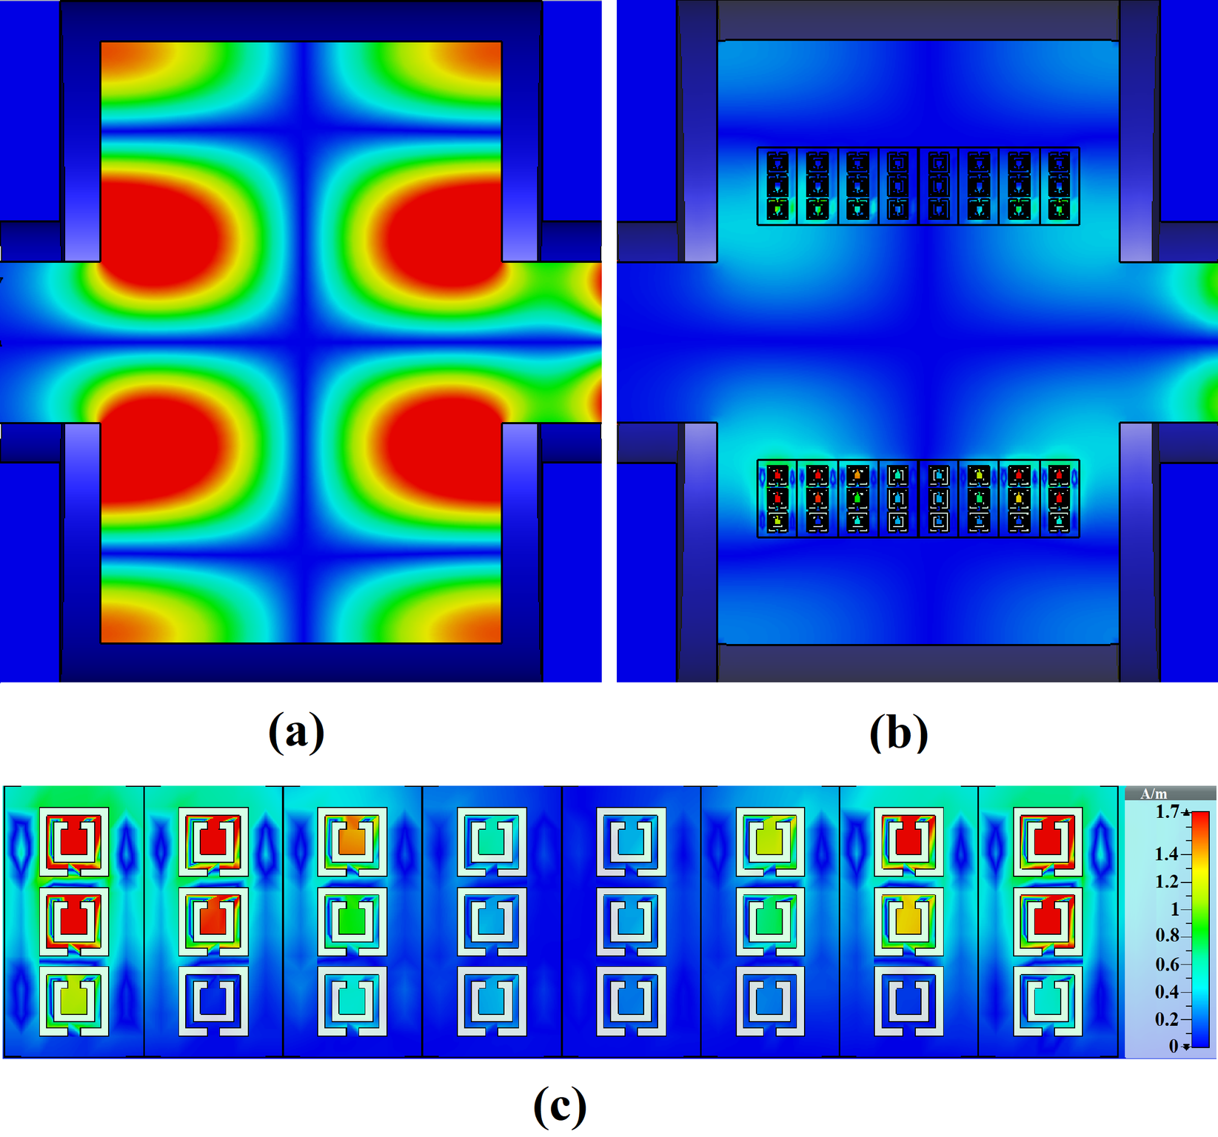
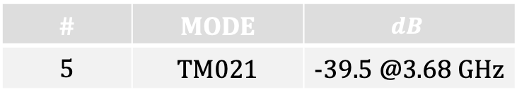
Split Ring Resonators
Alumina SRR sample
(external side 5mm)
# | MODE | $$dB$$
5 | TM021 | -39.5 @3.68 GHz

Slide 6
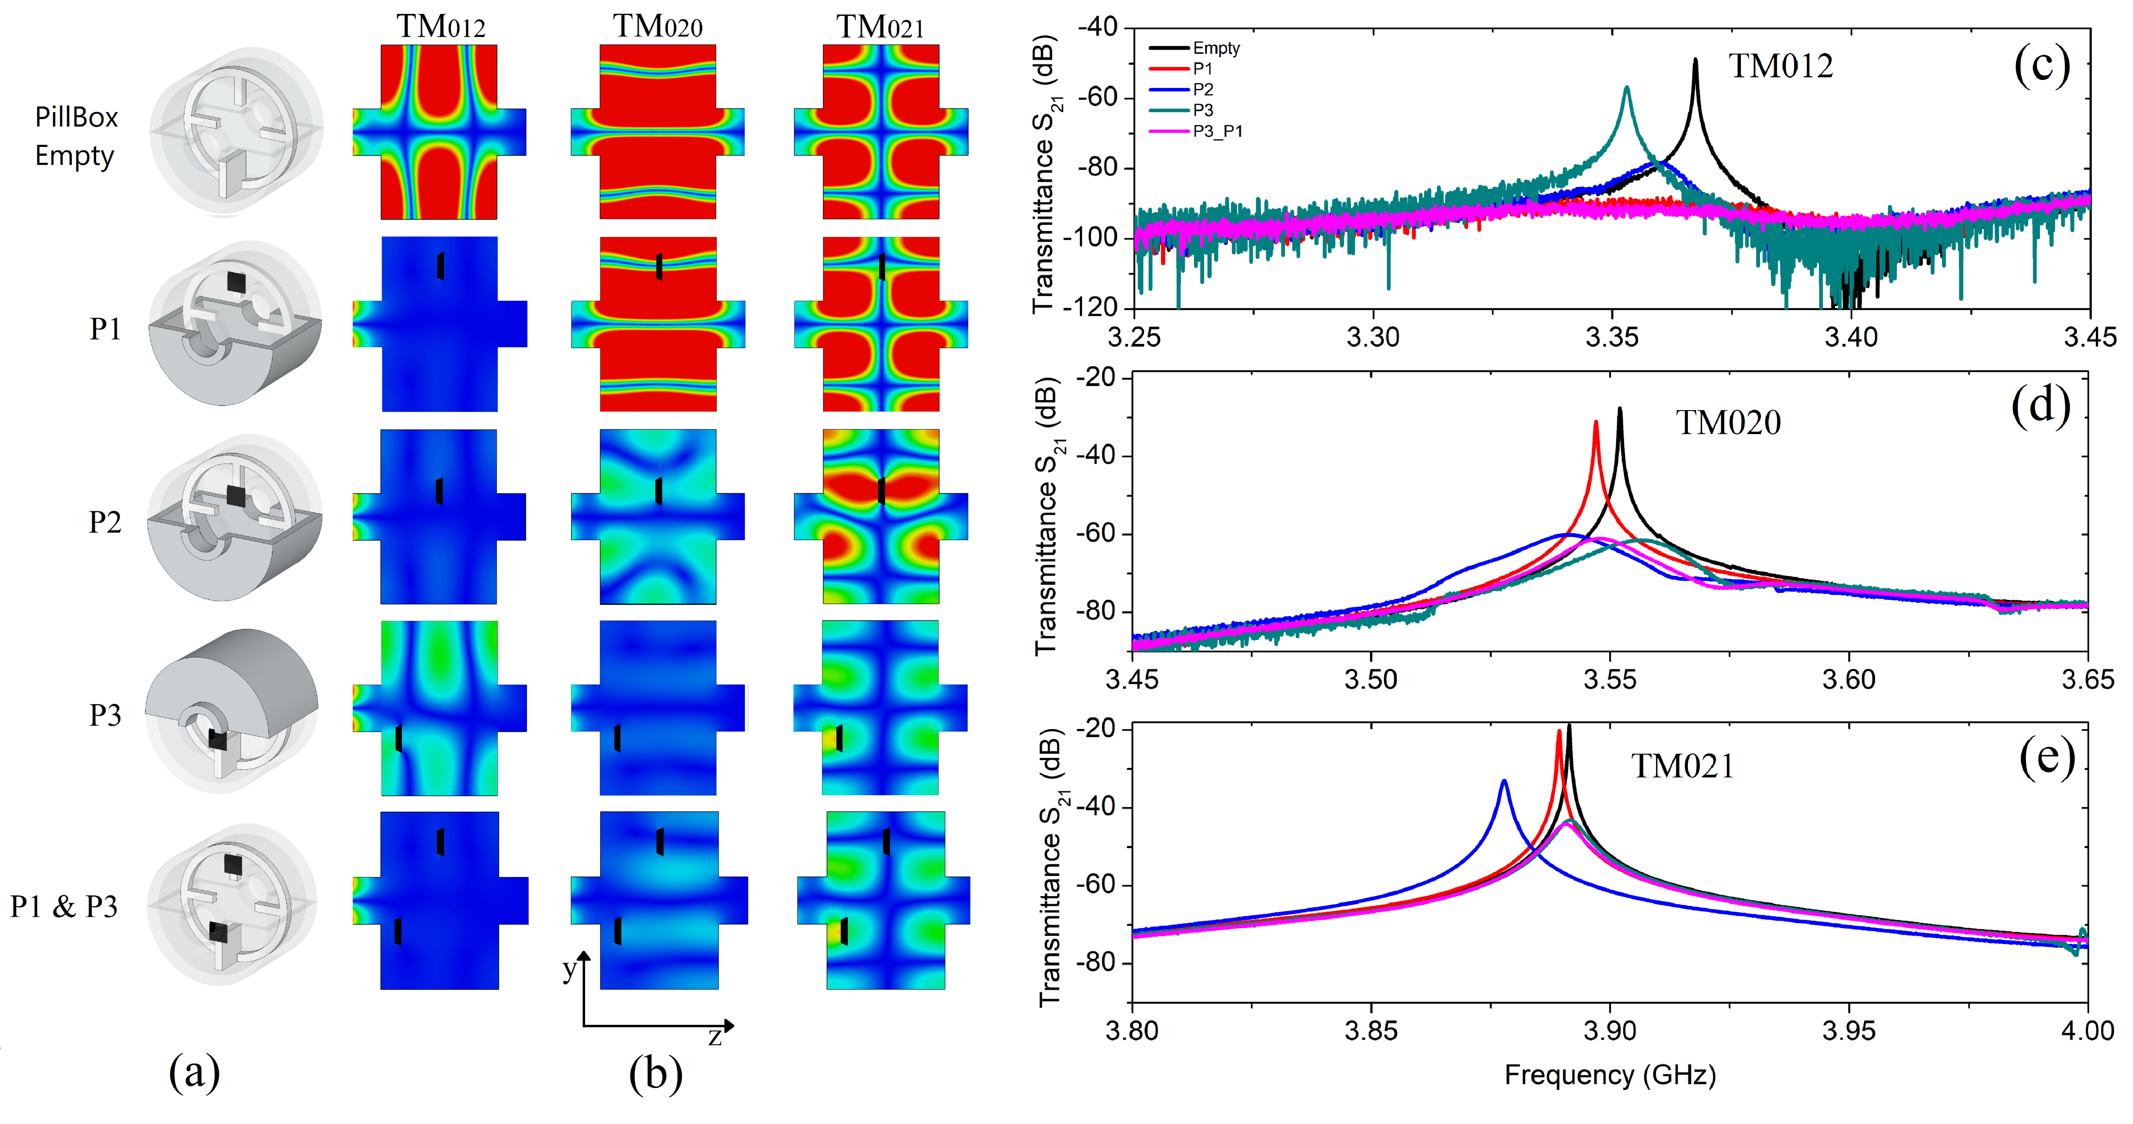
Pyramidal structures

Slide 7
Dielectric resonant cavity

Slide 8
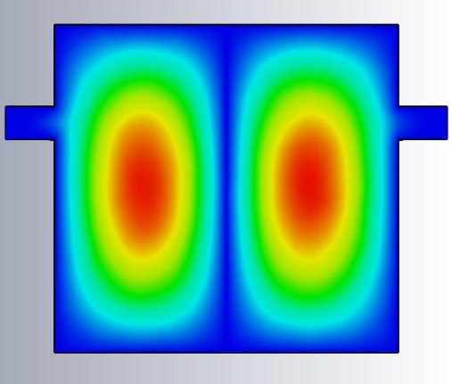
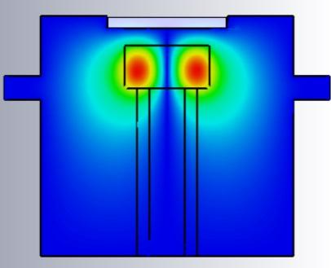
Resonant structure methodology
Dielectric resonator: Resonant structure methodology improves the sensitivity
for the electromagnetic characterization of very thin laser surface treated
structures and conductivity close to copper one
CU coated DUT
Sapphire
Hollow
holder
E field distribution
TE₀₁₁ mode

Slide 9
Resonant structure methodology
Copper vs. molybdenum coated DUT
Δh
sapphire
radius
The maximum Q-factor percentage difference is obtained
with a minimum distance between the DUT and the sapphire

Slide 10
Resonant structure methodology
Expected LESS
The sapphire with
larger radius (3.5 mm)
will be used, because
of its higher sensitivity
in EM characterization
of coating materials
(LESS)

