Slide 1
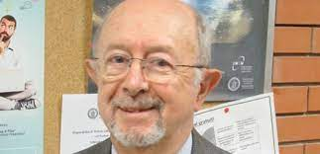
Caratterizzazione di materiali e realizzazione di componenti nel dominio GHz e THz
13/09/2021
Vittorio G. Vaccaro (INFN)
Can Koral (Uni AdR)
Andrea Passarelli
(INFN AdR)
Maria Rosaria Masullo (INFN)
Antonello Andreone (UNINA)

Slide 2
Group expertise (Physicists and Engineers)
Tradition on impedance (studies and laboratory measurements), linac traditional cavity design (LIBO, ACLIP) and innovative resonant cavity studies (PBG cavities) (GHz range)
+
Material science, measurements in normal and superconducting conditions. (from GHz to sub THz)
Frequency range: GHz – 4/5 THz
Lab. Equipment: Network Analyzers (from 100KHz to 20GHz), Time Domain THz spectrometer (from100GHz to 4/5THz)
Several CSN5 experiments: TEGAF, ACLIP, IMCA,MICA, ARYA, ETHIOPIA (new)
Collaboration with INFN-Mi, LNF and INFN-Roma1
Several collaboration agreement with CERN

Slide 3
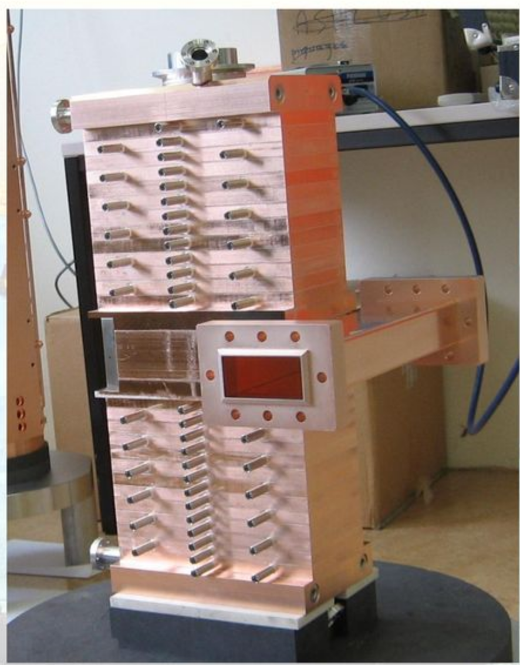
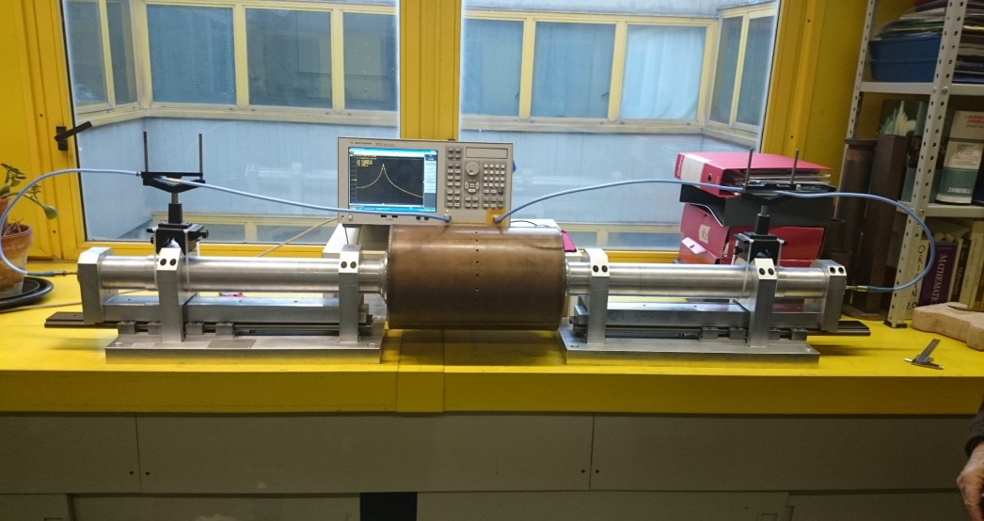
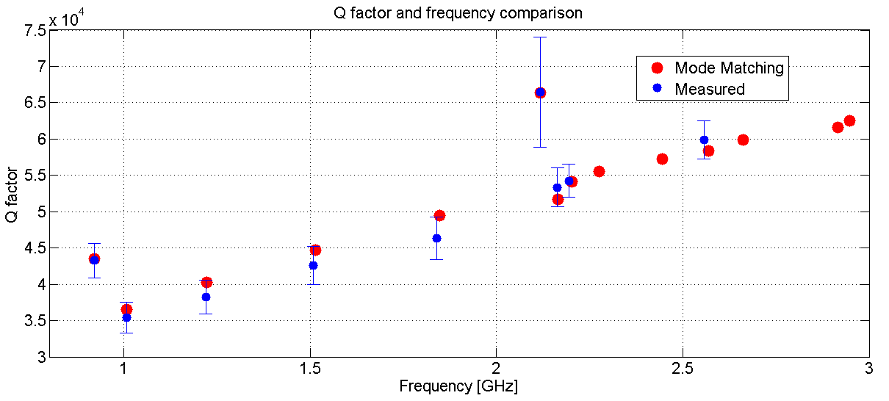
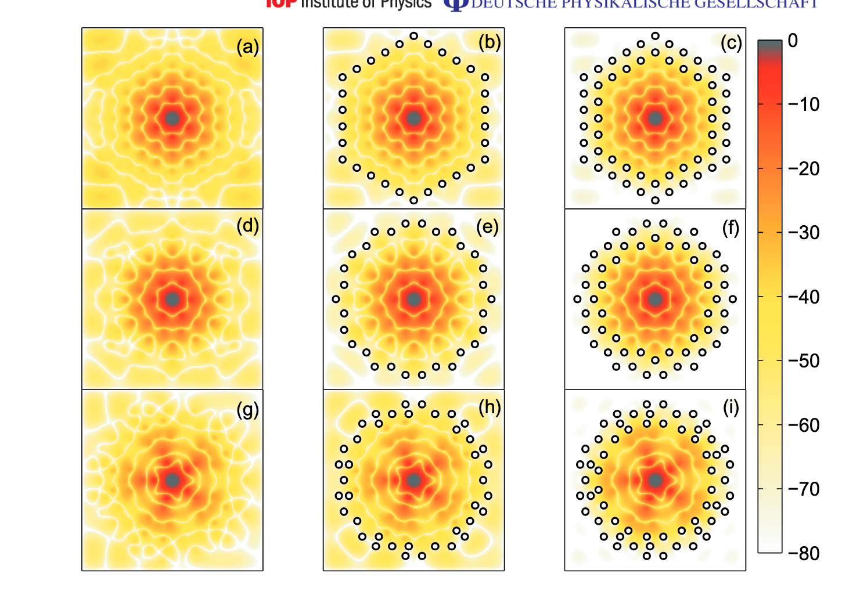
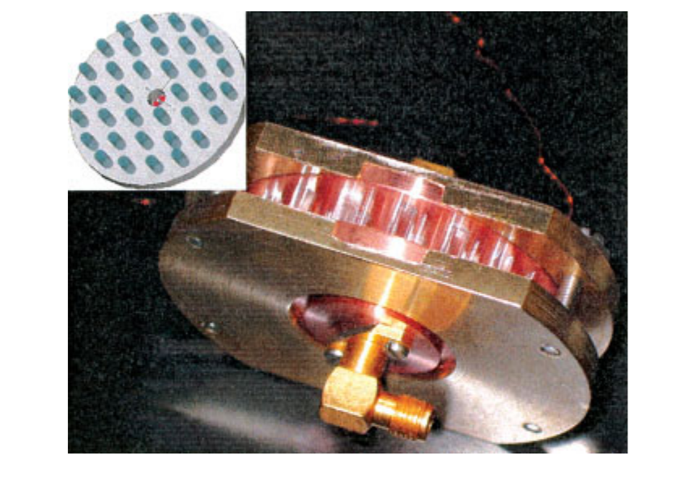
Expertise
3GHz SCL proton linac from 30 MeV (design, tuning, bead-pull measurements)
Lab. Impedance measurements, theory and experiments
Q-factor measurements: telescopic set-up
Photonic Band Gap cavities (normal and SC conductive) - 6-16GHz
Full metallic or dielectric

Slide 4
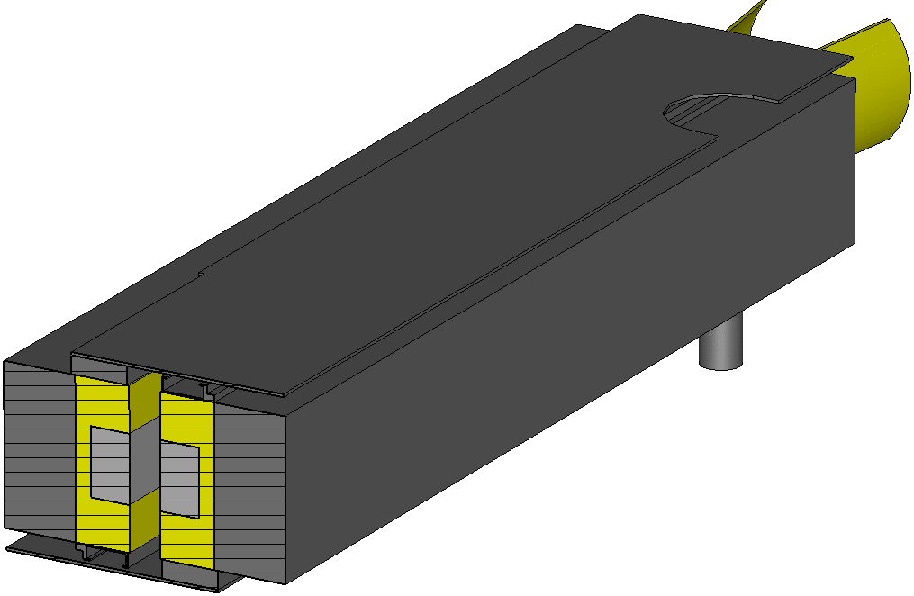
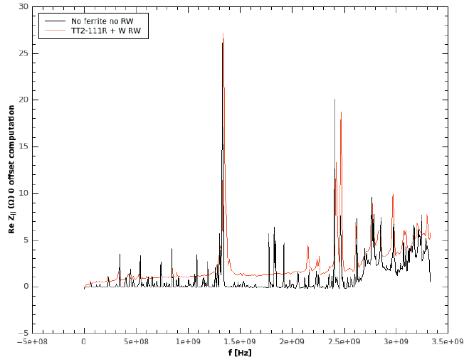
Damping of higher order modes
in resonating structures.
See talk
Many resonances
Not high quality factor, Q
LHC collimator
Conventional techniques:
RF-fingers
HOM dampers
ferrites
Our proposal as absorbers:
Metamaterials
No-invasive solutions
Easily scaling in frequency

Slide 5
Coatings and resistive wall impedance
Coatings required (as examples) for reducing surface degassing or for secondary electron yield mitigation…but layers of coating materials significantly increase the resistive wall impedance
Low conductivity, thin layer coatings (NEG, a‐C)
Rough surfaces (LESS)
Surface impedance of the beam pipe depends on electromagnetic properties of coatings.
Electromagnetic characterization of “coating materials” is fundamental to evaluate accelerator performance limitations and build up a machine impedance model.

Slide 6
Two different methods
Electromagnetic characterization of Coating materials
Dielectric resonant structure
Sub-THz waveguide
• high sensitivity
• small skin-depth
LESS Laser engineered surface structures)
NEG(Non-Evaporable Getter)
a-C (Amorphous carbon)
• conductivity compared with copper
• small samples
• homogeneous coating
• coating thickness issues

Slide 7
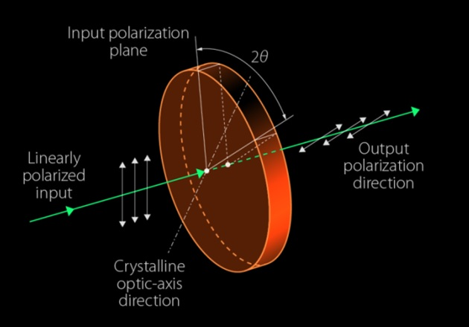
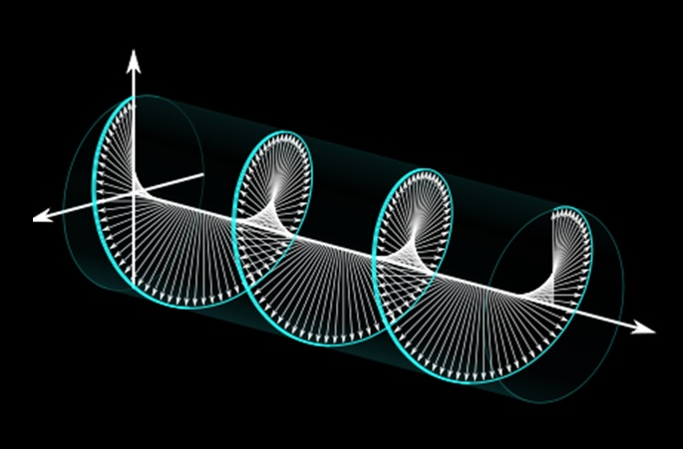
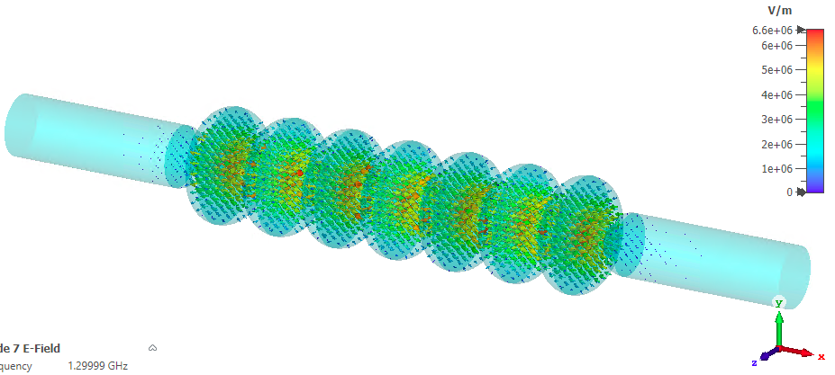
Devices for THz beam manipulation
Studies for TERA experiment and BrixSino project
Beam impedance and beam dynamics- not in this presentation
Beam impedance and wakefield studies (BrixSino project and collaboration with ELETTRA)
New coupling impedance measurements (collaboration with CERN)

Slide 8
RJ.J.J. Nivas, M. Valadan, M. Salvatore, R. Fittipaldi, M. Himmerlich, M. Rimoldi, A. Passarelli, E. Allahyari, S.L. Oscurato, A. Vecchione, C. Altucci, S. Amoruso, A. Andreone, S. Calatroni, M.R. Masullo, Secondary electron yield reduction by femtosecond pulse laser-induced periodic surface structuring, Surfaces and Interfaces, Volume 25, (2021), https://doi.org/10.1016/j.surfin.2021.101179 A. Passarelli, C. Koral, M. R. Masullo, W. Vollenberg,L. L. Amador, and A. Andreone, Sub-THz Waveguide Spectroscopy of Coating Materials for Particle Accelerators Condens. Matter 2020, 5(1), 9; https://doi.org/10.3390/condmat5010009 M. R. Masullo et al., "Metamaterial-Based Absorbers for the Reduction of Accelerator Beam-Coupling Impedance," in IEEE Transactions on Microwave Theory and Techniques, vol. 68, no. 4, pp. 1340-1346, April 2020. DOI: 10.1109/TMTT.2019.2957463 Chikhi, N., Passarelli, A., Andreone, A. et al. Pyramidal metamaterial absorber for mode damping in microwave resonant structures. Sci Rep 10, 19352 (2020). https://doi.org/10.1038/s41598-020-76433-3 Passarelli, Andrea and Bartosik, Hannes and Rumolo, Giovanni and Vaccaro, Vittorio Giorgio and Masullo, Maria Rosaria and Koral, Can and Papari, Gian Paolo and Andreone, Antonello and Boine-Frankenheim, Oliver, Novel measurement technique for the electromagnetic characterization of coating materials in the sub-THz frequency range, Phys. Rev. Accel. Beams,vol. 21,issue10, Oct.2018, https://link.aps.org/doi/10.1103/PhysRevAccelBeams.21.103101 Papari, G.P., Koral, C. & Andreone, A. Geometrical Dependence on the Onset of Surface Plasmon Polaritons in THz Grid Metasurfaces. Sci Rep 9, 924 (2019). https://doi.org/10.1038/s41598-018-36648-x
More recent bibliography

