Slide 1
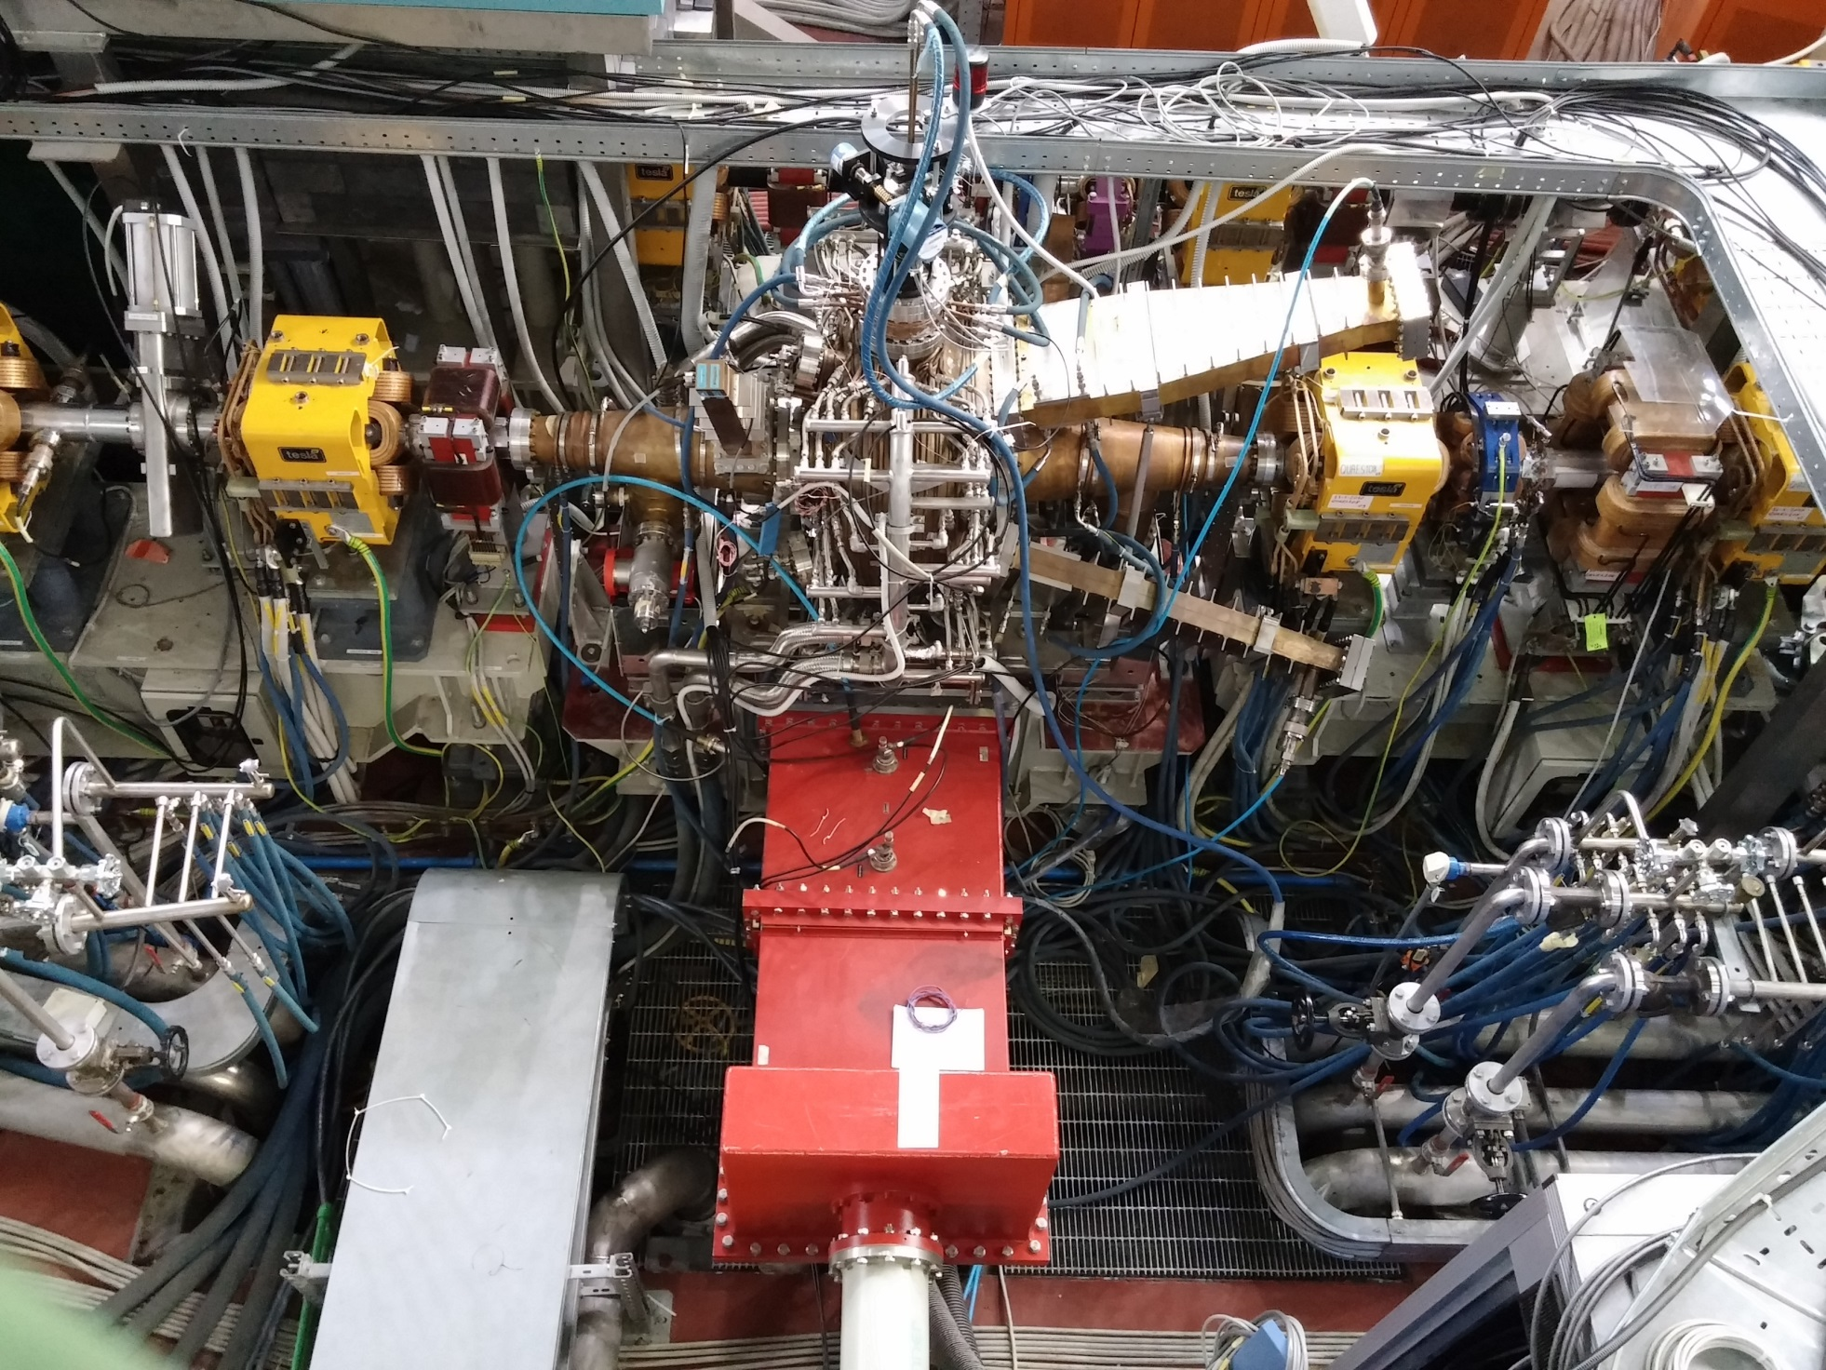
Radiofrequency activities at Frascati National Labs of INFN
Expertise Organization Manpower Infrastructures
A. Gallo
D. Alesini
B. Buonomo
L. Piersanti
and colleagues
1st INFN RF community National Meeting, Sept. 13 2021

Slide 2
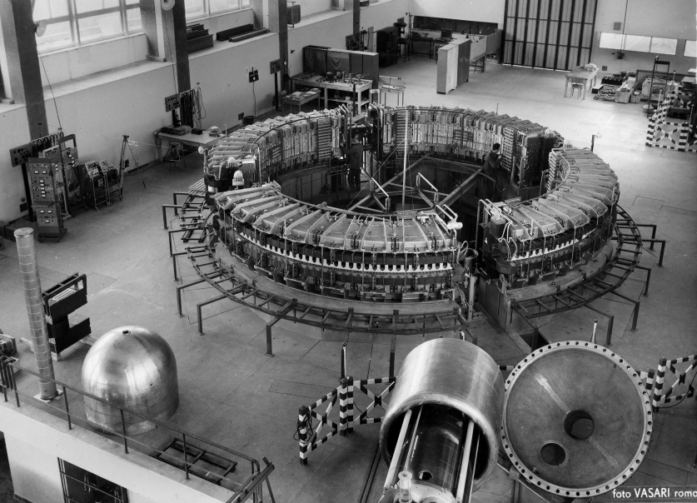
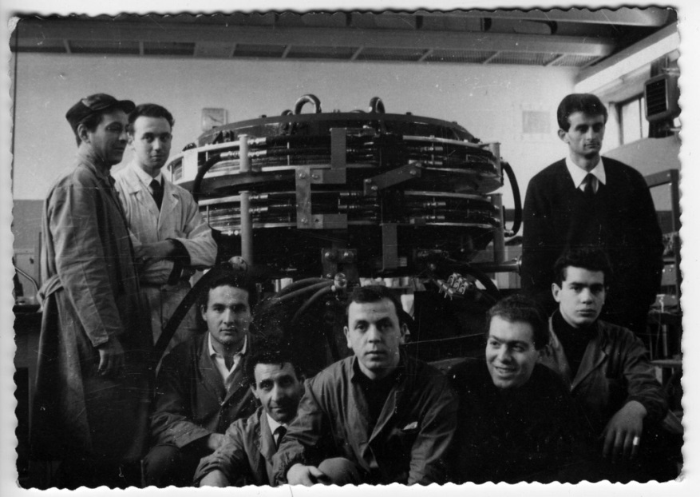
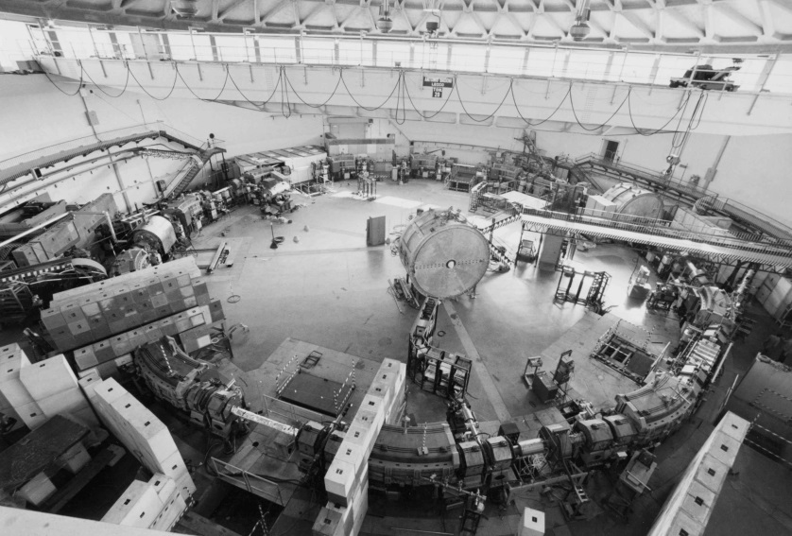
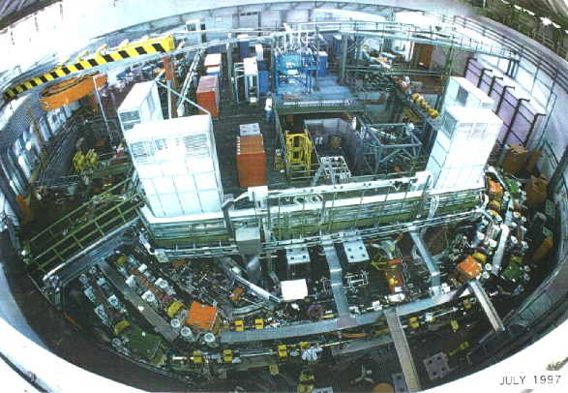
A. Gallo, Radiofrequency activities at Frascati National Labs of INFN
LNF is historically a storage ring based Lab
Electro-synchrotron, 1959
ADA, 1961
ADONE, 1969
DAΦNE, 1997-today
1st INFN RF community National Meeting, Sept. 13 2021

Slide 3
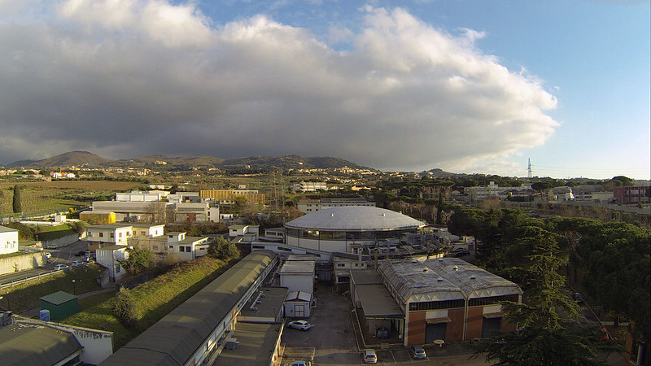
A. Gallo, Radiofrequency activities at Frascati National Labs of INFN
Historically, INFN Frascati is a high-energy physics lab, making use of storage rings to accelerate leptons.
The scientific mission has guided and imprinted the background of the accelerator physicists, including obviously the radio-frequency experts.
These kind of facilities require RF systems of two different types:
  CW NC system for low gradients (< 1 MV/m) and high beam current (> 1 A) in the rings;
  Pulsed NC high frequency (≈3 GHz and beyond) medium/high gradient (10÷20 MV/m) in the injector linac
1st INFN RF community National Meeting, Sept. 13 2021

Slide 4

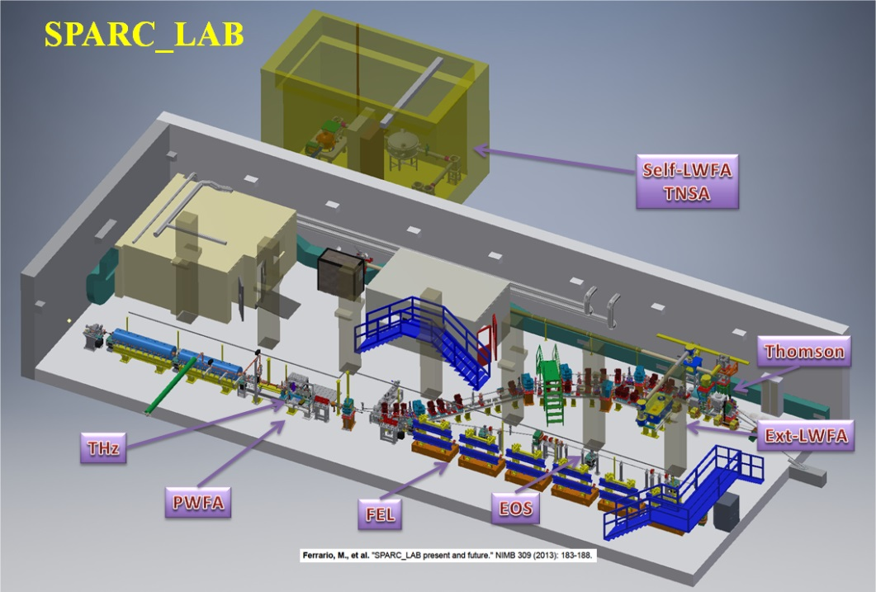
A. Gallo, Radiofrequency activities at Frascati National Labs of INFN
Expertise on S-band linac was one of the most relevant motivation to move on early 2000 toward a new field, the high brightness beam applications such as FEL radiation generation. This led to the construction of a second accelerator-based facility at LNF, named SPARC_Lab.
The SPARC_Lab core is a high brightness photo-injector based on high gradient S-band and C-band RF structures.
In recent years a plasma-cell has been installed downstream the photo-injector, to study and optimize electron-bunch accelerations through plasma waves.
This development has led to the proposal of the next accelerator facility to be built at LNF, called EuPRAXIA@SPARC_Lab, where electrons will be accelerated by a mix of state-of-the-art gradient X-band structures and particle driven plasma waves.
1st INFN RF community National Meeting, Sept. 13 2021

Slide 5
A. Gallo, Radiofrequency activities at Frascati National Labs of INFN
EuPRAXIA@SPARC_Lab project
S-band injector + High gradient X-band linac
X band power stations
TL to plasma, beam dumps and undulators
chicane
Klystron and modulator
Diagnostic chamber+ vacuum valve
X band modules
Pumps with T pumping units
BOC (PSI)
Low attenuation circular waveguide (4,7 m)
Stripline integrated into the quadrupole.
hybrids
X-band section
prototype (reduced length)
X-band RF accelerating module
1st INFN RF community National Meeting, Sept. 13 2021

Slide 6
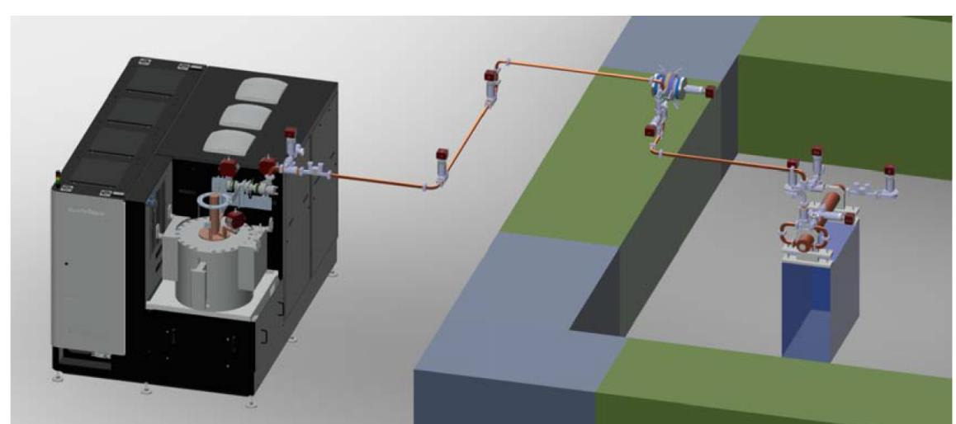
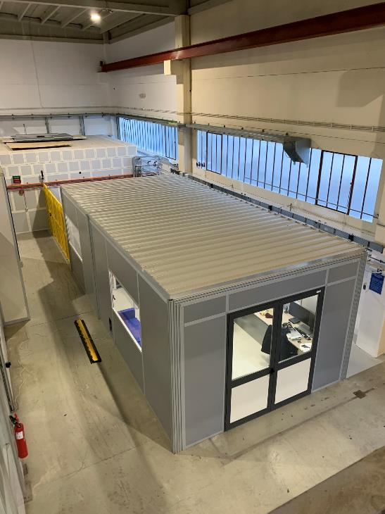
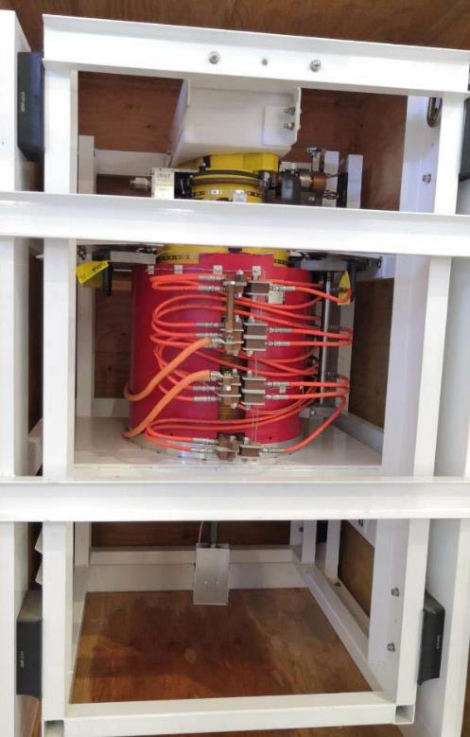
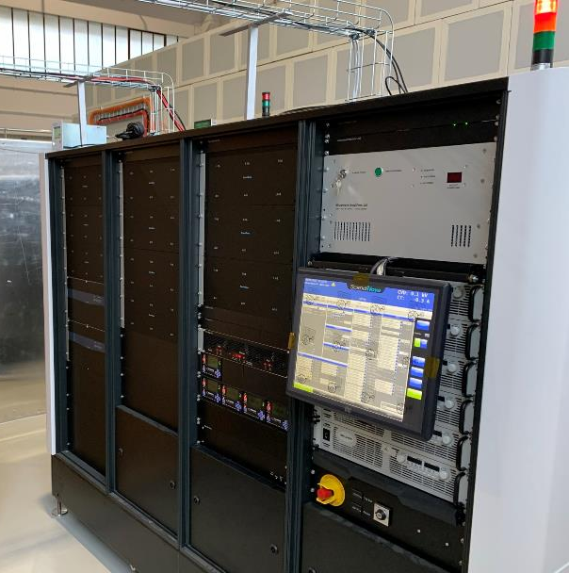
A. Gallo, Radiofrequency activities at Frascati National Labs of INFN
INFN-LNF X BAND TEXT FACILITY TEX
The TEX test stand (currently under implementation at LNF) has been conceived to test all the RF components and structures necessary for EuPRAXIA (including LLRF system, Vacuum, Control System,…).
TEX: it is fundamental to test all RF components at the nominal power and X band prototypes, there is a necessity to acquire asap a CPI klystron with the nominal parameters in term of power and rep. rate;
It has been co-funded by the Regione Lazio in the framework of the LATINO project
The setup of the test stand has been done in collaboration with CERN that provided the first CPI klystron and some waveguide component and will be also used to test CLIC structures.
klystron
Bunker
Courtesy
S. Pioli, F. Cardelli, E. Di Pasquale
Modulator
TEX Control Room
1st INFN RF community National Meeting, Sept. 13 2021

Slide 7
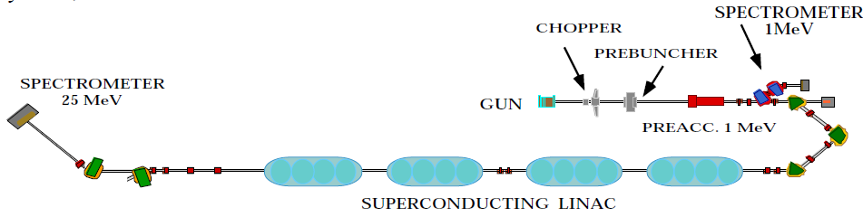
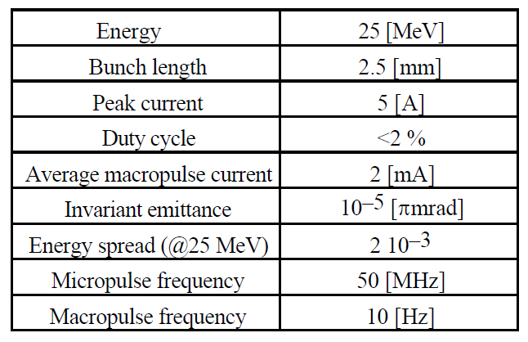
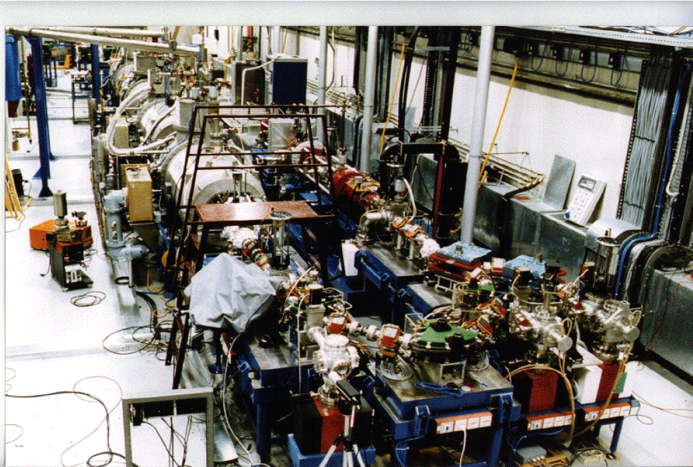
A. Gallo, Radiofrequency activities at Frascati National Labs of INFN
THE LNF SUPERCONDUCTING LINEAR ACCELERATOR LISA
For about a decade (mid 80s – mid 90s last century) LNF had been a SC RF expertise center driven by the construction of the SC linac LISA. The facility was aimed at delivering high average current of 25 MeV electrons to be used for a pioneeristic FEL experiment. The machine had been dismissed in 1996 and the hall subsequently reused to accommodate the SPARC photoinjector.
Regrettably, the SC RF expertise at LNF has been almost completely lost.
Modulator
1st INFN RF community National Meeting, Sept. 13 2021

Slide 8
A. Gallo, Radiofrequency activities at Frascati National Labs of INFN
RF DAFNE linac (whole)
Pulsed RF power stations (Sparc_Lab)
RF Storage Rings (whole)
LLRF (SPARC_Lab)
fs synchronization (Sparc_Lab)
RF devices design
RF devices engineering
RF devices construction
Common effort and collaboration for test and conditioning of new devices
1st INFN RF community National Meeting, Sept. 13 2021

Slide 9
A. Gallo, Radiofrequency activities at Frascati National Labs of INFN
Manpower (RF experts)
Name | Qualification | FTE
Alesini David | Dir Tec | 0,8
Buonomo Bruno | 1° Tec | 0,6
Bellaveglia Marco | Tecnologo | 0,4
Behtouei Mostafa | AR | 0,5
Cardelli Fabio | Tecnologo | 1
Di Giovenale Domenico | Tecnologo | 0,4
Di Giulio Claudio | Tecnologo | 0,4
Faillace Luigi | Tecnologo | 1
Falone Antonio | 1° Tec | 0,1
Foggetta Luca | Tecnologo | 0,3
Gallo Alessandro | Dir Tec | 0,3
Piersanti Luca | Ricercatore | 1
Spataro Bruno | Ass. senior | 0,5
TOTAL: 13 people |  | 7,3
Name | Qualification | FTE
Baldini Pietro | Ass. senior | 0,1
Belli Maurizio | Ass. senior | 0,1
Ceccarelli Matteo | Technician | 0,6
Ceccarelli Riccardo | Technician | 0,6
Cecchinelli Alberto | Technician | 0,6
Clementi Renato | Ass. senior | 0,2
Rossi Louis Antonio | Technician | 0,6
Piermarini Gaziano | Technician | 0,6
Quaglia Sergio | Technician | 1
Scampati Michele | Technician | 1
Scaselletta Giorgio | Technician | 1
Zarlenga Raffaele | Technician | 0,6
Zelinotti Luca | Technician | 1
TOTAL: 13 people |  | 8,0
Tecnologi / Ricercatori
Technicians
1st INFN RF community National Meeting, Sept. 13 2021

Slide 10
A. Gallo, Radiofrequency activities at Frascati National Labs of INFN
Facilities, Infrastructures, Projects
International collaborations:
CERN-CLIC (MoU)
IFAST (EU H2020)
XLS CompactLight (EU H2020)
SLAC, PSI, FERMI … (informal)
Internal:
DAΦNE/BTF
SPARC_Lab
TEX
LISA (dismissed)
EuPRAXIA@SPARC_Lab
(under design)
External projects:
ELI-NP
STAR / STAR-HE
1st INFN RF community National Meeting, Sept. 13 2021

Slide 11
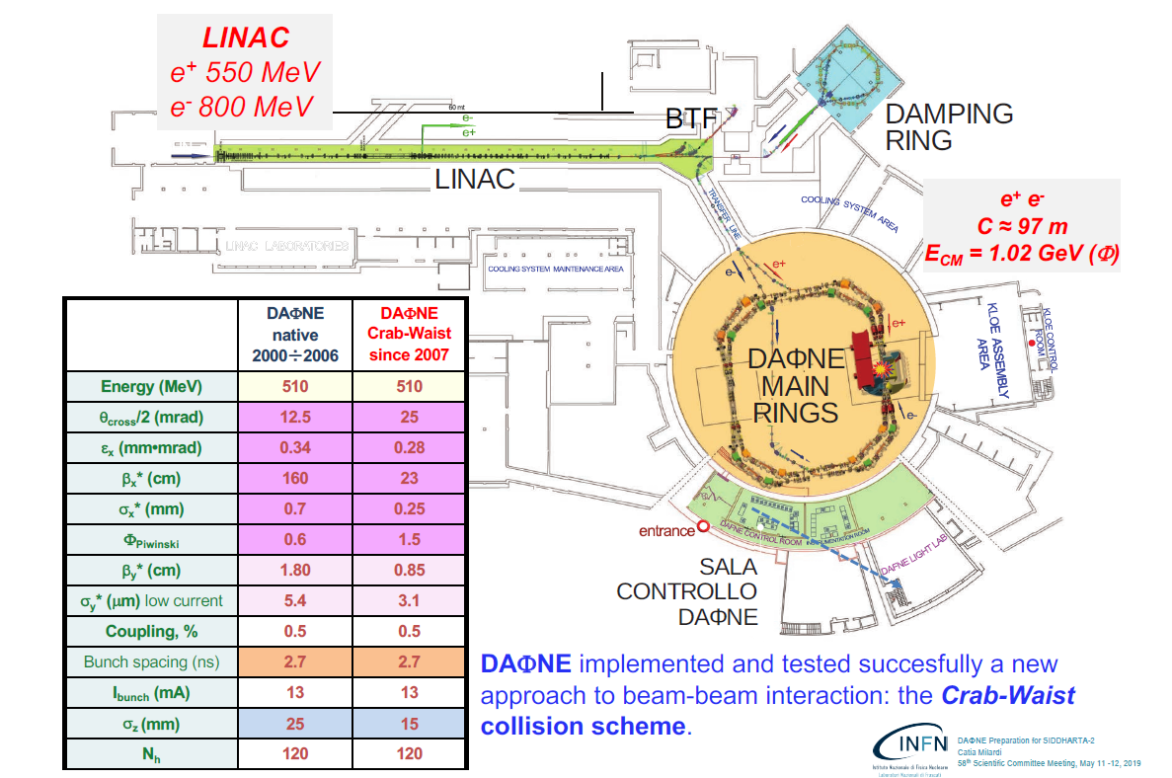
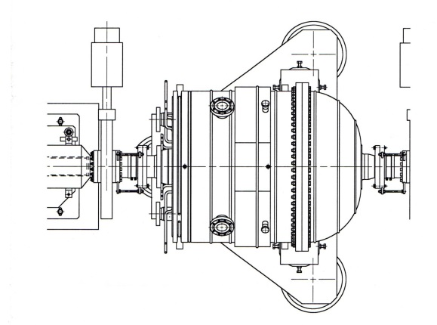
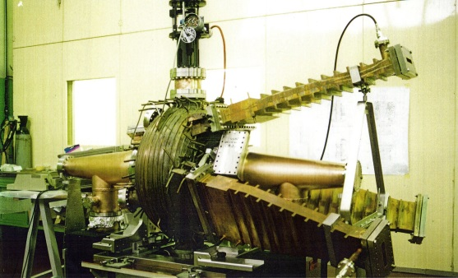
A. Gallo, Radiofrequency activities at Frascati National Labs of INFN
RF systems of the DAΦNE rings
1 x
73.7 MHz, λ/4 resonator
2 x
368.5 MHz, one-cell HOM damped
1st INFN RF community National Meeting, Sept. 13 2021

Slide 12
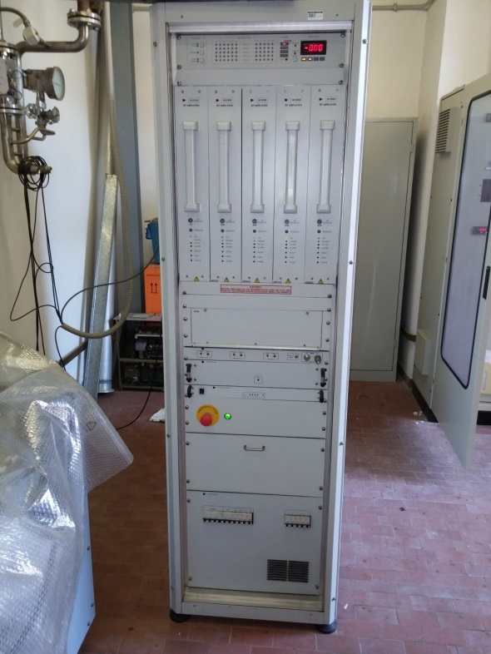
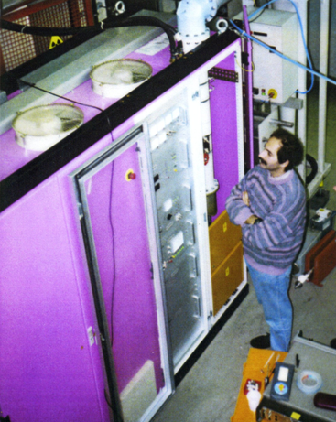
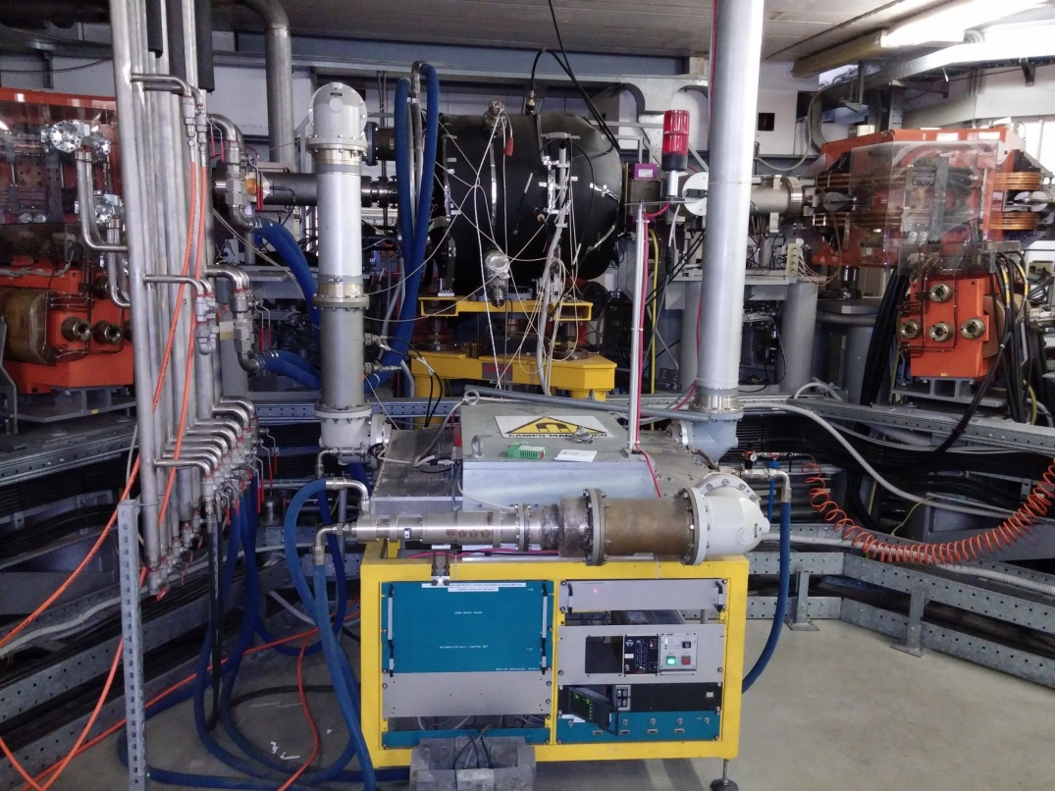
A. Gallo, Radiofrequency activities at Frascati National Labs of INFN
RF system of the DAΦNE damping ring
Cavity type: λ/4
Frequency: 73.7 MHz
# of cavities: 1
Max cavity voltage: 150 kV
Beam configuration: single bunch
Operation modality: CW, transient beam loading
RF source: 12 kW, solid state
Spare RF source: 30 kW, tetrode
12 kW Solid State amp
30 kW Tetrode amp
Huge experience on thermionic valve based station, bound to disappear
1st INFN RF community National Meeting, Sept. 13 2021

Slide 13
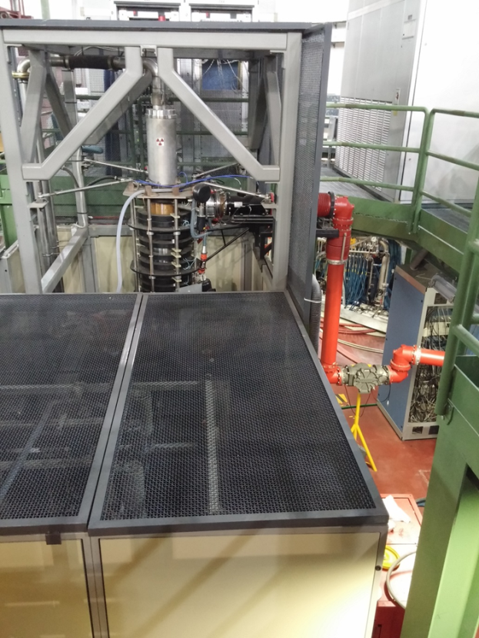
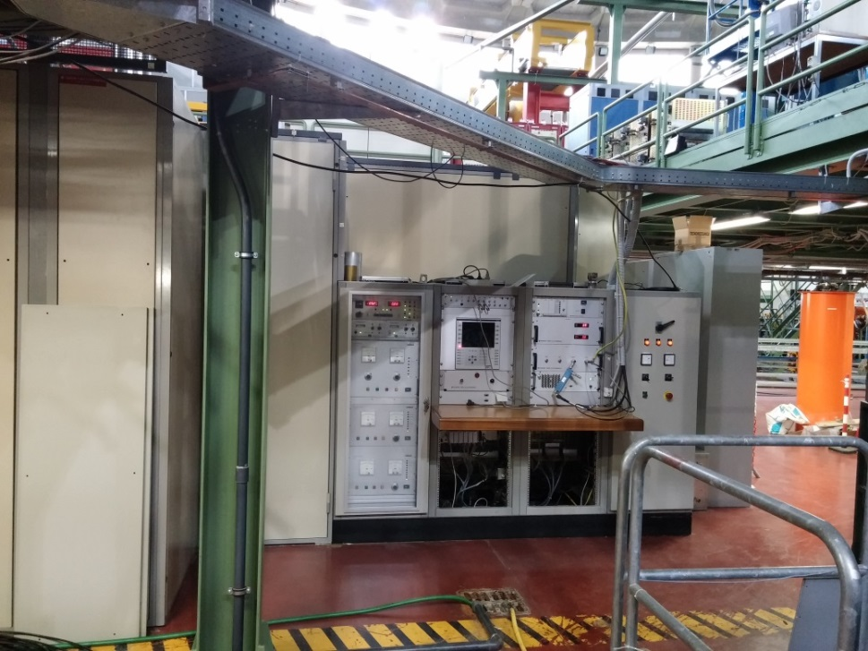
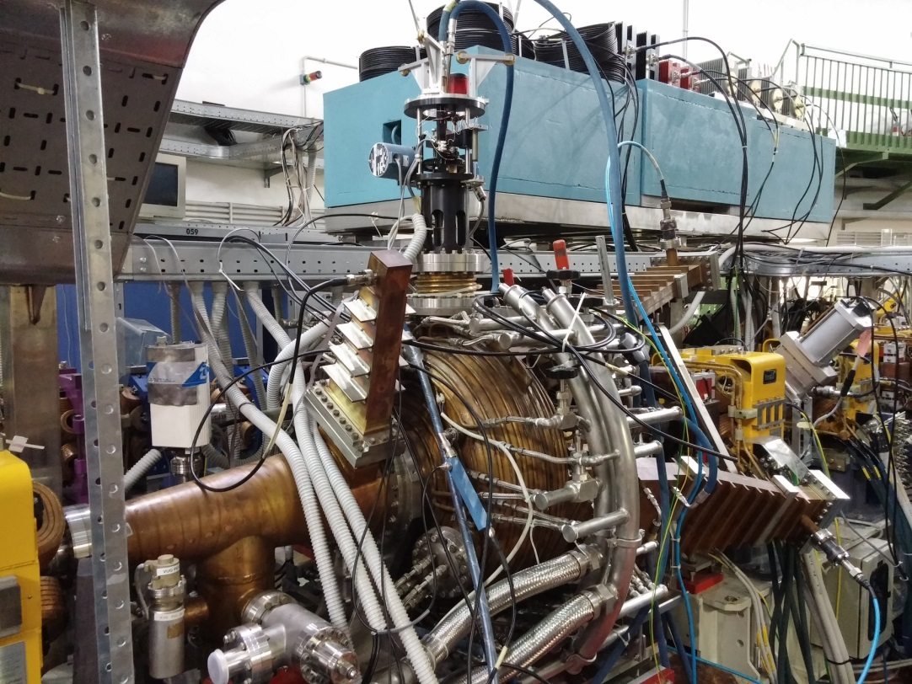
A. Gallo, Radiofrequency activities at Frascati National Labs of INFN
RF system of the DAΦNE main rings
Cavity type: single cell, heavy HOM damped
Frequency: 368.6 MHz
# of cavities: 1 per ring
Max cavity voltage: 300 kV
Beam configuration: multibunch, heavy beam loading
Operation modality: CW
RF source: 150 kW, CW klystron
150 kW CW power station based on klystron provided by THALES/THOMSON in middle 90s of last century, not in production anymore
1st INFN RF community National Meeting, Sept. 13 2021

