Slide 1


1st INFN RF community Meeting
RF sorgenti ioniche al plasma:
sistemi di launching, diagnostiche e applicazioni alla fusione
13 settembre 2021
Ornella Leonardi

Slide 2




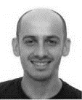



LNS Expertise and know-how
Ion Source design, realization and commissioning
Plasma Heating and microwave coupling mechanism
RF & MW launching scheme (FTE,TFH,O-X-B conversion)
Plasma Diagnostiche over e.m. spectrum
Magneto-Plasma modelling via autoconsistent PIC simulation
S. Gammino
D. Mascali
L.Neri
L. Celona
O.Leonardi
G. Torrisi
Pitadella
G.Castro
M. Mazzaglia
E. Naselli
G. Mauro
G. Sorbello
Di Donato

Slide 3
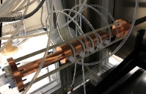


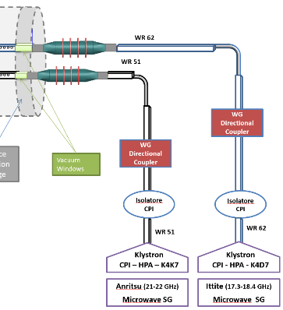
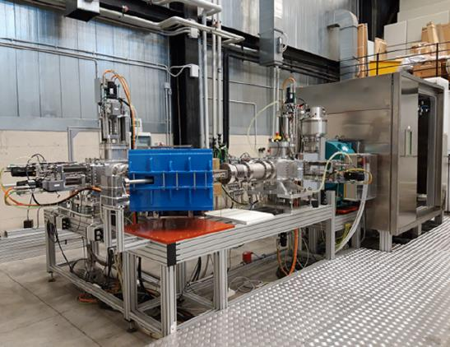
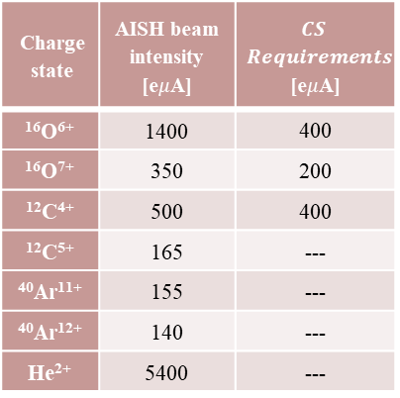
Launching Scheme in Ion Souce
Advanced Ion Source for Hadrontherapy - AISHa
ECR Ion souce
Multicharged ions beams
Low space occupation
High stability
High reproducibility
Low maintenance time
Charge state | AISH beam intensity [e$μ$A] | $$CS$$ $$Requirements$$ [e$μ$A]
¹⁶O⁶⁺ | 1400 | 400
¹⁶O⁷⁺ | 350 | 200
¹²C⁴⁺ | 500 | 400
¹²C⁵⁺ | 165 | ---
⁴⁰Ar¹¹⁺ | 155 | ---
⁴⁰Ar¹²⁺ | 140 | ---
He²⁺ | 5400 | ---
FTE - TFH
Digital Fast Tuner System
fine frequency tuning on 24 preset channel
Notes:
<q>∝ neTi,
I∝ ne/Ti,

Slide 4
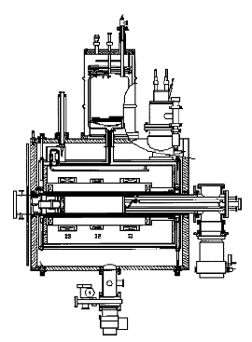
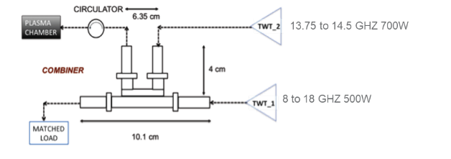
Launching Scheme in Ion Souce
CAESAR operating since 2002 at INFN-LNS
as injector of the Superconducting Cyclotron together with SERSE
In order to involve the TFH a Diplexer Hybrid Coupler Waveguide Combiner in the frequency band [13.5-15.6] GHz, up to 1.5 kW, is was used.
The 4-ports passive device implements a "multiplexing“ in the frequency domain allows to combine the power coming out from the two TWTs
we are able to simultaneously transmit two frequencies
without interference and power loss
Klystron CPI 18 GHZ 2kW
TWT CPI 17.3-18.4 GHz 500W
TWT CPI 13.7-14.5 GHz 500W
TWT Bonn 8-18 GHz 500W
Notes:
increasing the efficiency of ECR heating as a way to maximize the current of extracted ions.
Up to now, in fact, RF launching in these machines has been based on the very simple scheme of rectangular (or, more rarely, circular) waveguides mechanically matched to cylindrical plasma chamber
The “Two Frequency Heating" (TFH) has been implemented many times in ECRIS equipped by a double microwave-port at the injection endplate.
We tried to implement the same method in a compact ECRIS named CAESAR, and operating since 2002 at INFN-LNS as injector of the Superconducting Cyclotron.
Due to its compactness, the plasma chamber has only one microwave port allowing microwave launching.

Slide 5

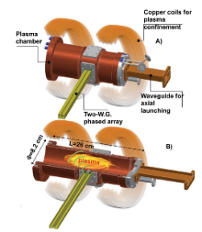
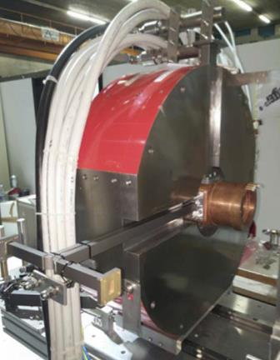
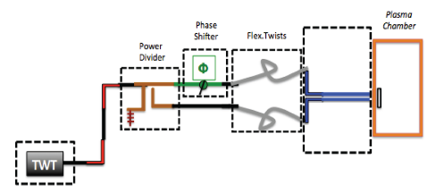
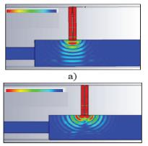
Launching Scheme in Ion Souce
This new lunching scheme arise to overcome
the so-called cut-off density (ne)
Electron Bernstein Waves Heating
unaffected by density cut-off issues
generated by electromagnetic-to-electrostatic mode conversion
FPT(Flexible Plasma Trap)
5 GHz
TWT [3-7 GHz]
Taking inspiration from phased multi-waveguide structures, designed to heat large toroidal plasmas
“waveguide grill”
Δϕ=0°
14 GHz
TWT [13.75-14.5 GHz]
Δϕ=180°
Compact ECR ion source
simple-mirror, magnetic beach and flat magnetic
field configuration
The launcher consists of two waveguide with relative phase controlled by a calibrate phase shifter, a loaded four-port power divider and two flexible and twistable WR62 waveguides. A steering of the radiated beam can be produced, in order to obtain an optimum incidence angle
Notes:
FPT is equipped by three solenoids normal condittivi providing three different possible profiles of the magnetic field: simple mirror; quasi-flat; and magnetic beach.
No beam extraction systems have been coupled to the machine. One of the chamber endplates is dedicated to microwave launching and gas-injection, the other one to plasma diagnostics.
O-X-B-like scenarios are possible by properly launching the pumping O-wave from the radial port.
As mentioned in the previous section, the antenna should be optimized in order to emit the heating power with an optimal k(r) angle with respect to the external magnetic field B0.
The absorption of the waves in the vicinity of the resonance layer should be almost complete in a single “pass", if the proper mode of irradiation is chosen.
I∝ ne/Ti,
alternative plasma heating schemes such as Electron Bernstein Waves (EBW) heating, being the EBW unaffected by density cut-off issues and generated by electromagnetic-to-electrostatic mode conversion mechanism

Slide 6
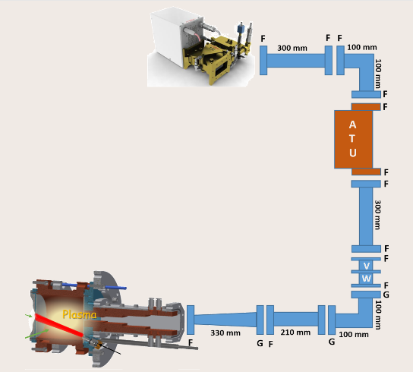

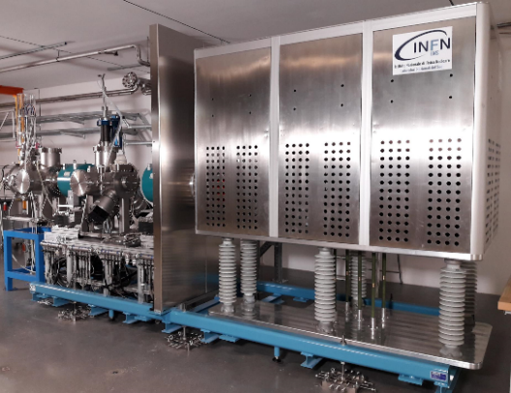
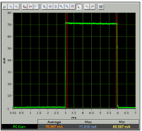
Launching Scheme in Ion Souce
PS-ESS – Proton Souce for Europian Spallation Source
DC
Sairem Magnetron 2.45 GHz – 2kW
ATU
2 x DC (40dB coupling - 25/30dB directivity)
WR340 and WR284
DC
MDIS – Microwave Discarge
High Extraction Current
Very Low charged beams (1+)
High stability

Slide 7

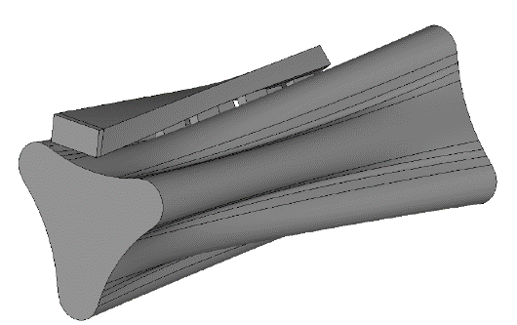
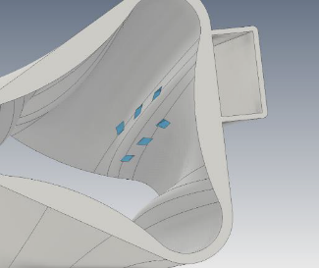
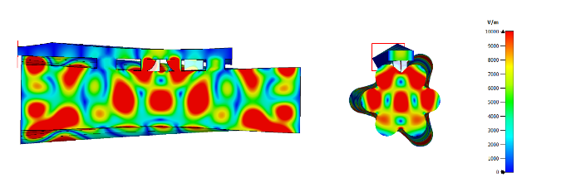
Launching Scheme in Ion Souce
IRIS (Innovative Resonators for Ion Source)
Unconventionally shaped plasma cavity, in which its geometry is inspired by the typical star-shaped ECR plasma, determined by the electrons trajectories as they move under the influence of the plasma-confining magnetic field together an innovative microwave injection system based on side-coupled slotted waveguides.
Supported by the 3rd Nat. Comm. of INFN, under the PANDORA_Gr3
Electric field module normalized @10 kV/m
Notes:
Additive Manufacturing

Slide 8

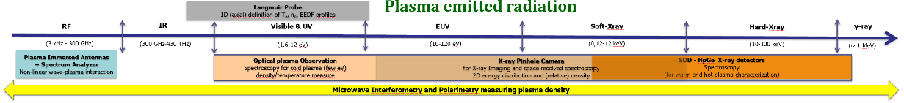

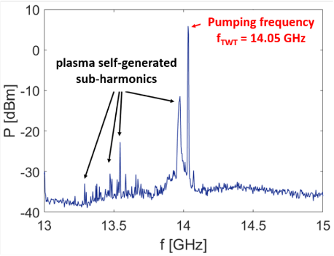
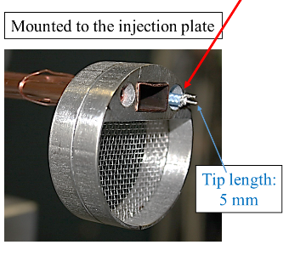
Divertor
Tokamak
Test
Diagnostics in Ion Souce
two-pins RF Probe
Attenuator
3-30dB
RF power limiter
Spectrum Analyzer
this setup is able to detect both the main pumping frequency and the self-plasma emitted radiations inside the plasma chamber after performing “frequency-resolved” spectra
the RF plasma self-emission sub-harmonics represents signatures of plasma kinetic instabilities
It can be used to detect and characterize turbulent plasma regimes in order to find a way to damp them and improve the ECRIS performances
Measurement done in the ATOMKI-ECRIS using a pumping frequency of 14.05 GHz by a TWT

Slide 9
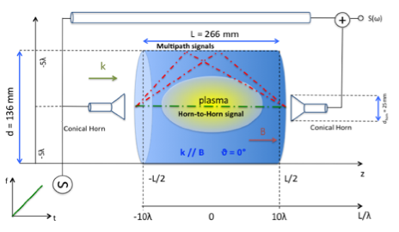
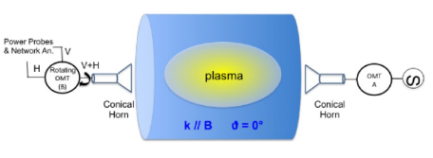
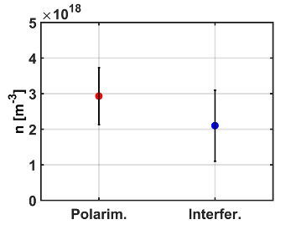
Divertor
Tokamak
Test
Diagnostics in Ion Souce
VESPRI (VEry Sensitive evaluation of Plasma density by micRowave Interferometry
Polarimetric system
based on Faraday rotation of the wave’s polarization plane crossing the magnetoplasma
Interferometry System
based on the phase-shift induced by the plasma refractive index
Estimation of the
whole electron population
The probing microwave signal is transmitting
inside the plasma chamber
The position of the OMT(B) is rotated (via in-vacuum rotatable joint connection in circular waveguide standard) in order to minimize the received power on
the Cross-polar port of the OMT (B) itself
The density is derived by the frequency shift
of a beating signal obtained during the fast sweep
of both probing and reference microwave signals.
By performing a fast Fourier transform analysis on the beating pattern, it is possible to filter out the dominant component from the multipath contributions

Slide 10
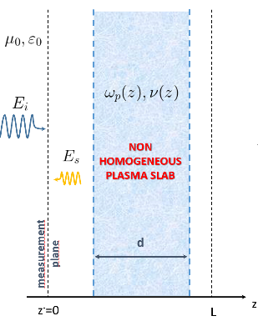
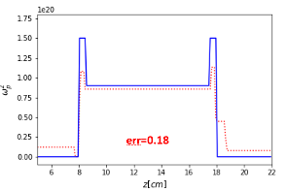
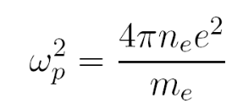
Divertor
Tokamak
Test
Diagnostics in Ion Souce
Microwave imaging profilometry (MIP) of plasma as 1D inverse scattering problem
Interferometric and polarimetric techniques provide line-integrated measurements and they cannot give local information about electron density, but only a line-of-sight integrated value
Microwave Imaging Profilometry (MIP) may allow the obtaining of tomographic, i.e., volumetric, information of plasma that could overcome some intrinsic limitations of the standard non-invasive diagnostic
By means of electromagnetic inverse scattering techniques requiring only measurements of the reflection coefficient in a quite large frequency band it possible obtain plasma imaging profilometry.
Adopting a high-frequency probing regime (i.e., probing frequencies much larger than the cyclotron frequency), the plasma can be assumed to be both isotropic and weak scatterer, and linear imaging recovery techniques are able to achieve quantitative characterization of plasma profiles

Slide 11
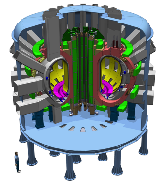
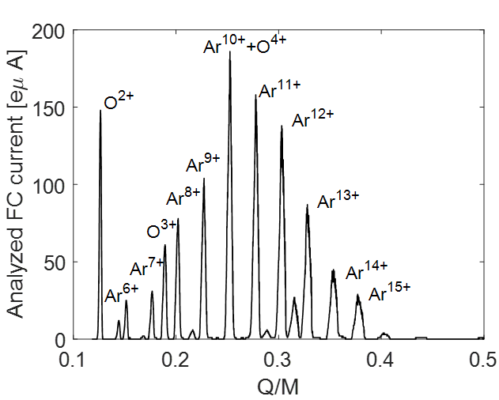
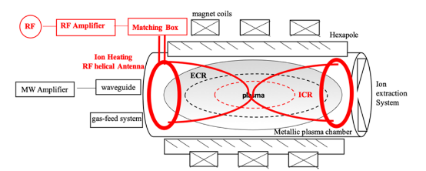
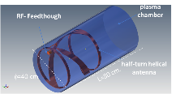
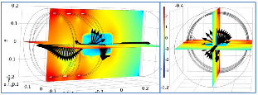
Divertor
Tokamak
Test
LNS activities for DDT
Sistema di accelerazione per DTT
    Neutral Beam Injection
Diagnostiche
    Optics
    Probes
    X-ray (soft, hard, imaging, etc.)
    Microwave (ECE, etc.)
    neutroni
Sistemi di riscaldamento RF
    Electron Cyclotron Resonance Heating
    Ion Cyclotron Resonance Heating
Sistema di heating a radiofrequenza selettiva degli ioni
allo scopo di modificare la distribuzione degli stati di carica
perturbando i processi di ionizzazione e ricombinazione
o causando perdite ad uno ione con un determinato stato di carica

Slide 12
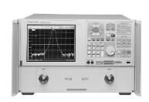
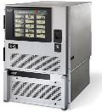

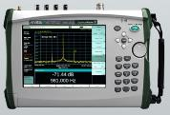

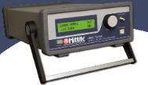


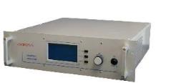


Lab Microwave
MG3693C
RF/Microwave Signal Generator, 0.1 Hz to 32 GHz
Agilent - 2-Port PNA-L - Network Analyzer
N5230A - 10 MHz to 50 GHz
Microwave Amplifier Klystron and TWTs
up to 18 GHz – up to 2KW
HMC-T2100
SG 10 MHz to 20 GHz
Anritsu Spectrum Analyzer
MS2720T-0743 9 kHz-43 GHz
40dB coupling - 25/30dB directivity
R&S®NRP-Z8x wideband power sensors
50 MHz to18 GHz - 60 dBm to +20 dBm
Sairem - Magnetron 2,45 GHZ 2kW
with Fast Shutdown Unit
SG1024 Solid State Microwave Generator 2.45 GHz -1,5 kW

Slide 13
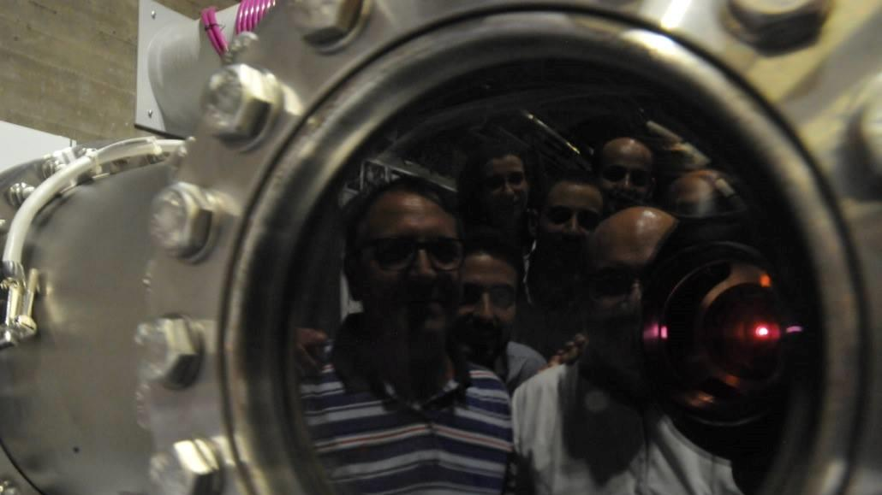
Grazie
per l’attenzione!

