Slide 1
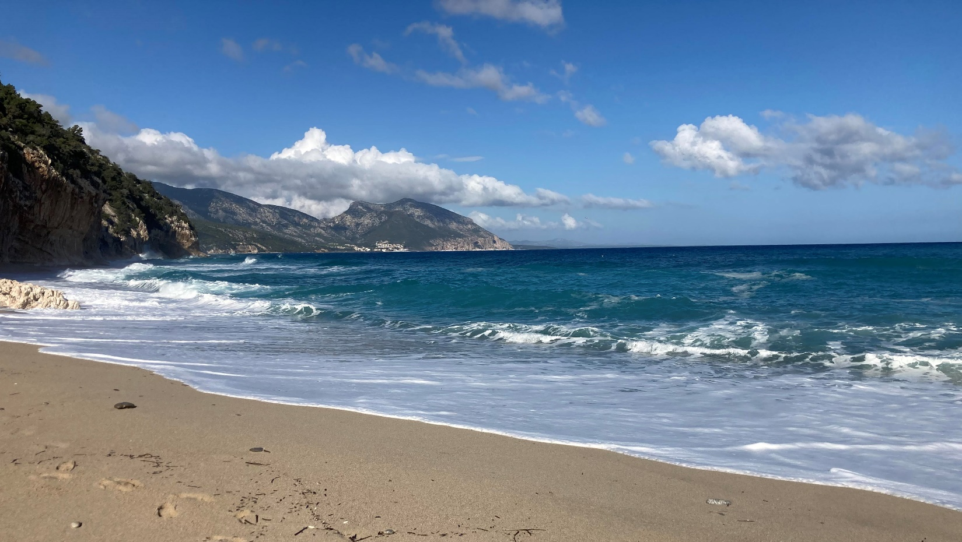
Einstein Telescope
Site Preparation Board workshop 8-11 November 2021, Nuoro (I)

Slide 2
Workshop goals (not exclusive)
Foster (also social) contacts between site exploration teams
Share experience: good/bad practice, hard-/software, tenders, •• •
Impact of site characteristics on civil engineering
Impact of site characteristics on Einstein Telescope sensitivity
  Which characteristics?
  Agree on specifications – Timeline?
  Quantify the characteristics – Timeline?
  [how do we score sites?]
Other site aspects:
  legal, planology, socio-economic, debris, sustainability, •• •
relevant in view
of ET’s
EU Preparatory Phase Proposal

Slide 3
Agenda
Mon 08/11: 9-13 Sardinia Geology, Long and Short term measurements
Mon 08/11: 15-19 EMR Geology, Long and Short term measurements
Tue 09/11: 9-13 Civil Engineering, layouts, prospects
Tue 09/11: 15-19 Hands-on session
Wed. 10/11: 9-13: Newtonian Noise Studies
Wed. 10/11: 14-22: Social events
Thu. 11/11: 9-13: Site Parameter Discussion
Thu. 11/11: 15-16:30: Summary and Final Conclusion

Slide 4
Logistics Info
Coffee breaks at the bar Nobel 26
Lunches will be served upstairs
Wifi Connection:
Network: EXME password: 88184418
Social Events:
  Geological excursion of the Sos Enattos site / Short visit to a Winery
  Visit to the Sos Enattos mine and Social Dinner
Poster Session:
  Wed. at the Mine Museum (Sos Enattos)
  Thu. morning

