Slide 1
E-TEST in EMR : Groundwater flow modeling for the EMR region
Mathieu Veeckmans, Philippe Orban, Frédéric Nguyen, Alain Dassargues

Slide 2
Content
Groundwater in the EMR region
Groundwater pumping in the EMR region
Conceptual model
Challenges faced for the modeling
Boundary conditions
Simplified geological model
Input parameters
Further goals
Sensitivity analysis
Model calibration
Local model
Notes:
Lines show routes for active acquisition, red point show location of passive seismic sensors.
At both ends of each line a length of 1.3 km is added (thin lines in order to the data from the last shot

Slide 3
Groundwater in the EMR region
Groundwater of the EMR region is intensively exploited for agricultural, industrial and domestic use
The E-TEST project might have an impact on several aquifer formations
During the construction of the infrastructures
During the exploitation if a large volume of groundwater need to be drained and pumped
Depending on the final localization and depth the following aquifer formations might be impacted
Chalky and sandy formations from the Cretaceous
Carboniferous limestone
Famenian sandstone
Notes:
Lines show routes for active acquisition, red point show location of passive seismic sensors.
At both ends of each line a length of 1.3 km is added (thin lines in order to the data from the last shot

Slide 4
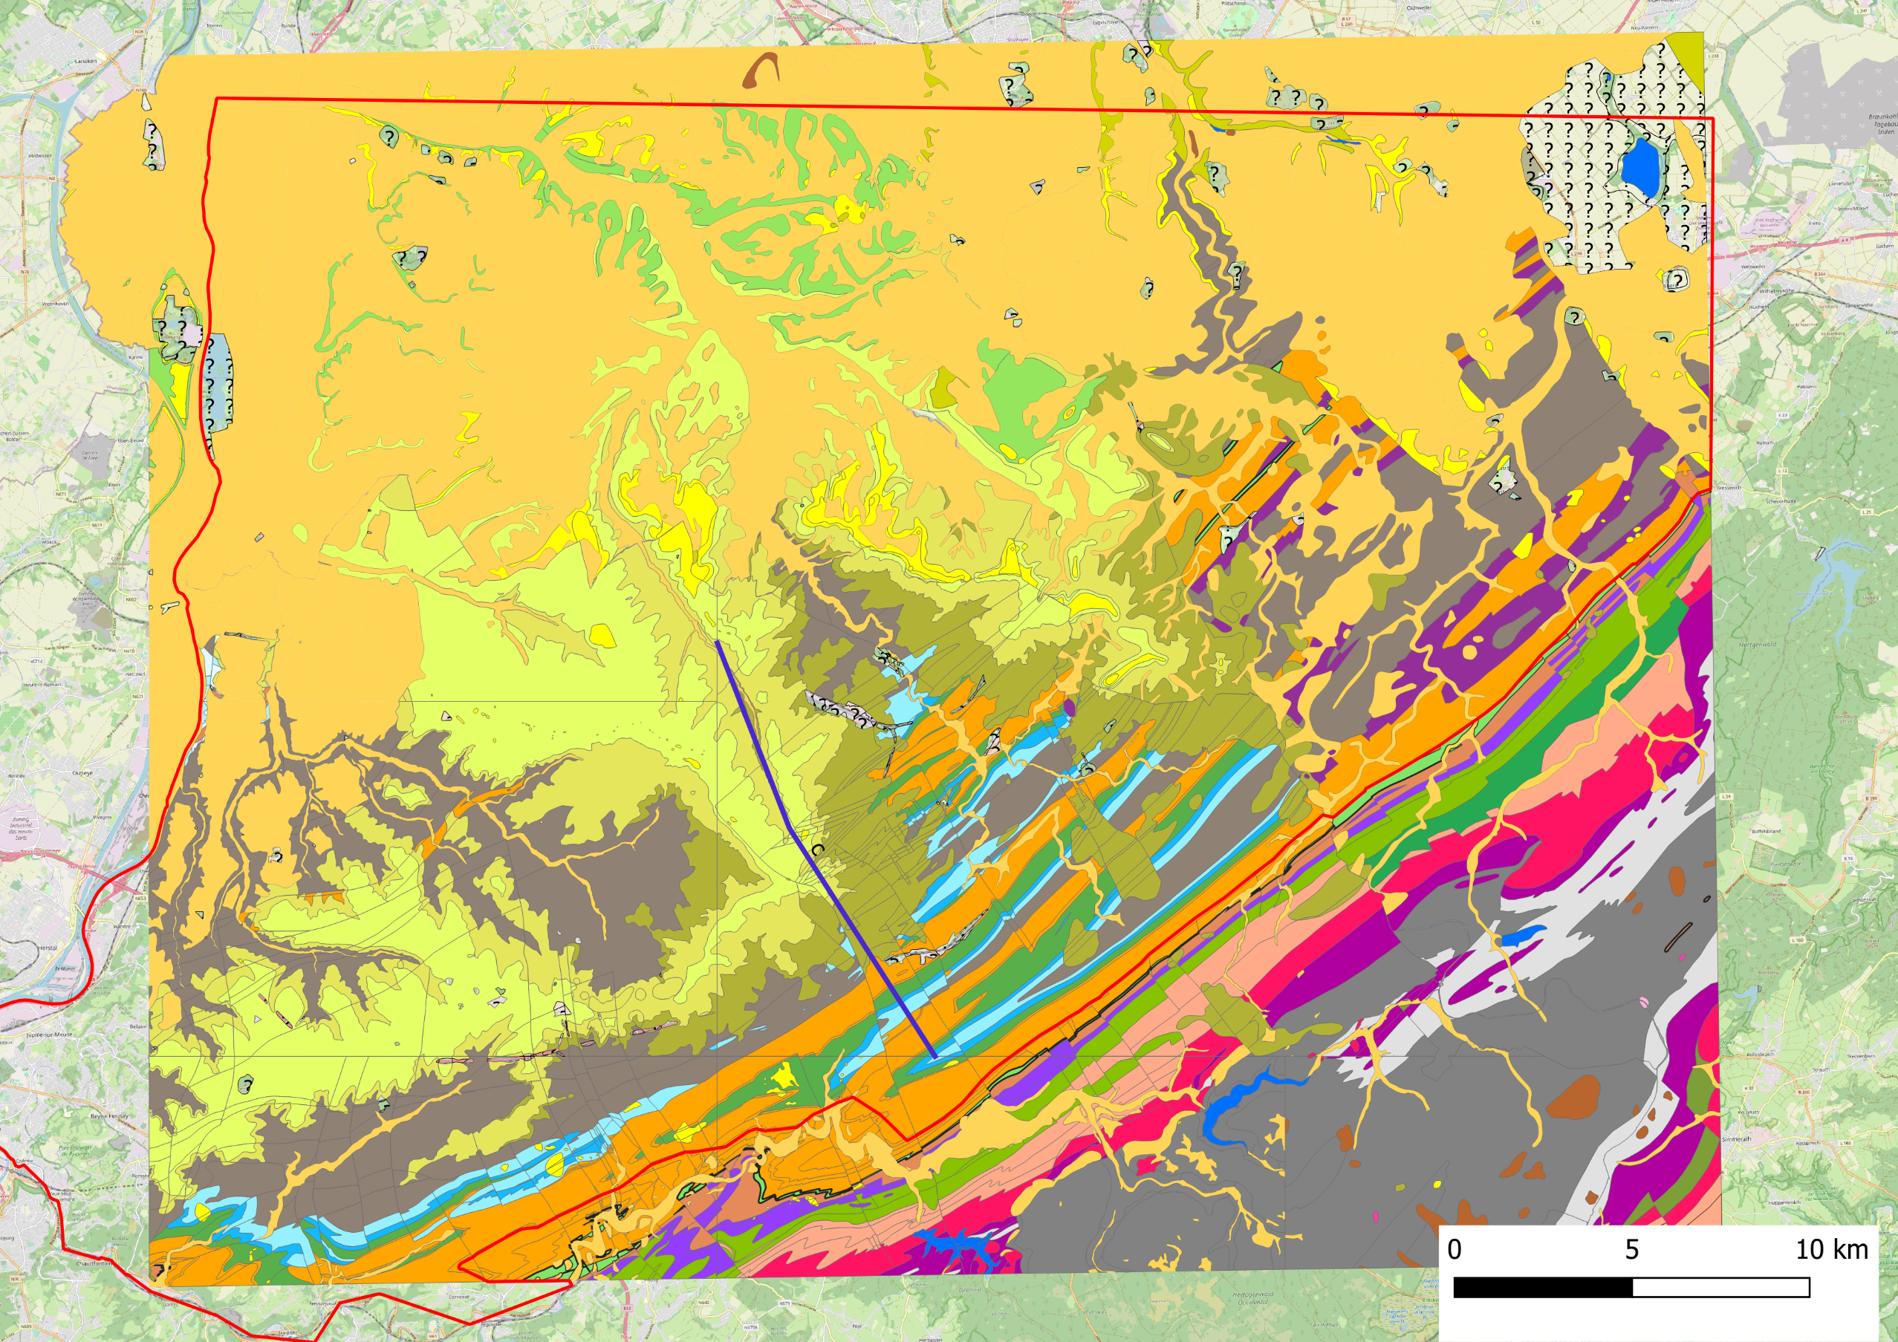
Groundwater in the EMR region
Notes:
Lines show routes for active acquisition, red point show location of passive seismic sensors.
At both ends of each line a length of 1.3 km is added (thin lines in order to the data from the last shot

Slide 5
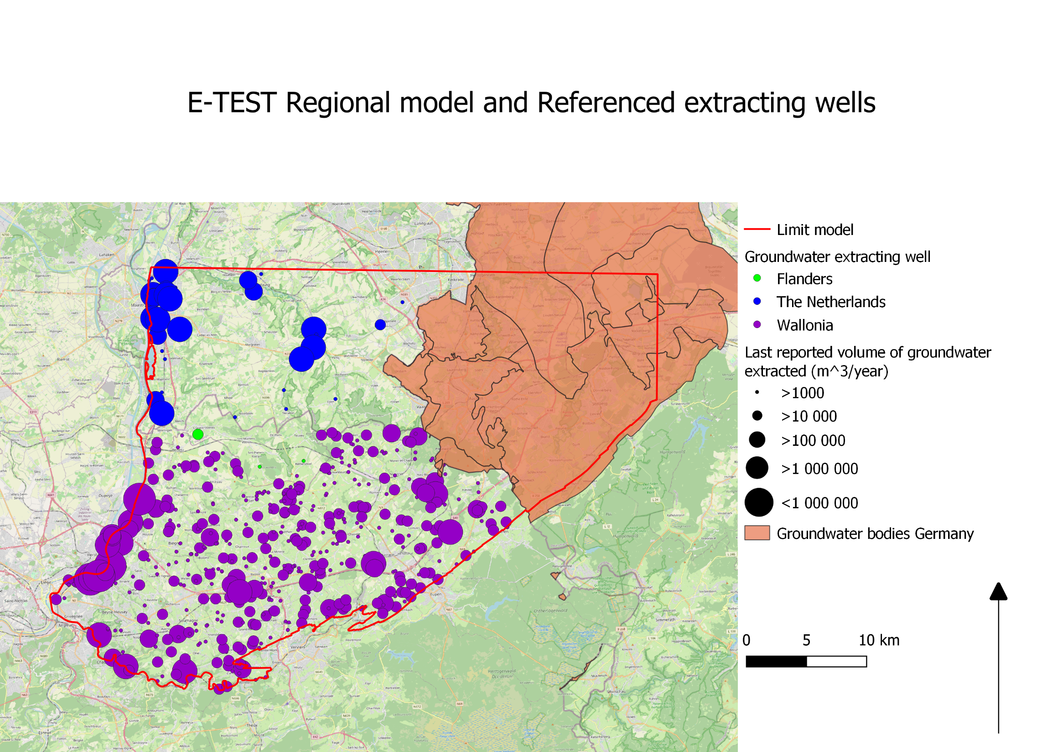
Groundwater pumping in the EMR region
At least 1370 groundwater extracting wells
Most of them extract water in shallow aquifers
28 200 000 m³ of water extracted in 2018
25 pumping wells with a mean annual pumping rate of 809 000 m³ per year account for 95 % of the water extracted in Wallonia, Flanders and the Netherlands
German extraction of groundwater is subtracted from the recharge

Slide 6
Conceptual model
Modeling in 2 phases:
Objective: representing the piezometric head on the whole region
Main Parameter: Hydraulic conductivity (assumed isotropic)->This parameter is not kwnon and partially constrained by the geology
Regional model
Area : 1100 km²
Depth : -500 m ASL
Stationary 3D groundwater flow
Boundary
Meuse and Vesdre River
Aquitard formation of the Famenian
No hydrogeological feature for the boundary on the North and East ->sufficiently far from the site location

Slide 7
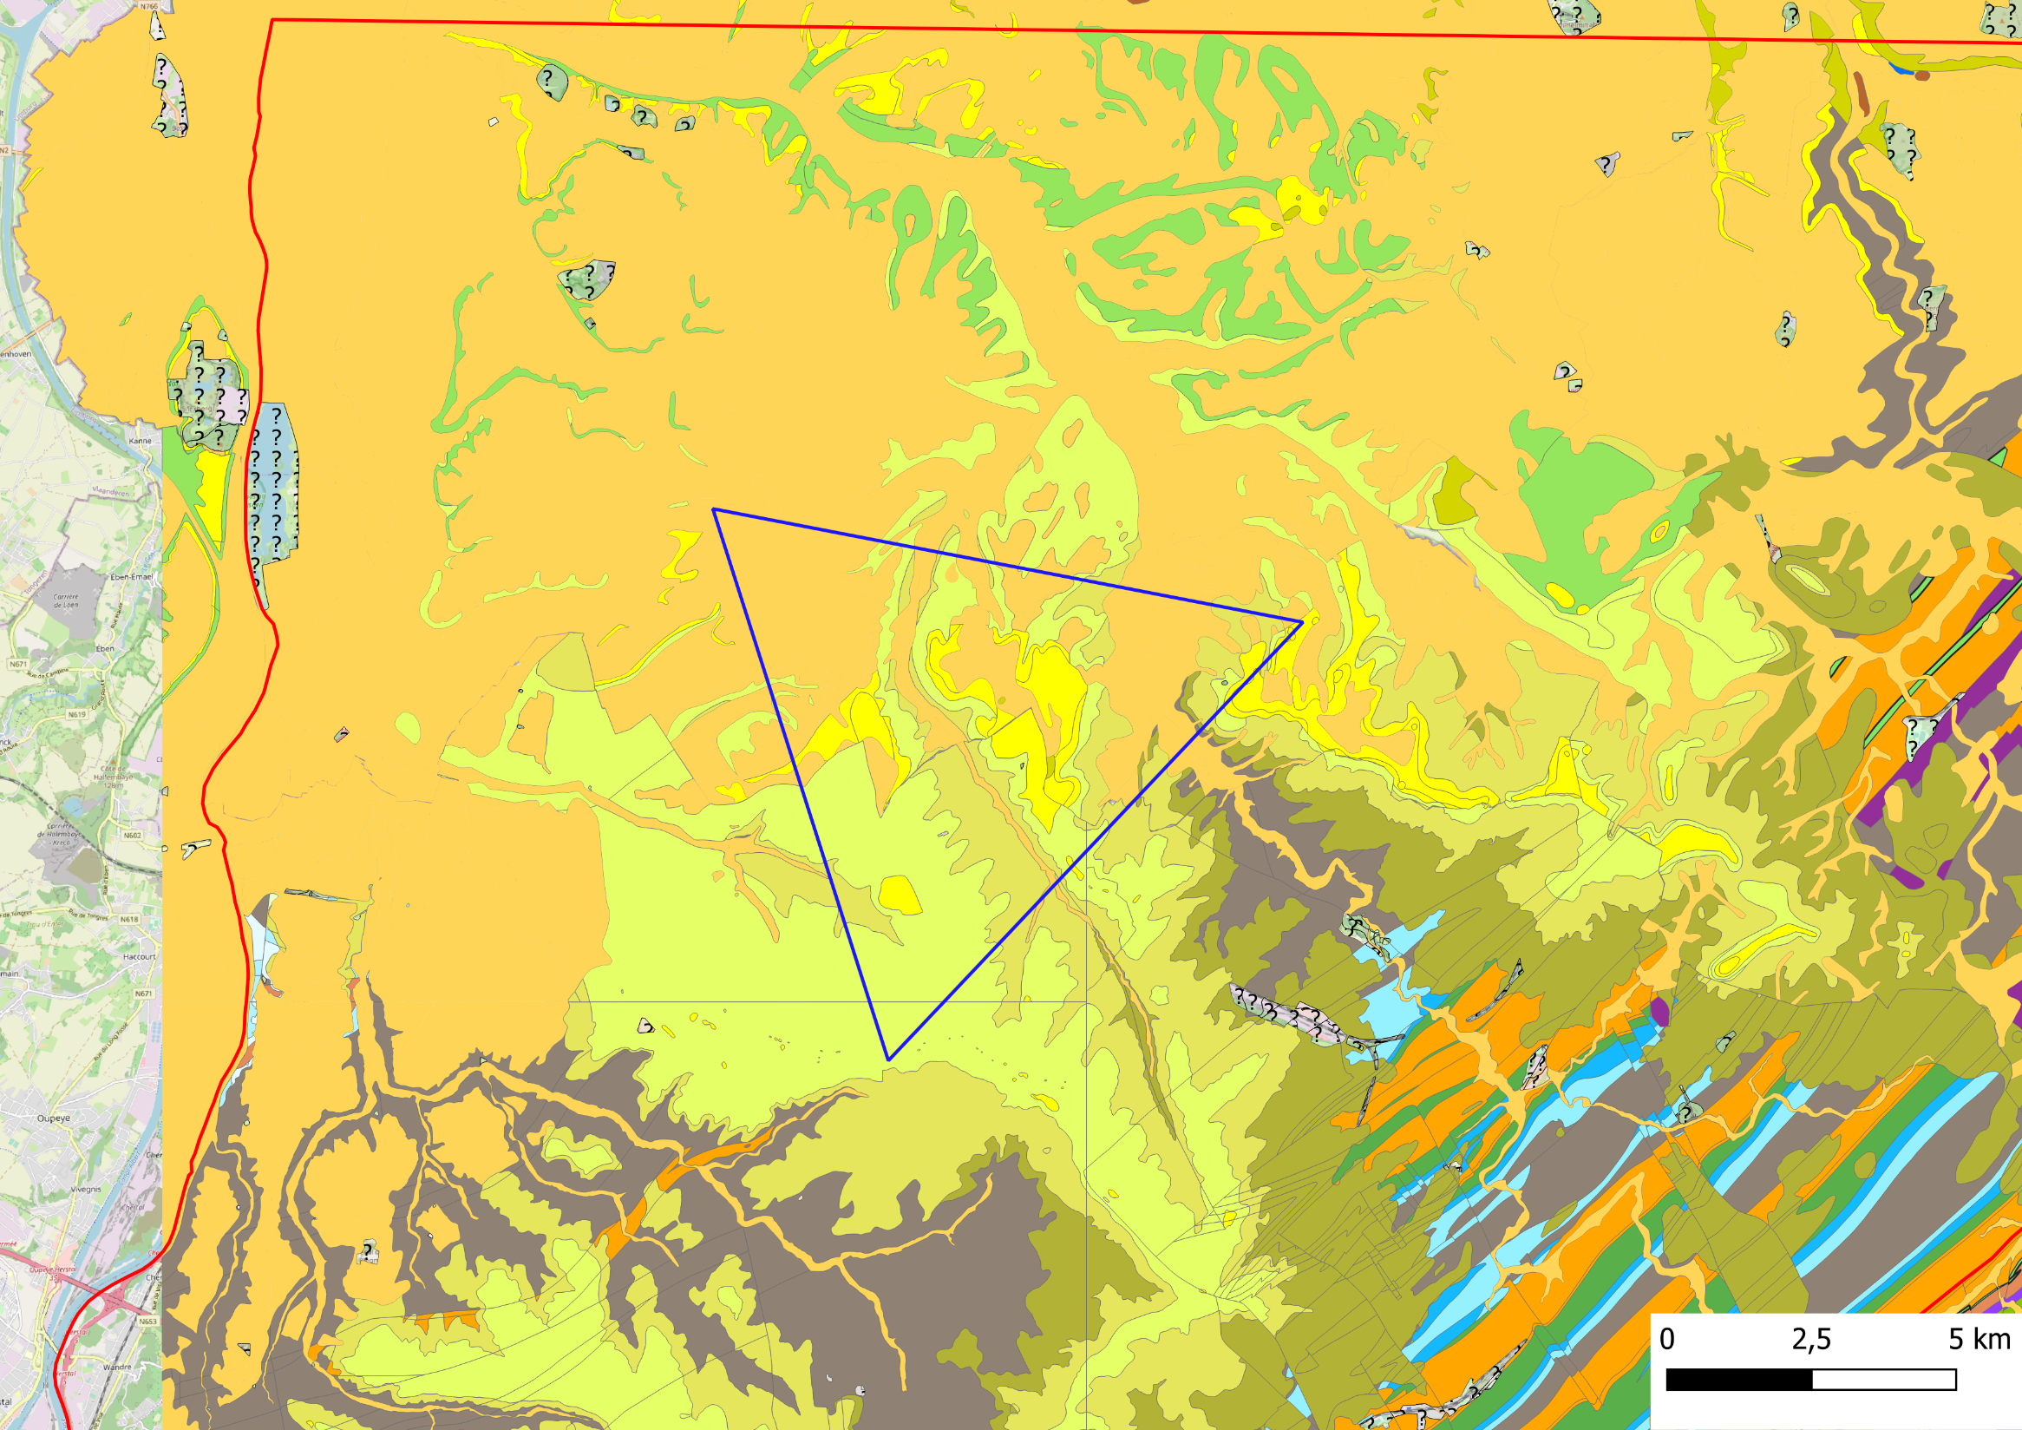
Conceptual model
Local model
Area : To be defined
Increased density of the mesh to better represent the variability of the hydraulic conductivity and the piezometric head
Depth : -500 m
Transient 3D groundwater flow
Boundary
Defined based on the regional model

Slide 8
Challenges faced for the modeling
No geological model was available
At the scale of the regional model, many geological features have limited influence on the hydrogeology
Boundary conditions are key features to simulate the groundwater flows
River level data are easy to collect and allow to apply realistic constrain on the groundwater level
Geological formation with very low hydraulic conductivity are natural boundaries where no flux are exchanged
When no other data is available the groundwater level is prescribed using available data

Slide 9
Challenges faced for the modeling
Hydraulic conductivity is not only defined by the geology
Porosity, fractures, alteration, depth,…
These conductivities have to be optimized based on piezometric data (calibration)
However, the data available are limited and focused on shallow aquifers
Groundwater flow and levels are also influenced by
R=P-E-R
Pumping and injection
All this stresses need to be taken into account on a large scale and with the limited data available in each country

Slide 10
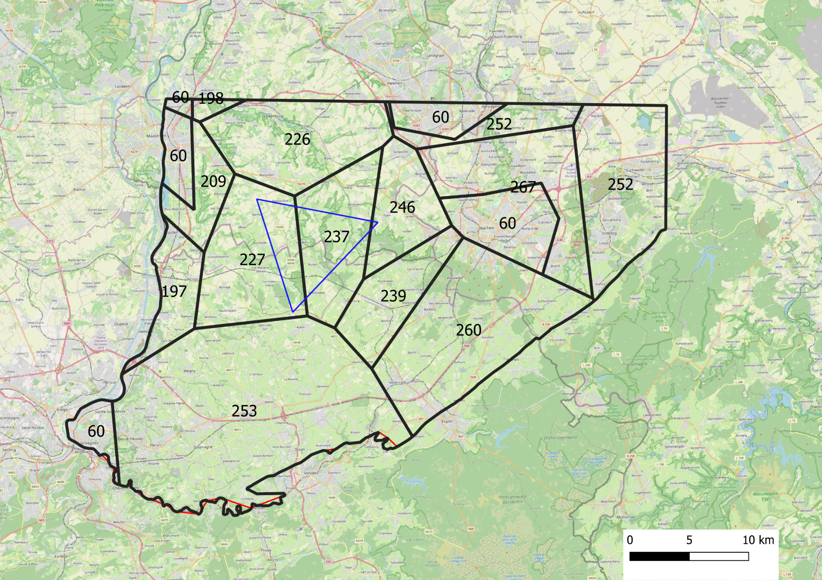
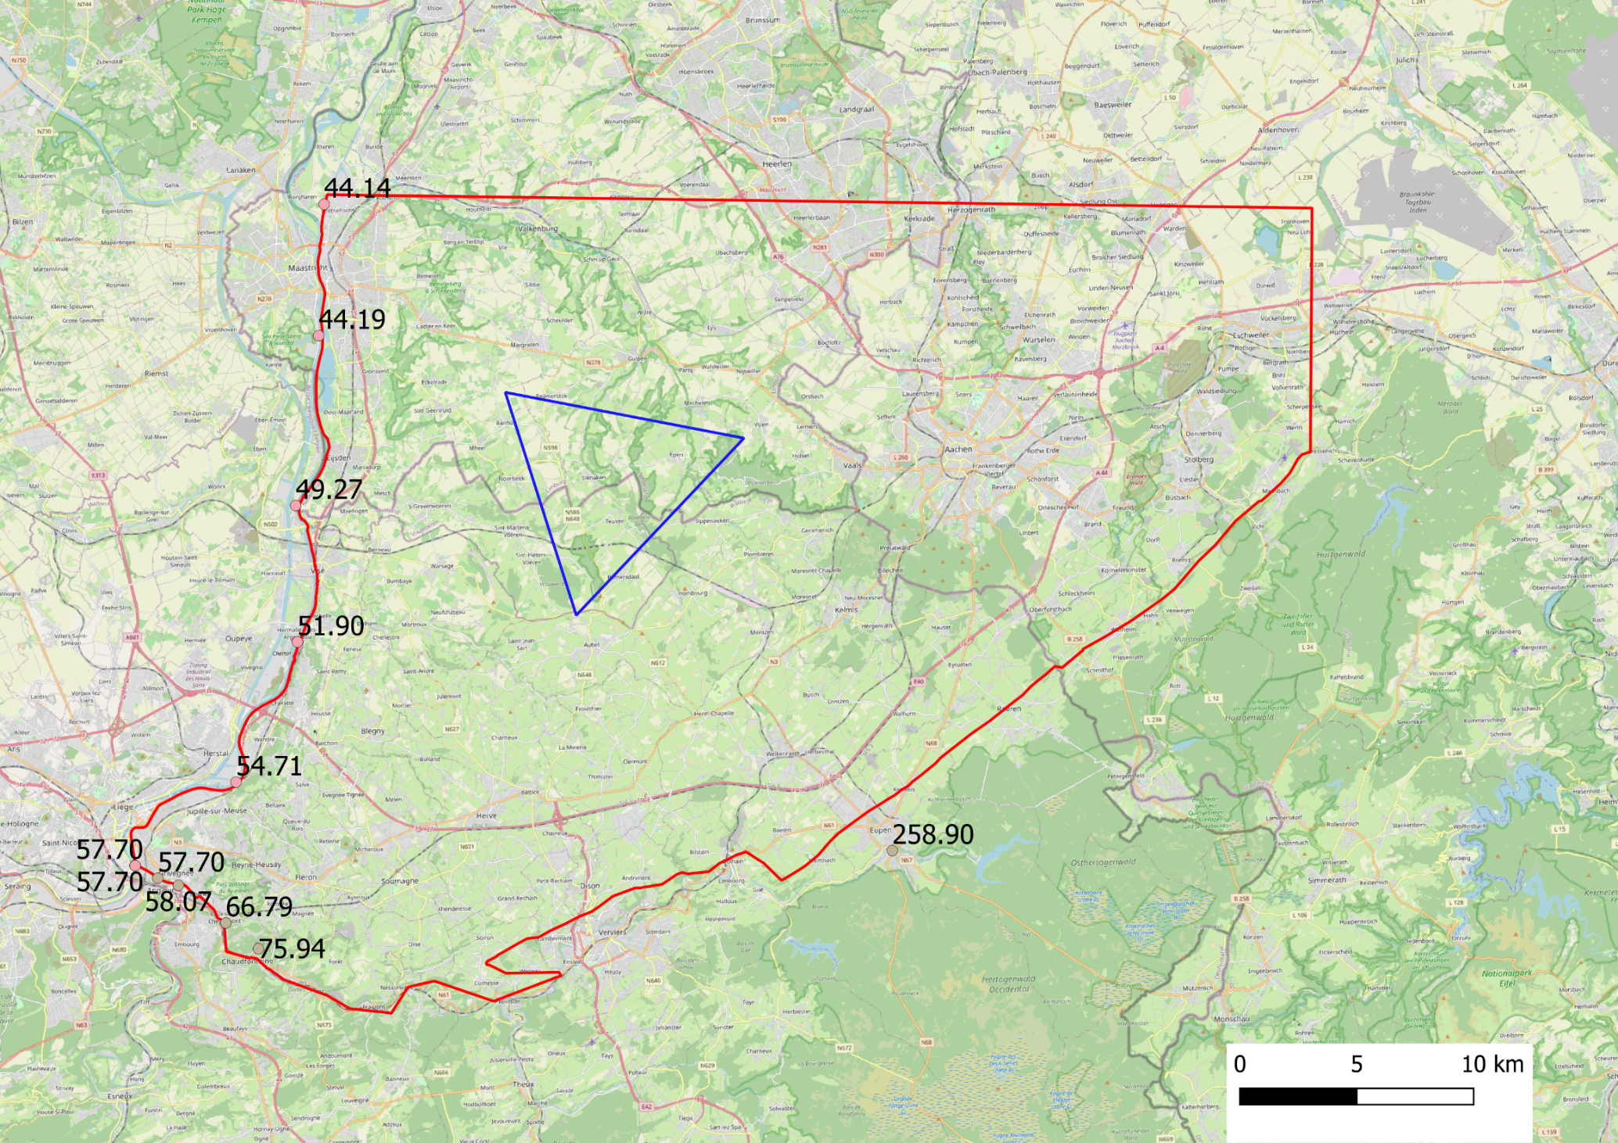
Challenges faced for the modeling

Slide 11
Challenges faced for the modeling
Solution proposed
First guess of the model based on mean expected hydraulic conductivities
Perform a sensitivity analysis to asses the influence of the deep aquifers on the piezometric levels of the shallow aquifers
Integration of the results of the tests from the deep boreholes
Revaluation of the depth of the model based on the result of the sensitivity analysis and perform a calibration by hand to represent piezometric data, general trend and known behavior

Slide 12
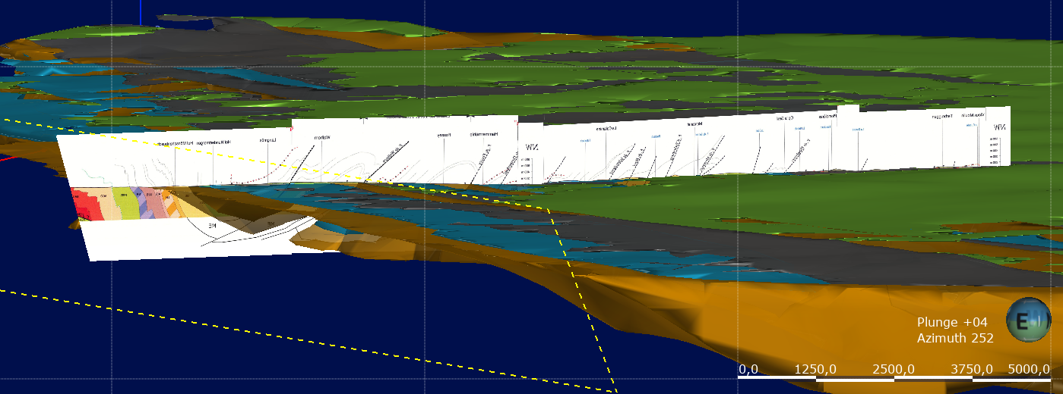
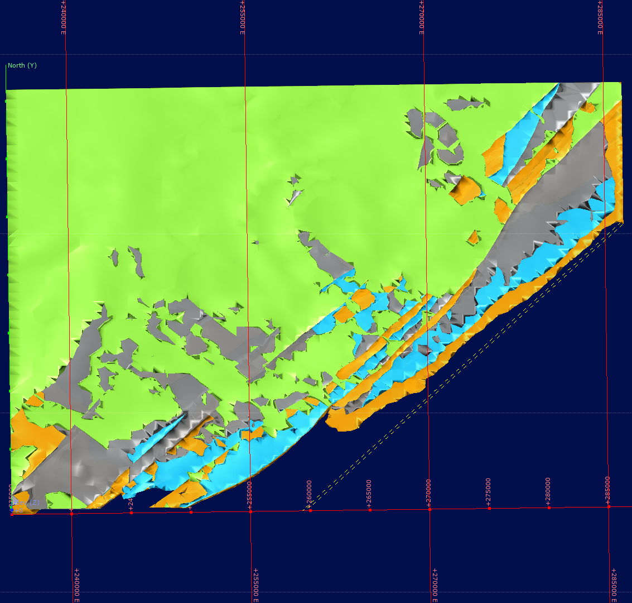
Challenges for the modeling
Notes:
Lines show routes for active acquisition, red point show location of passive seismic sensors.
At both ends of each line a length of 1.3 km is added (thin lines in order to the data from the last shot

Slide 13
Challenges for the modeling
Notes:
Lines show routes for active acquisition, red point show location of passive seismic sensors.
At both ends of each line a length of 1.3 km is added (thin lines in order to the data from the last shot

Slide 14
Challenges for the modeling
Notes:
Lines show routes for active acquisition, red point show location of passive seismic sensors.
At both ends of each line a length of 1.3 km is added (thin lines in order to the data from the last shot

Slide 15
Further goals
Development of the sensitivity analysis and the calibration
Preparation of the local model and calibration of the local model
Estimation of the volume to drain and pump during the building and the operation
Assessment of the impacts on surface/groundwater interactions, existing pumping wells, land subsidence

Slide 16
E-TEST is co-funded by the Regions:
E-TEST is also co-funded by the own-fundings of all Partners:

Slide 17
E-TEST partners

