Slide 1
Belle II
Roma, 08/09/2021 - riunione di referaggio
P. Branchini on behalf of the Belle II Italian Collaboration
INFN – Sezione di RomaTre
•
•
•
•
•
•
•
•
•
Latest news from SuperKEKB & Belle II
Schedule, funding
Belle2 and SuperKEKB roadmap
MOF
Sommario richieste 2021
Piano di spesa pluriennale
JENNIFER2
Milestones
Situazione economica restituzioni

Slide 2
SuperKEKB&Belle2 latest news

Slide 3
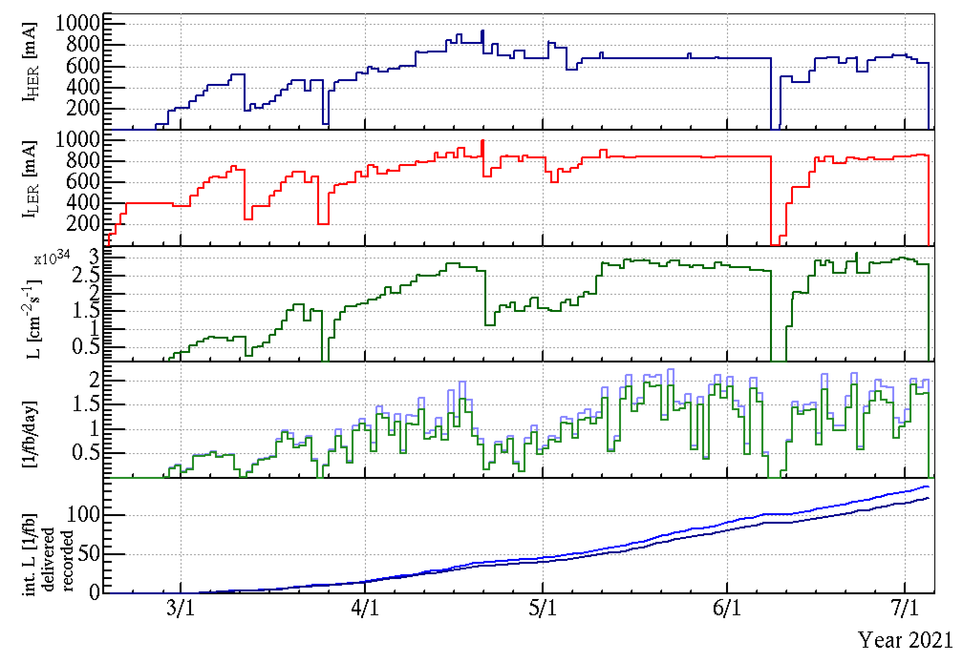
2021ab Operation Summary
D01V1 head replacement
D02V1 head replacement
HER BxB FB noise is fixed.
NIM bin and fanout replacement
β_{y}⇤ = 2 mm (3⇤ = 1 mm
y
The 2021a run started on 16th February and operated for 140 days (4 months and half).
The first ten days were devoted to the vacuum scrubbing.
We operated with β_{y}* = 2 mm to check hardwares and to test high current operation safely.
Calibrations of BPM and collimator head positions, etc. were also performed by using beams during the first two weeks.
We squeezed β_{y}* down to 1 mm on 10th March. Beam currents increased with "baking run". 1000 mA / 940 mA w/o physics run
D01V1(HER) head was replaced. The top jaw was short for the LER collimator head (May 23).
HER many aborts from April 20 to May 3.
D02V1(LER) head was replaced due damage (June 7).
940 mA
1000 mA
HER many aborts BxB FB noise
Lp 3.12x10³⁴

Slide 4
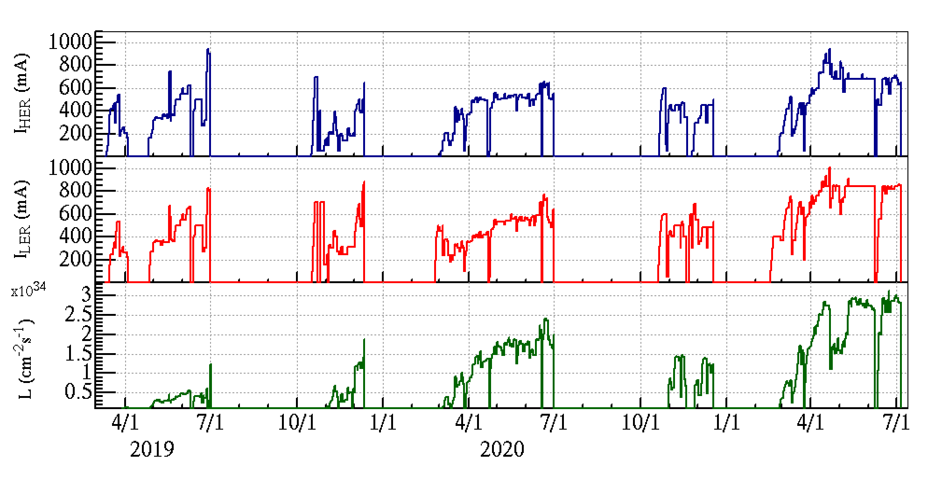
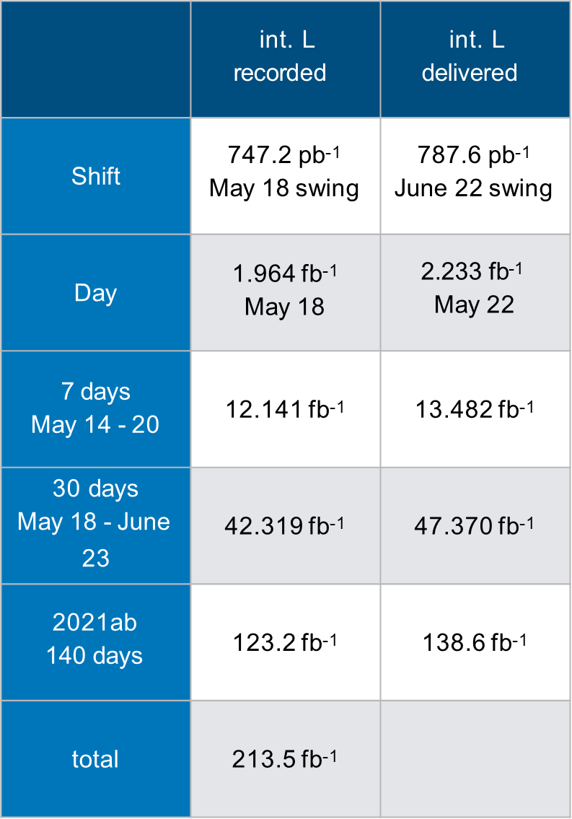
SuperKEKB Operation Summary
a: February - March b: April - July
c: October - December
Operation time
6 - 7 months per year
Peak Luminosity : 3.12 x 10³⁴ cm⁻2s⁻¹
2019a/b 2019c 2020a/b 2020c
2021a/b
"TMCI"
carbon collimator
Belle II off
Belle II off
Belle II on
Belle II on
βy* 3 → 2 mm
βy* 2 → 1 mm
βy* 1 → 0.8 mm
βy* 1 mm
βy* 1 mm
4

Slide 5
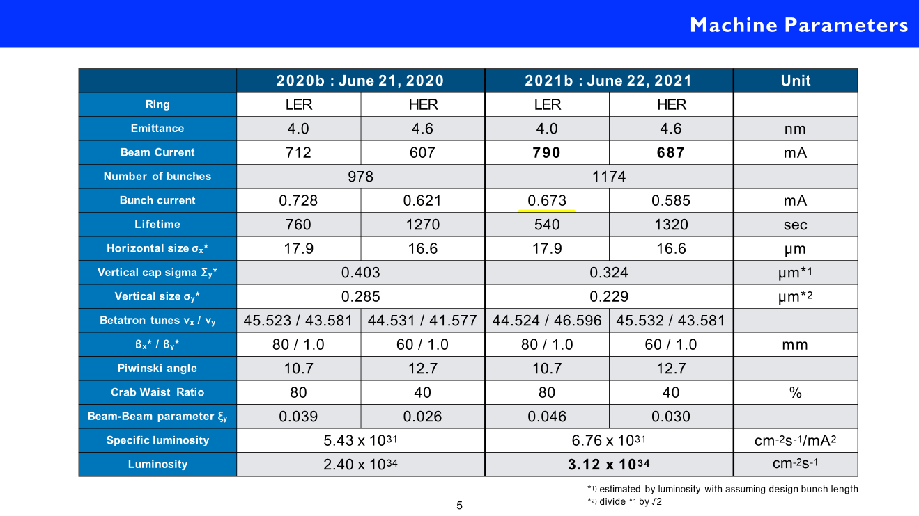
5

Slide 6
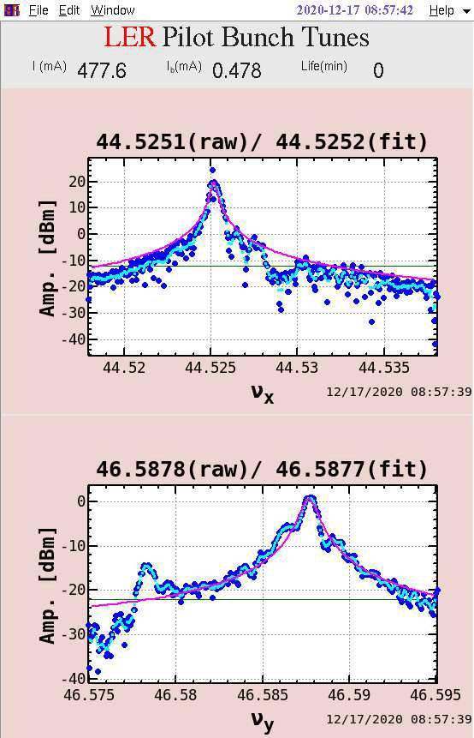
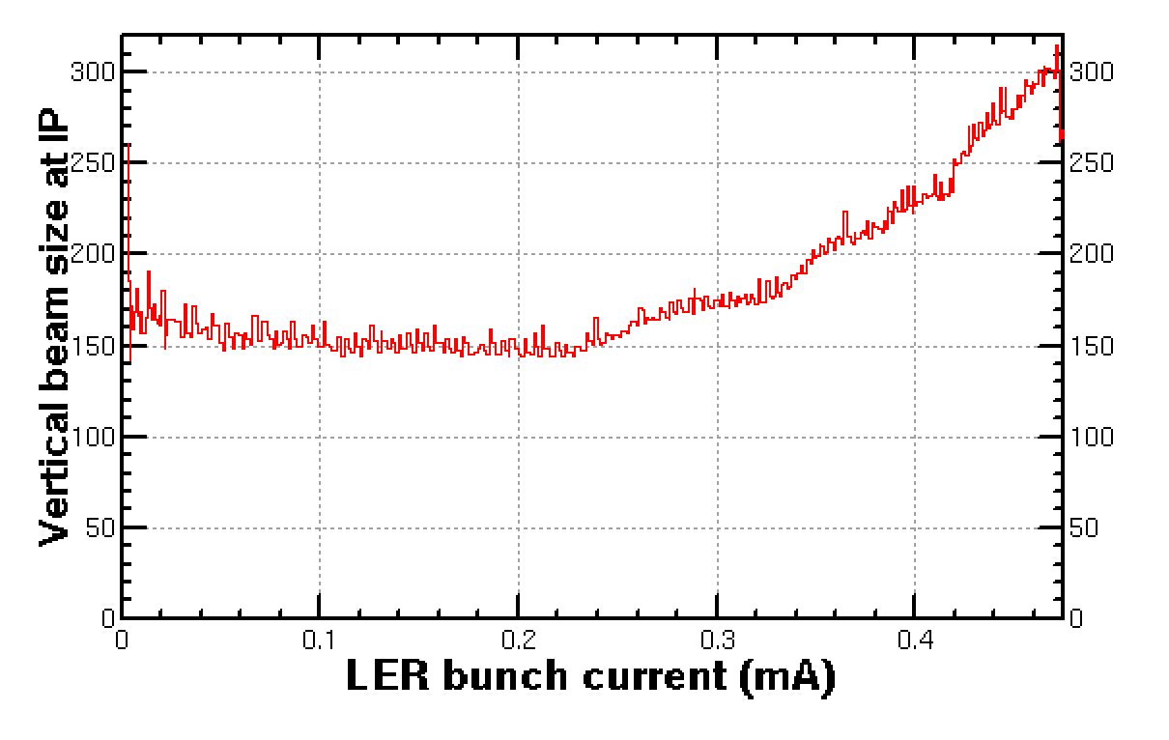
December 17, 2020 17:46 - 17:54
TMCI threshold
We observed TMCI in the LER at the operation beam current.
TMCI threshold depends on the collimator aperture.
The threshold also depends on the vertical tune. → localized impedance?

Slide 7
* measured value (M. Tobiyama)
Simple TMCI formula can not explain it.

Slide 8
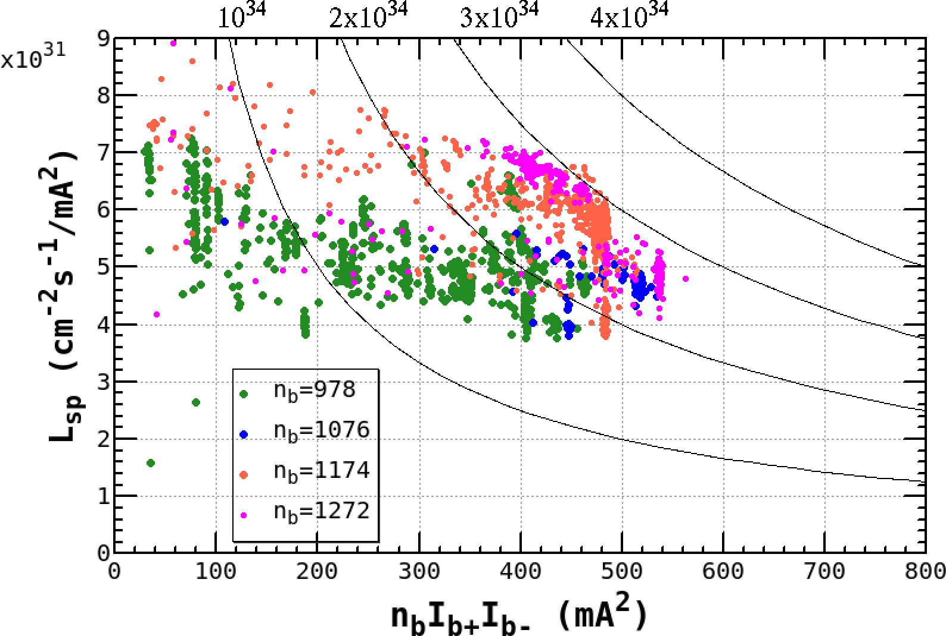
Projection of Specific Luminosity
max of nbIb+Ib- is 540 mA² (840 mA/818 mA, 1272)
target of 2021b 700 mA²
LER / HER : 1.1 A / 1.0 A n_{b} = 1565

Slide 9
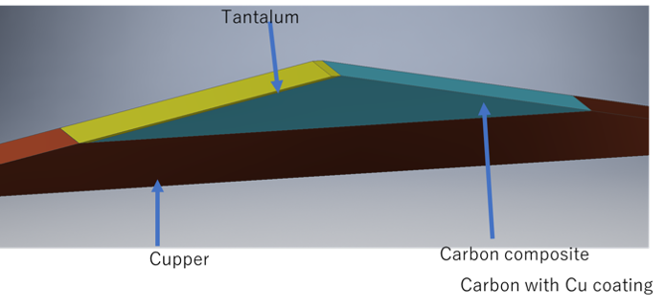
This Summer Shutdown:
Regular maintenance
Movable Collimator
Replacement of 2 collimator heads in HER
Upgrade of driving device of 2 collimators in HER
Replacement of collimator head (D06V2) with hybrid-type (tantalum and Cu coated carbon)
in LER
Relocation of D02V1 in LER (not decided)
Exchange of the mirror of SR beam size monitor in LER
Installation of HOM absorber at RF section (Nikko) in HER
Beam transport line (BT)
beam profile monitors with OTR screen
beam shutter at the injection in LER
Installation of strip-line kicker in RTL line (DR)
Infrastructures; measures against aging
Replacement of HV (66 kV and 6.6 kV) power cables
Repair of roof at power stations to avoid leakage rain drops
Replacement of old cooling water pumps
beam

Slide 10
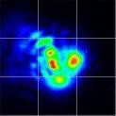
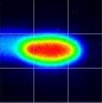
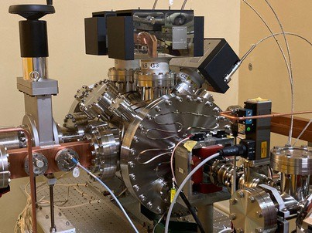
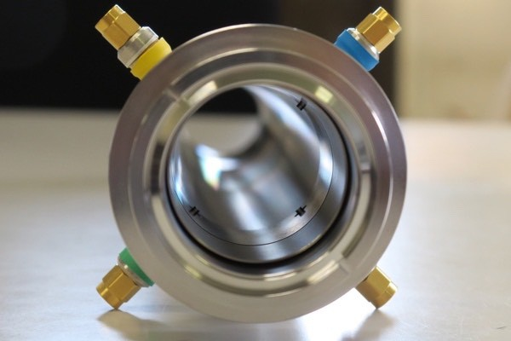
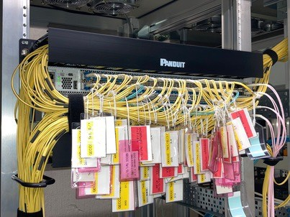
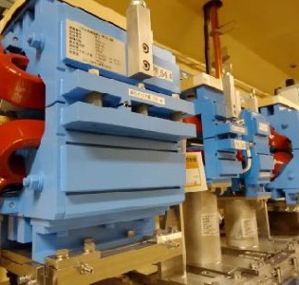
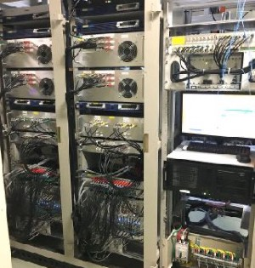
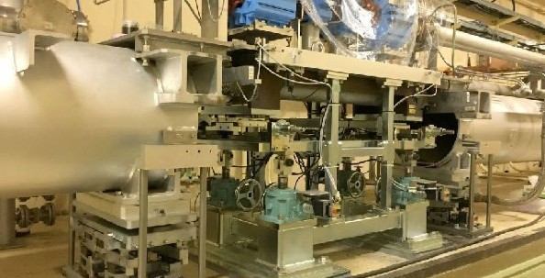
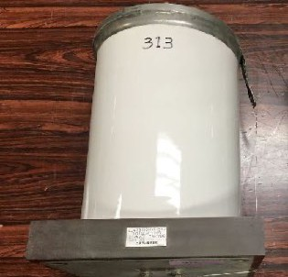
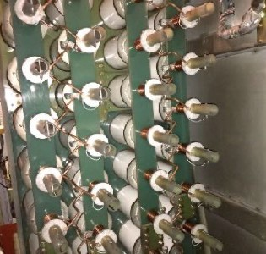
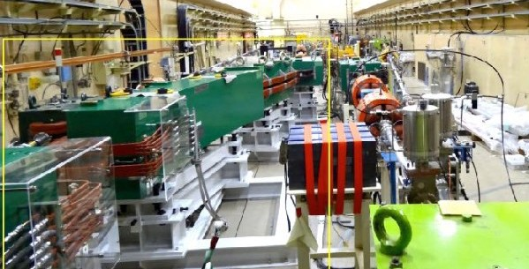
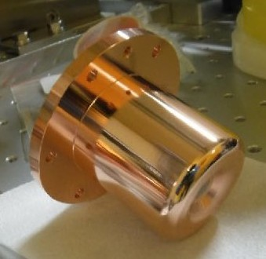
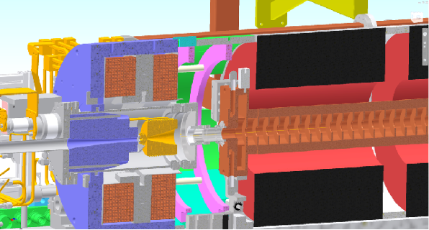
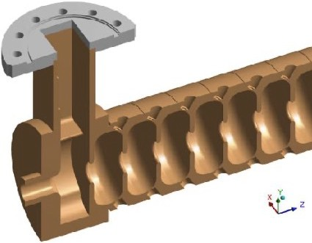
Near-Term Plans at Injector Linac
Summer 2021
Amplifier and optical elements to 2nd laser for rf-gun
Cathode and window replacement for rf-gun
Core switch upgrade for the computer network
Seven pulsed steering magnets in upstream linac
Solid state amplifiers to replace a mid-power klystron
Degraded rf waveguide replacements
Fast beam position monitor to separate e-/e+
2nd rf-gun as a backup/development, … and more
Upgrade before 2026
Pulsed magnets/fast kickers
Girder movers
K. Furukawa
Laser shaping with DOE
Secondary RF gun
New beam position monitor
Core network switches
Energy compression system
RF gun
Positron capturing
Accelerating structures
New capacitors to eliminate PCB
Pulsed magnets/kickers
High precision movers
PCB capacitor renewal
New energy compressor
RF gun
Positron capture section
Accelerating structure

Slide 11
MDI: PIPE Status

Slide 12
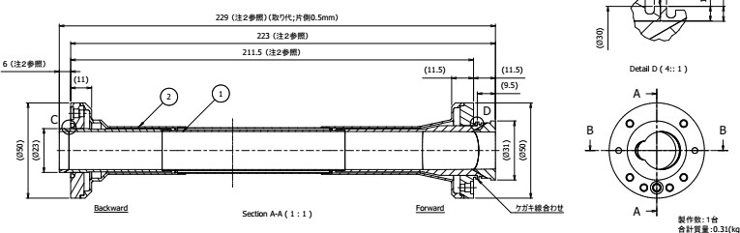
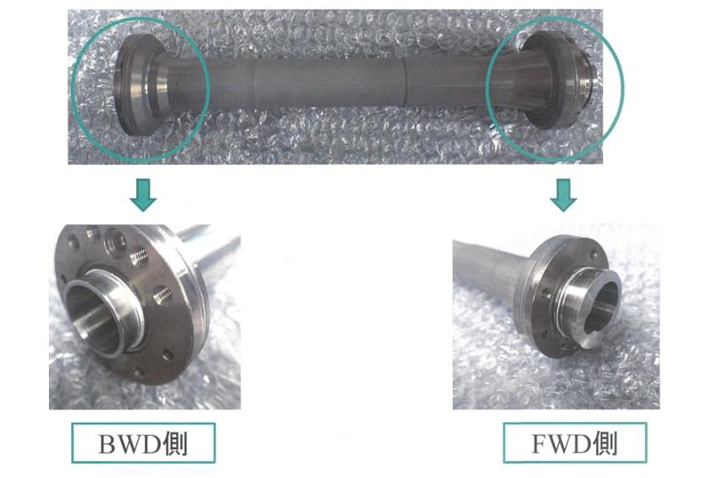
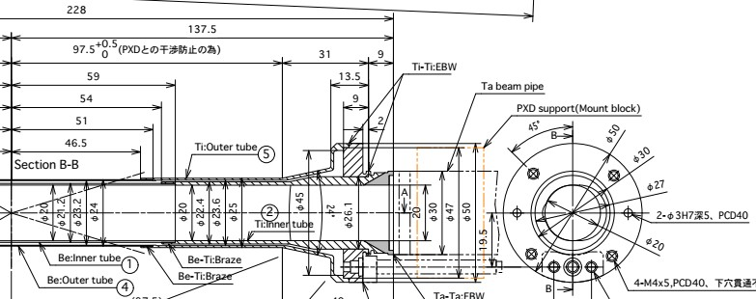
Production Status
IP part
Inner and outer pipe connection with EBW is finished
Milling side structure is ongoing (for inlay with crotch part)
10um gold sputtering inside the pipe has finished (middle of Aug.)
EBW point
–

Slide 13
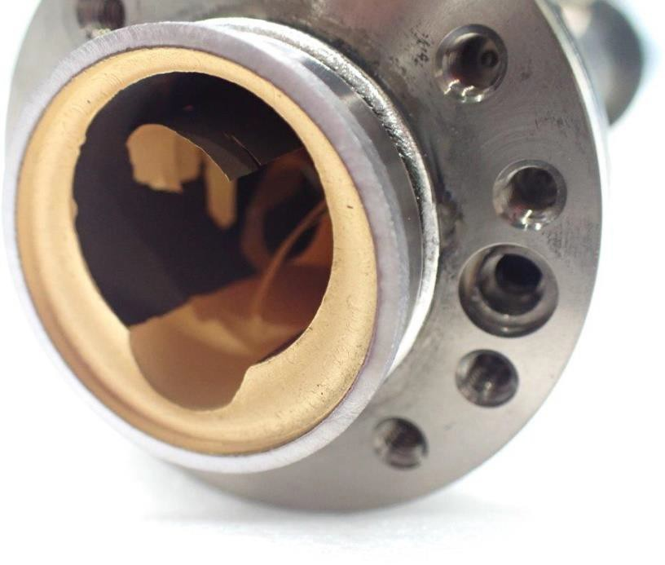
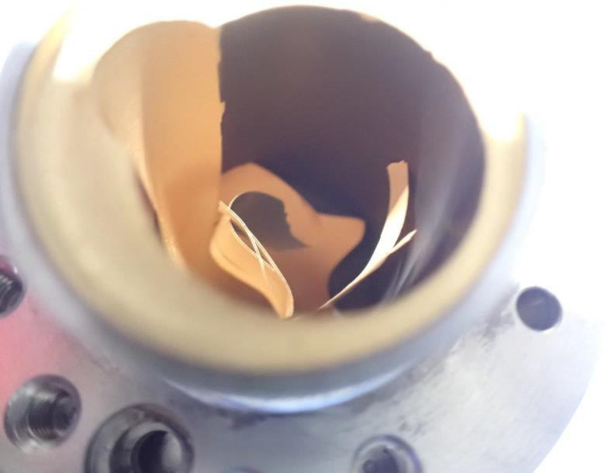
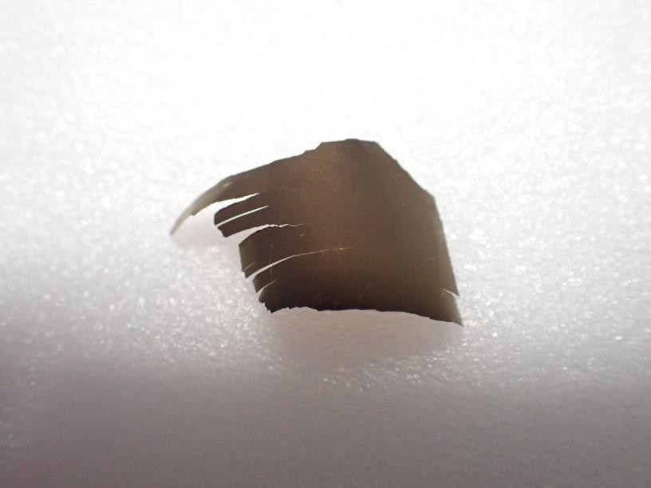
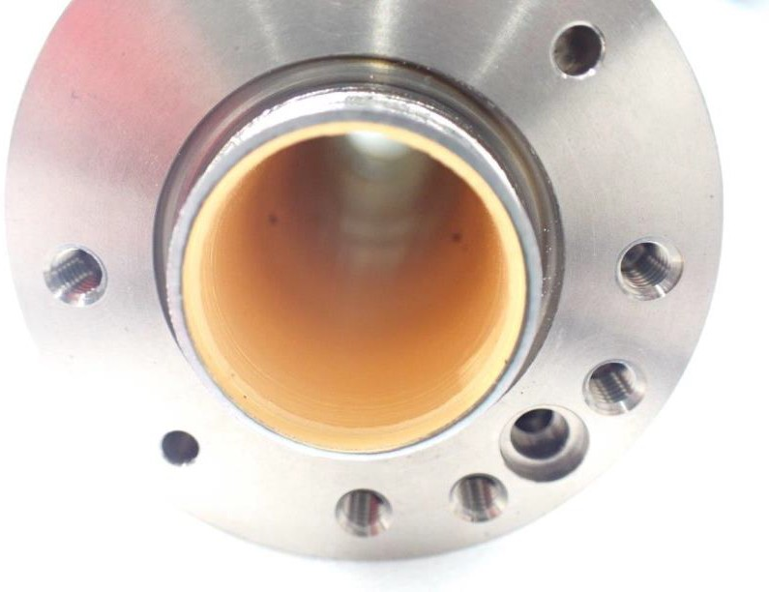
Gold film peel-off at FWD side occurred during nitrogen gas purge (2021/08/25) (between titanium layer (as base material) and IP pipe inner surface)

Slide 14
Counter-measure
Plan B1: Reproduction of IP part by the spare set:
1, Inner cylinder and outer cylinder spare parts are used (the quality of the inner surface is doubtful because it is also the re-brazed product)
2, Plating of inner cylinder (gold) and outer cylinder (titanium) (2 weeks)
3, Joining the inner cylinder and the outer cylinder (1.5 months)
4, Gold spatter inside IP pipe (2 weeks)
5, IP pipe and crotch pipe connection ：2 months
Since the production is delayed for about three-four month in total, it will probably be completed from February to March next year, and in August when the VXD is taken out, it will be in time for LS1. However, gambling remains because there is no period for investigating the cause of this problem.
Plan B2: Reuse of pipes currently in use
1, In this case, there is no additional shield for the SR problem of PXD, but I think that there is no big problem in the current operation even if it is used as it is.
2. Regarding the schedule, the VXD assembly period will be extended by about 2 months.

Slide 15
Plan B3 (same as Plan B1 except for whole re-manufacturing the inner and outer cylinders)
1, Inner cylinder, outer cylinder re-manufacturing (4 months: Be procurement, parallel machining + 1.5 months: brazing work)
It turns out that the spare of the inner cylinder Be is B class (ordering new pipe process has been submitted)
2, Plating of inner cylinder (gold) and outer cylinder (titanium) (2 weeks)
3, Joining the inner cylinder and the outer cylinder (1.5 months)
4, Gold spatter inside IP pipe (2 weeks)
5, IP pipe and crotch pipe connection ：2 months
Since the production is delayed for about 8 month in total, it will probably be completed around June-July next year, and in August when the VXD is taken out, it will be in time for LS1.
Cause investigation should be done in parallel with the re-production
Plan B3 seems most likely reasonable option
15

Slide 16
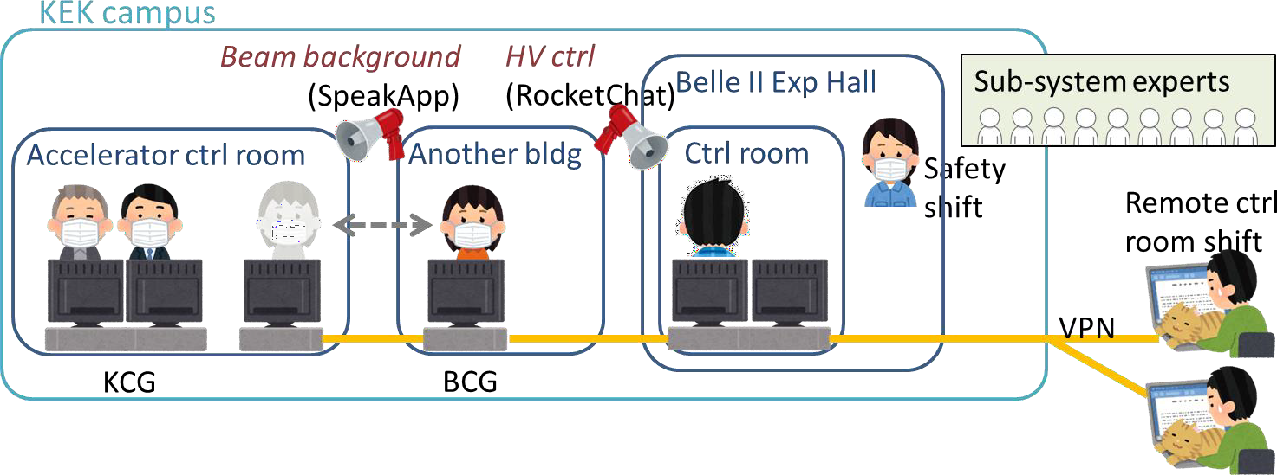
Belle II operation shifts in 2021ab
Same scheme as 2020c
Keep minimizing person-to-person contact, avoiding 3C, and taking hygiene.
2 remote + 1 local CR shifters
… Remote shifters are actively working, and load on local people has been reduced.
Many local and remote shifts were covered by a small number of people.
Many shift gaps remained until the last moment.
Regional shift managers helped a lot to fill many urgent gaps of CR remote shifts.

Slide 17
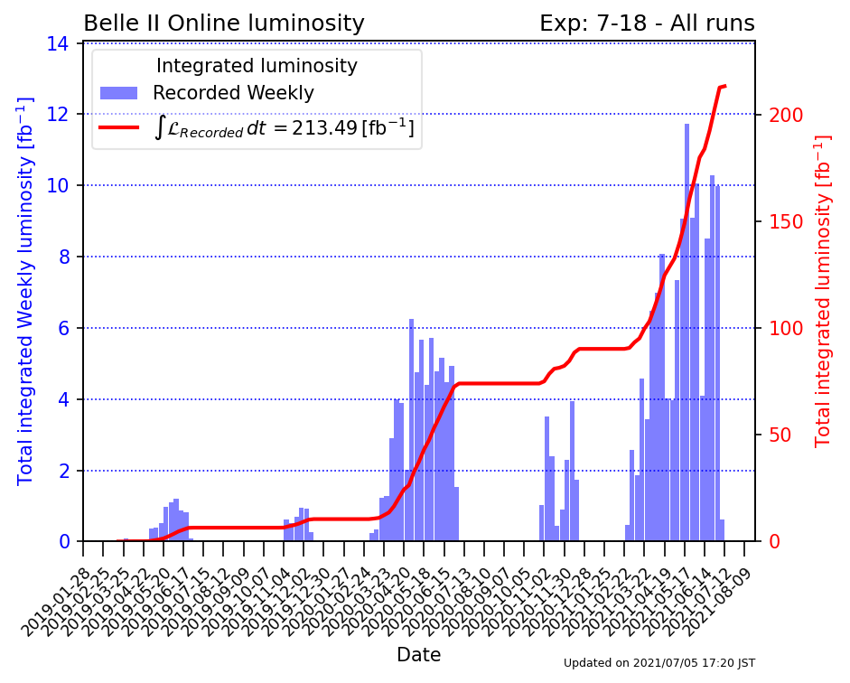
Highlights of 2021ab operation
Thank you all for the contributions to the operation under COVID-19 pandemic.
Integrated luminosity was
Regional shift managers
doubled in 2021ab.
helped a lot to fill many urgent gaps of remote CR shifts.
Data taking efficiency:
88.8 (2020c)
89.8% (as of Jun. 18)
in spite of more frequent DAQ stops due
Progress in the operation under a higher
luminosity and a higher beam background:
Thanks to
More automation, recovery tools
Improved documentation, training
Experienced local CR shifters
HLT filtering since 3/24 (exp17)
Prescale of L1 Bhabha trigger since 4/7 (exp18)
CLAWS beam abort since 5/28

Slide 18
Physics summary

Slide 19


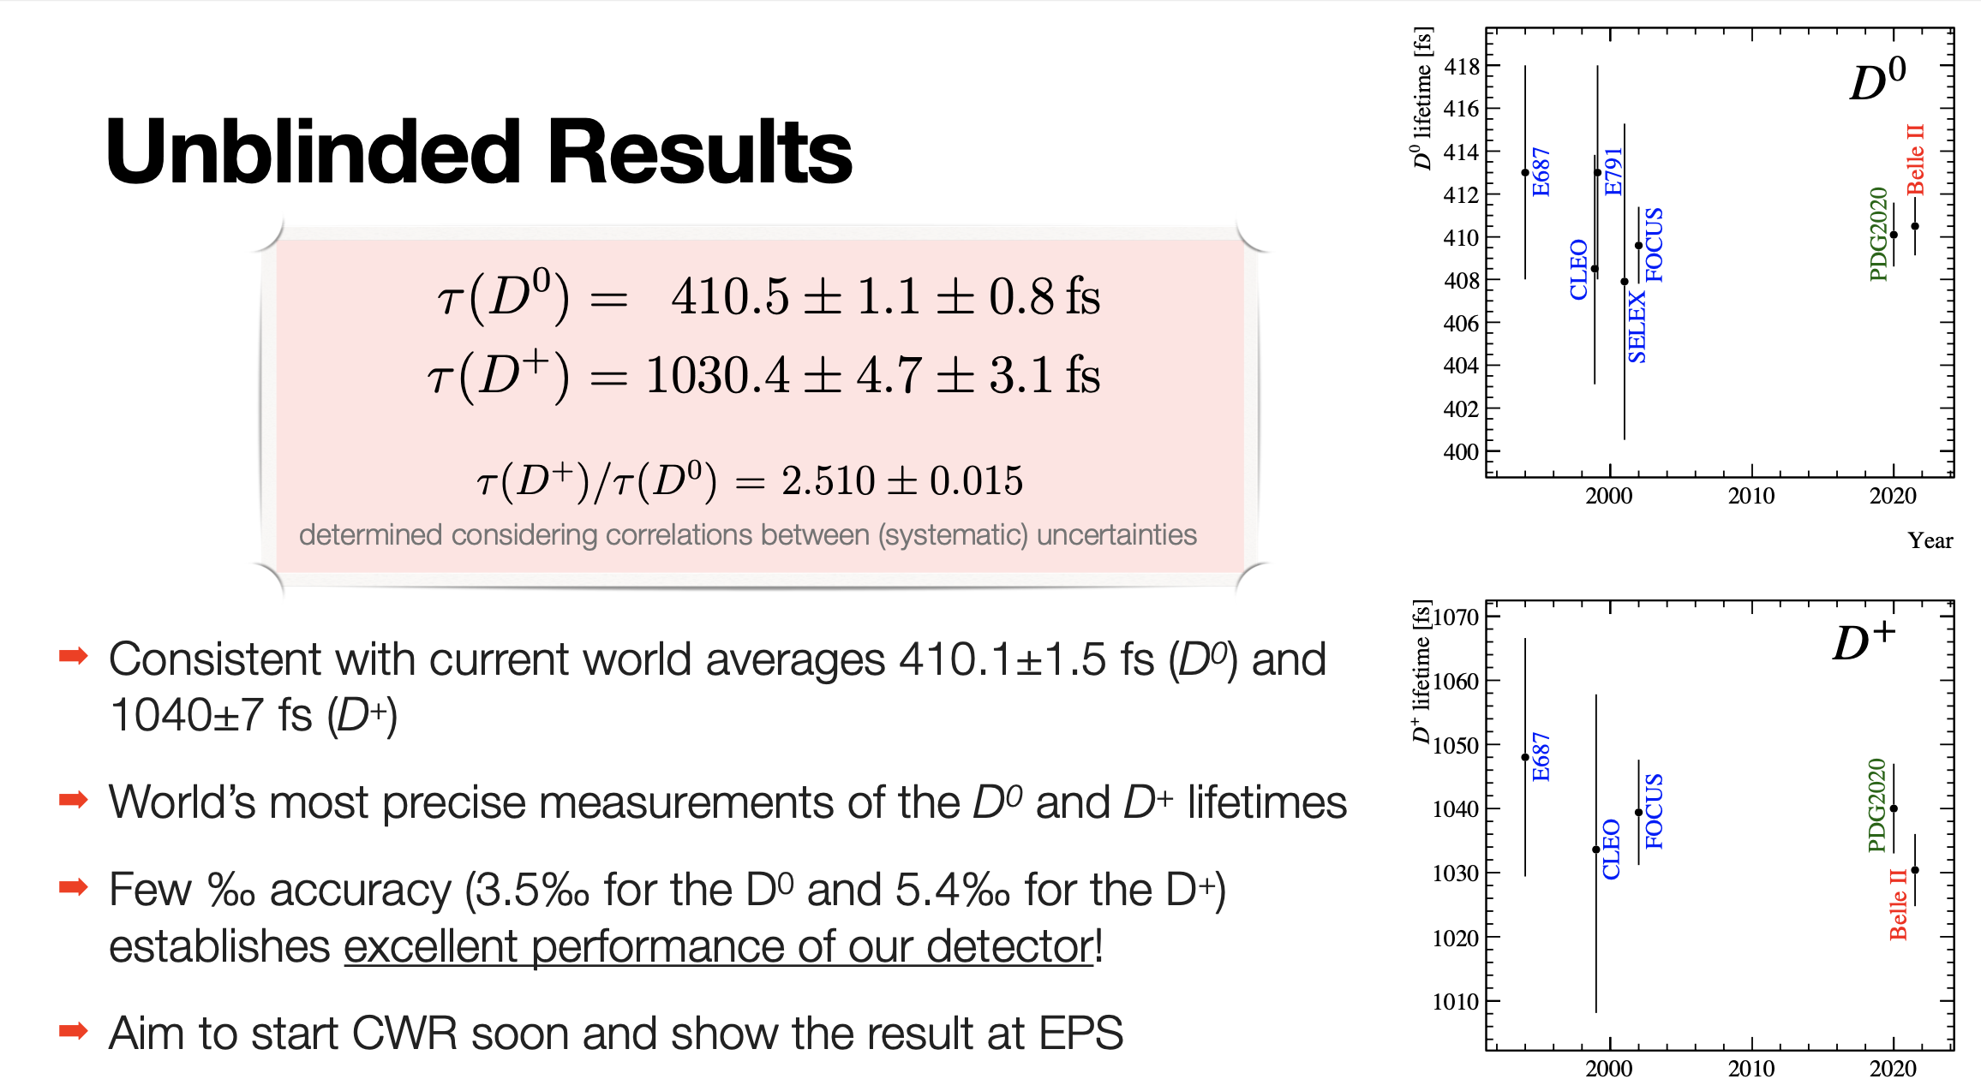
Fresh of submission: “Precise measurement of the D⁰ and D⁺ lifetimes at Belle II”
Presented at EPS and submitted to journal arXiv:2108.03216

Slide 20

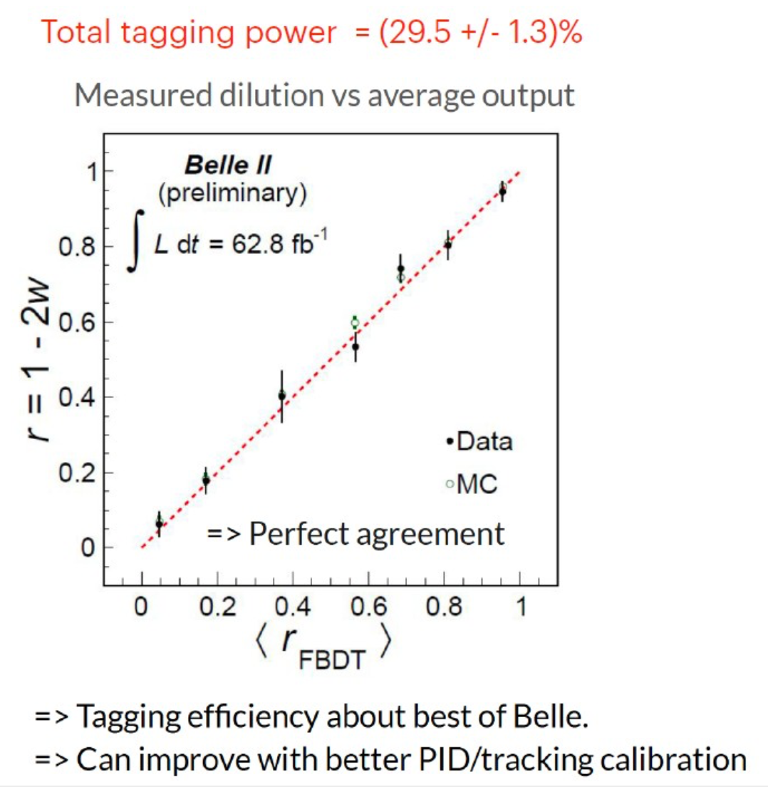

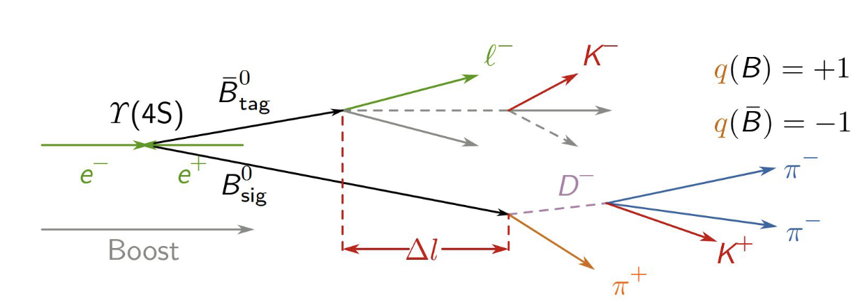
Next on deck (I): Flavour tagging
Essential in many CP-violation and B-mixing analysis, especially in analysis to determine φ₁/β and φ₂/α

Slide 21

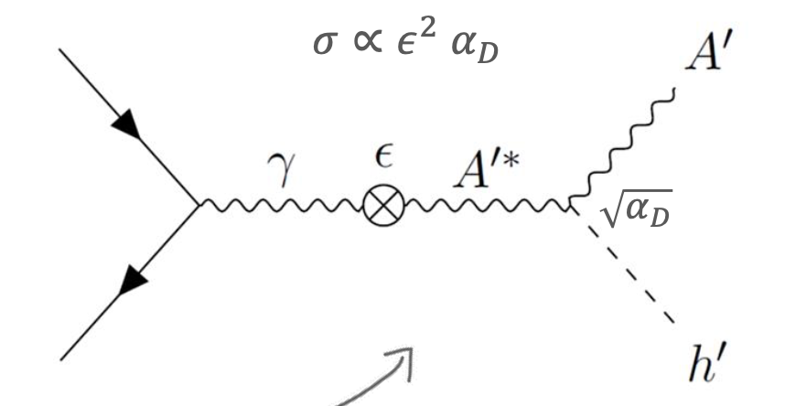

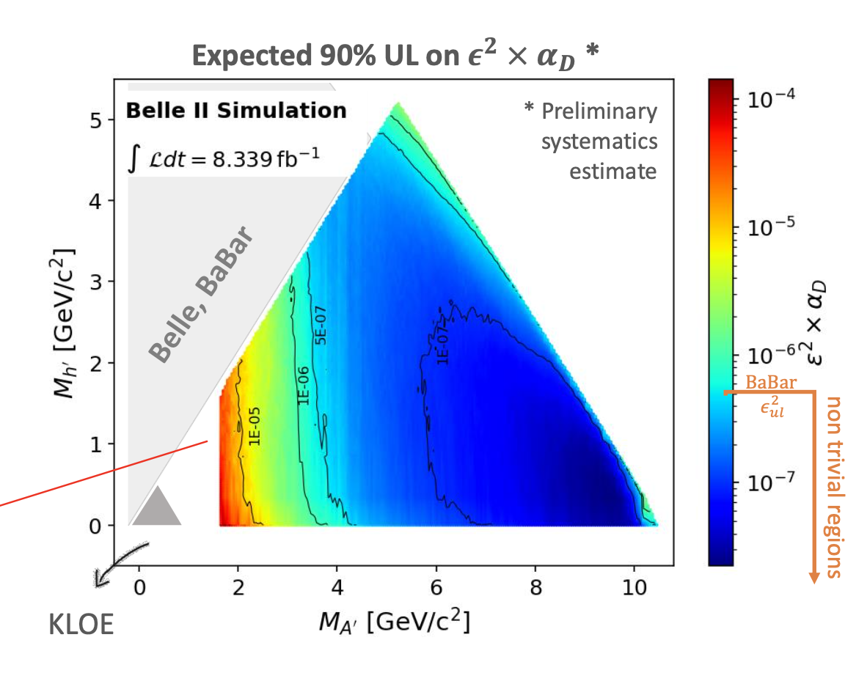
Next on deck (II): Search for Dark Higgsstrahlung
Search for invisible dark higgs (mh’ < mA’)
Expected UL on cross section translated in limit on the ∈²x𝛼D coupling
Promising results on 2019 dataset
Analysis close to box opening

Slide 22


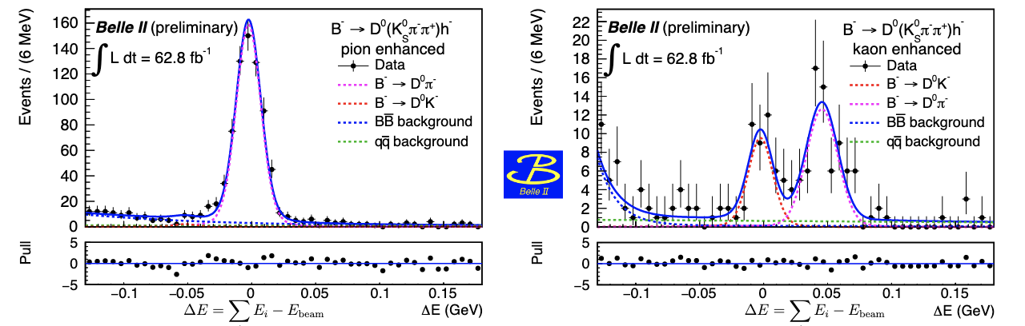
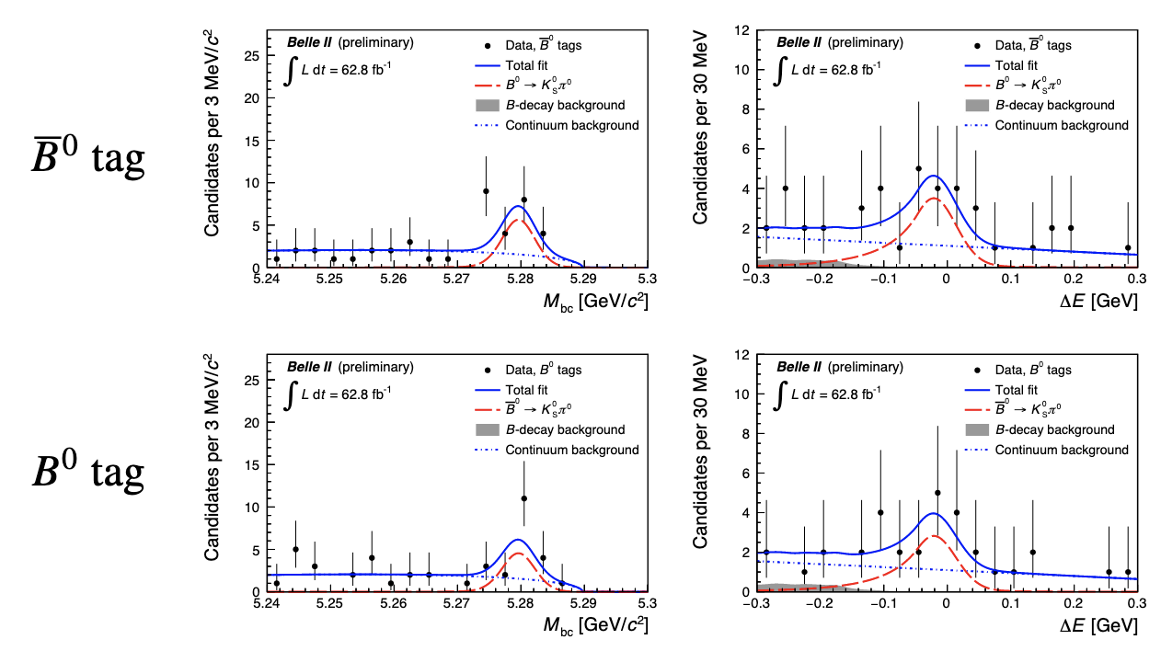
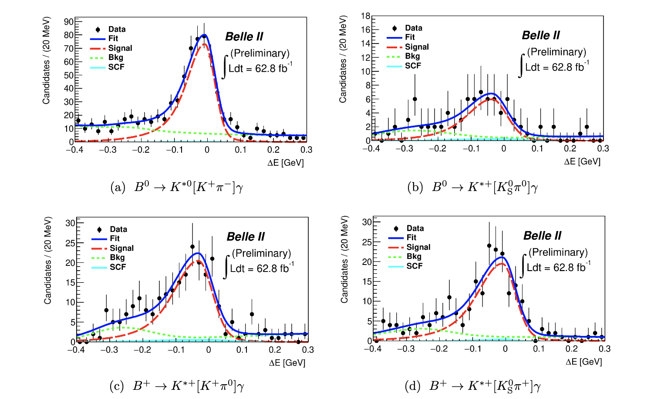
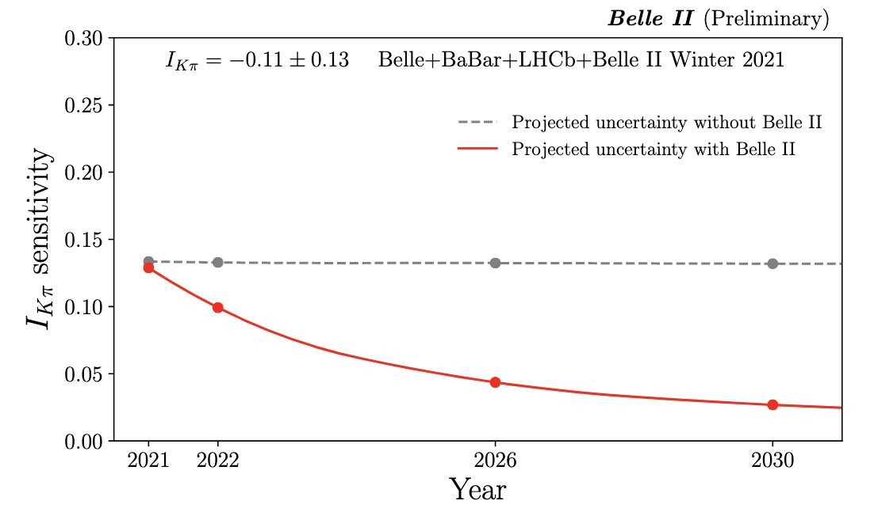
Highlights from summer conferences (I)
Aim for combined Belle+BelleII measurement in the short term
φ₃/𝛾 measurement in B→D^{(*)} K transitions
Solving K𝜋 puzzle
B→ K∗𝛾 branching fraction measurement

Slide 23

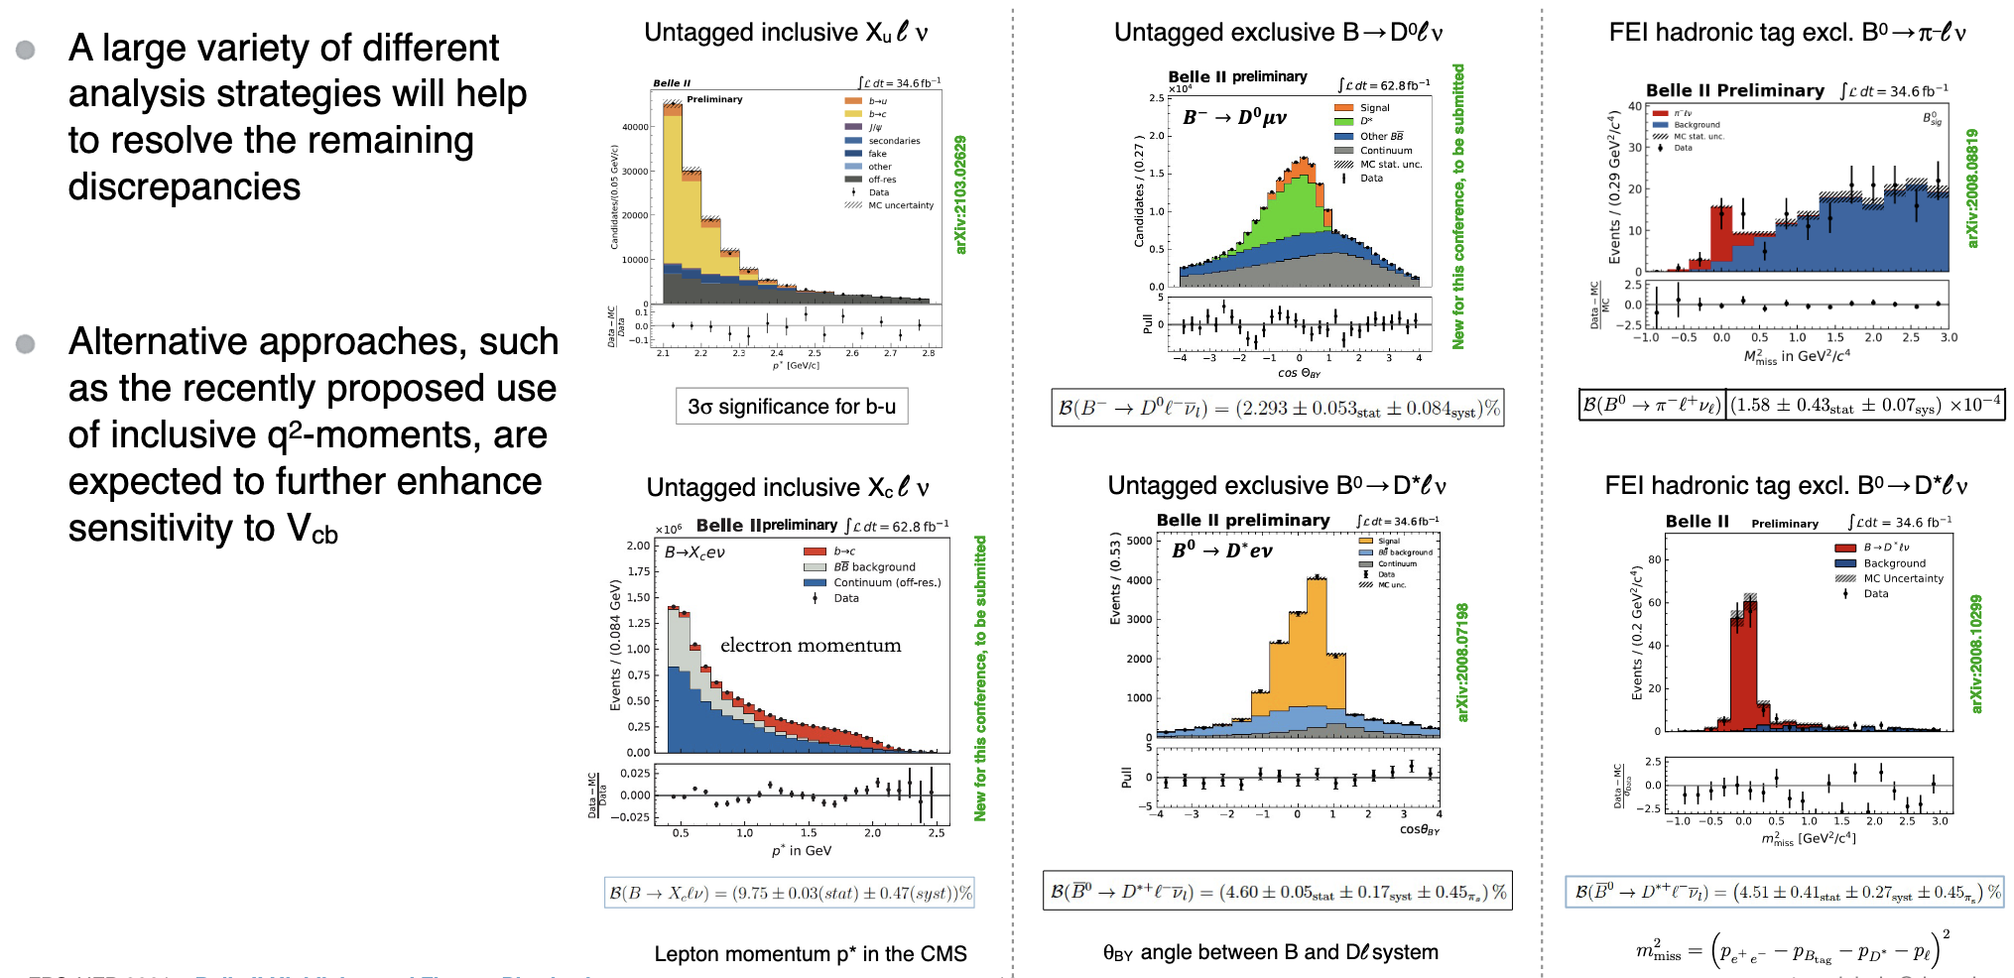
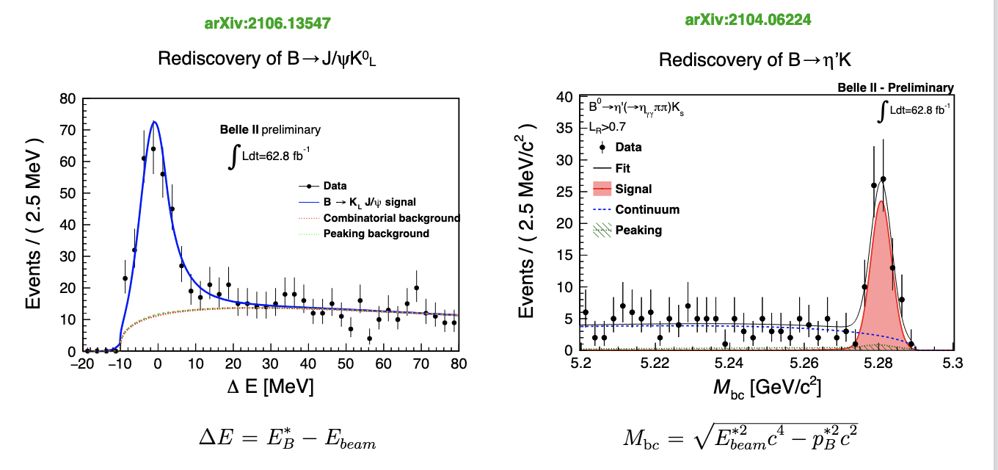
Highlights from summer conferences (II)
Toward inclusive and exclusive Vub and Vcb measurement
Toward Time dependent CPV measurements
🇮🇹
🇮🇹

Slide 24
Project time line

Slide 25
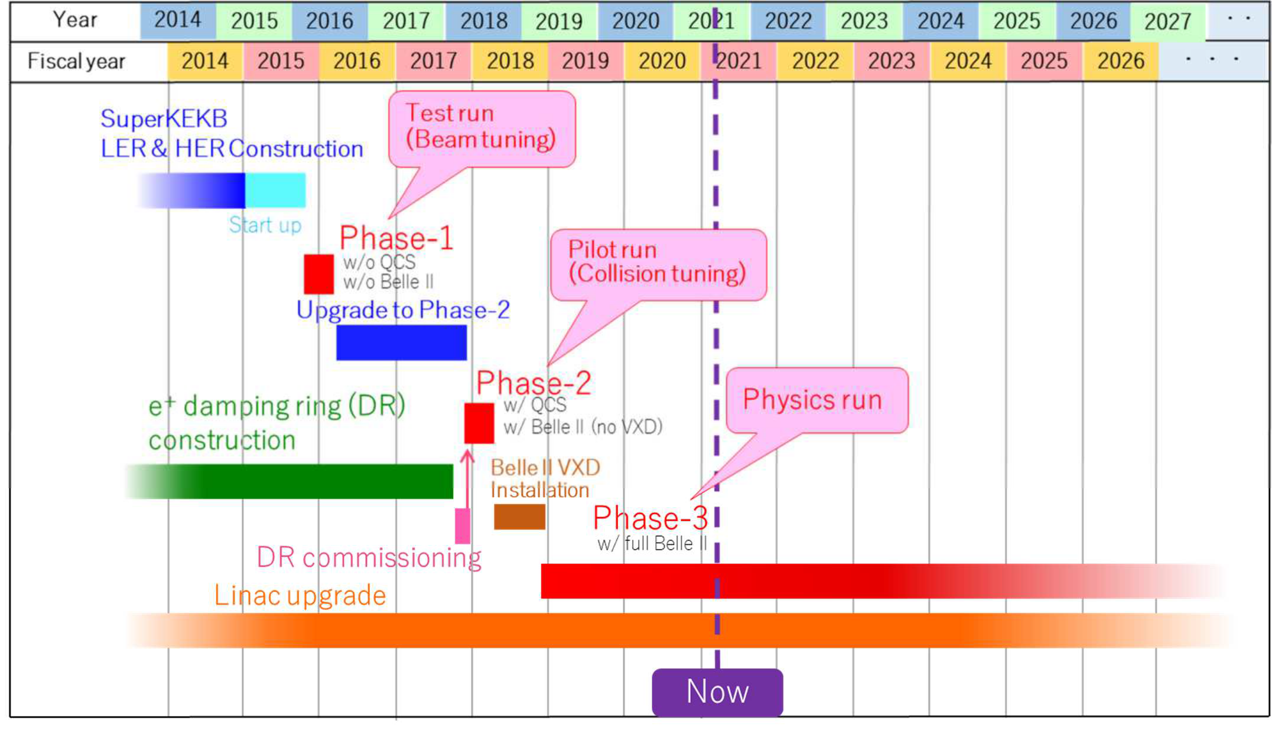
SuperKEKB project timeline
Construction: 2011-2016
Phase 1 Test run 2016.2 – 2016.6
Phase 2 Pilot run 2018.3-2018.7
Phase 3 Physics run 2019.3.11-present

Slide 26
Budget request for the next FY
The process of FY2022 budget request is going on with ~one month delay in the dead line this year.
the 2022 budget request to the submitted plan for the MEXT roadmap.
3.5 month operation in FY2022,
taking account of the long shutdown for the PXD installation.
budget requests for upgrade/maintenance
Since travelling to Japan still requires complex procedures to setup LS1 might be postoned by about 6 months (Today EB) decision will be taken in October B2GM.

Slide 27
SuperKEKB Roadmap 2021 si conferma roadmap precedente

Slide 28
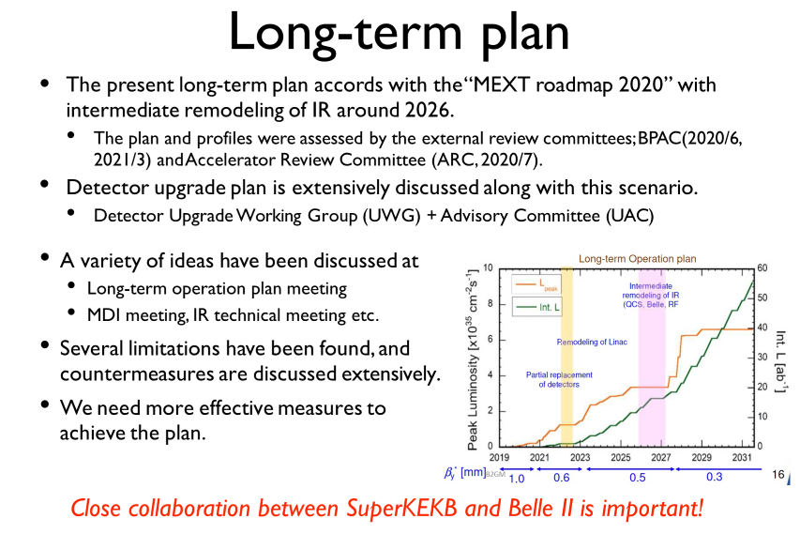

Slide 29
Main reasons to update the operation plan
Main reasons:
Increase in the running cost (utility cost )
Challenges found in the initial operations (～2019c) ：
Strong beam-beam effects at high bunch-current region
Narrow physical aperture in QCS
High background in Belle II
Small dynamic aperture at high bunch-current region at
small β * (~0.3 mm), which has been recognized from the
y
design phase.

Slide 30
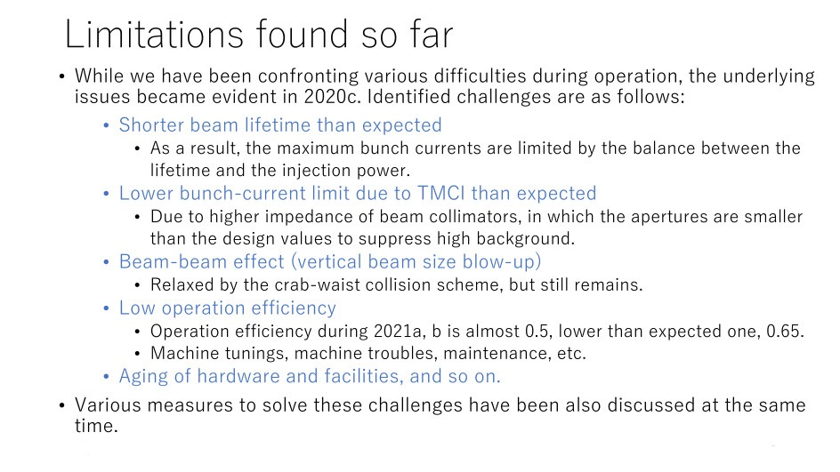

Slide 31
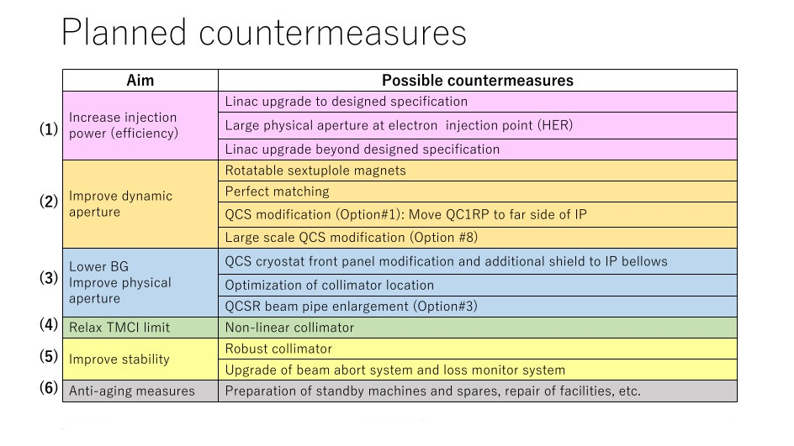

Slide 32
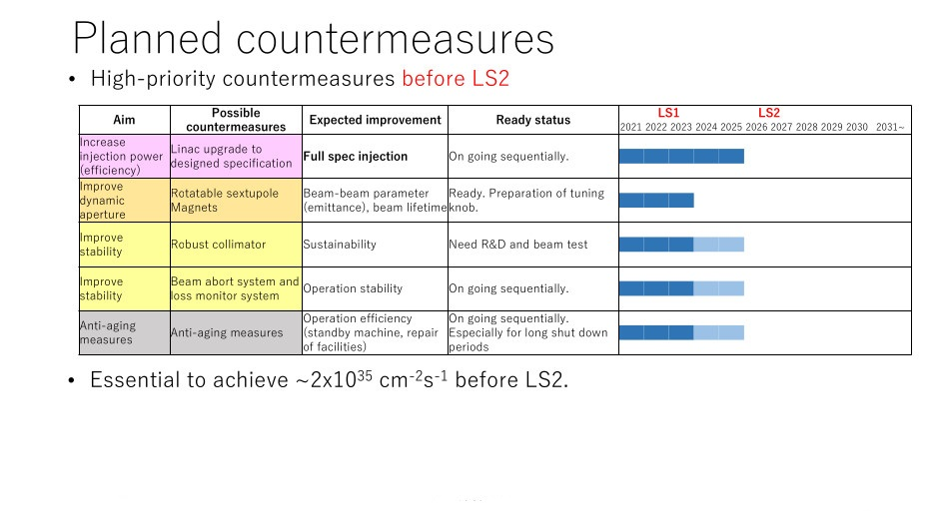

Slide 33
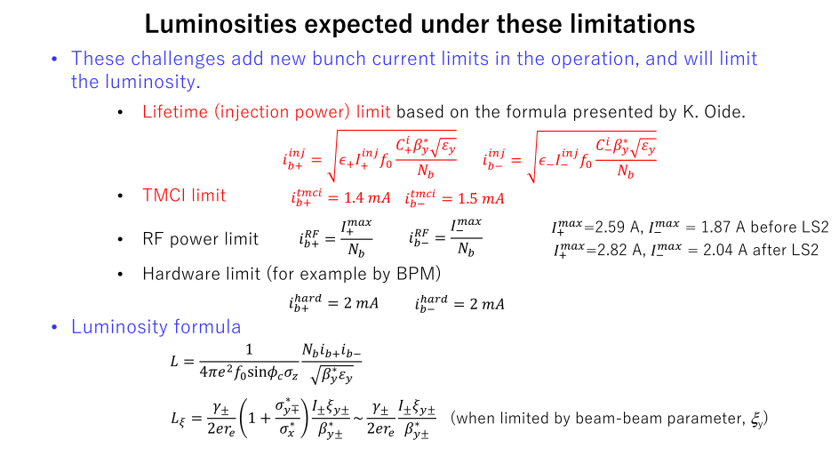

Slide 34
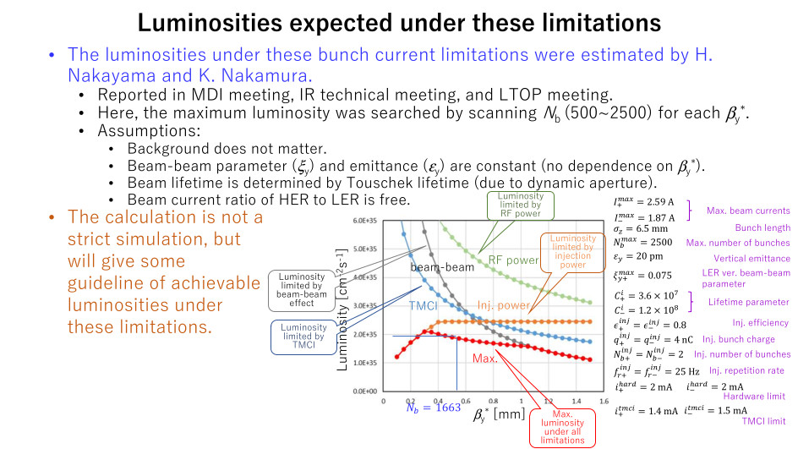
It is ESSENTIAL to reach 1-2 10³⁵ cm⁻² s⁻¹ before LS2

Slide 35
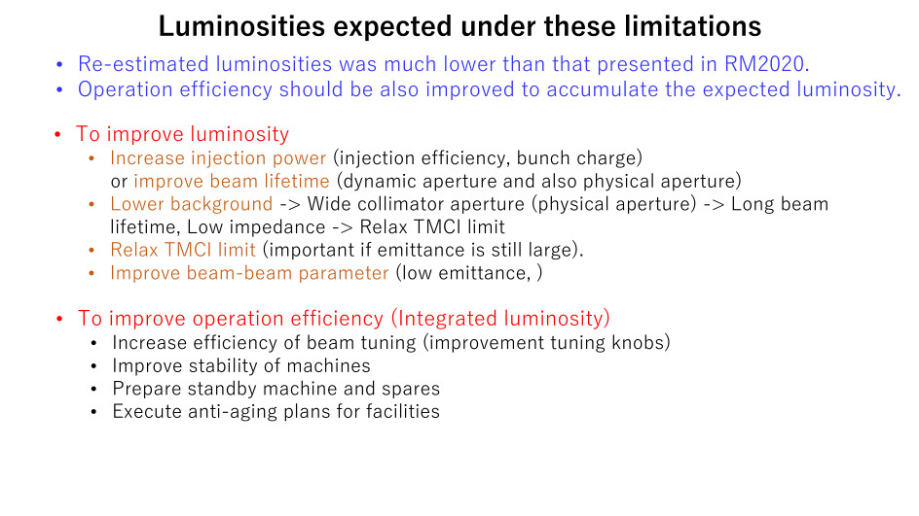

Slide 36
Time scales and major installations
Intermediate luminosity: 2022
Large installation planned for PXD2022. Fairly defined
Natural time to get something (if possible) and be included in the intermediate data sample
Half TOP PMTs will be replaced.
No time for R&D, need to define plan very soon
Almost ballistic: mostly managed by the Technical Board, information exchange important
Design/High luminosity: 2026
Large installation for QCS replacement. Still large uncertainties
Possible for larger upgrades if motivated/funded/ready
Very little time for R&D, need to move into a real construction plan soon
Upgrades: > 2032
A luminosity upgrade could be investigated.
Beam polarization could be investigated .
Need extensive R&D on instrumentation frontier since they cannot work with the expected background. Probably significant funding for construction
Important to start early and be part of the major planning processes

Slide 37
M&O Funds

Slide 38
M&O Funds
Decision on MOF
Financial Board (Experiment) P. Branchini
Make proposal for Maintenance and Operation Funds (July)
Scrutiny Group (nominated by FOP) F. Cossutti
Scrutinise proposal and past spending
Financial Oversight Panel (Funding Agencies) R. Tenchini
Meeting on the 22° of October
Who pays
50% of MOF are covered by KEK (+ 1.5 secretary)
The other 50% (+1.5 secretary) are covered by member countries, proportionally to the number of PhD physicists in the collaboration
INFN share, roughly 14%

Slide 39
Utilizzo fondi 2021

Slide 40
Proposta per gli anni a venire…

Slide 41
Gruppo italiano e richieste 2022

Slide 42

Situazione anagrafica e metabolismi 2021
Nel 2022:

Slide 43


Slide 44

Belle II organisational chart

Slide 45
Richieste 2022
Dettaglio nel foglio google:
https://docs.google.com/spreadsheets/d/1YQhum0k-haHudSn3u3D6aYtB05vZtMio4kZVUHxzx-k/edit#gid=683285174
Suddivise in 4 categorie:
Richieste di sottosistema
Categoria A: costo core necessario per le costruzioni
costruzione
Attrezzature di laboratorio specifiche per le costruzioni
Missioni specifiche: workshop specifici, contatti, montaggi
Categoria C: missioni per responsabilità
Categoria D: Assemblaggio, installazione e turni a KEK
Richieste di sezione
Categoria B: Consumi e missioni metabolici e generali
Consumi: 1.5kE/FTE
Missioni Italia: 1.0kE/FTE
Missioni a KEK: 1m.u./FTE
1m.u. in Giappone valutato 6kE (30gg di missione + 2 viaggi da 1kE)

Slide 46
Richieste 2022 - missioni per turni
TURNI DI ESPERIMENTO:
3 persone in turno per 3 turni al giorno
frazione PhD italiana = 14.2%
nel 2021 previsti 4.5 mesi di run
Richiesta = 3x3x4.5x0.142= 5.7 mu, 34,5 kE
I turni di esperimento sono chiesti in una tasca indivisa nella sede del RN
TURNI DI SOTTOSISTEMA:
Richieste diﬀerenti per i sottorivelatori, discussi nei talk speciﬁci.
I turni di sottosistema sono chiesti in una tasca indivisa nella sede del responsabile del sottosistema

Slide 47

Richieste 2022 - quadro complessivo

Slide 48
Piano di spesa Pluriennale

Slide 49
Evoluzione del piano finanziario pluriennale
 | SISTEMA | Item | TOTALE | 2013 | 2014 | 2015 | 2016 | 2017 | 2018 | 2019 | 2020 | 2021 | 2022 | 2023
 | VXD | TOTALE VXD BASE | 1573 | 67 | 262 | 254 | 243 | 235 | 196 | 68 | 62 | 62 | 62 | 62
 | PID | TOTALE PID | 849,5 | 64 | 89 | 154 | 36 | 7 | 140,5 | 170 | 66 | 41 | 41 | 41
 | ECL | TOTALE ECL | 530 | 19 | 188 | 68 | 121 | 10 | 68 | 40 | 4 | 4 | 4 | 4
 | KLM | TOTALE KLM | 762 | 0 | 0 | 0 | 223 | 65 | 61 | 81 | 83 | 66 | 83 | 83
 | COMP | COSTO a CARICO INFN | 1970 | 5 | 33 | 100 | 35 | 98 | 195 | 221 | 375 | 299 | 299 | 310
 | PHT | TOTALE PHT | 451 | 0 | 0 | 32 | 38 | 38 | 43 | 60 | 60 | 60 | 60 | 60
 | M&O | M&O FUNDS | 1380 | 0 | 37 | 58 | 95 | 140 | 95 | 135 | 200 | 200 | 210 | 210
 | SHIFTS | TOTALE SHIFTS | 550 | 0 | 0 | 0 | 0 | 0 | 65 | 97 | 97 | 97 | 97 | 97
 | ALL | Meeting e metab. 30 FTE Missioni * 10 | 3120 | 250 | 212,5 | 233,5 | 282 | 312 | 310 | 280 | 310 | 299 | 310 | 310
 | ALL | Lab e metab. 30 FTE consumi * 3.3 | 835 | 50 | 50 | 100 | 100 | 100 | 75 | 60 | 75 | 75 | 75 | 75
 |  | GRAND TOTALE BASE | 12020,5 | 455 | 871,5 | 999,5 | 1173 | 1005 | 1248,5 | 1212 | 1332 | 1203 | 1241 | 1252

Slide 50
2
EU grant n.822070
Il progetto è sospeso dal 1-4-2020. Il progetto è stato attivo 1 anno e deve farne altri 3, salvo possibili estensioni. Nel primo anno la componente Belle2-Italia ha già implementato il 30% dei secondments spettanti.
Fino a quando non sarà possibile riprendere viaggi regolari in Giappone sarebbe suicida riaprire il progetto (ovvero far scorrere il tempo senza implementare secondments, i.e. maturare budget).
Vi sono pressioni dalla REA per riprendere le attività: una discussione avverrà nel mese di settembre. A fronte delle limitazioni ai viaggi in Giappone c’è una disponibilità a prolungare la sospensione fino a fine anno.
Vanno studiate delle soluzioni per il 2022, per esempio:
Organizzare lunghe permanenze di poche persone. Serve totalizzare almeno 15-20 mesi l’anno.
Contrattare con la REA un ampliamento delle regole del progetto (per esempio accettare secondments fra istituzioni europee)

Slide 51

Anche quest’anno JENNIFER2 ha comunque organizzato una summer school online:
La summer school online è stata aperta a studenti di tutti i paesi, non solo europei.
Come sempre è diretta a studenti di fisica al termine del terzo o del quarto anno di studi.
Ricevute circa 150 domande, ammessi 80 studenti (30 europei, 8 italiani)

Slide 52
Fra i docenti Diego Tonelli, Alain Blodel, Antonio Pich, Torben Ferber, Peter Krizan.
Anche quest’anno un programma di MENTORSHIP (un «assaggio» di un lavoro di ricerca di un paio di settimane, seguiti da un ricercatore di JENNIFER2) è stato proposto agli studenti interessati come follow-up della scuola.

Slide 53
Milestones

Slide 54

Proposta per le milestones 2022

Slide 55

Completamento delle milestones 2021
100%
100%
100%
100%
100%
100%
100%
100%

Slide 56
Situazione Economica 1
Abbiamo avuto 200 keuro per pagare i MoU 2020.
Sono avanzati circa 20 keuro che devono essere
restituiti alla CSN1. Da fare in CSN1.

Slide 57
Situazione economica 2
I provvedimenti legati alla diffusione del COVID-19 hanno
causato l’immediata cessazione dei viaggi previsti per turni.
Al momento l’esperimento viene gestito da turnisti locali e noi italiani facciamo turni di esperti dei vari detector o turni di processamento dati. Al momento non abbiamo idea di quando torneremo alla normalità, ma abbiamo fatto l’esercizio di capire quali avanzi di missioni avremo assumendo di tornare a viaggiare a settembre e di poter riprendere quindi da settembre a fare turni di presa dati.

Slide 58
Avanzi previsti
LNF: 17 keuro
NA: 45 keuro
PI: 69 keuro
PD: 39 keuro
PG: 32 keuro
RM3: 87 + 78.5 s.j. keuro
TO: 57.5 keuro
TS: 51 keuro
397.5 keuro +78.5 keuro = 476 keuro

Slide 59
Backup slides

Slide 60
Change of phase
Need to move from a loosely coordinated R&D activities to a set of construction projects on different timescale
Need to update the charge to UWG and clarify dividing lines of responsibility with TB, while improving communication bandwidth
Essential to have clear endorsement from KEK on what the roadmap for SuperKEKB/ BELLE II will be
Important to start discussion with Funding agencies ASAP to understand available funding
This activity involves all Belle 2 subdectors, we’ll hear from sub detector coordinators about it

Slide 61



High Bunch Current Collision
Vertical emittance (pm)
Lsp
L_{sp} x10³¹ (cm⁻²s⁻¹/mA²)
n_{b} : 393
LER
HER
Vertical emittance (HER)
I_{HER}/I_{LER} (I_{LER} = 340 mA)
Vertical emittance (LER)
beam-beam
limit ?
s
r_{e} N
Horizontal emittance (LER)
⇠ =
⌥
y±
y±
2⇡ ± _{x} _{z}
"y⌥
We observed large beam-beam blowup in the LER. (40 pm w/o collision)
It depends on the HER beam current.
Horizontal emittance also increases.
We consider coherent beam-beam head-tail instability and/or dynamic beta/emittance effect.
1.2 x10³⁴ cm⁻²s⁻¹ at 0.57 mA² (393 bunches)
4.78 x 10³⁴ cm⁻²s⁻¹ is expected for 1565 bunches. (I_{LER} : 1.4 A / I_{HER} : 1.0 A)

Slide 62


ξ_{y}
LER
2021b HBCC
Beam-Beam Parameter
HER
ξ_{y+} : 0.0392 / ξ_{y-} : 0.0319
Bunch Current I_{b} (mA)
L =
L
sp
nbIb+Ib-
Specific luminosity for β_{y}* = 2 mm reproduces that of 2019 ab.
Specific luminosity for β_{y}* = 1 mm is improved compared to that of 2020ab.
Bunch current product is achieved larger than 0.5 mA².
The beam current ratio is kept to be I_{LER} : I _{HER} = 5 : 4 (circle)
Beam-beam limit was observed at around 0.03 for HER.
The bunch current ratio can be optimized to improve luminosity.
The optimized ratio of beam current is 10 : 7 (triangle) at I_{b+} > 0.8 mA.

Slide 63

History of Specific Luminosity
HER BxB feedback gain (vertical) decreased. Swing shift on May 9
HER many aborts (noise affects BxB FB)
D02V1 collimator head replacement
2021ab
2nd off-resonance (-60 MeV)
1st off-resonance ^{HER}
change νy
(43.572 → 43.578)
(-60 MeV)
0.45 - 0.50 mA²
0.40 - 0.45 mA²
0.35 - 0.40 mA²
0.30 - 0.35 mA²
0.25 - 0.30 mA²
0.20 - 0.25 mA²
< 0.20 mA²

Slide 64


More detail of Lsp
HER
change ν_{y}
43.572 → 43.578
HER BxB Feedback gain (vertical) decreased.
Swing shift on May 9
off-resonance (-60 MeV)
3.12x10³⁴
Linac energy FB trouble
maintenance

Slide 65


Schedule(before peel off)
IP pipe production schedule: (we expect to complete around end of this Oct.)
IP pipe completion time limit: end of 2021 Dec (IP pipe + HM assembly: Jan-Mar. 2022)
Diamond sensor mount ready : 2022 end of March.
(but we should pay attention for the diamond sensor expert availability) VXD extraction: around end August in 2022

Slide 66
Situazione produzione ADC
Progetto pronto e sottomesso alla ditta per la produzione.
Ci sono problemi per recuperare alcuni componenti.
La produzione terminera` non prima di Ottobre 2021.

Slide 67



ADC Board
Each bord is equipped with two 16 channel ADCs (32 chan/board)
250 Msample/sec per channel
Dedicated line for distributed clock
Standard FMC connector, can be plugged on different FPGA board

Slide 68


