Slide 1
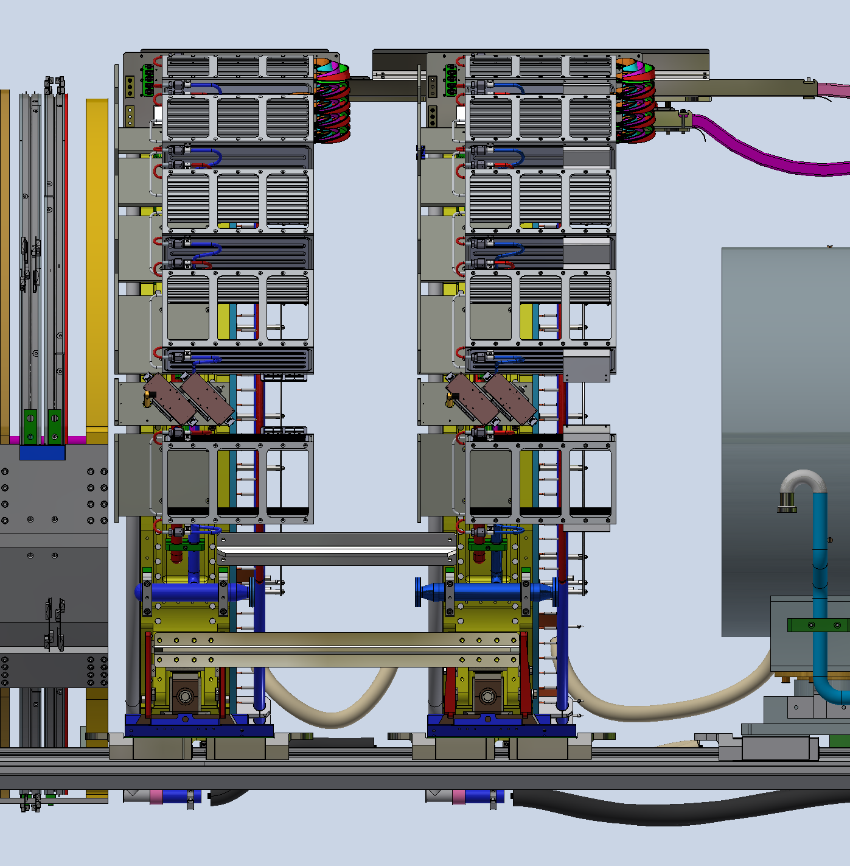
Linea 3 e 4 file excel
Mu2e 23 06 00 - 01 - Connecting Bar
Mu2e 23 06 00 - 02 - Connecting Bar

Slide 2
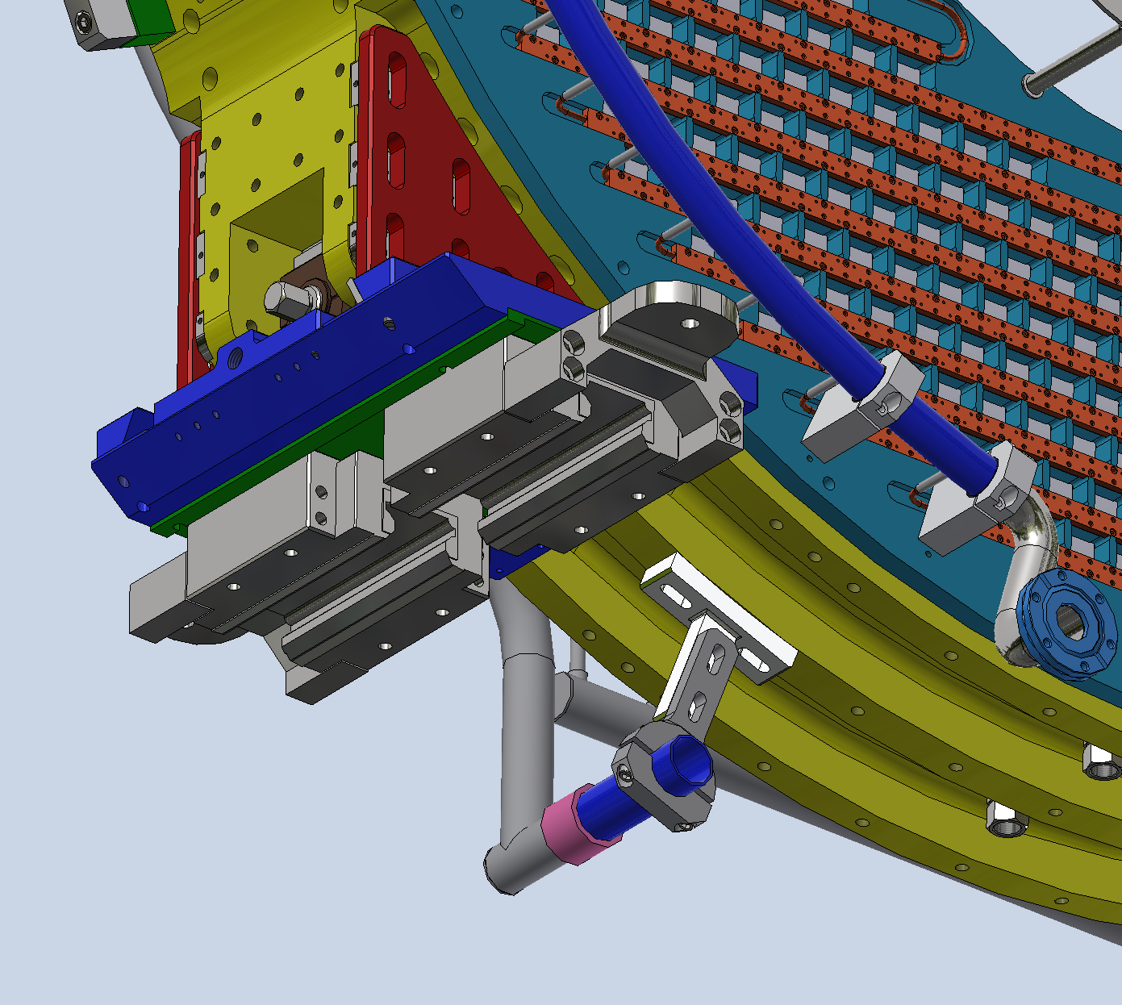
Linea 5 file excel
Mu2e 09 03 00 - 01 – Manifold Support

Slide 3
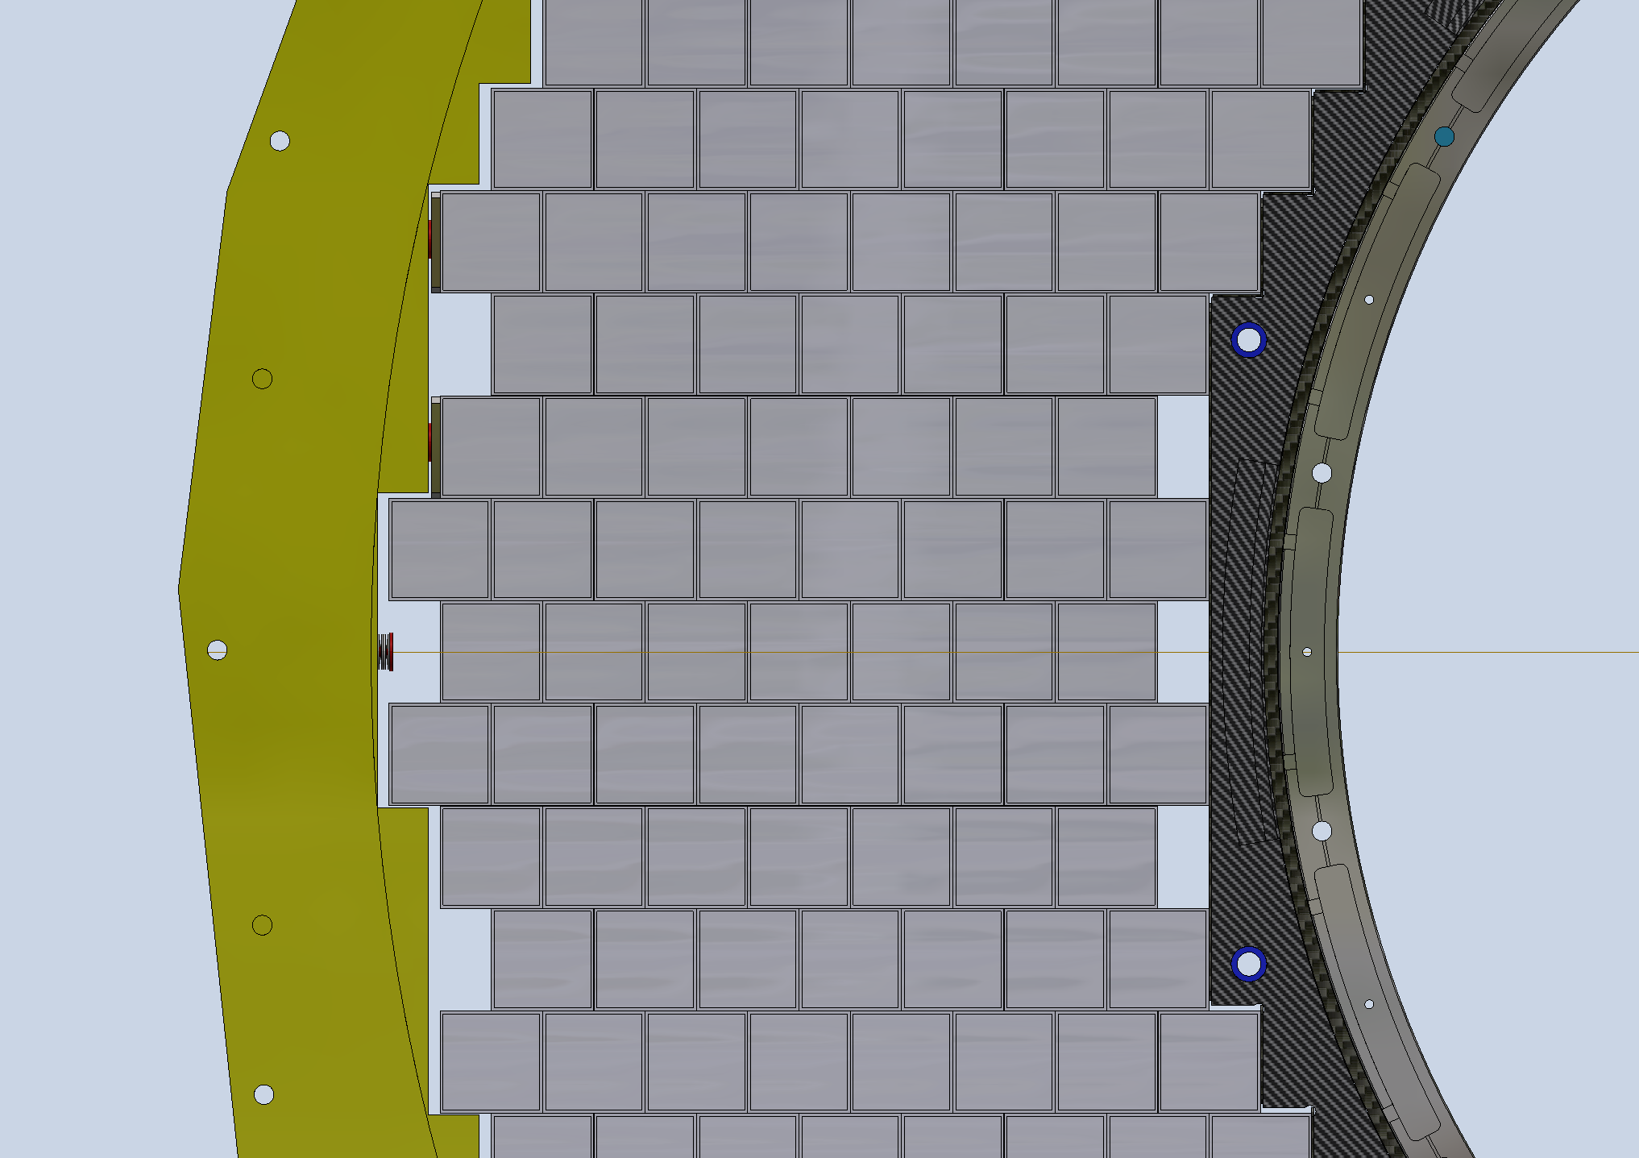
Linea 6,7 e 8 file excel
Mu2e 23 08 00 - 01 – Spacer
Mu2e 23 08 00 - 02 – Spacer
Mu2e 23 08 00 - 03 - Spacer

Slide 4
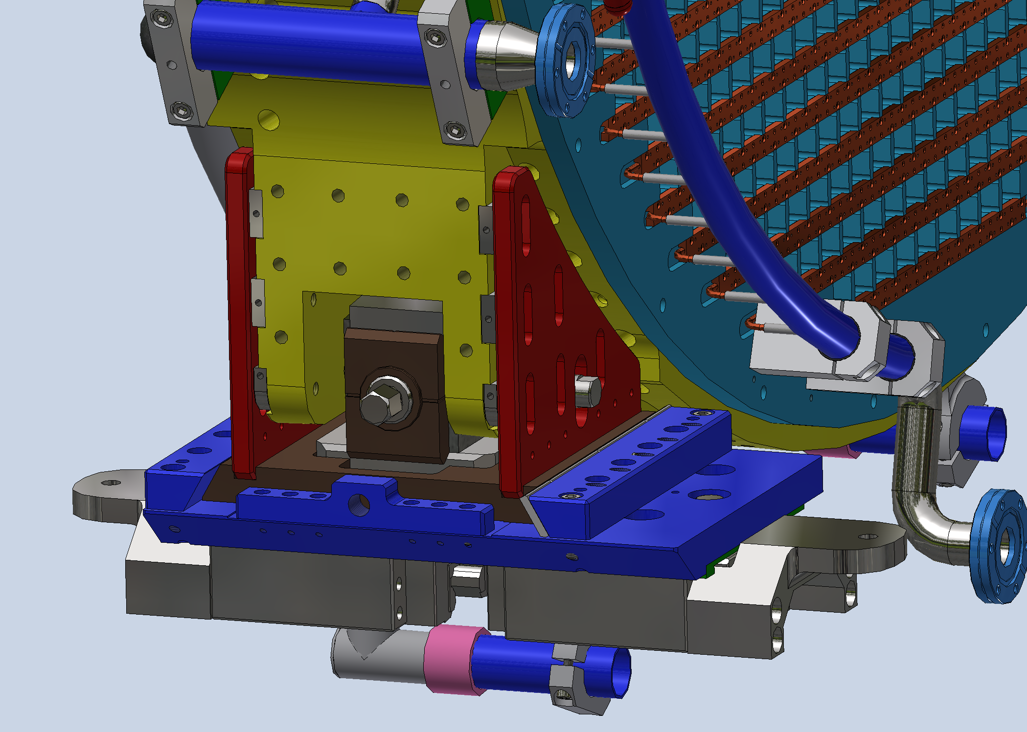
Linea da 12 a 19 file excel
Mu2e 01 00 00 - 06 – Spacer
Mu2e 01 00 00 - 07 – Spacer
Mu2e 01 00 00 - 08 – Spacer
Mu2e 01 00 00 - 09 – Spacer
Mu2e 01 00 00 - 16 – Spacer
Mu2e 01 00 00 - 17 – Spacer
Mu2e 01 00 00 - 18 – Spacer
Mu2e 01 00 00 - 19 - Spacer

Slide 5
Linea 23 file excel
Mu2e 23 07 00 - 00 - Locking Screw

Slide 6
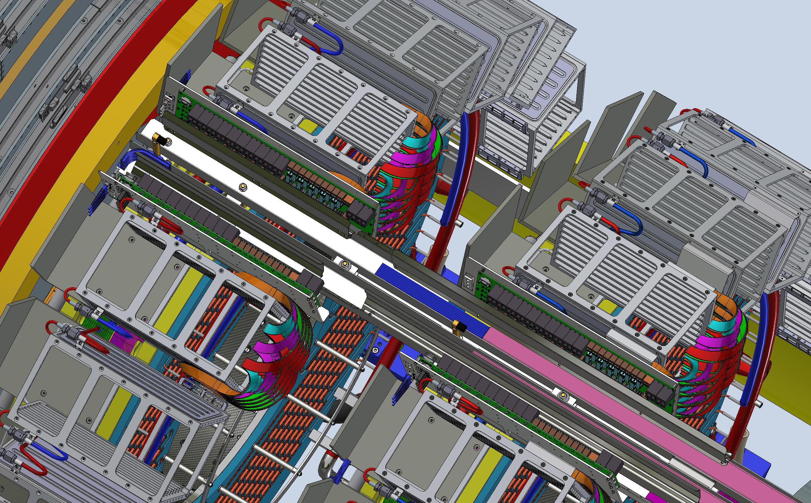
Linea 24 file excel
Mu2e 07 00 00 - 00 –
Supports of Primary Patch Panel

Slide 7
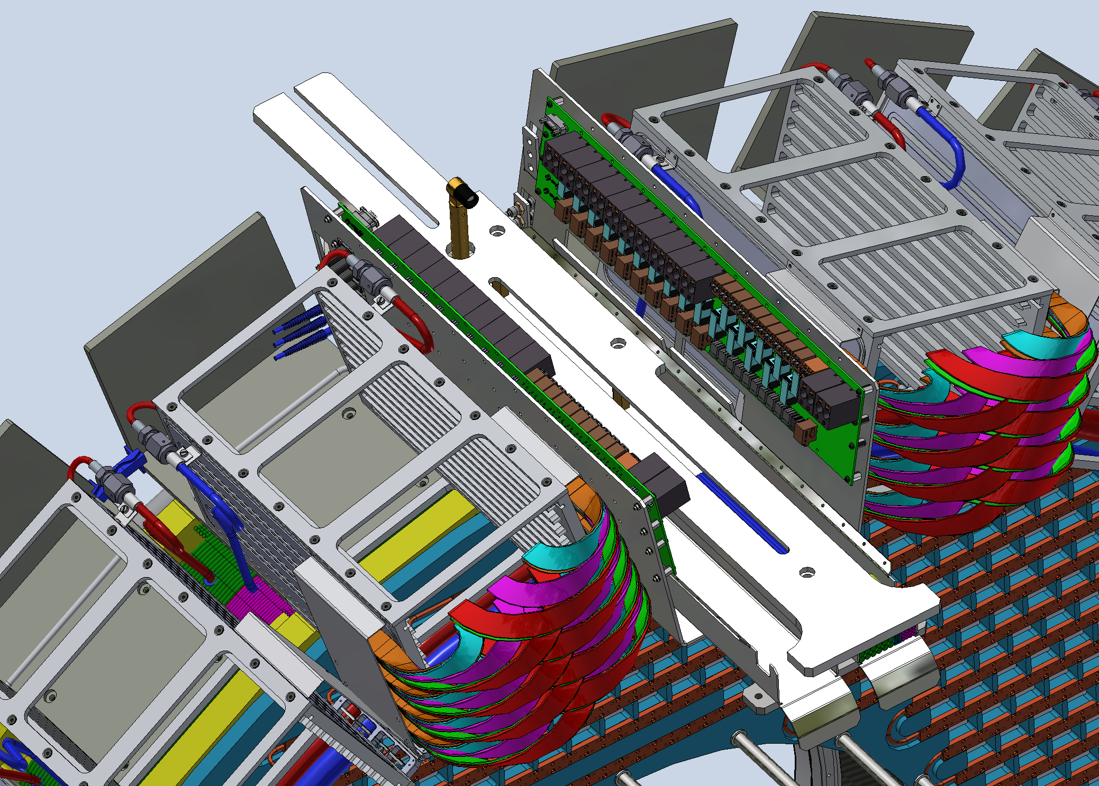
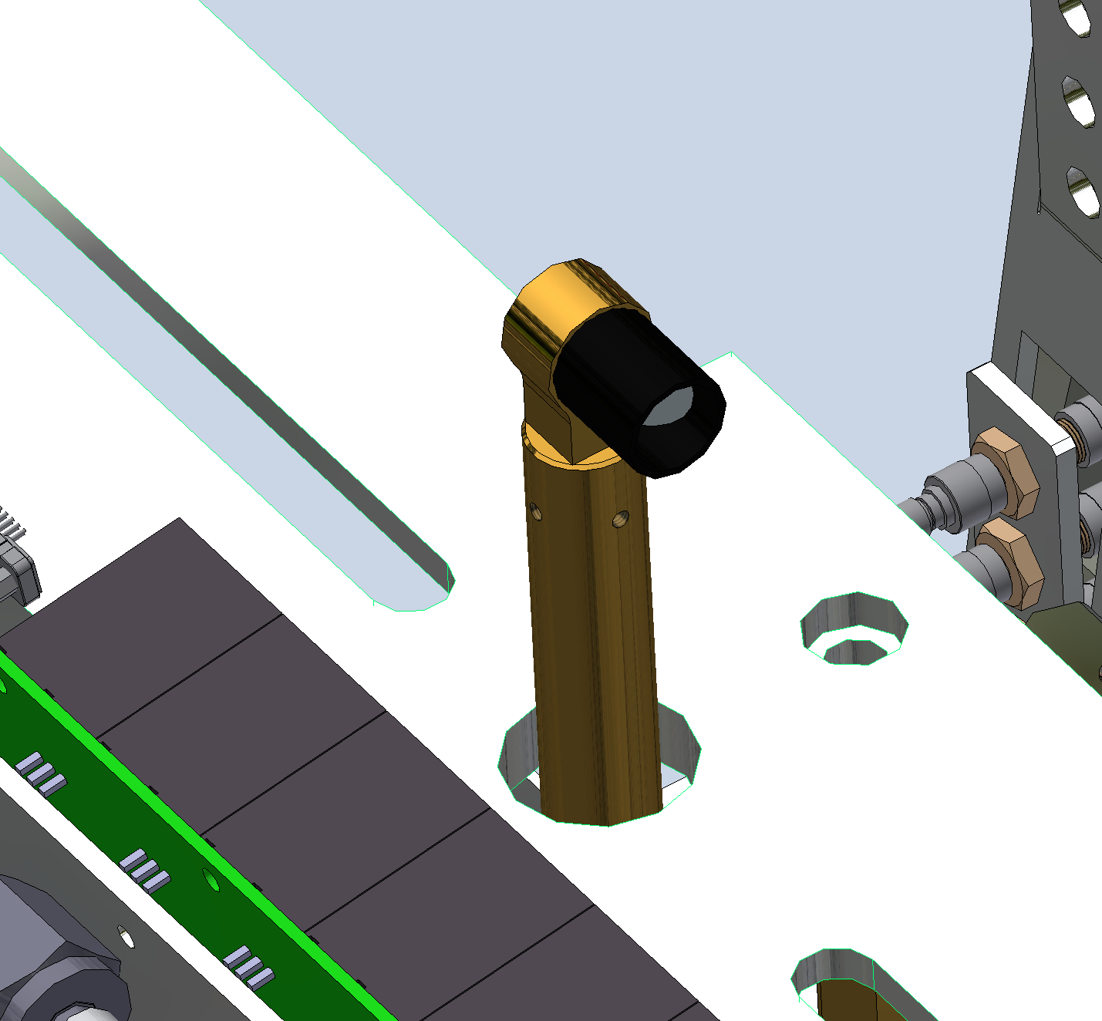
Linea 25 e 26 file excel
Mu2e 22 00 00 - 00 - Alignment Tool
Mire su anello esterno, Corner Cubes

Slide 8
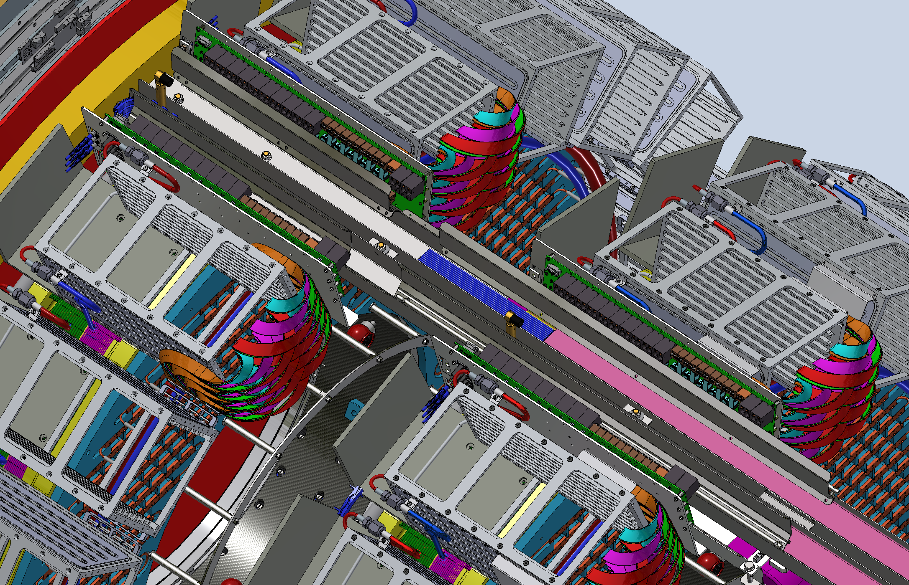
Linea 27 file excel
Mu2e 19 00 00 - 00 - Cable Trays&Cabling

Slide 9
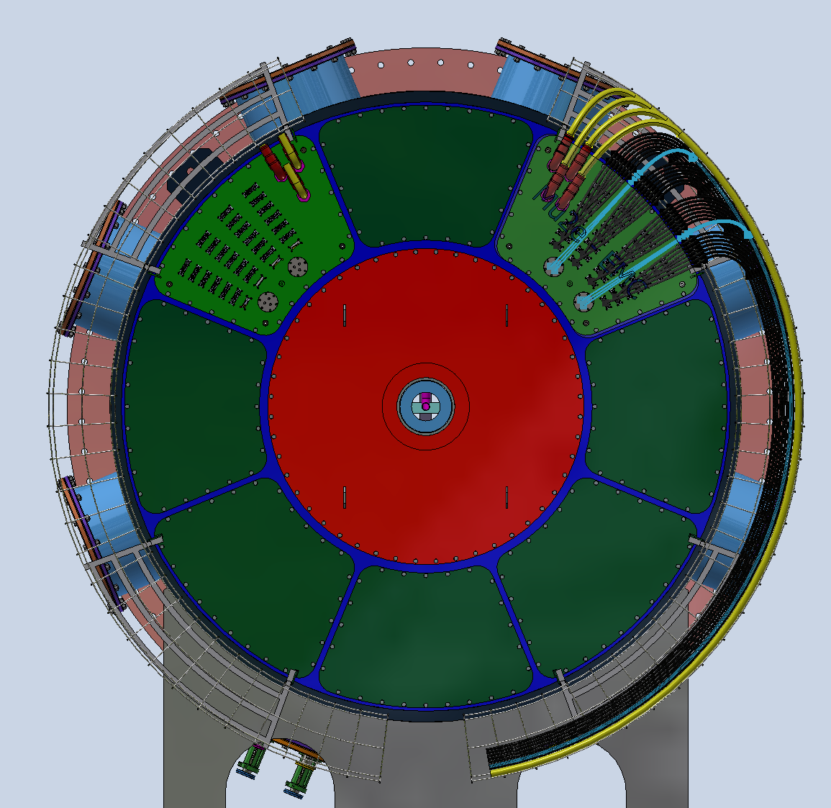
Linea 33 file excel
Mu2e 18 00 00 - 00 - IFB_Cables&Fibers Flange

Slide 10
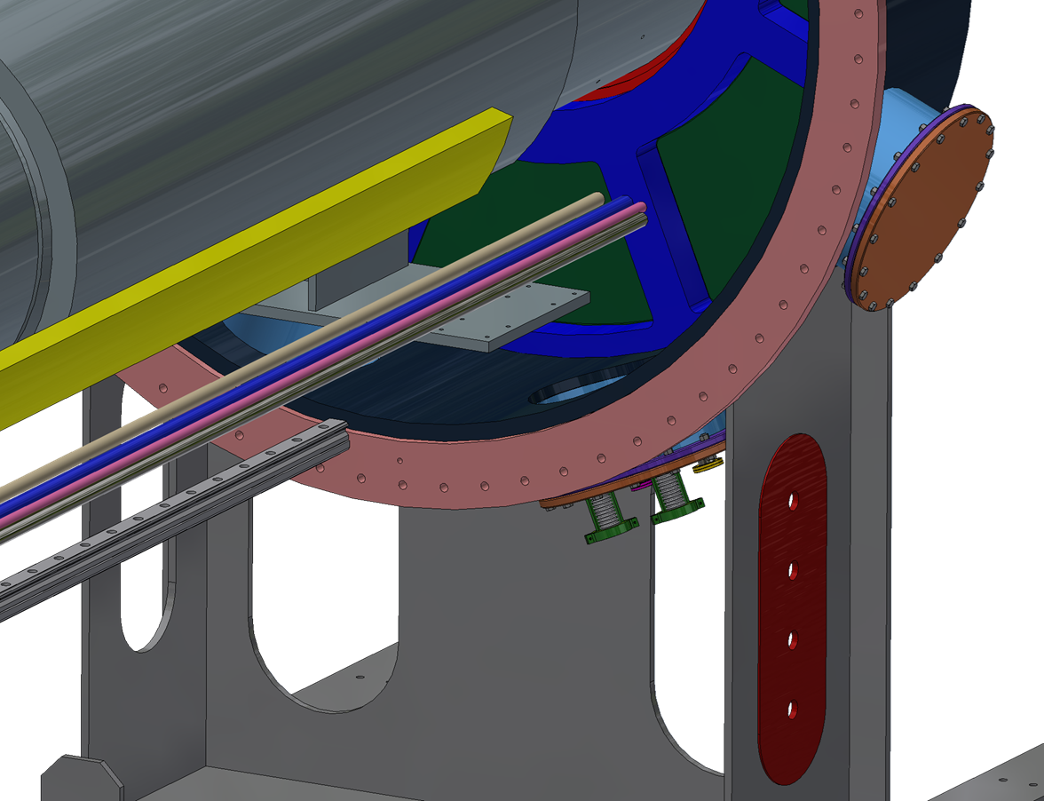
Linea 34 file excel
Mu2e 16 00 00 - 00 –
Cooling Piping

Slide 11
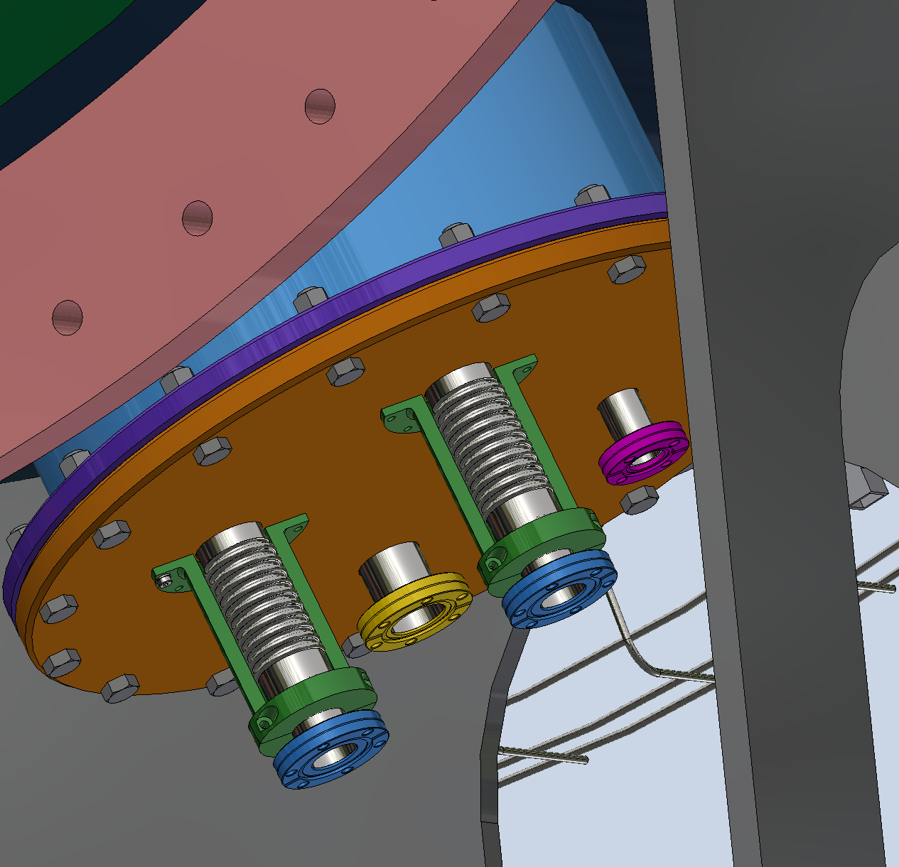
Linea 35 file excel
Mu2e 24 00 00 - 00 - IFB_Cooling Flange

Slide 12
