Slide 1
Mu2e-Overview: no Fuffa stuff
Stato dell’esperimento
  Solenoids
  Tracker
  REBASELINE
Stato del calorimetro (Next Talk)
Stato del SW (Next talk + Short Summary if needed)
S.Miscetti
Meeting with Referees
9-Aug-2021

Slide 2
Progress in the Age of COVID
END-of-June
All TS units delivered, tested, passed.
  Significant effort involving many people (applause would be appropriate here).
Significant progress on TSu. Assembly of TSd cold mass started.
> 60% of CRV modules completed
> 50% of Tracker panels complete. High quality panel production at Minnesota firmly established. Plane construction underway. Tracker infrastructure getting more attention.
PS Feedbox bellows repaired. Preparing for installation of HTS leads.
Stopping Target assembled.
Progress with Calorimeter, Tracker and CRV VSTs

Slide 3
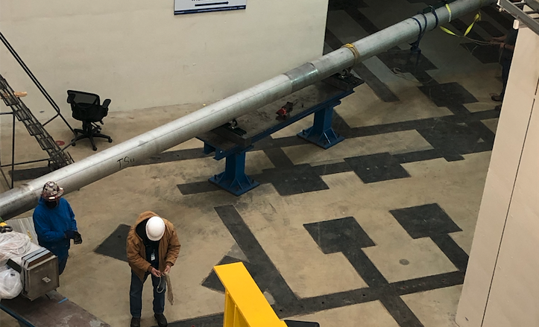
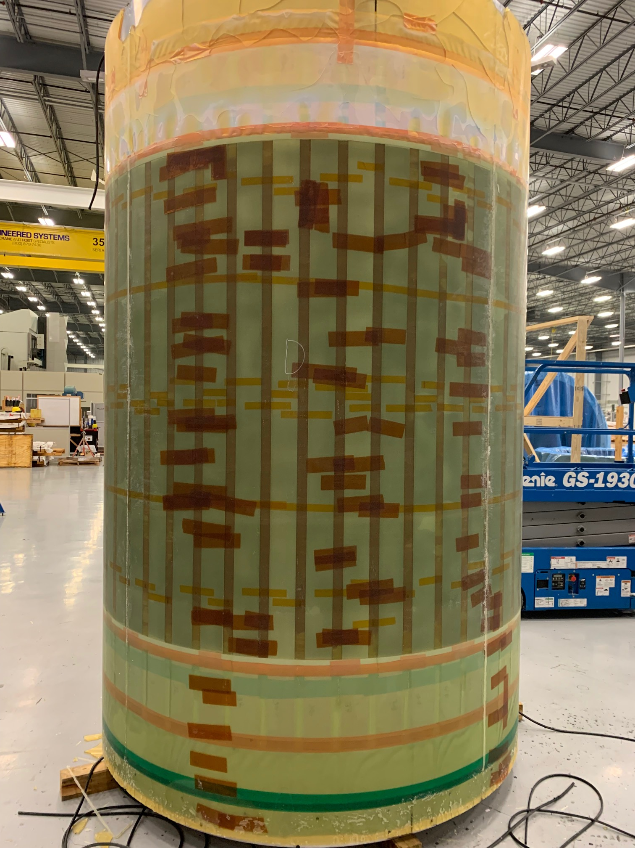
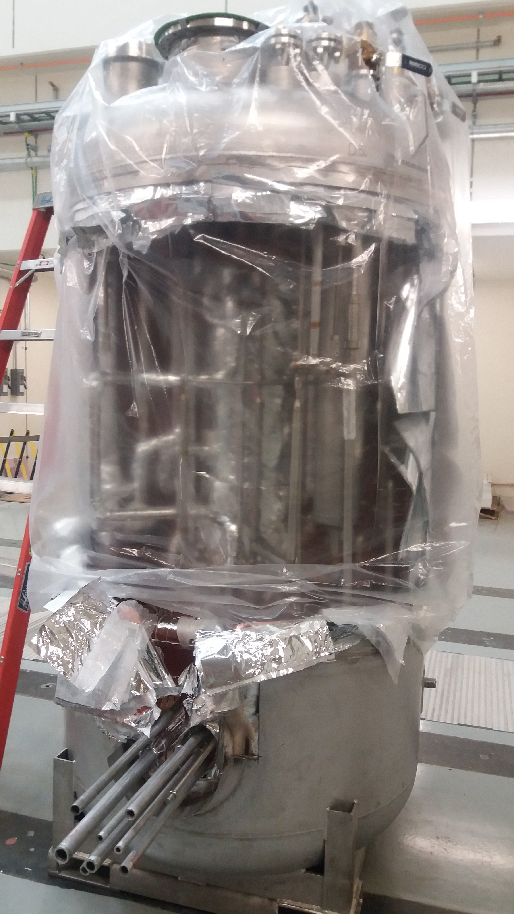
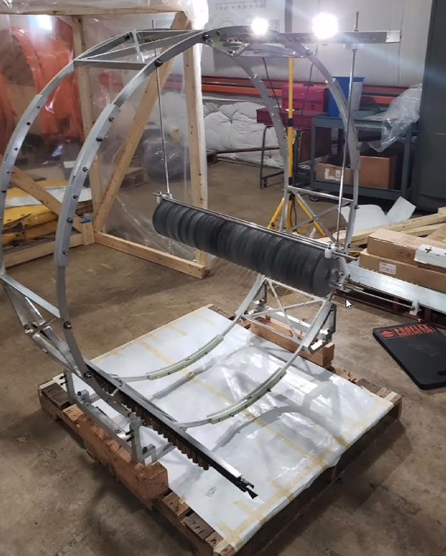
Repaired PS Feedbox bellows
TSu cryo line in Mu2e Hall
Feedbox opened and prepared for HTS installation
Assembled Stopping Target
VPI’d PS1 Coil

Slide 4
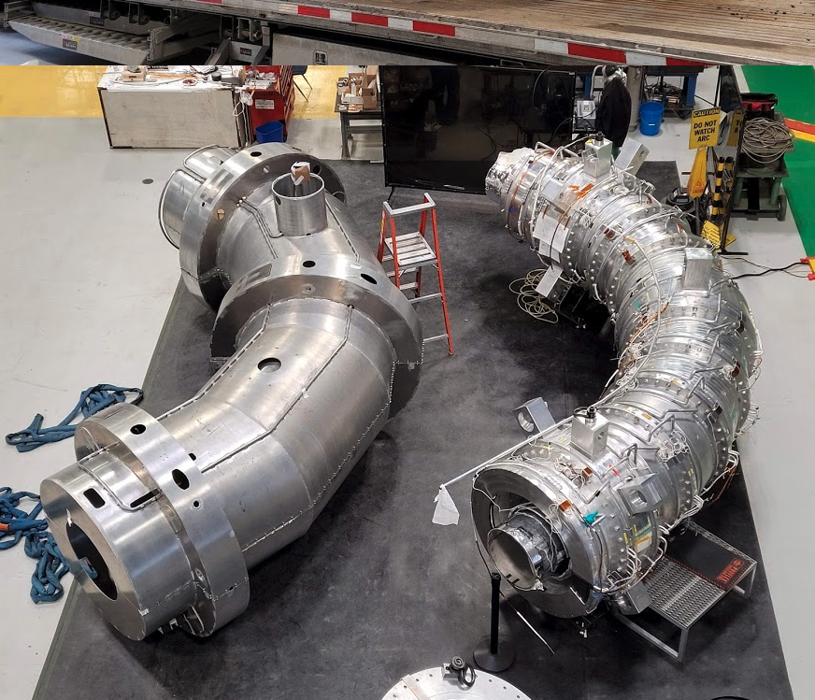
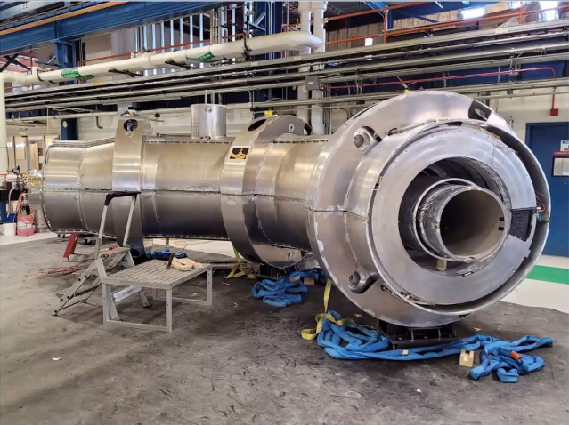
Transport Solenoid - TSu
TSu Thermal Shield and cold mass
Dry fit of TSu thermal shield

Slide 5
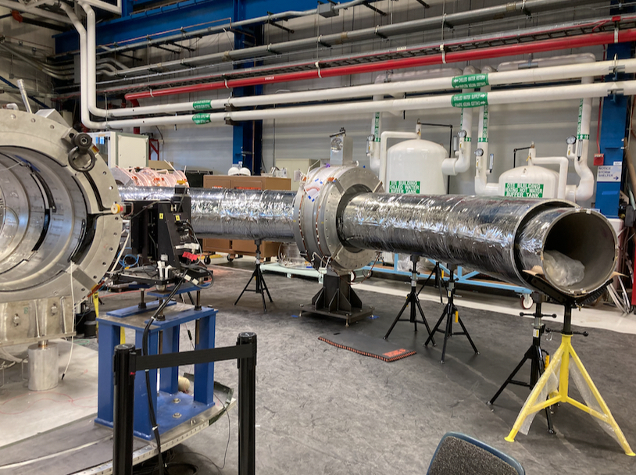
Transport Solenoid – TSd – to be updated

Slide 6
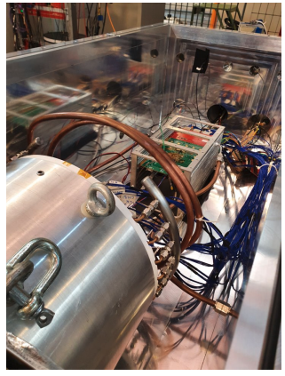
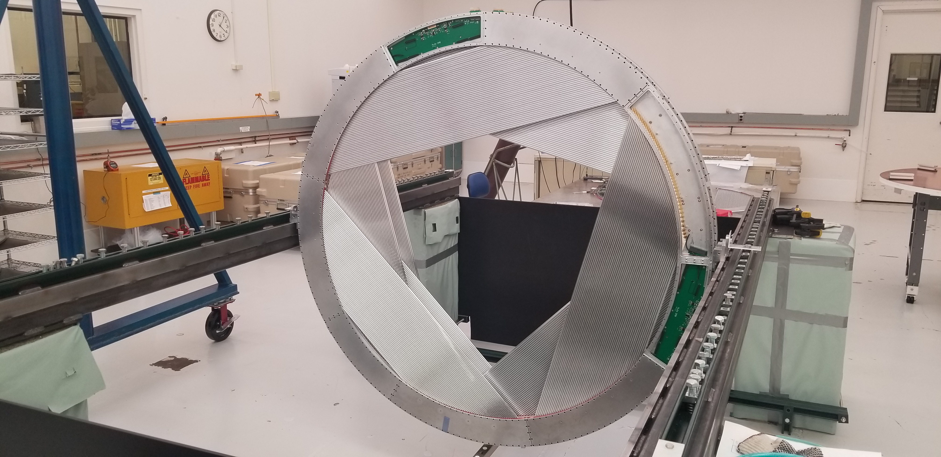
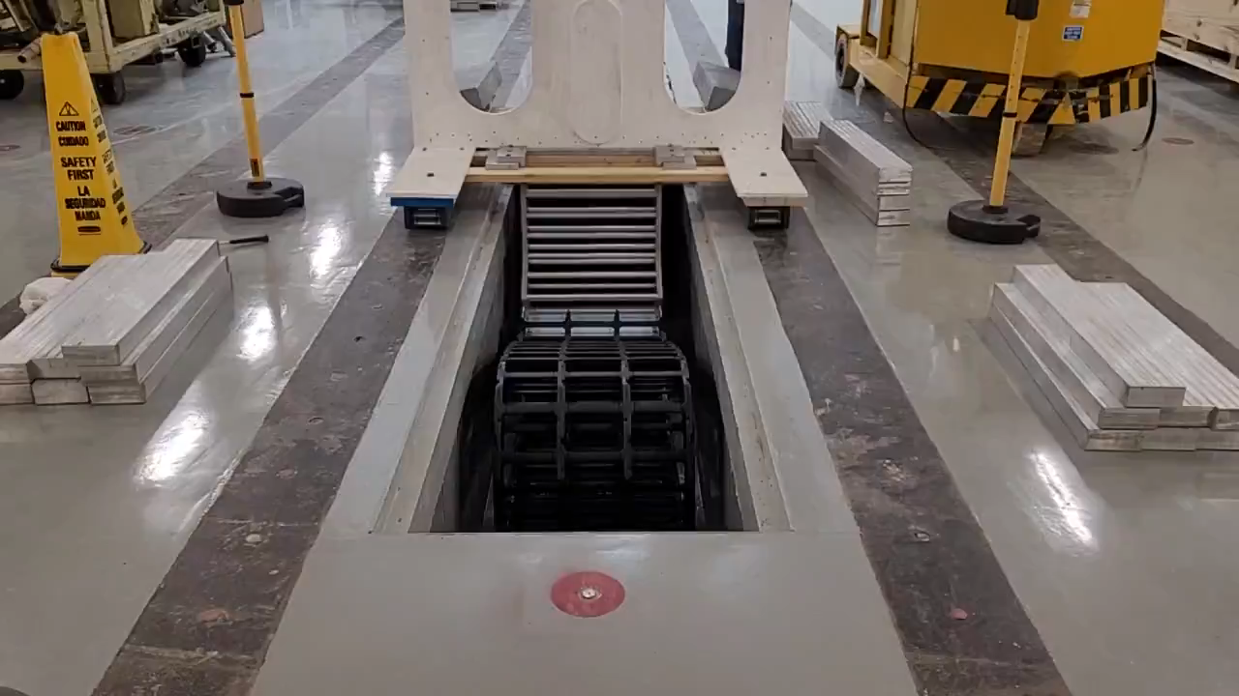
GENERAL PROGRESSES
Plane Storage at Lab 3
Calorimeter VST in vacuum with Module 0
Mockup of IFB and cable handling system

Slide 7
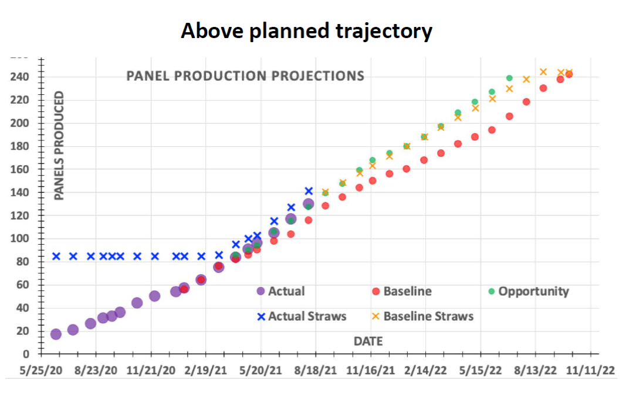
TRACKER
Still driving detector schedule critical path. Major improvements
INFN contributions are really reduced. G. Tassielli got a RTDA in Bari for ALICE!

Slide 8
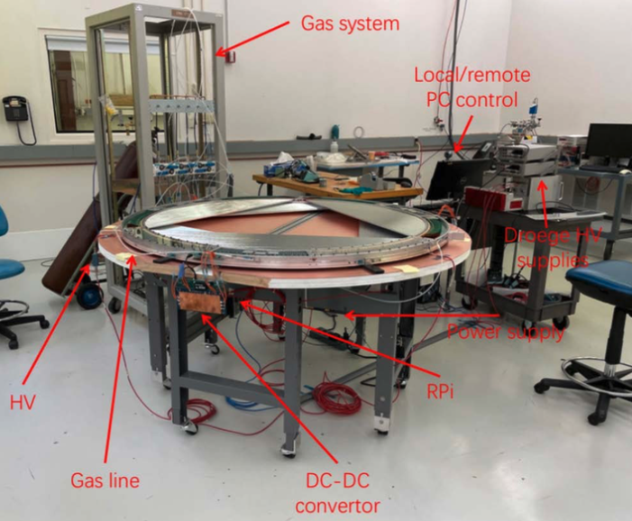
TRACKER – Vertical Slice Test, progressing well

Slide 9
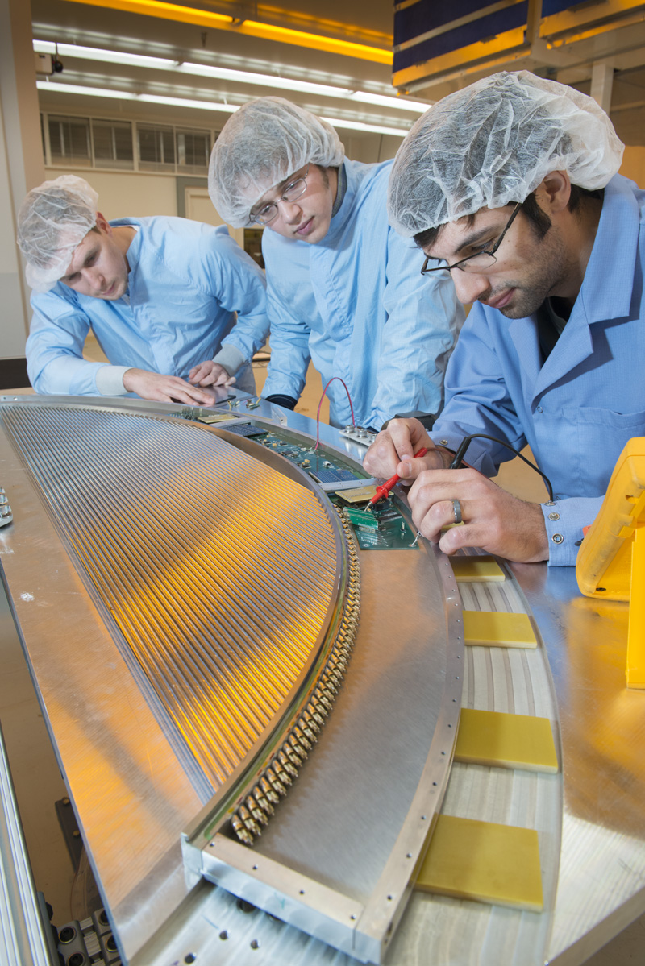
COVID Delays overall impacts
Pre COVID
COVID has had a significant impact on all aspects of the project.
  Shutdowns
  Reduced staff on site that continues
  COVID safe working protocols
    Social distancing – impacts efficiency
    Masks
    Additional work planning requirements – impacts efficiency
  Quarantines – Have hit us many times
Activities that used to take 8 hours now typically take 11 – 12 hours
  ~70% efficiency
COVID-precautions

Slide 10
COVID other Impacts
Mu2e is a mature Project that depends on completing field work
Largest impacts to detector systems and Transport Solenoid
Biggest impact is to Tracker panels because of close proximity work
  Panel production model involves a large crew of undergrads
Significant impact to Calorimeter due to recall of INFN personnel to Italy
  Continue to have problems getting INFN colleagues back to Fermilab
CRV module construction at Virginia impacted by limited availability of undergraduates and social distancing requirements.
Acceptance testing of TS modules and cold mass construction significantly impacted by shutdown, occupancy limits, social distancing and COVID quarantines. Now this is OVER
COVID occupancy limits likely to persist at least through the summer.

Slide 11
% Complete vs Time
COVID
% Complete = earned dollars/budgeted dollars
5% = $12M of work deferred

Slide 12
PS and DS Fabrication Delays
COVID was unexpected
Delays from General Atomics have been the norm for several years.
Since CD-3, GA has been on the critical path and has consistently consumed float to CD-4
Initial delays due to design flaw in winding machine.
Delays over the past 2 years have been due primarily to quality issues and ineffective GA management.
  GA delays are due in large part to on-the-job learning and remote management of Tupelo facility
    We hired GA because of experienced personnel they said they would assign to the job, but that’s not what happened.

Slide 13
Rebaseline of Project
The Project cannot be completed before the CD-4 milestone of 12/31/22.
There are two, largely independent, drivers of this delay
  The COVID-19 pandemic has significantly delayed the project completion date
    Biggest impacts are to the Tracker, Transport Solenoid and Calorimeter
  Delays at General Atomics have pushed the project completion date beyond the CD-4 milestone
    Impacts Production and Detector Solenoids.
    Biggest indirect impact is to Muon Beamline.

Slide 14
Evolution of PS and DS Delivery Dates
PS/DS delivery dates have slipped 17/21 months since initiation of successful production coil winding.
Recent performance has been better
  Straightened 3 DS shells
  Completed cold test of PS3
  All PS coils now wound
  PS1 coil now through VPI

Slide 15
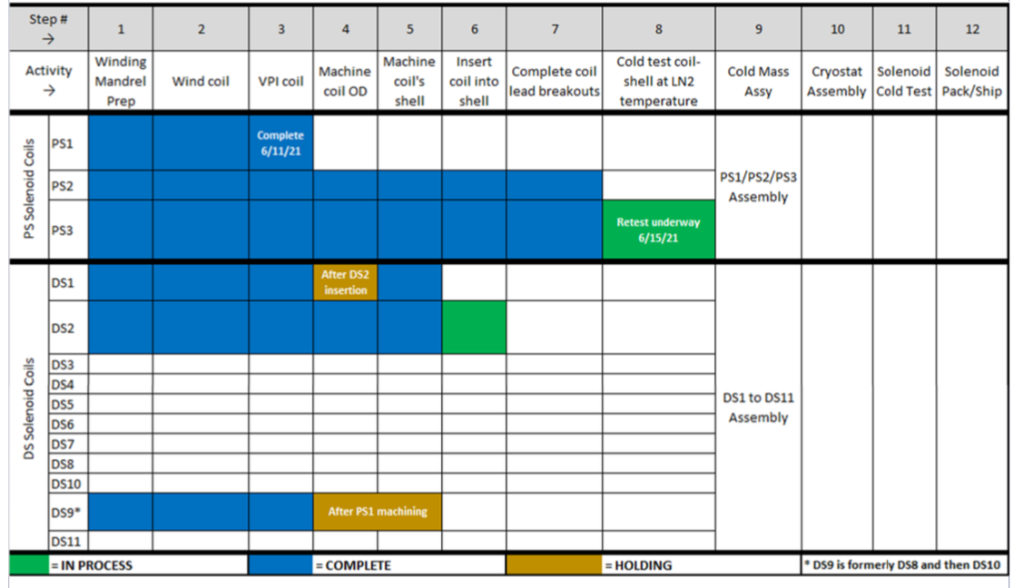
GA Progress
DS3 winding to begin in early July

Slide 16
Progress with GA
We have made some progress with GA over the past year.
  GA produced an updated and optimized schedule.
    Monthly schedule meetings
  GA added some additional labor to allow for more parallel work, but they could do more
  GA obtained priority access for Mu2e on shared machines in Tupelo
  GA performed a risk analysis
  GA Sr. management is now significantly more engaged.
  First relocation to Tupelo from San Diego earlier this year
    Good Engineer, but no superconducting experience
  GA Engineers from San Diego and Mu2e Solenoid team getting back to pre-COVID travel schedule.

Slide 17
Schedule With COVID and GA impact
PS Fabrication
TS Fabrication
DS Fabrication
Solenoid Installation and Commissioning
Accelerator and Beamline Construction
Project Closeout
TDAQ
Tracker Construction
Calorimeter Construction
Cosmic Ray Veto
Cosmic Ray System Test
Project Complete
April 2024
Acc KPP
Dec 2022
Current CD-4 Milestone
Detector KPP
Oct 2023
Solenoid KPP
Feb 2024
FY21 FY22 FY23 FY24 FY25

Slide 18
Rebaseline Issues: CAP with/without COVID?
There is a cap on the amount of money we can request for re-baselining
Re-baselining must address a number of needs
  Project Estimate at Complete
    1. currently exceeds our funding
    2. Includes most COVID costs
  Estimate uncertainty + Risk-based contingency
    Required to ensure project success
    DOE will require this to be > 30%
    This will consume a substantial fraction of available rebaseline funds
  General Atomics
    Risk mitigations
    Schedule incentives
    Other

Slide 19
Rebaseline Issues - COVID
We have written a white paper for DOE arguing that COVID resulted in a series of Directed Changes (shutdowns, social distancing, occupancy limitations, quarantines, etc.).
Costs associated with Directed Changes don’t count against re-baseline c
➔ DOE is open to this argument, at least for Mu2e.
➔ The numbers don’t work if COVID costs are included in CAP
  ➔Would require Lab to make up difference or further descoping
    ➔ These are both bad options
No decisions have been made yet, but a two-step process is being considered
  COVID rebaseline where project is compensated for directed change
    Would happen relatively soon (Fall?)
  Rebaseline of remainder of project
    Timeline depends on reaching an agreement with GA
      Significant ongoing activity. Not converging quickly.

Slide 20
Rebaseline Issues
No decisions have been made, but a two-step process is being considered
  COVID rebaseline where project is compensated for directed change
    Would happen relatively soon (Fall?)
  Rebaseline of remainder of project
    Timeline depends on reaching an agreement with GA
      Significant ongoing activity. Not converging quickly.

