Slide 1
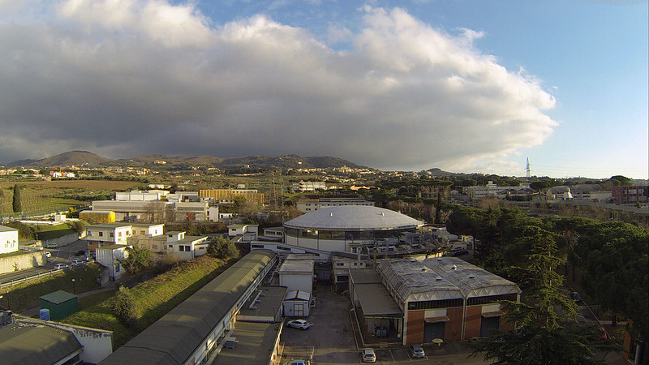
WELCOME
A. Gallo, LNF Accelerator Division Head
EuPRAXIA@SPARC_LAB user workshop, Oct. 14 2021

Slide 2
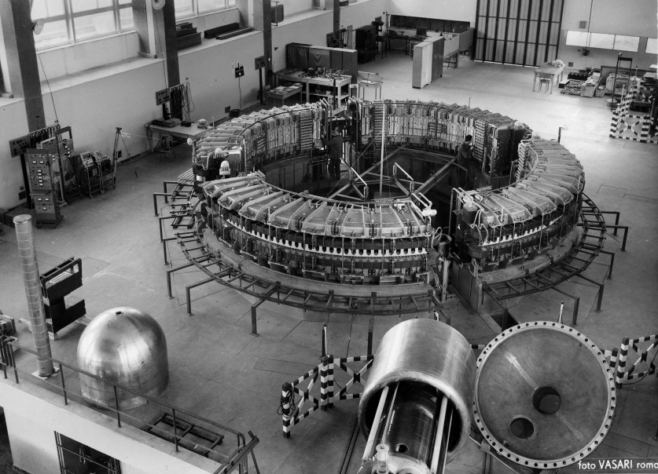
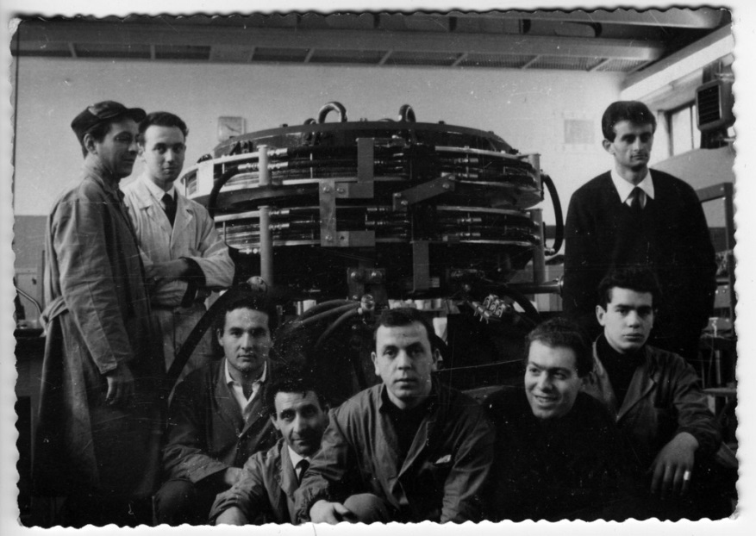
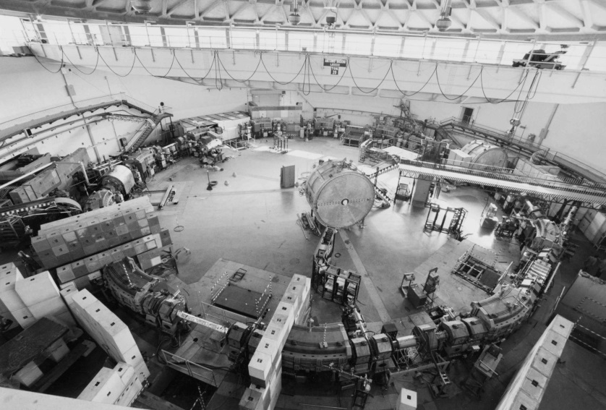
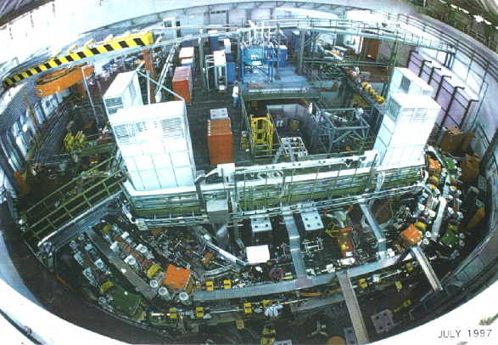
A. Gallo, Wshop WELCOME
Particle accelerators have always been at the core of the INFN Frascati Labs
LNF is born historically as a HEP accelerator based Lab for users from the sub-atomic and nuclear physics community
Electro-synchrotron, 1959
ADA, 1961
ADONE, 1969
DAΦNE, 1997-today
EuPRAXIA@SPARC_LAB user workshop, Oct. 14 2021

Slide 3

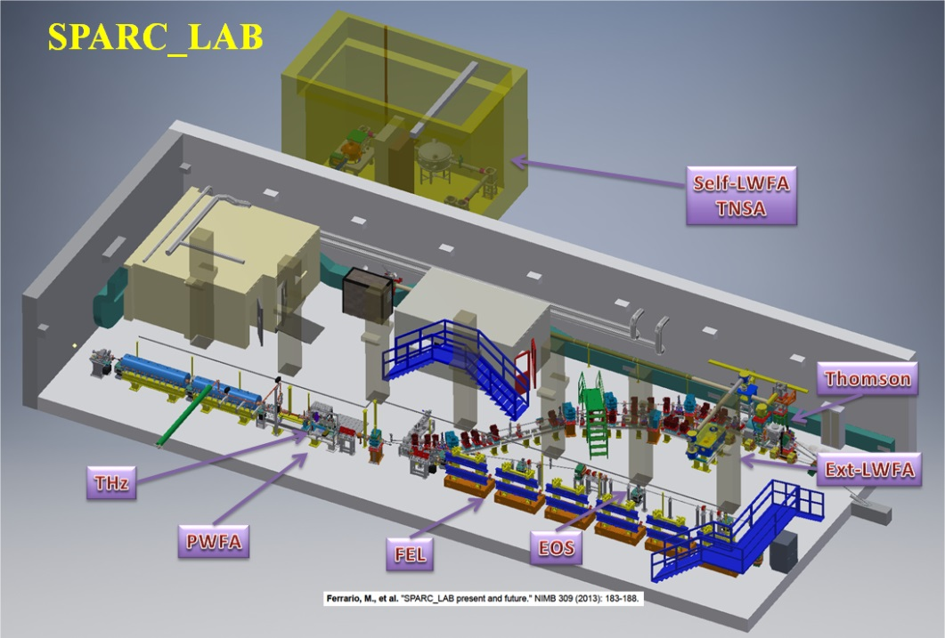
A. Gallo, Wshop WELCOME
The SPARC_Lab test faclity
In the new century many accelerator centers needed to revise their mission, SLAC and DESY as the major examples, moving from HEP to science based on state-of-the-art radiation sources (both synchrotron and FEL) for a different, wider and more articulated and interdisciplinary user community.
While in Frascati we are still in between this transition, having the DAFNE collider still in operation, the facility SPARC_Lab has given us the opportunity to enter and in the field of advanced study and applications of high brightness electron beam.
We could run an FEL experiment (not for users) and more recently to test experimentally plasma wave acceleration in the particle-driven modality, with extremely promising results.
In the same complex we also run the sub-PW laser system FLAME for stand-alone experiments or in combinations with the SPARC linac electrons.
EuPRAXIA@SPARC_LAB user workshop, Oct. 14 2021

Slide 4
A. Gallo, Wshop WELCOME
EuPRAXIA@SPARC_Lab project
X band power stations
TL to plasma, beam dumps and undulators
chicane
X band modules
High gradient X-band linac +
Plasma accelerating module
All this finally led to the EuPRAXIA@SPARC_Lab project proposal, where for the first time a user facility will be built based on plasma acceleration, placing again our Lab in a pioneeristic position such as in the ADA era, at the beginning of new history.
EuPRAXIA@SPARC_LAB user workshop, Oct. 14 2021

Slide 5
A. Gallo, Wshop WELCOME
The Accelerator Division structure is the backbone of the new facility realization
≈ 100 people, including staff, fellows and PhDs
9 technical services
secretary office
scientific staff
Many activities besides the new facility design and construction:
Run the existing facilities (DAFNE/BTF/SPARC/TEX)
Complete STAR HE (Compton source upgrade at University of Calabria)
Engagement in the ELI-NP finalization at IFIN Magurele (RO)
EU and INFN CSN5 projects and collaborations
…
EuPRAXIA@SPARC_LAB user workshop, Oct. 14 2021

Slide 6
A. Gallo, Wshop WELCOME
In Conclusion:
This is a very exciting period for the Lab, we have an extreme challenging enterprise ahead, but we can feel the support of INFN, the energy and the engagement of our young scientists and the expectations (but also the collaborative attitude) of our reference international scientific community.
And of course we are proud to serve again a community of users, which ultimately is the goal of our effort. Serving a scientific community is in the DNA of our Lab, that’s why we are glad to welcome you in this workshop and in the numerous following ones. Together with you we expect to focus and understand better the potentialities of our future realization, and to have indications on how the design of this instrument can be improved and tuned to produce beautiful and original physics in an efficient way.
WELCOME and have a nice fruitful meeting!
EuPRAXIA@SPARC_LAB user workshop, Oct. 14 2021

