Slide 1
Status of Athena SW
Wednesday 2021-07-22
The Software and Computing WG Conveners: Andrea Bressan (University of Trieste and INFN) , Dmitry Romanov (Jefferson lab) ,
Sylvester Joosten (Argonne National Laboratory) , Whitney Armstrong (Argonne National Laboratory) , Wouter Deconinck (The University of Manitoba)

Slide 2
Updates
Full simulation benchmarks are being setup; these benchmarks run the full chain: simulation and reconstruction
Git clone https://eicweb.phy.anl.gov/EIC/benchmarks/reconstruction_benchmarks.git
Cd reconstruction_benchmarks
./benchmarks/full/full_reconstruction.sh
Have a look to https://eic.phy.anl.gov/ip6/index.html

Slide 3
“Environment variables”
There are (sometimes) environment variables to be set
export ATHENA_PREFIX=/home/bressan/MonteCarlo/eic/DD4/local
export JUGGLER_DETECTOR=athena
export DETECTOR_PATH=/opt/detector/share/athena
export JUGGLER_INSTALL_PREFIX=$ATHENA_PREFIX
You have also to source /opt/detector/setup.sh (we are discussing about having env variables set within this script).
Reconstruction
Tracking reconstruction is working again
Some problems with the DIRC implementation will be solved soon
For developers, frequent pull outs are needed (even more than one/per day)

Slide 4
“What do you need to pull?”
The containerized environment
curl https://eicweb.phy.anl.gov/containers/eic_container/-/raw/master/install.sh | bash
Simulation codes:
git clone https://eicweb.phy.anl.gov/EIC/detectors/athena.git
git clone https://eicweb.phy.anl.gov/EIC/detectors/ip6.git
ln -s ../ip6/ip6 athena/ip6
Reconstruction codes:
git clone https://eicweb.phy.anl.gov/EIC/juggler.git (for reconstruction)
git clone https://eicweb.phy.anl.gov/EIC/eicd.git (for the data model)
Git clone https://eicweb.phy.anl.gov/EIC/NPDet.git (for Nuclear Physics detector library)
Compiling (for most of them):
cmake -B build -S . -DCMAKE_INSTALL_PREFIX=$ATHENA_PREFIX -DCMAKE_CXX_STANDARD=17

Slide 5
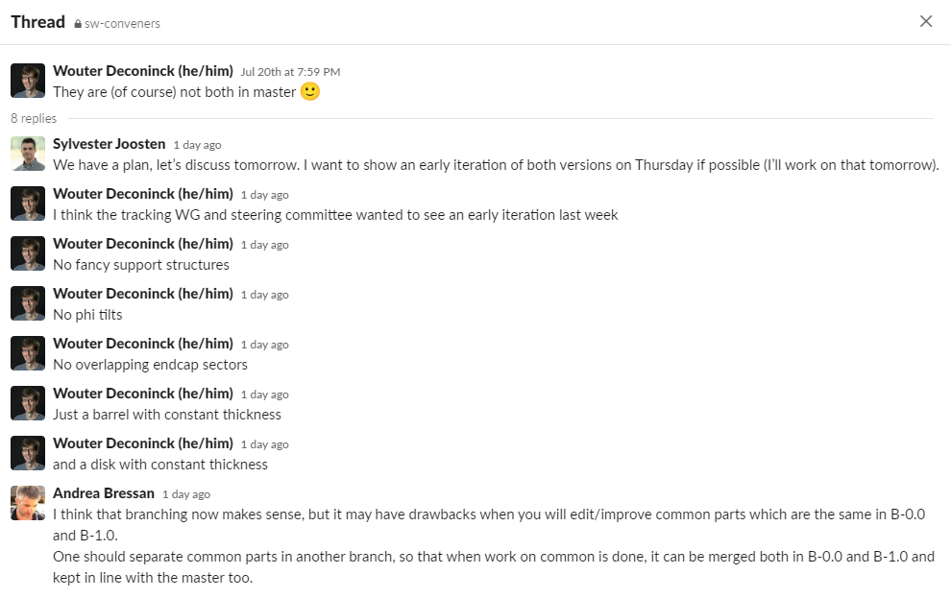
Preparation of detector options: B-0.0 and B-1.0
Option 0 is to go with two separated branches (not the master branch); of course one needs to find a solution to keep both branches aligned.

