Slide 1
Next Generation neutrino Experiments at Accelerators: the DUNE Experiment at FNAL
Sergio Bertolucci
University of Bologna and INFN
Pisa 21/07/2021

Slide 2
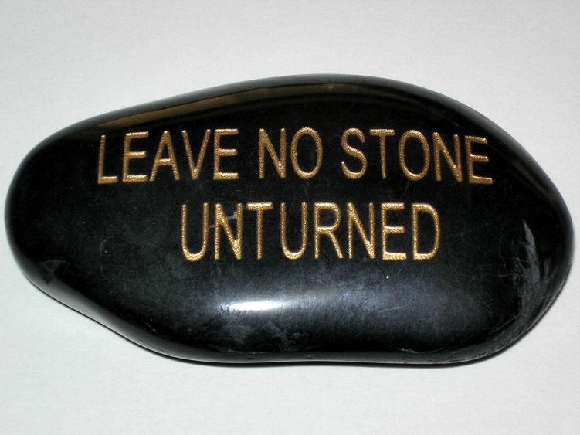
Looking for “unknown unknowns”
Needs a synergic use of:
High-Energy colliders
neutrino experiments (solar, atmospheric, cosmogenic, short/long baseline, reactors, 0νββ decays, masses)
cosmic surveys (CMB, Supernovae, BAO, Dark E)
gravitational waves
dark matter direct and indirect detection
precision measurements of rare decays and phenomena
dedicated searches (WIMPS, axions, dark-sector particles)
…..

Slide 3
From the P5 Report (USA)
Recommendation 12 : In collaboration with international partners, develop a coherent short- and long-baseline neutrino program hosted at Fermilab.
The minimum requirements to proceed are the identified capability to reach an exposure of at least 120 kt*MW*yr by the 2035 timeframe, the far detector situated underground with cavern space for expansion to at least 40 kt LAr fiducial volume, and 1.2 MW beam power upgradable to multi megawatt power. The experiment should have the demonstrated capability to search for supernova (SN) bursts and for proton decay, providing a significant improvement in discovery sensitivity over current searches for the proton lifetime.

Slide 4
From the European Strategy Document
f) Rapid progress in neutrino oscillation physics, with significant European involvement, has established a strong scientific case for a long-baseline neutrino programme exploring CP violation and the mass hierarchy in the neutrino sector.
CERN should develop a neutrino programme to pave the way for a substantial European role in future long-baseline experiments.
Europe should explore the possibility of major participation in leading long-baseline neutrino projects in the US and Japan.

Slide 5
From Japan HEP Community
The committee makes the following recommendations concerning large-scale projects, which comprise the core of future high energy physics research in Japan.
……….
Should the neutrino mixing angle θ₁₃ be confirmed as large, Japan should aim to realize a large-scale neutrino detector through international cooperation, accompanied by the necessary reinforcement of accelerator intensity, so allowing studies on CP symmetry through neutrino oscillations.
This new large-scale neutrino detector should have sufficient sensitivity to allow the search for proton decays, which would be direct evidence of Grand Unified Theories.

Slide 8
An Exciting Global Initiative to Understand the Most Abundant Known Matter Particle in the Universe
Deep Underground Neutrino Experiment
at the
Long Baseline Neutrino Facility
Short Baseline Neutrino Program

Slide 13
It’s not only statistics....
In the experiment we measure:
In order to get the physical quantities, we have to control flux, energy distribution/geometry of the beam, efficiencies, acceptances, etc..
Need one (or more) sophisticated Near Detector to
control beam and systematics

Slide 14
DUNE/LBNF
Long-Baseline Neutrino Facility
The biggest international project hosted in the US
DUNE Far Detector
DUNE Near Detector Neutrino Beam Source

Slide 15
DUNE Collaboration
198 Institutions in 33 Countries

Slide 16
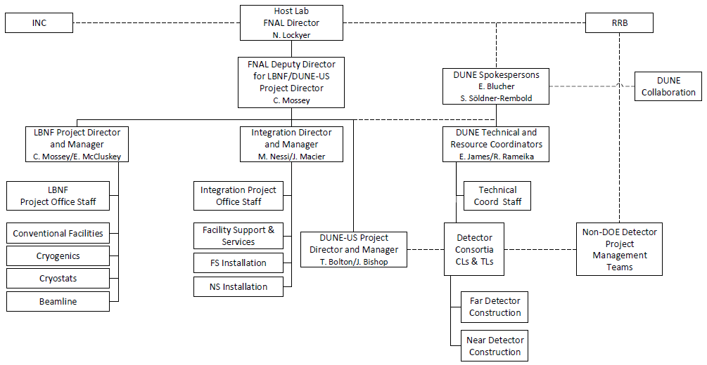
LBNF/DUNE Project Management
DOE Project
Manages LBNF DUNE-US DOE Project resources
Manages DUNE
International Collaboration

Slide 17
Far Detector Technical Design Report (Feb. 2020)
https://arxiv.org/abs/2002.02967
https://arxiv.org/abs/2002.03005
https://arxiv.org/abs/2002.03008
https://arxiv.org/abs/2002.03010

Slide 18
DUNE Primary Science Goals
Testing the Neutrino Three-Flavor Paradigm
CP Phase/CP Violation
Mass Ordering
Baryon Number Violation and Grand Unification
Nucleon Decay
Neutron/Anti-Neutron Oscillation
Neutrino Astrophysics
Supernova Burst Neutrinos

Slide 22
CP Violation and MH Sensitivity

Slide 24
Supernova Burst/Low Energy Neutrinos
Electron-capture SN at 10 kpc in 40-kt LArTPC [Huedepohl 2009]
10.25 MeV electron
collection plane
K* de-excitation γ
induction plane
boxes-reconstructed hits color-charge
Sensitive to ν_{e}; complementary to water Cherenkov detectors
Tracks only a few centimeters long but event-by-event energy reconstruction is possible in LAr
Pointing may be possible using elastic scattering (ES) from electrons
Triggering understood for SNB (100 sec readout buffer) but a challenge for solar neutrinos

Slide 25
INFN and DUNE
INFN intends to contribute to both Near and Far Detectors, to maximize the opportunities both on the core DUNE program as well as on the other physics measurements, which are enabled by the combination of a capable Near Detector with the unprecedented statistics.
The Nu_at_FNAL project is summarized in two documents following the new schemes of INFN Project Management:
a Conceptual Design Report for the Near Detector (SAND)
a Technical Design Report for the Photon Detection System of the Far Detector (PDS)
Ancillary documents are also included in the same repositories.
INFN is also contributing to the upgrade of the neutrino beam.

Slide 26
Fermilab Accelerator Complex
60-120 GeV proton beam
1.2 MW
upgradeable to 2.4 MW
Reference design similar to existing NuMI (used for the NOvA experiment), optimized to improve sensitivity to oscillation measurements

Slide 27
Proton Improvement Plan
PIP-II superconducting cryomodule
Megawatt proton beams
700-foot-long 800 MeV superconducting linear accelerator
PIP-II Groundbreaking November 2019!

Slide 28
INFN and DUNE
The contributions to the Far and Near Detectors, both substantial in terms of financial and human resources, differ in nature: in the former case INFN will contribute to the Photon Detection System (PDS) of the first LAr module (Horizontal Drift), with the provision to contribute to the PDS of the second module (Vertical Drift), while for the latter INFN is contributing the major part of a complete detector previously used in the KLOE experiment at Frascati, consisting of a magnet yoke, a 0.6 T large bore superconducting solenoid and a 4π fine grained electromagnetic calorimeter.
The refurbished detector (SAND), complemented by a suitable tracker and a (small) LAr active target, will permanently stay on the beam axis, while the other two detectors of the ND complex, a largish LAr detector (ArgonCube) and a magnetized detector (ND-GAr) will move 50% of beam time off-axis.

Slide 29
Composition of INFN groups in DUNE
The table does not include technicians and the sections support services (electronics, mechanics, design, etc)

Slide 30
INFN and DoE
INFN in-kind contributions: The magnet and calorimeter system that were deployed in the KLOE experiment’s detector at the DAΦNE collider at INFN’s Frascati National Laboratory (hereinafter “KLOE Components”), it being understood that INFN’s activities for the KLOE Components shall include their necessary refurbishment, maintenance, and subsequent delivery to Fermilab in accordance with the schedule to be developed by the DUNE Collaboration in consultation with the Participants. Once delivered, the refurbished KLOE Components shall form detector subsystems of the SAND detector; Electronics, power supplies, and trigger systems for the SAND calorimeter and magnet; Design and construction activities of the superconducting magnet for the ND-GAr detector in the DUNE ND experimental hall; and The DUNE FD light collection system, by providing a share of the associated silicon photomultipliers and related electronics. The contribution may include the first Single Phase Module and possibly the second “Vertical Drift” Module. Contribution to the development of the inner tracking system of SAND and of an active compact Liquid Argon target to be installed within the KLOE volume.

Slide 31
The PDS System
The PDS of the first module of DUNE is technically and financially set. No special surprises:
Well in schedule despite the COVID pandemic
Latest achievements quite impressive
Medium and long-term resource-loaded schedule is complete
The PDS of the second module of DUNE was in design phase six months ago:
The design phase is over and the CDR will be published very
soon.
Tests of the most critical items are ongoing
We presented the INFN interest and potential commitments and the cost sharing is close to completion

Slide 32
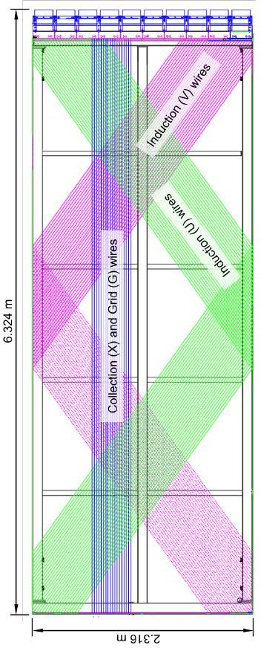
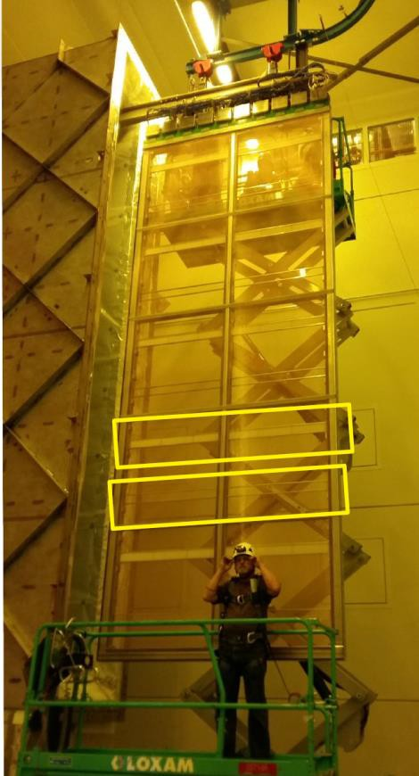
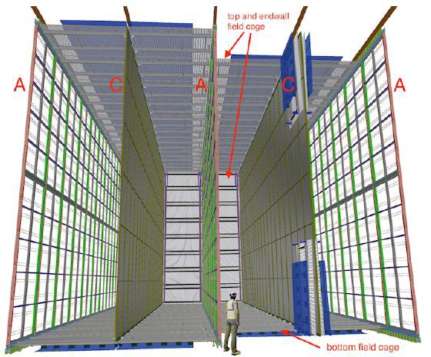
Collecting charge and light
The first DUNE module is based on a horizontal drift, where the cathode is interspersed between two “anodic planes” (APA).
The natural place for the photon detectors is inside the APA

Slide 33
The DUNE Photon Detection System
4

Slide 34
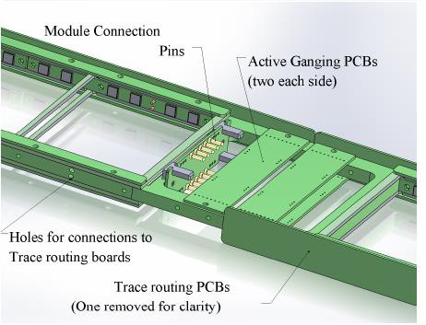
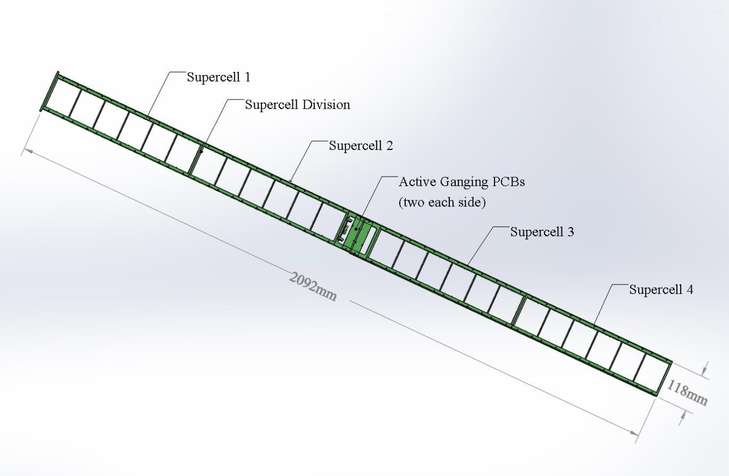
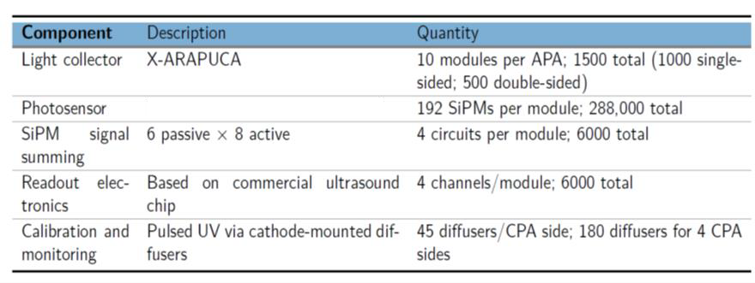
To Warm electronics: 2nd stage amplifier, digitizer, data transfer to DAQ [DAPHNE board]
The PDS module
Cold electronics: 1 amplifier per channel (4 amplifiers per PDS
module)
One electronic channel: 48 SiPMs readout in “active ganging”

Slide 35
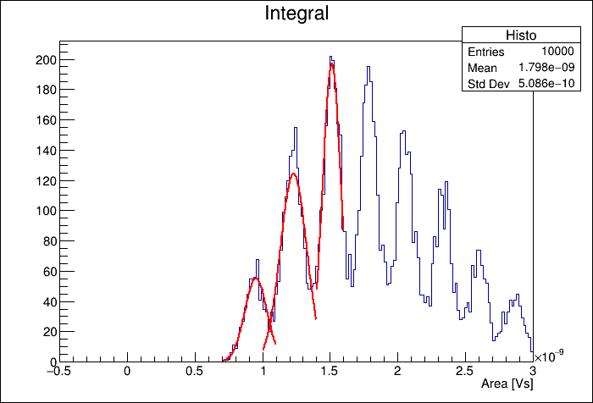
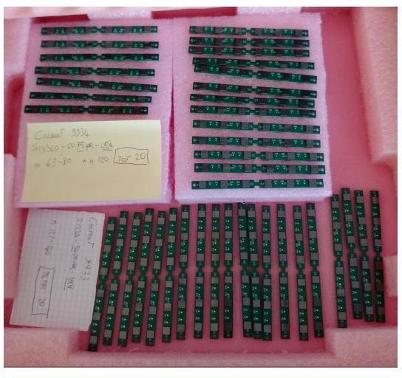
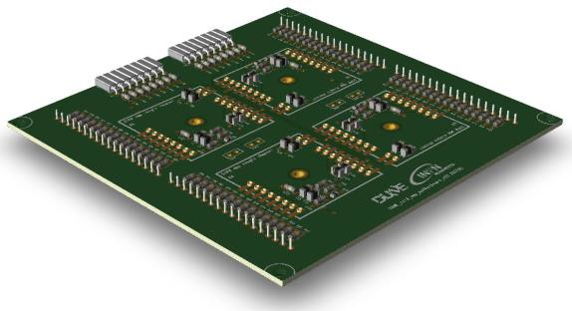
PDS Status
Identify the best custom sensors (cryo-reliability, DCR, PDE, correlated noise…) in spec for DUNE for at least two vendors (“two vendor scheme”). DONE
Fondazione Bruno Kessler (FBK): NUV-HD-CRYO-TT
Hamamatsu Photonics (HPK): S13160-6075HS-HQR
Test the ganging and cold amplifier. DONE
Test the entire chain up to the warm amplifier: in progress
In the next 8 months: produce, assemble and test the 40 modules for
ProtoDUNE-SP Run II
Active ganging plot– 48X FBK

Slide 36
Long-term plan
X-ARAPUCA
Det. Support Calibration
SiPMs
Cold
amplifiers
Warm
electronics
SiPMs, side
boards
Cold amplifiers,
ganging
Warm amplifier, digitizer (DAPHNE)
Mechanics, dichroic filter, WLS LED system
Leading institution: INFN
Spain Czech Rep.
Leading institution: INFN
Spain
US
Colombia Perù
Brasil
US
INFN roles in the PDS Consortium: Convenors (A. Montanari, P. Sala, C. Cattadori), Management Board: F. Terranova (INFN repr.), A. Montanari, L. Patrizii
Technical coordinators: D. Warner, F. Terranova

Slide 37
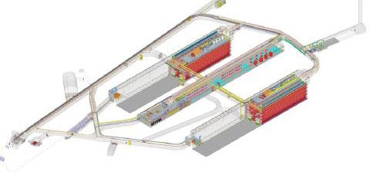
The DUNE second module (VD)
Several news since Dec 2020:
The design of the whole second DUNE module has been finalized
The CDR is ready but not yet publicly available (expected: summer 2021). I will
show some parts that should be considered as confidential
The cost sharing is well advanced
The Photon Detection System of the second module (PDS-VD) is based on the same concept as the first module (X-ARAPUCA) with some differences (see below)
The cost sharing for the PDS-VD is well advanced
The role of INFN in the PDS-VD is well defined and resources have been requested accordingly

Slide 38
Drift is vertical and the drift length is twice the first module: less electronic channels and, hence, less costs
Cathode in the middle of the TPC
Cold electronics in the top, accessible during data taking
No wires, replaced by PCB strips (less
costs)
Rationale:
A detector that has the same performance as the first module but a reduced cost. It arises from the R&D done in ProtoDUNE-DP

Slide 39
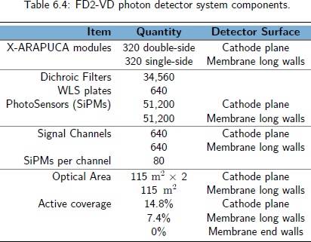
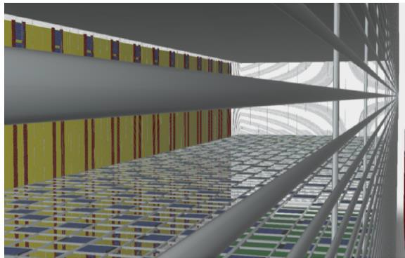
The good and the bad…
Tiles hanging on the cryostat beyond the field cage (“membrane tiles”)
Field cage
Less SiPMs (110,000)
Better SiPM-WLS coupling
Cathode tiles have a “ground” of 320 kV!!
The cathode tiles are a very smart idea, but also a technical risk . Its full validation will be performed in 2022 (backup solution: increase the number of membrane tiles)

Slide 40
Not Only Hardware….
The US groups are extremely strong in the analysis, and we want to take full advantage of the investment done in the detector. Even if it seems “early”, we already took steps to fill the gap with the US groups, especially in the PDS.
Since 2021, we have an analysis team of several post-docs + students at Master/PhD level that are very active (and recognized) in the DUNE Physics Groups
We are currently the leader of the analysis of Xe-doping, which is a must for the second module (VD)
We are the main group developing double calorimetry (charge+light) in DUNE from the GeV scale (beam events) to the MeV scale (supernove bursts, solar neutrinos)
We played an important role in the simulation of the second DUNE module

Slide 41
The ND complex and SAND
GAr and LAr Detectors off-axis for 50% of the time

Slide 42
The Near Detector Mission
Summarized here:

Slide 43
SAND Design Requirement
SAND is the only detector which will stay on-axis all the time.
As such we see SAND as a component of the ND complex, NOT a standalone detector to:
monitor the beam changes on a weekly basis with high sensitivity;
provide an independent measurement of the flux;
measure the flavour content of the neutrino beam;
contribute to remove degeneracies especially when the other components are off-axis;
add robustness to the ND complex to keep systematics under control;
be capable to provide a reasonable control of the systematics in the inauspicious case that it is the only available component on Day-1;
exploit the unprecedented high statistics to perform a rich physics program besides oscillations without any modification.

Slide 44
INFN and SAND
It is evident that the fulfilment of these requirements hinges on the design of the inner target-tracker system, whose choice must be primarily driven by physics performances supported by detailed and quantitative studies and then by a realistic assessment of technical feasibility, cost, funding, proponents, schedule, risks, etc. Politics should come as last criterion.

Slide 45
SAND Design Tools

Slide 46
INFN and SAND

Slide 47
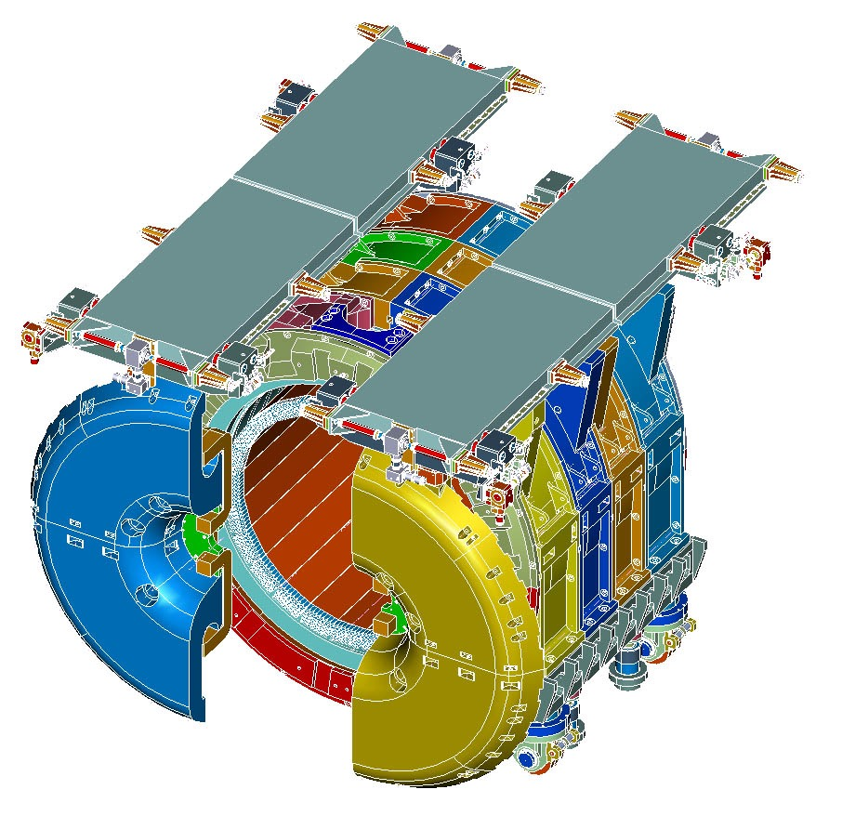

Slide 48
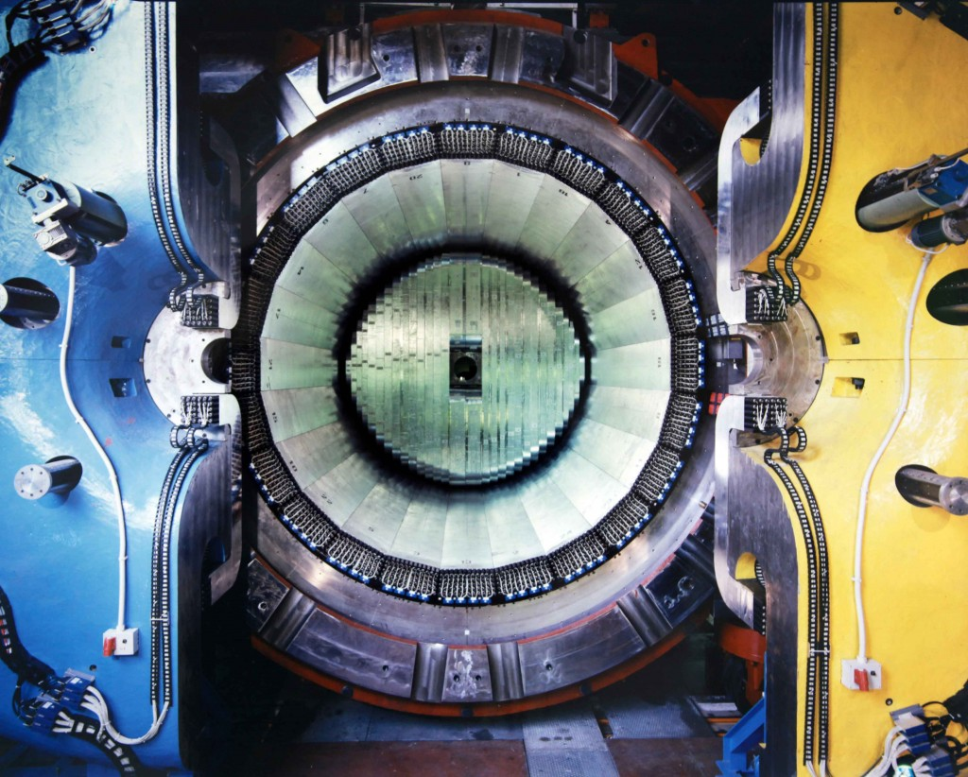
Supercond. Solenoid .6T
4π Pb-SciFi Calorimeter
43 m³ of space available
for a tracker

Slide 51
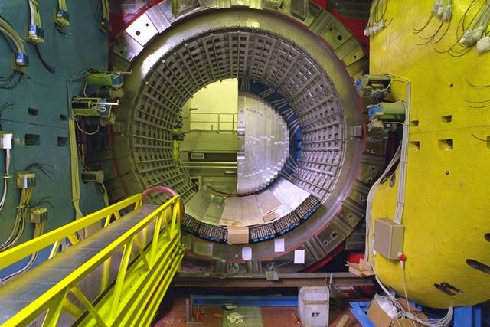
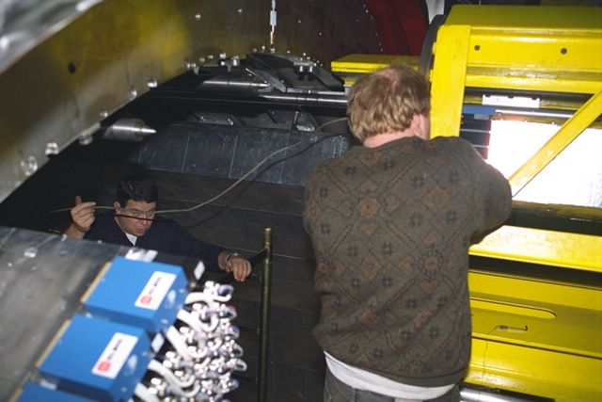
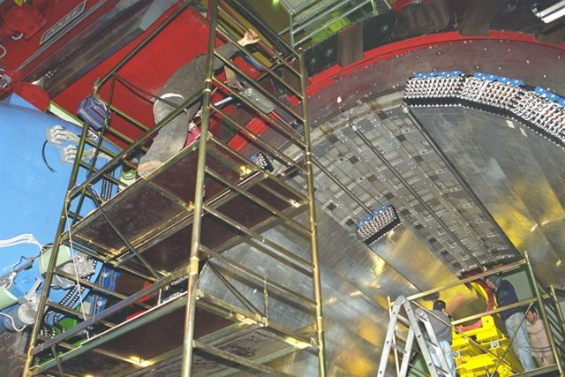

Slide 53
Operated from 1999 till 2018 with excellent performances for electron and photons and good capabilities for π/μ/e separation
Also: good neutron detection efficiency due to the small sampling fraction and the high sampling frequency.

Slide 54
Tracker Design Criteria
Provide enough mass to have sufficient statistics on ν interactions while still measuring kinematic quantities of charged particles with a good resolution.
Maximize acceptance for particle produced both in the tracker and in the upstream ECAL.
Retain a smooth efficiency across most of the volume.
Be easy to calibrate.
Have good PID capabilities.
Be based on mature technologies (detector, FE, ancillary systems), to save time and reduce risks/delays.
Have a proven extended lifetime.
Be easy to build, install, maintain (modularity highly preferred)
Minimize the need of bulky supporting structure, ease the integration with the other components.
Have the needed expertise within the proponent group.
Have a reasonable cost and realistic funding perspectives.

Slide 55
The Straw Tube (Target) Tracker
90 modules with planes of 5 mm φ straw tubes arranged in XXYY(XX) layers and operated at 1.9 bar.
78 modules with 5 mm CH₂ targets and radiator TRD foils operated with a mixture of Xe/CO₂ (standard modules)
7 modules with a 4 mm C target, interleaved among the CH₂ modules and operated with a Ar/CO₂ mixture (C modules)
5 modules XXYYXX, operated in Ar/CO₂, no targets, no radiators (tracking modules)
FV mass: 4.7 t CH₂, 557 kg C.

Slide 56
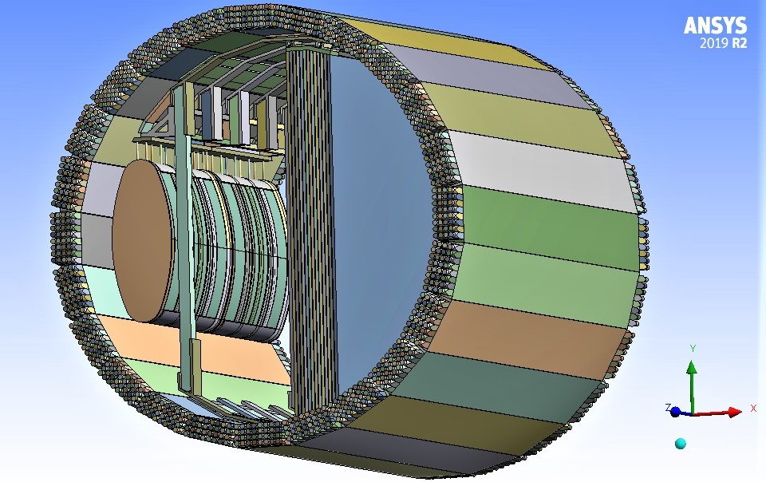
STT in SAND
The layout (starting from upstream):
A tracking module with 6 straw layers XXYYXX, following the internal LAr target
Two blocks (supermodules, SM), each composed of one C module followed by 11 standard modules
Two SM, each composed of one C module and 12 standard modules
Two SM , each composed of one C module and 11 standard modules
One SM with one C module and 10 standard modules (the last one with 6 straw layers XXYYXX)
Four tracking modules.
The total thickness of the STT in this configuration corresponds to about 1.34 X₀, including the straws and all target materials.

Slide 57
STT: a fully tunable/configurable precision instrument
STT designed to oﬀer a control of ν-target(s) similar to e± DIS experiments:
Thin (1-2% X₀) passive target(s) separated from active detector (straw layers);
“Transparent” target/tracker system with total length ∼ 1.3X₀ ;
Target layers spread out throughout tracker by keeping low density 0.005 ≤ ρ ≤ 0.18 g/cm³
Replaceable targets of high chemical purity give ∼ 97% of STT mass (straws 3%).
Accurate reconstruction of transverse plane kinematics from particle 4-momenta:
Δp/p ≤ 3%, Δθ/θ`≤ 1.5 mrad (inspired to the NOMAD concept) [Nucl.Phys.B 611 (2001) 3-39]
Combined particle ID & tracking over the entire STT volume:
Electron ID with Transition Radiation (TR) and dE/dx =⇒ π/e ∼ 10⁻³ ;
4π detection of π⁰ from γ conversions (∼ 49% within the STT volume);
p/π/K ID with dE/dx and range.
Good neutron event by event detection and reconstruction efficiency
Good synergy with PID performances of ECAL.

Slide 58
STT: a fully tunable/configurable precision instrument
In-situ calibrations:
Absolute momentum scale uncertainty from K₀ → π⁺π⁻ in STT volume (∆p < 0.2%) (337,000 in FHC);
p reconstruction and identification, vertex, etc. from Λ → pπ in STT volume (506,000 in FHC);
e± reconstruction and identification from γ → e⁺e⁻ in STT volume (8 × 10⁶ in FHC).
“Solid” Hydrogen concept: (anti)ν-H from subtraction of CH₂ and C targets:
Exploits high resolutions & control of chemical composition and mass of targets in STT;
Allows for model-independent data subtraction of dedicated C (graphite) target from main CH₂ target;
Kinematic selection provides large H samples of inclusive & exclusive CC topologies with 80-95% purity and 75-96% eﬃciency before subtraction
A viable and realistic alternative to liquid H₂ detectors, a powerful tool for meeting the ND requirements

Slide 59
GRAIN (GRanular Argon for Interactions of Neutrinos)

Slide 60
GRAIN

Slide 62
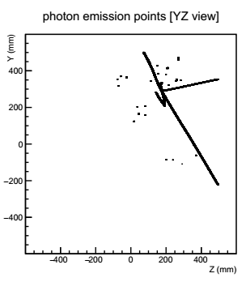
Lar Optical readout example:
ν_{μ}CC with E_{ν} = 2.44 GeV [YZ view]
n. of photons/SiPM
R1
R2
R3
ν
L1
L2
L3
SiPM size: 1 x 1 mm²
Distance between lens and SiPM plane: 4.4 cm

Slide 63
SAND/STT Simulation and Performance Studies
Completed detector simulation with detailed geometry of all sub-detectors
Option I: GEANT4 + GENIE + dunendggd;
Option II: FLUKA (with internal generator) + ROOT
Performed reconstruction using only detected quantities:
Cluster reconstruction in KLOE ECAL for γ, π₀,n (validated with real data);
Track & vertex reconstruction in STT for charged particles;
External backgrounds from rock and magnet and pileup eﬀects within spill;
Single particle reconstruction/identiﬁcation & neutrino energy reconstruction.
Performed physics sensitivity studies of key measurements for oscillation analyses
Full simulation +fast reconstruction of digitized hits from parameterized resolutions & acceptances;
All work documented and continually updated in https://docs.dunescience.org/cgi-bin/sso/RetrieveFile?docid=13262&filename=A_Near_Detector_for_DUNE.pdf&version=7 (104 authors)

Slide 64
A few examples: beam flavor composition

Slide 65
A few examples: “Solid Hydrogen” relative flux measurement

Slide 66
A few examples: “Solid Hydrogen” relative flux measurement

Slide 67
SAND High Level Timeline

Slide 68
Resources: costs and spending profile Nu_at_FNAL

Slide 69
DUNE Spending Profile

Slide 70
Our Next Steps
2021-2022 main activities:
PDS
Prepare, install, commission and operate ProtoDune-II PDS
Launch the SiPM tender for the HD module
Complete the R&D on the VD PDS
SAND
Complete the dismounting of the EMC, purchase spares for the calorimeter PM’s
Continue R&D and prototype on the LAr Active target (GRAIN)
Lead the design and the prototyping of the inner tracker

Slide 71
DUNE/LBNF Outlook
LBNF
Far site pre-excavation work underway (rock disposal systems etc.); cavern excavation 2021-24
Near site construction starts 2021
Neutrino beam construction started
DUNE
Far Detector TDR February 2020; Near Detector CDR fall 2020
Module 1 Single Phase installation begins end 2024
Followed immediately by a second module
Module 4 “module of opportunity” for a different design – a workshop later this year to begin exploration of ideas
First module live ~2026 – SNB & atmospheric neutrino
First beam end of 2028

Slide 72
Beyond Standard Model
Sterile Neutrino Sensitivity (ν_{e}CC appearance at Near Detector)
DUNE sensitive to many BSM particles and processes
Sterile neutrinos
Light dark matter
Boosted dark matter
Non-standard interactions, non- unitary mixing, CPT violation
Neutrino trident searches
Large extra dimensions
Neutrinos from dark matter annihilation in sun

Slide 73
To conclude
Since 1998, neutrinos have given us the most promising hints of BSM physics.
Their nature and their properties are still a central questions in particle physics.
A new generation of experiments is underway, with a substantial and strategic Italian involvement in DUNE
DUNE/LBNF is heralding this effort addressing the challenge in a global context and enabling a long term, first class environment to enhance our understanding of Fundamental Physics.

Slide 74
Thank You
…and thanks to E. Blucher, F. Cavanna, E. Worcester, et al. for the looted material and many useful discussions.

