Slide 1
Deep Learning implementation of MRF data reconstruction
PUMA meeting – 27/07/2021

Slide 2
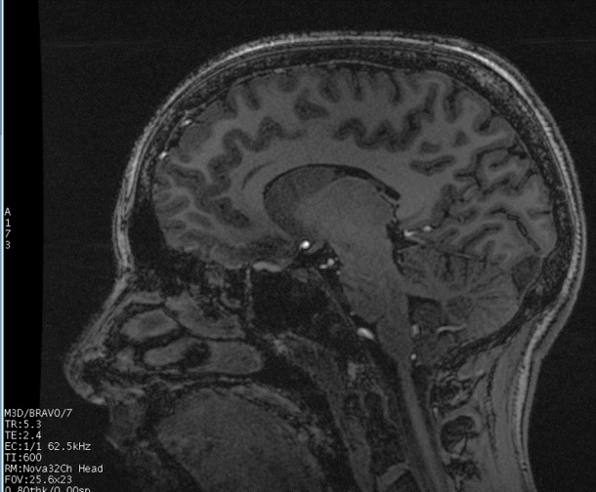
Quantitative MRI
Conventional MRI allows to obtain contrast images. No absolute on tissue parameters.
There is the need for quantitative measures, that can be used to improve diagnosis
Quantification is time and resource costly
Magnetic Resonance Fingerprinting (Dan Ma)

Slide 3
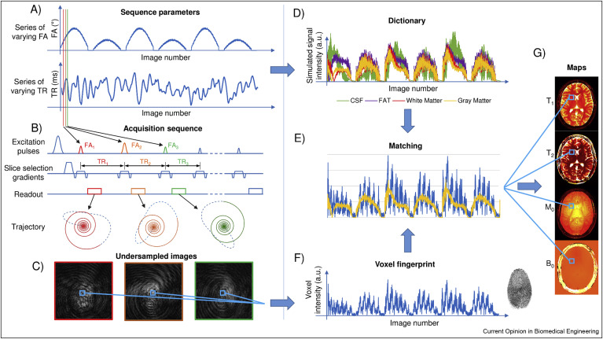
Magnetic Resonance Fingerprinting
Panda et al. Magnetic Resonance Fingerprinting

Slide 4
Pattern Matching
Where:
$$M_{0}\left(x,y\right)=ρ\left(x,y\right)B_{1}^{−}\left(x,y\right)e^{iφ\left(x,y\right)}$$
$M_{j}\left(θ\left(x,y\right)\right)=M_{0}\left(x,y\right)m\left(θ\left(x,y\right),t_{j}\right)$ (1)
in L2-space vectors
Where
$d$: measured data
$m$: predicted magnetization values
$$\left(\hat{M_{0}},\hat{θ}\right)=arg{\min_{M_{0},θ}{{\left\|M_{0}m\left(θ\right)− d\right\|}^{2}} } \left(2\right)$$
under the assumption of Gaussian noise:
$\hat{θ}= \arg{\max_{θ}{\frac{〈d,m\left(θ\right)〉}{{\left\|d\right\|}_{2}{\left\|m\left(θ\right)\right\|}_{2}}}}$ (3)
Notes:
We now concentrate on the Pattern matching step to better understand the problems related to it.
Given the local magnetization M in eq. 1, we can consider it composed by the static magnetization M0 and the dynamic magnetization m.
Where M0 can be written as the multiplication of the local proton density $ρ\left(x,y\right)$, the real-valued receiver sensitivity profile $B_{1}^{−}\left(x,y\right)$ and the transceiver phase $e^{iφ\left(x,y\right)}$
It’s possible to write a local estimation in L2-space vectors as in equation 2. where d is measured data and m the predicted magnetization values
The problem obtained is equivalent to a Maximum Likelihood Estimation (MLE) in eq.
This can be written as a Maximum Inner Product Search (MIPS), looking at the maximum correlation between the measured data d, and the simulated signal values, m(ϑ).

Slide 5
Pattern Matching with MIPS
$$\hat{θ}= \arg{\max_{θ}{\frac{〈d,m\left(θ\right)〉}{{\left\|d\right\|}_{2}{\left\|m\left(θ\right)\right\|}_{2}}}}$$
(4)
$$C_{θ}=\frac{\sqrt{\sum_{j=1}^{N_{t}}{{\left.m_{j}(θ\right)}^{†}{ d}_{j}}}}{\sqrt{\sum_{j=1}^{N_{t}}{{{ d}_{j}}^{†}{ d}_{j}}}\sqrt{\sum_{j=1}^{N_{t}}{\left.{\left.m_{j}(θ\right)}^{†}m_{j}(θ\right)}}}$$
$d$: measured data
$m(θ)$: simulating signal for certain values of $θ$
Maximum Inner Product Search (MIPS)
(5)
$$\hat{M_{0}}=\frac{{m\left(\hat{θ}\right)}^{H} d}{{\left\|m\left(\hat{θ}\right)\right\|}^{2}}$$
(6)
Notes:
So the problem will be solved with an exhaustive search over a pre-computed dictionary obtained simulating $m(θ)$ for certain values of $θ$, where $θ$ is evaluated over a grid of physically-acceptable parameters.
For every signal d we compute the scalar products C for each theta. The dictionary entry that achieve the highest C is considered the best match. Using the index of that entry and the precomputed lookup table, we can achieve the Theta parameters.
M0 can then be estimated with ne equation (6)

Slide 6
Considerations
Dictionary is typically computed with fine granularity over the entire range of possible tissue values to avoid errors in the reconstructed tissue maps
Dictionary size grows exponentially as the number of tissue parameters is increased.
Pattern matching requires extensive computational resources to process.
Neural Network approach

Slide 7
Parameter inference with NN
Input layer
(SVD space)
$x∈$ℂ¹⁰
ℝ⁶⁰⁰
ℝ¹⁰
ℝ³⁰⁰
ℝ¹⁰
Output layer
$θ∈$ℝ³
Gomez et al. Rapid three-dimensional multiparametric MRI with quantitative transient-state imaging

Slide 8
Multi-path NN architecture
ℝ¹
ℝ¹⁰
ℝ¹⁰
Output layer
$θ∈$ℝ³
ℝ²⁰⁰
ℝ¹⁰⁰
ℝ¹
ℝ²⁰⁰
ℝ¹⁰⁰
ℝ¹
Gomez et al. Rapid three-dimensional multiparametric MRI with quantitative transient-state imaging

Slide 9
Proton Density inference
Input layer
(SVD space)
$x∈$ℂ¹⁰
ℝ⁶⁰⁰
ℝ¹⁰
ℝ¹⁰
ℝ³⁰⁰
Output layer
$θ∈$ℝ³
$$θ$$
PD scaling factor $ρ_{n}$ at voxel $n:$
$$ρ_{n}=\frac{{\left\|x_{n}\right\|}_{2}}{θ_{n,3}} ,$$
Where
${\left\|x_{n}\right\|}_{2}$ represents the norm of the acquired data and $θ_{n,3}$ is the third output of the trained network
$θ$ = (T1, T2, norm(D))
Gomez et al. Rapid three-dimensional multiparametric MRI with quantitative transient-state imaging

Slide 10
Proton Density estimation with NN
Input layer
(SVD space)
$x∈$ℂ¹⁰
ℝ²⁰⁰
ℝ¹⁰⁰
Output layer
$x∈$ℝ¹⁰
ℝ¹⁰
ℝ¹⁰
Latent space
$θ∈$ℝ²
ℝ¹
ℝ¹
$$\hat{M_{0}}=\frac{{m\left(\hat{θ}\right)}^{H} d}{{\left\|m\left(\hat{θ}\right)\right\|}^{2}}$$
$$d\text{: }\text{measured} \text{data}$$
$$m(θ)\text{: }\text{simulating} \text{signal} \text{for} \text{certain} \text{values} \text{of} θ$$
(7)

Slide 11
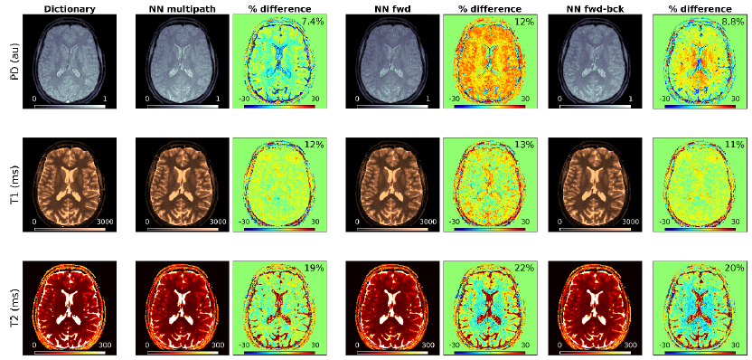
In-vivo Inference results
Neural network-based parameter inference—in vivo validation
The neural network architectures with separate pathways, i.e. NN multipath and NN fwd-bck, resulted in closer estimates with respect to the dictionary than NN fwd, which is based on a single-pathway scheme.

Slide 12
In-vitro Inference results
Multipath neural network-based parameter inference – in vitro validation.
95% confidence intervals in percentage differences to the dictionary are:
-4.45% – 6.00% for T1
-3.97% – 6.58% for T2.

Slide 13
Inference Time
Dictionary MIPS | 618 s
Neural Network | 19.8 s
Map size: 200x200x200
Dictionary entries: ~60k
Matching device: CPU

Slide 14
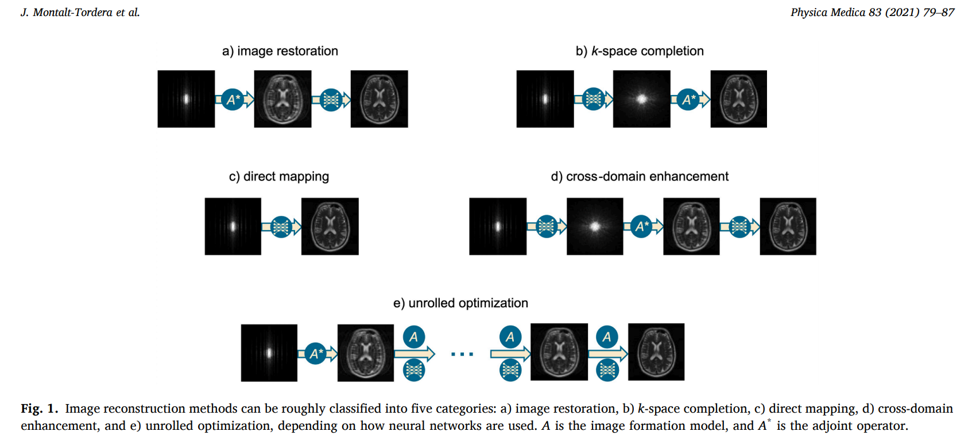
DL everywhere
Notes:
a) Image restoration techniques are those that operate in the image domain only (see Fig. 1-a). These methods relate closely to general image problems in non-medical contexts. Usage of CNN (denoising. superresolution)
b) adaptive convolutional neural networks for k-space data interpolation (ACNN-k-Space). large database without the need for explicit coil sensitivity map
c) AUTOMAP
d) cross-domain methods are hybrid methods that operate in both the image domain and the frequency domain. Typically, frequency domain subnetworks attempt to estimate the missing k-space samples, while image domain subnetworks attempt to remove residual artefacts.
e) ADMM, PGD Unrolled optimization methods are inspired by iterative optimization algorithms used in compressed sensing MRI. The idea is to unroll the iterations of such an algorithm to an end-to-end neural network, mapping the measured k-space to the corresponding reconstructed image. Then image transforms, sparsity-promoting functions, regularization parameters and update rates can be treated as either explicitly or implicitly trainable and fitted to a training dataset using backpropagation. This has three advantages with respect to classic optimization. First, learned parameters may be better adapted to image characteristics than hand-engineered ones. Second, it avoids the need for manual tuning, which is not a trivial process. Finally, reconstruction is faster, because such learned iterative schemes are trained to produce results with fewer iterations

Slide 15
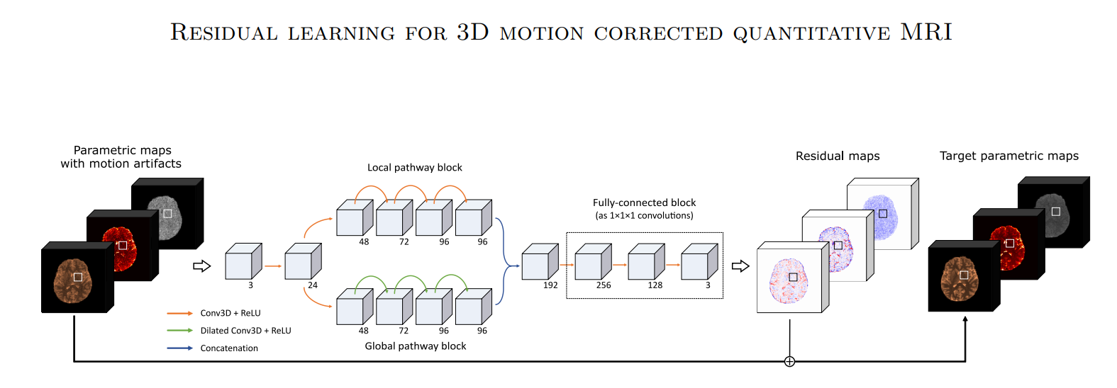
Motion correction
Pirkl et al. Residual learning for 3D motion corrected quantitative MRI: Robust clinical T1, T2 and proton density mapping

Slide 16
Compressed sensing and
iterative algorithms
It’s possible to reconstruct signals and images with high k-space undersampling
Compressed sensing has become an mature technology (recently approved by FDA)
The CS is implemented with many different non-linear iterative algorithms
The computational complexity of those algorithms is relative high

Slide 17
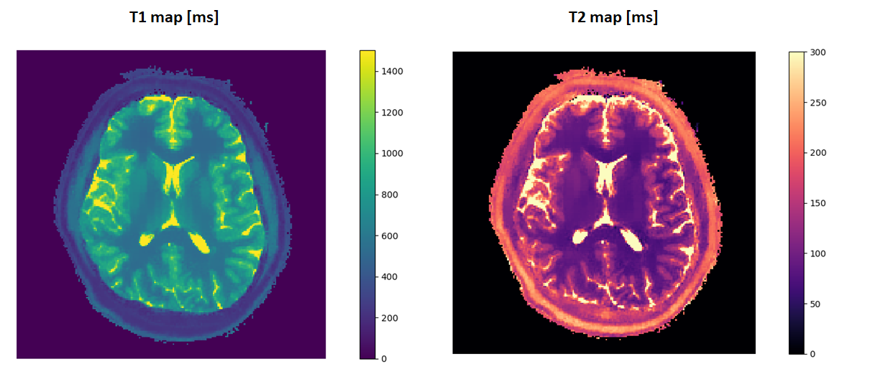
Compressed sensing and
iterative algorithms
T1 and T2 in-vivo parametric map estimated using compressed sensing and NN

Slide 18
Conclusions
Using the Neural Network produces comparable results
The inference time using the NN is more than an order of magnitude faster compare to MIPS
The Network occupies ~1Mb while the dictionary can need GBs of space
The Neural network can speed up iterative MRF methods for denoising
The DL approaches are used for a huge set of MRI reconstruction problems

