Slide 1


L’esperimento ALICE
Alessandra Fantoni
INFN, Laboratori Nazionali Frascati
Collaborazione ALICE
Consiglio di Laboratorio Aperto – Preventivi
07 Luglio 2010
1. Stato ALICE @ LHC
2. Il gruppo ALICE LNF (anagrafica e attivita’)
3. Attivita’ hardware EMCAL
4. Attivita’ software
5. EMCAL upgrade: DCAL
6. Conclusioni

Slide 2
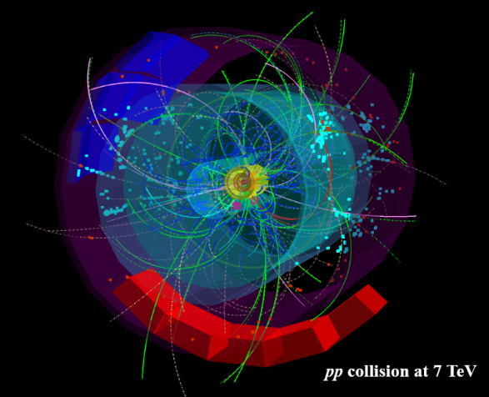
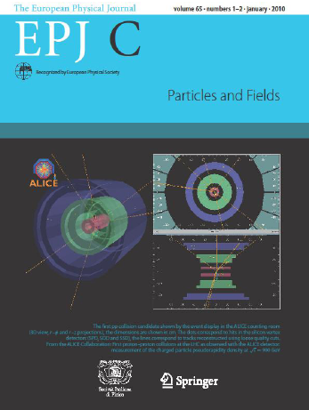
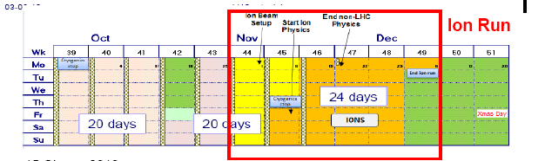
ALICE up and running
at very high efficiency
3 papers published + 5 circulating
  First pp collisions at the LHC as observed with the ALICE detector: measurement of the charged particle pseudorapidity density at sqrt(s)=900 GeV [EPJ C 65 (2010) 11] - The first LHC paper on real data
  Charged-particle multiplicity measurement in pp collisions at sqrt(s)=0.9 and 2.36 TeV with ALICE at LHC [accepted by EPJ, arXiv:1004.3034]
  Charged-particle multiplicity measurement in pp collisions at sqrt(s)=7 TeV with ALICE at LHC [accepted by EPJ, arXiv:1004.3514] – The first LHC paper (arXiv) on data at 7 TeV

Slide 3
Il gruppo Alice LNF: anagrafica
N. Bianchi (group leader)
G.P. Capitani
L. Cunqueiro Mendez
P. Di Nezza
A. Fantoni
P. Gianotti
S. Liuti
A. Moregula
V. Muccifora
Wanyan Quian
A.R. Reolon
F. Ronchetti
+
A. Orlandi
A. Viticchiè
12 ricercatori con 11.2 FTE
Partecipazione media 96%
INCARICHI RESPONSABILITA’
1 Deputy spokesperson EMCAL N.Bianchi
1 Coordinatore costruzione EMCAL (EU) e
DCAL (EU-Asia) A. Fantoni
2 Membri Management Board Calorimetro
N. Bianchi e P. Di Nezza
1 Expert on call F. Ronchetti
2 Shift leaders P. Di Nezza e A. Fantoni

Slide 4
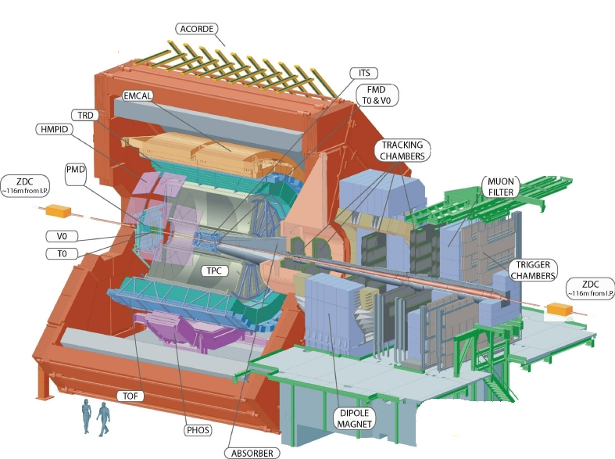
Il gruppo Alice LNF: attivita’
Costruzione del calorimetro e.m.
Online monitoring
Offline software
High Level Trigger
Jet physics:
Jet reconstruction
MC in QGP
Jets con part. Λ
associate:
TMDs in pp
Size 16x26 m²
Weight 10000 tons
Detectors 18
Notes:
The overall design of the EMCAL is heavily influenced by its integration within the ALICE magnet.
PHOS, TPC and HMPID define the azimuthal space available for the EMCal, limiting it to a region of about 110 degrees in azimuth. 10 supermodules, each spanning ~20 degrees in azimuth. EMCal is positioned to provide partial back-to-back coverage with the PHOS calorimeter. Small azimuthal gaps (~3cm) are provided between SMs to facilitate insertion and alignment (these gaps have no influence on the measured jet energy or jet resolution).

Slide 5
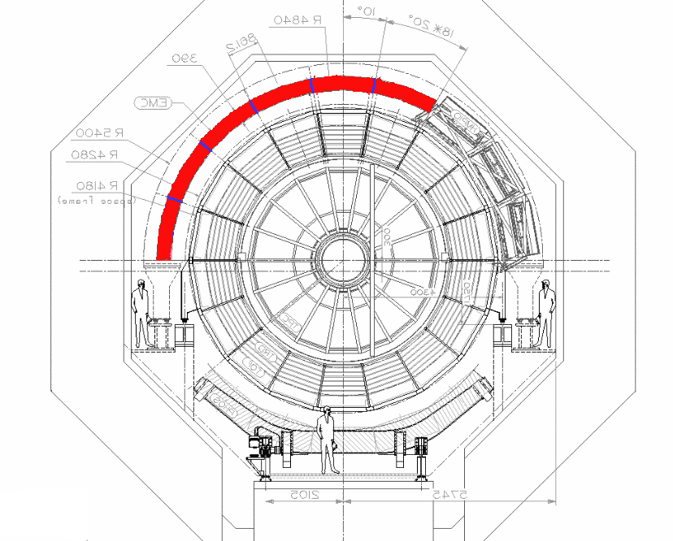
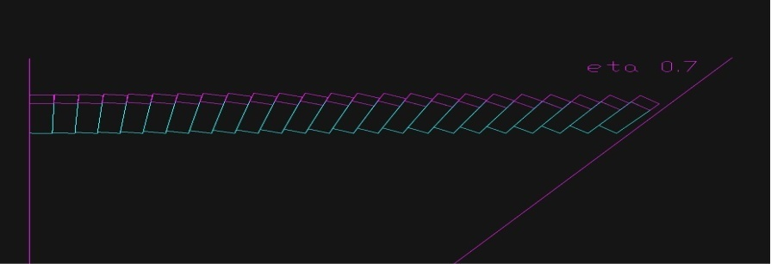
EMCAL Characteristics
To do jet (quenching) physics:
large coverage
good granularity
EMCAL
EMCAL
located inside the L3 solenoidal magnet
sampling calorimeter: 20.1 X₀
sandwich, 1.44 mm Pb/1.76 mm Scint
final geometry when installation completed
  -0.7 < η < 0.7
  ΔΦ = 100°
  small Φ gaps (~ 3 cm)
  aligned w/ TPC gaps
sampling fraction 1/10.5
density 5.86 g/cm³
R_{M} = 3.20 cm; X₀ = 12.3 mm
Scintillator = Polystyrene (BASF143E + 1.5% pTP + 0.04% POPOP)
10 super-modules in total
granularity: 11520 towers
tower size: Δη×Δφ ~ 0.0143×0.0143
σ_{E}/E ~ 10%
installed back to back with PHOS
PHOS
η
Notes:
EMCAL detector is a large area electromagnetic calorimeter.
ALICE capability to perform jet reconstruction is greatily improved by measuring in the EMCAL the neutral energy component of jets including photons and neutral pions. It also produce a fast, high pT trigger: the anticipated minimum bias average Pb-Pb interaction rate is very high (up to 8 kHz), thus a fast high-pT trigger will provide an enhancement in high pT events.
EMCAL participates also in the ALICE High Level Trigger performing online reconstruction at the full data rate trigger information based on reconstructed events

Slide 6
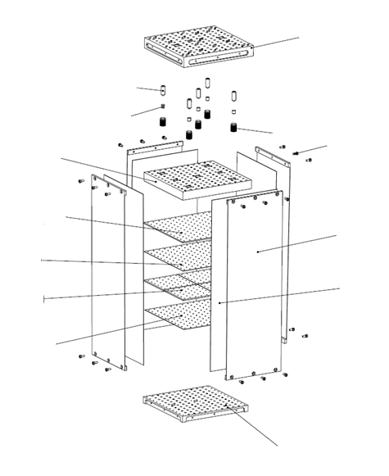
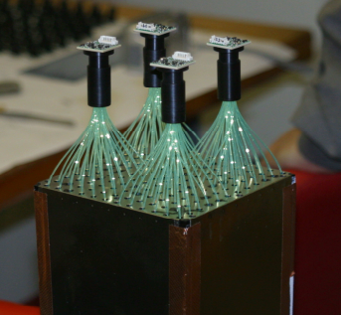
Containment: 88 parts
1) Back (holes: 144 thru for fibers + springs + mech. support), 1
2) Compression (holes: 144 thru for fibers + springs), 1
3) Front Plate (holes: 144 thru for fibers + springs + mech. support), 1
4) 5) Plungers (10)
6) Belleville washers (75)
Module Parts
1
4
Tensioning and Isolation:
40 parts
7) Stainless steel straps (4)
8) Screws (24)
9) Flanges (8)
10) Light tight stickers (4)
Sandwich:
538 parts
11) Lead tiles (76)
12) Scintillator tiles (308)
13) Bond paper sheets (154)
5
6
8
2
9
11
7
Readout : 165 parts
14) WLS fibers (144)
15) APD (4)
16) CSP (4)
17) Light guides (4)
18) Mount (4)
19) Collars (4)
20) Diffuser (1)
13
15
10
12
13
16
17
14
3
TOTAL components: 20
TOTAL parts: 831
18
19
Plus cabling, GMS and mech. supports
Notes:
Layered Pb-Sc sampling calorimeter with WLS fibers that run longitudinally throught the Pb-Sc stack providing light collection (Shashlik). The basic building block is a module consisting of 2x2 optically isolated towers which are read out individually, each spanning Dη x Dφ= 0.014 x 0.014. White, acid free, bond paper serves as a diffuse reflector on the scintillator surfaces and provides friction between layers. The scintillators edges are treated with TiO2, loaded reflector to improve the transverse optical uniformity within a single tower and to provide tower to tower optical isolation better than 99%.
All modules in the calorimeter are mechanically and dimensionally identical. The front face dimensions of the towers are ~ 6x6 cm2.
6

Slide 7
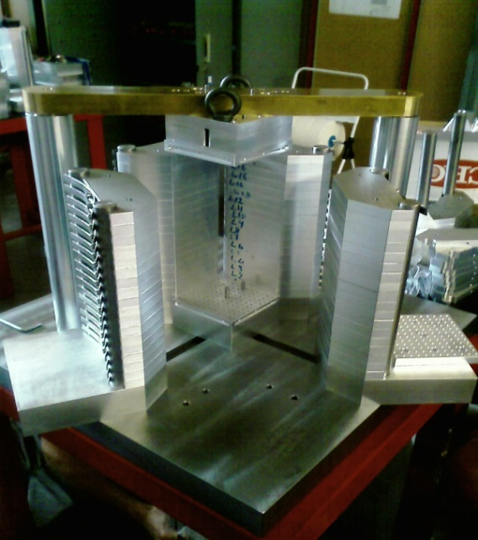
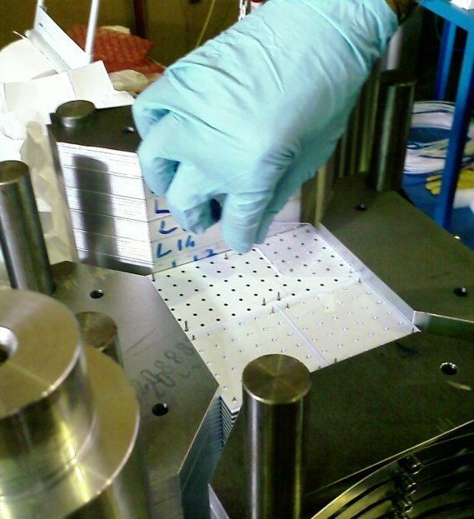
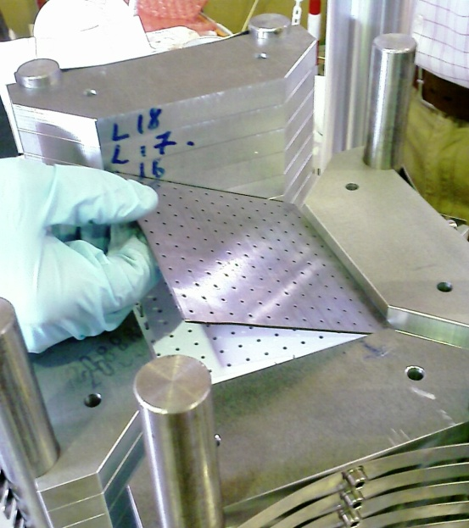
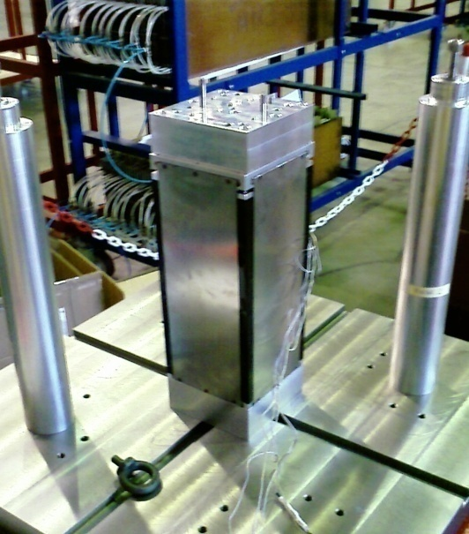
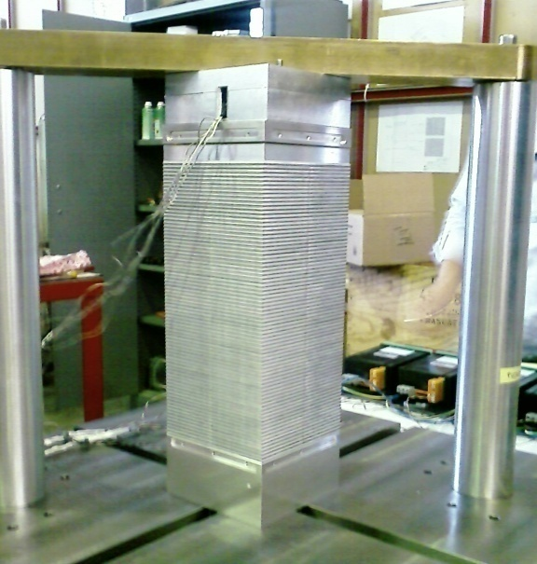
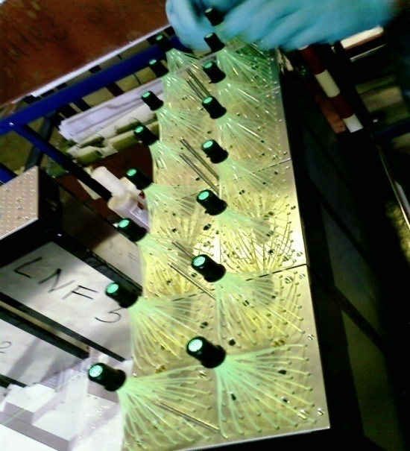
Module Production
Scintillator tile
Lead tile
Assembly station
Final module
350 Kg pressure
WLS insertion

Slide 8
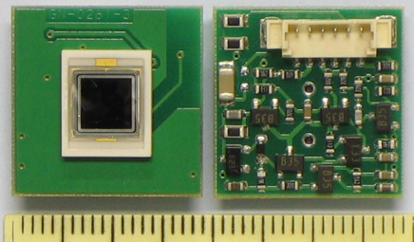
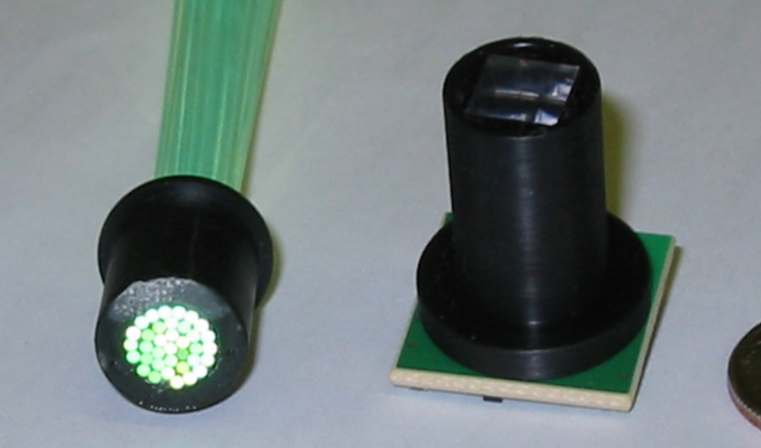
The EMCAL Readout
Y-11 (200) WLS double clad fibers
S8664-55 APD+CSP package
λ_{A}=430 nm, λ_{E}=476 nm, τ=7 ns
λ_{A}=480 nm, ε_{λ}=80%, T=25C°
fibers + light guide on package
Aluminization
Notes:
Scintillation photons produced in each tower are captured by an array of 36 Kuraray Y-11, double clad, WLS fibers. Each fiber within a given tower terminates in an aluminized mirror at the front face of the module and is integrated into a polished, circular group of 36 fibers at the photosensor end at the back of the module.
The 6.8 mm diameter fiber bundle from a given tower connects to the Avalanche PhotoDiode throught a short light guide/diffuser. APD=Hamamatsu S8664-55 for operating in magnetic field; APDs operating at moderate gain for low noise and high gain stability to maximize energy and timing resolution.
Number of primary electrons generated in APD by em shower approx 4.4 e/MeV, gain ~ 30.
The charge output from the APD is integrated by a Charge Sensitive Preamplifier (CSP) with a short rise time of ~10 ns and a long decay time of ~130mus.
Electronic readout equal to PHOS because light yield per unit of energy deposit is similar.
Avalanche Photo-Diode
(high reverse-bias voltages):
DM1v=3.3%, DM1T=-2.2%, M=50
Solid-state silicon device [n/p/p++]
g → e-, lm=420 nm, el=70%, T=25C°
Ordinary photodiode: g/e- ~1
APD: avalanche effect with g/e- ~ 1-1000 (up to breakdown)
Dark Current: 3 nA @ 25C°
High sensitivity + high speed
(10ns pulse)

Slide 9
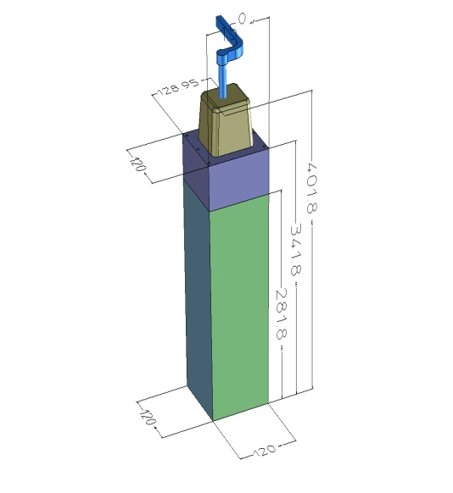
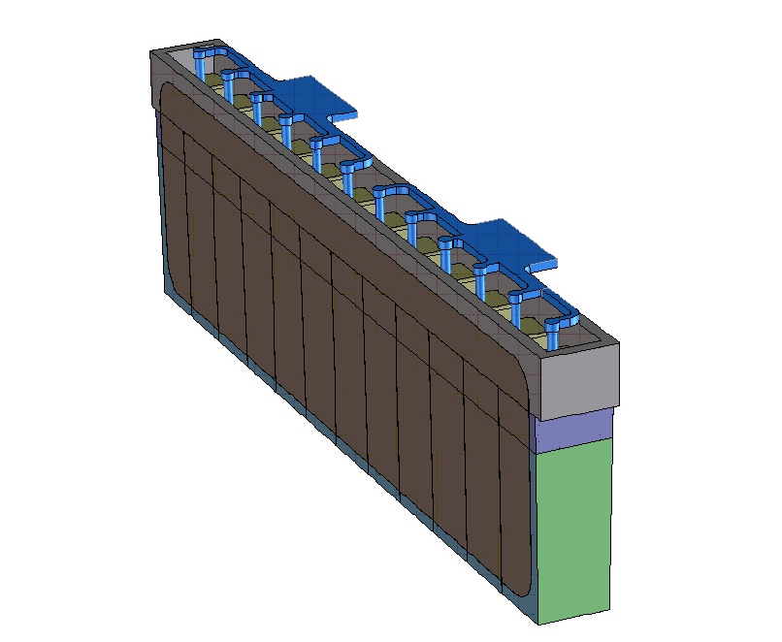
The EMCAL Modular Structure
One Module
One FULL Strip Module
Collaborazione
Francia, Italia, USA
  7 US SMs
  3 EU SMs (Italy and France)
  Construction started in 2008
  4/10 SMs installed in 2009
  Complete installation in 2011
12 modules
1 Module = 26.7 kg
1 Strip Module = 324 kg
1 Super-Module =288 modules ~ 7.7 tons
Full detector:
10 Super Modules,
total weight ~ 80 tons
One Super Module (SM)

Slide 10
Attivita’ hardware LNF EMCAL 2010 - 2011
COSTRUZIONE MODULI
2 assembly stations al Capannone Gran Sasso
Camera di sputtering costruita interamente in loco
(e richiesta anche da altri gruppi)
Assemblaggio 1/3 contributo Europeo (1 SM, 24 stripmoduli, 288 moduli)
Lavorazione, sputtering, assemblaggio ed incollaggio fibre per 3 SMs Europei EMCal e 3 SMs Eu-Asia DCal (piu’ di 200.000 fibre, raggruppate in circa 6000 bundles)
RICHIESTA INTERVENTI SPCM
Misure metrologiche sugli scintillatori
Test punti rottura straps per chiusura moduli
Notes:
First 2 SMs (1st EU h11 and 1st US h12) on muon arm side, while the other two on muon arm opposite side
10

Slide 11
Contributo LNF 2010 - 2011
Hardware
Data taking
Data analysis
High Level Trigger for EMCal
MC simulation – QPythia per Jet Physics
Data analysis on Jets with Λ particles associated
Online monitoring
EMCal – Dcal debugging
Calibration
F. Ronchetti (online)
P. Di Nezza, L. Cunqueiro Mendez, A. Moregula (offline)
Notes:
First 2 SMs (1st EU h11 and 1st US h12) on muon arm side, while the other two on muon arm opposite side
11

Slide 12
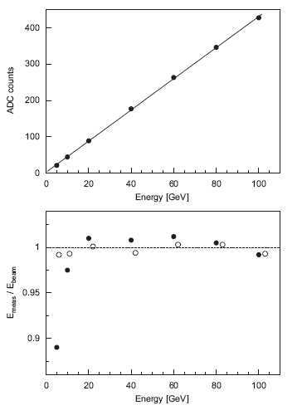
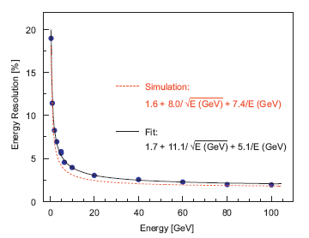
EMCAL carachteristiques from test beams
EMCAL prototypes (4 modules x 4 strips) under test beams:
FNAL, November 2005 & SPS + PS, September – October 2007
Energy resolution for electrons as a function of the incident beam momentum:
Linearity better than 1% above 20 GeV (3x3 tower cluster)
Articolo preparato LNF
NIM A 615 (2010) 6
Notes:
Stacked 4x4 array of EMCAL modules (8x8 towers) with the full electronic chain as in ALICE.
Led calibration system installed to monitor time-dependent gain changes.
Linearity better than 1%; at low energy data described by a cubic function, at high energy longitudinal shower leakage. Uniformity of energy response with 80 GeV e- RMS of 1 GeV, that means uniformity at 1% level.
Resolution: requirement of s/E=2+15/sqrtE.
Beam energy spread subtracted from the measured results. Data taken with configuration of beam perpendicular to the surface. Some data taken with configuration where modules tilted in f by 6 or 9 degrees at different surface position, no significant deviation from the average resolutions with no tilt has been observed. Constant term is due to miscalibration

Slide 13
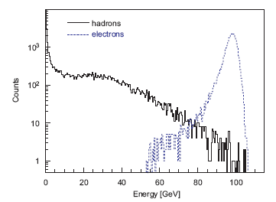
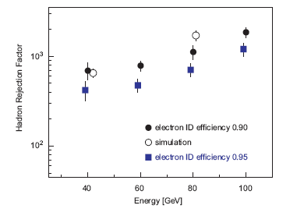
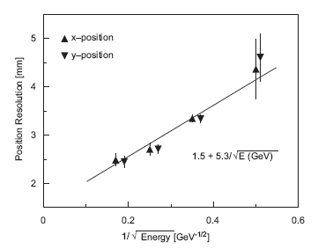
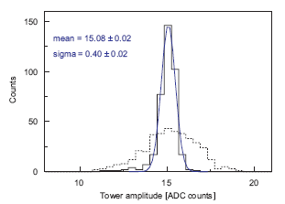
NIM A 615 (2010) 6
EMCAL response to h and e⁻
Hadron Rejection Factor 10²-10³
Position Resolution (mm):
Response of 384 towers before/after gain calibration
Notes:
Segmentation of calorimeters allows to obtain the hit position from the energy distribution inside a cluster with accuracy better than the tower size; x and y calculated with log weighting of the tower energy deposits; data from FNAL used where MWPC provided reference position measurement better than 1 mm. No difference in x and y; the two contributions (1.5 and 5.3) are added in quadrature.
Plot of reconstructed energy for beam e- and h of 100 GeV (both available at CERN PS).
Rejection factor of 100-1000 obtained over 40-100 GeV energy range.
HRF can be further improved by considering the characteristique shower shapes, as hadrons produce showers with wider spatial distributions than electrons.
Cosmic ray calibration of ALL modules will be performed BEFORE their insertion into ALICE, based on a measurement of cosmic ray muons at the minimum of ionization. Since the energy of MIP muons is too low to trigger the EMCAL, an external trigger is necessary. Individual gain calibration performed for each tower. After 3 iteration a final relative dispersion < 3% is reached. Julien’s talk.

Slide 14
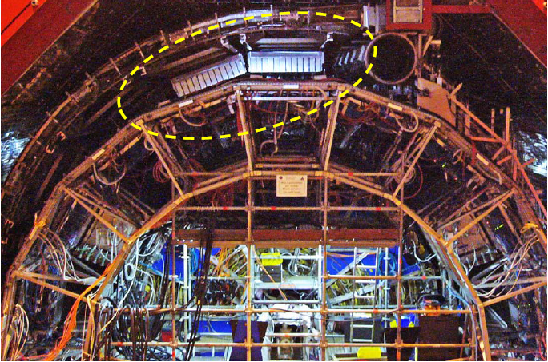
Stato EMCAL
4 SMs installati in ALICE
(2 a Marzo 09, 2 a Luglio 09), operativi e in presa dati
copertura parte installata:
Δη x Δφ = 1.4 x 1.05
4 SMs pronti e in fase di test/calibrazione
2 SM in preparazione
Assemblaggio di EMCAL completed prima dell’estate 2010
Calibrazione con cosmici da completare in autunno 2010
Installazione EMCal completa appena disponibile un lungo shutdown a LHC (2001) (2011)
Notes:
First 2 SMs (1st EU h11 and 1st US h12) on muon arm side, while the other two on muon arm opposite side
14

Slide 15
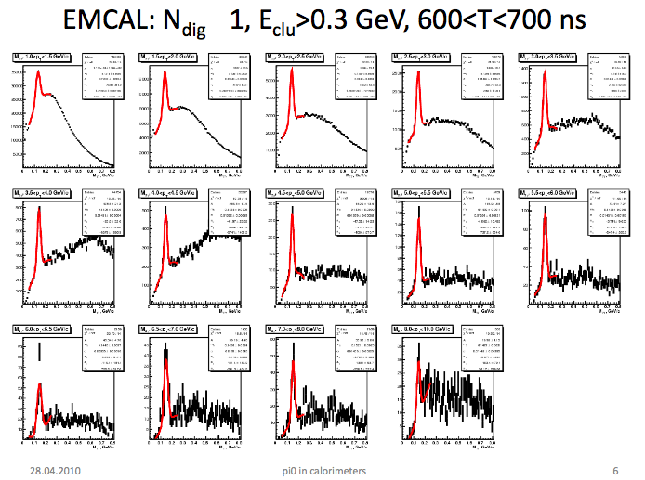
EMCal π⁰’s
Data taking
Work in progress
Notes:
With 30-40M events π⁰’s to p_{T}=10 GeV
Need to get non-linearity correction and geometry correct before rescaling energy scale
Continue to optimize noisy channel cuts
Need to use fiducial (edge) cuts to eliminate leakage effects
Begin to investigate methods to improve relative calibrations

Slide 16
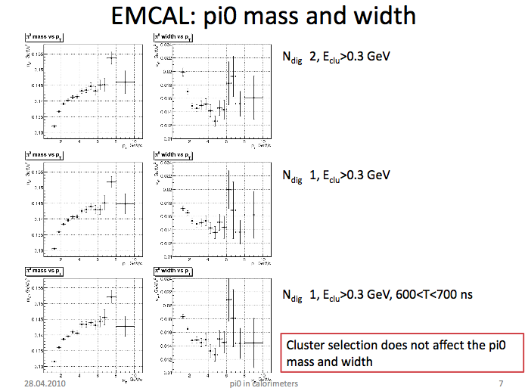
EMCal π⁰’s – Non linearity
Work in progress
Need to get non-linearity correction and geometry correct before rescaling energy scale
Notes:
Need to get non-linearity correction and geometry correct before rescaling energy scale
- Simulations used to get non-linearity correction must reproduce data
π⁰ mass shift, width (resolution), towers/cluster
- Need good π⁰ input: continue to optimize cuts, minimize backgrounds
Noisy channel cuts,Timing cuts, SM edge cuts
- Investigate relative calibrations via effect on π⁰ at high pT

Slide 17
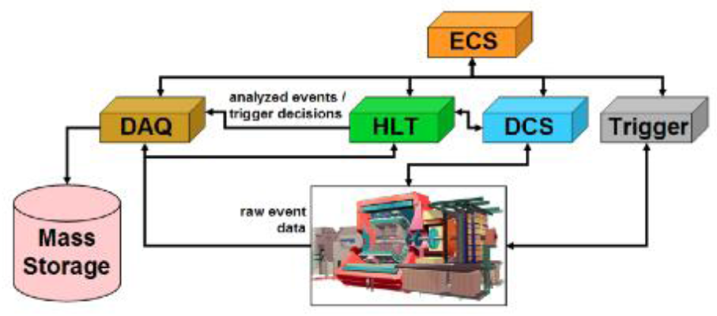
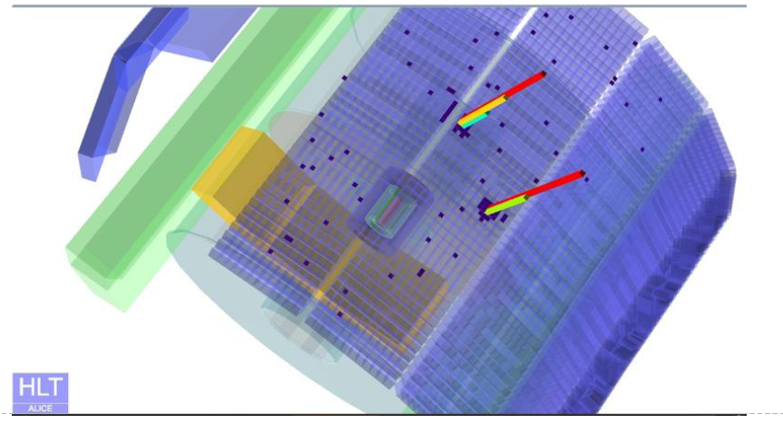
High Level Trigger for EMCal
- F. Ronchetti -
PbPb collisions @ 8 kHz corresponds to 2 kHz calo tower hit rate
HLT reduces to a 40% EMCal
data occupancy
Main HLT strategy:
Reconstruction for calibration and monitoring
Event rejection using high-E_{T} (cluster) trigger OR jet trigger

Slide 18
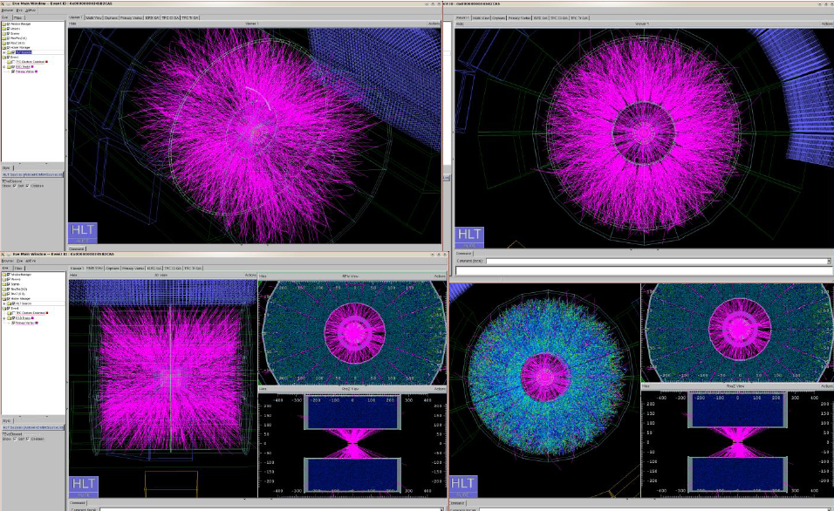
HLT study overlapping few hundreds of pp real events to simulate PbPb collisions

Slide 19
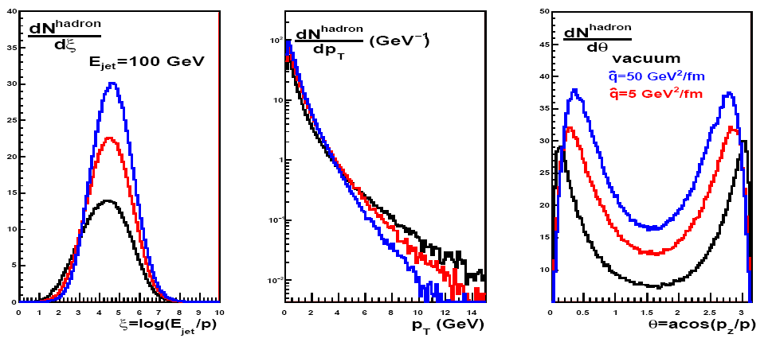
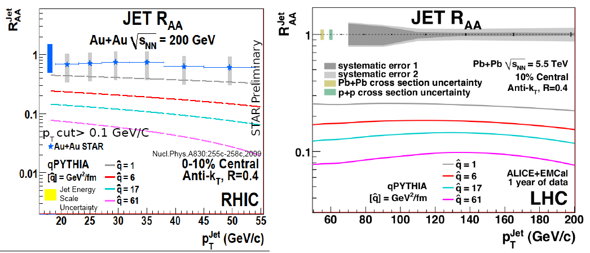
Jet Physics - QPythia: MC for Jet Quenching
- L. Cunqueiro -
In collaboration with Santiago Univ. theory group [Armesto, Cunqueiro, Salgado]
Distributions for different quenching
Comparison with RHIC data
Notes:
High-p_{T} partons produced in hard interactions undergo multiple interactions inside the collision region prior the hadronization … so they loose energy through medium induced gluon radiation → the jet quenching as a golden channel to probe the QGP
p_{T} shift correction due to the hadronization is important to compare data to parton level analytical calculation

Slide 20
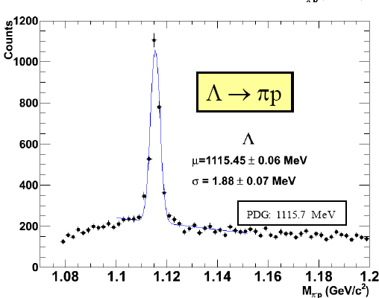
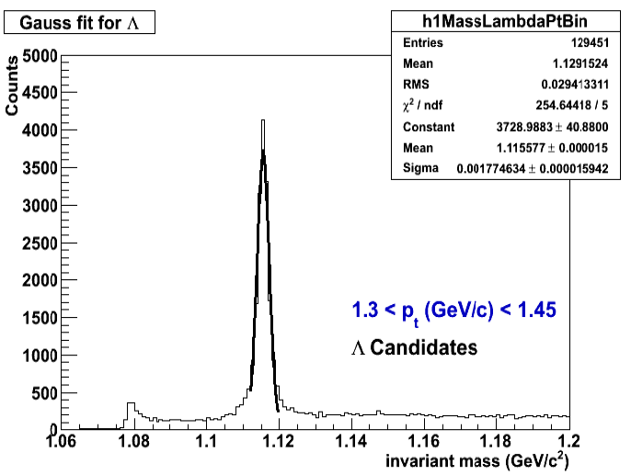
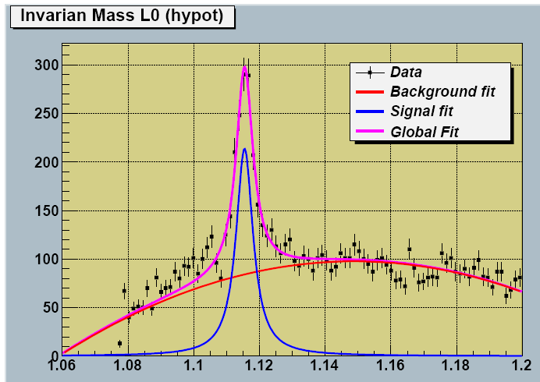
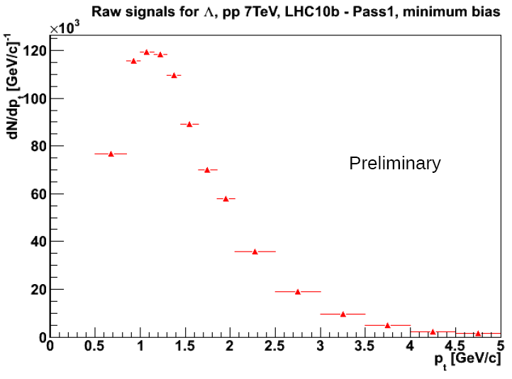
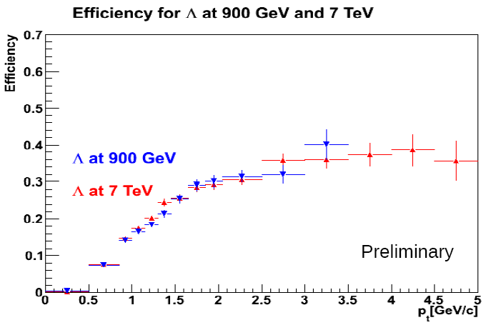
Transverse Λ polarization in unpol. pp scattering
- P. Di Nezza -
This opens the new channel of the TMDs (Transverse Momentum dependent Distribution and fragmentation functions)
pp@7TeV (E_{Λ} up to 16 GeV)
Λ inside jets

Slide 21
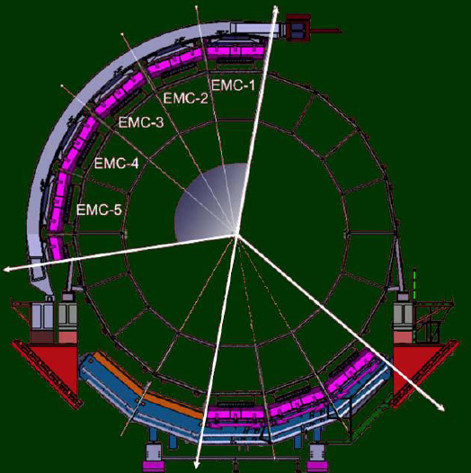
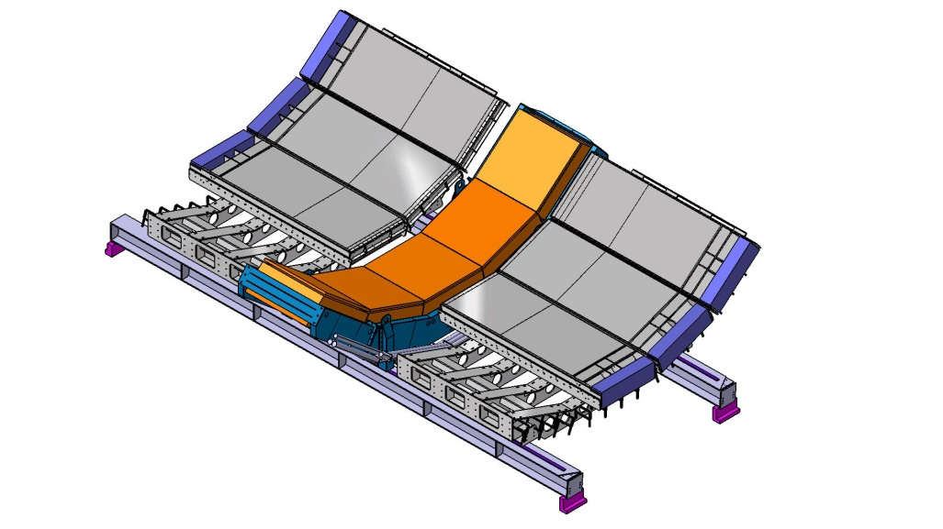
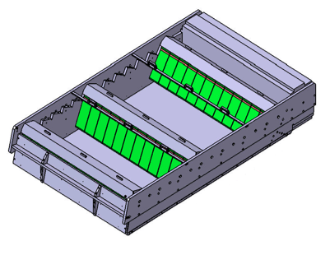
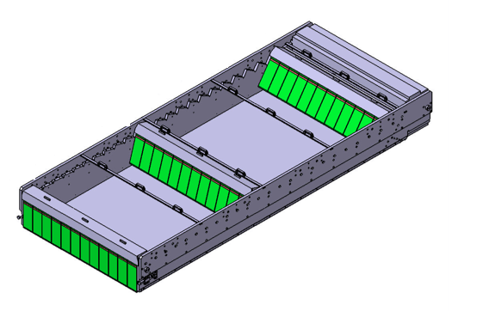
Estensione EMCAL: DCAL
EMCal ultimo rivelatore proposto in ALICE, solo parzialmente installato Primo upgrade approvato (Nov. 2009) estensione EMCal = DCAL
→ DCal back to back con EMCal per jet-jet e γ-jet physics
Inizio assemblaggio 6 DCal SMs dopo completamento EMCAL fino a 2011
Moduli DCAL:
Stessa tecnologia EMCal
SM piu’ corti (2/3 EMCal SM)
DCal – 6 super moduli
DCal SM
16 strip moduli
(2 mostrati)
Installazione
η= 0 to ~0.7
(incluso PHOS)
Δφ ~20 gradi
Δη~0.7
Standard EMCal SM
24 strip modules
(3 shown)
PHOS – 5 moduli mostrati
Notes:
DCAL will be situated back-to-back in azimuth relative to the EMCAL and adjacent to PHOS. It will enhance the existing capabilities of EMCAL and PHOS. Structure similar to EMCAL
B6 Configuration allows largest possible jet radii in Dcal.
Large effective acceptance for di-jets when used with the EMCAL with analysis cones up to raddi R=0.4. This is satisfied by a detector spanning 60 degrees in azimuth and 1.4 units of pseudo-rapidity placed back to back with the corresponding 60 degrees in azimuth of the ALICE EMCal. This is the maximum back to back coverage possible in ALICE given the installed location if the EMCal.

Slide 22
Contributo LNF DCAL
Tools:
2 assembly stations, 4 stazioni compressione, 1 camera sputtering, 4 stazioni incollaggio fibre, tools assemblaggio stripmoduli
Expertise:
Assemblaggio moduli, stripmoduli
Produzione fibre
Test scintillatori
Manpower:
Produzione (lavorazione, sputtering, assemblaggio ed incollaggio) fibre per DCAL Eu-Asia (3 SMs, circa 90.000 fibre in 2500 bundles) per 2011
Contributo all’assemblaggio moduli, stripmoduli
Contributo alla calibrazione con cosmici a Grenoble
Contributo all’installazione SMs al CERN
Notes:
First 2 SMs (1st EU h11 and 1st US h12) on muon arm side, while the other two on muon arm opposite side
22

Slide 23
Richieste 2011
MI 17 kEuro (Riunioni capigruppo, contatti ditte italiane per componenti DCAL e missioni Ct per assemblaggio, Convegno Nazionale Fisica Alice)
ME 130 kEuro (Partecipazione run, Alice weeks e Physics week, Physics working group, Offline weeks, Manutenzione EMCal, Installazione terzo SM al CERN + cablaggi, Commissioning con cosmici SM EmCal/Dcal a Grenoble)
Consumo 23 kEuro (M&O_B EMCal, Metabolismo per lavorazione, sputtering, assemblaggio e incollaggio fibre)
Trasporti 12 kEuro (Spedizione e smistamento materiali DCAL a Catania, Nantes, Grenoble, Wuhan e Tsukuba)
Inventario 8 kEuro (Pompa turba per sputtering)
Totale 190 kEuro per 11.2 ricercatori FTE

Slide 24
Conclusioni
12 persone coinvolte (11.2 FTE) in diversi settori:
Hardware (EMCal + Dcal):
- 4 EMCAL SMs installati per π⁰, γ e jet physics
- Primi risultati presa dati: EMCAL funzionante, ottimizzazione in corso
- Installazione EMCal durante lungo shutdown (2011)
- EMCAL upgrade: DCAL per γ-jet e jet-jet, lavoro iniziato, completamento nel 2011
Online/offline software calorimetro
Data taking
MC
Analisi dati
Diversi incarichi responsabilita‘
Notes:
First 2 SMs (1st EU h11 and 1st US h12) on muon arm side, while the other two on muon arm opposite side
24

