Slide 1
Richieste MPGD-based HCAL
MuColl Meeting
July 9 2021
Piet Verwilligen Anna Colaleo, Marcello Maggi, Rosamaria Venditti, …
Online, July 9th 2021

Slide 2
Outline
Requirements for Muon Collider HCAL?
Basically same requirements as for any leptonic collider (ILC,CLIC,FCC_{ee}) HCAL:
W,Z separation in dijet events – 3-4% resolution
Obtained through Particle Flow in High Granularity HCAL
Many work done in CALICE collaboration
AHCAL (scint+SiPM), DHCAL & SDHCAL (glass RPC, MPGD)
No extreme rate requirements (low BX-frequency)
Additionally:
Cleaning of Energy deposits due to muon decays
MPGD as active element offer:
High granularity, radiation hard, high rate capable
Exploit timing characteristics? (~5ns/MIP → better for HCAL)

Slide 3
Approach
Detector Design with Machine Learning techniques: MODE
MODE is a collaboration of physicists and computer scientists with the goal to use the differentiable programming for the optimization of the detector design for particle physics applications.
the aim is to develop a modular, customizable, and scalable, fully differentiable pipeline for the end-to-end optimization of articulated objective functions that model in full the true goals of experimental particle physics endeavours, to ensure optimal detector performance, analysis potential, and cost-effectiveness.
This approach is an alternative to the standard full simulation flow based:
radiation-matter interaction and detector geometry design with GEANT
Signal modelling with specific software (Garfield, Ansys)
Digitization
Reconstruction software (tracking, particle flow, PID)
Proposal to open sigla in CSN-V: INFN-MODE
INFN supporting Machine Learning techniques for particle detector optimization
Accommodate requests to test the designed detectors with small prototypes
We want to explore this possibility to design a HCAL for Muon Collider with MPGD-based active elements

Slide 4
Particle-Flow HCAL with MPGD: what has been done so far …
Mainly Linear Collider (ep) driven effort (CALICE)
Digital & Semi-Digital HCAL (DHCAL – SDHCAL)
Digital HCAL improves on Analog HCAL because less affected by Landau tails in energy distribution
Further improvement by Semi-Digital approach to give different weight to high and low energy deposit with 1bit and 2bit ADCs
Readout Pixel size studied so far: 1cm²
Gaseous detectors considered:
Glass RPC & MPGD: GEM, MM, RPWELL
We will start from existing knowledge in the field
However not clear wich MPGD is MPGD of choice
Want to test objectively different technologies
Want to understand the time resolution achievable for hadronic showers with standard MPGDs … and leave some room for MPGD R&D in future … FTM

Slide 5
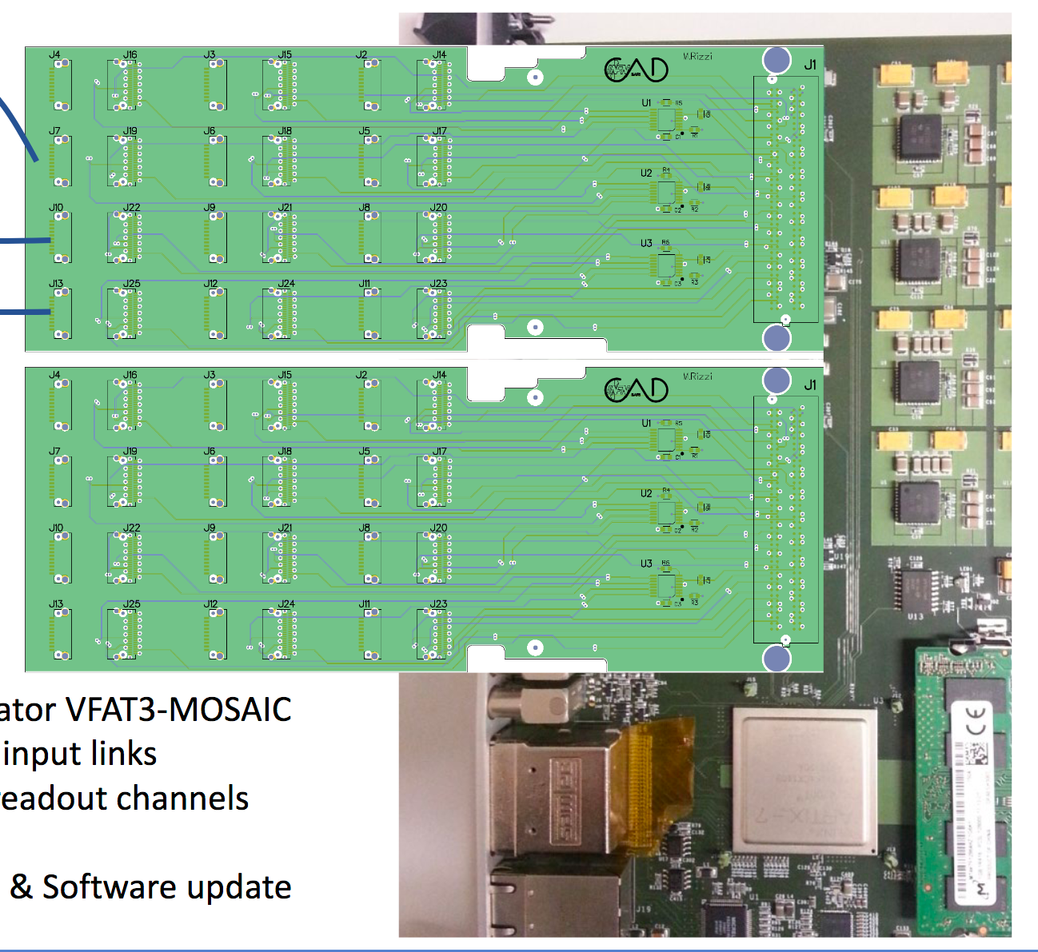
Design of MPGD-based HCAL cell
We would like to test different MPGD technologies in a small-size stack with Stainless steel absorbers:
Resistive Micromegas
Resistive micro-RWELL
Triple-GEM detectors
Read out all detectors with same FE electronics. Exploit new Front-End asic designed for FTM: FATIC (Time measurement + Charge measurement)
absorber
mpgd
absorber
absorber
mpgd
absorber
absorber
mpgd
mpgd
1
2
3
4
New concentrator boards for MOSAIC
MPGD 10 x 10 cm² - uRWELL - MM-resistivo
- GEM
4 FATIC₂
Plugincards with 4 FATIC2 chips
connector
LV
4 FATIC₂
connector
LV
MOSAIC FPGA-board
connector
connector
8 LVDS: 1RX 1Clk 4TX 1 F-OR 1 Reset

Slide 6
Financial Requests
RD_Mucoll:
10kEUR for 2 resistive Micro-Megas (MM)
Design provided by Mauro Iodice (RM3)
7kEUR for Electronics to read-out 2 MM:
4kEUR for 10 plugincards
2kEUR for concentrator board
1kEUR for high-speed cables
INFN-mode:
We will ask to finance the Stainless steel absorbers and mechanics (bosch) for the construction + Electronics to read out 2 GEMs from LEMMA
RD51 Common Project:
Ask small extra funding to RD51 collaboration through “Common Project”
Will allow to make modifications to the prototypes – change Readout board for GEMs …
Collaborating institutes: Roma 3 (ATLAS MM) & LNF (LHCb uRWELL)
Can however not pledge officially FTE to MuCOL but are very interested in the development of the hadron collider with MPGD readout
… remake of ALEPH PF-Calorimeter with state of the Art MPGDs …

Slide 7
Side Remarks
Hadron Calorimeter R&D is expensive task
ECAL: small moliere radius allows for small prototypes
HCAL: smallest prototype to contain most of hadronic shower: 50cm x 50cm
2500 pixels – 100 ASICs – 25 Front-end boards …
Need several sampling layers
Costs for detectors and Electronics explode ….
Cannot make demonstrators for each technology
Cannot easily test different electronics and compare …
So far no work was done on time-resolution of (S)DCAL prototypes (not even using the superb time-res of the glass-RPCs in CALICE!)
Gain in reduction of “confusion term” of energy resolution
Even though we cannot contain full hadronic shower, we will be able to contain the (EM) core of the hadronic shower
We believe timing is mostly driven by the energetic core
We will not concentrate on energy resolution (for this you need to contain full shower)

Slide 8
BACKUP
Online, July 9th 2021

