Slide 1
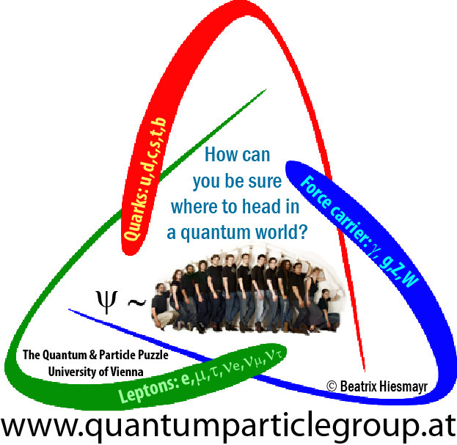
Testing Foundations in Quantum Mechanics with the neutral K-meson system
Spooky action at distance also for neutral kaons?
by
Beatrix C. Hiesmayr
On leave: University of Vienna
&
Quantum Information Research Center
Bratislava

Slide 2
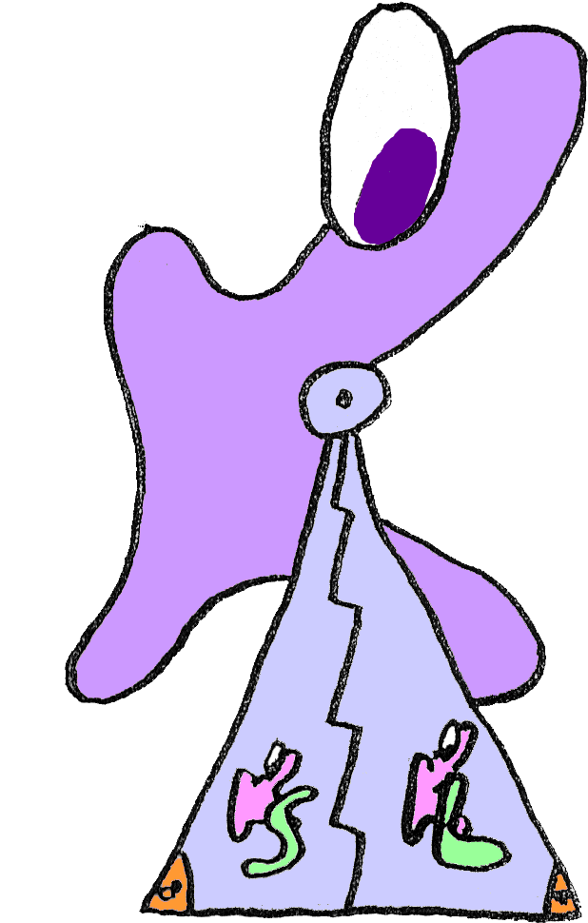
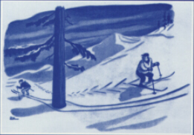
Outlook
Discrete 2010, Beatrix C. Hiesmayr
Part I: Bell inequalities in Particle Physics: What has nonlocality to do with CP violation?
Part II: Heisenberg’s Uncertainty relation: A new interpretation of measurements at accelerator facilities
Part II: How to detect the amount of entanglement? Decoherence in HEP Experiments (KLOE detector)?
Part III: An advantage of entangled neutral kaons: offers new possibilities for quantum erasure !!!

Slide 3

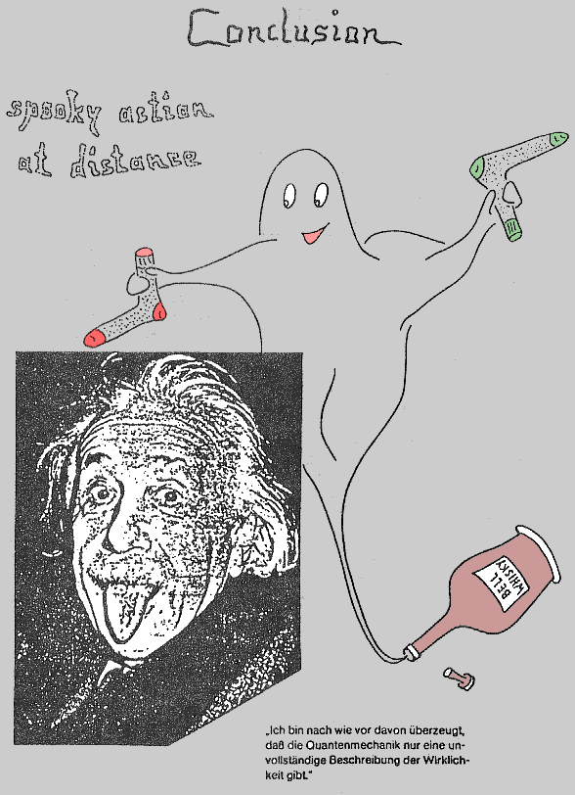
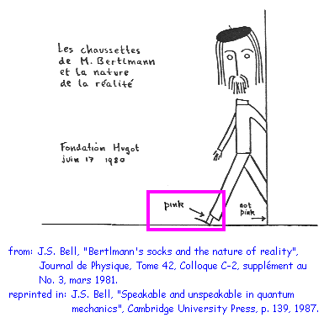
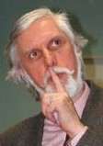
About correlations…
Discrete 2010, Beatrix C. Hiesmayr
drawn by R.A. Bertlmann to the 60th birthday of J.S. Bell

Slide 4
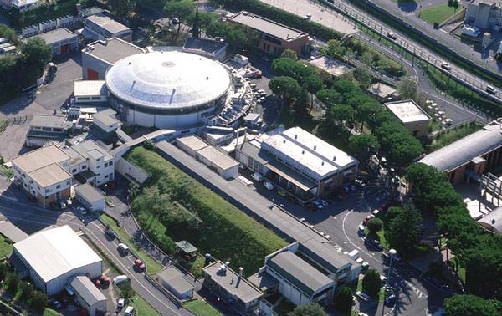
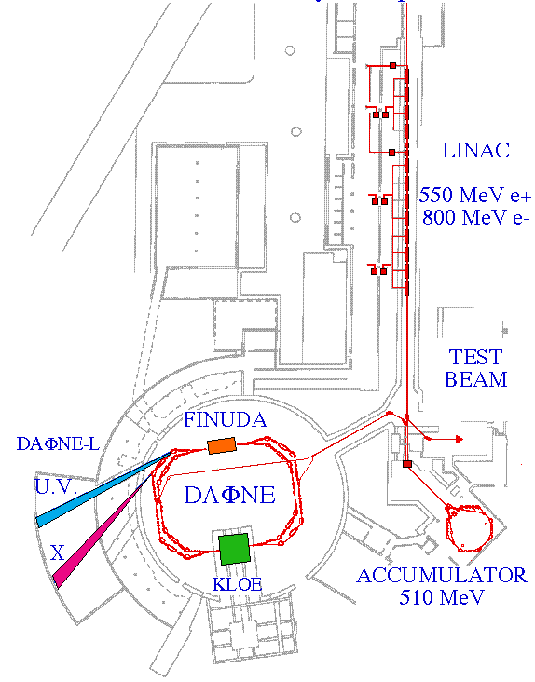
Outlook: DAPHNE, a Φ-factory (Italy)
"Physics with the KLOE-2 experiment at the upgraded DAPHNE„
G. Amelino-Camelia, F. Archilli, D. Babusci, D. Badoni, G. Bencivenni, J. Bernabeu, R.A. Bertlmann, D.R. Boito, C. Bini, C. Bloise, V. Bocci, F. Bossi, P. Branchini, A. Budano, S.A. Bulychjev, P. Campana, G. Capon, F. Ceradini, P. Ciambrone, E. Czerwinski, H. Czyz, G.D’Ambrosio, E. Dan´e, E. De Lucia, G. De Robertis, A. De Santis, P. De Simone, G. De Zorzi, A. Di Domenico, C. Di Donato, B. Di Micco, D. Domenici, S.I. Eidelman, O. Erriquez, R. Escribano, R. Essig, G.V. Fedotovich, G. Felici, S.Fiore, P. Franzini, P. Gauzzi, F. Giacosa, S. Giovannella, F. Gonnella, E. Graziani, F. Happacher, B.C. Hiesmayr, B. H¨oistad, E. Iarocci, S. Ivashyn, M. Jacewicz, F. Jegerlehner, T. Johansson, J. Lee-Franzini, W. Kluge, V.V. Kulikov, A. Kupsc, R. Lehnert, F. Loddo, P. Lukin, M.A. Martemianov, M. Martini, M.A.Matsyuk, N.E. Mavromatos, F. Mescia, R. Messi, S. Miscetti, G. Morello, D.Moricciani, P. Moskal, S. Müller, F. Nguyen, E. Passemar, M. Passera, A. Passeri, V. Patera, M.R. Pennington, J. Prades, L. Quintieri, A. Ranieri, M. Reece, P. Santangelo, S. Sarkar, I. Sarra, M.Schioppa, P.C. Schuster, B. Sciascia, A. Sciubba, M. Silarski, C. Taccini, N. Toro, L. Tortora, G.Venanzoni, R. Versaci, L.-T. Wang, W. Wislicki, M. Wolke, and J. Zdebik
European Physics Journal C 68, Number 3-4, 619-681 (2010)

Slide 5
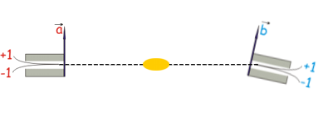
The EPR scenario
Bell state:
... spin 1/2
... qubit
... photon
... kaon
... B-meson
... single neutron in interferometer
R.A. Bertlmann, K. Durstberger, Y. Hasegawa and B.C. Hiesmayr PRA (2004)
→ Filipp et al., PRL (2009)

Slide 6
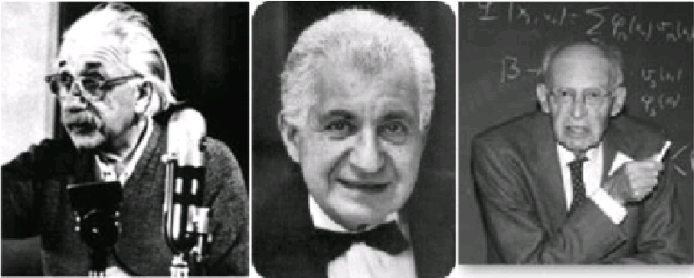
The EPR scenario
1935: Einstein-Podolsky-Rosen-PARADOX
The EPR reality criterion: “If without in any way disturbing a system, one can predict with certainty (i.e. with the probability equal to one) the value of a physical quantity, then there exists an element of physical reality corresponding to this physical quantity.”
→ Quantum Theory is not complete!

Slide 7
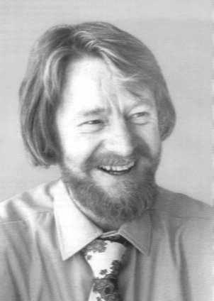
What are Bell inequalities?
No spooky action at distance!
realism
locality
free will
Local realistic theories:
Quantum Mechanics:
inequalities for probabilities → always satisfied!
→quantum mechanical probabilities may violate the inequalities!
Experiment has to decide!

Slide 8
Similarities/differences
Photons
Kaons
No decay

Slide 9
Generalized Bell inequality for kaons
Bertlmann, Hiesmayr, PRA 63 (2001)
What can Alice & Bob measure?
measurement device
Are you in a certain quasispin k_{n} or not at time t_{a}?
t_{a}
local realistic theories
vary in times
vary in quasi-spin
or both
Notes:
Anolgies ?

Slide 10
Generalized Bell inequality for kaons
local realistic theories
I. Vary in time:
Violation!
Bertlmann, Bramon, Garbarino, Hiesmayr, Phys. Lett. A (2004)
Bertlmann, Hiesmayr, Phys. Rev. A (2001)
Kaons?
NO violation!
Strangeness oscillation/decay:
PROPOSITION:
The CHSH-inequality is violated iff x>2 for kaons or for other mesons x>2.6.
B-mesons: x=0.77
D-meson: x<0.03
B_{s}-mesons: x>20.6
Notes:
Anolgies ?

Slide 11
Bell-CHSH type inequality for kaons
Bell-CHSH type inequality for kaons
Is it really not possible to distinguish between local realistic theories and quantum mechanics for neutral kaons in a direct experiment?
Bertlmann, Hiesmayr, PRA 63 (2001)
Photons:
Violation!
You have to be more tricky!
Kaons?
NO violation!
Bertlmann, Bramon, Garbarino, Hiesmayr, Phys. Lett. A (2004)
Bertlmann, Hiesmayr, Phys. Rev. A (2001)
Strangeness oscillation/decay:
PROPOSITION:
The CHSH-inequality is violated iff x>2 for kaons or for other mesons x>2.6.
B-mesons: x=0.77
D-meson: x<0.03
B_{s}-mesons: x>20.6
Notes:
Anolgies ?

Slide 12
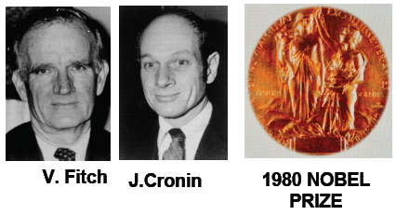

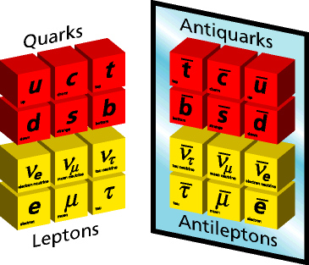
!?Nonlocality related to a symmetry violation?!
1964
Bell inequalities
CP violation
world
anti-world

Slide 13
What has a symmetry violation to do with nonlocality?
II. Vary in quasi-spin:
?! CP violation related to nonlocality !?
Bertlmann, Grimus, Hiesmayr,PRA (2001)
Hiesmayr, Found. of Phys. Lett (2001)
Leptonic charge asymmetry:
Notes:
Anolgies ?

Slide 14
Generalized Bell inequality for kaons
I. Vary in time:
Violation!
Kaons?
NO violation!
Notes:
Anolgies ?

Slide 15
Decay is “kind of decoherence” ?
short-lived state
long-lived state
Kaon in time:
→ state not normalized !!
Bertlmann, Grimus, Hiesmayr, Phys. Rev. A (2006)
!! particle decay is
``kind of decoherence´´ !!
System
Environment
Notes:
Anolgies ?

Slide 16
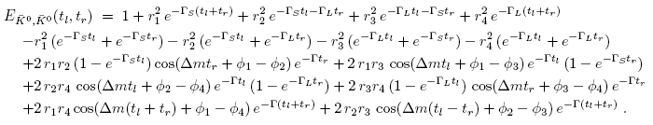
Bell inequality sensitive to strangeness violated?
Hiesmayr, Eur. Phys. J. C (2007)
local realistic theories
Can we violate the BI for a certain initial state and if, what is the maximum value?
Arbitrary initial state:
Expectation value:
Notes:
Anolgies ?

Slide 17
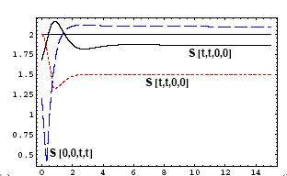

Bell inequality sensitive to strangeness violated?
Can we violate the BI for a certain initial state and if, what is the maximum value?
Hiesmayr, Eur. Phys. J. C (2007)
YES!!
The maximal violation is obtained for a non-maximally entangled state
A. DiDomenico,Frascati
antisymmetric state
Notes:
Anolgies ?

Slide 18
How much nonlocality is in a decaying system ?
Frascati 2010, Beatrix C. Hiesmayr
„dynamical“ nonlocality
Notes:
Anolgies ?

Slide 19
Realizable Bell inequality for KLOE2 ?!?
Discrete 2010, Beatrix C. Hiesmayr
Summary:
CP violation related to nonlocality
direct test not possible with antisymmetric state (also not with changed state due to regneration or due to CPTV,…)
Open:
construct another BI which is sensitive to the antisymmetric Bell state that is measured by KLOE
Good: have suitable framework
Bernabeu, Mavromatos
Phys.Rev. D74 (2006) 045014
Notes:
Anolgies ?

Slide 20
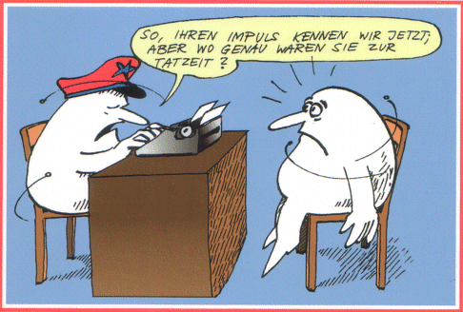

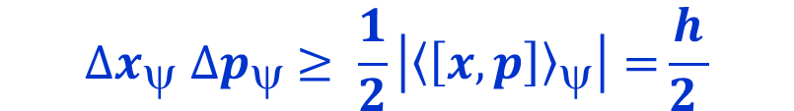

Heisenberg‘s uncertainty relation
Discrete 2010, Beatrix C. Hiesmayr
$${∆A}_{ψ} {∆B}_{ψ} ≥ \frac{1}{2}\left|{\left\langle \left[A,B\right]\right\rangle }_{ψ}\right|$$
${{∆A}_{ψ}}^{2}=\left\langle A^{2}\right\rangle $-${\left\langle A\right\rangle ψ}^{2}$
…uncertainty of observable A, standard deviations
Position and momentum:
$${∆x}_{ψ} {∆p}_{ψ} ≥ \frac{1}{2}\left|{\left\langle \left[x,p\right]\right\rangle }_{ψ}\right|=\frac{h}{2 }$$
Your momentum is now known but where have you been at that time of crime?

Slide 21
What questions are raised to the quantum system at accelerator facilities?
Discrete 2010, Beatrix C. Hiesmayr
Are you in a certain quasispin k_{n} or not at at time t_{a}?
measurement device
t_{a}
k_{n},t_{a}
Expectationvalue(k_{n},t_{a})= Tr( O(k_{n}) ρ(t_{a}))
Effective formalism:
Expectationvalue(k_{n},t_{a})= Tr( O_{eff}(k_{n},t_{a}) ρ)
Heisenberg picture,
solves a lot of subtle problems
[Unpublished]
Notes:
Anolgies ?

Slide 22

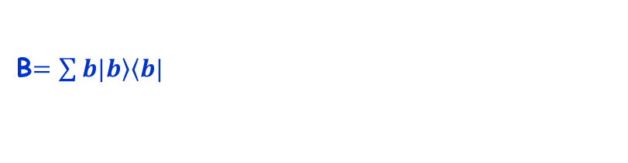
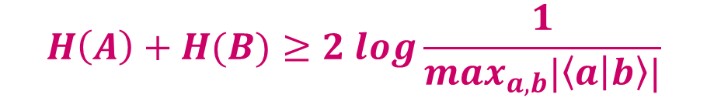



Entropic quantum uncertainty principle
Discrete 2010, Beatrix C. Hiesmayr
Heisenberg‘s uncertainty relation:
$${∆A}_{ψ} {∆B}_{ψ} ≥ \frac{1}{2}\left|{\left\langle \left[A,B\right]\right\rangle }_{ψ}\right|$$
Spectral decomposition:
…right hand side independent
of state and eigenvalues
A$=\sum{a|\left.a\right\rangle \left\langle a|\right.}$
B$=\sum{b|\left.b\right\rangle \left\langle b|\right.}$
$$H\left(A\right)+H(B)≥2 log\frac{1}{\max_{a,b}|\left\langle a | b\right\rangle |}$$
$$H\left(X\right)=−p log p−\left(1−p\right)log(1−p)$$
…binary entropy
Example:
$$max=\frac{1}{\sqrt{2}} , RHS:1$$
$$σ_{x},σ_{z}$$

Slide 23
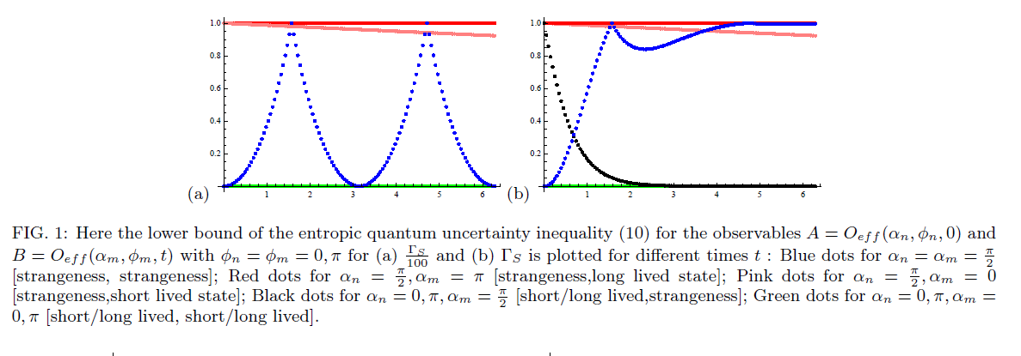
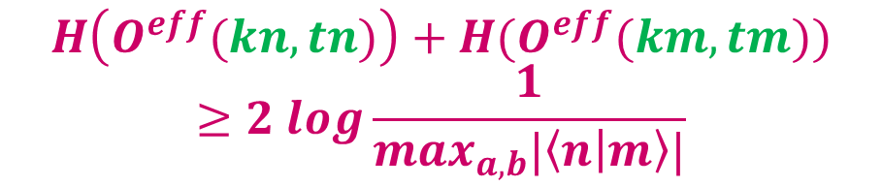
Comparing measurements at different times may increase or decrease the uncertainty in the system
Discrete 2010, Beatrix C. Hiesmayr
$$H\left(O^{eff}(kn,tn)\right)+H(O^{eff}(km,tm))≥2 log\frac{1}{\max_{a,b}|\left\langle n | m\right\rangle |}$$
blue… n=(kaon,t=0), m=(kaon,t)
red… n=(kaon,t=0), m=(long lived,t)
pink…n=(kaon,t=0), m=(short lived,t)
[Unpublished]

Slide 24
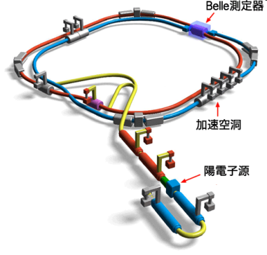
How to test the entanglement?
Part II:
a parameter ζ quantifying the amount of spontaneous factorization of the wave function (Schrödinger-Furry hypothesis)
ζ can be measured by experimental data (CERN,DAPHNE (Italy), KEK BELLE (Japan))
connect ζ to a decoherence model (master equation) with λ quantifying the strength of the interaction with the environment
connection to measures of entanglement (Von Neumann entropy, entanglement of formation or concurrence)

Slide 25
Spontaneous factorization of the wave function
Schrödinger-Furry Hypothesis:
50% 50%
Observable:
CPLEAR-experiment (1998):
Bertlmann, Grimus and Hiesmayr, Phys. Rev. D, 60, 114032 (1999)

Slide 26
Spontaneous factorization of the wave function
Schrödinger-Furry Hypothesis
50% 50%
:
CPLEAR-experiment (1998):
Bertlmann, Grimus and Hiesmayr, Phys. Rev. D, 60, 114032 (1999)

Slide 27

Testing entanglement/decoherence
decoherence in K_{S},K_{L}/loss of entanglement | decoherence in K⁰,K⁰:
Bertlmann, Grimus,
Hiesmayr, Phys.Rev. D (1999)
KLOE Coll.,
Phys. Lett. B (2006)
DiDomenico (2009)
But what about ζ(t)=1-e^{-λt}?
B-mesons:
Bertlmann, Grimus PRD (2001)
A.Go, BELLE, PRL (2008)
B.D. Yabsley (2008) arXiv:0810.1822 (D-mesons)

Slide 28
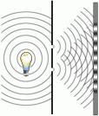
“Erasing the past and impacting the future”
1801 Thomas Young:
Photons interfere!
Interference lost because photon watched (gain which way info)!
1982 Drühl & Scully:
Erasing the which way info brings interference back!
No wonder Einstein would be confused!

Slide 29


The kaonic quantum eraser
Bramon, Garbarino, Hiesmayr, Phys. Rev. Lett. 92 (2004) 020405
Bramon, Garbarino, Hiesmayr, Phys. Rev. A 68 (2004) 062111
→ many experiments with photons, neutrons or atoms
Why, kaons?
just another quantum system?
because the working principle can be demonstrated in A NEW WAY,
!!only!! possible with kaons
new physics
Is this all?
and it can be performed at KLOE 2

Slide 30
What does Particle Physics teach us about QM?
... a lot!!
Bell inequalities for qm system others than ordinary matter and light
How to measure entanglement or decoherence?
“Kaonic” Quantum Erasers “Erasing the Past and Impacting the Future”
Bohr’s Complementarity in two-path interferomety or with CP violation (kaons are doubleslits given freely by Nature)
  CPT tests, Lorentzsymmetry,…
  Entanglement in a relativistic setting
New Physics !
Hiesmayr, Found. of Phys. Lett. 14 (2001).
Bertlmann, Bramon, Garbarino, Hiesmayr, Phys. Lett. A 332, (2004) 355.
Bertlmann, Grimus, Hiesmayr, Phys. Lett. A 289 (2001) 21.
Bertlmann, Hiesmayr, Phys. Rev. A 63 (2001) 062112.
....
KEK (Japan) & DAΦNE (Italy)
can be tested in experiments:
Bertlmann, Durstberger, Hiesmayr, Phys. Rev. A 68 (2003) 012111.
Bertlmann, Grimus, Hiesmayr,Phys. Rev. D 60 (1999) 114032.
Bramon, Garbarino, Hiesmayr, Phys. Rev. Lett. 92 (2004) 020405.
Bramon, Garbarino, Hiesmayr, Phys. Rev. A 68 (2004). 062111
offers new options !
Aharanov & Zubairy: Science 307:875, 2005
combines different fields of physics!
Bramon,Garbarino, Hiesmayr, Phys. Rev. A 69 (2004) 022112.
Hiesmayr, Huber, Phys. Lett. A (2007)
Bramon, Garbarino, Hiesmayr, Eur. J. Phys. C 32 (2004) 377.

Slide 31
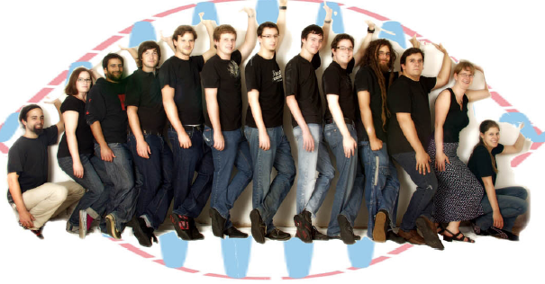
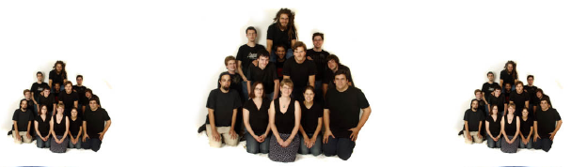
Thank you for Your attention!!!
The Quantum-Particle Group
Hansi Schimpf (Diploma)
Heidi Waldner (Diploma)
Theodor Adaktylos (Diploma)
Christoph Spengler (PhD)
Florian Hipp (Diploma)
Stefan Greindl (Diploma)
Markus Bauer (Diploma)
Andreas Gabriel (PhD)
David Schlögel (Diploma)
Marcus Huber (PostDoc)
Gerd Krizek (PhD)
B.C.Hiesmayr
Heidemarie Knobloch (Diploma)
Christina Peham (Diploma,without picture)
Paul Erker (without picture)
Sasa Radic (Diploma, without picture)
University of Vienna
www.quantumparticlegroup.at
Double slit

Slide 32
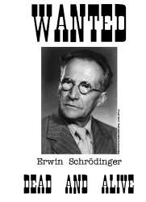

Take away messages
Spooky action at distance also for neutral kaons?
The full picture of entanglement and its manifestations is still missing
Investigating systems other than ordinary matter and light adds new aspects (CP violation, dynamical nonlocality)
…has/can be tested in experiments (loss of entanglement)
In higher dimensions or for more particles new featues arise (bounds on entanglement measures, simple inequalities to detect and classify genuine entanglement)
… the story has just started

Slide 33
A little history…
Drawn by R.A. Bertlmann to the 60th birthday of John Bell

Slide 34
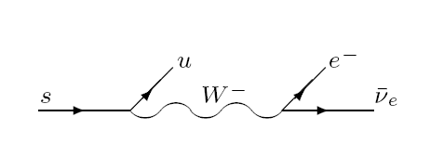
Measurements: active & passive
Strangeness basis:
“Active” measurement:
Strong interactions:
K⁰+p ➔ K⁺+n
K⁰+p ➔ Λ+π⁺
K⁰+n ➔ K⁻+p, Λ+π⁰
“Passive” measurement:
Semileptonic decay modes ΔQ=ΔS:
K⁰(sd) ➔ π⁻(ud)+l⁺+ν_{l}
K⁰(sd) ➔ π⁺(ud)+l⁻+ν_{l}
Lifetime basis:
K⁺
Λ+π⁺
K⁻
Λ+π⁰
K
“Active” measurement:
Free propagation:
  any decay mode observed before t+4.8 τ_{S} are identified as K_{S} at time t
Misidentification: few parts in 10⁻³!
“Passive” measurement:
Sensitive to the decay modes:
  2 π’s are identified as K_{S}
  3 π’s are identified as K_{L}
Misidentification: few parts in 10⁻³!

