Slide 1
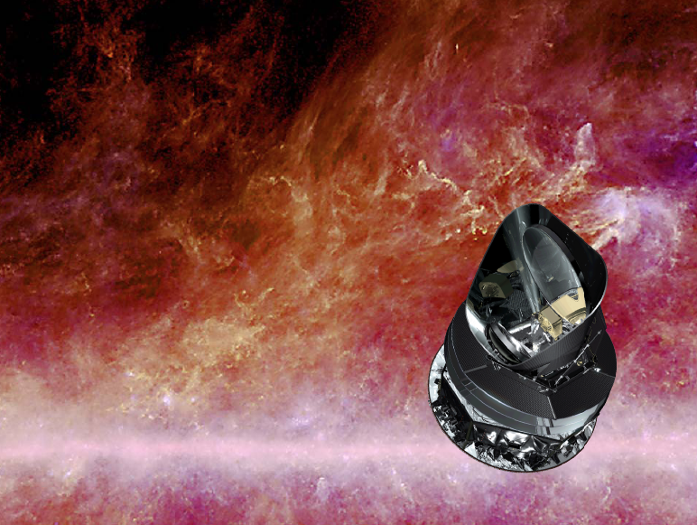
The Planck mission
Nazzareno Mandolesi
INAF/IASF Bologna
Planck LFI PI
On behalf of the Planck collaboration
http://www.esa.int/Planck
www.inaf.it
www.iasbfo.inaf.it
Discrete 2010 – Roma, 9 December 2010

Slide 2
The Standard Big Bang Model:
The Basic Framework
Isotropy
+
Homogeneity
Hubble
Expansion
Big Bang
Model
General
Relativity
CMB
Perfect Fluids
Made of several
Constituents
Nucleosynthesis
Large Scale Structure

Slide 3
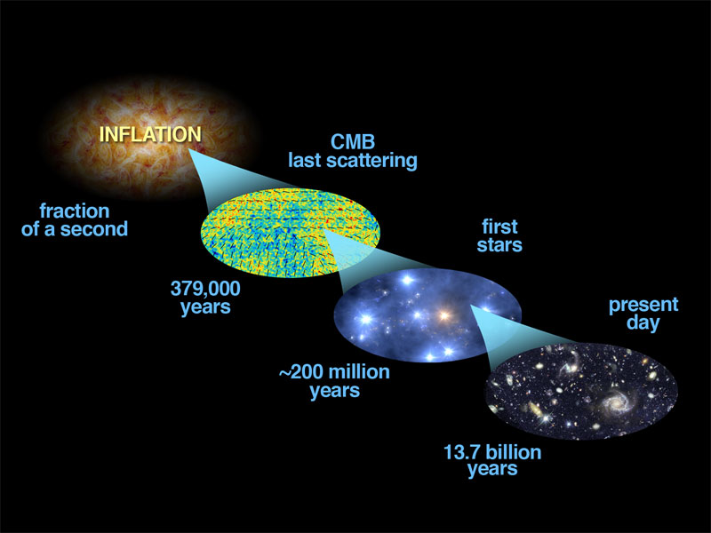
Fluctuation and GW generator
Fluctuation amplifier
But GW dissipator…
Hot Dense Smooth
Cool Rarefied Clumpy

Slide 4
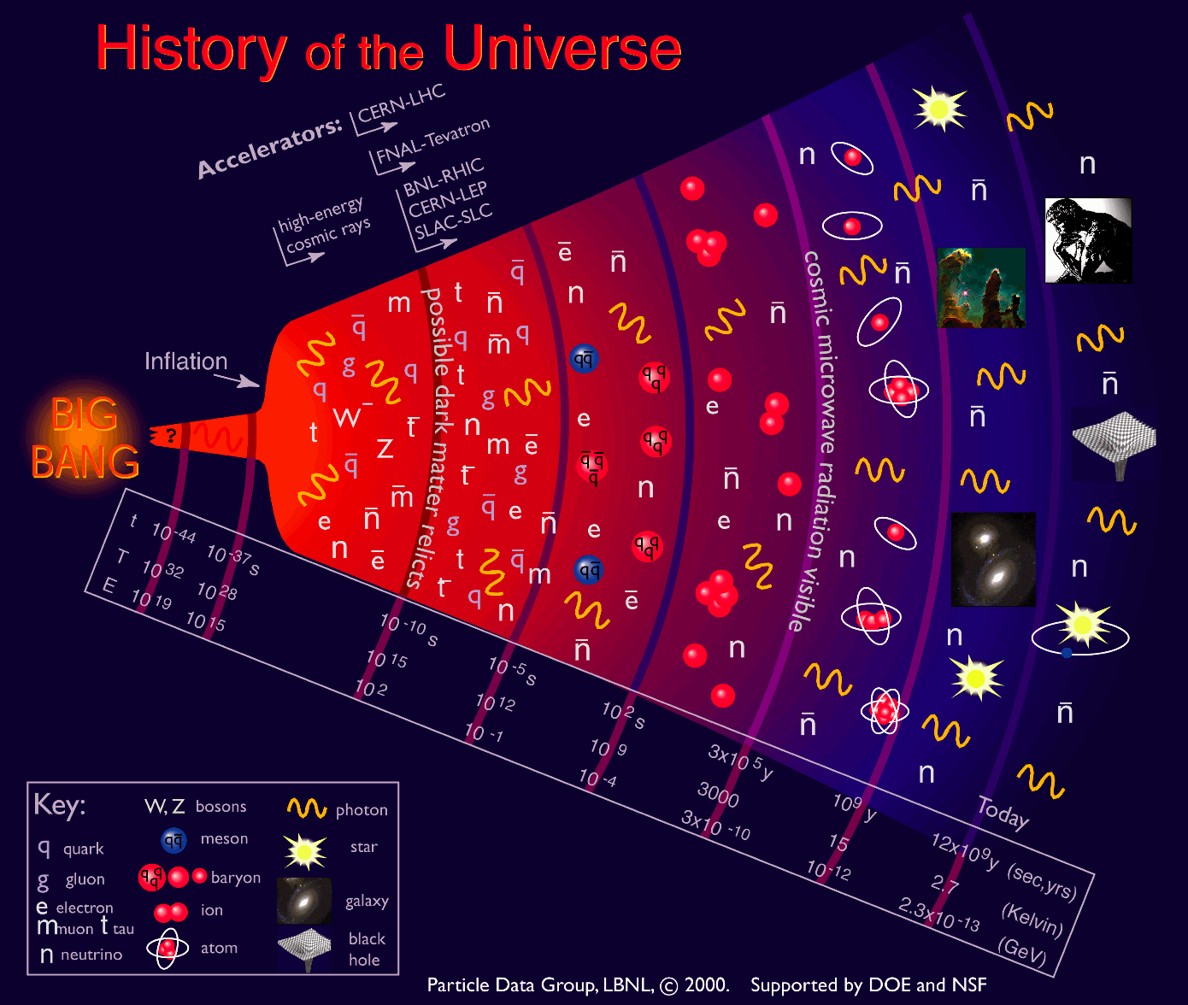
Accelerator
LHC
(pp)
Create particles & antiparticles that existed ~ 0.001 ns after Big Bang.
One
Force
Four
Forces
Particle physicists look at the properties of particles produced by accelerator.
Today
Astrophysicists look at the CMB, galaxies, etc. in the space.
4
Notes:
4

Slide 5
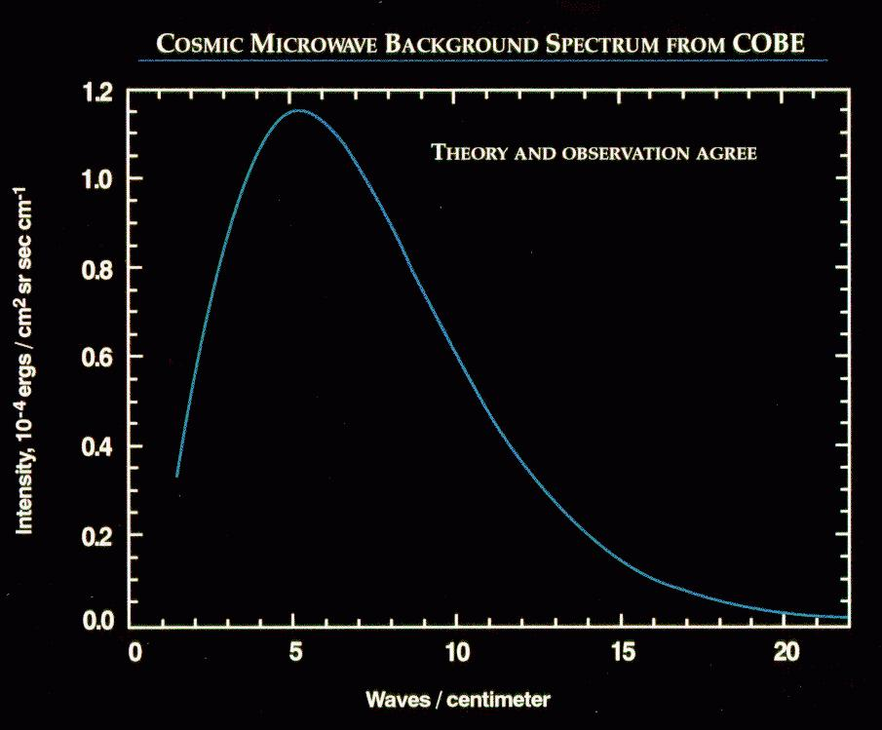
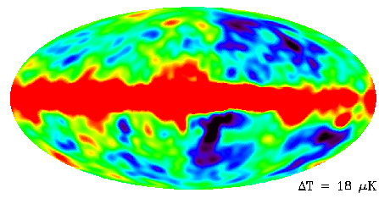
The Cosmic Microwave Background
Discovered 1965 (Penzias & Wilson)
  2.7 K blackbody
  Isotropic (<1%)
  Relic of hot “big bang”
1970’s and 1980’s
  3 mK dipole (local Doppler)
  δT/T < 10⁻⁵ on arcminute scales
COBE 1992
  Blackbody 2.728 K
  ℓ < 30 : δT/T ≈ 10⁻⁵

Slide 6
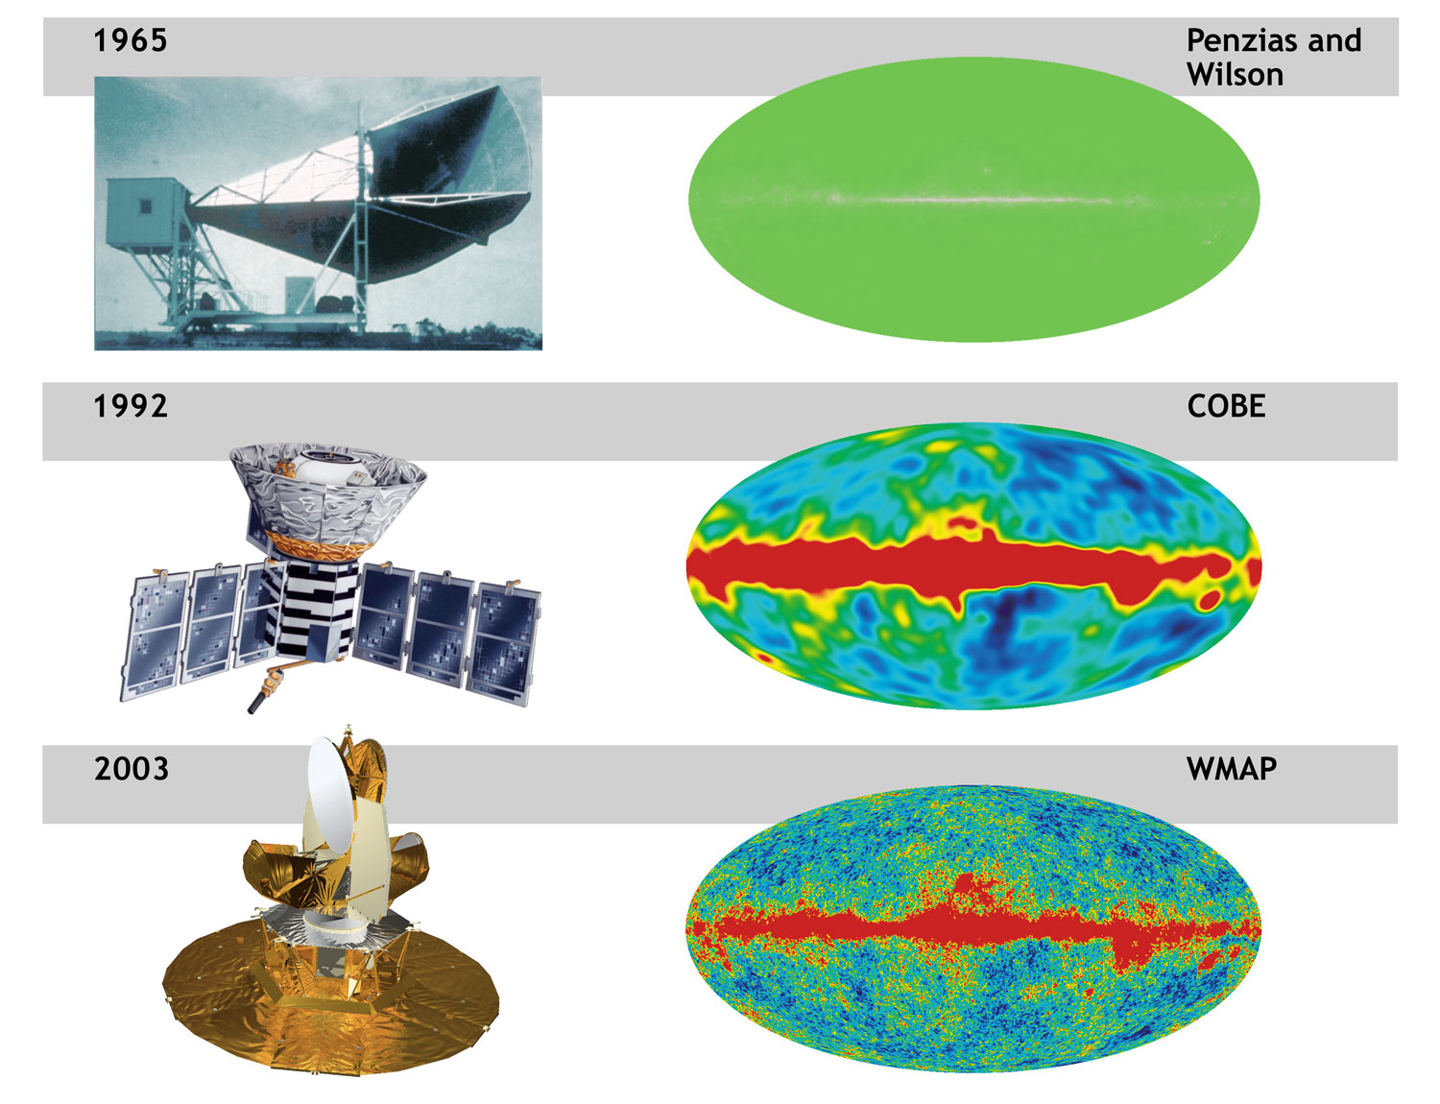
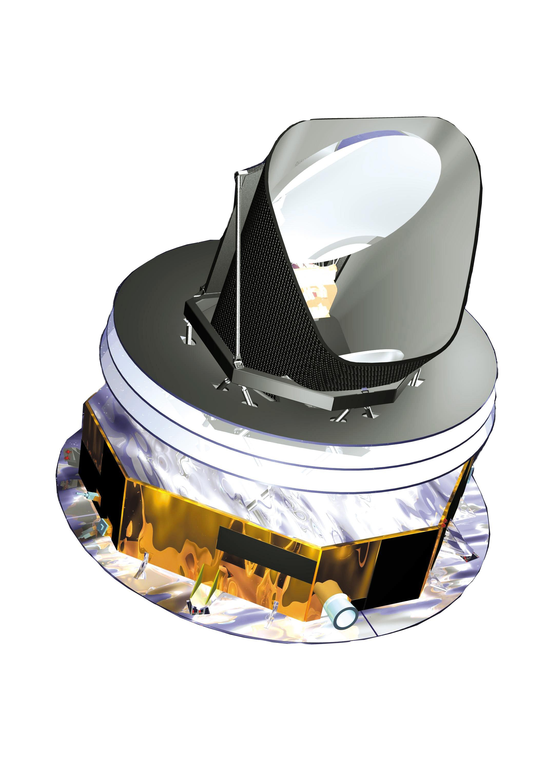
Cosmic Microwave Background Radiation Overview
The oldest light or the first light of the Universe
Discovered the remnant afterglow from the Big Bang. 2.7 K
Blackbody radiation, Discovered the patterns (anisotropy) in the afterglow. angular scale ~ 7° at a level ΔT/T of 10⁻⁵
(Wilkinson Microwave Anisotropy Probe): → angular scale ~ 15’
→ angular scale ~ 5’, ΔT/T ~ 2x10⁻⁶, 30~867 Hz
2009
Planck
Notes:
6

Slide 7
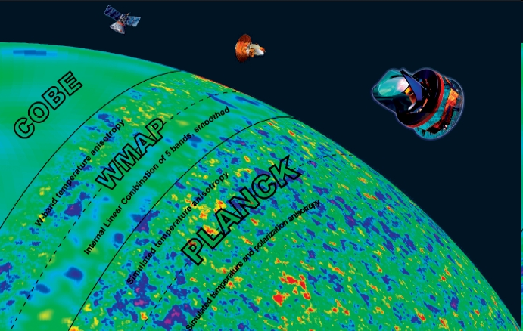

Slide 8
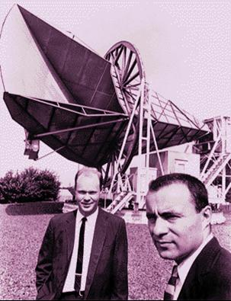
Arno Penzias & Robert Wilson
Nobel Prize in Physics, 1978
M. Maris - 09
Notes:
Scoperta della radiazione di fondo MICROONDE
4 GHz
2.7 K
Premio nobel 1978
Prova diretta del BB

Slide 9
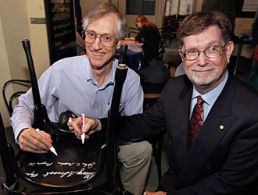
John Mather
George Smoot
Nobel Prize in Physics, 2006
M. Maris - 09

Slide 10
Planck
Planck is a project of the European Space Agency - ESA – with instruments provided by two scientific Consortia funded by ESA member states (in particular the lead countries: France and Italy) with contributions from NASA (USA), and telescope reflectors provided in collaboration between ESA and a scientific Consortium led and funded by Denmark
This talk is supported also by information provided by LFI, HFI and ESA

Slide 11
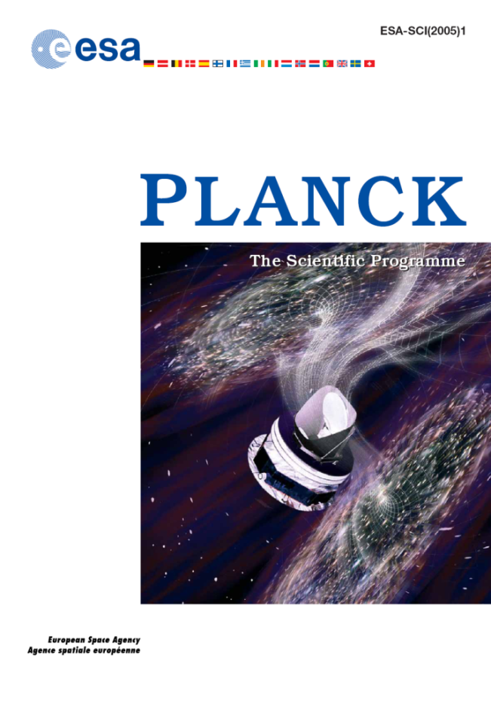
Science with the Cosmic Microwave Background
Determining cosmological parameters to high accuracy:
  Geometry, Contents, Dynamics of Universe
  Epoch of reionisation: birth of the first stars
  Constraining dark energy, neutrino mass, …
Testing inflation:
  Constraining the inflaton potential
  Finding signatures of primordial gravitational waves
Finding primordial non-Gaussianity in primordial perturbations:
  Testing different inflationary scenario
Evolution of structure and nature of dark matter
Testing fundamental symmetries: P, CPT
Astrophysics (Galactic & Extragalactic)
http://www.rssd.esa.int/Planck

Slide 12
Planck: the 3rd generation space CMB experiment
Planck gains a factor 3 in angular resolution and up to10 in instantaneous sensitivity with respect to WMAP
LFI uses coherent detection and HEMTS based amplifiers in 3 bands 30 to 70 GHz, photometric reference loads on the 4K box of the HFI FPU. LFI is cooled at 18 K, reads in total power (22 polarized channels, 44 total power signals). Small 1/f noise.
HFI bolometers are cooled to 100 mK, 6 bands 100 to 857 GHz, read in total power mode with a white noise from 10 mHz to 100 Hz (no 1/f noise in the signal range), nearly photon noise limited in the CMB channels (100-200 GHz)
Intensity power spectrum sensitivity is limited by the ability to remove foregrounds (supported by the broad frequency coverage: 30 GHz-1 THz)

Slide 13
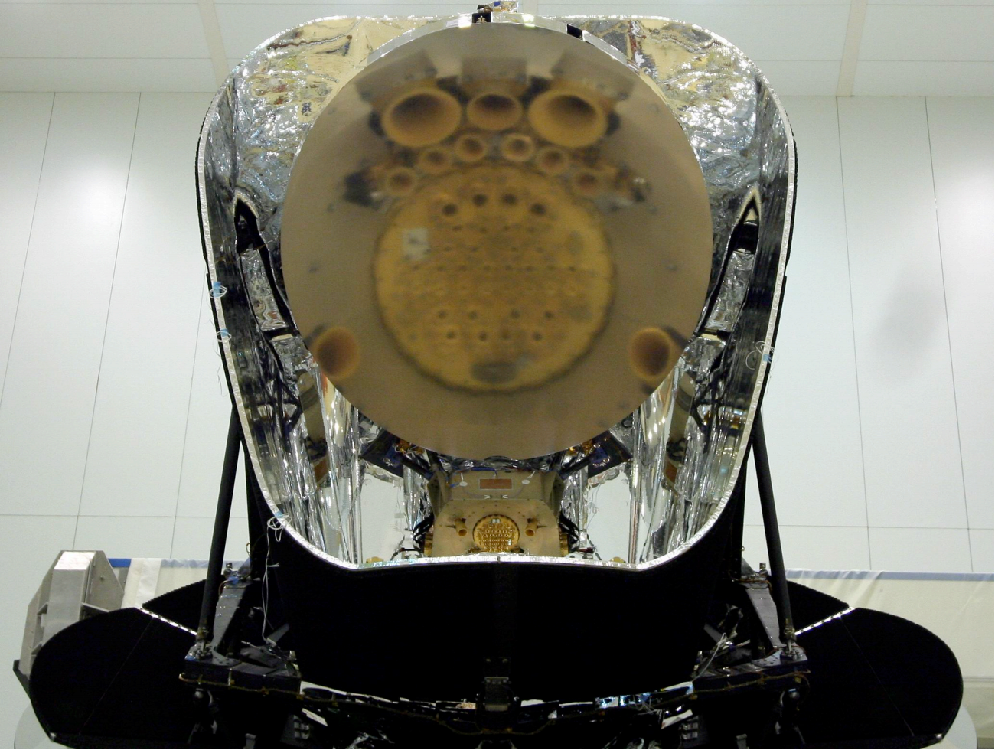

Slide 14
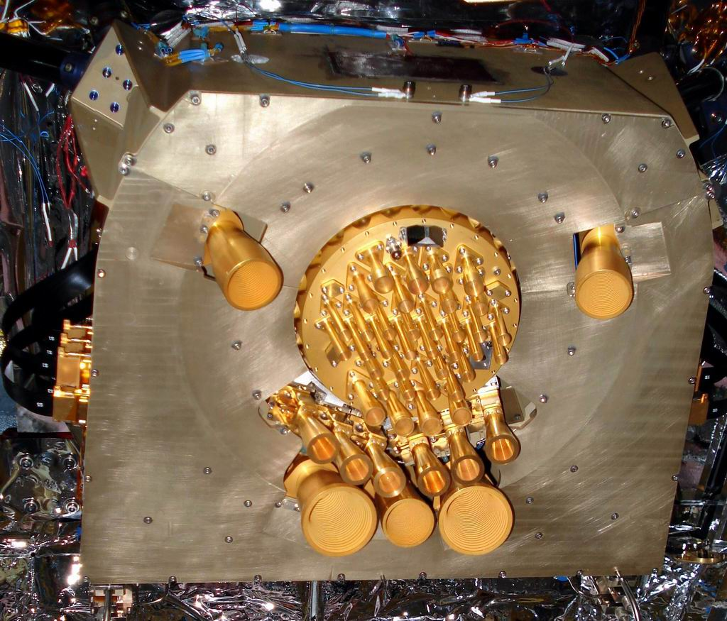

Slide 15
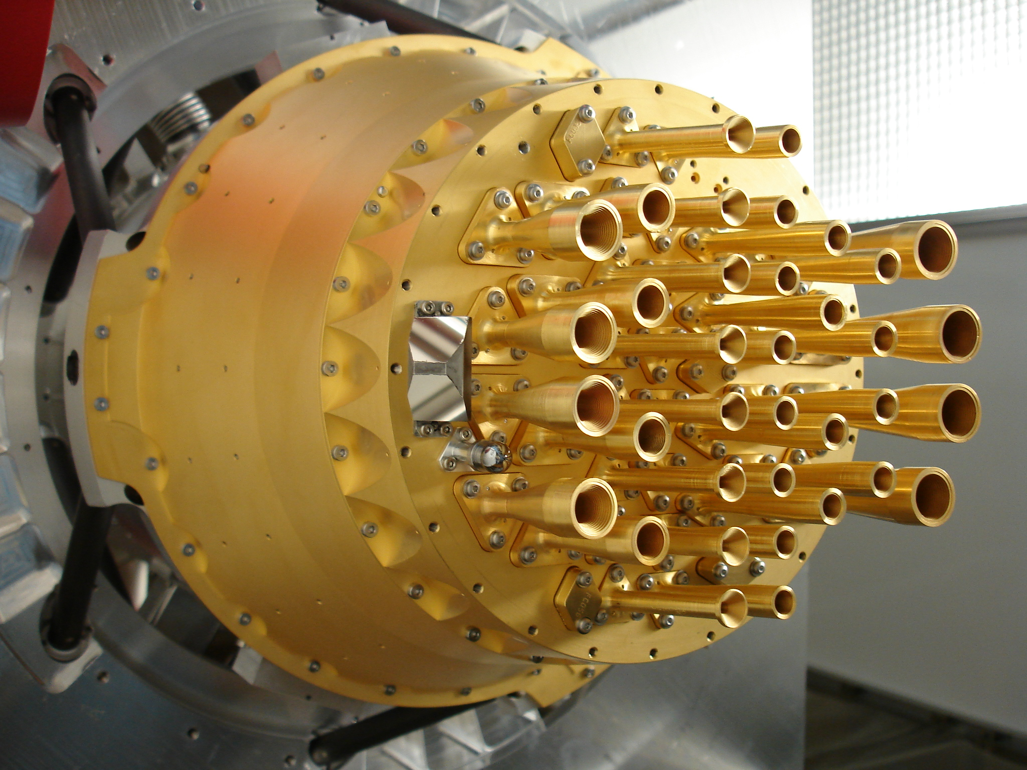

Slide 16
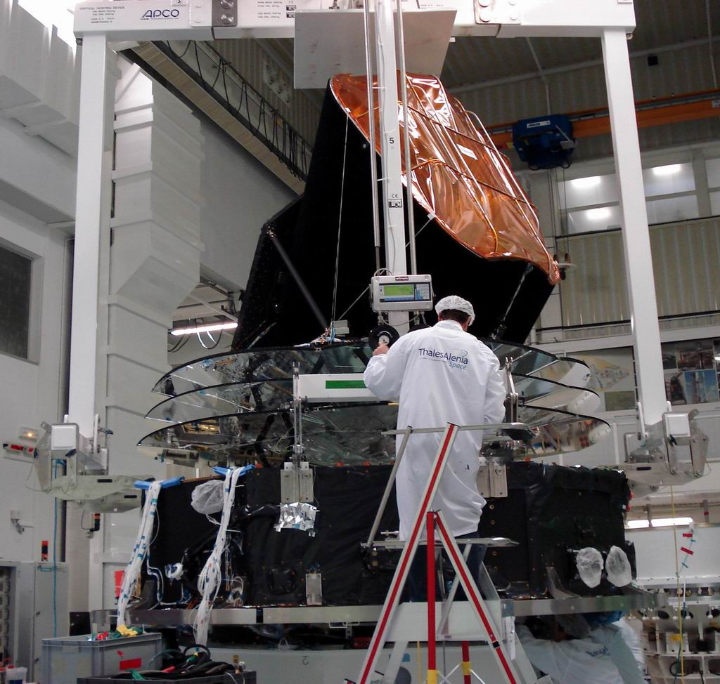

Slide 17
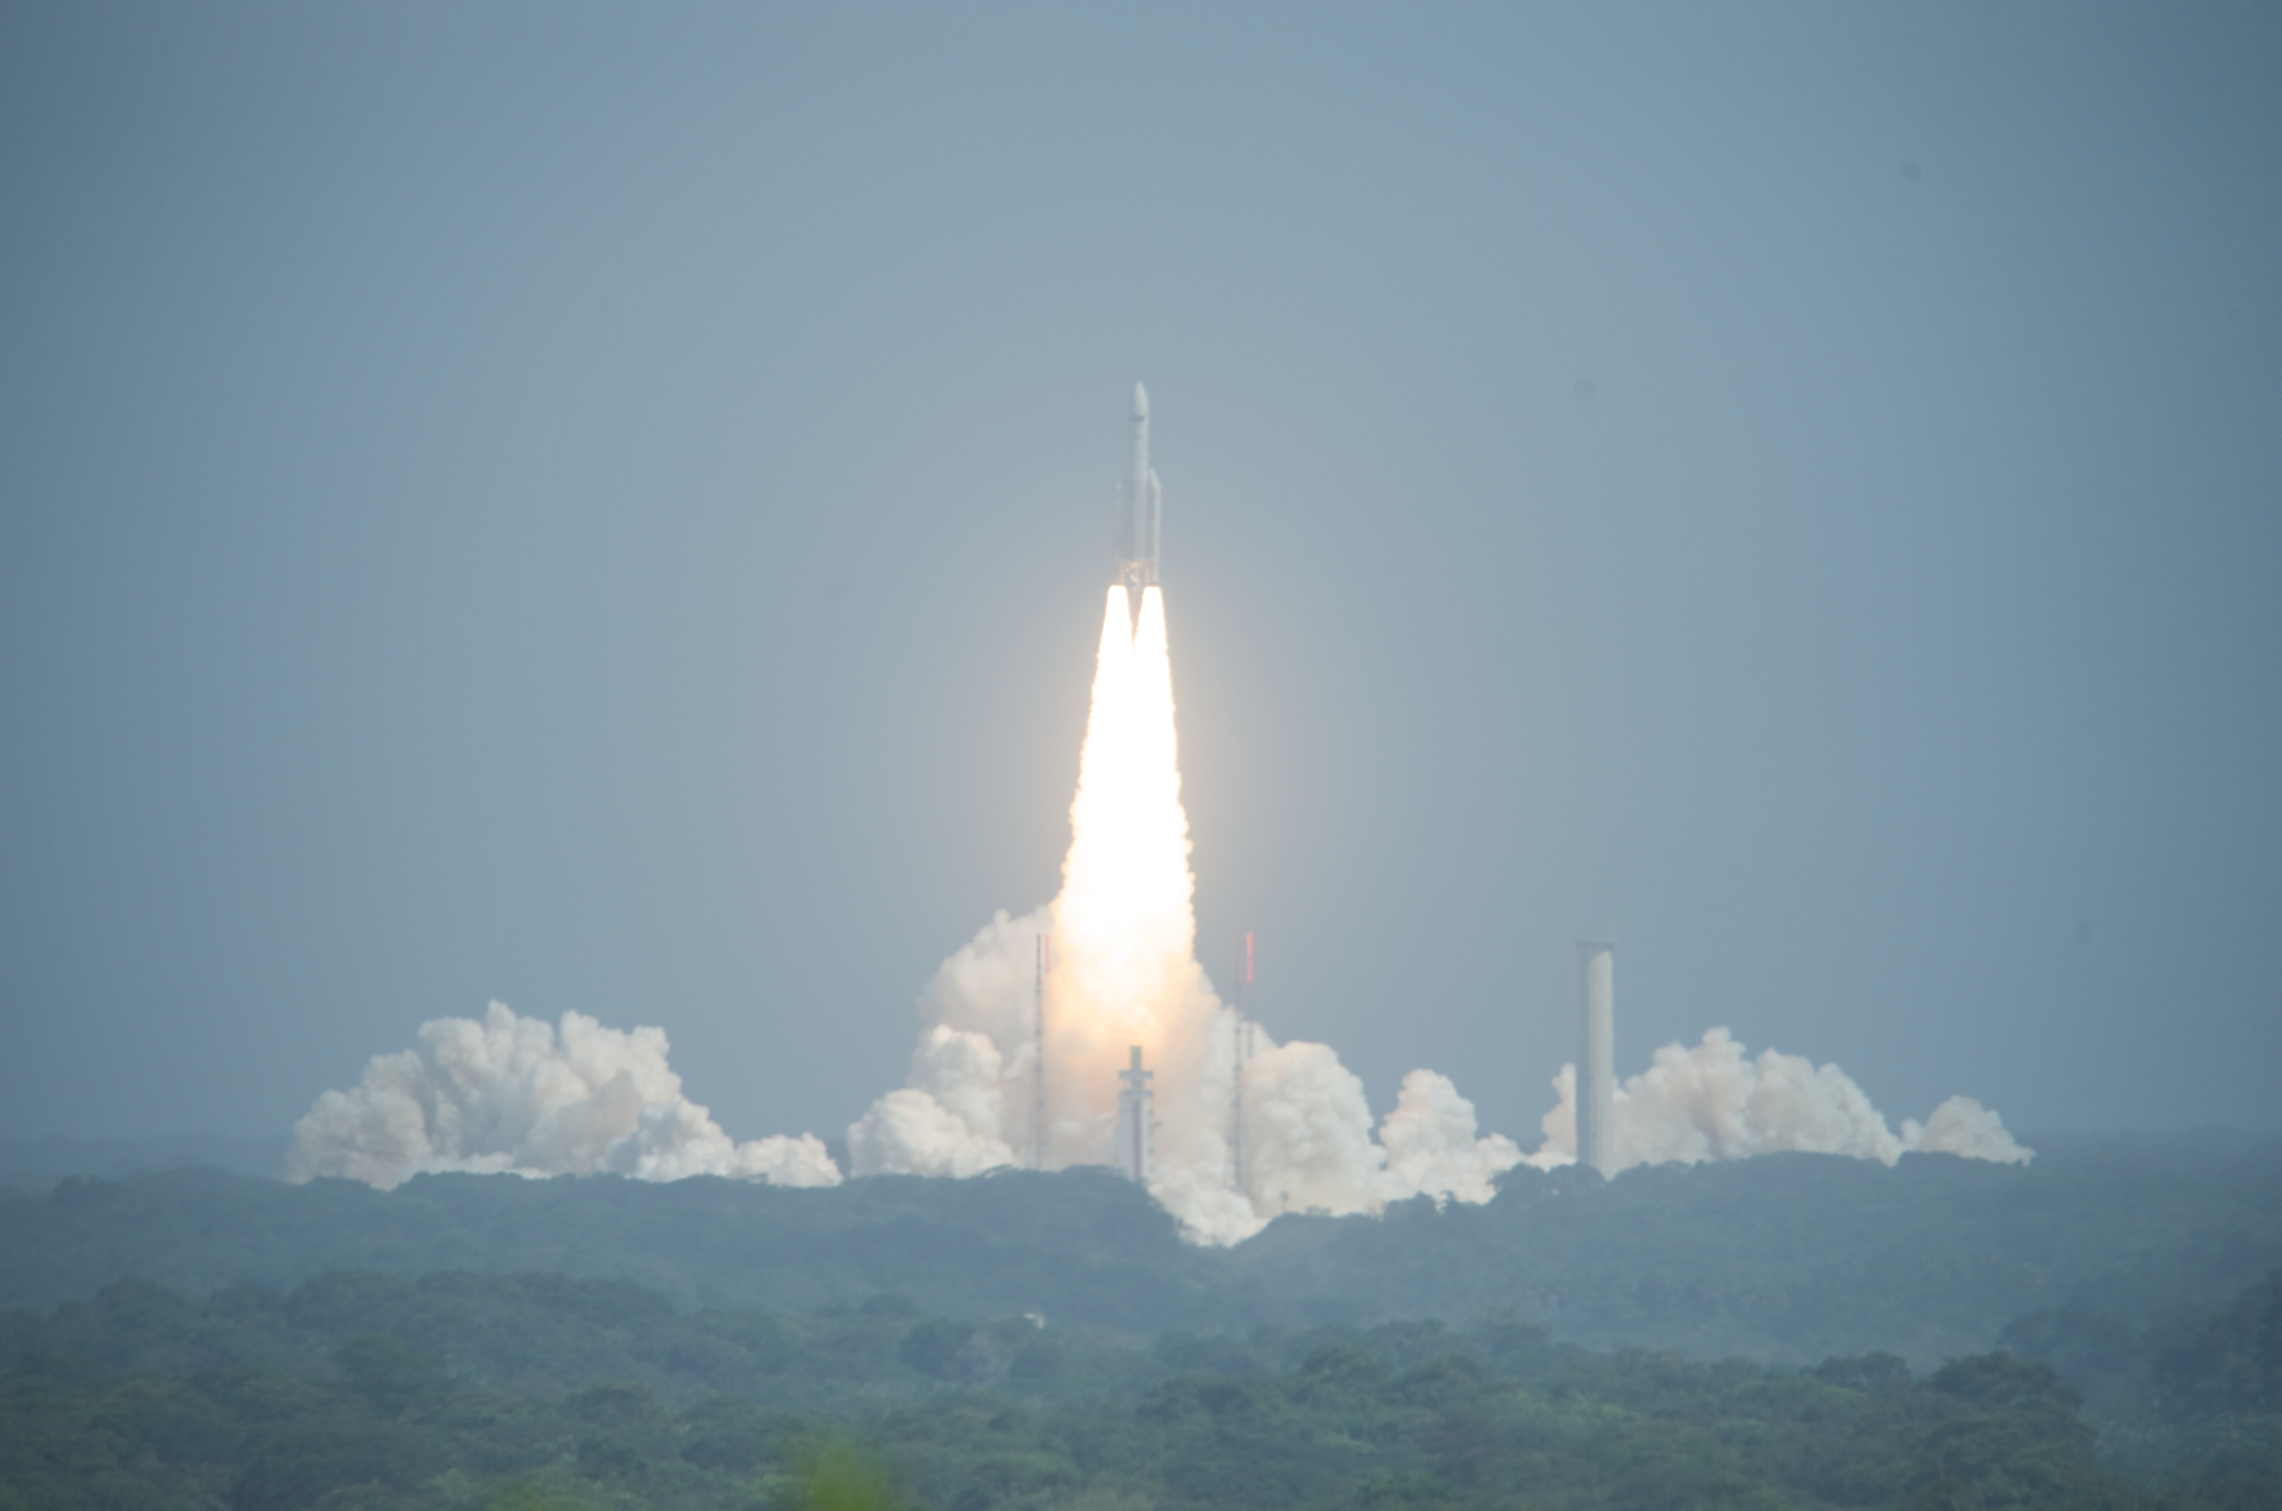

Slide 18
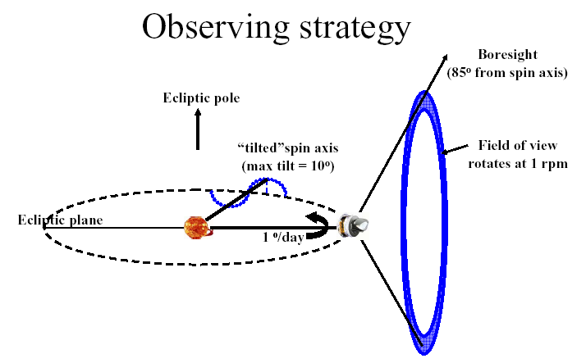

Slide 19
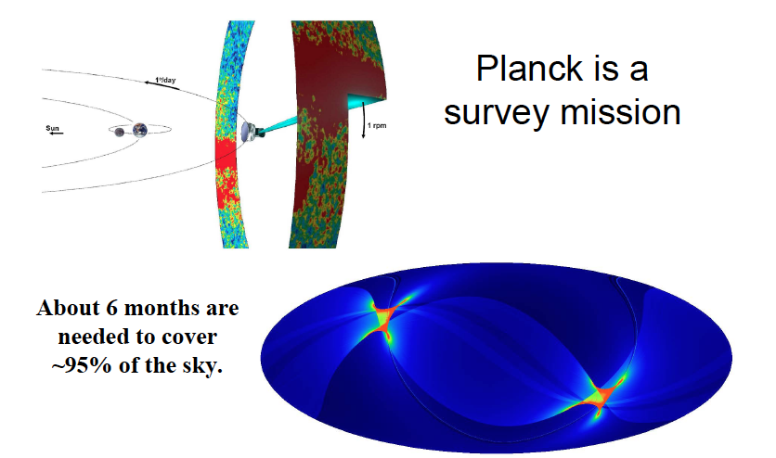

Slide 20
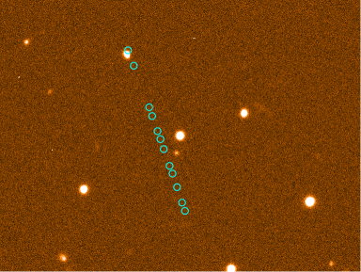
Planck visto dal telescopio 2.2 m ESO - Cile

Slide 21
Current Status
574 days since launch.
Satellite and instruments working nominally and continuously since start of sky surveys (mid August 2009)
Sky coverage is 100%
  All the sky has been surveyed more than twice.
  The currently approved mission operation (to end Nov 2011) will do over > four sky surveys, until the end of the cold phase (end January 2012) with two instruments: HFI + LFI
  A further 12 months extension has been approved with LFI only

Slide 22
Key Dates
ERCSC: “Early Release Compact Source Catalogue” - 11th January 2011 (catalogue of more than 10,000 sources at 30,44,70,100,143,217,353,857 GHz)
27 Early Astrophysical papers release – 11th January 2011
"The millimeter and submillimeter sky in the Planck mission era” Paris, Cité des Sciences-10-14 January 2011
Early 2012 – More results & papers in Component Separation (Conference in Bologna)

Slide 23
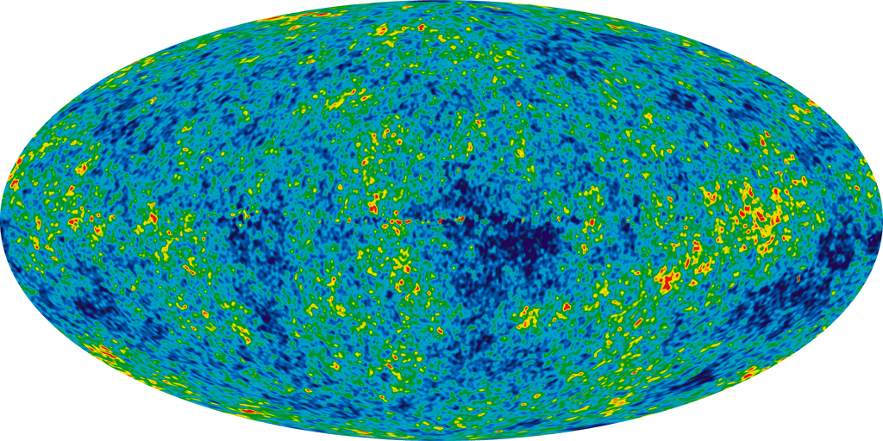
WMAP 7 CMB map
Courtesy WMAP Science Team

Slide 24
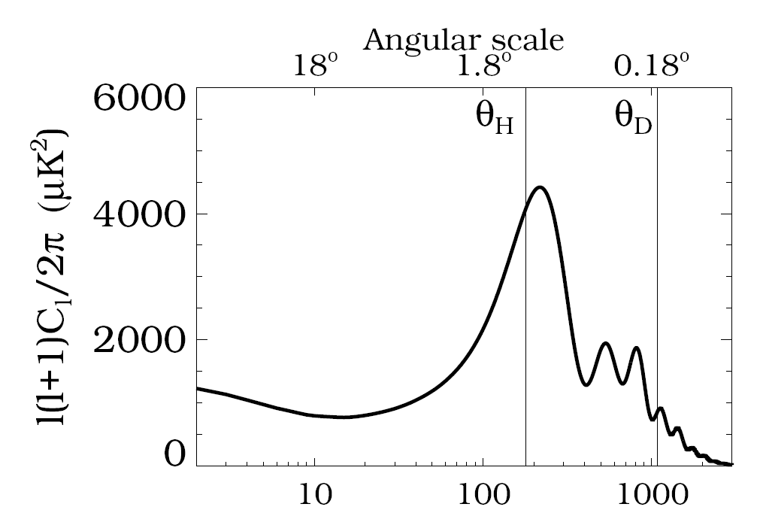

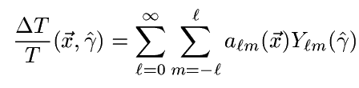
Typical model prediction for CMB anisotropy APS
Pre recombination (acoustic) oscillations of photon-baryon fluid
SW plateau: l(l+1)Cl ~ cost
Photon diffusion damping

Slide 25
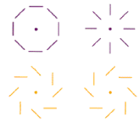
CMB Polarization
Linear Polarization is described by Stokes-Q and -U
These are coordinate dependent
The two dimensional field is described by a gradient of a scalar (E) or curl of a pseudo-scalar (B).
Scalar perturbations: energy density perturbations in the plasma
Tensor perturbatons: Gravity waves stretch and squeeze space
in orthogonal directions and stretch wavelength
Gravity waves coming from inflation would produce tensor perturbations
Grad (or E) modes
due to scalar and tensor perturbations
Curl (or B) modes
due to tensor perturbations
(density fluctuations have no handedness, so no contribution to B-modes).
B-Modes=Gravity Waves !!

Slide 26
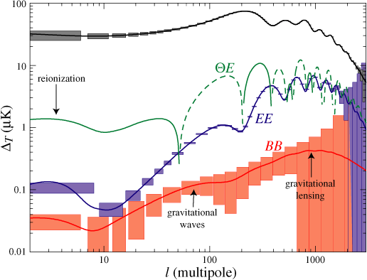
Planck: Predicted Power Spectrum
Planck “error boxes”
Note: polarization peaks out of phase w.r.t. intensity peaks due to flow velocities at z =1100
Goal for Beyond Einstein “Inflation Probe” – depends on energy scale of inflation
Predicted from large-scale structure
Hu & Dodelson ARAA 2002

Slide 27
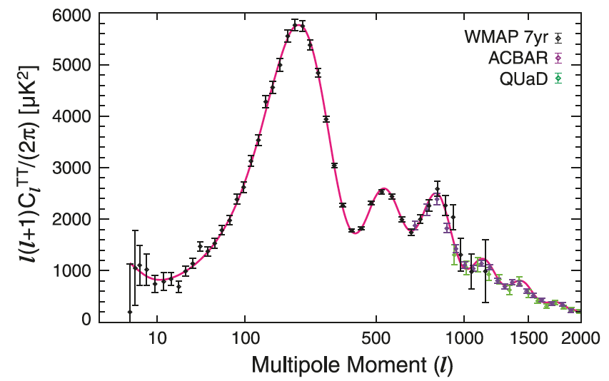
CMB Angular Power Spectrum
Courtesy WMAP Science Team
WMAP+ 7yr TT power spectrum (Komatsu et al. 2010)

Slide 28
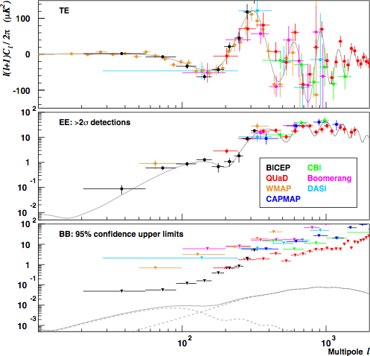
Current Status - 6/2009

Slide 29
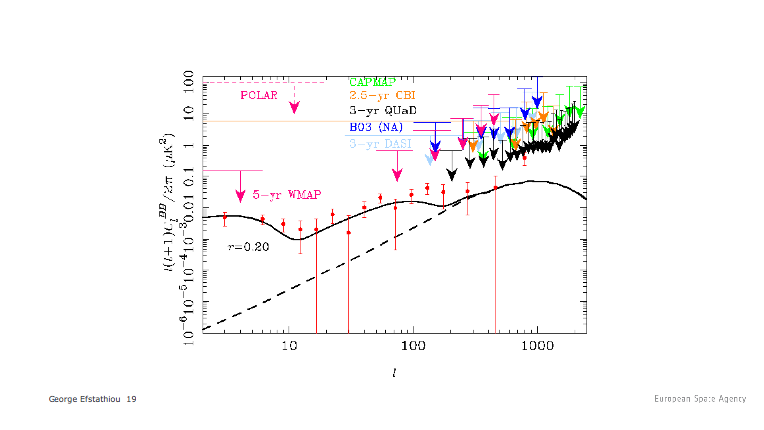
B-modes: present limits
Present best direct upper limit is 0.3 one sigma (Bicep: Chiang et al 2009)

Slide 30
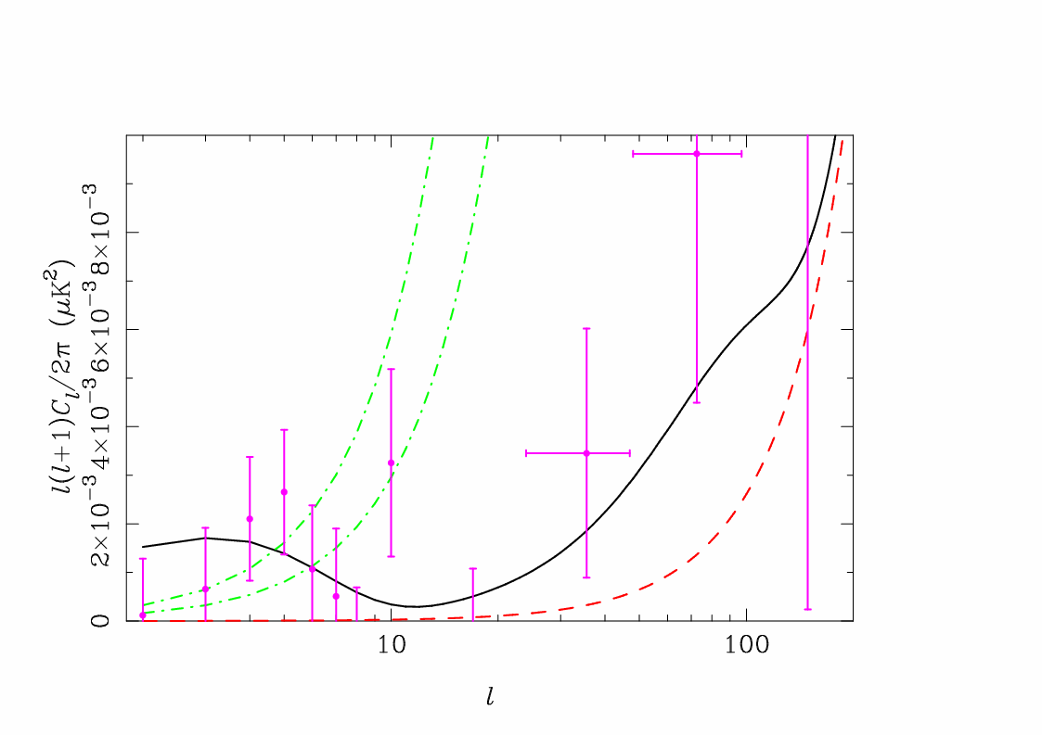
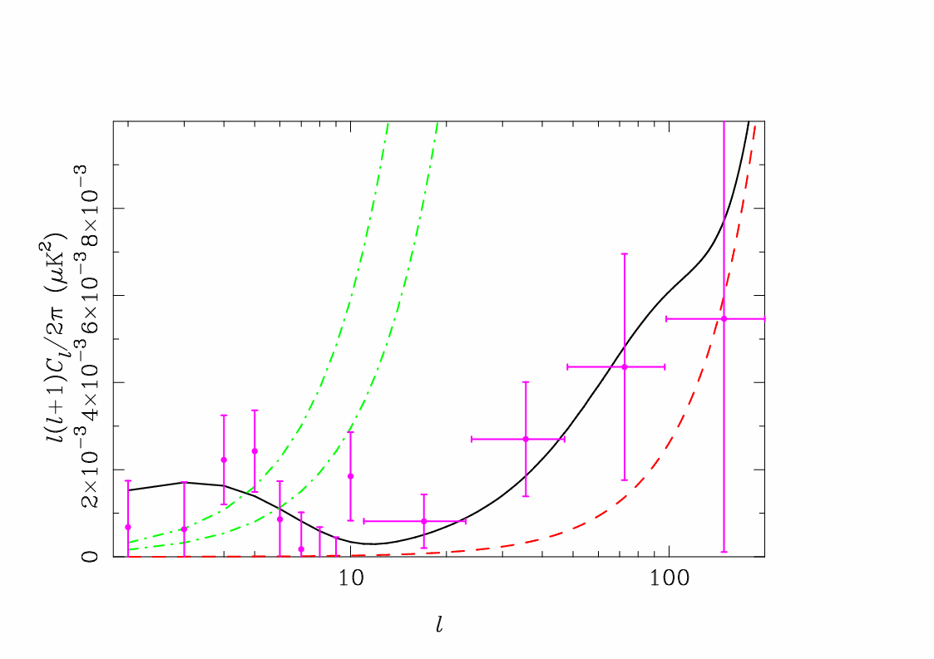
B-mode detectability
2 surveys
4 surveys
Noise spectra
CMB B-mode
Lensing spectrum
Efstathiou & Gratton 2009
B-modes are a signature of primordial gravitational waves
They point directly to inflation
With the sensitivity and control of systematics provided by 4 surveys, Planck will approach the limit of r~0.05

Slide 31
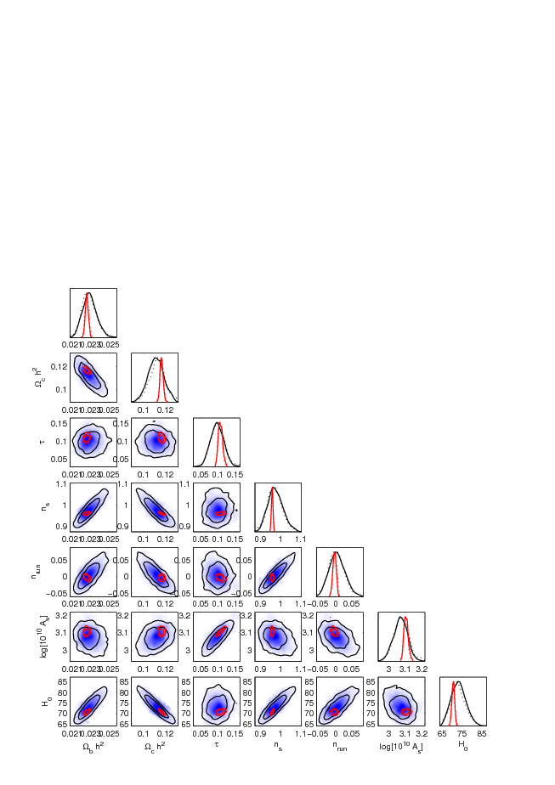
Blue: Today’s data
Red: Planck

Slide 32
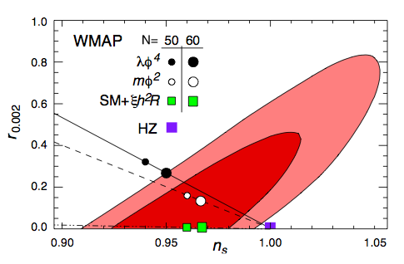
Planck and Higgs particle
Bezrukov e Shaposhnikov, 2007: if gravity and the Higgs boson are non minimally coupled, then the inflaton and the Higgs can be unified
In this theory the inflaton and the Higgs (which “gives” mass to elementary particles) are the dinamical evolution of a single field
Bezrukov e Shaposhnikov, 2007
CMB observations constrain inflationary parameters and for this theory thus also the Higgs mass!!!
Tevatron (FermiLab): 162 GeV > M_{Higg}> 166 GeV - LEP (CERN): M_{Higgs} > 115 GeV
LHC (CERN) will search for a Higgs boson up to about 250 GeV.
WMAP 5 years+ BAO + SNI => 139 < M_{Higgs}/GeV <161 [Popa, 2009]
PLANCK will go to 1% precision and together with LHC will be able to verify this theory!

Slide 33









Testing parity (P) symmetry through CMB anisotropies
spherical harmonics expansion for T anisotropies
behavior of T spherical harmonics coeff. under parity symmetry (i.e. even multipoles are invariant under parity whereas odd multipoles acquire a “-1”)
therefore it is possible to divide each T map in two subsets corresponding to even and odd multipoles, satisfying two different transformation under P symmetry. Considering the angular power spectrum contained in the two subsets it is possible to study the consistency with P symmetry
spherical harmonics expansion for Pol anisotropies
this means that the cross-correlations <T B> and <E B> have to be null to be consistent with Parity symm!
N. Mandolesi – Discrete 2010 -- 9 December 2010

Slide 34




Parity Estimators
For X = TT, TE, EE and BB:
(Kim & Naselsky, 2010)
For X = TB and EB:
these estimators, including a MC of 10000 realizations with realistic noise (both for WMAP 7 and Planck) have been computed at large angular scale considering an optimal APS estimator
(Gruppuso et al., MNRAS, 2010)
N. Mandolesi – Discrete 2010 -- 9 December 2010

Slide 35
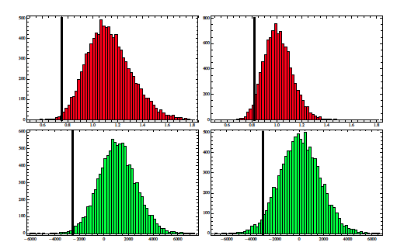
TT results (WMAP 7)
R
D
N. Mandolesi – Discrete 2010 -- 9 December 2010

Slide 36
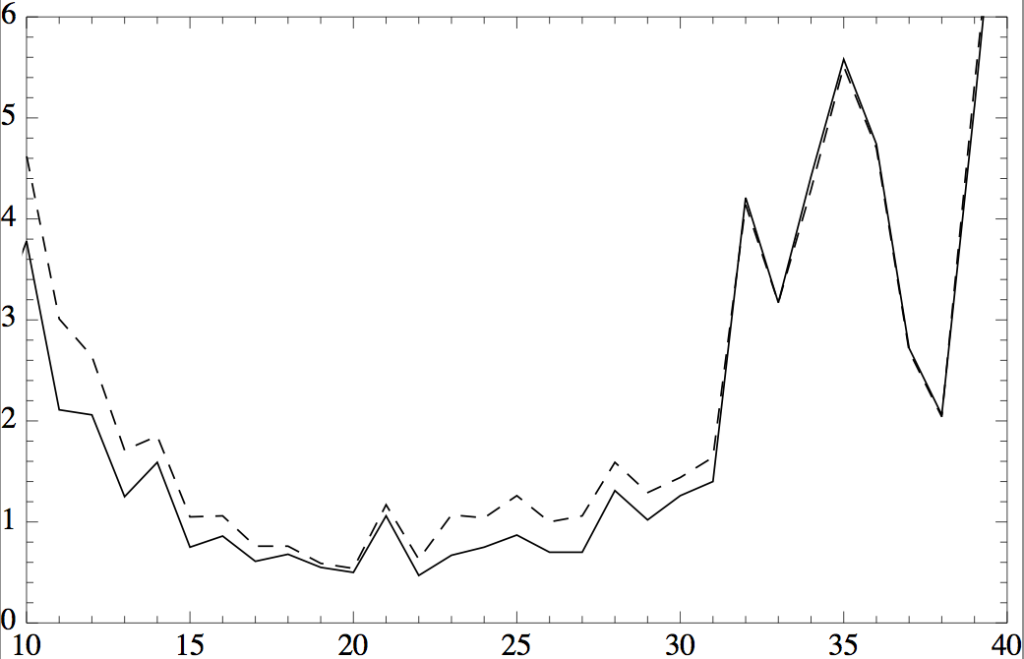
ell_max dependence
solid line: R estimator
dashed line: D estimator
%
ell_max
this plot suggests the existence of a characteristic scale lying in the range between 15 and 24 for which the estimators might be considered “anomalous” (<1%).
N. Mandolesi – Discrete 2010 -- 9 December 2010

Slide 37
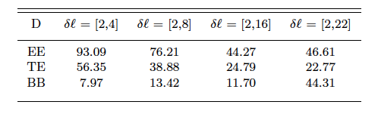
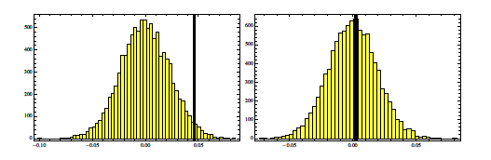
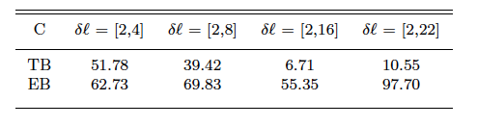
WMAP Polarization results
EB
No anomalies have been detected, WMAP noise level too high for studying Parity through polarization. We have to wait for Planck
N. Mandolesi – Discrete 2010 -- 9 December 2010

Slide 38
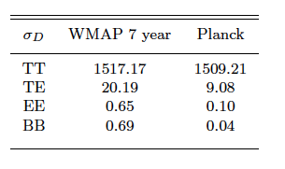
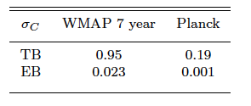
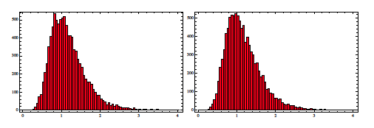
Planck forecasts
(143 GHz channel)
Standard deviations for D
Planck is much more sensitive to polarization estimators
Standard deviations for C
R on EE
N. Mandolesi – Discrete 2010 -- 9 December 2010

Slide 39
Conclusions on Parity analysis
TT anomaly detected @ large angular scale with a confidence level of 99.5%.
matter of taste if such percentage is to be considered anomalous
It is still unknown whether such a result comes from fundamental physics or if it is due to some not perfectly removed astrophysical foreground or systematic effect
Polarization analysis does not show any deviation from Parity symmetry but:
This might be due to the large WMAP 7 noise level that make the signal sinking
If ell_max is too large the considered estimators are testing the Parity of the WMAP noise
Planck data are awaited with great interest in this respect because:
Planck is observing the sky with a totally different scanning strategy wrt WMAP (benefit from the point of view of systematic effects analysis)
Confirm TT anomaly and extend the Polarization analysis
N. Mandolesi – Discrete 2010 -- 9 December 2010

Slide 40
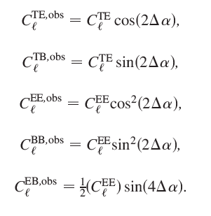
Testing CPT Symmetry
if terms like Chern-Simons have to be added to the standard electrodynamic Lagrangian, than Lorentz, P and CPT symmetries will be violated. This will induce a rotation of the polarization direction of each photon as it propagates from the LSS to us. This effect is called “Cosmic Birefringence”
alpha = Birefringence angle
from these equations it is possible to build estimators for alpha (as long as it is zero these violating terms are excluded)
N. Mandolesi – Discrete 2010 -- 9 December 2010

Slide 41

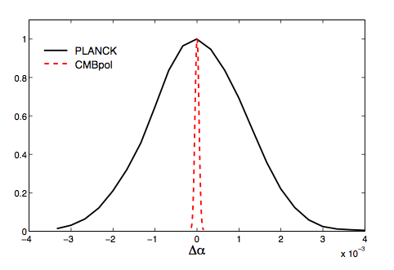

Current constraints
WMAP 7 (Komatsu et al. 2010, in press in ApJS)
QUAD (Wu et al. 2010, PRL)
Planck and CMBPol forecast
Xia et al. (2009), IJMPD
Planck
CMBPol
N. Mandolesi – Discrete 2010 -- 9 December 2010

Slide 42
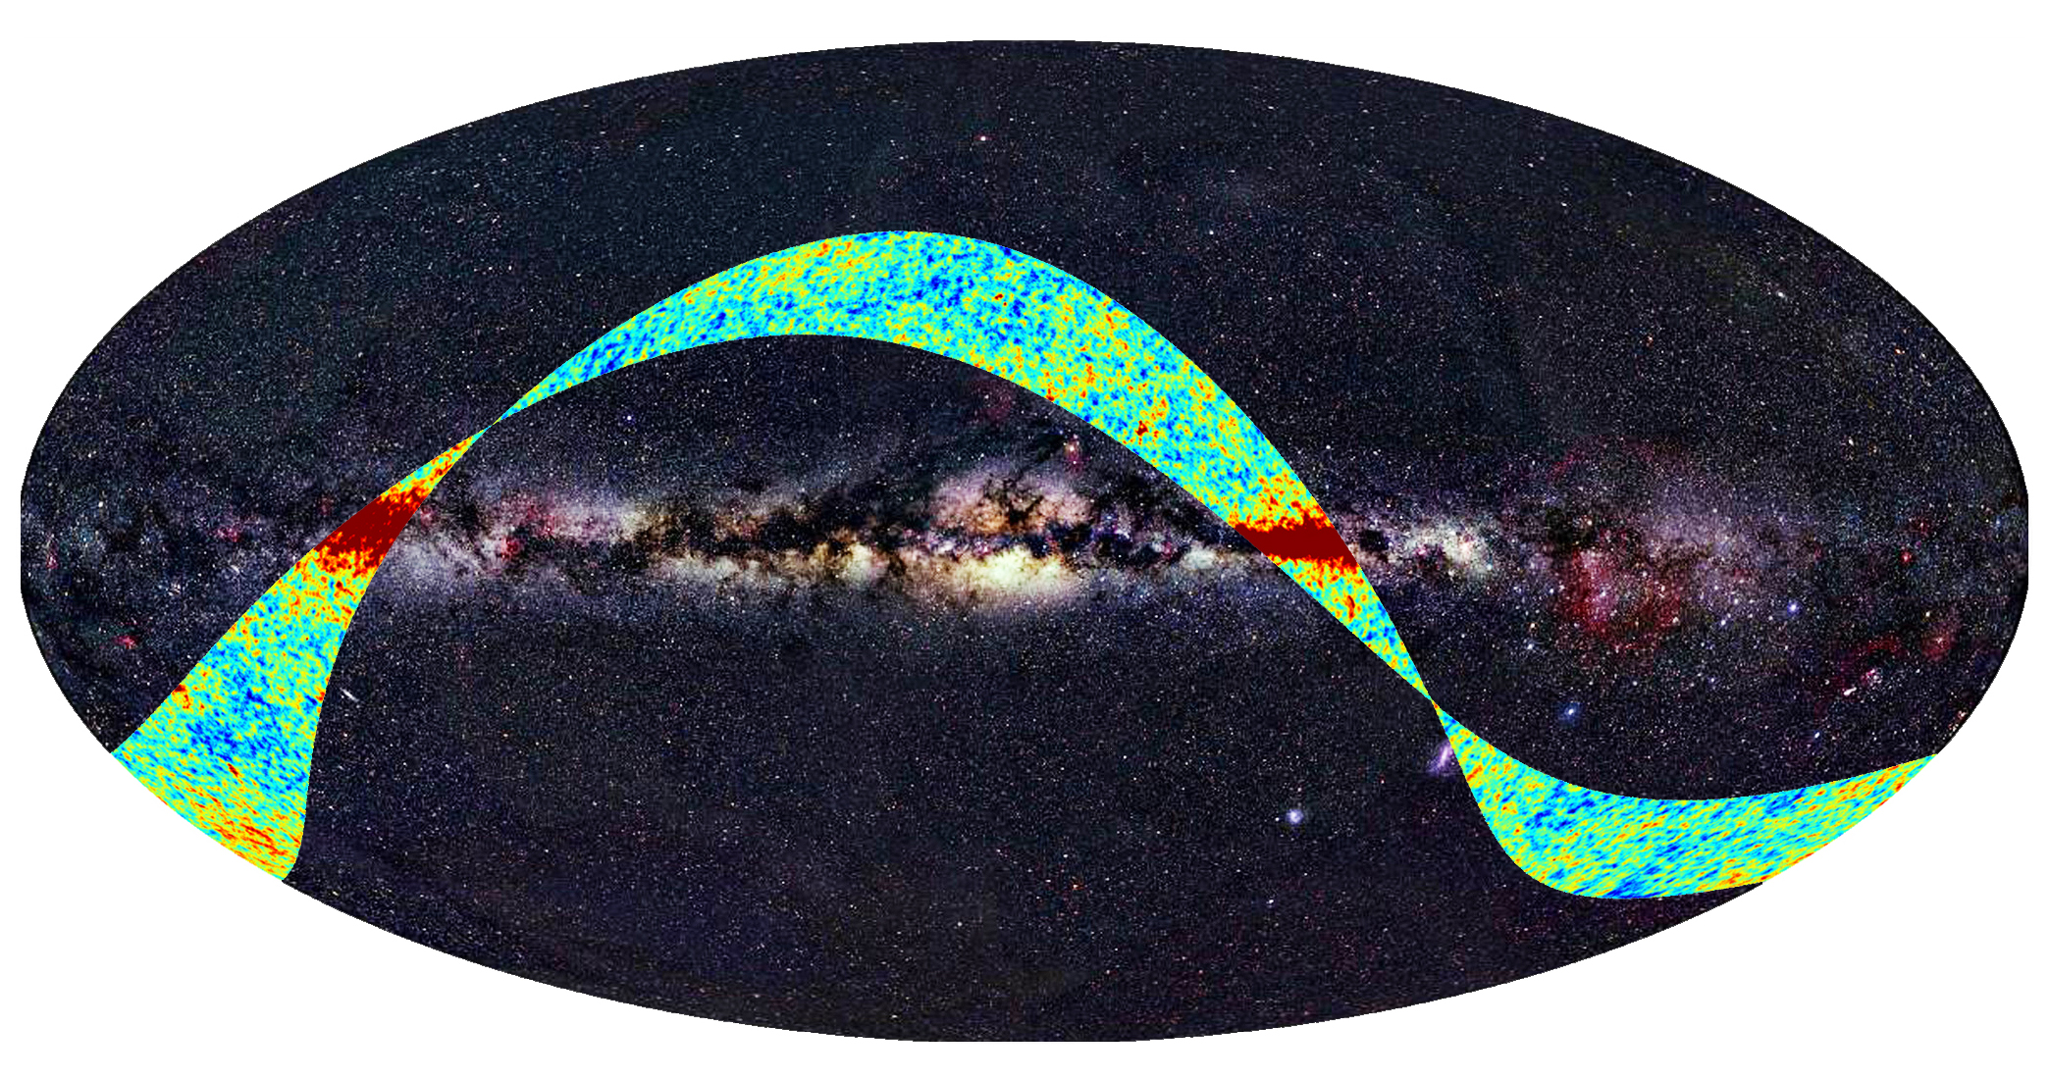
~ 7.5 % of the sky observed during the First Light Survey!
Credit: ESA

Slide 43
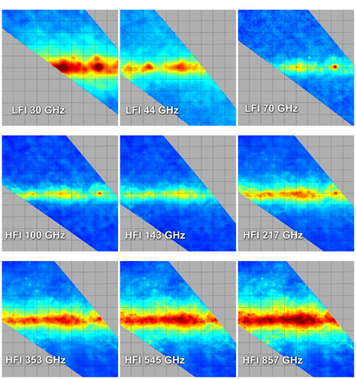
Credit: ESA

Slide 44
~ 7.5 % of the sky observed during the First Light Survey!
Credit: ESA

Slide 45
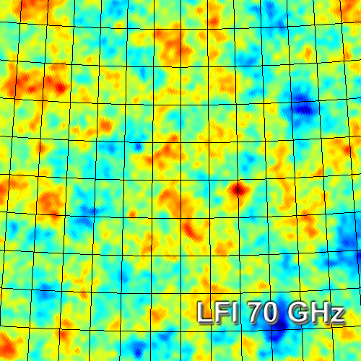
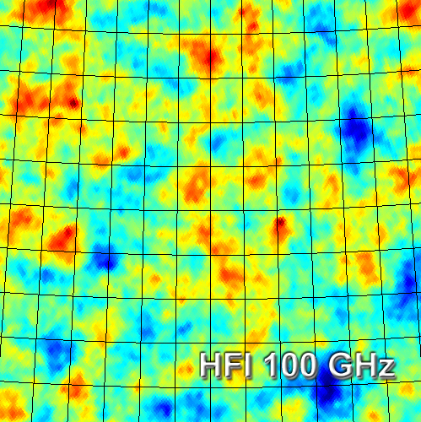

Slide 46
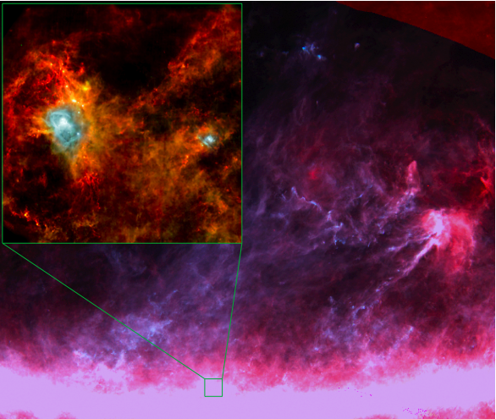
Cold dust in our Galaxy observed by
Planck and Herschel

Slide 47
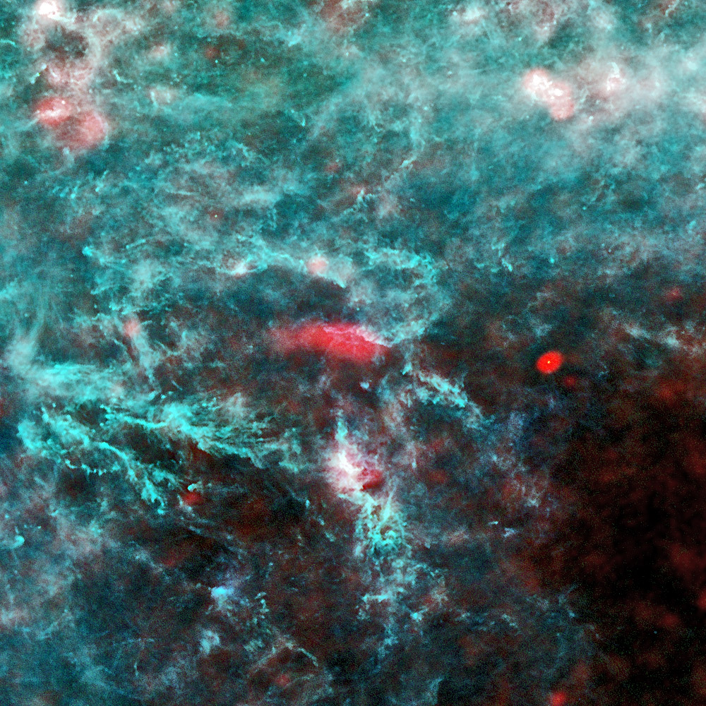
Perseus at 30, 353 & 857 GHz

Slide 48
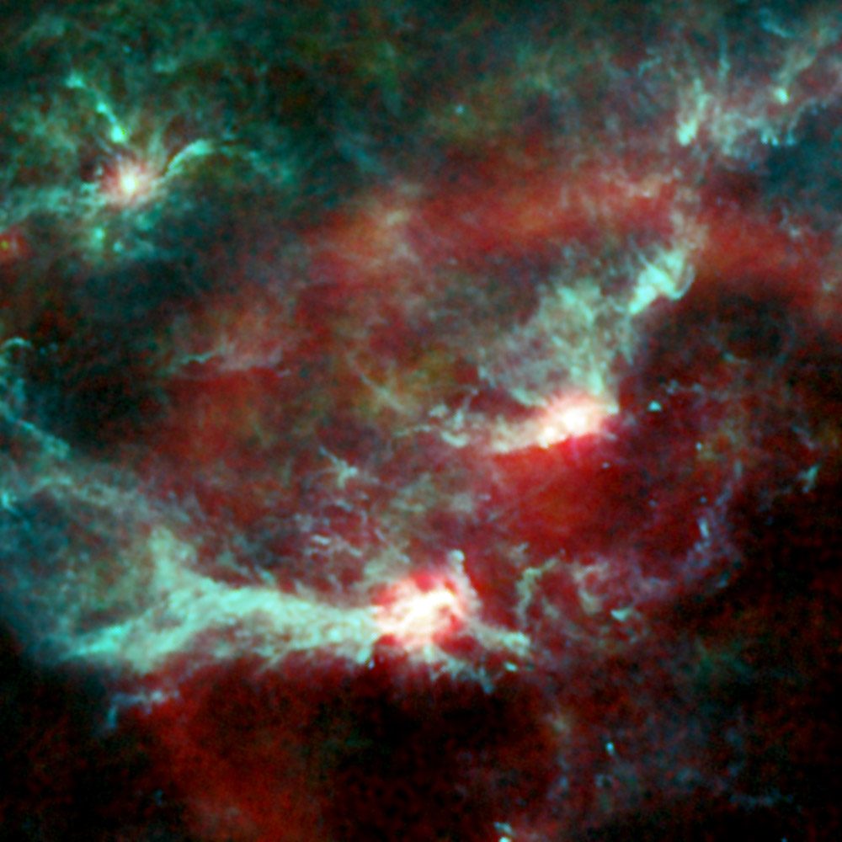
Orion at 30, 353 e 857 GHz

Slide 49
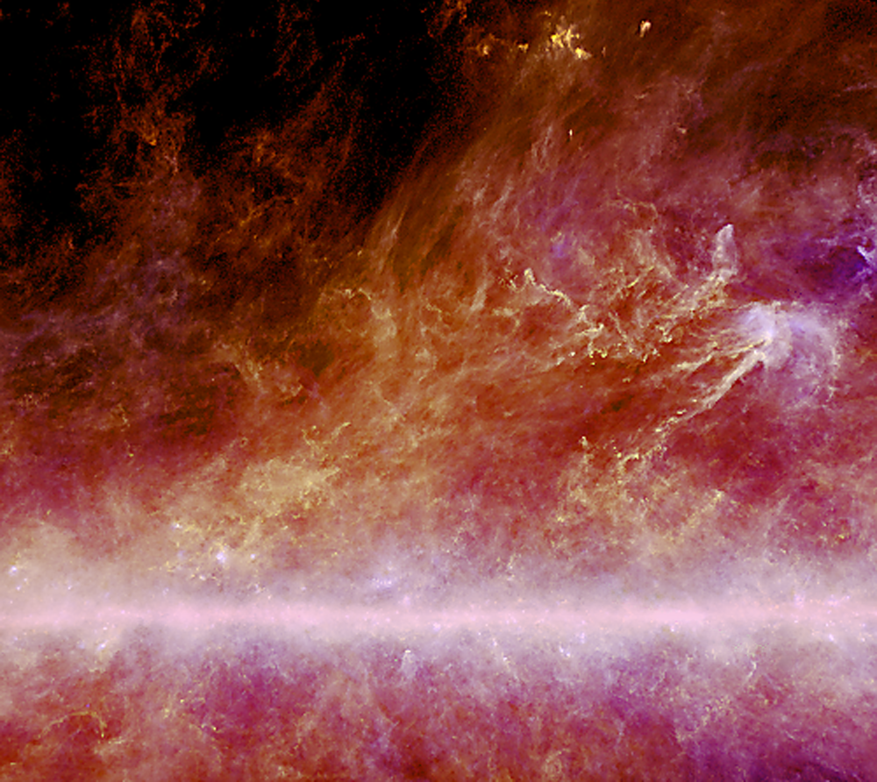
Dust structures at 500 l.y.

Slide 50
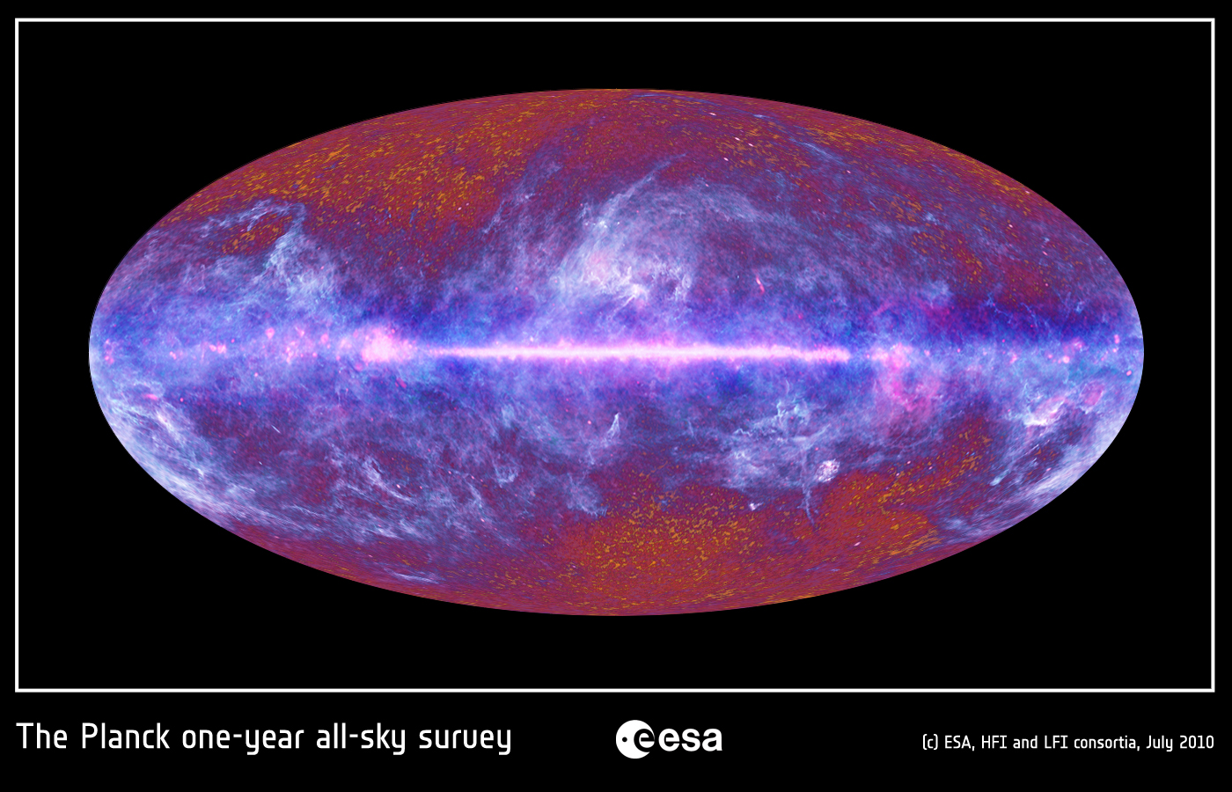

Slide 51


Slide 52


Slide 53


Slide 54




SZ effect on COMA Cluster
Abell 3219

Slide 55

A new supercluster

Slide 56
Acknowledgments
It is difficult to thank individually every single person (ESA, Industries, Funding Agencies, scientists, engineers, managers, technical staff in our Institutesand Universities; all over more than 1000 people) who has been deepley involved in Planck in the past 18 years, but we should always remember everyone with deep gratitude.

