Slide 1
Status and prospects for the
Large Hadron Collider
DISCRETE 2010
ROME
Gigi Rolandi – CERN/Ginevra and Scuola Normale Superiore/Pisa
LHC: the Superconducting Proton Accelerator and Collider
installed in a 27km circumference underground tunnel (tunnel cross-section diameter 4m) at CERN
Tunnel was built for LEP collider in 1985
S. Myers QUB March 11, 2009
1
Notes:
1

Slide 2
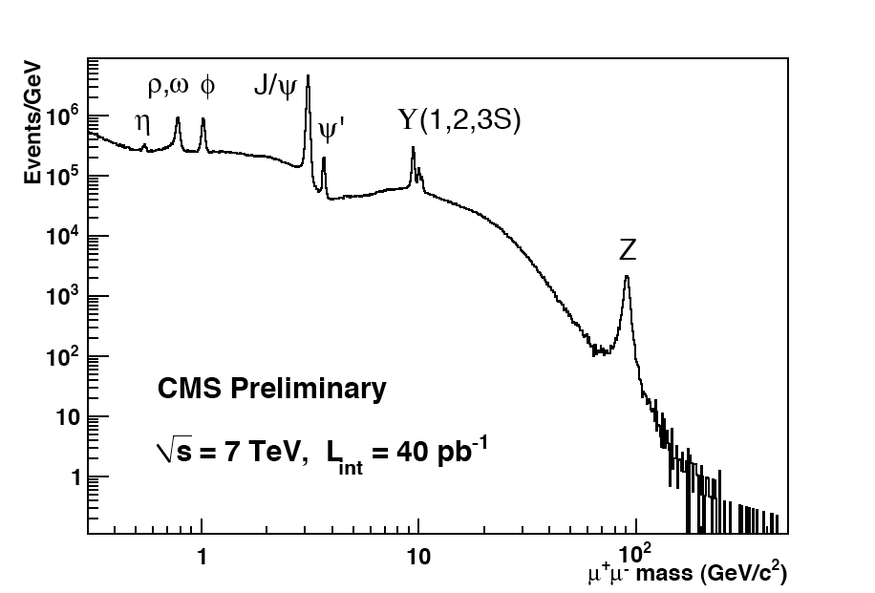
LHC operation: p-p till 4 Nov, Pb-Pb: 7 Nov - 6 Dec
LHC commissioning proceeding at an unprecedented pace:
Factor ~ 100’000 increase in peak luminosity since start-up
The four experiments demonstrated readiness in the exploitation of the 7 TeV data;
analyses proceeding very rapidly;
The journey through the Standard Model is ~ completed ..… and LHC has started to take us into uncharted territories.
Brilliant performances of the WLCG a key factor in the spectacular startup

Slide 3
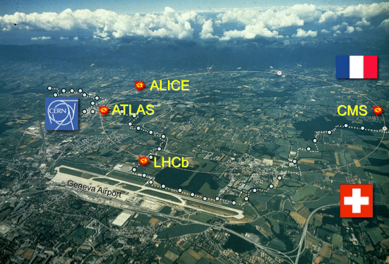
LHC: Exploration of a New Energy Frontier
Physics exploitation for the next 20 years
LHC
The LHC will illuminate a new landscape of physics, possibly answering some of the most fundamental questions in modern physics, like e.g.
The origin of mass
Unification of fundamental forces
Matter-Antimatter Asymmetry
New forms of matter
Extra dimensions of space-time

Slide 4
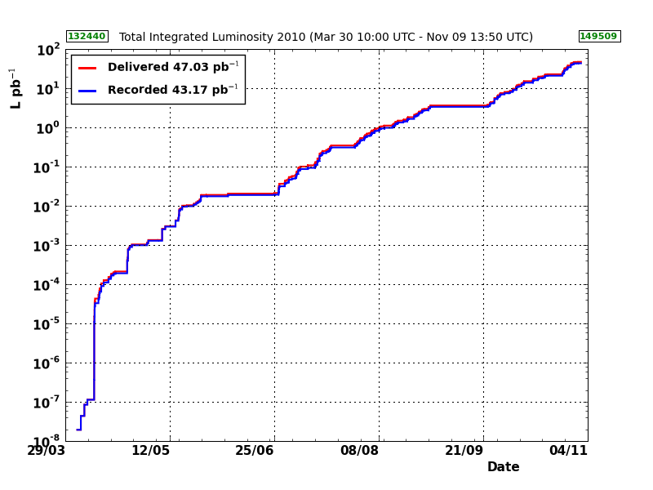
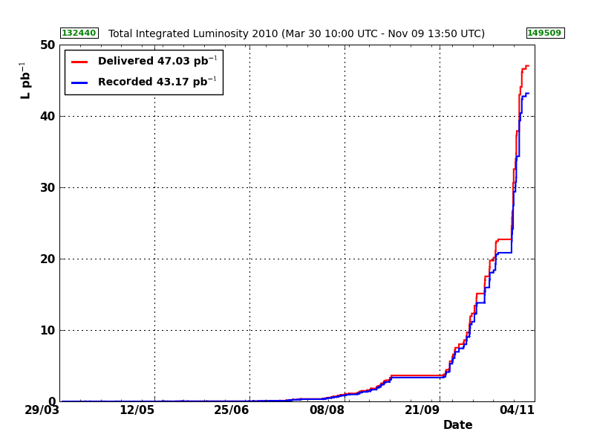
Integrated Luminosity since 30 March 2010
Searches
Top
W / Z
Jets
MinBias/ low-p_{T} Physics
Reliable operations with ~50 pb⁻¹ delivered by LHC
the experiments recorded more than 40 pb⁻¹. Overall data taking efficiency larger than 90%
Note: all subdetectors have at least 98% of all channels operational!

Slide 5
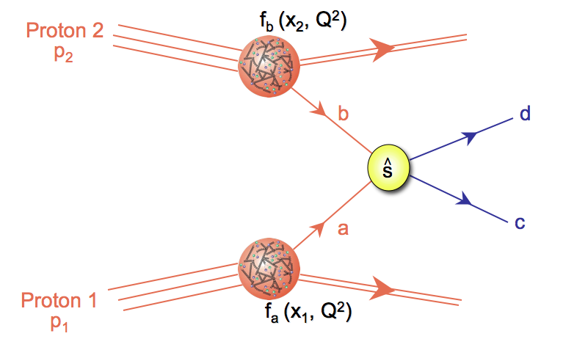
Basic processes at LHC
Hard scattering processes represent only a tiny fraction of the total inelastic pp cross section (~ 70 mb) eg. σ(pp → W+X) ~ 150 nb ~ 2・10⁻⁶ σ_{tot}(pp)

Slide 6
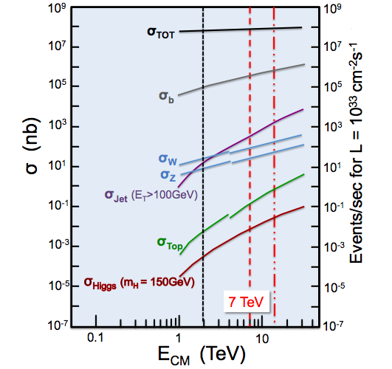
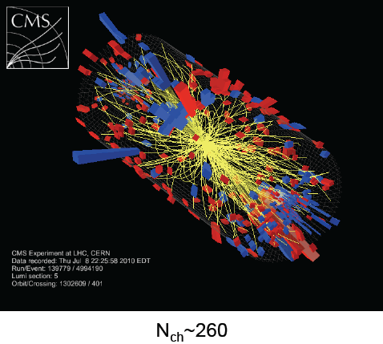
“Min-Bias”, low-p_{T} Physics
q/g
q/g
q/g
q/g

Slide 7
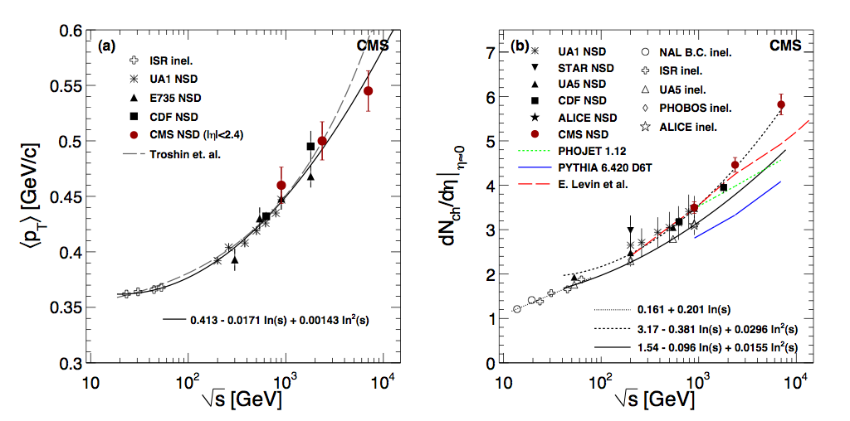
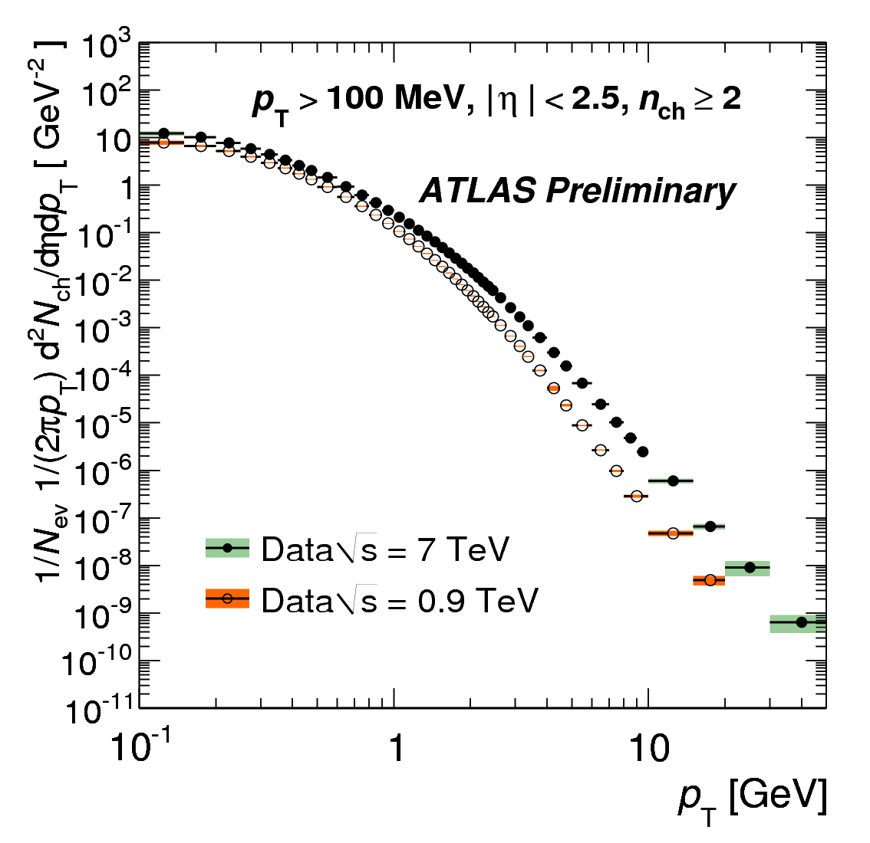
“Min-Bias”, low-p_{T} Physics
Soft collisions are not calculable reliably in pert. QCD, only phenomenological models available, but: parameters (multiplicity etc) poorly known (~50% or worse)
Important for tuning MC simulations and Pile-Up predictions

Slide 8
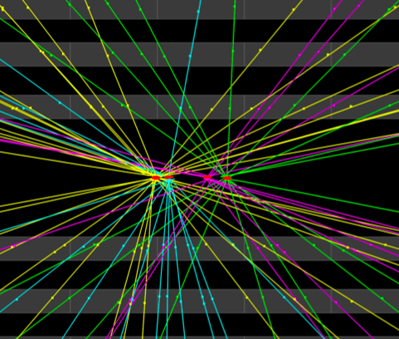
Pileup
4 pp interactions in the same bunch crossing
vertex resolution better than ~200 μm

Slide 9
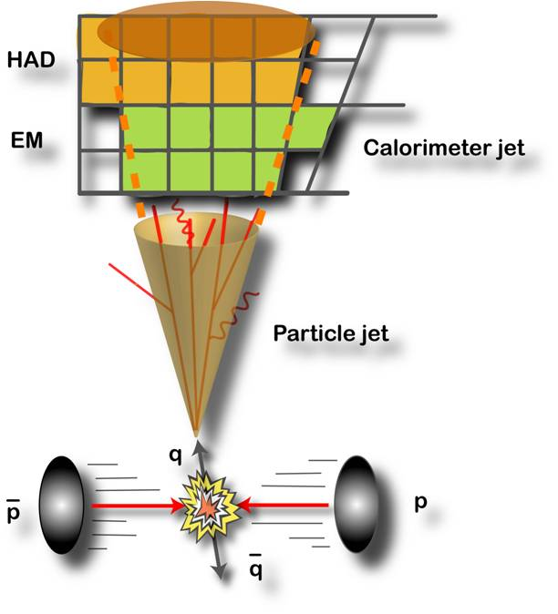
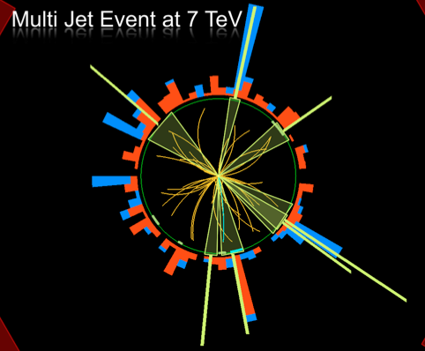
Jet Physics
q/g
q/g
q/g
q/g

Slide 10
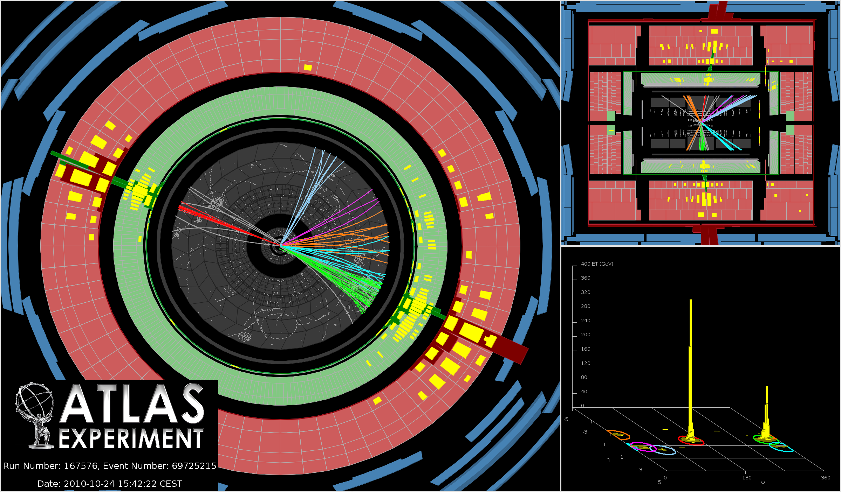
Highest Pt jet event collected by ATLAS
p_{T} jet1=1.3 TeV (also
p_{T} jet2=1.2 TeV, m_{jj}=2.6 TeV)

Slide 11
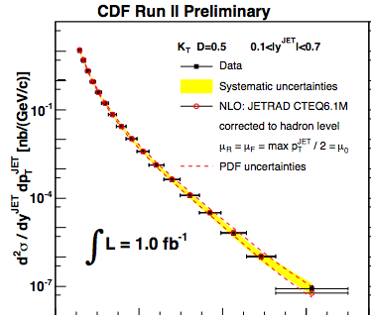
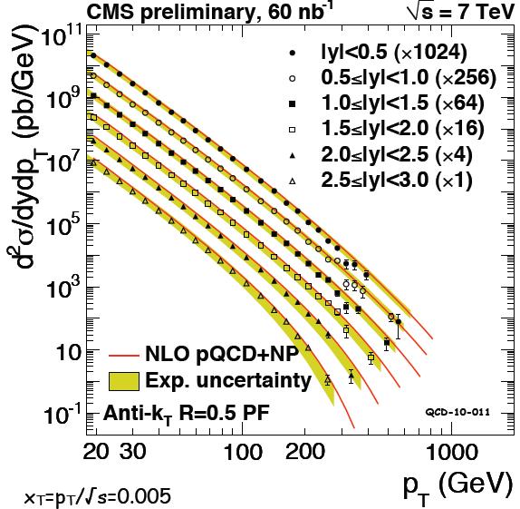
Jet production at 7 TeV − New Territory!
Tevatron
E_{CM}= 2 TeV
Factor 10⁵
in integr. L
LHC
E_{CM}= 7 TeV
Important test of pQCD over many orders of magnitude!
Jet energy precision in ATLAS and CMS better than expected

Slide 12
W and Z production at 7 TeV
q
l⁺
Z
−
q
l⁻

Slide 13
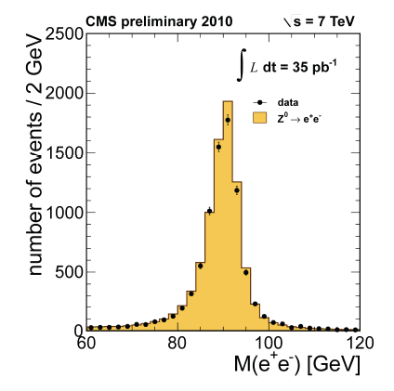
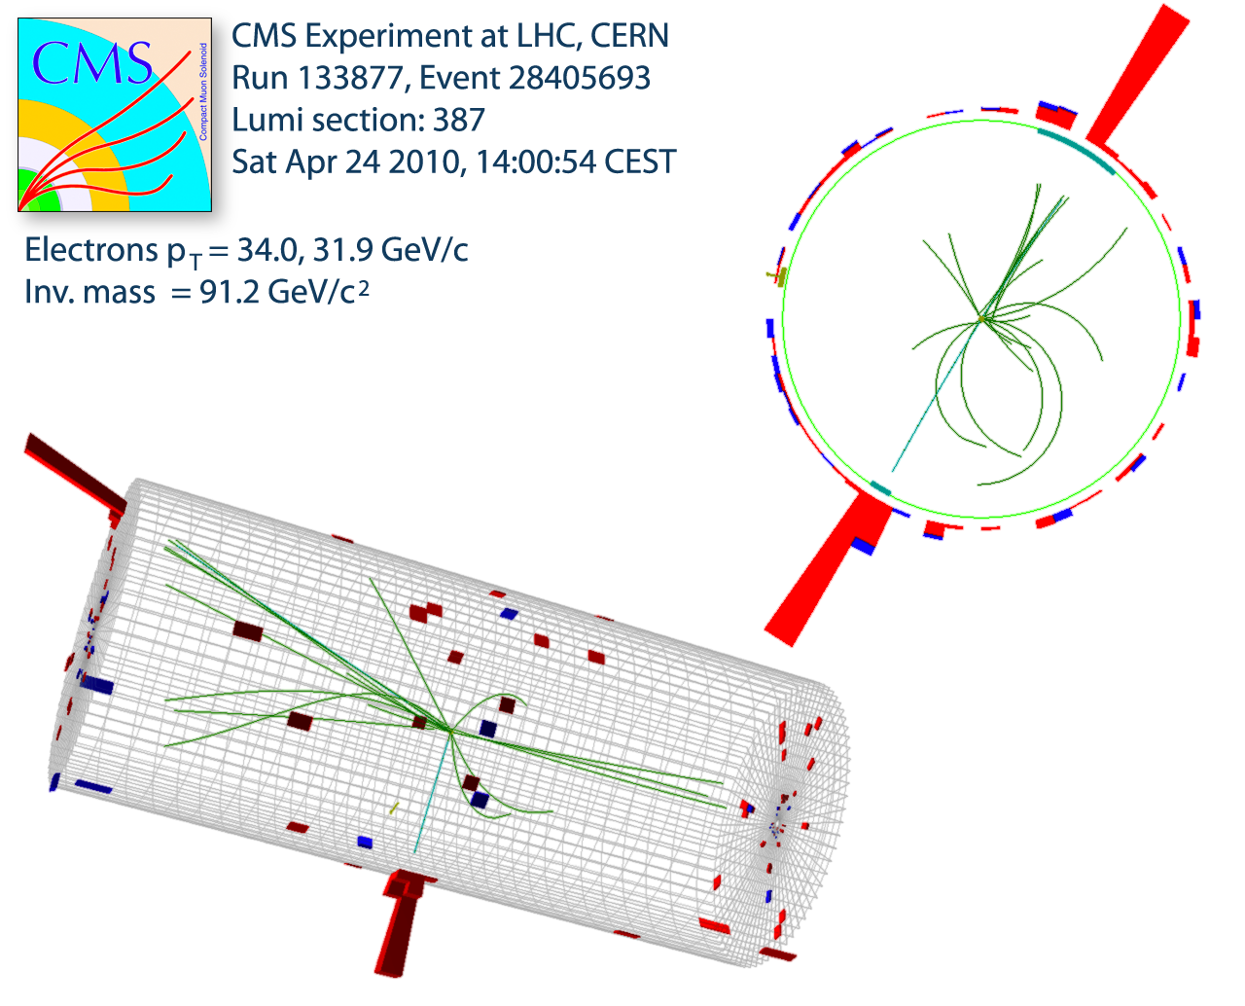
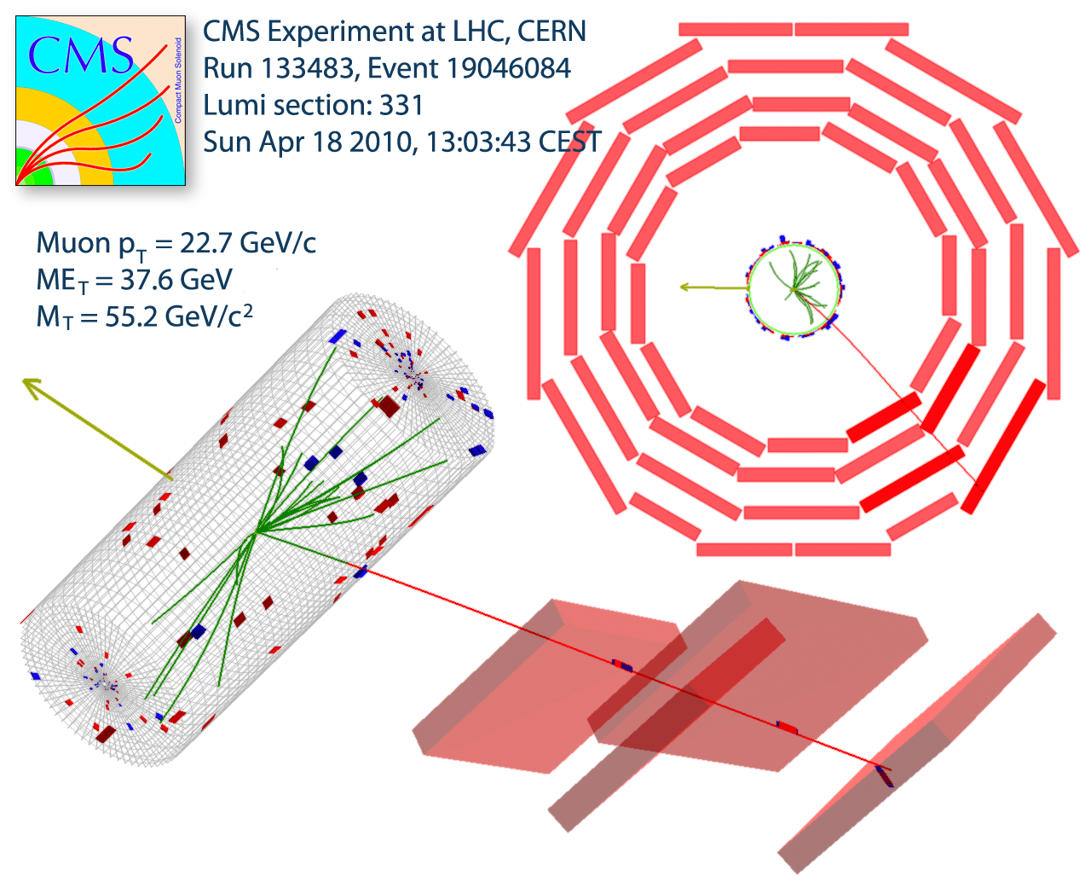
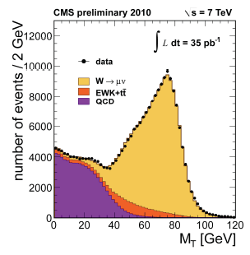
W and Z production at 7 TeV
Z

Slide 14
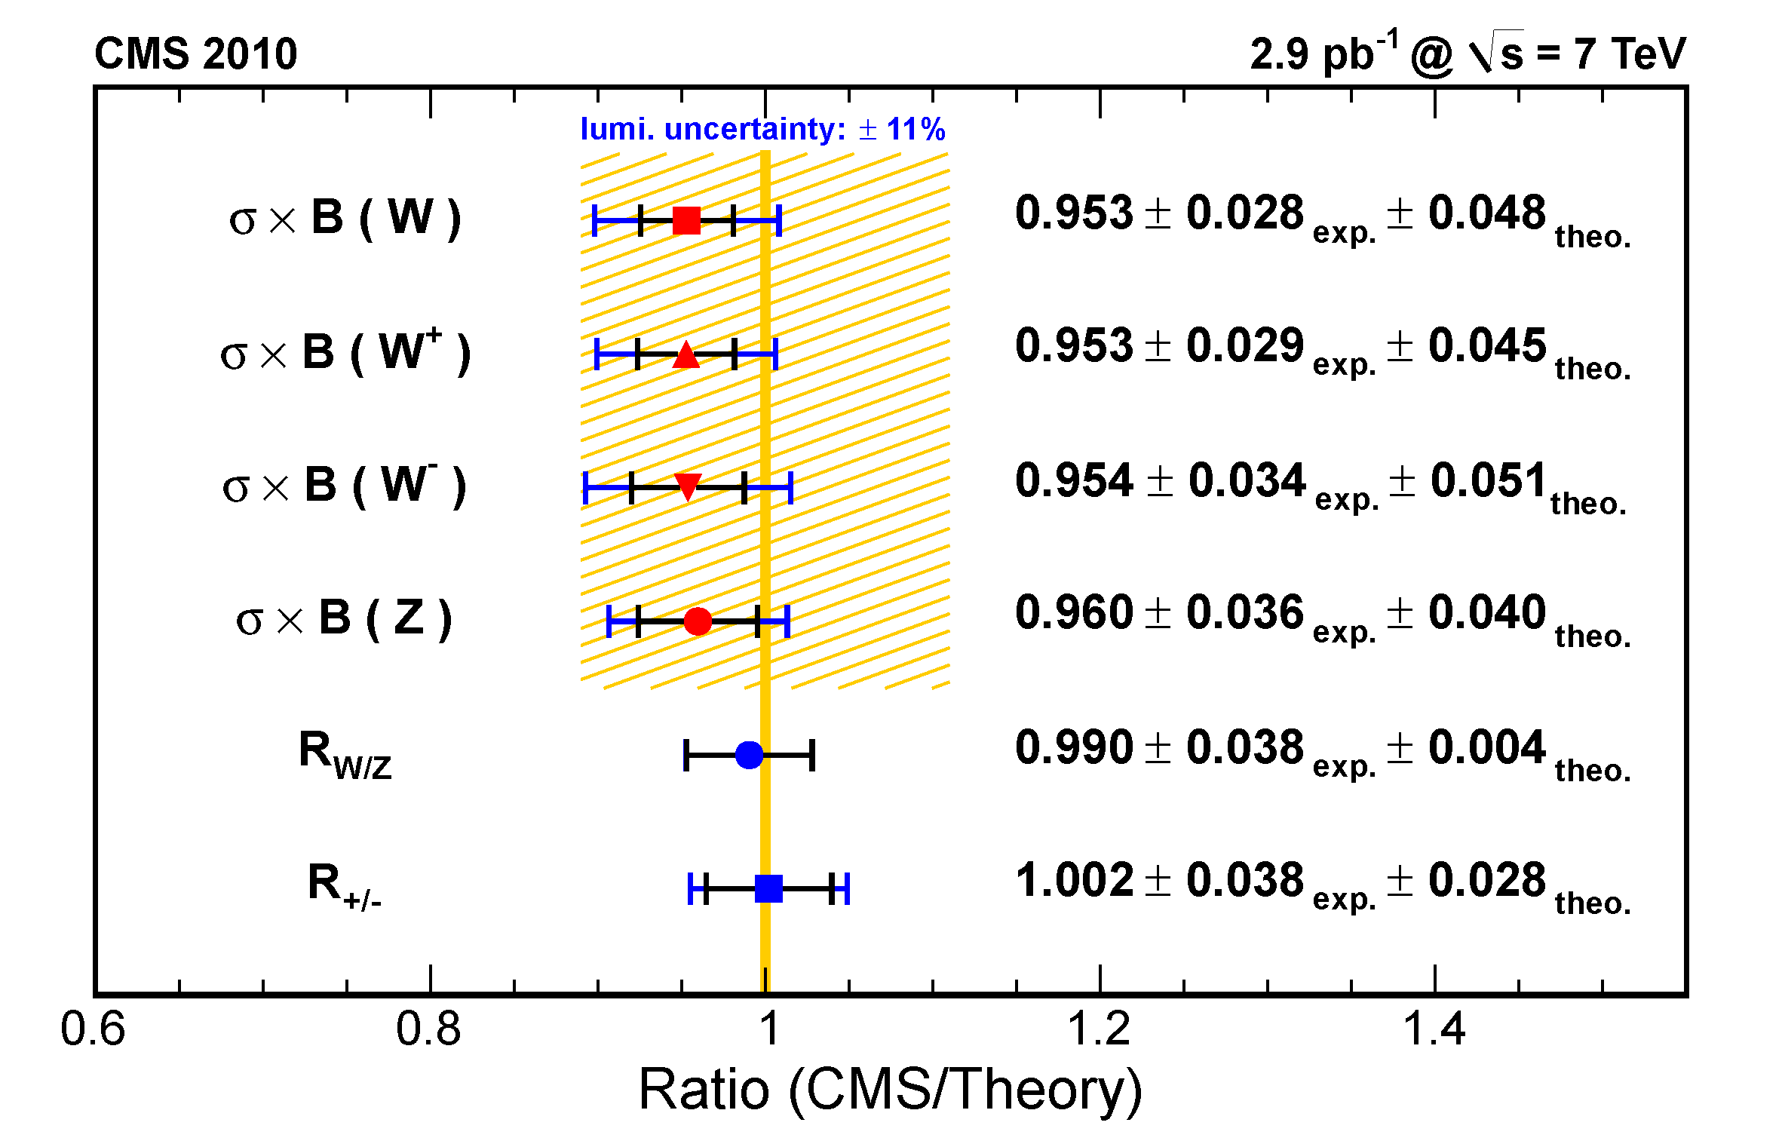
W and Z production at 7 TeV
Theoretical calculations (NNLO pert. QCD)

Slide 15
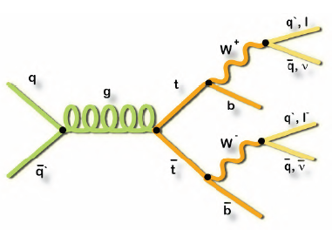
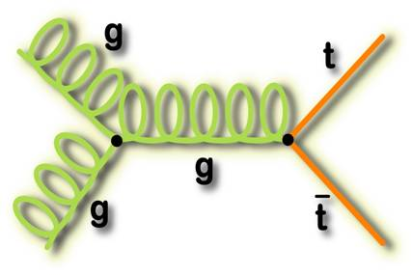
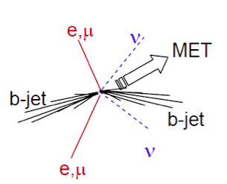
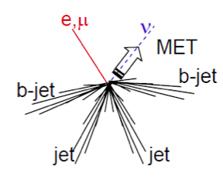
Top production at 7 TeV
~85% gluon-induced at LHC
di-leptons
Lepton + jet

Slide 16
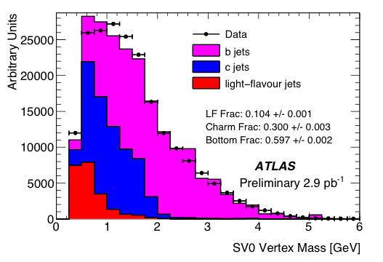
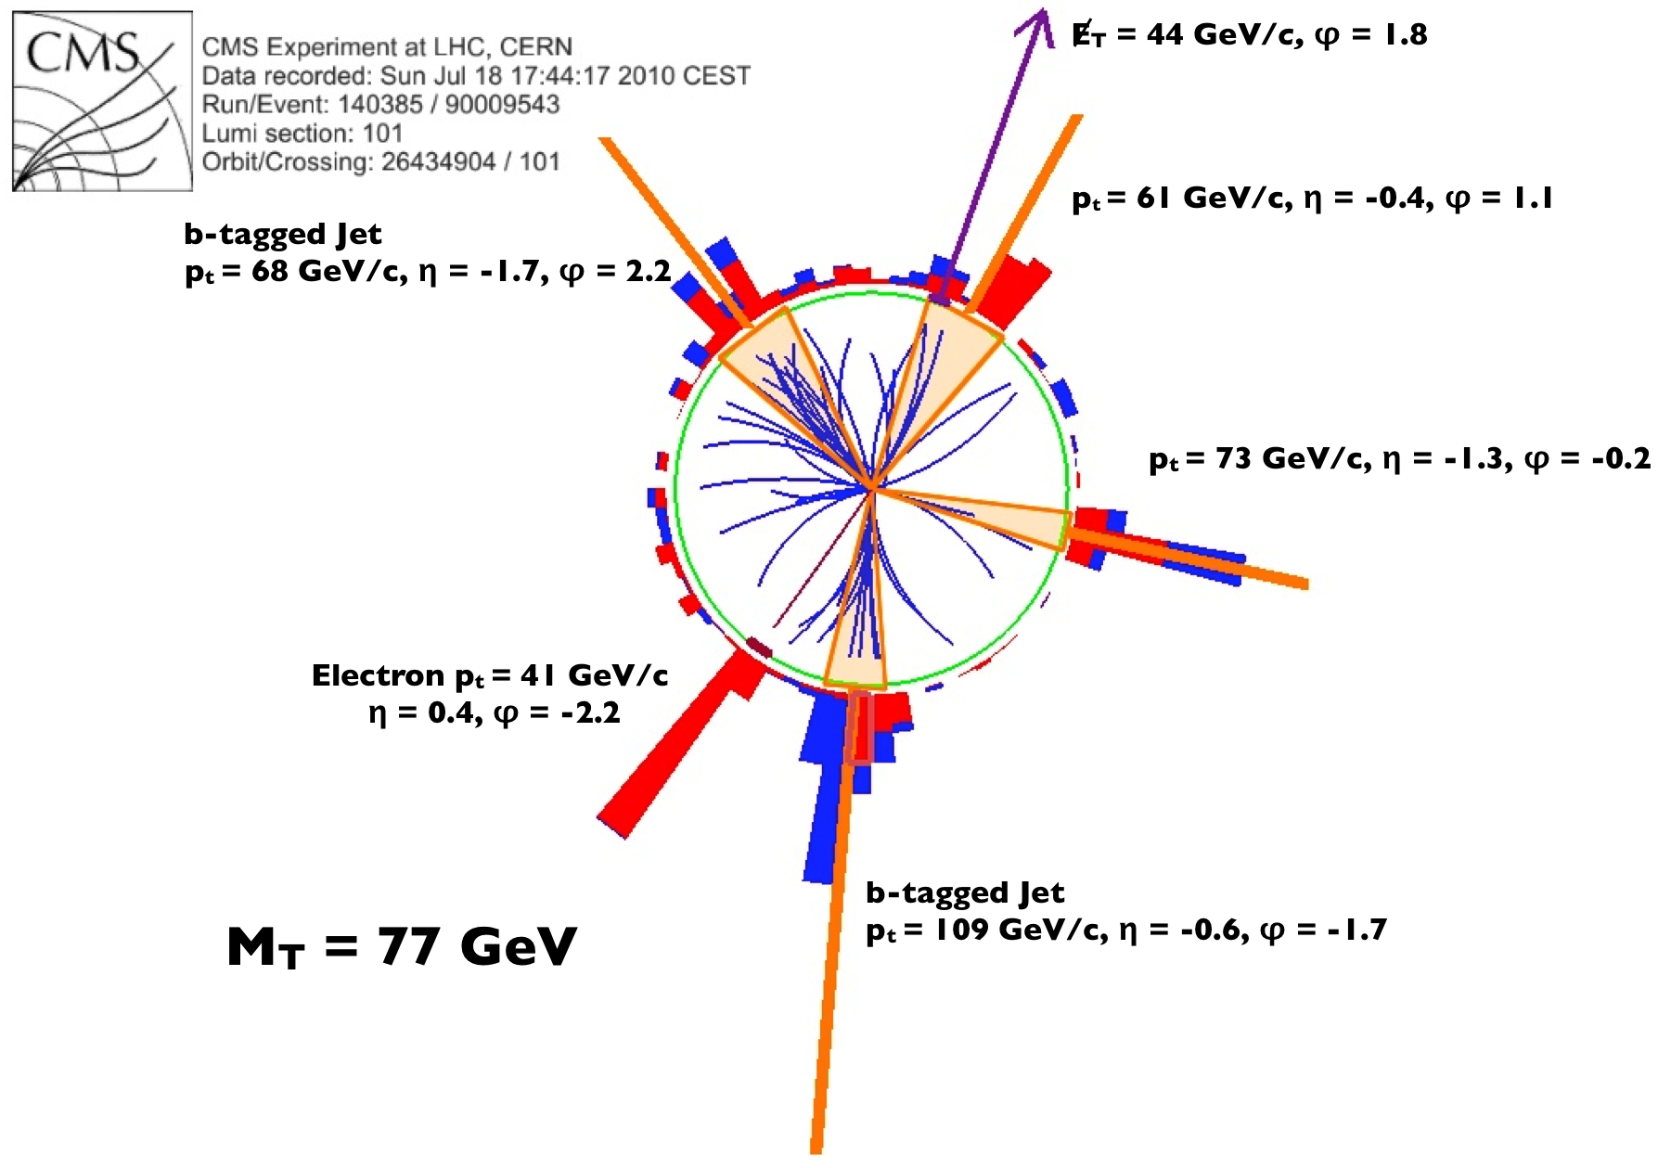
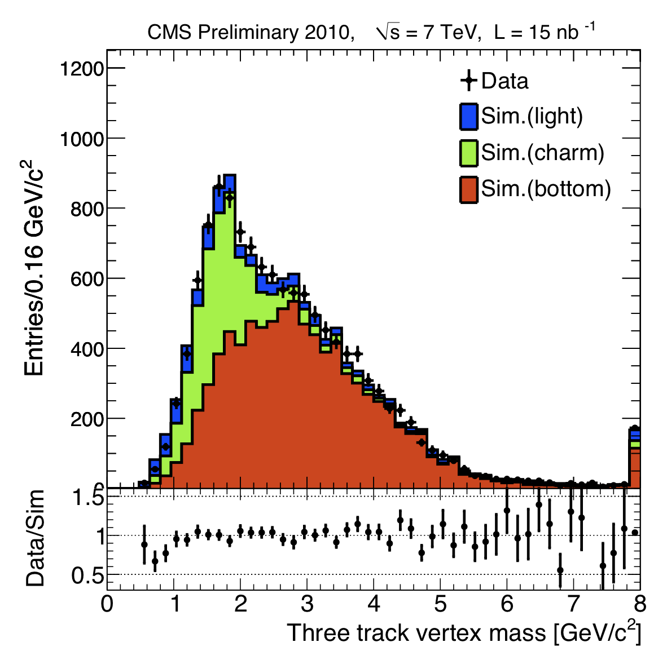
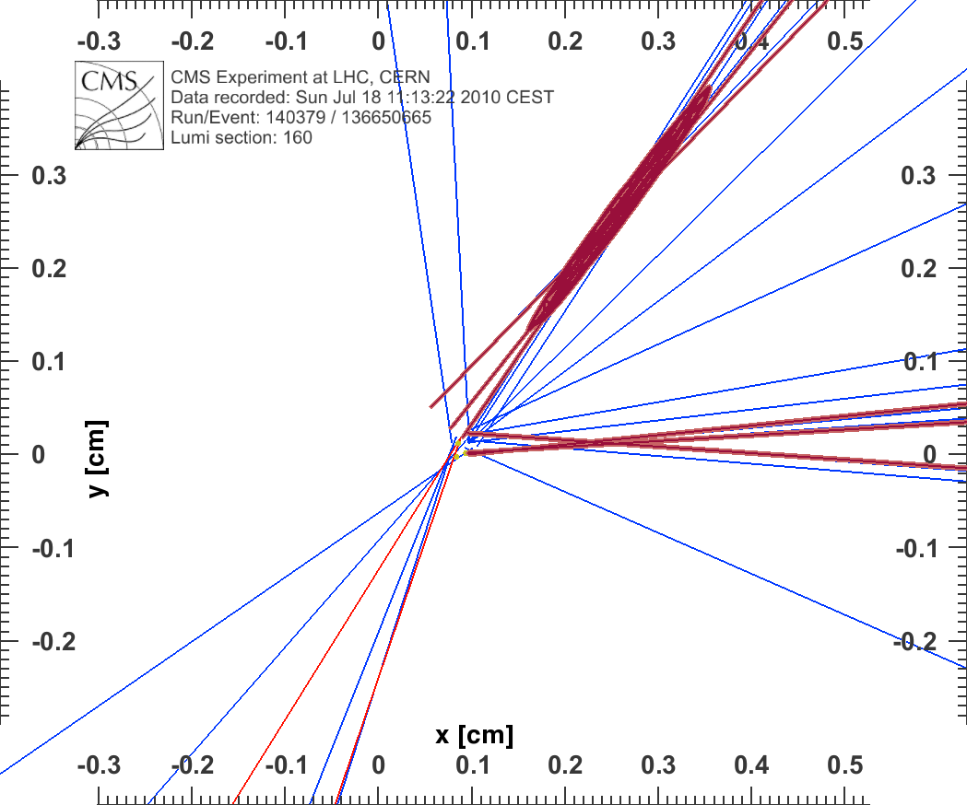
Top production at 7 TeV
Pixel Detector
excellent for
identifying b-jets
Electron+Jets Candidate

Slide 17
Top production at 7 TeV
di-leptons
First Publication on Top cross section at LHC
in the di-lepton channel
Observed: N_{data} =11
Predicted background: N_{BG} = 2.1
Predicted signal: N_{ttbar} = 7.7

Slide 18
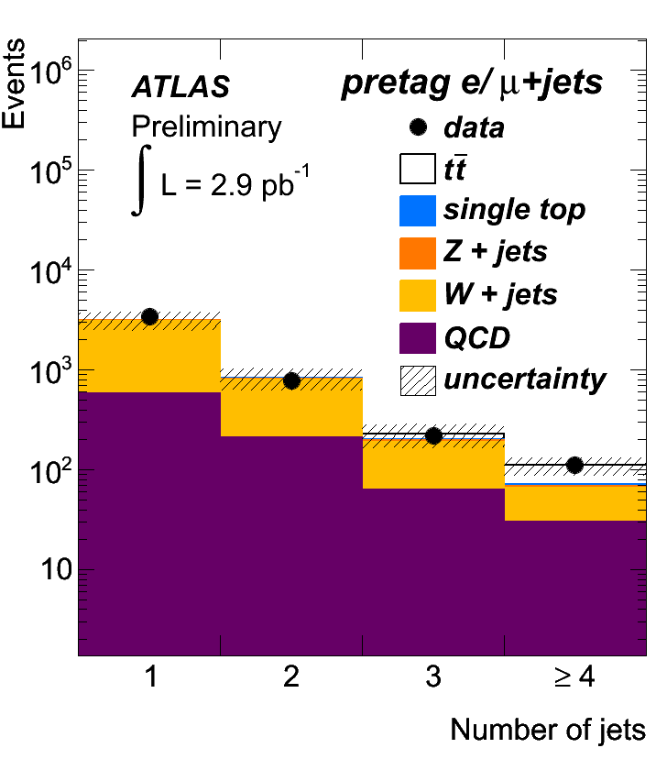
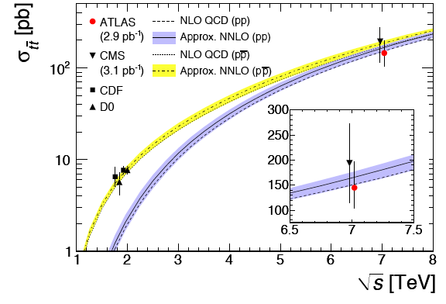
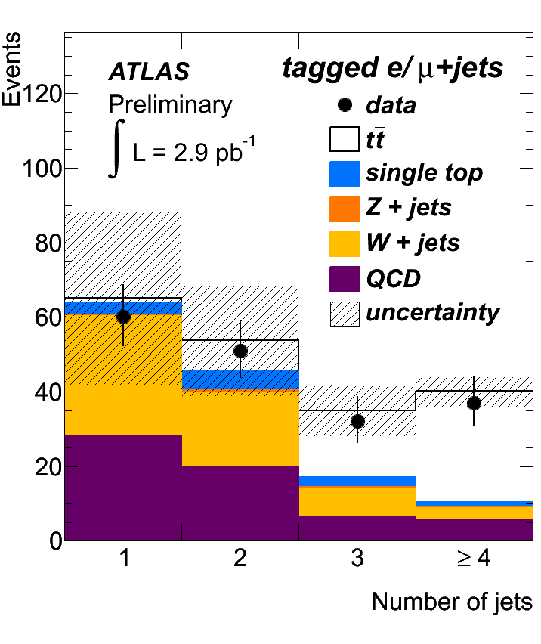
Top production at 7 TeV
lepton + jets
CMS measurement includes only dileptons
Observed: N_{data} =37
Predicted background: N_{BG} = 12.2
Predicted signal: N_{ttbar} = 29.9

Slide 19
Higgs at the LHC (at √s = 7TeV?)
g
W/Z
H
g
W/Z
competing with standard di-boson production
pp→WW + X

Slide 20
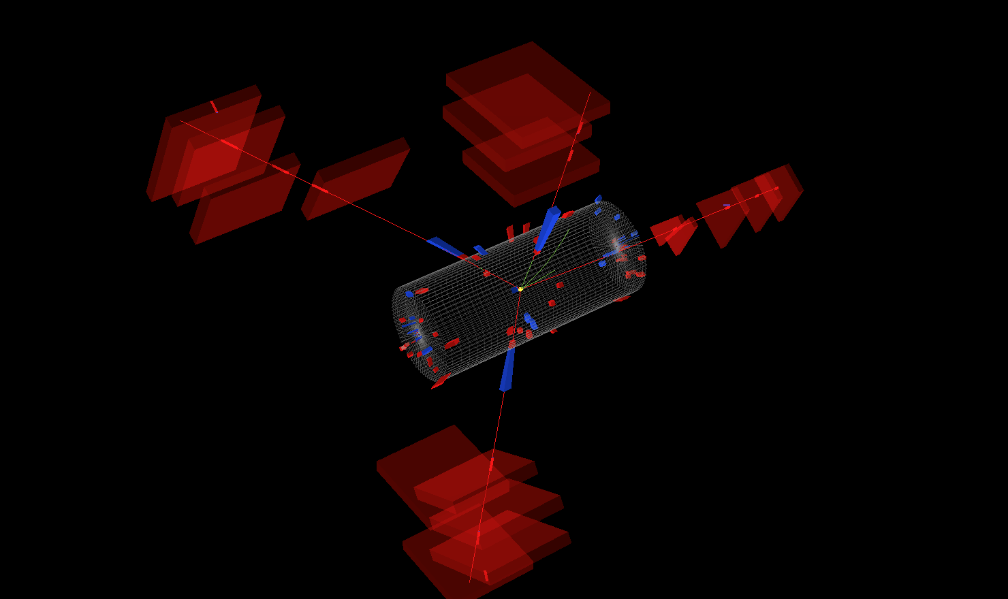
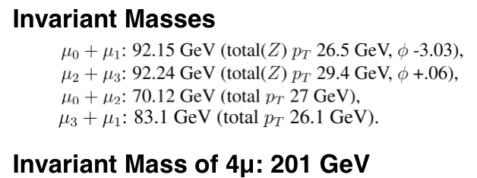
Candidate ZZ to μμμμ event in CMS

Slide 21
Candidate ZZ to μμνν in ATLAS
m_{μμ} 94 GeV, E_{T}^{miss} = 161 GeV

Slide 22
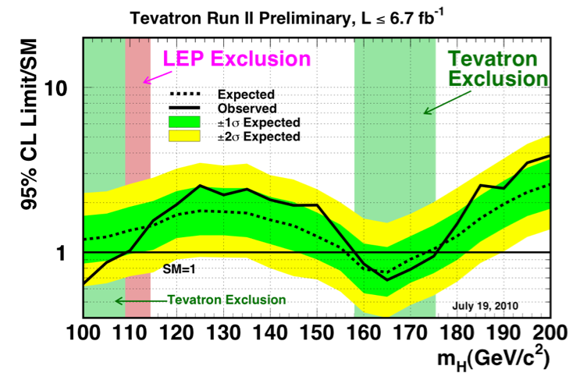
SM Higgs at the LHC
could exclude
123 < m_{H} < 540 GeV at 95% C.L.
3σ evidence over
130 < m_{H} < 450 GeV
ATLAS and CMS: improvement of analyses under way
Preliminary sensitivity for 1 fb⁻¹ per experiment and combining ATLAS+CMS:
3σ evidence over 130 < m_{H} < 450 GeV
could exclude 123 < m_{H} < 540 GeV at 95% C.L.

Slide 23
LHC − Next Steps: 2010 − 2016
….. as of today ……
….
Years
2010
2011
2012
2013
2014
2015
2016
LHC
DATA Taking
Shut down
DATA Taking
Shut down
E_{CM} = 7 TeV
2010: L~10²⁷ cm⁻²s⁻¹
→ L~10³² cm⁻²s⁻¹
2011: reach ~ 1fb⁻¹
E_{CM} ~ 14 TeV
Schedule F Flexibility
Depending on what we find …..
Heavy ion run at end of each year
Shut down: ~ 15 months
Consolidation for LHC operation
Repair and consolidate all splices
Add remaining Helium pressure release ports, etc
Expect an update after the Chamonix meeting early 2011 !
Notes:
1 hour = 3.6x10**3 seconds, 1 day = 8.64x10**4, 12 days at 10**32 flat-out yields about 100pb-1 (i.e. would mean 40% efficiency in data taking at 10**32

Slide 24
LHC − Next Steps: 2010 − 2016
….. as of possibly end of January ……
….
Years
2010
2011
2012
2013
2014
2015
2016
LHC
DATA Taking
Shut down
Shut down ?
E_{CM} = 7 TeV → 8 TeV
2010: L~10²⁷ cm⁻²s⁻¹
→ L~10³² cm⁻²s⁻¹
2011: reach ~ 1fb⁻¹
2012: reach ~ 10fb⁻¹
E_{CM} ~ 14 TeV
Schedule F Flexibility
Depending on what we find …..
Heavy ion run at end of each year
Shut down: ~ 15 months
Consolidation for LHC operation
Repair and consolidate all splices
Add remaining Helium pressure release ports, etc
Notes:
1 hour = 3.6x10**3 seconds, 1 day = 8.64x10**4, 12 days at 10**32 flat-out yields about 100pb-1 (i.e. would mean 40% efficiency in data taking at 10**32

Slide 25
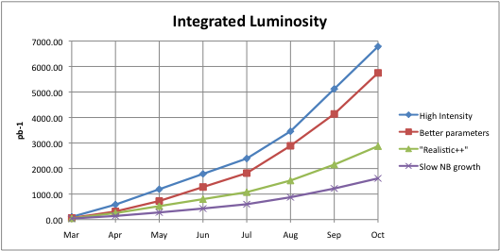
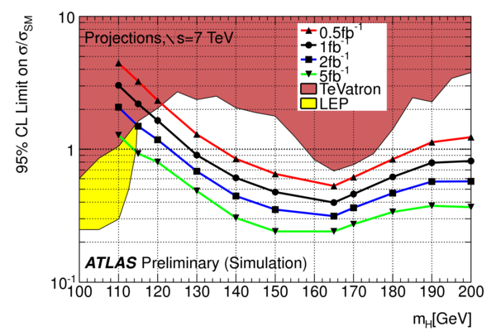
Prospects for the 2011 run
my personal guess-estimate

Slide 26
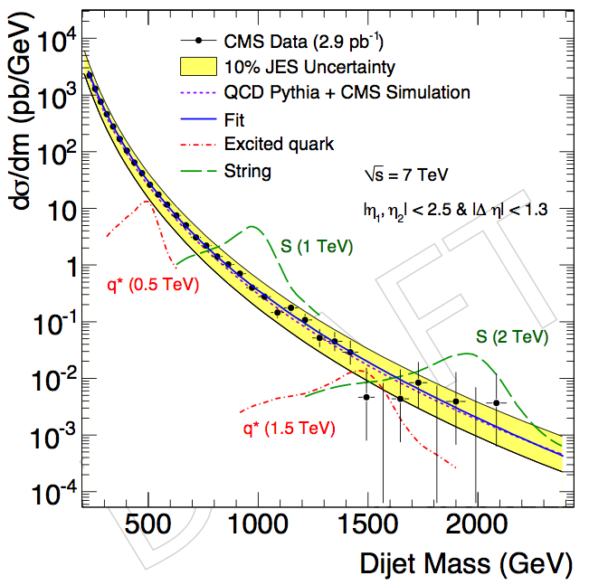
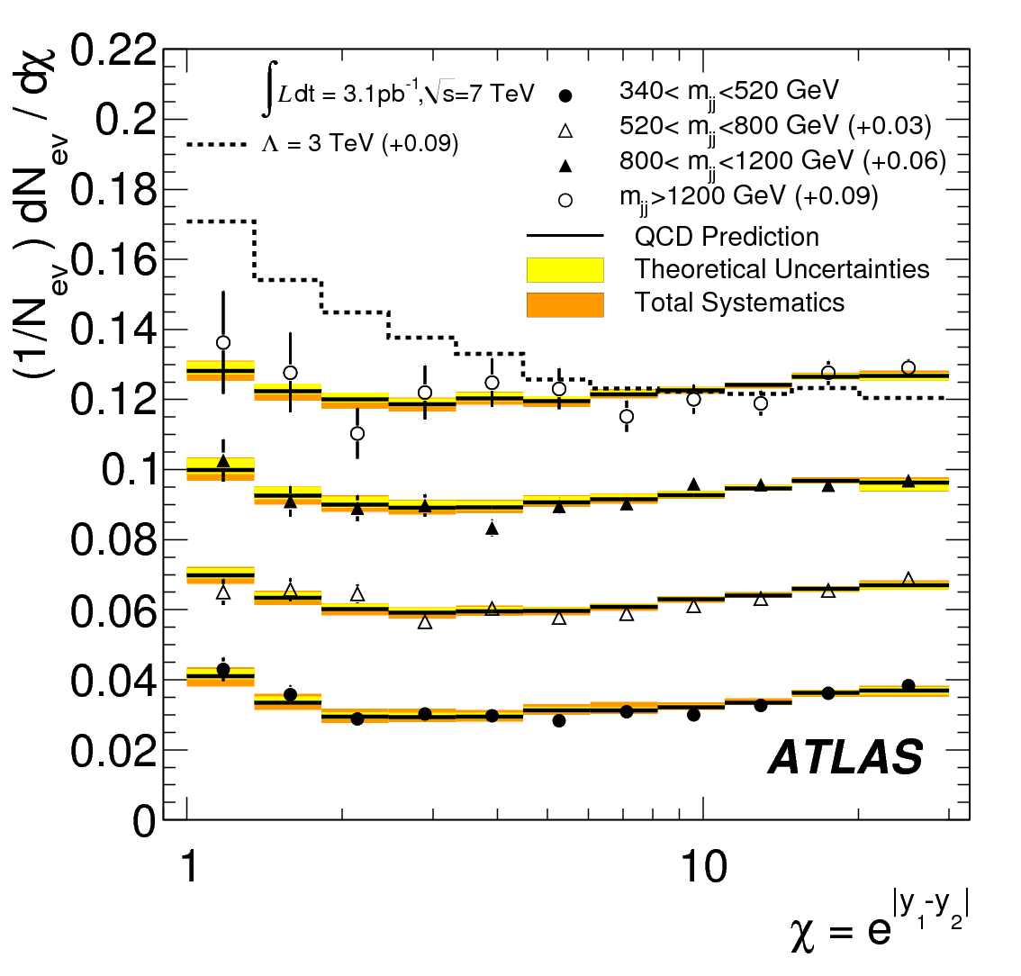
Physics Examples beyond SM
Excited quarks with
mass < 1.6 TeV @ 95% CL
Quark contact interactions with
scale Λ < 3.4 TeV @ 95% CL

Slide 27
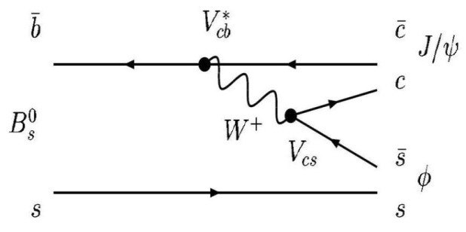
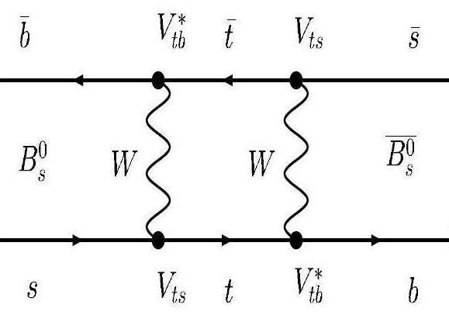
New Physics in CP violation ?
B_{s}→J/ψφ: The interference between the direct decay and the decay via B_{s} mixing gives rise to CP-violating phase Φ_{s,} small and well predicted by the Standard Model.
New Physics in the loop might increase the phase
CDF+D0 results (bounds in Γ_{s}-Φ_{s} plane) show slight deviation from SM, but so far with poor resolution
+

Slide 28
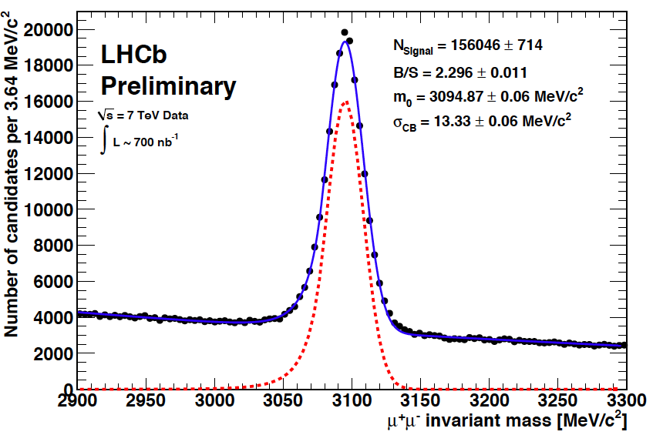
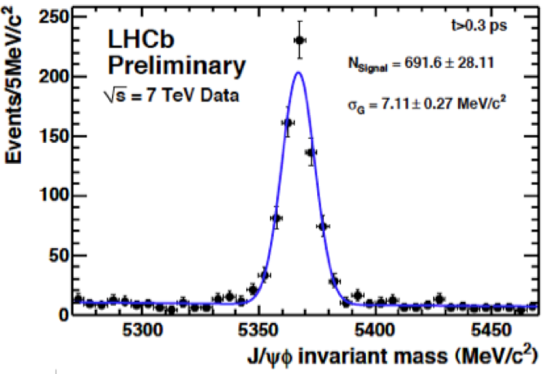
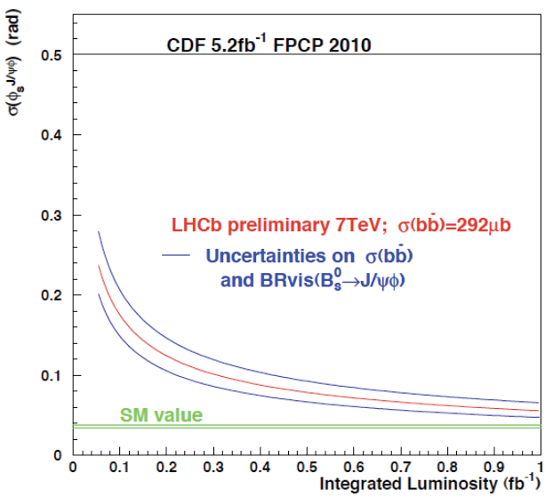
New Physics in CP violation ?

Slide 29
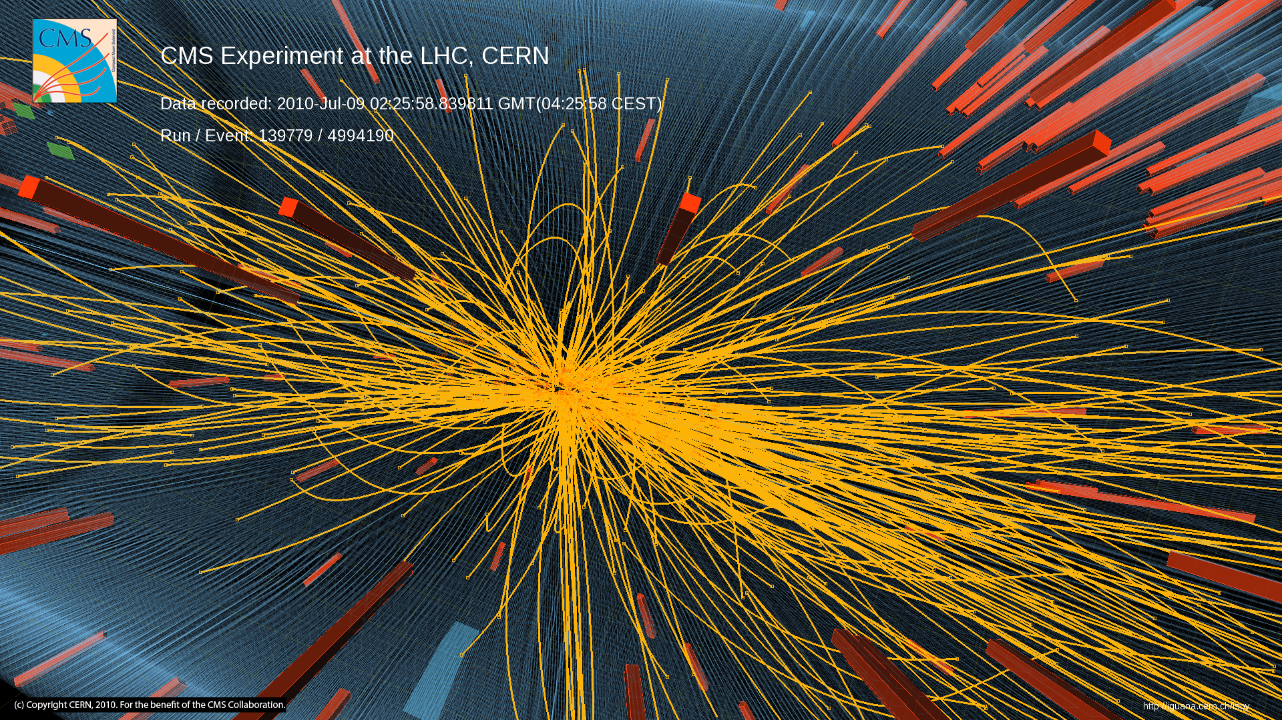
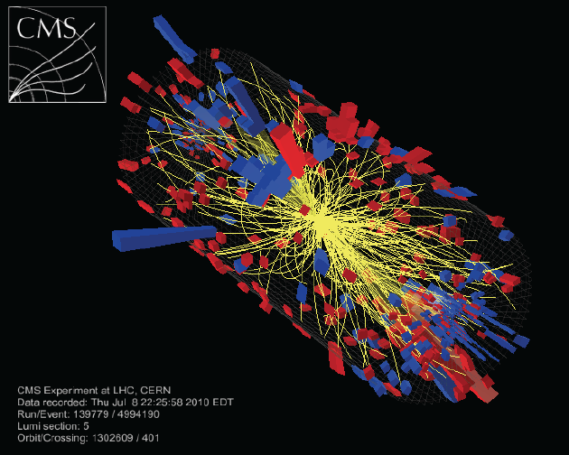
Unexpected Result …..
Long-Range, Near-Side Angular Correlations in pp Interactions in CMS
Published in JHEP
Dedicated high multiplicity trigger implemented
Statistics for high multiplicity events enhanced by O(10³)
Total datasets corresponding to 980nb⁻¹

Slide 30
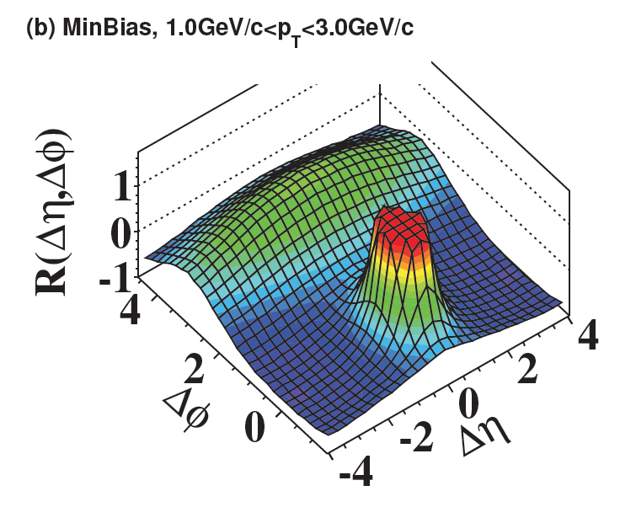
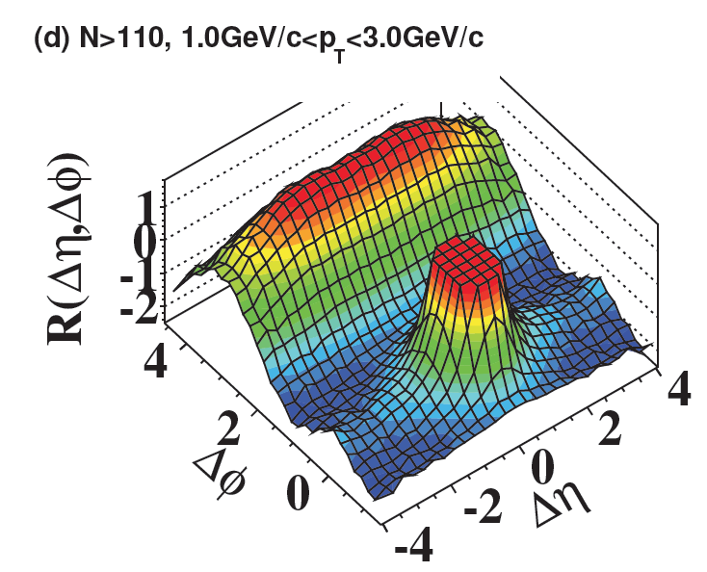
Unexpected Result ….. (1)
Minimum Bias no multiplicity cut
High multiplicity data set and N>110
First observation of this effect in pp collisions
New “ridge-like” structure extending to large Δη at ΔΦ ~ 0
The enhancement is most evident in the intermediate p_{T} range 1 < p_{T} < 3 GeV/c

Slide 31
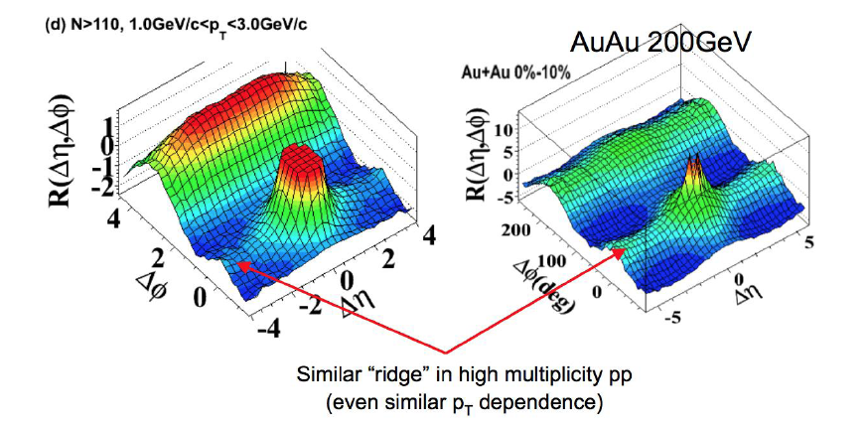
Unexpected Result ….. (2)
Effect is small but interesting
resembles a similar feature observed at RHIC
Interpretation at RHIC: hot and dense matter formed in relativistic heavy ion
collisions
LHC Heavy Ion programme started
on November 6 !

Slide 32
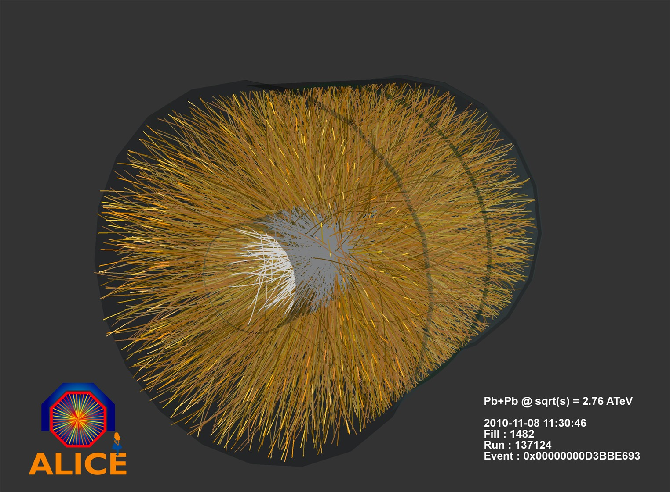
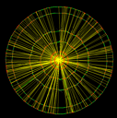
Heavy Ion run
Pb-Pb collision at √s=2.76 TeV / Nucleon
~ 1500 chg. particles produced at central rapidity
Astronomy
Experiments
Telescopes
Satellites
Standard
Cosmology
Model

Slide 33
Elliptic flow in Heavy ions collisions
Experimental observation: particles are emitted with azimuthally anisotropic distribution around the scattering plane
φ
Z
P_{y}
P_{z}
P_{x}
Reaction plane
Y
X
N_{ch} yield
Elliptic Flow v₂ is interpreted by Hydrodynamics
Pressure gradient converts
spatial anisotropy → momentum anisotropy
→ particle yield anisotropy

Slide 34
First measurement of v2 by ALICE
Experimental trend predicts a large rise
Theory predicts a small increase
LHC ?

Slide 35
Heavy Ion run
First Z ever seen in Heavy Ions collisions!

Slide 36
Jet quenching
……. in-medium modification of final state QCD parton showers
ATLAS

Slide 37
Heavy Ion run: Centrality
Characterize centrality by percentiles of total cross-section using forward calorimeter (FCal) ΣET
(3.2 < |η| < 4.9)
b

Slide 38
Energy imbalance

Slide 39
Asymmetry as function of centrality
For more central collisions, see:
Reduced fraction of jets with small asymmetry
Increased fraction of jets with large asymmetry
For all centralities, Δφ strongly peaked at π
Possible small broadening in central collisions

Slide 40
Conclusions
LHC had a very successful 2010: impressive startup of the accelerator and exceptional performance of the detectors
First results show that LHC is in good track for exploration of the high energy frontier
Exploration of uncharted territory will continue in 2011 with high luminosity. Search for events with large Missing Energy, Exotica and Higgs hunting : stay tuned

Slide 41
Detector Performances (examples)
4 pp interactions in the same bunch crossing
Two b-jets candidate
vertex resolution better than ~200 μm
Particle flow

Slide 42
SM Higgs production at the Tevatron
ICHEP
Tevatron so far
~ 9 fb⁻¹ delivered
~ 6 fb⁻¹ analyzed
Expect by end 2011:
10 fb⁻¹ analyzed
LEP: m_{H} > 114 GeV
Tevatron: 158 < m_{H} < 175 GeV
For m_{H} ~ 115 GeV (most difficult region at LHC): sensitivity is 1.5 x SM
Expectation: ~ 10 fb⁻¹ analyzed + analysis improvements
full region below 185 GeV could be excluded at 96% C.L.
3σ evidence for m_{H}=115 GeV

Slide 43
Z production at 7 TeV
UA1 at the
CERN SppS: Z→ e⁺e⁻
-
27 years later: Z’s observed at LHC at E_{CM} = 7 TeV
In the 1990’s: Millions of Z events analysed at LEP
1st Z event observed on 30 April 1983
at E_{CM} = 0.45 TeV

Slide 44
SM Higgs production at the LHC
CMS : hot off the press

