Slide 1

H2020-HITRI+ and H2020-IFAST
SC Magnets for Ions Gantry and Synchr.
(+overview of future HFM/Recovery Funds)
Lucio Rossi on behalf of LASA-Magnet team
Univ. of Milano- Physics dept. and INFN-LASA-Milano
Consiglio di Sezione INFN – Milano , 13 July 2021

Slide 2
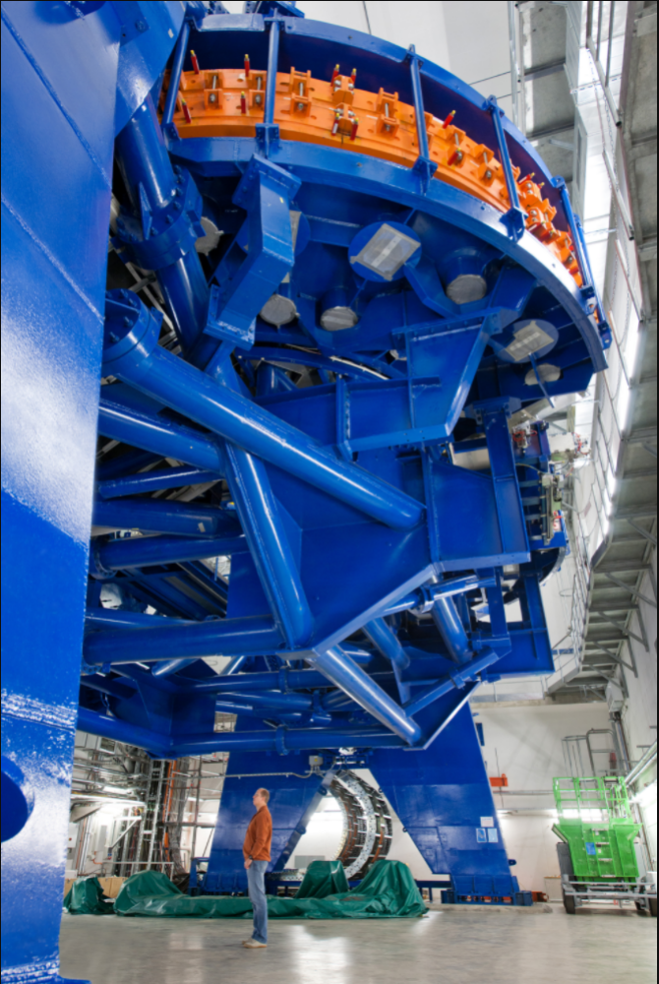
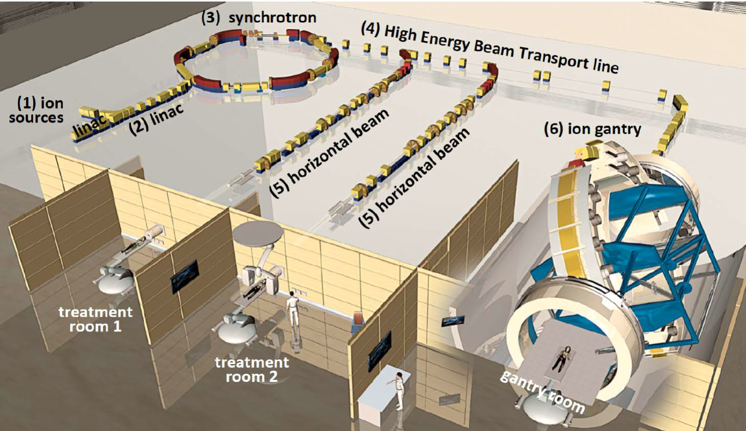
HIT - Heidelberg Ion Beam Therapy Center (first in EU)
25 m
25 m
Reducing footprint means cost reduction
Also saving electricity and infrastructure: superconductivty may play an important role
25 m long
13 m diameter
600 tons rotation
670 tons total

Slide 3


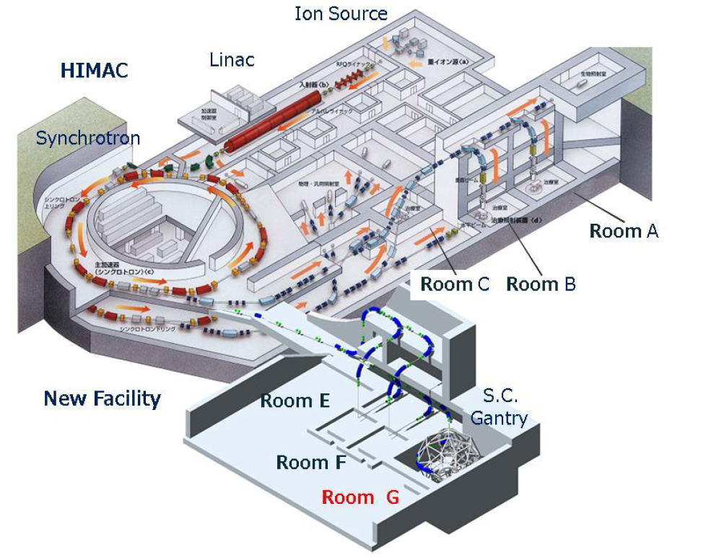
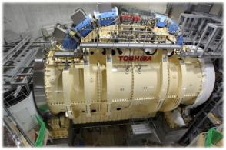
Japan: HIMAC at QST-NIRS
First SC Gantry in operation 2018
Cryocooled dry SC magnet
13 m
300 tons
Courtesy of T. Shirai, QST-NIRS

Slide 4
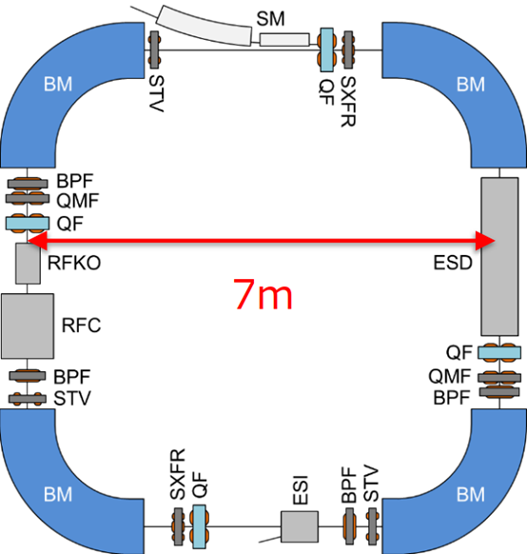
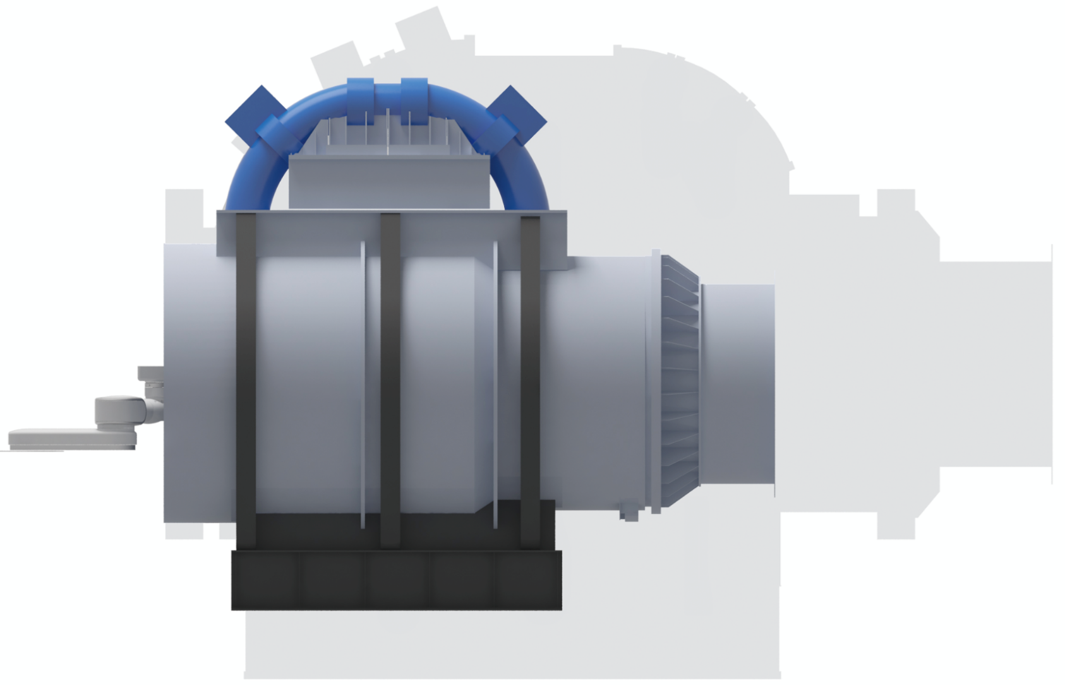
Japan: HIMAC at QST-NIRS strong push toward SC technologies
Courtesy of T. Shirai, QST-NIRS
operating SC gantry in NIRS
Courtesy of Koji Noda, QST-NIRS
2nd SC-gantry : L= 8 m (100 tons?)
With same SC as the synchrotron
B0 = 3.5 T reducing accelerator dia. 20 → 7-10 m
Dip. Field: 2.9→ 3.5 → ∼ 5 T
Ramp time: 60 → 5 → 3 s
Op. Temp. : 4-5 K …….→ 10-20 K this requires HTS

Slide 5
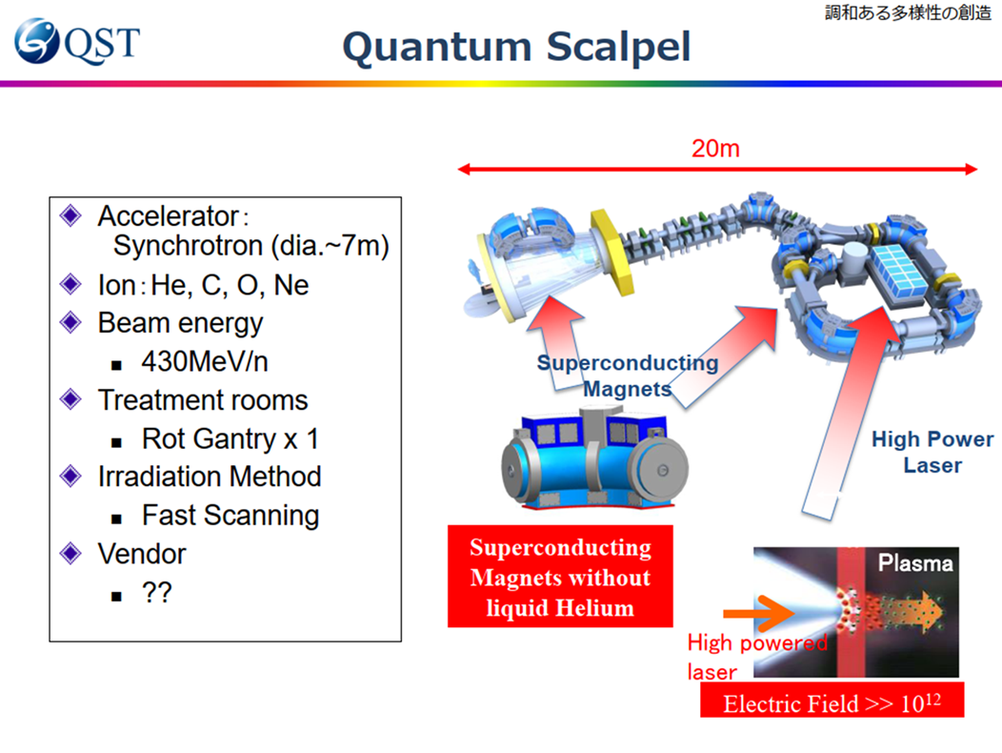
Bridge the gap with Japan..
Dip. Field: 2.9→ 3.5 → ∼ 5 T
Ramp time: 60 → 5 → 3 s
Op. Temp. : 4-5 K …….→ 10-20 K
this requires HTS

Slide 6

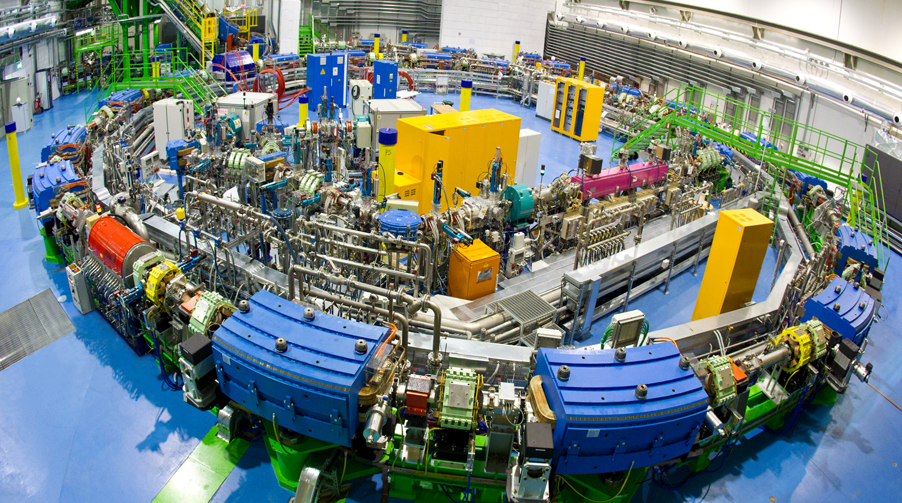
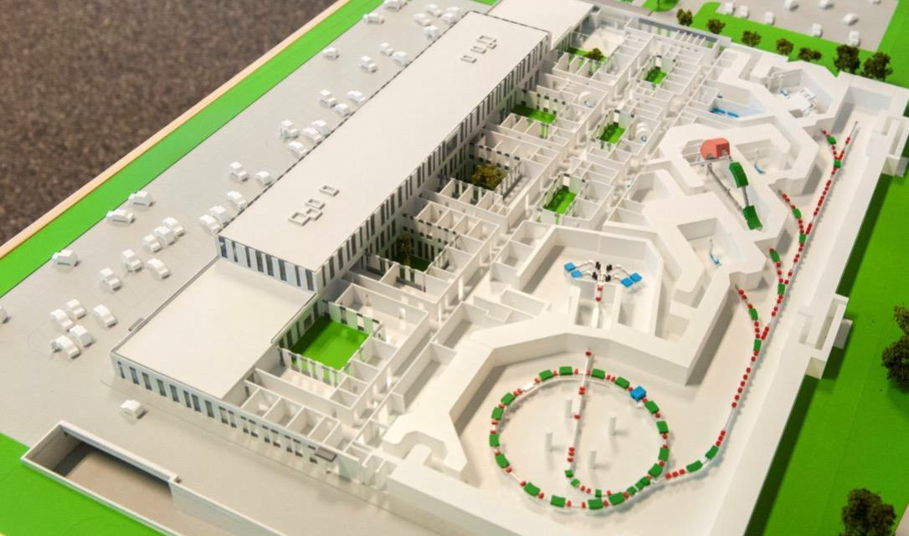

PARALLEL INITIATIVE collaboration
CERN-CNAO-INFN-MedAustron on C-ion GANTRY
Improve the efficiency (medical effectiveness and treatment time) of the existing facilities
  CNAO (Pavia, IT)
  MedAustron (Vienna, AT)
  others
Design a gantry compatible with the present layout without large civil engineering and infrastructure investment
Desing a Gantry based on improvement of present technologies with CURVED magnets and cryogen-free, for a new vey light gantry! 50 tons!!
→ SIG call2021 (presented this morning by F. Groppi)

Slide 7

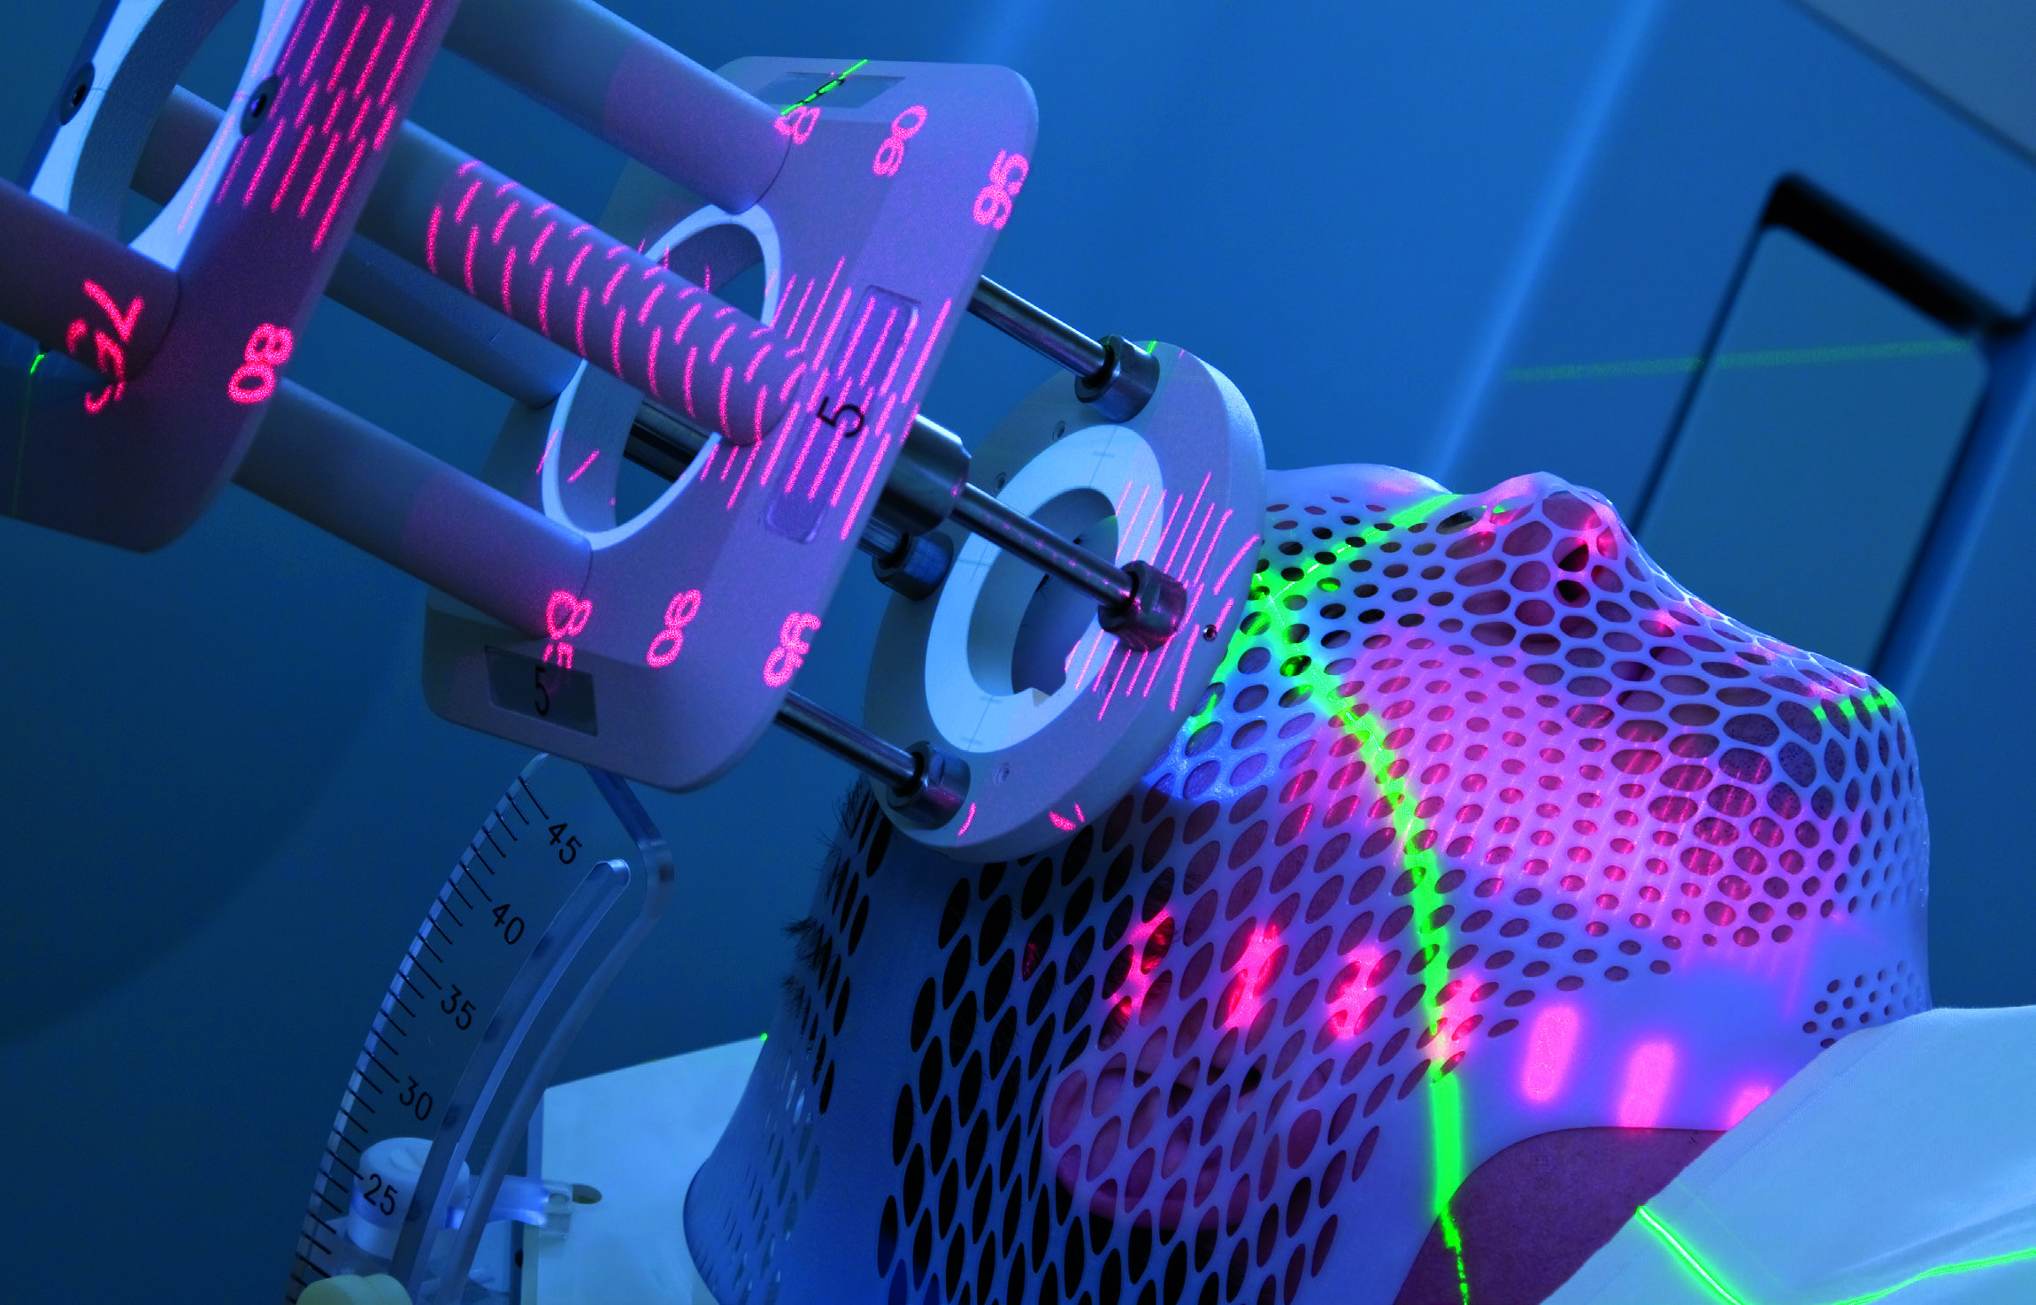
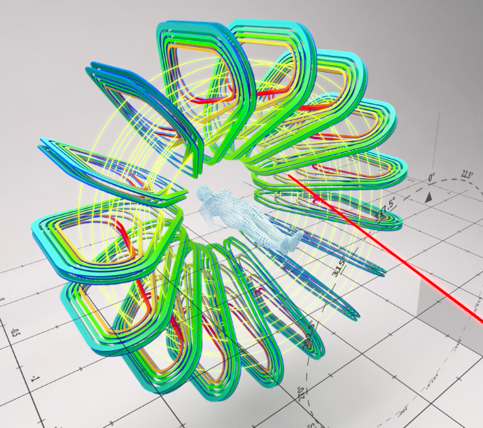
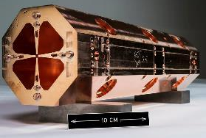
Comprehensive Dimension: both Cancer Therapy and Research Center with 50% of the beam time dedicated to research – other Unique Selling Points
MULTI-DISCIPLINARY RESEARCH WITH HEAVY IONS
BREAKTHROUGH IN TECHNOLOGY
SCIENCE
DIPLOMACY
Pre-clinical (medical, radiobiology)
Clinical, including clinical trials
Industrial research (microelectronics)
Material research
Ultra-high dose rates (FLASH)
Multi-ion synchrotron (beyond
presently used p and C-ions)
More compact and much cheaper Superconducting synchrotron
Superconducting gantry
Higher beam intensity, faster extraction; Real time imaging
Declaration of Intent signed at CERN in October 2017 by 8 SEE countries
MoC signed by 6 Prime Ministers of the SEE Region in July 2019, at the Summit of Berlin Process, Poznan
Political support by the Swiss
Government to establish SD roadmap
Cutting-edge innovative and novel research in any of these topics driven by novel technological opportunities
Complementary to all existing facilities
Will make cancer treatment with ions accessible to a large fraction of the European population and bring back Europe the lead position in this field
With the strong supporting consortium of 18 European research centers and clinics the SEE region is trying to revive its technological tradition

Slide 8
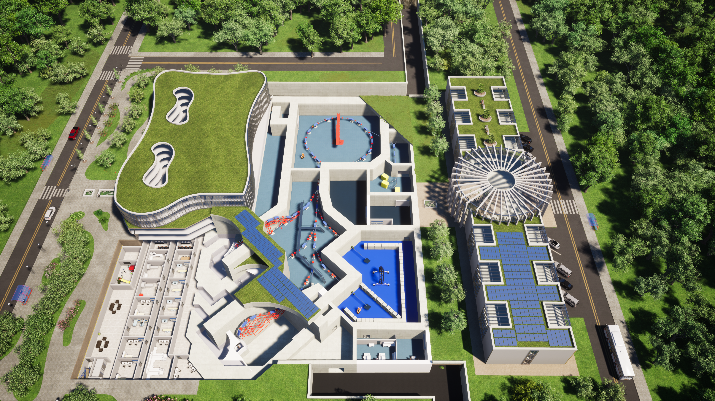

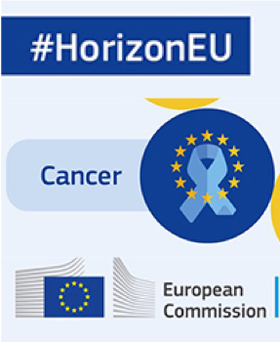

SEEIIST – First Green Infrastructure in line with
Horizon Europe Cancer Mission
SC magnet based synchrotron
(baseline is NC)
SC magnet based gantry (baseline)

Slide 9
New Technology: exploring (for SEEIIST and more) HEP SC technologies for advancing in Hadrontherapy
In 2019 beginning 2020 in the community raised a strong push for CCT
Nb-Ti remains the workshorse of superconductivity: first solution
Test of HTS conductor for real use….
For HiLumi LHC, now, and FCC-hh, in the near future, CERN and HEP communty is developing
  Canted Cosine Theta dipoles (Nb-Ti for HiLumi LHC, CERN and IHEP Beijing, Nb₃Sn for FCC-hh, PSI and LBNL)
For FCC-hh HEP is also exploring HTS coils for accelerator quality magnets:
  in Europe via mainly the EC funded FP7-EuCARD2 and H2020-ARIES
  In USA mainly in LBNL (in the frame of accelerator R&D for next collider).

Slide 10
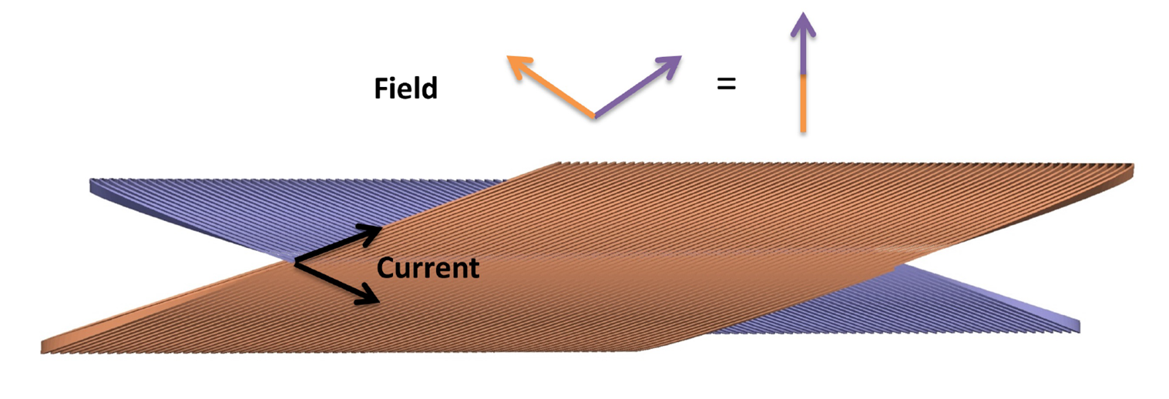
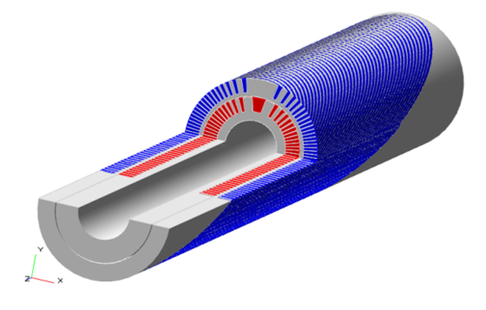

CCT : Canted Cosine Theta Magnet

Slide 11
The EC H2020 funded program
HITRI presented in Nov.2019 (not funded)
  Heavy Ion Therapy Research Infrastructure
  Scope: design study mainly (if not purely) for SEEIIST
  Not approved (March 2020): weak in medical part and use… (Physics part OK)
HITRIplus (Hitri+)
  Medical part improved, scope expanded not only to SEEIIST (still most prominent project in EU). Physics part same as HITRI
  WP8 on Magnet Design
    overview and assessment of various conductors (LTS, HTS, various types of cables) and magnet layouts (cosϑ, CCT, racetracks – spit coils or flare ends – etc…). Both for Synchrotrons (main dipole and extraction channel) and Gantry
    Design construction and test of 1 demontrator ∼500 mm long (either LTS or HTS)
    Very much CCT oriented!
  Started 1s April 2021 (4 year formal duratio: we aim at making it in three years)
I.FAST
  Is the omnibus program following CARE, Eucard, Eucard2, ARIES to integrate accelerator R&D across EU labs
  WP8 on Innovative Superconducting Magnets
    scope is fostering technology innovation: → exploring HTS cable in CCT magnet layout
    General consensus to go toward CCT: CORC® ?, stacked tapes? Roebel? Or Bi-2212 Rutherford cable? Other magnet layout not excluded
    The WP8 fosters also a panel among various lab to steer HTS for accelerator magnets in EU and the development of a HTS cable suitable for low losses - large size - fast cycling - synchrotrons (led by GSI)
    Approved and started on 1 May 2021!

Slide 12
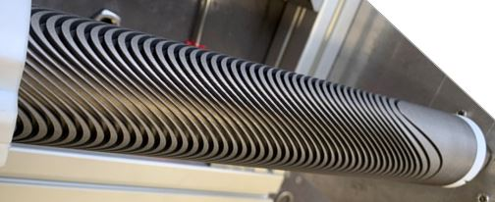
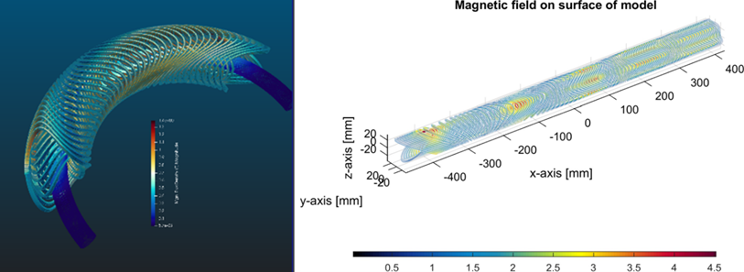
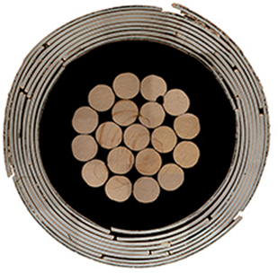
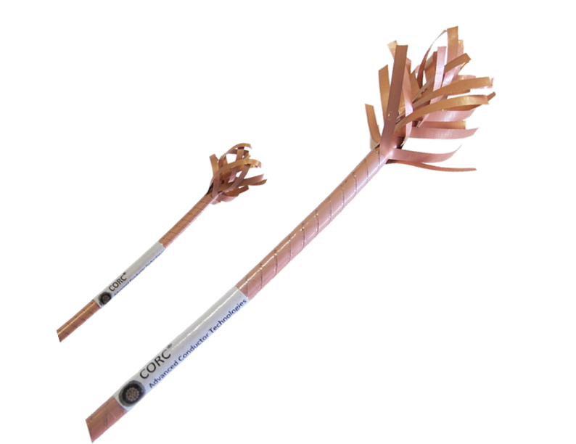
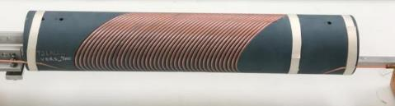
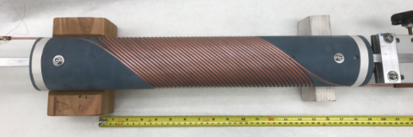
Possible layout
Solution for curved and straight CCT coils combining dipole and quadrupole in the same winding - Courtesy G. Kirby and J. van Nugteren, CERN
Courtesy of Xiaorong Wang, LBNL
Outer layer
Inner layer
The challenge is not the field level, rather designing for ramping field and cryocooled magnets

Slide 13








HITRI+ WP8 Magnet Design (with construction and test of a demonstrator)
CNAO Project Cootrdinator
INFN is the WP8 – Magnet Coordinator
CEA is the deputy coordinator
START: 1st April 2021

Slide 14



I.FAST WP8 Innovative SC Magnet. Demonstrator in Industry!!!
CERN is Project Coordinator
INFN is the WP8 – Magnet Coordinator (CEA is the deputy) START: 1 May 2021

Slide 15
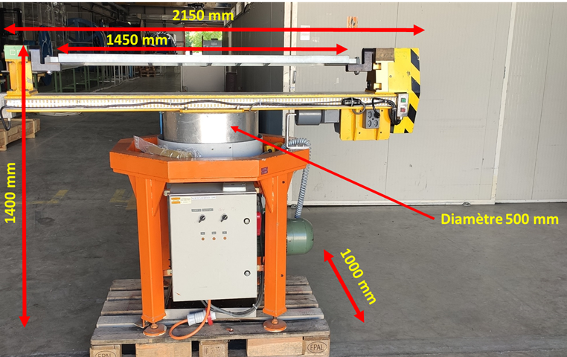
Resources 2021: summary
Prev. 2021 - 1Luglio2021s | Gr5 | Gr5 | Gr5
 | Hadrotherapy
 | HITRI | IFAST | (call)SIG
Lucio Rossi | 10% | 10% | 50%
Massimo Sorbi |  |  | 30%
Marco Statera | 10% | 10% | 10%
Francesco Broggi | 20% | 10% | 20%
Marco Prioli |  |  | 50%
Ernesto De Matteis (AR) | 30% | 10% | 20%
Samuele Mariotto (AR) | 20% | 10% | 20%
Riccardo Valente (PhD St.)
Tiina Benson (AR x INFN-A) |  |  | 20%
Magnus Dam (Borsa x stranieri)
TOT Ricercatori | 90% | 50% | 220%
Danilo Pedrini |  |  | 20%
Maurizio Todero | 30% |  | 50%
Arsenio Palmisano |  | 30%
Antonio Paccalini |  |  | 30%
Alessandro Pasini
Augusto Leone | 20%
Carlo Uva (Serv. Officina) |  |  | 30%
Luca Imeri (Serv. Criogenia)
TOT Tecnici | 50% | 30% | 130%
 | EU | Mach. Funds
HITRIPlus | 101.7 | 105
IFAST | 65 | 65
Solo per info
1 AdR 2-3 anni
Services: officina 10-15% dal 2022 ; then 2023-24: 30%
Criogenics: about 15% only from 2023 – after HLShoc)
Use of the rearrangement of the mech, shop to host magnet assembly and winding (driven by Falcon-D and SIG)
Time sheet EU
We heavily rely on the design and construction at LASA of devices of medium size: 1-1.5 m size of Hi-Tech content

Slide 16
Additional elements financed in i.FAST
WP9 Test of innovative superconducting accelerating cavities
WP6 (Novel particle accelerators concepts and technologies) Lasers for Plasma Acceleration (LASPLA) task 6.2 Lasers for Plasma Acceleration (LASPLA)
• Establish a roadmap to foster delivery of advanced industrial laser drivers with high-repetition rate and higher efficiency, for the first user plasma-based accelerator.
• Establish a coordination activity with networking and training of main laser labs, focused on laser-driver R&D.
The Task will identify strategies for the development of high-intensity lasers specifically as drivers of compact laserdriven plasma accelerators and novel radiation sources and applications to industrial, medical and biological sciences. Laser-drivers were identified as the main limitation to the societal exploitation of novel accelerator technologies. A comprehensive approach to the development of high-repetition rate lasers for plasma accelerators will tackle the key scientific issues currently limiting technological and industrial development

Slide 17
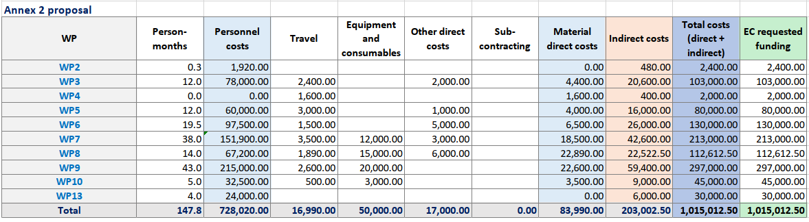
IFAST is a vast program of about 1 ME for INFN → about 230 kE of overheads (+40 kE for HITRI+)
In totale HITRPlus and especially IFAST generates about 90 kE for Milano INFN-section

Slide 18
Reserve slides HITRI-IFAST

Slide 19
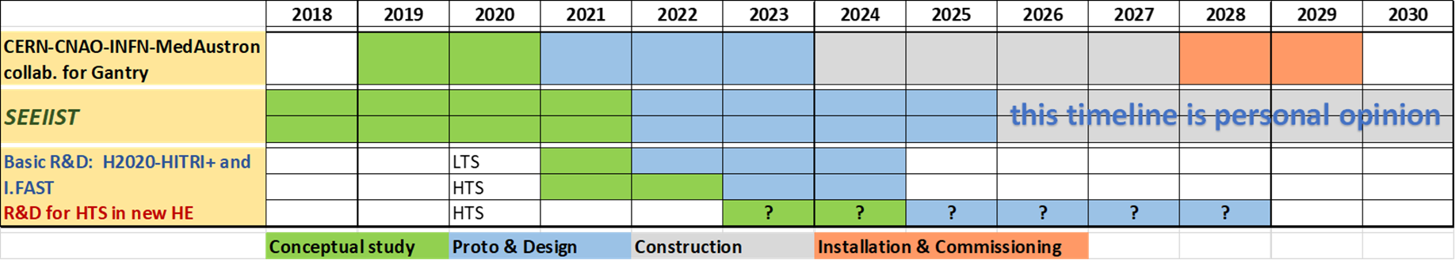
The EU roadmap for enabling a full SC C-ion facility: synchrotron + gantry
Disclaimer: roadmap to be reviewed with stakeholders

Slide 20
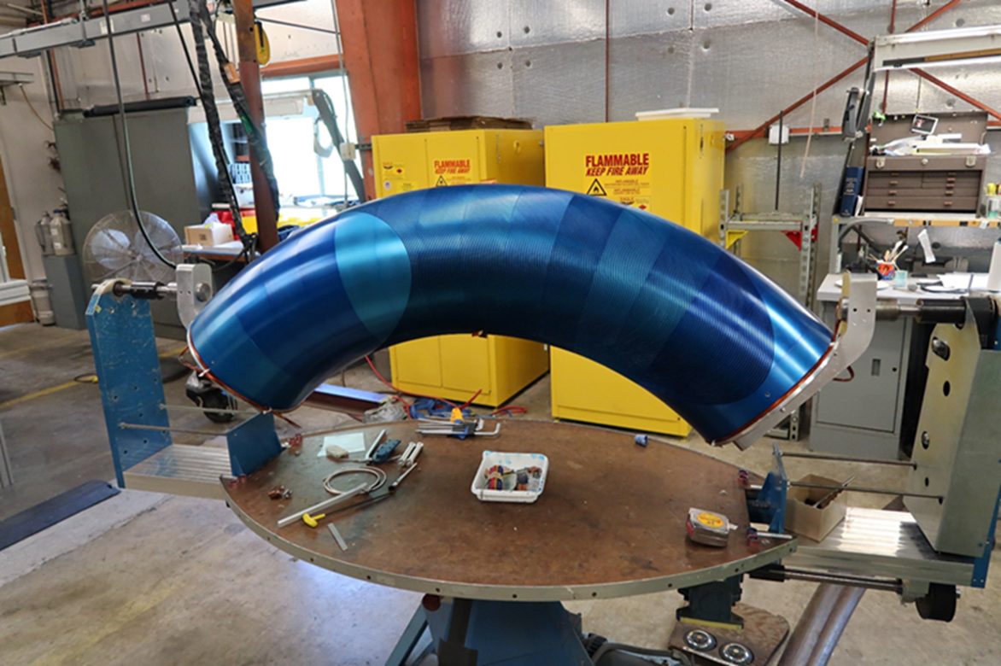
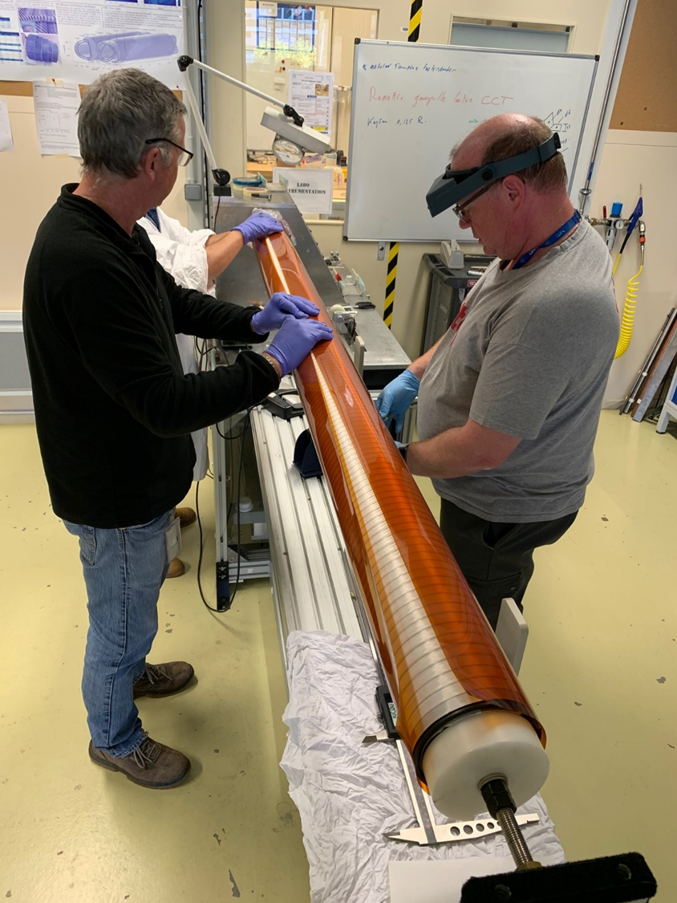
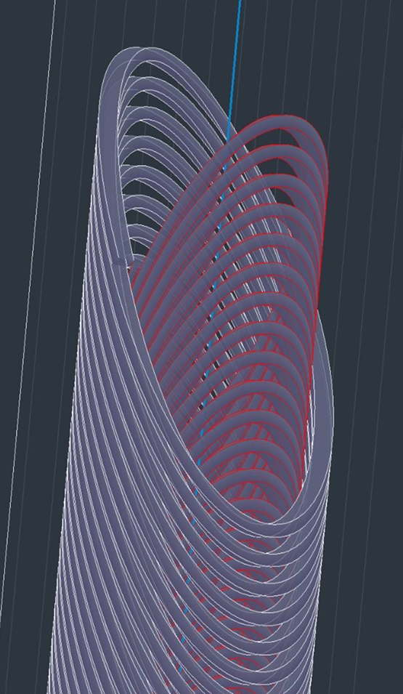
Nb-Ti Canted Cosine Theta (CCT): p-gantry and HiLumi LHC
LBNL: CCT coil prototype for large acceptance proton gantry ∅ = 400 mm: Successfully tested to 3.5 T; segmented former.
HiLumi LHC: CERN has designed, built and tested a dual 3 T, 2 m long - ∅ = 105 mm, straight CCT. Now IHEP Beijing producing 2x13 units
Short circuit at 3.5T!!
Proto 2m 2.9 T 105 mm very successful at CERN. However learning and transfer not easy (China…, SE)…

Slide 21


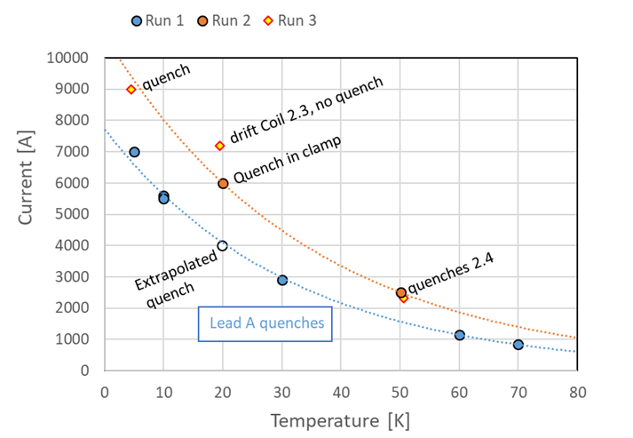
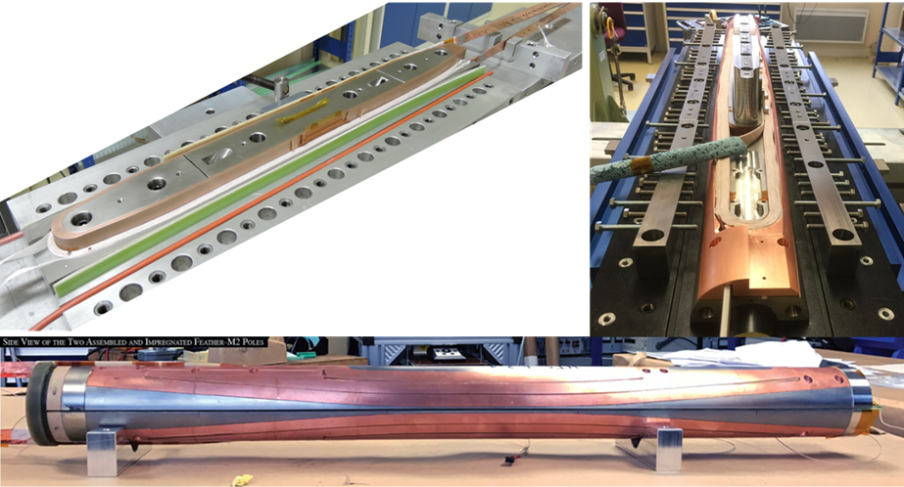
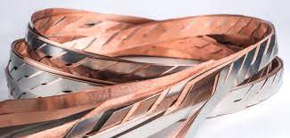
HTS for accelerator magnets: status in EU
CERN Feather_M2: flare end race track, REBCO Roebel cable, 40 mm bore
> 3 T in 2017; 1st magnet
> 4.5 T in 2019; 2nd magnet
∼ 6-7 T in 2021; 3rd magnet, hopefully!
This part might
be shifted
Roeble cable issue: failure
on test inside background field…
CEA has assembled a cosϑ dipole, 40 mm bore, with REBCO Roeble cable: test in 2021

Slide 22
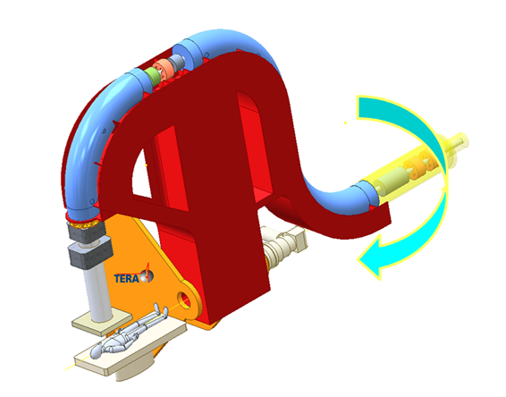
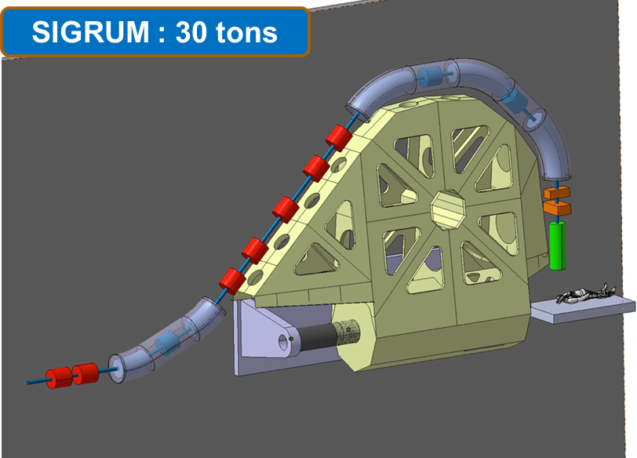
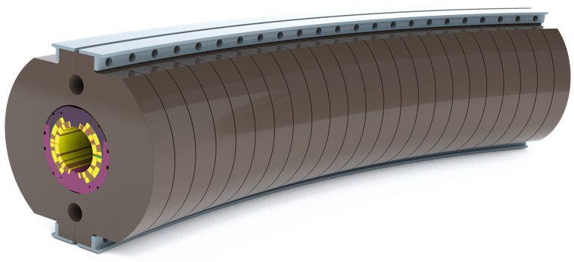
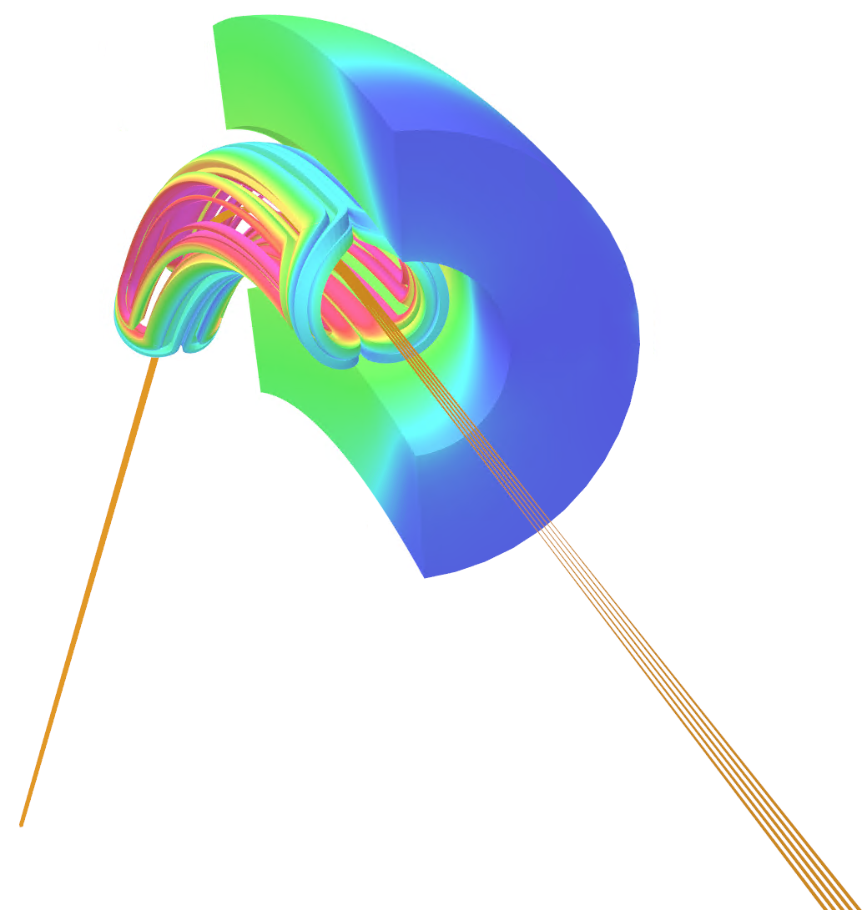
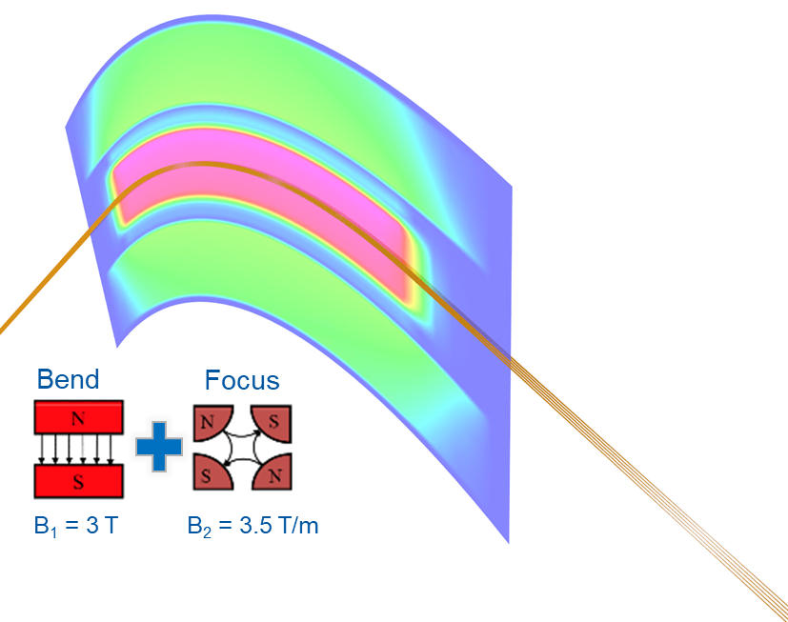
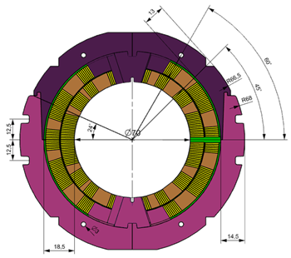
4PA: International Review in December 2021
Decision for SIGRUM: R&D and design needed…

Slide 23
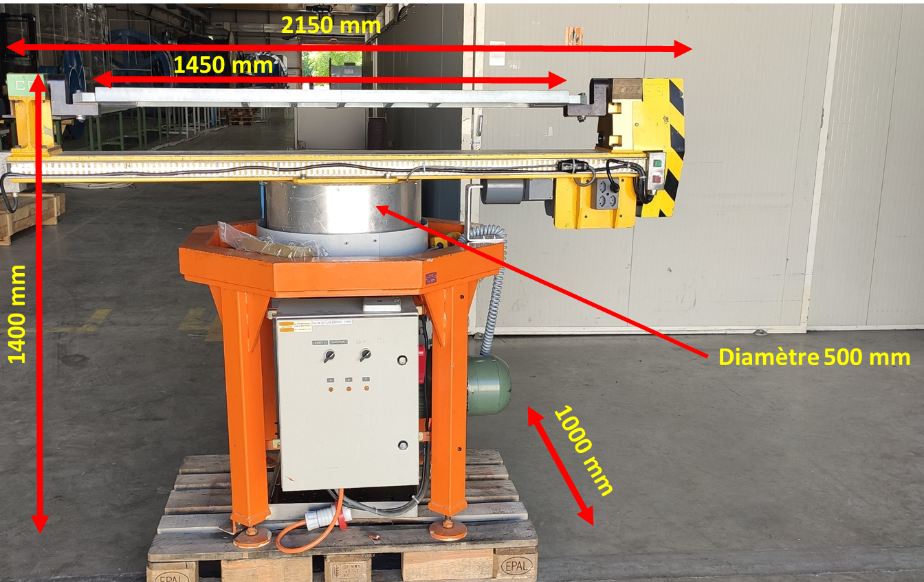
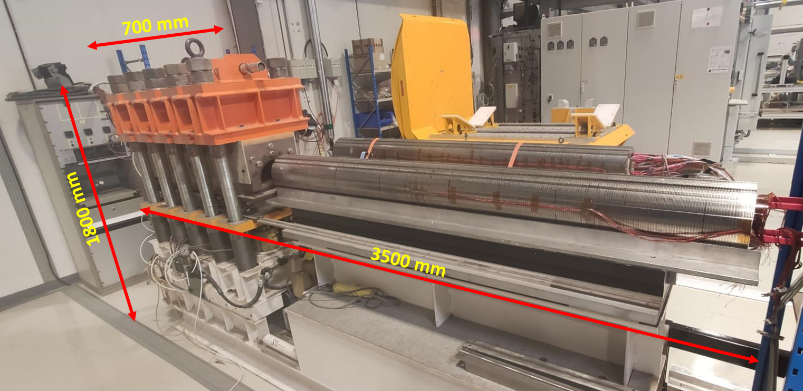
LASA infrastructure for demo magnets: for 4PA (and HFM, and various HTS demos)
CERN is considering to lend to INFN-LASA
1 winding machine - small coils (< 1m) Missing:
  Conductor tensioning system
  contact tooling for various process steps
1 precise strong press for demonstrator collaring and cold mass
Size is relatively small (50% of FalconD) to be manufactured and cold tested in LHe (first) at LASA and croycooler (later: at CERN?).

Slide 24
4PA: Possible near-term program (for INFN)
Participate to the group that has to revise the specs of the gantry and of the magnets
  I think a final revisitation before e launching construction is needed…
  Agree with CERN and other part the support (most from INFN but not all, I hope!)
  Decide the most convenient characteristics of the demonstrator
CosTheta (SIGRUM baseline ) is the choice
Give support also to the HITRI/IFAST initiative and see if CCT can constitute a serious alternative in the given time frame…

Slide 25
(future) High Field Magnet Program and “recovery funds”
Note: this are only projection for the future and under discussion with the GE.

Slide 26
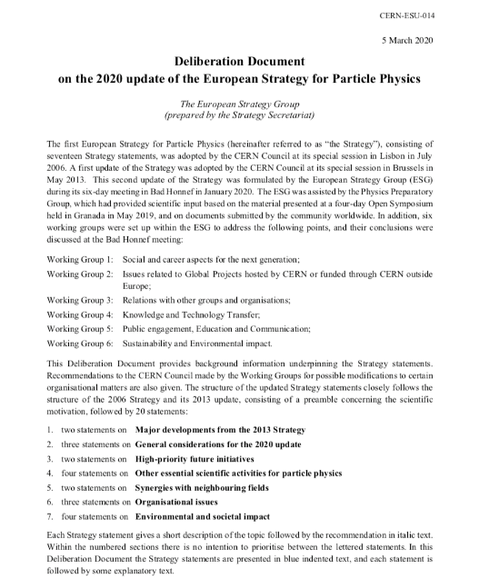
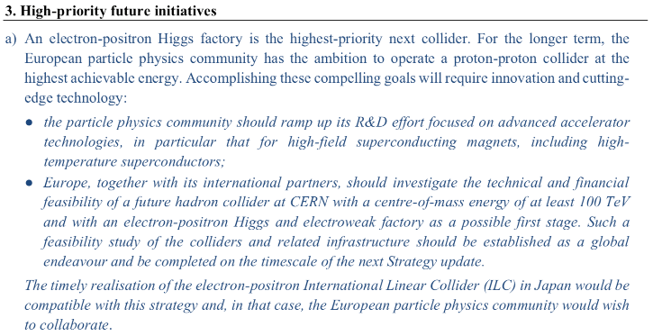
CERN-ESU-014
Available at https://cds.cern.ch/record/2720131/files/CERN-ESU-014.pdf
Notes:
The reason for this talk is that we have received a strong recommendation from the group that proposes priority for particle physics in Europe. The recommendation, received in March 2020 and approved at the Council session of June 2020, contains a very strong statement on the need to ramp-up R&D effort on high-field accelerator magnets

Slide 27
A unique chance for making this
The set up of the HFM CERN program (largest R&D program today)
  Budget of about 50 ME (in addition of the 20 engaged by FCC-hh)
For Italy:
  A declared support by our management to the ESU for PP.
  Out of 4 programs of INFN for the Piano Nazionale di Ripresa e Resilienza (PNRR) the Italian branch of the Next Generation EU (“Recovery Fund”), one is on Magnets
  (the other three being Einstein Telescope, an AI project and a QC center)
Initiative for a Sustainable Italian Magnet Program (SIMAP)
for FCC and other future Particle Physics accelerators:
  MI-LASA, GE, NA(Salerno) + other universites and Institutions (SPIN, ENEA…)

Slide 28
Recovery plan - Magnets
Magneti Superconduttori ad Alto Campo per Acceleratori e Società
Accelerator R&D as technology drivers for a better society
100 M€ budgetary evaluation
High (12 T to 14-16 T) and Very High (15-20 T) Field Dipole as technology driver.
Societal spin off : SC magnet Gantry and SC transmission line
Basic research infrastructure
  Magnet lab at LASA (with vertical test for naked magnets)- LMI – Laboratorio Magneti Italia
  Superconductor Lab with large I_{c} test at Genova: large bore dipole (with 20-30 kA capability)
  Cryostated-magnet test facility at 1.9 K in Salerno; testing long magnets
Industry Infrastructure (with large tooling for long magnets)
Technical Training

Slide 29
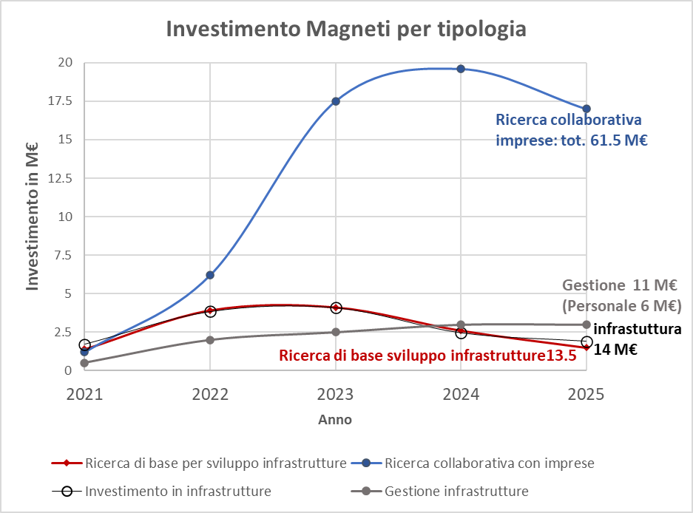
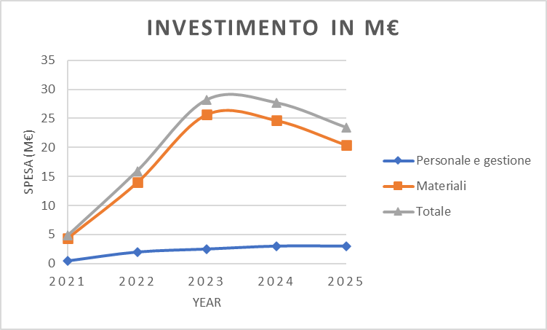

Slide 30
INFN Strategy for HFM program
NO PNRR-Magnets
PNRR- Magnets approved (full or part)
Define a 6-year plan
INFN takes up
  Design activity
  R&D and technology test
  Measurements for materials (SC, mechanical, thermal , etc.)
  Construction of short models in house
  Technology transfer with Industry
  Support to CERN for large construction in Industry
Must be spent by 2026
Extension of the activity to
  Internal Infrastructures
  Industry Infrastructure
  Long Magnets (proto) for industry scaling up
Societal Applications ( if fully approved)
Training for Academic and Technicians

Slide 31
Magnets for High Field – Nb3Sn Magnets
12 T dipole Nb₃Sn
  First we want to exploit FalconD experience and investment, ready to contribute to the further funding
  Further step toward a consolidated design as will be indicated by CERN and HFM collaboration. With short models.
14-16 T (to determine ultimate operability of Nb₃Sn)
  Only design, R&D and short models
Budget (first preliminary figures).
  0.5 ME/y in material
  0.6 ME/y in personnel (10 FTE, 50% of SC Magnet staff)
  We count on a contribution of CERN to match our material.

Slide 32
Magnets for High Field – HTS and technology
We consider HTS as strategic investment
We are ready work on
  HTS conductor development (including test)
  HTS magnet technology development
  HTS magnets with accelerator quality (small prototype)
Leveraging our existing infrastructure for technology innovation
  Modelling (multiphysics)
  Mock-ups and sample for cryogenic test
  SC properties
  Mechanical, thermal properties
Budget (first preliminary figures).
  0.3 ME/y in material
  0.3 ME/y in personnel (5 FTE, 25% of SC Magnet staff)
  We count on a contribution of CERN matching our material budget.

