Slide 1
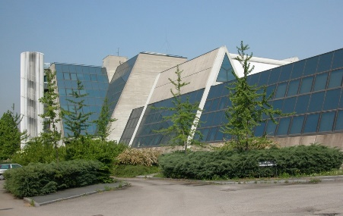
The FalconD Project Future Accelerator post-LHC Cos-theta Optimised Nb3Sn Dipole
Laboratorio Acceleratori e
Superconduttività Applicata
Massimo Sorbi on behalf of LASA-Magnet team
Univ. of Milano- Physics dept. and INFN-LASA-Milano
Consiglio di Sezione INFN – Milano , 13 July 2021

Slide 2
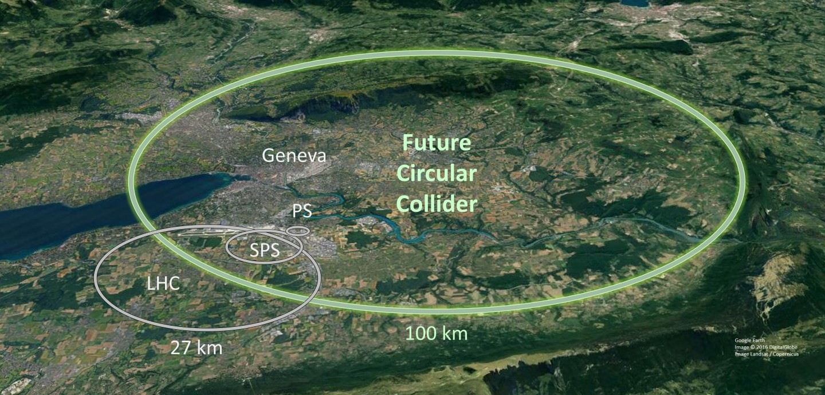
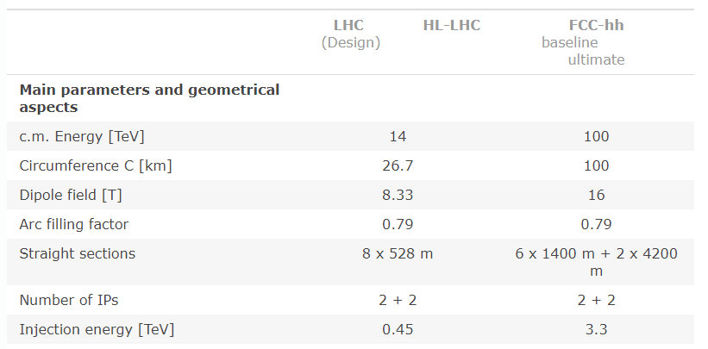
The context: FCC Project
Options:
FCC e⁺e⁻
FCC hh → very high field
FCC he

Slide 3
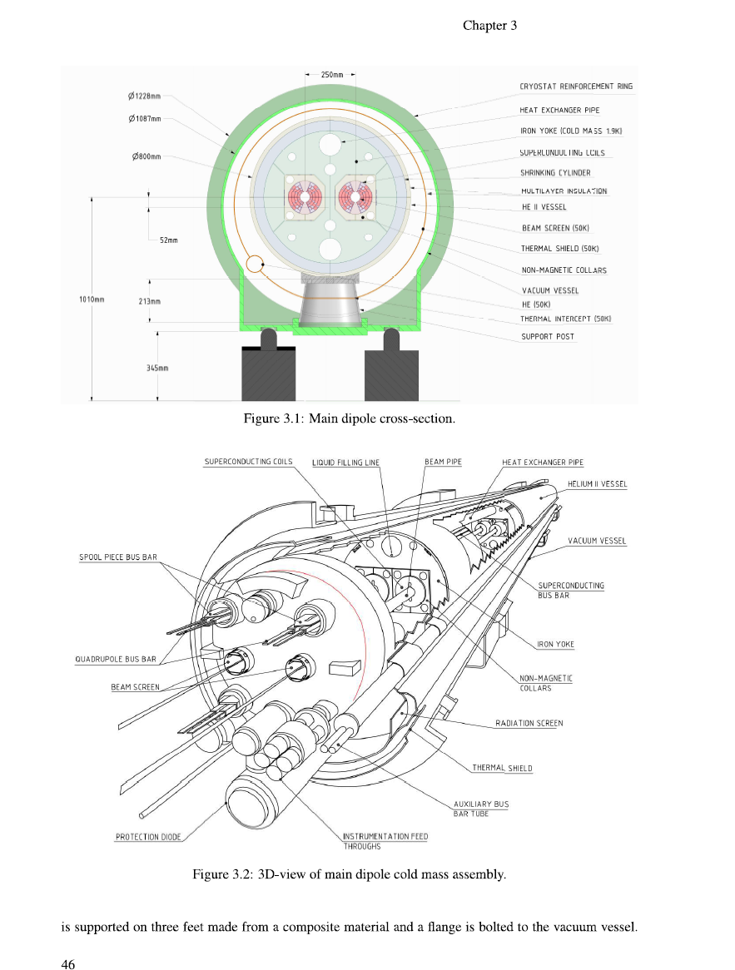
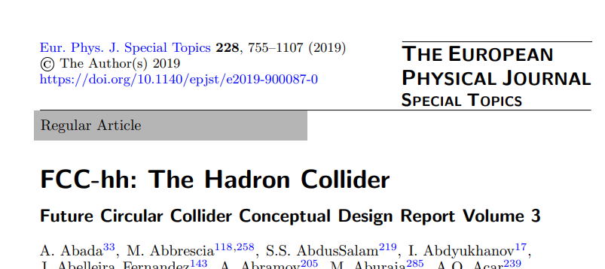
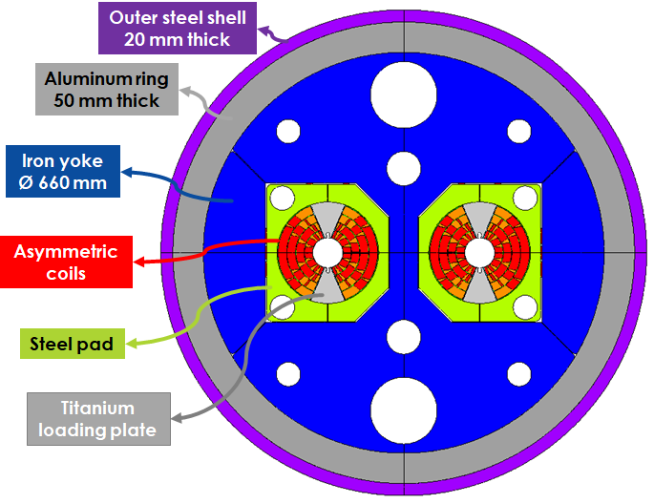
The starting point : EuroCirCol (H2020 project - 2014-2019)
INFN developed a design of a 16T cos-theta twin dipole for FCC, which was included in the CDR of FCC
INFN LASA & INFN Genova

Slide 4
From EuroCirCol to short model development (FalconD project)
In Oct 2018 CERN and INFN signed the agreement ADDENDUM No. KE4102/FCC to continue the activities, with new resources from CERN and INFN.
Final agreements are that INFN:
Development in four years of a significant model in collaboration with industry, simplifying as possible the structure
Basic choices: single aperture, comparable coil cross section with EuroCirCol design , length 1.5 m max
Magnetic field:
The minimum target is the first step beyond 11T (as this value is the consolidated state-of-art for accelerator dipoles): 12 T at 1.9K. This is also a reasonable target considering the limited experience of the team in Nb₃Sn technology and the involvement of the industry.
Theoretical “Short sample limit” of conductor 15.7 T
Under these condition a two layers dipole is feasible
Start with existing wire
Plan the construction of a significant number of coils
This activity is shared (full collaboration) between LASA & INFN-Ge

Slide 5
Actual agreement:
For a modulation of industry contract, the:
Manufactures the single aperture magnet (poles, including practice coils and poles) -> perfomed at ASG (industry)
Assembles the demonstrator magnet and deliver the complete short model (cold mass) -> performed at LASA
Proposal of a preliminary test -> performed at LASA
Partecipates in the cold test at CERN

Slide 6
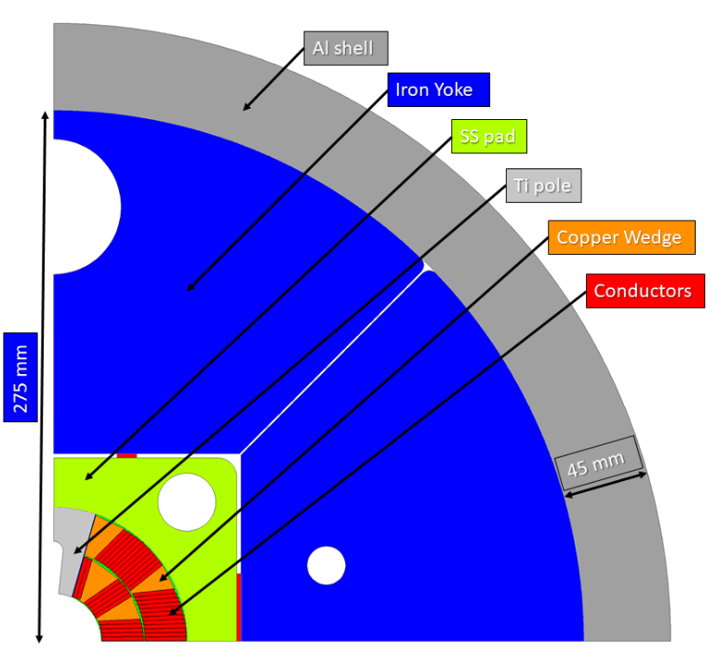
Assembling at LASA:
We expect to receive coils integrated in Stainless Steel pads from ASG (two poles already integrated)
Assembly the two poles in the iron yoke and Aluminium shell with Bladder and Key technology
Complete the 3D assembly, including cover ends, longitudinal rods, etc.
Very critical operation (at LASA)
We count to a very fruitful collaboration with CERN
Courtesy of A. Pampaloni

Slide 7
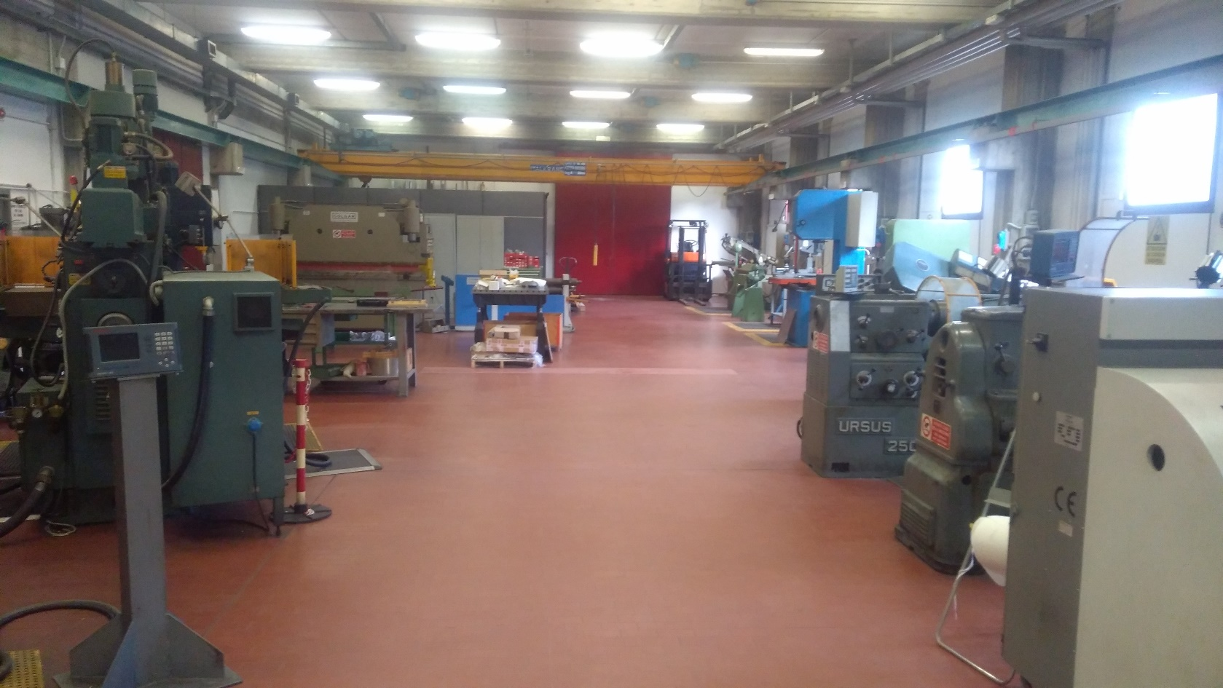
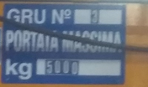
Assembling at LASA:
We aspect to perform the assembling in the actual LASA workshop (probably to be reconfigured into a «Mechanical Lab. for special application»)

Slide 8
Assembling at LASA:
Toghether with the technological material given by CERN it is necessary to find/purchase the special toolings:
Pumps for bladder
System for movimentation of coils, structures, cold mass
Tables for assembling
…………………

Slide 9
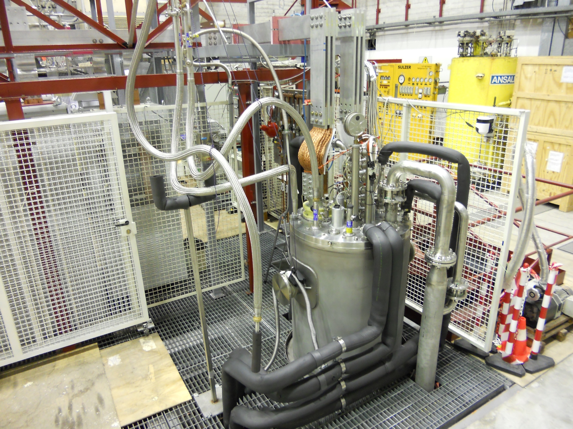
Preliminary test at LASA:
The proposal is to perform the test in the DISCORAP cryostat
ACTUAL SITUATION
Int. bore diam: 695 mm
Int. height: 9.2 m
- Bus bars &
rapid switch 10 kA
Power supplies &
Mech. switch 25 kA

Slide 10
Preliminary test at LASA:
Scope of the test:
verify the integrity and the functionality of the magnet
rapidly (possibly) intercept main problems
Proposal of test condition:
In boiling LHe (4.2 K)
Current: 25 kA (10 kA already possible with rapid switch)
Critical aspect:
Verify and implement protection system (QDS)
Develop internally fast switch at 25 kA (25 kA already possible with slow mechanical switch ∼180 ms)
Install new bas bar from 10 kA to 25 kA

Slide 11
Conclusion
Both the proposed activities for Falcond:
Assembling of cold mass with Bladder & Key
Functional test of the magnet at 4.2 K
very challenging!
They require a jump in the INFN technical capacities and organization
The basic competences for each single aspects (mechanics, electronics, power supply, cryogenics) are «in house»
Necessary to extend and integrate all compentences for a challenging program
A robust increment of technical staff is necessary

Slide 12
Spare
Material from CERN
Description of CERN contribution in materials
Conductor and main components:
Insulated conductor for 2 C_{u} dummy poles
Insulated conductor for 6 Nb₃Sn poles
Wedges, poles, loading plates and end spacers for 8 poles
Quench heaters and ground insulation
Material and components for finishing the magnet:
Laminations of iron, already packed and shaped
Special laminations for coil end (typically stainless steel)
Bladders for assembling
10 complete set of keys of different interference
Stainless insert in the iron for key insertion
Aluminum rings for pre-stress (outer shells)
Longitudinal rods and end plates
Sensors (strain gauges, temperature sensor)
Total cost (evaluated) [kEuro] | 250
From CERN to ASG
From CERN to LASA

